Slide 1
Einstein Telescope site selection
Ambient ground motion and gravity gradient noise
Jo van den Brand, Nikhef, Amsterdam
on behalf of the design study team

Slide 2
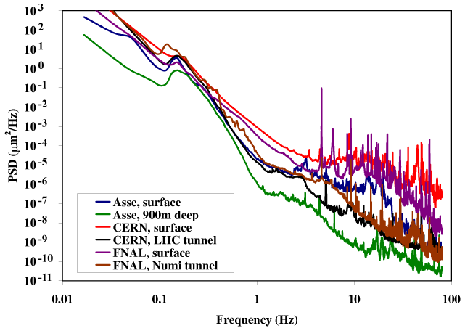

Ground motion is strongly site dependent
At 1 Hz:
Hiidenvesi cave: <1 nm/rtHz
Moxa station: 0.5 nm/rtHz
Asse 900 m: 0.5 nm/rtHz
Ongoing studies at Homestake with seismic network
Down to 4950 feet

Slide 3
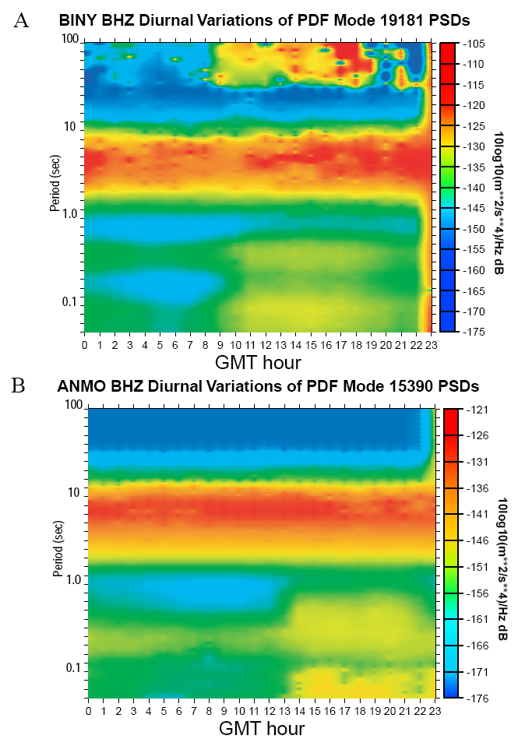
Cultural noise
Diurnal variations
  Binghamton New York:
    50 dB long periods
    20 dB above 1 Hz
  ANMO borehole station
    noise 10 dB above 1 Hz
  Deep borehole stations see cultural noise up to depths of 2 km
  BFO station: 180m depth
    Saw mills
Noise sources
  Water pumps, water in cooling pipes, cryogenic fluids
  Low frequency reciprocating devices
    Vacuum pumps, air, helium, hydrogen compressors
    Well defined sharp spectral lines
  Implement site policy

Slide 4
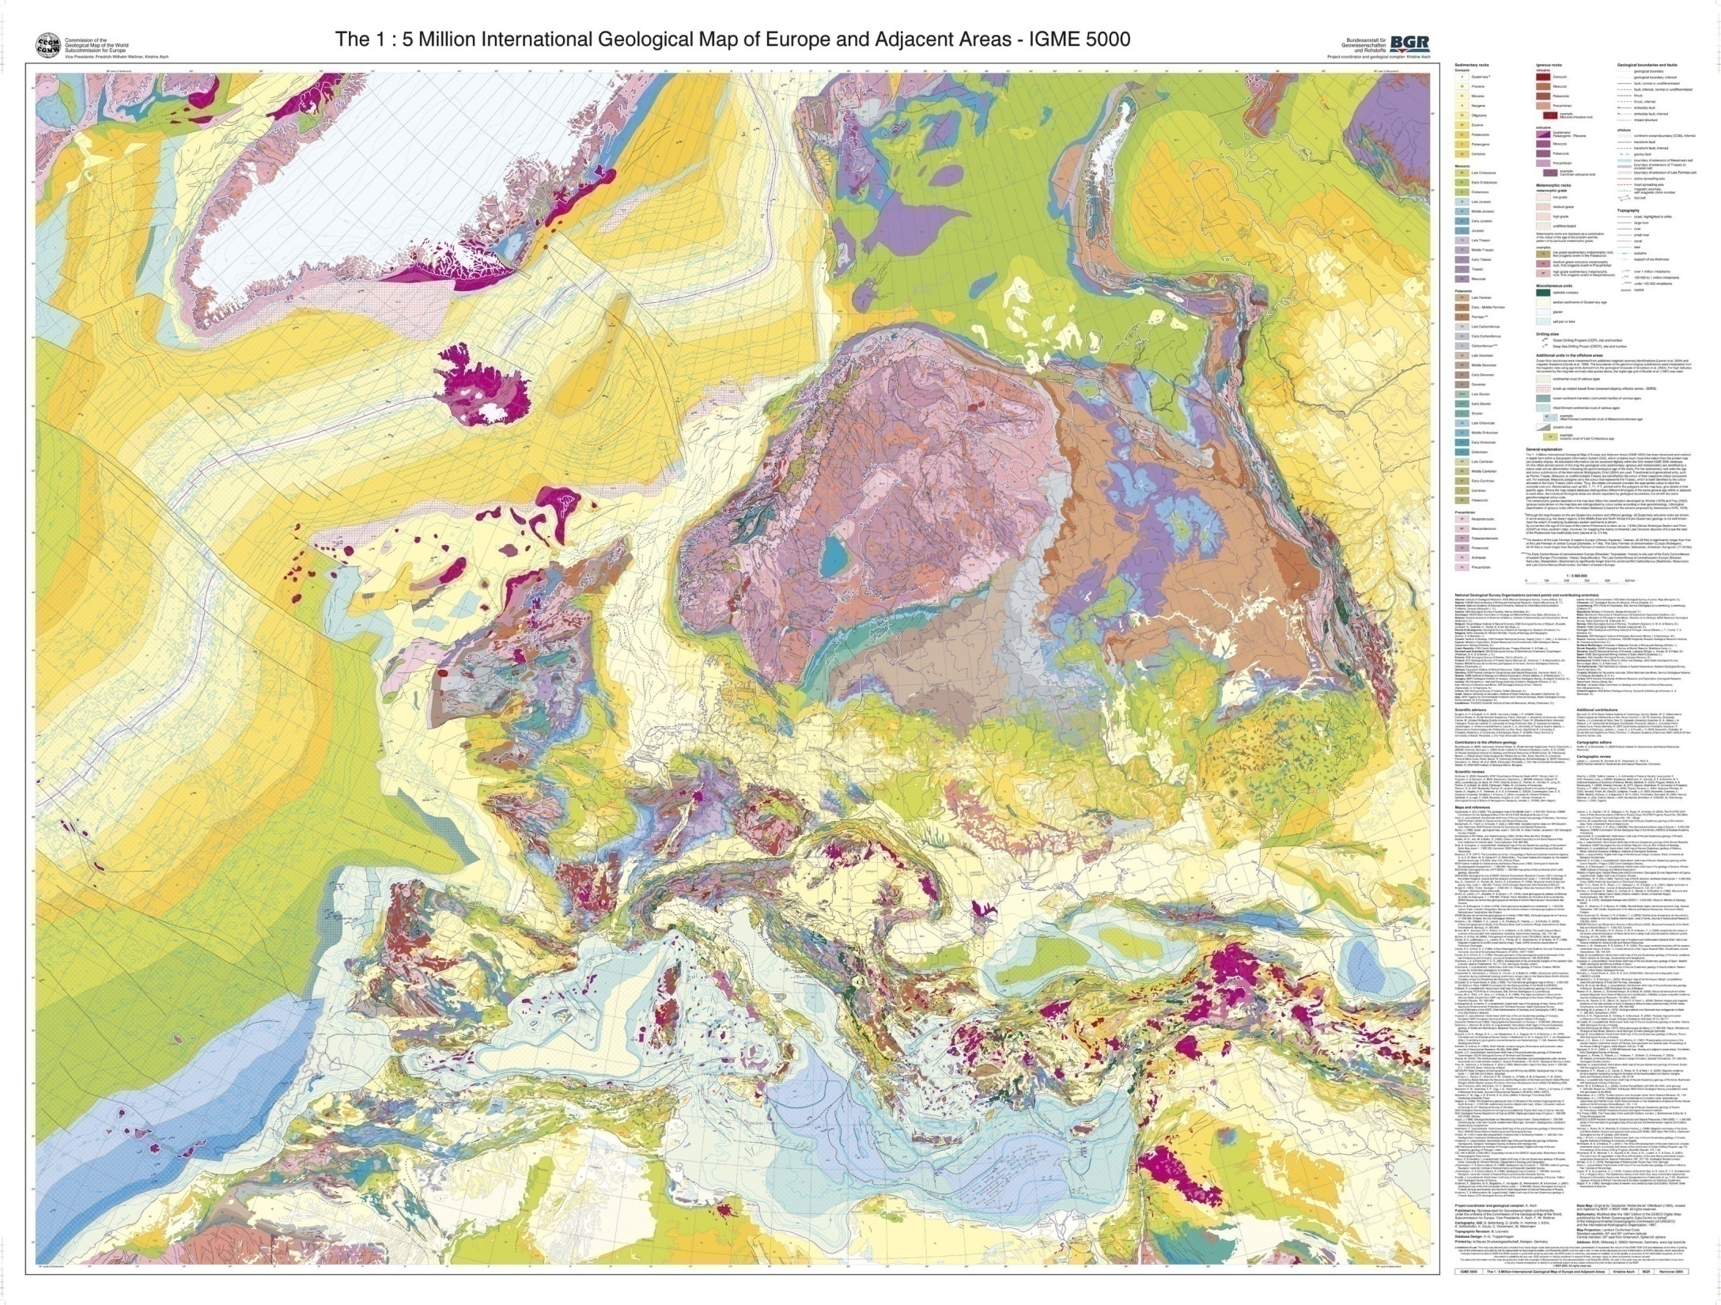
Large geological variations in Europe
large sediment regions
homogeneous materials: crystalline granite
Test candidate sites using a seismic network

Slide 5
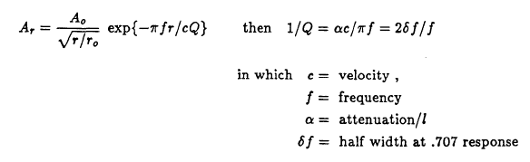
Finite element analysis
Mark Beker, David Rabeling, Caspar van Leeuwen, Eric Hennes
Surface waves
Rayleigh
Body waves
Head
Shear
Pressure
Reaction to vertical point oscillation
  Two layer geology
Wave attenuation has two components
  Geometrical (expansion of wave fronts) ~ r^{n}
    Rayleigh, n=-1/2
    Body waves at depth, n=-1
  Material (damping)
Example: sandstone, α = 3.5 x 10⁻⁸ f sec/cm, a plane wave disturbance at 1 Hz would be attenuated over 10 km by less than 4%

Slide 6

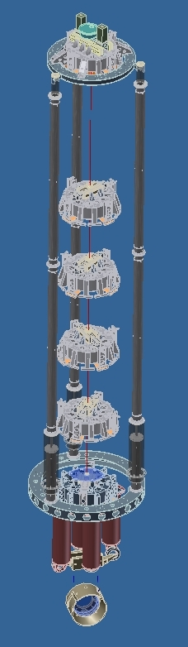
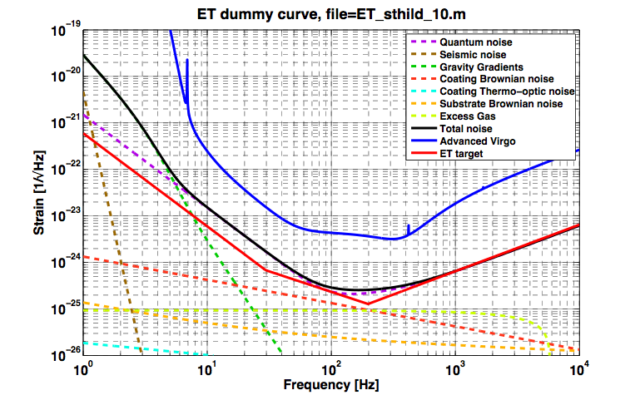
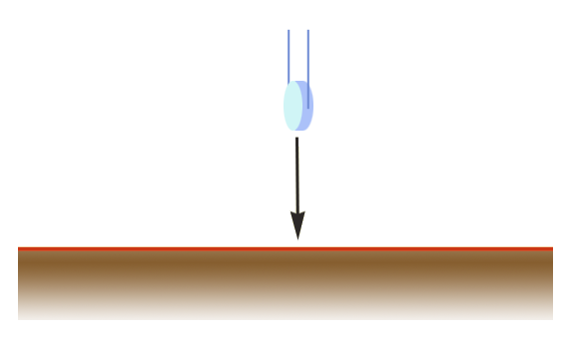
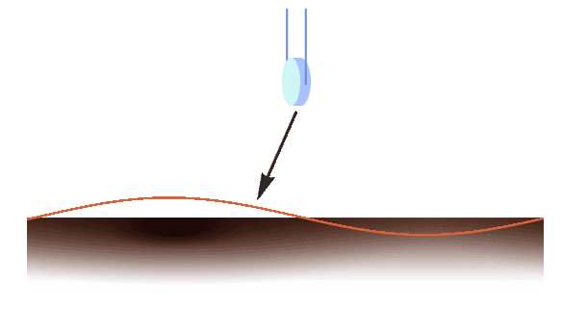
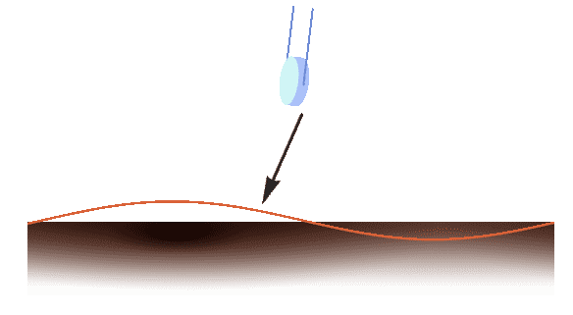
Effects of seismic noise
Seismic noise suppression
  Development of superattenuators
Gravity gradient noise
  Cannot be shielded
  Network of seismometers and development of data correction algorithms
Figure: M.Lorenzini

Slide 7
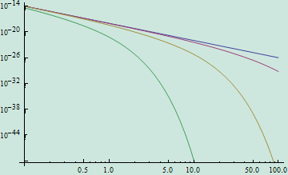
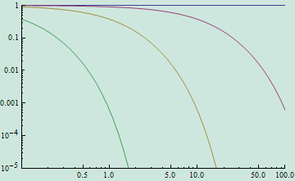
Underground detectors - Cella
Equivalent strain noise amplitude (Hz-1/2)
Analytical results by G. Cella
The 58th Fujihara Seminar (May 2009)
Surface
Z=-10 m
Assumptions:
C_{L} = 1000 m/s (lower is better)
C_{T}/C_{L} = 0.5 (lower is worse)
Surface modes and transverse mode only
V/H ratio = ½ (lower is better)
Z=-100 m
Z=-1000 m
Surface
Reduction factor
Z=-10 m
Feasible
Can we do better?
especially in the low frequency region
Volume waves!
Z=-100 m
Z=-1000 m
Frequency (Hz)

Slide 8
a [ m/s² ]
a_{x}
-16
a_{z}
H=400 m
a_{y}
c_{P}
c_{S}
Impulse response
- halve space
- damping
-16
H=500 m
S-wave passing 400m depth
-16
H=600 m
P-wave passing 600m depth
Time [ s ]
More realistic model and impulse response
  All wave types included
  GGN drops less than order of magnitude
  Little geometric suppression

Slide 9
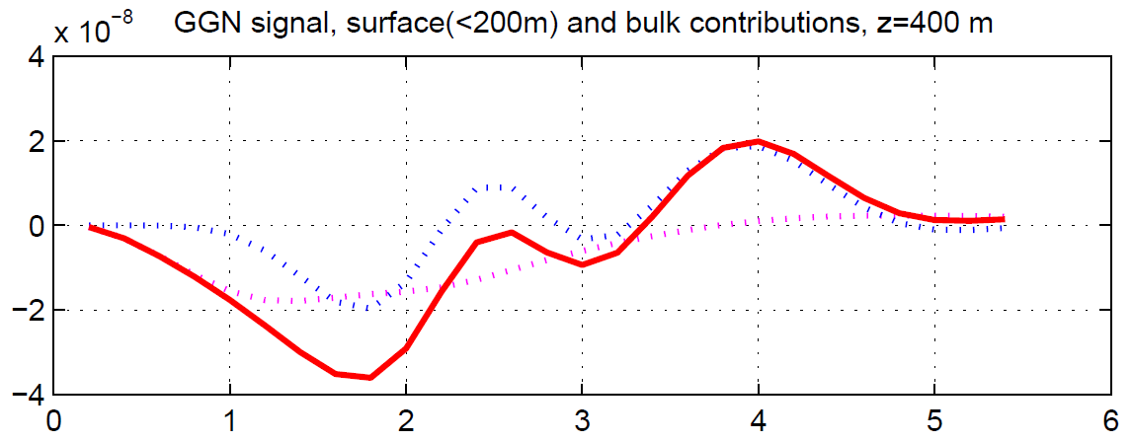
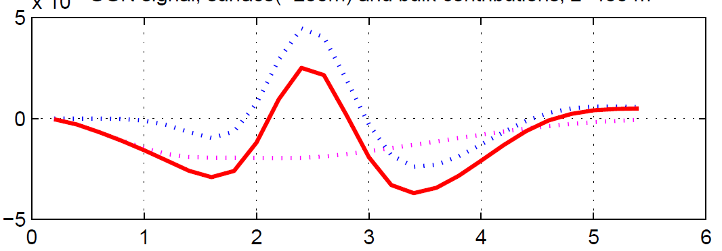
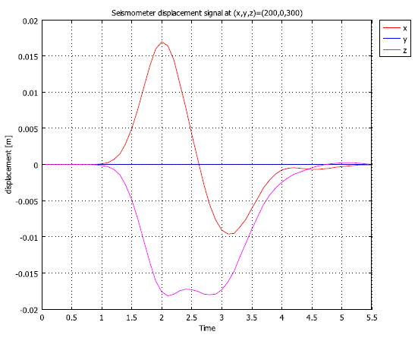
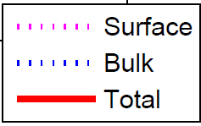
Decomposition of GGN signal
×10⁻¹⁶
x
×10⁻¹⁶
z
GGN composition
  Both surface and bulk contributions
  GGN signal `instantaneous’, sensors delayed response
  GGN subtractions schemes under study

Slide 10
Summary
Site selection
  Requires dedicated tests at candidate sites in Europe
    Effects of geology
    Influence of cultural noise
    Use results as input for FEA
Gravity gradient noise
  Limits sensitivity at low frequencies (1 – 10 Hz)
  FEA studies (and GGN subtraction schemes) in progress

