Slide 1
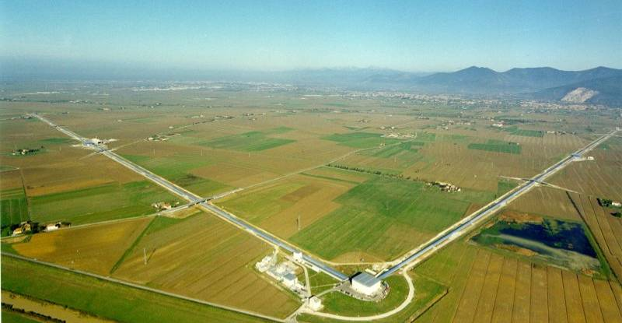

Advanced Virgo – Nikhef tasks
Jo van den Brand, Nikhef
June 16, 2009 - jo@nikhef.nl

Slide 2
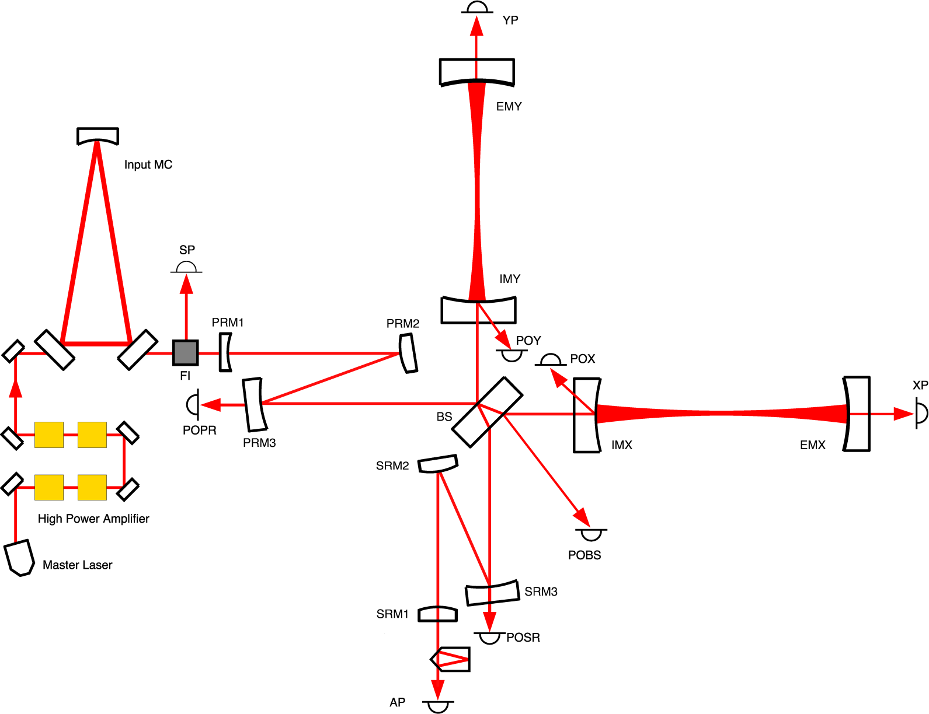
Outline
Cryo links
Sensing and control
  Longitudinal alignment
  Linear alignment
  Phase camera
Suspension and bench systems
  Internal injection bench
  IMC end mirror
  Internal detection bench
  External injection (laser bench)
  External detection bench
  External end benches
Einstein Telescope
  Measurements
    Homestake
    Kamioka
    Gran Sasso
  FEA simulations GGN

Slide 3
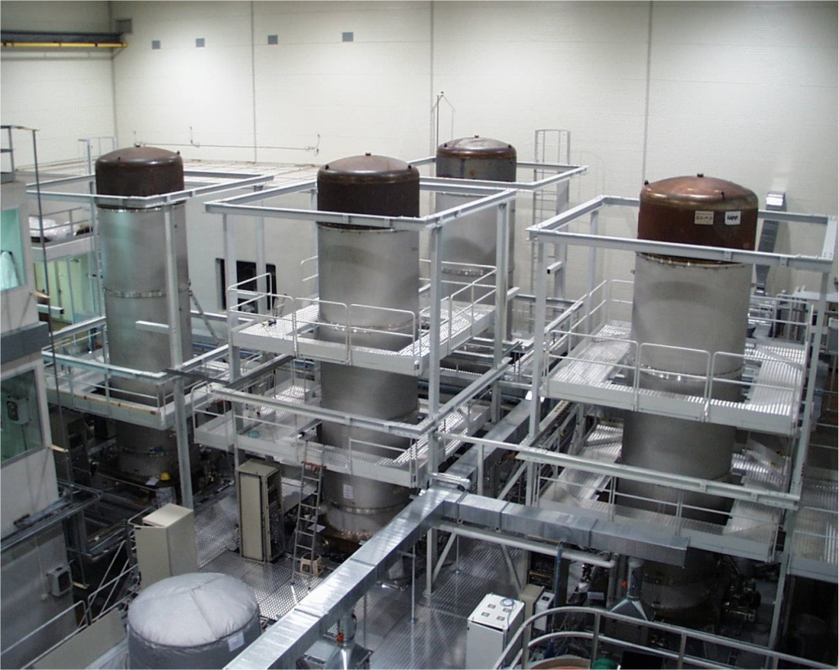
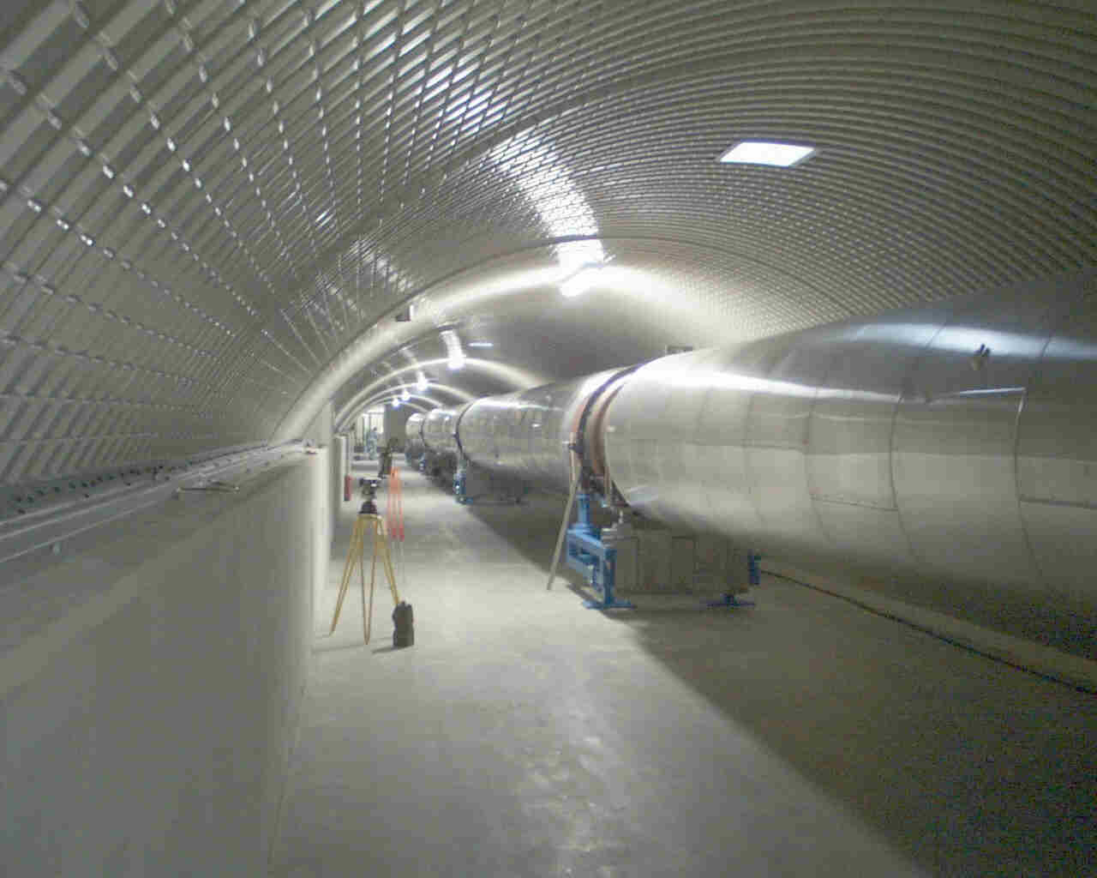
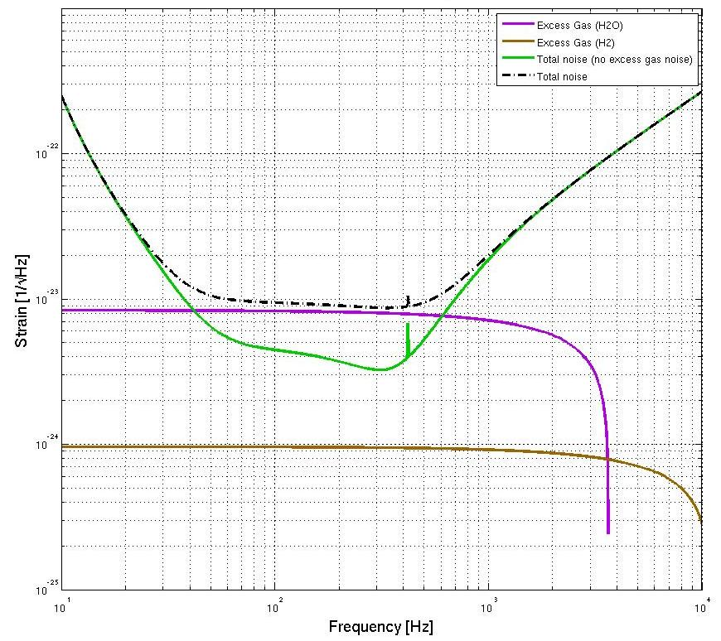
Vacuum system
UHV (<10⁻⁹ mbar)
Two 3 km arms

Slide 4
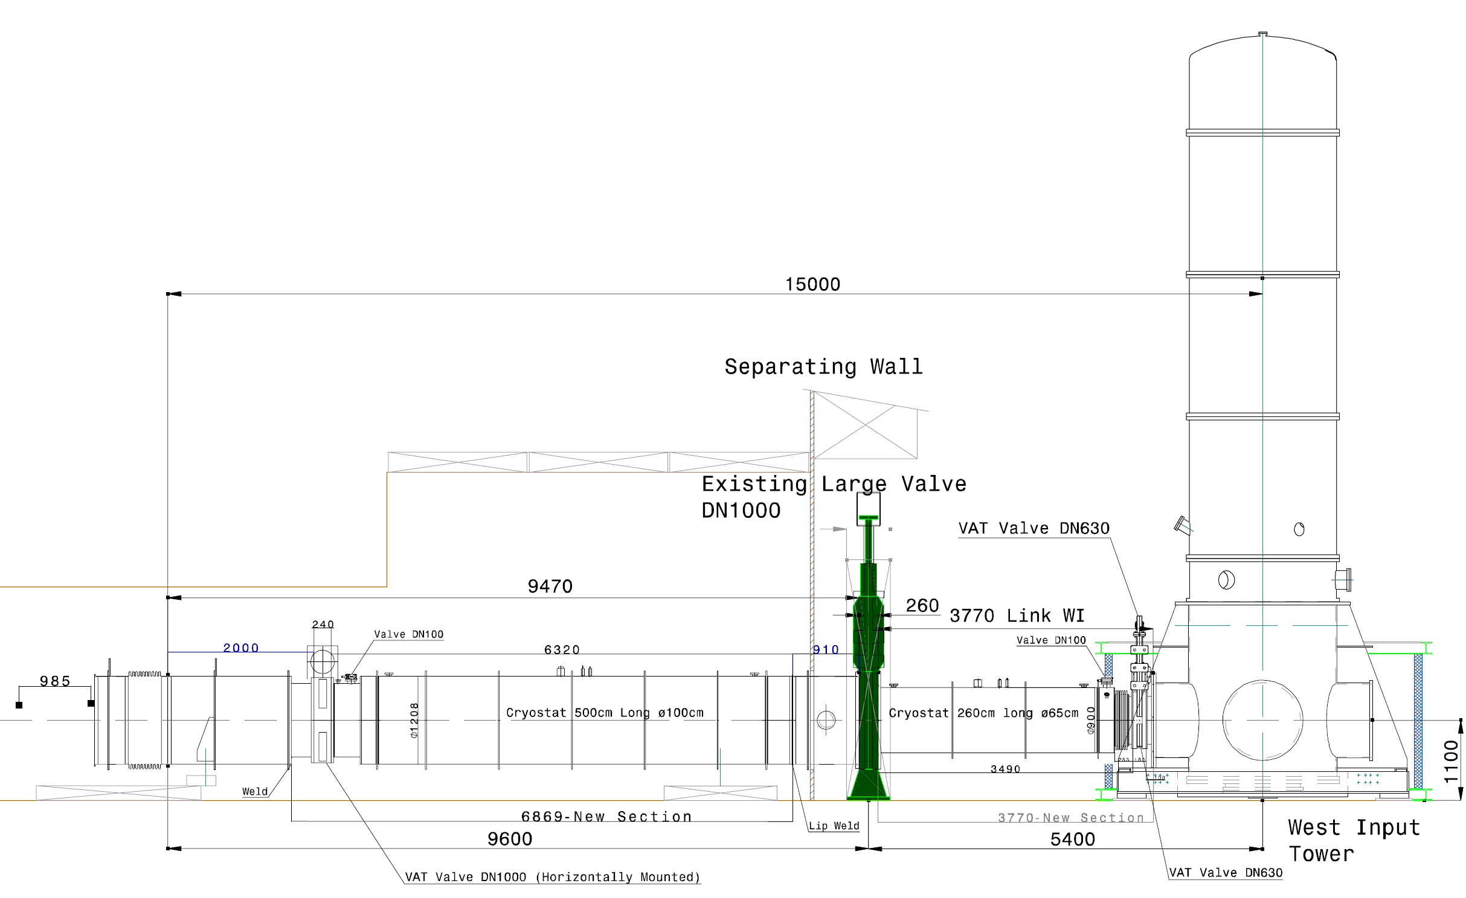
West input
Options:
- small or large link
- small link: small or large diameter
Rotated DN1000 standard valve

Slide 5
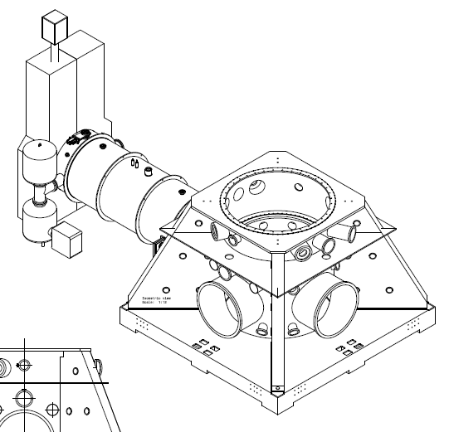
West input
Short cryo link

Slide 6
West input
DN1000 standard valve
Ion pumps
DN630 standard valve (D = 650 mm)

Slide 7
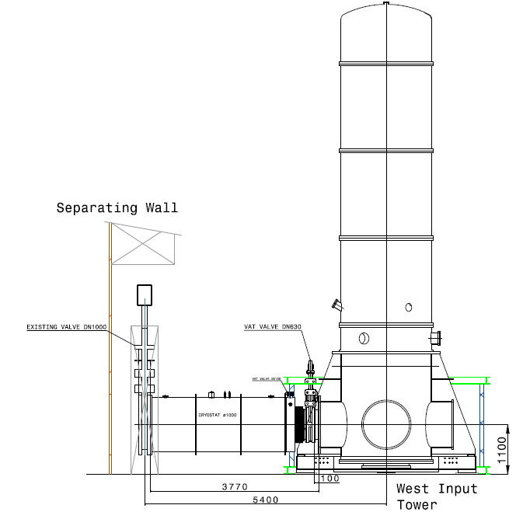
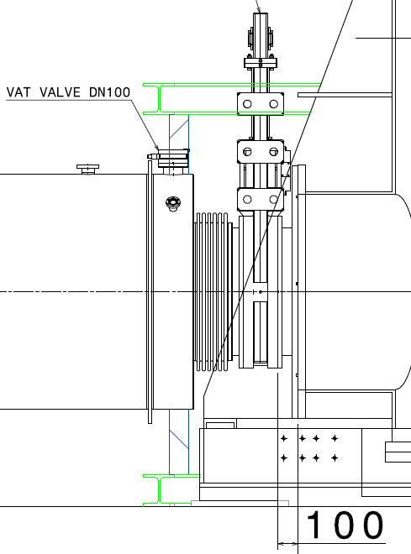
West input
Valve DN630
New valve position
Adapter
700 for end stations

Slide 8
West / North end
Mirror
Cold surface:
length: 2023 mm
diameter: 1000 mm
Baffles:
diameter: 600 mm
3 needed to cover cold surface
temperature influences mirror temperature
material: stainless / glass?

Slide 9
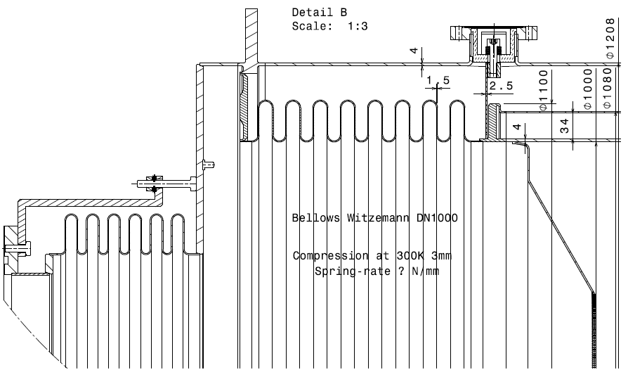
Cryo link details
LN2 vessel support
superinsulation
3.2 mm/m
Heat bridge/expansion bellows
LN2 (200 l)
Baffle
D= 620 mm

Slide 10
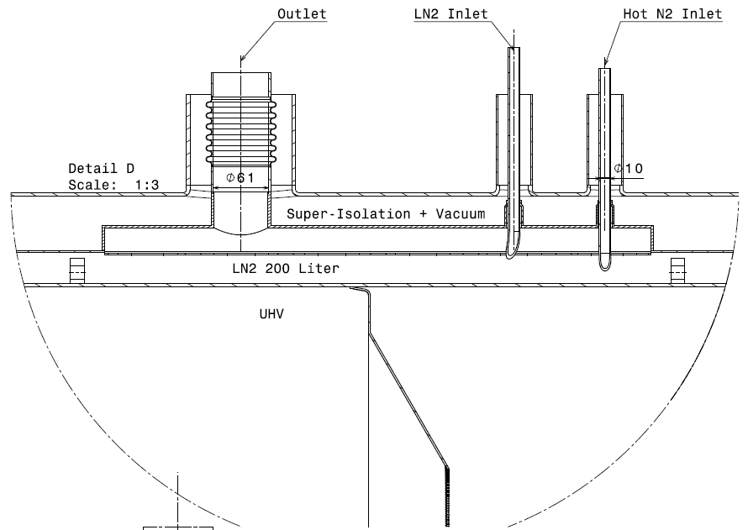
Transfer line connections
Rapid heatup
60 mm
34 mm
LN2 inlet duct
LN2 max level (control ± 10 mm)
Bath width: 325 mm

Slide 11
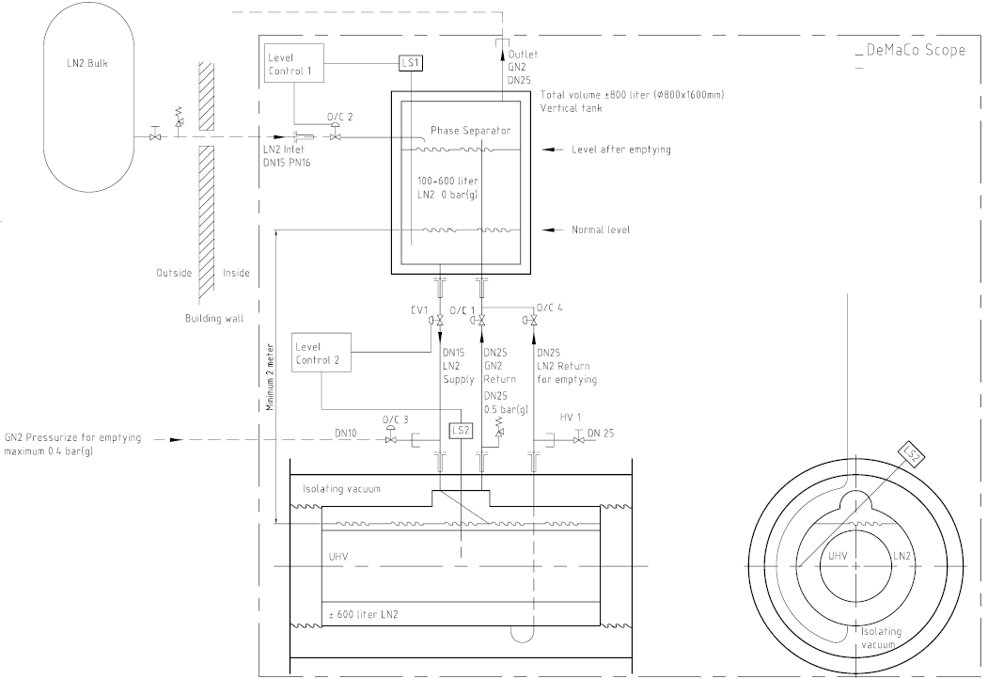
Phase separator
2 m above cryo link

Slide 12
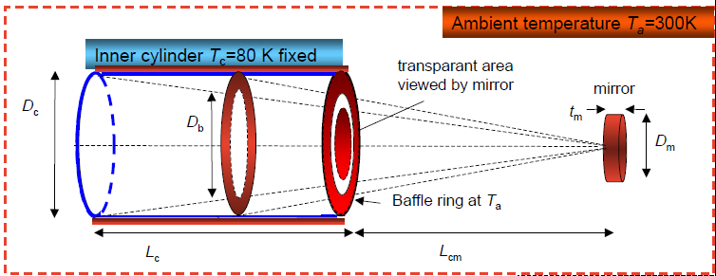
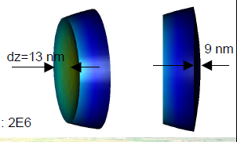
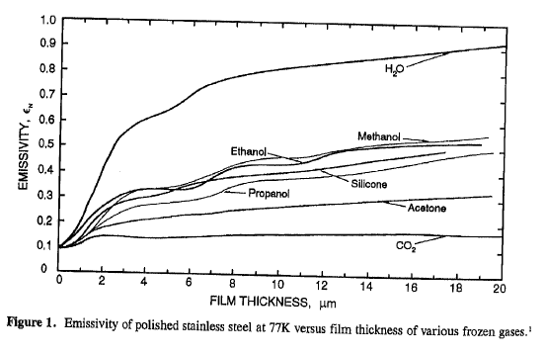
Performance
Expected water load: 10⁻⁴ mbar l/s
  Q_{1 year} = 3150 mbar l gas
  22,400 mbar l = 1 mol = 18 gram
  Thus, expected load 0.14 mol or 2.5 gram water
Expected layer
  Length 2.0 m, diameter 1 m, Area = πDL
  Number of sites 10¹⁵ cm⁻²
  After 1 year expect 0.4 micron layer
Heat load and LN2 consumption
  Depends on emissivity 0.1 – 0.2
  Heat load 200 – 300 W
    LN2 consumption: 3.5 liter/hour
    Expected gas load: 0.2 liter/s

Slide 13
Logistics
Quotations: total 789 kEuro (939 kEuro including VAT)
  R&D phase 10 kEuro
  Design & engineering 45 kEuro
  Short link 125 kEuro x 4
    Standard phase separator
    Simple LN2 extraction
    Simplification of separation rings for LN2 circuit
  Valve DN630 39.8 kEuro x 4
    ex VAT
    ex 7.5% discount
  Other items 75 kEuro
    Valve DN100
    Turbo molecular pump station
    Gauges, control, tubing, etc.
Manpower ~ 5 fte
  Mechanical and control system design
  Construction of (support) structures, etc
  Testing
  Installation
Cryo links |  |  | aantal |  | +VAT
R&D phase |  |  |  | € 10.00
Design & engineering |  |  |  | € 45.00 |  | obtain CE pressure vessel certification
Prototype |  |  |  | € 125.00 |  | reuse? |  |  |  |  |  | Additional cost for larger valves
Production links |  | € 125.00 | 4 | € 500.00 |  |  |  |  |  |  |  | DN800 | DN1000
Valve DN630 |  | € 39.80 | 4 | € 159.20 |  | for DN800 87.260 dan -7% *1.19 |  |  |  |  |  | € 227.08 | € 354.31
Others: valve, pumps, gauges |  |  |  | € 75.00
 |  |  |  | € 914.20 | € 1,087.90 | based on quotations |  |  |  |  |  | Total cost for larger valves
FTE |  | 5 |  |  |  |  |  |  |  |  |  | DN800 | DN1000
 |  |  |  |  |  |  |  |  |  |  |  | € 416.53 | € 543.76
M. Doets, E. Hennes, H. Boer Rookhuizen
vdB

Slide 14
Cryo links – summary
Preliminary design for short cryo links
  Length 2.0 m, diameter 1 m
  Capacity > 1 year for 1 micron layer
  Reduced heat load: 200 – 300 W
    LN2 consumption: 3.5 liter/hour
    Low gas load (0.2 liter/s), less bubbles, less noise
  Thermal effect on mirrors acceptable
  Reduced cost
Test set-up
  Operations
    External vs closed loop condensor
    Consumption versus coverage (emissivity development)
    Control issues (normal running, regeneration, …)
  Bubble induced noise – perform tests

Slide 15
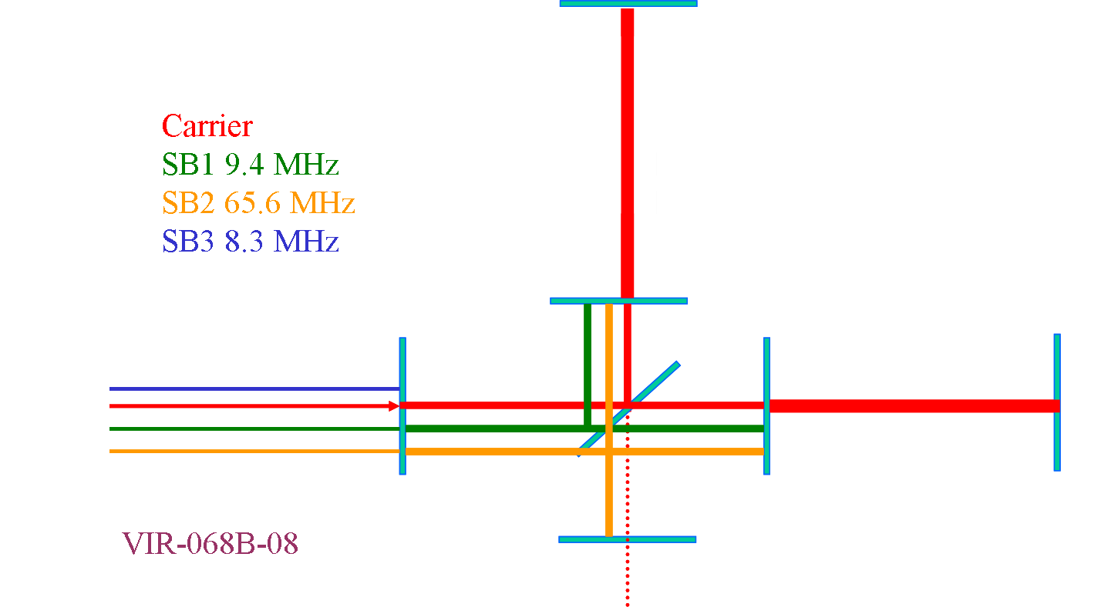
Sensing and control
Reference design:
  Auxiliary laser to lock the high finesse cavities
  Extended Variable Finesse technique for full lock
  Requirements, a set of cavity lengths and mod. frequencies defined
  Linear control scheme defined
The reference control strategy requires to move all the long towers in the central building

Slide 16
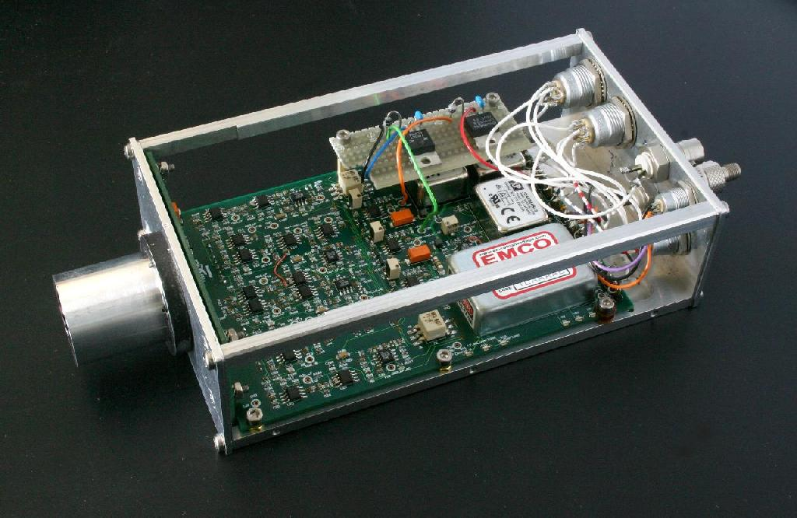
Noise in transimpedance amp
Simplified noise model
  All noise source parallel except e_{N}
100 μA and 1000 Ω
shot noise (100 μA)
eN noise
Dark current and Johnson noise

Slide 17
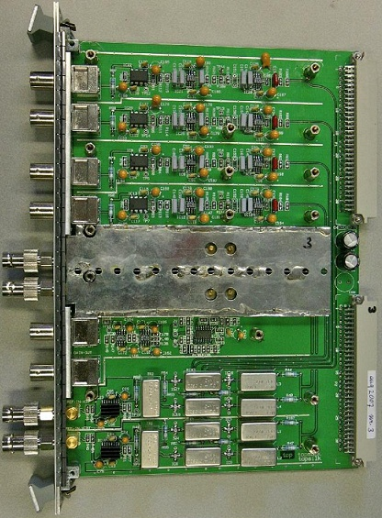
Demodulator boards
Improvements
Amplifier (noise)
8.35 MHz (band filter)
9.4 MHz
R&D 65.6 (quad diodes)
Long. and linear alignment
Han Voet, VU Amsterdam

Slide 18
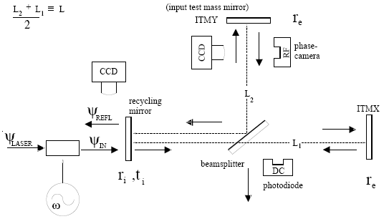
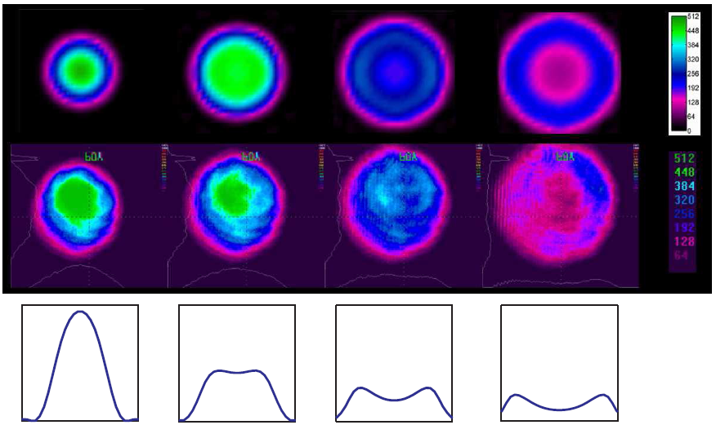
Phase camera
Measure wave fronts in cavity
H. Groenstege, H. Voet
Ketel, vdB
Phase camera- David Rabeling, H. Voet, etc.
Longitudinal alignment |  |  |  | € 130.00 |  | to be decided in July
Linear alignment |  |  |  | € 80.00
Local electronics |  |  |  | € 30.00 |  | to be decided in July
Phase camera |  |  |  | € 20.00
Han Voet, VU Amsterdam

Slide 19
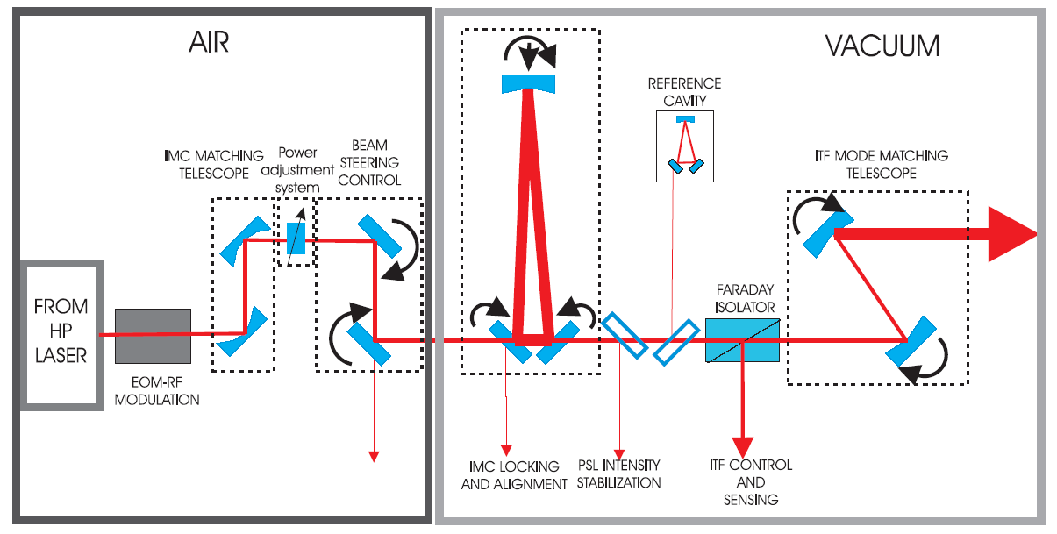
Injection system
Input mode cleaner: 144 m suspended triangular cavity
Large Faraday isolator with thermal compensation (DKDP crystal)
Non degenerate PR cavity: the matching telescope is moved inside the cavity. The PRM and the folding mirror must be suspended on the injection bench

Slide 20
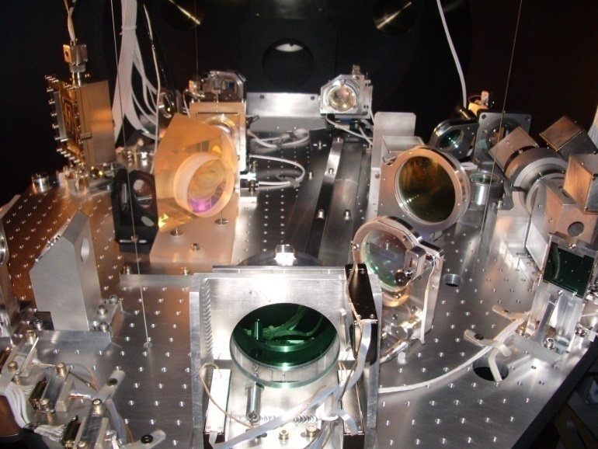
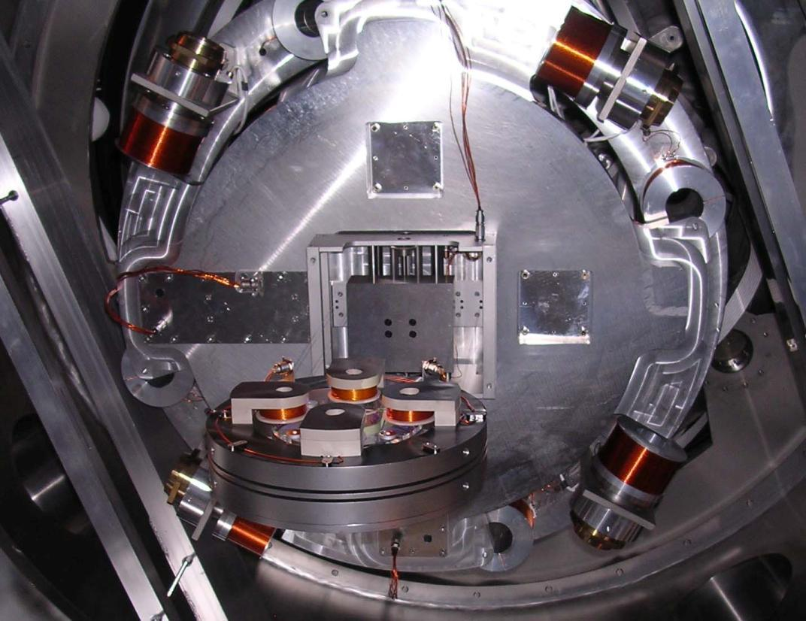
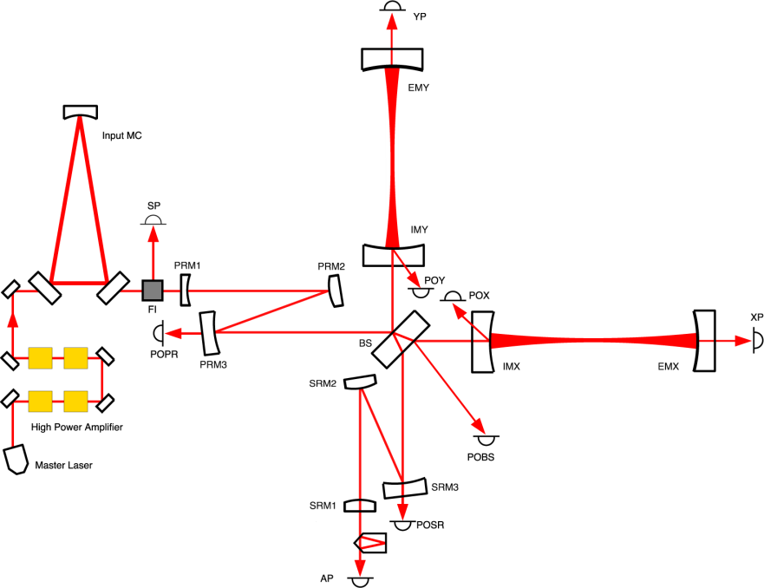
Suspension and bench systems
Mirrors and optical benches need to be suspended in vacuum
Injection bench: PRM1
Detection bench: SRM3
Input mode cleaner

Slide 21
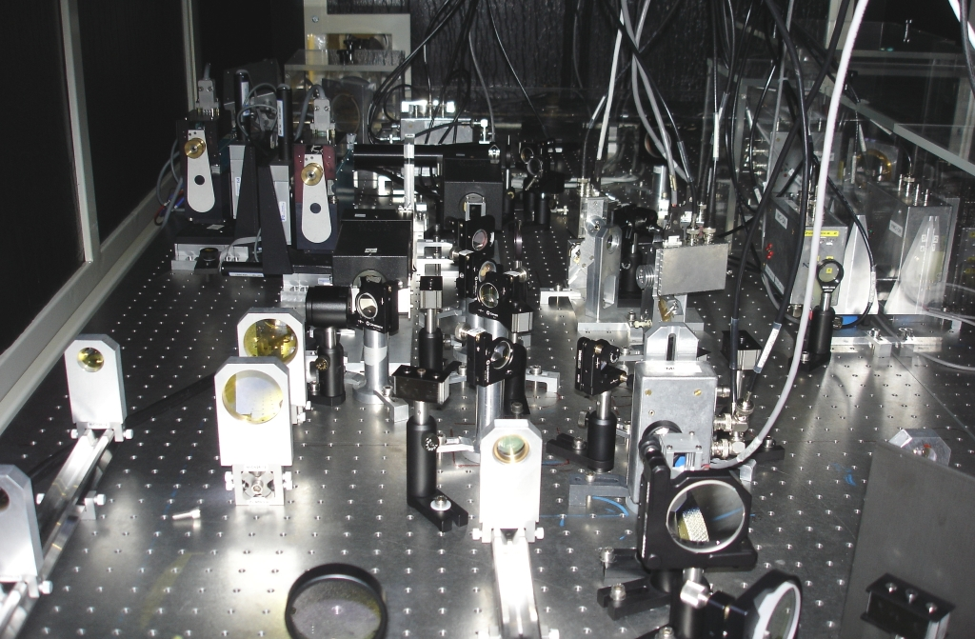
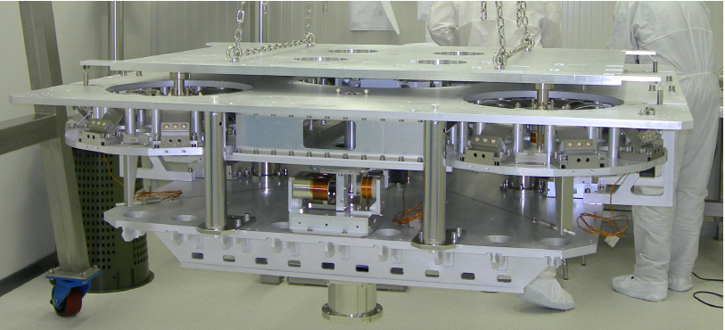
Suspension and bench systems
External optical benches: >= 6 benches
External injection bench
INJ payload |  |  |  | € 90.00
DET payload |  |  |  | € 90.00
IMC payload |  |  |  | € 30.00
 |  |  |  | € 210.00 | € 249.90

Slide 22
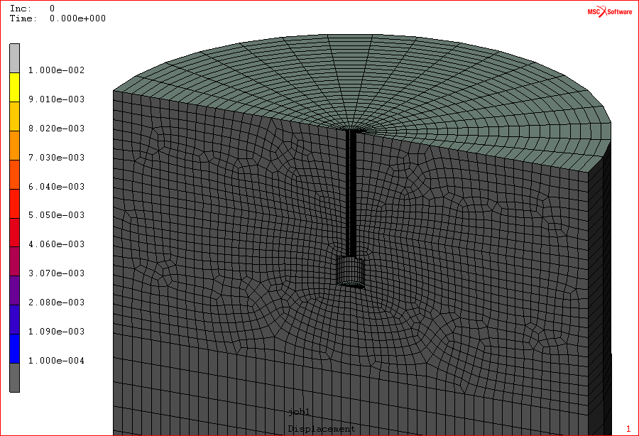
Einstein Telescope: site selection and infrastructure
Newtonian noise
  FEA crucial to determine
    Depth
    Cavity shape
    Performance of ET
System design
  Vacuum system
  Hall, caverns, infrastructure
  Cost estimates
Seismic data
  Seismic measurements
clay
granite
Eric Hennes
ET will feature 100 – 200 m long cryogenic suspensions

