Slide 1
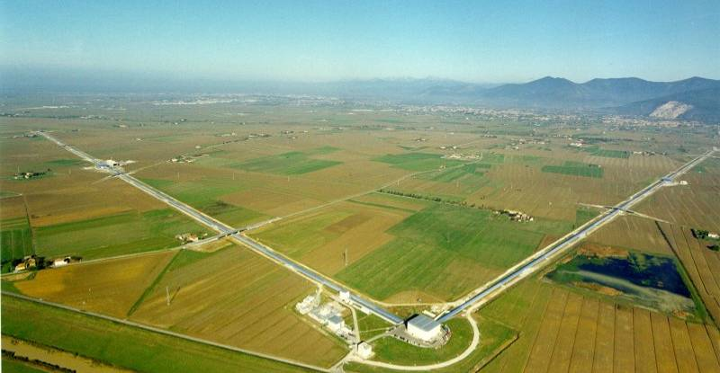
Gravitation
The dynamics of spacetime
Jo van den Brand
Kronig Lecture TU Delft, March 8, 2011; jo@nikhef.nl

Slide 2

Motivation
Einstein gravity :
Gravity as a geometry
Space and time are physical objects
Gravitation
  Least understood interaction
  Large world-wide intellectual activity
    Theoretical: GR + QFT, Cosmology
    Experimental: Interferometers on Earth and in space
Gravitational waves
  Dynamical part of gravitation, all space is filled with GW
  Ideal information carrier, almost no scattering or attenuation
  The entire universe has been transparent for GWs, all the way back to the Big Bang

Slide 3
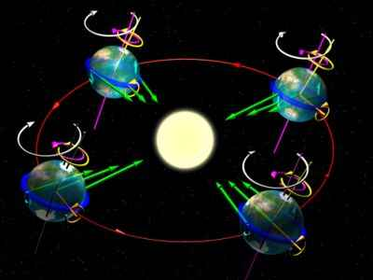



Gravitation
Newton’s theory of gravity (1687)
  Gravitation is a force that masses exert on each other
  This force is instantaneous

Slide 4
Gravitation
Newton’s theory of gravity (1687)
  Gravitation is a force that masses exert on each other
  This force is instantaneous
Einstein’s Special Relavity (1905)
  Physical laws are identical for all inertial observers
  Light travels with the same velocity for all observers
→ Close relation between space and time (`spacetime’)
→ Information exchange: not faster than with the speed of light
How does gravity fit in?

Slide 5
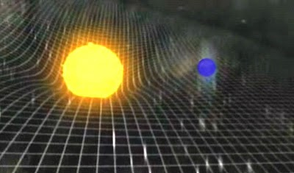

Gravitation
Newton’s theory of gravity (1687)
  Gravitation is a force that masses exert on each other
  This force is instantaneous
Einstein’s Special Relavity (1905)
  Physical laws are identical for all inertial observers
  Light travels with the same velocity for all observers
→ Close relation between space and time (`spacetime’)
→ Information exchange: not faster than with the speed of light
How does gravity fit in?
Einstein’s General Relativity (1915)
  Inertial observers in curved spacetime
  Matter produces the curvature
  Gravity is a side effect of this curvature

Slide 6
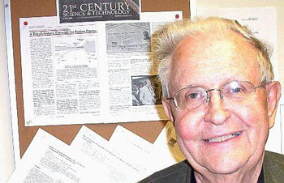
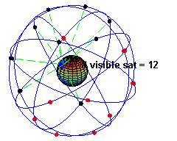
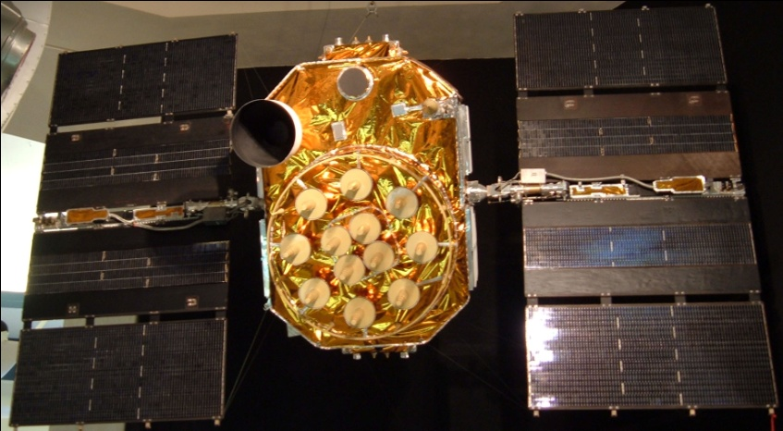
GPS (Global Positioning System)
Friedwardt Winterberg (1955): employ atomic clocks in orbit to test GR
Sputnik (1957): Doppler effect yields location (20 and 40 MHz radio signals)
GPS (1973 conceived, 1978 first satellite, 1993 operational)
Precision:
  Atomic clocks 1 ns/day)
  (light travels 30 cm per ns)
  GR 45.900 ns/day faster than on Earth
  SRT 7,200 ns/day slower
All GR confirmations are static effects in weak gravity fields
How about the dynamics

Slide 7
Gravitational waves
Predicted by general relativity
GW = space-time metric wave
  Distance variation
  Strain amplitude h:
GW
L-
Δ
L
L+
Δ
L
time
GW produced by mass acceleration
  d = source distance
  Q = quadrupole moment
Small coupling factor → astrophysical sources
L=20 m, d = 2 m, 27 rad/s
Earth-sun: 313 W

Slide 8
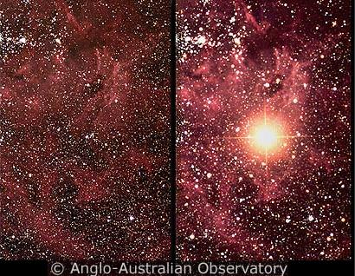
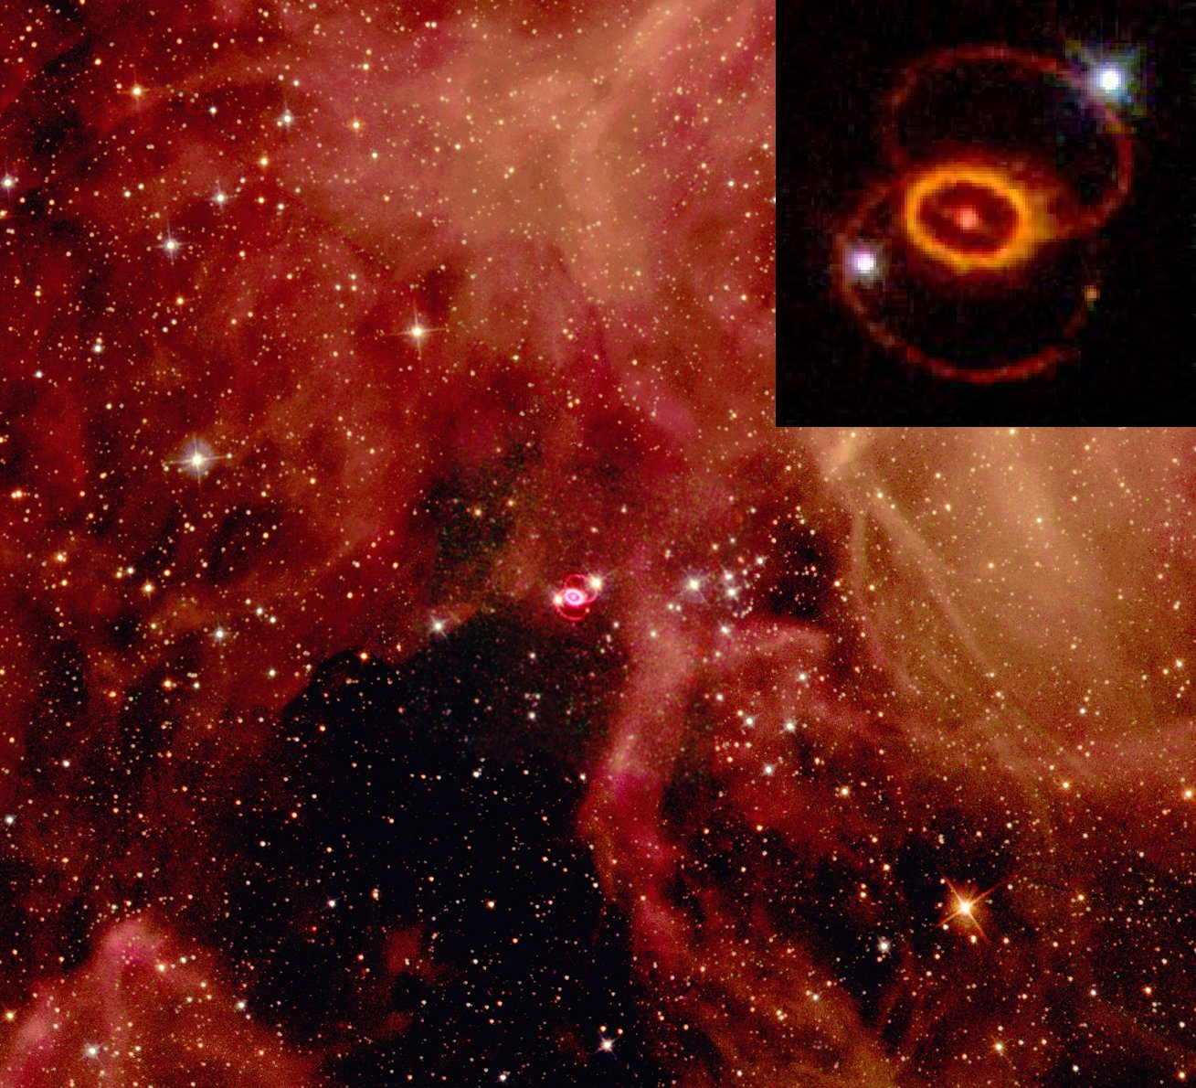
SN1987A

Slide 9
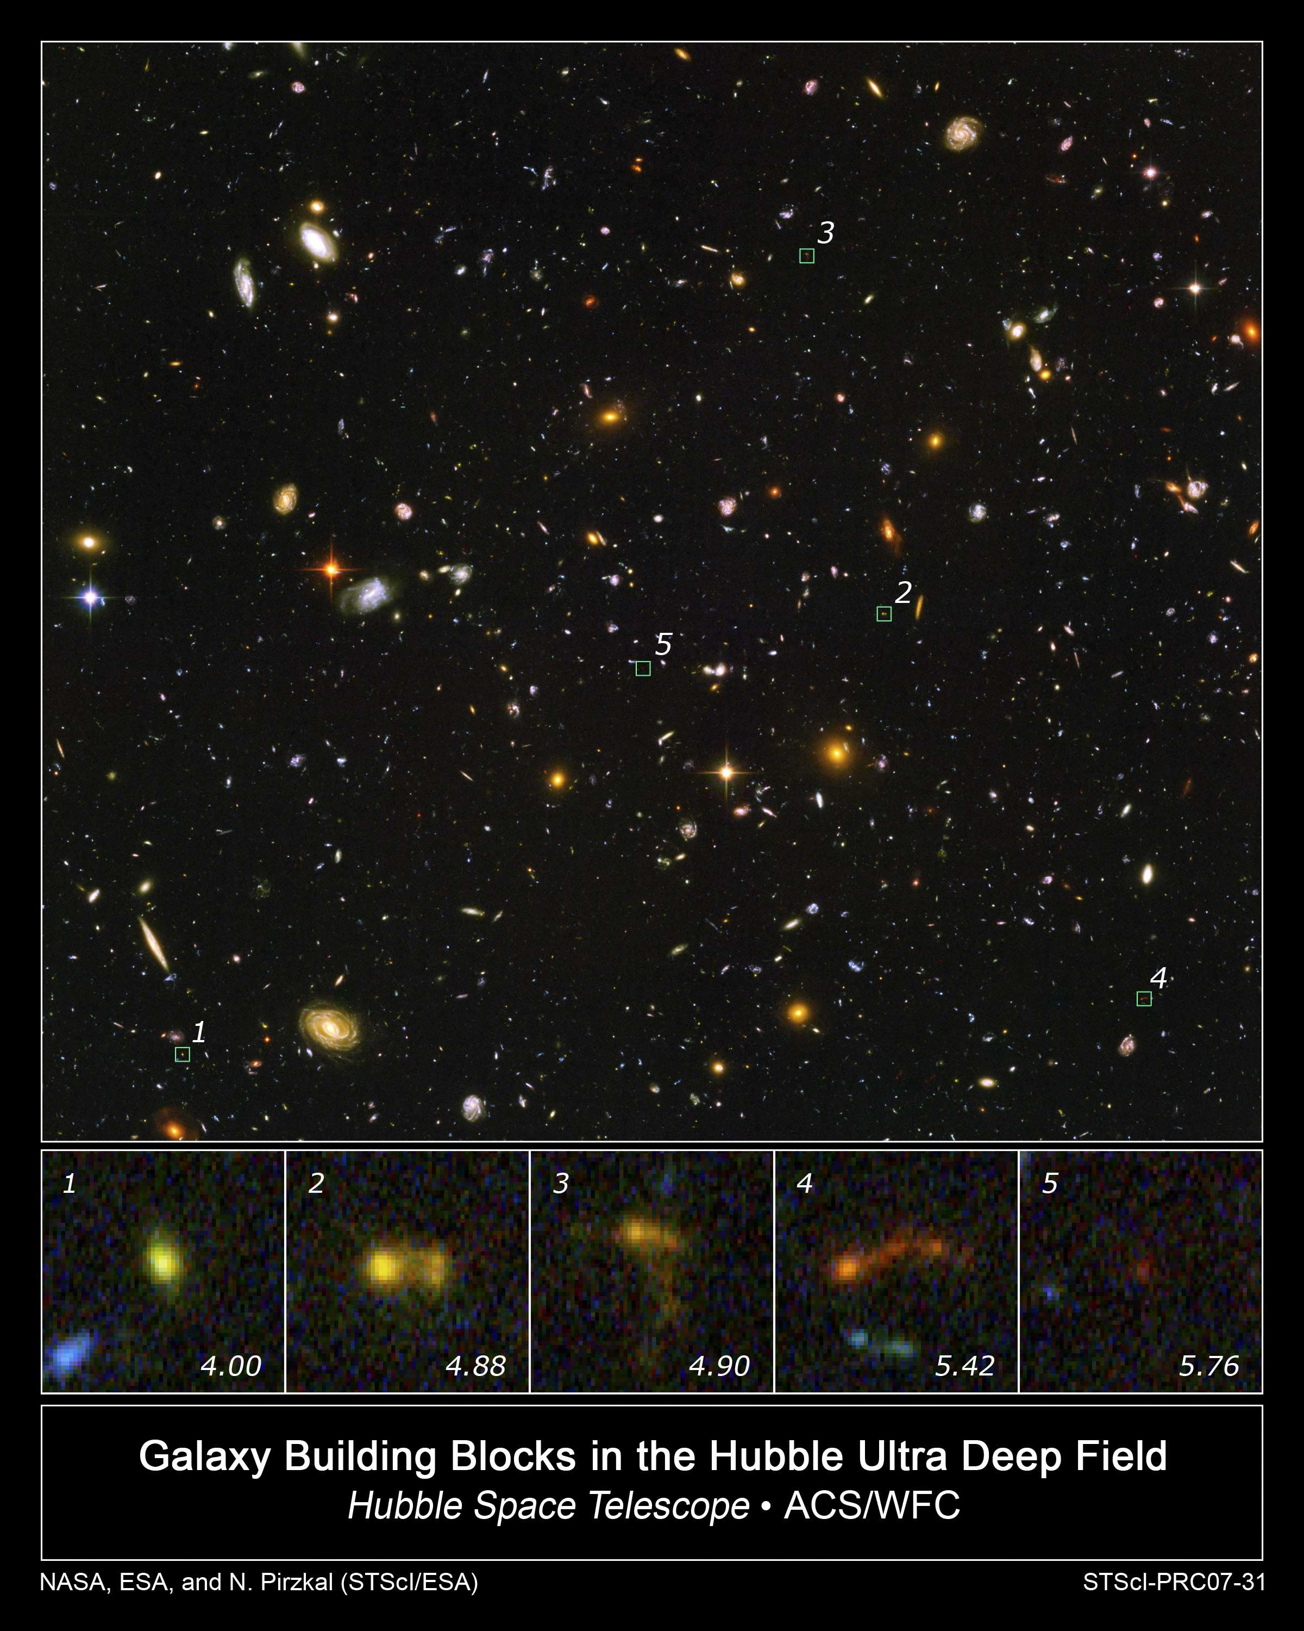
Hubble Ultra Deep Field

Slide 10
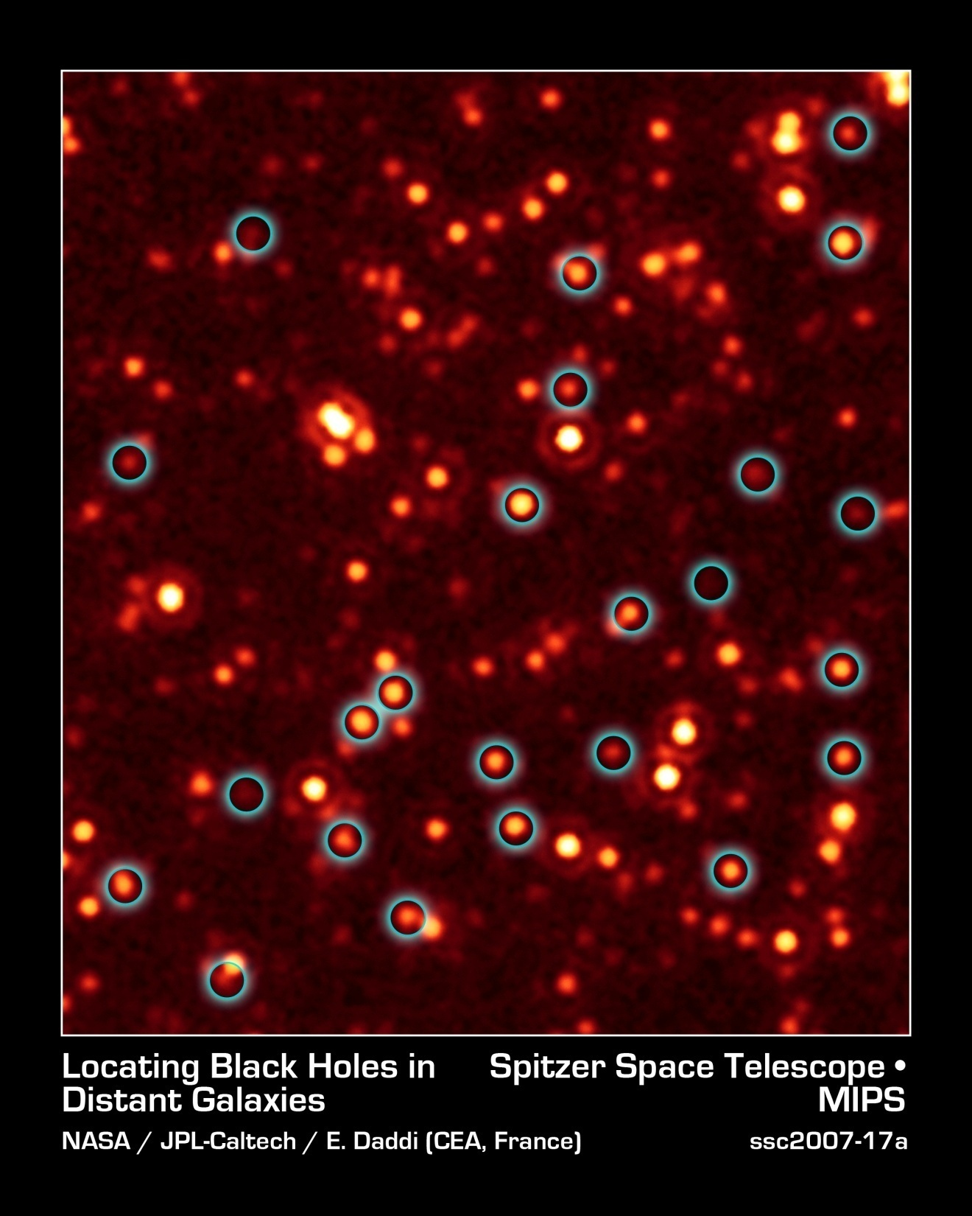
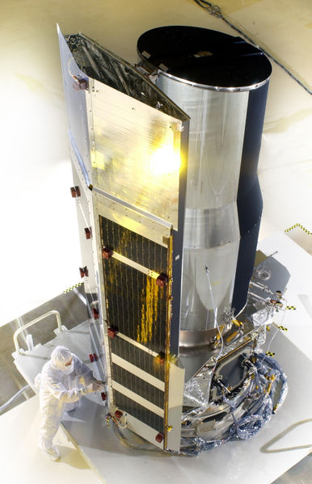
Spitzer space telecope
NS and BH are the most compact objects

Slide 11
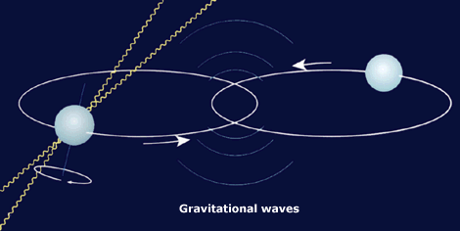
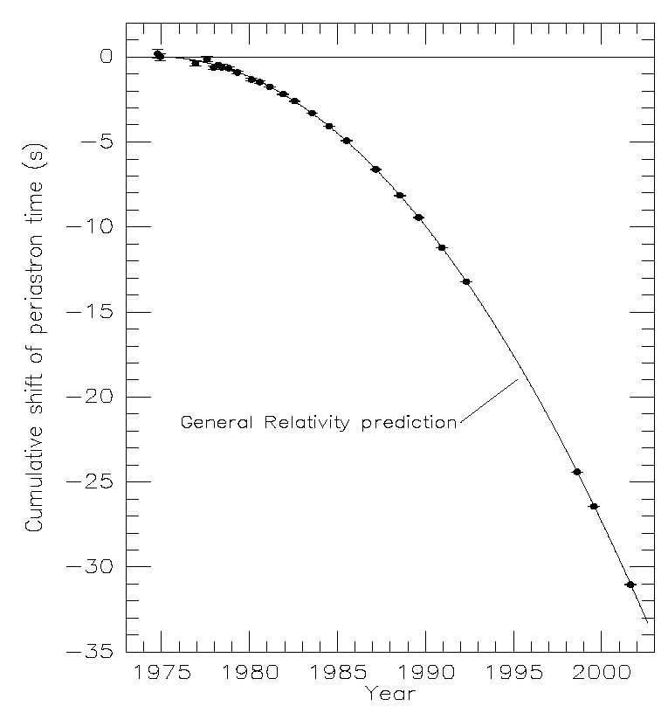

Evidence for gravitational waves
PSR 1913+16
  R. Hulse, J. Taylor (1974)
  Binary pulsar (T = 7.75 hr)
  1 pulsar (17 rev/s) → get the orbital parameters
  Orbital period decreases
    Energy loss due to GW emission (~10²⁵ W)
    Good agreement with GR
    Inspiral lifetime about 300 Myears (3.5 m/yr)
    Expected strain, h~10⁻²⁶ m
The fastest: J0737-3039
16.8 degrees per year

Slide 12
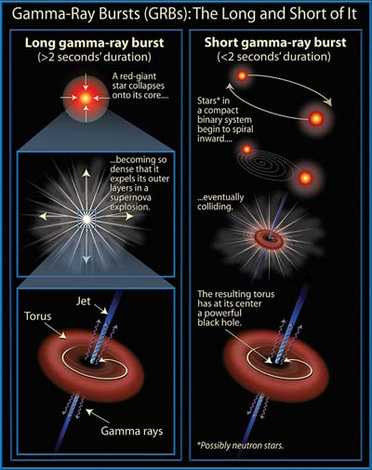
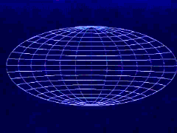

Burst sources: gamma-ray bursts
Recent satellite missions shown a series of explosive events in the Universe generating a huge quantity of energy
The origin of GRB is still unknown but some model has been developed

Slide 13
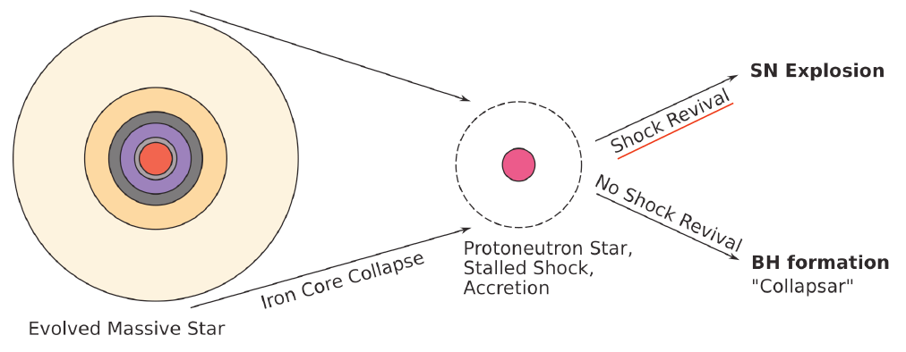
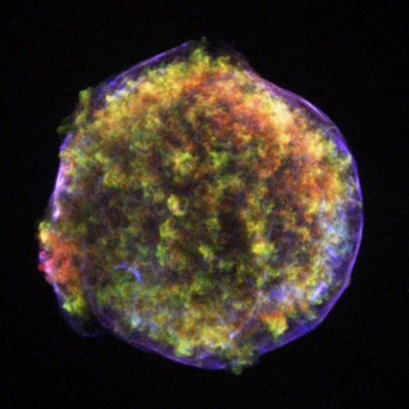
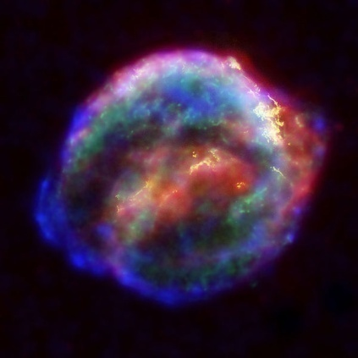
Supernovae
Mechanism of the core-collapse SNe still unclear
  Shock Revival mechanism(s) after the core bounce TBC
SN 1572 @ 2.3 kpc
SN 1604 @ 6kpc
GWs generated by a SNe should bring information from the inner massive part of the process and can constrains on the core-collapse mechanisms

Slide 14
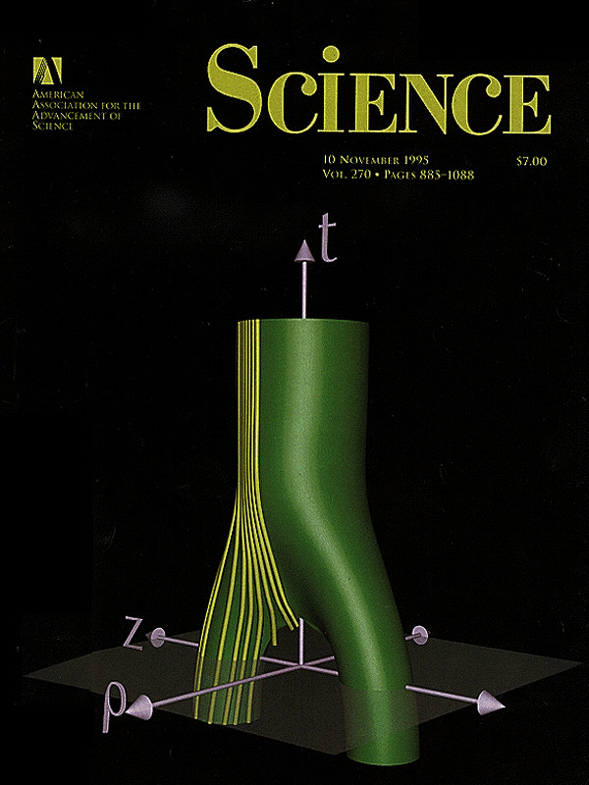
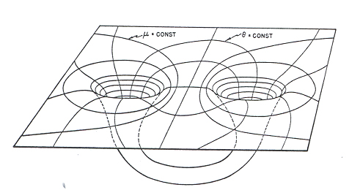
Collision of two black holes
Two-body problem in general relativity
Numerical solution of Einstein equations required
Problem solution started 45 years ago (1963 Hahn & Lindquist, IBM 7090)
Wave forms critical for gravitational wave detectors
A PetaFLOPS-class grand challenge
Oct. 10, 1995
Matzner, Seidel, Shapiro, Smarr, Suen, Teukolsky, Winicuor

Slide 15
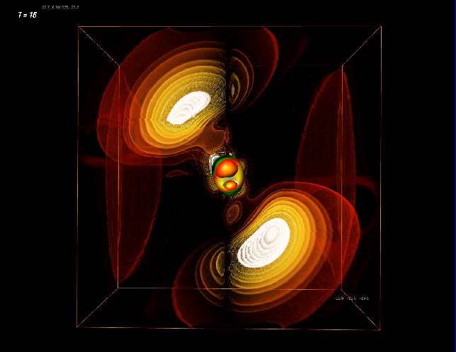
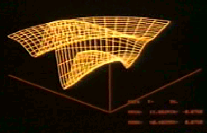
Numerical relativity
1977
Eppley & Smarr
CDC 7600
One processor
Each 35 Mflops
5 hours
1999
Seidel & Suen, et al.
SGI Origin
256 processors
Each 500 Mflops
40 hours
300X
30,000X

Slide 16
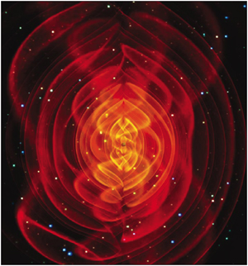
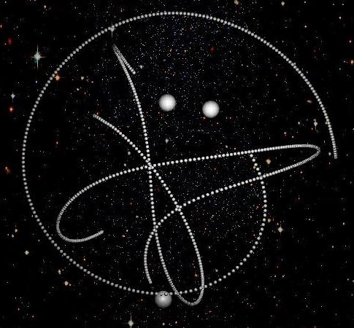
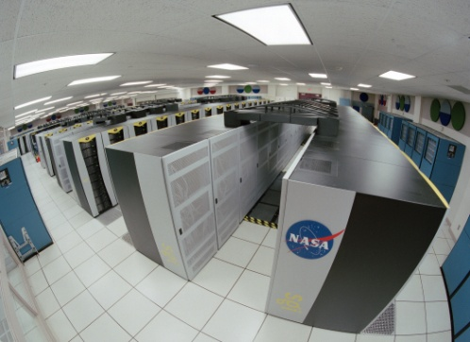
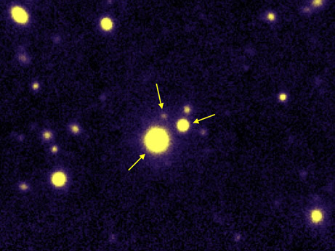
Numerical relativity
First merger of three black holes simulated on a supercomputer
ScienceDaily (Apr. 12, 2008)
Manuela Campanelli, Carlos Lousto and Yosef Zlochower—Rochester Institute of Technology Center for Computational Relativity and Gravitation
Triple quasar (10.8 Gly)
S. G. Djorgovski et al.,
Caltech, EPFL (Jan. 2007)

Slide 17
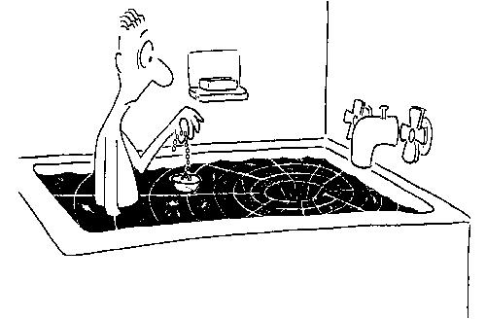
Numerical relativity
Collapse to a black hole (http://www.aei.mpg.de/~rezzolla)
Coalescense of two black holes is a pure spacetime event
The GW luminosity of a binary black hole outshines, during merger, the EM luminosity of all stars in the Universe
Compact binaries are standard sirens

Slide 18
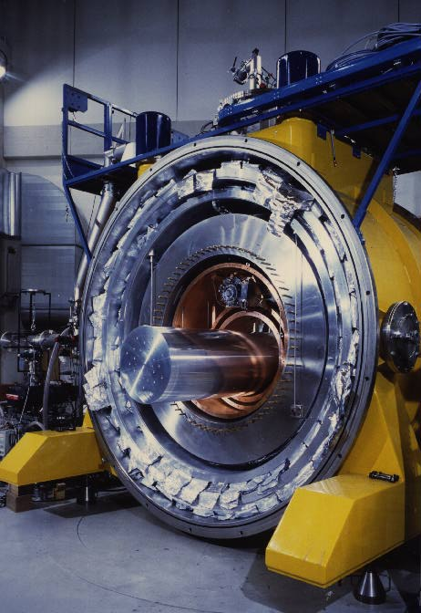
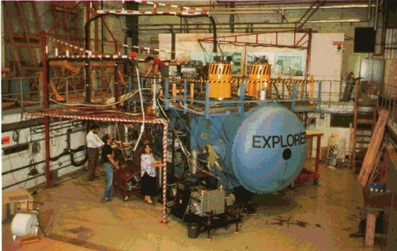
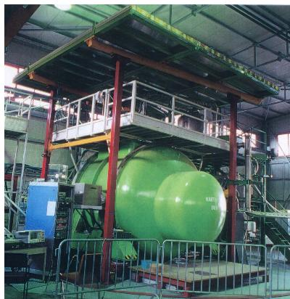
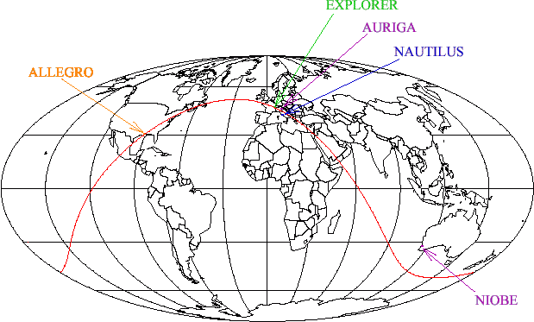
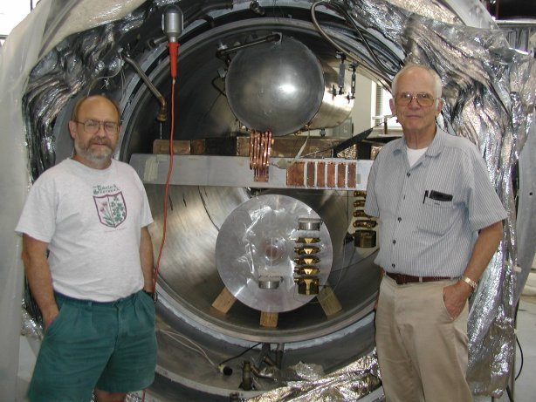
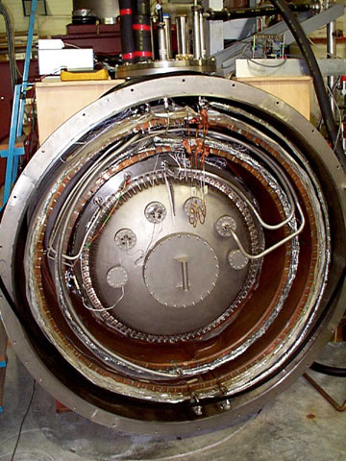


Bar detectors: IGEC collaboration
  Built to detect gravitational waves from compact objects

Slide 19
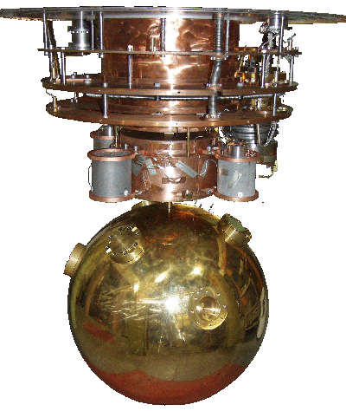
Mini-GRAIL: a spherical `bar’ in Leiden

Slide 20
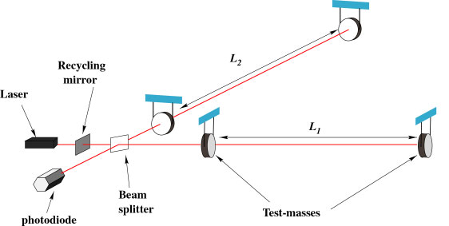
Interferometer Concept
…causing the interference pattern to change at the photodiode
As a wave passes, the arm lengths change in different ways….
Suspended
Masses

Slide 21
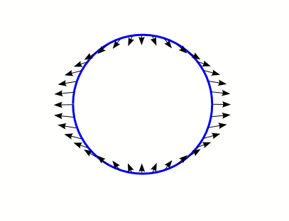
Tidal gravitational forces of FW
Tidal forces
  Gravitational effect of distant source can only be felt through its tidal forces
  Tidal accelerations Earth-Moon system
  GW can be considered as traveling, time dependent tidal forces
  Tidal forces scale with size, typically produce elliptical deformations
Earth Moon
Solid Earth will fall with this acceleration
After subtraction of central acceleration

Slide 22
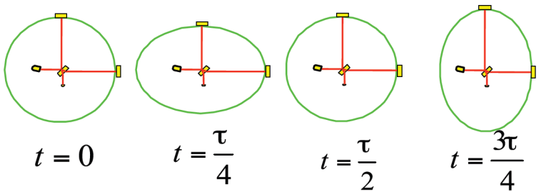
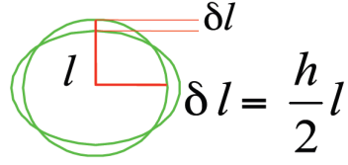


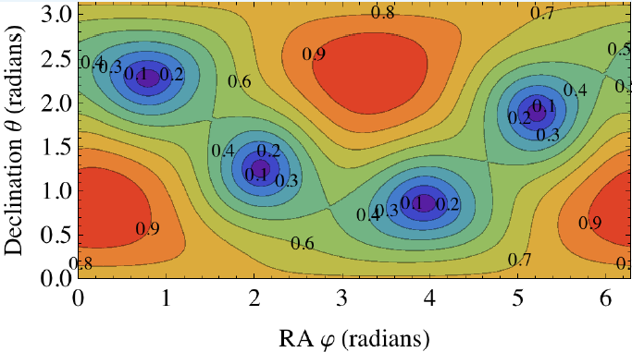
Interferometer approach
Test masses
  System of free-falling test masses is displaced by GW
  Equip test masses with mirrors and measure relative displacement (strain)
  Plus- and cross polarization states
  Antenna pattern funtions
Virgo

Slide 23
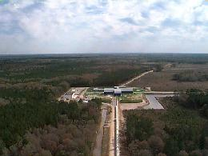
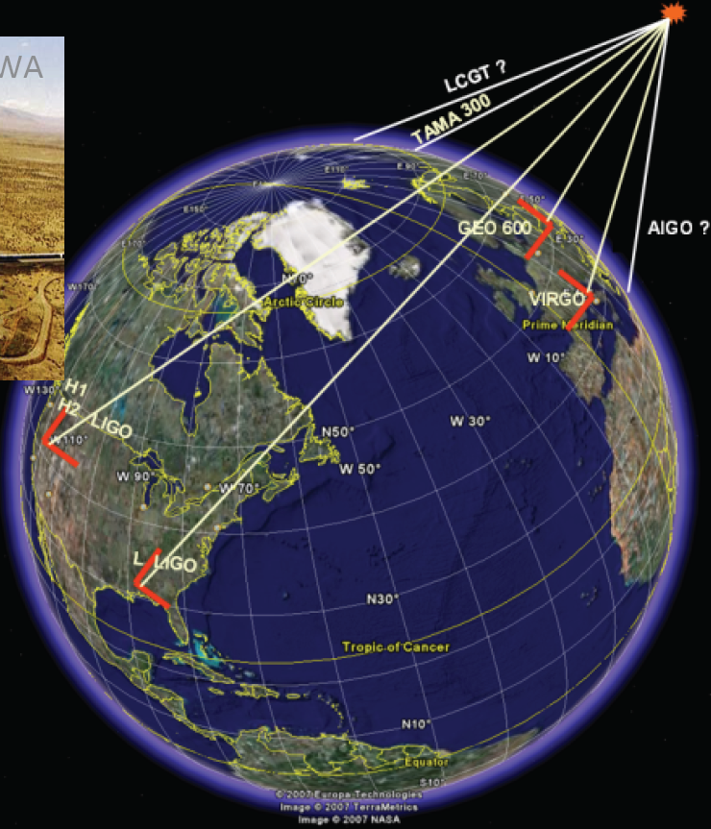
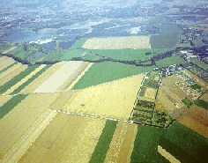
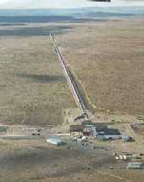
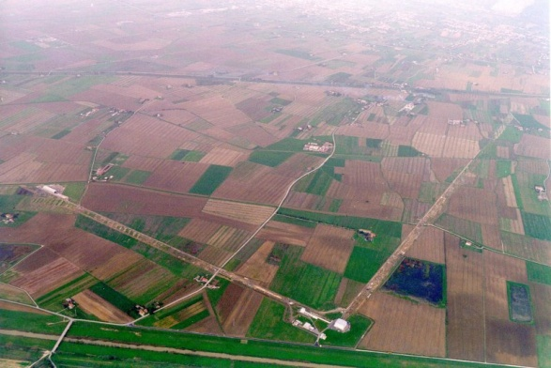
A worldwide network of interferometers
LIGO, Livingston, LA
GEO600, Hanover, Germany
LIGO, Hanford, WA
Virgo, Cascina, Italy
decompose the polarization of gravitational waves
detection confidence
locate the sources

Slide 24
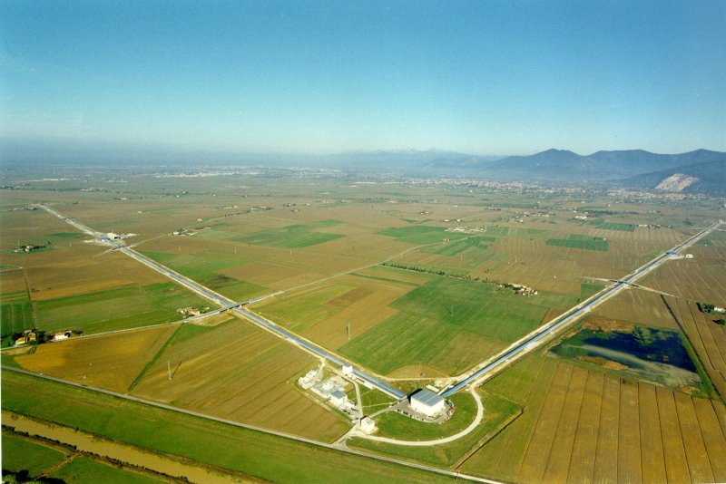
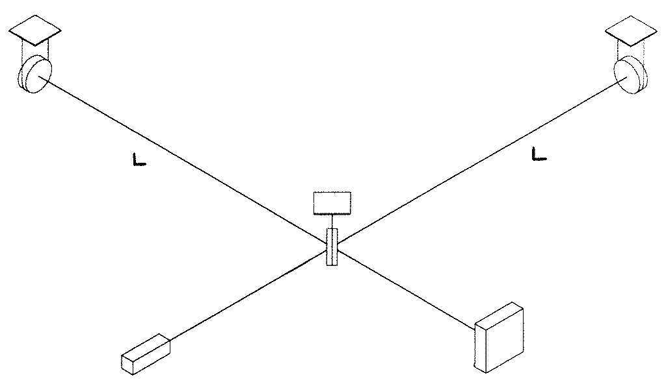
Interferometer as GW detector
Principle: Measure distances between free test masses
  Michelson interferometer
  Test masses = interferometer mirrors
  Sensitivity: h = ΔL/L
    We need large interferometer
    For Virgo L = 3 km
Virgo: CNRS+INFN
(ESPCI-Paris, INFN-Firenze/Urbino, INFN-Napoli, INFN-Perugia, INFN-Pisa, INFN-Roma,LAL-Orsay, LAPP-Annecy, LMA-Lyon, OCA-Nice)
+ Nikhef joined 2007
Next science run starts in June 4, 2011
Suspended
mirror
Suspended
mirror
Beam splitter
Light
Detection
LASER

Slide 25
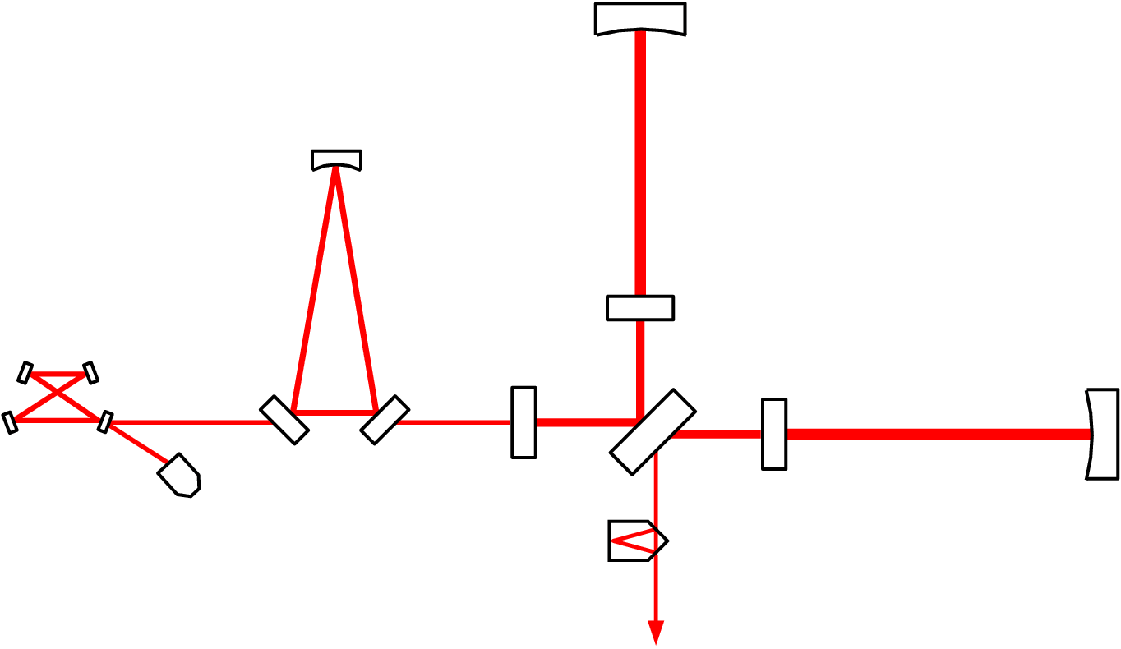
VIRGO Optical Scheme
Input Mode Cleaner (144 m)
3 km long Fabry-Perot
Cavities
Laser 20 W
Power
Recycling
Output Mode
Cleaner (4 cm)

Slide 26
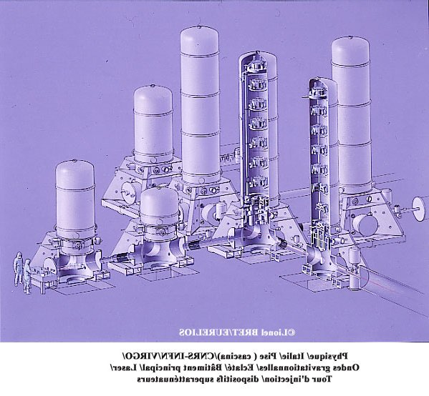
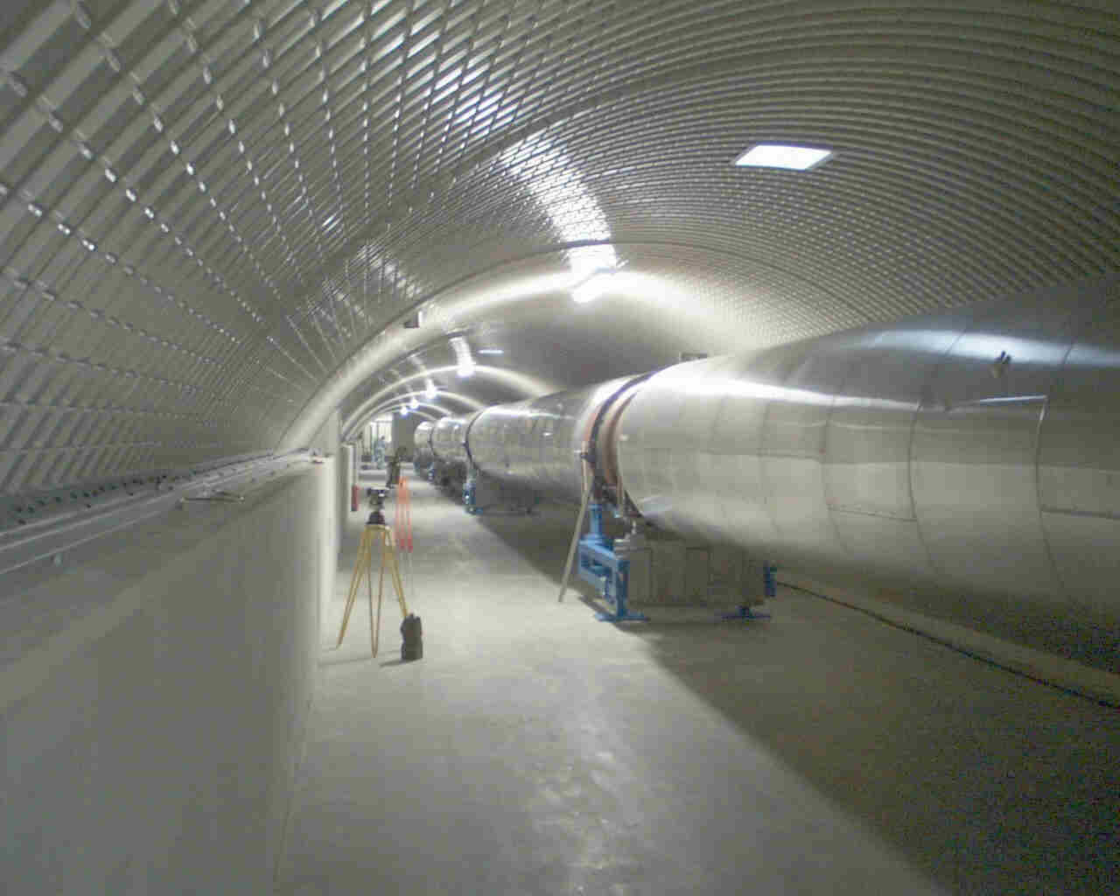
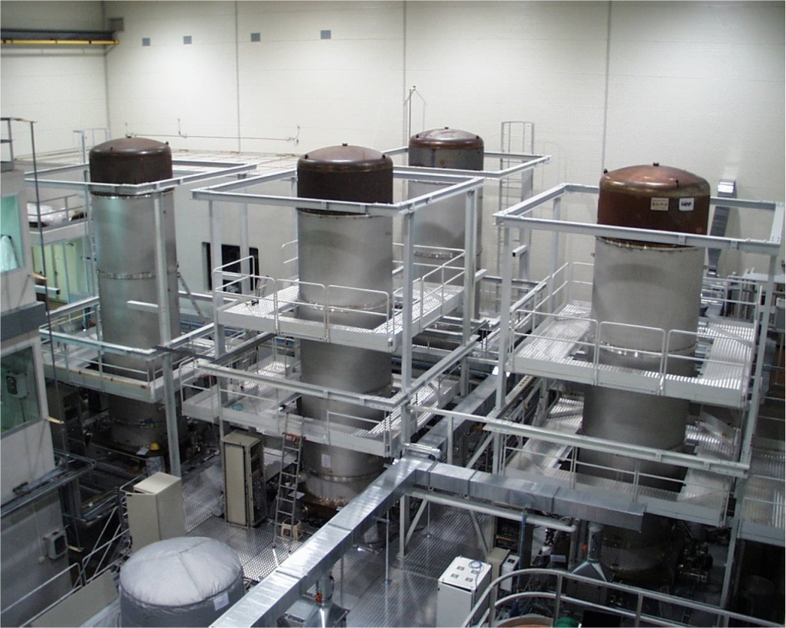
Vacuum system
UHV

Slide 27

Mirrors
High quality fused silica mirrors
  35 cm diameter, 10 cm thickness, 21 kg mass
  Substrate losses ~1 ppm
  Coating losses <5 ppm
  Surface deformation ~l/100
Quantum Non-demolition Measurements

Slide 28


Thermal noise
Mechanical modes are in thermal equilibrium
  Modes:
    Pendulum mode
    Wire vibration
    Mirror internal modes
    Coating surface
  Energy associate: k_{B}T
Thermal motion spectrum:
Strategy:
  use low dissipative materials:
  → concentrate the motion at the resonance frequency

Slide 29

The seismic noise challenge
Noise spectrum:
Goal:
  More than 10 orders of magnitude above 4Hz
Vertical to horizontal coupling > 2 ×10⁻⁴
  Need to filter vertical motions!
3 km
6400 km

Slide 30


VIRGO superattenuator
Solution:
  Chain of filters
Passive device
  Combine:
    blades (vertical)
    wires (pendulum)
6 seismic filter (in all DOFs)
Inverted pendulum for low freq. control
2 Control stages:
  Marionetta (longitudinal-angular)
  reference mass (longitudinal)
Expected attenuation: 10¹⁴ @ 10 Hz
Various control strategies

Slide 31



Superattenuators

Slide 32
Virgo Status
& Commissioning

Slide 33











Evolution of sensitivity

Slide 34

Interferometers – sensitivity
  The horizon (best orientation) for a binary system of two 10 solar mass black holes is 63 Mpc
Notes:
De instrumenten bestaan en hebben reeds on fantastische gevoeligheid.
Als U het vergelijkt met de wortel uit de Planck tijd, dan ziet U dat we toegang hebben tot details op de Planck schaal.

Slide 35
Interferometers – sensitivity
  The horizon (best orientation) for a binary system of two 10 solar mass black holes is 63 Mpc
  Compare to square root of Planck time:
  For capability to study details at Planck scale
Notes:
De instrumenten bestaan en hebben reeds on fantastische gevoeligheid.
Als U het vergelijkt met de wortel uit de Planck tijd, dan ziet U dat we toegang hebben tot details op de Planck schaal.

Slide 36

Virgo joint analyses
Virgo – Bars joint analysis
Burst events and stochastic signals
Bars, GEO600 and 2km Hanford in Astrowatch
Virgo – LIGO collaboration
Working group for burst, inspiral events, stochastic and periodic sources
Formal MoU
Publish together
  Virgo now at <1e-22 / rtHz

Slide 37
LIGO and VIRGO: scientific evolution
At present hundreds of galaxies in range for 1.4 M_{o} NS-NS binaries
Enhanced program
  In 2009 about 10 times more galaxies in range
Advanced detectors
  About 1000 times more galaxies in range
  In 2014 expect 1 signal per day or week
  Start of gravitational astrophysics
  Numerical relativity will provide templates for interpreting signals

Slide 38
Evolution of ground-based GW detectors
Unlikely detection
1st generation interferometric detectors
  Initial LIGO, Virgo, GEO600
Science data taking
Set up network observation
We are here
Plausible detection
    Enhanced LIGO, Virgo+
Lay ground for multi-
messenger astronomy
2nd generation detectors
  Advanced LIGO, Advanced Virgo, GEO-HF
Likely detection
Routine observation
Towards GW astronomy
Thorough observation
of Universe with GW
3rd generation detectors
  Einstein Telescope, US counterpart to ET

Slide 39




Advanced Virgo (AdV)
PROJECT GOALS
Upgrade Virgo to a 2nd generation detector. Sensitivity: 10x better than Virgo
Be part of the 2nd generation GW detectors network. Timeline: in data taking with Advanced LIGO

Slide 40
Other GW projects

Slide 41

Underground detector in Kamioka

Slide 42



Experience: Japan
LISM: 20 m Fabry-Perot interferometer, R&D for LCGT, moved from Mitaka (ground based) to Kamioka (underground)
Seismic noise much lower:
Operation becomes easier
  10² overall gain
  10³ at 4 Hz

Slide 43



2022
Design Study Proposal approved by EU within FP7
Large part of the European GW community involved EGO, INFN, MPI, CNRS, Nikhef, Univ. Birmingham, Cardiff, Glasgow
Recommended in Aspera / Appec roadmap

Slide 44


Einstein Telescope
  Triangular topology
  Underground
    Depth: 100 – 200 m
    Gravity gradient noise
  Cryogenic mirrors
  10 km arms
  Xylophone detector
    HF ITF
    LF ITF
    Up to 6 ITFs

Slide 45



ET infrastructure
Infrastructure: largest cost driver
  Tunnels, caverns, buildings
  Vacuum, cryogenics, safety systems
  Collaborate with industry
    COB (Amsterdam, October 9, 2008)
    Saes Getters Italy
    Demaco Netherlands
Experience
  LIGO, Virgo, GEO
  Underground labs
    Gran Sasso, Canfranc,
    Kamioka, Dusel, etc.
  Mines
  Particle physics
    ILC, Cern, Desy, FLNL
  Seismology
    KNMI, Orfeus
  Geology

Slide 46

ET infrastructure

Slide 47

ET infrastructure

Slide 48
ET infrastructure

Slide 49



Expected sensitivities – rates
Binary mergers
Einstein Telescope: ~1000 per day
GW observatory

Slide 50



Gravitational wave antenna in space - LISA
  3 spacecraft in Earth-trailing solar orbit separated by 5 x10⁶ km.
  Measure changes in distance between fiducial masses in each spacecraft
  Partnership between NASA and ESA
  Launch date >2020+

Slide 51

Complementarity of Space- & Ground-Based Detectors
Difference of 10⁴ in wavelength:
Like difference between X-rays and IR!
Rotating
Neutron Stars
LISA
VIRGO
LISA will see all the compact white-dwarf and neutron-star binaries in the Galaxy (Schutz)
Notes:
Advanced LIGO (from White Book)

Slide 52

Studies of supermassive black holes
Center of our Milky Way is obscured by dust

Slide 53

Infrared telescopes peer through the dust

Slide 54


Röntgen radiation
Gamma radiation

Slide 55

Radio image

Slide 56


Slide 57



Stellar orbits in the direct vicinity of Sagittarius A*

Slide 58



Massive black hole mergers
MBH = 0.005M_{bulge}
But do they merge?
D. Richstone et al., Nature 395, A14, 1998

Slide 59


Massive black hole mergers
Several observed phenomena may be attributed to MBH binaries or mergers
  X-shaped radio galaxies (see figure)
  Periodicities in blazar light curves (e.g. OJ 287)
  X-ray binary MBH: NGC 6240
See review by Komossa [astro-ph/0306439]
[Merritt and Ekers, 2002]
Notes:
The big switch:
jets (inset) from the core of radio galaxy NGC326 appear to have changed direction suddenly, interpreted as a result of black holes merging. The jets initially pointed to the 10 o'clock and 4 o'clock directions. They now point to 2 o'clock and 8 o'clock. Please photo credit as follows: National Radio Astronomy Observatory / AUI, observers Murgia et al.; STScI (for the

Slide 60


LOI to ESA – LISA analysis
Nikhef, VU, RUN and SRON
Netherlands: Bulten/Nelemans

Slide 61
LISA Video

Slide 62





Science goals
    What happens at the edge of a Black Hole?
Chandra - Each point of x-ray
light is a Black Hole!
Is Einstein’s theory still right in these conditions of extreme gravity? Or is new physics awaiting us?
Notes:
62
Studies van extreme gravitatie.

Slide 63



EMRI - capture orbits
Filtering the data to find these orbits in a huge parameter space
Dealing with source confusion
Challenges:
  Computing the orbits
Stellar-type black holes (10 M) sometimes fall into supermassive holes.
Orbits complicated, can have 10⁴ or more cycles, provide detailed examination of black-hole geometry.
Tests of black-hole no-hair theorems, strong-field gravity.
Typical EMRI event: 10 M BH captured by 10⁶ M BH

Slide 64


Science goals
    What is the mysterious Dark Energy pulling the Universe apart?
We do not know what 95% of the universe is made of!
Dark energy and matter interact through gravity
Notes:
64
Een nieuwe probe, die directe toegang biedt tot het hele Universum.
Studie van donkere energie en materie.
Gevoelig voor dynamica.

Slide 65

Science goals
    What powered the Big Bang?
Gravitational Waves Can Escape from Earliest Moments of the Big Bang
Inflation
(Big Bang plus
10⁻³⁴ Seconds)
light
Big Bang plus 380,000 Years
gravitational waves
Now
Big Bang plus
14 Billion Years
Notes:
In principe een directe toegang tot het vroege Universum.

Slide 66



Signals from inflation and phase transitions
Theoretical (astro)particle physics community
  GW, inflation, string theory, cosmic defects
  Jan Willem van Holten et al. (Nikhef, Leiden)
Provide templates, spectra, etc.
  Participate in Virgo – LIGO analysis
    G. Koekoek
    Galluccio et al; Phys. Rev. Lett. 79 (1997)
Notes:
De mogelijke detectie van directe signalen uit het vroege heelal is zeer opwindend.
Vereist goede samenwerking met theoretische gemeenschap.
Dit mondt uit in templates voor dergelijke signalen, en data analyse.

Slide 67
Summary: science case
Was Einstein right?
  Is the nature of gravitational radiation as predicted by Einstein?
  Are black holes hairless and are there naked singularities?
Unsolved problems in astrophysics
  What is the origin of gamma ray bursts?
  What is the structure of neutron stars and other compact objects?
Cosmology
  What is dark energy?
  How did massive black holes at galactic nuclei form?
Fundamental questions
  What were the physical conditions at the Big Bang?
  Are there really ten spatial dimensions?

Slide 68
Summary
Gravitational wave physics
  Component of Dutch Astroparticle Physics initiative
  Exciting new physics program
    Important questions are addressed
    Program with a long-term scientific perspective
VIRGO and LIGO
  Sensitivity is improving fast
  First science runs completed
  Advanced detectors in preparation
Future
  Third-generation GW detector: Einstein Telescope
  LISA: GW in space

Slide 69




Gravity gradient noise
Gravity gradient noise
  Time varying contributions to Newtonian background driven by seismic compression waves, ground-water variations, slow-gravity drifts, weather, cultural noise
  Determines low-frequency cut-off
  Cannot be shielded against
Counter measures
  Network of seismometers and development of data correction algorithms
    Analytical studies: G. Cella
    Numerical studies: E. Hennes
Figure: M.Lorenzini

Slide 70
Surface (Rayleigh) and body (P/S/Head) waves as a result of vertical point source load
Surface waves
Rayleigh
Body waves
Head
Shear
Pressure
Wave attenuation has two components
  Geometrical (expansion of wave fronts) ~ r^{n}
    Raleigh, n=-1/2
    Body waves on surface, n=-2
    Body waves at depth, n=-1
  Material (damping)
  Geometrical damping could be why S-wave has maximum at 45 degrees, still trying to find reference to confirm this.

Slide 71



GW sources: pulsars
Rotating asymmetric neutron star
GW Amplitude function of the unknown asymmetry
  ε = star asymmetry = ??
  Upper limit set by the pulsar spin down
A few pulsars around a few 100 Hz
  Only 800 pulsars plotted out of 10⁹ in the galaxy
Weak signal but could be integrated for months
  But a complex problem due to the Doppler effect
  CPU issues
Crab pulsar
N
f (Hz)
LIGO: < 4% of energy in GW

Slide 72


Detection system
Theory:
  One photodiode
Reality
  Multiple beams, multiple photodiodes, mod/demodulation electronics, camera, DAQ,…
  > 1400 « ADC channels »
  18 Mbytes/s of raw data

Slide 73
Nikhef activities

Slide 74



Input mode cleaner
Mode cleaner cavity: filters laser noise, select TEM00 mode
Input beam
Transm. beam
Refl. beam

Slide 75


Input mode cleaner end-mirror

Slide 76

Nikhef: Linear alignment of VIRGO
Phase modulation of input beam
Demodulation of photodiode signals at different output beams
  => longitudinal error signals
Quadrant diodes in output beams
  => Alignment information
  (differential wavefront sensing)
Anderson-Giordano technique
  2 quadrant diodes after arm cavities
W
N
EOM

Slide 77

VIRGO design sensitivity
Shot noise
Seismic noise
Thermal noise
Shot noise
1

Slide 78
Virgo analysis at Nikhef

Slide 79




Radiation from rotating neutron stars
“Mountain” on neutron star
Wobbling neutron star
Accreting neutron star
R-modes

Slide 80


Pointing at known neutron stars
Targeted search of GWs from known isolated radio pulsars
S1analysis: upper-limit (95% confidence) on PSR J1939+2134:
  h₀ < 1.4 x 10⁻²² (e < 2.9 x 10⁻⁴) Phys Rev D 69, 082004 (2004)
S2 analysis: 28 pulsars (all the ones above 50 Hz for which search parameters are “exactly” known)

Slide 81



All sky search – Nikhef
Doppler shifts
  Frequency modulation: due to Earth’s motion
  Amplitude modulation: due to the detector’s antenna pattern.
Assume original frequency is 100 Hz and the maximum variation fraction is of the order of 0.0001
Note the daily variations
After FFT: energy not in a single bin, so the SNR is highly reduced
Bin in galactic coordinates
Re-sampling
Short FFTs
Hough maps
Include binary systems
ALL SKY SEARCH
enormous computing challenge
(Sipho van der Putten, Henk Jan Bulten, Sander Klous)

Slide 82


Binaire pulsars
Include binary system in analysis

