Slide 1
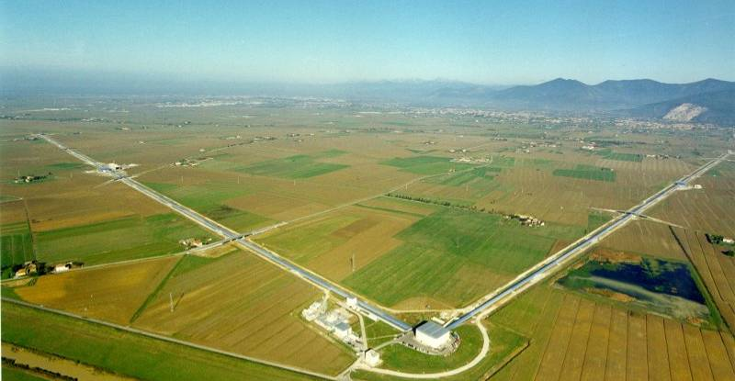
Gravitation
The dynamics of spacetime
Jo van den Brand
Kronig Lecture TU Delft, March 8, 2011; jo@nikhef.nl

Slide 2
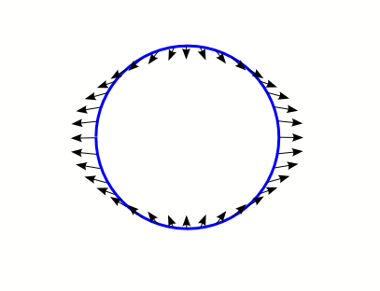
Tidal gravitational forces of FW
Tidal forces
  Gravitational effect of distant source can only be felt through its tidal forces
  Tidal accelerations Earth-Moon system
  GW can be considered as traveling, time dependent tidal forces
  Tidal forces scale with size, typically produce elliptical deformations
Earth Moon
Solid Earth will fall with this acceleration
After subtraction of central acceleration

Slide 3
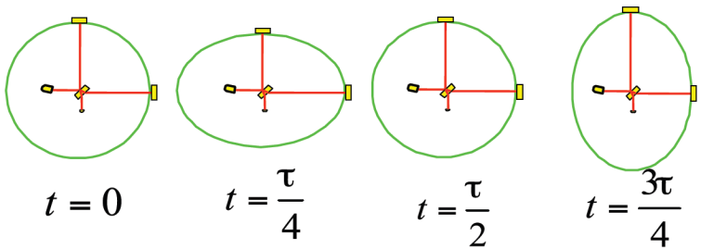
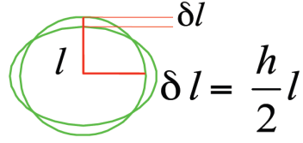


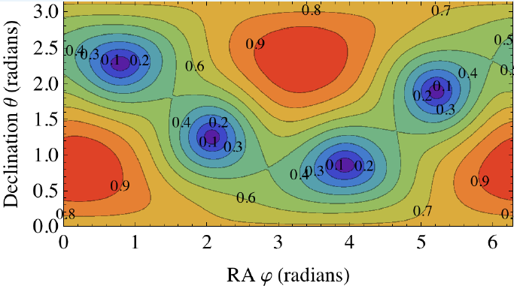
Interferometer approach
Test masses
  System of free-falling test masses is displaced by GW
  Equip test masses with mirrors and measure relative displacement (strain)
  Plus- and cross polarization states
  Antenna pattern funtions
Virgo

Slide 4
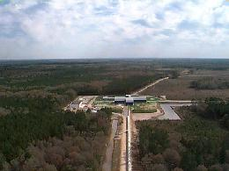
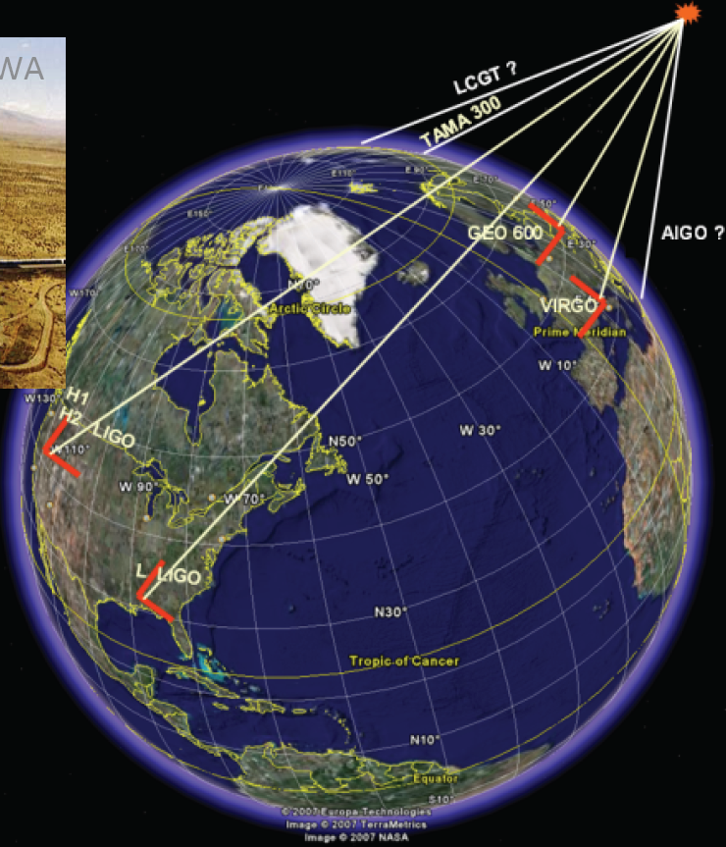
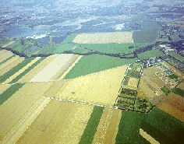
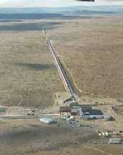

A worldwide network of interferometers
LIGO, Livingston, LA
GEO600, Hanover, Germany
LIGO, Hanford, WA
Virgo, Cascina, Italy
decompose the polarization of gravitational waves
detection confidence
locate the sources

Slide 5
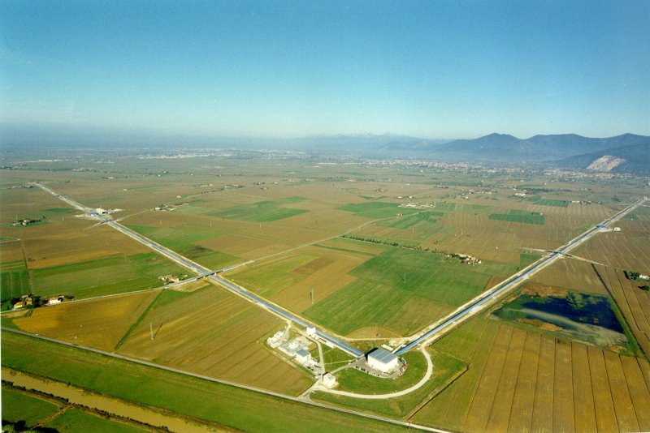
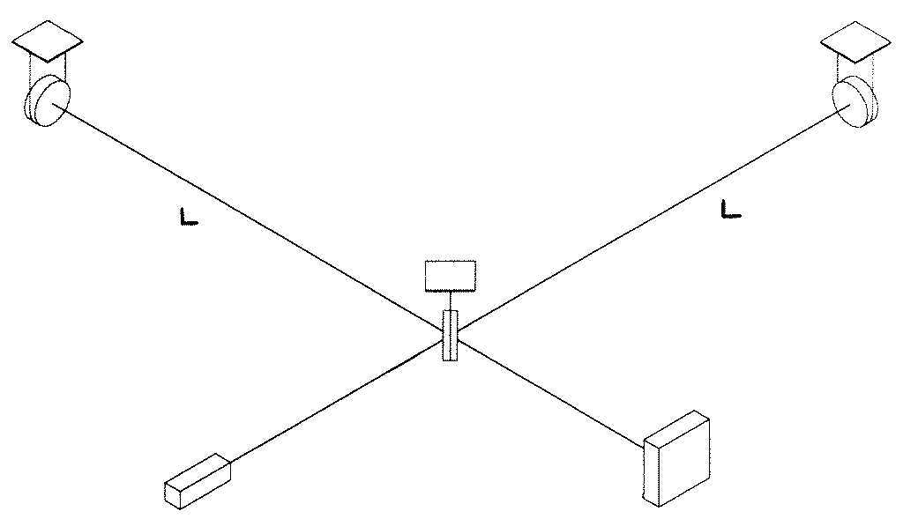
Interferometer as GW detector
Principle: Measure distances between free test masses
  Michelson interferometer
  Test masses = interferometer mirrors
  Sensitivity: h = ΔL/L
    We need large interferometer
    For Virgo L = 3 km
Virgo: CNRS+INFN
(ESPCI-Paris, INFN-Firenze/Urbino, INFN-Napoli, INFN-Perugia, INFN-Pisa, INFN-Roma,LAL-Orsay, LAPP-Annecy, LMA-Lyon, OCA-Nice)
+ Nikhef joined 2007
Next science run starts in June 4, 2011
Suspended
mirror
Suspended
mirror
Beam splitter
Light
Detection
LASER

Slide 6
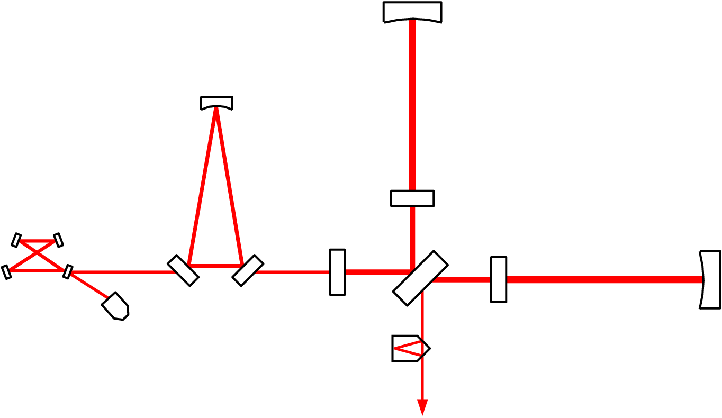
VIRGO Optical Scheme
Input Mode Cleaner (144 m)
3 km long Fabry-Perot
Cavities
Laser 20 W
Power
Recycling
Output Mode
Cleaner (4 cm)

Slide 7
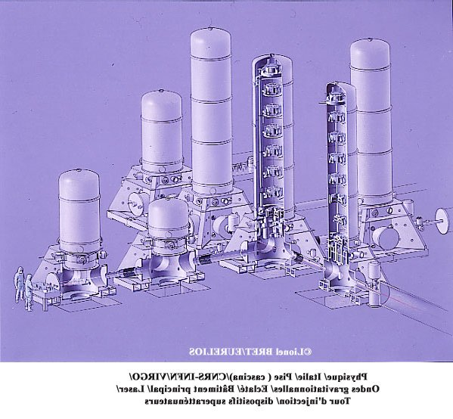
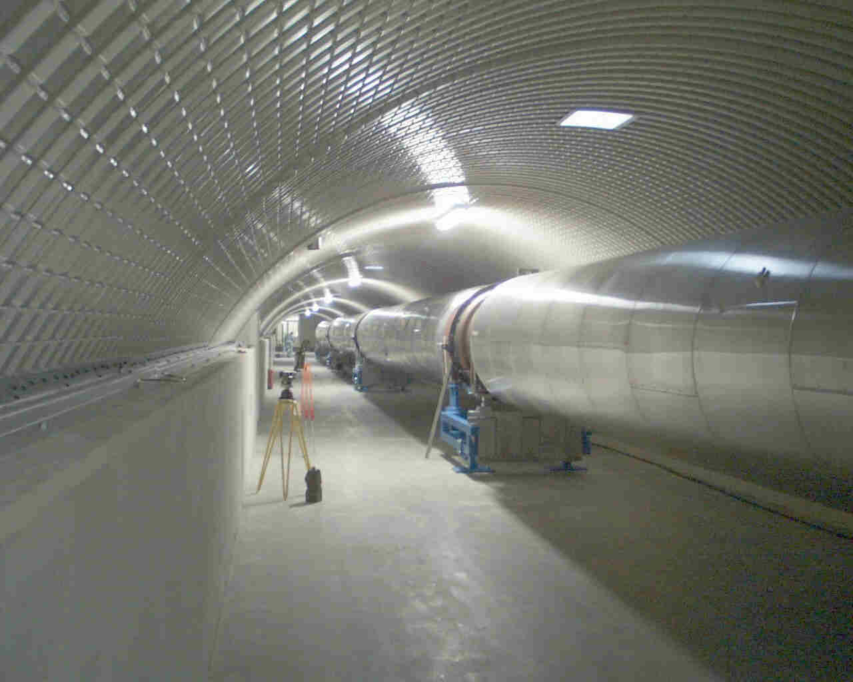
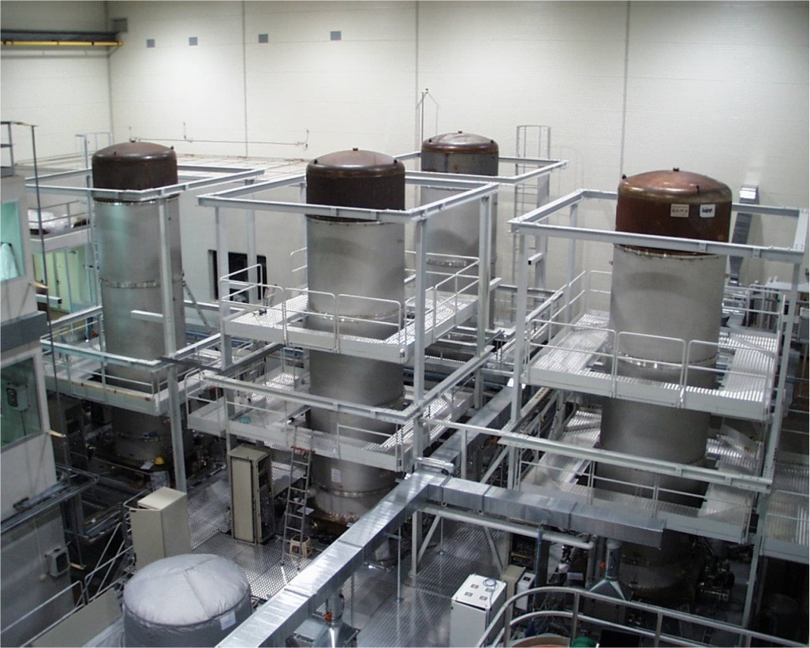
Vacuum system
UHV

Slide 8
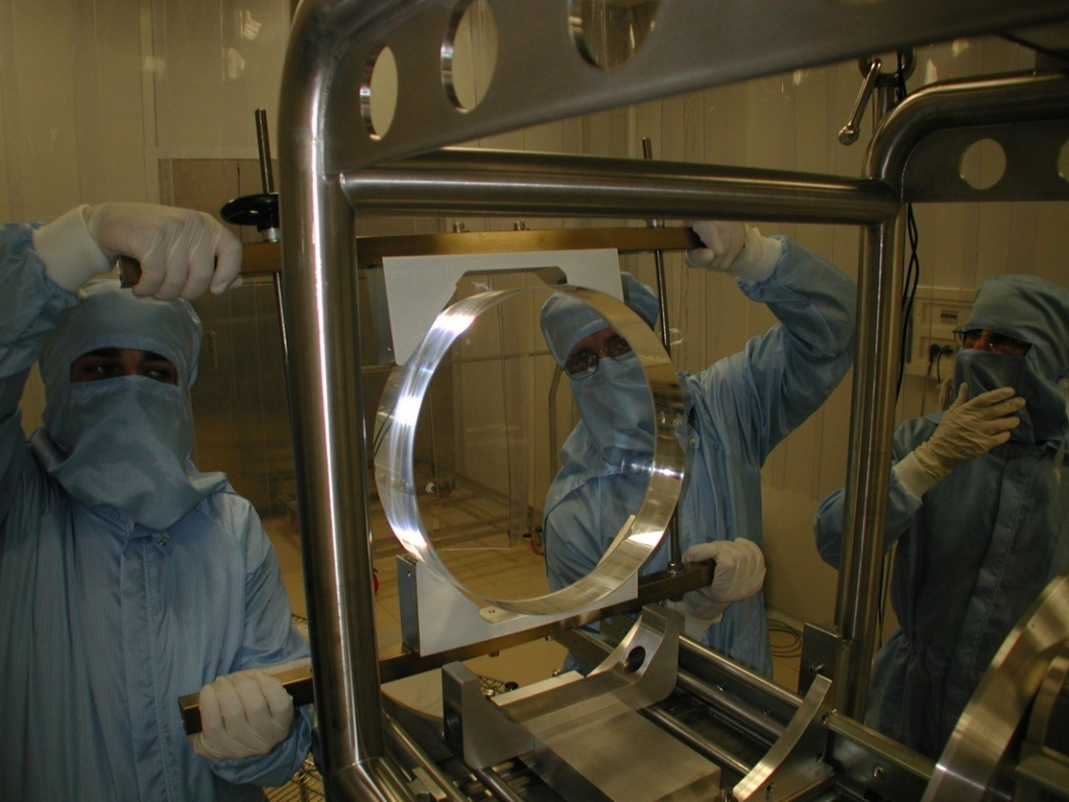
Mirrors
High quality fused silica mirrors
  35 cm diameter, 10 cm thickness, 21 kg mass
  Substrate losses ~1 ppm
  Coating losses <5 ppm
  Surface deformation ~l/100
Quantum Non-demolition Measurements

Slide 9
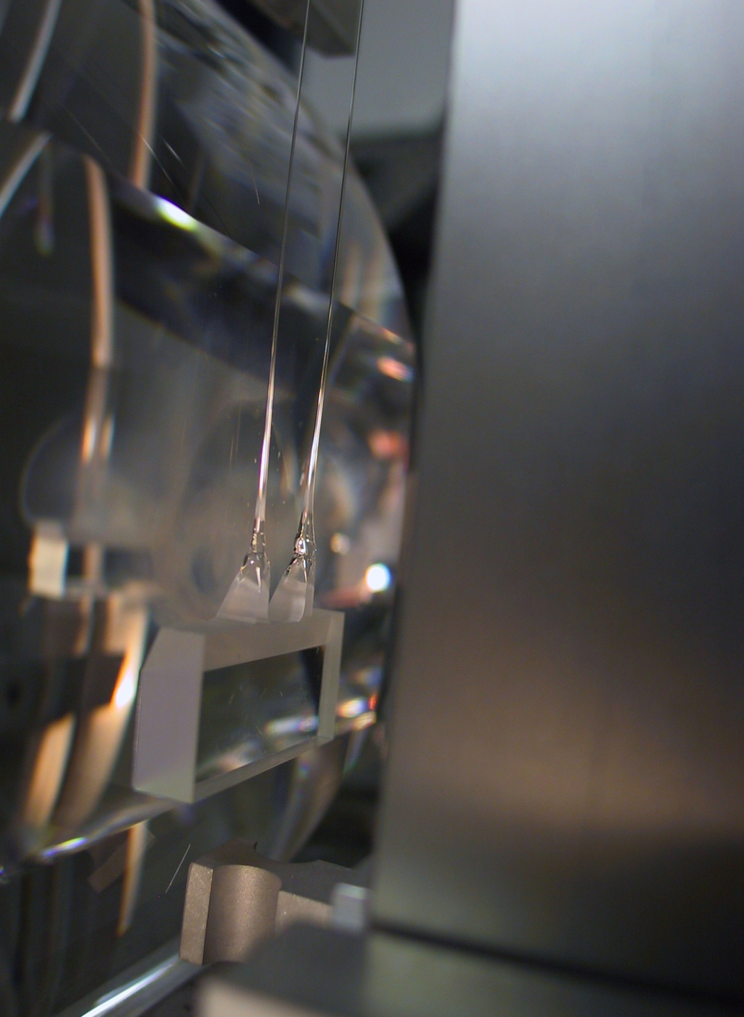
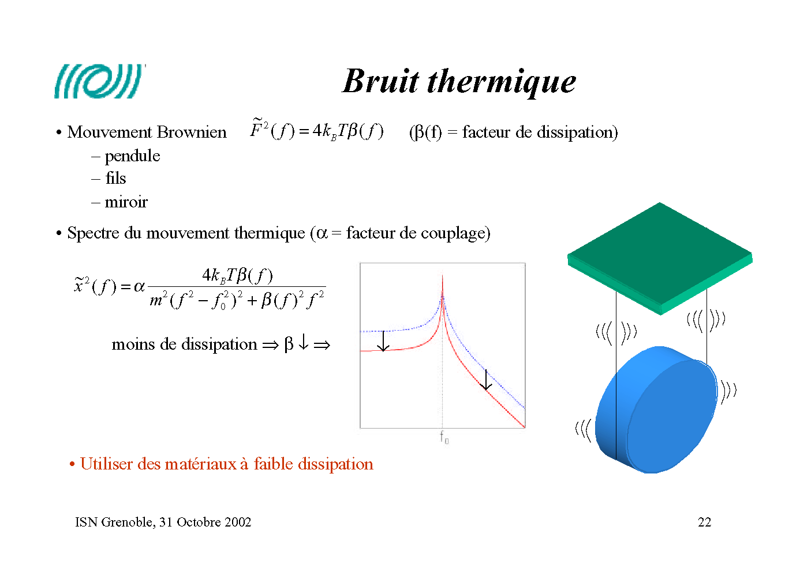
Thermal noise
Mechanical modes are in thermal equilibrium
  Modes:
    Pendulum mode
    Wire vibration
    Mirror internal modes
    Coating surface
  Energy associate: k_{B}T
Thermal motion spectrum:
Strategy:
  use low dissipative materials:
  → concentrate the motion at the resonance frequency

Slide 10
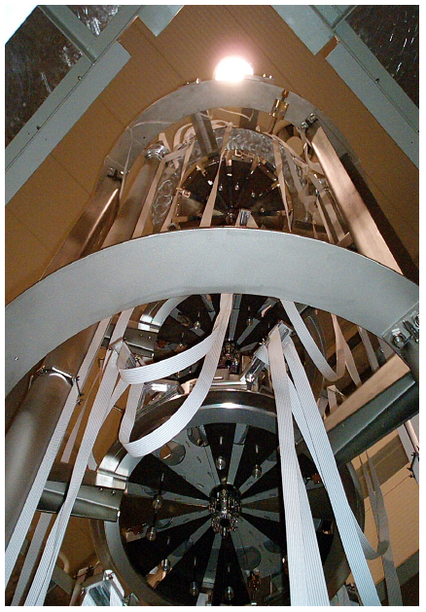
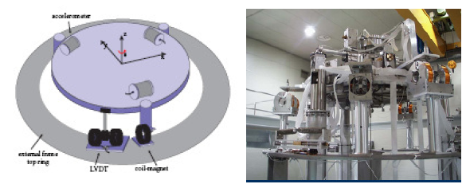
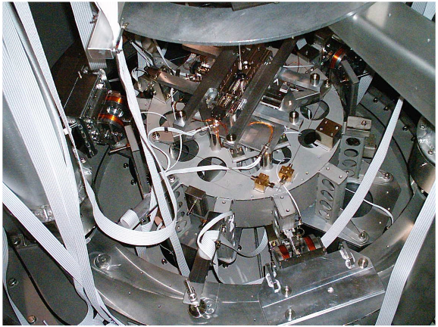
Superattenuators

Slide 11
Virgo Status
& Commissioning

Slide 12
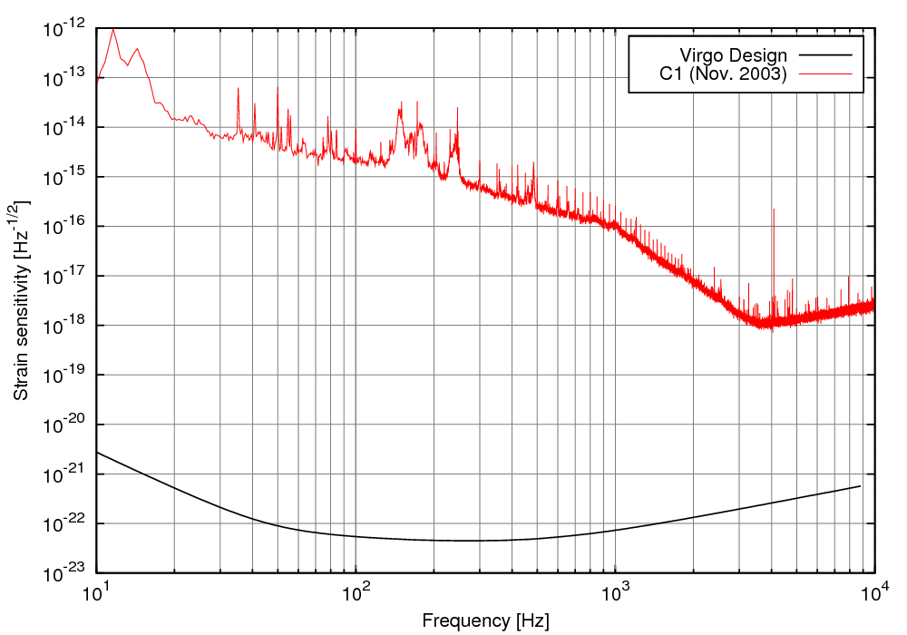
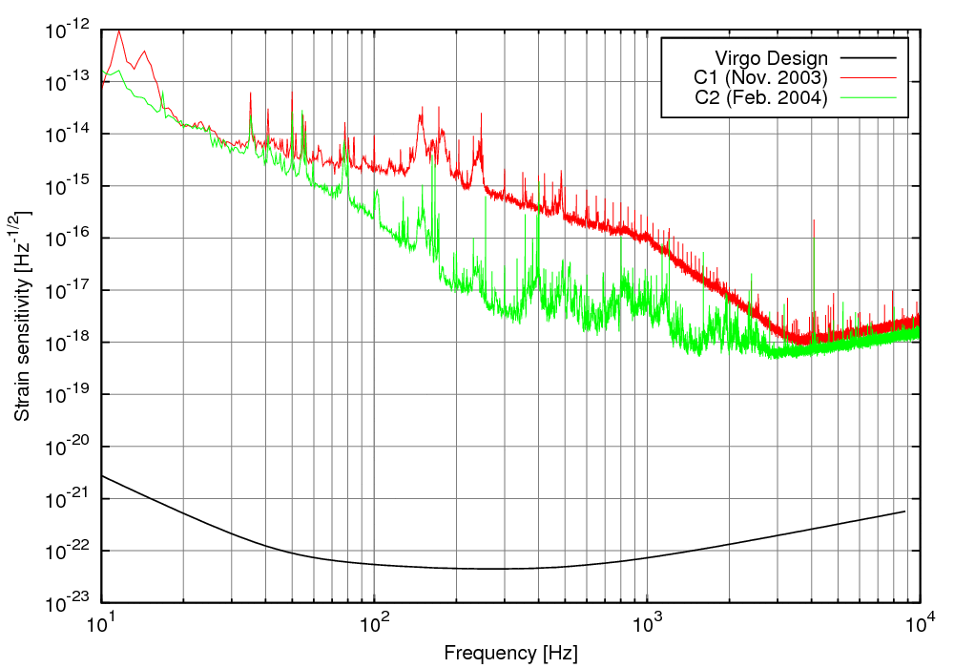
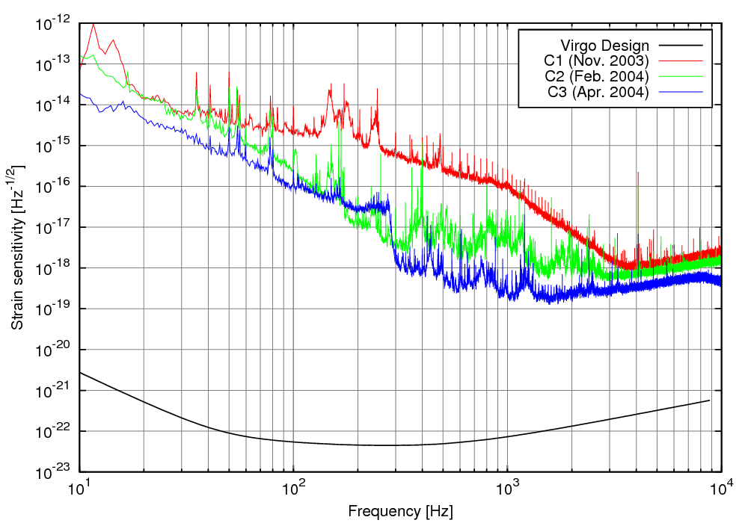
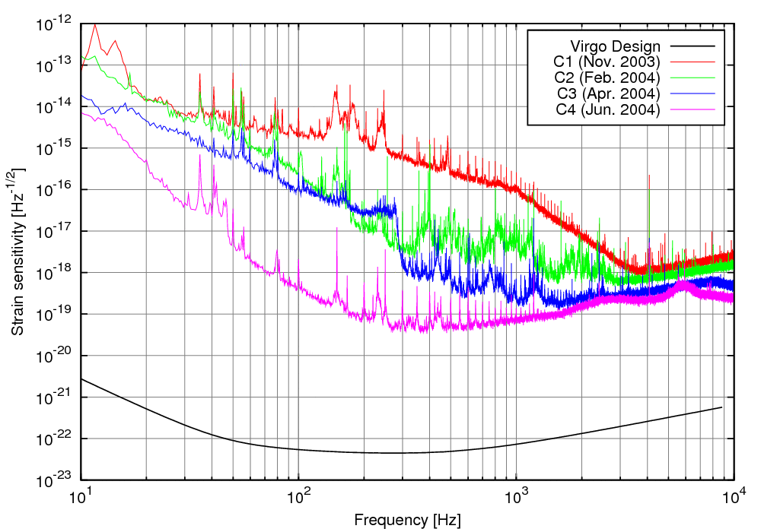
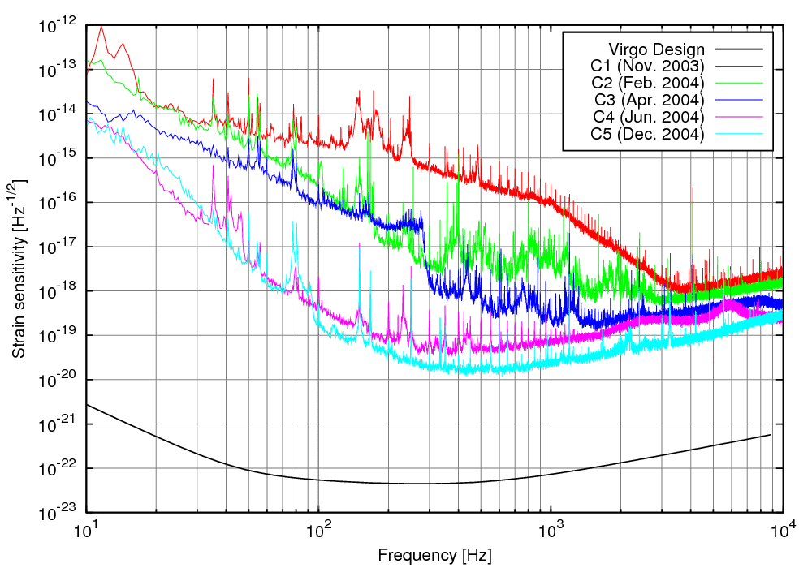
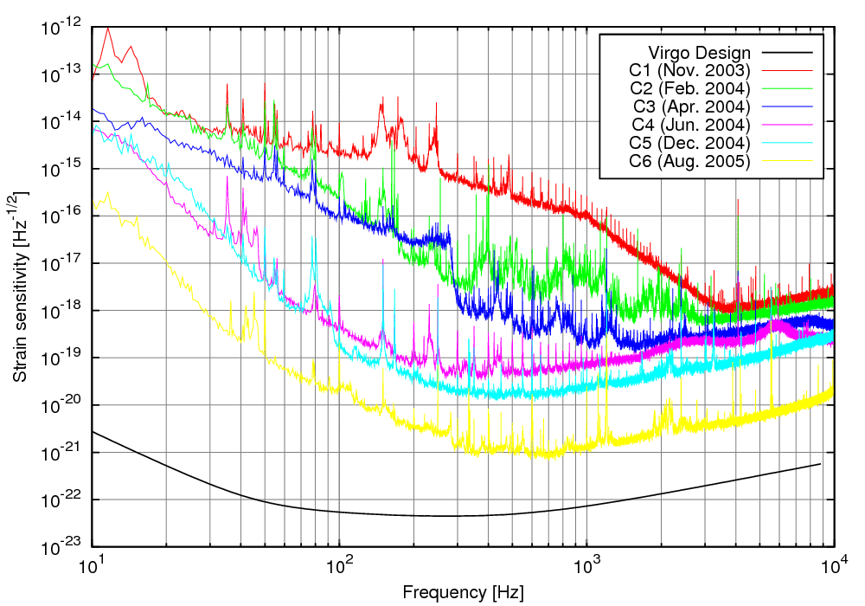
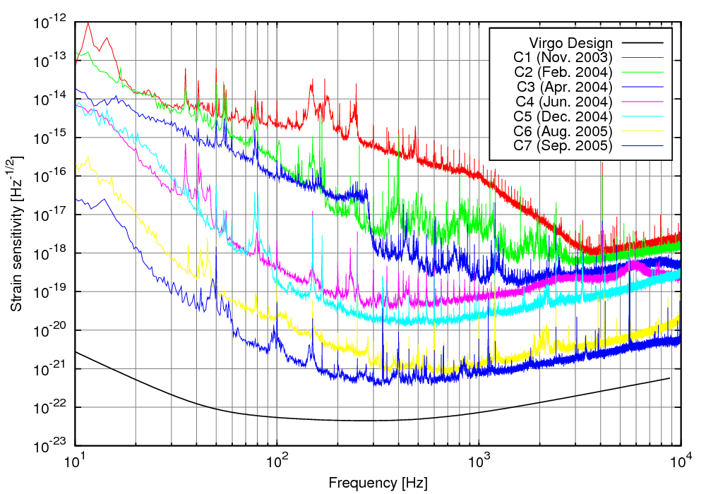
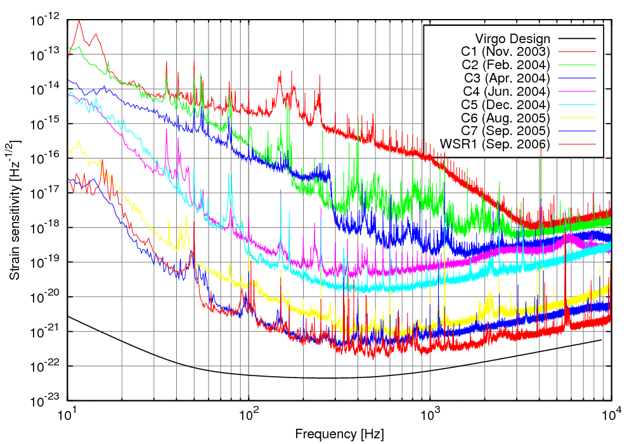
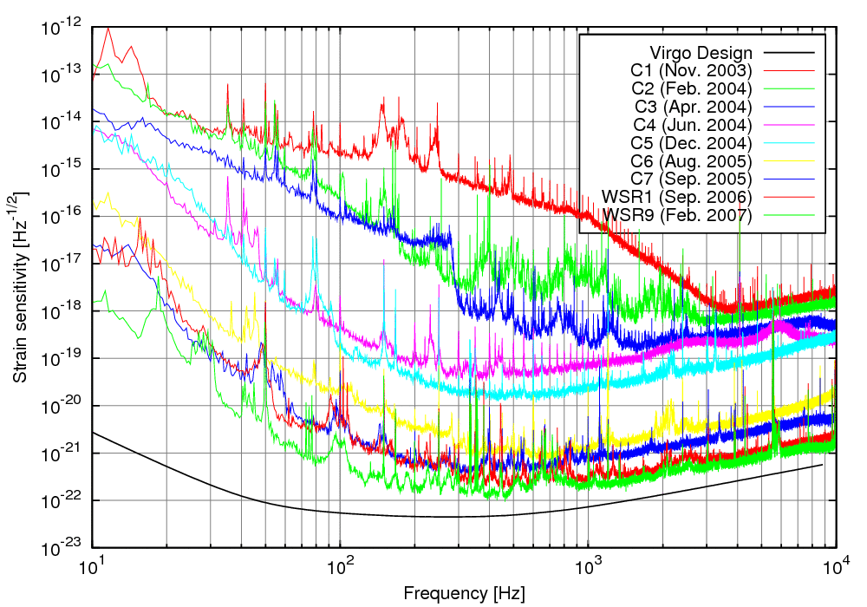
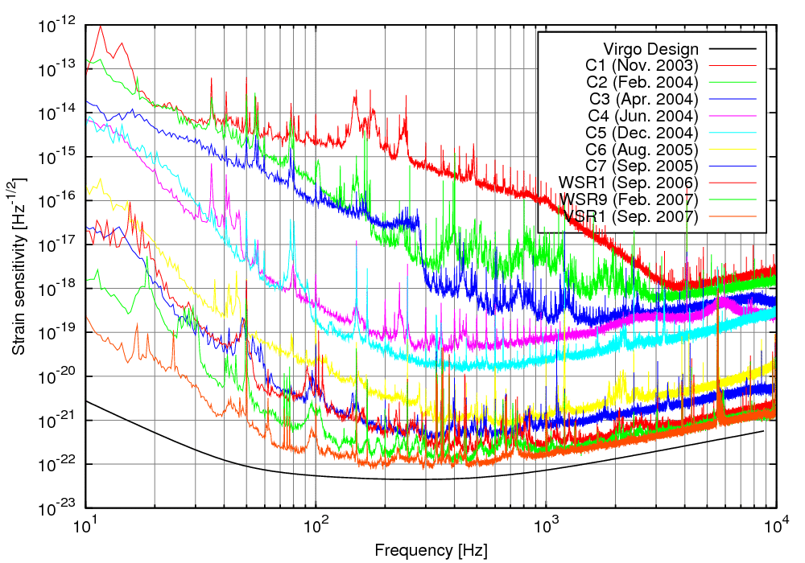
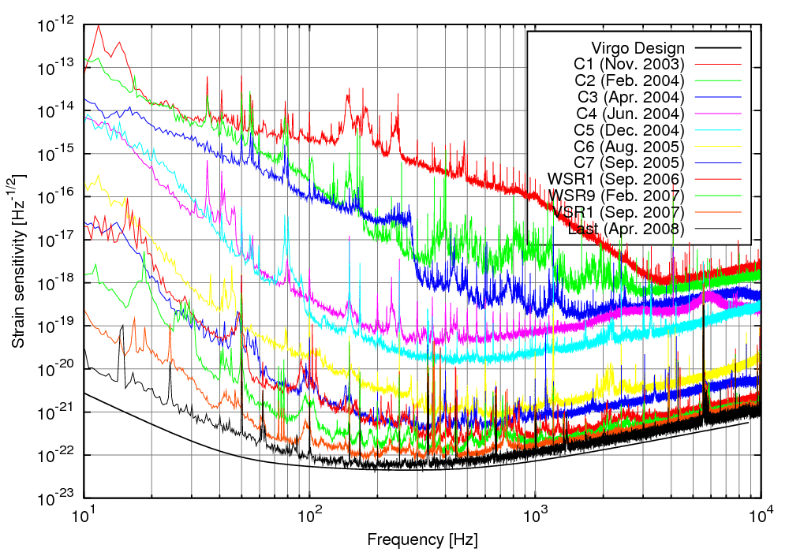
Evolution of sensitivity

Slide 13
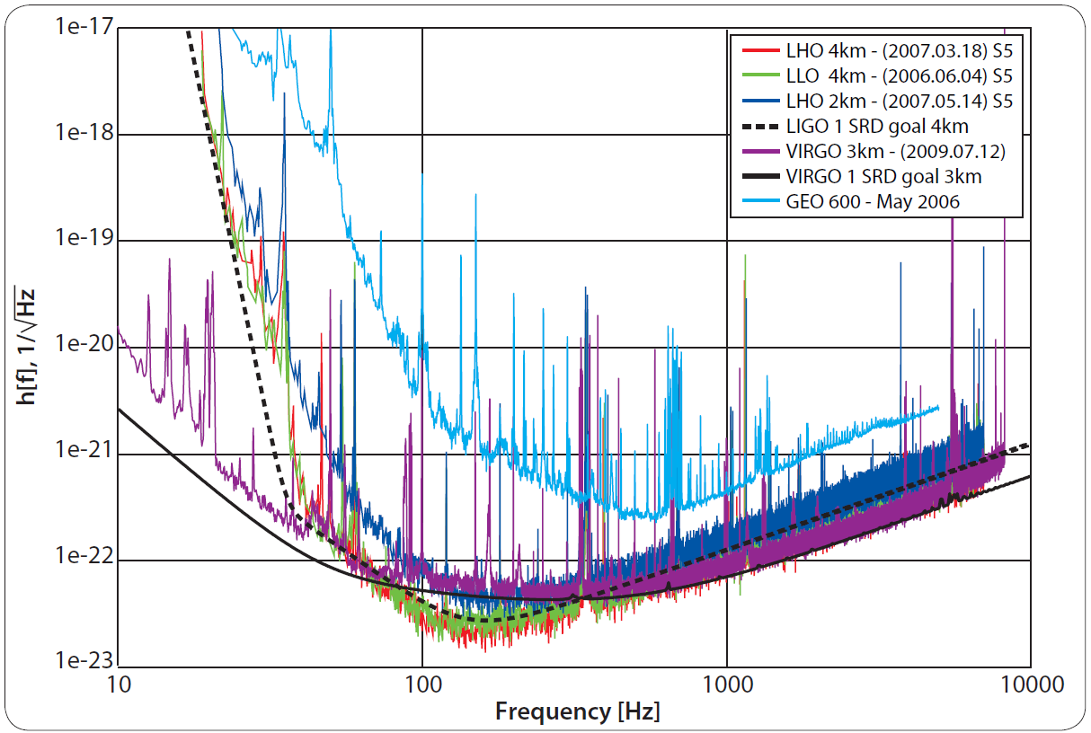
Interferometers – sensitivity
  The horizon (best orientation) for a binary system of two 10 solar mass black holes is 63 Mpc
Notes:
De instrumenten bestaan en hebben reeds on fantastische gevoeligheid.
Als U het vergelijkt met de wortel uit de Planck tijd, dan ziet U dat we toegang hebben tot details op de Planck schaal.

Slide 14
Interferometers – sensitivity
  The horizon (best orientation) for a binary system of two 10 solar mass black holes is 63 Mpc
  Compare to square root of Planck time:
  For capability to study details at Planck scale
Notes:
De instrumenten bestaan en hebben reeds on fantastische gevoeligheid.
Als U het vergelijkt met de wortel uit de Planck tijd, dan ziet U dat we toegang hebben tot details op de Planck schaal.

Slide 15
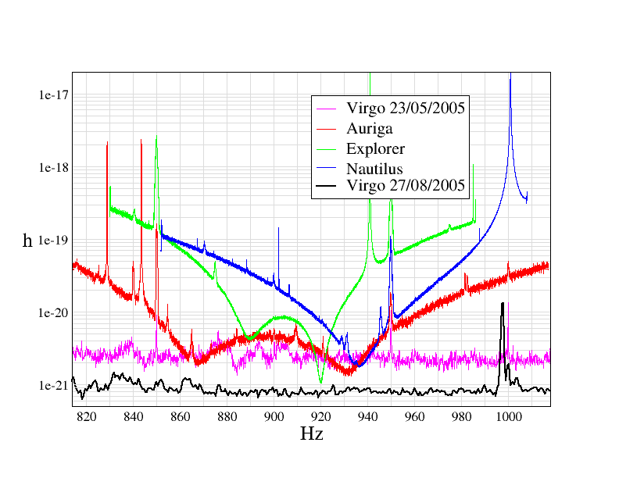
Virgo joint analyses
Virgo – Bars joint analysis
Burst events and stochastic signals
Bars, GEO600 and 2km Hanford in Astrowatch
Virgo – LIGO collaboration
Working group for burst, inspiral events, stochastic and periodic sources
Formal MoU
Publish together
  Virgo now at <1e-22 / rtHz

Slide 16
LIGO and VIRGO: scientific evolution
At present hundreds of galaxies in range for 1.4 M_{o} NS-NS binaries
Enhanced program
  In 2009 about 10 times more galaxies in range
Advanced detectors
  About 1000 times more galaxies in range
  In 2014 expect 1 signal per day or week
  Start of gravitational astrophysics
  Numerical relativity will provide templates for interpreting signals

Slide 17
Evolution of ground-based GW detectors
Unlikely detection
1st generation interferometric detectors
  Initial LIGO, Virgo, GEO600
Science data taking
Set up network observation
We are here
Plausible detection
    Enhanced LIGO, Virgo+
Lay ground for multi-
messenger astronomy
2nd generation detectors
  Advanced LIGO, Advanced Virgo, GEO-HF
Likely detection
Routine observation
Towards GW astronomy
Thorough observation
of Universe with GW
3rd generation detectors
  Einstein Telescope, US counterpart to ET

Slide 18
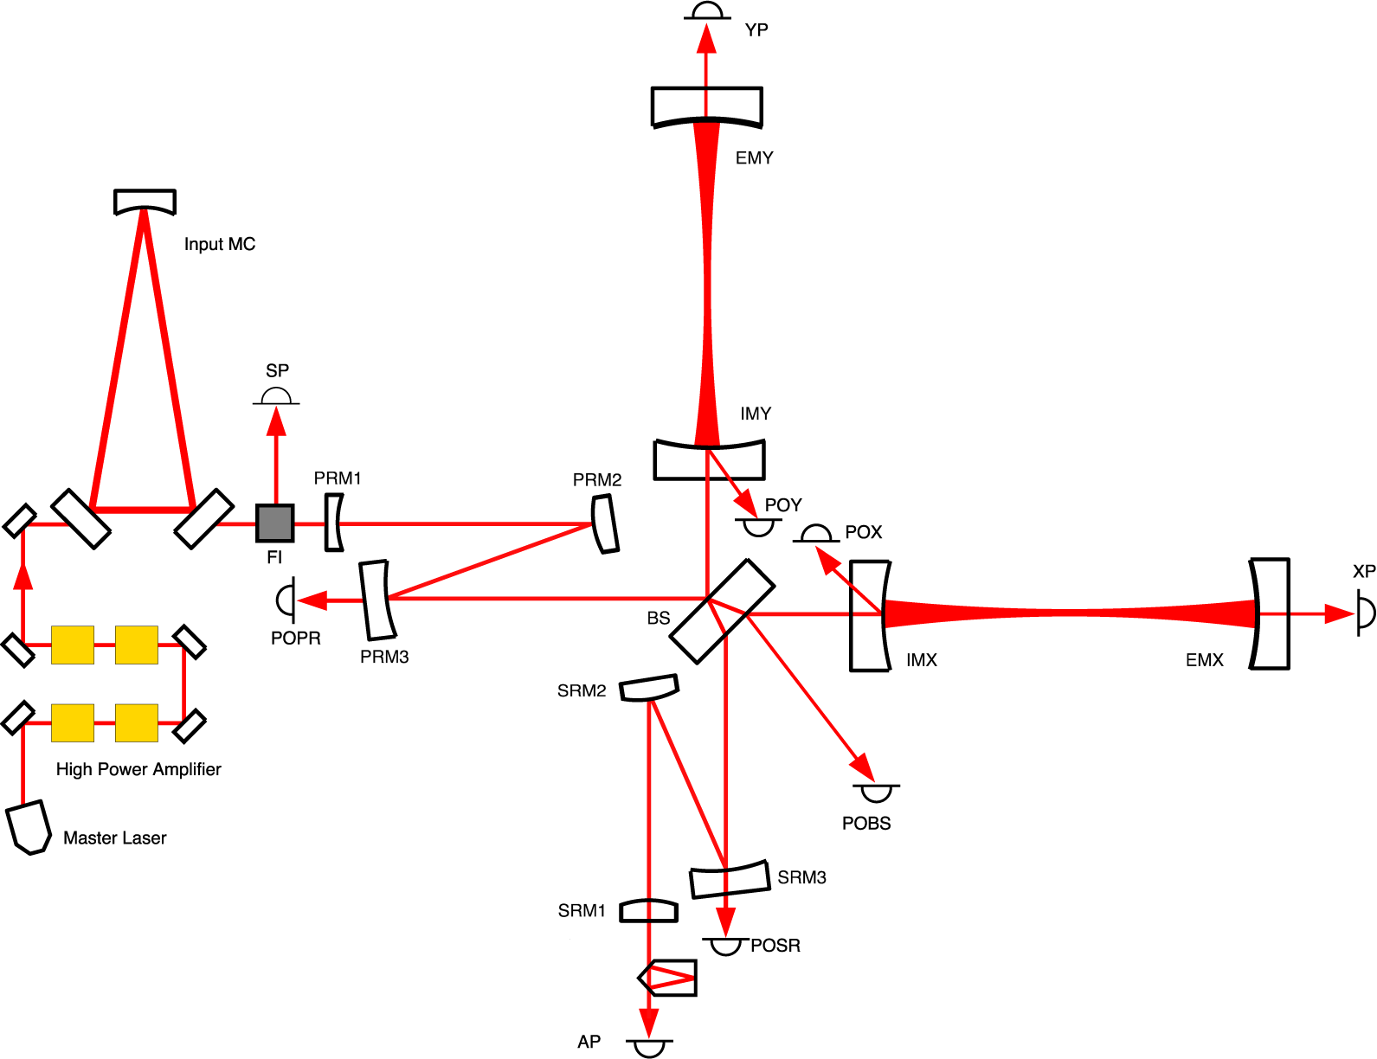
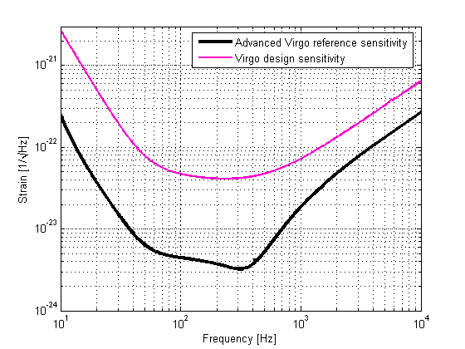
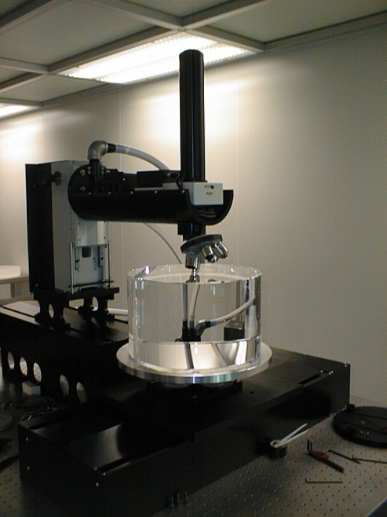

Advanced Virgo (AdV)
PROJECT GOALS
Upgrade Virgo to a 2nd generation detector. Sensitivity: 10x better than Virgo
Be part of the 2nd generation GW detectors network. Timeline: in data taking with Advanced LIGO

Slide 19
Other GW projects

Slide 20
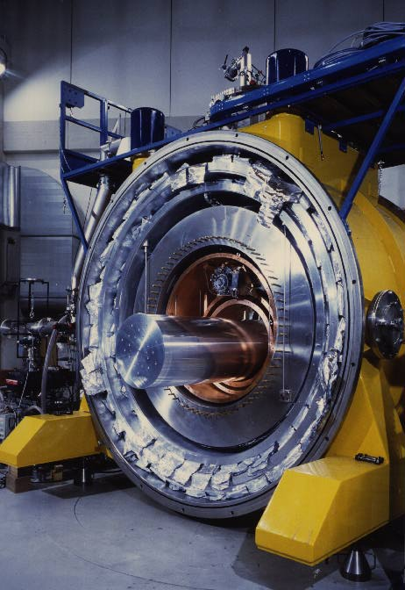
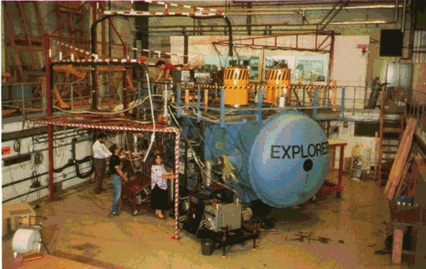
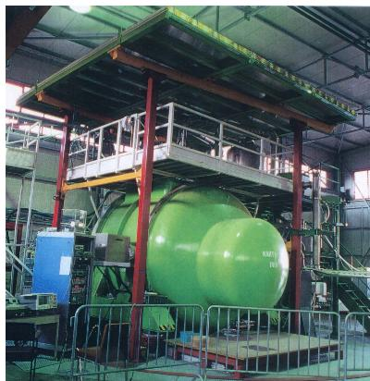
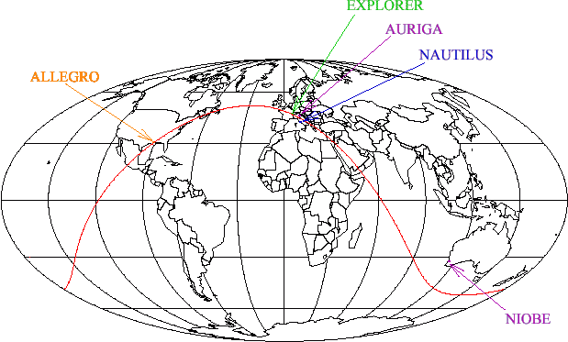
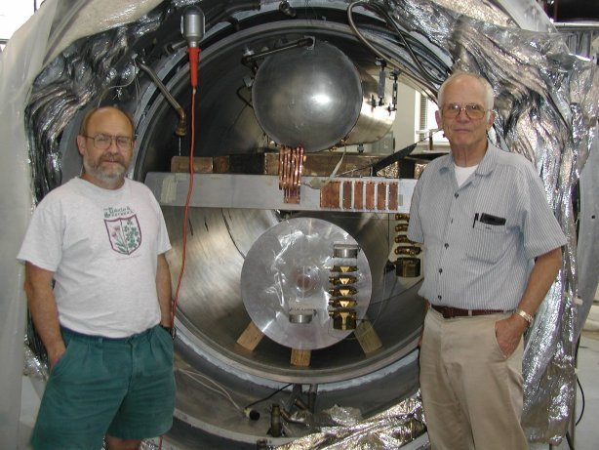
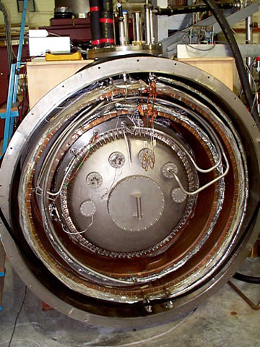


Bar detectors: IGEC collaboration
  Built to detect gravitational waves from compact objects

Slide 21
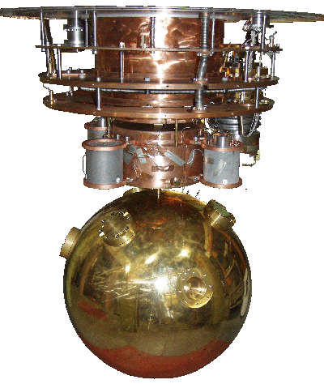
Mini-GRAIL: a spherical `bar’ in Leiden

Slide 22

Underground detector in Kamioka

Slide 23
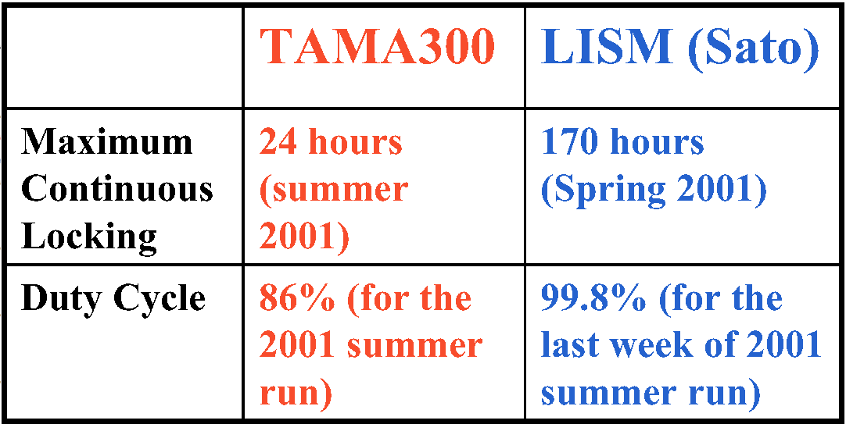
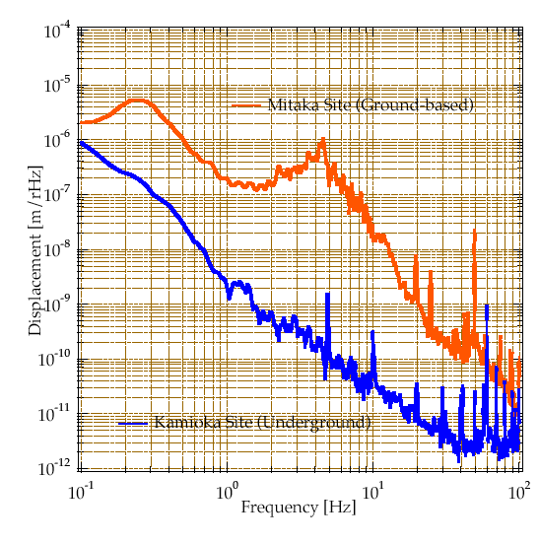
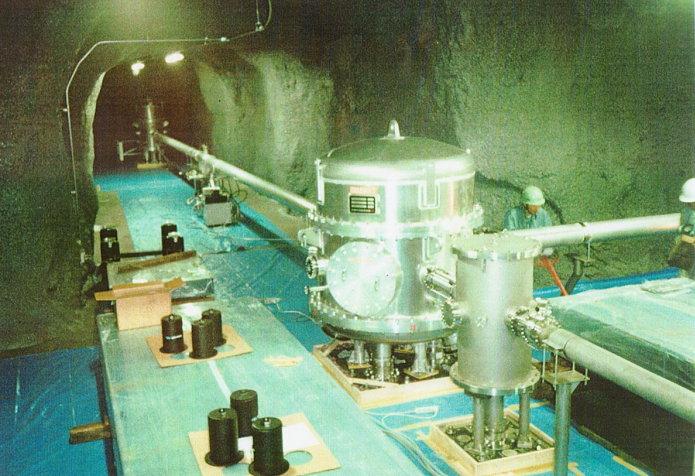
Experience: Japan
LISM: 20 m Fabry-Perot interferometer, R&D for LCGT, moved from Mitaka (ground based) to Kamioka (underground)
Seismic noise much lower:
Operation becomes easier
  10² overall gain
  10³ at 4 Hz

Slide 24
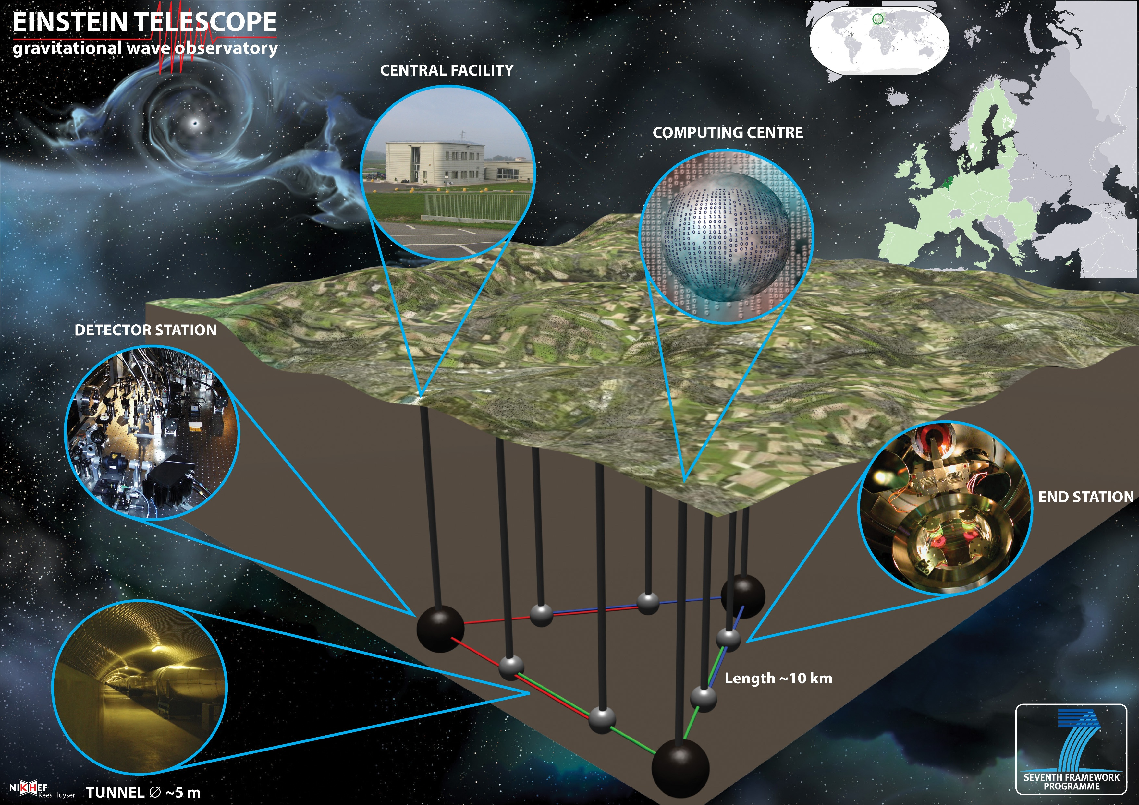


2022
Design Study Proposal approved by EU within FP7
Large part of the European GW community involved EGO, INFN, MPI, CNRS, Nikhef, Univ. Birmingham, Cardiff, Glasgow
Recommended in Aspera / Appec roadmap

Slide 25
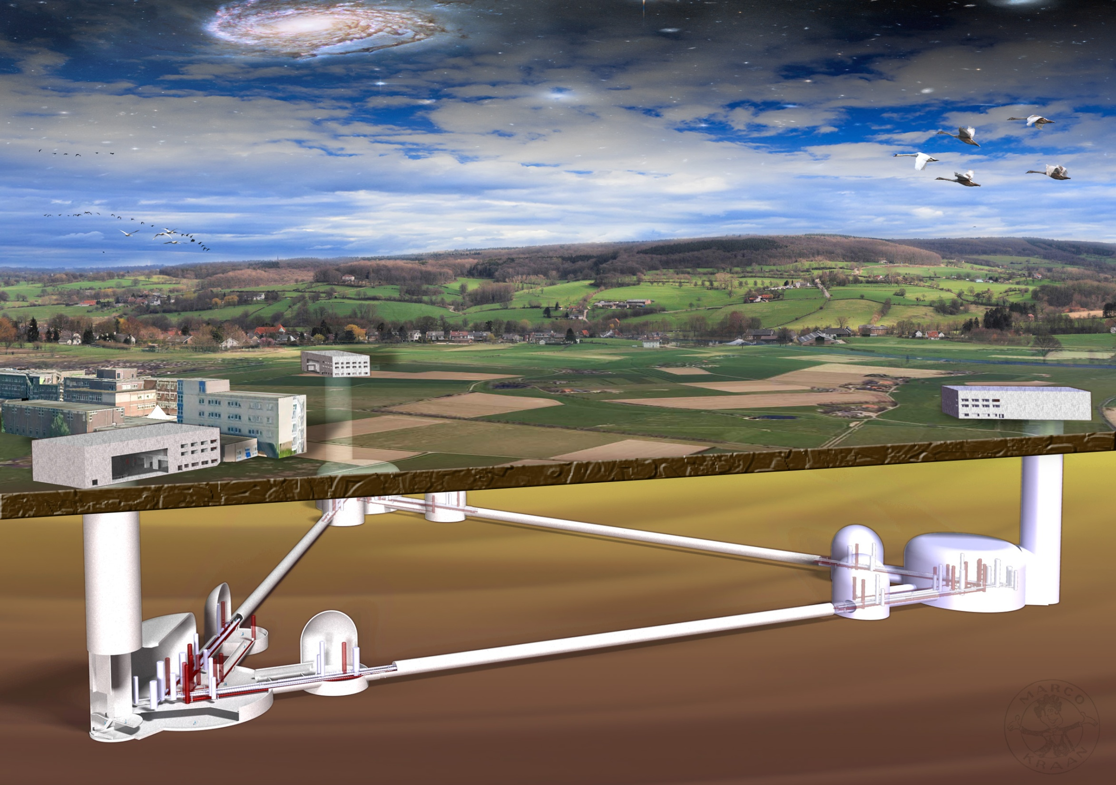
Expected future sensitivities

Slide 26
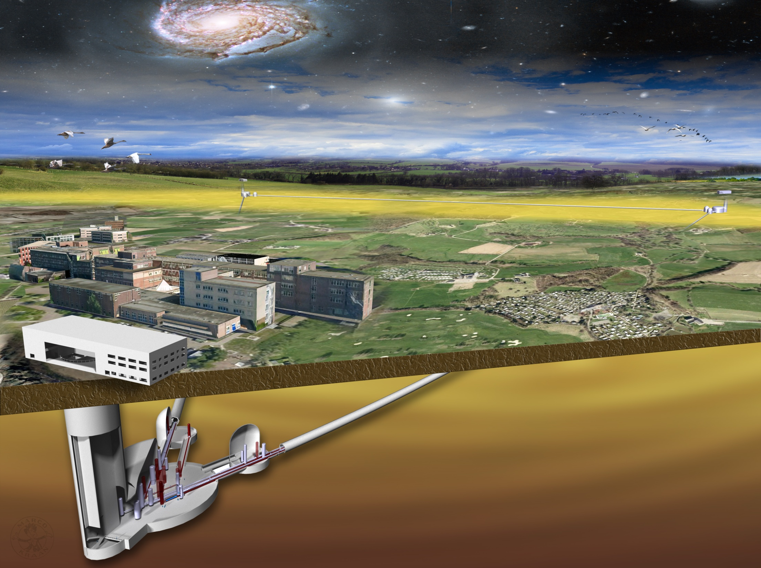
Expected future sensitivities

Slide 27


Einstein Telescope
  Triangular topology
  Underground
    Depth: 100 – 200 m
    Gravity gradient noise
  Cryogenic mirrors
  10 km arms
  Xylophone detector
    HF ITF
    LF ITF
    Up to 6 ITFs

Slide 28



ET infrastructure
Infrastructure: largest cost driver
  Tunnels, caverns, buildings
  Vacuum, cryogenics, safety systems
  Collaborate with industry
    COB (Amsterdam, October 9, 2008)
    Saes Getters Italy
    Demaco Netherlands
Experience
  LIGO, Virgo, GEO
  Underground labs
    Gran Sasso, Canfranc,
    Kamioka, Dusel, etc.
  Mines
  Particle physics
    ILC, Cern, Desy, FLNL
  Seismology
    KNMI, Orfeus
  Geology

Slide 29

ET infrastructure

Slide 30

ET infrastructure

Slide 31
ET infrastructure

Slide 32

Expected future sensitivities

Slide 33

Pulsar timing arrays

Slide 34

Pulsar timing arrays – SKA

Slide 35
GW sources

Slide 36

Burst Sources
Gravitational wave bursts
  Black hole collisions
  Supernovea
  Gamma-ray bursts (GRBs)
Short-hard GRBs
  Could be the results of merger of a neutron star with another NS or a BH
Long-hard GRBs
  Could be triggered by supernovae
SN1572 (Tycho) composite image (X + IR)

Slide 37

Continuous Wave Sources
Rapidly spinning NS
  Mountains on neutron stars
Low mass X-ray binaries
  Accretion induced asymmetry
Magnetars and other compact objects
  Magnetic field induced asymmetries
Relativistic instabilities
  r-modes, etc.
SN1052 (Crab) composite movie (X + visible)
X-Ray Image Credit: NASA/CXC/ASU/J.Hester et al.
Optical Image Credit: NASA/HST/ASU/J.Hester et al.

Slide 38


Compact Binary Mergers
Binary neutrons stars
Binary black holes
Neutron star – black hole binaries
Loss of energy leads to steady inspiral whose waveform has been calculated to order v7 in post-Newtonian theory
Knowledge of the waveforms allows matched filtering
SN1052 (Crab) composite movie (X + visible)
X-Ray Image Credit: NASA/CXC/ASU/J.Hester et al.
Optical Image Credit: NASA/HST/ASU/J.Hester et al.

Slide 39


Merging neutron star binaries
PSR 1913+16
  Energy loss by GW
J0737-3039
  Double pulsar
  Strongly relativistic, P_{b} = 2.5 Hrs
  Mildly eccentric, e = 0.088
  Highly inclined, i > 87 deg
The most relativistic
  Greatest periastron advance: 16.8 deg/hr (almost entirely general relativistic effect), compared to Mercury’s 42 sec/century
  Orbit is shrinking by a 7 millimeters each day due to gravitational radiation reaction
  Measure spin-orbit coupling?
Burgay, et al., 2004, Science, 303, 1153-1157.
Notes:
Figure 3 Constraints on the masses of the two neutron stars in the PSR J0737-3039A/B system. The yellow regions are forbidden by the constraint that the sine of the orbit inclination angle cannot exceed unity. The solid diagonal lines (marked R) define the limits on the mass ratio. Additional constraints are provided by the detection of relativistic effects in the timing of the A pulsar, interpreted in the framework of general relativity. The diagonal dashed lines are limits on the sum of the masses based on the observed precession of periastron and the dot-dash lines are limits based on variations in time dilation as the pulsar moves around its somewhat eccentric orbit. The other two constraints, marked r and s, are based on the observed Shapiro delay. The inset shows an expanded plot of the region of intersection of the various constraints. (Lyne et al. 2004)
References: Burgay, M., D Amico, N., Possenti, A., Manchester, R.N., Lyne, A.G., Joshi, B.C., McLaughlin, M.A., Kramer, M., Sarkissian, J. M. Camilo, F., Kalogera, V., Kim, C, & Lorimer, D.R., 2003, Nature, 426, 531-533. Lyne, A.G., Burgay, M., Kramer, M., Possenti, A, Manchester, R.N., Camilo, F., McLaughlin, M.A., Lorimer, D.R., D'Amico, N., Joshi, B.C., Reynolds, J.E. & Freire, P.C.C., 2004, Science, 303, 1153-1157.

Slide 40


Stellar mass black holes
Stellar Mass Black Hole GRS 1915+105
Credit: X-ray (NASA/CXC/Harvard/J.Neilsen et al); Optical (Palomar DSS2)
GRS 1915+105 is a system containing a black hole about 14 times the Sun's mass in orbit with a companion star.
Researchers monitored this system with Chandra and RXTE for over eight hours and saw that it pulses in X-ray light every 50 seconds in a pattern similar to an electrocardiogram of a human heart.
The X-ray pulses are generated by changes in the flow of material falling toward the black hole.
Stellar Mass Black Hole M33 X-7
M33 X-7, a binary system in the nearby galaxy M33. In this system, a black hole is revolving around a star about 70 times more massive than the Sun (large blue object). This black hole is almost 16 times the Sun's mass, a record for black holes created from the collapse of a giant star. Other black holes at the centers of galaxies are much more massive, but this object is the record-setter for a so-called "stellar mass" black hole.
Notes:
This optical and infrared image from the Digitized Sky Survey shows the crowded field around the binary system GRS 1915+105 (GRS 1915 for short) located near the plane of our Galaxy. The top-left inset shows a close-up of the Chandra image of GRS 1915 , and the bottom-right inset shows the remarkable "heartbeats" seen in the X-ray light from this system. Using Chandra and the Rossi X-ray Timing Explorer (RXTE), astronomers have discovered what drives these heartbeats and given new insight into the ways that black holes can regulate their intake and severely curtail their growth.
GRS 1915 contains a black hole about 14 times the mass of the Sun that is feeding off material from a nearby companion star. As the material swirls toward the black hole, a disk forms. The black hole in GRS 1915 has been estimated to rotate at the maximum possible rate, allowing material in the inner disk to orbit very close to the black hole -- at a radius only 20% larger than the event horizon -- where the material travels at 50% the speed of light.
Researchers monitored this black hole system with Chandra and RXTE over a period of eight hours. As they watched, GRS 1915 gave off a short, bright pulse of X-ray light approximately every 50 seconds. This type of rhythmic cycle closely resembles an electrocardiogram of a human heart -- though at a slower pace. It was previously known that GRS 1915 can develop such heartbeats, but researchers gained new understanding into what drives the beats, and used the pulses to figure out what controls how much material the black hole consumes from the RXTE data.
The astronomers also used Chandra's high-resolution spectrograph to study the effects of this heartbeat variation on regions of the disk very far from the black hole, at distances of about 100,000 to a million times the radius of the event horizon. By analyzing the Chandra spectrum, they found a very strong wind being driven away from the outer parts of the disk. The rate of mass expelled in this wind is remarkably high, as much as 25 times the maximum rate at which matter falls onto the black hole. This massive wind drains material from the outer disk and eventually causes the heartbeat variation to shut down.

Slide 41


Intermediate mass black holes
Intermediate Mass Black Hole M82 X-1
Credit: X-Ray: NASA/SAO/CXC
Intermediate Mass Black Hole GCIRS 13E
Credit: Gemini Observatory
Notes:
NASA's Chandra X-ray Observatory captured this image of the central region of the starburst galaxy M82. From 1999-2000, this source was seen by Chandra to increase dramatically in intensity over a period of three months (compare right and left panels), an indication of black hole activity. With NASA's Rossi Explorer, a team led by Philip Kaaret has found evidence of a star (too small to be imaged) orbiting around the suspected black hole, called M82 X-1. This may confirm that M82 X-1 is part of a new "in-between" category called intermediate-mass black holes. Credit: NASA/SAO/CXC
A middleweight black hole
of 1,300 Solar-masses with
seven young, massive stars
may orbit the Milky Way's
supermassive, central black
hole

Slide 42




Supermassive binary black holes
Binary Black Hole in 3C 75
Credit: X-Ray: NASA / CXC / D. Hudson, T. Reiprich et al. (AIfA);
Radio: NRAO / VLA/ NRL
NGC 6240: Two Supermassive Black Holes in Same Galaxy
Credit NASA/CXC/MPE/S.Komossa et al
The Chandra image of NGC 6240, a butterfly-shaped galaxy that is the product of the collision of two smaller galaxies, revealed that the central region of the galaxy (inset) contains not one, but two active giant black holes. (at about 100 Mpc)
Notes:
Binary Black Hole in 3C 75
Credit: X-Ray: NASA / CXC / D. Hudson, T. Reiprich et al. (AIfA);
Radio: NRAO / VLA/ NRL Explanation: What's happening in the middle of this massive galaxy? There, two bright sources at the center of this composite x-ray (blue)/radio (pink) image are thought to be co-orbiting supermassive black holes powering the giant radio source 3C 75. Surrounded by multimillion degree x-ray emitting gas, and blasting out jets of relativistic particles the supermassive black holes are separated by 25,000 light-years. At the cores of two merging galaxies in the Abell 400 galaxy cluster they are some 300 million light-years away. Astronomers conclude that these two supermassive black holes are bound together by gravity in a binary system in part because the jets' consistent swept back appearance is most likely due to their common motion as they speed through the hot cluster gas at 1200 kilometers per second. Such spectacular cosmic mergers are thought to be common in crowded galaxy cluster environments in the distant universe. In their final stages the mergers are expected to be intense sources of gravitational waves.

Slide 43



Numerical relativity
Two-body problem in general relativity
Numerical solution of Einstein equations required
Problem solution started 45 years ago (1963 Hahn & Lindquist, IBM 7090)
Wave forms critical for GW detectors
A PetaFLOPS-class grand challenge
Oct. 10, 1995
Matzner, Seidel, Shapiro, Smarr, Suen, Teukolsky, Winicuor

Slide 44



Simulation – merging of BBH
Pretorius 2005 (arXiv:gr-pc/0507014)
  BBH orbit, merger and ringdown
  Energy loss by GW
Rezzolla
  Templates with sufficient precision for Advanced LIGO and Virgo

Slide 45



Waveforms for inspiraling binaries
Late-time dynamics of compact binaries
  Highly relativistic
  Dominated by non-linear GR effects
Post-Newtonian theory
  Model evolution now to O(v⁷)
Gravitational radiation
  Shape and strength depend on masses, spins, distance, orientation, sky location, …
Amplitude
Increasing spin
Time

Slide 46

Waveforms BBH and NS-BH binary
Signal modulation
  Amplitude and frequency
  Due to spin-orbit precession of the orbital plane
Gravitational waves
  Merger phase dominates
  Direct insight into dynamics of spacetime at extreme curvatures
  Unambiguous evidence for existance of black holes
Time domain Frequency domain

Slide 47
Astrophysics

Slide 48
Astrophysics
Unveiling progenitors of short-hard GRBs
  Short-hard GRBs believed to be merging NS-NS and NS-BH
Understanding supernovae
  Astrophysics of gravitational collapse and supernova?
Evolutionary paths of compact binaries
Finding why pulsars glitch and magnetars flare
  What causes sudden excursions in pulsar spin frequencies
  What is behind ultra high-energy transients in magnetars
Ellipticity of neutron stars
  Mountains of what size can be supported on neutron stars?
NS spin frequencies in LMXBs
  Why are spin frequencies of neutron stars in low-mass X-ray binaries bounded, CFS instability and r-modes

Slide 49


Expected coalescense rates
Distance reach
  Intrinsic mass (red)
  Observed mass (blue)
  Spinning objects with spin parameter χ = 0.75 (upper)
Star formation rate
  Enhanced at z ≈ 1 – 3
BH and SN
  Expected to form after Type II supernovae
  About 1 / 100 yr in MWEG
Binaries
  BNS from observational evidence
  BH-BH and BH-NS entirely from theory (uncertainties from delay birth to merger, metallicity, etc.)
ET
Expected rate in local (z ≈ 0) Universe
Expected rate in local (z ≈ 0) Universe

Slide 50


GRB progenitors
Intense flashes of gamma rays
  Explosive events seen by satellite missions
  Most luminous EM source since Big Bang
  X-ray, UV and optical afterglows
Bimodal distribution of durations
  Short hard GRBs
    Duration T₉₀ < 2 s
    Mean redshift of 0.5
  Long GRBs
    Duration T₉₀ > 2 s
    Higher z
    Track star formation rate

Slide 51

GRBs
Long GRBs
  CC SNe
  GW emissions not well understood
  Could emit burst of GW
Short GRBs
  Could be the end of the evolution of compact binaries
    BNS
    NS-BH

Slide 52



LSC – Virgo observations
GRB 070201
  LSC searched for binary inspirals and did not find any events (ApJ 681 1419 2008)
  Excludes binary progenitor in M31
  Soft Gamma-ray Repeater (SGR) models predict energy release
  SGR not excluded by GW limits
LSC – Virgo search
  Nov 2005 – Oct 2007: 212 GRBs
  Null results
Notes:
GALEX near-UV image, obtained on UTC 2003 September 5 (1940 s exposure), of the region of the error quadrilateral of GRB 070201 that intersects with M31. The red lines mark the revised error quadrilateral (Mazets et al. 2008), and the blue lines show the original one (Hurley et al. 2007); the red circles show the positions of X-ray sources detected during the XMM-Newton observations in 2007, the yellow squares mark the XMM-Newton X-ray sources detected in 2002, the blue diamonds mark the positions of X-ray sources listed in the ROSAT PSPC catalog of M31 (Supper et al. 2001), and the cyan crosses mark the positions of known supernova remnants in M31 (Magnier et al. 1995). The size of the symbols (in arcseconds) of the X-ray sources corresponds to their flux (F) in the 0.2-10 keV band using the relation 10 + 10(15 + log F[ergs s^{–1} cm^{–2}]). More than one symbol of the same type at almost the same position corresponds to detection of the same source in the overlap regions between images taken during the same year. The ROTSE-IIIb observations cover the entire error region south of the yellow line.

Slide 53


Spin-down limit on Crab pulsar
Crab pulsar
  2 kpc away, formed in 1054 AD
  Losing energy in the form of particles and radiation, leading to its spin-down
    Spin frequency ν = 29.78 Hz
    Spin-down rate -3.7×10⁻¹⁰ Hz s⁻¹
LSC – Virgo search
  Search for GW in data in S5 and VSR1
  Limit on ellipticity a factor 4 better than spin-down limit
  Less than 2% of energy in GW
M1
LSC, ApJ Lett., 683, (2008) 45
Notes:
Explanation: The Crab Nebula is catalogued as M1, the first object on Charles Messier's famous list of things which are not comets. In fact, the Crab is now known to be a supernova remnant, expanding debris from the death explosion of a massive star. This intriguing false-colour image combines data from space-based observatories, Chandra, Hubble, and Spitzer, to explore the debris cloud in x-rays (blue-purple), optical (green), and infrared (red) light. One of the most exotic objects known to modern astronomers, the Crab Pulsar, a neutron star spinning 30 times a second, is the bright spot near picture centre. Like a cosmic dynamo, this collapsed remnant of the stellar core powers the Crab's emission across the electromagnetic spectrum. Spanning about 12 light-years, the Crab Nebula is 6,500 light-years away in the constellation Taurus.

Slide 54


Pulsar glitches
C. Flanagan, HartRAO
Pulsars have stable rotation rates
  Secular increase in pulse period observed
  Glitches are sudded dips in period
    VELA (PSR B0833-45) glitches once every few years
    Spin-down rate -3.7×10⁻¹⁰ Hz s⁻¹
Mechanism unclear
  Perhaps due to transfer of angular momentum from core to crust
    At some critical lag rotation rate superfluid core couples to the crust imparting energy

Slide 55



NS normal mode oscillations
Excitation of modes due to
  Sudden glitch and superfluid vortex unpinning may cause oscillations of core
    These normal mode oscillations have characteristic frequencies and damping times that depend on the EOS
  Accretion of matter in a binary
  Phase transition
    Strange star or pion condensate
GW emission
  Detecting and measuring normal modes could reveal EOS of NS and their internal structure

Slide 56



Accreting neutron stars
Spin frequencies of accreting NS
  Seem to be stalled below 700 Hz
    Well below the break-up speed
What could be the reason for this stall?
  Balance of accretion torque with GW back reaction torque
Could be explained if ellipticity is about 10⁻⁸
  Could be induced by mountains or relativistic instabilities, e.g. r-modes
< 1 M_{Sun}
NS
Pulses & burst oscillations

Slide 57





Detection limits for known pulsars
Upper limits and spin-down limits
  Averaged over sky positions and pulsar orientations
  False alarm rate 1%
  False dismissal rate 10%
  Spin-down limits assume
    1 – 3 x 10³⁸ kg m² MOI
    ±10% distance uncertainty
  Integration time
    Initial LIGO and Virgo: 2 years, the rest 5 years

Slide 58
Cosmology

Slide 59
Cosmology
Cosmography
  H₀, dark matter and dark energy densities, dark energy EoS w
Black hole seeds
  Black hole seeds and their hierarchical growth
Anisotropic cosmologies
  In an anisotropic Universe the distribution of H on the sky could show residual quadrupole and higher-order anisotropies
Primeordial gravitational waves
  Quantum fluctuations in the eary Universe, stochastic background
Production of GW during early Universe phase transitions
  Phase transitions, pre-heating, re-heating, etc.

Slide 60

Stochastic backgrounds
Primeordial background
  Quantum fluctuations produce a background GW that is amplified by the background gravitational field
Phase transitions in the early Universe
  Cosmic strings – kinks can form and `break’producing a burst of GW
Astrophysical background
  A population of Galactic white-dwarf binaries produces a background above instrumental noise in LISA

Slide 61

Stochastic background search
GW contribution
Nucleosynthesis upper-limit
Upper limit from LIGO data from the 4th science run
S5 data will improve this to better than the nucleosynthesis limit
Notes:
Omega is fractional energy density

Slide 62




Stochastic background search
S5 data improve this to better than the nucleosynthesis limit
  LIGO and Virgo now provide best limit on Ω_{GW}
Other limits
  Models involving cosmic strings
    Network with string tension μ
    CMB limit Gμ < 10⁻⁶
    Reconnection probability p
    Loop size determined by gravitational back reaction and parametrized by e
  Pre-Big-Bang models
    Above turn-over frequency Ω_{GW}(f)~f^{3-2μ}

Slide 63


Primordial stochastic background
Wide-band sources
  Numerous inflation models
    Approx. Harrison-Zeldovich spectrum
    Reheating to at least T needed for primordial nucleosynthesis
    Tensor to scalar ratio r sensitive to V^{1/4}
    For scale invariant spectrum CMB implies that interferometers cannot access SBGW
  Processes extend over a large range of scale factor
    Flat spectrum
  Pre-Big Bang Cosmology
  Cosmic string evolution
    Topological defects
    Brane inflation models
Peaked sources
  Phase transitions and reheating
    Need temperatures of 10⁶ – 10⁷ GeV for ET
Grojean and Servant, Phys. Rev. D75, p. 043507, 2007

Slide 64

Confusion background
Stochastic background
  Superposition of unresolved sources since beginning of stellar activity
    Binary neutron stars
    Core collapse
    Rotating neutron stars: instabilities
    Rotating neutron stars: tri-axial emission
Competes with primordial signals
  Multiple non co-located detectors needed

Slide 65
Cosmological parameters
Luminosity distance versus redshift
  Depends on a number of cosmological parameters
    H₀, Ω_{M}, Ω_{Λ} ,w, etc.
Einstein Telescope
  Expected rate several 100,000 for BNS and NS-BH
  Assume that for 1% of the source (GRBs) can be identified and the redshift can be measured
  A fit to such observation can determine the cosmological parameters to better than a few percent
Cosmography with standerd sirens
  Independent access to dynamical properties of the cosmoc without the troubles of a distance ladder
  Employ `self calibrating’ sources

Slide 66




Compact binaries: standard sirens
Schutz 1986
Amplitude of gravitational waves
  Depends on
For binary inspiral
This yields
Matched filtering
  Yield mass parameter (M, ν)
  Fiducial parameters (t₀, Φ₀)
Interferometer network
  Angular parameters: polarizations and time delays
  Sky position from optical counterpart

Slide 67




GW cosmography
Catalogue of 1,000 BNS merger events
  Simulated 5,190 realizations of catalogue
  With(out) correction for weak-lensing errors
  Assume Ω_{Λ} = 0.73
  Variation of w with redshift
Van Den Broeck, et al.

Slide 68

Growth of black holes
Supermassive black holes in galactic nuclei
  Growth maybe by hierarchical merger
ET could observe seed black holes if they are of order 1000 solar masses

Slide 69
Fundamental physics

Slide 70
Fundamental physics
Properties of gravitational waves
  Test wave generation formula beyond quadrupole approximation
  Number of GW polarizations?
  Do gravitational waves travel at the speed of light?
Equation of state of dark energy
  GW from inspiralling binaries are standard sirens
Equation of state of supra-nuclear matter
  Signature NS of EoS in GW from binary neutron star mergers
Black hole no-hair theorem and cosmic censorship
  Are black hole candidates black holes of general relativity?
Merger dynamics of spinning black hole binaries

Slide 71



Are gravitons massive?
Coincident EM and GW observation of supernova
  ET can constrain the speed of gravitational waves to fantastic degree
Time difference Δt
  Difference in arrival times of GW and optical radiation
  D is the distance to the source
  The fractional difference in the speed
GW phasing of inspiral waveform due to dispersion of gravitational waves; no EM counterpart needed
Brans-Dicke parameter

Slide 72


Tests of post-Newtonian theory
Test of general relativity without assuming alternative model
  Based on post-Newtonian phase expansion of BBH inspiral signal
  Single (2, 20) M_{sun} BBH merger (zero spin): PN coefficients all depend on only the component masses. Thus only two are independent
  Fit to a model where three PN coefficients are treated as independent
  Test non-linear predictions (e.g. tail terms, logarithmic terms)

Slide 73


Counting polarization states
  Polarization tests are qualitative tests
  A single measurement is good enough to rule the theory out
Only two states in GR
  Plus and cross polarizations
Polarization states in a scalar-tensor theory
  Six different polarization modes

Slide 74




Test of BH uniqueness theorem
  Kerr metric is the unique end state of gravitational collapse
    Based on assumptions
      Spacetime is vacuum, axisymmetric and stationary
      There is a horizon in spacetime
      Absence of closed timelike curves
IMRI can map spacetime
  ET can see IMRIs out to z ≈ 3
  See few % deviation quadrupole
BH no-hair theorem
  Perturbed GW has QNM given by M and S
  Kerr relation for multipole moments
Cosmic Censorship Hypothesis
Notes:
Boson stars have Q about 100 times bigger than BH

Slide 75
Summary
Was Einstein right?
  Is the nature of gravitational radiation as predicted by Einstein?
  Are black holes in nature black holes of GR?
  Are there naked singularities?
Unsolved problems in astrophysics
  What is the origin of gamma ray bursts?
  What is the structure of neutron stars and other compact objects?
Cosmology
  Measurement of Hubble parameter, dark matter density, etc.
  Demography of massive black holes at galactic nuclei?
  Phase transitions in the early Universe?
Fundamental questions
  What were the physical conditions at the Big Bang?
  What is dark energy?

Slide 76
Gravitational waves
Predicted by general relativity
GW = space-time metric wave
  Distance variation
  Strain amplitude h:
GW
L-
Δ
L
L+
Δ
L
time
GW produced by mass acceleration
  d = source distance
  Q = quadrupole moment
Small coupling factor → astrophysical sources
L=20 m, d = 2 m, 27 rad/s
Earth-sun: 313 W

Slide 77


SN1987A

Slide 78

Hubble Ultra Deep Field

Slide 79


Spitzer space telecope
NS and BH are the most compact objects

Slide 80



Evidence for gravitational waves
PSR 1913+16
  R. Hulse, J. Taylor (1974)
  Binary pulsar (T = 7.75 hr)
  1 pulsar (17 rev/s) → get the orbital parameters
  Orbital period decreases
    Energy loss due to GW emission (~10²⁵ W)
    Good agreement with GR
    Inspiral lifetime about 300 Myears (3.5 m/yr)
    Expected strain, h~10⁻²⁶ m
The fastest: J0737-3039
16.8 degrees per year

Slide 81



Supernovae
Mechanism of the core-collapse SNe still unclear
  Shock Revival mechanism(s) after the core bounce TBC
SN 1572 @ 2.3 kpc
SN 1604 @ 6kpc
GWs generated by a SNe should bring information from the inner massive part of the process and can constrains on the core-collapse mechanisms

Slide 82


Expected sensitivities – rates
Binary mergers
Einstein Telescope: ~1000 per day
GW observatory

Slide 83


Röntgen radiation
Gamma radiation

Slide 84

Radio image

Slide 85


Slide 86



Stellar orbits in the direct vicinity of Sagittarius A*

Slide 87



Massive black hole mergers
MBH = 0.005M_{bulge}
But do they merge?
D. Richstone et al., Nature 395, A14, 1998

Slide 88


Massive black hole mergers
Several observed phenomena may be attributed to MBH binaries or mergers
  X-shaped radio galaxies (see figure)
  Periodicities in blazar light curves (e.g. OJ 287)
  X-ray binary MBH: NGC 6240
See review by Komossa [astro-ph/0306439]
[Merritt and Ekers, 2002]
Notes:
The big switch:
jets (inset) from the core of radio galaxy NGC326 appear to have changed direction suddenly, interpreted as a result of black holes merging. The jets initially pointed to the 10 o'clock and 4 o'clock directions. They now point to 2 o'clock and 8 o'clock. Please photo credit as follows: National Radio Astronomy Observatory / AUI, observers Murgia et al.; STScI (for the

Slide 89


LOI to ESA – LISA analysis
Nikhef, VU, RUN and SRON
Netherlands: Bulten/Nelemans

Slide 90





Science goals
    What happens at the edge of a Black Hole?
Chandra - Each point of x-ray
light is a Black Hole!
Is Einstein’s theory still right in these conditions of extreme gravity? Or is new physics awaiting us?
Notes:
90
Studies van extreme gravitatie.

Slide 91


EMRI - capture orbits
Filtering the data to find these orbits in a huge parameter space
Dealing with source confusion
Challenges:
  Computing the orbits
Stellar-type black holes (10 M) sometimes fall into supermassive holes.
Orbits complicated, can have 10⁴ or more cycles, provide detailed examination of black-hole geometry.
Tests of black-hole no-hair theorems, strong-field gravity.
Typical EMRI event: 10 M BH captured by 10⁶ M BH

Slide 92


Science goals
    What is the mysterious Dark Energy pulling the Universe apart?
We do not know what 95% of the universe is made of!
Dark energy and matter interact through gravity
Notes:
92
Een nieuwe probe, die directe toegang biedt tot het hele Universum.
Studie van donkere energie en materie.
Gevoelig voor dynamica.

Slide 93

Science goals
    What powered the Big Bang?
Gravitational Waves Can Escape from Earliest Moments of the Big Bang
Inflation
(Big Bang plus
10⁻³⁴ Seconds)
light
Big Bang plus 380,000 Years
gravitational waves
Now
Big Bang plus
14 Billion Years
Notes:
In principe een directe toegang tot het vroege Universum.

Slide 94



Signals from inflation and phase transitions
Theoretical (astro)particle physics community
  GW, inflation, string theory, cosmic defects
  Jan Willem van Holten et al. (Nikhef, Leiden)
Provide templates, spectra, etc.
  Participate in Virgo – LIGO analysis
    G. Koekoek
    Galluccio et al; Phys. Rev. Lett. 79 (1997)
Notes:
De mogelijke detectie van directe signalen uit het vroege heelal is zeer opwindend.
Vereist goede samenwerking met theoretische gemeenschap.
Dit mondt uit in templates voor dergelijke signalen, en data analyse.

Slide 95



GW sources: pulsars
Rotating asymmetric neutron star
GW Amplitude function of the unknown asymmetry
  ε = star asymmetry = ??
  Upper limit set by the pulsar spin down
A few pulsars around a few 100 Hz
  Only 800 pulsars plotted out of 10⁹ in the galaxy
Weak signal but could be integrated for months
  But a complex problem due to the Doppler effect
  CPU issues
Crab pulsar
N
f (Hz)
LIGO: < 4% of energy in GW

Slide 96


Detection system
Theory:
  One photodiode
Reality
  Multiple beams, multiple photodiodes, mod/demodulation electronics, camera, DAQ,…
  > 1400 « ADC channels »
  18 Mbytes/s of raw data

Slide 97




Radiation from rotating neutron stars
“Mountain” on neutron star
Wobbling neutron star
Accreting neutron star
R-modes

Slide 98


Pointing at known neutron stars
Targeted search of GWs from known isolated radio pulsars
S1analysis: upper-limit (95% confidence) on PSR J1939+2134:
  h₀ < 1.4 x 10⁻²² (e < 2.9 x 10⁻⁴) Phys Rev D 69, 082004 (2004)
S2 analysis: 28 pulsars (all the ones above 50 Hz for which search parameters are “exactly” known)

Slide 99



All sky search – Nikhef
Doppler shifts
  Frequency modulation: due to Earth’s motion
  Amplitude modulation: due to the detector’s antenna pattern.
Assume original frequency is 100 Hz and the maximum variation fraction is of the order of 0.0001
Note the daily variations
After FFT: energy not in a single bin, so the SNR is highly reduced
Bin in galactic coordinates
Re-sampling
Short FFTs
Hough maps
Include binary systems
ALL SKY SEARCH
enormous computing challenge
(Sipho van der Putten, Henk Jan Bulten, Sander Klous)

Slide 100


Binaire pulsars
Include binary system in analysis

