Slide 1

Energy Science
FEW course
Jo van den Brand
April 27, 2010

Slide 2
Algemene ontwikkeling
Overzicht
Tentamenstof
Ter informatie
Docent informatie
  Jo van den Brand
  Email: jo@nikhef.nl
  URL: www.nikhef.nl/~jo
  0620 539 484 / 020 598 7900
  Kamer: T2.69
Rooster informatie
  Dinsdag 13:30 – 15:15 in S655 (totaal 8 keer); HC vdB
  Donderdag 15:30 – 17:15 in S345 (totaal 7 keer); WC Roel Aaij
Boek en dictaat
  Andrews & Jelley, Hoofdstukken 8 en 9
  Zie website voor pdf van dictaat
Cijfer
  Huiswerk 20%, tentamen 80%

Slide 3
Contents
Energy from fission
  History
  Binding energy & stability
  Neutron-induced fission
  Energy from fission
  Chain reactions, moderators
  Core design & control
  Power output, waste products
  Radiation shielding
  Fast breeder reactors
  Present day reactors
  Economics of nuclear power
  Safety, public opinion, outlook
Energy from fusion
  Magnetic confinement
  D – T fusion reactor
  Fuel resources
  Lawson, plasmas
  Charged particle motion
  Magnetic mirror, tokamak
  Plasma equilibrium
  Energy confinement
  Divertor tokamak
  Inertial confinement
  ITER

Slide 4
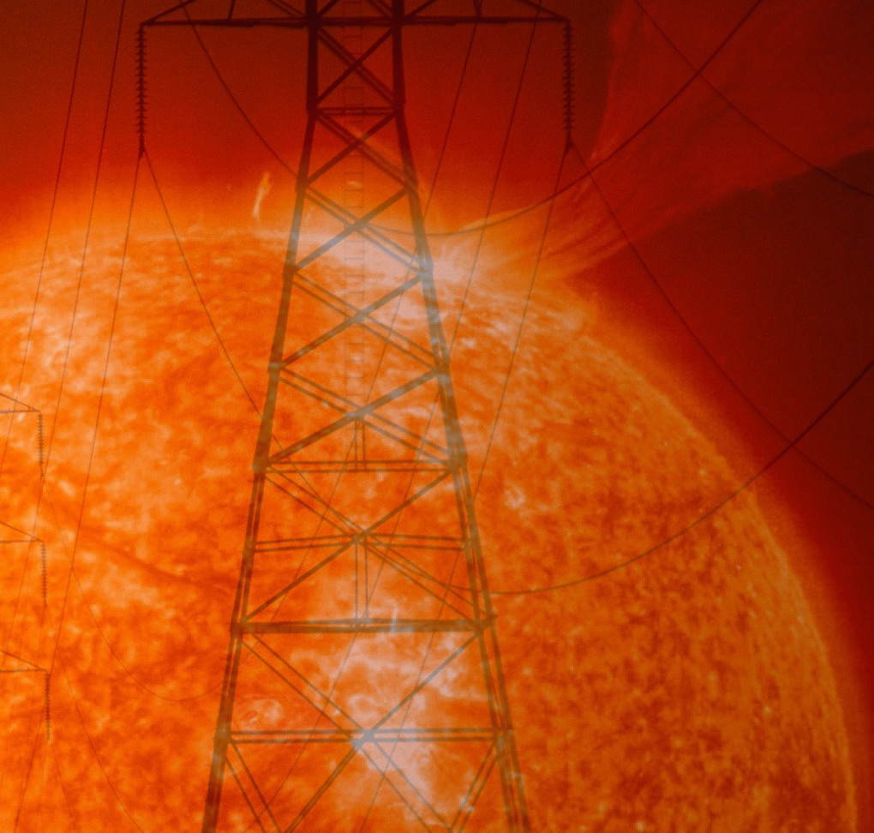
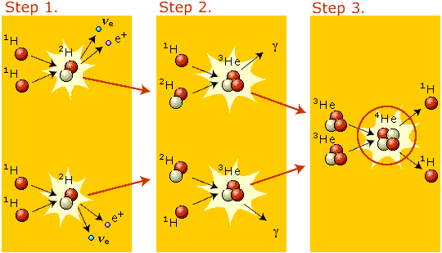
Nuclear fusion
Energy-producing mechanism in stars
Each second about 600 million ton hydrogen is converted through weak interaction
Power density in Sun is only 0.3 W/m³

Slide 5
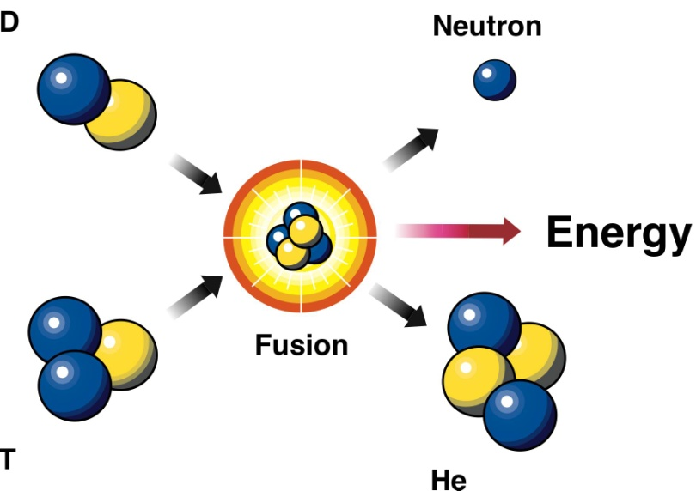
Physics of fusion
Fusion here refers to the controlled process in which two light atoms are fused together generating a heavier atom with the aim of generating energy.
Binding energy is the energy that is released when a nucleus is created from protons and neutrons.
It is released during the formation of a nucleus.
The greater the binding energy per nucleon in the atom, the greater the atom’s stability.
Fission
Mass
Number
(A)
Charge
Number
Symbol
Fusion
Binding energy (in MeV) per particle as a function of the mass number (A)

Slide 6

Fusion reactions and energy released
Often considered fusion reactions (note more than one reaction possible)
The released energy follows from the mass deficit. Consider the reaction
The masses of the different products are
The mass deficit (initial mass minus total final mass) is

Slide 7
Calculation of the released energy
The mass deficit is
The energy then follows from Einstein’s formula
Used unit of energy is the electron volt (eV), kilo-electron volt (1 keV = 1000 eV) or Mega-electron volt (1 MeV = 10⁶ eV)
1 kg of a Deuterium/Tritium mixture would allow for a number of fusion reactions N
This amount of reactions would generate an energy
This is around 4 GW for 24 hours

Slide 8
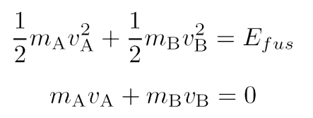
Temperature and kinetic energy
Temperature is always used to express an averaged energy. The unit is again eV, i.e.
where T is the temperature and T_{k} is the temperature in Kelvin.
Note
1 eV = 11605 K 17.56 MeV = 2 10¹¹ K
The energy is released in the form of kinetic energy
The kinetic energy is not equally distributed over the products since both energy as well as momentum need to be conserved
These equations can be solved to give
Lightest particle takes most kinetic energy
Take the now famous reaction
Helium nuclei are roughly 4 times more heavy than the neutron and will thus acquire 20% of the energy (3.5 MeV) whereas the neutron obtains 80% (14.1 MeV)

Slide 9
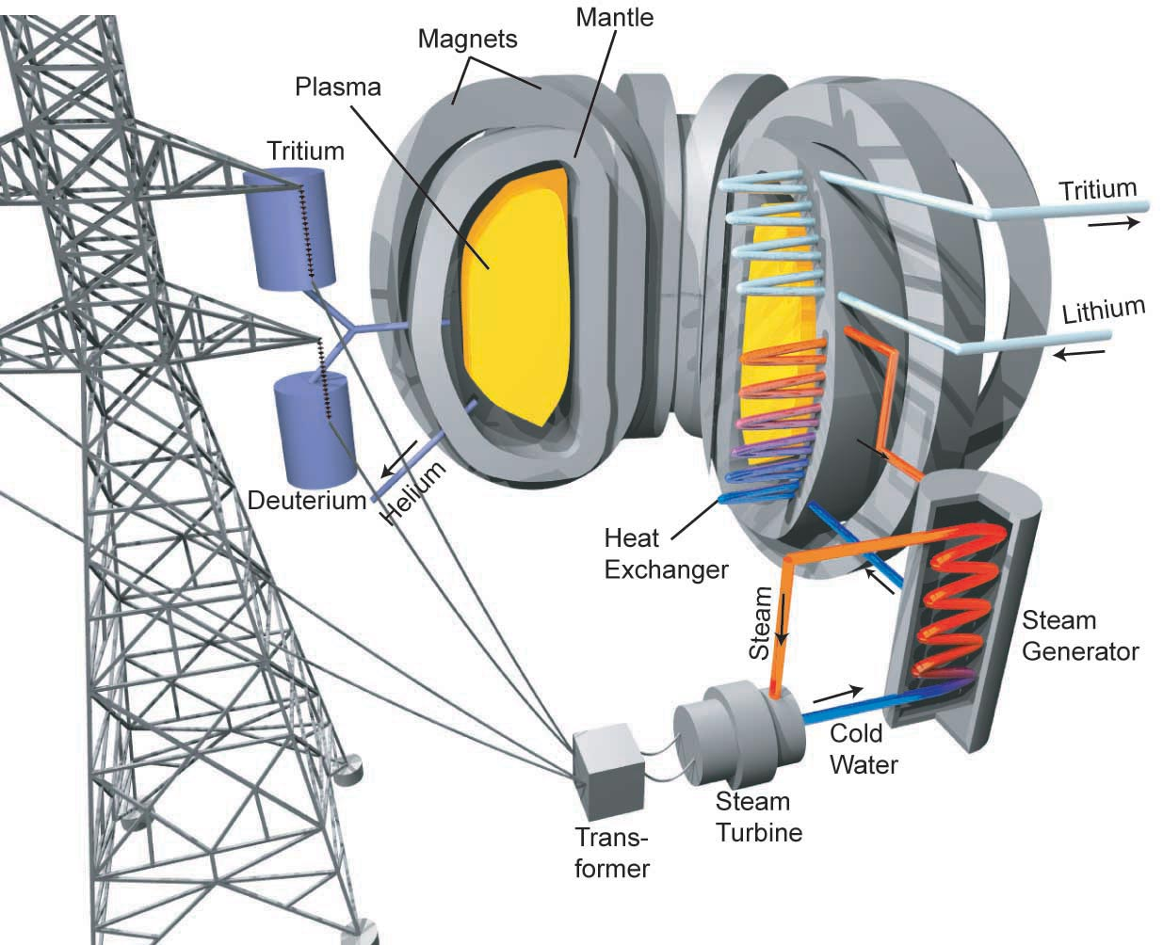
Fusion power station
n heat mantel, ⁴He the plasma

Slide 10
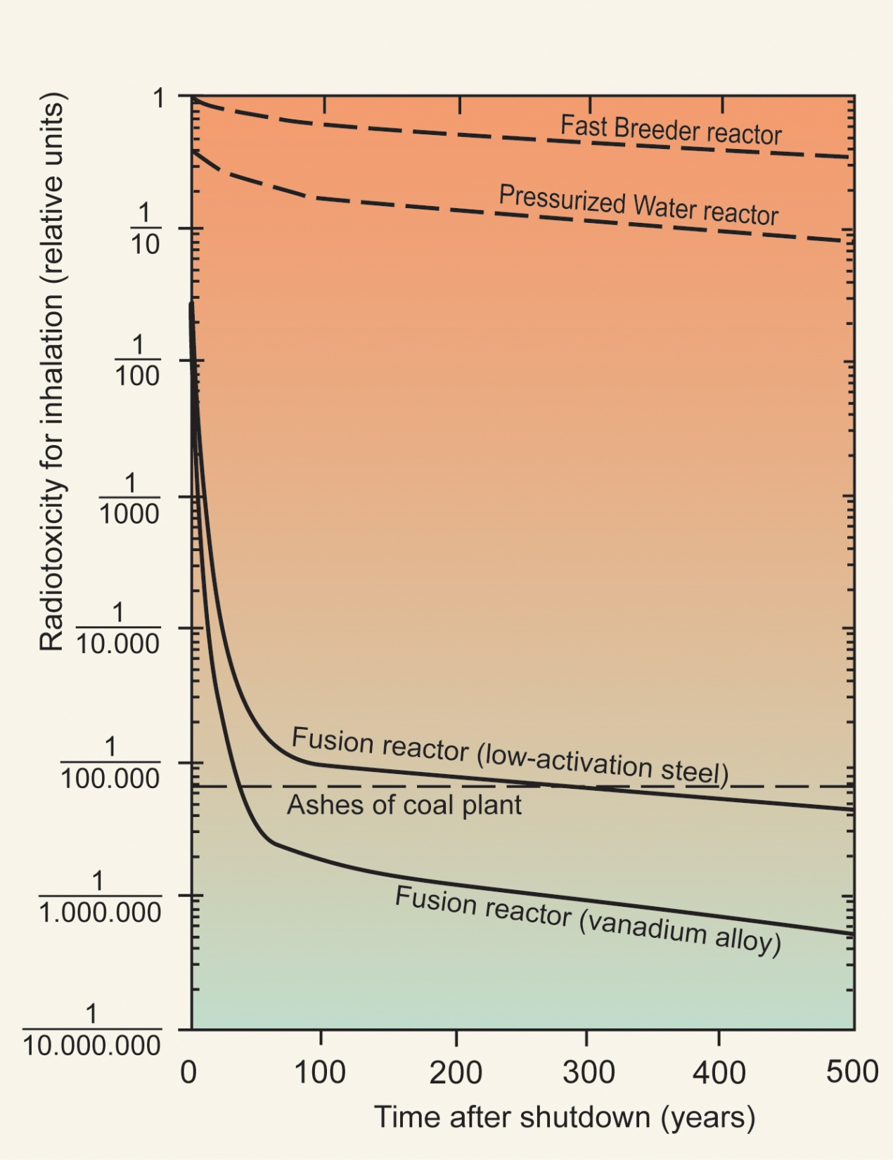
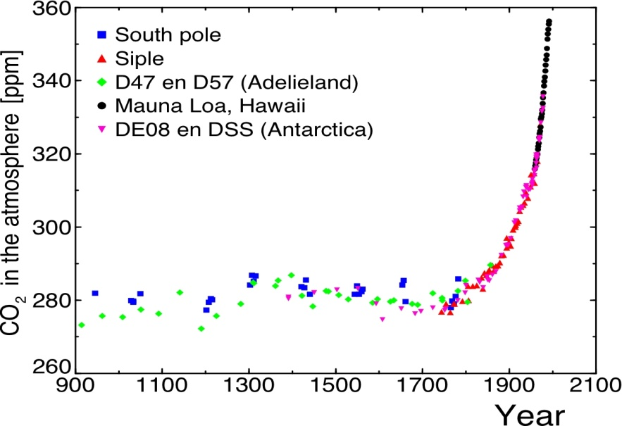
Radiotoxicity for inhalation

Slide 11
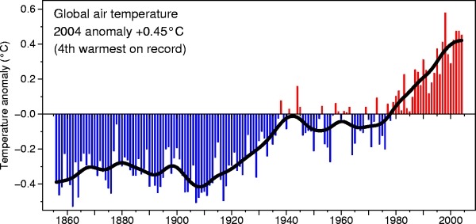
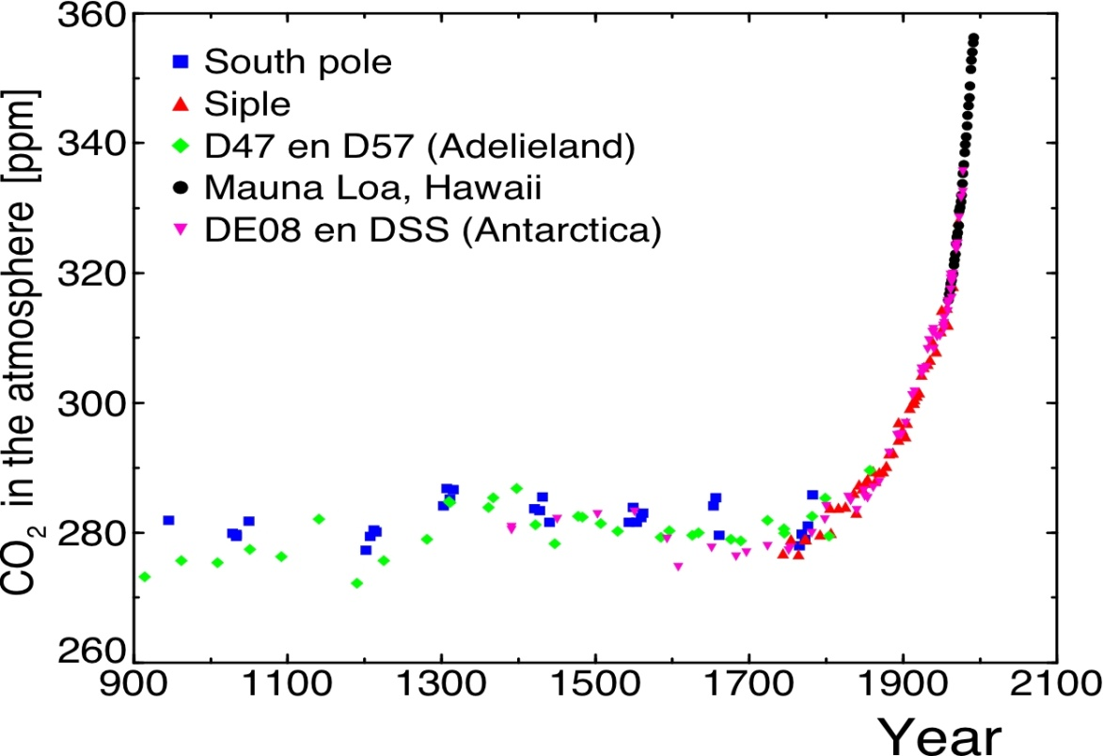
Climate issues

Slide 12
Cross section and Coulomb barrier
At large distances the deuteron and triton only experience the repulsive Coulomb force
At short distances there is attraction because of the strong force
Particles tunnel through the Coulomb barrier
The cross section of various fusion reactions as a function of the energy (note logarithmic scale)
The cross section is the effective area connected with the occurrence of a reaction
For snooker balls the cross section is πr² (with r the radius of the ball)
1 barn = 10⁻²⁸ m²

Slide 13
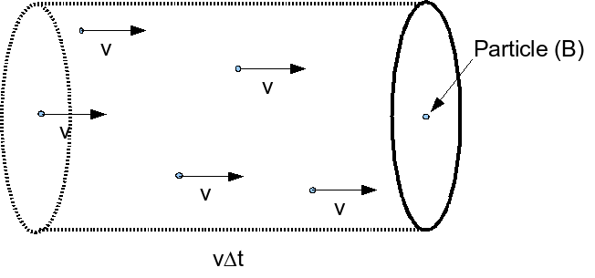

Averaged reaction rate
One particle (B) colliding with many particles (A)
Number of reactions in Δt is
Both σ as well as v depend on the energy which is not the same for all particles. One builds the average
The cross section σ
Schematic picture of the number of reactions in a time interval Δt
The cross section must be averaged over the energies of the particles. Assume a Maxwell
Averaged reaction rates for various fusion reactions as a function of the temperature (in keV)

Slide 14
Compare the two distributions
Averaged reaction rate vs temperature
Cross section as a function of energy
The averaged reaction rate does not fall of as strongly when going to lower energies
The cross section
Even for temperatures below the energy at which the cross section reaches its maximum, there is a sufficient amount of fusion reactions due to the number of particles in the tail of the Maxwell distribution
The Maxwell (multiplied with the velocity)
Schematic picture of the calculation of the averaged reaction rate (Integrand as a function of energy)
The product of distribution and cross section

Slide 15
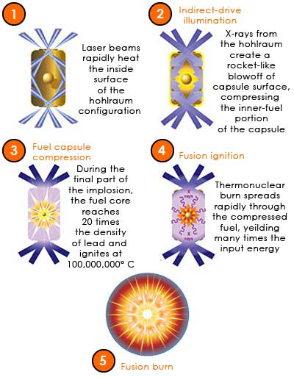
Current fusion reactor concepts
Reactors designed to operate at around 10 keV (note this is still 100 million Kelvin, matter is fully ionized or in the plasma state)
Are based on a mixture of Deuterium and Tritium
Both are related to the cross section
Some time scales can be estimated using the thermal velocity
This is 10⁶ m/s for Deuterium and 6 ×10⁷ m/s for the electrons
In a reactor of 10 m size the particles would be lost in 10 ms.
Inertial confinement fusion (ICF) is based on the rapid compression, and heating of a solid fuel pellet through the use of laser or particle beams. In this approach one tries to obtain a sufficient amount of fusion reactions before the material flies apart, hence the name,.
Magnetic confinement fusion (MCF)
  The Lorentz force connected with a magnetic field makes that the charged particles can not move over large distances across the magnetic field
  They gyrate around the field lines with a typical radius
At 10 keV and 5 Tesla this radius of 4 mm for Deuterium and 0.07 mm for the electrons

Slide 16
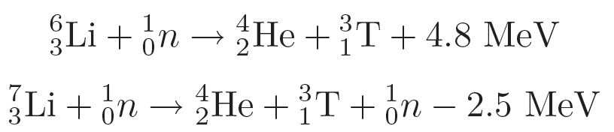
Availability of the fuel
The natural abundance of Deuterium is one in 6700. There is enough water in the oceans to provide energy for 3×10¹¹ years at the current rate of energy consumption (larger than the age of the universe)
Deuterium is also very cheaply obtainable. Calculating the price of electricity solely on the basis of the cost of Deuterium, would lead to a drop of 10³ in your electricity bill
Tritium is unstable with a half age of 12.3 years. There is virtually no natural available resource of Tritium
Tritium however can be bred from Lithium
Note that the neutron released in the fusion reaction can be used for this purpose
The availability of Lithium on land is sufficient for at least 1000 if not 30000 years, and the cost per kWh would be even smaller than that of Deuterium.
If the oceans are included it is estimated that there is enough fuel for 3×10⁷ years.

Slide 17
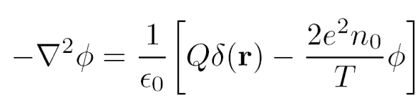
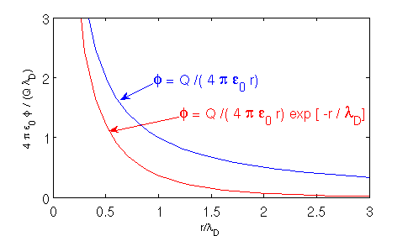
Quasi-neutrality and the Debye length
Using the Poisson equation
And a Boltzmann relation for the densities
One arrives at an equation for the potential
Positive added charge Response of the plasma
The solution of the Poisson equation is
Vacuum and plasma solution
Potential in vacuum Shielding due to the charge screening
The length scale for shielding is the Debye length which depends on both temperature and density. It is around 10⁻⁵ m for a fusion plasma

Slide 18
Quasi-neutrality
For length scales larger than the Debye length the charge separation is close to zero. One can use the approximation of quasi-neutrality
The charge density is assumed zero
Note that this does not mean that there is no electric field in the plasma
Under the quasi-neutrality approximation the Poisson equation can no longer be used to calculate the electric field
since it would give a zero field
Typical distance that particles are separated in a plasma
Distance where relative kinetic energy (kT) equals Coulomb energy is given by
In typical plasmas r_{s}/r_{c} >> 1 and binary Coulomb interactions are rare. These plasmas are called weakly coupled and we treat such plasmas as collisionless. Pressure exerted by the plasma is given by p = nkT.
Length scales of the phenomena are larger than the Debye length
The current is divergence free and displacement current is negligible

Slide 19
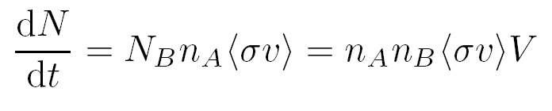
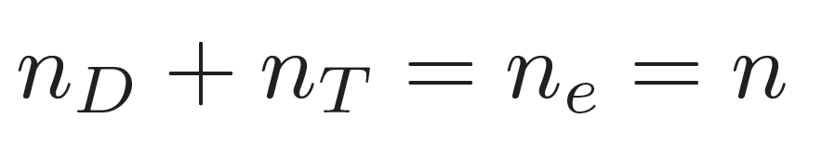

Lawson criterion and fusion power
Derives the condition under which efficient production of fusion energy is possible
Essentially it compares the generated fusion power with any additional power required
The reaction rate of one particle B due to many particles A was derived
In the case of more than one particle B one obtains
The total fusion power then is
Using quasi-neutrality
For a 50-50% mixture of Deuterium and Tritium
To proceed one needs to specify the average of the cross section.
In the relevant temperature range 6-20 keV
The fusion power can then be expressed as
with n₂₀ in #/10⁻²⁰ cm³ and V in cm³.

Slide 20
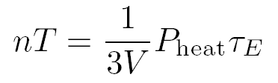
Power loss
The fusion power must be compared with the power loss from the plasma
For this we introduce the energy confinement time τ_{E}
Where W is the stored energy
If the plasma is stationary
Combine this with the fusion power
One can derive the so called n-T-tau product

Slide 21

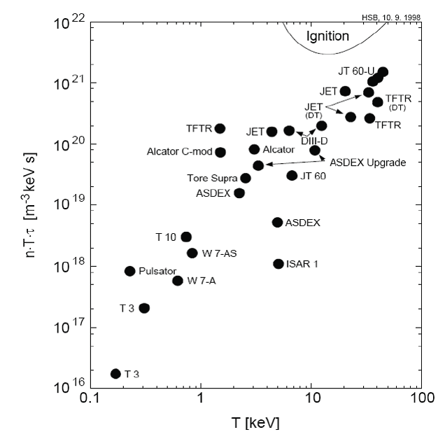
Break-even and ignition
The break-even condition (Lawson criterion) : total fusion power is equal to the heating power
Note that this does not imply that all the heating power is generated by the fusion reactions
Ignition: energy produced by the fusion reactions is sufficient to heat the plasma
Only the He atoms are confined (neutrons escape the magnetic field)
Therefore, only 20% of the total fusion power is available for plasma heating
Over the years the n-T-tau product shows an
exponential increase
Current experiments are close to break-even
The next step ITER is expected to operate well
above break-even but still somewhat below ignition

Slide 22
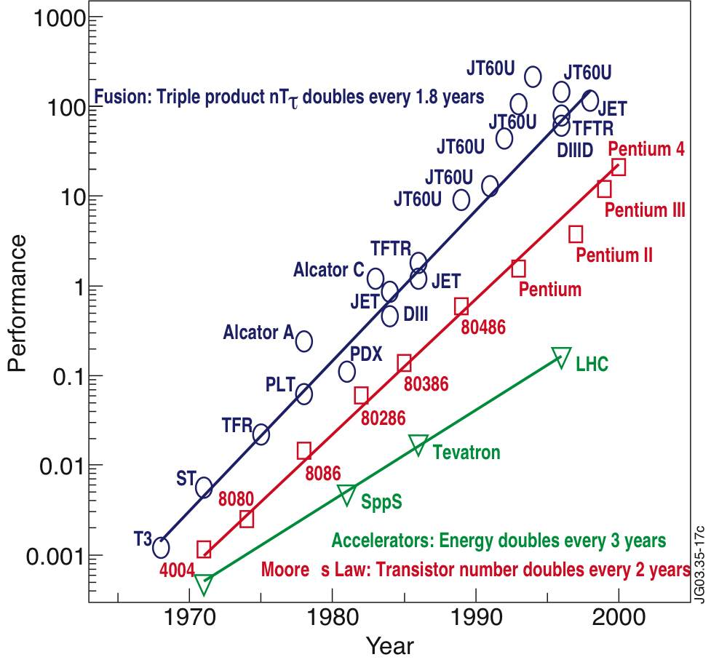
Progress in fusion machines

Slide 23

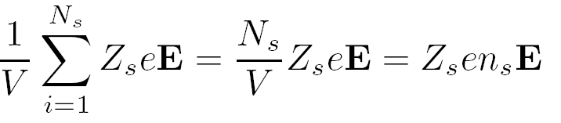
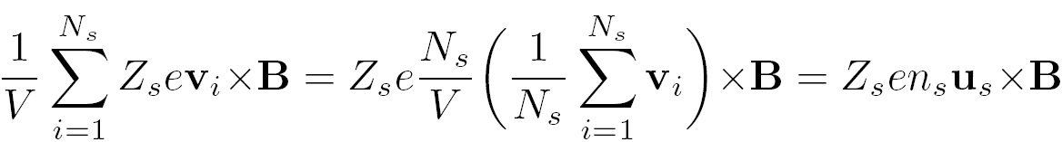
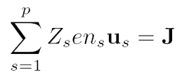
Force on the plasma
The force on an individual particle due to the electro-magnetic field (s is species index)
Assume a small volume such that
Then the force per unit of volume is
For the electric field
Define an average velocity
Then for the magnetic field
Averaged over all particles
Now sum over all species
The total force density therefore is
For a fluid with a finite temperature one
has to add the pressure force

Slide 24
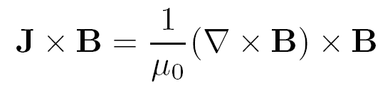
Reformulating the Lorentz force
Using
The force can be written as
Then using the vector identity
One obtains
Important parameter (also efficiency parameter) the plasma-beta
Magnetic field pressure Magnetic field tension

Slide 25
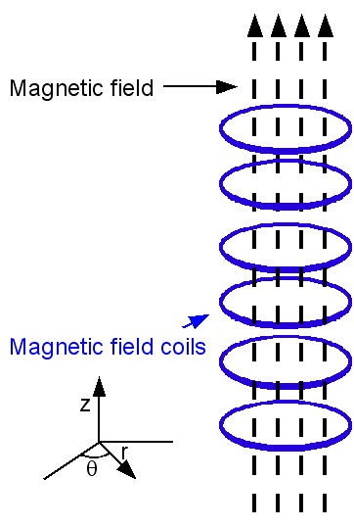

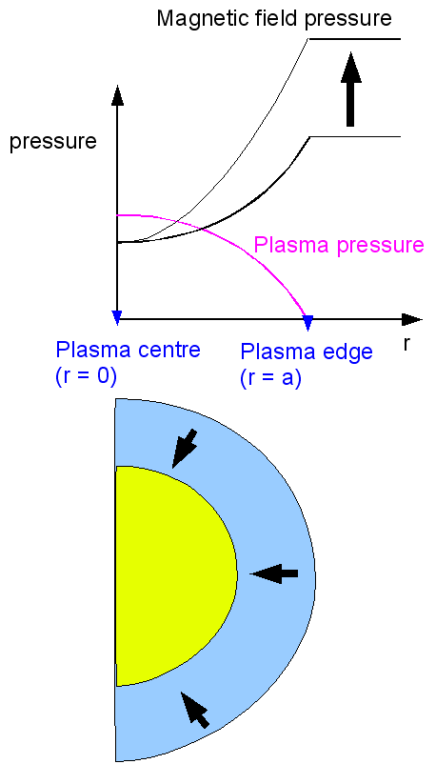
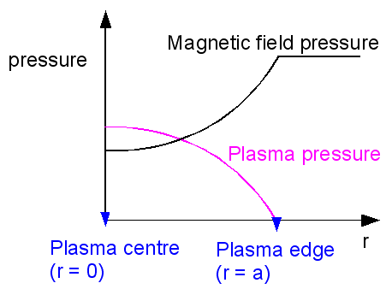
Theta pinch
Plasma escapes at the ends; go toroidal …
Straight magnetic field no tension
Equation gives constant total pressure
Magnetic field is reduced inside the plasma
i.e. the plasma is diamagnetic
Ramp up the magnetic field by
ramping the current in the coils
The magnetic field pressure will
increase and is no longer balanced by
the plasma pressure
The plasma is compressed
Compression leads to work against
the pressure gradient force which will
heat the plasma

Slide 26
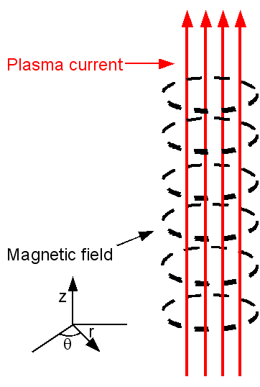
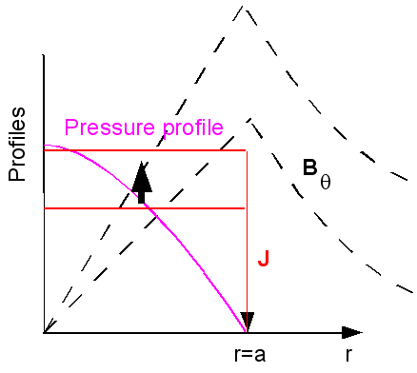
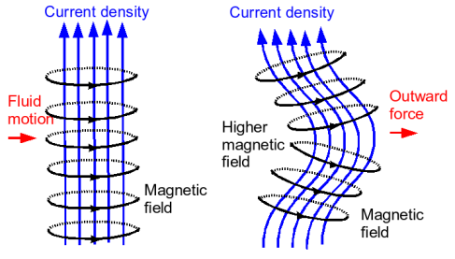
Z-pinch
A strong current is generated in the z-direction
This current generates a magnetic field in the θ direction
JxB force is then fully determined
Pressure gradient must balance the JxB force and is then
also fully determined by the current
Poloidal
Current is the source of the magnetic field
Magnetic pressure
Ramping of the current will increase the magnetic field which will compress the plasma
Besides the heating due to compression, the current will also
dissipate heat when the plasma resistivity is finite
The Z-pinch is unstable. Most relevant instability is the kink

Slide 27
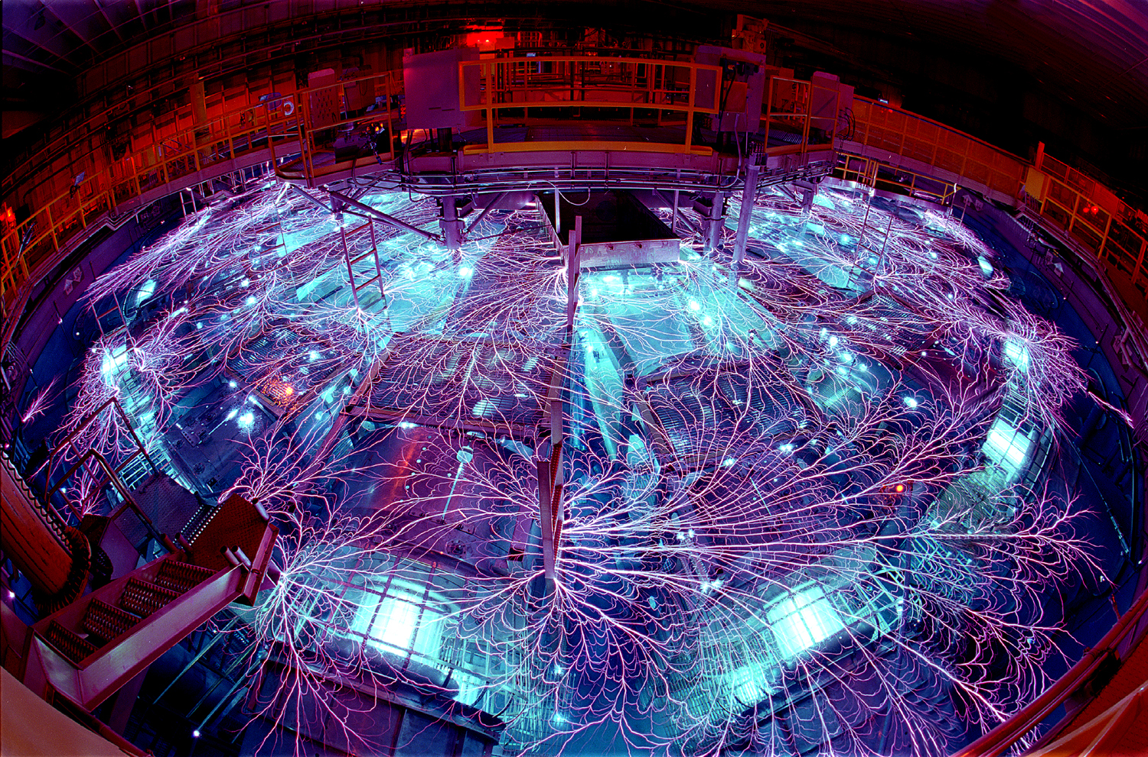
Sandia labs – Z pinch: 200 TW X-rays

Slide 28
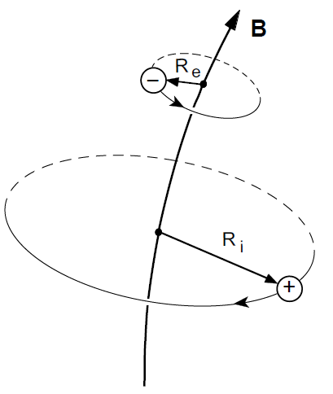
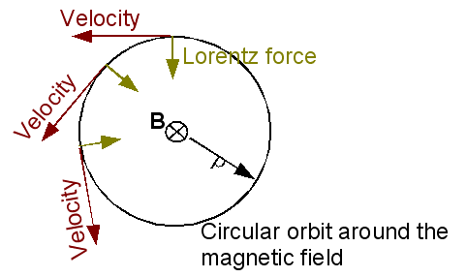
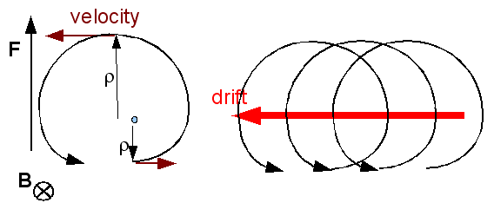
Gyro motion
Lorentz force leads to a gyration of the
particles around the magnetic field
We will write the motion as
Parallel and rapid gyro-motion
Finite additional force F (=qE) leads to drift
For 10 keV and B = 5T:
Larmor radius of deuterons ~4 mm
electrons ~0.07 mm
alpha particles (3.5 MeV) ~5.4 cm
Cyclotron frequency:
80 MHz for hydrogen
130 GHz for electrons
Physics picture behind the drift velocity
Parallel motion
Gyration
ExB drift
Polarization drift
Grad-B and curvature drift

Slide 29
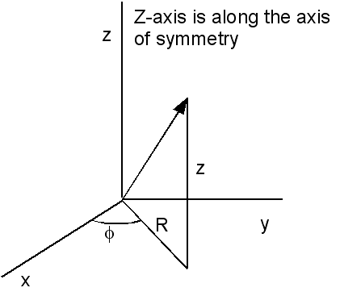
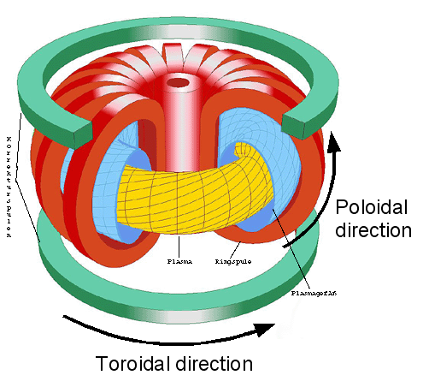
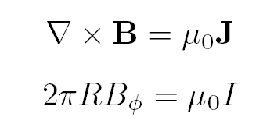
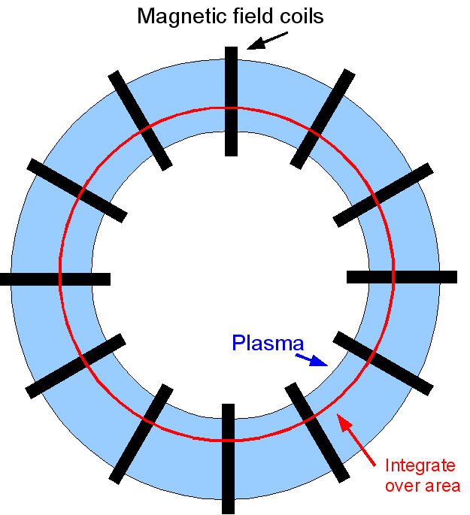
Tokamak
Bend the theta pinch into a donut shape
No end losses because the field lines go
around and close on themselves
The magnetic field follows form
And therefore varies with major radius R as
Top view of tokamak
Schematic picture of the tokamak

Slide 30
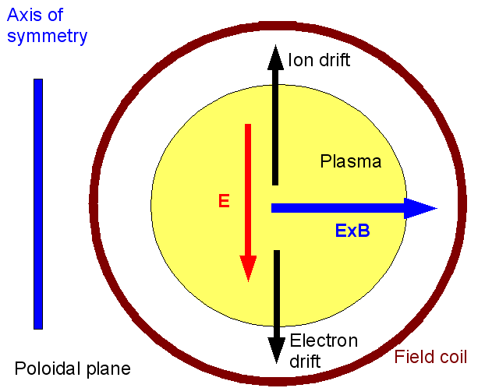
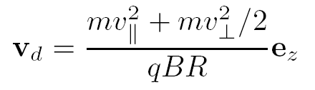
Toroidal curvature has its price
The toroidal magnetic field has a gradient
Which leads to a drift in the vertical direction
Note that the sign of the drift depends on the sign of the charge q
The drift
leads to charge separation
Build up of an electric field
and then to an ExB velocity
The ExB velocity
Is directed outward and will move the plasma
on the wall in a short timescale
This effect is no surprise since
Poloidal cut of the tokamak.
Remedy: a toroidal
plasma current will
generate a poloidal field

Slide 31
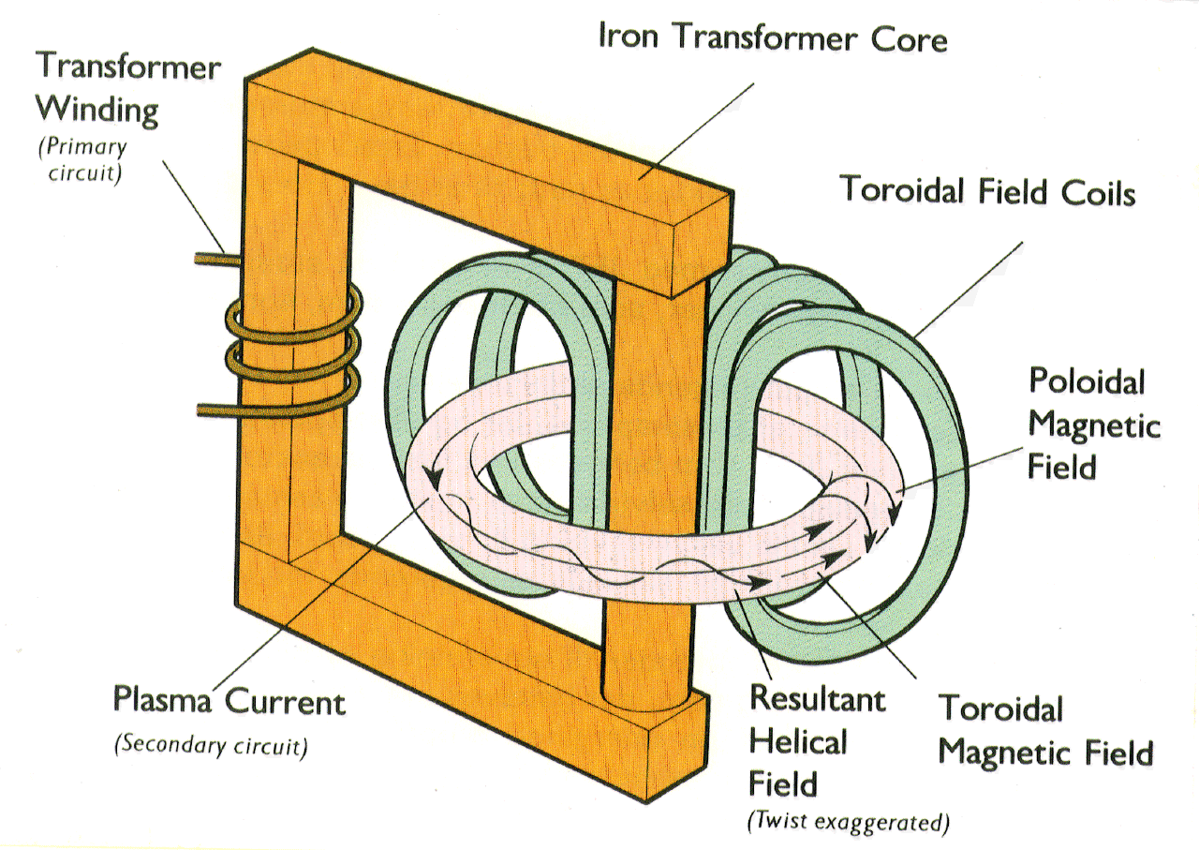
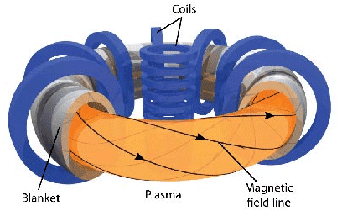
The toroidal electric field
Plasma is the second winding of a transformer
Flux in the iron core cannot be increased forever.
The tokamak is necessarily a pulsed machine
That is not good for energy production
Also thermal stresses are associated with the
pulsed character
One can either: live with it / drive current another
way / use a different concept
Because of the plasma current the field lines wind
around helically

Slide 32
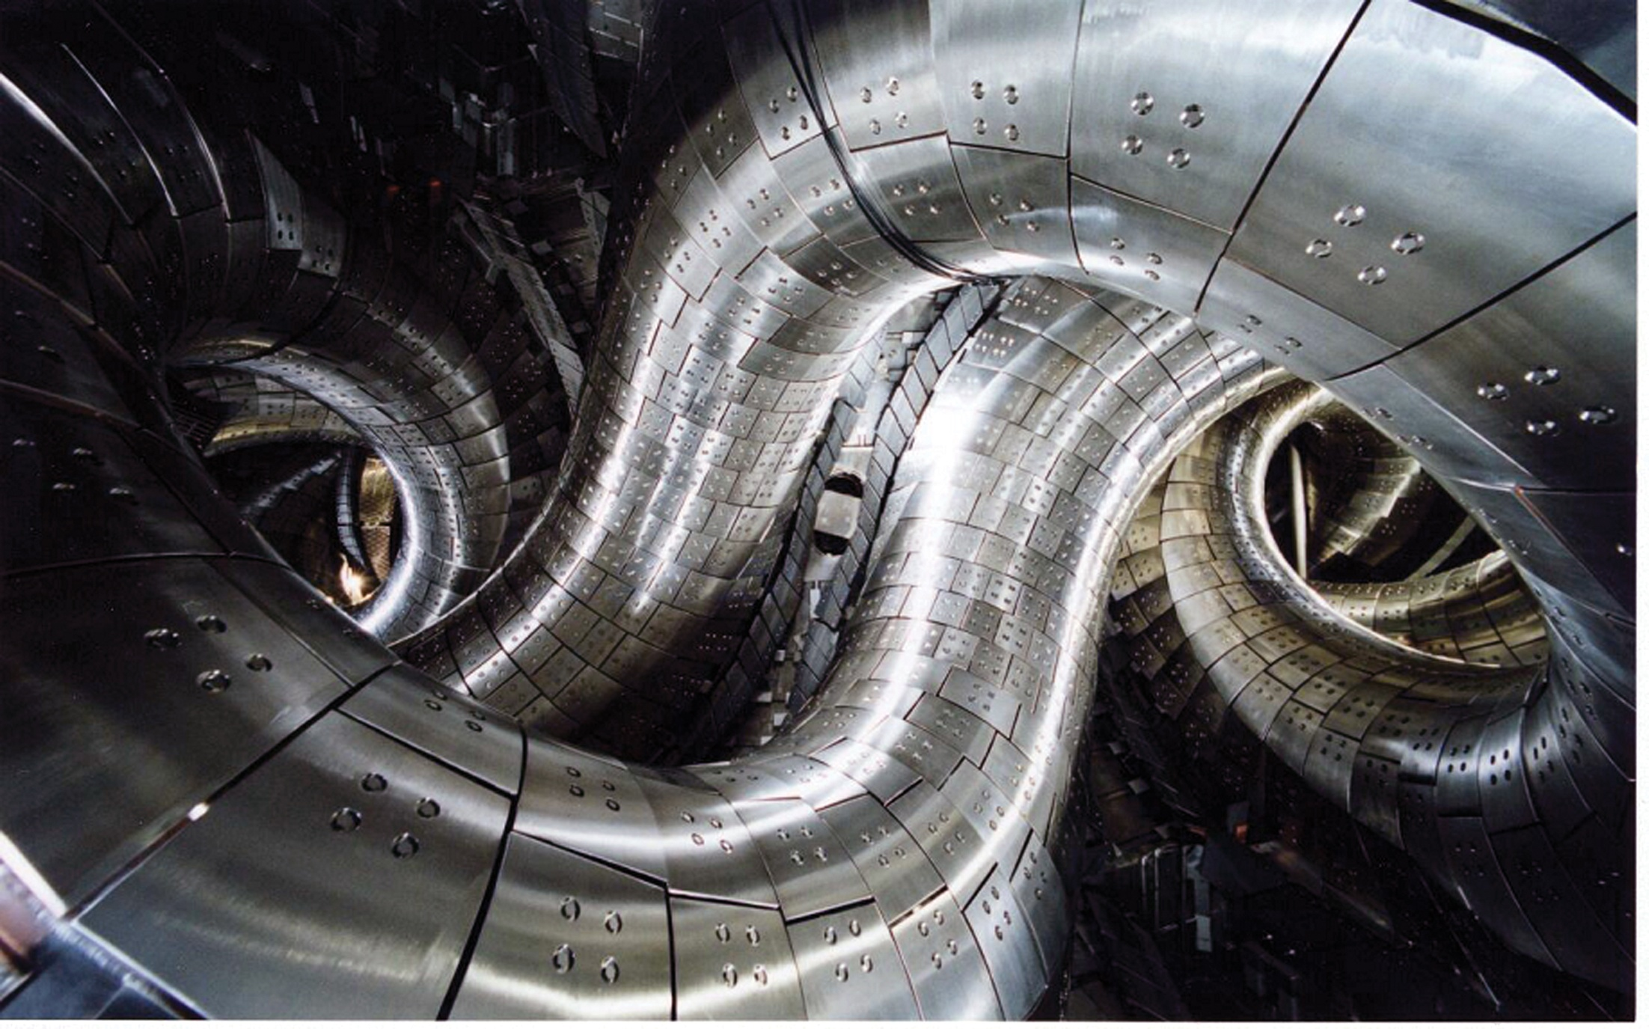
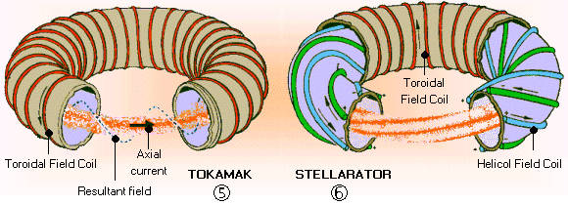
Stellarator – LHD in JAPAN
If the field is not toroidally symmetric the motion in the toroidal direction will move the field line
from regions of positive poloidal field into regions of negative field
Then a net poloidal turn of the field line can be achieved
Steady state operation is possible at the cost of greater complexity

Slide 33
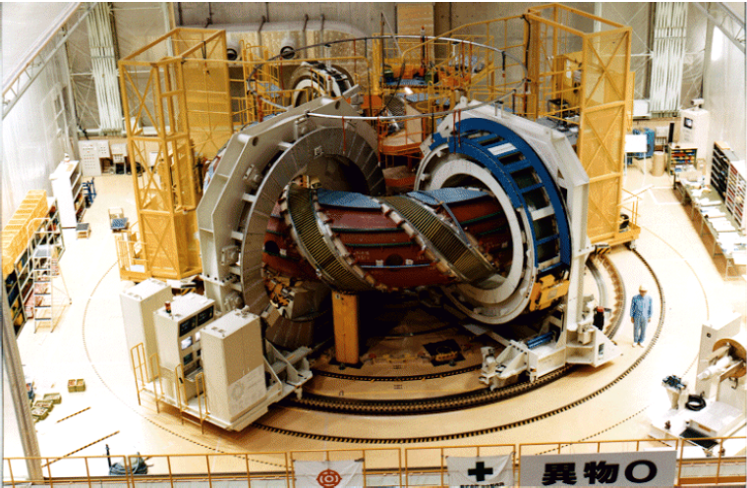
Large Helical Device (LHD,Japan)

Slide 34
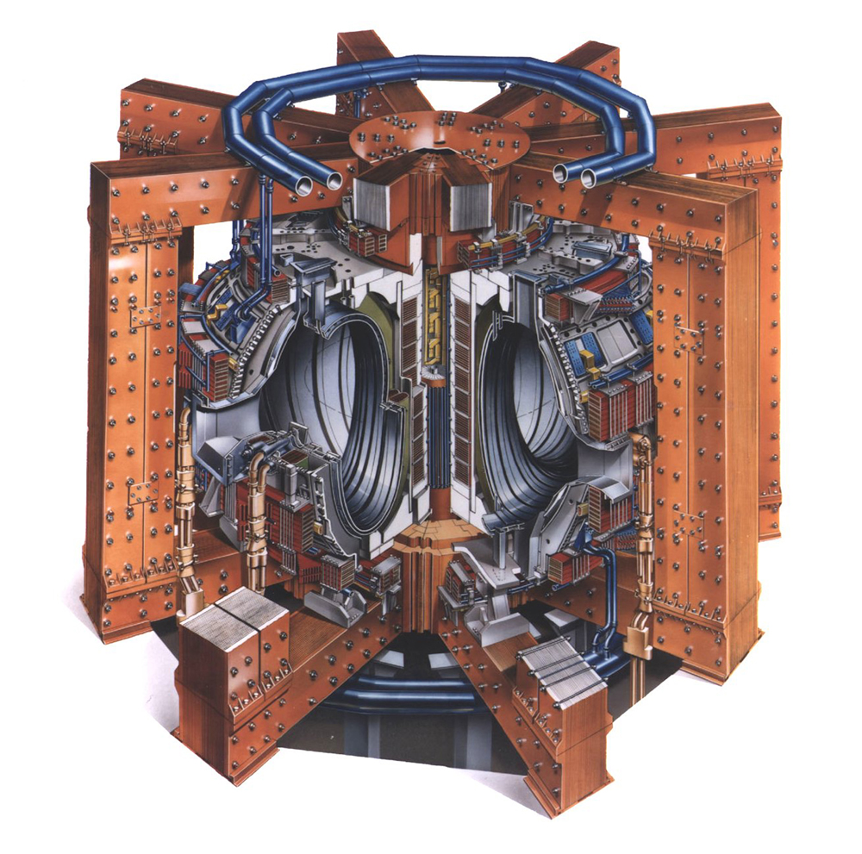
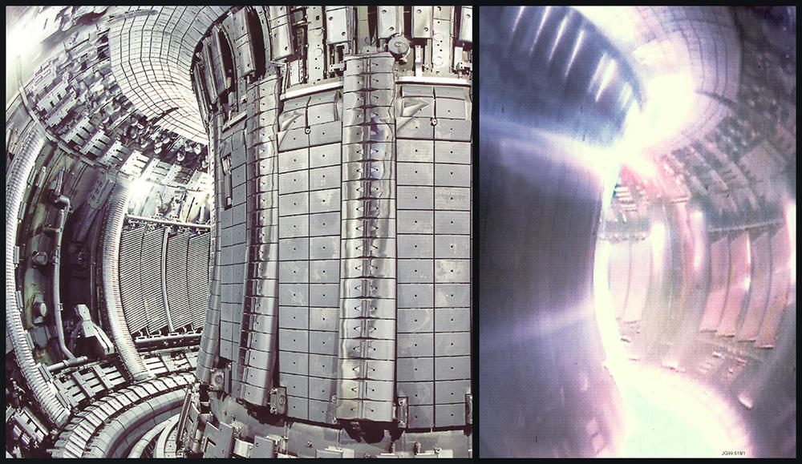
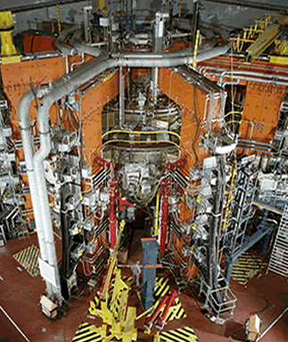
Largest tokamak: JET (EU,UK)
Major radius 3 m
Minor radius 1. m
Magnetic field < 4 T
Plasma volume 100 m³
Plasma current < 7 MA
Plasma duration 10 s

Slide 35
Comparison of confinement time
Confinement time of tokamaks and stellarators compared
Confinement times of LHD are below those
of the large tokamaks
This is mostly due to the smaller plasma volume
LHD
Advantage of the stellarator
Stationary plasma operation
No current in the plasma, and therefore no current driven instabilities
Disadvantage
Complex magnetic field coils
Curved coils lead to large forces (strong supporting structures)
Difficult to make compact devices

Slide 36
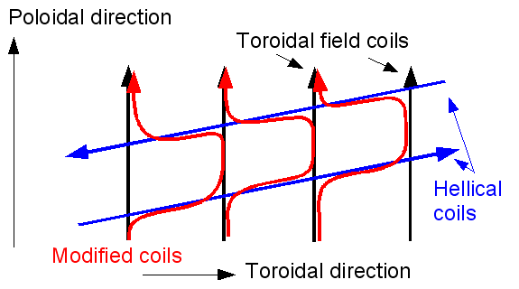
Helical coils can be simplified
The picture shows how the combination of helical coils and toroidal field coils can be changed to use modular coils

Slide 37
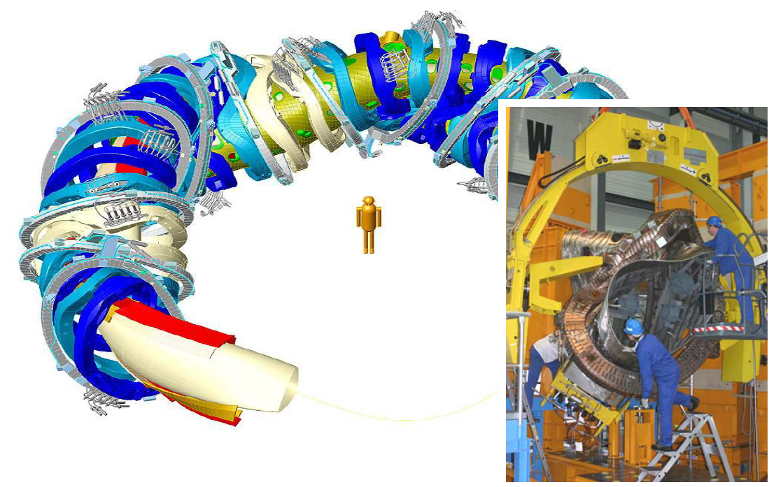
Applied in W7X
A combination of helical coils and toroidal field
coils can be changed to use modular coils
Modular coils of W7x
There is a large disadvantage in the use of the
modular coils. They are highly bend and therefore
there are large force on them
In general it is difficult to build a compact device with
a big plasma. The poloidal field one imposes from
the outside decays rapidly with distance from the
coils

Slide 38
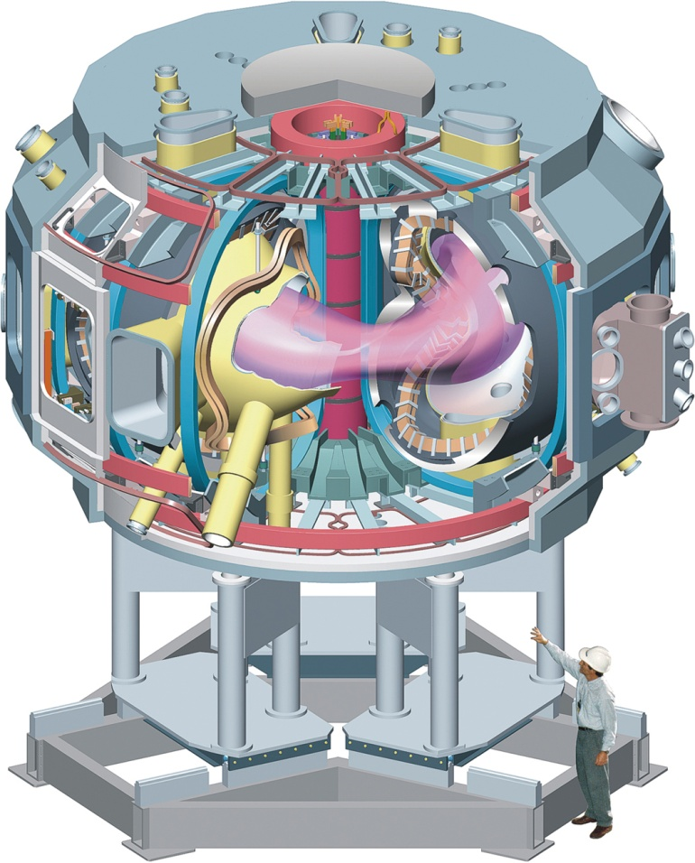

Compact stellarator NCSX princeton
Compact stellarators are a challenge. The plasma current in this device is not driven by a transformer.

Slide 39

A tokamak
Plasma (purple) Notice the shape
Surrounded by plates
Vessel (pumps)
Coils mostly outside vessel (finite reaction time)
Ohmic transformer / toroidal field coils (green)
Schematic Drawing of the poloidal cross section of the ASDEX Upgrade tokamak

Slide 40

A tokamak
Magnetic surfaces are the surfaces traced out by the magnetic field
They are nested (best confinement)
Centre is shifted outward
Large passive coils
Magnetic field ends on a set of plates
Large set of small coils for diagnostic purposes

Slide 41
Plasma manipulation
Several coils around the plasma
The vertical coils can shape the plasma and control its position
Dominant shaping is the vertical elongation of the plasma
Schematic Drawing of the poloidal cross section of the ASDEX Upgrade tokamak

Slide 42

Plasma elongation
Plasma can be diverted onto a set of plates
Close to the coils the field of the coils dominates
In between the field is zero resulting in a purely toroidal field line
This shows up as an X-point in the figure of the magnetic surfaces
Surfaces outside the one with the X-point are not close with the field ending on the plates

Slide 43




Preventing impurities – divertor
Given a fixed electron density, impurities dilute the fuel
Acceleration of electrons by the ions in the plasma lead to radiation losses known as
‘Bremstrahlung’
The radiation scales with the average charge. High Z impurities enhance the radiation
High Z-impurities also lead to energy loss through line radiation
Density of the impurity with charge Z
Effective charge
Plasma facing components have to be
chosen carefully
Carbon / Beryllium have a low Z
Carbon does not melt but has the problem
that it binds well with Tritium (contamination
of the machine)
Tungsten has very high Z, but takes the
heat loads very well

Slide 44
Plasma instabilities
Plasma vertical instability with growth rates of the order 10⁶ s⁻¹
For this reason the passive coils have been placed in the plasma
When the plasma moves it changes the flux through the coils which generates a current that pushes the plasma back
Growth rate is reduced to the decay time of the current in the coils (ms)

Slide 45

ITER

Slide 46

What is ITER?
ITER = (International Tokamak Experimental Reactor) is the next step in tokamak research.
Largest tokamak in world
Project has started in Cadarache, France
Joint project of Europe, China, Japan, Korea, Russia (and the US).
Cross section of the plasma area in the poloidal plane for different devices

Slide 47
More on ITER
Main objective
Demonstrate the feasibility of a fusion reactor. This includes generating a plasma that is dominantly heated by fusion reactions, but also demonstrating that an integrated design can meet the technological constraints
Project
Cost 5 billion euro construction + 5 billion euro for operation (most expensive experiment on earth)
Construction of building started in 2008 /Assembly starting on 2012
Assembly estimated to last 7 years
20 years of operation planned

Slide 48

Design - main features
Central Solenoid
Blanket Module
Outer Intercoil Structure
Vacuum Vessel
Cryostat
Toroidal Field Coil
Poloidal Field Coil
Divertor
Machine Gravity
Supports
Torus
Cryopump

Slide 49
ITER parameters
Total fusion power 500 MW
Q = fusion power/auxiliary heating power ≥10 (inductive)
Average neutron wall loading 0.57 MW/m²
Plasma inductive burn time ≥ 300 s
Plasma major radius 6.2 m
Plasma minor radius 2.0 m
Plasma current 15 MA
Vertical elongation @95% flux surface/separatrix 1.70/1.85
Triangularity @95% flux surface/separatrix 0.33/0.49
Safety factor @95% flux surface 3.0
Toroidal field @ 6.2 m radius 5.3 T
Plasma volume 837 m³
Plasma surface 678 m²
Installed auxiliary heating/current drive power 73 MW (100 MW)

Slide 50
Main differences ………
All components must be actively cooled
Superconducting coils. For 5 T and a major radius of 6 m one can work out the total current in the toroidal field coils
If the electric field is 1 V/m this will lead to a dissipation (EJ Volume) of 4.5 GW. Much more than the fusion power.
The best superconductor has a critical magnetic field of around 11 T. This limits the field in the plasma to 5 T !!!!
Neutron shielding. Superconducting coils must be shielded from the neutrons, which could damage the material or lead to the quenching of the superconductor

Slide 51
Design - vessel
The double-walled vacuum vessel is lined by modular removable components, including divertor cassettes, and diagnostics sensors, as well as port plugs for limiters, heating antennae, and diagnostics.
The total vessel/in-vessel mass is ~10,000 t.
These components absorb most of the radiated heat and protect the magnet coils from excessive nuclear radiation. The shielding is steel and water, the latter removing heat from absorbed neutrons.

Slide 52
Design - divertor
The divertor is made up of 54 cassettes. The target and divertor floor form a V which traps neutral particles protecting the target plates, without adversely affecting helium removal. The large opening between the inner and outer divertor balances heat loads in the inboard and outboard channels.
The design uses C at the vertical target strike points. W is the backup, and both materials have their advantages and disadvantages. C is best able to withstand large power density pulses (ELMs, disruptions), but gives rise to dust and T co-deposited with C which has to be periodically removed. The best judgement of the relative merits can be made at the time of the experiments.

Slide 53

Remote handing to replace to cassettes

Slide 54

Design – Tokamak building
Provides a biological shield around cryostat to minimize activation and permit human access.
Additional confinement barrier.
Allows contamination spread to be controlled.
Provides shielding during remote handling cask transport.
Can be seismically isolated.

Slide 55


Schedule
ITER IO
LICENSE TO CONSTRUCT
TOKAMAK ASSEMBLY STARTS
FIRST PLASMA
2005
2006
2007
2008
2009
2010
2011
2012
2013
2014
2015
2016
EXCAVATE
Bid
Contract
TOKAMAK BUILDING
OTHER BUILDINGS
Construction License Process
Complete
blanket/divertor
First sector
Complete VV
TOKAMAK ASSEMBLY
Install
cryostat
PFC
Install CS
COMMISSIONING
Bid
Vendor’s Design
MAGNET
Contract
PFC
TFC
CS
Last TFC
Last CS
Bid
fabrication start
VESSEL
Contract
First sector
Last sector

Slide 56

Inertial confinement fusion concept

Slide 57
Plasma conditions during ICF
Before compression and ignition
Density: solid DT ice at 0.225 g/cm³ and gas
Temperature: few Kelvin
During the burn phase
Density: 300 to 1000 times liquid density
300 to 1000 g/cm³ ≈ 10²⁶ cm⁻³ Temperature: around 10.000.000 K or 10 keV
Pressure: around 10¹² bar
Confinement time needed: around 200 ps

Slide 58

Possible drivers: Z - pinches
Advantages:
Good energy coupling
(many x-rays)
Large Targets
Disadvantages:
Very slow
(one shot / day)
Only one device worldwide
Z-Machine, Sandia labs, Albuquerque USA

Slide 59

Possible drivers: ion beams
Advantages:
Excellent conversion from electric power to beam energy
Large targets
Disadvantages:
Concept was never tested
Beam intensity is still too low
FAIR facility,
Darmstadt, Germany
10 to 20 rings needed
for fusion power plant!

Slide 60

Possible drivers: lasers (best shot)
Advantages:
Well advanced technology
Good control of energy release
Disadvantages:
Bad energy conversion
Very expensive to build
National Ignition Facility (NIF), Livermore, USA

Slide 61


Possible drivers: lasers
Target chamber, NIF with 192 laser beams
National Ignition Facility (NIF), Livermore, USA

Slide 62





Possible drivers: lasers
~1000 large Optics:
real NIF target
192 beam lines:
Schematic
Engineering challenges at NIF
DT capsule

Slide 63

Problems blocking fusion energy
Technical and engineering problems
High energy drivers are expensive and untested
Energy conversion is too low (gain of >100 needed now)
Repetition rate of drivers are too low (3-10 Hz needed)
Physics Problems
Instabilities and Mixing
► Rayleigh-Taylor unstable compression
► Break of symmetry destroys confinement
How to improve energy coupling into target
What is the best material for the first wall?

Slide 64

Rayleigh-Taylor Instability – spherical implosions / explosions
Energy must be delivered as sysmmetric as possible!

Slide 65


Relaxing the symmetry conditions – indirect drive
Hohlraum
for the
Z-machine
Laser beams heat walls
Walls emit thermally (X-rays)
X-rays compress and heat the fusion capsule
X-rays highly symmetric!
NIF design (laser)

Slide 66

Relaxing the symmetry conditions – fast ignition
Fast ignition scheme
with many facets
Idea: separate compression and ignition with two pulses
Less compression, cooler targets, lower densities
Problem: How can energy be transferred to hot spot?

Slide 67

Interesting experiments to come
National Ignition Facility (NIF, Livermore, USA)
► More than 90% completed, first tests done
► First full scale experiments this year; ignition in 2010?
Laser Mega-Joule (LMJ, France)
► Commissioning (full scale) in 2011
FIREX I and FIREX II (ILE, Osaka, Japan)
► Fast ignition experiments showed prove-of-principle
► Fully integrated experiments in 2010 / 2011
HiPER project (Europe)
► Fast ignition proposal
► Full funding pending
ITER

Slide 68

Summary
Advantages
Large amount of fuel available, at low price.
Fusion is CO₂ neutral.
Only small quantity of radioactive waste.
No risk of uncontrolled energy release.
Fuel is available in all locations of the earth.
  Fusion is of interest especially for those regions that do not have access to other natural resources.
  Geo-political importance
Non-proliferation of weapon material
Disadvantages
To be demonstrated. The operation of a fusion reactor is hindered by several, in itself rather interesting, physics phenomena.
The cost argument is not all that clear, since the cost of the energy will be largely determined by the cost of the reactor.

