Slide 1

Energy Science
FEW Cursus
Jo van den Brand
April 20, 2010

Slide 2
Algemene ontwikkeling
Overzicht
Tentamenstof
Ter informatie
Docent informatie
  Jo van den Brand
  Email: jo@nikhef.nl
  URL: www.nikhef.nl/~jo
  0620 539 484 / 020 598 7900
  Kamer: T2.69
Rooster informatie
  Dinsdag 13:30 – 15:15 in S655 (totaal 8 keer); HC vdB
  Donderdag 15:30 – 17:15 in S345 (totaal 7 keer); WC Roel Aaij
Boek en dictaat
  Andrews & Jelley, Hoofdstukken 8 en 9
  Zie website voor pdf van dictaat
Cijfer
  Huiswerk 20%, tentamen 80%

Slide 3
Contents
Energy from fission
  History
  Binding energy & stability
  Neutron-induced fission
  Energy from fission
  Chain reactions, moderators
  Core design & control
  Power output, waste products
  Radiation shielding
  Fast breeder reactors
  Present day reactors
  Economics of nuclear power
  Safety, public opinion, outlook
Energy from fusion
  Magnetic confinement
  D – T fusion reactor
  Fuel resources
  Lawson, plasmas
  Charged particle motion
  Magnetic mirror, tokamak
  Plasma equilibrium
  Energy confinement
  Divertor tokamak
  Inertial confinement
  ITER

Slide 4
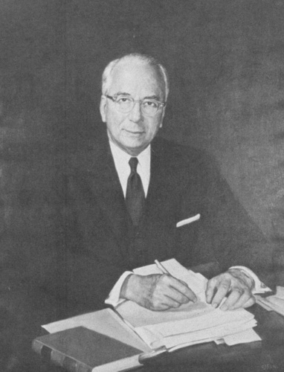
Introduction
Lewis Strauss, Chairman of the U.S.
Atomic Energy Commission (1954
Nuclear power today:
Provides 16% of world’s electricity
  19% in U.S.
  77% in France
  54% Belgium
  26% Germany
  46% Sweden
  4% Netherlands
69% of U.S. non-carbon electricity generation
About 439 plants in the world
  147 in European Union (200+ in Europe)
  104 in U.S.
    None built in US since the 1970s
    Small budgets for nuclear R&D
“It is not too much to expect that our children will enjoy in their homes [nuclear generated] electrical energy too cheap to meter.”

Slide 5
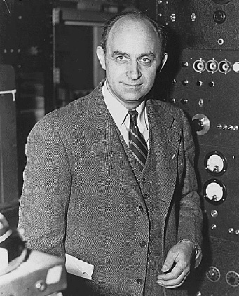
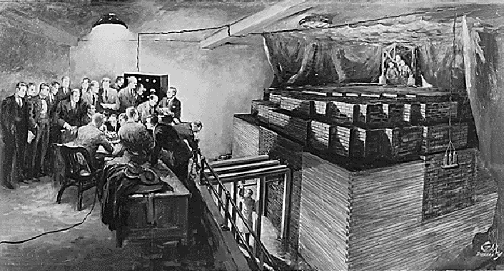
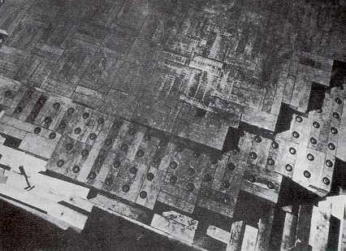
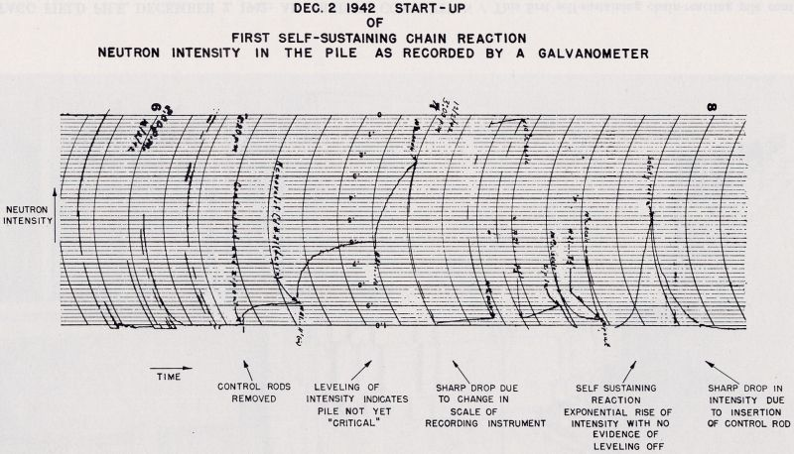
Early beginnings
Enrico Fermi
Chicago, Dec. 2, 1942
Criticality reached

Slide 6
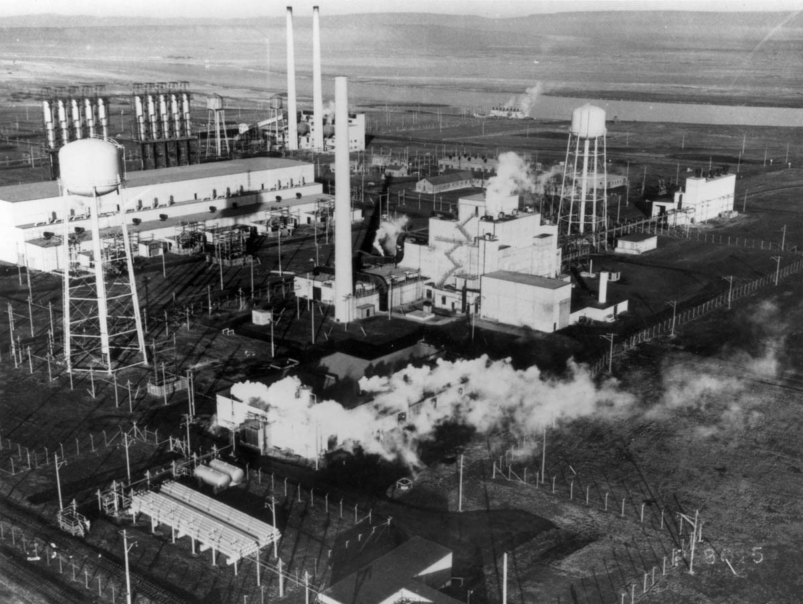
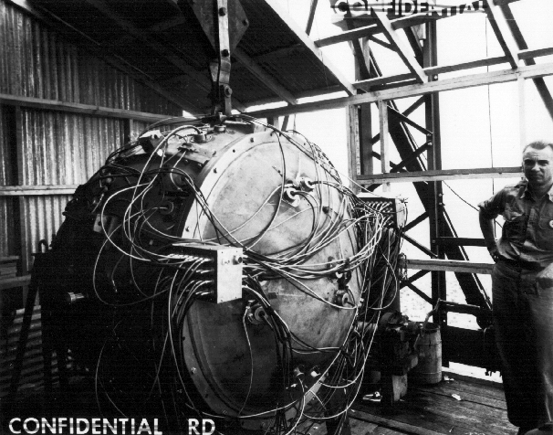
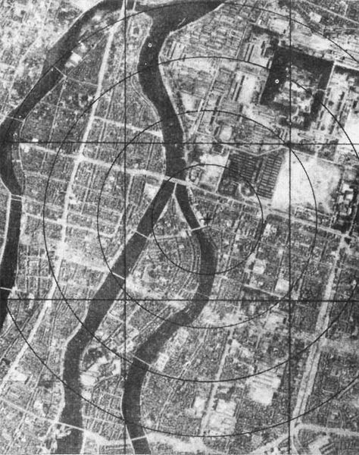
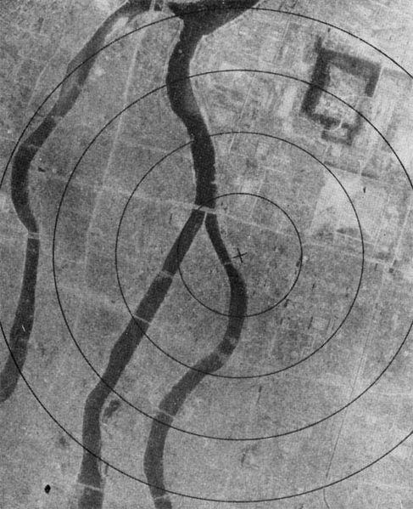
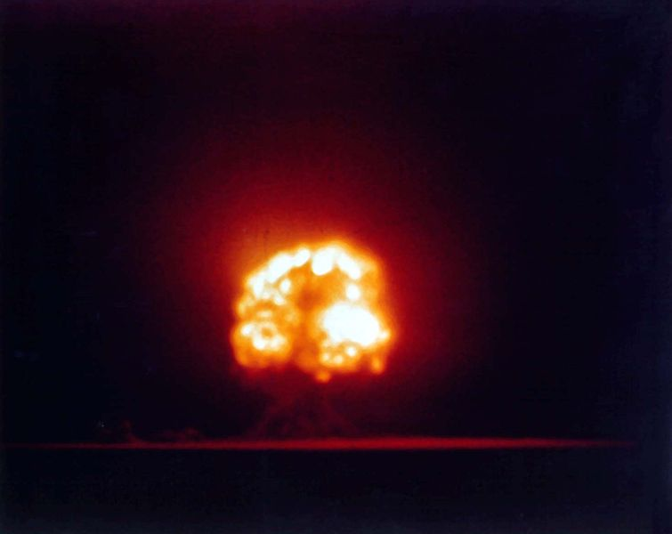
Early beginnings
Manhattan project
Plutonium production
Reactor B in Hanford
Trinity: the gadget
Nagasaki bomb

Slide 7
Early beginnings
Atomic Energy Commission (AEC) established by Congress in 1946 as part of the Atomic Energy Act
AEC authorized the construction of Experimental Breeder Reactor I ( EBR-1) at a site in Idaho in 1949
in August of 1951, criticality (a controlled, self-sustained, chain reaction) was reached using uranium
A football sized core was created and kept at low power for four months until December 20, 1951
power was gradually increased until the first usable amount of electricity was generated, lighting four light bulbs and introducing nuclear generated power for the first time
In 1953, the EBR-1 was creating one new atom of nuclear fuel for every atom burned, thus the reactor could sustain its own operation
With this creation of new cores, enough energy was created to fuel additional reactors
A few years later, the town of Arco, Idaho became the world's first community to get its entire power supply from a nuclear reactor
This was achieved by temporarily attaching the town’s power grid to the reactor’s turbines

Slide 8
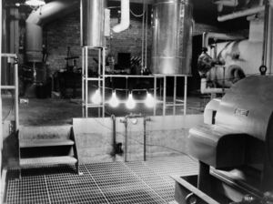
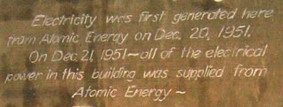
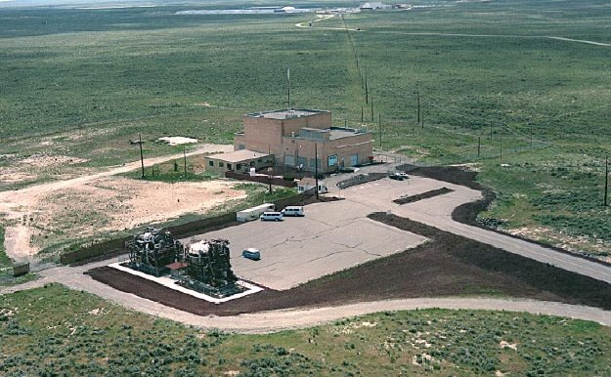
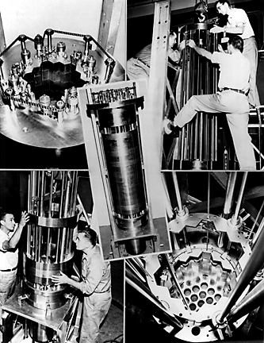
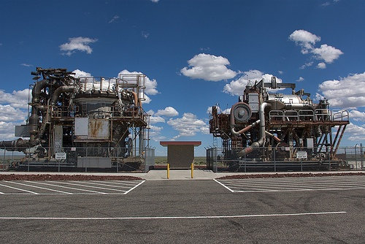
EBR – 1 at Idaho (1951)

Slide 9
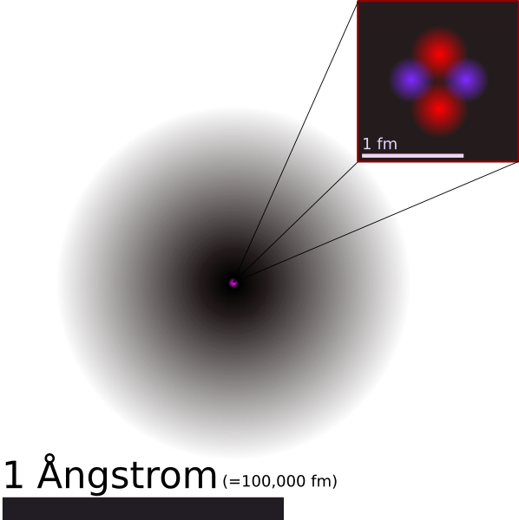
Basic knowledge about atom
Atoms
The smallest particle (10⁻¹⁰ m or 0.1 nm) of an element that still retains the characteristics of the element.
An atom has a very small size (10⁻¹⁵ m) nucleus surrounded by negatively charged electrons.
Nucleus consists of protons (positively charged) and neutrons.
Proton and neutron have about the same mass that is very larger than electron’s. So an atom's mass is essentially the mass of its nucleus.

Slide 10
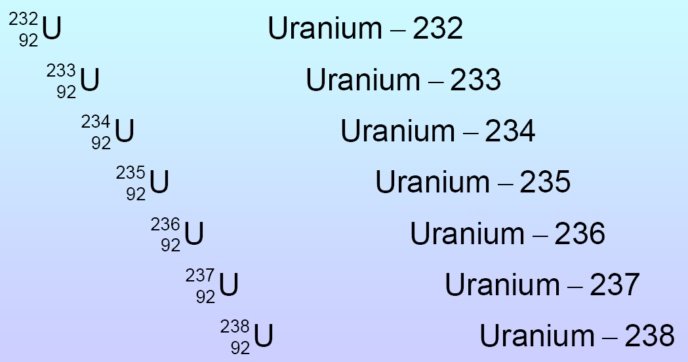
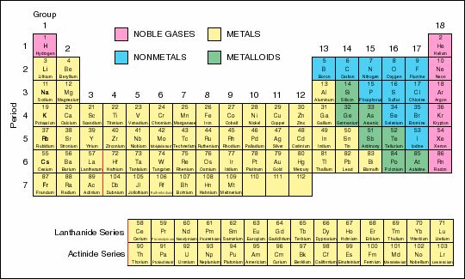
Binding energy and nuclear stability
The number of protons (the atomic number) determines which element it belongs to.
Nuclide: a specific nuclear configuration
Isotopes: atoms with the same atomic number but different number of neutrons, e.g., ²³⁵U and ²³⁸U.
Electron configuration
Use diagonal rule
1s
2s | 2p
3s | 3p | 3d
4s | 4p | 4d | 4f
5s | 5p | 5d | 5f
6s | 6p | 6d
7s

Slide 11
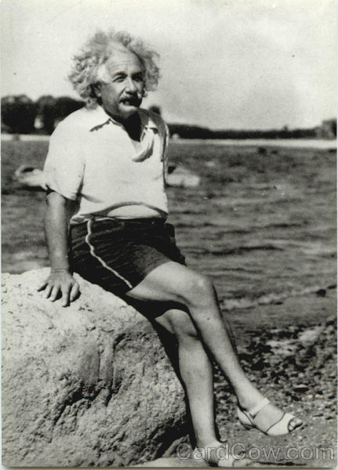
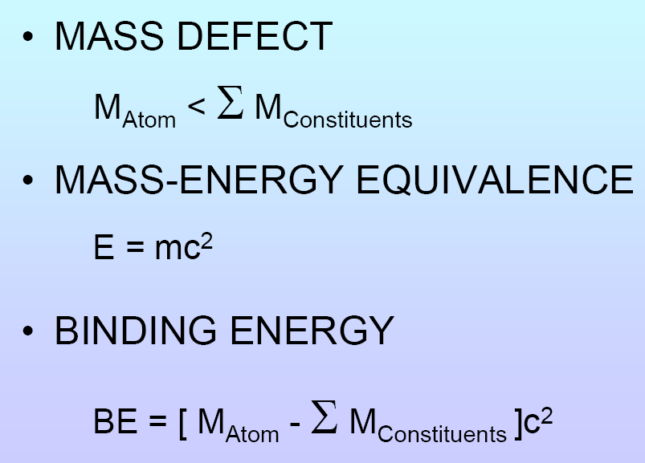
Binding energy
Nuclear force needed to overcome repulsive force between protons
It is strong and short-ranged

Slide 12
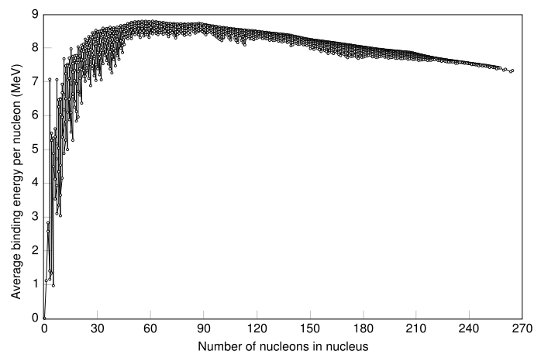
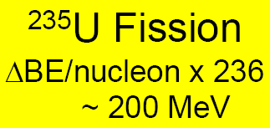
Binding energy per nucleon
DBE
Fission products

Slide 13
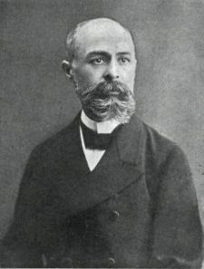

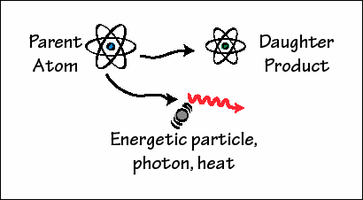
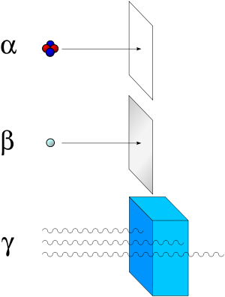
Radioactive decay
Some elements will spontaneously turn into other elements. This is called radioactivity and was discovered in 1896 by Henri Becquerel.
It happens randomly and the probability only depends on the structure of the nucleus (isotope).
Scientists use half-life to describe the probability of decay.
dN=-lN(t)dt → N(t)=N₀e^{-lt}
t = 1/l en t_{1/2}=t ln2
1903

Slide 14
Radioactive decay
Example: ²³⁸U ²⁰⁶Pb + 8 ⁴He + 6ß
The half-life T_{1/2} of ²³⁸U is about 4.5 billion years.
The graph shows the number of ²³⁸U and ²⁰⁶Pb at time t
N₂₀₆(t) = N₀-N₂₃₈(t)
N₂₃₈(t) = N₀/2 ^{t/T}

Slide 15
Radioactive dating
²⁰⁶Pb/²³⁸U = 2^{t/T} - 1
This can be used in the opposite way: if we can count how much daughter isotope in the sample as compared to the parent isotope we can get the age of the sample
t = T log₂ (²⁰⁶Pb/²³⁸U + 1)
This method is called radioactive dating.
By using it, we find that Earth is ~4.5 Ga old.

Slide 16
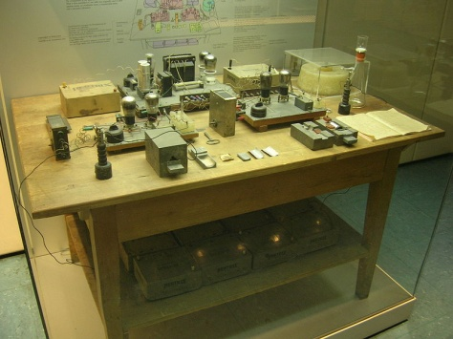
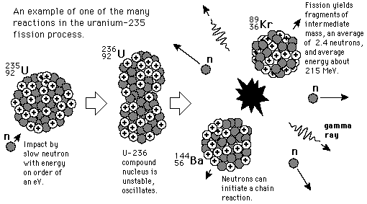
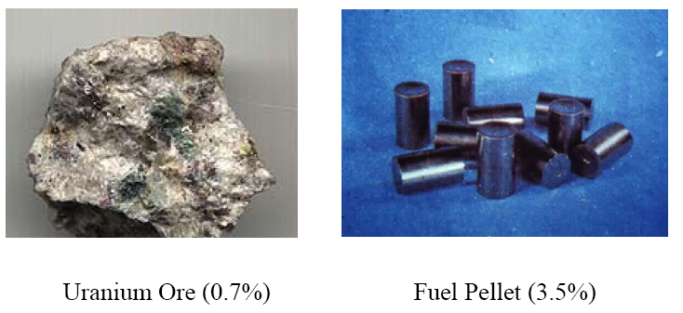
Neutron induced decay: fission of ²³⁵U
Neutron induced nuclear fission of heavy nuclei was predicted by Enrico Fermi and discovered by Otto Hahn, Lise Meitner and Fritz Strassmann (Dec.1938)
Change of elements: create gold from lead ...
Traces of Barium found
Energy release in fission of uranium

Slide 17
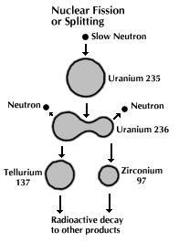
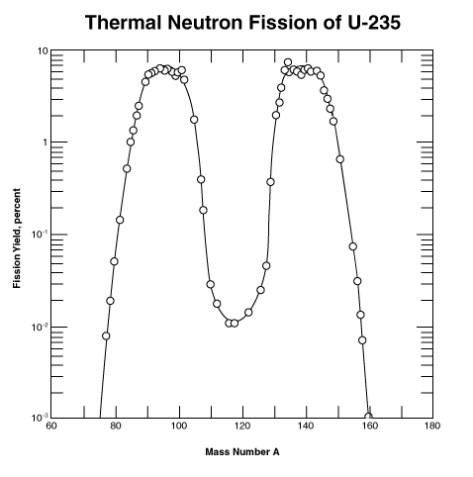
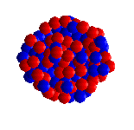
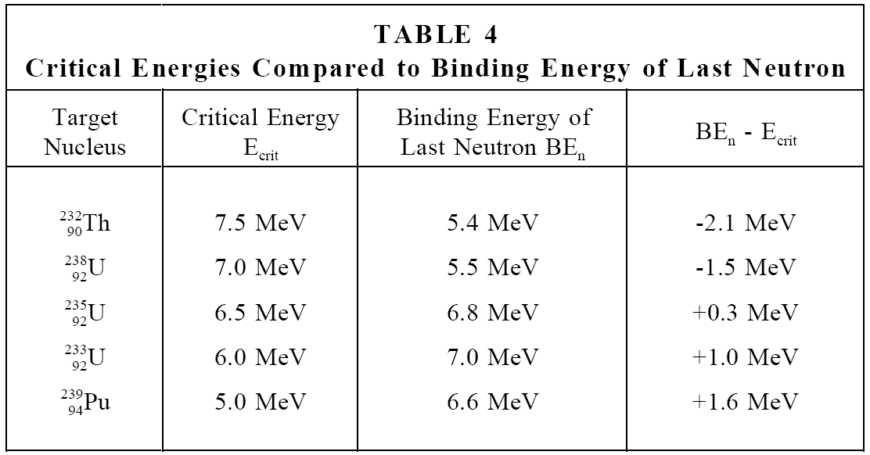
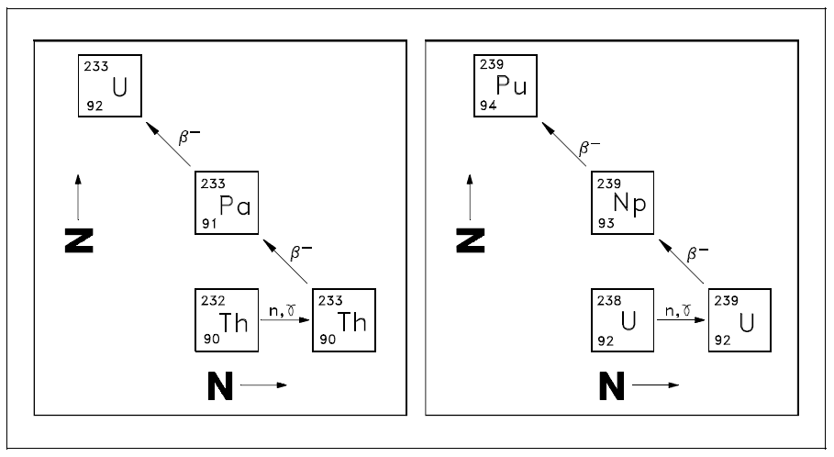
Neutron induced decay: fission of ²³⁵U
Fission of heavy nuclei be understood in terms of liquid drop model
Energy of excited state = BE of initial nucleus + kinetic energy of neutron
When E_{exc} > E_{crit} then nucleus fissions
Breeding: Fertile material becomes fissile through transmutation
Excite oscillations by neutron capture
Fission by thermal neutrons possible

Slide 18
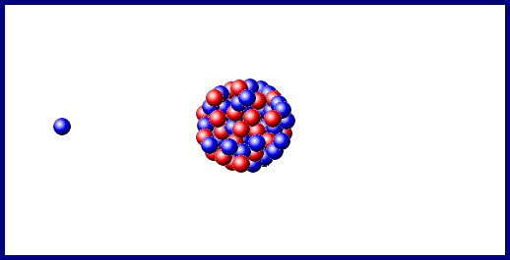
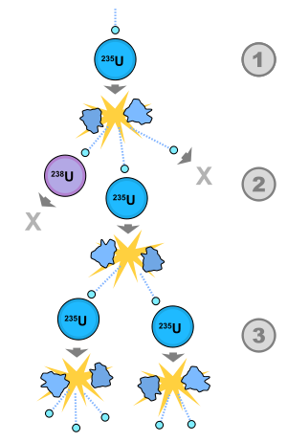
Nuclear chain reaction
For ²³⁵U and ²³⁹Pu, one fission takes one neutron and produces 2.4 neutrons on average. The produced neutrons can be used to split more ²³⁵U and start a chain reaction
To sustain the chain reaction, it is necessary to have many fissionable atoms around to catch neutrons.
The smallest amount of fissile material is called critical mass.
The critical mass depends on the density of the material and how easy for ²³⁵U to capture a neutron.
Inside a nuclear power plant, the reaction is controlled by absorbing neutrons and moderating their speed.
Slow neutrons can be captured more easily so nuclear power plants can use low-grade uranium (a few per cent in ²³⁵U) as fuel.
Fission of one ²³⁵U atom releases energy of 235 × 0.85 MeV/nucleon = 235 × 0.85 × 1 10⁶ × 1.6 10⁻¹⁹ = 3.2 10⁻¹¹ J.
235 gram of ²³⁵U has 6.0 10²³ atoms (Avogadro’s number). Thus 1 kg of uranium enriched to 3% in ²³⁵U has a yield of
0.03 × 1,000/235 × 6.0 10²³ × 3.2 10⁻¹¹ = 2.4 10¹² J =2,450 GJ.
Coal: C + CO CO₂ + 4.2 eV = 7 10⁻¹⁹ J
50 million times less per atom than nuclear fission.

Slide 19
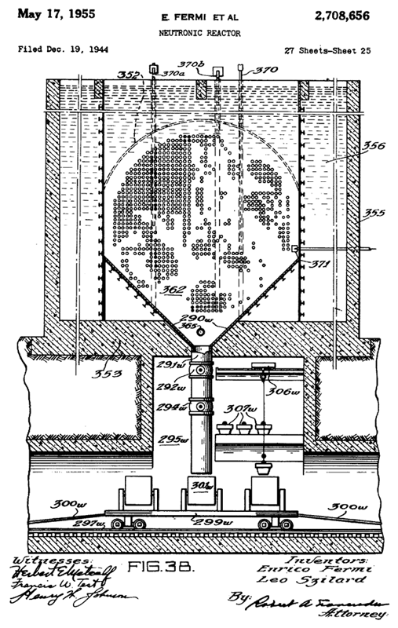
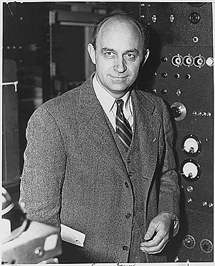
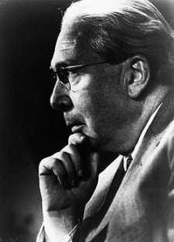
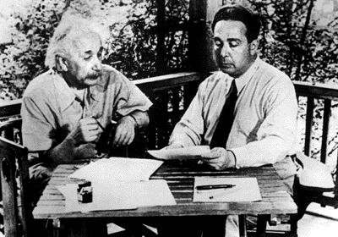
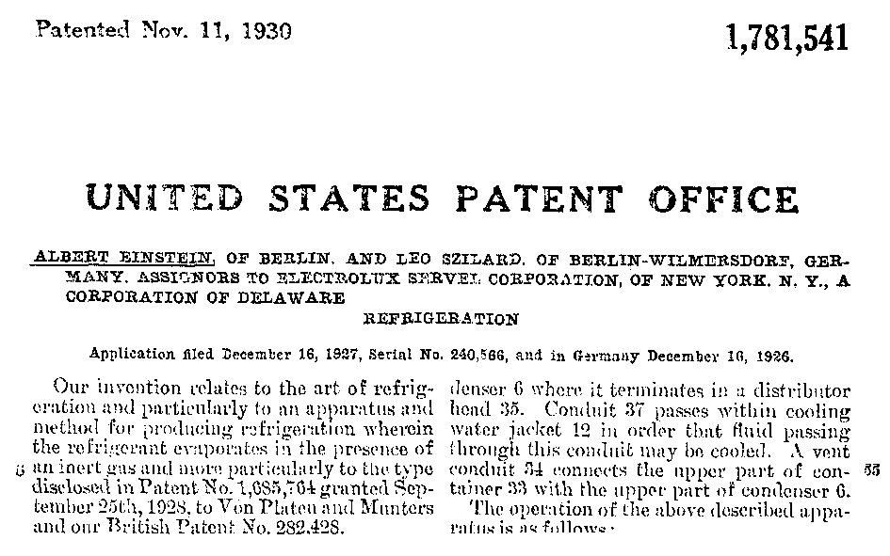
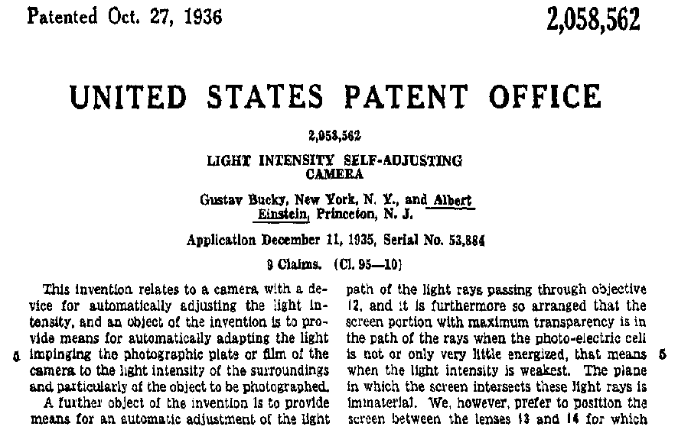
Patents
Enrico Fermi & Leo Szilard (1955) US PATENT 2,708,656

Slide 20
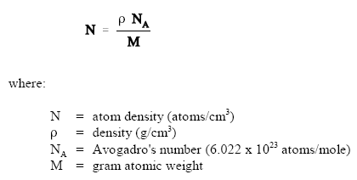
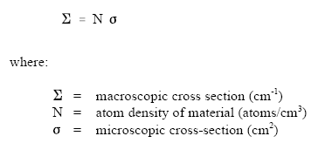
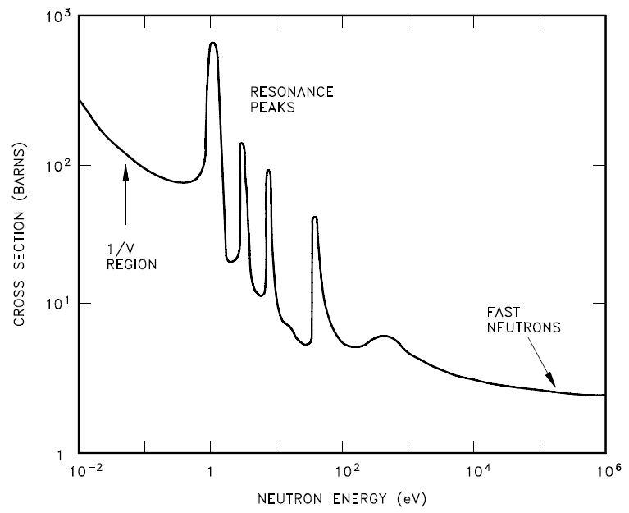



Reactor theory: neutron cross sections
Atom density (N) is the number of atoms of a given type per unit volume of material.
Microscopic cross section (s) is the probability of a given reaction occurring between a neutron and a nucleus.
Microscopic cross sections are measured in units of barns, where 1 barn = 10⁻²⁴ cm².
Macroscopic cross section (S) is the probability of a given reaction occurring per unit length of travel of the neutron. The units for macroscopic cross section are cm⁻¹.
Total: absorption + scattering
Scattering: elastic + inelastic
Absorption: fission + capture

Slide 21
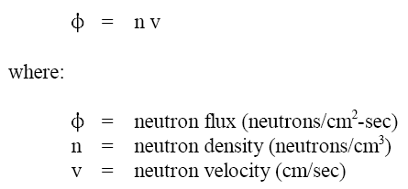
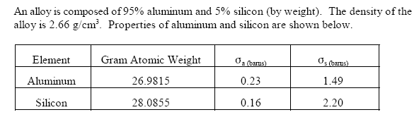
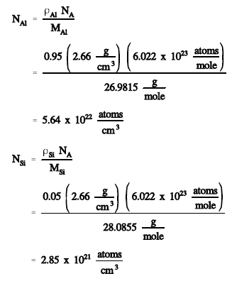
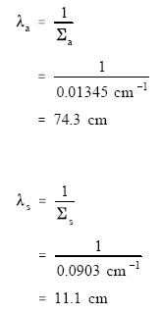
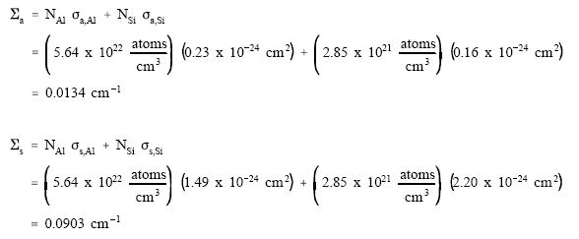
Reactor theory: neutron flux and mfp
The mean free path (l) is the average distance that a neutron travels in a material between interactions.
Neutron flux (f = nv) is the total path length traveled by all neutrons in one cubic centimeter of material during one second.
The mean free path equals 1/ S.
The macroscopic cross section for a mixture of materials can be calculated using the equation
S = N₁s₁ + N₂s₂ + N₃s₃ + ....... N_{n}s_{n}
Self-shielding is where the local neutron flux is depressed within a material due to neutron absorption near the surface of the material.
Atom densities
Example
Mfp
Macr. cross sections

Slide 22
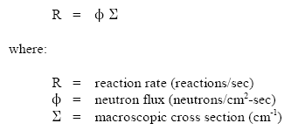




Reactor theory: reaction rates
The reaction rate is the number of interactions of a particular type occurring in a cubic centimeter of material in a second.
The reaction rate can be calculated by the equation R = fS.
Over a period of several days, while the atom density of the fuel can be considered constant, the neutron flux is directly proportional to reactor power.
Power released in a reactor
Fission of one ²³⁵U atom releases energy of 235 × 0.85 MeV/nucleon = 235 × 0.85 × 1 10⁶ × 1.6 10⁻¹⁹ = 3.2 10⁻¹¹ J.
Thus 1 Watt requires 1/ 3.2 10⁻¹¹ = 3.12 10¹⁰ fissions per second.

Slide 23




Reactor theory: moderators
Thermalization is the process of reducing the energy level of a neutron from the energy level at which it is produced (~ 2 MeV) to an energy level in the thermal range (0.025 eV).
The moderator is the reactor material that is present for the purpose of thermalizing neutrons (in as few collisions as possible, without absorbing them). Low A materials are used.
Moderating (MR) ratio is the ratio of the macroscopic slowing down power to the macroscopic cross section for absorption.
The average logarithmic energy decrement (ξ) is the average change in the logarithm of neutron energy per collision.
Macroscopic slowing down power is the product of the average logarithmic energy decrement and the macroscopic cross section for scattering.
There are three desirable characteristics of a moderator.
  large scattering cross section
  small absorption cross section
  large energy loss per collision
The energy loss after a specified number of collisions can be calculated using the equation E_{N} = E₀ (1 – x)^{N} where x is the fractional energy loss per collision.
ξ = DE/E

Slide 24




Reactor theory: prompt and delayed neutrons
Prompt neutrons are released directly from fission within 10⁻¹³ seconds of the fission event.
Delayed neutrons are released from the decay of fission products that are called delayed neutron precursors. Delayed neutron precursors are grouped according to half-life. Half-lives vary from fractions of a second to almost a minute.
The fraction of neutrons born as delayed neutrons is different for different fuel materials. For ²³⁵U: 0.0065 and ²³⁹Pu: 0.0021.
The delayed neutron generation time is the total time from the birth of the fast neutron to the emission of the delayed neutron in the next generation. Delayed neutron generation times are dominated by the half-life of the delayed neutron precursor. The average delayed neutron generation time is about 12.5 seconds.
Delayed neutrons are responsible for the ability to control the rate at which power can rise in a reactor. If only prompt neutrons existed, reactor control would not be possible due to the rapid power changes
Fraction: 0.65 %
Average half life: 12.5 s
Average generation time
Reactor can be controlled

Slide 25






Reactor theory: neutron life cycle
The infinite multiplication factor, k¥, is the ratio of the neutrons produced by fission in one generation to the number of neutrons lost through absorption in the preceding generation.
The effective multiplication factor, k_{eff}, is the ratio of the number of neutrons produced by fission in one generation to the number of neutrons lost through absorption and leakage in the preceding generation.
Critical is the condition where the neutron chain reaction is self-sustaining and the neutron population is neither increasing nor decreasing.
Subcritical is the condition in which the neutron population is decreasing each generation.
Supercritical is the condition in which the neutron population is increasing each generation.
n-²³⁸U
Infinite reactor core (no leakage)
Four-factor formula

Slide 26




Reactor theory: thermal utilization factor
Thermal utilization factor
U, m and p for uranium, moderator and poison
Homogeneous reactor (same flux and volume everywhere)

Slide 27





Reactor theory: reproduction factor
Reproduction factor
When core contains ²³⁵U and ²³⁸U

Slide 28




Reactor theory: effective multiplication factor
Effective multiplication factor
Fast non-leakage probability
Thermal non-leakage probability
Total non-leakage probability depends on coolant temperature with negative temperature coefficient.
As coolant temperature rises, the coolant expands. Density of the moderator is lower; there neutrons travel farther while slowing down.
Six factor formula

Slide 29

Neutron life cycle for k_{eff}=1 in a thermal reactor
Enrichment affects thermal utilization and reproduction factor, and resonance escape probability
Life cycle in a fast breeder reactor is different.
Thermalization is minimized and almost all fissions take place by fast neutrons.

Slide 30


PWR – Pressurized water reactor
PWR most common reactor type (~1 GW) with thermal efficiency ~30 %.
Keep water under pressure (~15 MPa) so that it heats (~315 ºC), but does not boil.
Water from the reactor and the water in the steam generator (~5 Mpa) never mix. In this way, most of the radioactivity in the reactor area.
Use enriched uranium as fuel.
Fuel in rods increases resonance escape probability p and fast fission factor e.

Slide 31


Pressurized water reactor

Slide 32




PWR – Reactor control
Reactivity: If there are N₀ neutrons in the preceding generation, then there are N₀(k_{eff}) neutrons in the
present generation. The numerical change in neutron population is (N₀k_{eff} – N₀). The relative change, reactivity is
The number of neutrons present in the core after a given number of generations is
Effect of fuel temperature
Amount of moderator influences product pf
  Thermal utilization factor: fraction f of thermal neutrons absorbed on U rather than moderator.
  Resonance escape probability: The fraction p of neutrons that escape resonance capture on ²³⁸U and manage to slow down to thermal energies.

Slide 33





PWR – Reactor control
The reactor period is defined as the time required for reactor power to change by a factor of "e," where "e" is the base of the natural logarithm and is equal to about 2.718.
The reactor period is given by
Stable operation (no prompt term and stable reactivity in core)

Slide 34


Power plant

Slide 35


Fuel assembly

Slide 36

PWR core

Slide 37


Reactor vessel

Slide 38


Reactor vessel

Slide 39


Reactor core containment

Slide 40

Reactor core containment

Slide 41


Cooling water systems

Slide 42


Cooling water systems

Slide 43


BWR – Boiling water reactor
In BWRs, the water heated by fission actually boils and turns into steam to turn the generator.
Simpler design and lower operating pressure (7.5 Mpa and 285 ºC in core), thus more commercially attractive.
Natural water circulation is used.
Lower radiation load on reactor vessel.
Much larger pressure vessel than PWR at same power.

Slide 44

BWR

Slide 45

BWR fuel

Slide 46

BWR water

Slide 47

BWR heat removal

Slide 48

BWR emergency core cooling

Slide 49


BWR buildings

Slide 50

BWR buildings

Slide 51


Magnox and UNGG reactors
Used in UK (26 units). Now obsolete type, but 2 in operation. Used for power and plutonium production. Magnox is now realized in N. Korea.
Pressurized, CO₂ gas cooled, graphite moderated, natural uranium as fuel. Similar to France UNGG reactor: Uranium Naturel Graphite Gaz
Coolant is a gas, so explosive pressure buildup from boiling (Chernobyl) is not possible.
Magnesium non-oxidizing.

Slide 52

MSR – Molten salt reactor
Generation IV reactor: primary coolant is a molten salt.
Nuclear fuel dissolved in the molten fluoride salt coolant (LiF and BeF₂) as uranium tetrafluoride UF₄. Graphite core serves as the moderator.
Low pressure: makes design simpler and safer, high temperature cooling: makes turbines more efficient.
Compact: MSRE study to power aircraft.
Inherently safe, but immature technology. Pressure explosion impossible, meltdown proof.
Molten salt thorium breeders possible (thorium is abundant and cheap). Can operate decades without refueling.
Co-locate with reprocessing facility.

Slide 53


Gabon natural fission reactors
Predicted by Paul Kuroda (Univ. of Arkansas) (1956).
Fifteen natural reactors found (in 1972) at the Oklo mine in Gabon.
Nuclear fission reactions took place 1.5 billion years ago, and ran for a few hundred thousand years (100 kW).
Uranium-rich mineral deposit became inundated with groundwater that acted as a neutron moderator.
Extensively studied by scientists interested in geologic radioactive waste disposal.
Geological situation in Gabon leading to natural nuclear fission reactors
1. Nuclear reactor zones
2. Sandstone
3. Uranium ore layer
4. Granite

