Slide 1
GW scenario
Hilversum; December 6, 2015; jo@nikhef.nl

Slide 2
Background information
The international hunt for gravitational waves is on
Significant investments worldwide
    LIGO, Virgo, GEO600, KAGRA interferometers
    Approval eLISA project door European Space Agency (ESA)
    Studies for Einstein Telescope project
Instruments now have the sensitivity to allow first detection
  100 years after Einstein’s General Relavity
  Measurements of vibrations of space and time itself
    Opening a new window on the Universe
    Up to now mostly electromagnetics observations have been done, e.g. with light, X-rays, infrared, radio waves, etc. while the Universe only for a few percent consists of components subject to electromagnetic interactions
    Universe is 70% dark energy, and 25% dark matter (we do not know what this is)
    With gravitational waves (GWs) one in principle can observe everything that has mass, energy, and momentum
    For example black holes

Slide 3
Project definition
Prepare a series of short films (from 30 to 60 seconds and up to 5 minutes) that we can hand over to the press during press release. This will help reporters showcase their stories
An outline of these stories will be made in close contact with a few key persons: EGO Federico - Ferrini, Nikhef - Jo van den Brand
It will cover:
  What do people need to know to understand the importance of GW?
  How / where are we hunting for the waves?
  The struggle of the hunt
  Animations, different sites, some of the key people
These films will be part of a documentary about the hunt for gravitational waves, to be broadcasted later in 2016 (length up to 1 hour)
The look and feel is to bring science to a bigger audience

Slide 4
Project definition
Create a documentary for a broad target public which gives insight in the hunt for gravitational waves. One that shows the importance of the way we look at the Universe
For Virgo: ensure that Virgo’s role in the quest for GWs is highlighted
For Nikhef: ensure that Dutch contributions receive sufficient attention
Explain the technology/instrumentation challenges facing our scientists
The hunt for GWs takes place in various locations worldwide, but also in space. Provide an overview and sketch the future playing field
Think about:
  LIGO and Virgo sites
  The launch of LISA Pathfinder
  the Einstein Telescope project
  International context: KAGRA, Indigo, PTA, atom interferometers, …
Provide insight to the intensive global cooperation, by shooting at various locations

Slide 5
Story line documentary
History and context
  Space, time, spacetime, relativity, Einstein’s GR, BHs, GWs
Present
  The quest for GWs with our large instruments
  Understanding of GR
The impact of detection
  Why do we do this? A completely new tool for science
  Start of the new field of gravitational astronomy
Future
  Advanced LIGO and Virgo, KAGRA, Indigo
  Einstein Telescope in context
  eLISA

Slide 6
Cast (proposal)
History and context
  Robbert Dijkgraaf
  Gerard ‘t Hooft
  Jan Willem van Holten
  Adalberto Giazotto
  Rai Weiss
Present situation
  Fulvio Ricci
  Gaby Gonzalez
  Giovanni Losurdo
  Bas Swinkels
  Luciano Rezzolla
  Chris Van Den Broeck
Impact of GW discoveries
  Federico Ferrini
  Kip Thorne
  Frank Linde
Future plans
  Michele Punturo
  Karsten Danzmann
Einstein Telescope
  Bjorn Vink
  Maria Bader

Slide 7
Cast
History and context
  Robbert Dijkgraaf
  Gerard ‘t Hooft
  Jan Willem van Holten
  Adalberto Giazotto
  Rai Weiss

Slide 8
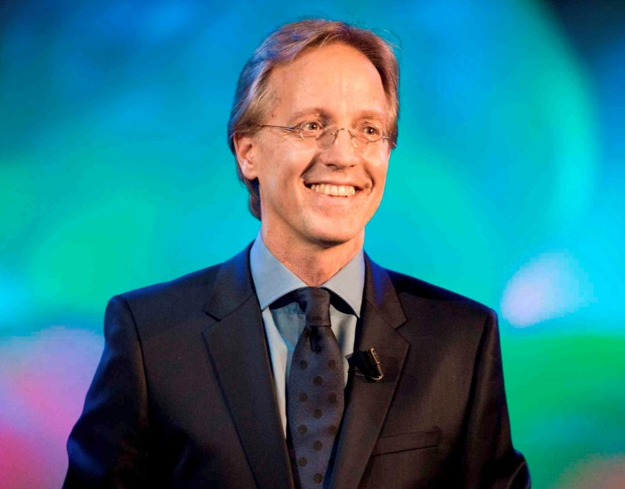
Cast
History and context
Robbert Dijkgraaf
Robertus Henricus "Robbert" Dijkgraaf is a Dutch mathematical physicist and string theorist
Director and Leon Levy professor at the Institute for Advanced Study in Princeton
Professor at the University of Amsterdam
Filmed at NEMO, Amsterdam
December 4, 2015

Slide 9
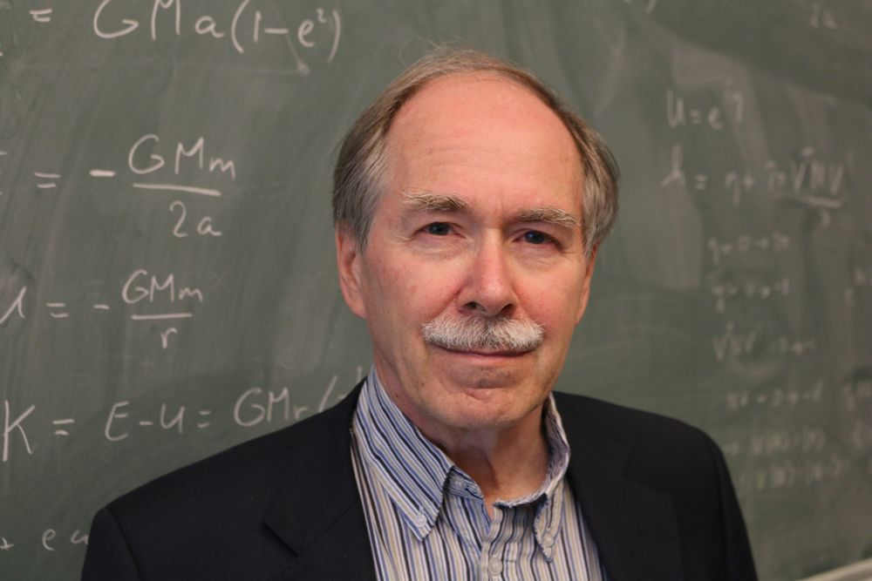
Cast
History and context
Gerard ‘t Hooft
Gerardus 't Hooft is a Dutch theoretical physicist and professor at Utrecht University, the Netherlands
He shared the 1999 Nobel Prize in Physics with his thesis advisor Martinus Veltman
Einstein’s General Relativity
Under consideration

Slide 10
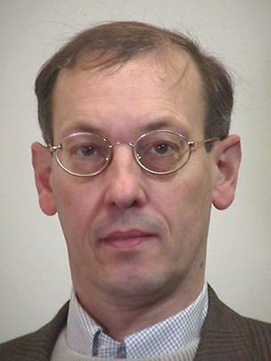
Cast
History and context
Jan Willem van Holten
Jan Willem van Holten is a Dutch theoretical physicist and professor at Leiden University, the Netherlands. Also on the scientific staff at Nikhef
Leiden had long and deep connections with Einstein
Theoretical work on GWs
Under consideration

Slide 11
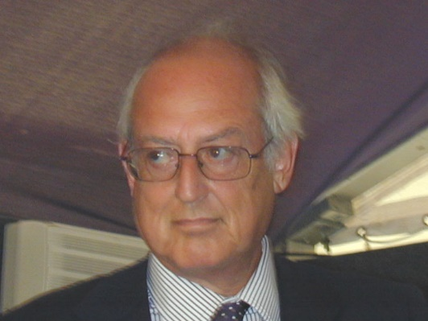
Cast
History and context
Adalberto Giazotto
Professor at Pisa University
Initiator with Alain Brillet of the Virgo experiment
Former spokesman for Virgo
Can explain why interferometers have been chosen. Why Virgo was built in Italy, etc.
I propose to interview him in December 2015
Since he has a famous collection of crystals, we may try to take advantage of this
I also have a suggestion for the background music …

Slide 12
Cast
Present situation
  Fulvio Ricci
  Gaby Gonzalez
  Giovanni Losurdo
  Bas Swinkels
  Luciano Rezzolla
  Chris Van Den Broeck

Slide 13
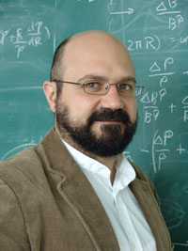
Cast
Present
Luciano Rezzolla
Chair of Theoretical Astrophysics, Institute of Theoretical Physics, Frankfurt, Germany
Relativistic astrophysicist who uses Einstein’s theory of general relativity to describe and explain high-energy astronomical observations of black holes and neutron stars
Beautiful simulations on formation and merger of black holes, gravitational radiation emission, jets, etc.
Nice movies and animations: http://astro.uni-frankfurt.de/rezzolla/
Can explain in detail the physics that happens during a black hole merger
Under consideration

Slide 14
Cast
Impact of GW discoveries
  Federico Ferrini
  Kip Thorne
  Frank Linde

Slide 15
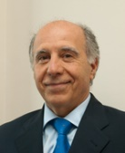
Cast
Impact of GW discoveries
Federico Ferrini
Professor at Pisa University, Italy
Director of the European Gravitational Observatory – EGO that hosts the Virgo interferometer. EGO also manages the Einstein Telescope initiative
Under consideration

Slide 16
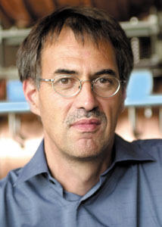
Cast
Impact of GW discoveries
Frank Linde
Professor at University of Amsterdam, the Netherlands
Chair of the General Assembly of the Astroparticle Physics European Consortium ApPEC
Under consideration

Slide 17
Cast
Einstein Telescope
  Bjorn Vink
  Maria Bader

Slide 18
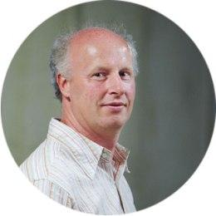
Cast
Einstein Telescope
Bjorn Vink
Geologist, Province Limburg, Netherlands
Geologist and hydrologist with expertise on the geology of Limburg, the southern most province of the Netherlands
Collaborates in site studies for Einstein Telescope in the Netherlands, Belgium and Germany
See https://www.youtube.com/watch?v=pAahAoQKVN4
Filmed in Limburg
November 25, 2015

Slide 19
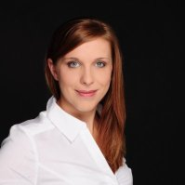
Cast
Einstein Telescope
Maria Bader
PhD student at Nikhef
Active in seismic studies at candidate sites for Einstein Telescope. Networks for gravity gradient noise subtraction will be part of her PhD work
See https://www.linkedin.com/in/maria-bader-96964aa8
Filmed in Limburg
November 25, 2015

Slide 20
Virgo at the EGO site
December 14 to 16, 2015
Interview with Federico Ferrini (director European Gravitational Observatory EGO)
  Role and importance of international collaboration to realize Virgo
  Ambitions to host ET
Interview Fulvio Ricci (spokesman van Virgo, Prof. in La Sapienza, Roma)
  Importance of Virgo in the hunt for GWs
  Scientific collaboration within Europe, USA, and Japan
Interview Michele Punturo (scientific coordinator Einstein Telescope)
  Scientific importance of ET
  How does he see the future
Interview met Giovanni Losurdo (Advanced Virgo project leader)
  Responsible to get Advanced Virgo online
Interview met Bas Swinkels
  Responsible for commissioning of Advanced Virgo
Interview Adalberto Giazotto (initiator of Virgo, together with Alain Brillet)
Do we have footage of EGO/Tuscany with drone, or helicopter

Slide 21
Logistics
Producer
Budget estimate
IP rights

Slide 22
Producer
Information
  Name: Astrid Serkei
    www.sureas.nl
  Camera man and sound engineer
    Gijs …
  Contacts in The Netherlands
    NTR
      Karel Kuiten, program coordinator
    Kennis van NU
      Arnoud Jaspers, end editor
      Bauer van Straten
      Diederic Jekel, presentor

Slide 23
Budget
Production cost
  Estimate grand total of about k€ 50
  Agreement with producer on bare bone cost of about k€ 30 in case producer has the rights to the documentary, with EGO and Nikhef to promotional material
Nikhef
  Prepared to make about k€ 10 available
  Propose to spend this on takes in The Netherlands
    Dijkgraaf, ‘t Hooft, van Holten, Van Den Broeck, Linde, Vink, Bader, …
EGO
  Funds available via outreach activities
  Propose to spend this on takes in Italy
    Giazotto, Ricci, Losurdo, Ferrini, Punturo, Swinkels
    EGO site and Virgo instrumentation: bench installation
Apply for additional funds
  Filmfonds
    http://www.filmfonds.nl/film-producties/screen-nl/ontwikkeling

Slide 24
IP rights
Proposed agreement
  Virgo promotional material with EGO
    Specify deliverables
  Dutch promotional material with Nikhef
    Specify deliverables
  Documentary with producer

