Slide 1

Kernenergie
HOVO cursus
Jo van den Brand en Gideon Koekoek
www.nikhef.nl/~jo/energie
15 november 2011
Week 8, jo@nikhef.nl

Slide 2
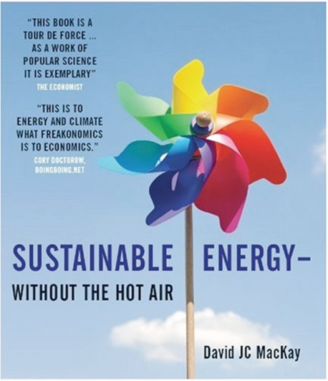
Inhoud
Jo van den Brand
  Email: jo@nikhef.nl URL: www.nikhef.nl/~jo/energie
  0620 539 484 / 020 598 7900, Kamer T2.69
Gideon Koekoek
  Email: gkoekoek@nikhef.nl
Dictaat
  Werk in uitvoering
Boeken
  Energy Science, John Andrews & Nick Jelley
  Sustainable Energy – without the hot air, David JC MacKay
  Elmer E. Lewis, Fundamentals of Nuclear Reactor Physics
Inhoud van de cursus
    Week 1 Motivatie, exponentiële groei, CO2 toename, broeikasteffect, klimaat
    Week 2 Energieverbruik: transport, verwarming, koeling, verlichting, landbouw, veeteelt, fabricage
    Week 3 Energie, thermodynamica
    Week 4 Entropie, enthalpie, Carnot, Otto, Rankine processen, informatie
    Week 5 Kernenergie: kernfysica, splijting
    Week 6 Kernenergie: reactorfysica I
    Week 7 Kernenergie: reactorfysica II
    Week 8 Kernenergie: maatschappelijke discussie (risico’s, afval), kernfusie
    Week 9 Energiebronnen: fossiele brandstoffen (olie, gas, kolen), wind, zon (PV, thermisch, biomassa), waterkracht, geothermisch
    Week 10 Energie: scenario’s voor Nederland, wereld, fysieke mogelijkheden, politiek, ethische vragen, economische aspecten
Gratis te downloaden
With thanks to dr. Stefan Hild, University of Glasgow

Slide 3
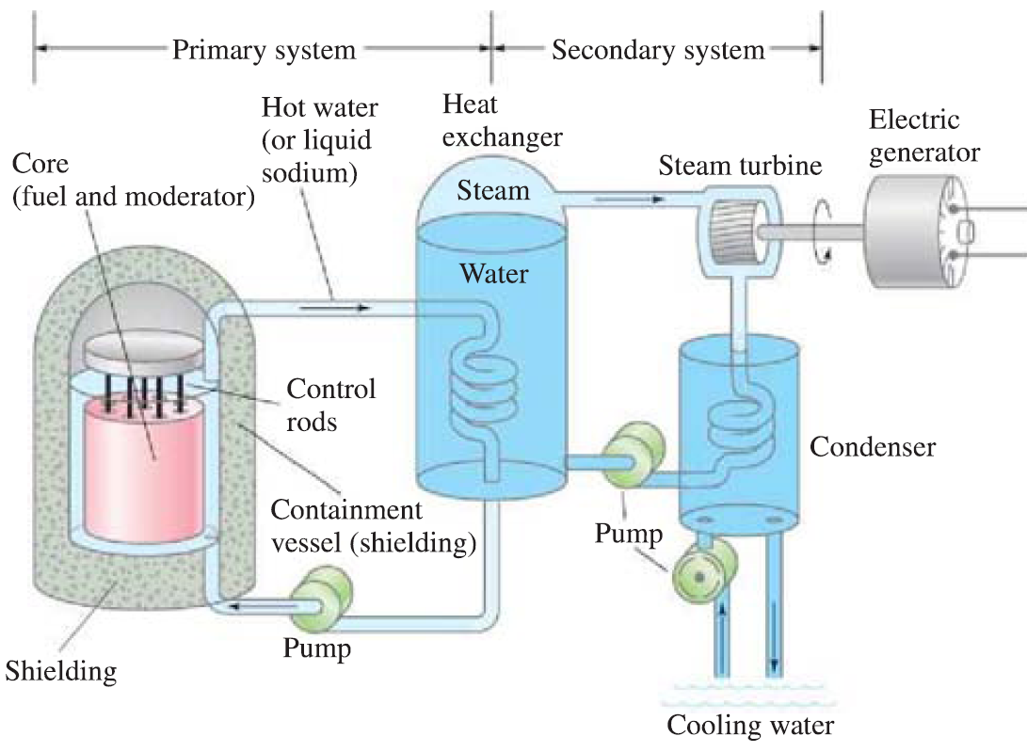
Kernreactor
Stabiel bedrijf vereist multiplicatiefactor k = 1: per reactie moet gemiddeld 1 neutron weer een nieuwe kernsplijting induceren
Subkritisch (superkritisch): k < 1 (k > 1)
Regelstaven van cadmium (of boron) absorberen neutronen en zorgen dat de reactor precies kritisch (k = 1) blijft
Regeling is enkel mogelijk dankzij een kleine fractie (1%) vertraagde neutronen afkomstig van kernverval met levensduur van enkele seconden
Reactor voor onderzoek: neutronenbron voor productie van isotopen
Reactor voor productie van energie
Verrijkt uranium van 2 – 4%
Water of vloeibaar zout onder hoge druk

Slide 4
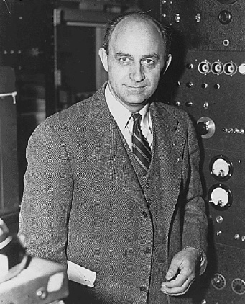
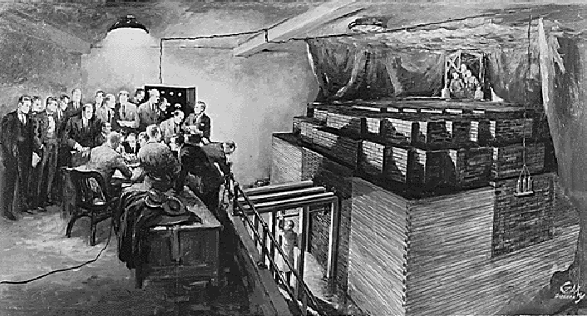
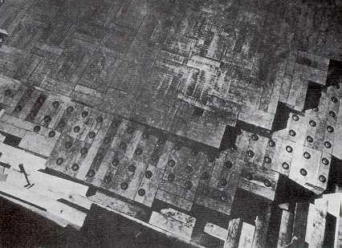
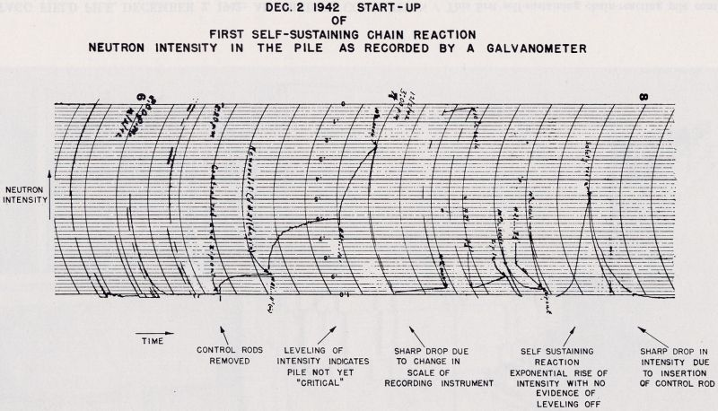
Het begin
Enrico Fermi
Chicago, Dec. 2, 1942
Criticality reached

Slide 5
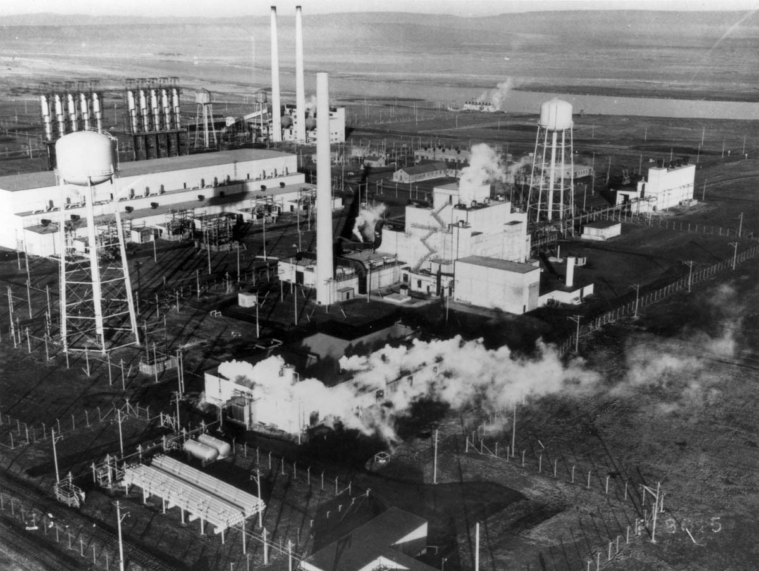
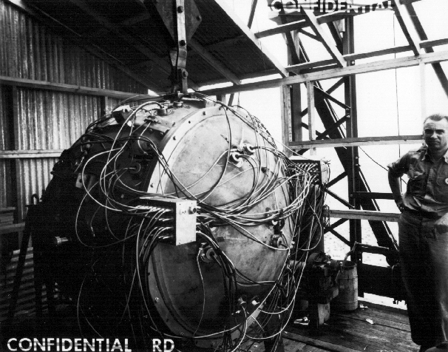
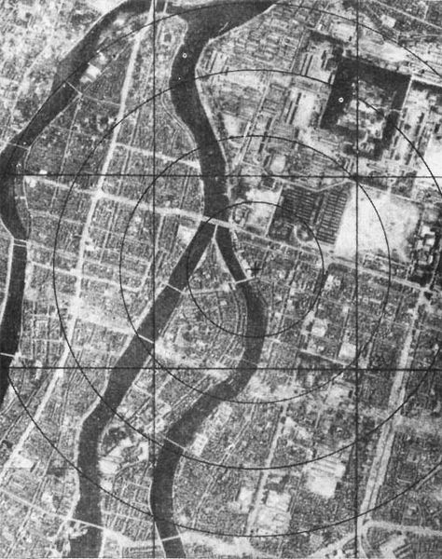
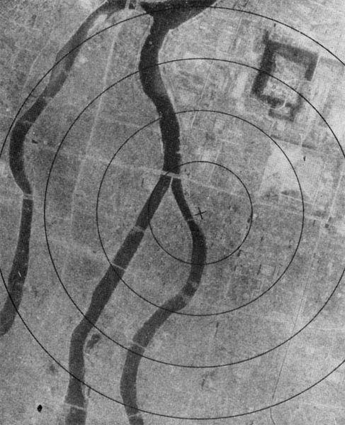
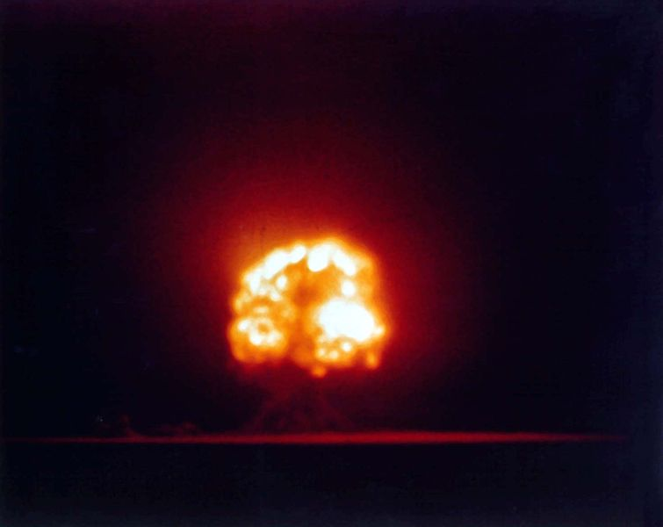
Het begin
Manhattan project
Plutonium productie
Reactor B in Hanford
Trinity: the gadget
Nagasaki bom

Slide 6
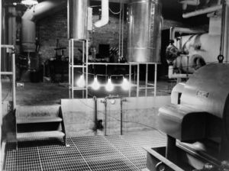
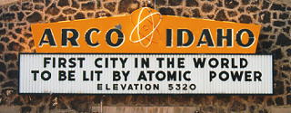
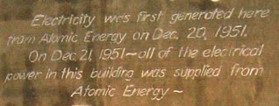
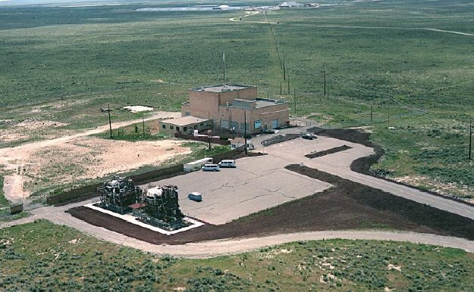
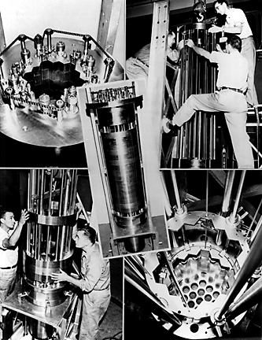
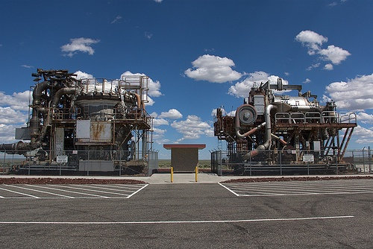
EBR – 1 in Idaho (1951)

Slide 7
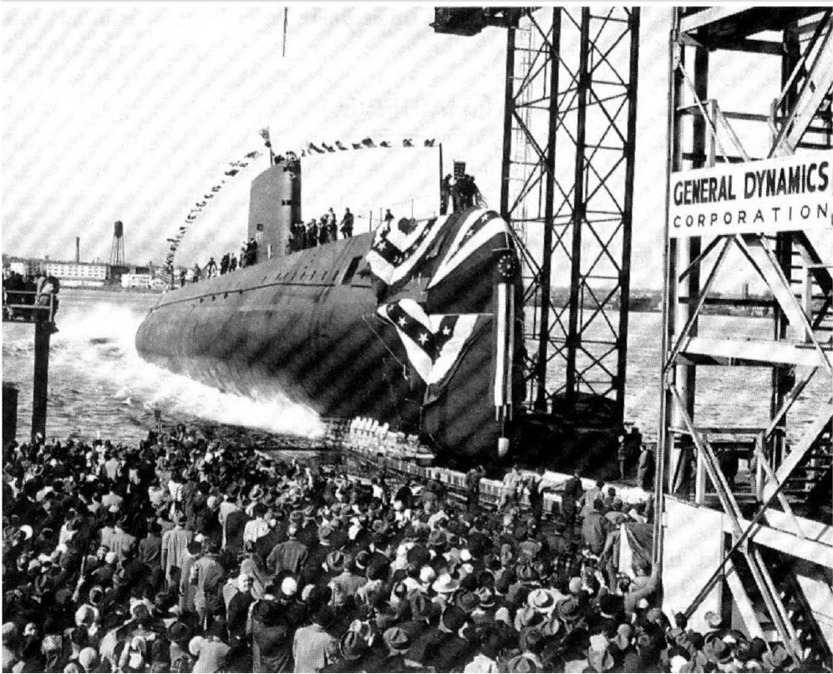
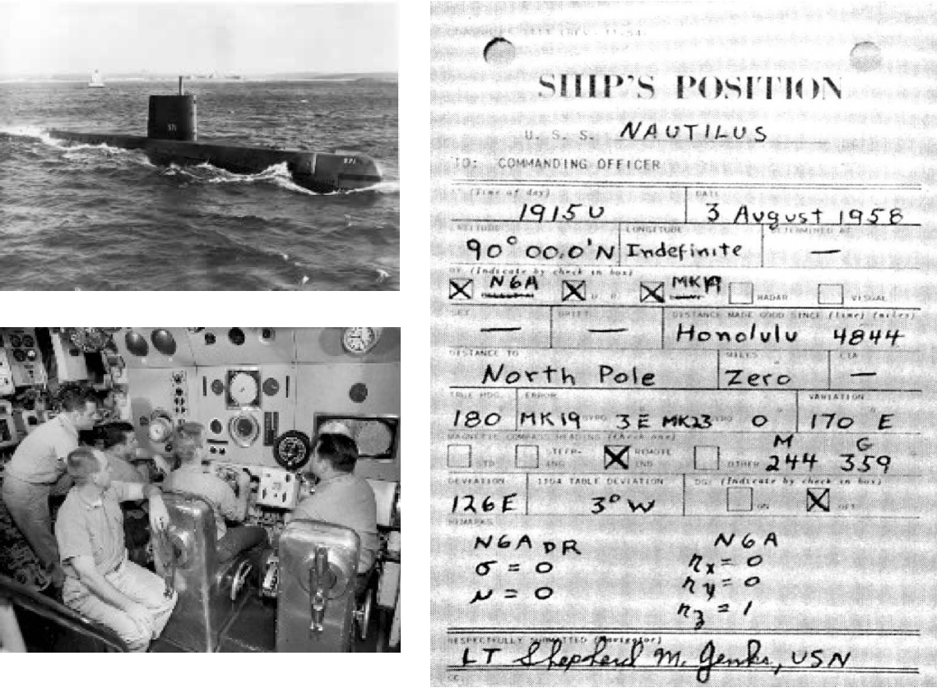
Nautilus (1954)

Slide 8
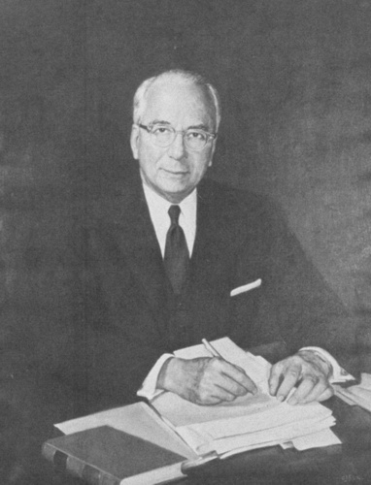
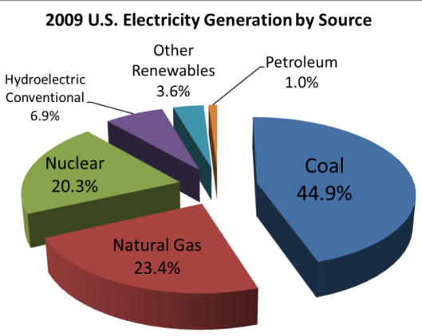
Kernenergie
Lewis Strauss, Chairman of the U.S.
Atomic Energy Commission (1954
Kernenergie vandaag:
Levert 16% van de elektriciteit in de wereld
  20% in USA
  77% in Frankrijk
  54% Belgie
  26% Duitsland
  46% Zweden
  4% Nederland
69% van de non-carbon elektriciteit in USA
Ongeveer 441reactoren in de wereld
  147 in EU (200+ in Europe)
  104 in USA
    Geen gebouwd in USA na 1970s
    Kleine budgetten voor R&D
“It is not too much to expect that our children will enjoy in their homes [nuclear generated] electrical energy too cheap to meter.”

Slide 9
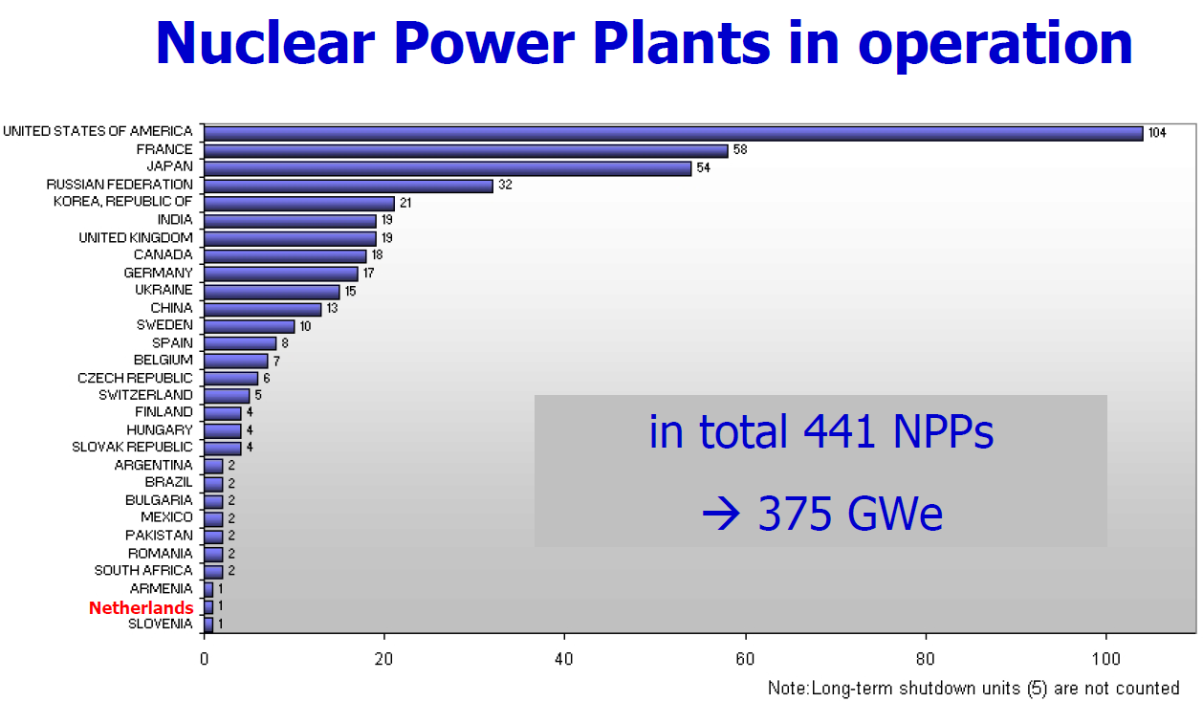
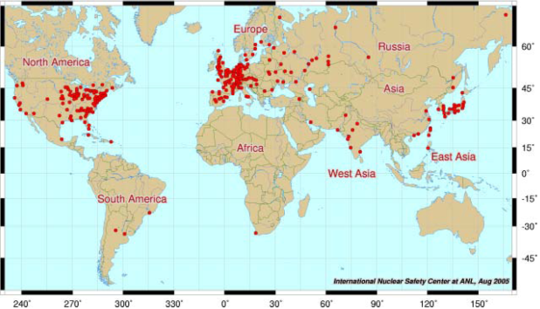
Alle reactoren in de USA zijn gebouwd in ongeveer 25 jaar

Slide 10
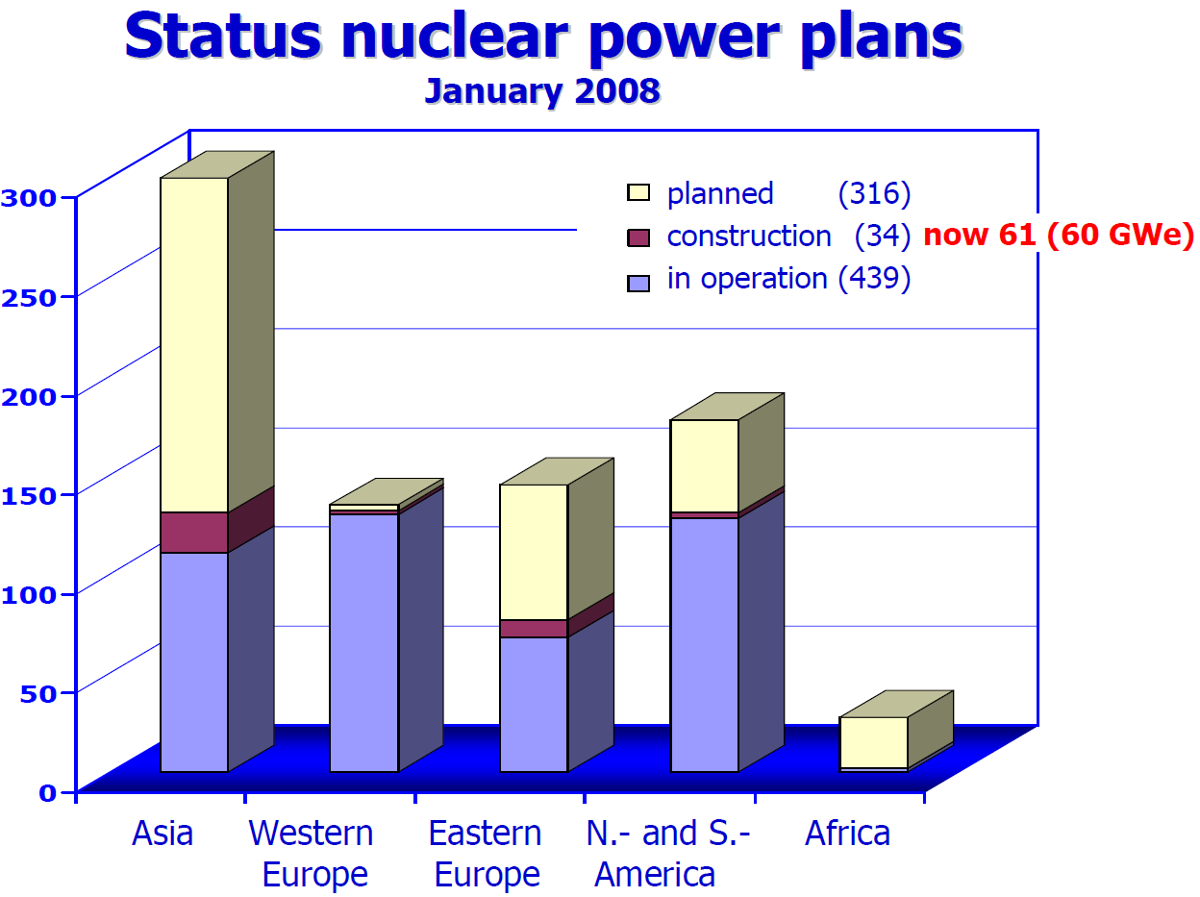

Slide 11
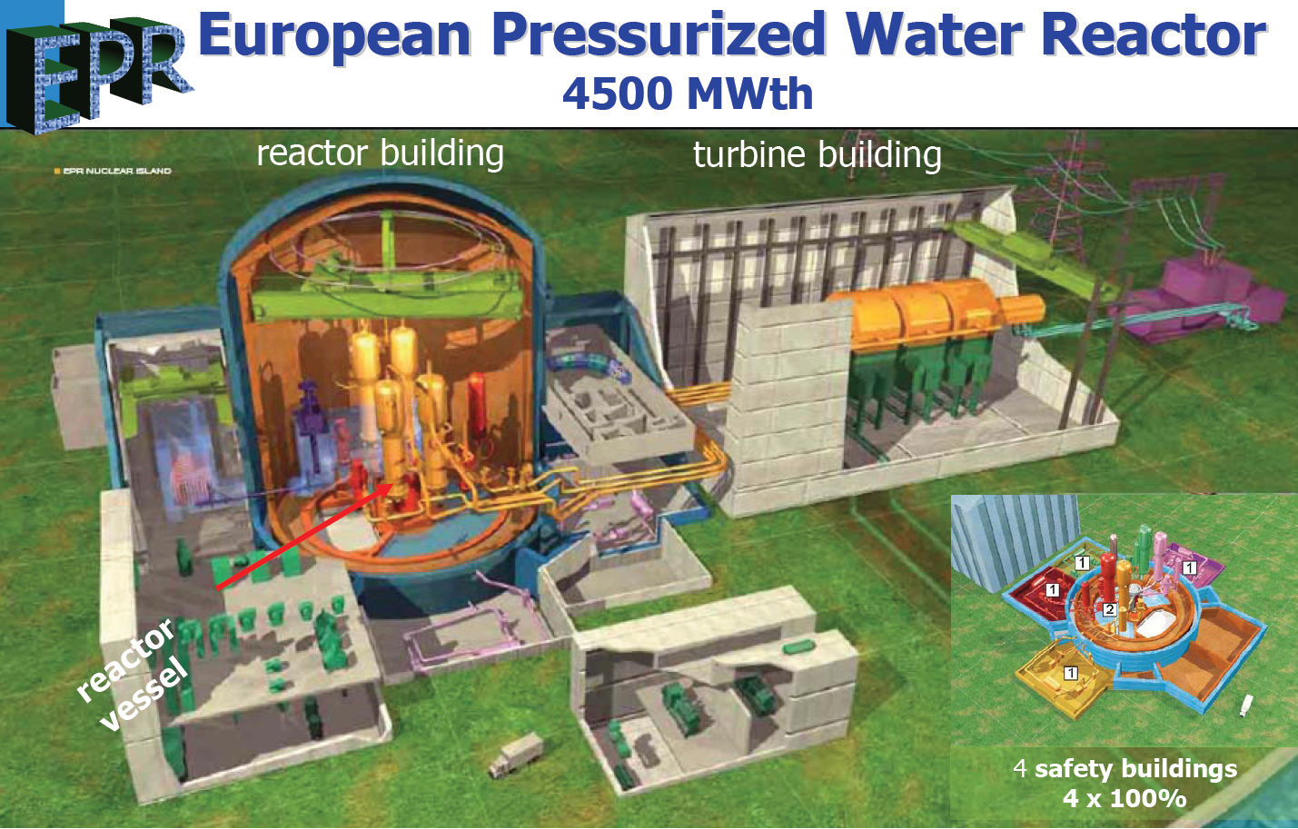

Slide 12
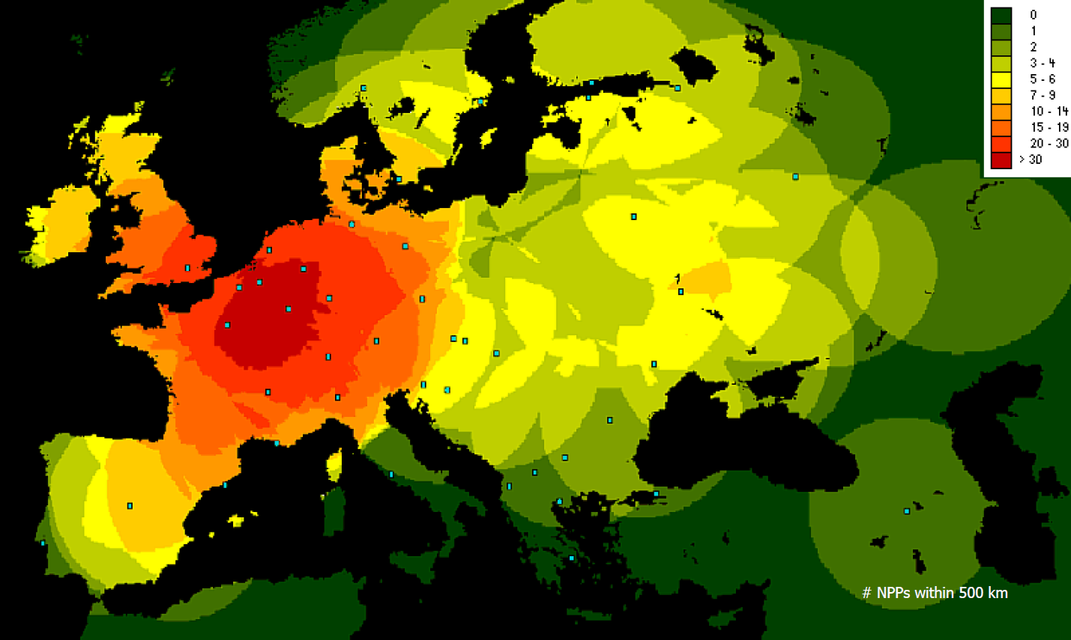
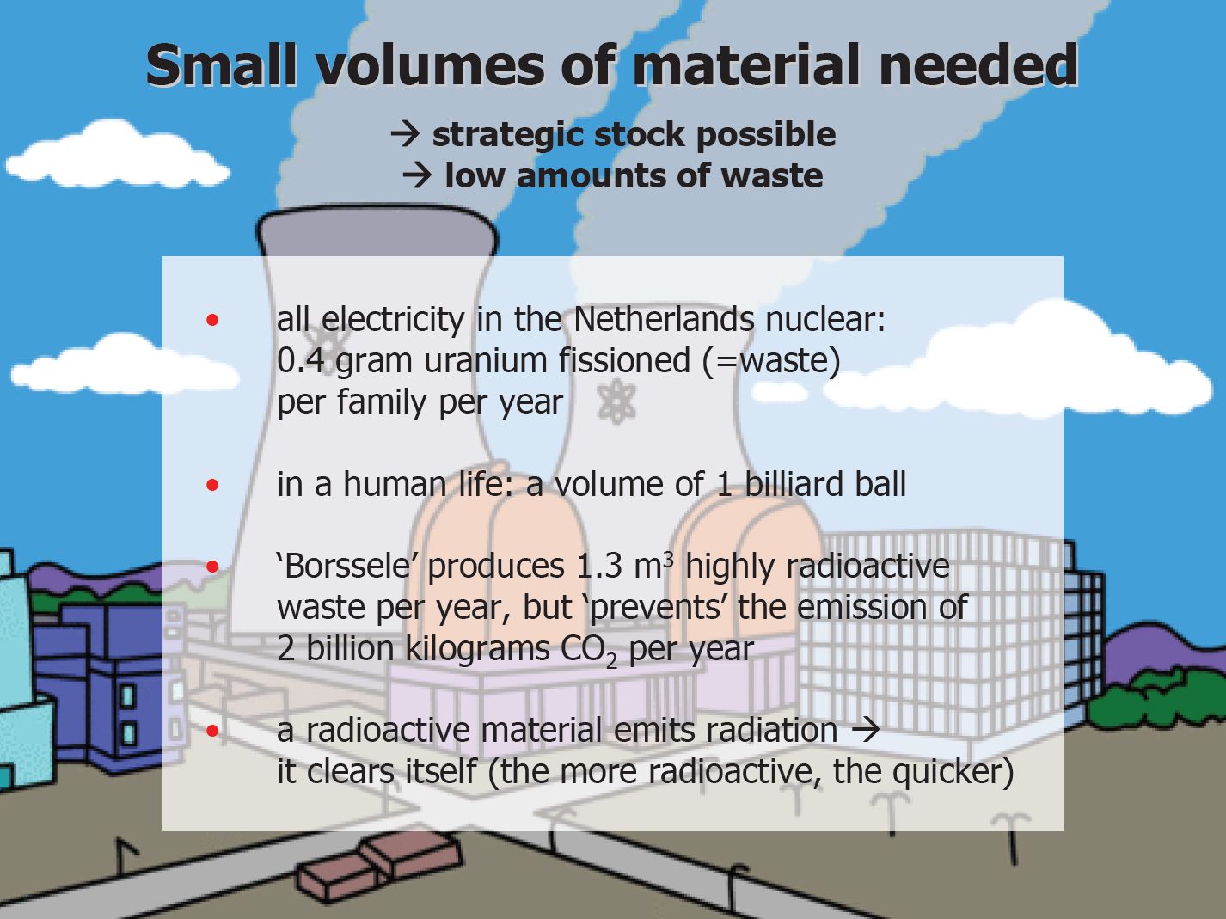
Kernenergie en Nederland

Slide 13
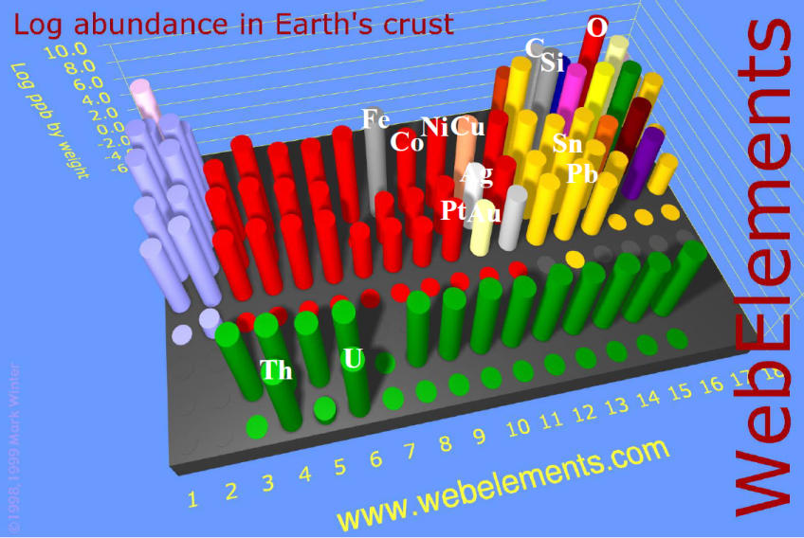
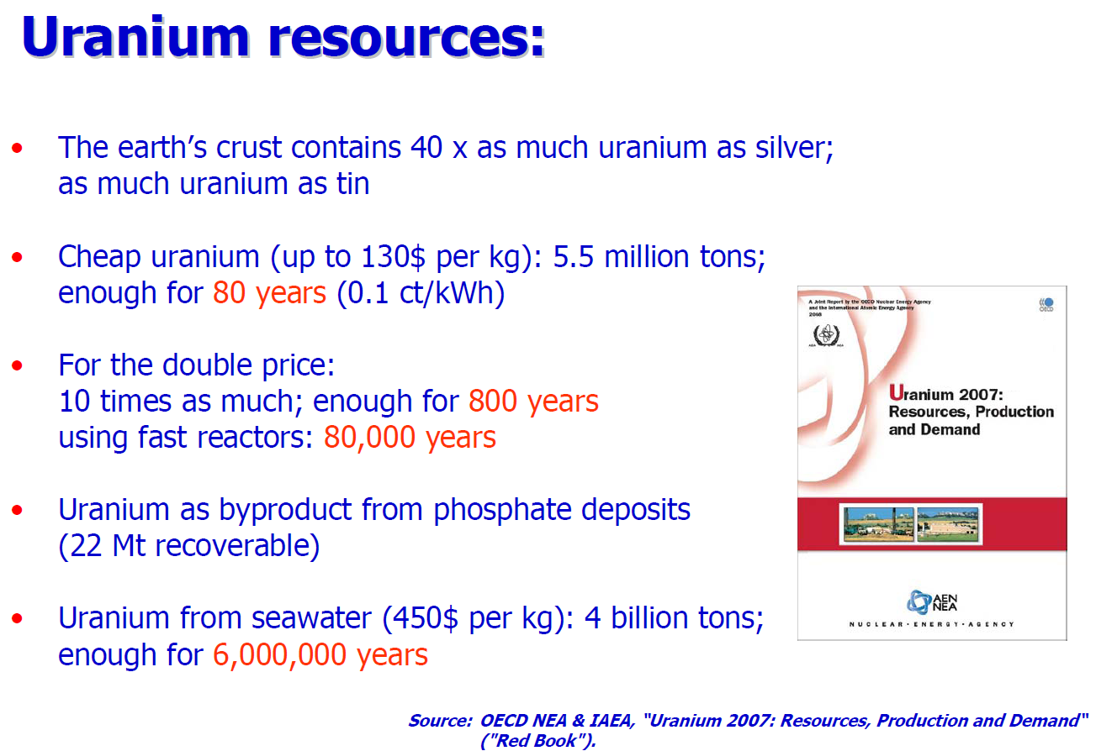
Beschikbaarheid uranium

Slide 14
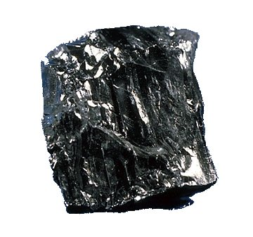

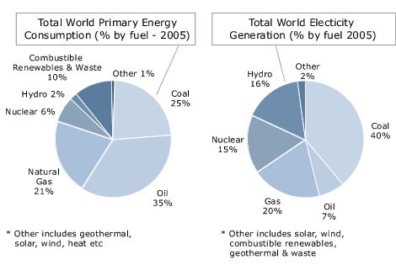
Mining accidents
Fatalities and injuries for mining in USA
Year | Average Annual Deaths | Average Annual Injuries
1936-1940 | 1,546 | 81,342
1941-1945 | 1,592 | 82,825
1946-1950 | 1,054 | 63,367
1951-1955 | 690 | 38,510
1956-1960 | 550 | 28,805
1961-1965 | 449 | 23,204
1966-1970 | 426 | 22,435
1971-1975 | 322 | 33,963
1976-1980 | 254 | 41,220
1981-1985 | 174 | 24,290
1986-1990 | 122 | 27,524
1991-1995 | 99 | 24,201
1996-2000 | 86 | 17,500
2001-2005 | 62 | 12,952
2006-2007 | 69 | 11,800
PR China | 2482Mt | Russia | 233Mt
USA | 990Mt | Indonesia | 169Mt
India | 427Mt | Poland | 95Mt
Australia | 309Mt | Kazakhstan | 92Mt
South Africa | 244Mt | Colombia | 64Mt
deadliest year in U.S. coal mining history was 1907, with 3,242 deaths
Benxihu (Honkeiko) Colliery (本溪湖媒礦), located at Benxi, Liaoning, China. On April 26, 1942, a gas and coal-dust explosion in the mine killed 1,549, 34% of the miners working that day.

Slide 15

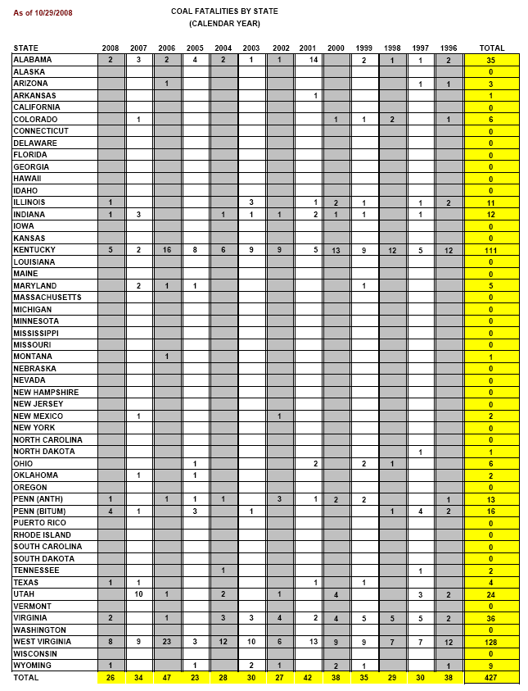

Coal mining accidents: USA and China
Source: State Administration of Work Safety
Year | Total number of coal mine accidents | Total number of deaths
2000 | 2,863 | 5,798
2001 | 3,082 | 5,670
2002 | 4,344 | 6,995
2003 | 4,143 | 6,434
2004 | 3,639 | 6,027
2005 | 3,341 | 5,986
In 2004: China official statistics: 6,027 deaths
USA reported 28 deaths in the same year
Coal production in China is twice that of the USA, while the number of coal miners is around 50 times that of the USA
Thus, deaths in coal mines in China are
4 times as common per worker
108 times as common per unit output
as in the USA.

Slide 16

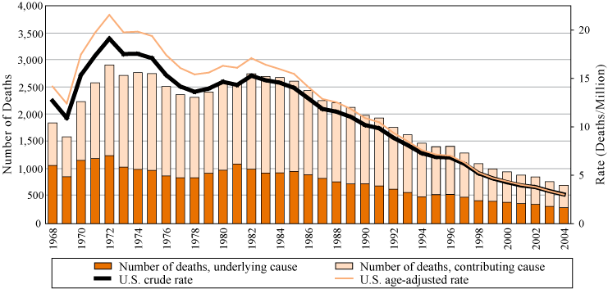
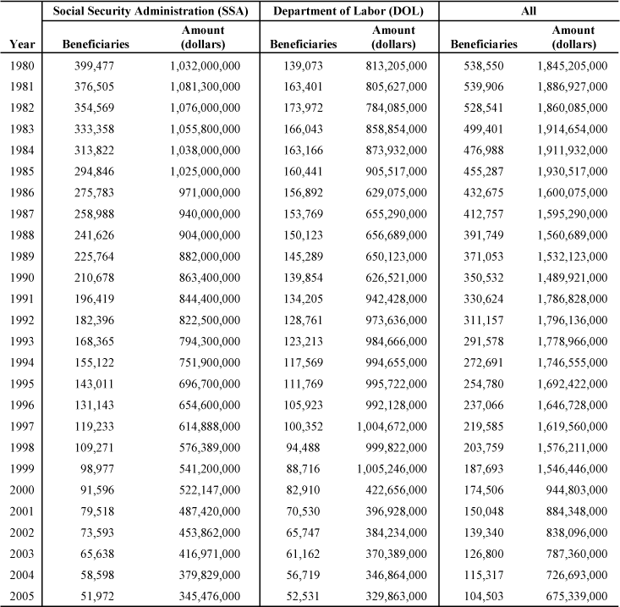
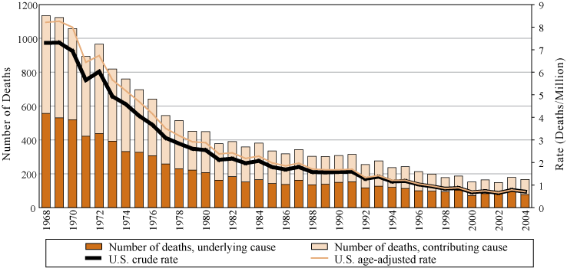
Work-Related Lung Disease (WoRLD) Surveillance System
Pneumoconiosis
42,252 underground miners (2000)
10,000 deaths last 10 years
http://www.cdc.gov/
US residents, age 15 and over, 1968 - 2004
Federal Black Lung Program:
Silicosis
Federal Black Lung Program:
4000 new cases of black lung every year in the USA (4% of workers annually)
10 000 new cases every year reported in China (0.2% of workers).

Slide 17
Black lung disease in China
Black lung disease claims 140,000 lives in China
The black lung disease has claimed 140,000 lives in the Chinese mainland since the occupational disease report system was founded in 1950s, revealed vice Health Minister Jiang Zuojun at a televised conference for prevention and treatment of occupational diseases held in Beijing March 17, 2005. A total of 580,000 black lung cases have been reported in China so far, and there are 440,000 people suffering from black lung disease at present. The number of black lung case is increasing roughly 10,000 annually. In addition, China reports nearly 30,000 poison cases relating to occupation and use of pesticide in production. About 1,500 people die from poison. Jiang acknowledged the occupational disease has grown so rampant in some areas that "black lung village" and "poison village" have emerged. Many laborers have become impoverished due to the disease. Moreover inappropriate settlement of disputes over occupational diseases has led to incidents that influence social harmony and stability, including blockade of road, strike, demonstration, and group appeal to higher authority for help. Occupational disease has become a grave problem that harms public health and social stability. To strengthen prevention and treatment of occupational diseases, the Chinese government has adopted occupational health review system for construction projects; imposed strict approval for aptitude of service departments for occupational health; rectified diagnosis and appraisal for occupational disease. The Health Ministry has decided to launch a publicity week with feature "Safeguard laborer's health by prevention of occupational diseases", in which consultation regarding prevention and treatment of occupational disease will be offered to laborers free of charge. By People's Daily Online

Slide 18





Radiation exposure of coal
Science 8 December 1978: Vol. 202. no. 4372, pp. 1045 – 1050 DOI: 10.1126/science.202.4372.1045
 | Articles Radiological Impact of Airborne Effluents of Coal and Nuclear Plants J. P. McBride ¹, R. E. Moore ², J. P. Witherspoon ², and R. E. Blanco ³ ¹ Research staff member of the Chemical Technology Division, Oak Ridge, Tennessee 37830 ² Research staff members of the Health and Safety Research Division, Oak Ridge, Tennessee 37830 ³ Manager of Radioactive Waste Management Research and Development Programs at Oak Ridge National Laboratory, Oak Ridge, Tennessee 37830 Radiation doses from airborne effluents of model coal-fired and nuclear power plants (1000 megawatts electric) are compared. Assuming a 1 percent ash release to the atmosphere (Environmental Protection Agency regulation) and 1 part per million of uranium and 2 parts per million of thorium in the coal (approximately the U.S. average), population doses from the coal plant are typically higher than those from pressurized-water or boiling-water reactors that meet government regulations. Higher radionuclide contents and ash releases are common and would result in increased doses from the coal plant. The study does not assess the impact of non-radiological pollutants or the total radiological impacts of a coal versus a nuclear economy.
The extremely high standards of the nuclear industry result in a regimen of care and containment
NCRP Report No. 95, Radiation Exposure of the U.S. Population from Consumer Products and Miscellaneous Sources
NCRP Report No. 95 is another of the assessment series of reports. This Report recognizes that there are many consumer products available which emit ionizing radiation, in some cases as an essential element of the proper performance of the device and in other cases as incidental or extraneous to the purpose for which the product was designed. The Report evaluates the exposures from all of these types of products. Treated are electronic products such as television receivers and airport luggage inspection systems; radioactive materials such as radioluminous products, building materials, glass and ceramics; and miscellaneous exposure sources such as high voltage vacuum electronic units. Also covered are exposures resulting from disposal of radioactive surplus items and transport of radioactive materials. Recommendations for dose reduction are also provided in the Report

Slide 19

Unclean Fuels Kill 1.5 Million People Per Year - UN
GENEVA - Half the world's population burns wood, coal, dung and other solid fuels to cook food and heat their homes, exposing them to dangerous smoke that kills 1.5 million people a year, the UN health agency said on Thursday.
The World Health Organisation (WHO) said women and children in Africa and Asia were especially vulnerable to indoor air pollution from open fires and poorly ventilated stoves.
Children make up 800,000 of the 1.5 million people who die each year from polluting household fuels, women account for 500,000 deaths and the remaining 200,000 are men.
"Day in day out, and for hours at a time, women and their small children breathe in amounts of smoke equivalent to consuming two packs of cigarettes per day," the WHO said.
Yet in a report entitled "Fuel For Life: Household Energy and Health," the Geneva-based agency said it could cost as little as US$6 per family to install better-insulated and fuel efficient stoves in developing countries.
"Making cleaner fuels and improved stoves available to millions of poor people in developing countries will reduce child mortality and improve women's health," WHO Director General Lee Jong-wook said.
Inhaling indoor smoke doubles a child's risk of pneumonia and makes adults three times as likely to suffer chronic pulmonary disease than those who cook with electricity, gas and other clean-burning fuels, it said.
Halving the 3 billion people worldwide cooking with solid fuels by 2015 would cost between US$13 billion to US$43 billion a year depending on the new energy source used, WHO said. Using liquefied petroleum gas would be cheaper than ethanol.
But it would save up to US$91 billion a year over 10 years due to health care savings, less illness, fewer deaths, and higher productivity due to less time-intensive fuel collection and cooking.
"With more time available, children would do better at school, while their mothers could engage in child care, agriculture or other income-generating activities," it said.
Making better-ventilated stoves available to half of those currently using inefficient cookers could save US$34 billion in fuel expenditure each year, it said.
Story Date: 5/5/2006

Slide 20
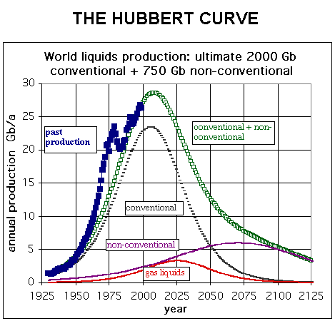

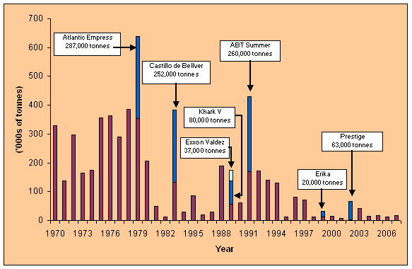
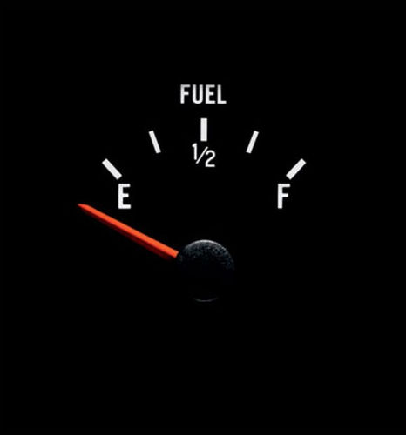
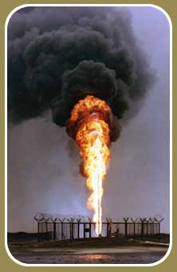
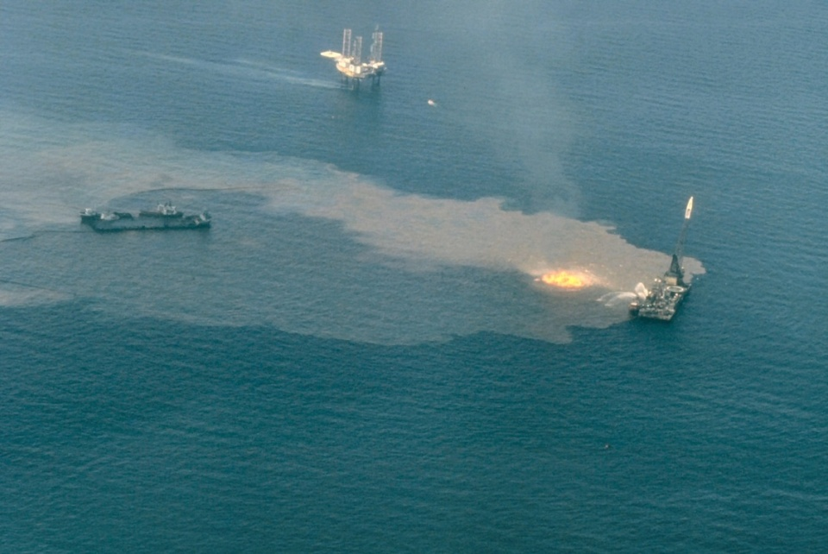
Oil spills
Gulf war oil spill, 1991, 0.8 - 1.5Gt
IXTOC I oil well blowout
1979, Gulf of Mexico, 480Mt

Slide 21
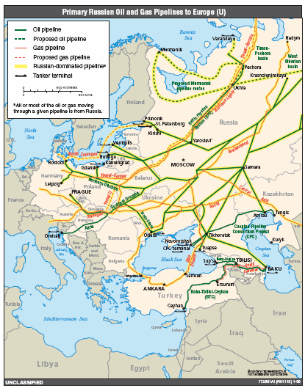
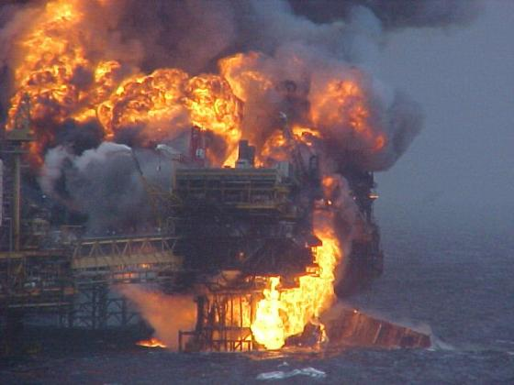
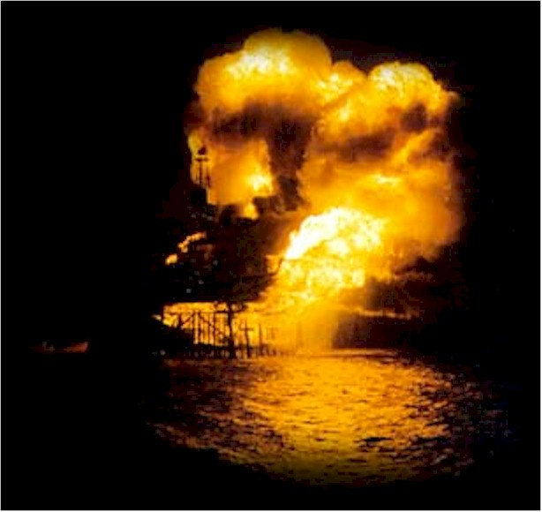
Oil: pipeline ruptures, platform accidents
Piper Alpha was a North Sea oil production platform operated by Occidental Petroleum (Caledonia) Ltd. The platform began production in 1976, first as an oil platform and then later converted to gas production. An explosion and resulting fire destroyed it on July 6, 1988, killing 167 men. Total insured loss was about US$ 3.4 billion.

Slide 22
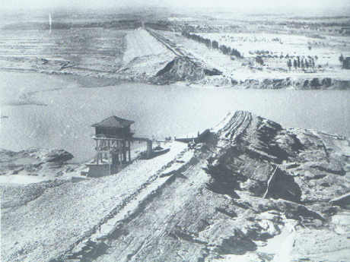
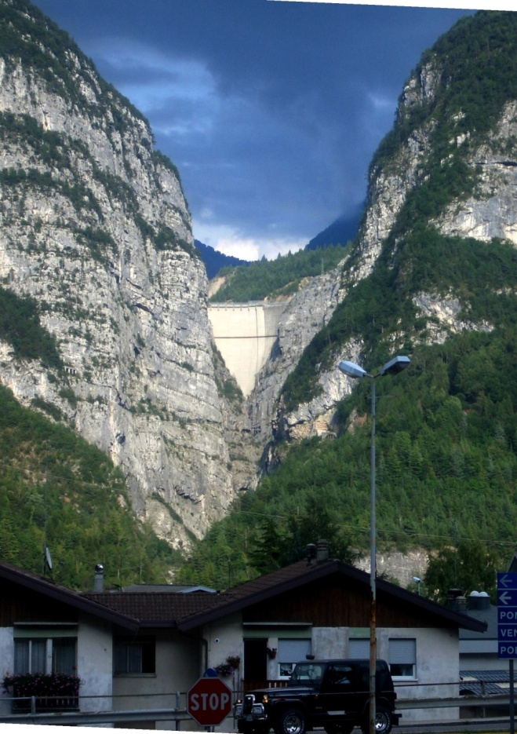
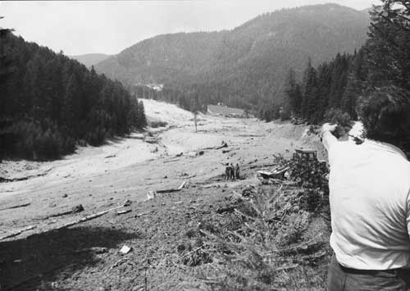
Dam disasters
Banqiao dam failure – 1975
According to the Hydrology Department of Henan Province, in the province, approximately 86,000 people died from flooding and another 145,000 died during subsequent epidemics and famine. In addition, about 5,960,000 buildings collapsed, and 11 million residents were affected.
Val di Stava dam disaster – 1985
268 deaths
Vajont dam disaster – 1963
One of the highest dams in the world measuring 262 metres
Its 1963 failure during initial filling was caused by geological instability
Total of 1910 casualties

Slide 23

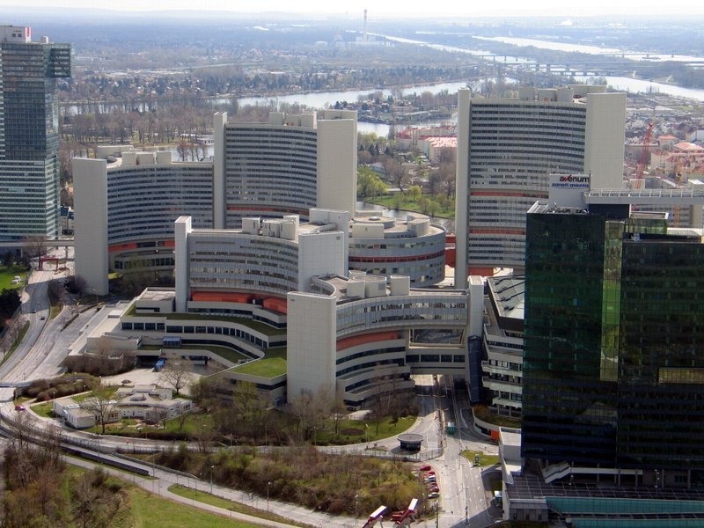
International Nuclear Event Scale
International Atomic Energy Agency
Level 7: Major accident | Chernobyl | Large off-site impact
Level 6: Serious accident | Mayak | Significant off-site release
Level 5: Accident with wider consequences | Windskale, Three mile island | Severe reactor damage, limited off-site release
Level 4: Accident with local consequences | Sellafield, Saint-Laurent, Tokaimura | Public exposure (near limits), fatal exposure
Level 3: Serious incident | Thorp Sellafield, Paks | Public exposure (below limits), near accident
Level 2: Incident | Asco, Forsmark | No off-site impact, overexposure of worker
Level 1: Anomaly | Tricastin | Anomaly (water leak, contamination)

Slide 24
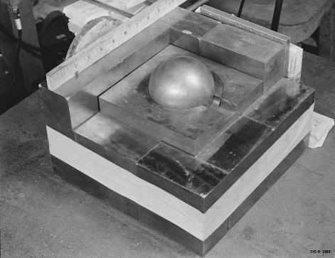
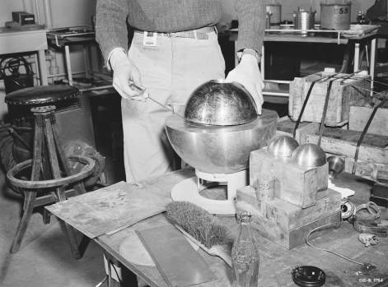
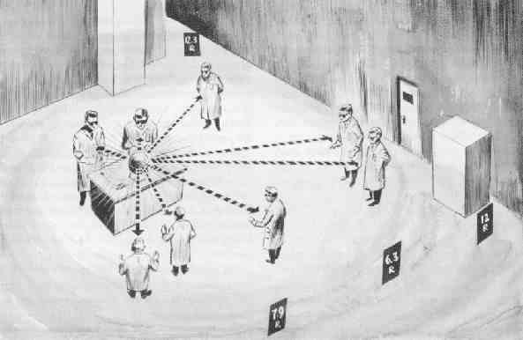
First nuclear accidents
Harry K. Daghlian, Jr., (1921 – September 15, 1945)
Physicist of Armenian descent with the Manhattan Project who accidentally irradiated himself on August 21, 1945 during a critical mass experiment at the remote Omega Site facility at Los Alamos National Laboratory in New Mexico, resulting in his death 21 days later.
Daghlian was irradiated as a result of a criticality accident that occurred when he accidentally dropped a small tungsten carbide brick onto a 6.2 kg delta phase plutonium bomb core.
This core was later nicknamed the "Demon core”
Louis Alexander Slotin (December 1, 1910 – May 30, 1946)
Canadian physicist and chemist who took part in the Manhattan Project.
Performed experiments with uranium and plutonium cores to determine their critical mass values. After World War II, Slotin continued his research at Los Alamos National Laboratory.
On May 21, 1946, Slotin accidentally began a fission reaction, which released a burst of hard radiation. He was rushed to hospital, and died nine days later.

Slide 25




Three Mile Island – TMI-2
Release few weeks before accident
TMI-2: PWR (Babcock & Wilcox)
March 28, 1979. Biggest nuclear accident in USA. Pump of secondary non-nuclear cooling fails. Turbine and reactor are shutdown (normal procedure).
Temperature and pressure in reactor rise (normal). Relief valve of pressurizer (PORV) opens.
PORV should close, but fails to do so (not noticed by operators). Pressure keeps dropping, cooling water pours out of PORV. Reactor core overheats.
Backup system failed since after tests prior to accident people forgot to open valves (human error). Half of the core melted. All contained. Radioactive noble gases (~43 kCi krypton) were vented (<20 Ci of I-131).
Average dose to people within ten miles was 8 mrem. Nobody received more than 100 mrem (power plant workers norm: < 5 rem per year. Estimate of additional cancers <~ 1.

Slide 26

Tsjernobyl
Grootste kernramp in de geschiedenis
  26 april 1986
  Level 7 op International Nuclear Event Scale
De ramp
  Test met kernreactor nummer 4
  Schakel generator uit en kijk of er voldoende vermogen is om de koelinstallatie 60 seconde te laten werken totdat de noodaggregaten aanslaan
  Reactorvermogen onbedoeld naar 30 MW
  Hierdoor Xenon vergiftiging
  Alle regelstaven uit en vermogen naar 200 MW
  Voor de test was minimaal 600 MW nodig
  Test toch voortgezet: waterpompen ingeschakeld
  Door extra n-absorptie zakte vermogen verder
  20 van de 26 handbediende veiligheidsstaven uit
  Turbine uit: vermogen steeg exponentieel
  Noodstop uitgevoerd, maar dat duurt 19 seconden
  Brandstofstaven braken, controlestaven klem
  Reactor bereikt 30 GW, staven smelten
  Stoomontploffing: 2000 ton dak van reactor
  Grafiet moderator vat vlam

Slide 27


Tsjernobyl
Consequenties
  42 werkers gedood door straling binnen weken
  600.000 burgers en militaire `liquidators’ blootgesteld aan hoge stralingsniveaus: decontaminatie reactor, site, straten en constructie sarcofaag
  Radioactieve besmetting van 3000 km2 oppervlak door cesium-37 (halfwaardetijd gamma-emitter 30 jaar)
  Groeiende epidemie van schildklierkanker door besmetting met jodium
  Andere kankersoorten worden verwacht, maar zijn niet detecteerbaar vanwege de hoge achtergrond van kanker door andere oorzaken. Een theoretische studie stelt op basis van Hiroshima en Nagasaki overlevenden dat 4000 extra kankerdoden voor de 600.000 liquidators, 5000 voor de 6 miljoen mensen die in besmette gebieden (> 37 kBq/m2 voor cesium-137), en ongeveer 7000 voor de 500 miljoen Europeanen. Totaal 16.000 (6700 – 38.000 voor 95% confidence level)
Gemiddeld
  Eind 2008: 10.000 GWe-jaar kernreactor ervaring
  Dus minder dan 2 doden per GWe-jaar; dat is minder dan bij fossiele brandstoffen
  Trauma groot: 200.000 mensen verplicht verhuisd

Slide 28


Tsjernobyl
Economische aspecten
  Schattingen varieren van $ 6.7 miljard tot $235 en $148 door overheden van Belarus en Ukraine
  Sociale uitkeringen (Tsjernobyl gerelateerd) aan 7 miljoen mensen in 3 landen)
  Verplaatsing populatie
  Verlies van assets: 784.320 hectare landbouwgrond en 694.200 hectare bos. Merendeel is nu weer in gebruik
  Belarus: 20% nationaal budget in 1992, 5% in 2001
  Betaald door 18% extra belasting voor non-agricultural firms in 1994
  Chernobyl Shelter Fund: $1.2 miljard voor de grootste bewegende structuur die ooit gebouwd is (span 270 m, hoogte 100 m en lengte 150 m; 2024 ton massa)
  Potentiele kosten van een brand in spent-fuel pools in de USA worden op honderden miljarden geschat

Slide 29
Nuclear power – October 2008
The world total annual energy consumptions amount to 14 billion coal equivalent.
Reactor type | In operation |  |  | Under construction
 | Number | net capacity MWe |  | Number | net capacity MWe
PWR | 265 | 243,295 |  | 27 | 24,195
BWR | 94 | 85.287 |  | 3 | 3,925
AGR, GGR | 18 | 9,034 |  | - | -
CANDU/D₂O-PWR | 44 | 22,390 |  | 4 | 1,298
RBMK | 16 | 11,404 |  | 1 | 925
SNR | 2 | 690 |  | 2 | 1.220
total | 439 | 372,100 |  | 34 | 31,563

Slide 30


Energy reserves – 2006
Natural gas | 235 billion t coal equivalent
Mineral oil/shales/liquid gas | 232 billion t coal equivalent
Natural uranium | 27 billion t coal equivalent
Coal (all forms) | 726 billion t coal equivalent.
The world total annual energy consumptions amount to 14 billion coal equivalent.

Slide 31

Nuclear installations in The Netherlands

Slide 32


Borssele PWR
1969 PZEM bestelt reactor bij Siemens/KWU
25 Oktober 1973 levering
  Na succesvolle eerste testen
  Overheid geeft permanente bedrijfsvergunning
1979 – 1984 Upgrade veiligheid
  Reserve koelwatersysteem
  Na Harrisburg, Maart 1979
1990 EPZ wordt eigenaar
11 Juli 1994 EZ stekt dat bedrijf wordt verlengd tot 2007
  Upgrade project `Modifications’
  450 miljoen gulden
  Er dient voldoende terugverdiendtijd te zijn
Mei - Juni 2003 Balkenende-2
  Sluiting uiterlijk in 2013
16 Juni 2006 Borssele Covenant
  Bedrijf mogelijk tot 2034
  Nuclear Energy Act Licence: elke 10 jaar safety check
  Essent en Delta investeren 250 miljoen €duurzaam
  Overheid idem dito

Slide 33

Borssele PWR
PWR met 485 MWe
Brandstof
  MOX
  Uranium van Kazakhstan
Kernafval
  Borssele produceert 12 ton per jaar
  Areva NC doet reprocessing
  Restafval moet teruggenomen worden en wordt opgeslagen door COVRA
  Voldoende opslagcapaciteit voor 100 jaar
  Transporten naar La Hague
  Eerste in Juni 2011; 10 in 2012 – 2015
  Reprocessed uranium wordt verrijkt in Rusland met uranium van duikboten; 25% blijft in Rusland
2009 Delta memorandum voor 2e centrale
  Kosten 4 – 5 miljard euro
  Verzoek tot vergunning in 2012
  Start constructie in 2013, bedrijf in 2018

Slide 34



Kernsplijting
Opslag van radioactief materiaal staat ter discussie
Ongelukken hebben grote gevolgen (Chernobyl, Fukushima)
Decommissioning moet beschouwd worden
Snelle broedreactoren: genereren hun eigen brandstof (plutonium)
Proliferatie, diefstal van plutonium moet voorkomen worden
Manhattan project in WOII
Oppenheimer & Groves
Uranium en plutonium bommen (1945)
Nuclear weapons test ban treaty (1963) verbiedt testen van kernwapens in atmosfeer (fall-out is gevaarlijk in verband met consumptie)
Nagasaki

Slide 35
Kernfusie

Slide 36



Kernfusie
Energie komt vrij bij de fusie van kernen
Proton – proton cyclus in de Zon levert 26.7 MeV
CNO cyclus (hete sterren)

Slide 37


“Zwakke” wisselwerking

Slide 38

Fusie
Mechanisme van energie productie in sterren
Elke seconde wordt er ongeveer 600 miljoen ton waterstof omgezet door de zwakke wisselwerking
Power dichtheid in de Zon is slechts 0.3 W/m³

Slide 39

Temperatuur en kinetische energie
Temperatuur wordt altijd gebruikt om gemiddelde energie te geven. De eenheid is weer eV, i.e.
metT de temperatuur en T_{k} de temperatuur in Kelvin.
Merk op
1 eV = 11605 K 17.56 MeV = 2 10¹¹ K
De energie komt vrij in de vorm van kinetische energie
De kinetische energie is niet gelijk verdeeld over de eindtoestanden, omdat zowel energie als impuls behouden moeten zijn
Dez vergelijkingen kunnen opgelost worden en geven
Lichtste deeltje heeft de meeste kinetische energie
Neem de beroemde reactie
Helium kernen zijn ongeveer 4 keer zwaarden dan het neutron en krijgen dus 20% van de energie (3.5 MeV) terwijl het neutron 80% (14.1 MeV) krijgt

Slide 40

Fusie station
n warmen de mantel, ⁴He het plasma

Slide 41


Kernfusie reactoren
Gebruik isotopen van waterstof
Abondantie van deuterium is 1 gram per 80 liter water
Praktisch probleem is het overwinnen van de Coulomb afstoting
Hoge temperatuur nodig in fusie reactor (paar honderd miljoen K)
Opsluiting van het plasma is een uitdaging
Magnetisch opsluiting in een magnetisch fles
Plasma lekt weg aan de uiteinden

Slide 42
Werkzame doorsneden
Averaged reaction rate vs temperature
Cross section as a function of energy
The averaged reaction rate does not fall of as strongly when going to lower energies
The cross section
Even for temperatures below the energy at which the cross section reaches its maximum, there is a sufficient amount of fusion reactions due to the number of particles in the tail of the Maxwell distribution
The Maxwell (multiplied with the velocity)
Schematic picture of the calculation of the averaged reaction rate (Integrand as a function of energy)
The product of distribution and cross section

Slide 43


Tokamak
Magnetisch opsluiting met toroidaal veld (langs de as van de toroide)
Elektrische stromen in het plasma produceren poloidaal magneetveld
Superpositie levert een helisch veld en dat sluit het plasma op
Lawson criterium voor ontsteking van het plasma
Typisch t = 1 – 3 seconde
Break-even wordt al een factor 10 lager bereikt (TFTR in Princeton, 1990)
ITER is het fusieproject van de toekomst (2016)

Slide 44


Gyro motion
Lorentz force leads to a gyration of the
particles around the magnetic field
We will write the motion as
Parallel and rapid gyro-motion
Finite additional force F (=qE) leads to drift
For 10 keV and B = 5T:
Larmor radius of deuterons ~4 mm
electrons ~0.07 mm
alpha particles (3.5 MeV) ~5.4 cm
Cyclotron frequency:
80 MHz for hydrogen
130 GHz for electrons
Physics picture behind the drift velocity
Parallel motion
Gyration
ExB drift
Polarization drift
Grad-B and curvature drift

Slide 45




Tokamak
Bend the theta pinch into a donut shape
No end losses because the field lines go
around and close on themselves
The magnetic field follows form
And therefore varies with major radius R as
Top view of tokamak
Schematic picture of the tokamak

Slide 46


Toroidal curvature has its price
The toroidal magnetic field has a gradient
Which leads to a drift in the vertical direction
Note that the sign of the drift depends on the sign of the charge q
The drift
leads to charge separation
Build up of an electric field
and then to an ExB velocity
The ExB velocity
Is directed outward and will move the plasma
on the wall in a short timescale
This effect is no surprise since
Poloidal cut of the tokamak.
Remedy: a toroidal
plasma current will
generate a poloidal field

Slide 47


The toroidal electric field
Plasma is the second winding of a transformer
Flux in the iron core cannot be increased forever.
The tokamak is necessarily a pulsed machine
That is not good for energy production
Also thermal stresses are associated with the
pulsed character
One can either: live with it / drive current another
way / use a different concept
Because of the plasma current the field lines wind
around helically

Slide 48


Tokamak niet enige oplossing: W7X
A combination of helical coils and toroidal field
coils can be changed to use modular coils
Modular coils of W7x
There is a large disadvantage in the use of the
modular coils. They are highly bend and therefore
there are large force on them
In general it is difficult to build a compact device with
a big plasma. The poloidal field one imposes from
the outside decays rapidly with distance from the
coils

Slide 49


Compact stellarator NCSX princeton
Compact stellarators are a challenge. The plasma current in this device is not driven by a transformer.

Slide 50


Stellarator – LHD in JAPAN
If the field is not toroidally symmetric the motion in the toroidal direction will move the field line
from regions of positive poloidal field into regions of negative field
Then a net poloidal turn of the field line can be achieved
Steady state operation is possible at the cost of greater complexity

Slide 51

A tokamak
Magnetic surfaces are the surfaces traced out by the magnetic field
They are nested (best confinement)
Centre is shifted outward
Large passive coils
Magnetic field ends on a set of plates
Large set of small coils for diagnostic purposes

Slide 52

Plasma manipulation
Several coils around the plasma
The vertical coils can shape the plasma and control its position
Dominant shaping is the vertical elongation of the plasma
Schematic Drawing of the poloidal cross section of the ASDEX Upgrade tokamak

Slide 53

Plasma elongation
Plasma can be diverted onto a set of plates
Close to the coils the field of the coils dominates
In between the field is zero resulting in a purely toroidal field line
This shows up as an X-point in the figure of the magnetic surfaces
Surfaces outside the one with the X-point are not close with the field ending on the plates

Slide 54




Preventing impurities – divertor
Given a fixed electron density, impurities dilute the fuel
Acceleration of electrons by the ions in the plasma lead to radiation losses known as
‘Bremstrahlung’
The radiation scales with the average charge. High Z impurities enhance the radiation
High Z-impurities also lead to energy loss through line radiation
Density of the impurity with charge Z
Effective charge
Plasma facing components have to be
chosen carefully
Carbon / Beryllium have a low Z
Carbon does not melt but has the problem
that it binds well with Tritium (contamination
of the machine)
Tungsten has very high Z, but takes the
heat loads very well

Slide 55
Plasma instabilities
Plasma vertical instability with growth rates of the order 10⁶ s⁻¹
For this reason the passive coils have been placed in the plasma
When the plasma moves it changes the flux through the coils which generates a current that pushes the plasma back
Growth rate is reduced to the decay time of the current in the coils (ms)

Slide 56

Voortgang in fusie onderzoek

Slide 57

ITER

Slide 58

Wat is ITER?
ITER = (International Tokamak Experimental Reactor) is de volgende stap in tokamak research.
Grootste tokamak in de wereld
Project is gestart in Cadarache, France
Samenwerking tussen Europa, China, Japan, Korea, Rusland (en de US).
Doorsnede van het plasmavolume

Slide 59
Meer over ITER
Belangrijkste missie
Demonstreer dat het mogelijk is een fusiereactor te bedrijven. Dit omvat het genereren van een plasma dat door fusie reacties verwarmd wordt, maar ook dat aan de technische eisen voldaan kan worden.
Project
Kosten 5 miljard Euro constructie + 5 miljard Euro voor bedrijf (het duurste experiment op Aarde)
Constructie van het gebouw is begonnen in 2008 / Assemblade begint in 2012
Assemblage gaat ongeveer 7 jaar duren
20 jaar bedrijf is geplanned

Slide 60

Ontwerp – belangrijkste eigenschappen
Central Solenoid
Blanket Module
Outer Intercoil Structure
Vacuum Vessel
Cryostat
Toroidal Field Coil
Poloidal Field Coil
Divertor
Machine Gravity
Supports
Torus
Cryopump

Slide 61
ITER parameters
Total fusion power 500 MW
Q = fusion power/auxiliary heating power ≥10 (inductive)
Average neutron wall loading 0.57 MW/m²
Plasma inductive burn time ≥ 300 s
Plasma major radius 6.2 m
Plasma minor radius 2.0 m
Plasma current 15 MA
Vertical elongation @95% flux surface/separatrix 1.70/1.85
Triangularity @95% flux surface/separatrix 0.33/0.49
Safety factor @95% flux surface 3.0
Toroidal field @ 6.2 m radius 5.3 T
Plasma volume 837 m³
Plasma surface 678 m²
Installed auxiliary heating/current drive power 73 MW (100 MW)

Slide 62

Availability of the fuel
The natural abundance of Deuterium is one in 6700. There is enough water in the ocean to provide energy for 3×10¹¹ years at the current rate of energy consumption (larger than the age of the universe)
Deuterium is also very cheaply obtainable. Calculating the price of electricity solely on the basis of the cost of Deuterium, would lead to a drop of 10³ in your electricity bill
Tritium is unstable with a half age of 12.3 years. There is virtually no natural available resource of Tritium
Tritium however can be bred from Lithium
Note that the neutron released in the fusion reaction can be used for this purpose
The availability of Lithium on land is sufficient for at least 1000 if not 30000 years, and the cost per kWh would be even smaller than that of Deuterium.
If the oceans are included it is estimated that there is enough fuel for 3×10⁷ years.

Slide 63




Theta pinch
Plasma escapes at the ends; go toroidal …
Straight magnetic field no tension
Equation gives constant total pressure
Magnetic field is reduced inside the plasma
i.e. the plasma is diamagnetic
Ramp up the magnetic field by
ramping the current in the coils
The magnetic field pressure will
increase and is no longer balanced by
the plasma pressure
The plasma is compressed
Compression leads to work against
the pressure gradient force which will
heat the plasma

Slide 64



Z-pinch
A strong current is generated in the z-direction
This current generates a magnetic field in the θ direction
JxB force is then fully determined
Pressure gradient must balance the JxB force and is then
also fully determined by the current
Poloidal
Current is the source of the magnetic field
Magnetic pressure
Ramping of the current will increase the magnetic field which will compress the plasma
Besides the heating due to compression, the current will also
dissipate heat when the plasma resistivity is finite
The Z-pinch is unstable. Most relevant instability is the kink

Slide 65

Sandia labs – Z pinch: 290 TW X-rays

Slide 66


Sandia labs – Z pinch IFE
Laser of X-ray straling
Materiaal verdampt
Back-reaction comprimeert sample
Kernfusie treedt op
Sandia Z pinch
27 miljoen ampere
95 nanoseconde
350 Terawatt (80x wereld)
2.7 MJ X-ray energie
3.7 GK temperatuur bereikt
deuterium fusie gerealiseerd in 2006
metalen platen versneld tot 34 km/s
ZN (Z neutron fusie machine: p – 7Li)

Slide 67

Possible drivers: ion beams
Advantages:
Excellent conversion from electric power to beam energy
Large targets
Disadvantages:
Concept was never tested
Beam intensity is still too low
FAIR facility,
Darmstadt, Germany
10 to 20 rings needed
for fusion power plant!

Slide 68

Possible drivers: lasers (best shot)
Advantages:
Well advanced technology
Good control of energy release
Disadvantages:
Bad energy conversion
Very expensive to build
National Ignition Facility (NIF), Livermore, USA

Slide 69


Possible drivers: lasers
Target chamber, NIF with 192 laser beams
National Ignition Facility (NIF), Livermore, USA

Slide 70





Possible drivers: lasers
~1000 large Optics:
real NIF target
192 beam lines:
Schematic
Engineering challenges at NIF
DT capsule

Slide 71

Problems blocking fusion energy
Technical and engineering problems
High energy drivers are expensive and untested
Energy conversion is too low (gain of >100 needed now)
Repetition rate of drivers are too low (3-10 Hz needed)
Physics Problems
Instabilities and Mixing
► Rayleigh-Taylor unstable compression
► Break of symmetry destroys confinement
How to improve energy coupling into target
What is the best material for the first wall?

Slide 72

Rayleigh-Taylor Instability – spherical implosions / explosions
Energy must be delivered as sysmmetric as possible!

Slide 73


Relaxing the symmetry conditions – indirect drive
Hohlraum
for the
Z-machine
Laser beams heat walls
Walls emit thermally (X-rays)
X-rays compress and heat the fusion capsule
X-rays highly symmetric!
NIF design (laser)

Slide 74

Relaxing the symmetry conditions – fast ignition
Fast ignition scheme
with many facets
Idea: separate compression and ignition with two pulses
Less compression, cooler targets, lower densities
Problem: How can energy be transferred to hot spot?

Slide 75

Interesting experiments to come
National Ignition Facility (NIF, Livermore, USA)
► More than 90% completed, first tests done
► First full scale experiments this year; ignition in 2010?
Laser Mega-Joule (LMJ, France)
► Commissioning (full scale) in 2011
FIREX I and FIREX II (ILE, Osaka, Japan)
► Fast ignition experiments showed prove-of-principle
► Fully integrated experiments in 2010 / 2011
HiPER project (Europe)
► Fast ignition proposal
► Full funding pending
ITER

Slide 76
Stralingsschade

Slide 77



Stralingsschade
Geladen deeltjes (alfa en beta stralen, protonen, ionen) ioniseren het medium waar ze doorheen gaan
Fotonen: foto-elektrisch effect, Compton effect en paarvorming
Neutronen: kernreacties
Materialen worden bros
Biologische schade: ionisatie in cellen, DNA schade
Bron activiteit in curie of becquerel (SI)
Activiteit neemt af in de tijd
Geabsorbeerde dosis [ gray ] (energie per kg materiaal)
Relative biological effectiveness (RBE), ook wel QF
Effectieve dosis in rem of sievert (SI)
Natuurlijke achtergrond ongeveer 3 mSv
X-rays, scans ongeveer 0.6 mSv (limiet 1.0 mSv)
Fatale dosis: 4 Sv in korte tijd (50% fataal)

Slide 78





Stralingstherapie
Gebruik van straling om mensen met kanker te behandelen
Relatief grote dosis nodig voor effectieve bestrijding
Kleine bundel g straling voor behandeling goed gelokaliseerde tumoren
Roteer bron om schade aan gezond weefsel te minimaliseren
Bron: of een X-ray machine voor 200 keV tot 5 MeV
Actueel: proton en (koolstof) ionen therapie
Proton 170 (190) MeV

Slide 79





Tracers
Radioactieve isotopen zoals of
Autoradiografie met planten in een CO₂ omgeving
Medische diagnose met technetium-99 met levensduur van 6 uur
Technetium-99 kan in diverse verbindingen gebruikt worden, die specifiek zijn voor verschillende organen
Gamma camera’s maken dynamische studies mogelijk

Slide 80





Tomografie: CT en PET
Conventionele X-ray (een soort schaduw-opname)
CT: computed (axiaal) tomografie (beeld slices af)
Een smalle bundel gaat door het lichaam
Bron en detector maken slices
Roteer apparaat met 1º en maak slice
Fan-beam scanner
Beeldverwerking: pixels

Slide 81



Emissie tomografie
Single photon emission (computed) tomografie: SPET of SPECT
Meet X-rays van een tracer en doe CT
Positron emission tomografie (PET)
Gebruik positron emitters:
Positron annihileert met elektron
Er worden 2 fotonen geproduceerd
Gebruik een ring van foton detectoren

Slide 82





Kernspin resonantie (NMR)
Kern in magneetveld heeft energie
Proton spin kan twee instellingen hebben (up, down)
Dit leidt tot twee energieniveaus
Er geldt
In NMR opstelling plaatsen we een sample in een statisch veld B
Vervolgens geven we een RF pulse met frequentie f, zodat
Op deze wijze induceren we overgangen tussen beide niveaus
Voor een proton hebben we 42.48 MHz voor een 1.0 T veld
Voor een gebonden proton geldt
De frequentieverandering t.g.v. de moleculaire binding noemen we chemical shift

Slide 83



Magnetic Resonance Imaging (MRI)
MRI maakt beelden op basis van de proton spin (NMR principe)
CT technieken worden gebruikt in de 2D of 3D beeldproductie
Statisch magneetveld heeft een gradient
Hierdoor is resonantie beperkt tot slechts 1 plaats (voor 1 frequentie)
De plaats van resonantie wordt gevarieerd (door gradienten of frequentie)

Slide 84


Samenvatting
Voordelen
Grote hoeveelheden brandston (lage prijs).
Fusie is CO₂ neutraal.
Kleine hoeveelheid radioactief afval.
Geen risico van snelle energie afgifte.
Brandstof is overal op Aarde beschikbaar.
  Fusie is dus van belang voor iedereen die geen natuurlijke energiebronnen heeft.
  Geo-politiek belang.
Geef proliferatie van materiaal voor wapens
Nadelen
Nog niet gedemonstreerd. Het bedrijf wordt gehinderd door allerlei, op zichzelf interessante natuurkundig fenomenenen.
Het kostenplaatje is onduidelijk. Met name de kosten van de reactor.

