Slide 1
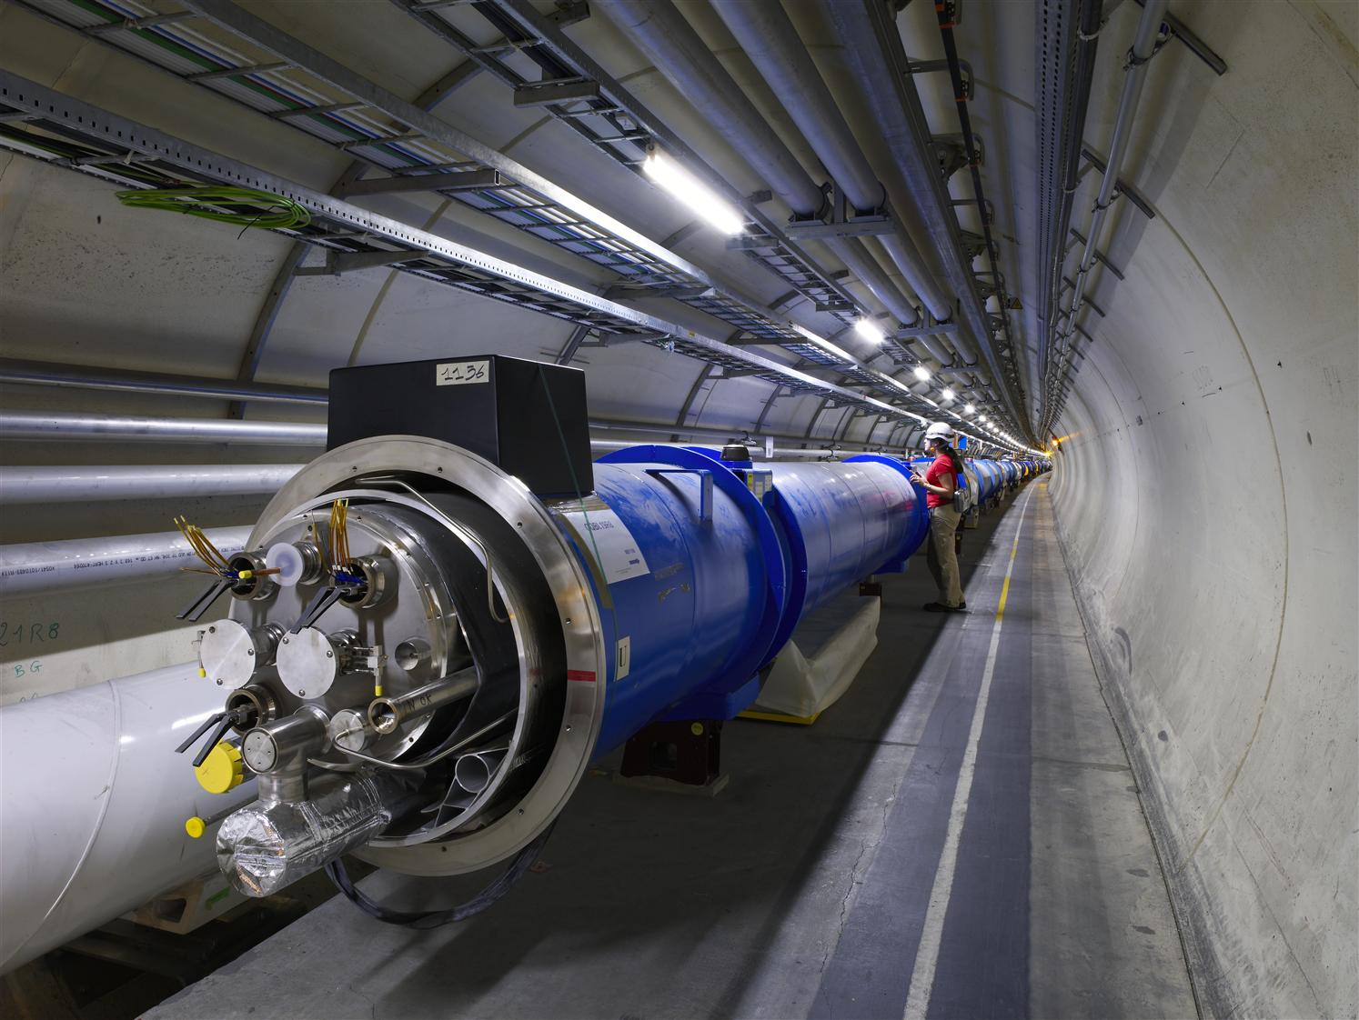
The elementary building blocks of nature
Large Hadron Collider
The Higgs boson
Supersymmetry
Extra dimensions
Delft Master student visit, 4 June 2013
Ivo van Vulpen

Slide 2
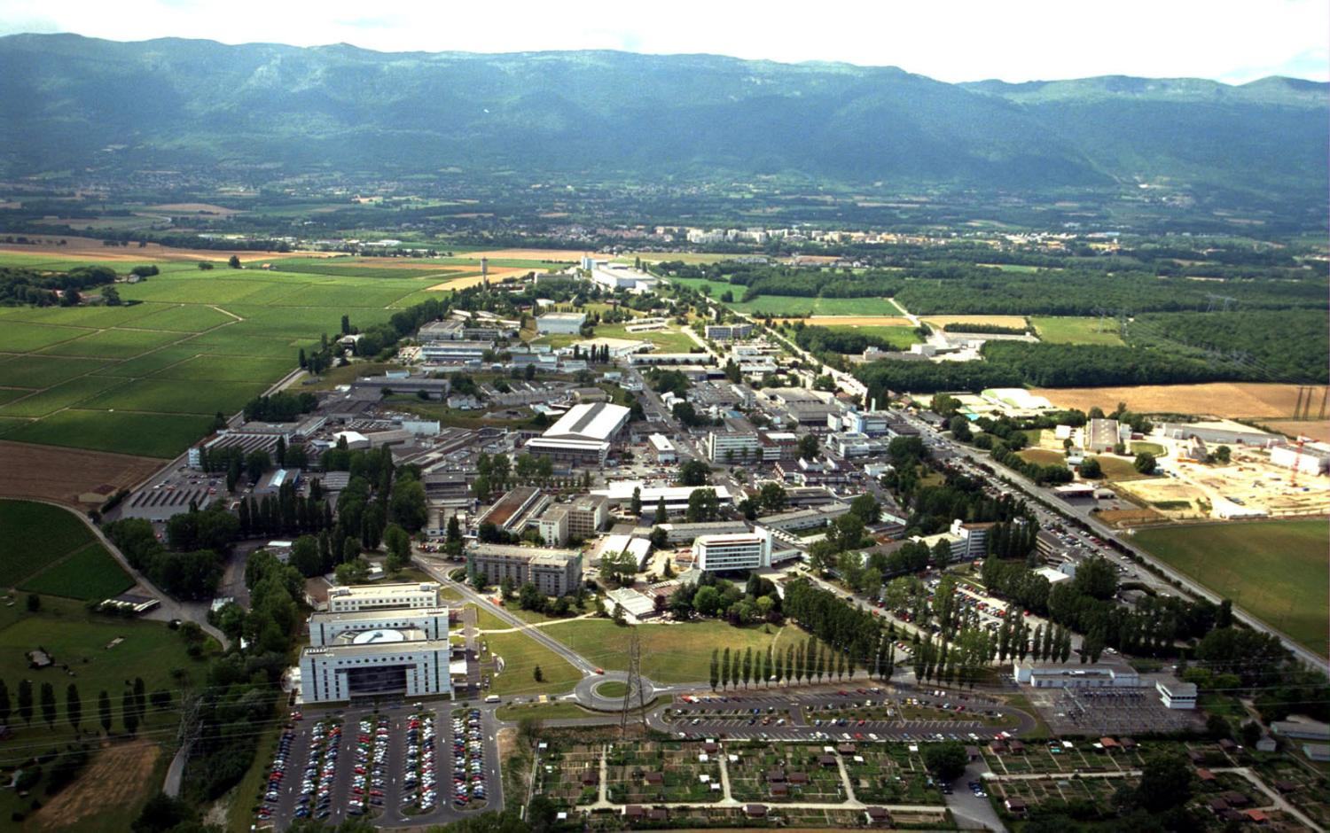
CERN in Genève, Zwitserland
My old house
ATLAS experiment
sleep
director
eat
work

Slide 3


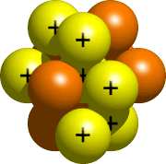


Particle Physics
Studies nature at distance scales < 10⁻¹⁵ m
Harry van der Graaf
10⁻¹⁵ m
Paul de Jong
Atom nucleus
Standard Model:
Quantumfield theory that describes phenomena down to 10⁻¹⁹ m
Niels Tuning
Notes:
Below 10⁻¹⁵ m need 2 extra forces …
Transition: What is the current theory ?

Slide 4
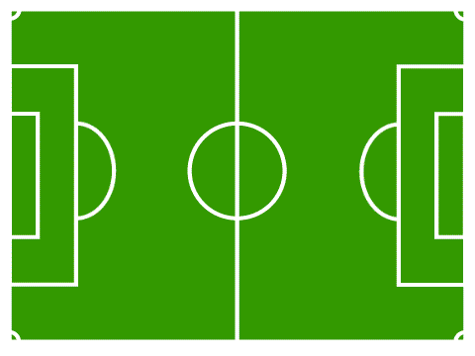

Discover the rules ?

Slide 5



The atomic world
Electrons do not fall onto the nucleus
Laws of physics: quantisation
-
electron
+
2) Protons and Neutrons stick together
kern
Force: weak & strong
3) Pattern in # electrons per orbit
Properties: spin

Slide 6

New phenomena, new forces ?
Refine models
New forces
?
2 forces
Newton/Maxwell
2 forces
Einstein/ Bohr
4 forces
Standard Model
10⁻¹⁰ m
10⁻¹⁵ m
10⁻¹⁹ m

Slide 7
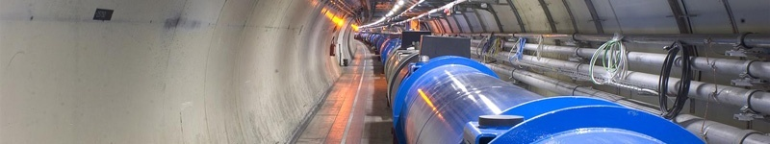
Where are we on March 1st 2013 ?
particles
http:// pdg.lbl.gov

Slide 8



The Standard Model
up/down
top
Particles
Forces
1) Electromagnetism (photon)
2) Weak force (W⁺, W⁻, Z)
3) Strong force (8 gluons)
Quarks
Leptons
Fermions Bosons
electron
muon
The Standard Model
Weak iso-spin, hypercharge, colour
5/78
Notes:
Particles and Forces.
Quarks make up the proton/neutron, the electron (famous), neutrino’s (news)
With only 2 colored strings you can make a beautiful carpet → Like it, our simple model describes complex patterns in nature.
Transition: Why uncomfortable and why does this picture of nature break down ?

Slide 9
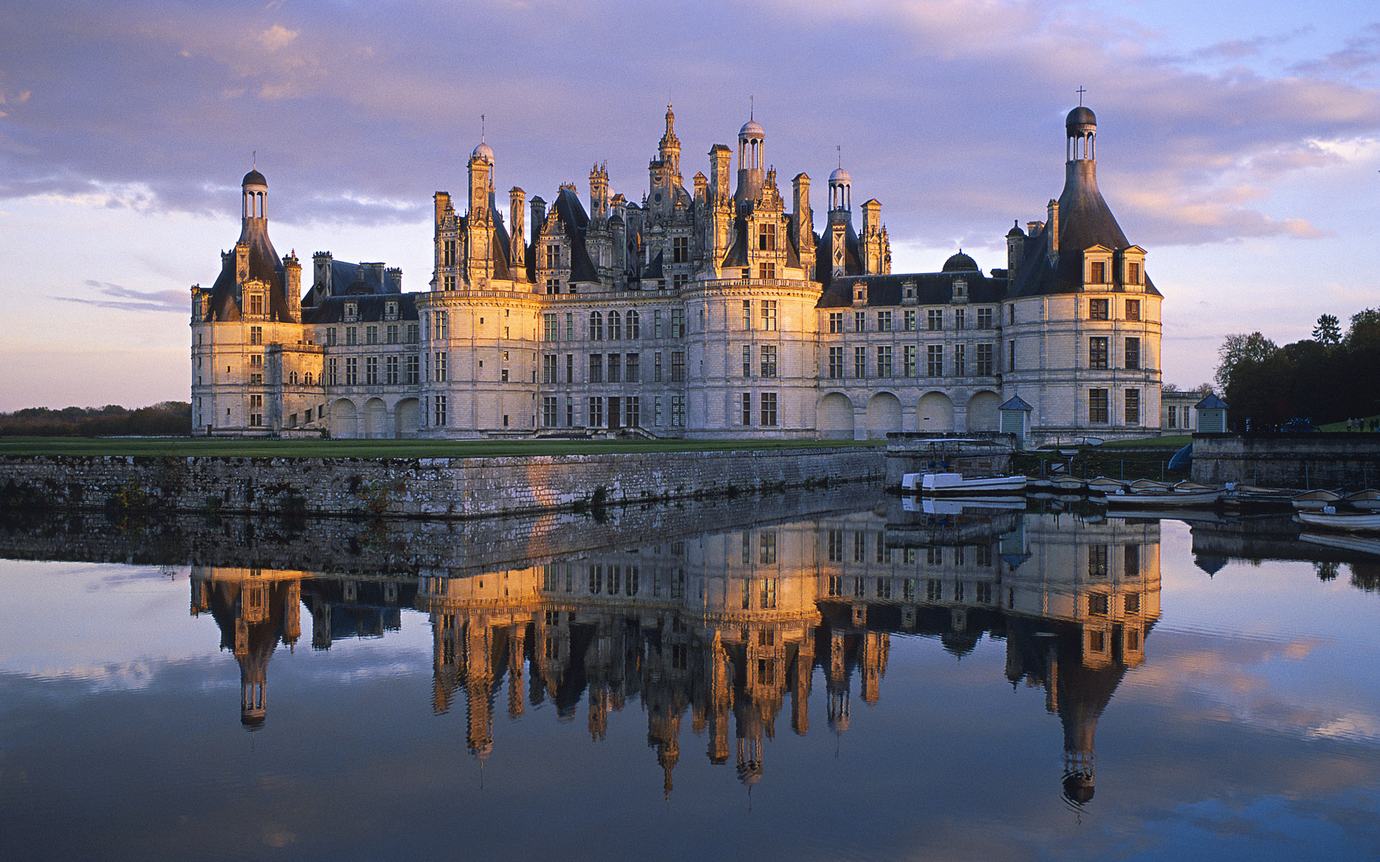
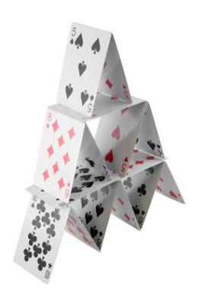
particles
anti-particles
The Standard Model

Slide 10
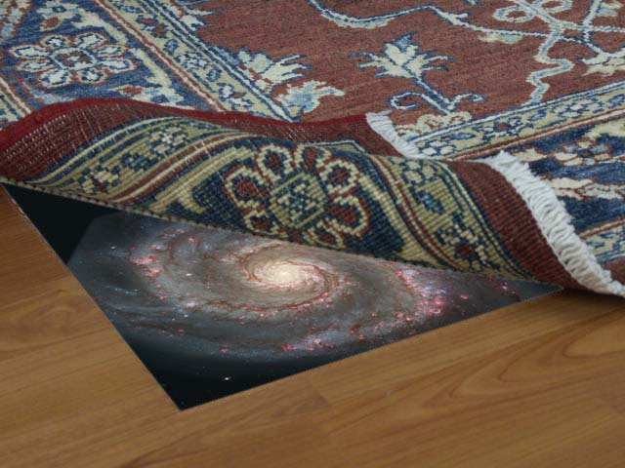

Slide 11
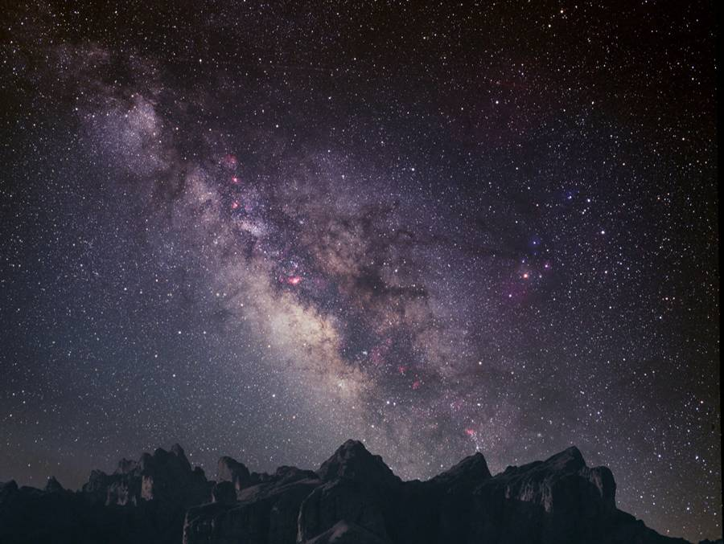
Paar ‘kleine’ dingetjes:
96% of the energy in the universe is unknown
→ dark matter (24%) what is that ?
→ dark energy (72%) what is that ?
Where did all the anti-matter go ?
How do particles acquire mass ? Higgs boson
Why is gravity so weak ?
1
2
3
4

Slide 12
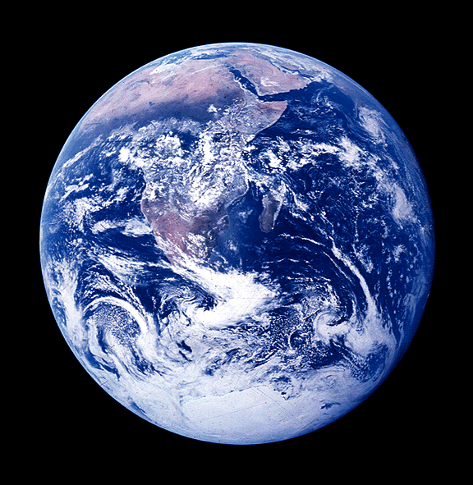
Theory
Reality
Comes at a price: extra scalar particle
The Higgs boson
≠
The Standard Model:
Describes all phenomena
Massive (force-)particles
Massive (force-)particles

Slide 13
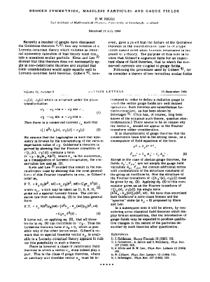
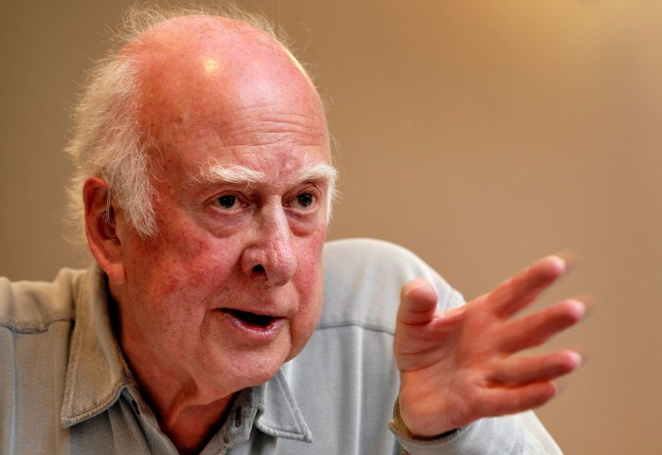
Theory
Reality
Comes at a price: extra scalar particle
The Higgs boson
=
The Standard Model:
Massive (force-)particles
The Higgs mechanism
Higgs field in the vacuum
“If I am right there should be a new particle in nature: the Higgs boson”
- September 1964 -

Slide 14

The last missing piece

Slide 15
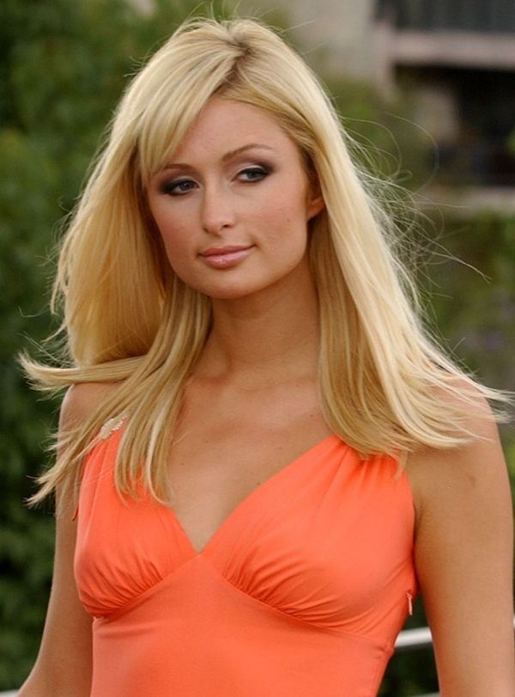

(In)famous Higgs boson
The Higgs boson Paris Hilton
Being famous is not the same as being important

Slide 16
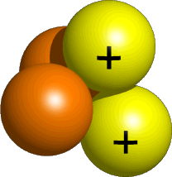
The mass of the Higgs boson
Properties of the Higgs boson are known … as a function of it’s unknown mass
0
50
100
150
200
250
300
350
400
450
500
Higgs boson mass (GeV)
W/Z boson
Alpha particle

Slide 17
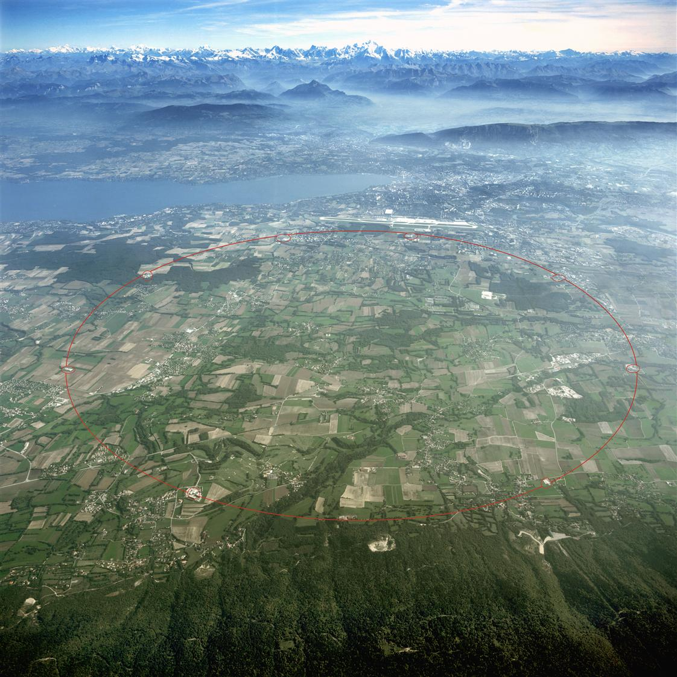
Large Hadron Collider

Slide 18
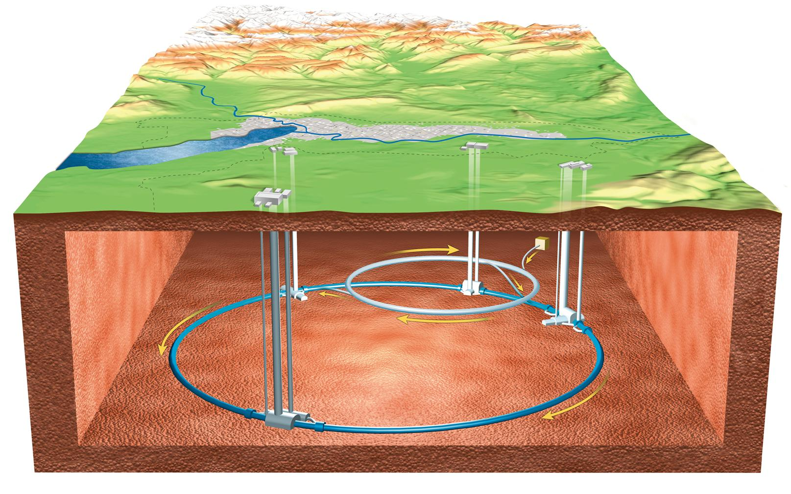
The Large hadron collider
LHCb
ATLAS
Alice
CMS

Slide 19
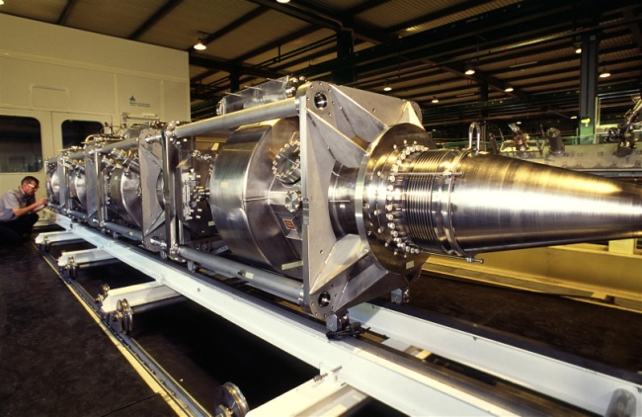
Acceleration is ‘easy’

Slide 20
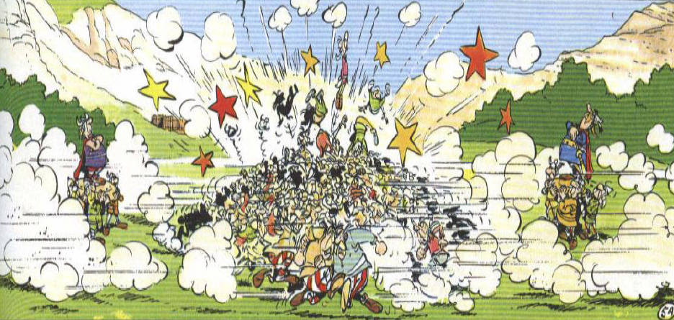
Phenomenology of proton-proton collisions
“Proton is a bag full of (anti-)quarks and gluons”
proton
proton
x₁P
x₂P
Only a fraction of the collision energy available for ‘hard’ interaction

Slide 21
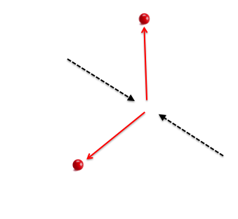
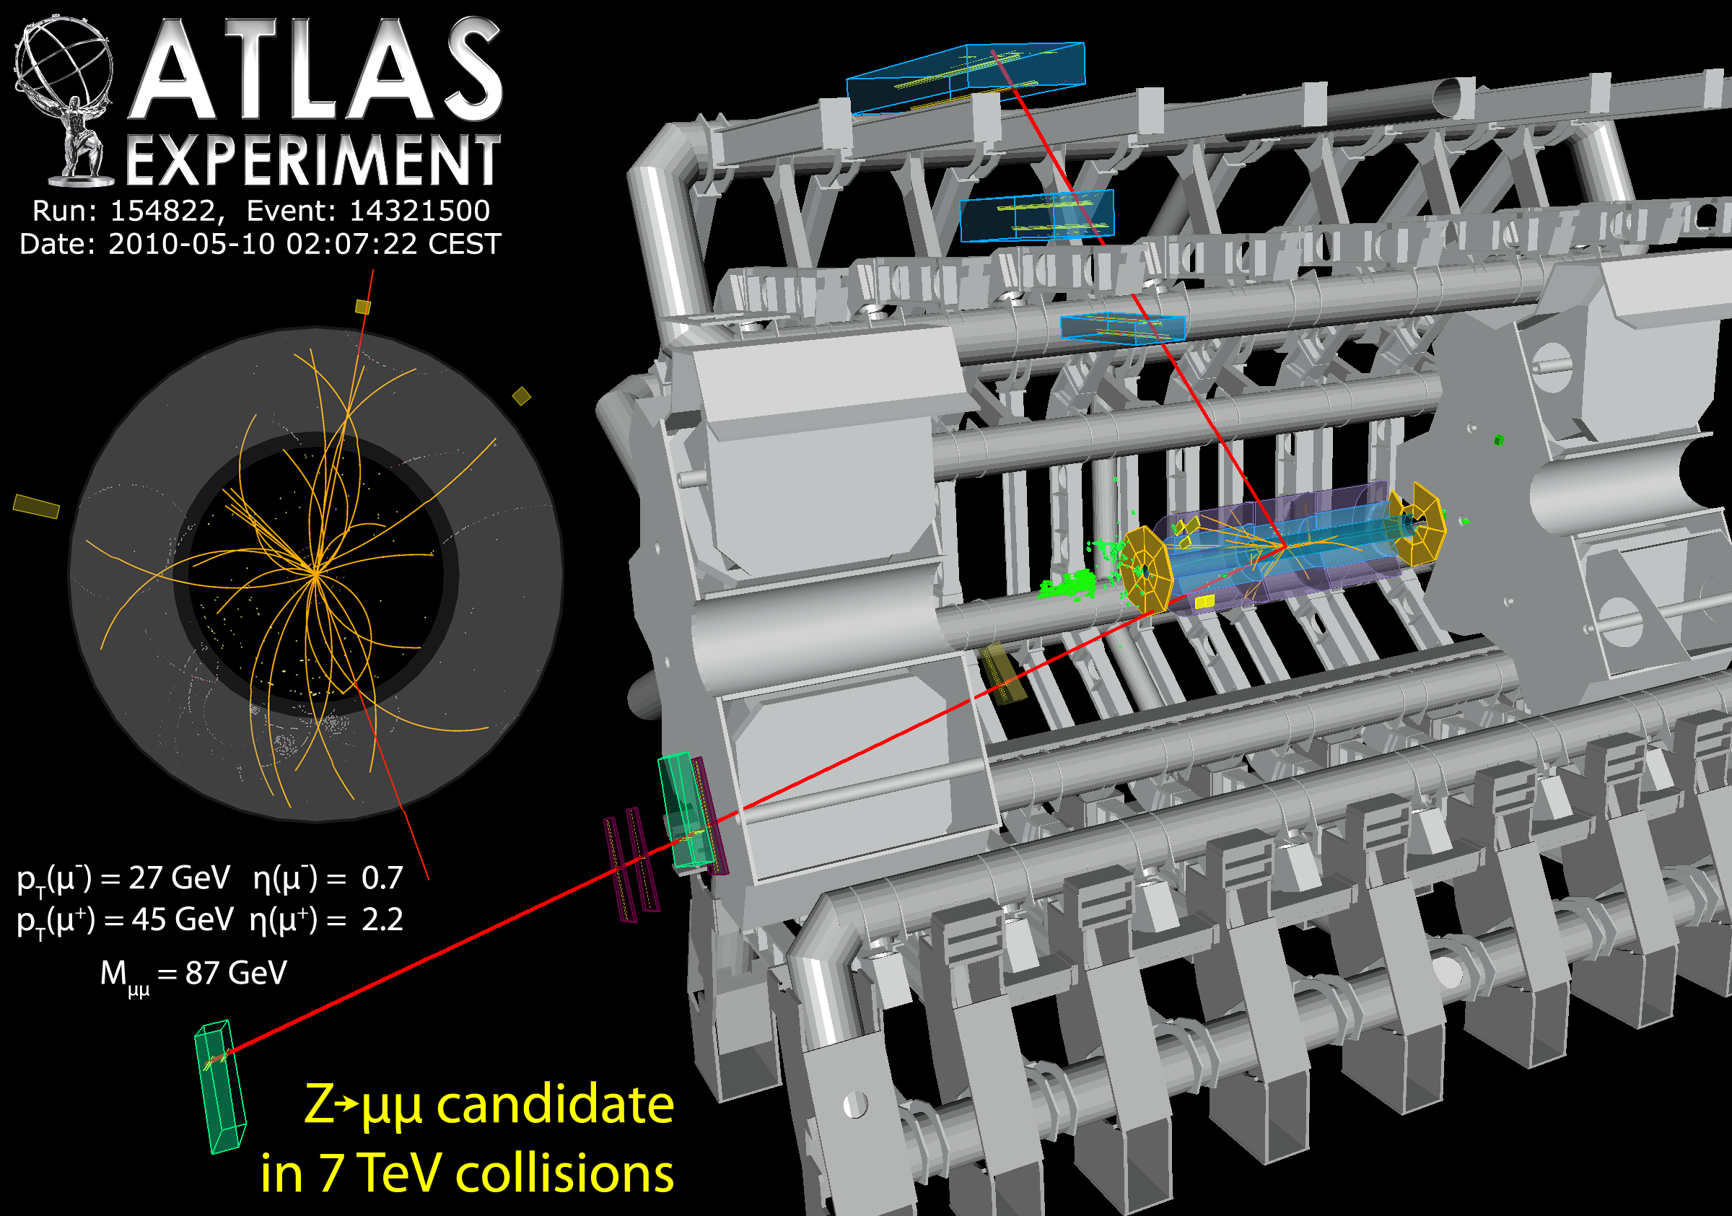

How do you discover a Z particle ?
Deviations from the prediction without a Z boson
muon
2-muons as seen in the ATLAS detector
proton
Z-particle ?
proton
muon
What is the fingerprint of the Z particle:
→ the di-muon mass

Slide 22

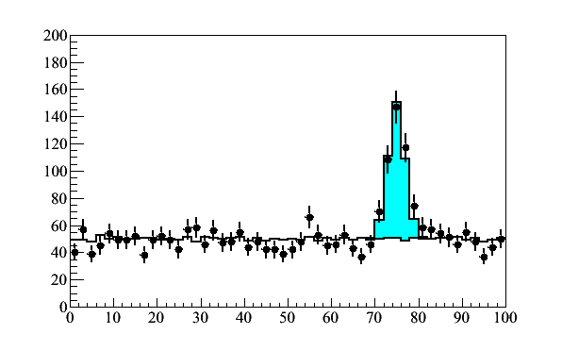
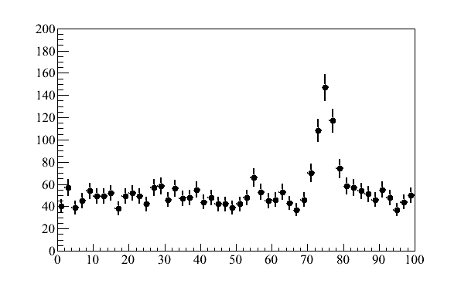
di-muon mass
‘other’: no preference/structure
Z-boson: Breit-Wigner  resolution
di-muon mass
di-muon mass
Z-boson
Number of candidates
Number of candidates
‘other’
di-muon mass (GeV)
di-muon mass (GeV)

Slide 23
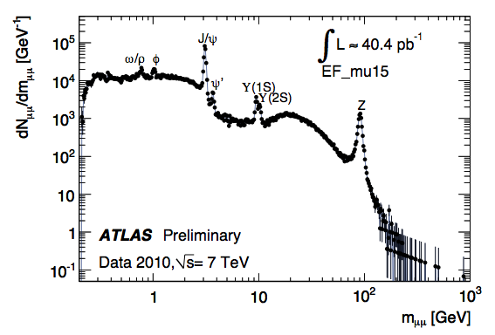
Di-muon resonances seen at the LHC
di-muon mass
We now have 500x more data

Slide 24
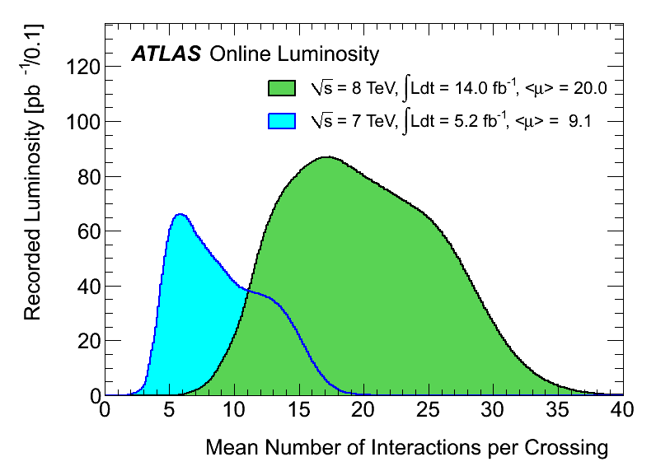
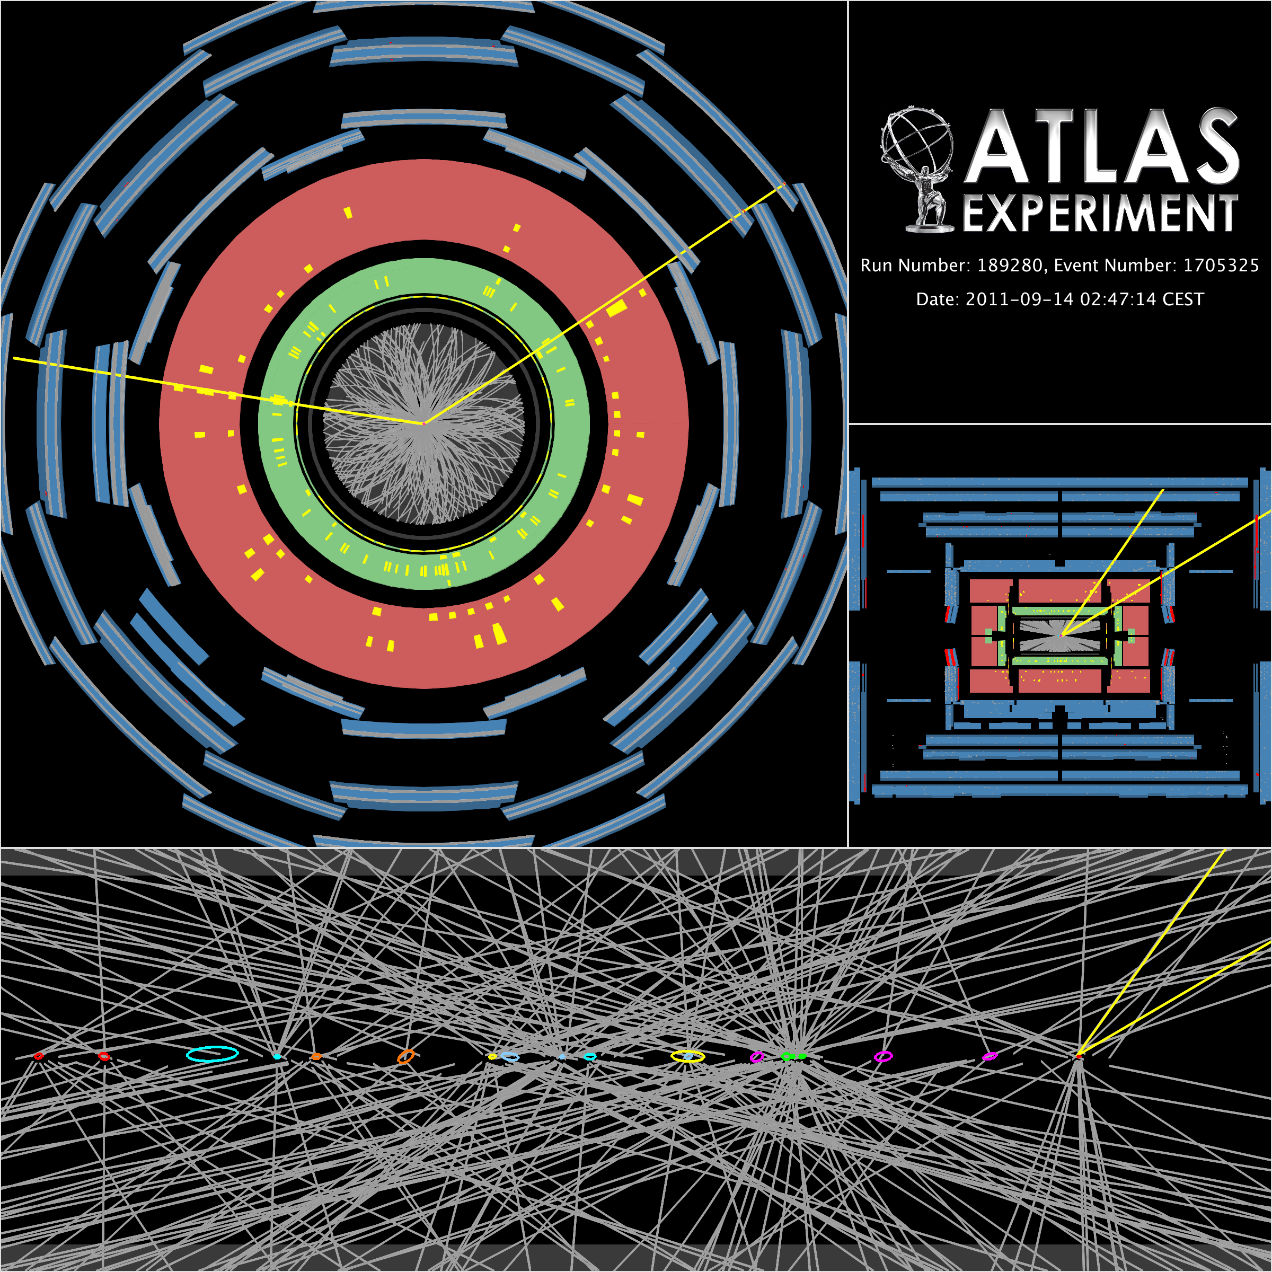
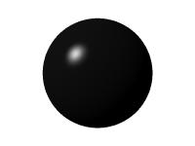
LHC is not a quiet environment
Number of interactions
per bunch crossing
Z →μ⁺μ⁻ event with 20 vertices
μ⁺
√s = 7 TeV
<μ>= 9.1
√s = 8 TeV
<μ>= 20.0
μ⁻
μ⁺
μ⁻
Vertex region

Slide 25
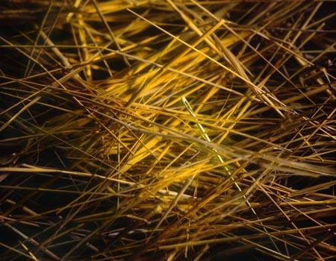
Trigger:
From 40 MHz (LHC) to a few hundred Hz
Bottleneck: disk space
Selecting interesting physics from an e-nor-mous background
15-dec-2011
Amsterdamse Academische Club UvA
25

Slide 26
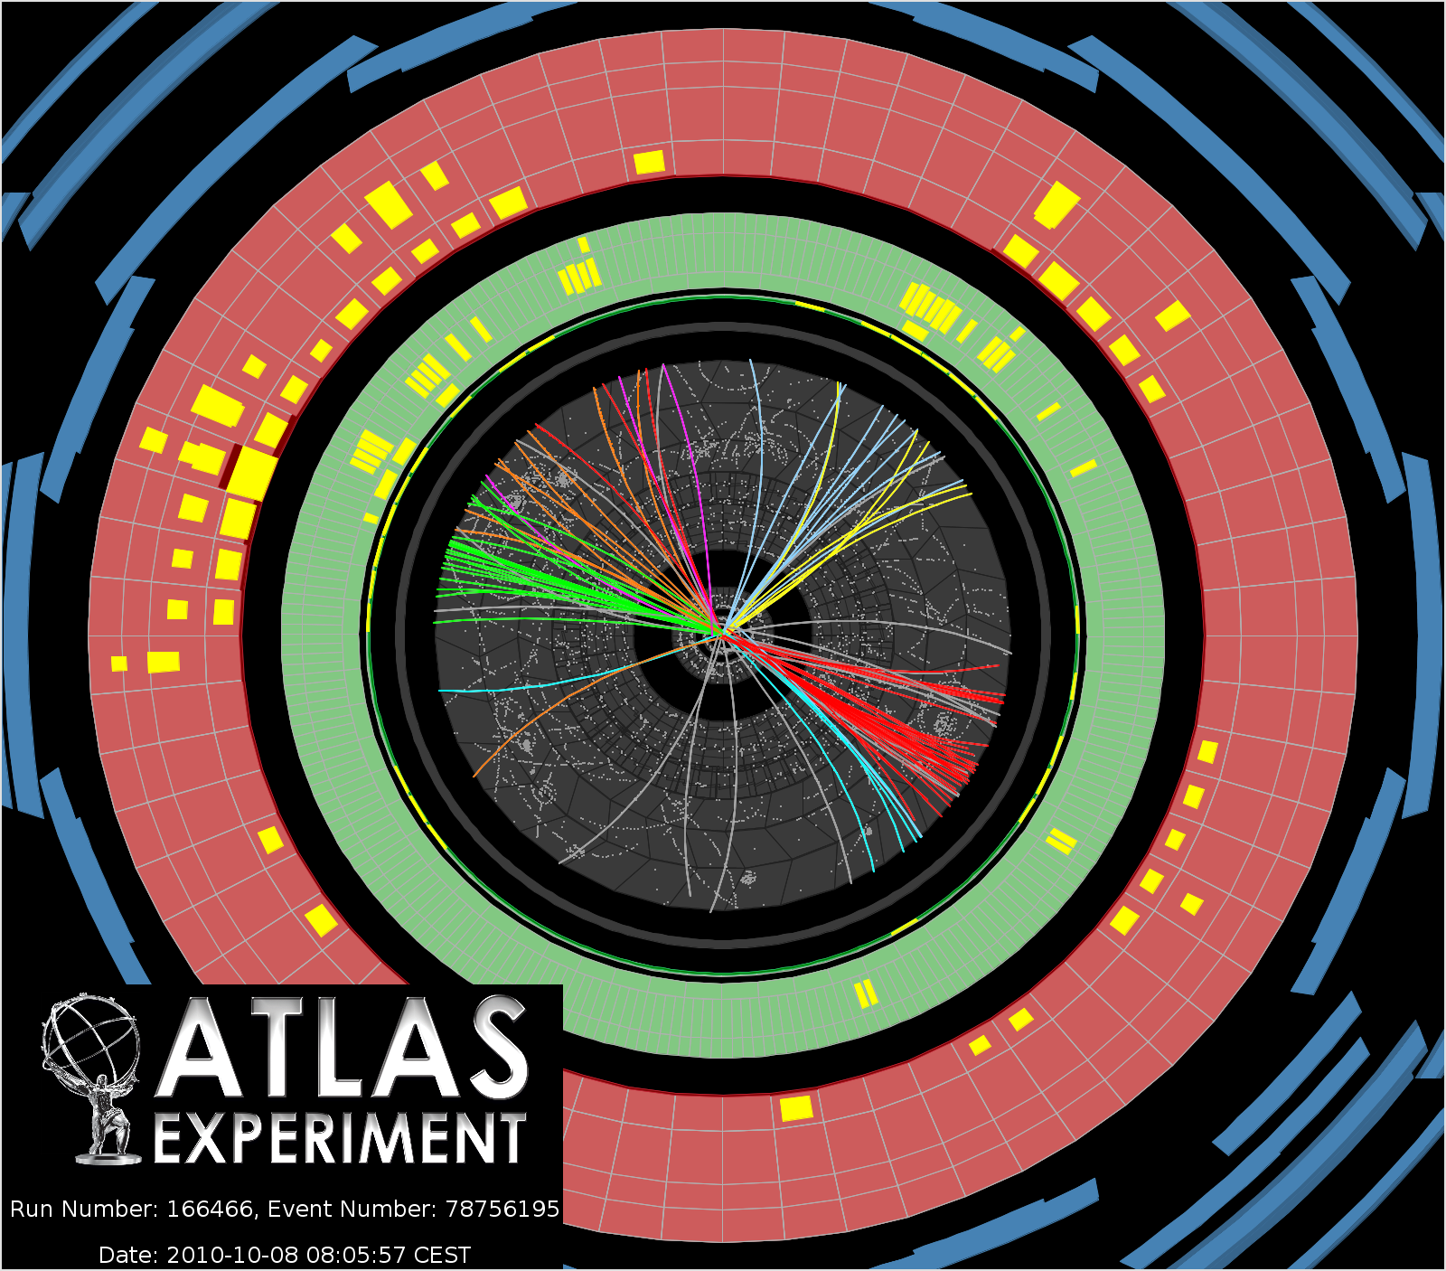
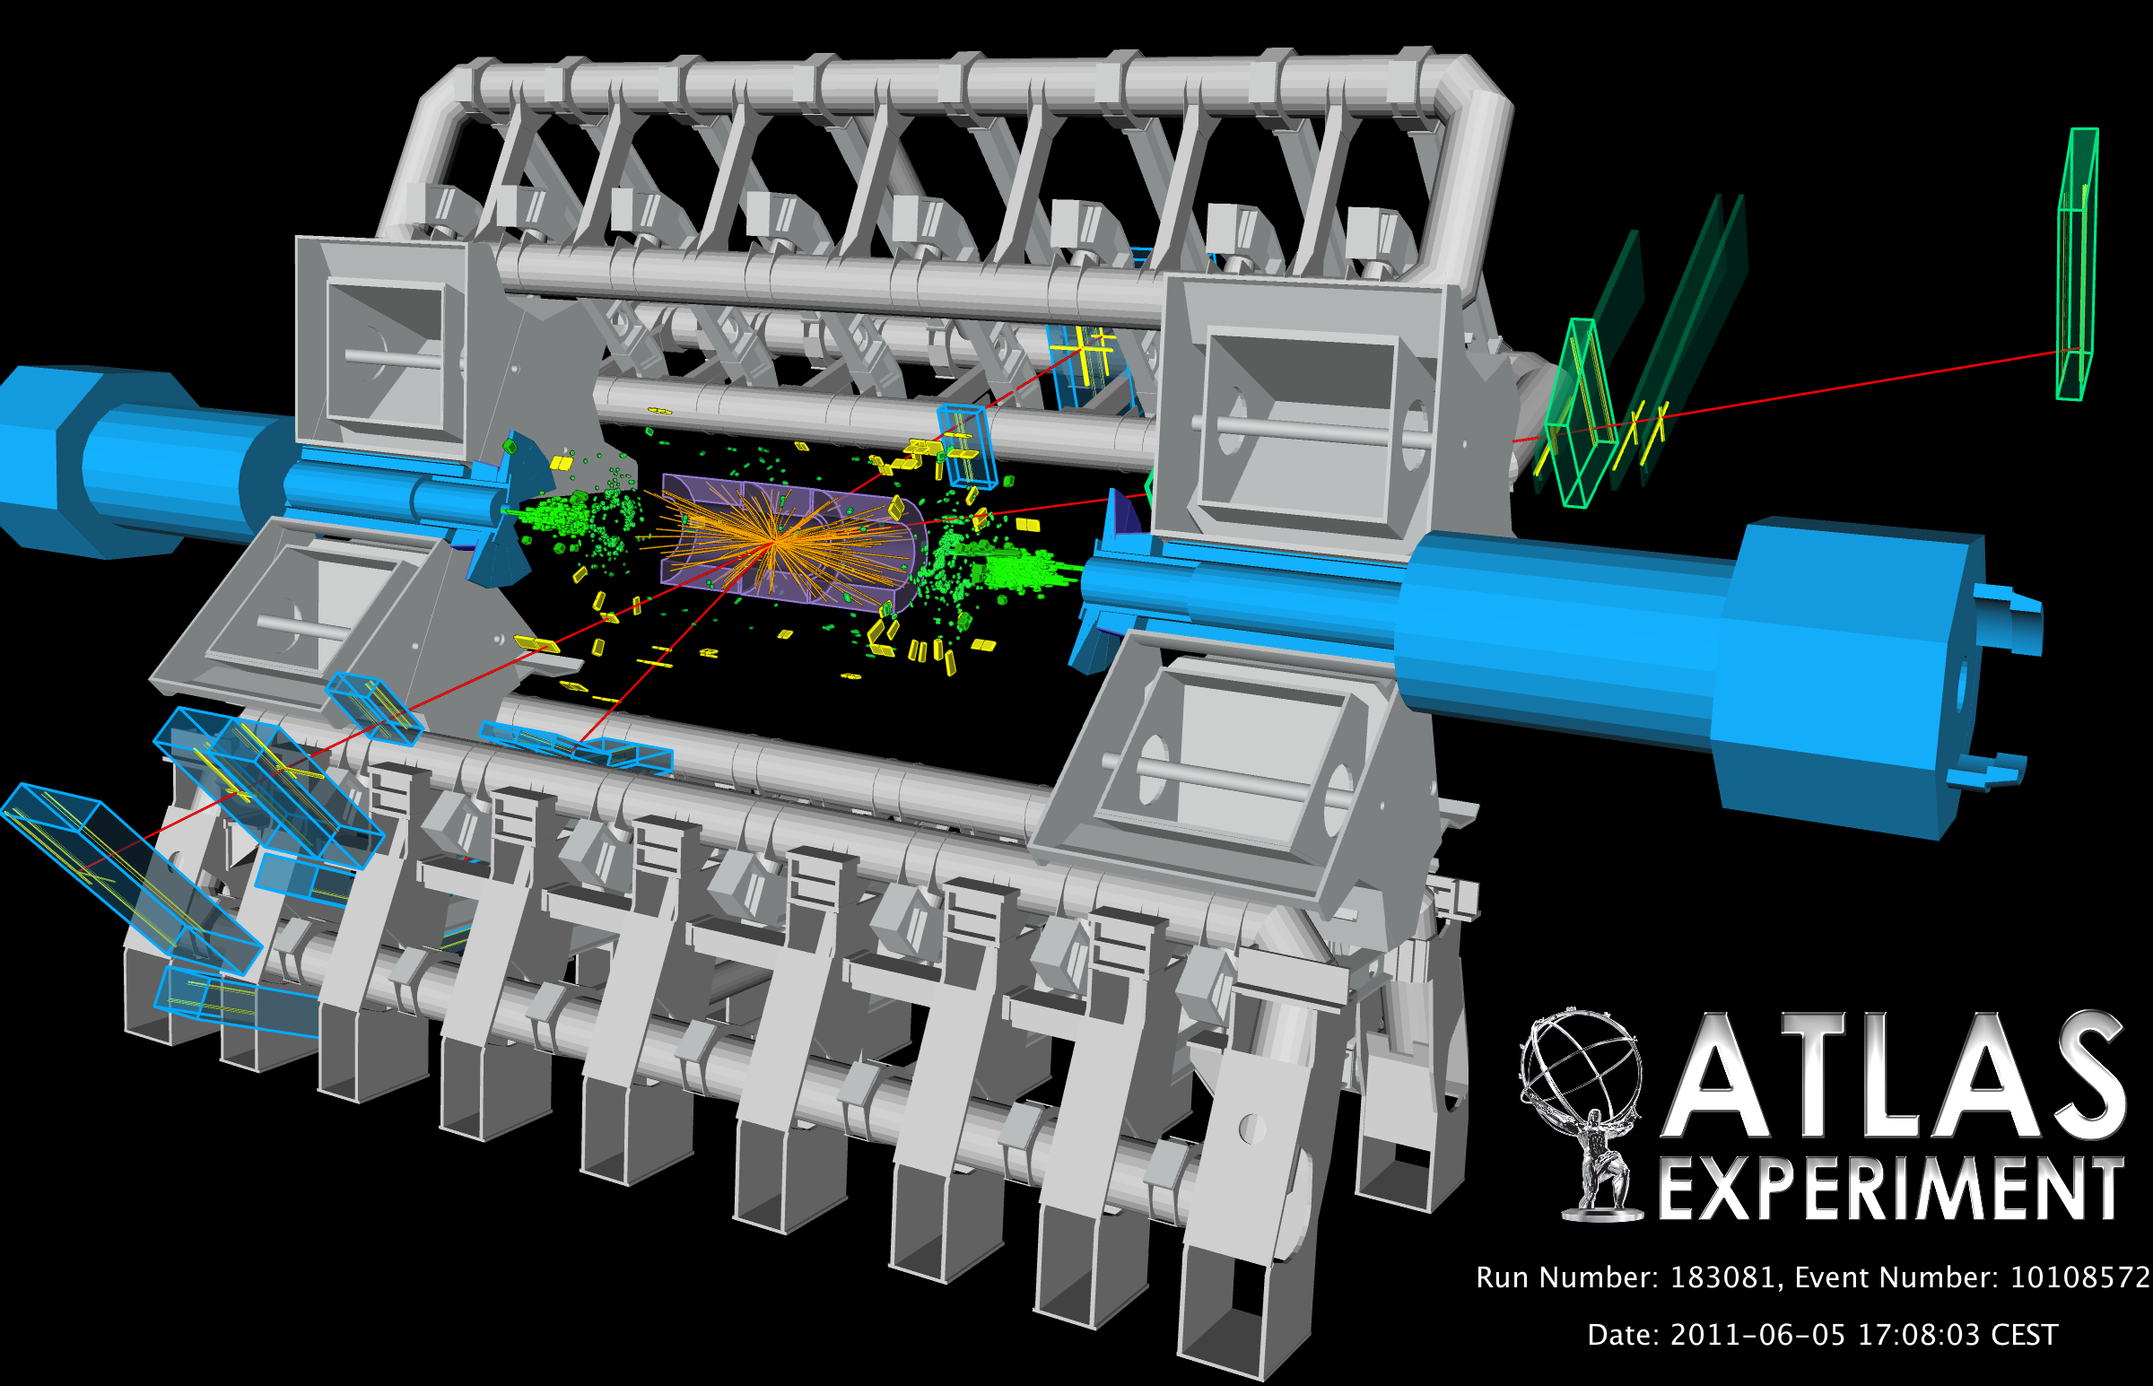
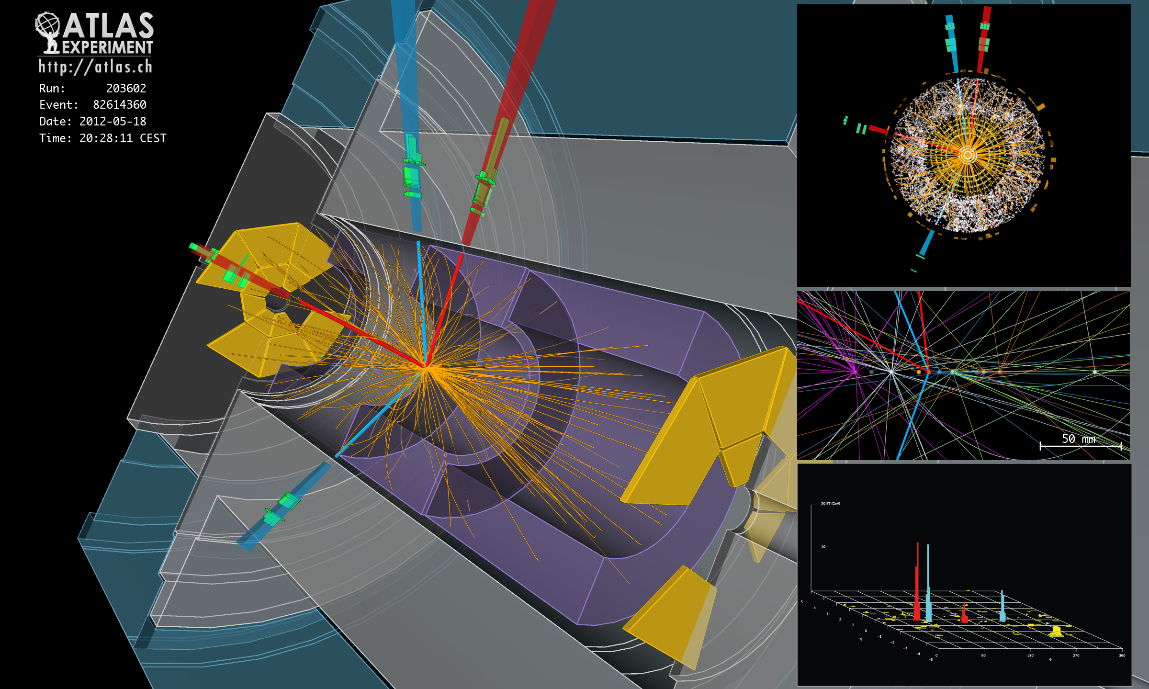
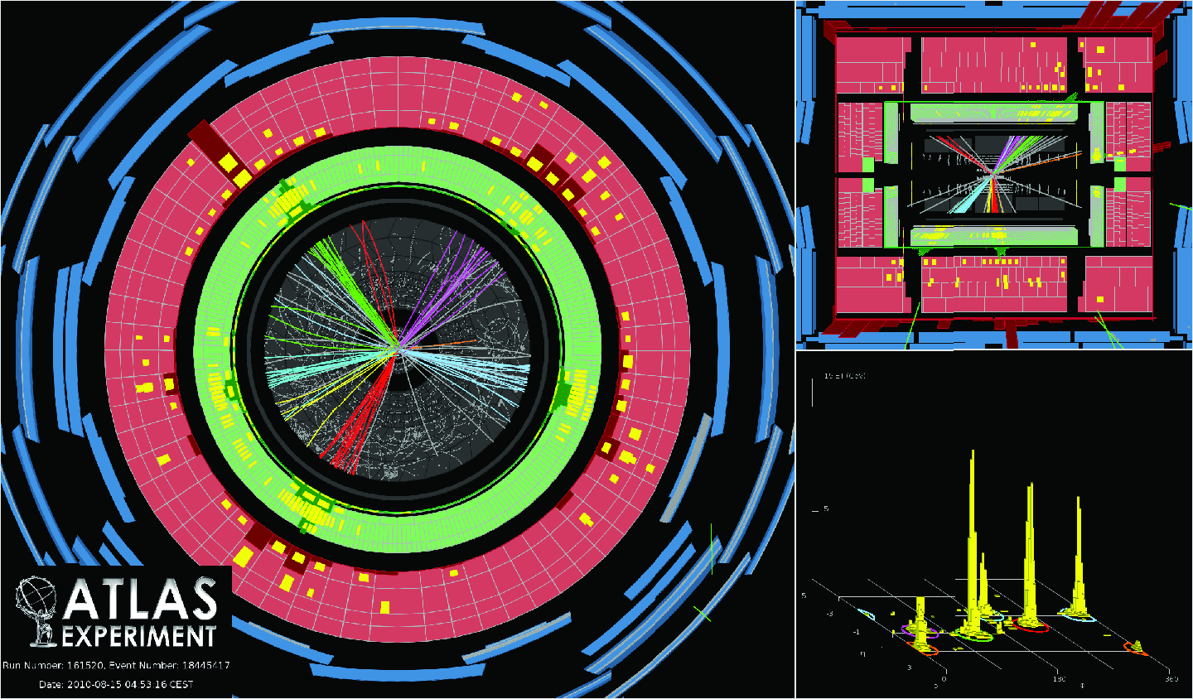
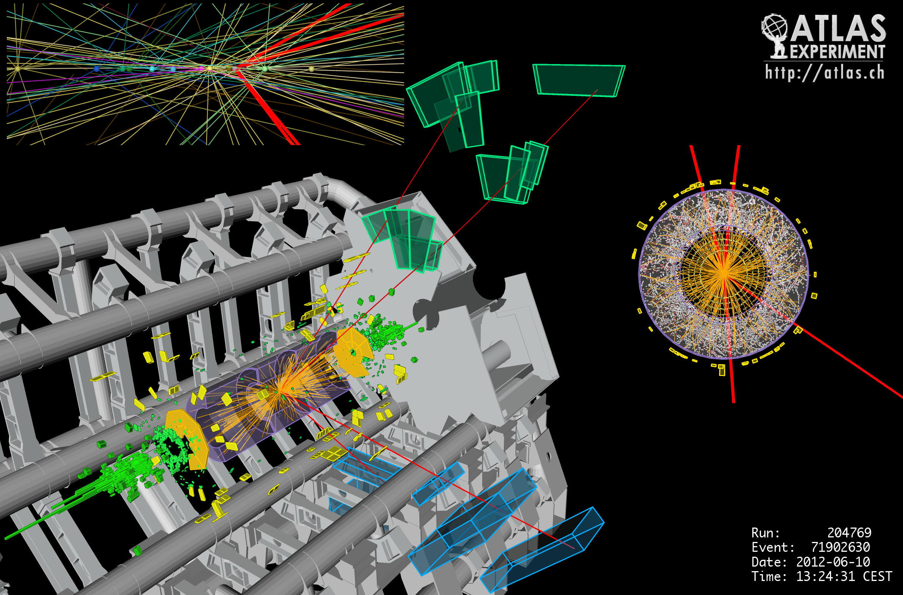
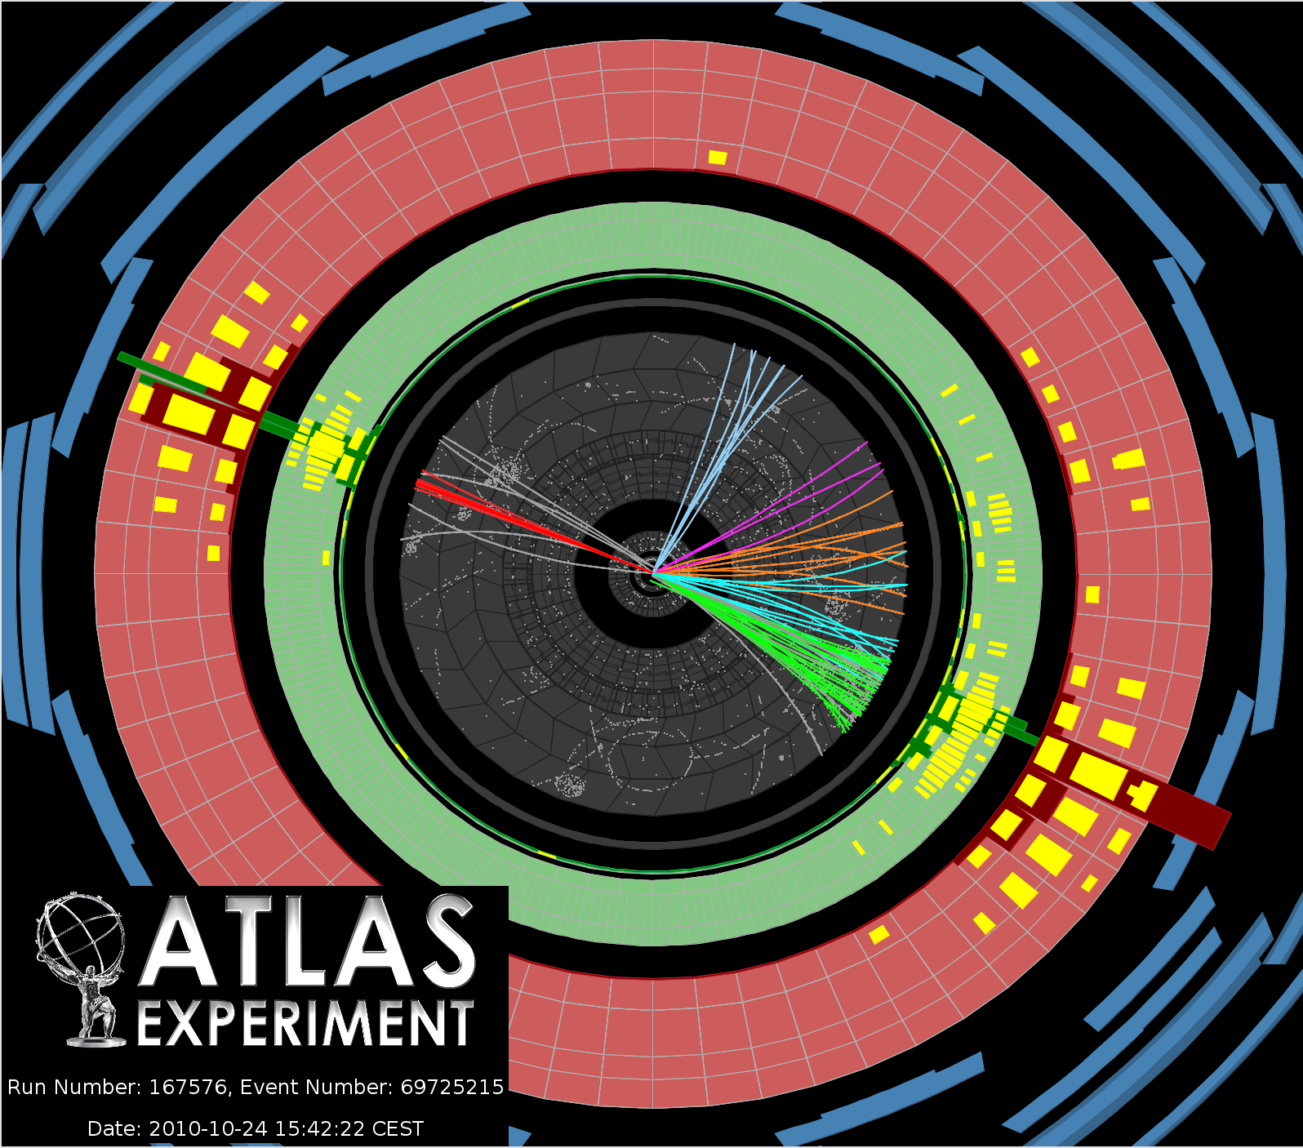

Slide 27
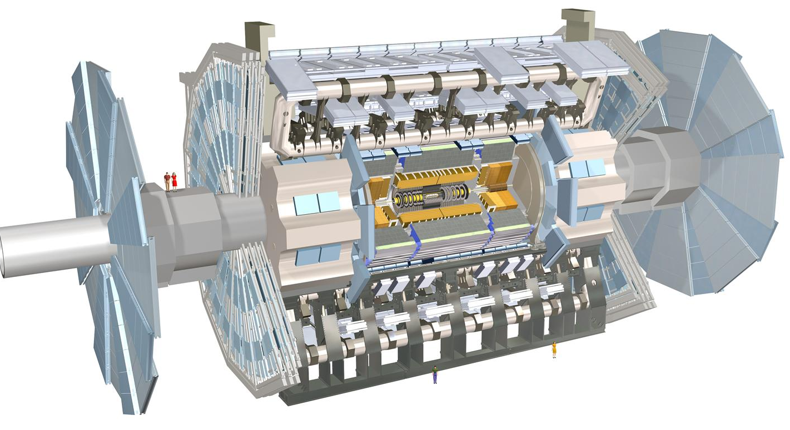
The ATLAS detector
(as a computer model)

Slide 28
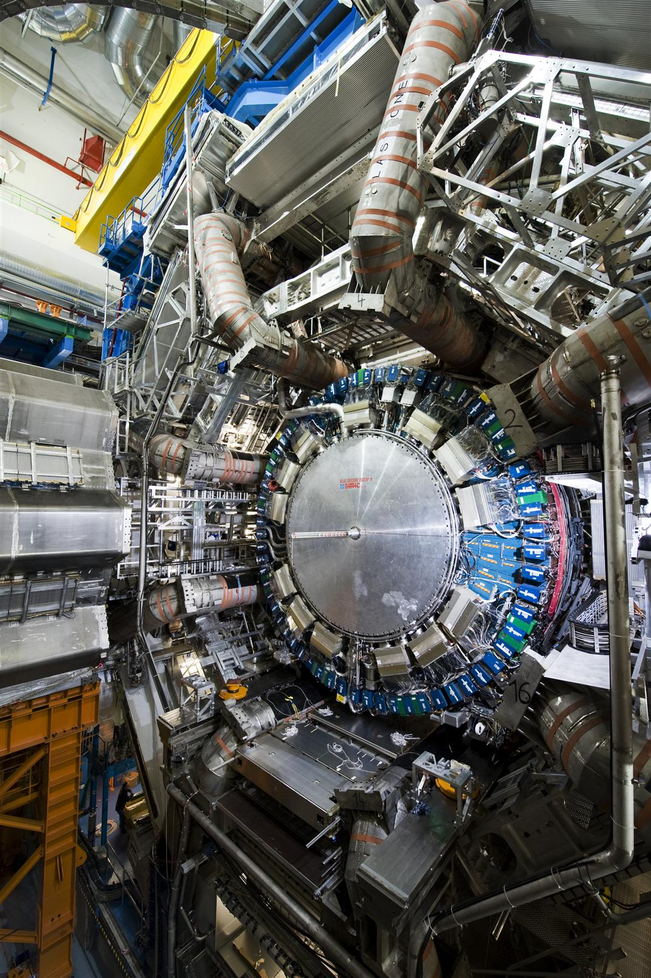
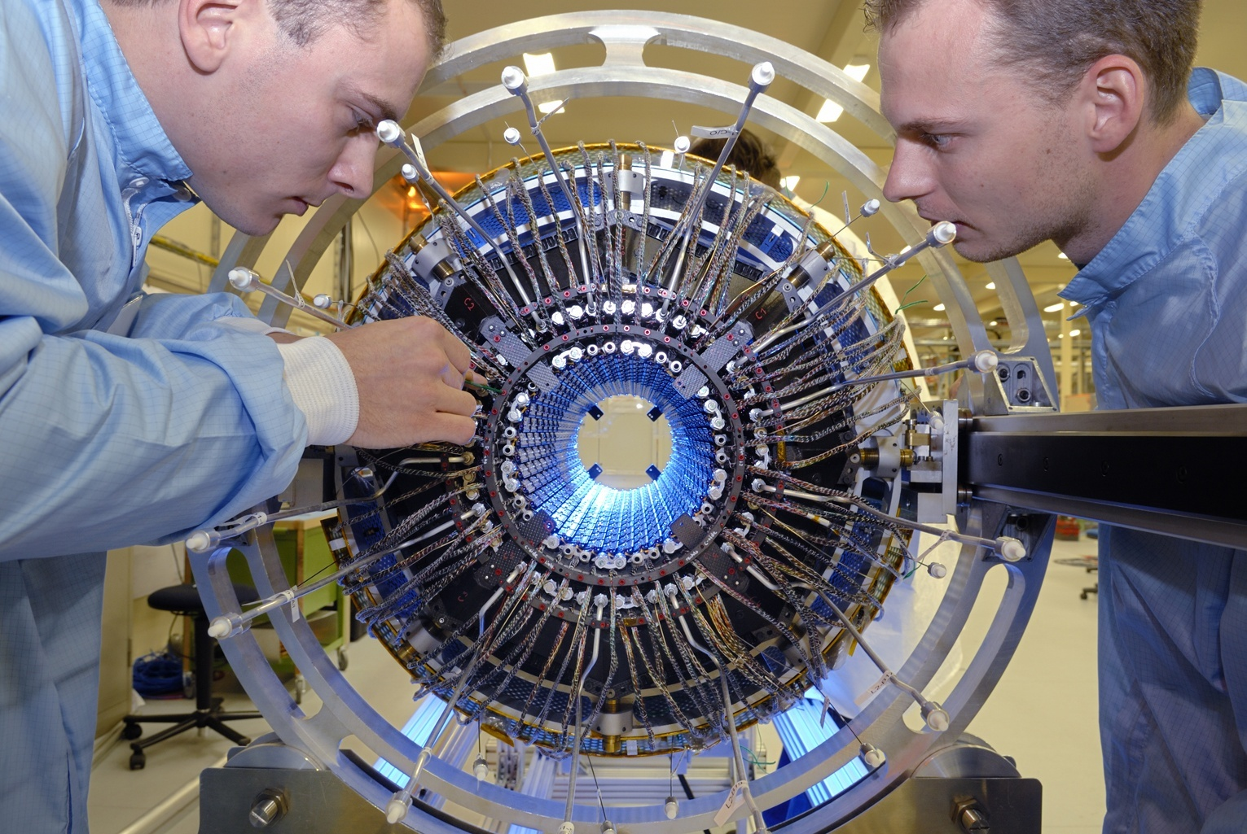
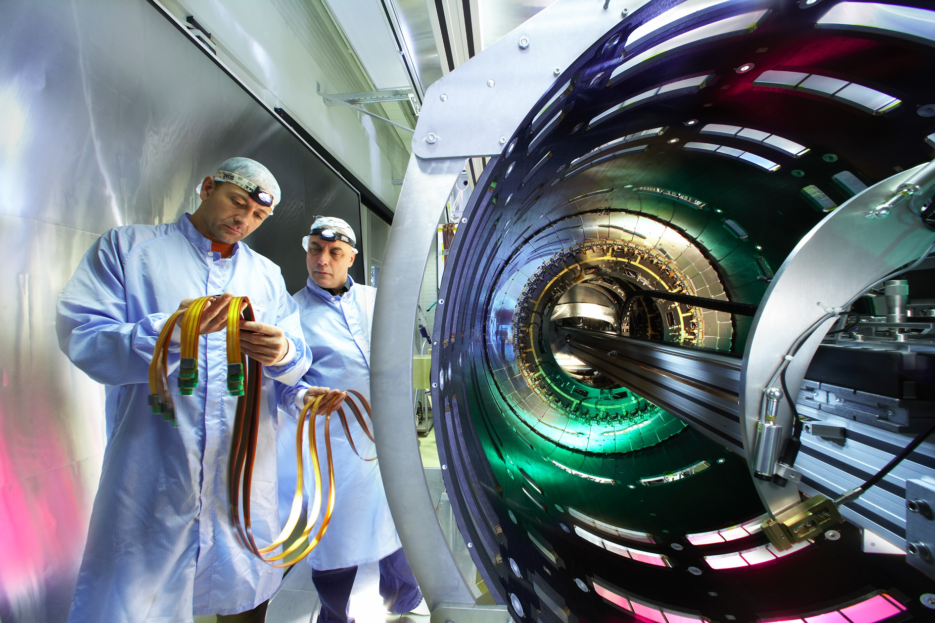
The ATLAS detector
(in real life)
25/78

Slide 29
The Atlas pixel detector
80 MegaPixel camera
40.000.000 pictures per second

Slide 30
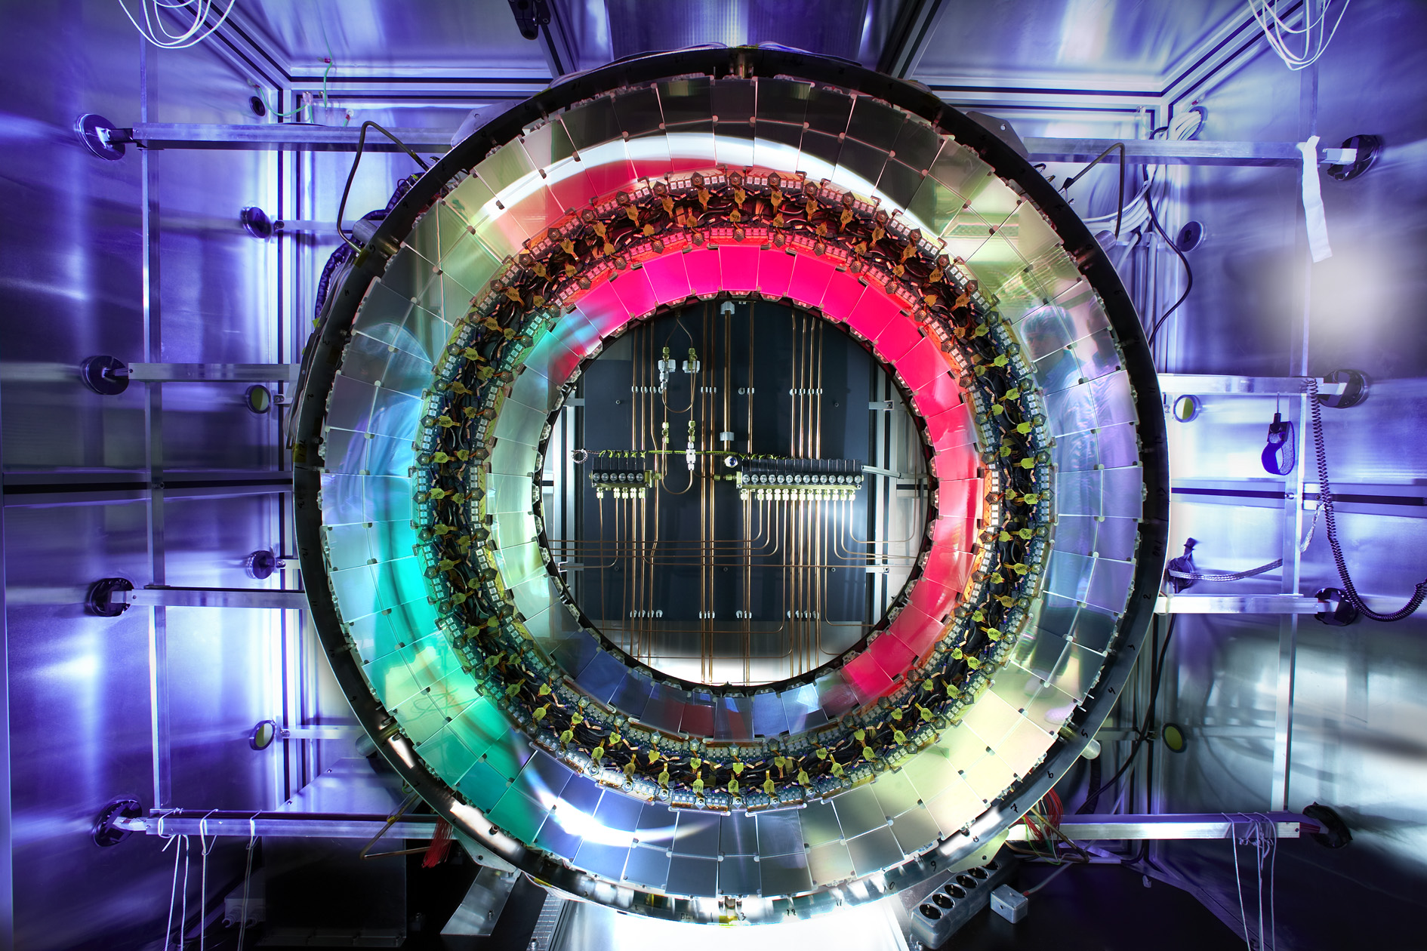
Part of the ATLAS detector has been designed and built at Nikhef

Slide 31
μ⁻
μ⁺
Z → μ⁺μ⁻ candidate

Slide 32
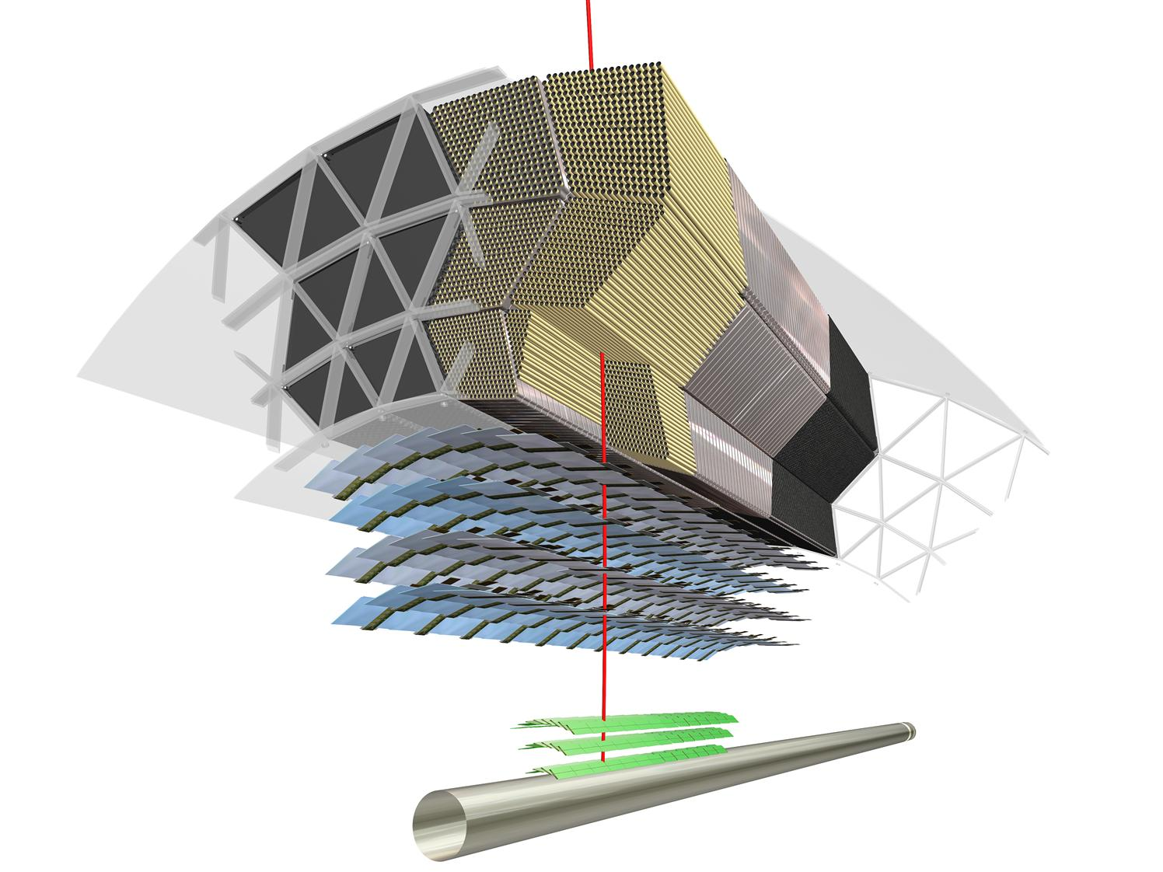
Complex structure ATLAS detector ?
Wide range of particle types / characteristics
particle
Transition Radiation Tracker
barrel: ≥ 30 straws
SemiConductor Tracker
barrel: 4 layers (x2)
Pixel detector
Momentum charged particles: Tracking detectors in a 2T solenoid field
barrel: 3 layers
30/78

Slide 33
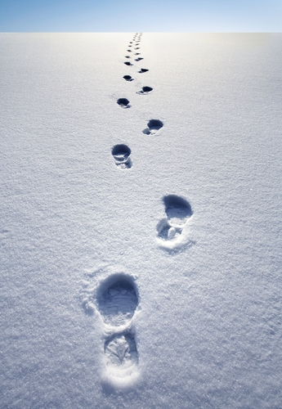
Rabbit, car or human ?

Slide 34


Quarks (jets)
Neutrino
Charged particles
CSI CERN
electrons
B-quarks
Trigger
Muons

Slide 35
The mass of the Higgs boson
0
50
100
150
200
250
300
350
400
450
500
Higgs boson mass (GeV)
W/Z boson
Gold atom
Alpha particle

Slide 36
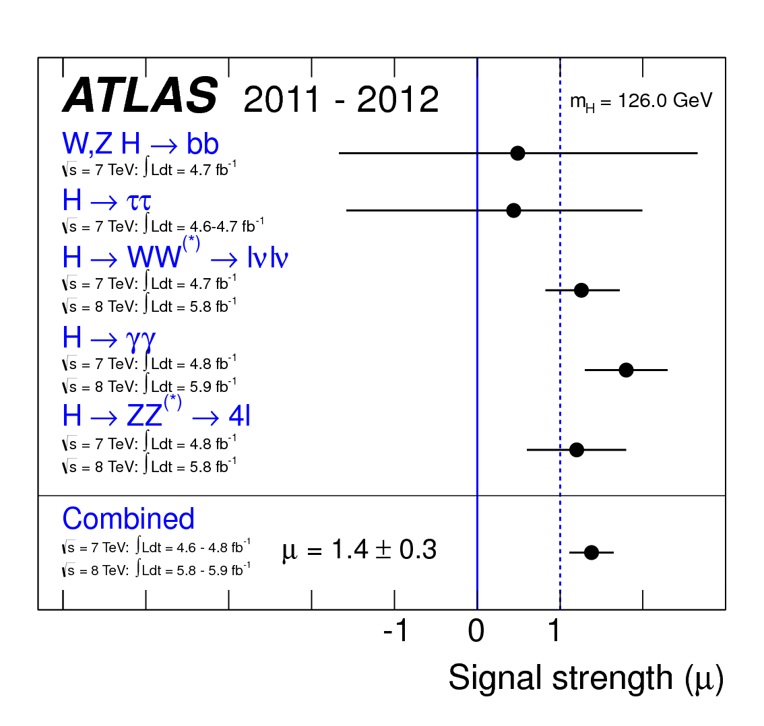

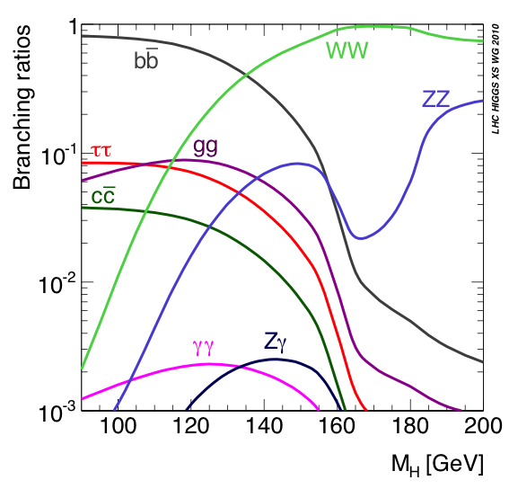
Kloppen Higgs’ eigenschappen ?
m_{h}=125 GeV
Standaard Model
Higgs boson massa (GeV)
voorspelling
meting
55/60

Slide 37
Higgs boson verval naar 2 fotonen

Slide 38
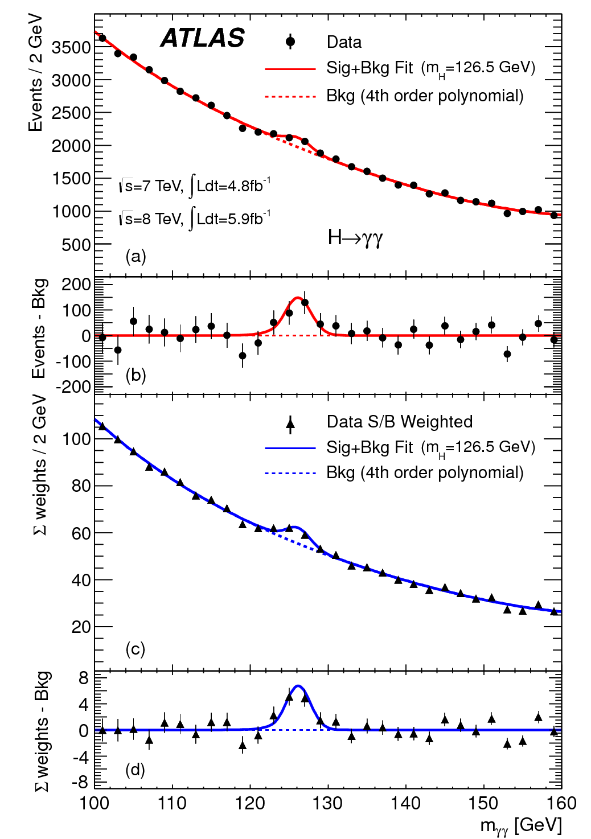
The ATLAS data

Slide 39
The ATLAS data
7 TeV + 8 TeV data
Quantify the significance ?

Slide 40

Combine the evidence
h→γγ, h→ZZ* and h→WW*

Slide 41
Higgs boson verval naar 4 muonen

Slide 42
muon
muon
muon
muon
Higgs → ZZ*→ 4μ candidate

Slide 43

Look here (m_{h} = 125 GeV)

Slide 44
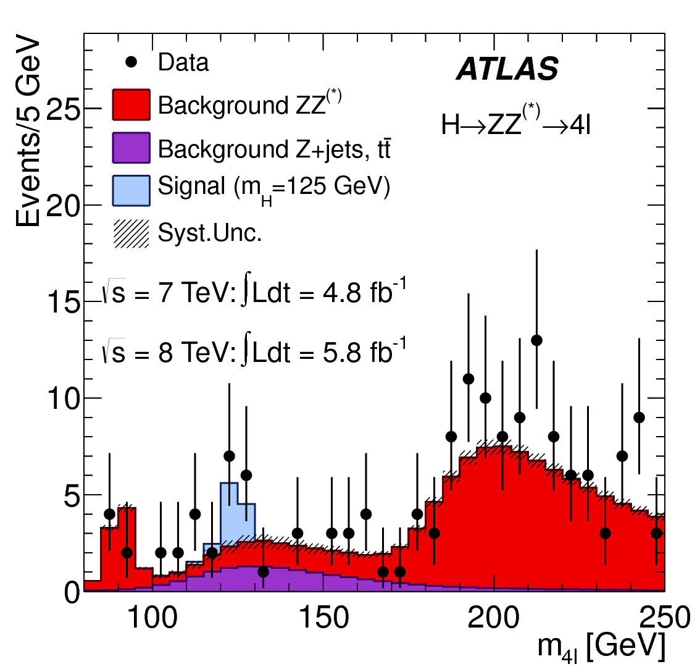

Slide 45
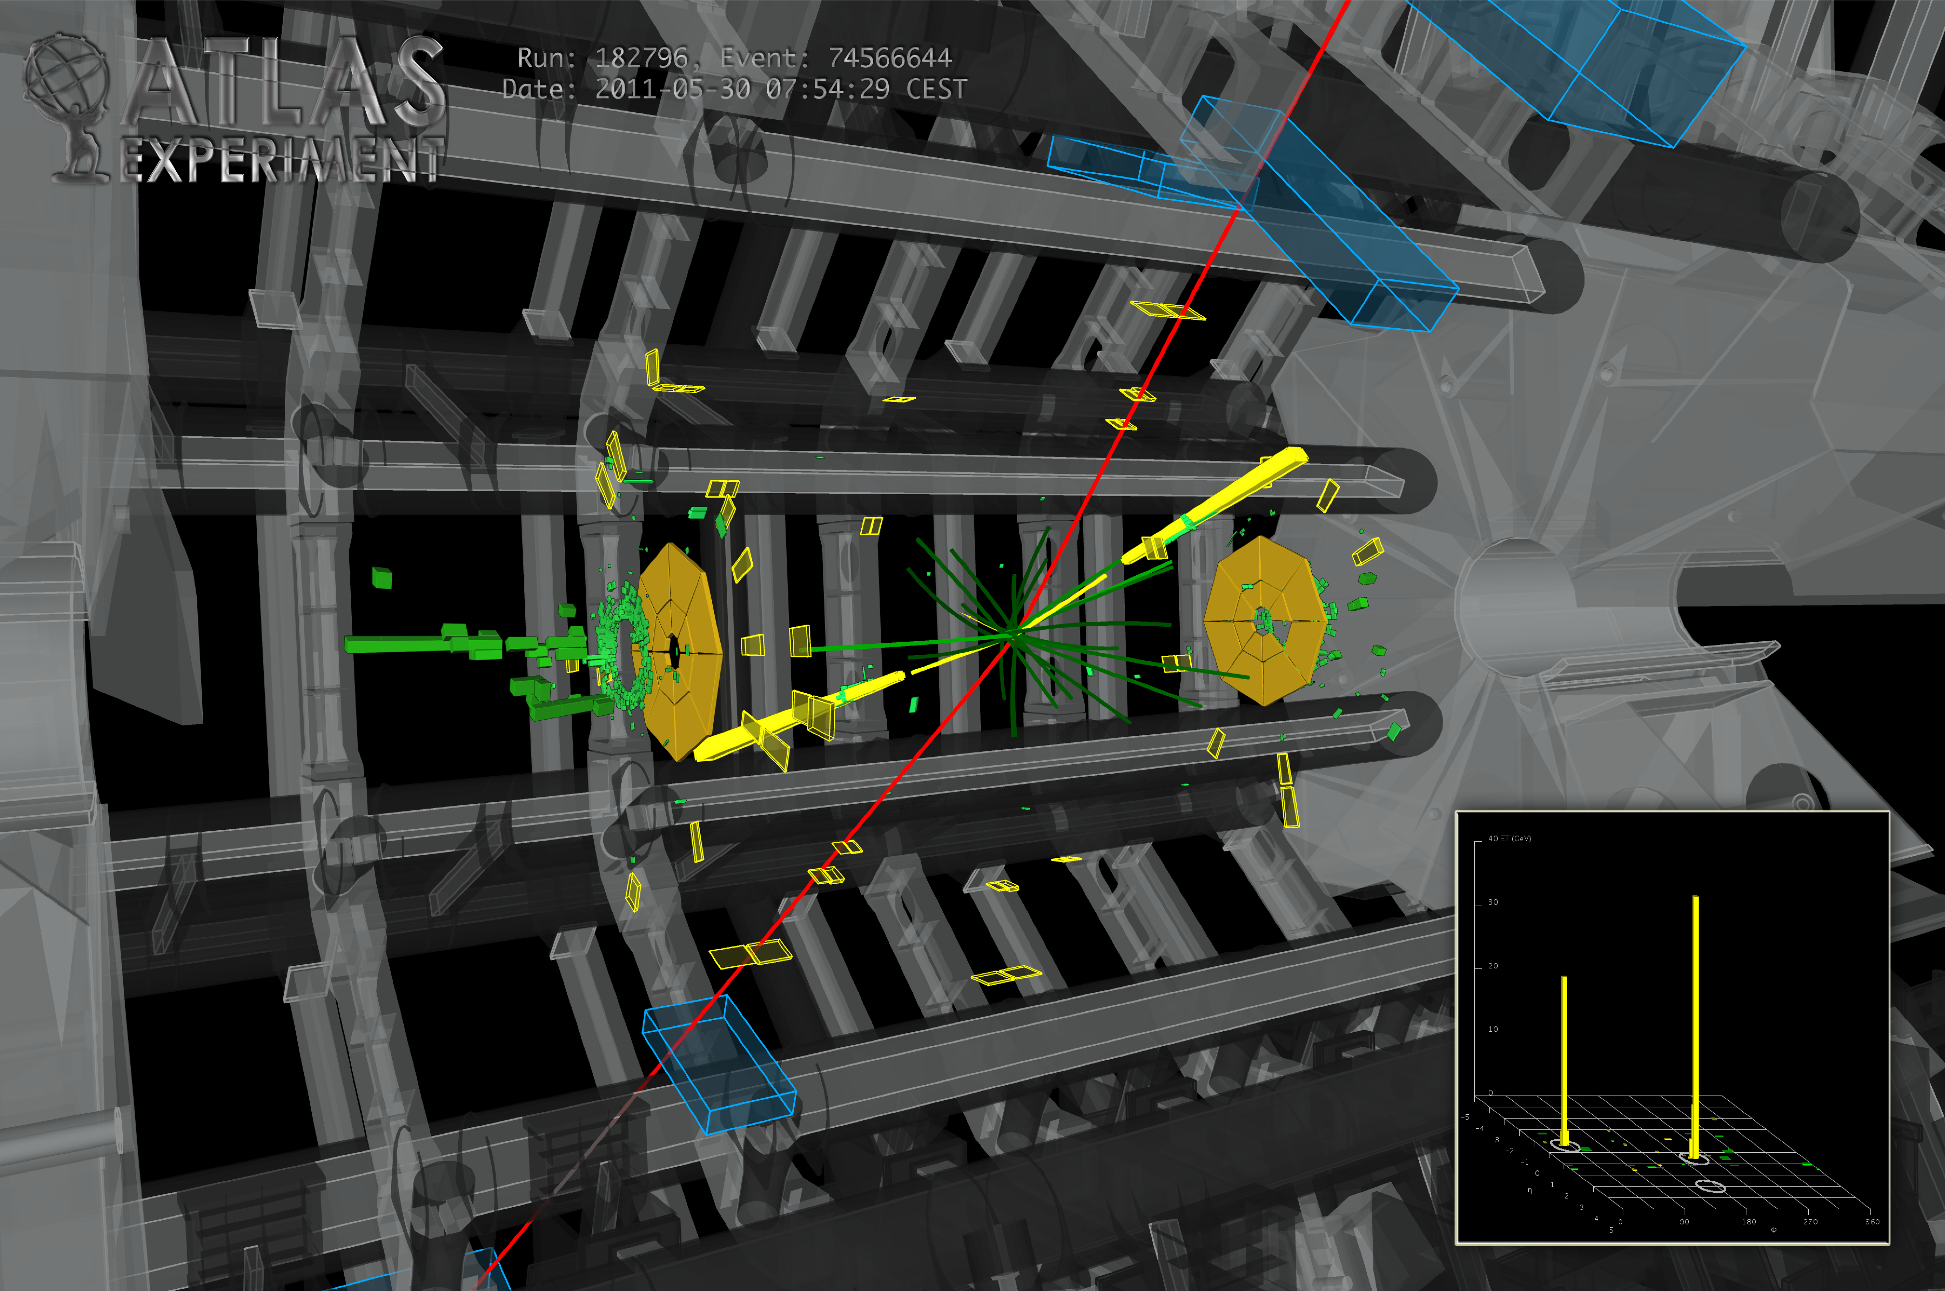
Another Higgs candidate: 2 electrons and 2 muons

Slide 46
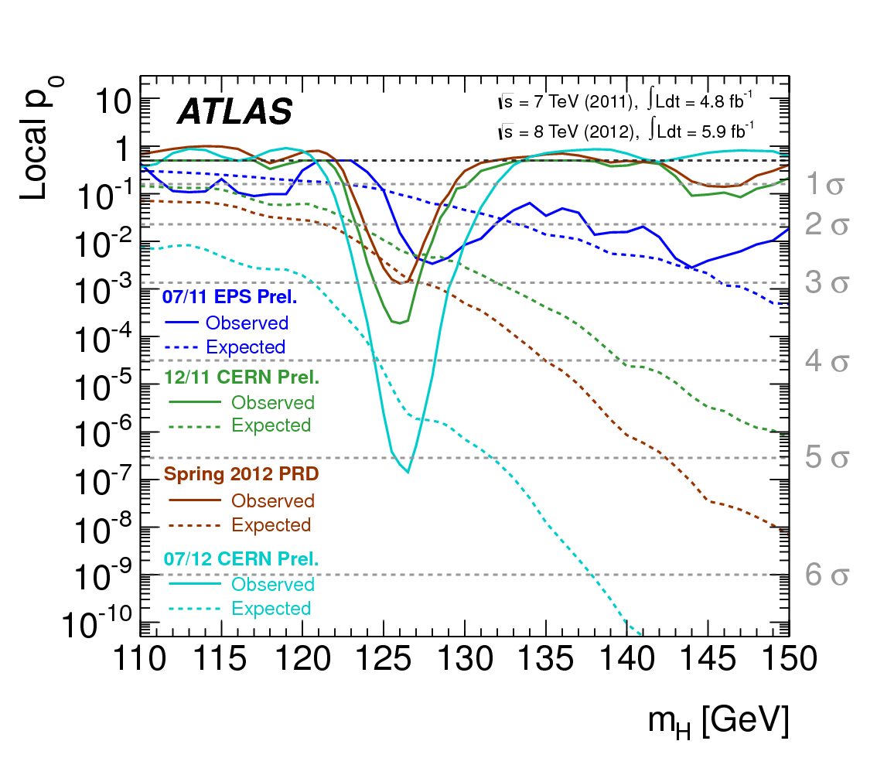
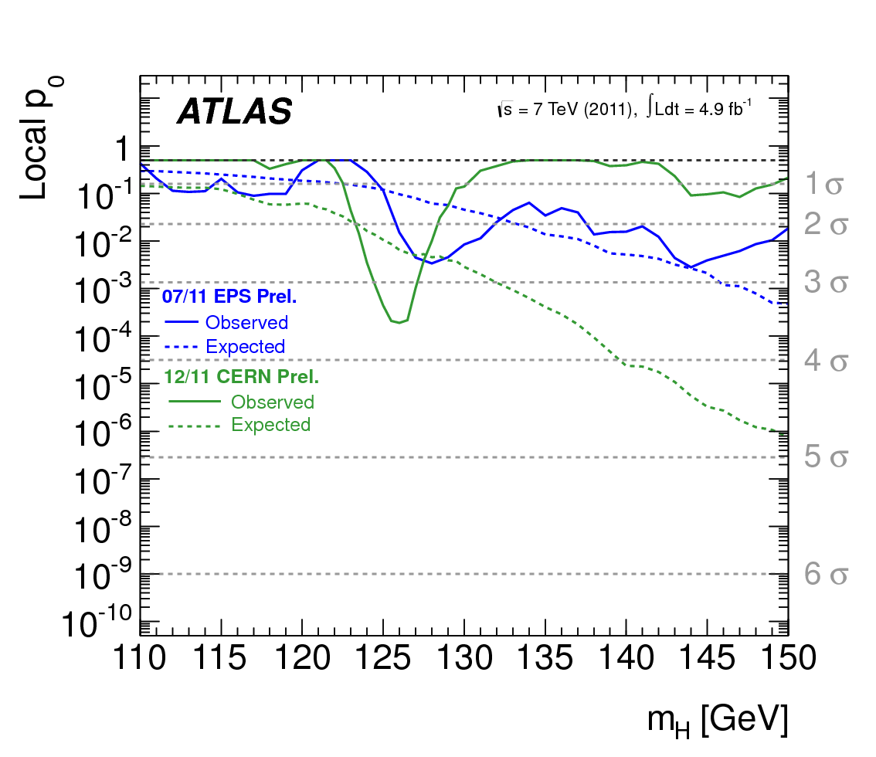
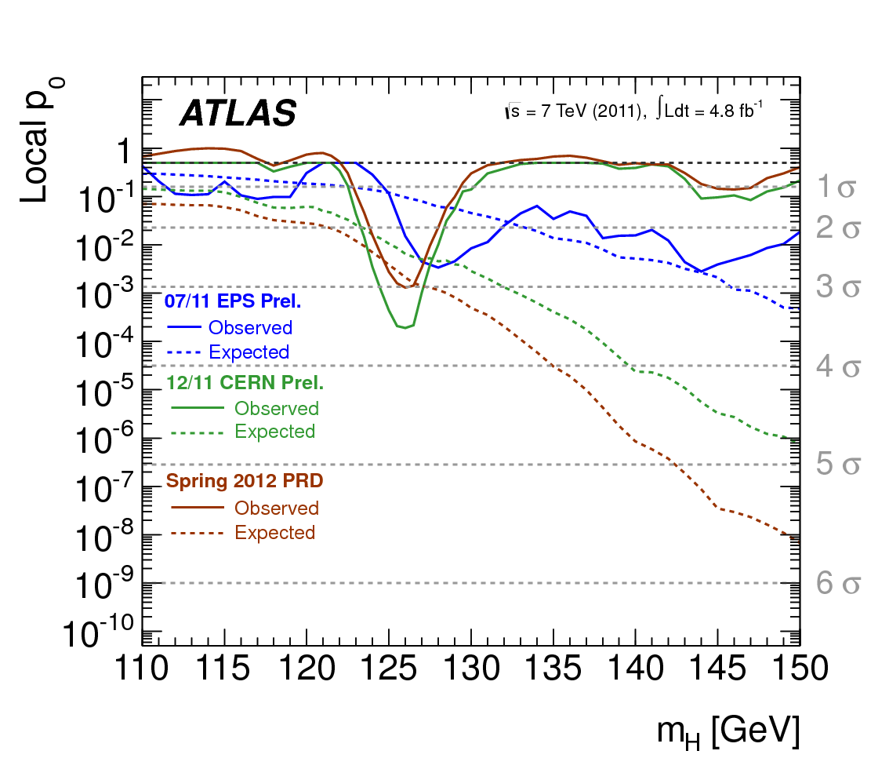
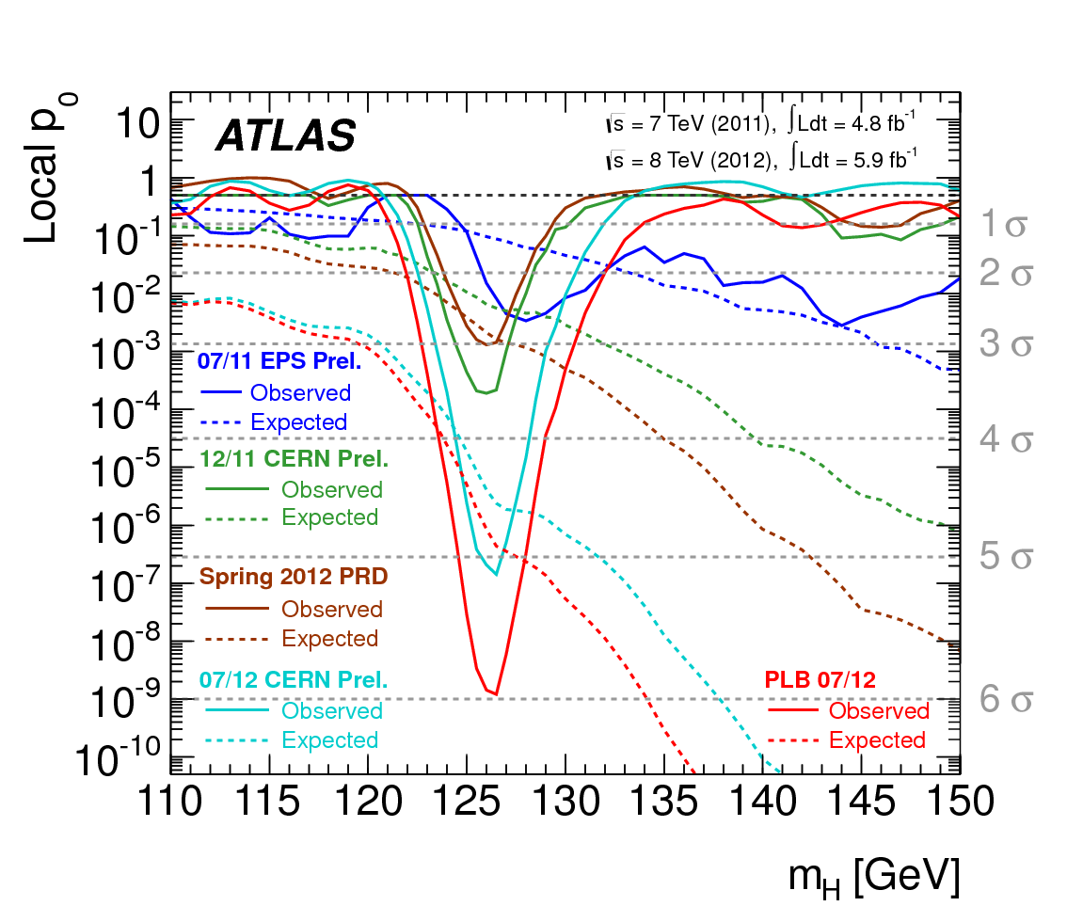
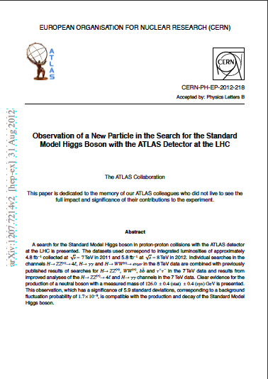

A discovery in slow-motion
Time-line higgs discovery
jul/11
jul/11
jul/11
mar/12
jul/11
mar/12
mar/12
dec/11
dec/11
dec/11
dec/11
jul/12
jul/12
aug/12
m_{h} = 126.0 ± 0.4 (stat) ± 0.4 (syst) GeV

Slide 47

‘Are you sure Ivo ?’
‘Yes Diederik, we’re pretty sure’
‘Independent cross-check ?’ ‘ Yep!’

Slide 48


Comparison results from ATLAS and CMS experiments
CMS
ATLAS experiment
Conclusion (in July):
2 experiments observe new particle
- CMS more sensitive than ATLAS
… but ATLAS was lucky
ATLAS had highest observed significance
expected
observed
70/78

Slide 49



Presentation CMS en ATLAS experiment: Higgs boson discovery

Slide 50

5 juli 2012: ok now what ?

Slide 51



Imagine that one of the mars landers finds life …
… then 1000 questions come up

Slide 52
Kloppen Higgs’ eigenschappen ?
m_{h}=125 GeV
Standaard Model
Higgs boson massa (GeV)
voorspelling
meting
55/60

Slide 53

Some ‘tiny’ issues in a world with a Higgs field:
Higgs does not give any hint to particle masses or dark matter
Contribution to factor 10⁵⁴ off
Why is the universe larger than a football ?

Slide 54
What are the remaining mysteries ?

Slide 55
Paar ‘kleine’ dingetjes:
96% of the energy in the universe is unknown
→ dark matter (24%) what is that ?
→ dark energy (72%) what is that ?
Where did all the anti-matter go ?
How do particles acquire mass ? Higgs boson
Why is gravity so weak ?
1
2
✔
3
4

Slide 56
particles
anti-particles
Supersymmetric-particles

Slide 57



Dark Matter
Theoretical idea: supersymmetry:
Anti-particles
particles
Lightest one = dart matter ?
Produce it yourself (LHC)
Look for collisions in earth (Xenon) ?
Signatures in space (Fermi)
supersymmetry: every particle has a heavier ‘brother’

Slide 58
Paar ‘kleine’ dingetjes:
96% of the energy in the universe is unknown
→ dark matter (24%) what is that ?
→ dark energy (72%) what is that ?
Where did all the anti-matter go ?
How do particles acquire mass ? Higgs boson
Why is gravity so weak ?
1
2
3
4

Slide 59
Is de zwaartekracht echt wel zoveel zwakker
dan de andere 3 natuurkrachten ?
Within a nucleus, all forces (except gravity) are equally strong
… and quantum theories
gravity ~10⁴⁰ times smaller
New theory: 1) Gravity is as strong as the other forces, but it only appears weak
because of the presence of extra space-dimensions
2) Around 10⁻²⁰ m gravitaty is as strong as the other forces

Slide 60


De 3+1 forces of nature
quantum theories
Sterkte
Standaard Model
onzeker > 1 TeV
sterke kernkracht
zwakke kernkracht
gravitatie
no quantum theorie
string theorie?
electromagnetische kracht
~10⁴⁰
Energie (GeV) ∝ afstand⁻¹
Electrozwakke schaal
Planck schaal
100 GeV ~10⁻¹⁸ m
10¹⁹ GeV ~ 10⁻³⁵ m

Slide 61



The 4 forces of nature
LHC experimenten
Standaard Model
onzeker > 1 TeV
Sterkte
Afwijkingen van Newtons 1/r²
Quantum gravitatie: gravitonen en mini zwarte gaten
Gravitonen zien eruit als piekjes in de 2-muon massa
1/r^{2+n}
1/r²
Energie (GeV) ∝ afstand⁻¹

Slide 62
particles
anti-particles
Wat do we know
What do we not know:
Nature moves in mysterious ways
LHC works beautifully!
Standard Model. Doing just fine!
The Higgs boson exists
Why the large spread in masses
What is dark matter made of ?
Why does gravity behave so different ?
Where did all the anti-matter go ?
Great adventure the coming years !
Ivo.van.Vulpen@nikhef.nl

