Slide 1
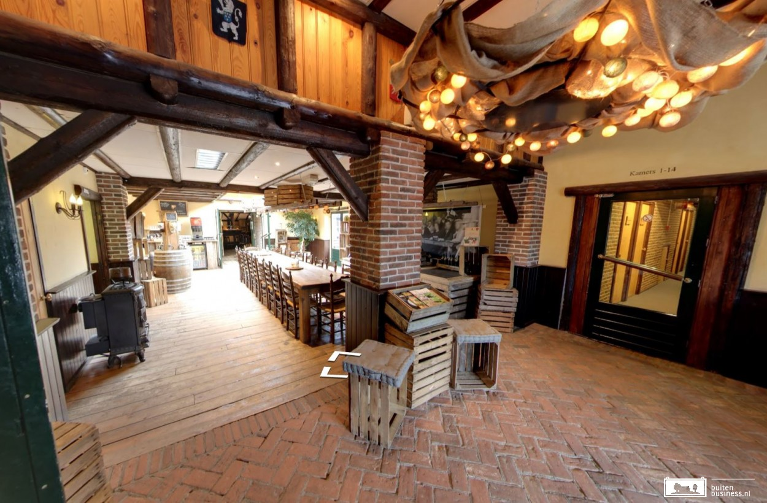
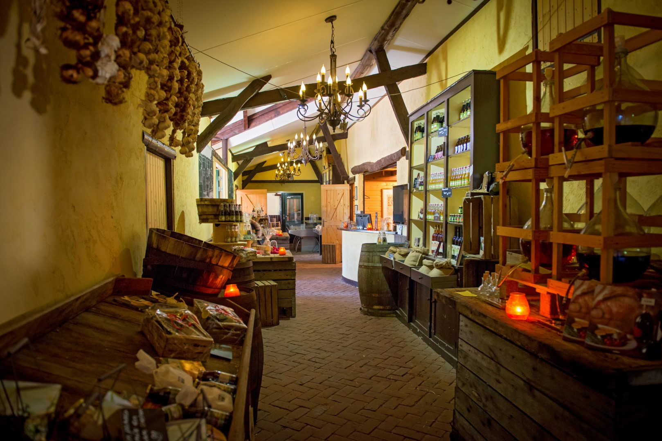
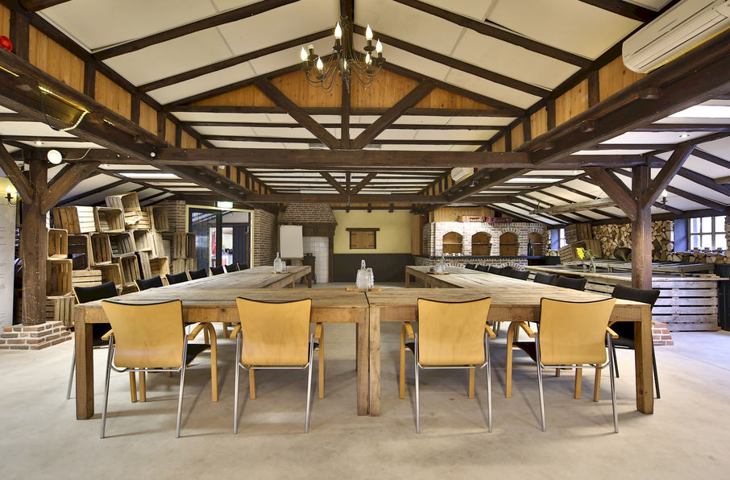
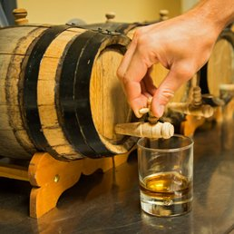
Welkom in de Heische Hoeve, welkom in Brabant!

Slide 2
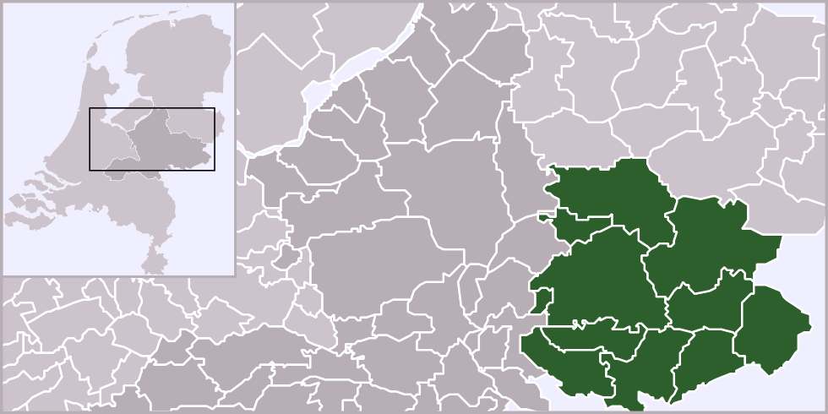
Welkom in de Heische Hoeve, welkom in Brabant!
Achterhoek = “De Graafschap”
Last year Maarten explained us the history of the achterhoek, as he grew up in the neighborhood.
Groenlo

Slide 3
Welkom in de Heische Hoeve, welkom in Brabant!
This year we are in Loosbroek, close to…
… Veghel!
So:

Slide 4
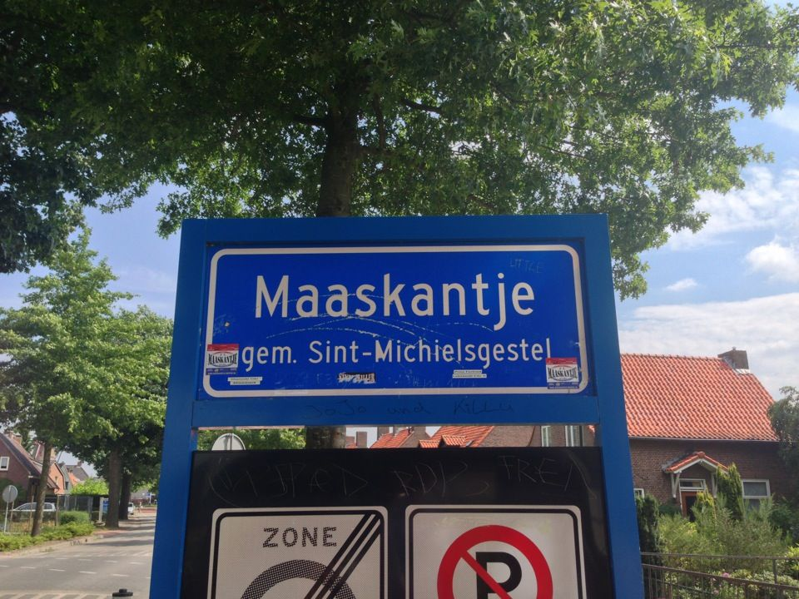
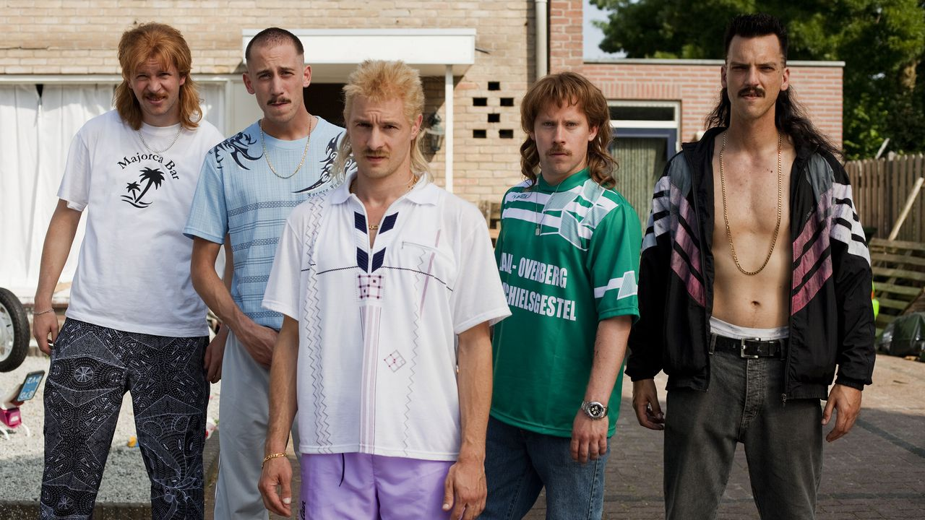
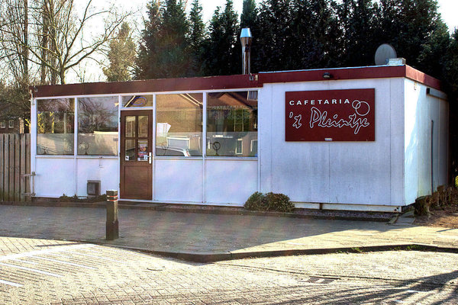
Welkom in de Heische Hoeve, welkom in Brabant!
But we also close to…
Broodje Bakpao
(“Wie is hier nou de snackbar?”)

Slide 5
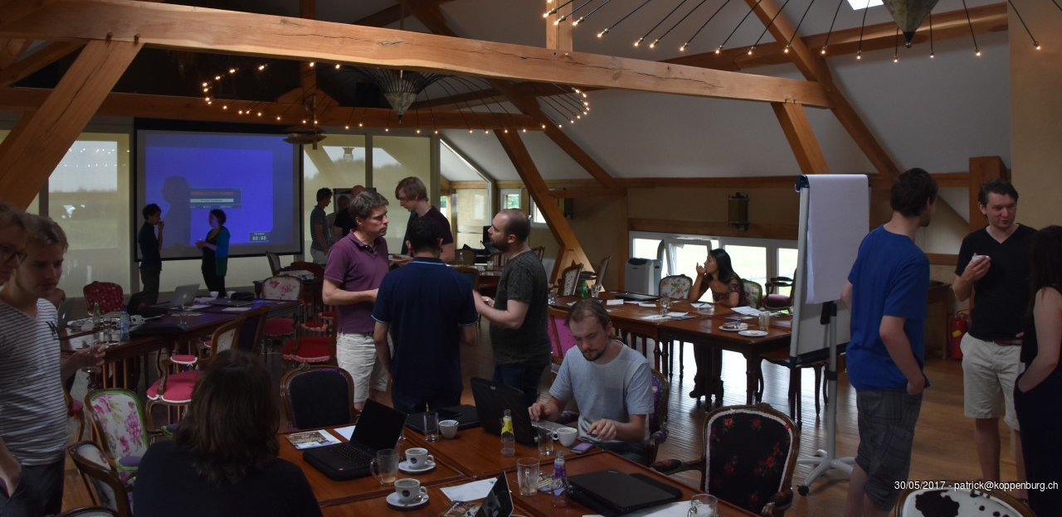
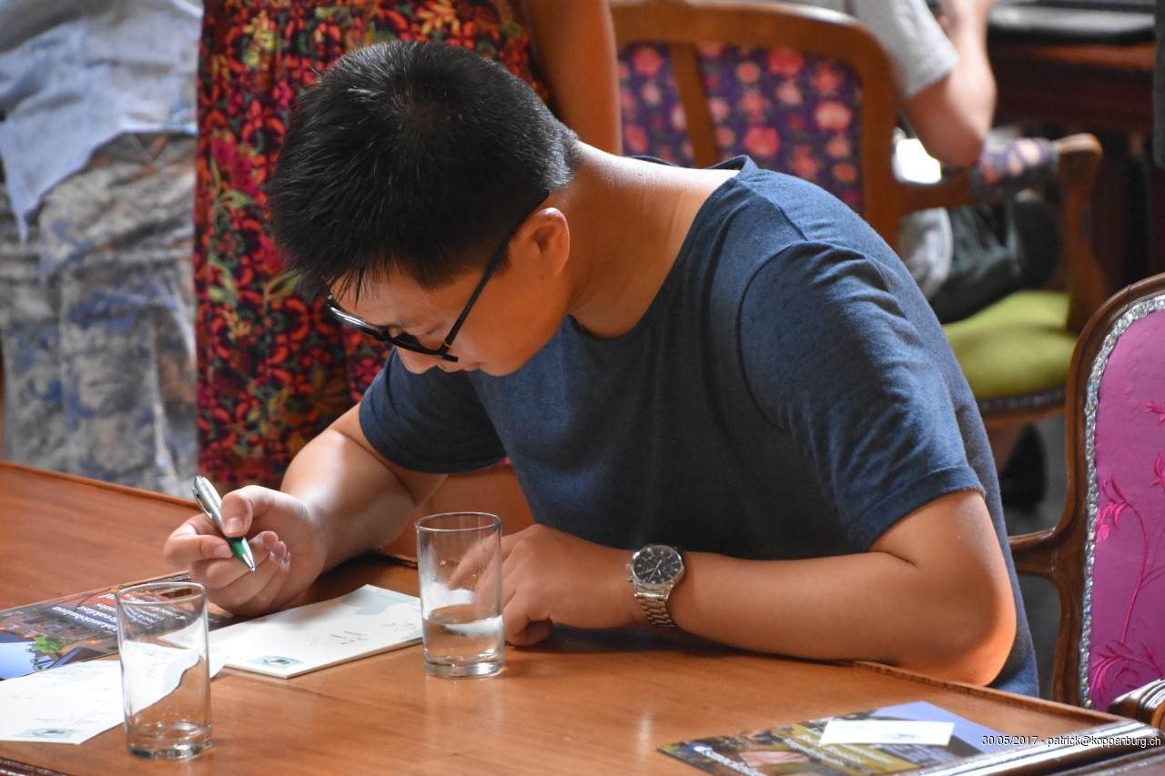
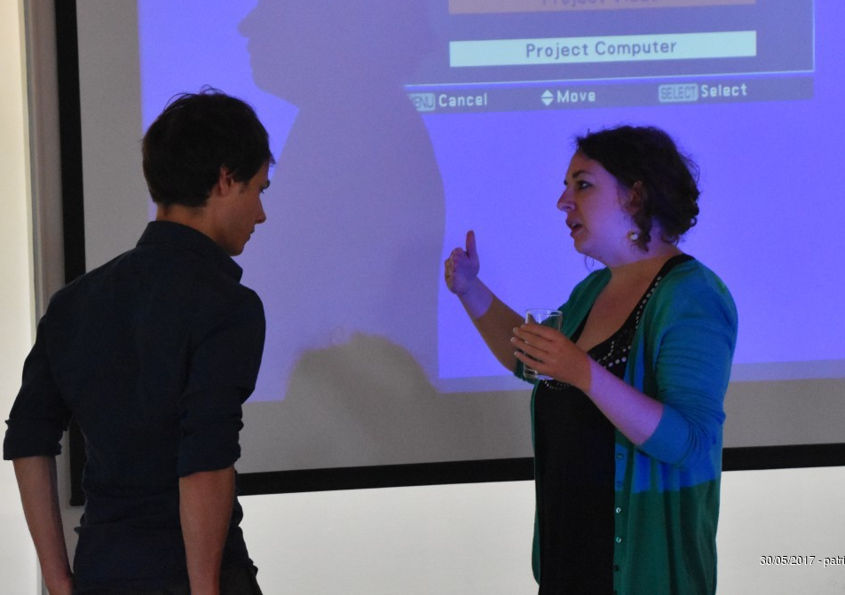
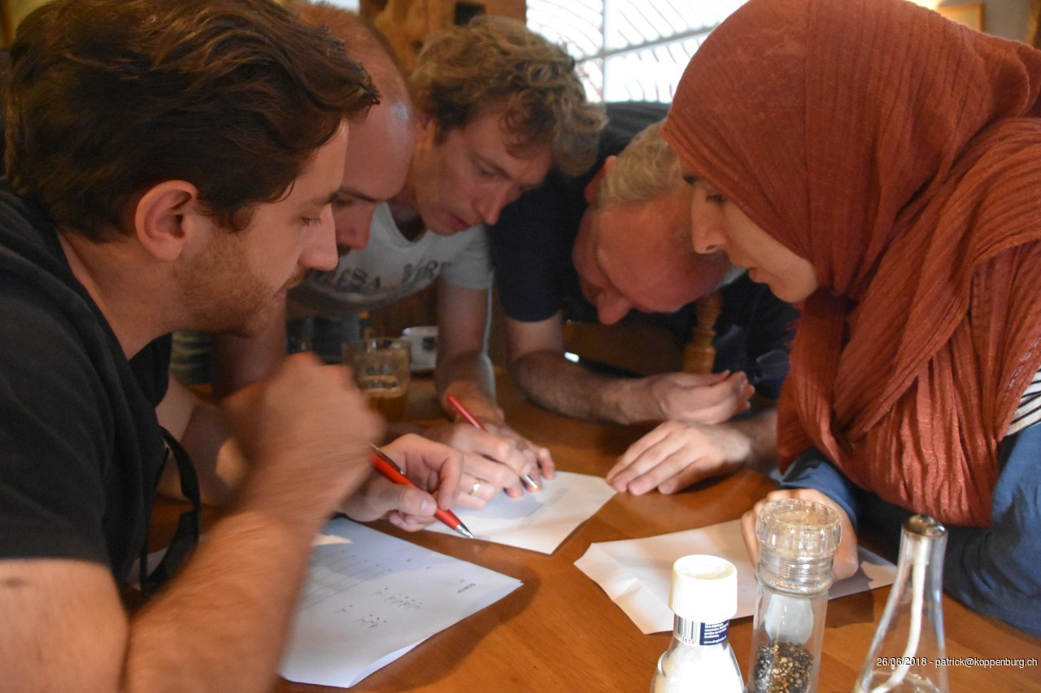
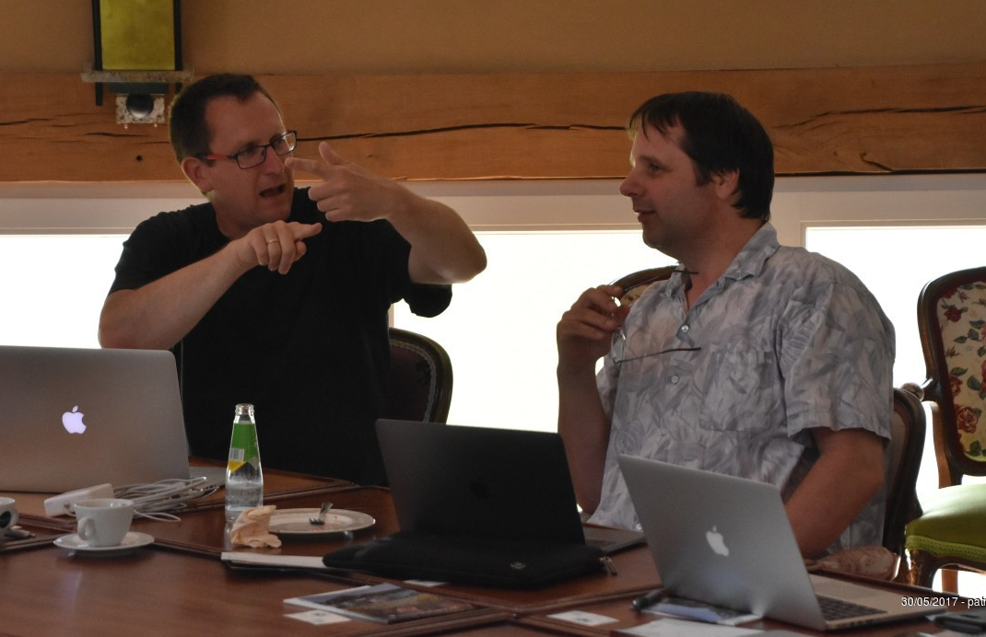
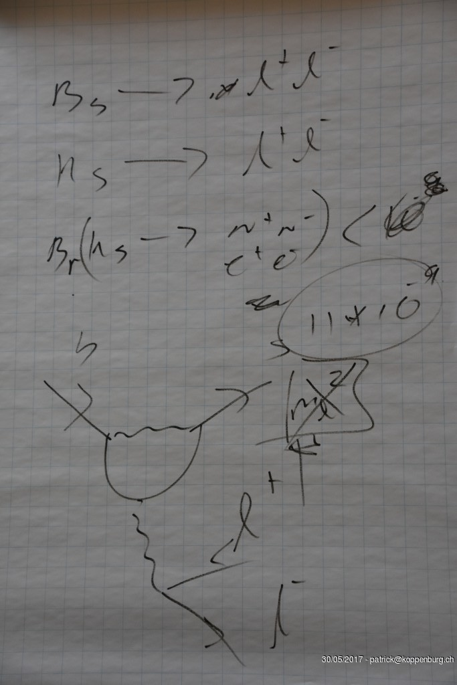
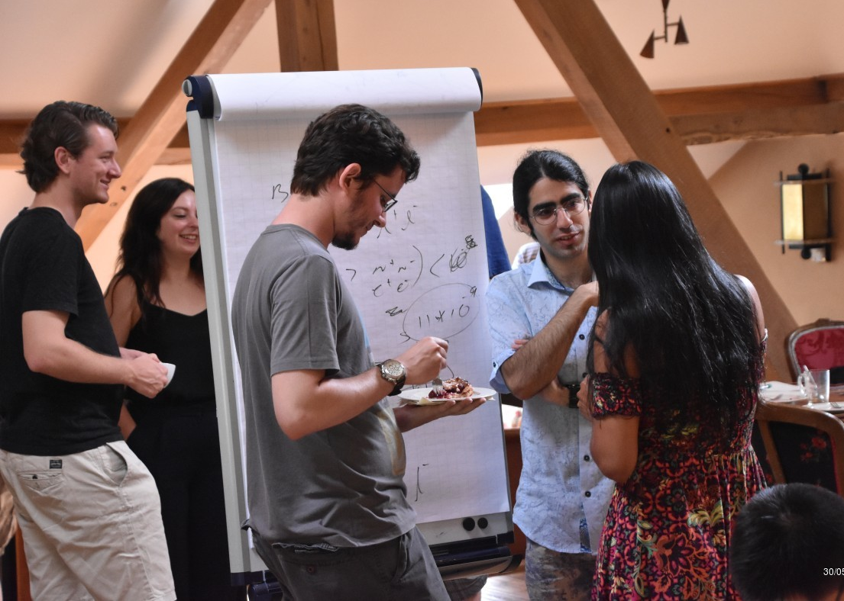
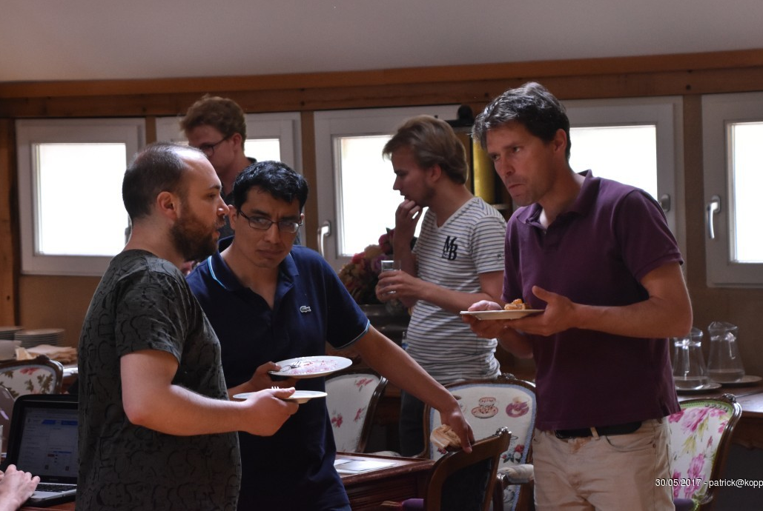
The Bfys Workshop

Slide 6
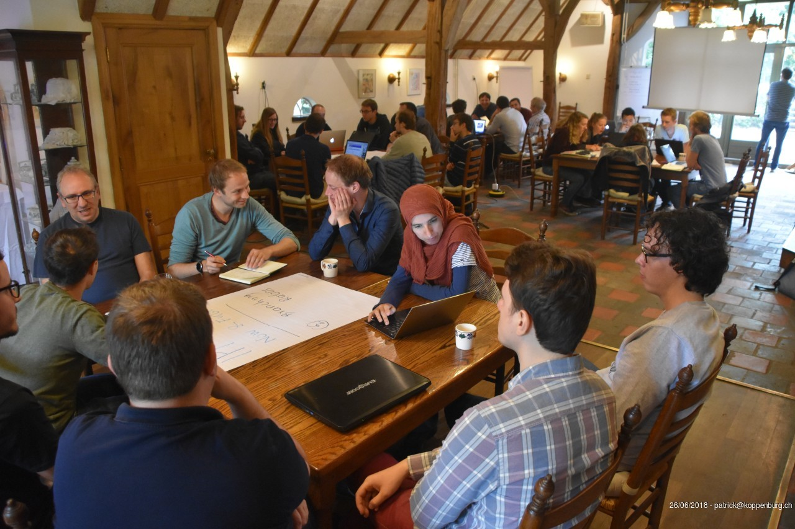
Group Discussions

Slide 7
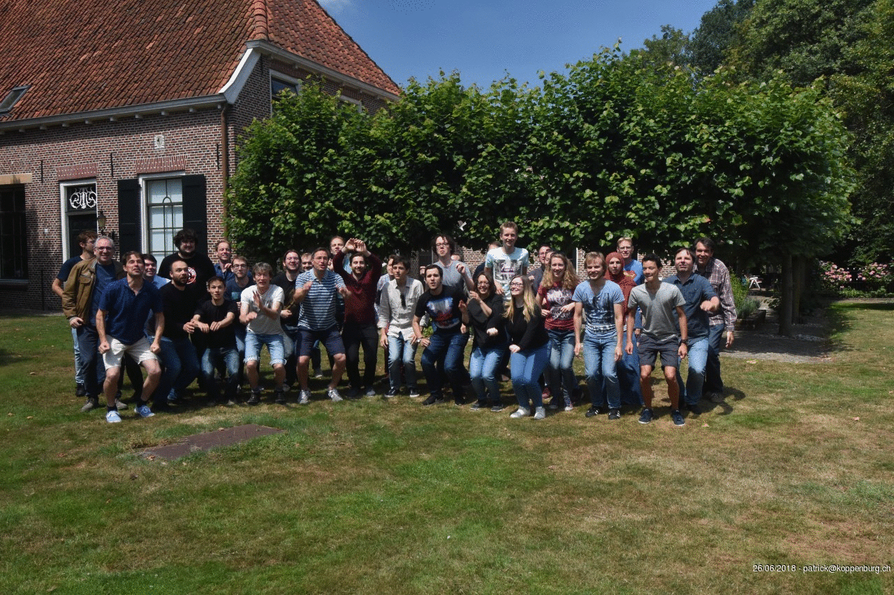
Group Photo
Notes:
Staff: Antonio, Niels, Gerhard, Wouter, Gerco, Kazu, Martin, Marcel Postdocs: Roman, Daniel, Jacco, Sevda, Carlos, Sean, Flavio,

Slide 8
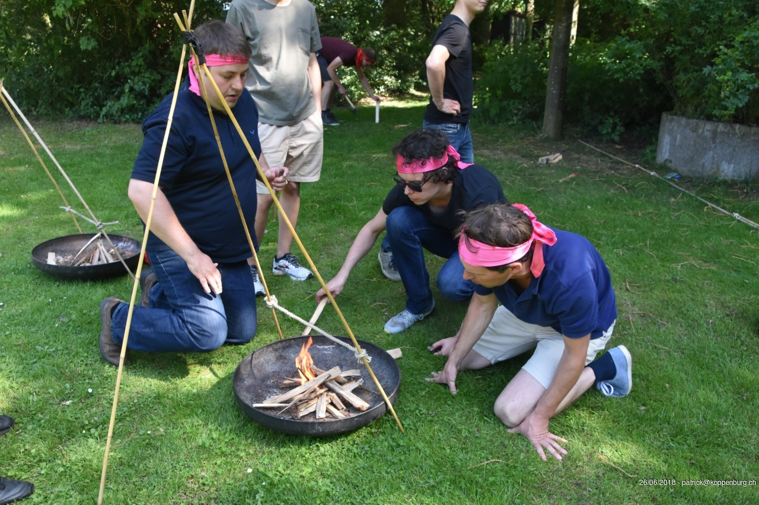
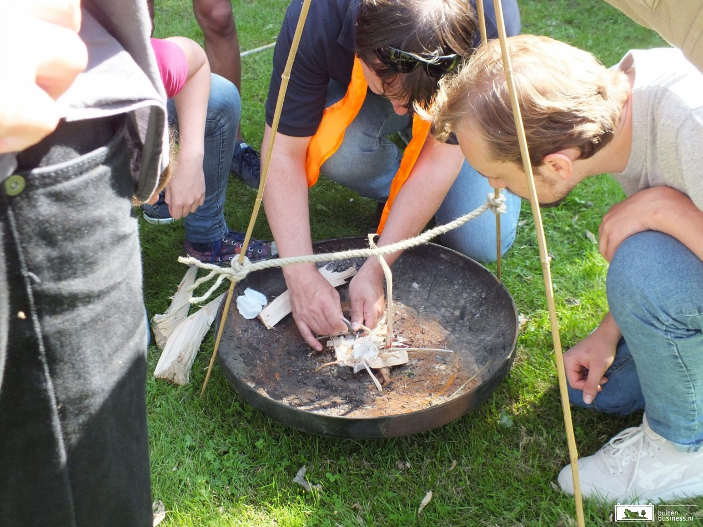
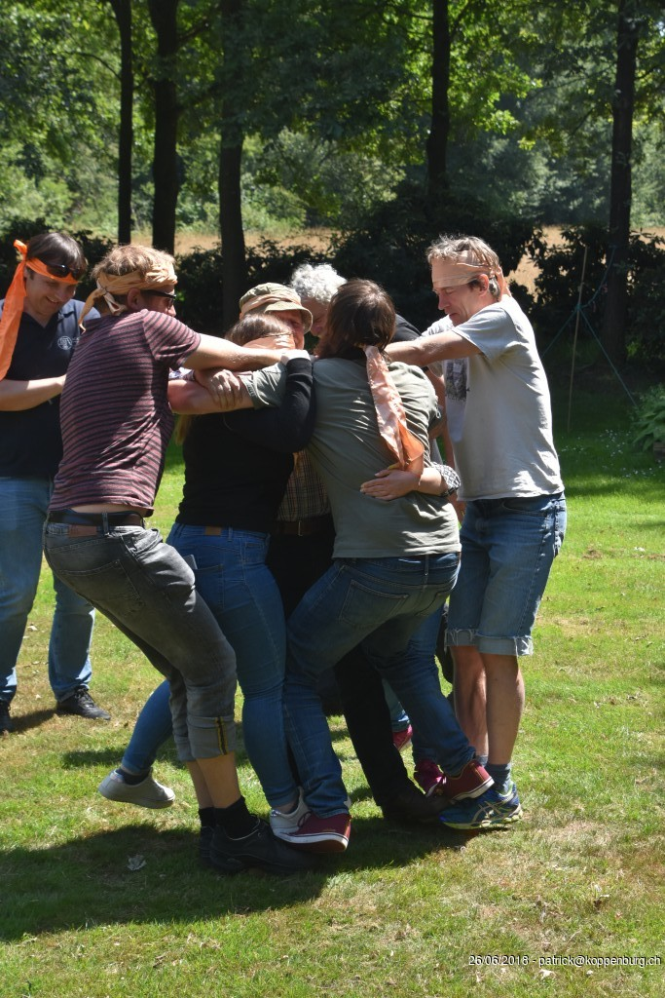
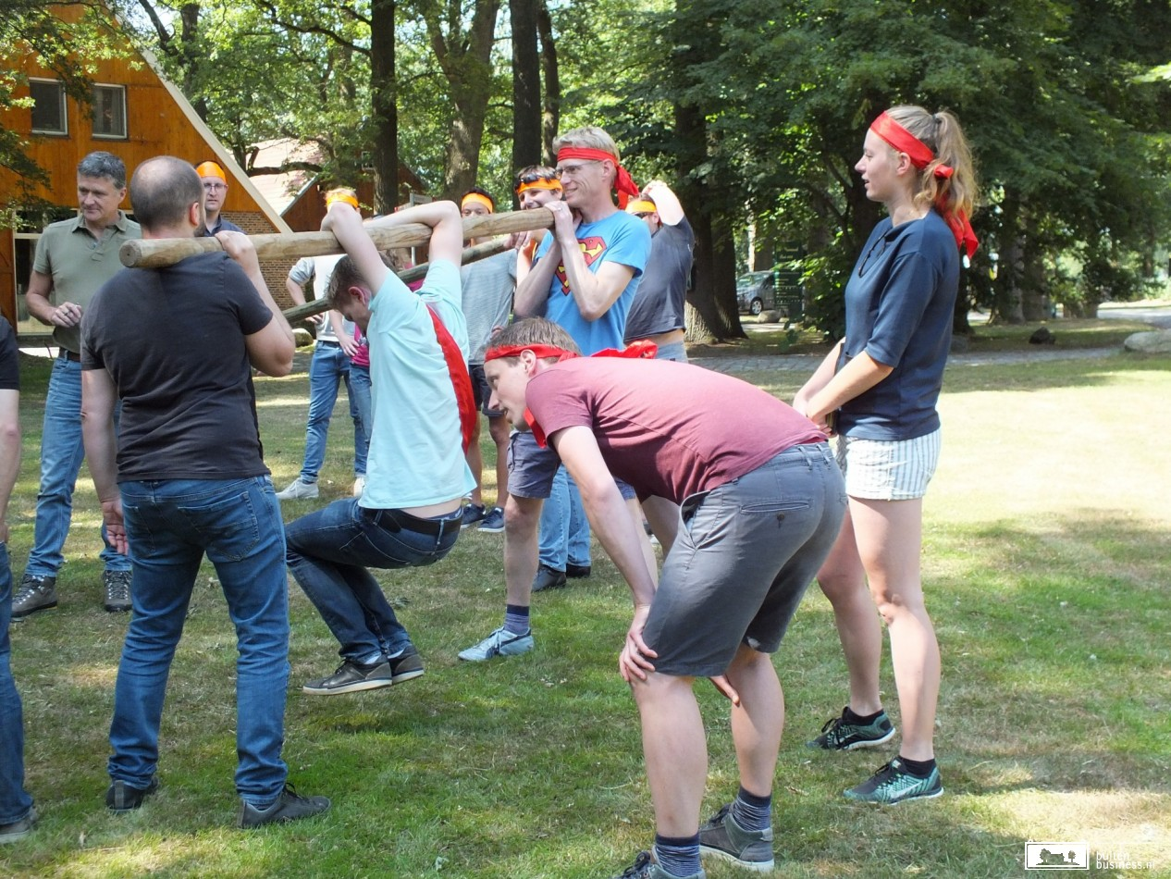
Group Challenges

Slide 9
2019 Bfys workshop: “What’s Your Question?”
2006, 2007, 2008: Nikhef; each person gives short presentation.
2009: Egmond aan Zee; hands-on data analysis.
“Segway”
2010: Erve Hulsbeek; discussions + report.
“Laser-shooting”, “Klootschieten”
2011: Limburg; “Theses from the past.”
“Caves”
2012: Hindeloopen; “V_{CKM} and V_{PMNS}.”
“Sailing”
2013: Renesse; “Analysis methods.”
“Kite-carting”
2014: Groenlo; Funding proposals.
“Building Catapults”
2015: Egmond aan Zee; “Phase Transitions: Physics, Analysis, Detector”.
“Arrow Shooting” and “Wave-rafting”
2016: Erve Hulsbeek; “Horizons: novel ideas”.
“Quad-riding” and “Klootschieten”
2017: Heijenrath; “Commonalities”.
Cycling to Val-Dieu for beer & cheese tasting
2018: Groenlo; “Expert and Newcomers View”.
Survival ”Robinson”

Slide 10
”What’s your Question”
After 7$1/2$ million years of computing Deep Thought provided the ultimate answer to the question of Life the universe and everything.
But what was the exact question?
We search for answers on research questions. But a finding is always followed by a new, deeper question: What is your next question?
Don’t Panic

Slide 11
”What’s your Question”
Agenda
Monday afternoon:
What’s your question Run 2 and Run 3
Teams presentations
Monday eventing:
Pizza Workshop and Pub Quizz
Tuesday morning:
Round table discussions and anonymous questions
Tuesday afternoon:
Open Mike and Outdoor Activity
Tuesday evening:
Invited speaker: Fabian Jansen
Wednesday morning:
Plenary reports on the round table discussions.
Don’t be shy and bring up your ideas…
There should be sufficient time for discussions!

