Slide 1
Round Table Discussions
Bfys Workshop

Slide 2
Three Rounds of Discussion with Chairperson
LHC Data Analysis:
Very Rare (Mick), Flavor Universality (Cristina), Long-lived (Lera), Time dep CPV (Jordy)
Detectors:
Magnet Tracking (Sevda), Vertex Tracking (Carlos), Fast Timing (Daniel), New Ideas (Kazu)
Reconstruction:
Pattern Recog (Sesegma), Track Fit (Maarten), Combinatorics (Maxime), Accelerators (Roel)
Chairperson 10 min summary report tomorrow

Slide 3
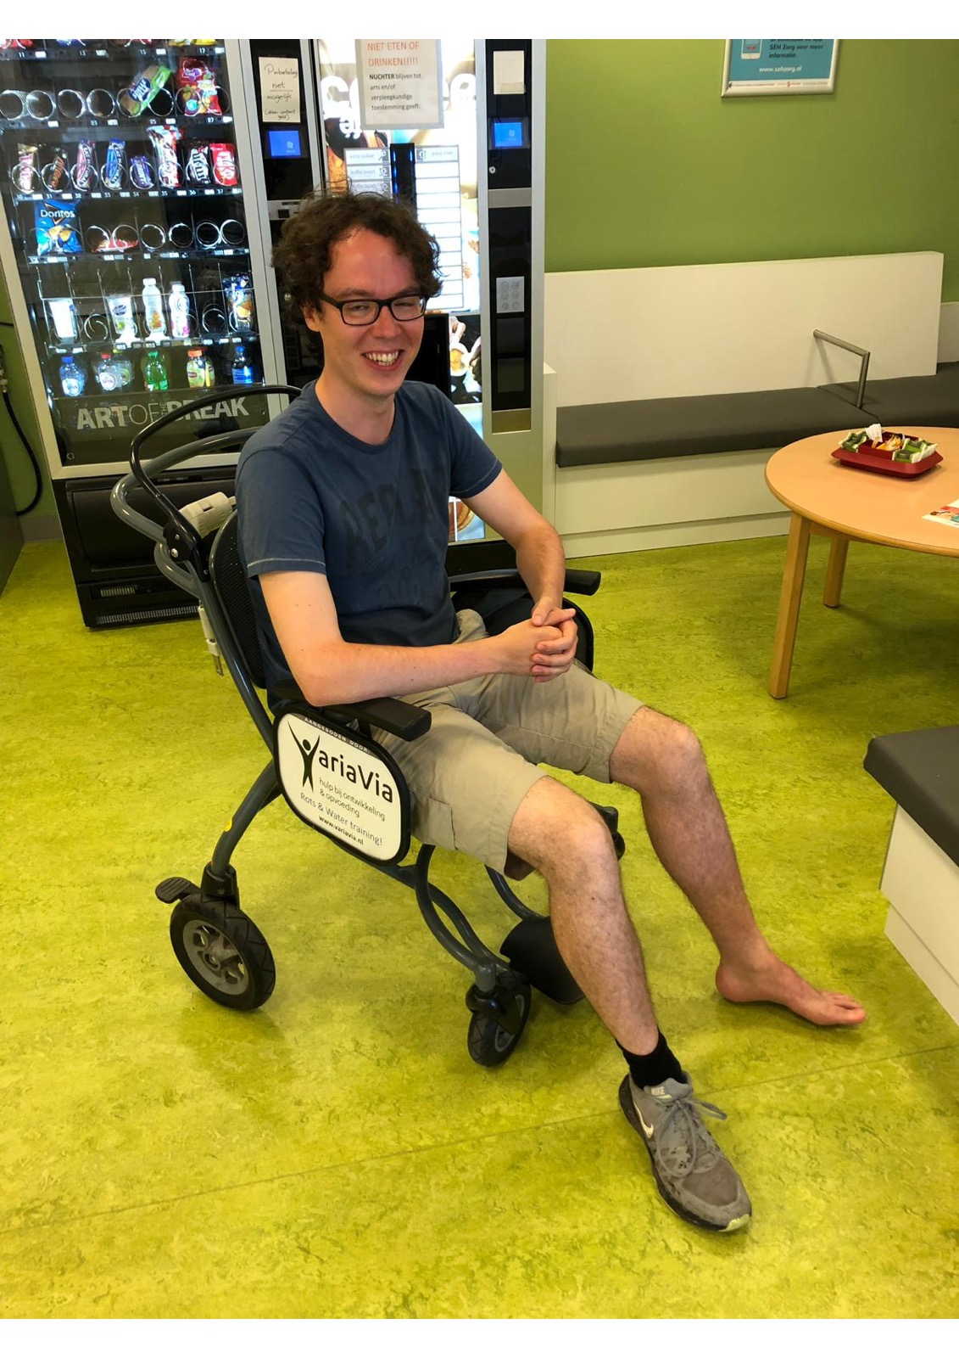
More news soon…

