Slide 1
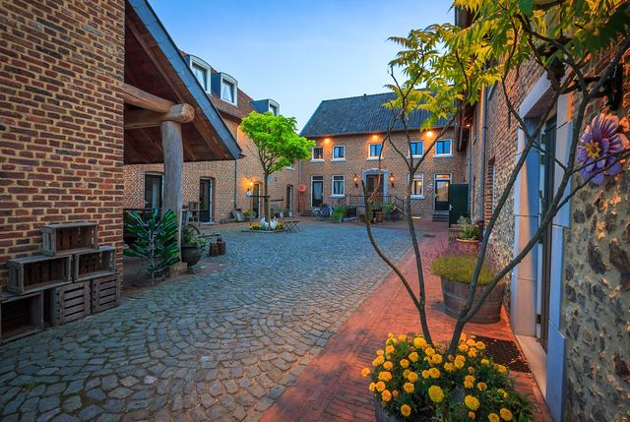
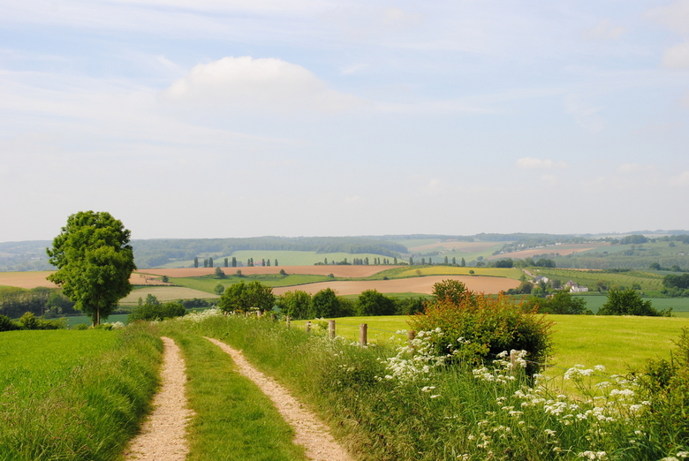
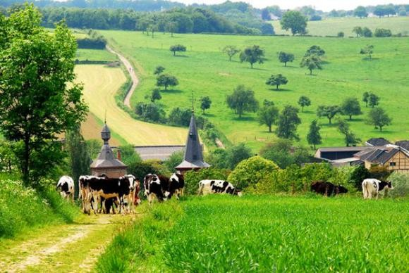
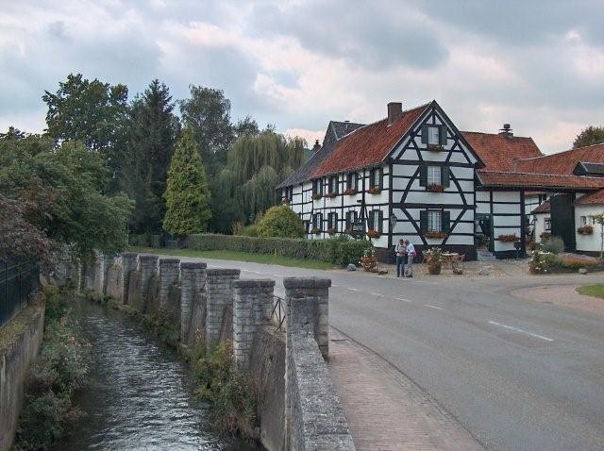
Welcome to
Zuid-limburg

Slide 2
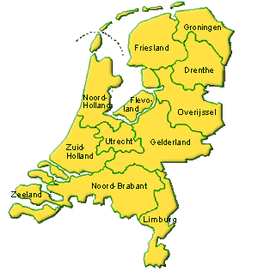
Where are we?

Slide 3
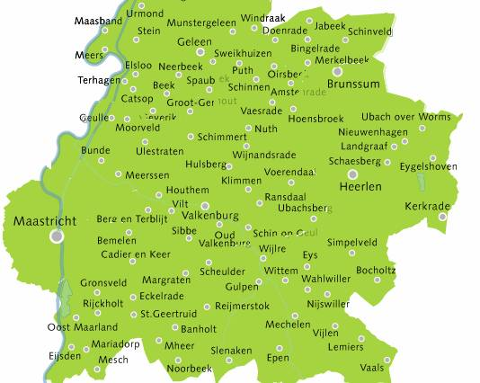
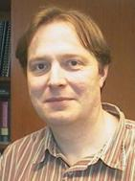
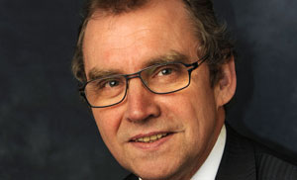
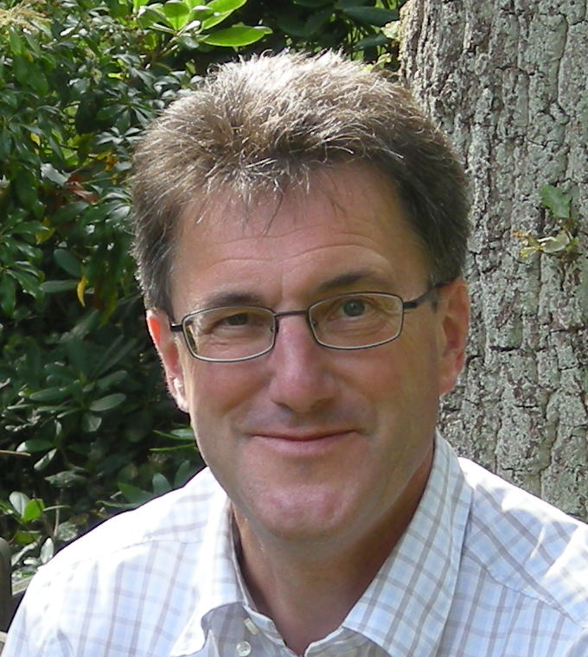
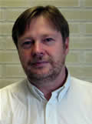
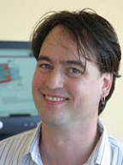
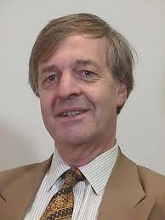
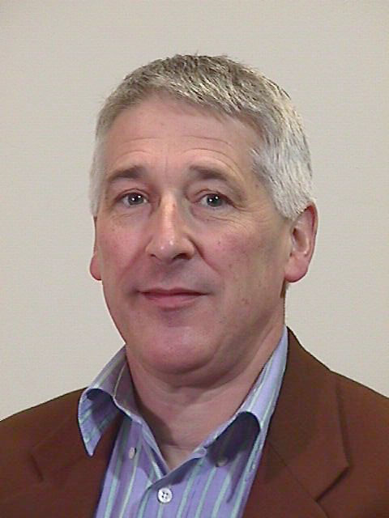
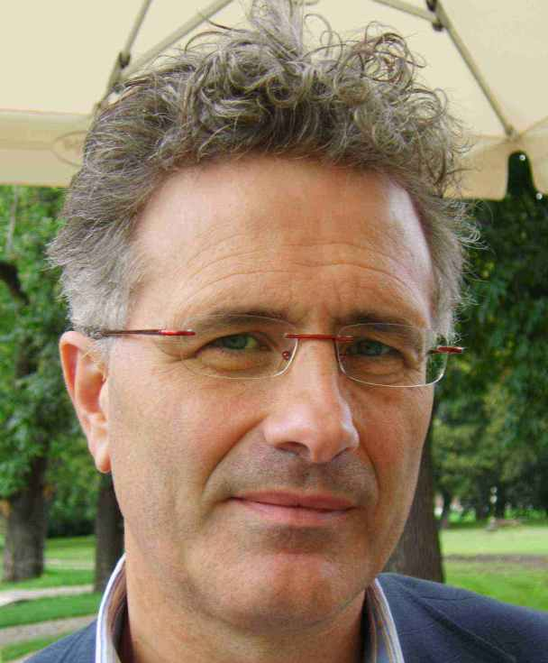
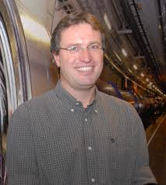
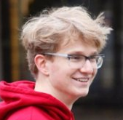
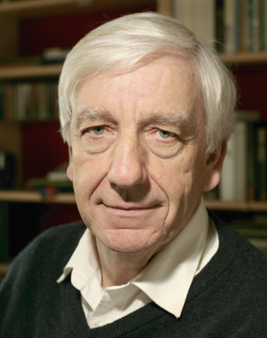
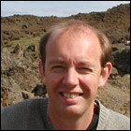

Slide 4
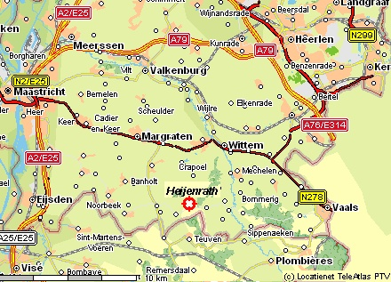

Slide 5
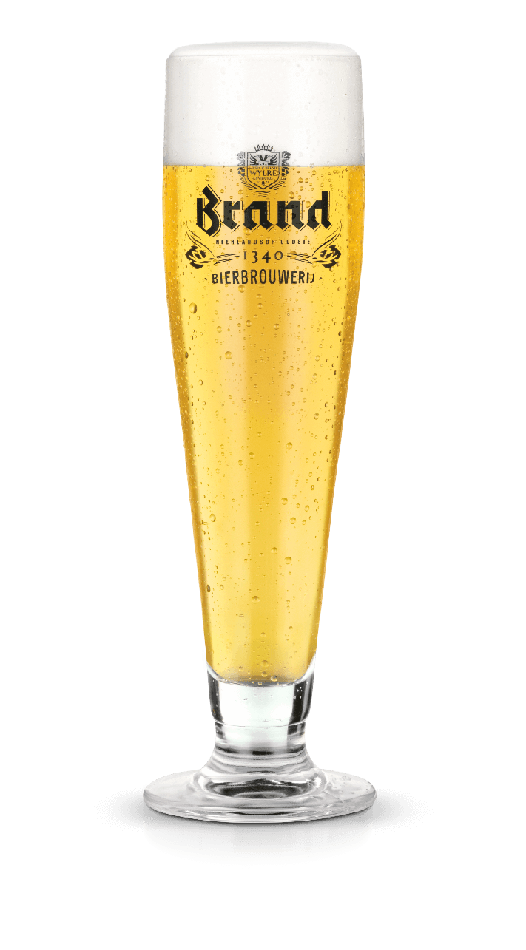
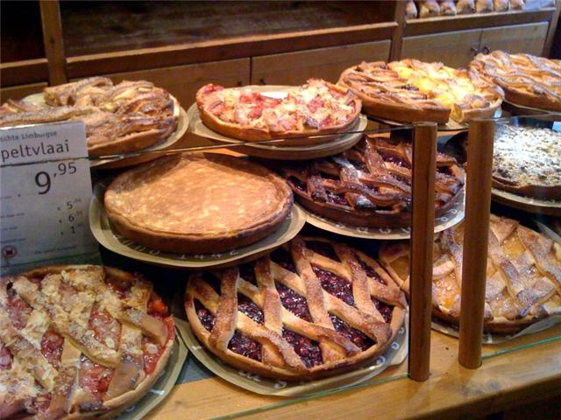
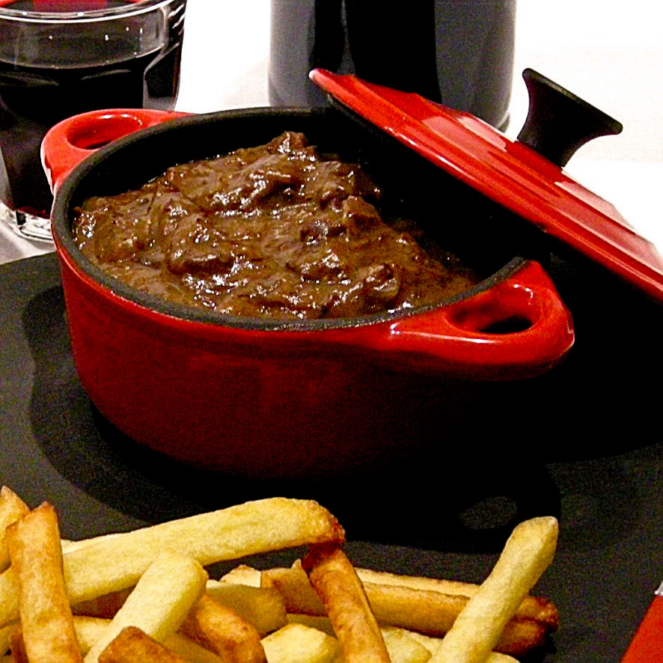
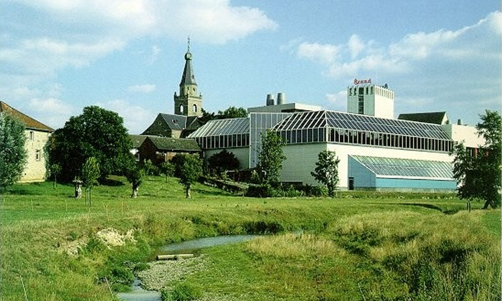
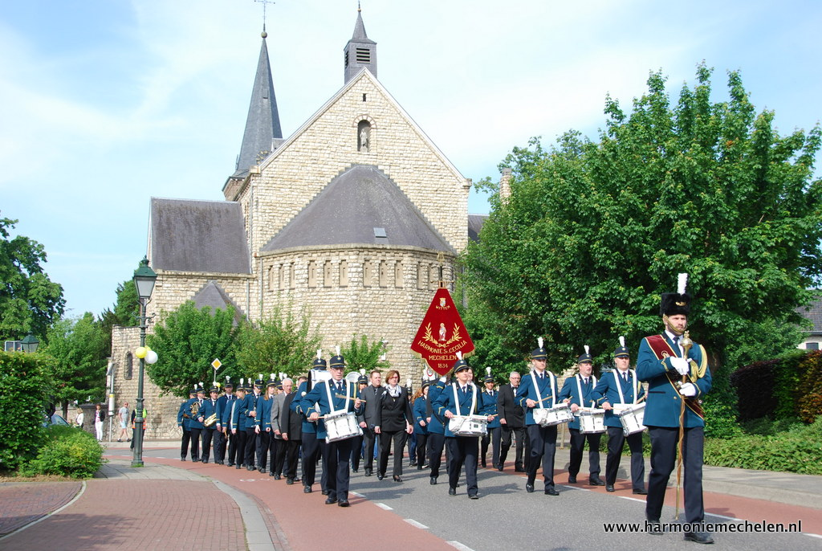
Regional specialties
vlaai
zoervleis
sjroep

Slide 6
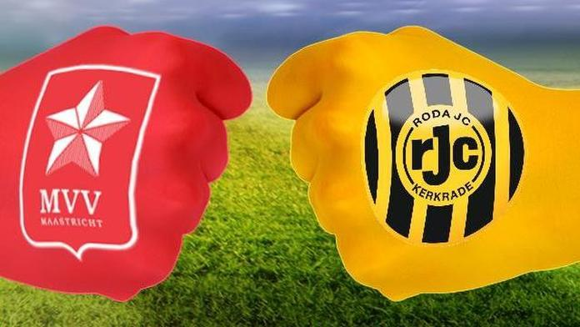
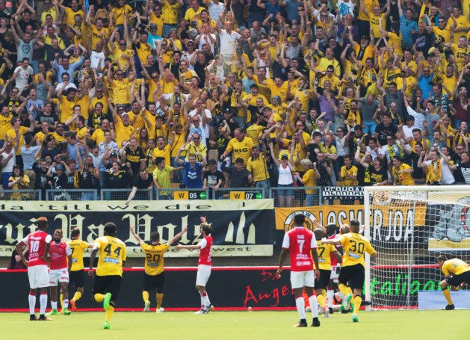
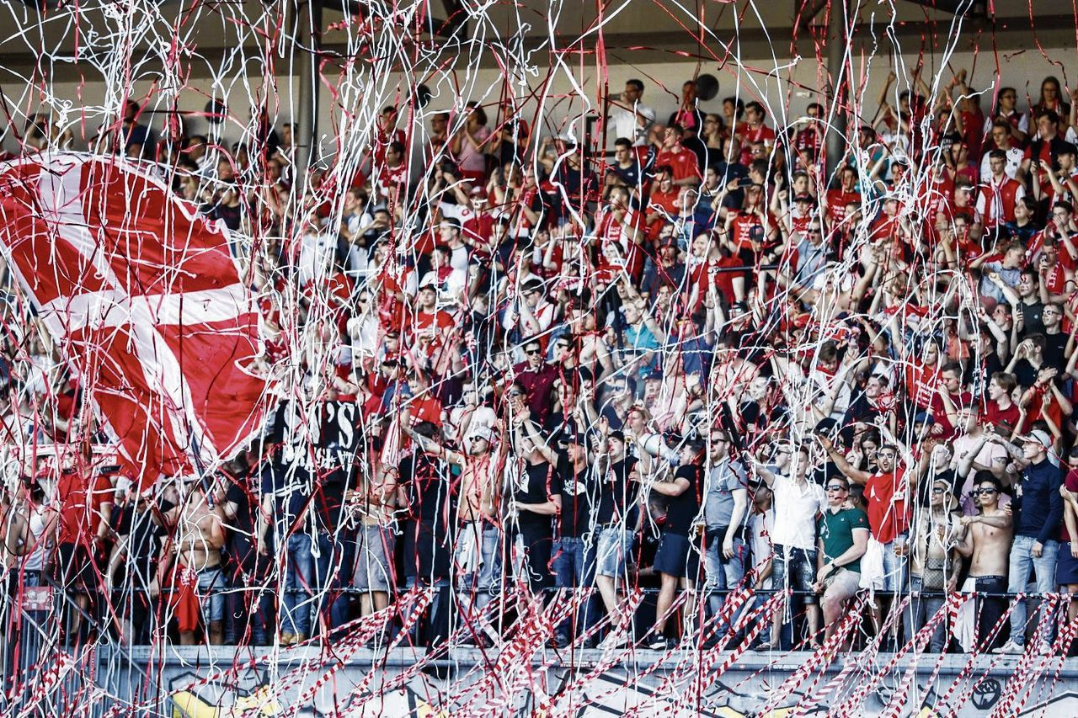
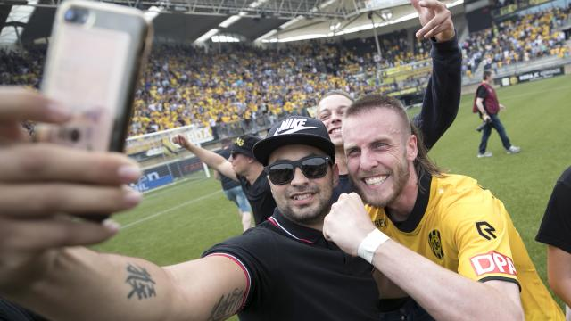
Regional Excitement

Slide 7
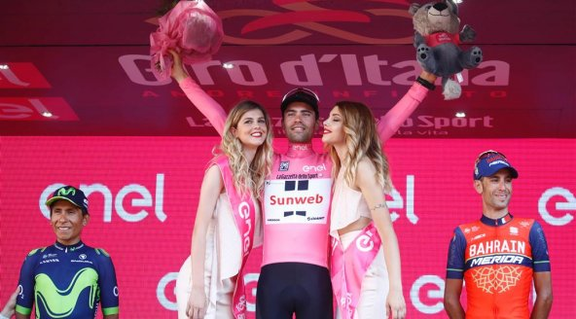

Slide 8
Previous Workshops
2006, 2007, 2008: Nikhef; each person gives short presentation.
2009: Egmond aan Zee; hands-on data analysis.
“Segway”
2010: Erve Hulsbeek; 4 group discussions + report.
“Laser-shooting”, “Klootschieten”
2011: Limburg; experience from previous theses.
“Caves”
2012: Hindeloopen; Elements of V_{CKM} and V_{PMNS}.
“Sailing”
2013: Renesse; Analysis methods (FOM program + investement).
“Kite-carting”
2014: Groenlo; Funding proposals.
“Building Catapults”
2015: Egmond aan Zee; “Phase Transitions: Physics, Analysis, Detector”.
“Arrow Shooting” and “Wave-rafting”
2016: Erve Hulsbeek; “Horizons: novel ideas”.
“Quad-riding” and “Klootschieten”
2017: Heijenrath; “Commonalities”.
Cycling to Val-Dieu for beer & cheese tasting

Slide 9
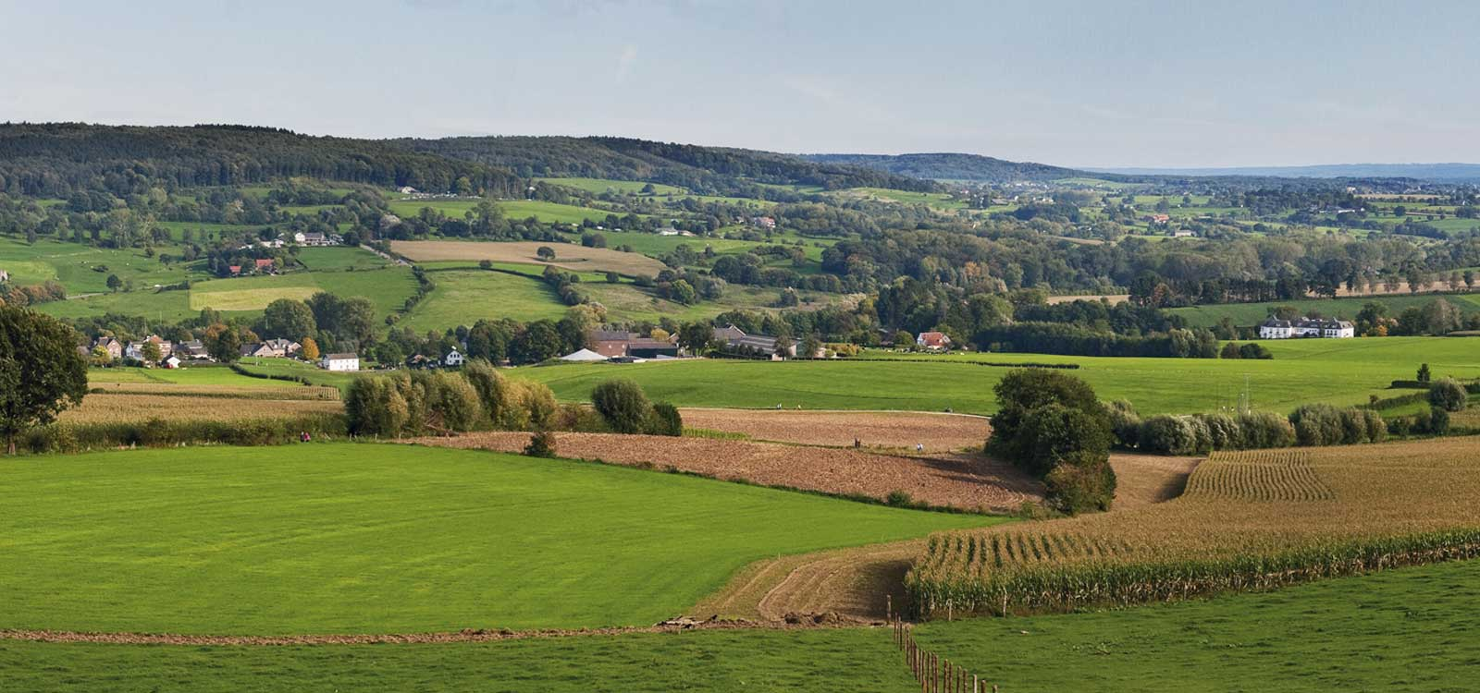
Workshop Commonalities
Commonality: the fact of sharing interests, experience or other
characteristics with someone or something
Share ideas between:
Physics models, detector features, reconstruction methods, analysis techniques
Day 1: Groups present their ideas
20 minute presentation without discussion
Day 2: Round table discussions
One time receive input
One time provide input
Day 3: Plenary discussion on the idea
20 minutes discussion

Slide 10
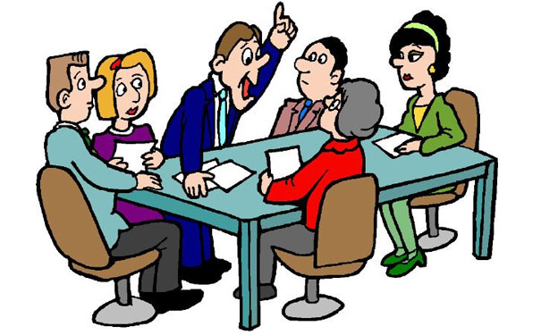
Enjoy the Workshop
Don’t be shy and bring up your ideas…
There should be sufficient time for discussions!

Slide 11
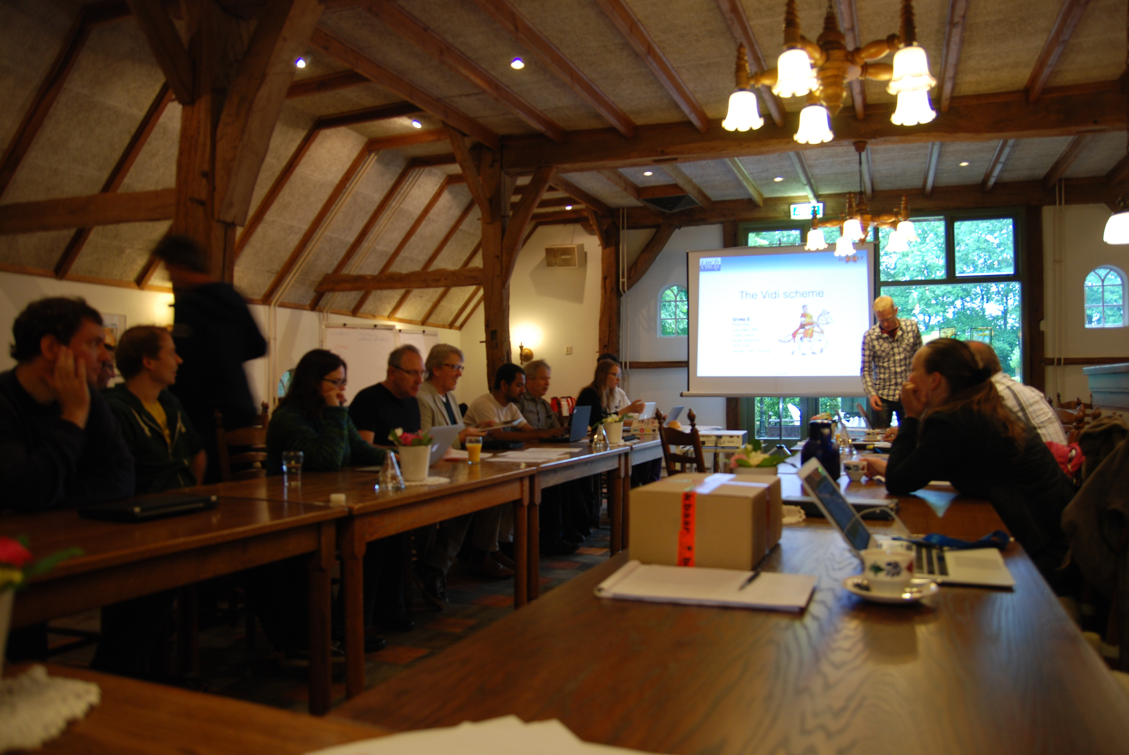
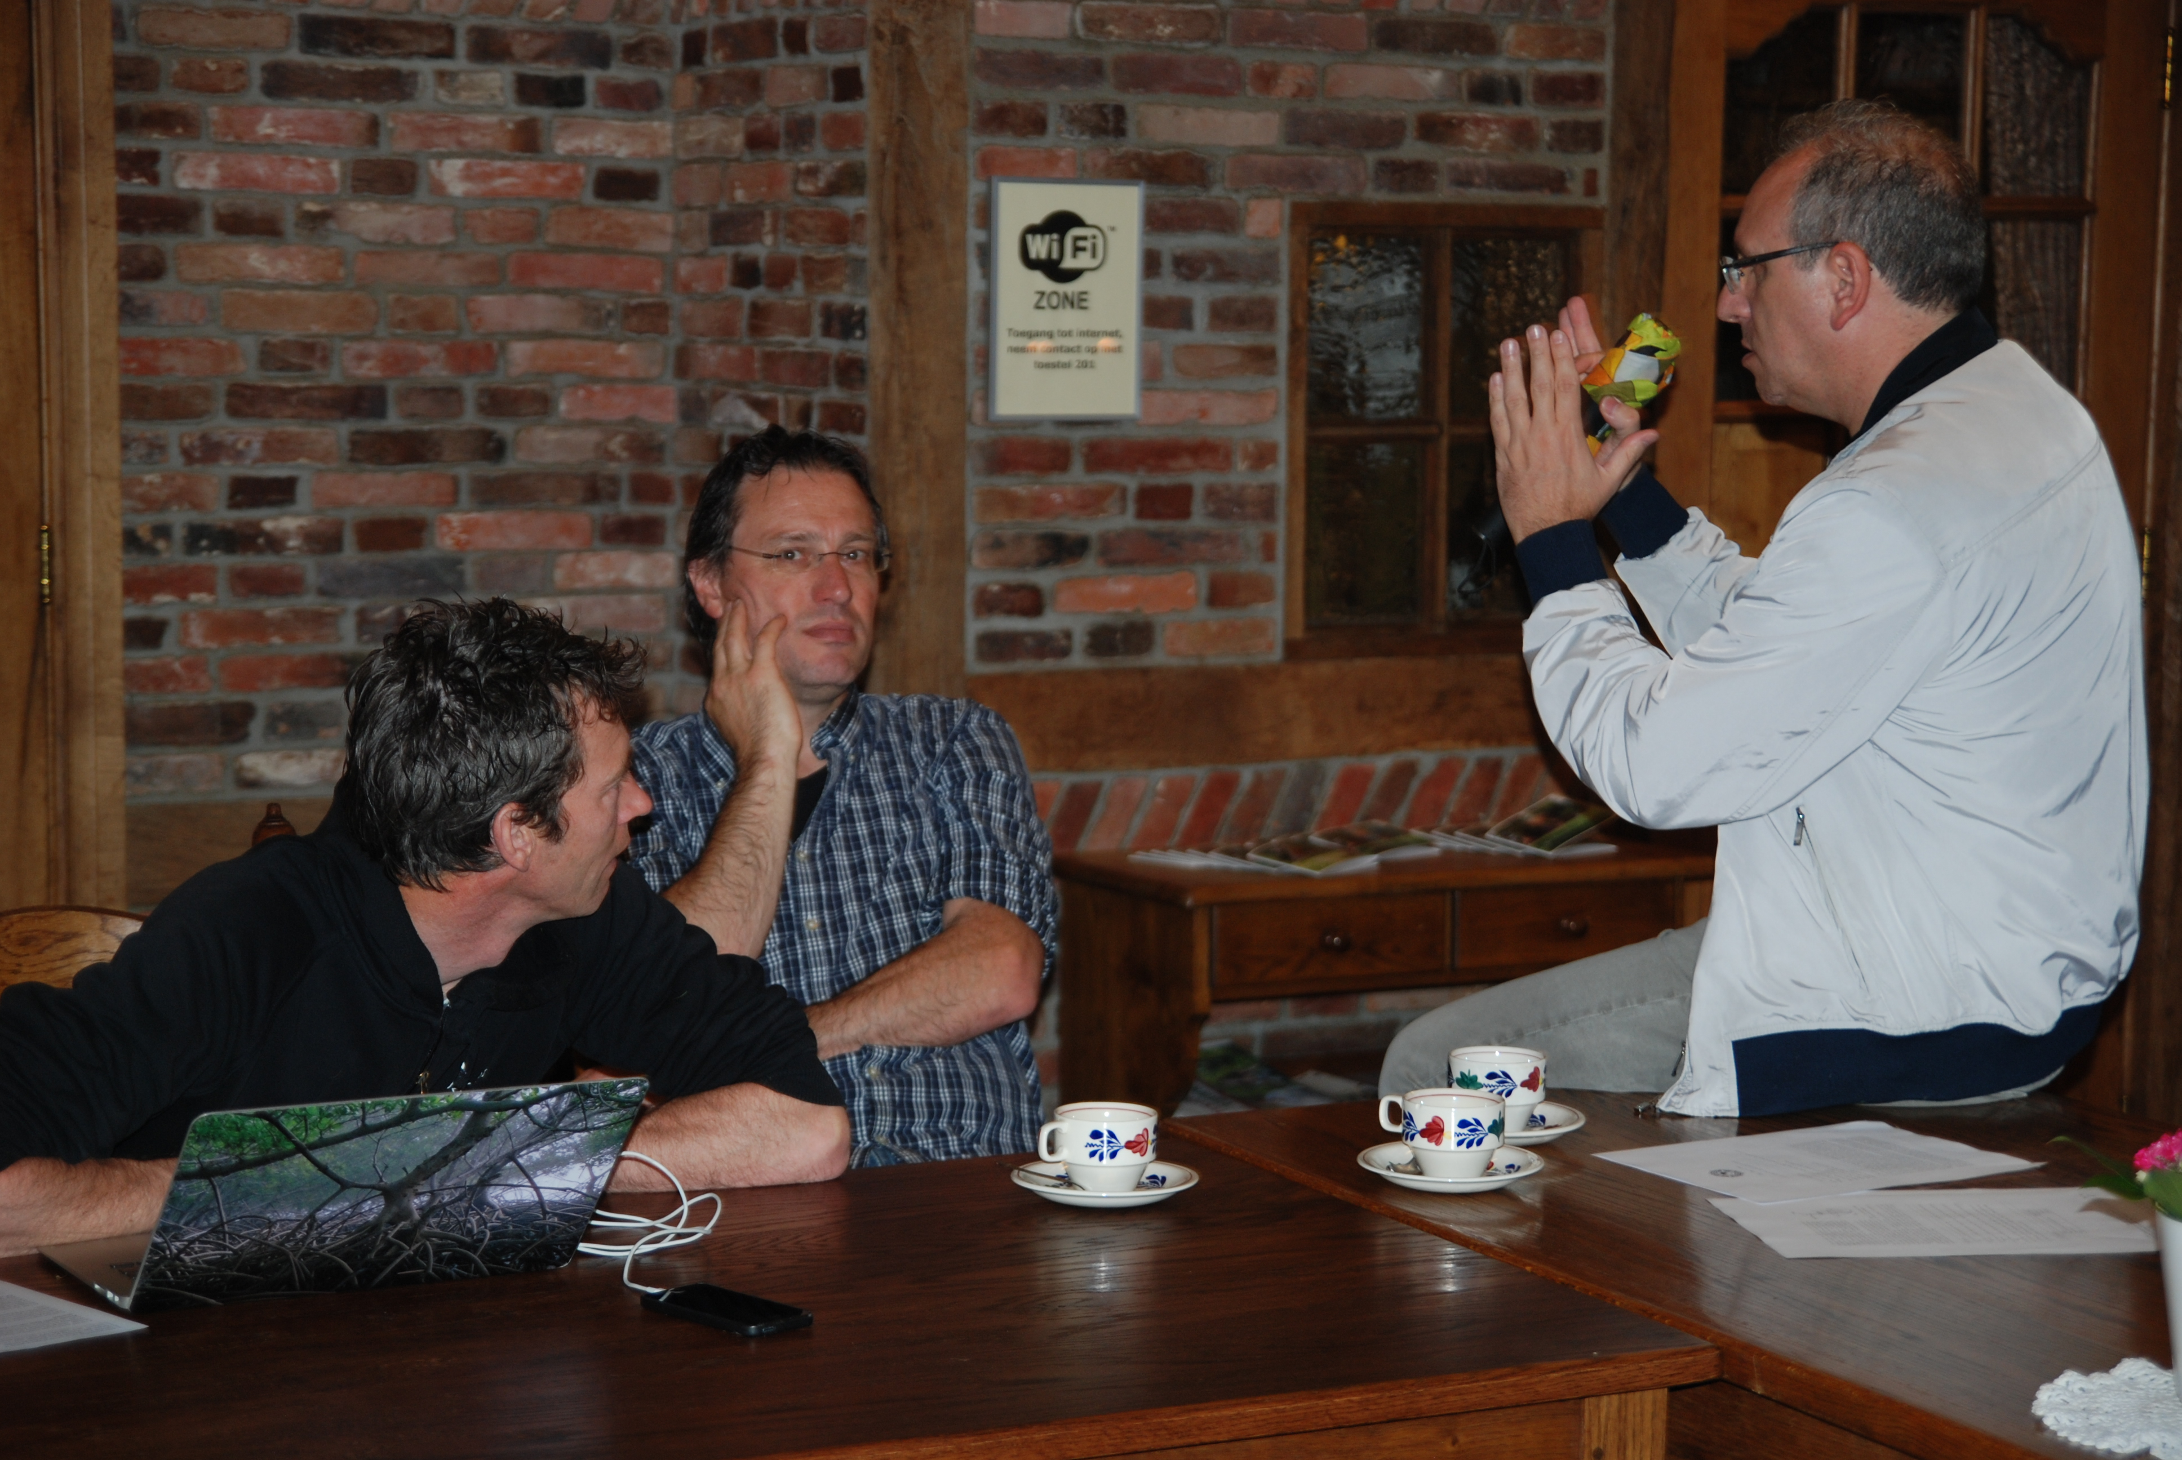
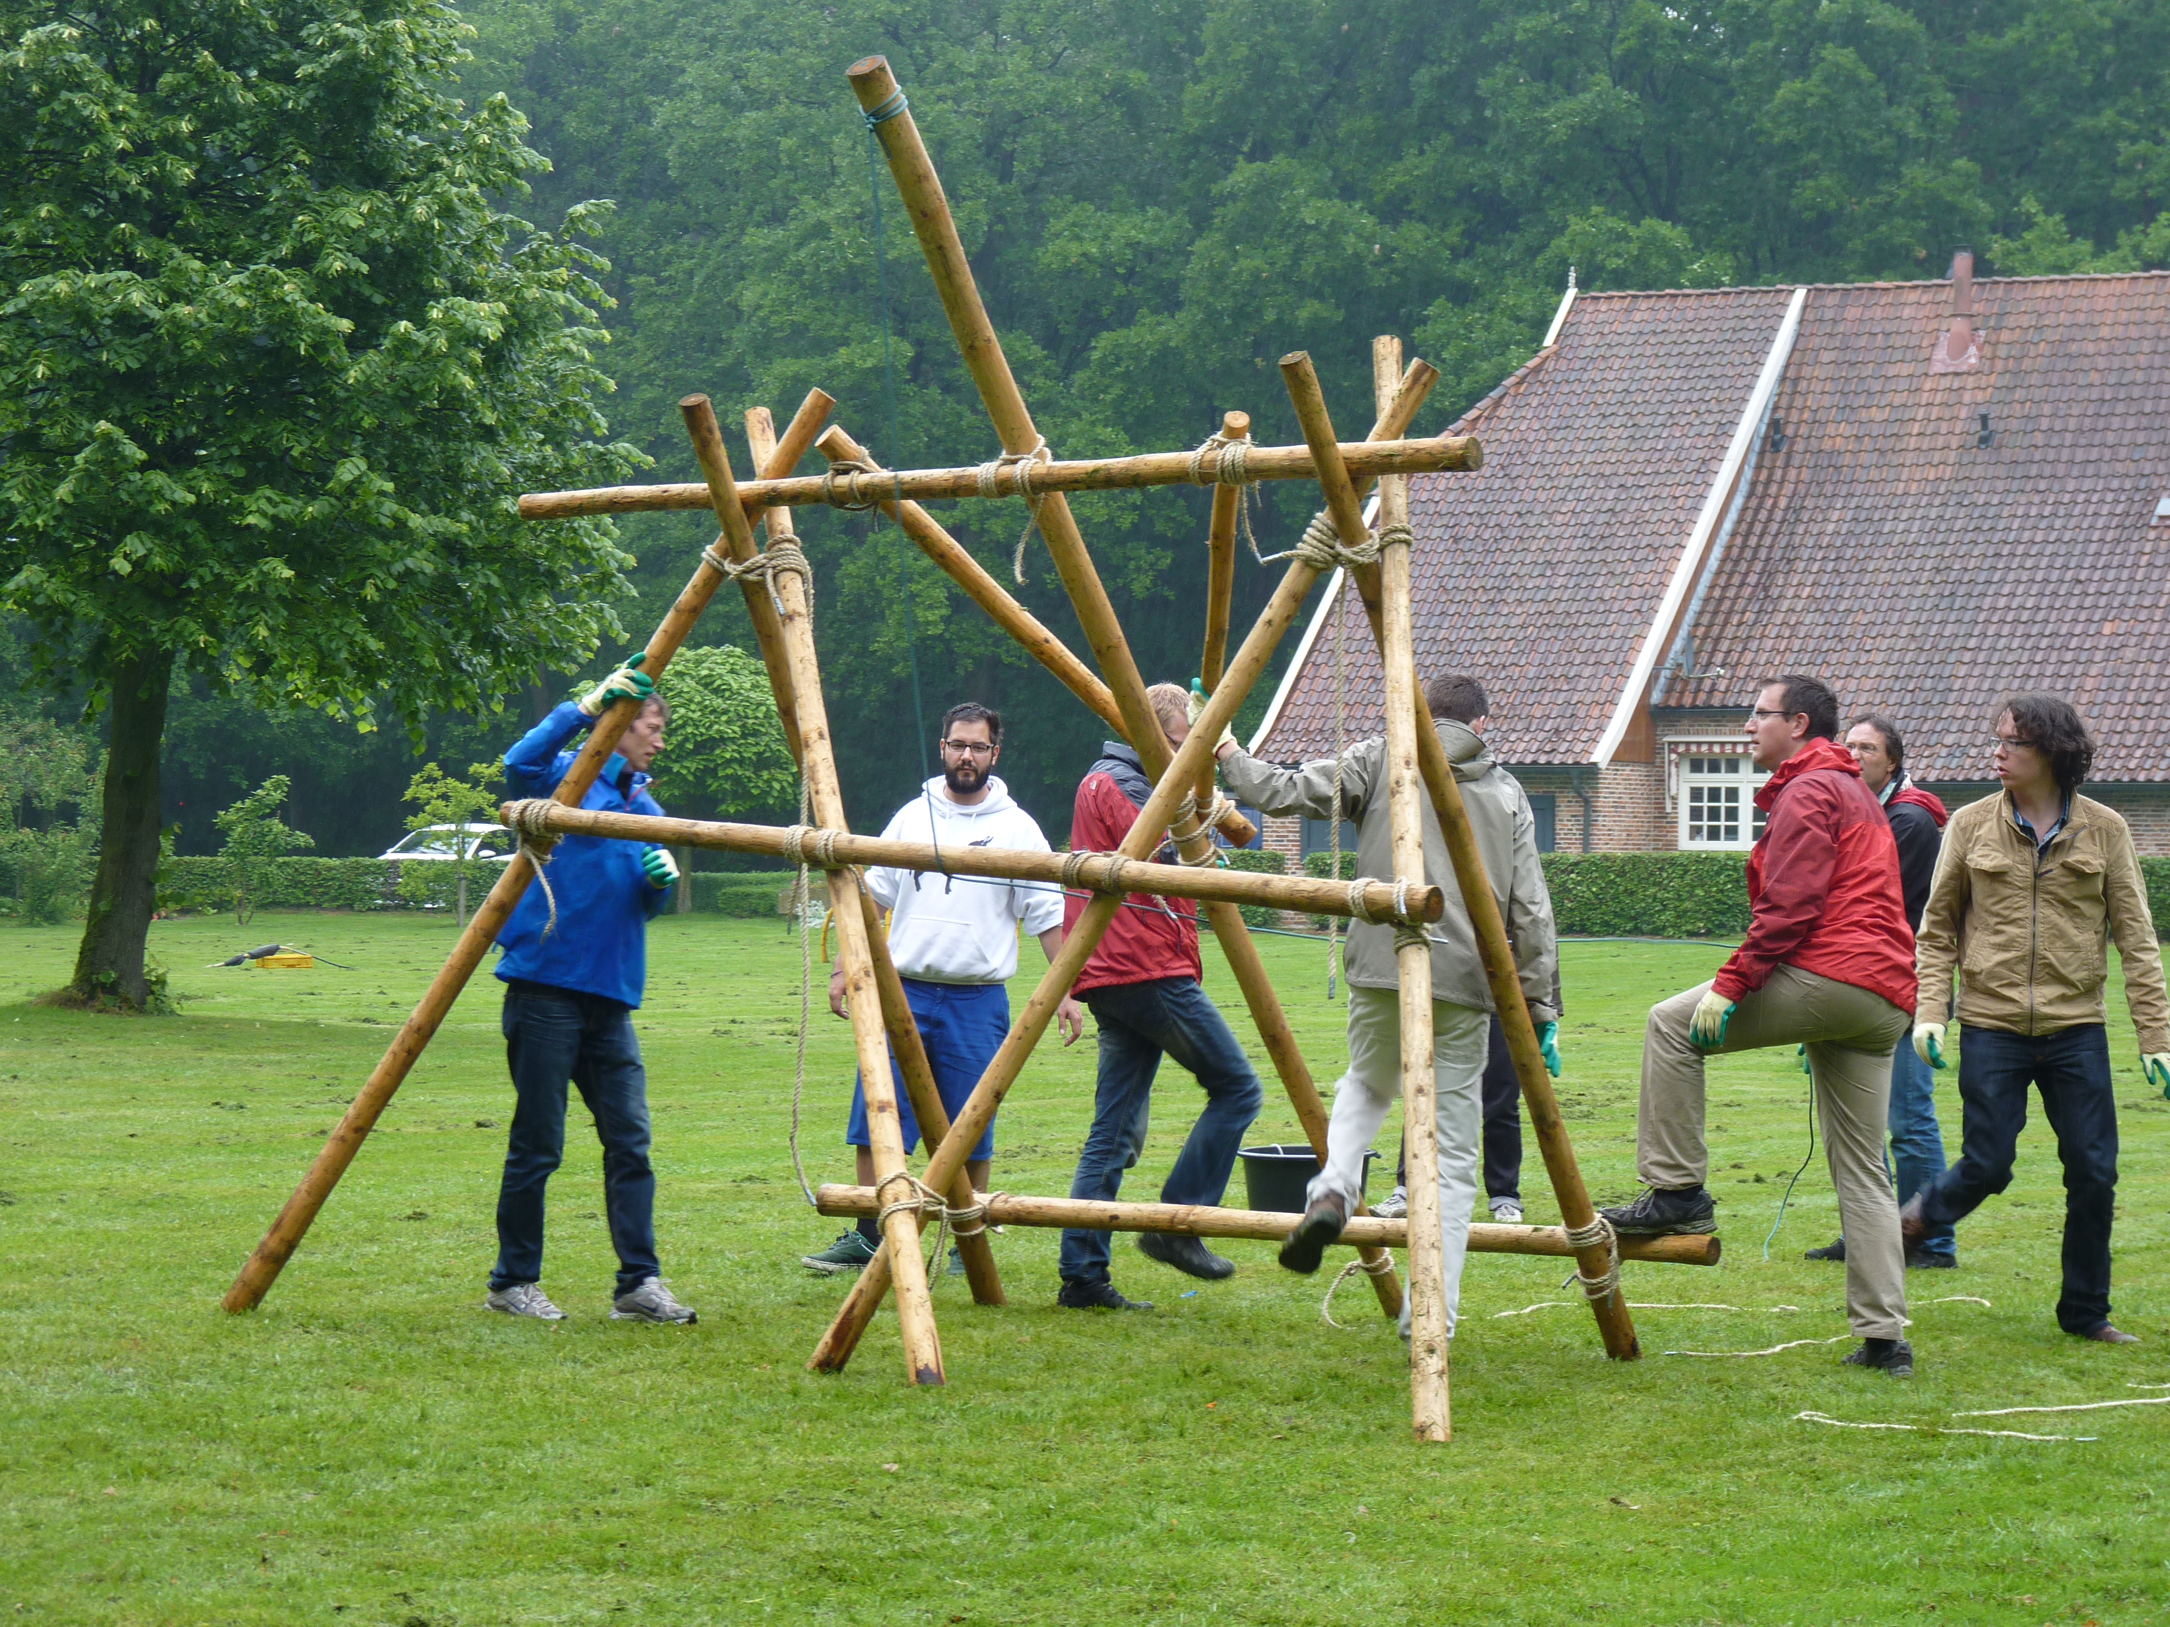
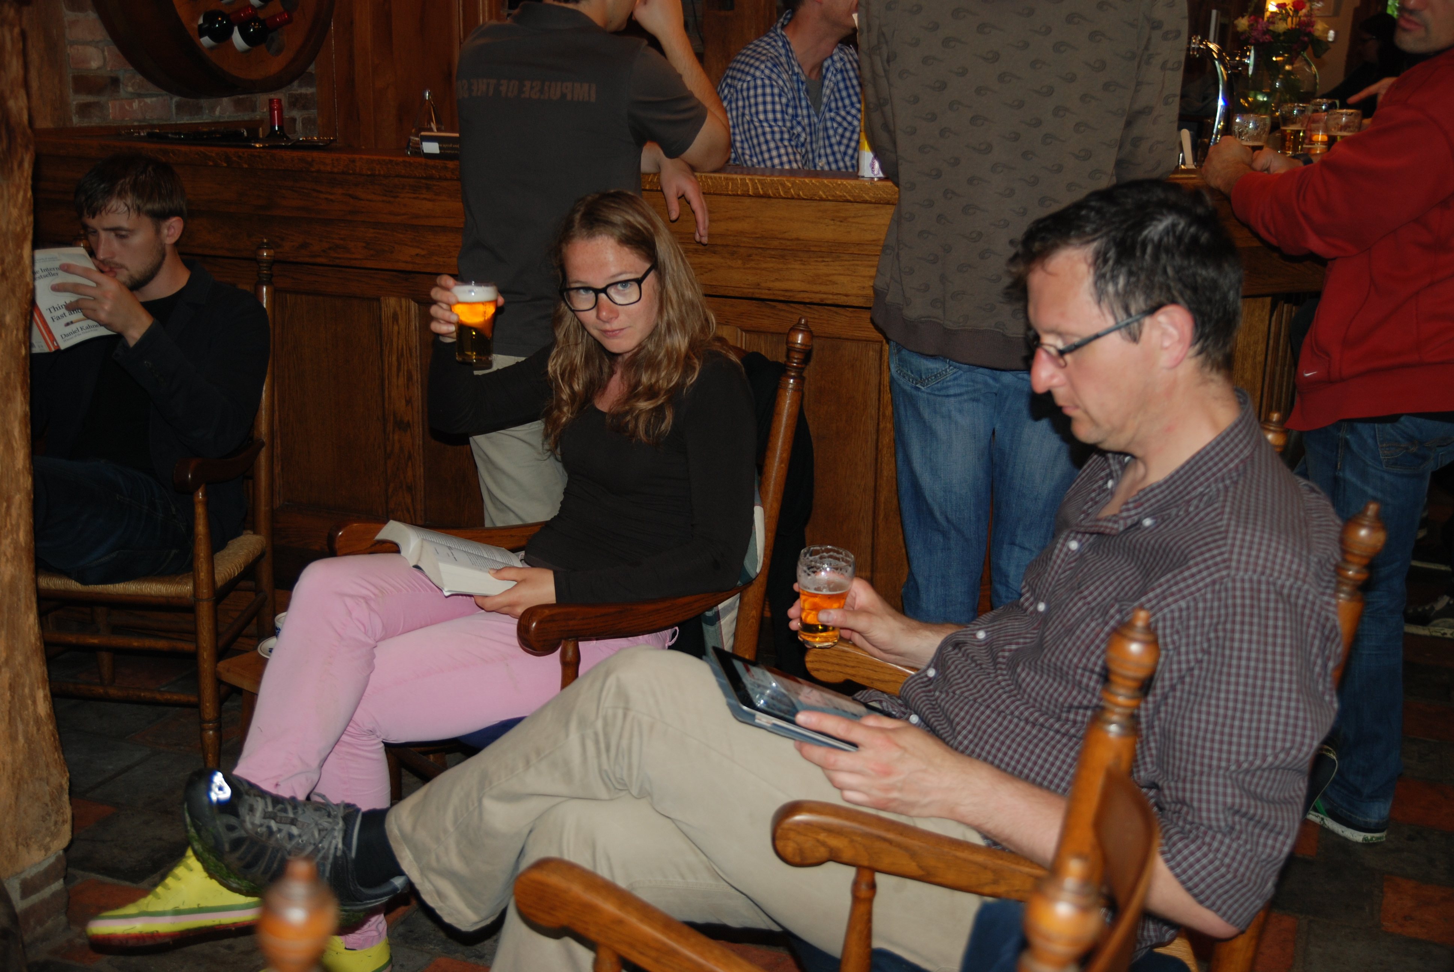
Groenlo

Slide 12
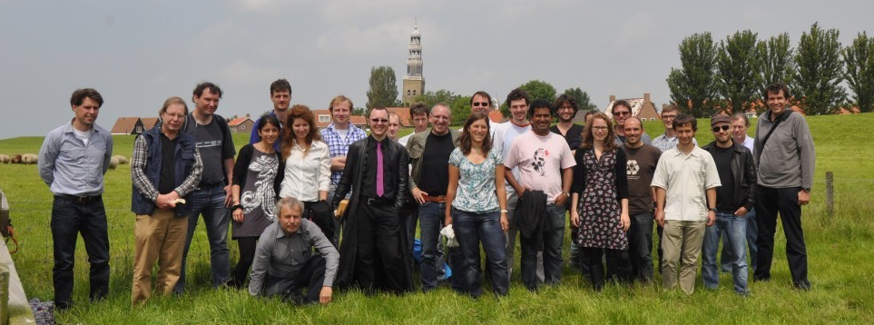
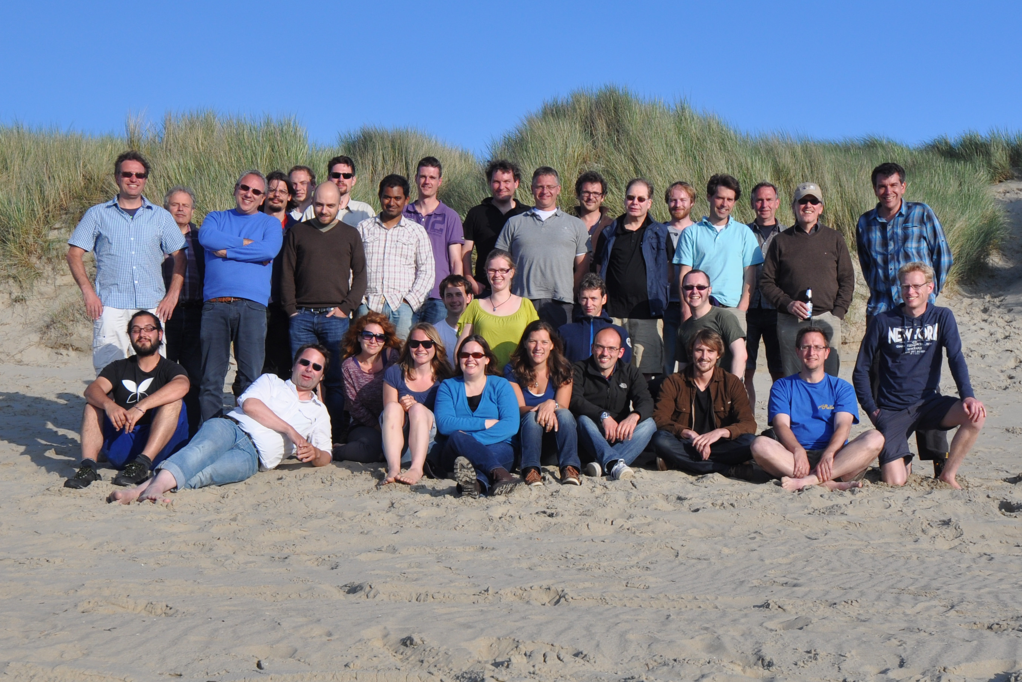
Hindeloopen
Renesse
Valkenburg

Slide 13
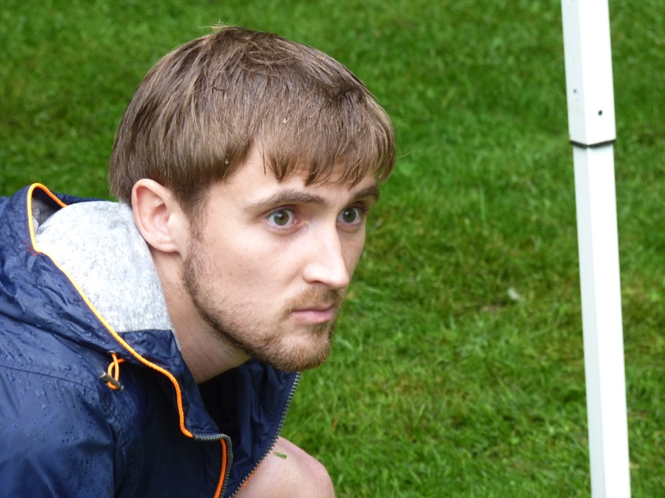
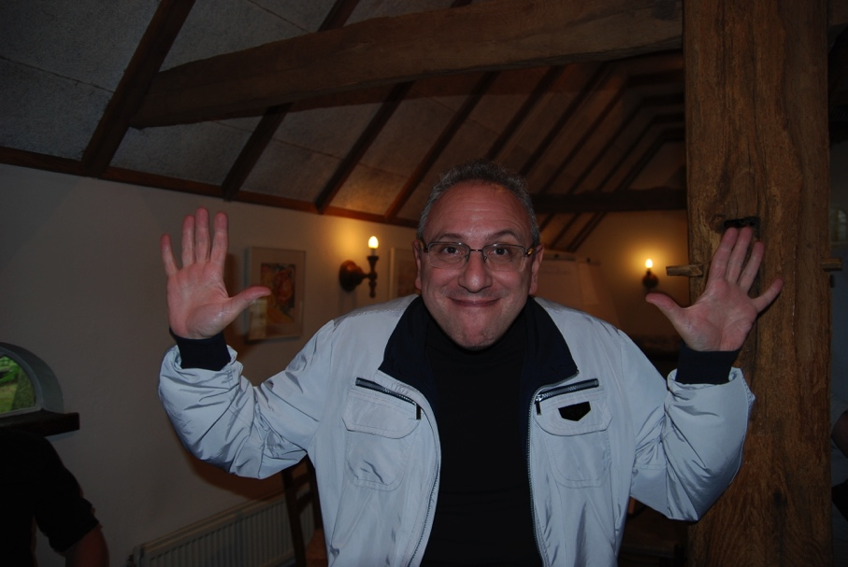
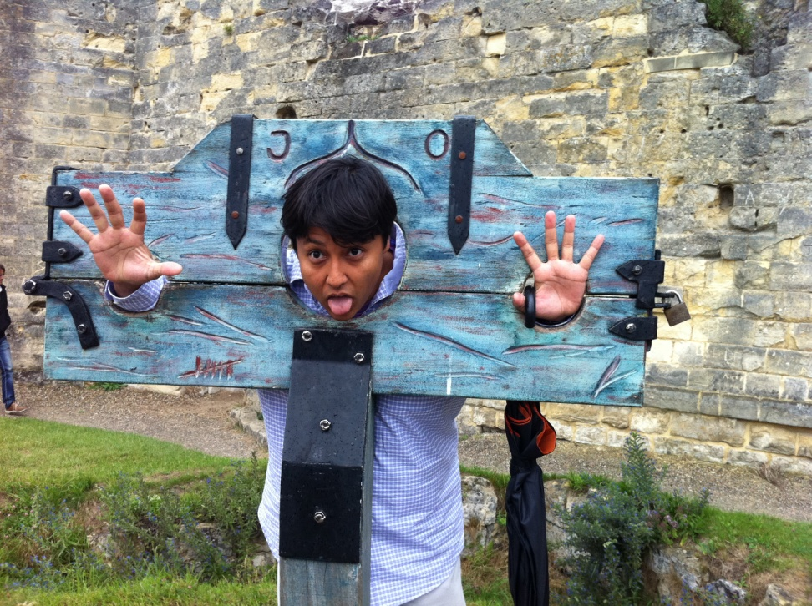
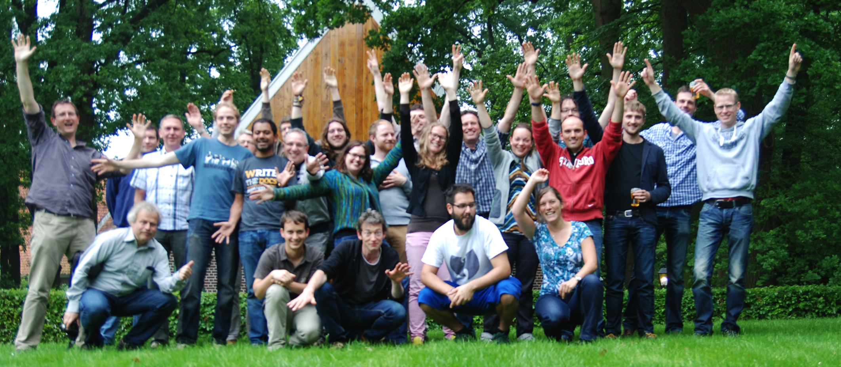
Dear Memories…

Slide 14
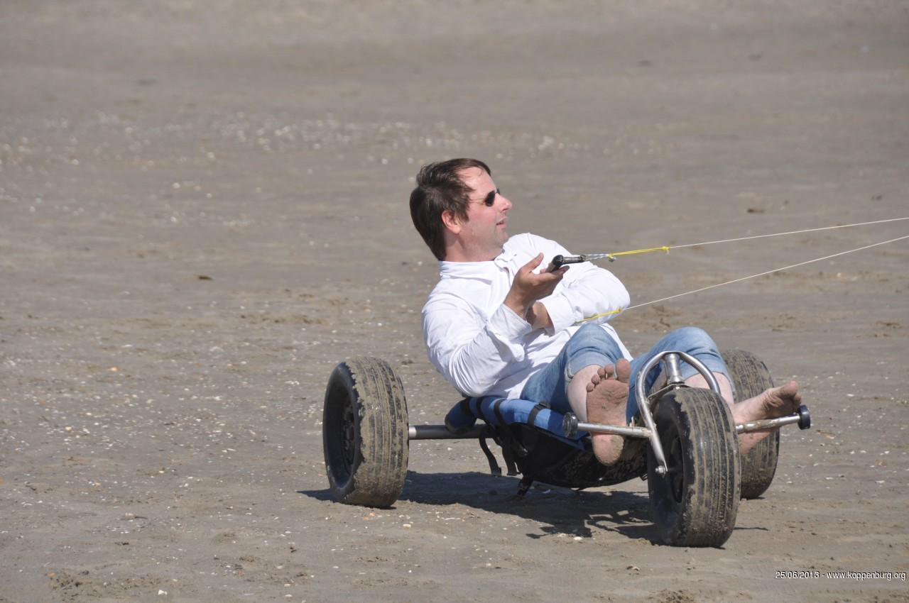
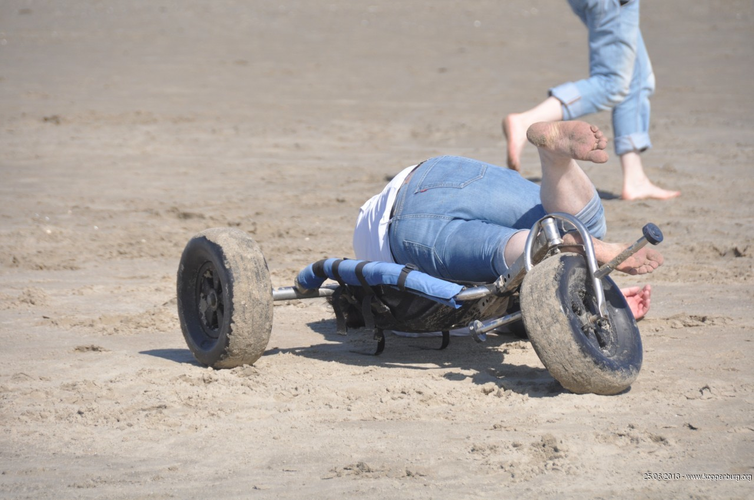
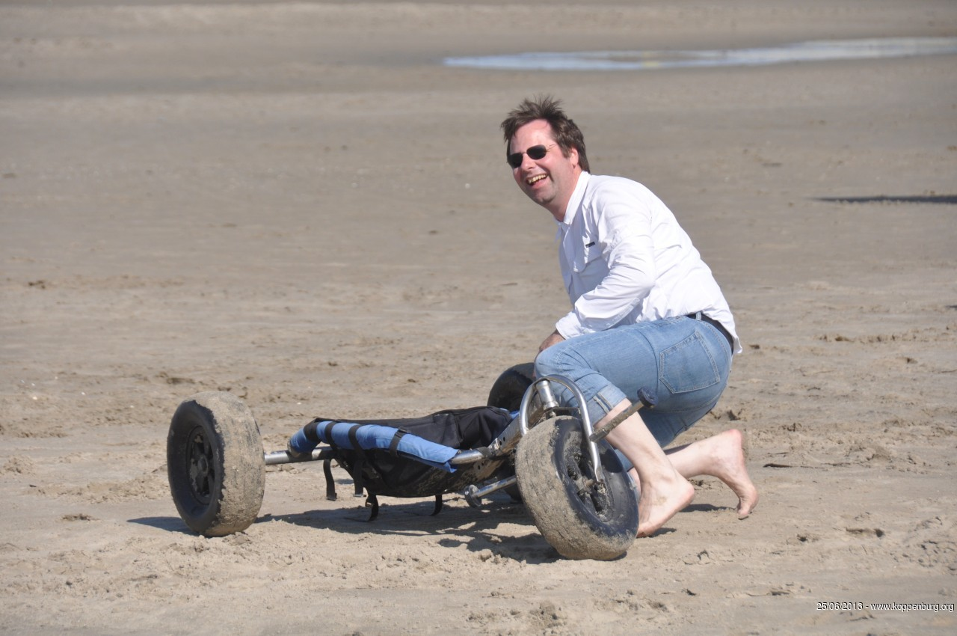
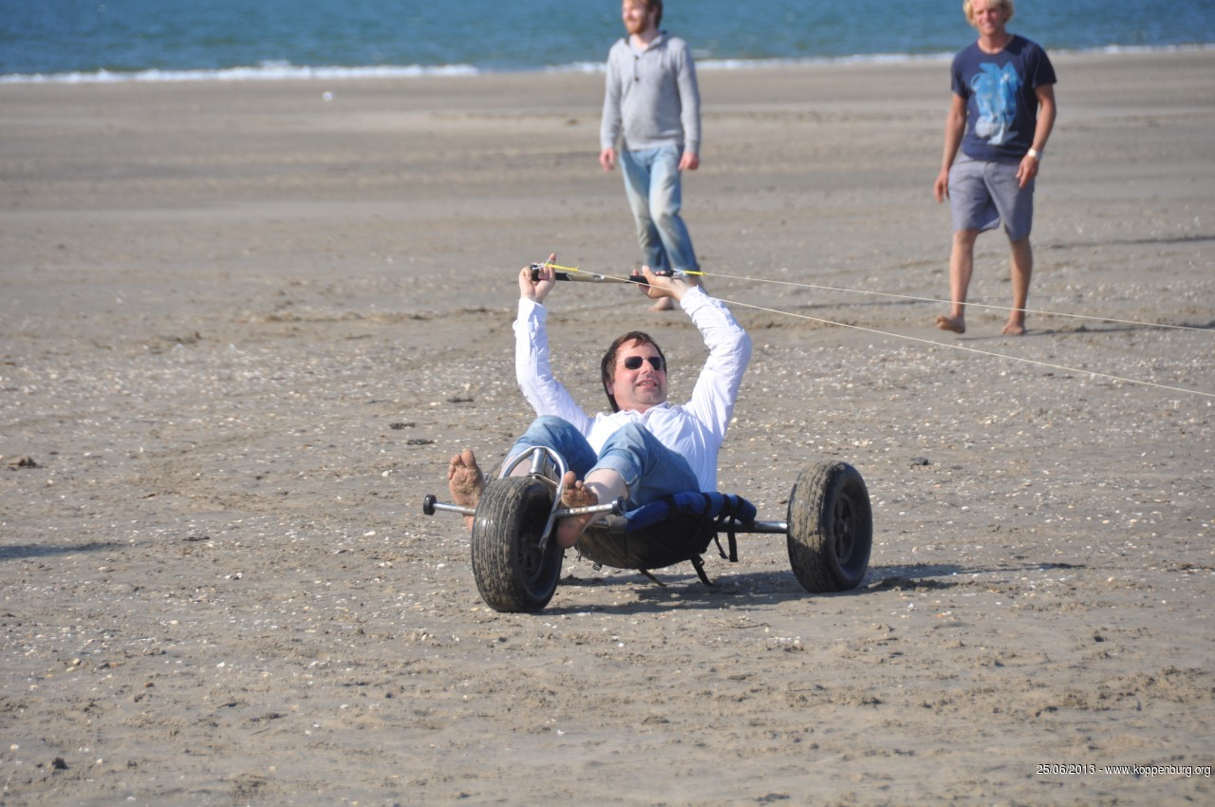
Workshop
Fun…
Challenging…
Don’t give-up…
Success!

Slide 15
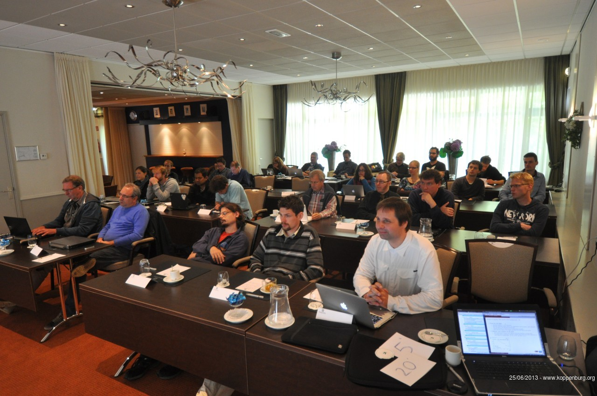
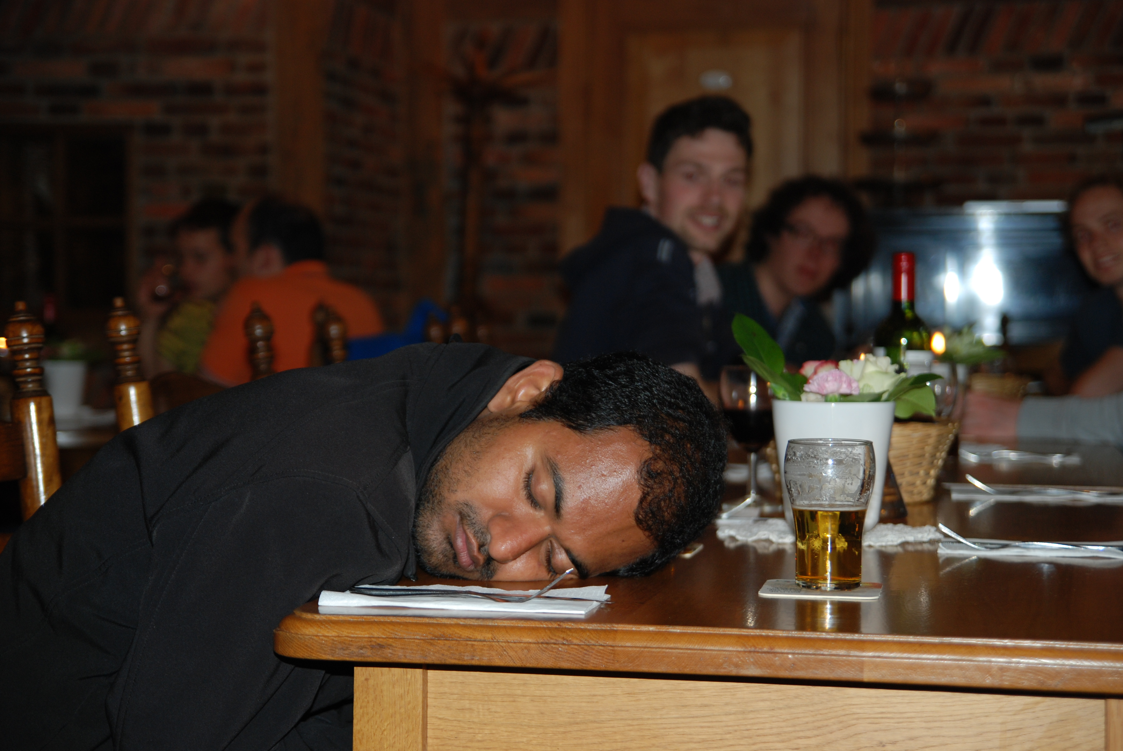
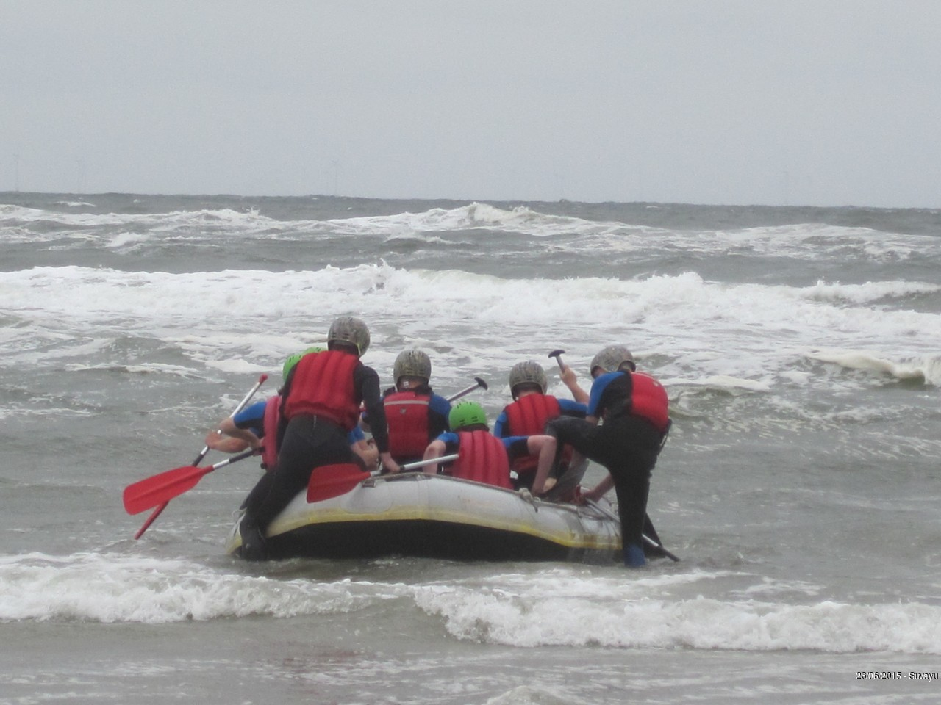
Pictures
To show to the rest of Nikhef how hard we work…
…and how dedicated we are!

Slide 16
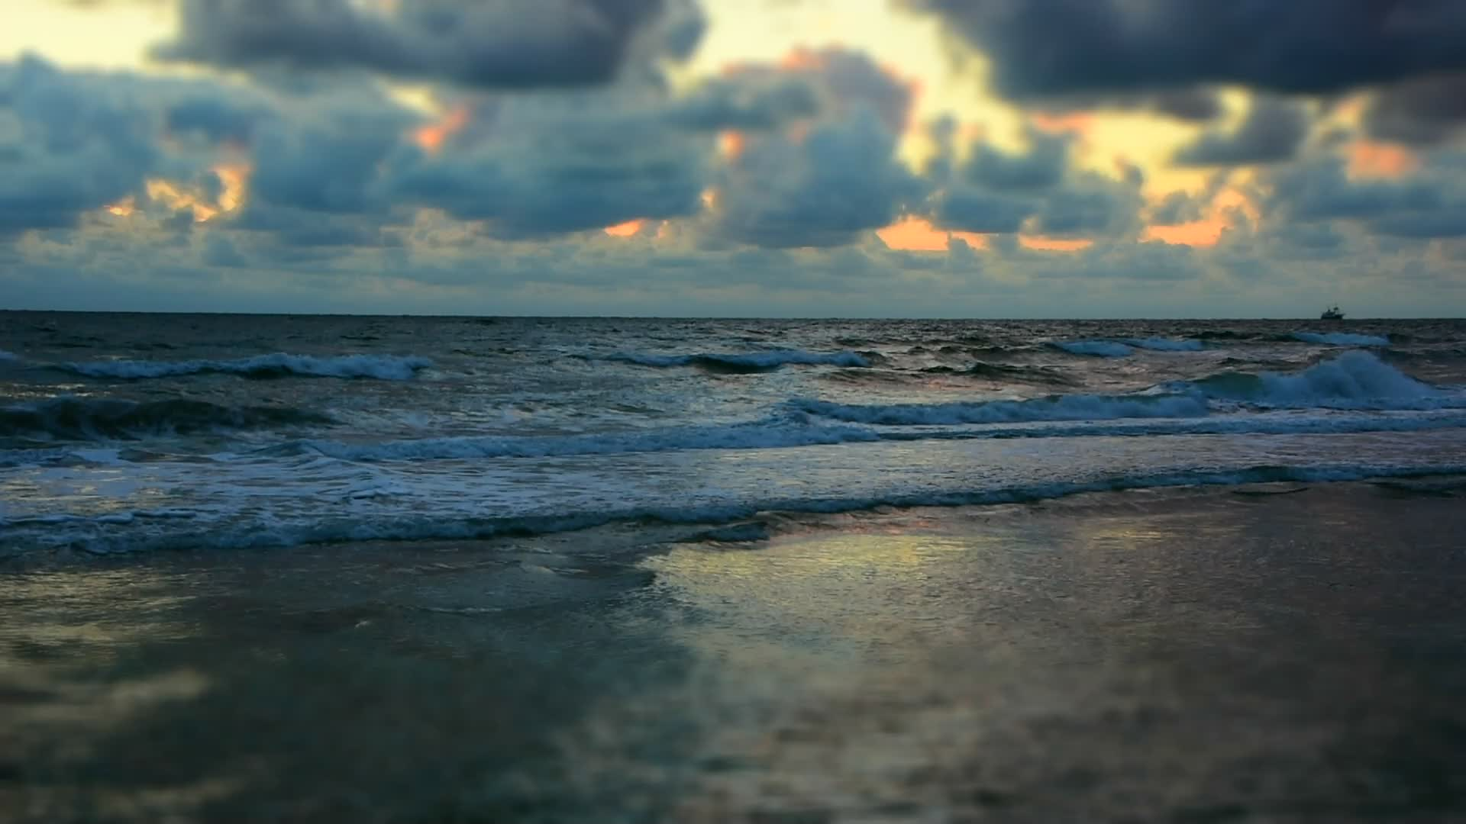
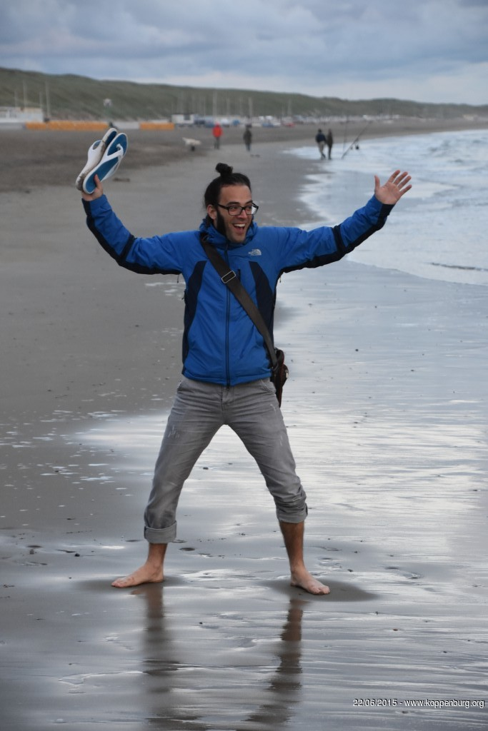
Come get your PhD with us…
Panos is happy to have escaped
Vasilis still trying hard…

Slide 17
Cheering Foto
Egmond aan Zee

Slide 18
Cheering Foto
Hulsbeek
Groenlo

Slide 19
Enjoy the Workshop
Don’t be shy and bring up your ideas…
There should be sufficient time for discussions!

