Slide 1
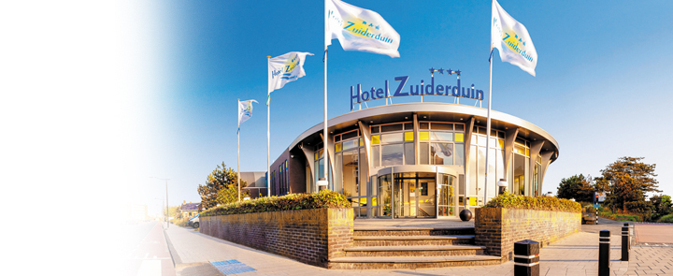
Bfys Workshop
“Facing Phase Transitions”
June 22 – 24, 2015, Egmond aan Zee

Slide 2
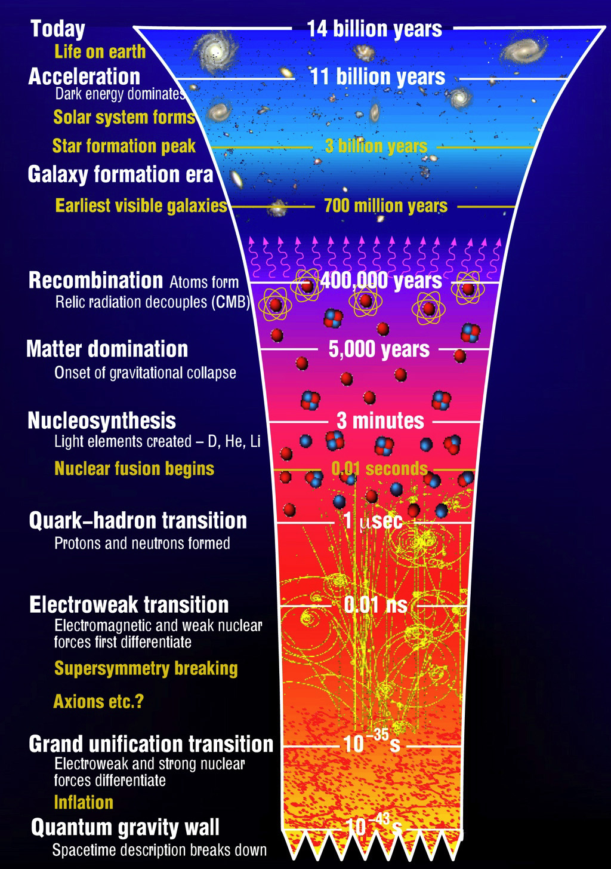
Facing Phase Transitions
Monday
  14h00 – 18h00, “Physics”:
  Standard Model → Beyond (?)
  20h00 – 21h00, “Guest Talk”:
  The Electroweak Phase Transition
  in the Universe
Tuesday
  09h30 – 13h00, “Analysis”:
  Run 1 → Run 2
  Statistical Errors → Systematic Errors
  14h00 – 18h00, “Outdoor”:
  Beach → Waves
Wednesday
  09h30 – 13h00 “Detector”:
  LHCb →Upgrade

Slide 4
Physics Puzzels from Run-1
B_{d}→μ⁺μ⁻ is observed earlier than expected
B→K*μ⁺μ⁻ P5’ and B_{s}→φμ⁺μ⁻ BR.
R_{K}: B⁺→K⁺μ⁺μ⁻ / B⁺→K⁺ e⁺e⁻
R_{D}: B→D⁽*⁾ τ ν / B→D⁽*⁾ μ ν
Exclusive V_{ub} vs includive V_{ub}
Di-boson resonances Atlas/CMS…
➔All rather intriguing! Very excited about Run-2

Slide 5
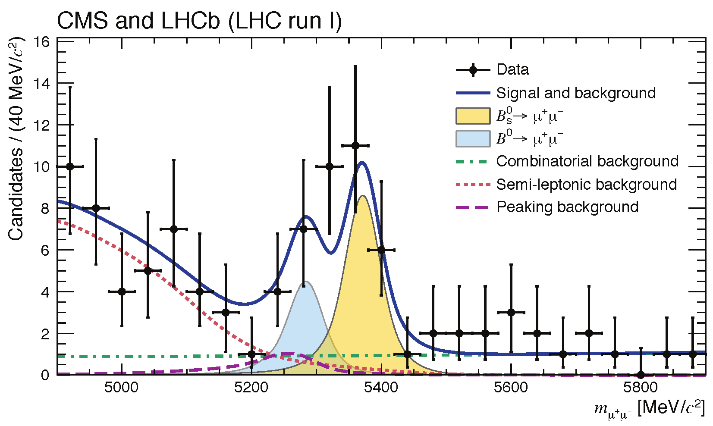
Very Rare Decays
Bd→μ⁺μ⁻ / Bs→μ⁺μ⁻ ? τμ? eμ?

Slide 6
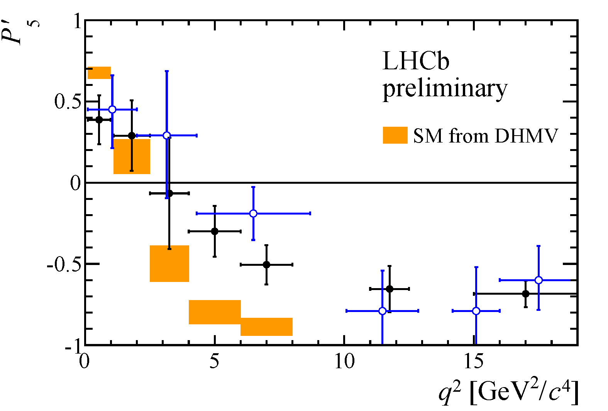
Electroweak Penguins
1) P5’: is it a charm loop, form factors
or perhaps NP a la Z’ (2-7 TeV)?
2) Bs→φ μμ lower than expected?
3) R_{K}: B⁺→K⁺μμ / B⁺→K⁺ee:
Lepton non-universality → LFV?
2.6 σ

Slide 7
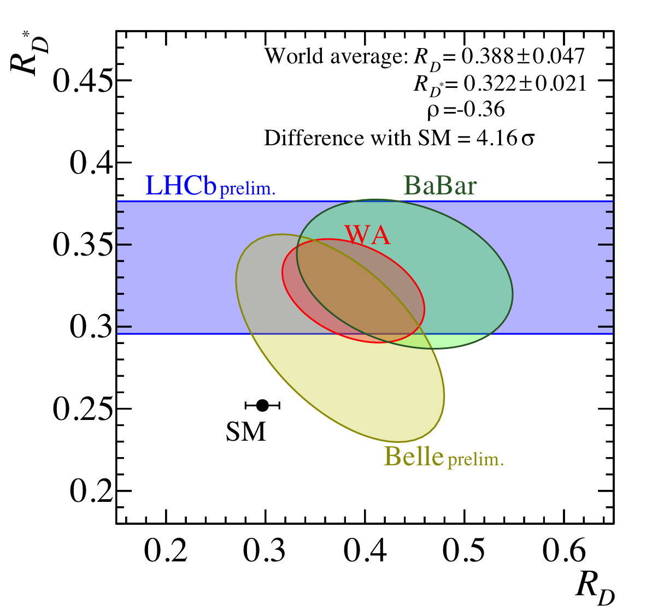
B→D^{(*)} τ ν / B→D^{(*)} μ ν
LHCb-PAPER-2015-025
BaBar and LHCb discrepancy
Belle is halfway?
Summary from
Jeroen van Tilburg
NP candidate: Charged Higgs ??

Slide 8
Inclusive vs Exclusive discrepancy
arXiv:1504.01568

Slide 9
Atlas di-Boson Signals
3.4 σ
2.6 σ
2.9 σ
Local significances (correlated data)
Di-boson jet reconstruction from arXiv:1506.00962v2

Slide 10
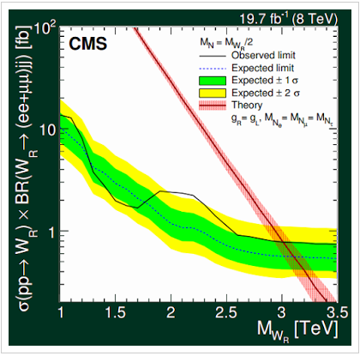
CMS: pp →l₁l₂qq
Hint for
W’ ?

Slide 11
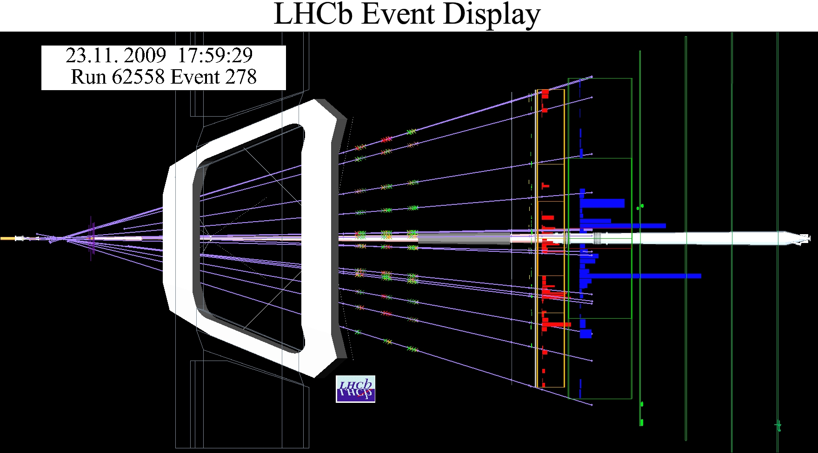
Run 1

Slide 12
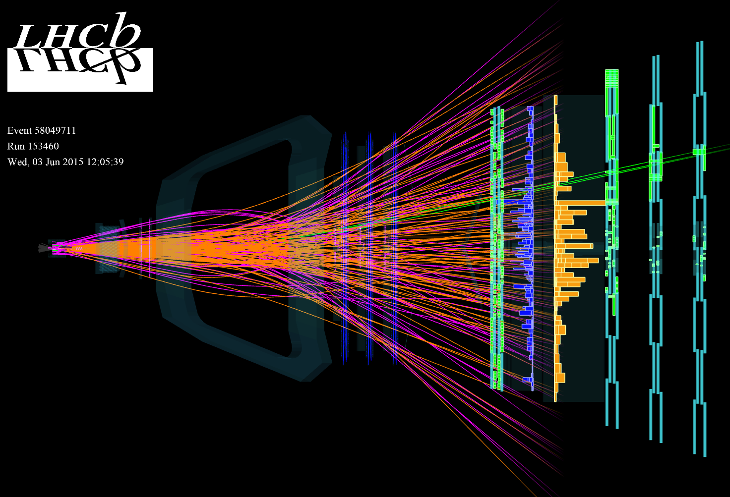
Run 1 → Run 2

Slide 13
Upgrade

Slide 14
Velo Upgrade

Slide 15
Tracker Upgrade
P - Resolution
Efficiency:
Ghost Rate:
ν = 3.8
ν = 3.8
ν = 7.6
ν = 7.6
How to make optimal use of the improved performance of the upgrade detector?

Slide 16
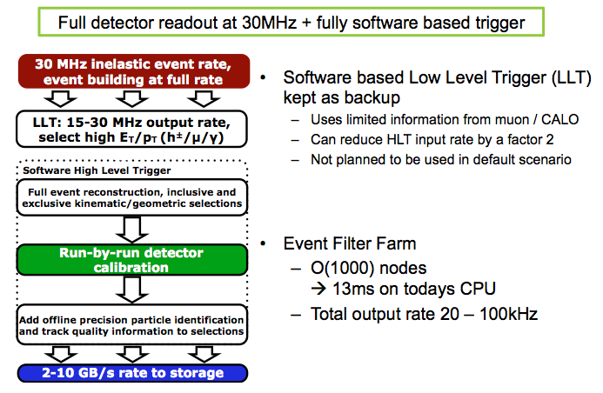
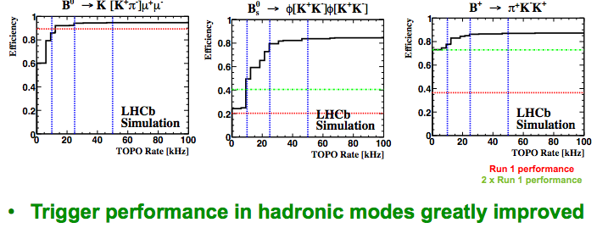
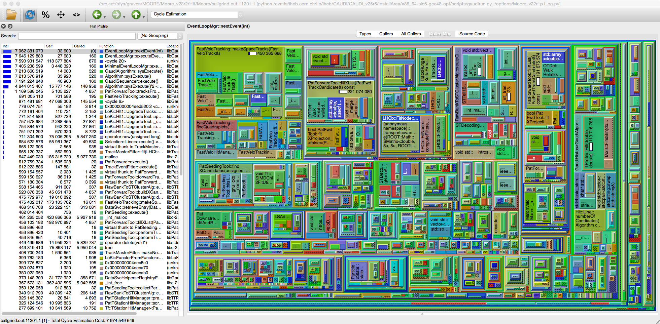
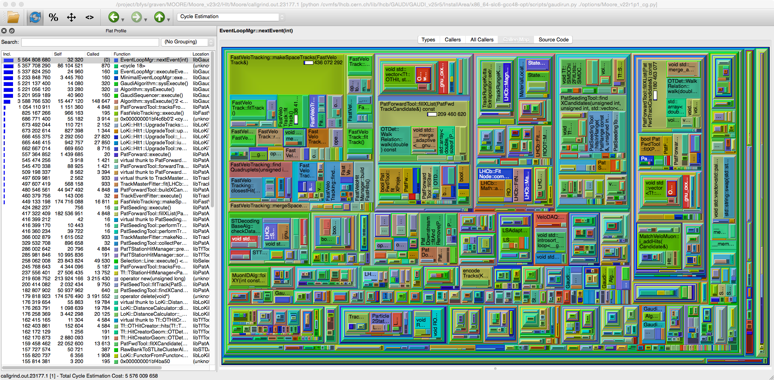

High Level Trigger
Performance vs bandwidth output
Further optimizations a la:
7974M Cycles
(30/11/2014)
5576M Cycles
(15/01/2015)

Slide 17
Upgrade Performance Example
Expected precision
on angle γ

Slide 18
Finally… TTFU
Beyond the current LHCb upgrade… TTFU
Phase 1b (LS3): Upgrade ideas at “moderate” lumi:
  Magnet side chambers
  TORCH
  New muon shield (remove HCAL?)
  New muon chambers?
  New inner region ECAL?
Phase 2 (LS4?): Upgrade ideas at high lumi:
  Inst. Lumi >= 10³⁴, Integrated: >= 300 fb⁻¹
  Displace interaction region to keep RICH occup “low”
  New Velo, tracker, “time-tag” detectors to suppress pileup…
  Physics case?

Slide 19

Enjoy the Workshop
Don’t be shy and bring up your ideas…
There should be sufficient time for discussions!

