Slide 1
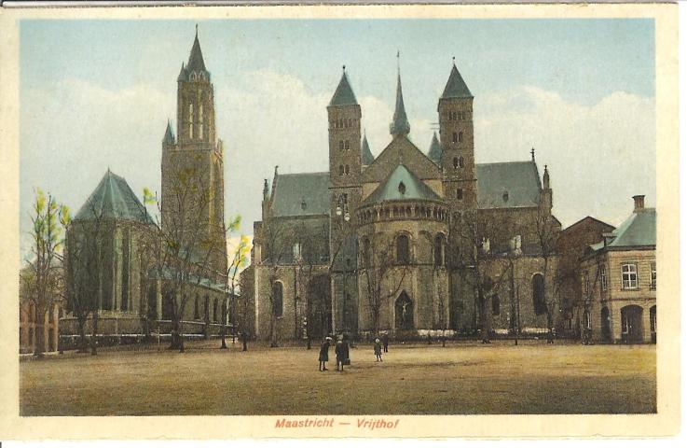
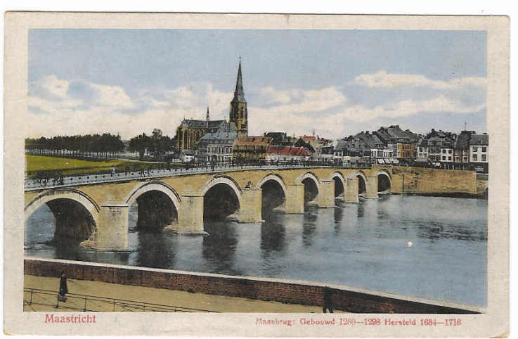
Maastricht “Mestreech”
Impression of history and language
“Mestreechter taol, doe zeute spraok”

Slide 2
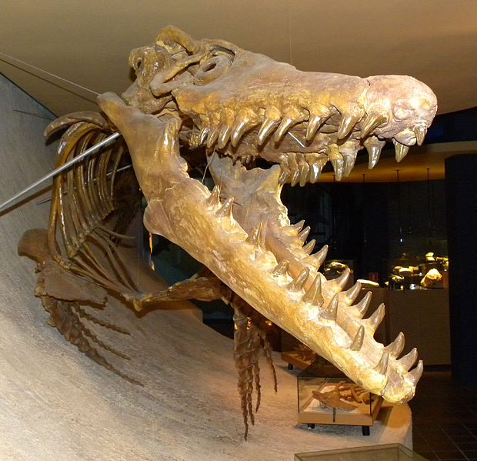
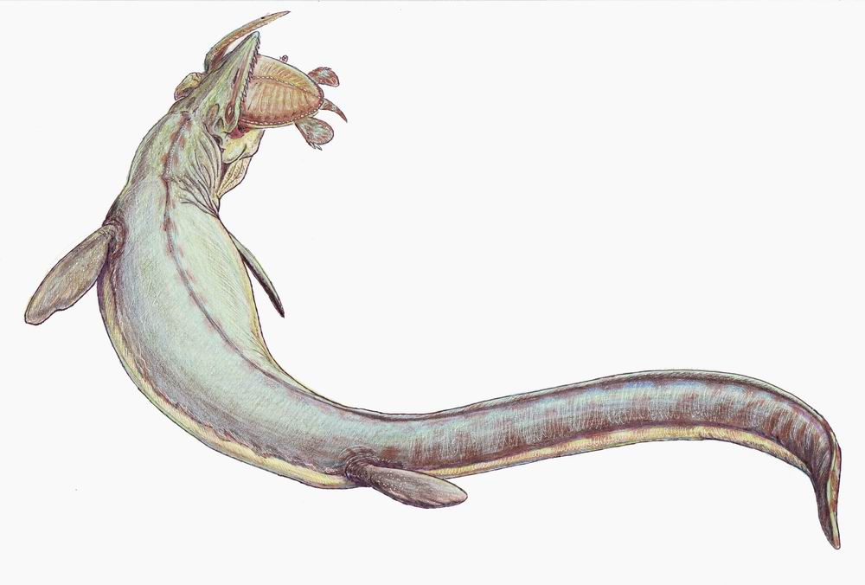
History: First Inhabitants
First inhabitant: Bèr
Mosasaurus can be seen in natural history museum
Found in sandstone (mergel) caves (~ 70 million years old – “krijt”)
Rests of encampement found of middle paleolithicum
~80000 BC (Neanderthal?)
“Bandkeramische“ culture 5500 BC – 4400 BC (neolithicum)
Farmers and pottery
Celtic settlement ~ 500 BC
In 2008 a Celtic coin treasure was found at about 200 m from my parents house
Roman road from Boulogne to Cologne
Crossing point over the river Maas (Trajectum ad Mosam)
Bèr

Slide 3
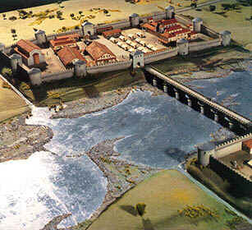
The oldest city of Netherlands?
Debate between Nijmegen (Noviomagum), Voorburg (Forum Hadriani) and Maastricht (Traiectum ad Mosam)
What is the definition?
All three have claimed to be oldest city
Roman encampment along the roman “highway”

Slide 4
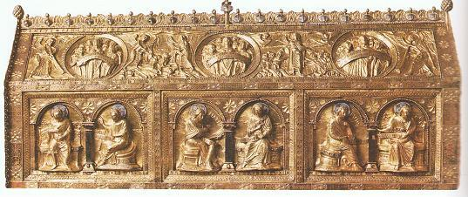
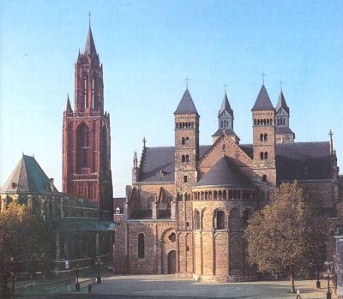
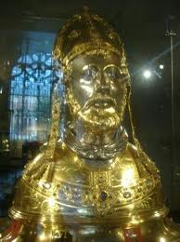
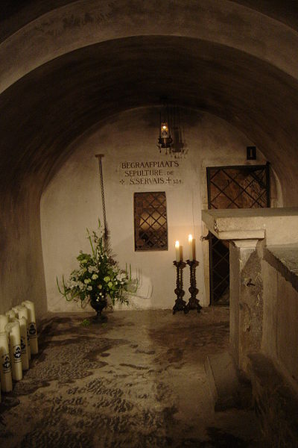
St Servatius
Bisshop in Maastricht
From Armenia
Brought Catholicism to Netherlands
Built first church in Maasticht
Onze Lieve Vrouwe
Died in 384 outside Maastricht

Slide 5
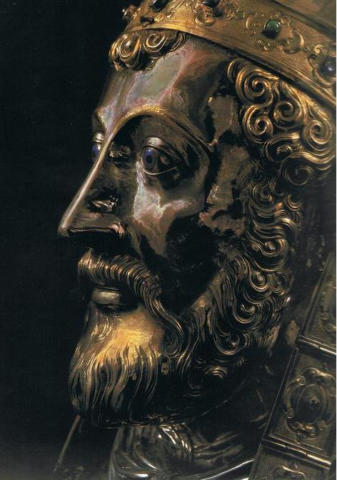
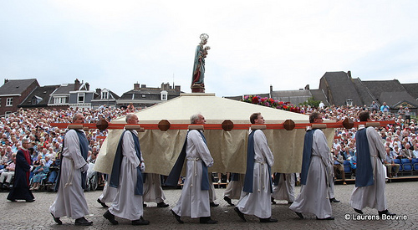
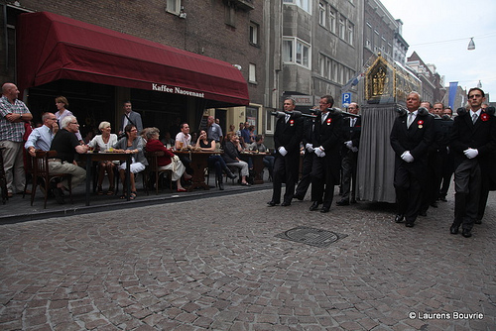
Religion
Every 7-th year pilgrimage to Maastricht in name of St Servaas
Happened last weekend

Slide 6
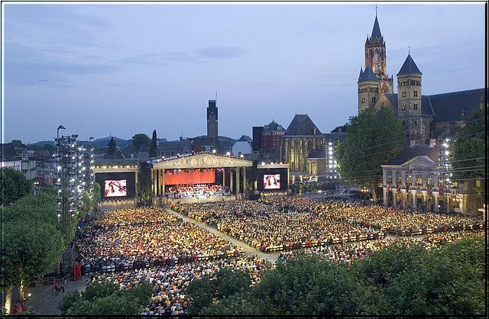
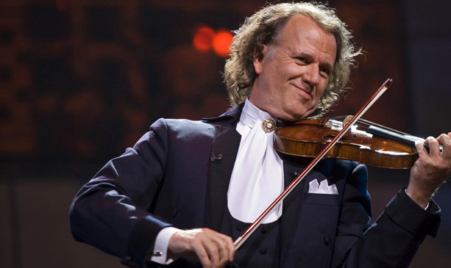
Very Different Pelgrimage this weekend

Slide 7
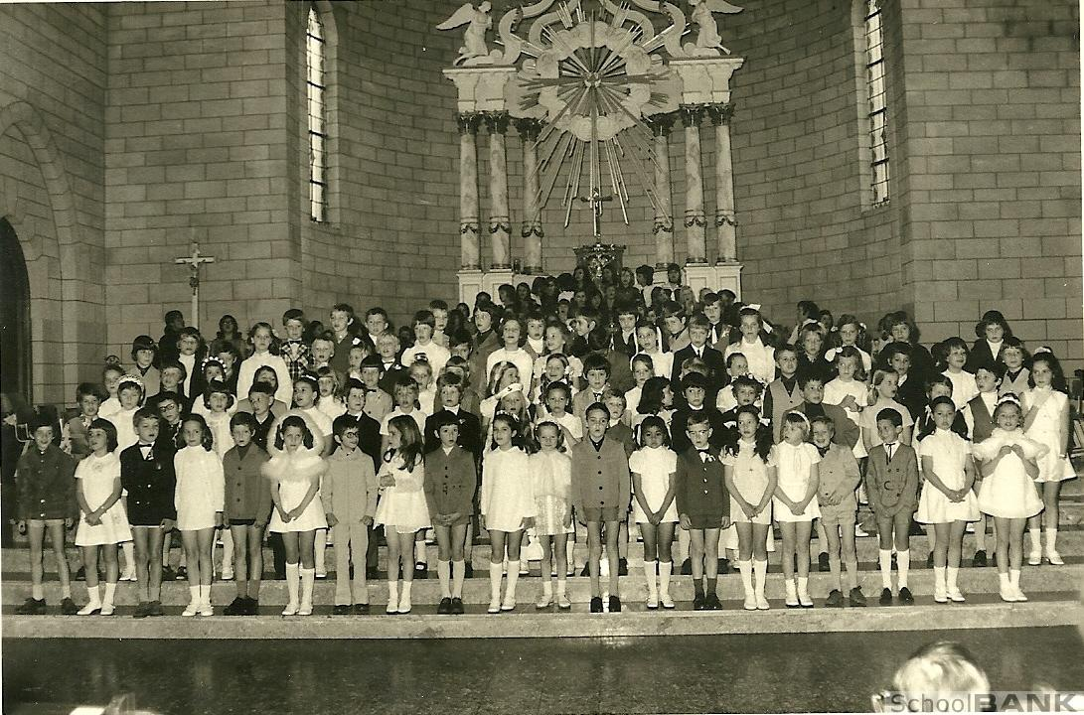
St Antonius of Padua Church - 1972

Slide 8
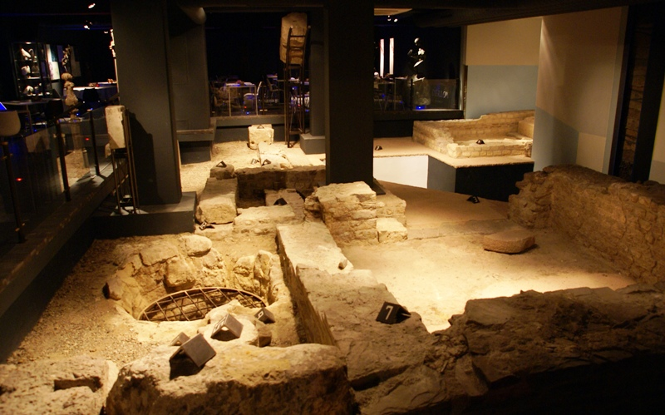
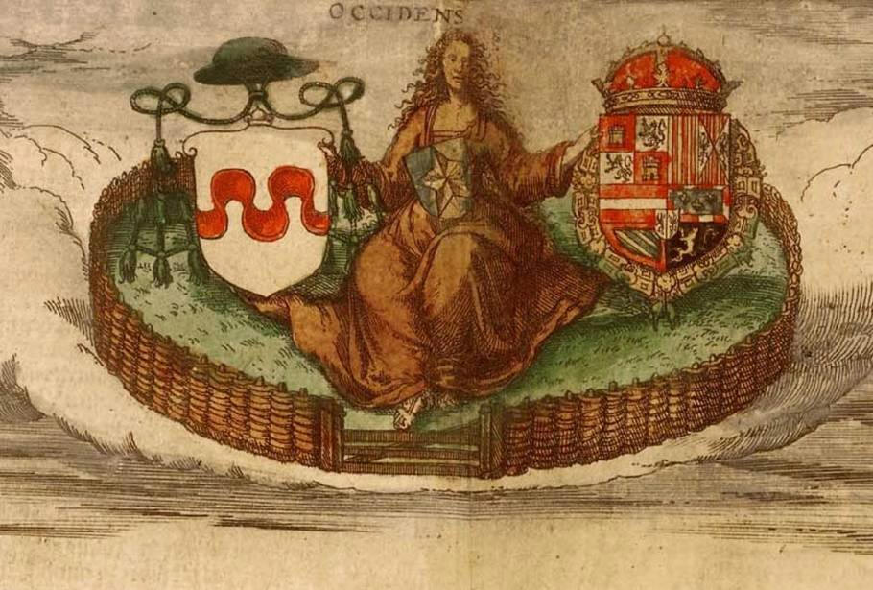
Roman remains in basement hotel Derlon
Inhabited in Karoling and Meroving period
In middle-ages (from 1204) two-rulers (“twee-herigheid”):
Duke of Brabant
Prins Bisschop of Liege (Luik)

Slide 9
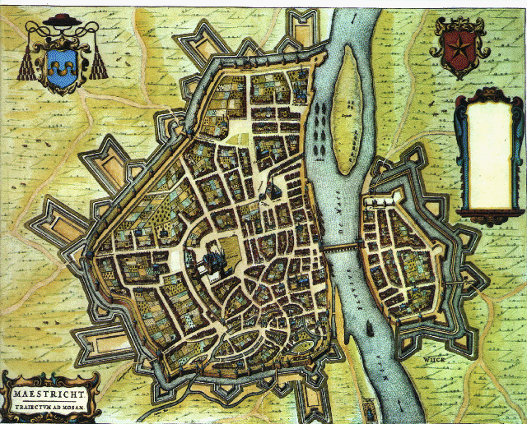
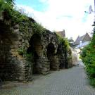
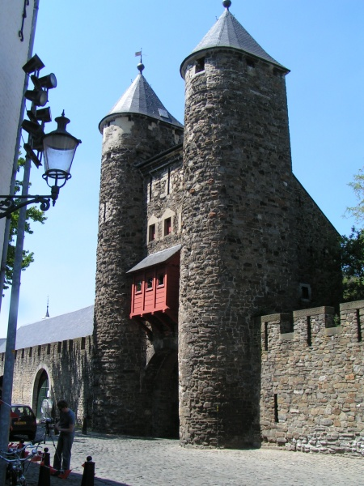
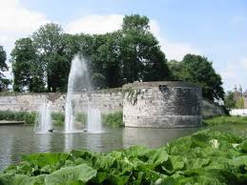
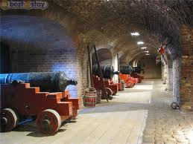
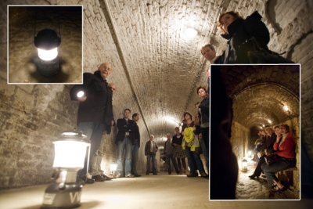
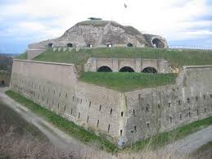
Fortifications:
1229 first brick wall
Second wall 1375
Third wall 16th century

Slide 10
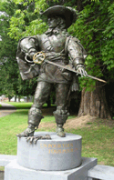
Many battles
1400 under Burgundy
1477 Habsburg
1500 under Spanish
1632 Maastricht fights at the side of the Spanish against the Dutch
First taken by the dutch
Later the spanish recover surrounding cities but Maastricht stays dutch enclave in which catholics are tolerated.
1673 the french capture maastricht (Louis XIV).
Musketeer d’Artagnan dies outside
1814 Maastricht part of the Netherlands
1830 – 1832 South of NL became part of Belgium (but Maastricht was dutch enclave)
1839 The Netherlands as we know it today

Slide 11
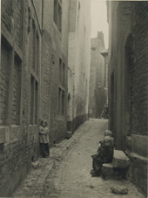
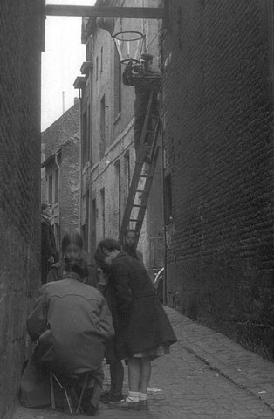
Industry: Rich and Poor .
Maastricht was the first industrialised city in NL
Before the industry maastricht was very poor
The industry attracted many people
1800→ 18000, 1850→25000, 1900→ 40000
This lead to slums
Main figure Petrus Regout
Glas and pottery
Bruxelles and Maastrich became romanised (“frenchified”) cities
Until 1892 the newspaper was in French
The current dialect is a mix of french, german and dutch

Slide 12
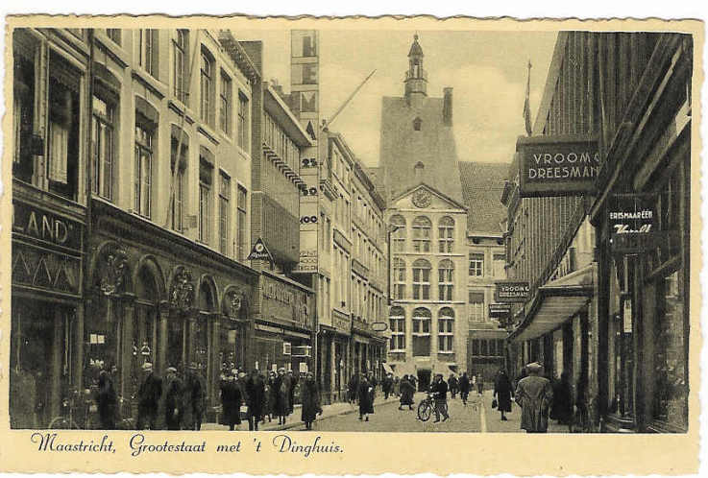
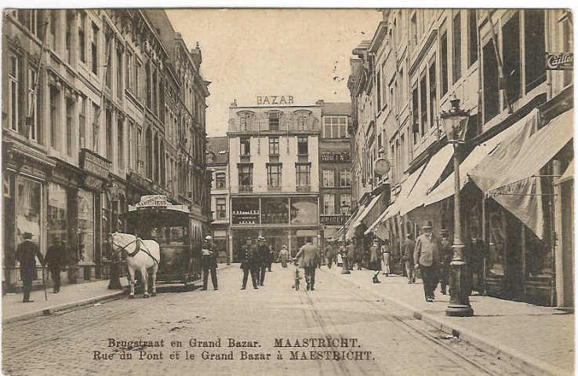
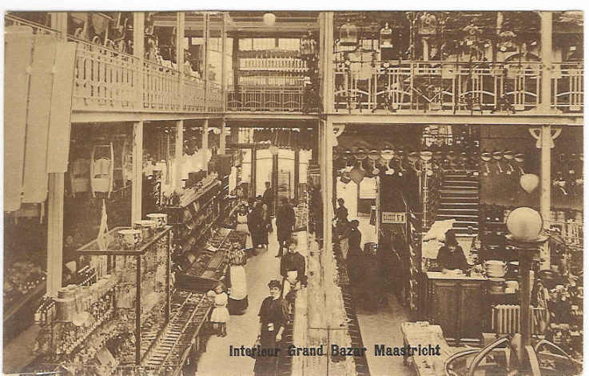
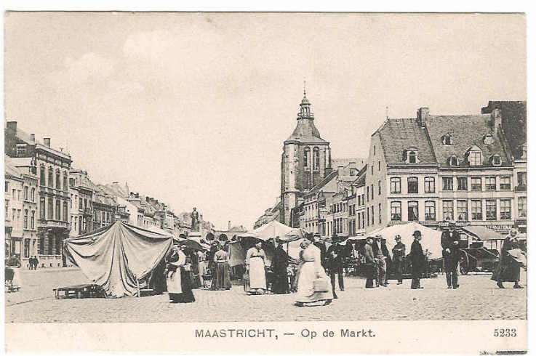
Shopping and “flaneren”

Slide 13
Strange People…
Male person from Maastricht: Unne “Sjeng”
Very “chauvenistic” (?)
Maastricht is the best place in the world
“The truth may be said”
This opinion doesn’t make them popular
Traditionally 3 kinds of people in the Netherlands:
“Mestreechteneere” (highest class)
“Boere” (farmers): rest of south limburg (simple people – no manners)
“Hollenders”: rest of the Netherlands – the poor (but arrogant) devils can’t help it.
The rest of the world:
Belgians and Germans

Slide 14
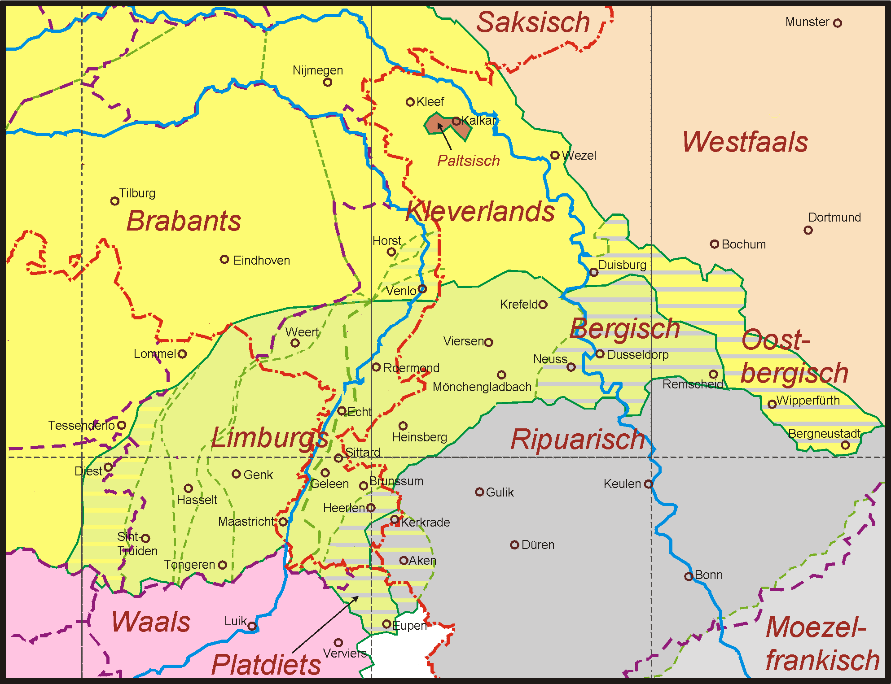
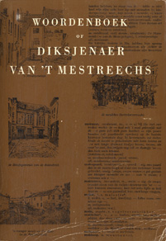
Strange Language .
Mestreechs – a city-dialect
About 60 thousand speakers
Mix of dutch/french/german: versjèt / teleur
Spoken and written language
Dictionary and grammar rules
Lively literature – dates back to Henric van Veldeke
Spoken
“short maastrichts” – upper class”
“long maastrichts” – lower class” (peerd)
Written
Mainly since 1900 – Fons Olterdissen wrote comic opera’s – Maastricht anthem
Maastricht language has “tonality”
Intonation might give words complete different meaning
Similar to chinese – but less extreme
“zege” -> blessing and sawing (“stoottoon” vs “sleeptoon”)
Eine stein – twie stein

Slide 15
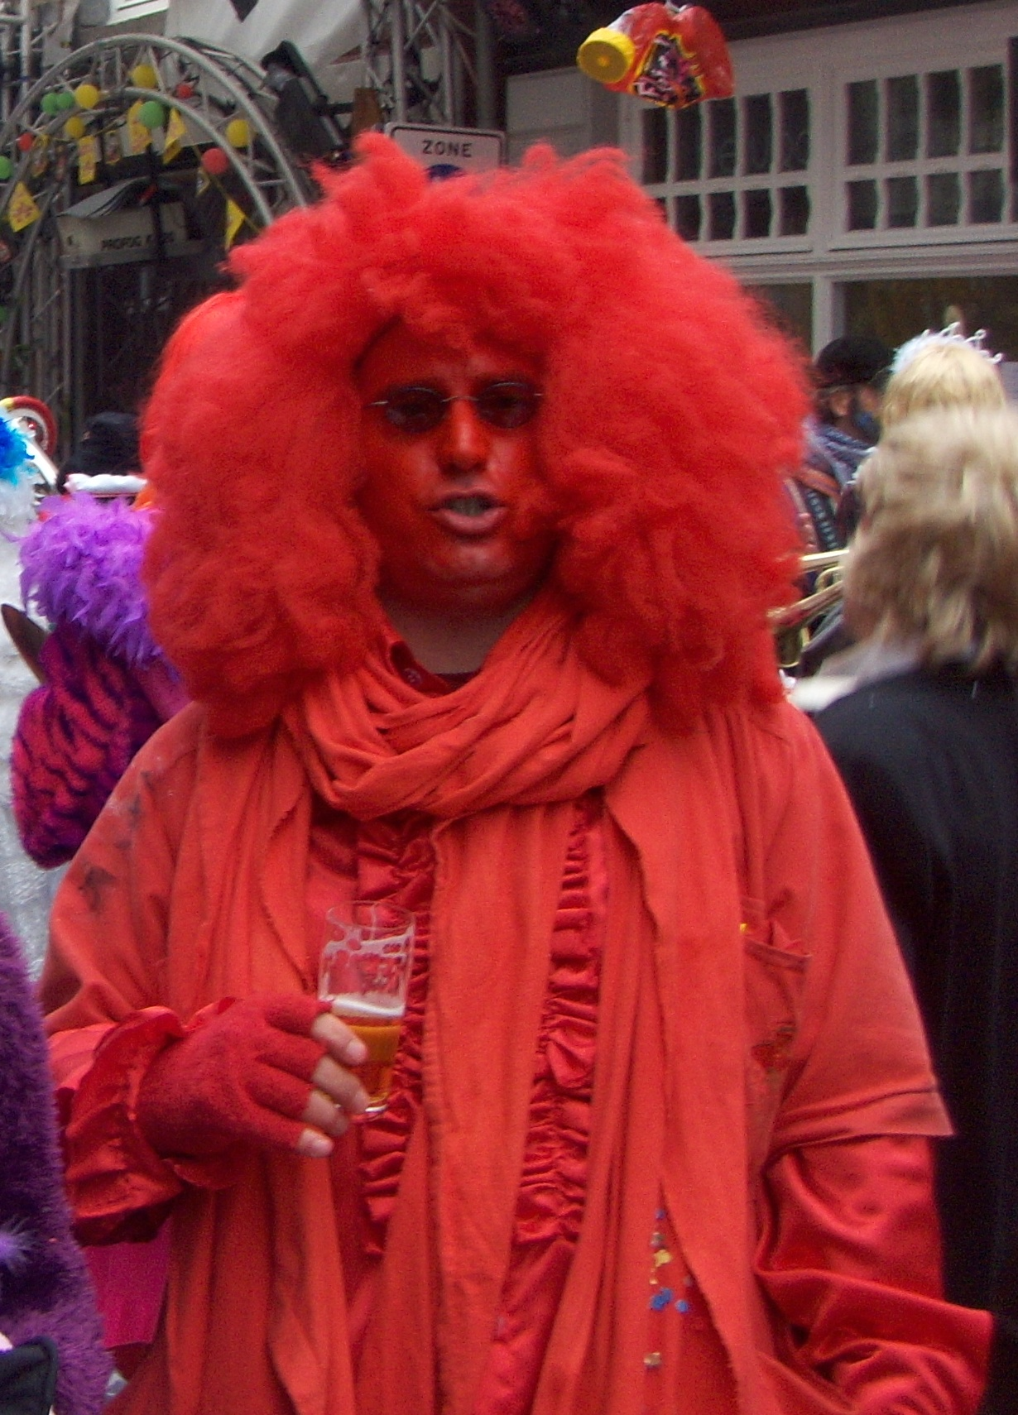
Strange custom…Carnaval

Slide 16
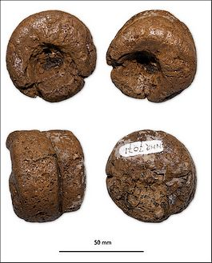
Most famous and simple carnaval song
Veer hubbe sjiet aon de luij (3x)
Veer hubbe luij aon de sjiet (1x)
A curious obsession:
The maastricht languange is very rich in relation to the human bottom and its product….

Slide 17
Folk-wisdom
“Wee hoeger wèlt sjiete es zien eige gaat, dans wie un hin op un gleujetigge plaat”
“Whoever wants to shit higher as his own ass, danses like a chicken on a burning plate”
➔If you are too ambitious you will be punished (Hoogmoed wordt gestraft)
“Heer sjit nog neet veur elf oore en daan is ut nog mèr eh-eh”
He can’t shit before 11 o’clock, and even then it is still only “eh-eh”
➔ Is saif about someone who is stingy (doesn’t want to spend money)
“Es ut mode is, blaos de köster mèt zien vot de keerse oet”
When it is fashionable, the sexton (koster?) blows out the candle with his ass
➔Always go with the latest fashion

Slide 18
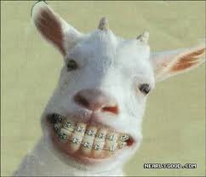
It’s bad…
“Lache wie un geit die brommele sjit”
“Laughing like a goat that shits blackberries”
➔Laugh in case unexpected positive surprise
“Peerdskeutele veur de hèl rape”
“Collecting horse dung in front of hell”
➔ Doing an effort for nothing

Slide 19
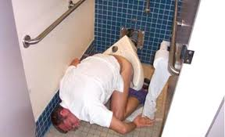
It gets worse…
“Me mos z’n vot neet aofveege veurtot me gekak heet”
“One should not wipe his behind before being done”
➔Let’s start at the beginning

Slide 20
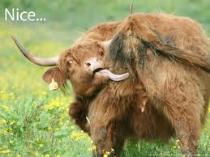
… and worse…
“Leefde is blind, zag de boer, en ‘r puunde ‘t kaaf z’n vot door ‘n kroonselehègk”
“Love is blind, the farmer said, and he kissed the calf’s behind through the gooseberrie- bushes”
➔If you love someone, you don’t see his/her weak side

Slide 21
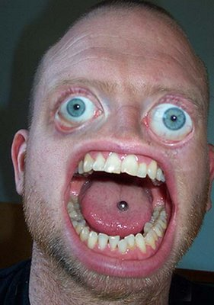
…and even worse.
“Zien vel is te kort; er ‘r z’n aoge tow deit geit z’n vot oope”
“His skin is too short; if he closes his eyes, his ass opens up”
➔ Is said when someone farts unintentionally

Slide 22
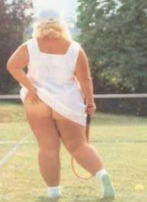
Applicable at the end of this workshop
“Höbste lang neegel, daan kinste miech aon mien gaat kretse”
“If you have long nails you can scratch my ass”
➔The answer you give if you owe someone money but you don’t have anything

Slide 23
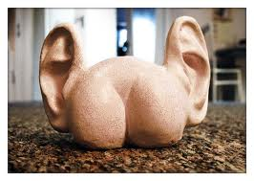
Well… just put a face like this
“Dat is un vot mèt oere”
“He looks like a bottom with ears”
➔ Not a compliment

