Slide 1
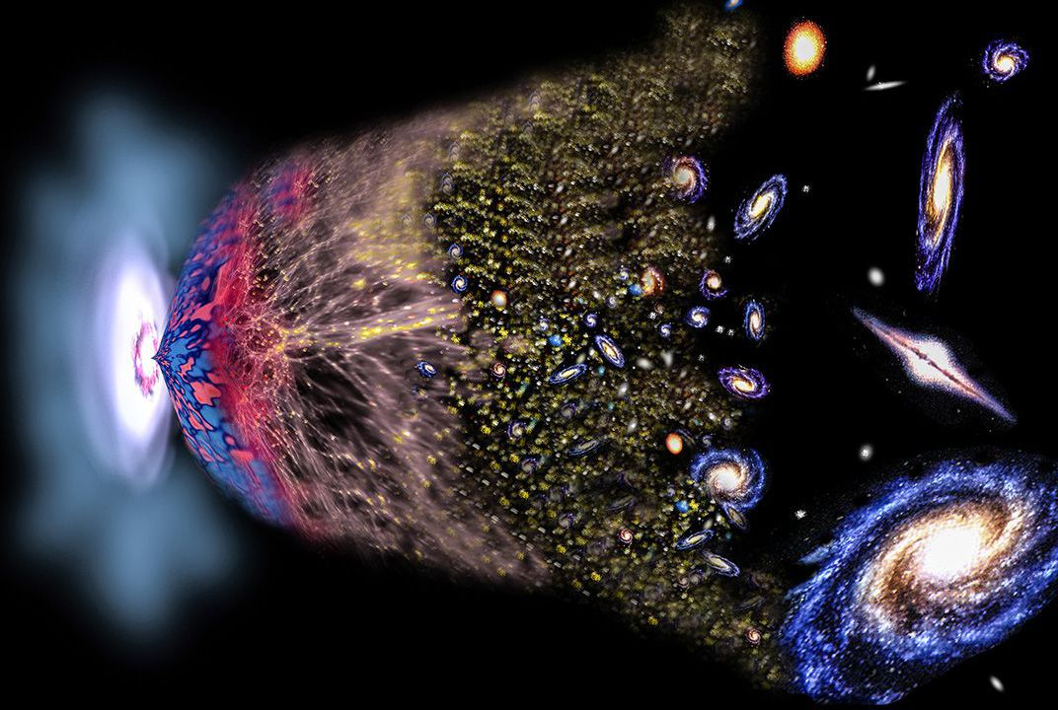
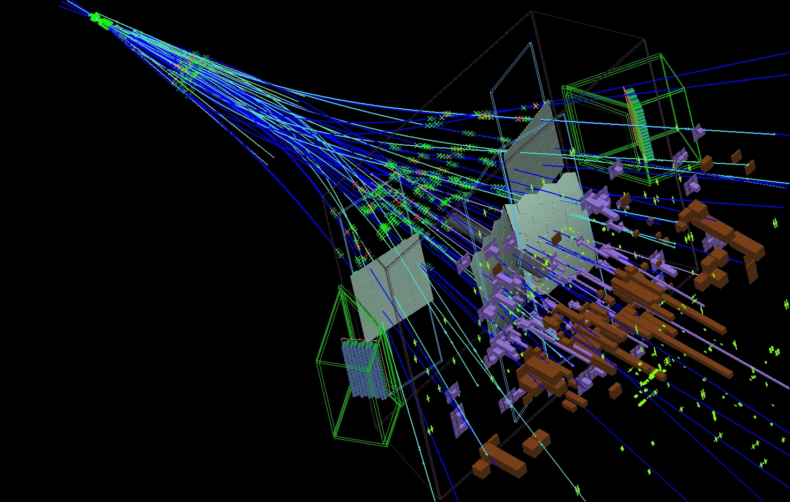
Flavour Physics and CP Violation
Marcel Merk
Nikhef Lectures PP2
Notes:
About early universe and physics at LHC(b)

Slide 2

Flavour Physics and CP Violation
1
2
3
Why three generations of particles?
Why is there no antimatter?
Why is an atom electric neutral?
Notes:
Fundamental particles: Standard Model
Matter particles:
3 generations: only 1-st one stable matter
Fundamental laws symmetric matter antimatter
Why is an atom neutral: charge proton=-electron?

Slide 3


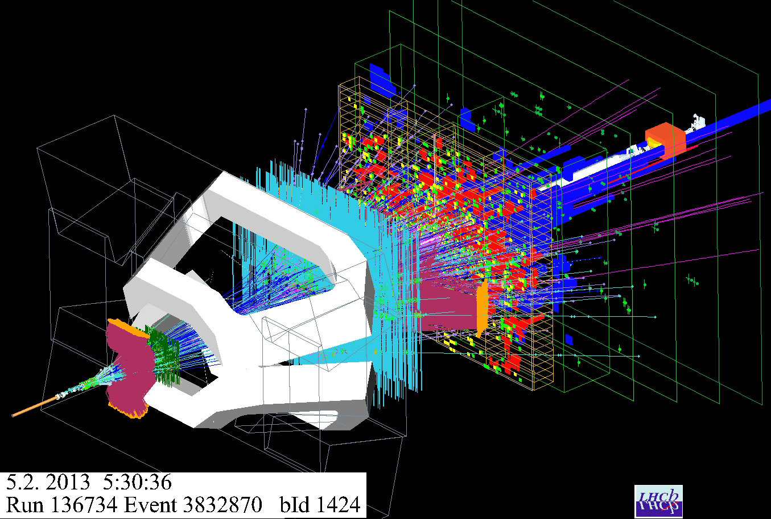
Introducing the lecturers
Lecture notes: www.nikhef.nl/~i93/Teaching#MasterPP2
Lecturer:
Marcel Merk
Tutors:
Jordy Butter
Suzanne Klaver
Research (“theoretical”):
- Why a matter-vs-antimatter asymmetry in nature?
- Why do we have three generations of particles?
Research (”experimental”):
- Detector technology at the Large Hadron Collider.
- Measurements of CP violation and rare b-decays

Slide 4
The Antimatter Mystery

Slide 5

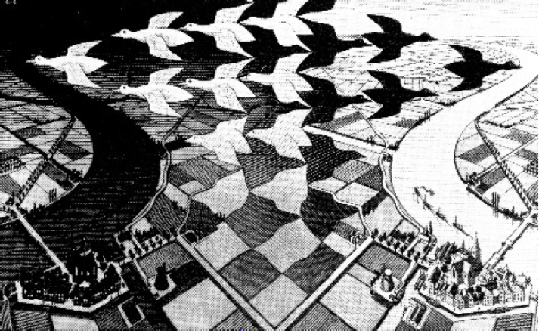
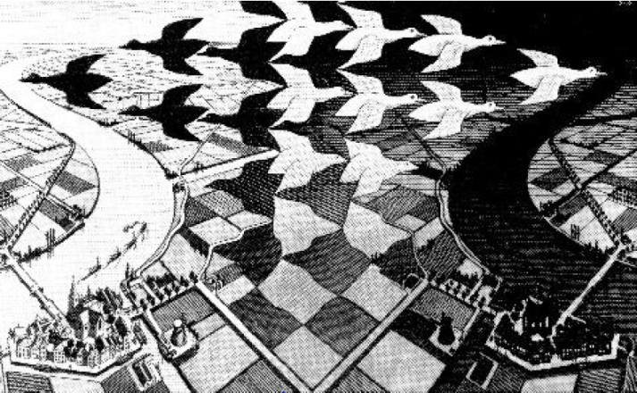
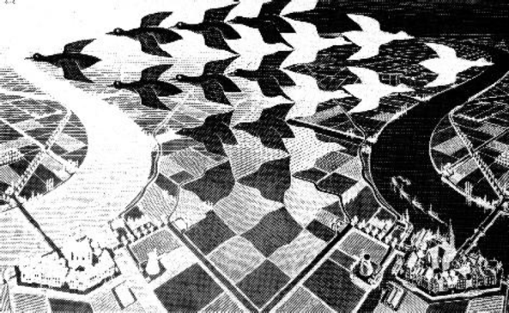
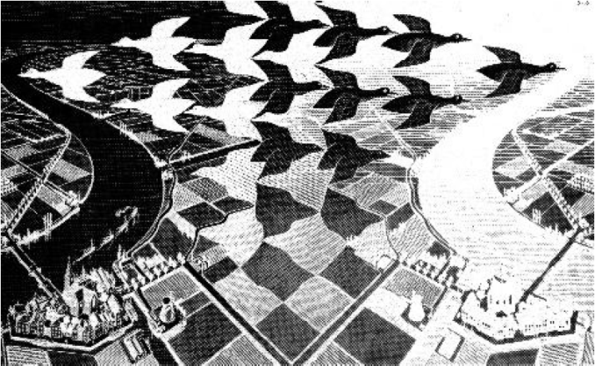


Flavour Physics and CP Violation
1
“Matter world”
“Day and Night”, Escher, 1938
White
CP:
CP Violation!
Black
$$C$$
Complex amplitudes
in Weak interaction?!
“Antimatter world”
$$P$$
Left
Right

Slide 6
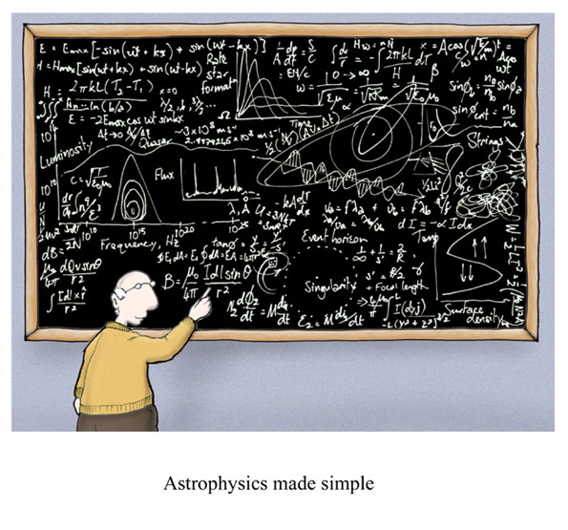
Flavour Physics and CP Violation
2
Contents per Week:
CP Violation
  Discrete Symmetries
  CP Violation in the Standard Model
  Jarlskog Invariant and Baryogenesis
B-Mixing
  CP violation and Interference
  B-mixing and time dependent CP violation
  Experimental Aspects: LHC vs B-factory
B-Decays
  Effective Hamiltonian
  Lepton Flavour Non-Universality

Slide 7

Flavour Physics and CP Violation
2
Contents per Week:
CP Violation
  Discrete Symmetries
  CP Violation in the Standard Model
  Jarlskog Invariant and Baryogenesis
B-Mixing
  CP violation and Interference
  B-mixing and time dependent CP violation
  Experimental Aspects: LHC vs B-factory
B-Decays
  Effective Hamiltonian
  Lepton Flavour Non-Universality
Don’t be afraid to ask questions…

Slide 8
Flavour Physics and CP Violation
2
Contents per Week:
CP Violation
  Discrete Symmetries
  CP Violation in the Standard Model
  Jarlskog Invariant and Baryogenesis
B-Mixing
  CP violation and Interference
  B-mixing and time dependent CP violation
  Experimental Aspects: LHC vs B-factory
B-Decays
  Effective Hamiltonian
  Lepton Flavour Non-Universality

Slide 9
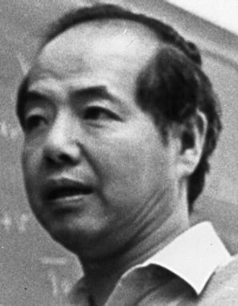
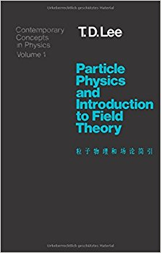
Symmetry and non-Observables
Background info
3
T.D.Lee: “The root to all symmetry principles lies in the assumption that it is impossible to observe certain basic quantities; the non-observables”
There are four main types of symmetry:
Permutation symmetry:
Bose-Einstein and Fermi-Dirac Statistics
Continuous space-time symmetries:
translation, rotation, velocity, acceleration,…
Discrete symmetries:
space inversion, time reversal, charge conjugation,…
Unitary symmetries: gauge invariances:
U₁(charge), SU₂(isospin), SU₃(color),…
If a quantity is fundamentally non-observable it is related to an exact symmetry
If it could in principle be observed by an improved measurement; the symmetry is said to be broken
Noether Theorem:
symmetry
conservation law
Notes:
Symmetries are fundamental. Relation between symmetries and non-observables: mention each.
identity of QM particle
2) absolute position, direction
3) handedness, directionof time, sign of charge
4)internal symmetries: phase of a wave function, rotation in SU(N) (p-n) difference
Noether proved theorem in fact only for continuous symmetries with conservative forces.
Broken Symmetries: Discrete

Slide 10
Symmetry and non-observables
Background info
4
Non-observables | Symmetry Transformations | Conservation Laws or Selection Rule
Difference between identical particles | Permutation | B.-E. or F.-D. statistics
Absolute spatial position | Space translation: $\vec{r}→\vec{r}+\vec{Δ}$ | momentum
Absolute time | Time translation: $t→t+ τ$ | energy
Absolute spatial direction | Rotation: $\vec{r}→\vec{r}′$ | angular momentum
Absolute velocity | Lorentz transformation | generators of the Lorentz group
Absolute right (or left) | $$\vec{r}→−\vec{r}$$ | parity
Absolute sign of electric charge | $$e→−e$$ | charge conjugation
Relative phase between states of different charge Q | $$ψ→e^{iθQ}ψ$$ | charge
Relative phase between states of different baryon number B | $$ψ→e^{iθN}ψ$$ | baryon number
Relative phase between states of different lepton number L | $$ψ→e^{iθL}ψ$$ | lepton number
Difference between different coherent mixture of p and n states | $$\left({p \atop n}\right)→U\left({p \atop n}\right)$$ | isospin
Notes:
Non-observable: acceleration vs gravity
Momentum an d energy conservation: see QM course.

Slide 11
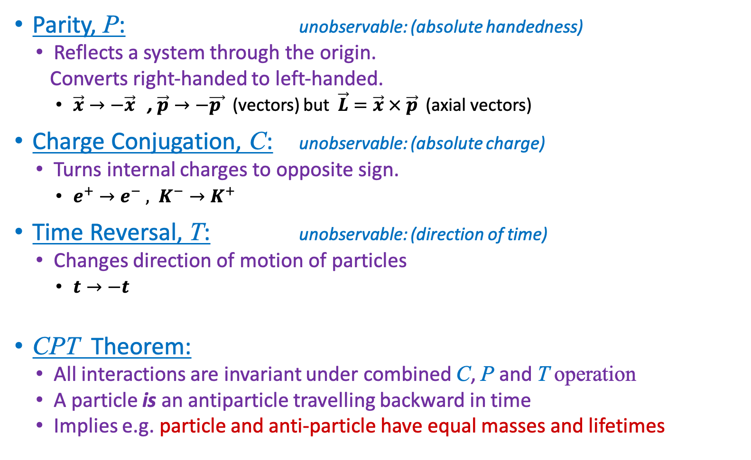
C, P, T Discrete Symmetries
5
Parity, P: unobservable: (absolute handedness)
  Reflects a system through the origin.
  Converts right-handed to left-handed.
    $\vec{x}→−\vec{x}$ , $\vec{p}→−\vec{p }$ (vectors) but $\vec{L}=\vec{x} × \vec{p}$ (axial vectors)
Charge Conjugation, C: unobservable: (absolute charge)
  Turns internal charges to opposite sign.
    $e^{+}→e^{−} , K^{−}→K^{+ }$
Time Reversal, T: unobservable: (direction of time)
  Changes direction of motion of particles
    $t→−t$
CPT Theorem:
  All interactions are invariant under combined C, P and T operation
  A particle is an antiparticle travelling backward in time
  Implies e.g. particle and anti-particle have equal masses and lifetimes
+
−
Notes:
CPT → Lagrangian is Hermitian L(x)=>L-dagger(-x)

Slide 12

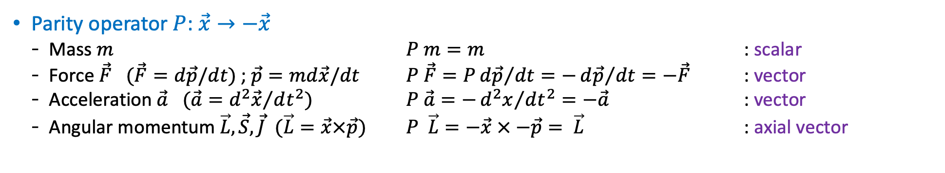
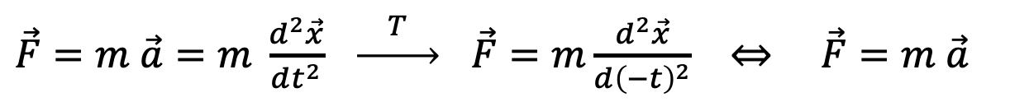
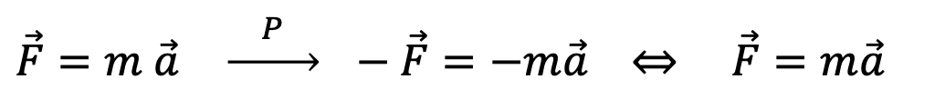
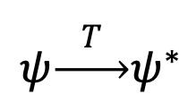
Classical Mirror Worlds
→ Invariant!
6
Parity operator $P$: $\vec{x}→−\vec{x}$
  Mass $m$ $P m=m$ : scalar
  Force $\vec{F}$ $(\vec{F}=d\vec{p}/dt)$; $\vec{p}=md\vec{x}/dt$ $P \vec{F}=P{d\vec{p}}/{dt}=−{d\vec{p}}/{dt=−\vec{F}}$ : vector
  Acceleration $\vec{a}$ $(\vec{a}={d^{2}\vec{x}}/{dt^{2})}$ $P \vec{a}=−{d^{2}x}/{dt^{2}}=−\vec{a}$ : vector
  Angular momentum $\vec{L}, \vec{S}, \vec{J}$ $(\vec{L}=\vec{x}×\vec{p})$ $P \vec{L}=−\vec{x} × −\vec{p}= \vec{L}$ : axial vector
Parity: Newton’s law is invariant under P-operation (i.e. the same in the mirror world):
$\vec{F}=m \vec{a} \underset{→}{ P } −\vec{F}=−m\vec{a} ⇔ \vec{F}=m\vec{a}$
Charge: Lorentz Force in the C-mirror world is invariant:
$$\vec{F}=q \left[\vec{E}+\vec{v}×\vec{B}\right] \underset{→}{ C } \vec{F}=−q\left[−\vec{E}+\vec{v}×−\vec{B}\right]$$
Time: laws of physics are also invariant unchanged under T-reversal, since:
$\vec{F}=m \vec{a}=m \frac{d^{2}\vec{x}}{dt^{2}} \underset{→}{ T } \vec{F}=m\frac{d^{2}\vec{x}}{d{\left(−t\right)}^{2}} ⇔ \vec{F}=m \vec{a}$
$$ih\frac{∂ψ}{∂t}=−\frac{{\vec{∇}}^{2}ψ}{2m}$$
QM: Consider Schrodinger’s equation $(t→−t$) :
Complex conjugation of the equation is required to stay invariant:
$$ψ\underset{→}{ T }ψ^{∗}$$
Notes:
Unitary U^dagger U = 1 or U ^dagger = U^-1.
Eigenvalues of unitary matrices are orthogonal, but not necessarily real (like Hermitean matrices).
P\psi(r) = e^iphi/2 \psi(-r) , since an overall phase is unobservable.

Slide 13
C-, P-, T- Symmetry
7
Classical Theory is invariant under C, P, T operations; i.e. they conserve C, P, T symmetry
  Newton mechanics, Maxwell electrodynamics.
Suppose we watch some physical event. Can we determine unambiguously whether:
  We are watching the event where all charges are reversed or not?
  We are watching the event in a mirror or not?
    Macroscopic biological asymmetries are considered accidents of evolution rather than fundamental asymmetry in the laws of physics.
  We are watching the event in a film running backwards or not?
    The arrow of time is due to thermodynamics: i.e. the realization of a macroscopic final state is statistically more probable than the initial state
Notes:
Macroscopic: human body, left handed molecules etc.
Second law of thermodynamics

Slide 14
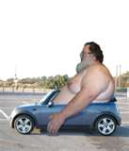
Macroscopic time reversal (T.D. Lee)
8
At each crossing: 50% - 50% choice to go left or right
After many decisions: reverse the velocity of the final state and return
Do we end up with the initial state?
Notes:
But the microscopic laws of physics for each decision (50%-50% choice) are time inversion invariant.

Slide 15
Macroscopic time reversal (T.D. Lee)
8
Very unlikely!
At each crossing: 50% - 50% choice to go left or right
After many decisions: reverse the velocity of the final state and return
Do we end up with the initial state?
Notes:
But the microscopic laws of physics for each decision (50%-50% choice) are time inversion invariant.

Slide 16
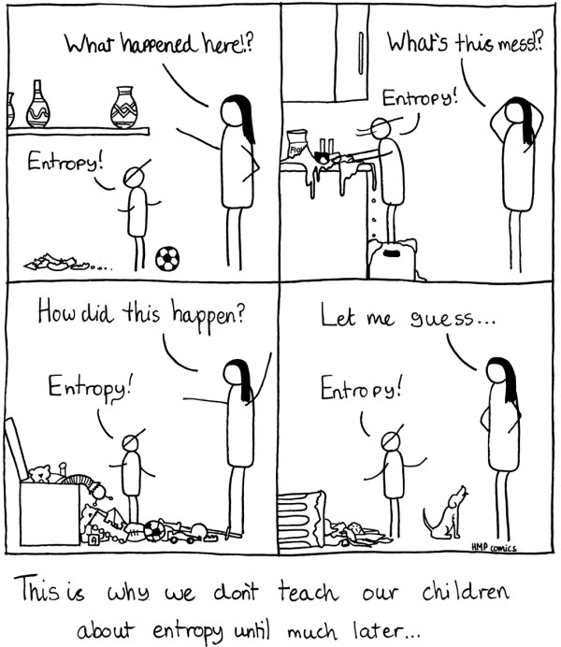
Macroscopic time reversal
9

Slide 17

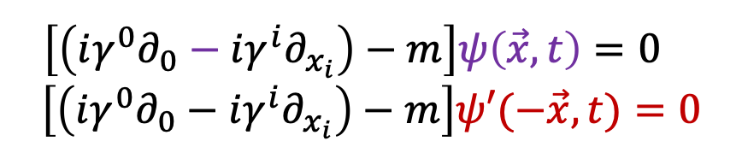
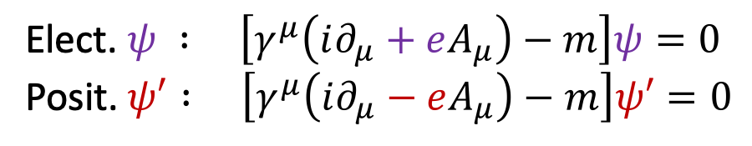
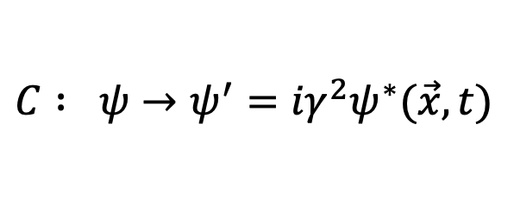
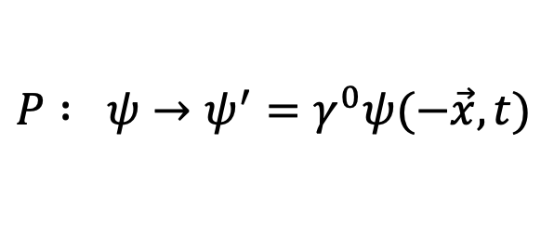
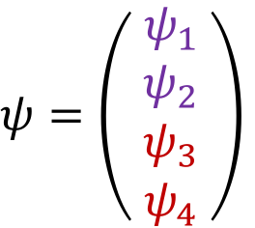
C, P operations and Dirac theory (QED)
10
In Dirac theory particles are represented as spinors
$ψ=\left(\begin{matrix}{ ψ}_{1} \\ \begin{aligned}ψ_{2} \\ ψ_{3}\end{aligned} \\ ψ_{4}\end{matrix}\right)$
+1/2, -1/2 helicity solutions for the particle
Antimatter!
+1/2, -1/2 helicity solutions for the antiparticle
Implementation of P and C operators in Dirac theory:
See lecture notes: 1.3
$$P : ψ→ψ^{′}=γ^{0}ψ(−\vec{x},t)$$
$$C : ψ→ψ^{′}={iγ}^{2}ψ^{∗}(\vec{x},t)$$
$\left[\left(iγ^{0}∂_{0}−i{γ^{i}∂}_{x_{i}}\right)−m\right]ψ\left(\vec{x},t\right)=0$
$$\left[\left(iγ^{0}∂_{0}−iγ^{i}∂_{x_{i}}\right)−m\right]ψ′(−\vec{x},t)=0$$
)
Elect. $ψ : \left[γ^{μ}\left(i∂_{μ}+eA_{μ}\right)−m\right]ψ=0$
Posit. $ψ′ : \left[γ^{μ}\left(i∂_{μ}−eA_{μ}\right)−m\right]ψ′=0$
)
(
(
QED (Dirac theory) is symmetric under C, P conjugation. Reversing electric charges keeps electrodynamics invariant. See lecture notes for more details.
Notes:
Note i gamma^2 = real . Take complex conjugate of Dirac eq.
0. gamma0 is 1,-1, since particle and antiparticle have opposite parity
1. Only the square of a wave function has physical meaning, so a phase rotation is allowed. So, P**2=1 is not required, only |P**2|=1
2. The difference in behaviour has its root in the fact that the additive quantum numbers are the eigenvalues of the generators of some continuous transformations, while parity and C-parity are the eigenvalues of (discrete) transformations themselves.

Slide 18
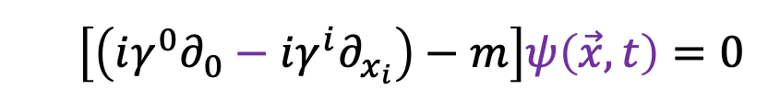
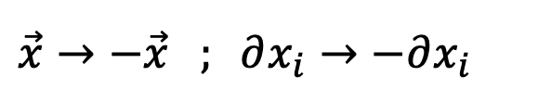

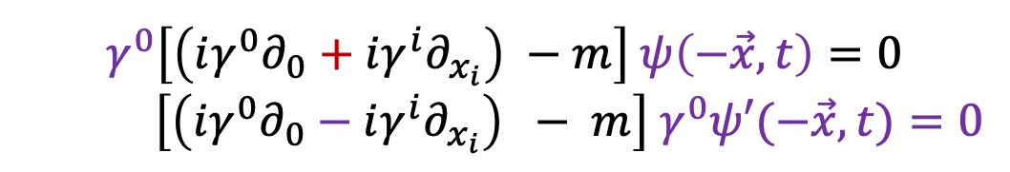
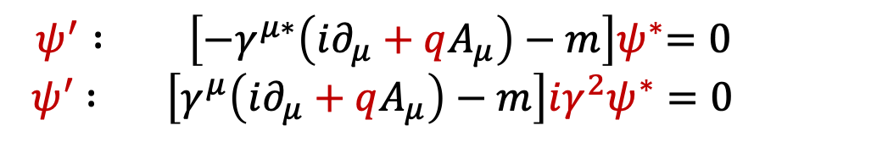
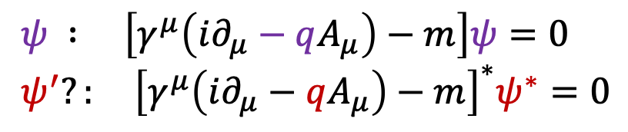

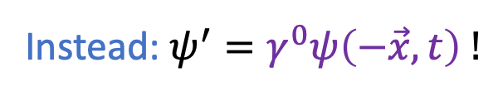



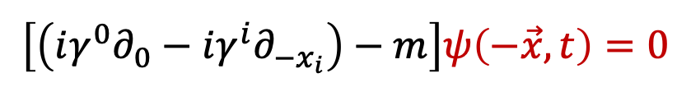
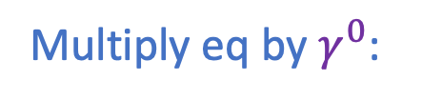
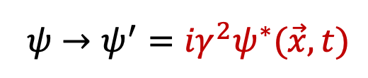
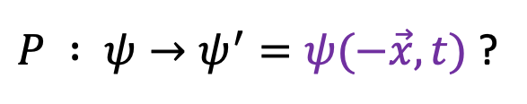

C, P operations and Dirac theory (QED)
See lecture notes: 1.3
11
$$γ^{0∗}=γ^{0}$$
$$γ^{1∗}=γ^{1}$$
$$γ^{2∗}={−γ}^{2}$$
$$γ^{3∗}=γ^{3}$$
$$γ^{0}= \left(\begin{matrix}1 & 0 & 0 & 0 \\ 0 & 1 & 0 & 0 \\ 0 & 0 & −1 & 0 \\ 0 & 0 & 0 & −1\end{matrix}\right), γ^{1}=\left(\begin{matrix}0 & 0 & 0 & 1 \\ 0 & 0 & 1 & 0 \\ 0 & −1 & 0 & 0 \\ −1 & 0 & 0 & 0\end{matrix}\right) , γ^{2}=\left(\begin{matrix}0 & 0 & 0 & −i \\ 0 & 0 & i & 0 \\ 0 & i & 0 & 0 \\ −i & 0 & 0 & 0\end{matrix}\right) , γ^{3}=\left(\begin{matrix}0 & 0 & 1 & 0 \\ 0 & 0 & 0 & −1 \\ −1 & 0 & 0 & 0 \\ 0 & 1 & 0 & 0\end{matrix}\right)$$
$\left[\left(iγ^{0}∂_{0}−i{γ^{i}∂}_{x_{i}}\right)−m\right]ψ\left(\vec{x},t\right)=0$
In Dirac equation:
Implementation of P operator in Dirac:
$$\vec{x}→−\vec{x} ; ∂x_{i}→−∂x_{i}$$
$P : ψ→ψ^{′}=ψ(−\vec{x},t)$ ?
$$\left[\left(iγ^{0}∂_{0}−i{γ^{i}∂}_{−x_{i}}\right)−m\right]ψ\left(−\vec{x},t\right)=0$$
$\left[\left(iγ^{0}∂_{0}+i{γ^{i}∂}_{x_{i}}\right) −m\right]ψ\left(−\vec{x},t\right)=0$ Does not work!
Multiply eq by $γ^{0}$:
$$γ^{0}\left[\left(iγ^{0}∂_{0}+i{γ^{i}∂}_{x_{i}}\right) −m\right] ψ\left(−\vec{x},t\right)=0$$
$\left[\left(iγ^{0}∂_{0}−iγ^{i}∂_{x_{i}}\right) − m\right]{ γ}^{0}ψ′(−\vec{x},t)=0$
Instead: $ψ^{′}=γ^{0}ψ\left(−\vec{x},t\right) !$
OK!
$$C :q→−q ;$$
$$ψ→ψ^{′}={iγ}^{2}ψ^{∗}(\vec{x},t)$$
Implementation of C operator in Dirac:
$ψ : \left[γ^{μ}\left(i∂_{μ}−qA_{μ}\right)−m\right]ψ=0$
$ψ^{′}?: {\left[γ^{μ}\left(i∂_{μ}−qA_{μ}\right)−m\right]}^{∗}ψ^{∗}=0$
$$ψ^{′} : { \left[{−γ}^{μ∗}\left(i∂_{μ}+qA_{μ}\right)−m\right]ψ}^{∗}=0$$
${ ψ}^{′} : {\left[γ^{μ}\left(i∂_{μ}+qA_{μ}\right)−m\right]iγ^{2}ψ}^{∗}=0$
$$iγ^{2}$$
OK
Notes:
Note i gamma^2 = real
gamma0 is 1,-1, since particle and antiparticle have opposite parity
Only the square of a wave function has physical meaning, so a phase rotation is allowed. So, P**2=1 is not required, only |P**2|=1
.

Slide 19
Parity Violation
9
Before 1956 physicists were convinced that the laws of nature were left-right symmetric. Strange?
A “gedanken” experiment: consider two perfectly mirror symmetric cars:
Gas pedal
Gas pedal
driver
driver
“L” and “R” are fully symmetric,
Each nut, bolt, molecule etc.
However the engine is a black box
“L”
“R”
Person “L” gets in, starts, ….. 60 km/h
Person “R” gets in, starts, ….. What happens?
What happens in case the ignition mechanism uses, say, Co⁶⁰ β decay?

Slide 20
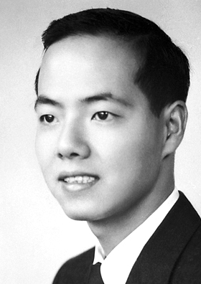
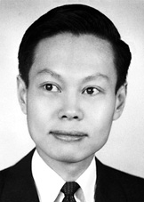
Parity Violation
12
Before 1956 physicists were convinced that the laws of nature were left-right symmetric. Strange?
A “gedanken” experiment: consider two perfectly mirror symmetric cars:
Gas pedal
T.D. Lee
Gas pedal
driver
driver
C.N. Yang
“L” and “R” are fully symmetric,
Each nut, bolt, molecule etc.
However the engine is a black box
“L”
“R”
Person “L” gets in, starts, ….. 60 km/h
Person “R” gets in, starts, ….. What happens?
What happens in case the ignition mechanism uses, say, Co⁶⁰ β decay?
Notes:
Lee and Yang posed Parity violation as a solution of the theta-tau puzzle: K_S, K_L

Slide 21
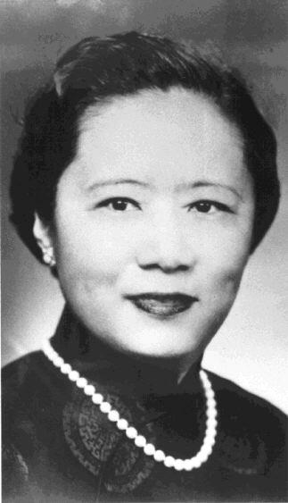
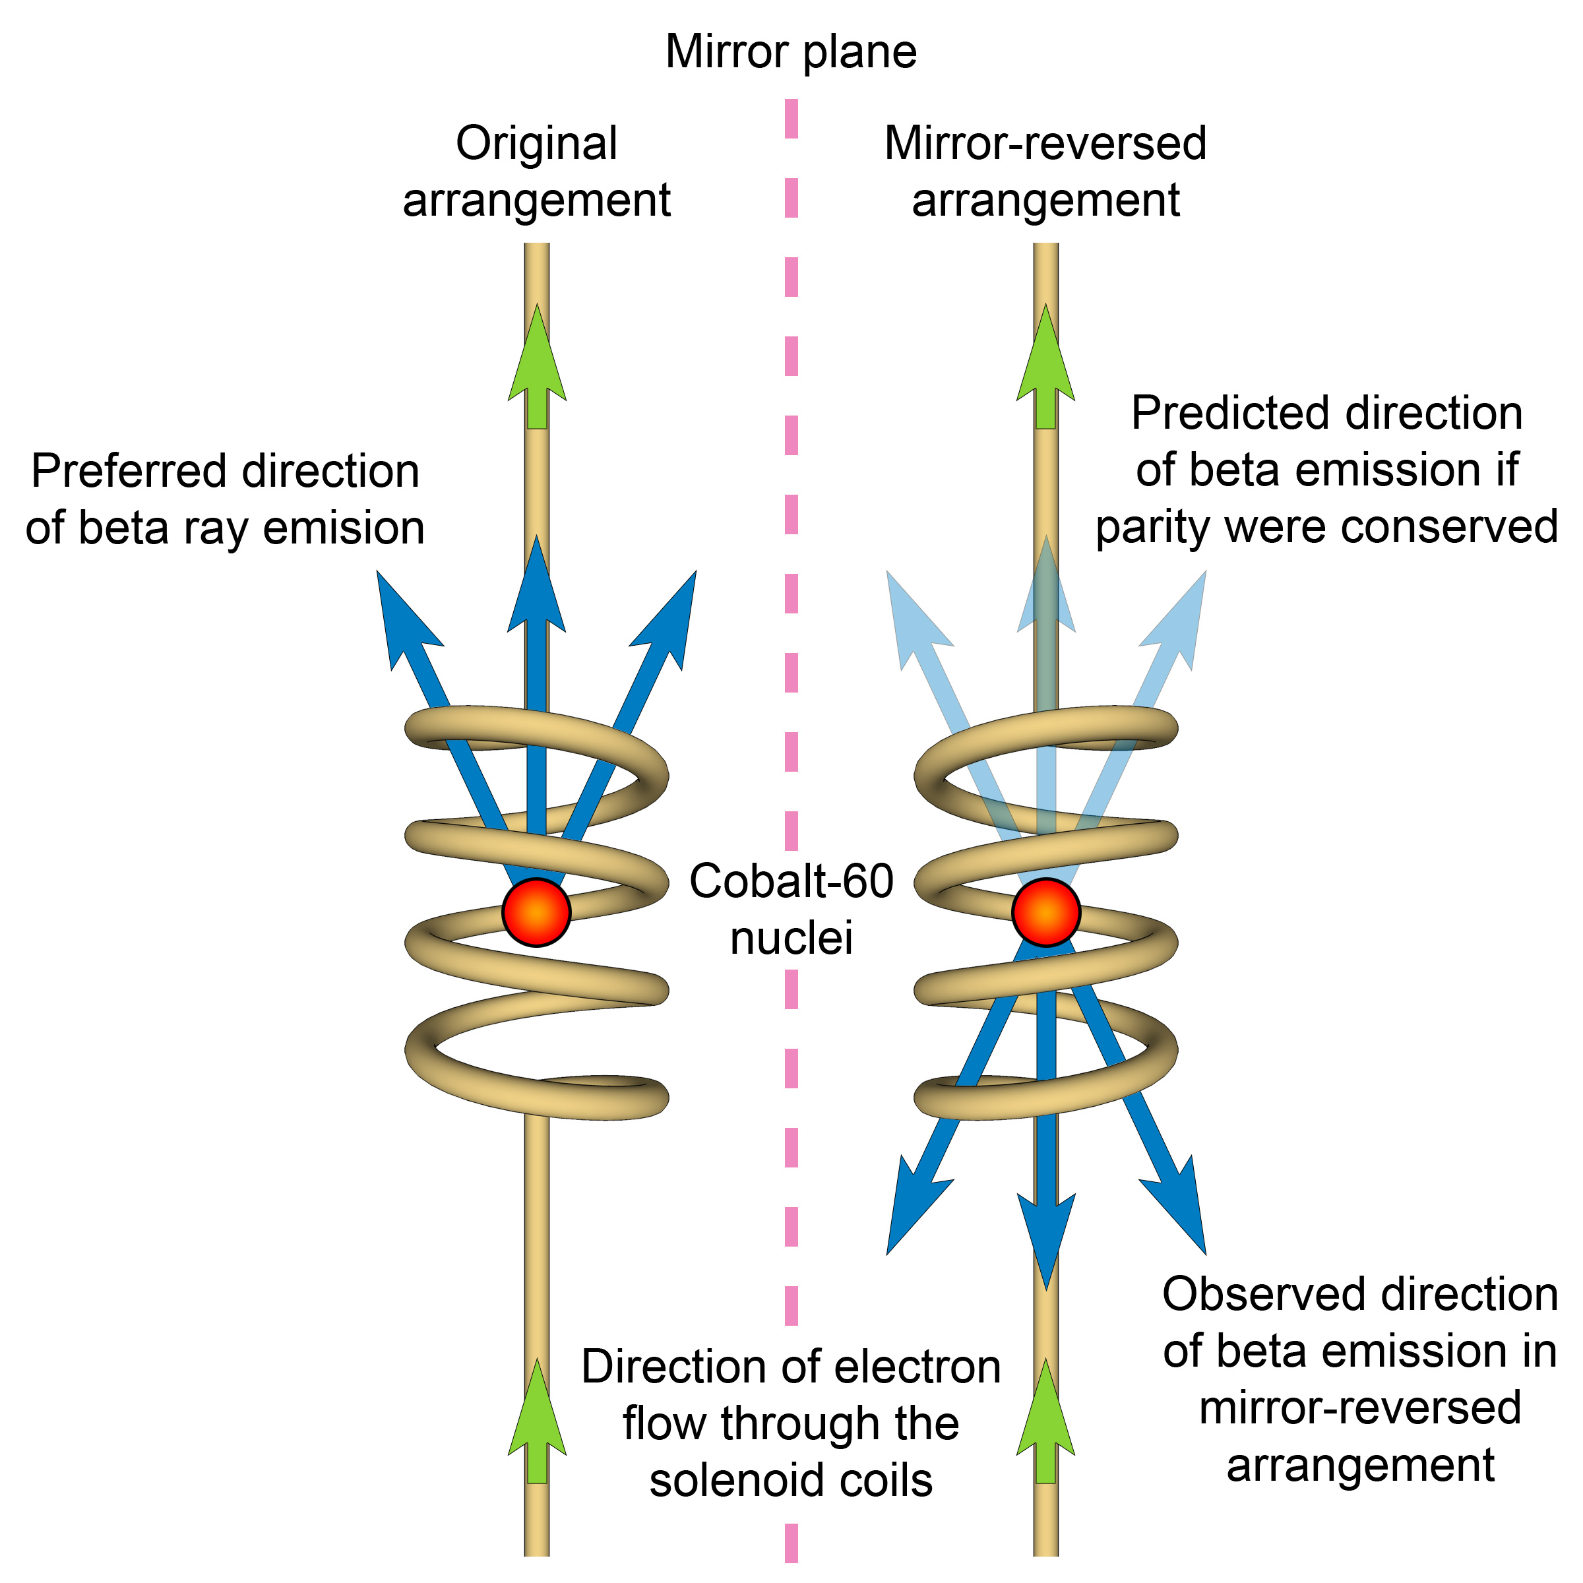
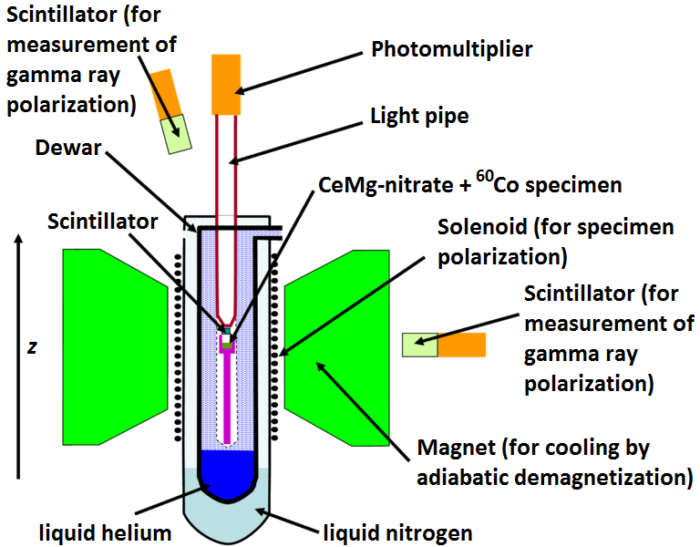
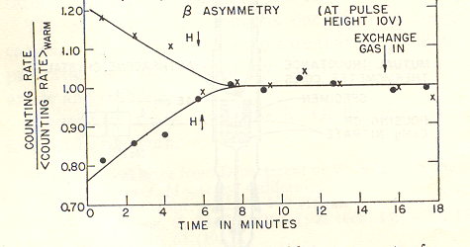



Discovery of Parity Violation
13
Spin is pseudoscalar, P: $\vec{S}→\vec{S}$
C.S. Wu
Parity
B-field
$${}_{27}^{60}{Co}→{}_{28}^{60}{Ni}+e^{−}+\overline{ν_{e}}$$
Preferred
S: 5 4 ½ ½
Symmetric?
Is physics is parity invariant?
Only if electron decay rate is symmetric wrt spin direction!
B
More electrons emitted opposite the $\vec{S}$ direction
Not equal → Parity violation!
Notes:
60Co -> 60Ni* + e- + v. 60Co has J=5, 60Ni has J=4, so J=1. Temperature 0.01 K, the nuclei are aligned in the magnetic field. Measure the electron intensity along the polarization. Spin of the electron must be in the direction of the B field.
The essence is that vec(J) . Vec(p) is a pseudoscalar (changes sign under Parity) variable has a non-zero expectation value!

Slide 22
So $P$ is violated, what’s next?
14
Wu’s experiment was shortly followed by another clever experiment by L. Lederman: Look at decay π⁺ → μ⁺ ν_{μ}
  Pion has spin 0, while μ,ν_{μ} both have spin ½
  → spin of decay products must be oppositely aligned
  → Helicity of muon is same as that of neutrino.
Ledermans result: All neutrinos are left-handed and all anti-neutrinos are right-handed
μ⁺
π⁺
ν_{μ}
OK
OK

Slide 23

Charge conjugation symmetry?
15
Introducing $C$-symmetry
  The $C$(harge) conjugation is the operation which exchanges particles and anti-particles (not just electric charge)
  It is a discrete symmetry, just like $P$, i.e. $C$² = 1
$C$ symmetry is broken by the weak interaction
  Just like$P$
μ⁺
π⁺
ν_{μ}(LH)
OK
C
μ⁻
π⁻
ν_{μ}(LH)
OK

Slide 24
Weak Force breaks C and P, is CP really OK?
16
Weak interaction breaks C and P symmetry maximally!
  Nature is left-handed for matter and right-handed for antimatter.
Despite maximal violation of C and P, combined CP seems conserved.
Is combined CP really exactly conserved?
C
e⁺_{R}
e⁻_{R}
W⁺
W⁻
ν_{L}
ν_{L}
e⁺_{L}
e⁻_{L}
P
W⁺
W⁻
ν_{R}
ν_{R}

Slide 25
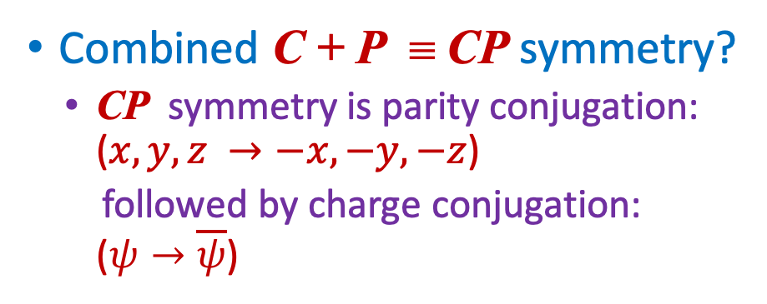
The Weak force and $CP$ violation
17
Combined C + P ≡ CP symmetry?
  CP symmetry is parity conjugation: ($x,y,z →−x,−y,−z$)
  followed by charge conjugation: ($ψ→\overline{ψ}$)
ν_{μ}
μ⁺
μ⁻
Intrinsic
spin
π⁺
P
π⁺
C
π⁻
CP symmetry appears to be preserved in the weak interaction
But in 1964, Christenson, Cronin, Fitch and Turlay observed CP violation in decays of neutral kaons…
μ⁺
ν_{μ}
ν_{μ}
CP

Slide 26
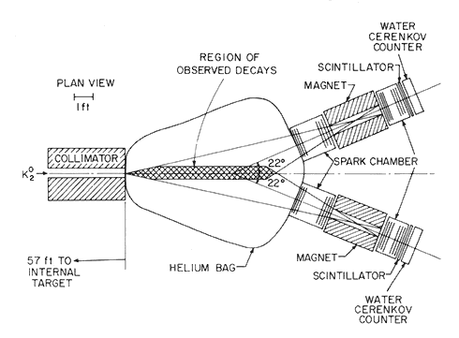
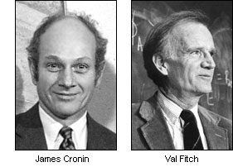
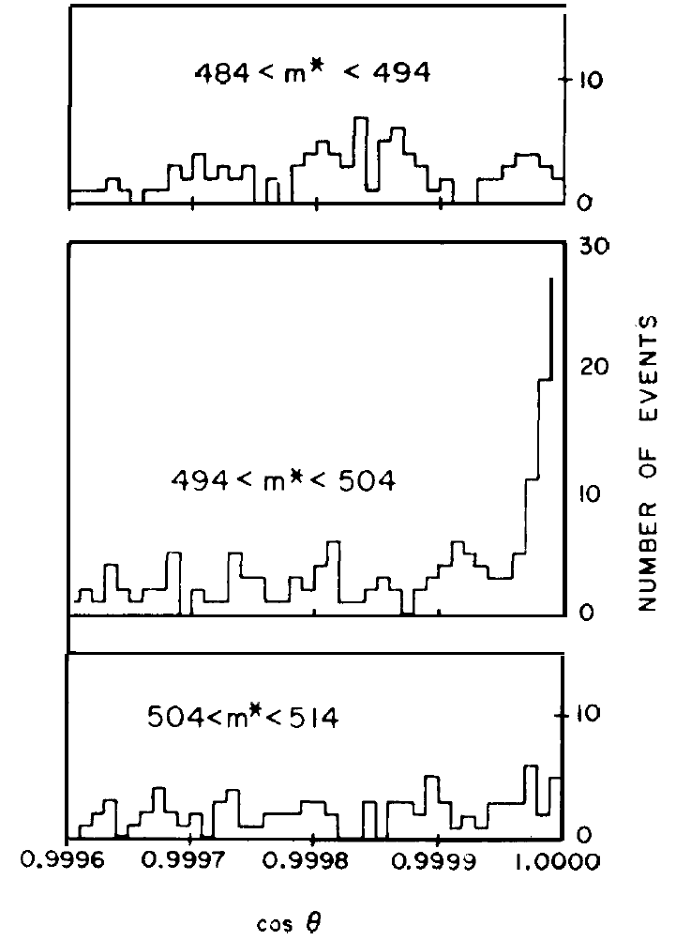


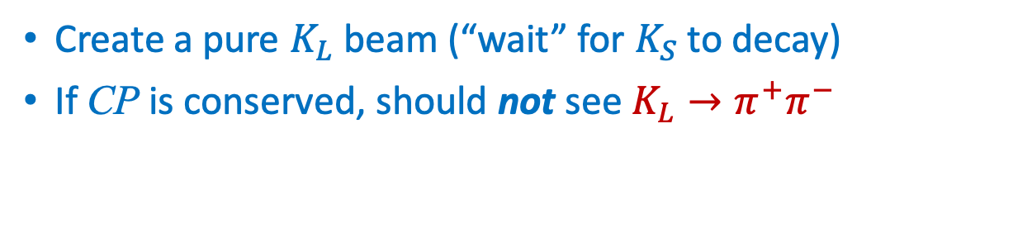
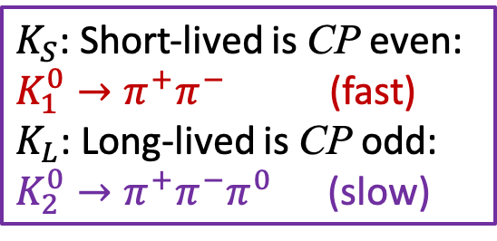


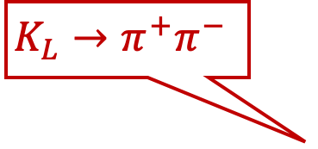


Discovery of CP-Violation with $K^{0}$ decays
15
$K_{S}$: Short-lived is CP even:
$K_{1}^{0}→π^{+}π^{−}$ (fast)
$K_{L}$: Long-lived is CP odd:
$K_{2}^{0}→π^{+}π^{−}π^{0}$ (slow)
Create a pure $K_{L}$ beam (“wait” for $K_{S}$ to decay)
If CP is conserved, should not see $K_{L}→π^{+}π^{−}$
$$K^{0}$$
$$K_{L}→π^{+}π^{−}$$
James Cronin
Val Fitch
Effect is tiny:
about 2/1000
mass, $θ$
CP violating Signal: $K_{L}→π^{+}π^{−}$
$$M_{K_{S}}=498 MeV$$
Background: $K_{L}→π^{+}π^{−}π^{0}$
θ
$π^{0}$ remains undetected
cos θ
Notes:
Christenson, Cronin, Fitch, Turlay
Pion parity=-1. Signal will appear in Kaon mass window and zero theta angle.

Slide 27

Discovery of CP-Violation with $K^{0}$ decays
15
$K_{S}$: Short-lived is CP even:
$K_{1}^{0}→π^{+}π^{−}$ (fast)
$K_{L}$: Long-lived is CP odd:
$K_{2}^{0}→π^{+}π^{−}π^{0}$ (slow)
Create a pure $K_{L}$ beam (“wait” for $K_{S}$ to decay)
If CP is conserved, should not see $K_{L}→π^{+}π^{−}$
$$K^{0}$$
$$K_{L}→π^{+}π^{−}$$
James Cronin
Val Fitch
Effect is tiny:
about 2/1000
mass, $θ$
CP violating Signal: $K_{L}→π^{+}π^{−}$
$$M_{K_{S}}=498 MeV$$
Background: $K_{L}→π^{+}π^{−}π^{0}$
θ
$π^{0}$ remains undetected
cos θ
Notes:
Christenson, Cronin, Fitch, Turlay
Pion parity=-1. Signal will appear in Kaon mass window and zero theta angle.

Slide 28
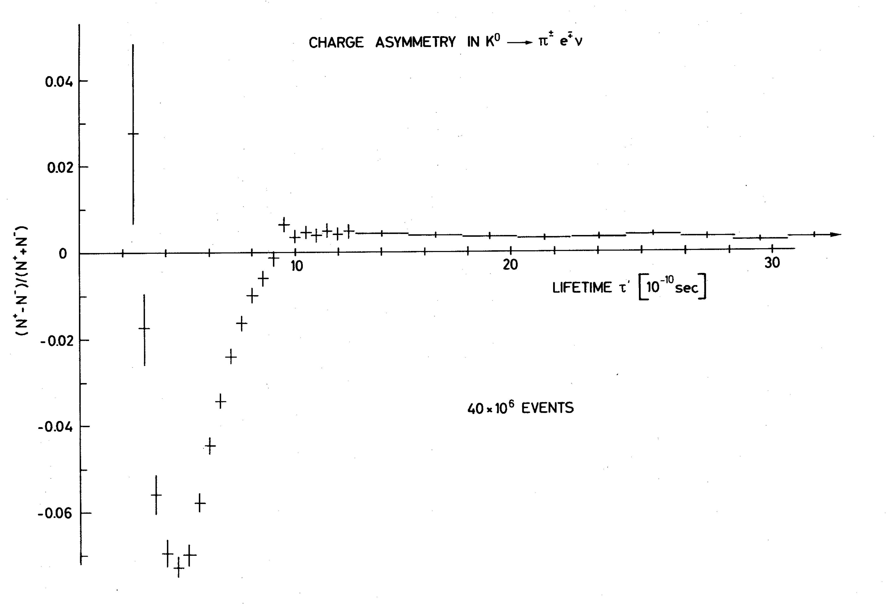
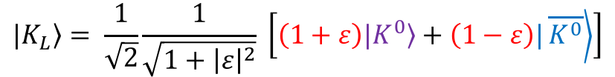
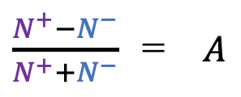











Alternative: Charge Asymmetry in $K^{0}$ decays
19
Measure $A= \frac{N^{+}−N^{−}}{N^{+}+N^{−}}$ with $\begin{matrix}N^{+}=K^{0}→π^{−}e^{+}ν \\ N^{−}= \overline{K^{0}}→π^{+}e^{−}\overline{ν}\end{matrix}$ vs the $K^{0}$ decay time
$\frac{N^{+}−N^{−}}{N^{+}+N^{−}}$ = $A$
Thesis Vera Luth, CERN 1974
Kaon has $J^{P}=0^{−}$:
$$\left.P|K^{0}\right\rangle =−\left.|K^{0}\right\rangle$$
$$K_{S}$$
$$K_{L}$$
$$\left.P|K^{0}\right\rangle =−\left.|K^{0}\right\rangle$$
Two CP states:
$$\left.|K_{1}\right\rangle =\frac{1}{\sqrt{2}}\left[|\left.K^{0}\right\rangle −|\left.\overline{K^{0}}\right\rangle \right]$$
time
$$\left.|K_{2}\right\rangle =\frac{1}{\sqrt{2}}\left[|\left.K^{0}\right\rangle +|\left.\overline{K^{0}}\right\rangle \right]$$
CP violation in meson mixing.
Two particles:
$$\left.|K_{L}\right\rangle = \frac{1}{\sqrt{2}}\frac{1}{\sqrt{1+{\left|ε\right|}^{2}}} \left[\left(1+ε\right)|\left.K^{0}\right\rangle +\left(1−ε\right)|\left.\overline{K^{0}}\right\rangle \right]$$
$$\left.|K_{S}\right\rangle ≃\left[\left|\left.K_{1}\right\rangle +ε\right|K_{2}\right]$$
$→π^{−}e^{+}ν$
$$→π^{+}e^{−}\overline{ν}$$
$$\left.|K_{L}\right\rangle ≃\left[\left|\left.K_{2}\right\rangle +ε\right|K_{1}\right]$$
Notes:
Create K0, particles, after time K_s has decayed and K_L remains. CPV in mixing. Thesis work at Heidelberg/CERN!
Parity quark and antiquark are opposite.

Slide 29




Contact with Aliens !
20
Are they made of matter or anti-matter?
Compare $K_{L}^{0}→π^{+}e^{−}\overline{ν}$ to $K_{L}^{0}→π^{−}e^{+}ν$
Compare the charge of the most abundantly produced electron with that of the electrons in your body:
If opposite: matter If equal: anti-matter

Slide 30

CPT Violation…
21
CPT symmetry implies that an antiparticle is identical to a particle travelling backwards in time.

Slide 31

CPT is conserved, but does anti-matter fall down?
22

Slide 32
Flavour Physics and CP Violation
23
Contents per Week:
CP Violation
  Discrete Symmetries
  CP Violation in the Standard Model
  Jarlskog Invariant and Baryogenesis
B-Mixing
  CP violation and Interference
  B-mixing and time dependent CP violation
  Experimental Aspects: LHC vs B-factory
B-Decays
  Effective Hamiltonian
  Lepton Flavour Non-Universality

Slide 33

Flavour Physics and CP Violation
23
Contents per Week:
CP Violation
  Discrete Symmetries
  CP Violation in the Standard Model
  Jarlskog Invariant and Baryogenesis
B-Mixing
  CP violation and Interference
  B-mixing and time dependent CP violation
  Experimental Aspects: LHC vs B-factory
B-Decays
  Effective Hamiltonian
  Lepton Flavour Non-Universality

Slide 34














Weak interaction in three Flavour Generations
24
Weak Interaction is 100% parity violating.
  Wolfgang Pauli: “I cannot believe God is a weak left-hander.”
Implement an SU(2)_{L} symmetry for massless particles:
$𝓛_{W}= \frac{g}{\sqrt{2}}{u′}_{L} γ_{μ} W^{μ} {d′}_{L}$ x3 !
Note:
$$ψ_{L}=\frac{1}{2}\left(1−γ^{5}\right)ψ$$
Wolfgang Pauli
Flavour universality: identical interactions in three generations.
  In fact: how to distinguish a massless $d^{′}$quark from $s^{′}$quark?
$$d′$$
$$s′$$
$$b′$$
$$u′$$
$$W^{+}$$
$$c′$$
$$W^{+}$$
$$W^{+}$$
$$t′$$
There is no CP violation in these massless interactions
  What happens when particles acquire mass?
Notes:
Note the quotes: massless particles

Slide 35

Spontaneous Symmetry Breaking→ Origin of Mass
Lecture notes: 1.4
25
Yukawa couplings to massless particles (Weinberg):
$𝓛_{Y}$ $=Y_{ij}^{d}{ \left(\overline{u_{i}^{′}},\overline{d_{i}^{′}}\right)}_{L} \left( {φ^{+} \atop φ^{0}} \right)d_{jR}^{′} + Y_{ij}^{u}{ \left(\overline{u_{i}^{′}}, \overline{d_{i}^{′}}\right)}_{L} \left( {φ^{0} \atop φ^{−}} \right) u_{jR}^{′}$
• Yukawa interaction is not flavour universal!
Unknown origin of Yukawa matrix acting on generations “i” and “j”

Slide 36






Spontaneous Symmetry Breaking→ Origin of Mass
Lecture notes: 1.4
25
Yukawa couplings to massless particles (Weinberg):
$𝓛_{Y}$ $=Y_{ij}^{d}{ \left(\overline{u_{i}^{′}},\overline{d_{i}^{′}}\right)}_{L} \left( {φ^{+} \atop φ^{0}} \right)d_{jR}^{′} + Y_{ij}^{u}{ \left(\overline{u_{i}^{′}}, \overline{d_{i}^{′}}\right)}_{L} \left( {φ^{0} \atop φ^{−}} \right) u_{jR}^{′}$
• Yukawa interaction is not flavour universal!
Unknown origin of Yukawa matrix acting on generations “i” and “j”
$$v$$
SSB: B-E-H Mechanism:
$$\left({φ^{+} \atop φ^{0}}\right)→ \left(\begin{matrix}0 \\ v/\sqrt{2}\end{matrix}\right)$$
Massive W- and
Z- bosons
Robert Brout
Francois Englert
Peter Higgs

Slide 37

Spontaneous Symmetry Breaking→ Origin of Mass
Lecture notes: 1.4
26
Yukawa couplings to massless particles (Weinberg):
$𝓛_{Y}$ $=Y_{ij }^{d}{ \left(\overline{u_{i}^{′}},\overline{d_{i}^{′}}\right)}_{L} \left({0 \atop v/\sqrt{2}}\right)d_{jR}^{′} + Y_{ij }^{u} {\left(\overline{u_{i}^{′}}, \overline{d_{i}^{′}}\right)}_{L} \left({v/\sqrt{2} \atop 0}\right)u_{jR}^{′}$
• Yukawa interaction is not flavour universal!
Unknown origin of Yukawa matrix acting on generations “i” and “j”
➔Massive
fermions
$$v$$
SSB: B-E-H Mechanism:
$$\left({φ^{+} \atop φ^{0}}\right)→ \left(\begin{matrix}0 \\ v/\sqrt{2}\end{matrix}\right)$$
Massive W- and
Z- bosons
Robert Brout
Francois Englert
Peter Higgs

Slide 38




Spontaneous Symmetry Breaking→ Origin of Mass
Lecture notes: 1.4
27
Yukawa couplings to massless particles:
$𝓛_{Y}$ $=Y_{ij }^{d}{ \left(\overline{u_{i}^{′}},\overline{d_{i}^{′}}\right)}_{L} \left({0 \atop v/\sqrt{2}}\right)d_{jR}^{′} + Y_{ij }^{u} {\left(\overline{u_{i}^{′}}, \overline{d_{i}^{′}}\right)}_{L} \left({v/\sqrt{2} \atop 0}\right)u_{jR}^{′}$
𝑣
Diagonalize${ Y}_{ij}$:
$u_{i}={\left(V^{u}\right)}_{ij} u_{j}^{′}$
and
$d_{i}={\left(V^{d}\right)}_{ij} d_{j}^{′}$
  → mass and flavour eigenstates
$$v$$

Slide 39



Spontaneous Symmetry Breaking→ Origin of Mass
Lecture notes: 1.4
27
Yukawa couplings to massless particles:
$𝓛_{Y}$ $=Y_{ii }^{d}{ \left(\overline{u_{i}},\overline{d_{i}}\right)}_{L} \left({0 \atop v/\sqrt{2}}\right)d_{iR} + Y_{ii }^{u} {\left(\overline{u_{i}}, \overline{d_{i}}\right)}_{L} \left({v/\sqrt{2} \atop 0}\right)u_{iR}$
𝑣
Diagonalize${ Y}_{ij}$:
$u_{i}={\left(V^{u}\right)}_{ij} u_{j}^{′}$
and
$d_{i}={\left(V^{d}\right)}_{ij} d_{j}^{′}$
  → mass and flavour eigenstates
$$v$$
$$M_{ij} =Y_{ij} v/\sqrt{2}$$
Mass terms:
${𝓛_{Y}→𝓛}_{H}$ $= m_{d} d_{L} d_{R} + m_{u} u_{L} u_{R}$
Physical particles
$$m_{top} =1.0 v/\sqrt{2}$$
Top quark mass:
  To first order Higgs couples only to top with coupling strength 1.0 !
    Very flavour non-universal

Slide 40










Flavour Puzzle: particle masses? Origin Yukawa couplings?
28
Weak interaction flavour universal
Higgs interaction almost purely 3rd generation
e
μ
τ
$$m_{e}=0.5 MeV$$
$$m_{μ}=0.5 MeV$$
$$m_{τ}=1.8 GeV$$
top-Yukawa = 1.0 ?!
u
c
t
$$m_{u}=2.2 MeV$$
$$m_{c}=1.3 GeV$$
$$m_{t}=173 GeV$$
d
s
b
$$m_{d}=4.7 MeV$$
$$m_{s}=96 MeV$$
$$m_{b}=4.2 GeV$$

Slide 41










The Weak Interaction → Flavour Mixing
29
$𝓛_{W}= \frac{g}{\sqrt{2}}{u′}_{L} γ_{μ} W^{μ} {d′}_{L}$
No CP violation
$$d^{′}$$
$$s^{′}$$
$$b^{′}$$
$$u^{′}$$
$$W^{+}$$
$$c^{′}$$
$$W^{+}$$
$$t^{′}$$
$$W^{+}$$
Redefine: $u_{i}^{′}= {\left(V^{u}\right)}_{ij} u_{i}$ and: $d_{i}^{′}= {\left(V^{d}\right)}_{ij}^{†}d_{i}$ , such that: $V_{CKM}={\left(V^{u}V^{d†}\right)}_{ij}$ …

Slide 42


































The Weak Interaction → Flavour Mixing
30
(Interaction basis)
(Mass basis)
$𝓛_{W}= \frac{g}{\sqrt{2}}{u′}_{L} γ_{μ} W^{μ} {d′}_{L}$
$𝓛_{W}= \frac{g}{\sqrt{2}} V_{CKM} u_{L} γ_{μ} W^{μ} d_{L}$
Redefine: $u_{i}^{′}= {\left(V^{u}\right)}_{ij} u_{i}$ and: $d_{i}^{′}= {\left(V^{d}\right)}_{ij}^{†}d_{i}$ , such that: $V_{CKM}={\left(V^{u}V^{d†}\right)}_{ij}$ …
Generation structure of weak interaction, now includes CP violation.
$$s$$
$$b$$
$$V_{ub}$$
$$d$$
$$V_{ud}$$
$$V_{us}$$
$$W^{+}$$
$$u$$
$$W^{+}$$
$$u$$
$$W^{+}$$
$$u$$
$$d$$
$$s$$
$$V_{cs}$$
$$b$$
$$V_{cb}$$
$$V_{cd}$$
$$c$$
$$W^{+}$$
$$c$$
$$W^{+}$$
$$c$$
$$W^{+}$$
$$d$$
$$s$$
$$V_{ts}$$
$$b$$
$$V_{tb}$$
$$V_{td}$$
$$t$$
$$W^{+}$$
$$t$$
$$W^{+}$$
$$t$$
$$W^{+}$$

Slide 43








The Weak Interaction → Flavour Mixing
31
(Interaction basis)
(Mass basis)
$𝓛_{W}= \frac{g}{\sqrt{2}}{u′}_{L} γ_{μ} W^{μ} {d′}_{L}$
$𝓛_{W}= \frac{g}{\sqrt{2}} V_{CKM} u_{L} γ_{μ} W^{μ} d_{L}$
Redefine: $u_{i}^{′}= {\left(V^{u}\right)}_{ij} u_{i}$ and: $d_{i}^{′}= {\left(V^{d}\right)}_{ij}^{†}d_{i}$ , such that: $V_{CKM}={\left(V^{u}V^{d†}\right)}_{ij}$ …
Generation structure of weak interaction, now includes CP violation.
Convention: instead, we do as if: $u_{i}^{′}= u_{i}$ and $d_{i}^{′}= {\left(V_{CKM}\right)}_{ij} d_{j}$
$$d^{′}$$
$$s^{′}$$
$$b^{′}$$
$$u$$
$$W^{+}$$
$$c$$
$$W^{+}$$
$$t$$
$$W^{+}$$
$|\left.d′\right\rangle =V_{ud} \left.|d\right\rangle +{ V}_{us}\left. |s\right\rangle +V_{ub}\left. |b\right\rangle$
$|\left.s′\right\rangle =V_{cd} \left.|d\right\rangle +{ V}_{cs}\left. |s\right\rangle +V_{cb}\left. |b\right\rangle$
$|\left.b′\right\rangle =V_{td} \left.|d\right\rangle +{ V}_{ts}\left. |s\right\rangle +V_{tb}\left. |b\right\rangle$

Slide 44







How about leptons?
32
$𝓛_{W}= \frac{g}{\sqrt{2}}ν_{e_{L}}^{′} γ_{μ} W^{μ} {e′}_{L}$
No CP violation
$$e′$$
$$μ′$$
$$τ′$$
$$ν_{e}′$$
$$W^{+}$$
$$ν_{μ}′$$
$$W^{+}$$
$ν_{τ}$’
$$W^{+}$$
Redefine: $ν_{i}′= {\left(U^{ν}\right)}_{ij} ν_{i}$ and: $l_{i}^{′}= {\left(U^{l}\right)}_{ij}^{†}l_{i}$ , such that: $U_{MNS}={\left(U^{ν}U^{l†}\right)}_{ij}$ …

Slide 45





























How about leptons?
33
(Interaction basis)
(Mass basis)
$𝓛_{W}= \frac{g}{\sqrt{2}}{ν′}_{L} γ_{μ} W^{μ} {e′}_{L}$
$𝓛_{W}= \frac{g}{\sqrt{2}} U_{MNS} ν_{L} γ_{μ} W^{μ} e_{L}$
Redefine: $ν_{i}^{′}= {\left(U\right)}_{ij} ν_{i}$ and: $l_{i}^{′}= {\left(U^{d}\right)}_{ij}^{†}l_{i}$ , such that: $U_{MNS}={\left(U^{u}U^{d†}\right)}_{ij}$ …
Generation structure of weak interaction, now includes CP violation.
$$μ$$
$$U_{μ1}$$
$$τ$$
$$V_{τ1}$$
$$e$$
$$U_{e1}$$
$$W^{+}$$
$$ν_{e}$$
$$W^{+}$$
$$ν_{e}$$
$$W^{+}$$
$$ν_{e}$$
$$e$$
$$μ$$
$$U_{μ2}$$
$$τ$$
$$U_{τ2 }$$
$$U_{e2}$$
$$ν_{μ}$$
$$W^{+}$$
$$ν_{μ}$$
$$W^{+}$$
$$ν_{μ}$$
$$W^{+}$$
$$e$$
$$μ$$
$$U_{μ3}$$
$$τ$$
$$U_{τ3}$$
$$U_{e3}$$
$$ν_{τ}$$
$$W^{+}$$
$$ν_{τ}$$
$$W^{+}$$
$$ν_{τ}$$
$$W^{+}$$

Slide 46









How about leptons?
34
(Interaction basis)
(Mass basis)
$𝓛_{W}= \frac{g}{\sqrt{2}}{ν′}_{L} γ_{μ} W^{μ} {e′}_{L}$
$𝓛_{W}= \frac{g}{\sqrt{2}} U_{MNS} ν_{L} γ_{μ} W^{μ} e_{L}$
Redefine: $ν_{i}^{′}= {\left(U\right)}_{ij} ν_{i}$ and: $l_{i}^{′}= {\left(U^{d}\right)}_{ij}^{†}l_{i}$ , such that: $U_{MNS}={\left(U^{u}U^{d†}\right)}_{ij}$ …
Generation structure of weak interaction, now includes CP violation.
Convention: instead we do as if: $ν_{1,2,3}= {\left(U_{MNS}\right)}_{ij}{ ν}_{e,μ,τ}$ and $l_{i}′=l_{i}$
For neutrinos we label the mass eigenstates as: 1, 2, 3 instead of $e, μ, τ$
$$e$$
$$μ$$
$$τ$$
$$ν_{1}$$
$$W^{+}$$
$$ν_{2}$$
$$W^{+}$$
$$ν_{3}$$
$$W^{+}$$
$|\left.ν_{1}\right\rangle =U_{e1} \left.|ν_{e}\right\rangle +{ U}_{μ1}\left. |ν_{μ}\right\rangle +U_{τ1}\left. |ν_{τ}\right\rangle$
$|\left.ν_{2}\right\rangle =U_{e2} \left.|ν_{e}\right\rangle +{ U}_{μ2}\left. |ν_{μ}\right\rangle +U_{τ2}\left. |ν_{τ}\right\rangle$
$|\left.ν_{3}\right\rangle =U_{e3} \left.|ν_{e}\right\rangle +{ U}_{μ3}\left. |ν_{μ}\right\rangle +U_{τ3}\left. |ν_{ τ}\right\rangle$

Slide 47


Food for thought-1: which states mix?
35
Quarks: $\left({u \atop d^{′}}\right)=\left({u \atop V_{ud} d +{ V}_{us} s +V_{ub} b}\right)$ ; We say “the down-type quarks mix”.
Leptons: $\left({ν_{1} \atop e}\right)=\left({U_{e1} ν_{e}+ U_{μ1} ν_{μ} + U_{τ1} ν_{τ} \atop e}\right)$ ; We say “the neutrinos mix.”
Why the “down-types” in one case and the “up-types” in another?
Answer: it is convention! Both mix individually (in an unknown way).
  The interaction is always: $𝓛_{W}= \frac{g}{\sqrt{2}} V_{CKM} u_{L} γ_{μ} W^{μ} d_{L}$
  i.e up and down-type combined!
Paradox question: does this mean neutrino mixing is unphysical??

Slide 48








Food for thought-2: Where did the CP violation come from?
27
Yukawa couplings to massless particles:
$𝓛_{Y}$ $=Y_{ij }^{d}{ \left(\overline{u_{i}^{′}},\overline{d_{i}^{′}}\right)}_{L} \left({0 \atop v/\sqrt{2}}\right)d_{jR}^{′} + Y_{ij }^{u} {\left(\overline{u_{i}^{′}}, \overline{d_{i}^{′}}\right)}_{L} \left({v/\sqrt{2} \atop 0}\right)u_{jR}^{′}$
𝑣
Diagonalize${ Y}_{ij}$:
$u_{i}={\left(V^{u}\right)}_{ij} u_{j}^{′}$
and
$d_{i}={\left(V^{d}\right)}_{ij} d_{j}^{′}$
  → mass and flavour eigenstates
$$v$$
Universality violation: Higgs !
  Higgs coupling is not universal, and mixes generations
  Complex couplings: allows for CP Violation!
$$q_{j}$$
$$Y_{ij}$$
$${\overline{q}}_{j}$$
$$Y_{ij}^{∗}$$
CP
$$q_{i}$$
$$H$$
$${\overline{q}}_{i}$$
$$H$$

Slide 49








Food for thought-2: Where did the CP violation come from?
27
Yukawa couplings to massless particles:
$𝓛_{Y}$ $=Y_{ij }^{d}{ \left(\overline{u_{i}^{′}},\overline{d_{i}^{′}}\right)}_{L} \left({0 \atop v/\sqrt{2}}\right)d_{jR}^{′} + Y_{ij }^{u} {\left(\overline{u_{i}^{′}}, \overline{d_{i}^{′}}\right)}_{L} \left({v/\sqrt{2} \atop 0}\right)u_{jR}^{′}$
𝑣
Diagonalize${ Y}_{ij}$:
$u_{i}={\left(V^{u}\right)}_{ij} u_{j}^{′}$
and
$d_{i}={\left(V^{d}\right)}_{ij} d_{j}^{′}$
  → mass and flavour eigenstates
$$v$$
Higgs: redefines quarks states in mass eigenstates
($i↔i$)
$m_{i}$: Real couplings only! ➔ No CP violation
$$q_{j}$$
$$Y_{ij}$$
$$q_{i}^{m}$$
$$m_{i}$$
$$q_{i}$$
$$H$$
$$q_{i}^{m}$$
$$H$$

Slide 50
Flavour Changing Quark Interactions
Lecture notes: chapter 2
36
Flavour changing currents
3
2
1

Slide 51
Flavour Changing Quark Interactions
Lecture notes: chapter 2
37
Flavour changing currents
3
2
1

Slide 52
Flavour Changing Quark Interactions
Lecture notes: chapter 2
38
Flavour changing currents
3
2
1

Slide 53
Flavour Changing Quark Interactions
Lecture notes: chapter 2
39
Flavour changing currents
3
2
1

Slide 54
Flavour Changing Quark Interactions – CP Violation
40
Flavour changing currents
3
2
Complex coupling constants are the source of CP viol.
1
Particles and antiparticles have complex conjugated coupling constants
Notes:
Why complex? See Dirac slide. Also T is Initial->Final – complex conjugation.

Slide 55








The CKM matrix $V_{CKM}$ - 3 Generations
41
$V_{CKM}$:
$d$ $s$ $b$
$$u$$
$$c$$
$$t$$
$$\left(\begin{matrix}V_{ud} & V_{us} & V_{ub} \\ V_{cd} & V_{cs} & V_{cb} \\ V_{td} & V_{ts} & V_{tb}\end{matrix}\right)$$
Wolfenstein parametrization: $V_{CKM}$ =
$$\left(\begin{matrix}1−1/2λ^{2} & λ & Aλ^{3}\left(ρ−iη\right) \\ −λ & 1−1/2λ^{2} & Aλ^{2} \\ Aλ^{3}\left(1−ρ−iη\right) & −Aλ^{2} & 1\end{matrix}\right)$$
Lincoln Wolfenstein
1 complex degree of freedom
CP violating phase
It follows from unitarity:
$V_{CKM}^{†} V_{CKM}=1$

Slide 56










The CKM matrix and unitarity triangle
47
The CKM is a mixing matrix, ie. a complex rotation in 3x3 flavour space
  This implies that the matrix is unitary: $V_{CKM}^{†} V_{CKM}=1$
$$\left(\begin{matrix}V_{ud}^{∗} & V_{cd}^{∗} & V_{td}^{∗} \\ V_{us}^{∗} & V_{cs}^{∗} & V_{ts}^{∗} \\ V_{ub}^{∗} & V_{cb}^{∗} & V_{tb}^{∗}\end{matrix}\right)\left(\begin{matrix}V_{ud} & V_{us} & V_{ub} \\ V_{cd} & V_{cs} & V_{cb} \\ V_{td} & V_{ts} & V_{tb}\end{matrix}\right)=\left(\begin{matrix}1 & 0 & 0 \\ 0 & 1 & 0 \\ 0 & 0 & 1\end{matrix}\right)$$
Triangle in the complex plane:
There are 9 orthonormality equations
  Example: $V_{ub}^{∗}V_{ud}+V_{cb}^{∗}V_{cd}+V_{tb}^{∗}V_{td}=0$
$$V_{tb}^{∗}V_{td}$$
$$V_{ub}^{∗}V_{ud}$$
$$≈Aλ^{3}\left(1−ρ−iη\right)$$
$$≈Aλ^{3}\left(ρ+iη\right)$$
Wolfenstein parametrization:
$$V_{CKM}=\left(\begin{matrix}1−\frac{1}{2}λ^{2} & λ & Aλ^{3}\left(ρ −i η\right) \\ −λ & 1−\frac{1}{2}λ^{2} & Aλ^{2} \\ Aλ^{3}\left(1−ρ−iη\right) & −Aλ^{2} & 1\end{matrix}\right)$$
$$V_{cb}^{∗}V_{cd}$$
$$≈Aλ^{2}⋅−λ$$
Notes:
Unitarity triangle: 1st column times 3rd column

Slide 57








The CKM matrix and unitarity triangle
48
The CKM is a mixing matrix, ie. a complex rotation in 3x3 flavour space
  This implies that the matrix is unitary: $V_{CKM}^{†} V_{CKM}=1$
$$\left(\begin{matrix}V_{ud}^{∗} & V_{cd}^{∗} & V_{td}^{∗} \\ V_{us}^{∗} & V_{cs}^{∗} & V_{ts}^{∗} \\ V_{ub}^{∗} & V_{cb}^{∗} & V_{tb}^{∗}\end{matrix}\right)\left(\begin{matrix}V_{ud} & V_{us} & V_{ub} \\ V_{cd} & V_{cs} & V_{cb} \\ V_{td} & V_{ts} & V_{tb}\end{matrix}\right)=\left(\begin{matrix}1 & 0 & 0 \\ 0 & 1 & 0 \\ 0 & 0 & 1\end{matrix}\right)$$
Triangle in the complex plane:
$$(ρ,η)$$
There are 9 orthonormality equations
  Example: $V_{ub}^{∗}V_{ud}+V_{cb}^{∗}V_{cd}+V_{tb}^{∗}V_{td}=0$
$$\frac{V_{ub}^{∗}V_{ud}}{V_{cb}^{∗}V_{cd}}$$
$$\frac{V_{tb}^{∗}V_{td}}{V_{cb}^{∗}V_{cd}}$$
$$≈−\left(1−ρ−iη\right)$$
$$≈−\left(ρ+iη\right)$$
Wolfenstein parametrization:
$$V_{CKM}=\left(\begin{matrix}1−\frac{1}{2}λ^{2} & λ & Aλ^{3}\left(ρ −i η\right) \\ −λ & 1−\frac{1}{2}λ^{2} & Aλ^{2} \\ Aλ^{3}\left(1−ρ−iη\right) & −Aλ^{2} & 1\end{matrix}\right)$$
$$(0,0)$$
$$\frac{V_{cb}^{∗}V_{cd}}{V_{cb}^{∗}V_{cd}}≡1$$
$$(1,0)$$
Renormalize horizontal scale to 1
Notes:
Unitarity triangle: 1st column times 3rd column

Slide 58










The CKM matrix and unitarity triangle
49
CKM in terms of phases:
$$V_{CKM}=\left(\begin{matrix}\left|V_{ud}\right| & \left|V_{us}\right| & \left|V_{ub}\right|e^{−iγ} \\ −\left|V_{cd}\right| & \left|V_{cs}\right| & \left|V_{cb}\right| \\ \left|V_{td}\right|e^{−iβ} & −\left|V_{ts}\right|e^{iβ_{s}} & \left|V_{tb}\right|\end{matrix}\right)$$
  $$V_{CKM}^{†} V_{CKM}=1$$
Triangle in the complex plane:
$$(ρ,η)$$
There are 9 orthonormality equations
  9 complex numbers: 9 real + 9 imaginary
  5 unobservable relative quark phases: $ψ_{i}^{′}→e^{φ_{i}}ψ_{i}$
  18 – 9 – 5 = 4 degrees of freedom
$$α=π−β−γ$$
$$α$$
Wolfenstein parametrization:
$$V_{CKM}=\left(\begin{matrix}1−\frac{1}{2}λ^{2} & λ & Aλ^{3}\left(ρ −i η\right) \\ −λ & 1−\frac{1}{2}λ^{2} & Aλ^{2} \\ Aλ^{3}\left(1−ρ−iη\right) & −Aλ^{2} & 1\end{matrix}\right)$$
$$γ$$
$$β$$
$$(0,0)$$
$$(1,0)$$
There are 4 degrees of freedom:
  3 real (Euler angles) and one phase
Notes:
Unitarity triangle: 1st column times 3rd column

Slide 59


The CKM matrix and unitarity triangle
50
CKM in terms of phases:
$$V_{CKM}=\left(\begin{matrix}\left|V_{ud}\right| & \left|V_{us}\right| & \left|V_{ub}\right|e^{−iγ} \\ −\left|V_{cd}\right| & \left|V_{cs}\right| & \left|V_{cb}\right| \\ \left|V_{td}\right|e^{−iβ} & −\left|V_{ts}\right|e^{iβ_{s}} & \left|V_{tb}\right|\end{matrix}\right)$$
Triangle in the complex plane:
  $$V_{CKM}^{†} V_{CKM}=1$$
Wolfenstein parametrization:
$$V_{CKM}=\left(\begin{matrix}1−\frac{1}{2}λ^{2} & λ & Aλ^{3}\left(ρ −i η\right) \\ −λ & 1−\frac{1}{2}λ^{2} & Aλ^{2} \\ Aλ^{3}\left(1−ρ−iη\right) & −Aλ^{2} & 1\end{matrix}\right)$$
CP Violation:
Non-zero unitary phases
Triangle surface $≠0$
  Jarlskog invariant “J”
Notes:
Unitarity triangle: 1st column times 3rd column

Slide 60

The CKM matrix $V_{CKM}$ - 3 Generations
41
$V_{CKM}$:
$d$ $s$ $b$
$$u$$
$$c$$
$$t$$
$$\left(\begin{matrix}V_{ud} & V_{us} & V_{ub} \\ V_{cd} & V_{cs} & V_{cb} \\ V_{td} & V_{ts} & V_{tb}\end{matrix}\right)$$
Wolfenstein parametrization: $V_{CKM}$ =
$$\left(\begin{matrix}1−1/2λ^{2} & λ & Aλ^{3}\left(ρ−iη\right) \\ −λ & 1−1/2λ^{2} & Aλ^{2} \\ Aλ^{3}\left(1−ρ−iη\right) & −Aλ^{2} & 1\end{matrix}\right)$$
Lincoln Wolfenstein
$➔$ 1 CP violating phase

Slide 61







The CKM matrix $V_{CKM}$ - 3 vs 2 Generations
42
$V_{CKM}$:
$d$ $s$ $b$
$V_{CKM}$:
$d$ $s$
$$u$$
$$c$$
$$t$$
$$\left(\begin{matrix}V_{ud} & V_{us} & V_{ub} \\ V_{cd} & V_{cs} & V_{cb} \\ V_{td} & V_{ts} & V_{tb}\end{matrix}\right)$$
$$\left(\begin{matrix}V_{ud} & V_{us} \\ V_{cd} & V_{cs}\end{matrix}\right)$$
$$u$$
$$c$$
1 free variable =
8 (4 complex)
– 4 orthonormality
– 3 quark phases
Wolfenstein parametrization: $V_{CKM}$ =
$V_{CKM}$ =
$$\left(\begin{matrix}1−1/2λ^{2} & λ & Aλ^{3}\left(ρ−iη\right) \\ −λ & 1−1/2λ^{2} & Aλ^{2} \\ Aλ^{3}\left(1−ρ−iη\right) & −Aλ^{2} & 1\end{matrix}\right)$$
$$\left(\begin{matrix}1−1/2λ^{2} & λ \\ −λ & 1−1/2λ^{2}\end{matrix}\right)$$
$➔$ 1 CP violating phase
$➔$No CP violation
3 generations is the minimal particle content to generate CP violation (In Standard Model).

Slide 62

3 Generations of particles – How do we know?
43
LEP: The heavy Z boson decays into 3 light neutrino types.
LEP @ CERN:
1989-2000
  No additional weakly interacting light fermion generations.

Slide 63


3 Generations of particles – How do we know?
44
LEP: The heavy Z boson decays into 3 light neutrino types.
LEP
4 neutrinos
3 neutrinos
Number of events
2 neutrinos
measurements
=3
Collision Energy (GeV)
  No additional weakly interacting light fermion generations.

Slide 64
3 Generations of particles – How do we know?
45
LHC: Higgs production:
Loop diagram is proportional to the mass of the heaviest fermion.
$$H→γγ$$
$$H→4μ$$
3
i = 1, 2, 3
  Top is the heaviest fermion flavour.
  3 Flavour generations

Slide 65






How about leptons?
51
Equivalent of CKM-Matrix $V_{CKM}$ for leptons is PMNS-Matrix
  Pontecorvo-Maki-Nakagawa-Sakata matrix: $U_{PMNS}$
Neutrinos: $U_{PMNS}$ • Quarks: $V_{CKM}$
$$\left(\begin{matrix}ν_{e} \\ ν_{μ} \\ ν_{τ}\end{matrix}\right)=\left(\begin{matrix}U_{e1} & U_{e2} & U_{e3} \\ U_{μ1} & U_{μ2} & U_{μ3} \\ U_{τ1} & U_{τ2 } & U_{τ3}\end{matrix}\right)\left(\begin{matrix}ν_{1} \\ ν_{2} \\ ν_{3 }\end{matrix}\right)$$
$$\left(\begin{matrix}d′ \\ s′ \\ b^{′}\end{matrix}\right)=\left(\begin{matrix}V_{ud} & V_{us} & V_{ub} \\ V_{cd} & V_{cs} & V_{cb} \\ V_{td} & V_{ts } & V_{tb}\end{matrix}\right)\left(\begin{matrix}d \\ s \\ b\end{matrix}\right)$$
?
ν₁
ν₂
ν₃
d
s
b
Completely different hiearchy

Slide 66


Slide 67
Flavour Physics and CP Violation
52
Contents per Week:
CP Violation
  Discrete Symmetries
  CP Violation in the Standard Model
  Jarlskog Invariant and Baryogenesis
B-Mixing
  CP violation and Interference
  B-mixing and time dependent CP violation
  Experimental Aspects: LHC vs B-factory
B-Decays
  Effective Hamiltonian
  Lepton Flavour Non-Universality

Slide 68

Flavour Physics and CP Violation
52
Contents per Week:
CP Violation
  Discrete Symmetries
  CP Violation in the Standard Model
  Jarlskog Invariant and Baryogenesis
B-Mixing
  CP violation and Interference
  B-mixing and time dependent CP violation
  Experimental Aspects: LHC vs B-factory
B-Decays
  Effective Hamiltonian
  Lepton Flavour Non-Universality

Slide 69





How large is CP violation?
53
Large CP violation requires large mixing and large phases in the CKM matrix.
  Surface of unitarity triangle
  Jarlskog invariant: $J=3 ×{10}^{−5}$
CP violation also requires three generations with non-zero quark masses
  In fact, different masses are required:
    $m_{u}≠m_{c} ; m_{c}≠m_{t} ; m_{t}≠m_{u}$
    $m_{d}≠m_{s} ; m_{s}≠m_{b} ; m_{b}≠m_{d}$
Jarlskog criterion (1987) for amount of CP violation:
det$\left[M_{u}M_{u}^{†} , M_{d}M_{d}^{†}\right]=2 i J \left(m_{t}^{2}−m_{c}^{2}\right)\left(m_{c}^{2}−m_{u}^{2}\right)\left(m_{u}^{2}−m_{t}^{2}\right)$
$× \left(m_{b}^{2}−m_{s}^{2}\right)\left(m_{s}^{2}−m_{d}^{2}\right)\left(m_{d}^{2}−m_{b}^{2}\right)$
$$M_{ij} =Y_{ij} v/\sqrt{2}$$
Cecile Jarlskog

Slide 70

SU(2)
54
W interaction flavour universal
$𝓛_{W}= \frac{g}{\sqrt{2}}{u′}_{L} γ_{μ} W^{μ} {d′}_{L}$
𝑣

Slide 71
SU(2) → Higgs vev
54
W interaction flavour universal
$𝓛_{W}= \frac{g}{\sqrt{2}}{u′}_{L} γ_{μ} W^{μ} {d′}_{L}$
Higgs interaction not flavour universal
𝑣
$𝓛_{H}$ $=Y_{ij}^{d}{ \left(\overline{u_{i}^{′}},\overline{d_{i}^{′}}\right)}_{L} \left({0 \atop v}\right){ d}_{jR}^{′} +Y_{ij}^{u} {\left(\overline{u_{i}^{′}}, \overline{d_{i}^{′}}\right)}_{L} \left({v \atop 0}\right) { u}_{jR}^{′}$
$$v$$

Slide 72



SU(2) → Higgs vev → Origin of Mass
54
W interaction flavour universal
$𝓛_{W}= \frac{g}{\sqrt{2}}{u′}_{L} γ_{μ} W^{μ} {d′}_{L}$
Higgs interaction not flavour universal
𝑣
$𝓛_{H}$ $=Y_{ij}^{d}{ \left(\overline{u_{i}^{′}},\overline{d_{i}^{′}}\right)}_{L} \left({0 \atop v}\right){ d}_{jR}^{′} +Y_{ij}^{u} {\left(\overline{u_{i}^{′}}, \overline{d_{i}^{′}}\right)}_{L} \left({v \atop 0}\right) { u}_{jR}^{′}$
Mass vs Interaction states:
$u_{i}={\left(V^{u}\right)}_{ij} u_{j}^{′}$
$d_{i}={\left(V^{d}\right)}_{ij} d_{j}^{′}$
$$v$$
Amount of CP violation:
det$\left[M_{u}M_{u}^{†} , M_{d}M_{d}^{†}\right]=2 i J \left(m_{t}^{2}−m_{c}^{2}\right)\left(m_{c}^{2}−m_{u}^{2}\right)\left(m_{u}^{2}−m_{t}^{2}\right)$
$× \left(m_{b}^{2}−m_{s}^{2}\right)\left(m_{s}^{2}−m_{d}^{2}\right)\left(m_{d}^{2}−m_{b}^{2}\right)$

Slide 73
SU(2) → Higgs vev → Origin of Mass → Origin of CP violation?
54
W interaction flavour universal
$𝓛_{W}= \frac{g}{\sqrt{2}}{u′}_{L} γ_{μ} W^{μ} {d′}_{L}$
Higgs interaction not flavour universal
𝑣
$𝓛_{H}$ $=Y_{ij}^{d}{ \left(\overline{u_{i}^{′}},\overline{d_{i}^{′}}\right)}_{L} \left({0 \atop v}\right){ d}_{jR}^{′} +Y_{ij}^{u} {\left(\overline{u_{i}^{′}}, \overline{d_{i}^{′}}\right)}_{L} \left({v \atop 0}\right) { u}_{jR}^{′}$
Mass vs Interaction states:
$u_{i}={\left(V^{u}\right)}_{ij} u_{j}^{′}$
$d_{i}={\left(V^{d}\right)}_{ij} d_{j}^{′}$
$$v$$
Amount of CP violation:
det$\left[M_{u}M_{u}^{†} , M_{d}M_{d}^{†}\right]=2 i J \left(m_{t}^{2}−m_{c}^{2}\right)\left(m_{c}^{2}−m_{u}^{2}\right)\left(m_{u}^{2}−m_{t}^{2}\right)$
$× \left(m_{b}^{2}−m_{s}^{2}\right)\left(m_{s}^{2}−m_{d}^{2}\right)\left(m_{d}^{2}−m_{b}^{2}\right)$
Does the Standard Model include CP violation before symmetry breaking?
  Is CP violation perhaps an emergent phenomenon?

Slide 74


The Baryogenesis Puzzle – Electroweak Baryogenesis?
55
Baryon asymmetry
Matter - antimatter asymmetry
Non - reversal
Sacharov Conditions
  All present in S.M.
✓ Baryon Number Violation
✓ C and CP Violation
✓ Thermal non-equilibrium
Adler-Bell-
Jackiw
1st order
‘t Hooft, PRL
37 (1976) 8
V
Axial Anomaly:
f
f
tunnel
f
Quantum anomaly
Weak Interaction
φ
Higgs Phase Transition
Baryogenesis from Higgs symmetry breaking?
symmetric phase
broken phase
expanding bubble (Higgs condensates)
Notes:
Adler_Bell_Jacqiw quantum anomaly. Non conserved axial current that leads to baryon/lepton number violation B-L constant.

Slide 75



The Baryogenesis Puzzle – Electroweak Baryogenesis?
56
Baryon asymmetry
Matter - antimatter asymmetry
Non - reversal
Sacharov Conditions
  All present in S.M.
  Not Enough?
✓ Baryon Number Violation
✘ C and CP Violation
✘ Thermal non-equilibrium
1st order
Adler-Bell-
Jackiw
‘t Hooft, PRL
37 (1976) 8
2nd order
SM
V
V
Axial Anomaly:
f
f
tunnel
f
Quantum anomaly
Weak Interaction
φ
Higgs Phase Transition
✓ Sphalerons
✘ 1st order?
• SM: M_{H} < ~70 GeV
• THDM: M_{H} ~ 125 OK
✘ CPV from CKM
  − BAU: $\frac{Δn_{B}}{n_{γ}}≈{10}^{−10}$
− $A_{CP}=J_{inv} × \left(m_{t}^{2}−m_{c}^{2}\right)\left(m_{c}^{2}−m_{u}^{2}\right)\left(m_{u}^{2}−m_{t}^{2}\right)$
$×\left(m_{b}^{2}−m_{s}^{2}\right)\left(m_{s}^{2}−m_{d}^{2}\right)\left(m_{d}^{2}−m_{b}^{2}\right)$
    From CKM: ${A_{CP}}/{T_{c}^{12}}≈{10}^{−20 }$ → Too small
    Used $T_{c}∼100$ GeV

Slide 76
The Baryogenesis Puzzle – Electroweak Baryogenesis?
57
Expanding bubbles of broken phase
In a medium of symmetric phase
Baryon production in
front of bubble wall
Was the phase transition in the early universe of 1st order?
  Higgs potential?
If new physics is abundant in thermal plasma of early universe:
➔ Likely to be of TeV energy scale.
Notes:
Excess of left handed particle in front of the bubble wall. Baryon # violating sphalerons are in thermal equilibrium and restore chiral symmetry converting it into a baryon asymmetry. These baryons are absorbed by the bubble. For sphalerons to be out of equilibrium, need v > 1.1 T

Slide 77

Alternative Explanation…

Slide 78
Flavour Physics and CP Violation
58
Contents per Week:
CP Violation
  Discrete Symmetries
  CP Violation in the Standard Model
  Jarlskog Invariant and Baryogenesis
B-Mixing
  CP violation and Interference
  B-mixing and time dependent CP violation
  Experimental Aspects: LHC vs B-factory
B-Decays
  Effective Hamiltonian
  Lepton Flavour Non-Universality

