Slide 1
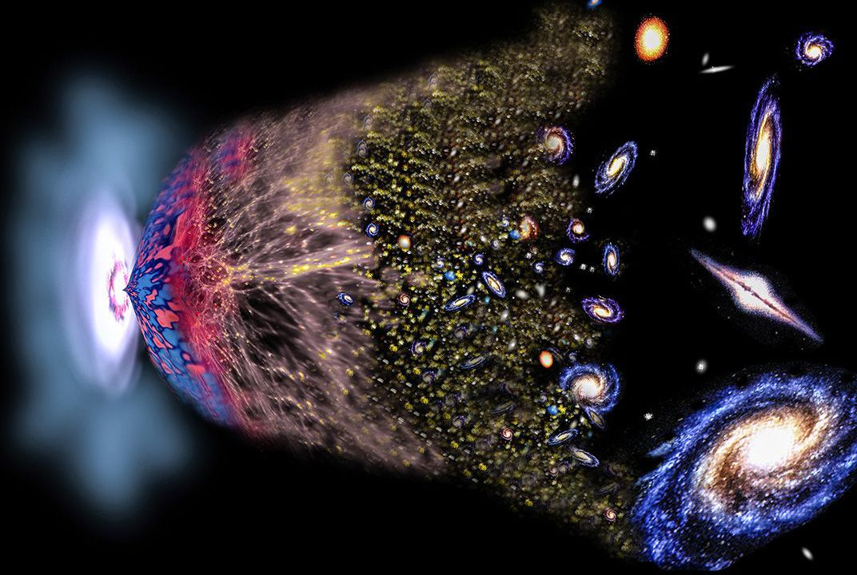
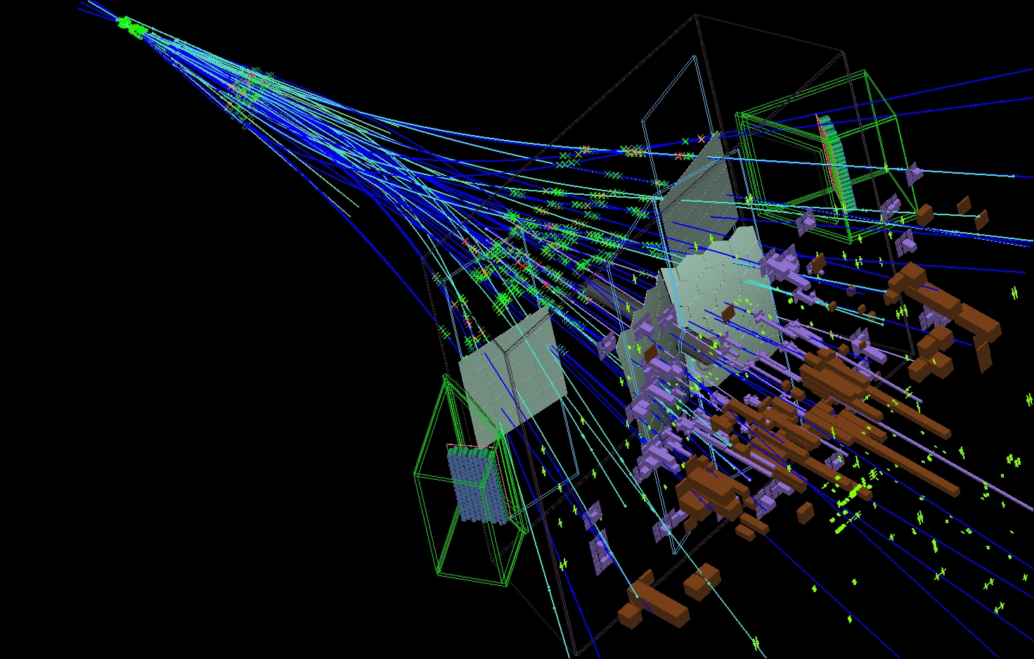
Flavour Physics and CP Violation
Marcel Merk
Nikhef, UM, VU
Notes:
About early universe and physics at LHC(b)

Slide 2
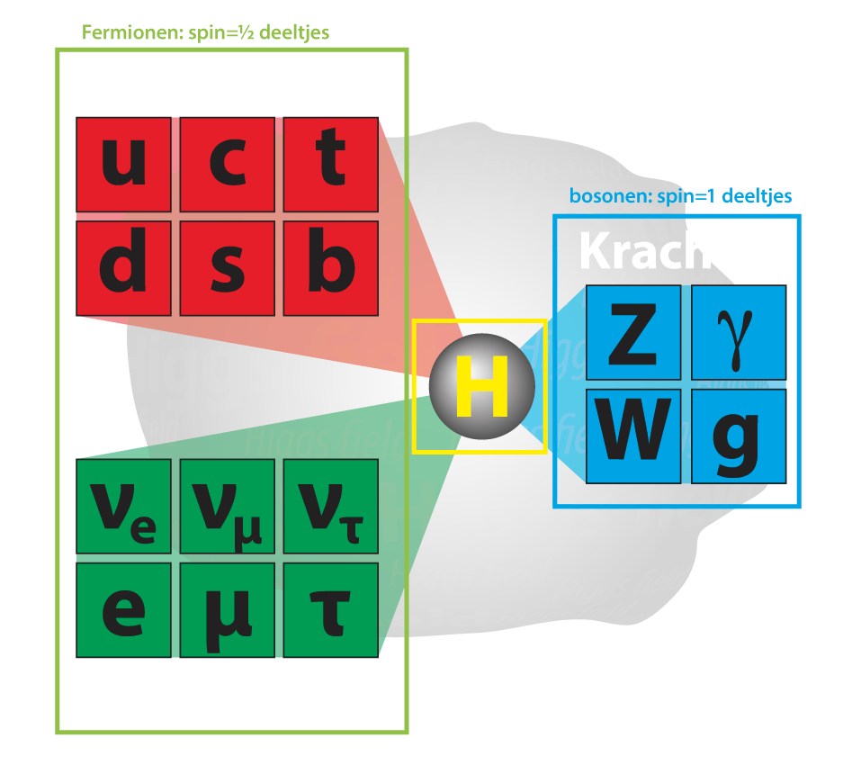
Flavour Physics and CP Violation
1
2
3
Why three generations of particles?
Why is there no antimatter?
Why is an atom electric neutral?
Notes:
Fundamental particles: Standard Model
Matter particles:
3 generations: only 1-st one stable matter
Fundamental laws symmetric matter antimatter
Why is an atom neutral: charge proton=-electron?

Slide 3
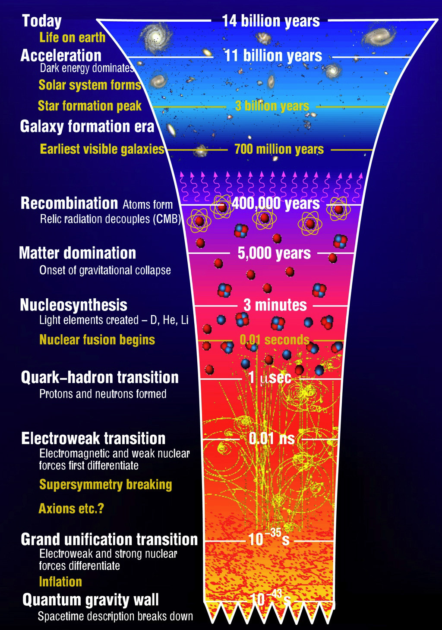

Recap: Flavour Universality in very Early Universe
1
Quark and lepton generations interact identically
  No difference between particles of different generation?
  No matter – antimatter asymmetry (CP Violation)?
$$q_{i}$$
$$q_{i}$$
$$\sqrt{α}$$
$$\sqrt{α_{s}}$$
Electromagnetic:
Strong:
$$q_{i}$$
$$γ$$
$$q_{i}$$
$$g$$
$$q_{i}$$
$$q_{i}^{d}$$
$$\sqrt{α_{W}}$$
$$\sqrt{α_{Z}}$$
Weak NC:
Weak CC:
$$q_{i}$$
$$Z$$
$$q_{i}^{u}$$
$$W^{+}$$
Universality violation: Higgs !
  Higgs coupling is not universal, and mixes generations
  Complex couplings: allows for CP Violation!
$$q_{j}$$
$$Y_{ij}$$
$${\overline{q}}_{j}$$
$$Y_{ij}^{∗}$$
CP
$$q_{i}$$
$$H$$
$${\overline{q}}_{i}$$
$$H$$

Slide 4
Recap: Flavour Universality in very early universe
2
Weak charged current interaction:
($i↔i$)
$$i=1$$
$$i=2$$
$$i=3$$
$$d$$
$$s$$
$$b$$
$$u$$
$$W^{+}$$
$$c$$
$$W^{+}$$
$$t$$
$$W^{+}$$
Universality violation: Higgs !
  Higgs coupling is not universal, and mixes generations
  Complex couplings: allows for CP Violation!
($i↔j$)
$$q_{j}$$
Massless particles
$$Y_{ij}$$
$${\overline{q}}_{j}$$
$$Y_{ij}^{∗}$$
CP
$$q_{i}$$
$$H$$
$${\overline{q}}_{i}$$
$$H$$

Slide 5
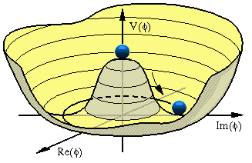
Recap: Flavour Universality → Symmetry Breaking → Flavour Mixing
3
Weak charged current interaction:
($i↔j$)
$$d^{m}$$
$$s^{m}$$
$$V_{us}$$
$$b^{m}$$
$$V_{ub}$$
$$V_{ud}$$
$$u^{m}$$
$$W^{+}$$
$$u^{m}$$
$$W^{+}$$
$$u^{m}$$
$$W^{+}$$
$$d^{m}$$
$$V_{cd}$$
$$s^{m}$$
$$V_{cs}$$
$$b^{m}$$
$$V_{cb}$$
$$c^{m}$$
$$W^{+}$$
$$c^{m}$$
$$W^{+}$$
$$c^{m}$$
$$W^{+}$$
vev$≠0$
$$d^{m}$$
$$V_{td}$$
$$s^{m}$$
$$V_{ts}$$
$$b^{m}$$
$$V_{tb}$$
$$t^{m}$$
$$W^{+}$$
$$t^{m}$$
$$W^{+}$$
$$t^{m}$$
$$W^{+}$$
Massive particles
redefines quark states in mass eigenstates:
Higgs:
($i↔i$)
$$q_{j}$$
$$Y_{ij}$$
$$q_{i}^{m}$$
$$m_{i}$$
$$q_{i}$$
$$H$$
$$q_{i}^{m}$$
$$H$$

Slide 6
Recap: Flavour Universality → Symmetry Breaking → Flavour Mixing
4
Weak charged current interaction:
$$d^{m}$$
$$s^{m}$$
$$V_{us}$$
$$b^{m}$$
$$V_{ub}$$
$$V_{ud}$$
Weak interactions mixes the generations of mass eigenstates.
Complex couplings $V_{ij}$ allow for CP violating phenomena.
  At least 3 generations required!
$$u^{m}$$
$$W^{+}$$
$$u^{m}$$
$$W^{+}$$
$$u^{m}$$
$$W^{+}$$
$$d^{m}$$
$$V_{cd}$$
$$s^{m}$$
$$V_{cs}$$
$$b^{m}$$
$$V_{cb}$$
$$c^{m}$$
$$W^{+}$$
$$c^{m}$$
$$W^{+}$$
$$c^{m}$$
$$W^{+}$$
vev$≠0$
$$d^{m}$$
$$V_{td}$$
$$s^{m}$$
$$V_{ts}$$
$$b^{m}$$
$$V_{tb}$$
$$t^{m}$$
$$W^{+}$$
$$t^{m}$$
$$W^{+}$$
$$t^{m}$$
$$W^{+}$$
Massive particles
redefines quark states in mass eigenstates:
Higgs:
$$q_{j}$$
$$Y_{ij}$$
$$q_{i}^{m}$$
$$m_{i}$$
$$q_{i}$$
$$H$$
$$q_{i}^{m}$$
$$H$$

Slide 7

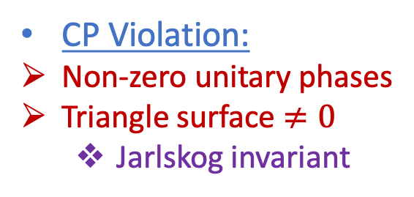
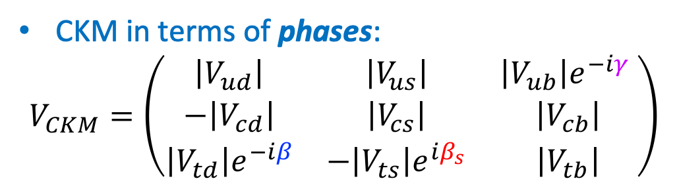
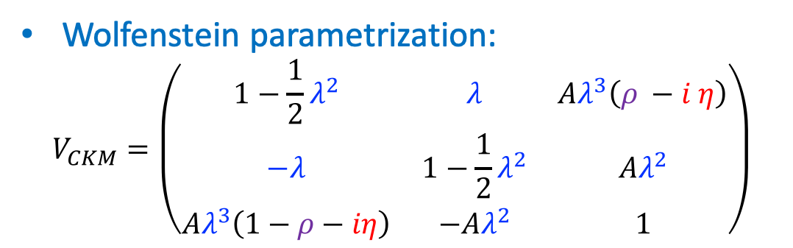
Recap: The CKM matrix and unitarity triangle
5
CKM in terms of phases:
$$V_{CKM}=\left(\begin{matrix}\left|V_{ud}\right| & \left|V_{us}\right| & \left|V_{ub}\right|e^{−iγ} \\ −\left|V_{cd}\right| & \left|V_{cs}\right| & \left|V_{cb}\right| \\ \left|V_{td}\right|e^{−iβ} & −\left|V_{ts}\right|e^{iβ_{s}} & \left|V_{tb}\right|\end{matrix}\right)$$
Triangle in the complex plane:
  $$V_{CKM}^{†} V_{CKM}=1$$
Wolfenstein parametrization:
$$V_{CKM}=\left(\begin{matrix}1−\frac{1}{2}λ^{2} & λ & Aλ^{3}\left(ρ −i η\right) \\ −λ & 1−\frac{1}{2}λ^{2} & Aλ^{2} \\ Aλ^{3}\left(1−ρ−iη\right) & −Aλ^{2} & 1\end{matrix}\right)$$
CP Violation:
Non-zero unitary phases
Triangle surface $≠0$
  Jarlskog invariant
Notes:
Unitarity triangle: 1st column times 3rd column

Slide 8
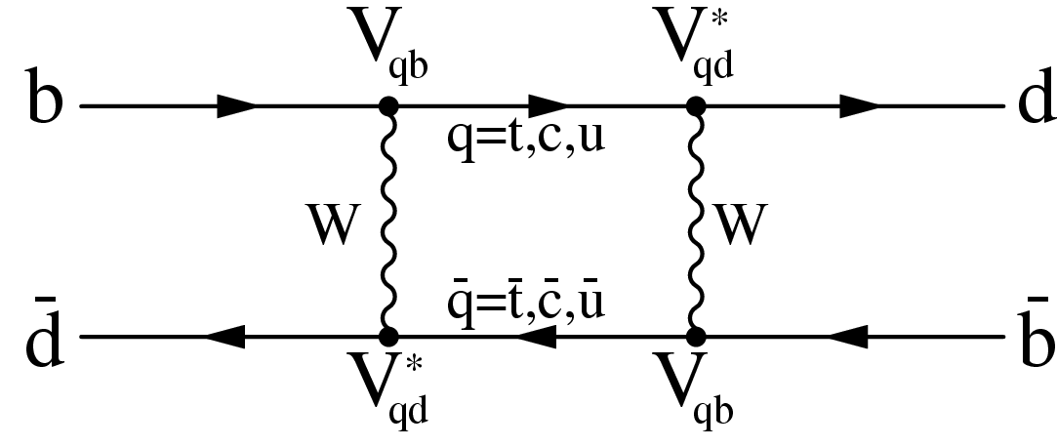
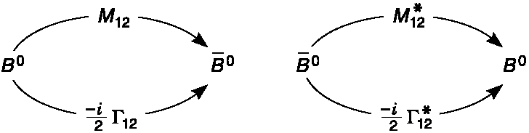
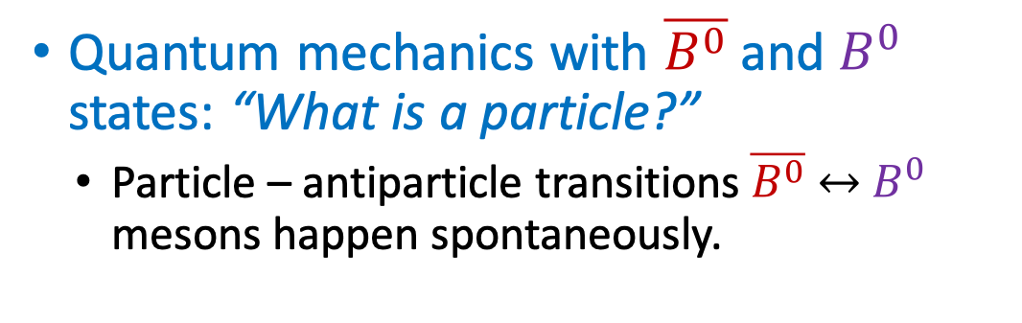
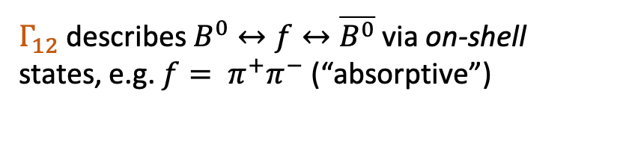

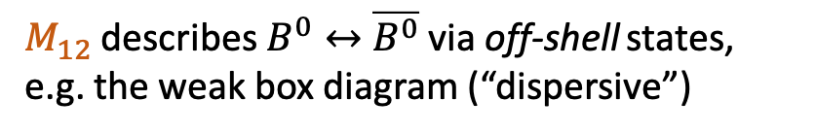

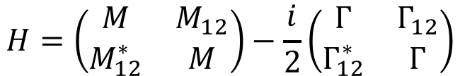
Recap: Flavor Oscillations
6
Quantum mechanics with $\overline{B^{0}}$ and $B^{0}$ states: “What is a particle?”
  Particle – antiparticle transitions$\overline{B^{0}}$ $↔$ $B^{0}$ mesons happen spontaneously.
$$\overline{B^{0}}$$
$$B^{0}$$
Time evolution of $B^{0}$ and $\overline{B^{0}}$ described by an effective Hamiltonian
$$i\frac{∂}{∂t}ψ=Hψ → ψ\left(t\right)=a\left(t\right)\left|\left.B^{0}\right\rangle +b\left(t\right)\right|\left.\overline{B^{0}}\right\rangle ≡ \left(\begin{matrix}a(t) \\ b(t)\end{matrix}\right)$$
$$H=\left(\begin{matrix}M & M_{12} \\ M_{12}^{∗} & M\end{matrix}\right)−\frac{i}{2}\left(\begin{matrix}Γ & Γ_{12} \\ Γ_{12}^{∗} & Γ\end{matrix}\right)$$
Hermitean Mass-matrix
Hermitean Decay-matrix
$M_{12}$ describes $B^{0}↔\overline{B^{0}}$ via off-shell states, e.g. the weak box diagram (“dispersive”)
$Γ_{12}$ describes $B^{0}↔f↔\overline{B^{0}}$ via on-shell states, e.g. $f= π^{+}π^{−}$ (“absorptive”)
Notes:
Focus on concepts. Math is there to help. If you don’t follow the math: doesn’t matter.

Slide 9
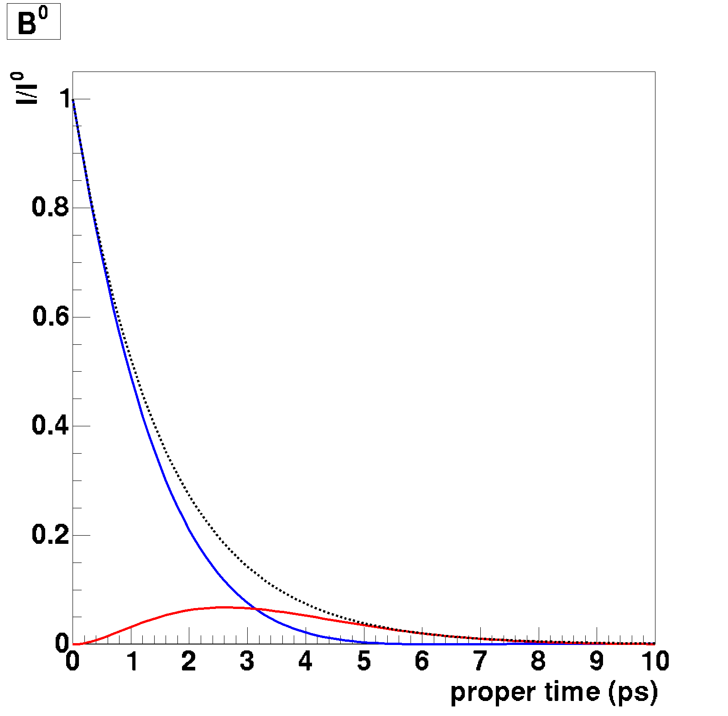
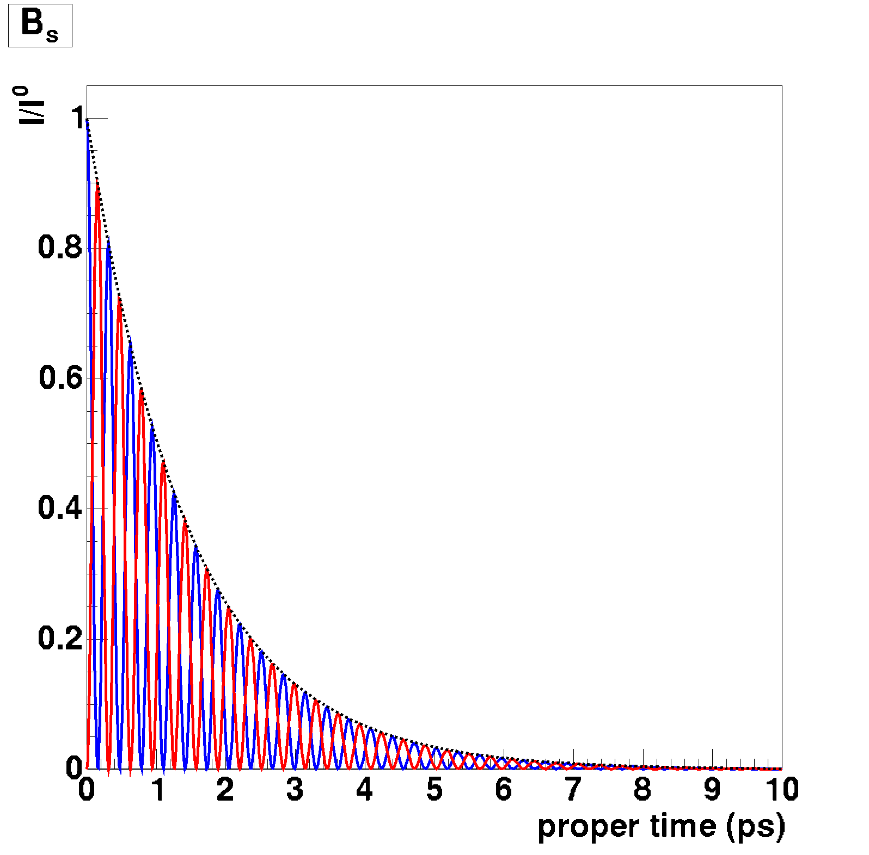


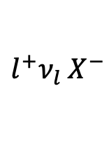
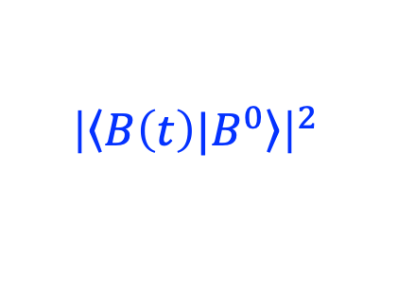


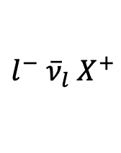



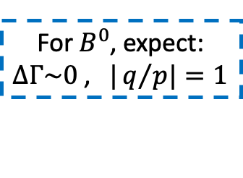

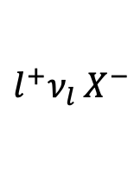
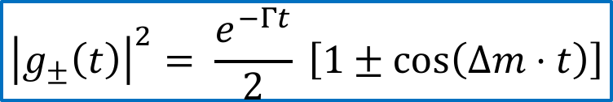

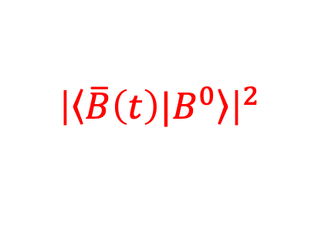



Recap: $B^{0}$ Oscillations
7
Calculate:
$$B^{0}$$
$$B^{0}$$
$${\left|\left\langle B\left(t\right)|\left.B^{0}\right\rangle \right.\right|}^{2}$$
$$g_{+}\left(t\right)$$
$${\frac{p}{q}g}_{−}\left(t\right)$$
$$l^{−}{ \overline{ν}}_{l}{ X}^{+}$$
$$l^{−}{ \overline{ν}}_{l}{ X}^{+}$$
$${\left|\left\langle \overline{B}\left(t\right)|\left.B^{0}\right\rangle \right.\right|}^{2}$$
$$B^{0}$$
$$\overline{B^{0}}$$
$${\frac{q}{p}g}_{−}\left(t\right)$$
$$l^{+}ν_{l}{ X}^{−}$$
$$l^{+}ν_{l}{ X}^{−}$$
$$g_{+}\left(t\right)$$
For $B^{0}$, expect:
$ΔΓ\sim 0$ , $|q/{p|}=1$
$$\overline{B^{0}}$$
$$\overline{B^{0}}$$
$${\left|g_{±}\left(t\right)\right|}^{2}= \frac{e^{−Γt}}{2} \left[1±\cos\left(Δm⋅t\right)\right]$$
Decay Probability
$B^{0}$ meson
$B_{s}^{0}$ meson
Flavour Oscillations!
,S
,S
S,
Decay Proper Time (ps)
,S

Slide 10
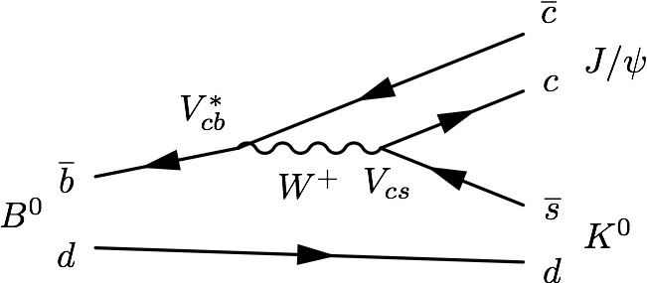
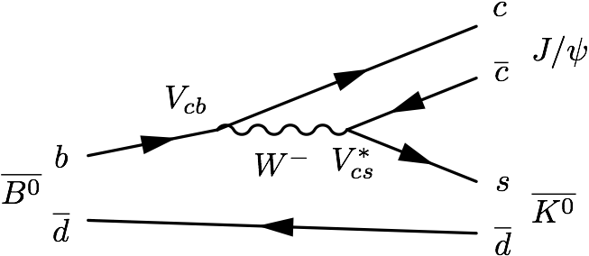

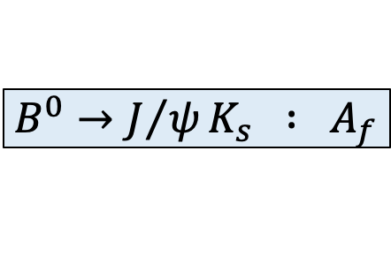

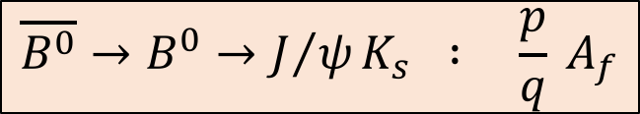


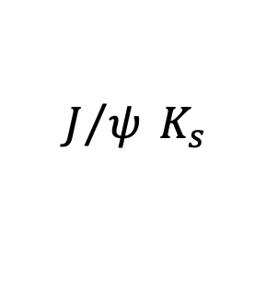

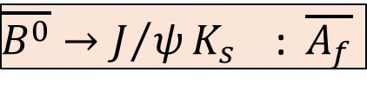


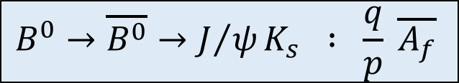

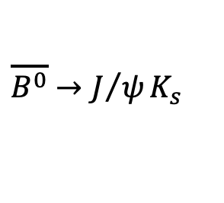


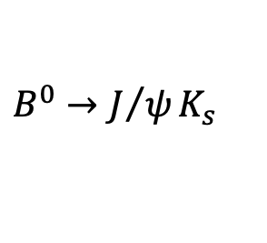
Recap: $B$ Decays to common final states: $CP$ eigenstates
8
$$B^{0}$$
$$B^{0}$$
$$g_{+}\left(t\right)$$
$$B^{0}→J/ψK_{s}$$
$$\overline{B^{0}}→J/ψK_{s}$$
$${\frac{p}{q}g}_{−}\left(t\right)$$
+
+
$$B^{0}$$
$$J/ψ K_{s}$$
$$\overline{B^{0}}$$
$$J/ψ K_{s}$$
$${\frac{q}{p}g}_{−}\left(t\right)$$
$$B^{0}→\overline{B^{0}}→J/ψK_{s}$$
$$\overline{B^{0}}→B^{0}→J/ψK_{s}$$
$$g_{+}\left(t\right)$$
$$\overline{B^{0}}$$
⬅CP➔
$$\overline{B^{0}}$$
$$B^{0}→J/ψK_{s} : A_{f}$$
$\overline{B^{0}}→J/ψK_{s}$ : $\overline{A_{f}}$
+
+
$$B^{0}→\overline{B^{0}}→J/ψK_{s} : \frac{q}{p} \overline{A_{f}}$$
$$\overline{B^{0}}→B^{0}→J/ψK_{s} : \frac{p}{q} A_{f}$$
$$\overline{b}$$
$$\overline{d}$$
$$b$$
$$d$$
$$B^{0}$$
$$\overline{B^{0}}$$
$$d$$
$$b$$
$$\overline{d}$$
$$\overline{b}$$

Slide 11

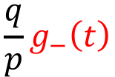







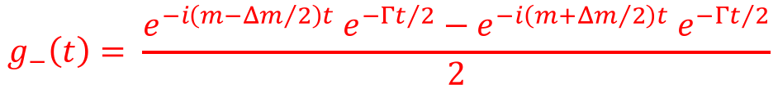


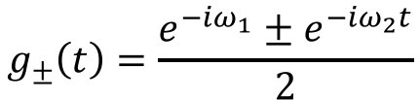
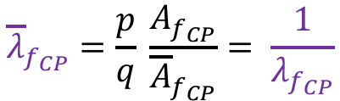


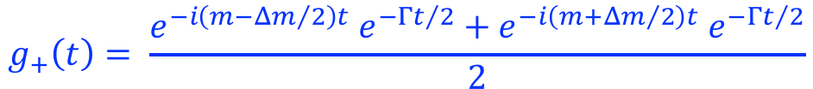
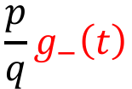

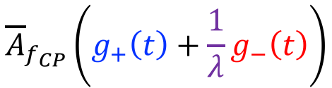
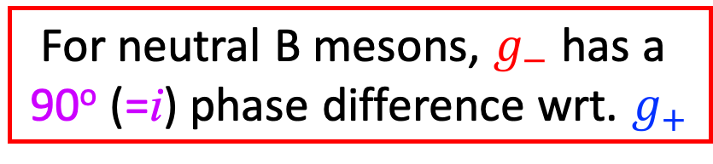

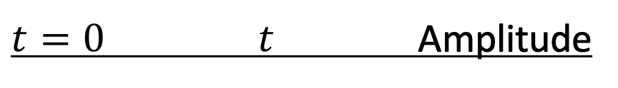



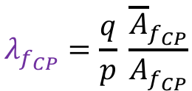

Recap: How does it give CP violation?
9
$t=0$ $t$ Amplitude
$$g_{±}\left(t\right)=\frac{e^{−iω_{1}}±e^{−iω_{2}t}}{2}$$
$$\overline{B^{0}}$$
$$A_{f_{CP}}\left(g_{+}\left(t\right)+λg_{−}\left(t\right)\right)$$
$$\frac{q}{p}g_{−}\left(t\right)$$
$${{\overline{A}}_{f}}_{CP}$$
$$g_{+}\left(t\right)= \frac{e^{−i\left(m−{Δm}/2\right)t} e^{−{Γt}/2}+e^{−i\left(m+{Δm}/2\right)t} e^{−{Γt}/2}}{2}$$
$$λ_{f_{CP}}=\frac{q}{p} \frac{{\overline{A}}_{f_{CP}}}{A_{f_{CP}}}$$
$$B^{0}$$
$$f_{CP}$$
$$= e^{−imt} e^{−{Γt}/2} \cos{\frac{Δmt}{2}}$$
$$g_{+}\left(t\right)$$
$${A_{f}}_{CP}$$
$$B^{0}$$
$$g_{−}\left(t\right)= \frac{e^{−i\left(m−{Δm}/2\right)t} e^{−{Γt}/2}−e^{−i\left(m+{Δm}/2\right)t} e^{−{Γt}/2}}{2}$$
$$CP$$
$$B^{0}$$
$$= e^{−imt}{ e}^{−{Γt}/2 }i \sin{\frac{Δmt}{2}}$$
$${\overline{A}}_{f_{CP}}\left(g_{+}\left(t\right)+\frac{1}{λ}g_{−}\left(t\right)\right)$$
$$\frac{p}{q}g_{−}\left(t\right)$$
$${A_{f}}_{CP}$$
$$\overline{B^{0}}$$
$$f_{CP}$$
$${\overline{λ}}_{f_{CP}}=\frac{p}{q} \frac{A_{f_{CP}}}{{\overline{A}}_{f_{CP}}}= \frac{1}{λ_{f_{CP}}}$$
For neutral B mesons, $g_{−}$ has a
90º (=i) phase difference wrt. $g_{+}$
$${{\overline{A}}_{f}}_{CP}$$
$$g_{+}\left(t\right)$$
$$\overline{B^{0}}$$

Slide 12




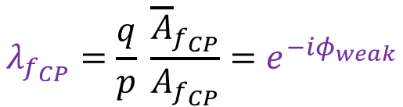




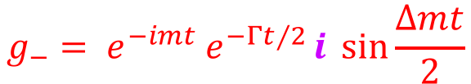



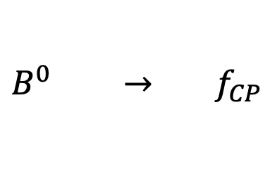

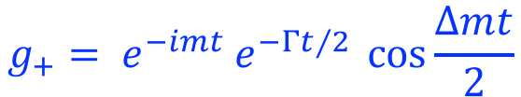



Recap: Interfering Amplitudes: CP violation!
10
$t=0$ $t$ Amplitude
$$g_{+}= e^{−imt} e^{−{Γt}/2} \cos{\frac{Δmt}{2}}$$
$$B^{0} →{ f}_{CP}$$
$$A_{f_{CP}}\left(g_{+}\left(t\right)+λg_{−}\left(t\right)\right)$$
$${\overline{A}}_{f_{CP}}\left(g_{+}\left(t\right)+\frac{1}{λ}g_{−}\left(t\right)\right)$$
$$g_{−}= e^{−imt}{ e}^{−{Γt}/2 }i \sin{\frac{Δmt}{2}}$$
$$\overline{B^{0}} →{ f}_{CP}$$
$$λ_{f_{CP}}=\frac{q}{p} \frac{{\overline{A}}_{f_{CP}}}{A_{f_{CP}}}=e^{−iφ_{weak}}$$
(CKM)
$$g_{−}\left(t\right)$$
$$g_{−}\left(t\right)$$
$$g_{+}\left(t\right)+\frac{1}{λ}g_{−}\left(t\right)$$
$$g_{+}\left(t\right)+λg_{−}\left(t\right)$$
$${\frac{1}{λ} g}_{−}\left(t\right)$$
$${λ g}_{−}\left(t\right)$$
$$φ_{weak}$$
$$φ_{weak}$$
← CP-Violation →
$$g_{+}\left(t\right)$$
$$g_{+}\left(t\right)$$
im
$$B^{0}→f_{CP}$$
$$\overline{B^{0}}→f_{CP}$$
re

Slide 13









Recap: Interfering Amplitudes: time dependent CP violation!
11
$t=0$ $t$ Amplitude
$$A_{f_{CP}} e^{−imt}e^{−i{Γt}/2}\left(\cos{\frac{Δmt}{2}}+i λ \sin{\frac{Δmt}{2}}\right)$$
$$B^{0} →{ f}_{CP}$$
$$\overline{B^{0}} →{ f}_{CP}$$
$${\overline{A}}_{f_{CP}} e^{−imt}e^{−i{Γt}/2}\left(\cos{\frac{Δmt}{2}}+i \frac{1}{λ} \sin{\frac{Δmt}{2}}\right)$$
$$φ_{weak}$$
$$φ_{weak}$$
$$φ_{weak}$$
$$B^{0}→f_{CP}$$
$$φ_{weak}$$
$$φ_{weak}$$
$$φ_{weak}$$
$$\overline{B^{0}}→f_{CP}$$
$${Δmt}/2=0$$
$${Δmt}/2=π/4$$
$${Δmt}/2=π/2$$
$${Δmt}/2={3π}/4$$
No CPV
CPV!
No CPV
CPV!
➔Decay-Time Dependent CP Asymmetry!

Slide 14













Recap: $B_{s}→D_{s}K$ : Quantum Interference Experiment @ LHCb
12
“slit A”:
$$B_{s}→D_{s}^{−}K^{+}$$
An interference pattern:
$$D_{s}^{−}$$
$$B_{s}$$
Decay time
$$K^{+}$$
Decay rate
$$B_{s}→D_{s}^{−}K^{+}$$
“slit B”:
$$B_{s}→\overline{B_{s}}→D_{s}^{−}K^{+}$$
$$B_{s}→D_{s}^{+}K^{−}$$
CP-mirror
“slit A”:
$$\overline{B_{s}}→D_{s}^{+}K^{−}$$
$$D_{s}^{+}$$
$$\overline{B_{s}}$$
Decay time
$$K^{−}$$
Decay time (ps)
“slit B”:
$$\overline{B_{s}}→B_{s}→D_{s}^{+}K^{−}$$
Time dependent $CP$ violation!

Slide 15



Recap: Measuring $B_{s}$ - $\overline{B_{s}}$ Oscillations
13
$$π^{+}$$
Proper-time dependent decay rate:
$$B_{s}→D_{s}^{−}π^{+}$$
Experimental Situation:
Ideal measurement (no dilutions)
+ Realistic flavour tagging dilution
+ Realistic decay time resolution
+ Background events
+ Trigger and selection acceptance
$$B_{s}→D_{s}^{−}π^{+} \left(2 fb^{−1}\right)$$

Slide 16








Recap: Compare LHC with B-factory for $B^{0}→J/ψ K_{S}$
14
Decay-time dependent
$CP$ violation:
$$A_{CP}\left(t\right)=\frac{Γ_{\overline{B}→f}\left(t\right)−Γ_{B→f}(t)}{Γ_{\overline{B}→f}\left(t\right)+Γ_{B→f}(t)}$$
Interfere direct and mixed
$$B^{0}$$
$$J/ψ K_{s}$$
$$e^{i2β}$$
$$\overline{B^{0}}$$
LHCb
$$\left(\begin{matrix}\left|V_{ud}\right| & \left|V_{us}\right| & \left|V_{ub}\right|e^{−iγ} \\ −\left|V_{cd}\right| & \left|V_{cs}\right| & \left|V_{cb}\right| \\ \left|V_{tb}\right|e^{−iβ} & −\left|V_{ts}\right|e^{iβ_{s}} & \left|V_{tb}\right|\end{matrix}\right)$$

Slide 17

Flavour Physics and CP Violation
15
Contents:
CP Violation
  Discrete Symmetries
  CP Violation in the Standard Model
  Jarlskog Invariant and Baryogenesis
B-Physics
  CP violation and Interference
  B-mixing and time dependent CP violation
  Experimental Aspects: LHC vs B-factory
Rare B-Decays
  Effective Hamiltonian
  Lepton Flavour Non-Universality

Slide 18





S.M.: No Flavour Changing Neutral Currents (FCNC)
16
CKM: Flavour changing charged currents
SM does not have Flavour changing neutral currents
Neutral currents are possible via higher order processes:
Decay via
“Penguin diagram”:
$$B→K^{∗}μ^{+}μ^{−}$$
Flavour Oscillation
via “Box diagram”:
$$\overline{B_{s}}→B_{s}$$

Slide 19





$B$-decays and effective couplings
17
Beta decay: “charged current”:
$$\frac{G_{F}}{\sqrt{2}}=\frac{g^{2}}{8M_{W}^{2}}$$
$$n→p e^{−}\overline{ν_{e}}$$
Rare B decay: “Flavour changing neutral current”:
$$B^{0}→K^{∗}μ^{+}μ^{−}$$
Eff Hamiltonian:
$$ℋ_{eff}=− \frac{4 G_{F}}{\sqrt{2}}V_{CKM}\sum_{i=1}^{10}{𝒞_{i}𝒪_{i}}$$
Effective Operators $𝒪_{i}$ with Wilson coefficients${ 𝒞}_{i}$ predicted by the Standard Model.
Notes:
Wilson coefficients C_i: perturbative short distance: above mu. Operators: long distance gluon stuff: color structure

Slide 20

Strong Interaction causes trouble
18
Semileptonic decays
  Factorization!
$${\text{𝓗}}_{eff}= \frac{G_{F}}{\sqrt{2}} V_{cb} \underset{Dirac spinors}{\underbrace{\left[{\overline{u}}_{l}{ γ}^{α}\left(1−γ_{5}\right){ u}_{ν}\right]}} \underset{hadronic ME}{\underbrace{\left[D^{+}\left|\overline{c} γ^{β}\left(1−γ_{5}\right) b\right|\overline{B_{d}^{0}}\right] }}$$
Hadronic decays
  Factorization?
Factorizable QCD:
Non-Factorizable QCD:

Slide 21





Solution: Effective couplings
19
Operator Product Expansion:
  Integrate out heavy fields
  Separate perturbative Wilson coefficients $𝒞_{i}$ from non-perturbative local operators $𝒪_{i}$
$$𝓗_{SM}$$
$$𝓗_{eff}$$
$$𝓗_{SM}$$
$$𝓗_{eff}$$
$$𝓗_{eff}=\frac{G_{F}}{\sqrt{2}} V_{us}^{∗} V_{cb} \left[𝓒_{1}𝒪_{1}+ 𝒞_{2}𝒪_{2}\right]$$

Slide 22
Rare $B$-decays and effective couplings: $b→sq\overline{q}$
20
𝒪₁
𝒪₂
𝒪₃ – 𝒪₆
𝒪₇ – 𝒪₁₀

Slide 23
Rare $B$-decays and effective couplings: $b→sl^{+}l^{−}$
22
𝒪_{7γ}
𝒪_{8G}
𝒪_{9V} – 𝒪_{10A}

Slide 24


Rare $B$-decays and effective couplings: $b→sμ^{+}μ^{−}$
23
Effective 4-fermion coupling:
$$b→sμ^{+}μ^{−}$$
$$ℋ_{eff}=− \frac{4 G_{F}}{\sqrt{2}}V_{tb}V_{ts}^{∗}\sum_{i=1}^{10}{𝒞_{i}𝒪_{i}}$$
Standard Model diagrams:
Beyond Standard Model:
Photon penguin:
Vector, Axial vector:
O₇
O₉ , O₁₀
Experimental test: Compare calculable C_{i} coefficients to experimental data
    Sensitivity for NP in Wilson coefficients C₇, C₉, C₁₀
Notes:
Miriam

Slide 25



Very Rare $B$-Decays
24
$$ℋ_{eff}=−\frac{4G_{F}}{\sqrt{2}} V_{CKM}\sum_{i}{C_{i} {\text{𝒪}}_{i}}$$
$$B_{s}^{0}→μ^{+}μ^{−}$$
$$B_{d}^{0}→μ^{+}μ^{−}$$
SM
SM
SM
SM: CKM and helicity suppressed: very small B.R.
→ Axial vector coupling C₁₀
NP
NP
NP
NP: Sensitive to new particles via additional (C₁₀, C_{S}, C_{P}) couplings.
→ eg.: Z’ , (pseudo-)scalars, …
C₁₀
C_{S}
C_{P}
Notes:
Silvia

Slide 26




Very Rare $B$-Decays
25
$$B_{s}^{0}→μ^{+}μ^{−}$$
$$B_{d}^{0}→μ^{+}μ^{−}$$
Multivariate technique to suppress Backgrounds.
• Detached vertex
• Muon identification

Slide 27



Very Rare $B$-Decays
26
PRL 118 (2017) 191801
7.8 σ
$$B_{s,d}^{0}→μ^{+}μ^{−}$$
Very strongly suppressed in the SM
High sensitivity for physics beyond SM
Hot topic for LHCb
m(μ⁺μ–) [MeV/c²]
B⁰_{d}→ μ⁺μ⁻ vs B⁰_{s}→ μ⁺μ⁻
Effective lifetime B⁰_{s}→ μ⁺μ⁻

Slide 28
Flavour Physics and CP Violation
27
Contents:
CP Violation
  Discrete Symmetries
  CP Violation in the Standard Model
  Jarlskog Invariant and Baryogenesis
B-Physics
  CP violation and Interference
  B-mixing and time dependent CP violation
  Experimental Aspects: LHC vs B-factory
Rare B-Decays
  Effective Hamiltonian
  Lepton Flavour Non-Universality

Slide 29

Flavour Physics and CP Violation
27
Contents:
CP Violation
  Discrete Symmetries
  CP Violation in the Standard Model
  Jarlskog Invariant and Baryogenesis
B-Physics
  CP violation and Interference
  B-mixing and time dependent CP violation
  Experimental Aspects: LHC vs B-factory
Rare B-Decays
  Effective Hamiltonian
  Lepton Flavour Non-Universality

Slide 30













$B$-decays and lepton universality
28
$b→c l ν$ charged current: ”Allowed” → large decay rates
$$c$$
$$R_{D}= \frac{B→Dτν}{B→Dμν }$$
$$b$$
$$τ/μ$$
i=3/2
$$R_{D^{∗}}= \frac{B→D^{∗}τν }{B→D^{∗}μν }$$
$${ν_{τ}}/{ν_{μ}}$$
$b→sl^{+}l^{−}$ neutral current: “Suppressed” → rare decays
$$R_{K}= \frac{B^{+}→K^{+}μ^{+}μ^{−}}{B^{+}→K^{+}e^{+}e^{−}}$$
$$s$$
$$b$$
$${μ^{+}}/{e^{+}}$$
$$R_{K^{∗}}= \frac{B^{0}→K^{∗0}μ^{+}μ^{−}}{B^{0}→K^{∗0}e^{+}e^{−}}$$
i=2/1
$${μ^{−}}/{e^{−}}$$

Slide 31





$R_{D}$ and $R_{D^{∗}}$
29
$b→c l ν$:
allowed charged current
$$R_{D^{∗}}$$
$$R\left(D^{\left(∗\right)}\right)=\frac{BR(B→D^{\left(∗\right)}τν) }{BR(B→D^{\left(∗\right)}μν) }$$
$\sim 3$ –$4 σ$ deviation
$$c$$
SM
$$b$$
$$τ/μ$$
$${ν_{τ}}/{ν_{μ}}$$
$$R_{D}$$
Potential large effect ➔ Involves particles of 2nd and 3rd generation

Slide 32






$R_{K}$ and $R_{K^{∗}}$
39/51
30
$$R_{K}$$
$b→s l^{+}l^{−}$
Suppressed neutral current
$$R\left(K\right)=\frac{BR(B^{+}→K^{+}μ^{+}μ^{−}) }{BR(B^{+}→K^{+}e^{+}e^{−}) }$$
$$s$$
$$b$$
$${μ^{+}}/{e^{+}}$$
~ 3 $σ$
$${μ^{−}}/{e^{−}}$$
$$R\left(K^{∗}\right)=\frac{BR(B^{0}→K^{∗}μ^{+}μ^{−}) }{BR(B^{0}→K^{∗}e^{+}e^{−}) }$$
$$R_{K^{∗}}$$
Small effect ➔ Particles of 1st and 2nd generation

Slide 33

Branching fractions of Rare Decays: $b→s μ^{+}μ^{−}$
31
JHEP 06 (2014) 133
JHEP 06 (2014) 133
JHEP 06 (2014) 133
JHEP 08 (2013) 131
JHEP 09 (2015) 179
JHEP 06 (2015) 115
Branching fractions related to $b→s μ^{+}μ^{−}$transition consistently lower than predicted.

Slide 34










Variable $P_{5}^{′}$ in $B^{0}→K^{∗0}μ^{+}μ^{−}$
32
$$d$$
$$K$$
$$d$$
$$s$$
$$B^{0}→K^{∗0}μ^{+}μ^{−}$$
$$B$$
$$b$$
$$μ^{+}$$
$$μ^{−}$$
LHCb: Study angular distribution of the produced particles
~3σ from SM
  $P_{5}^{′}:$ count blue minus red:
$$\cos{θ_{K}}$$
$$φ$$

Slide 35




Global Fit of $b→s μ^{+}μ^{−}$
33
$$ℋ_{eff}=− \frac{4 G_{F}}{\sqrt{2}}V_{CKM}\sum_{i=1}^{10}{C_{i}O_{i}}$$
Weak Effective couplings: $C_{9}^{NP} , C_{10}^{NP}$
Semileptonic Penguin operators: $O_{9}, O_{10}$
Good fit for: $C_{9}^{NP}=−C_{10}^{NP}≃−1$
  New effective $V−A$contribution
  Suppressed $b→s μ^{+}μ^{−}$ penguin
$$s$$
$$b$$
$$μ^{+}$$
Note:
Suppressed
penguin
≠
Depressed
penguin
$$μ^{−}$$

Slide 36




Interpretation as a single cause: contradicting effects?
34
$b→c l ν{: R}_{D}, R_{D^{∗}}$
  ~ 25% effect at enhanced tree level
    Large effect → Large 3rd generation couplings
$b→s l^{+}l^{−}: R_{K}, R_{K^{∗}}$
  ~ 25% effect at suppressed penguin level
    Small effect; Small 2nd generation couplings
Weak Effective couplings: $C_{9}^{NP} , C_{10}^{NP}$
$$R_{D^{∗}}$$
SM
SM
$$R_{D}$$
Similar to Higgs couplings: large for 3rd generation, small for 2nd generation, tiny for 1st generation.
➔ New particle perhaps has similar flavour structure as the Higgs?

Slide 37


Universality?
…Indian Yoga
Russian Yoga…

Slide 38


Flavour Physics at high mass: GGL model
35
Effective New Physics operators point at left-handed vector coupling
New physics occurs above weak scale (~TeV)
  Before EWSB: physics that is invariant under
  SU(3)_{C} x SU(2)_{L} x U(1)_{Y}
  Operates on massless interaction states
3rd generation is special ($eg. Y_{top}$ = 1)
Glashow, Guagdagnoli, Lane (GGL) model: Operator for NP in 3rd generation:
  $G \left({\overline{b^{′}}}_{L} γ_{μ} {b′}_{L}\right) \left({\overline{τ^{′}}}_{L} γ^{μ} τ_{L}^{′}\right)$
𝑣
$$v$$

Slide 39



Where does GGL operator come from?
36
Glashow, Guagdagnoli, Lane (GGL) model: operator for NP:
  $G \left({\overline{b^{′}}}_{L} γ_{μ} {b′}_{L}\right) \left({\overline{τ^{′}}}_{L} γ^{μ} τ_{L}^{′}\right)$
Relate massive particles to massless states:
  $b_{L}^{′}=V_{31}^{d} d+V_{32}^{d} s+V_{33}^{d} b$ and
  $τ_{L}^{′}=V_{31}^{l} e+V_{32}^{l} μ+V_{33}^{l} τ$
CKM Hierarchy suggests:
  $V_{33}^{d}≃V_{33}^{l}≃1$ and $V_{31}^{d,l }≪V_{32}^{d,l }≪1$
GGL operator becomes:
  $G \left[V_{33}^{d} V_{32}^{∗d} {\left|V_{32}\right|}^{2}\right] \left({\overline{b}}_{L} γ_{μ}s_{L}\right)\left({\overline{μ}}_{L}γ^{μ}μ_{L} \right)$
Large effect in 3rd generation, small effect in 2nd generation
𝑣
$$V_{CKM}={\left(V^{u}V^{d†}\right)}_{ij}$$
$$V_{MNS}={\left(V^{ν}V^{l†}\right)}_{ij}$$
$$v$$

Slide 40


GGL operator – more general
37
Allow effective operators that are SU(2) x U(1) invariant:
  Singlet neutral current:
    $O_{S}^{NP}= G_{S} \left({\overline{Q^{′}}}_{L} γ_{μ} Q_{L}^{′}\right) \left({\overline{L^{′}}}_{L} γ^{μ} L_{L}^{′}\right)$
  Triplet neutral current + two charged currents:
    $O_{T}^{NP}= G_{T} \left({\overline{Q^{′}}}_{L} γ_{μ} σ^{I}Q_{L}^{′}\right) \left({\overline{L^{′}}}_{L} γ^{μ} σ^{I}L_{L}^{′}\right)$
These operators with CKM hierarchy “naturally” give simultaneous explanation of:
  $R_{D}$ , $R_{D^{∗}},$ charged current, 3rd generation
    → large effect
  $R_{K}$ ,$R_{K^{∗}}$ , $b→s μ^{+}μ^{−}$,neutral current, 2nd generation
    → small effect
$Q^{′}=\left(\begin{matrix}t′ \\ b′\end{matrix}\right)$ and $L′=\left(\begin{matrix}ν_{τ}′ \\ τ′\end{matrix}\right)$
𝑣
$$v$$

Slide 41




Which particle/field could it be?
38
LFNU is currently a hot topic, many theory papers, see eg. arXiv:1706.07808 for overview.
• New gauge bosons
Z’, W’
• LeptoQuarks
LQ
Best Single LQ model:
  Vector LQ U1(3,1,2/3)
  Scale of NP should be ~2 TeV
  Possible UV completions:
    Pati-Salam models SU(4)
      Lepton←→4-th color
    SU(5) GUT
    4321 model
    S₁ & S_{3,} etc., etc.
  Shine light on flavour puzzles?!
$$G_{s}$$
$$G_{T}$$
Notes:
Pati Salam: Spontaneously broken SU(4): leptons are a 4-th color. Requires existence of vector like quarks.

Slide 42
Which particle/field could it be?
39
LFNU is currently a hot topic, many theory papers, see eg. arXiv:1706.07808 for overview.
• New gauge bosons
Z’, W’
• LeptoQuarks
LQ
Best Single LQ model:
  Vector LQ U1(3,1,2/3)
  Scale of NP should be ~2 TeV
  Possible UV completions:
    Pati-Salam models SU(4)
      Lepton←→4-th color
    SU(5) GUT
    4321 model
    S₁ & S_{3,} etc., etc.
  Shine light on flavour puzzles?!
LQ relates charge of leptons to quarks!
Towards an understanding why atoms are electrically neutral?
Notes:
Pati Salam: Spontaneously broken SU(4): leptons are a 4-th color. Requires existence of vector like quarks.

Slide 43

Recent: direct search for specific 3rd generation leptoquarks
40
CMS search for direct LQ production, arXiv:2012.04178, 7 Dec 2020
  Exclusion limit (98%): $M_{LQ}<0.98$- $1.73 TeV$
  (depending on the model parameters)
LQ production at LHC:
“Single LQ”
“Double LQ”
  arXiv:2012.04178, Dec 2020
Allowed
Excluded

Slide 44

Soon more news in Winter conferences…(“Moriond”)
41

Slide 45

Conclusions
42
CP Violation requires three generations of particles.
  Does not explain the matter antimatter asymmetry in the universe.
  LHC has not yet directly observed new massive particles.
Forces are flavour universal across particle generations.
Higgs is strongly non-universal, coupling mainly to 3rd generation.
Precision measurements hint at the existence of new particles with non-universal couplings:
  LeptoQuark candidate; couples to quarks and leptons
  LeptoQuarks are a long sought particles that may address:
    The matter - antimatter asymmetry of the universe,
    Why proton has equal but opposite charge wrt electron.
Updates expected in winter conferences.
𝑣
$$v$$

Slide 46


Slide 47
Conclusions & Outlook
• Why 3? → no antimatter?
• Non Universality → why 3?
• EWSB super interesting
• Flavour probes deeply into
quantum (CP, rare decays)
•LHCb→Upgrade1→Upgrade2
• Belle2, …

Slide 48

Thank You
Don’t be afraid to ask questions…

