Slide 1

Higgs physics
Ivo van Vulpen (Nikhef/UvA)

Slide 2
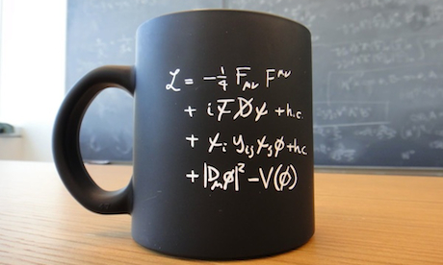

Structure of the Standard Model
force carriers
interactions
fermion masses
gauge boson masses
Higgs boson

Slide 3
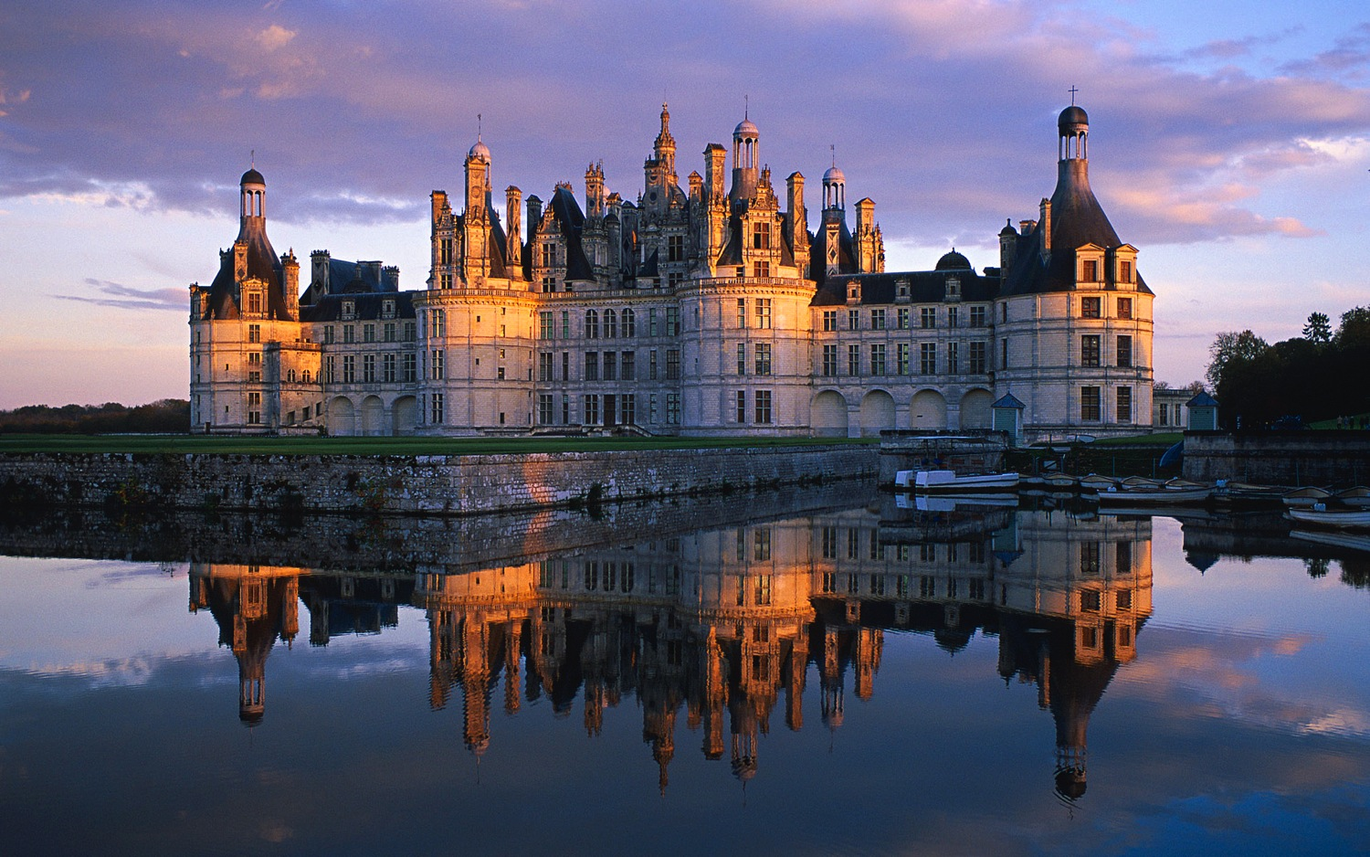
particles
anti-particles
Mass term fermion
Mass term gauge boson
Standard Model does not allow for massive gauge bosons or fermions

Slide 4
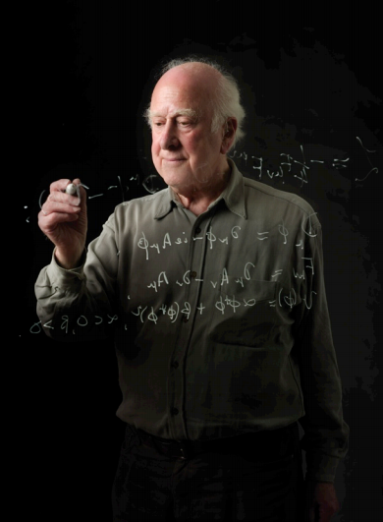
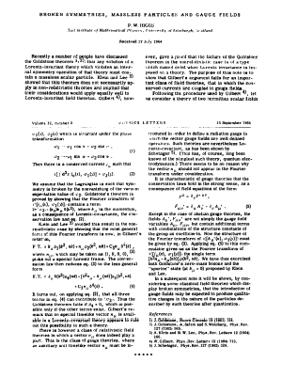
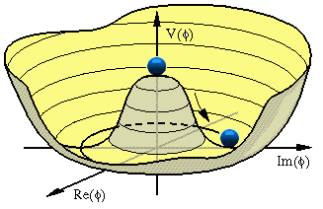
Peter Higgs
1964, 1 page
“Additional field in the vacuum”

Slide 5

Higgs production & decay at the LHC

Slide 6



Production of the Higgs boson
Gauge bosons
Fermions
Massive gauge boson ?
… then the Higgs couples to it
Massive fermion ?
… then the Higgs couples to it
W,Z
Lepton, quarks
higgs
higgs
Anti-lepton, anti-quarks
W,Z
Notes:
Blikje in de keuken … Feynmann diagrammen: x = tijd … samensmelten in balletjes -> vormen Higgs boson

Slide 7
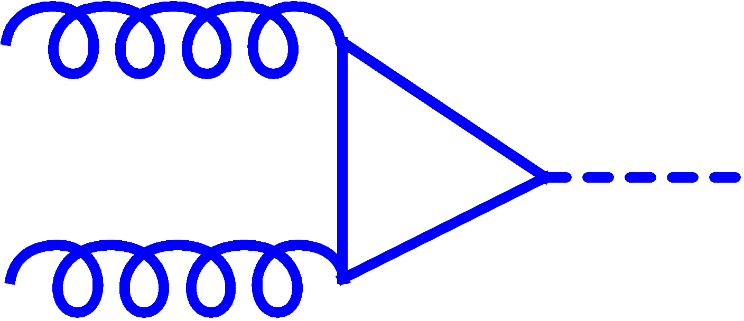

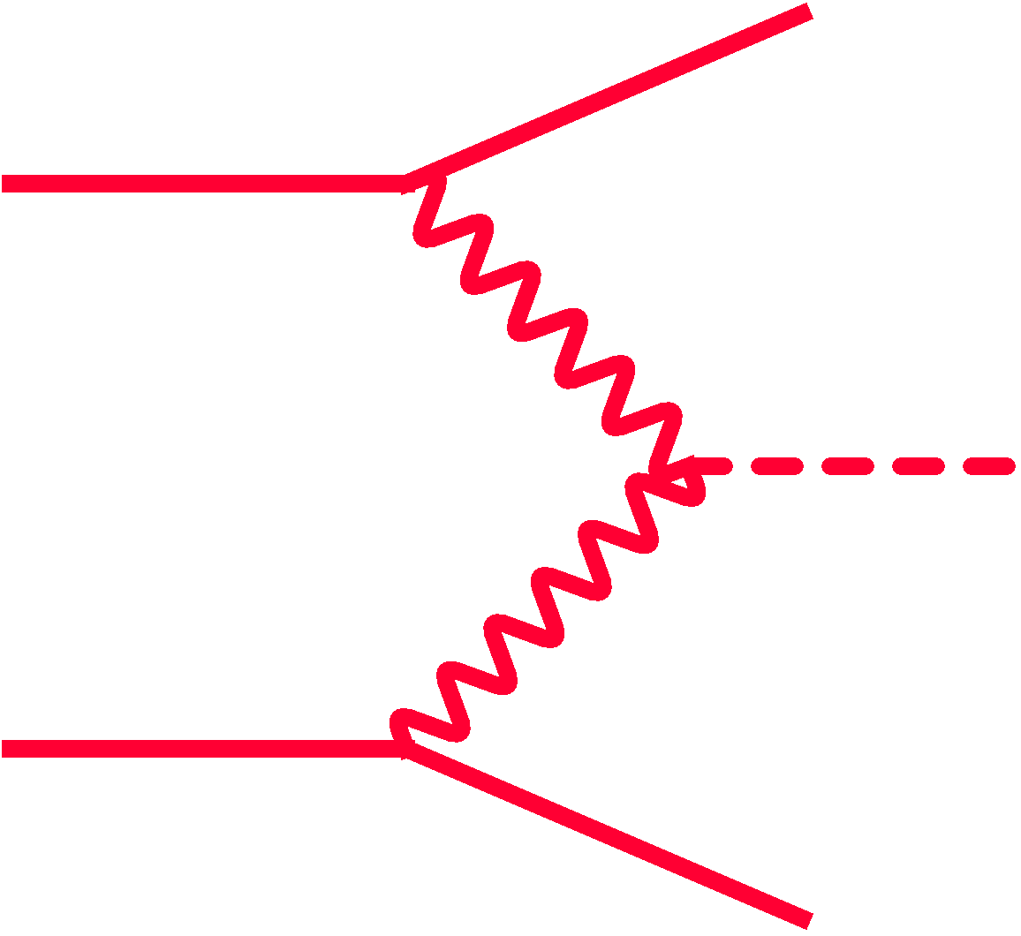



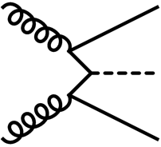
Production of the Higgs boson
t
Higgs production
t
h
t
√s=7 TeV
Gluon fusion
W/Z
h
W/Z
Vector boson fusion
W/Z
W*/Z*
t
h
h
Associated production
t
tth
https://twiki.cern.ch/twiki/bin/view/LHCPhysics/CERNYellowReportPageBR3
Notes:
Guess: dominating uncertainties are scale uncertainties (+12% -7%) and PDFs (8%)
https://twiki.cern.ch/twiki/bin/view/LHCPhysics/CrossSections
σ_{pp→Higgs}(√s=14 TeV) ~ 3-4 x σ_{pp→Higgs}(√s=7 TeV)

Slide 8
Decay of the Higgs boson
Gauge boson
Fermion
Massive gauge boson ?
… then the Higgs couples to it
Massive fermion ?
… then the Higgs couples to it
W,Z
W,Z
higgs
higgs
lepton, quarks
Lepton, quarks
higgs
higgs
Anti-lepton, anti-quarks
Anti-lepton, anti-quarks
W,Z
W,Z
Higgs boson decay
Higgs boson production

Slide 9
Higgs branching fractions
m_{h} = 125 GeV
Br(h→bb) = 57.7 %
Br(h→WW) = 21.5 %
Br(h→ττ) = 6.32 %
Br(h→ZZ) = 2.64 %
Br(h→γγ) = 0.23 %
Br(h→Zγ) = 0.15 %
https://twiki.cern.ch/twiki/bin/view/LHCPhysics/CERNYellowReportPageBR3

Slide 10
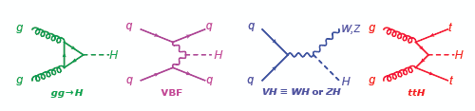
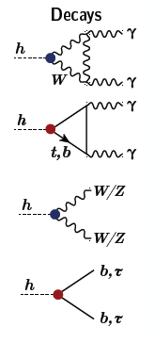
Higgs production and decay
Test all combinations

Slide 11
10¹¹
proton-proton
10¹⁰
production rate
10⁹
10⁸
10⁹
10⁷
10⁶
2-jets (0.1<m_{jj}<5 TeV)
10⁵
10⁴
10³
10²
Access rare processes:
- focus on clear signatures:
leptons/photons
- study many collisions
Z→μ⁺μ⁻
10¹
higgs→γγ/4μ
10⁰
production process

Slide 12
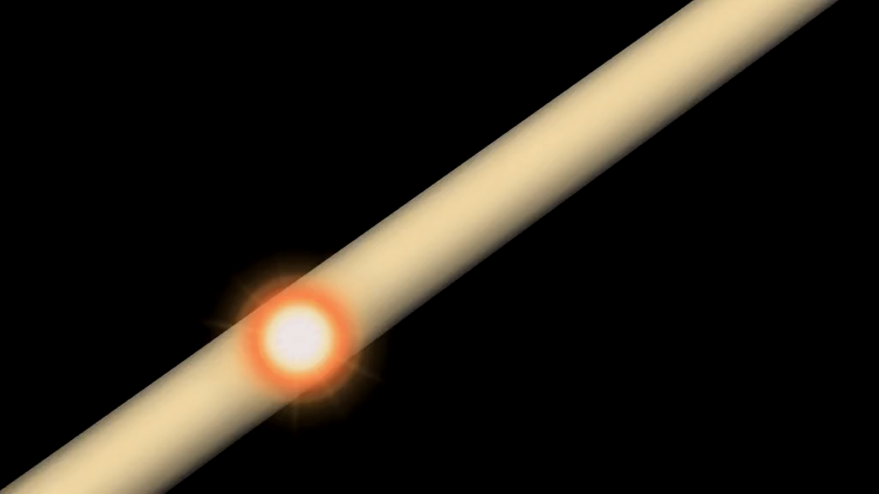
The Large Hadron Collider at CERN

Slide 13
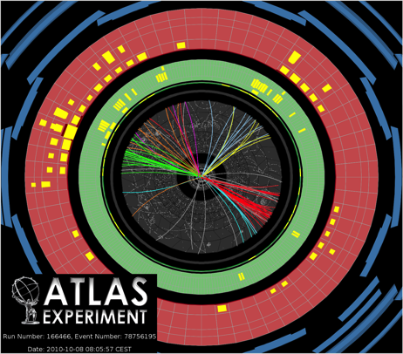
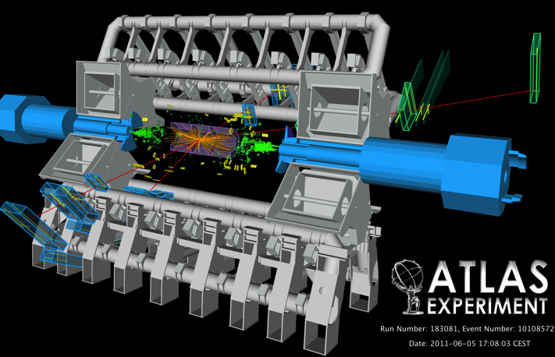
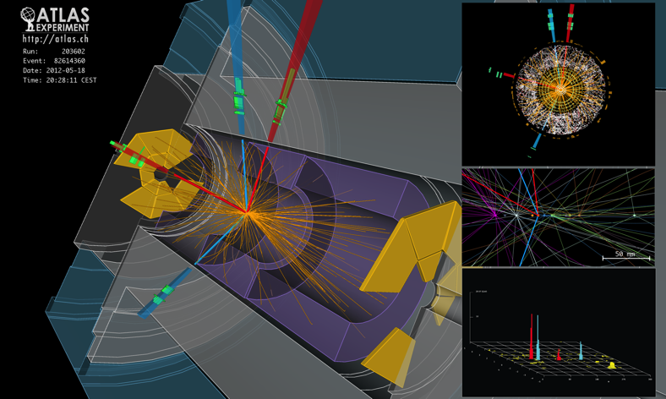
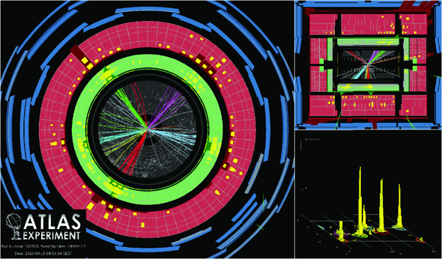
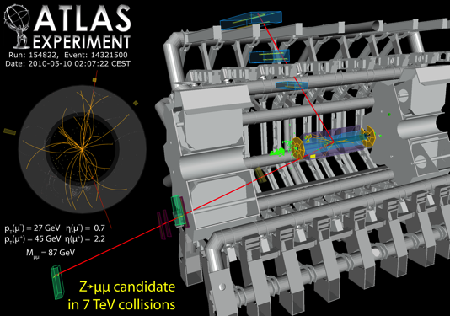
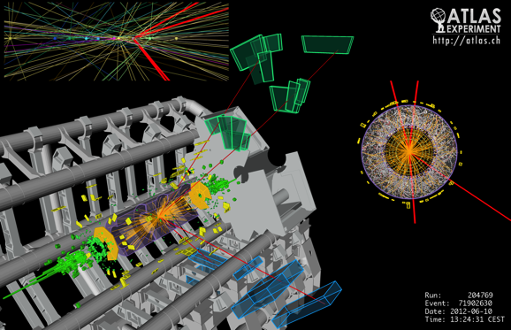
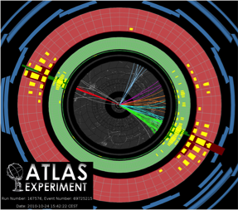
1 billion pictures per second

Slide 14
small number 4-muon events
Tricky:
- 1 billion per second
…. can only store 200

Slide 15
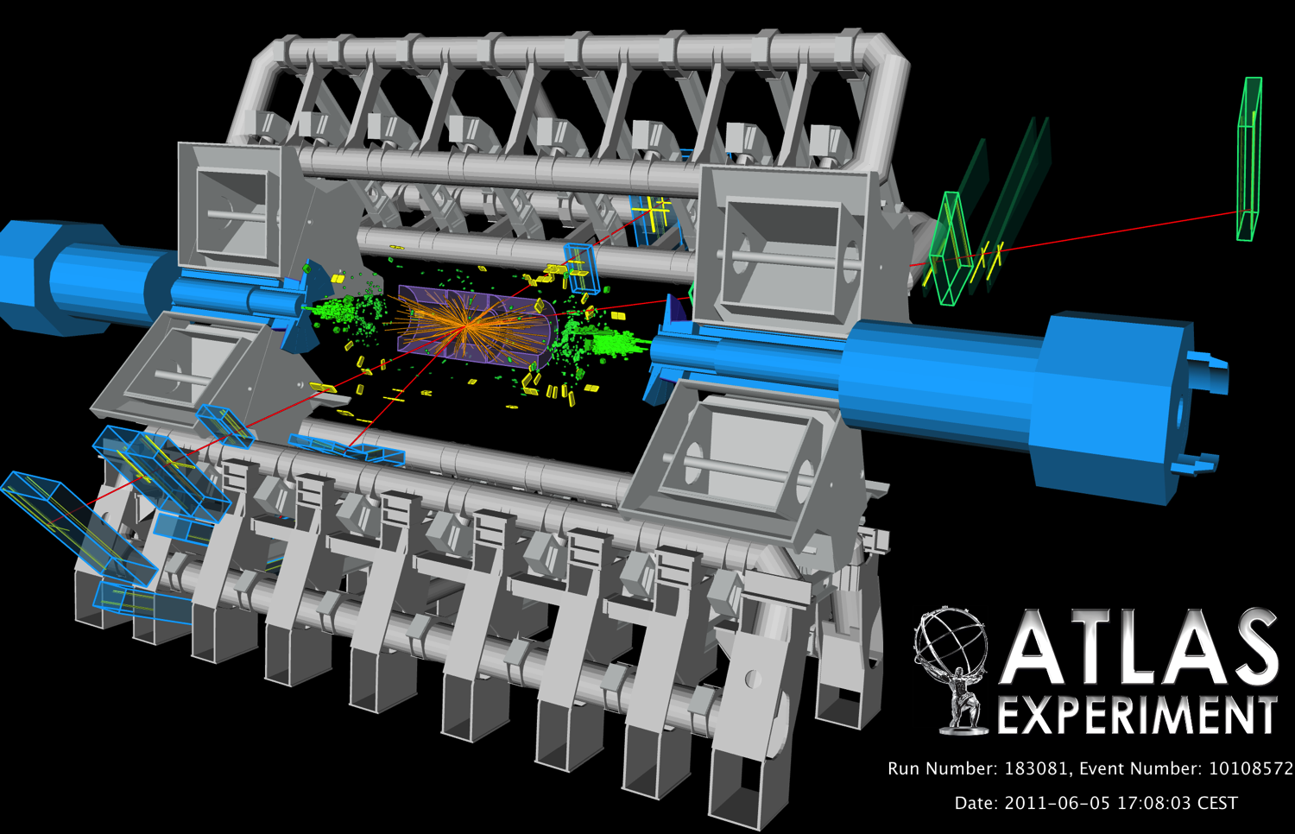
muon
muon
muon
muon

Slide 16
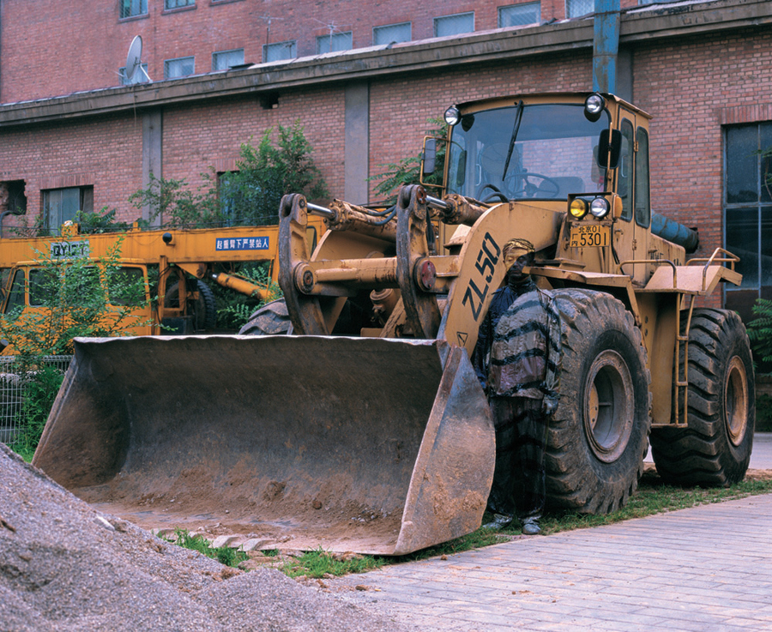
Liu Bolin

Slide 17
discovery

Slide 18
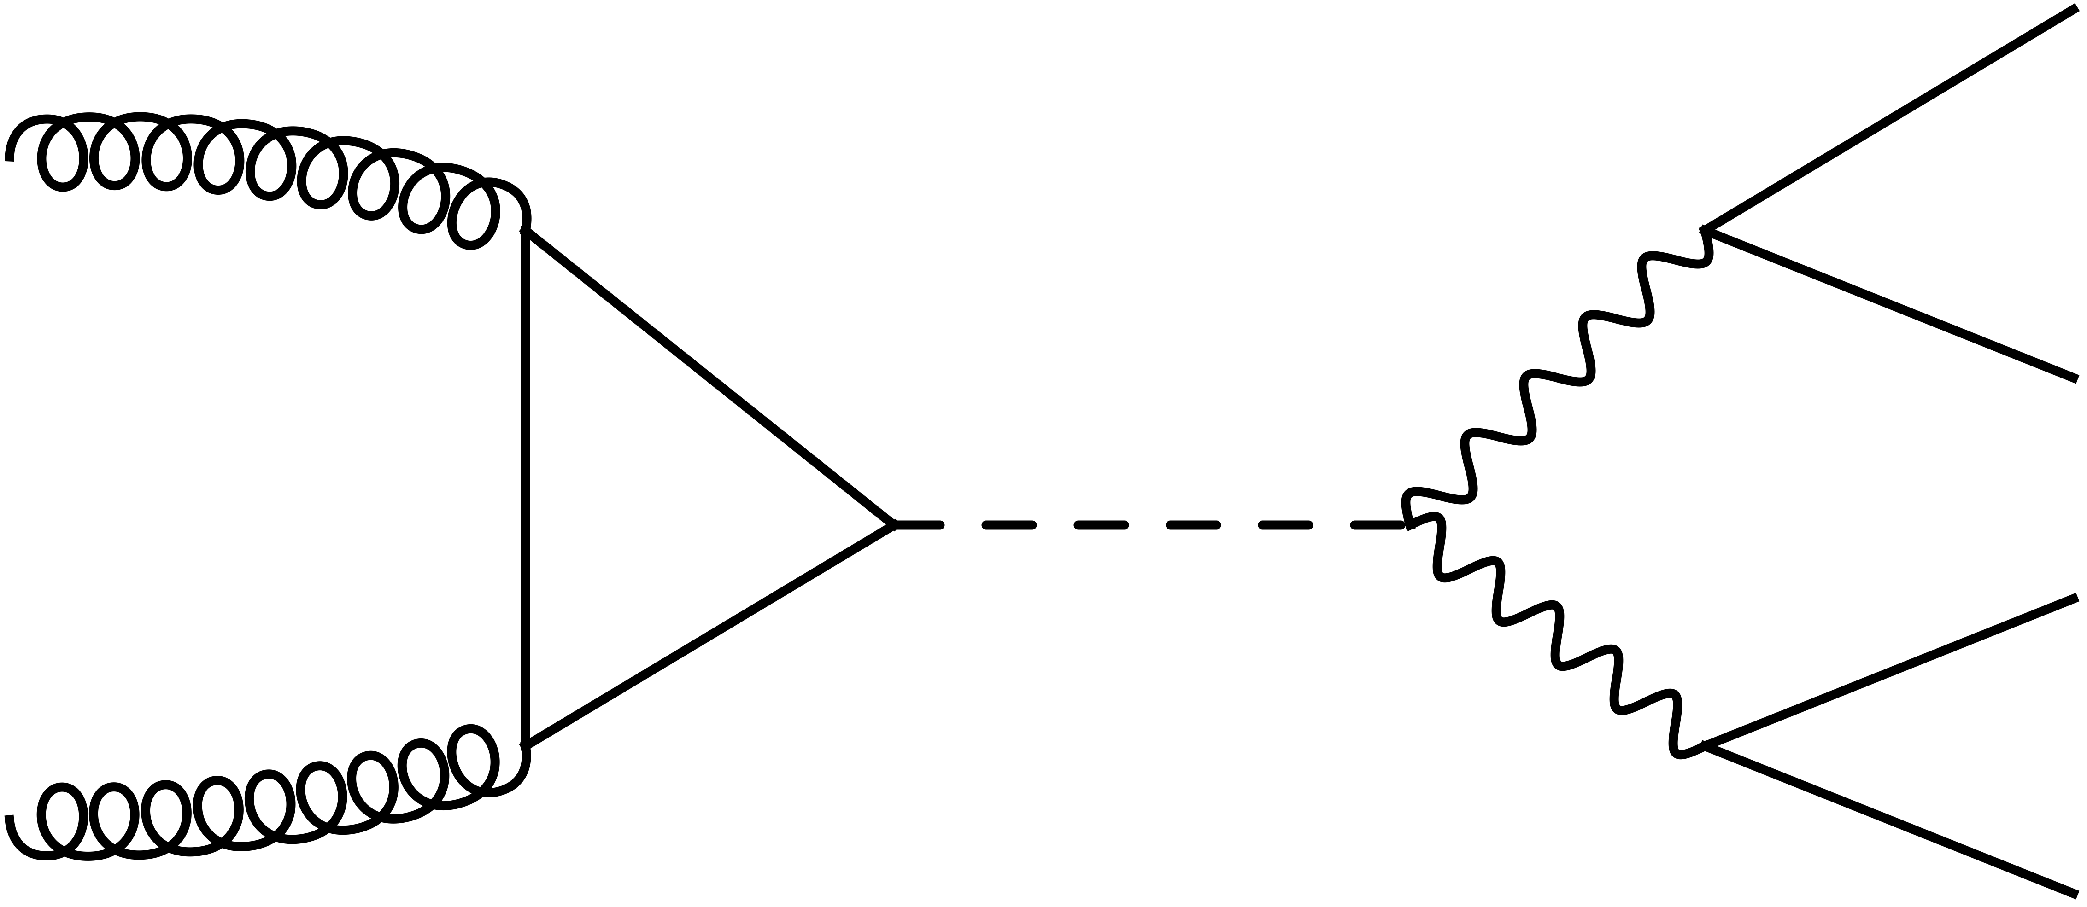
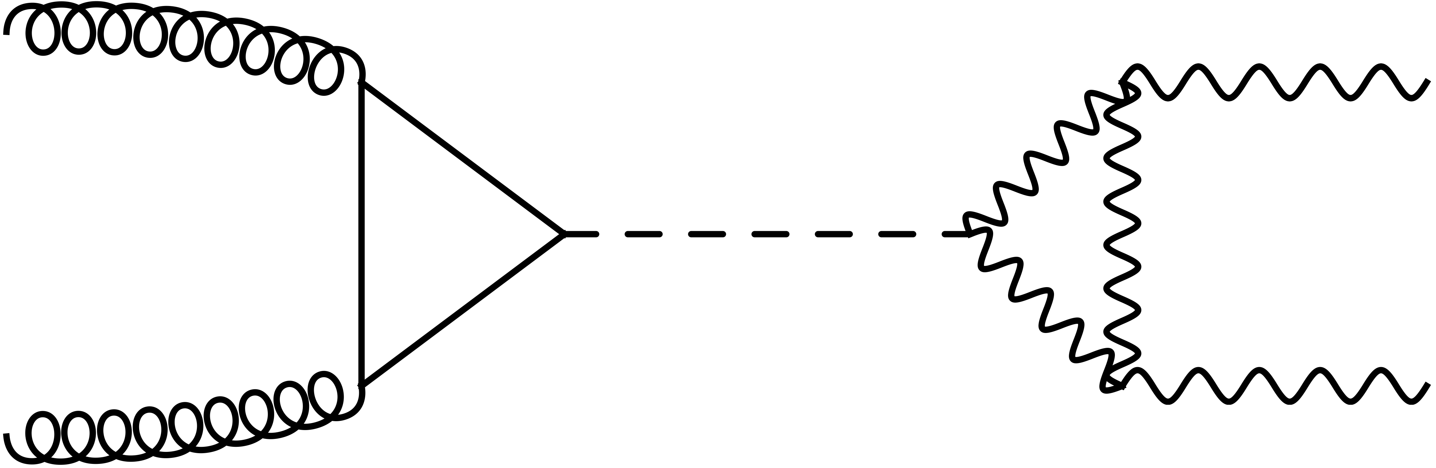
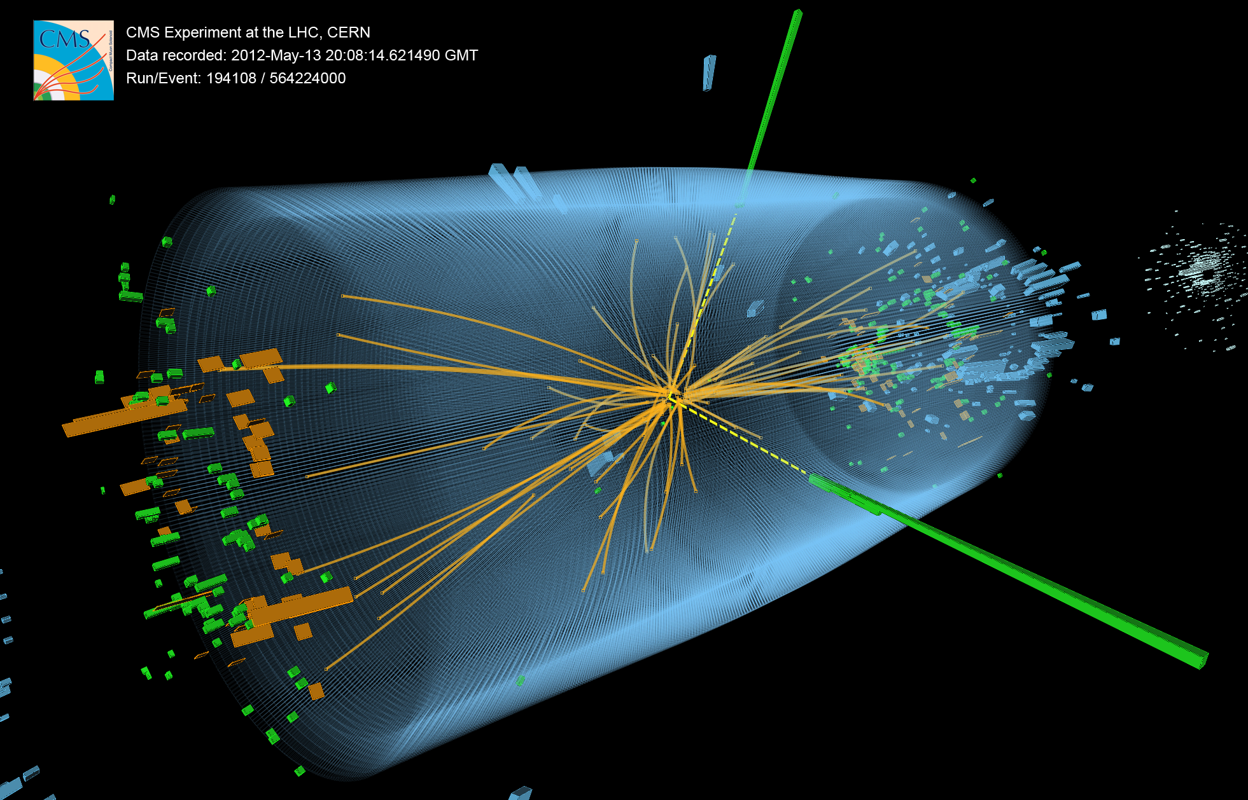

Higgs boson decay to 2 photons
Higgs boson decay to 4 leptons
μ⁺
γ
Z
higgs
higgs
μ⁻
top
top
μ⁺
γ
Z
μ⁻
CMS di-photon event
ATLAS 4 lepton event

Slide 19
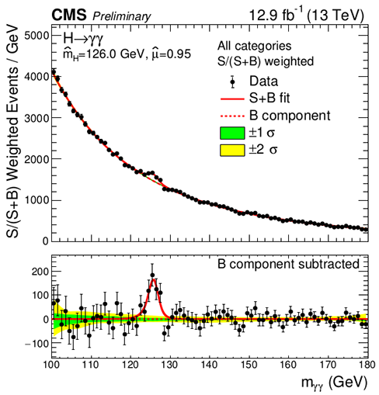
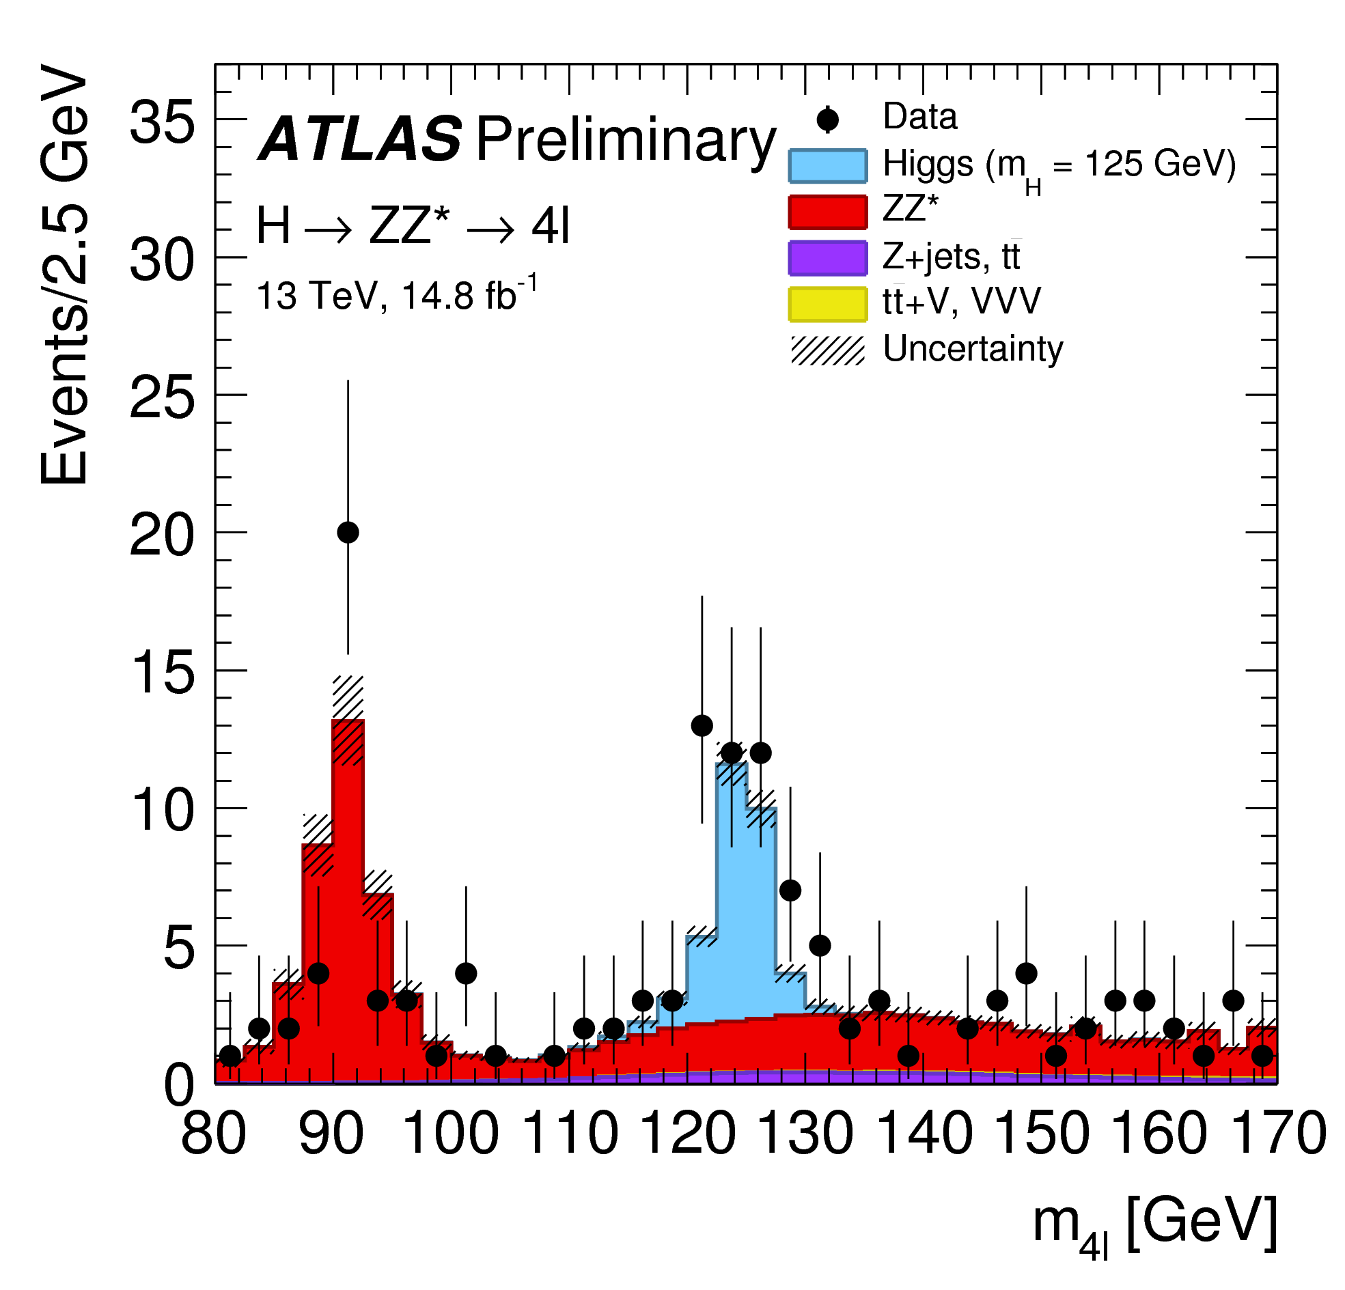
Higgs boson decay to 2 photons
Higgs boson decay to 4 leptons
μ⁺
γ
Z
higgs
higgs
μ⁻
top
top
μ⁺
γ
Z
μ⁻
ATLAS+CMS: m_{h} = 125.09 ± 0.21(stat) ± 0.11(syst) GeV

Slide 20
What is significance ?
25
Data: N_{data} = 25
20
New physics: N_{sig} = 5
15
10
Standard Model: N_{bgr} = 15
5
Significance: probability to measure N events (or more)
under the background-only hypothesis

Slide 21
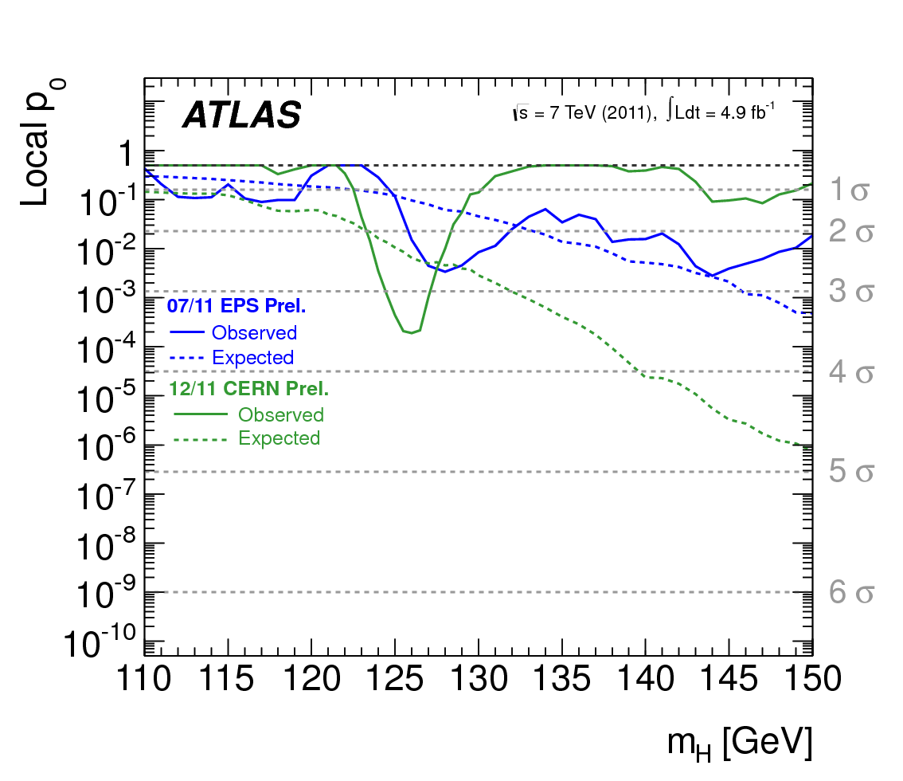
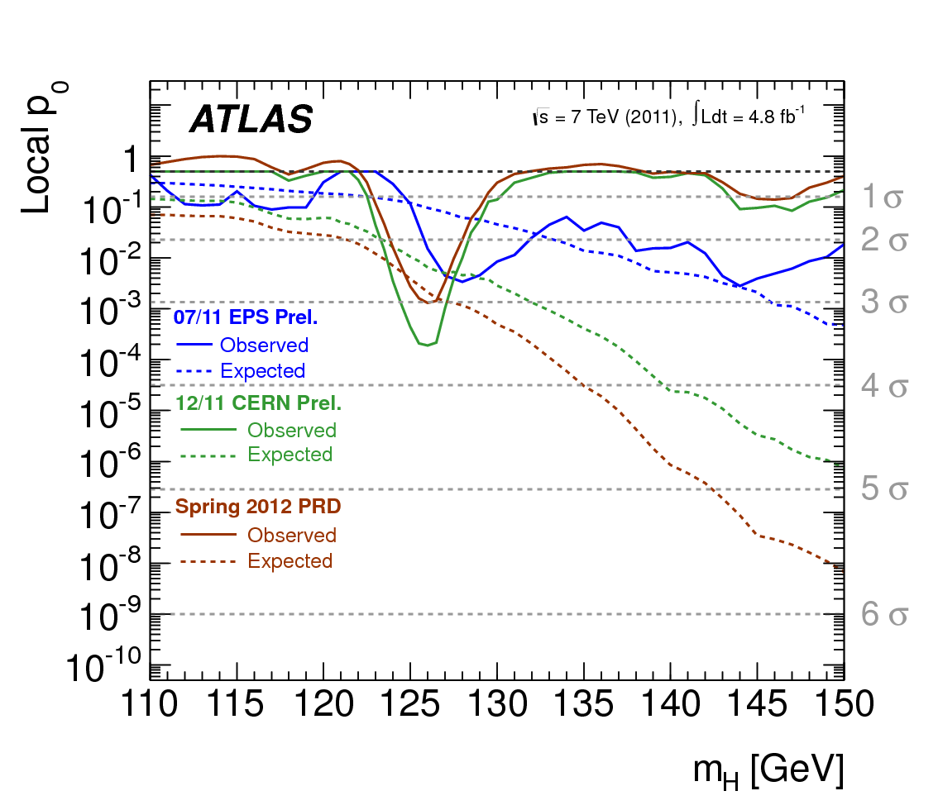
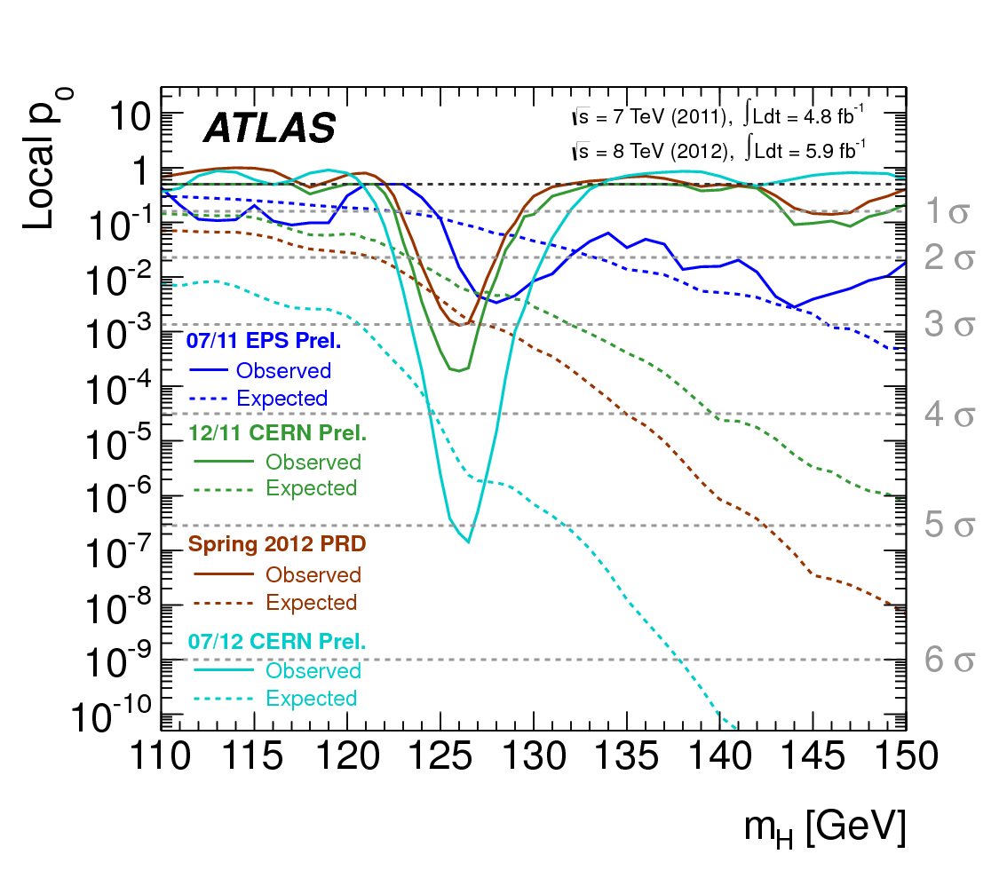
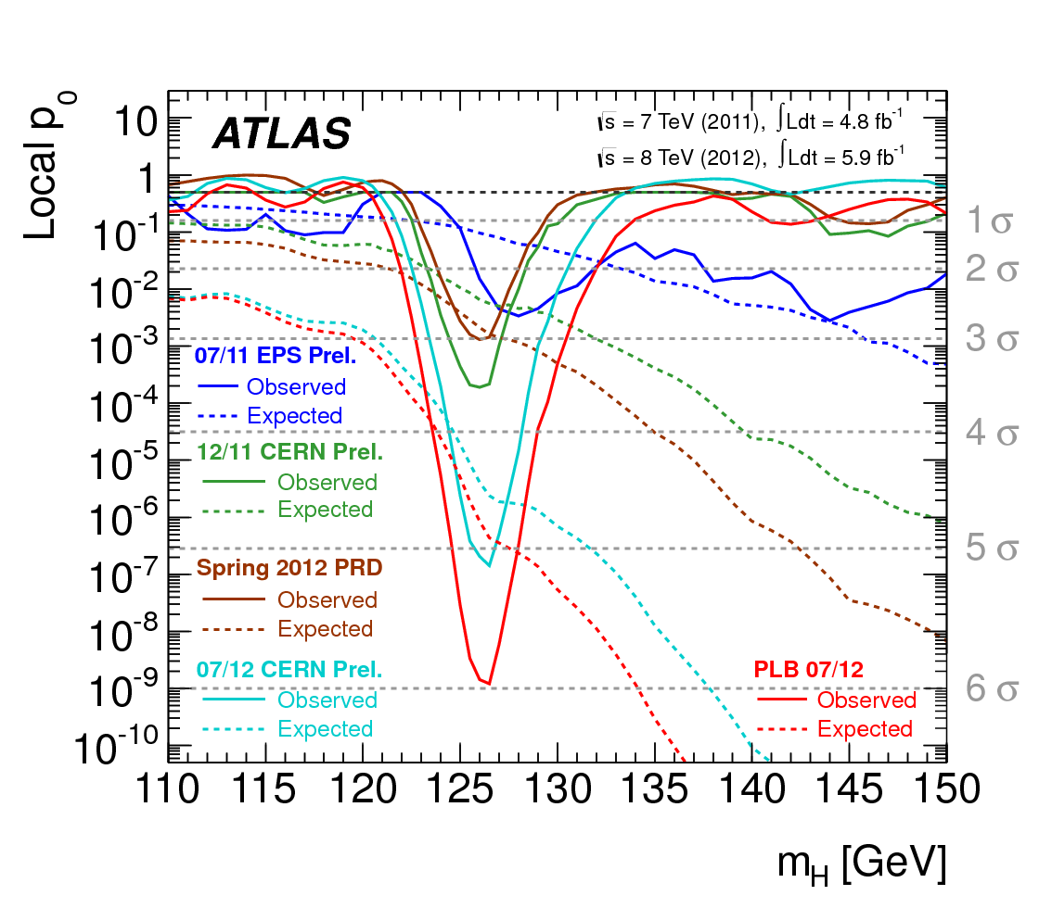
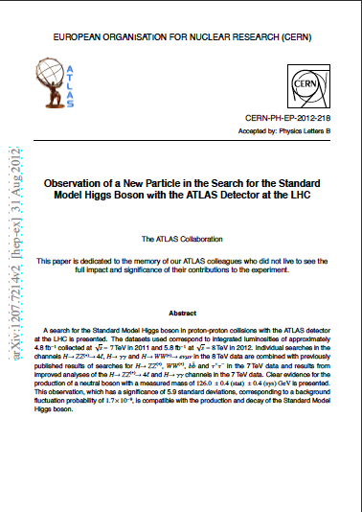



A textbook discovery in slow-motion
Local p-value versus mass
Jul/11
jul/11
jul/11
mar/12
jul/11
mar/12
mar/12
dec/11
dec/11
dec/11
dec/11
jul/12
jul/12
aug/12

Slide 22
A textbook discovery in slow-motion
Local p-value versus mass
aug/12

Slide 23

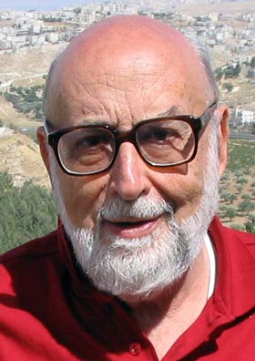
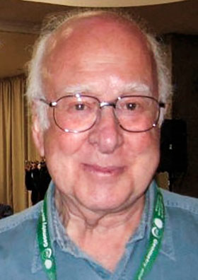
Nobelprize Physics 2013
“There is a Higgs field in the vacuum”
François Englert
Peter Higgs

Slide 24
couplings

Slide 25
Higgs production and decay
Test all combinations

Slide 26
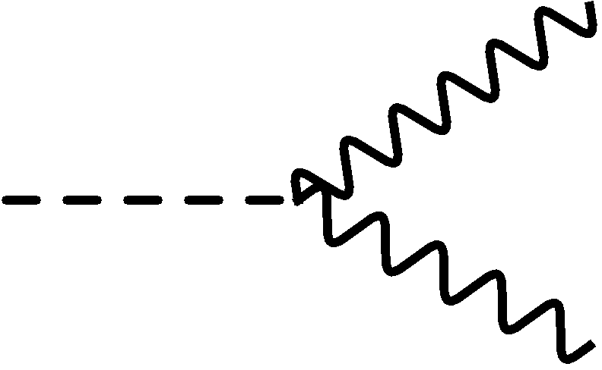
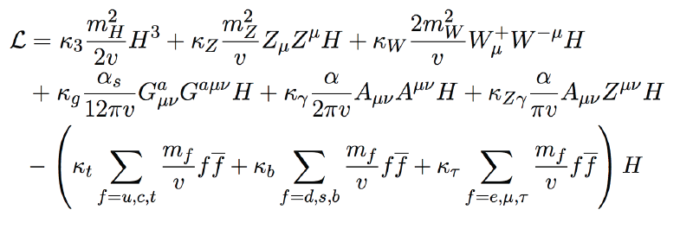
Effective Lagrangian
Z
W
h
h
κ_{Z}
Z
κ_{W}
W
Use scale factors κ to parametrise deviations from SM (κ=1):

Slide 27
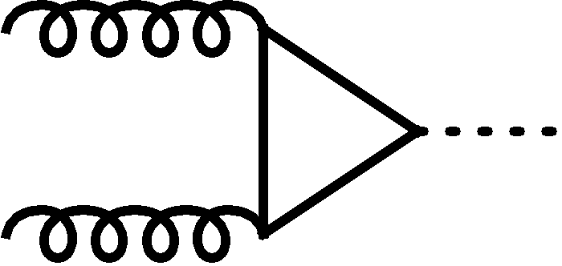
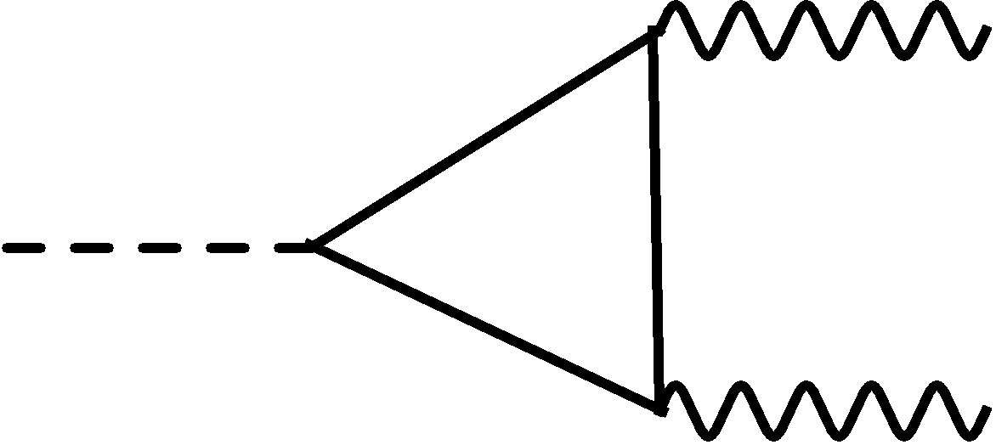
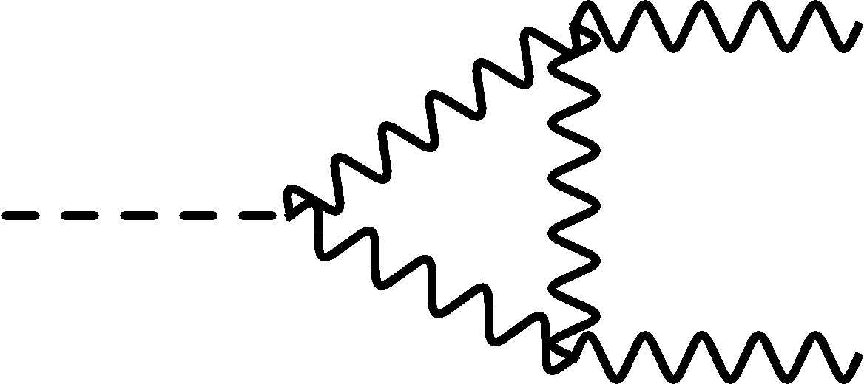
γ
γ
h
h
t,(b)
t
κ_{t}(κ_{b})
κ_{t}
γ
κ_{W}
γ
Rates and relations are modified if non-SM particles enter in the loops

Slide 28
Extending the Higgs sector
(1) compositeness
(2) extra EW singlet
SM-doublet &
V(ϕ) = μ²ϕ² + λϕ⁴
(3) Two Higgs doublet models
Standard Model:
1 doublet CP-even neutral scalar
h A H H⁺ H⁻
specific couplings h to fermions/bosons
(4) Dark Matter portal
Invisible Higgs decays

Slide 29
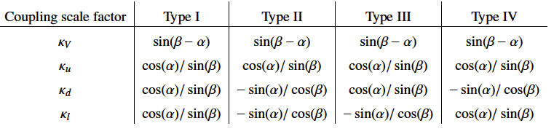
Two Higgs doublet models
5 Higgs bosons, lightest one looks very much like the SM one
Coupling lightest Higgs boson w.r.t Standard Model prediction:
vector bosons
up-type quarks
down-type quarks
leptons
TYPE I:
1 doublet for vector bosons
1 doublet for fermions
TYPE II: MSSM-like:
1 doublet for up-type
1 doublet for down-type

Slide 30
Why measure the mass to high precision ?
Branching ratio’s depend on the mass of the Higgs boson
Δm Δ Γ/Γ₁₂₅
m_{h} = 123.7 GeV Γ(h→ZZ) = 2.34% -1% -11%
m_{h} = 124.0 GeV Γ(h→ZZ) = 2.41%
m_{h} = 124.5 GeV Γ(h→ZZ) = 2.52% 0.4% -4.5%
m_{h} = 125.0 GeV Γ(h→ZZ) = 2.64% 0.0% 0.0%
m_{h} = 125.5 GeV Γ(h→ZZ) = 2.76% 0.4% +4.5%
m_{h} = 126.0 GeV Γ(h→ZZ) = 2.89%
m_{h} = 126.3 GeV Γ(h→ZZ) = 2.97% +1% +12%

Slide 31
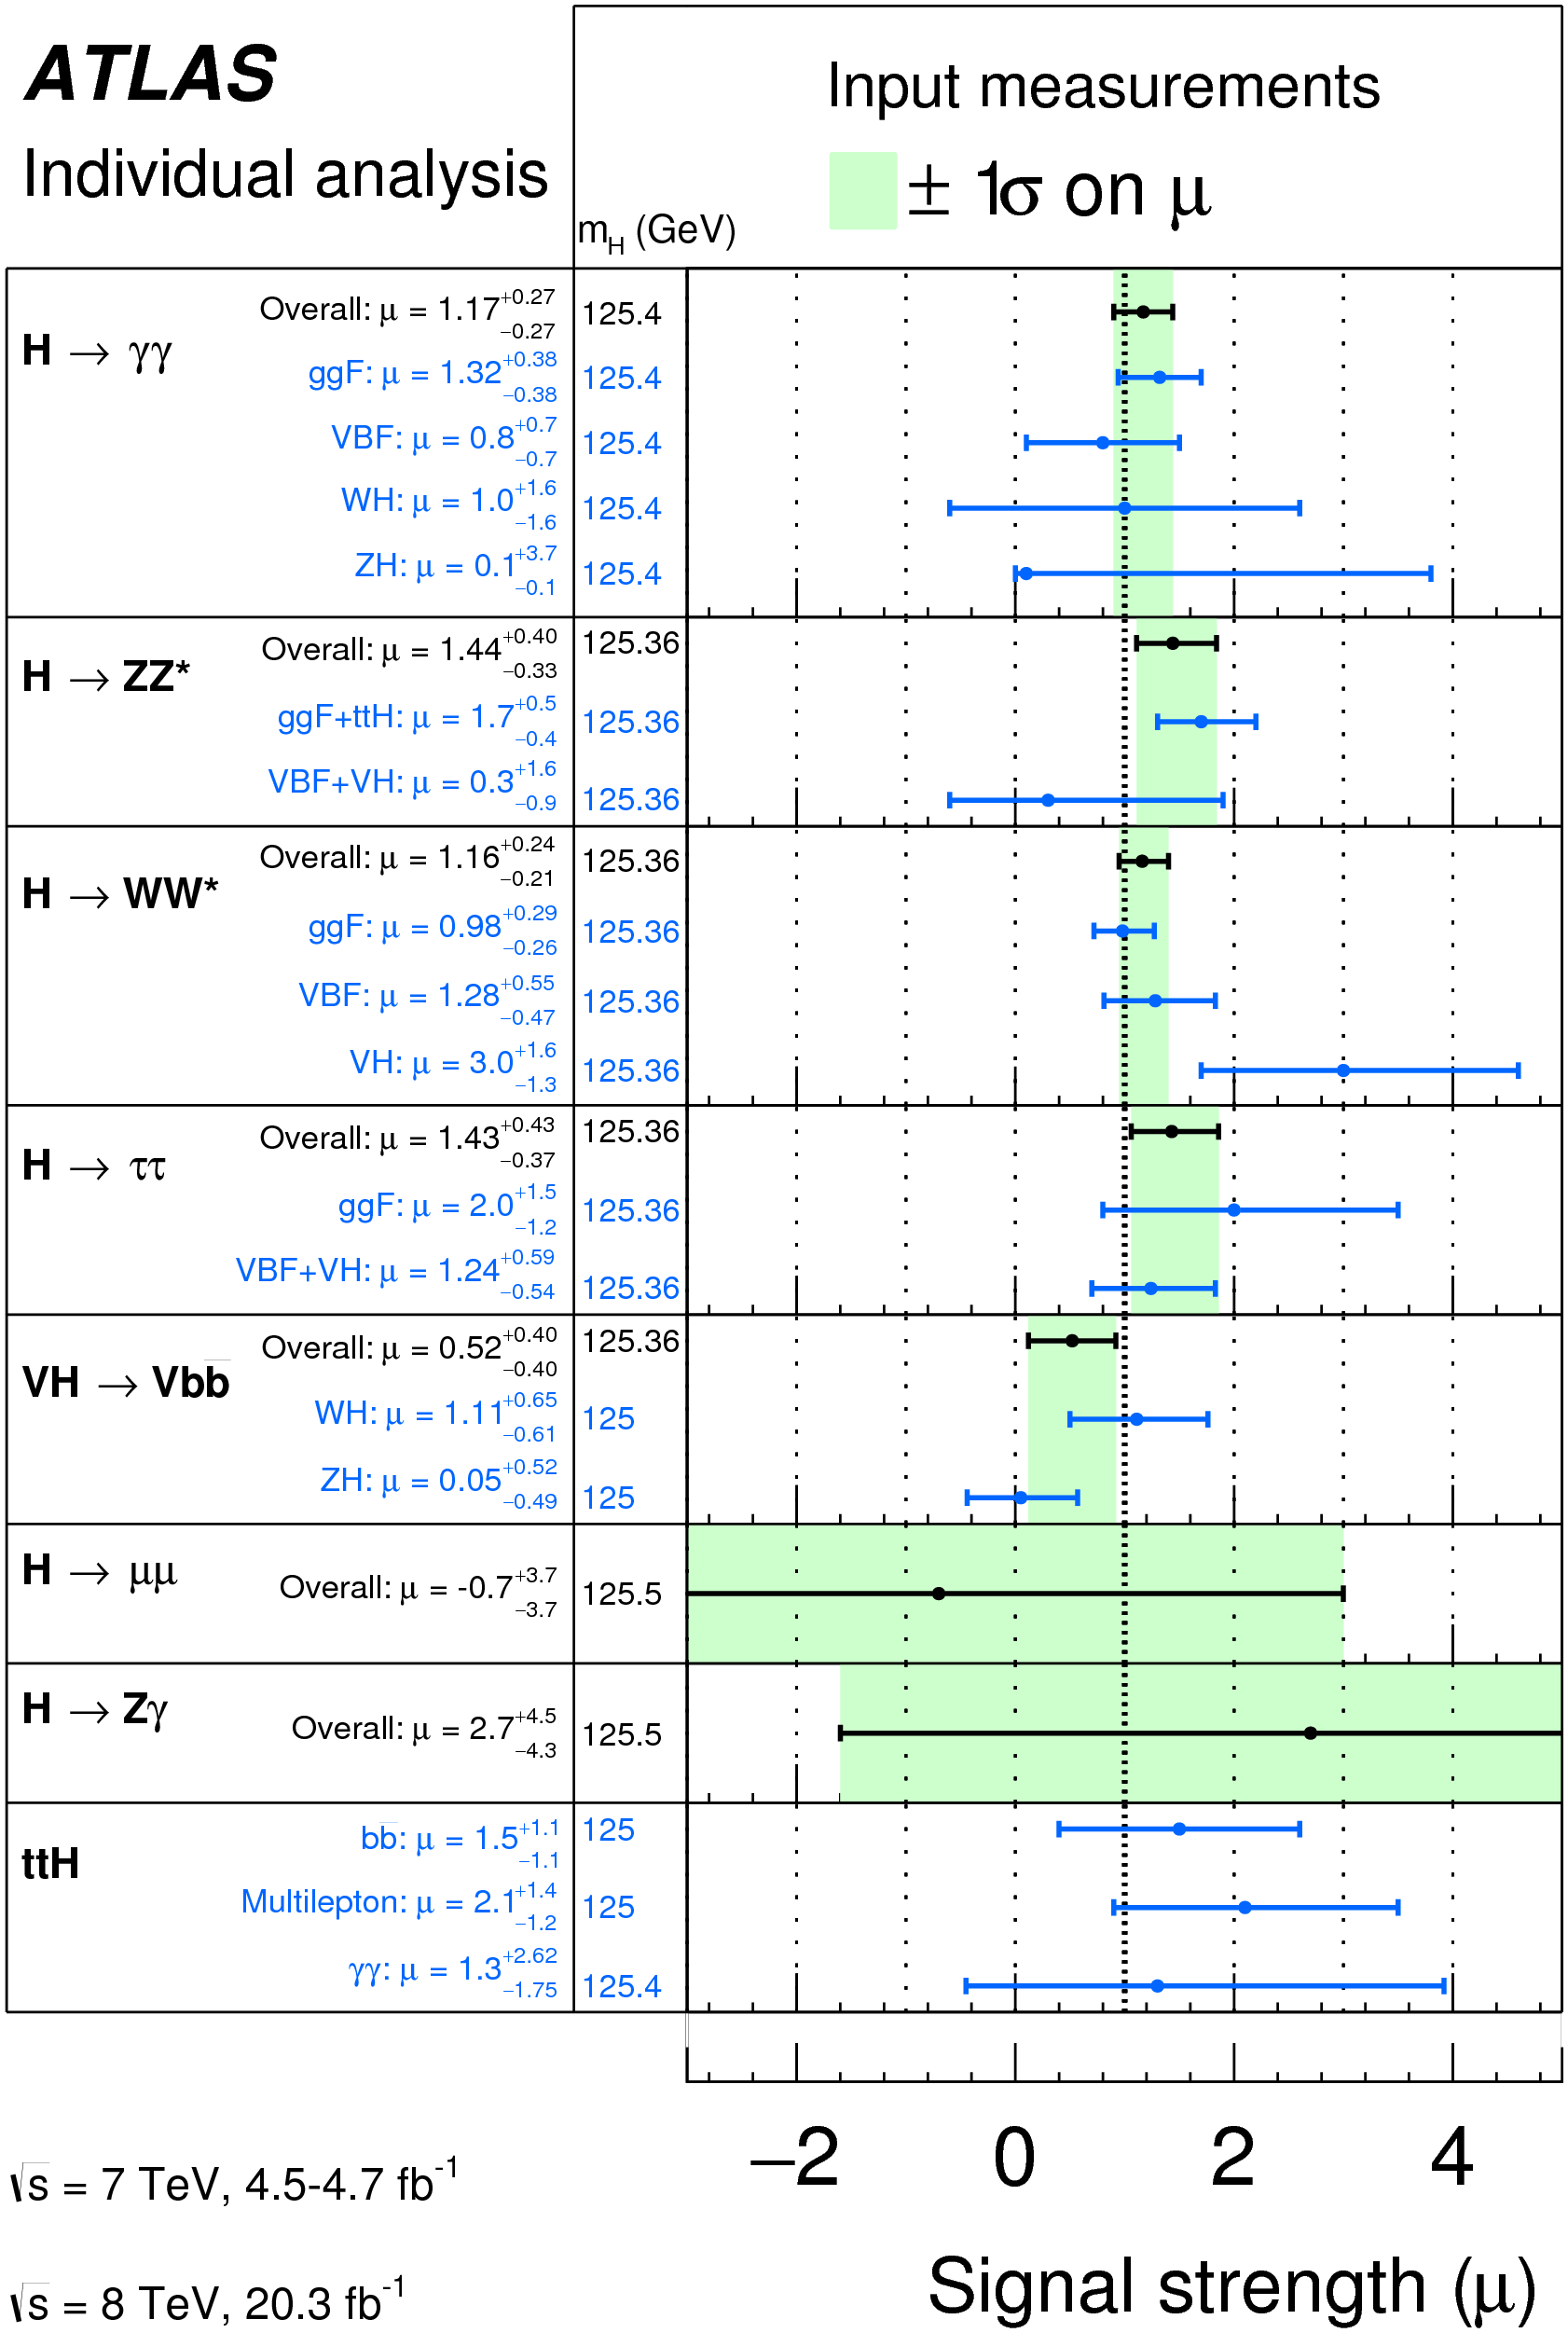
Higgs boson couplings
Theory
125 GeV
Experiment
SM
strength relative to SM
Change in m_{h} of 500 MeV (0.4%) changes Γ(h→ZZ) by ± 4.5%

Slide 32


Observed particle looks very much like SM Higgs boson
Higgs boson

Slide 33
Higgs potential

Slide 34
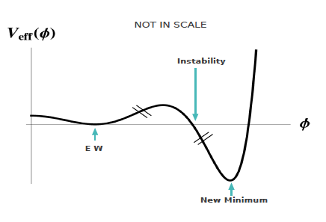
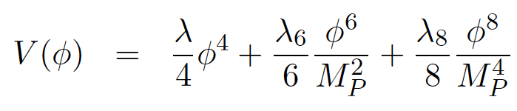

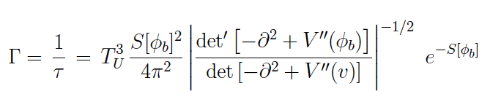
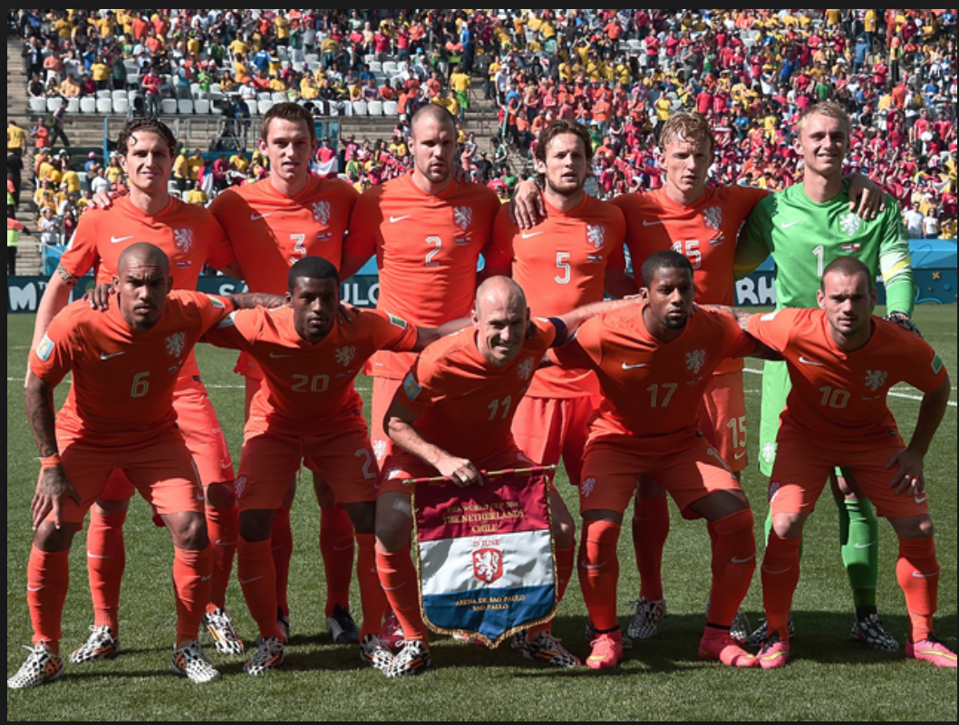
Stability of the vacuum: meta-stability
New physics at the Planck scale: 2 higher dimensional operators
Tunneling time to true vacuum
Meta-stable
EW vacuum
True vacuum
Not before these guys become World Champion

Slide 35
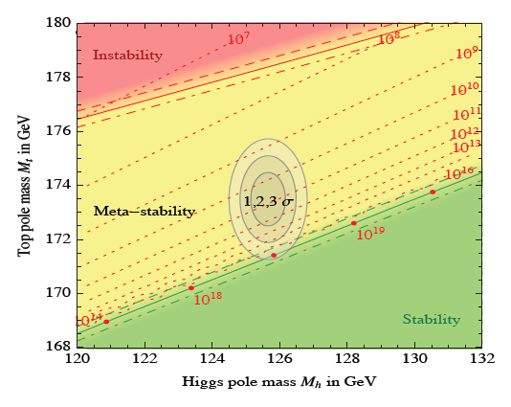

Stability of the vacuum: Higgs potential at high energy
Unstable (λ<0)
SM-doublet &
V(ϕ) = μ²ϕ² + λϕ⁴
Top quark mass (GeV)
Meta-stable
stable
Higgs boson mass (GeV)
Branchia ICHEP

Slide 36
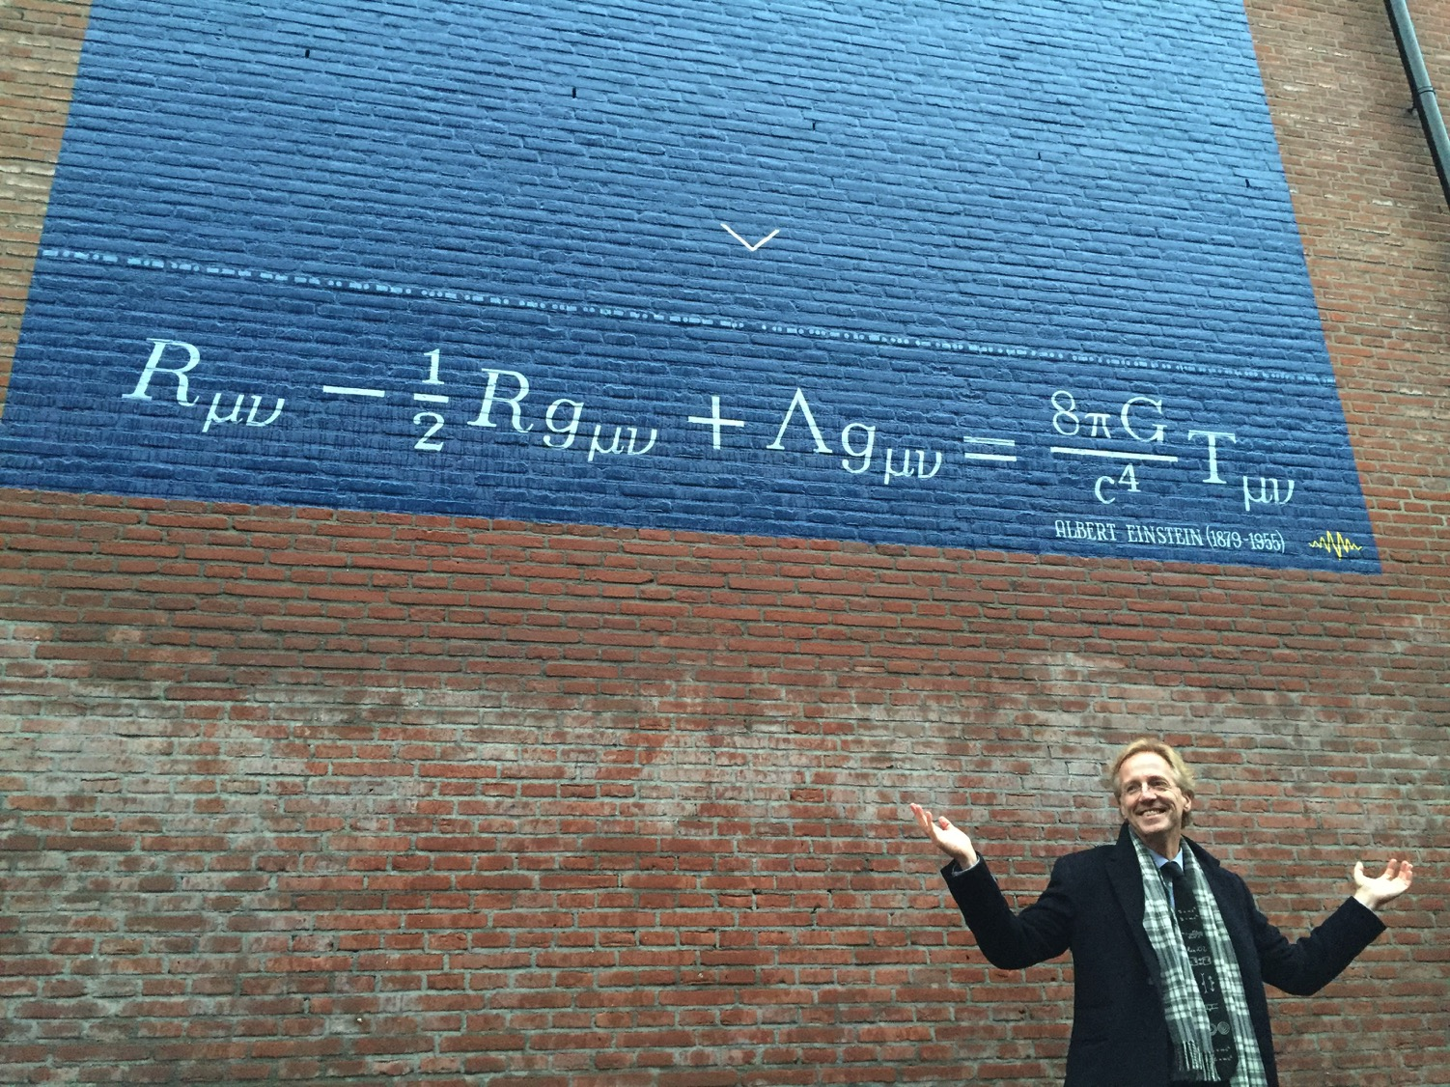
1) Vacuum energy:
Higgs field
Higgs field prediction: 1.00
data (CMB): 0.0000000000000000000000000000000000000000000000000000001
2) Range and pattern in fermion masses
3) Higgs quantum corrections
h
top
10¹⁵ %

Slide 37
spin

Slide 38
Higgs quantum numbers: spin and parity
Parity = +
Charge conjugation = +
J^{PC}
Scalar spin=0
Differences in each of these parameters lead to different event topologies
Production angle for different production mechanisms
Decay angles and event topologies for decay channels

Slide 39
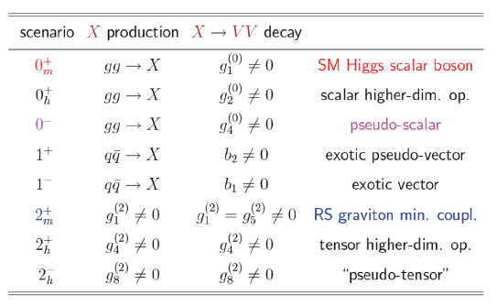
Different scenario’s for new particle X
scenario production parameters Model

Slide 40
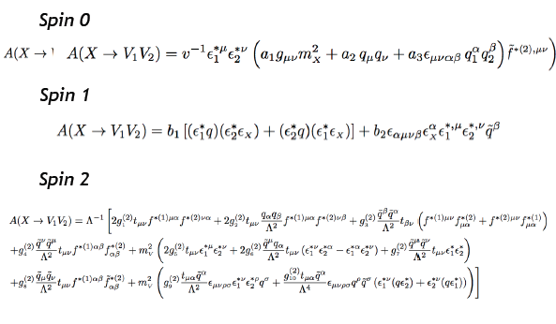
Structure of the matrix element
Spin 0 (qq production)
Spin 1 (qq production)
Spin 2 (gg and qq production)

Slide 41

Conclusions:
Vacuum is indeed filled with the Higgs field
Feels, smells, tastes like SM Higgs
Big questions still open
LHC run 2 already started

Slide 42

bigger problems

Slide 43
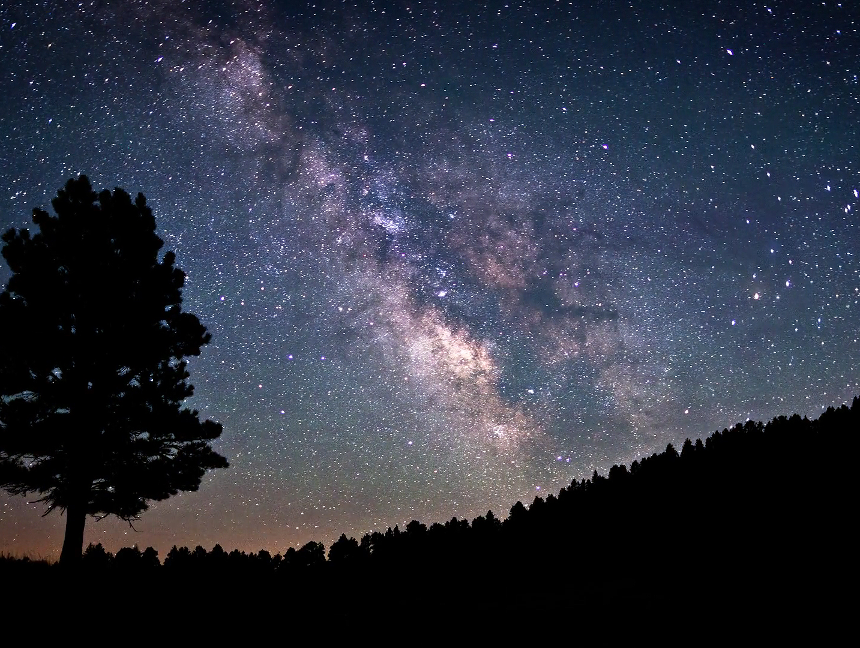
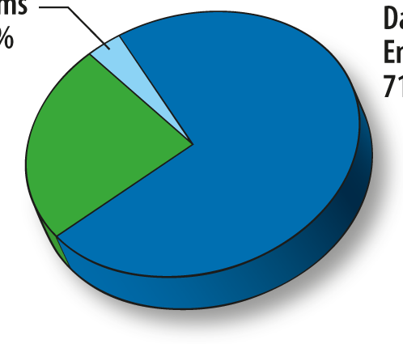
Standard Model is not the final theory:
Higgs boson - contribution to vacuum energy 10⁵⁰ wrong
Higgs boson - quantum corrections diverge
Fermions: range of fermion masses (10¹²)
Fermions: neutrino mass & fermion/majorana
Structure: why 3 particle families, why 3 forces
Structure: why is gravity not included
Universe: where is the anti-matter
Universe: what composes dark matter
…
SM particles
dark energy
dark matter
Solutions predict deviations from SM & new phenomena
… at 10⁻²⁰ m (10 TeV)

Slide 44

Dreams at the Large Hadron Collider
supersymmetry
extra Higgs bosons
extra gauge groups
extra dimensions

Slide 45
anti-matter (0%)
matter (4%)
dark matter
(no idea)
dark energy
(no idea)

Slide 46
Hypothesis from physicists
dark
energy
dark
matter
Particle from a mirror world ?

Slide 47
particles
anti-particles
stable matter
dark matter
supersymmetric particles

Slide 48



particles
anti-particles
particles
anti-particles
Lightest particle is stable
→ dark matter ?
supersymmetric particles
supersymmetric
particles

Slide 49
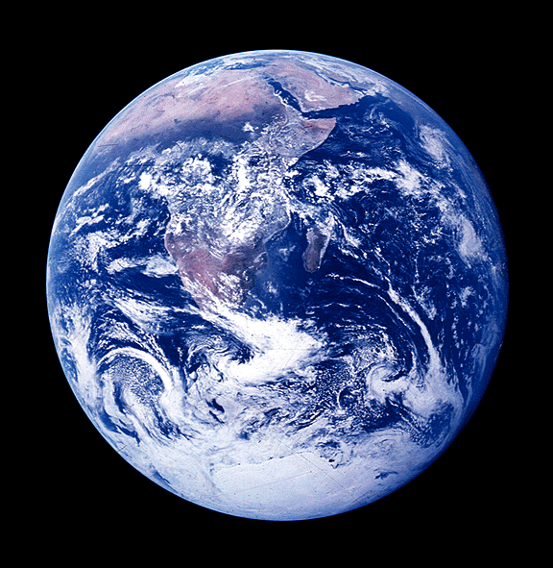





Top quark
Stop squark
FERMIONS
quarks
Squarks
leptons
Sleptons
Z⁰
BOSONS
Lightest neutral stable (dark matter candidate)

Slide 50



the super in supersymmetry
1) Higgs propagator
stop
h
top
h
-Cm²_{top}Λ²
+Cm²_{stop}Λ²
2) Unification forces
Supersymmetry
Standard Model
3) Dark Matter
Lightest supersymmetric particle is stable

Slide 51
Resonances
Extra gauge bosons and Kaluza-Klein graviton towers (extra dimensions)

Slide 52
New gauge bosons:
Elementary particles
Interactions
up-quark
down-quark
elektron
neutrino
U(1)_{B} x
U(1)_{Y} x SU(2)_{L} x SU(3)_{C}
β
g’, g, α_{s}
Z’
γ, W⁺, W⁻, Z, 8 gluons
single spinor (1 big family)
gauge unification: SO(10)

Slide 53


Looking for di-lepton Z’-resonances
old resonance Z-boson (91 GeV)
μ⁺μ⁻ invariant mass
new resonances (simulation)
Constraints on Z’ masses [TeV]
Models with extra (space) also predict di-lepton resonances (Kaluza-Klein)
backup

Slide 54

ATLAS
control room

Slide 55


Looking for breakdown of the Standard Model
All results are public:
https://twiki.cern.ch/twiki/bin/view/AtlasPublic

Slide 56



problems
dreams
Much more data coming up …

Slide 57
The Standard Model
Works well
Help us !
Big problems

