Slide 1
Setting up qtcreator for use with the top level
FELIX CMakeLists.txt file as project file
Jos Vermeulen, 28-Feb-2023

Slide 2
setupcreator
Setup shown in the next slides only has to be done once. Information entered is stored in the CMakeLists.txt.user file in the software directory and in the $HOME/.config directory. Deleting the CMakeLists.txt.user file and deleting the build directory may help if qtcreator does not behave correctly. If this does not solve the issue try to delete QtProject.conf and the directory QtProject in $HOME/.config
# Versions
export GDB_VERSION=11.2
export GIT_VERSION=2.28.0
export GCC_VERSION=11.3.0
export OS_VERSION=x86_64-centos7
# —> Set here the path to gdb and git
export LCG_CVMFS_BASE=/cvmfs/sft.cern.ch/lcg
export LCG_CVMFS_VERSION=$LCG_FULL_VERSION
export LCG_CVMFS_BINARYTAG=$BINARY_TAG
export LCG_CVMFS_GDB=$LCG_CVMFS_BASE/releases/LCG_$LCG_CVMFS_VERSION/gdb/$GDB_VERSION/$LCG_CVMFS_BINARYTAG
export LCG_CVMFS_GIT=$LCG_CVMFS_BASE/contrib/git/$GIT_VERSION/$OS_VERSION
# —> Next three environment variables need to be picked up by qtcreator (with %(Env:NAME}
# —> These are used for running cmake by cmake_config, only the first is essential for qtcreator
export CMAKE_MODULE_PATH=$PWD/cmake_tdaq/cmake/modulesexport BUILDNAME=$BINARY_TAG
export CMAKE_BUILD_TYPE=Release
# —> for python
export PYTHON_BASE=$LCG_BASE/releases/LCG_$LCG_FULL_VERSION/Python/$PYTHON_VERSION/$BINARY_TAG
# -> qtcreator gets confused by the LD_LIBRARY_PATH that also points to a directory with LCG qt5 libraries
# -> remove pointer to LCG qt5 libraries from LD_LIBRARY_PATH
export LD_LIBRARY_PATH=$(printenv LD_LIBRARY_PATH | sed s%:%:'\\\n'%g | sed '/qt5/d' | tr -d '\\\n')
# —> debugger (gdb)
export PATH=$LCG_CVMFS_GDB/bin:$PATH
export LD_LIBRARY_PATH=$LCG_CVMFS_GDB/lib:$LD_LIBRARY_PATH
export MANPATH=$LCG_CVMFS_GDB/share/man:$MANPATH
# —> git (git)
export PATH=$LCG_CVMFS_GIT/bin:$PATH
export MANPATH=$LCG_CVMFS_GIT/share/man:$MANPATH
# —> python (needed when using gdb in qtcreator):
# export PATH=$PYTHON_BASE/bin:$PATH
export LD_LIBRARY_PATH=$PYTHON_BASE/lib:$LD_LIBRARY_PATH
export MANPATH=$PYTHON_BASE/share/man:$MANPATH
export PYTHONHOME=$PYTHON_BASE
# —> sets maximum number of parallel bulding processes, typically equal to the maximum number of hyperthreads
export MAKEFLAGS="-j16 QUICK=1
The script (with name setupcreator)
has to be run after cd-ing to the
software directory and after running
setup.sh and starting qtcreator the CMakeLists.txt file from the same software directory has to be loaded
For starting qtcreator the correct path has to be specified, e.g. at Nikhef:
/project/atlas/tdaq/qt5121/Tools/QtCreator/bin/qtcreator &

Slide 3
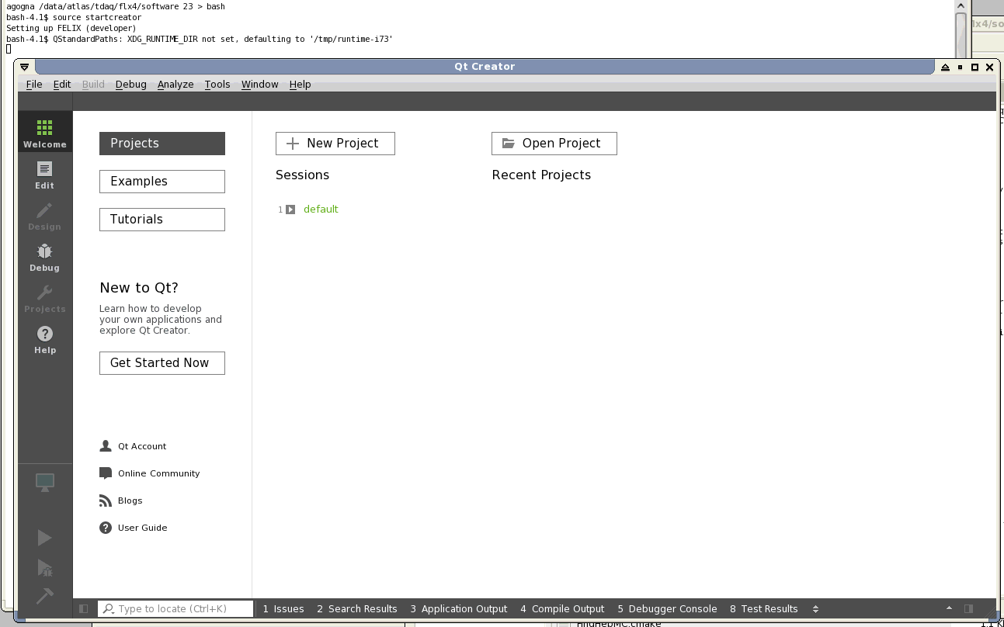
Screen after starting qtcreator

Slide 4
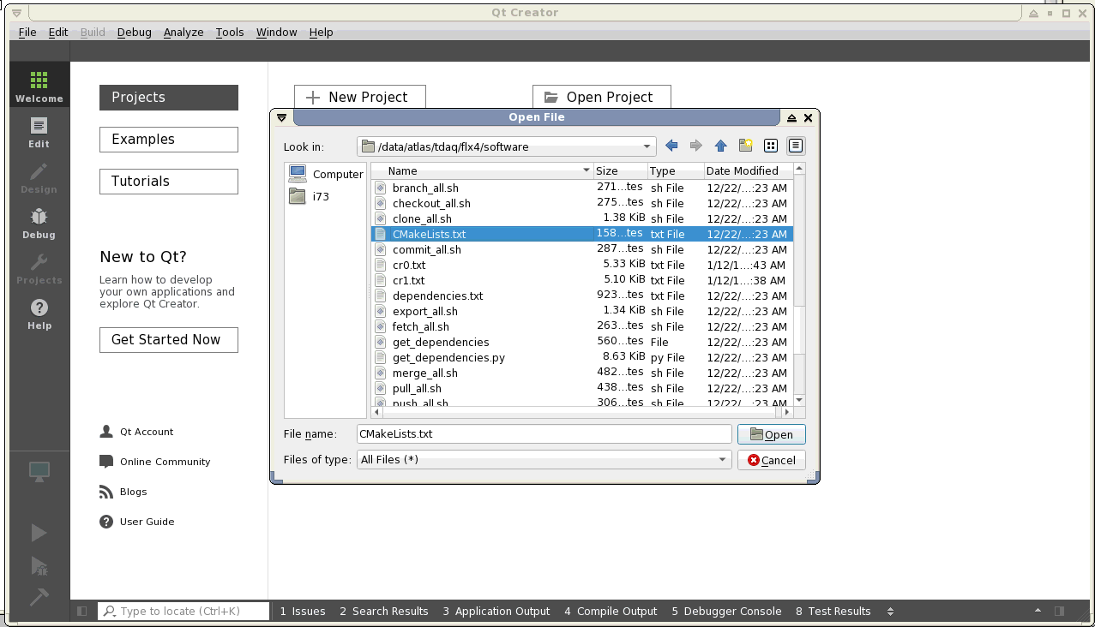
Select “Open File or Project...”
from File Menu

Slide 5
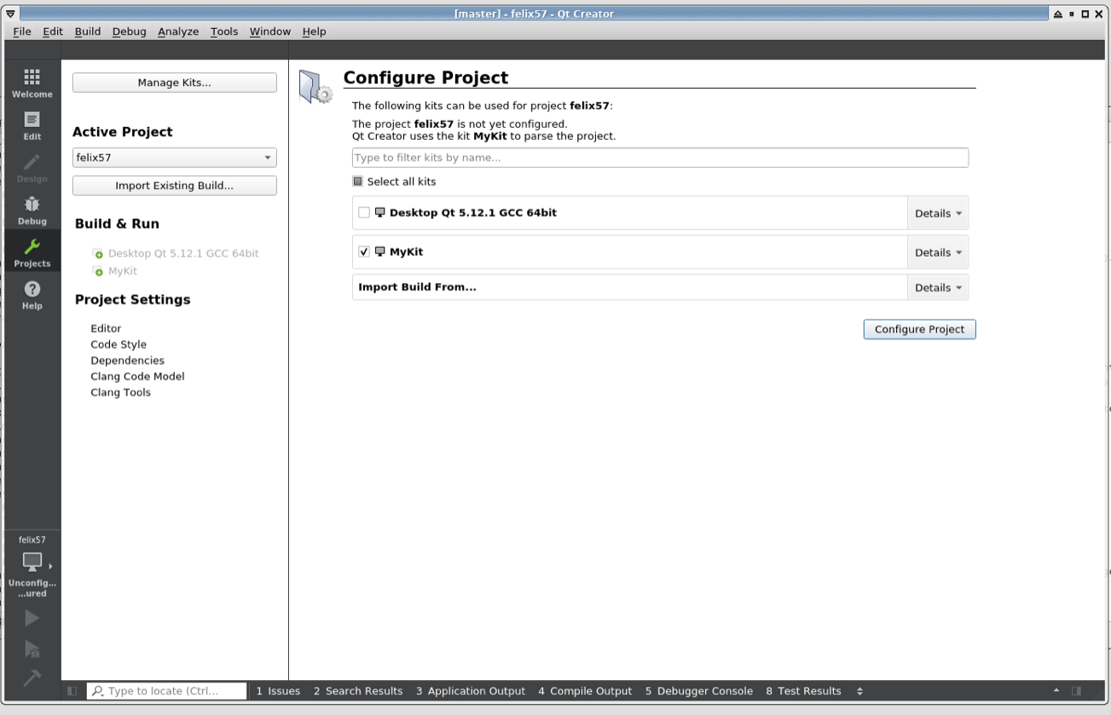
“Manage...” appears here if
mouse hovers over it, click it

Slide 6
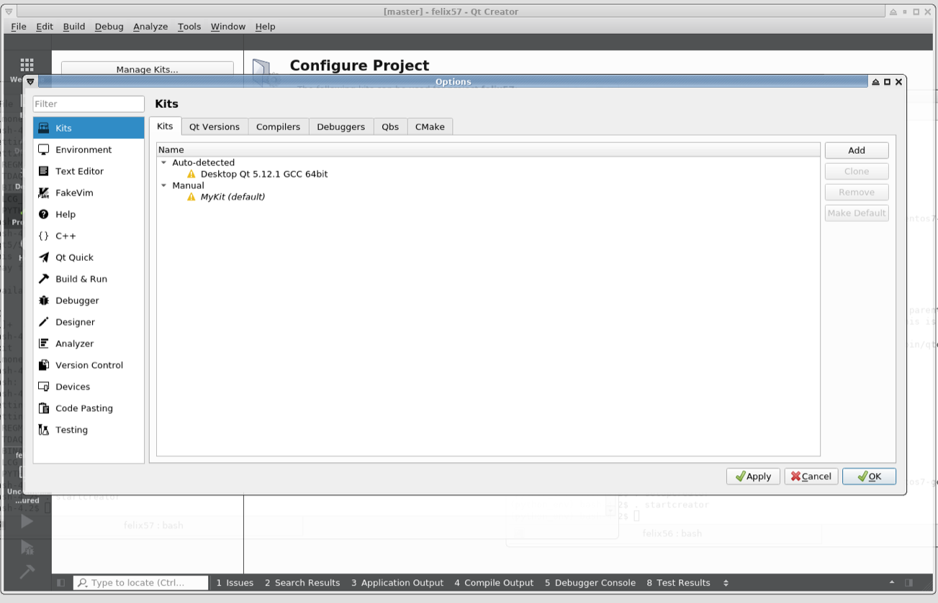
Click and remove if desired
(scroll right if buttons
no longer visible)

Slide 7
If this is not visible, click this
Select correct
versions from
cvmfs
Qt not correct,
but elinkconfig is
correctly built,
optionally manage with this button

Slide 8
Optional
Click kits when done
This one could be selected, it is found in the local LCG copy. If it is not specified, click Add.. and browse for the
correct version, the qmake file has to be found

Slide 9
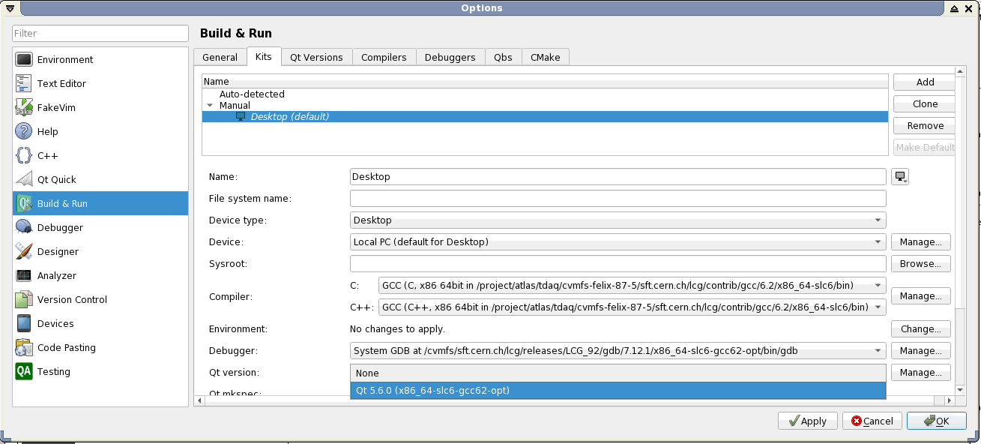
Optional
With this pull-down menu a Qt version can be selected, “None” is also OK

Slide 10
Scroll down and check for correct CMake version.
If not correct, pull down menu and select correct
version, if not available: ”Manage..”
Hit this button

Slide 11
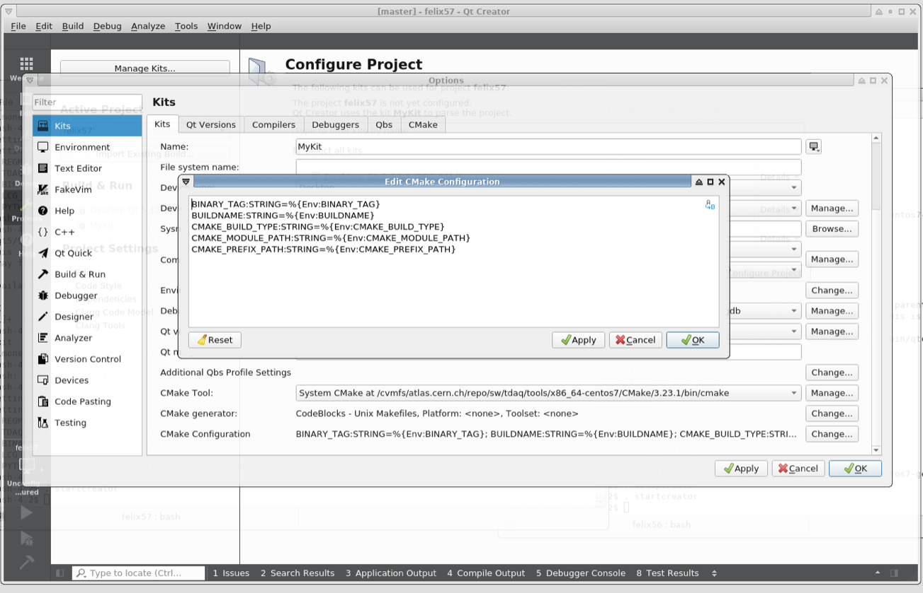
Delete the original information, insert this text (can be pasted with ctrl-V), and hit OK for this and the “Build&Run” window
click this for modifying the CMake configuration

Slide 12
With this button
compiler selection
etc. can be changed
And hit this box
The yellow pop-up box appears
when hovering over the region of the kit. Check that the correct
compilers etc. are specified. Hit the check box of the kit with the correct compilers etc.
NB: The result of the procedure outlined in slides 7 – 11 (5 previous slides) is stored in the $HOME/.config directory and therefore does not need to be repeated if qtcreator is used with another software directory.

Slide 13
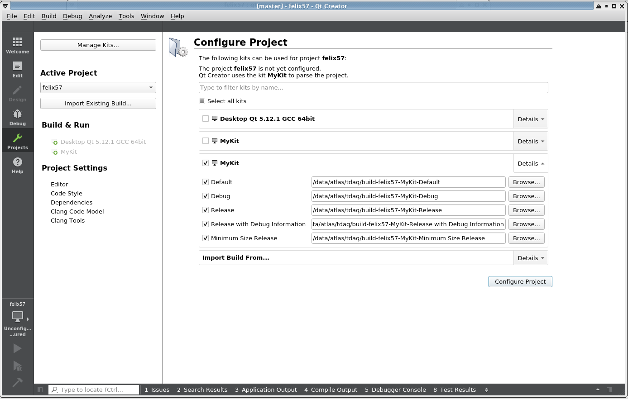
And browse for a build
directory
Select only one of the options. How the software is built
is determined by CMAKE_CXX_FLAGS set in cmake_tdaq/cmake/modules/FELIX.cmake
(Currently –O3 –g, i.e. optimized but with debugging info added)
The standard build directory is x86_64-centos7-gcc11-opt. This has to available (cmake_config produces it,
but as this script is not used together with qtcreator the directory has to be made with a mkdir statement).
U using the standard build directory name as the path for the excutables is set to point to this directory

Slide 14
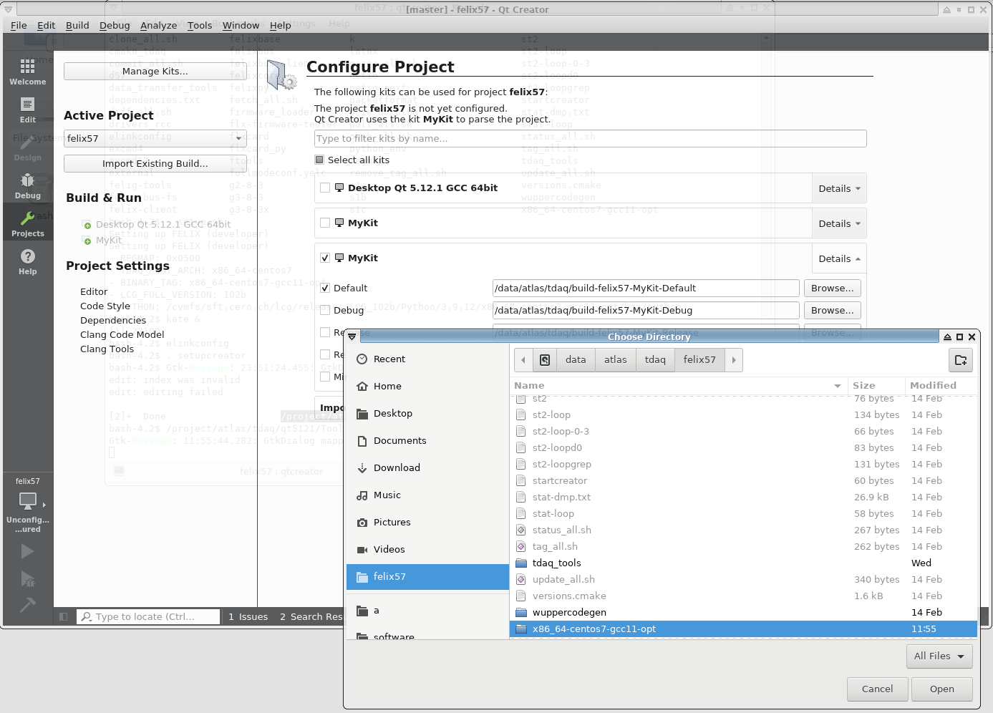
Choose

Slide 15

Click this first and wait until
processing is finished

Slide 16
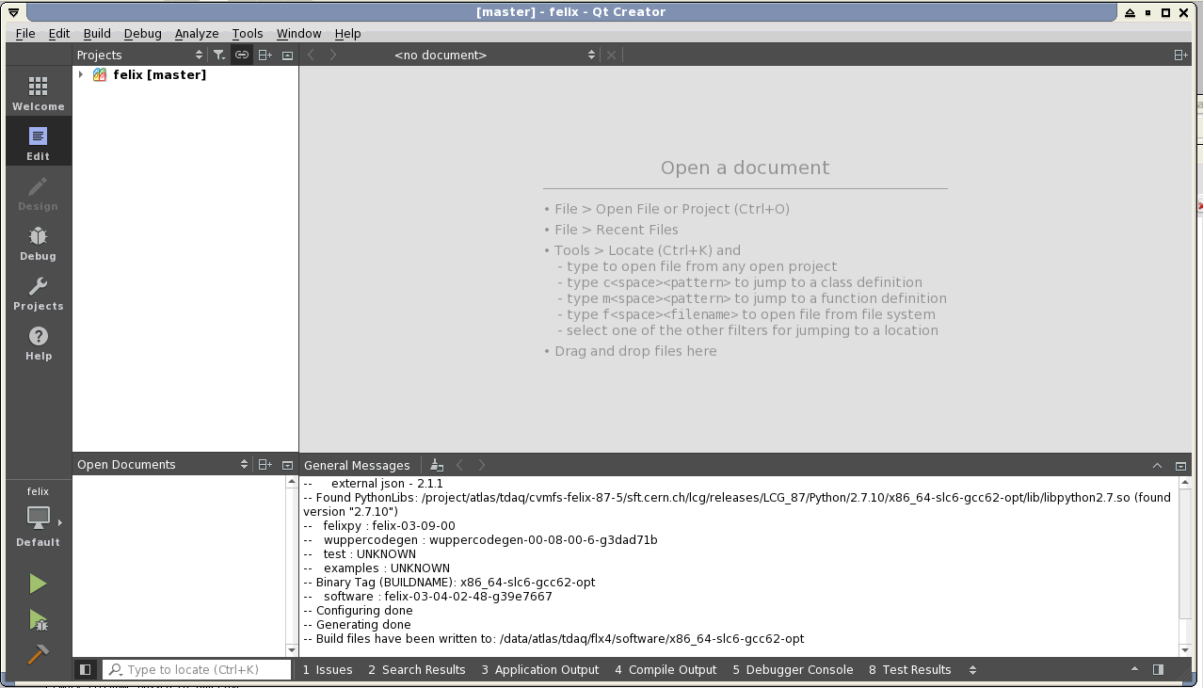
This appears only after
running cmake has finished
Hit “Projects”

Slide 17
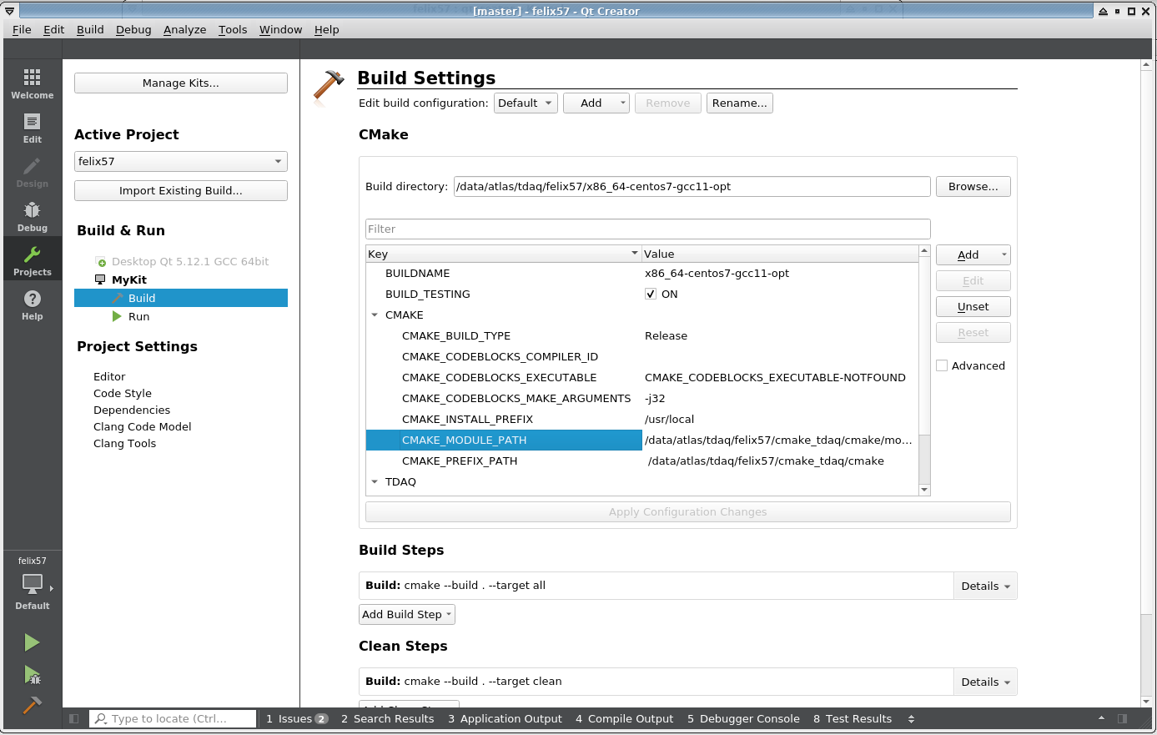
Hit “Edit” after processing finished
Without this step the debugger cannot find the executable selected (it is not understood why), needs to be redone if a CMakeLists.txt file is loaded for the first time
Scroll down to CMAKE-PREFIX_PATH
and click item, and then click “Unset”,
then click “Apply Configuration Changes”
17

Slide 18
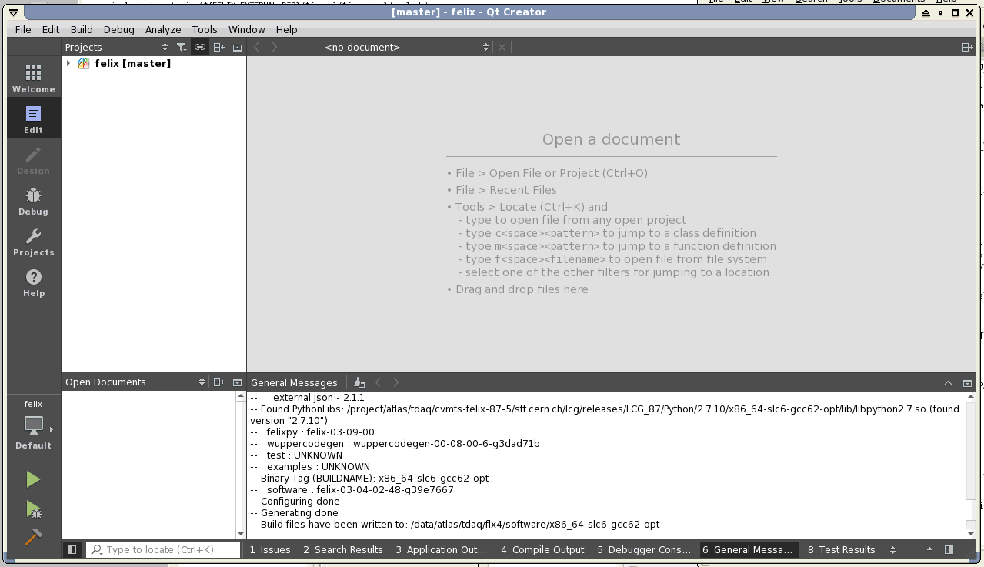
Expand to see all
directories and
files included
in project.
Double click any file
to edit
For deleting contents of list
Collapse list
Expand list to full window
After scrolling up somewhat

Slide 19
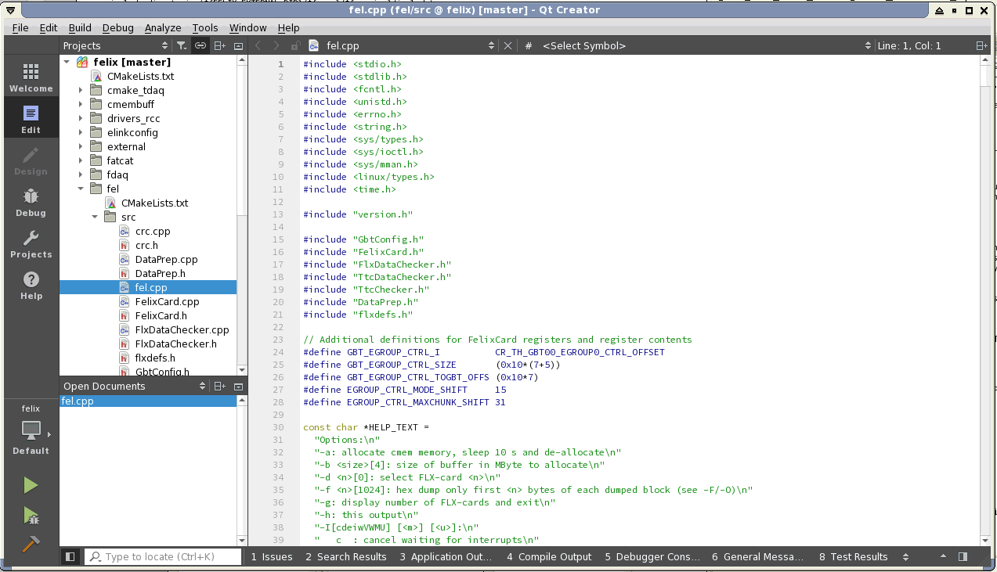
Click here for pop-up menu with list of functions etc. and for selecting item to jump to
Click here to compile
everything that needs
to be compiled
Click here to see side bar with list of functions etc.
Click here to see output of compilation

Slide 20
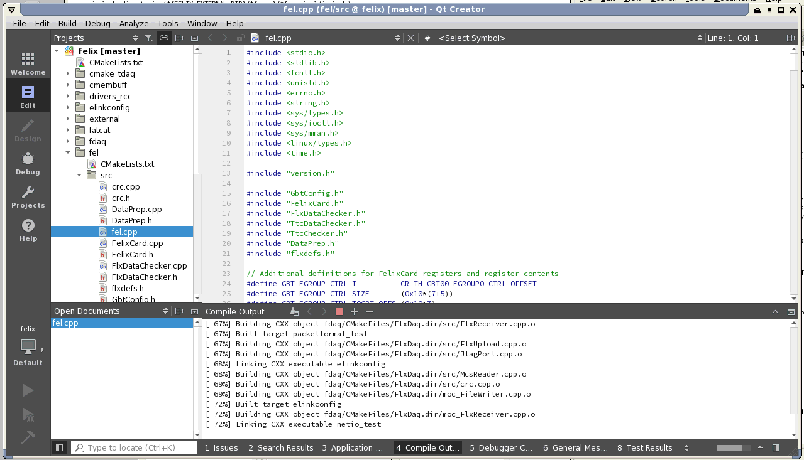
Click here for selecting an executable
If there are any issues click here for information and double click to jump to source of problem

Slide 21
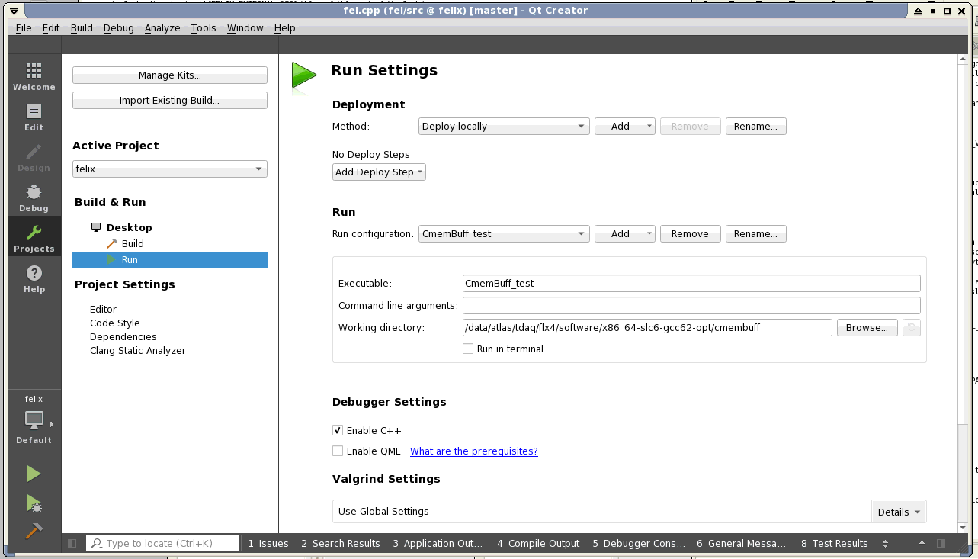
Click here for
selecting an
executable
Command line arguments can be specified here
Click here
The working directory
can be set here

Slide 22
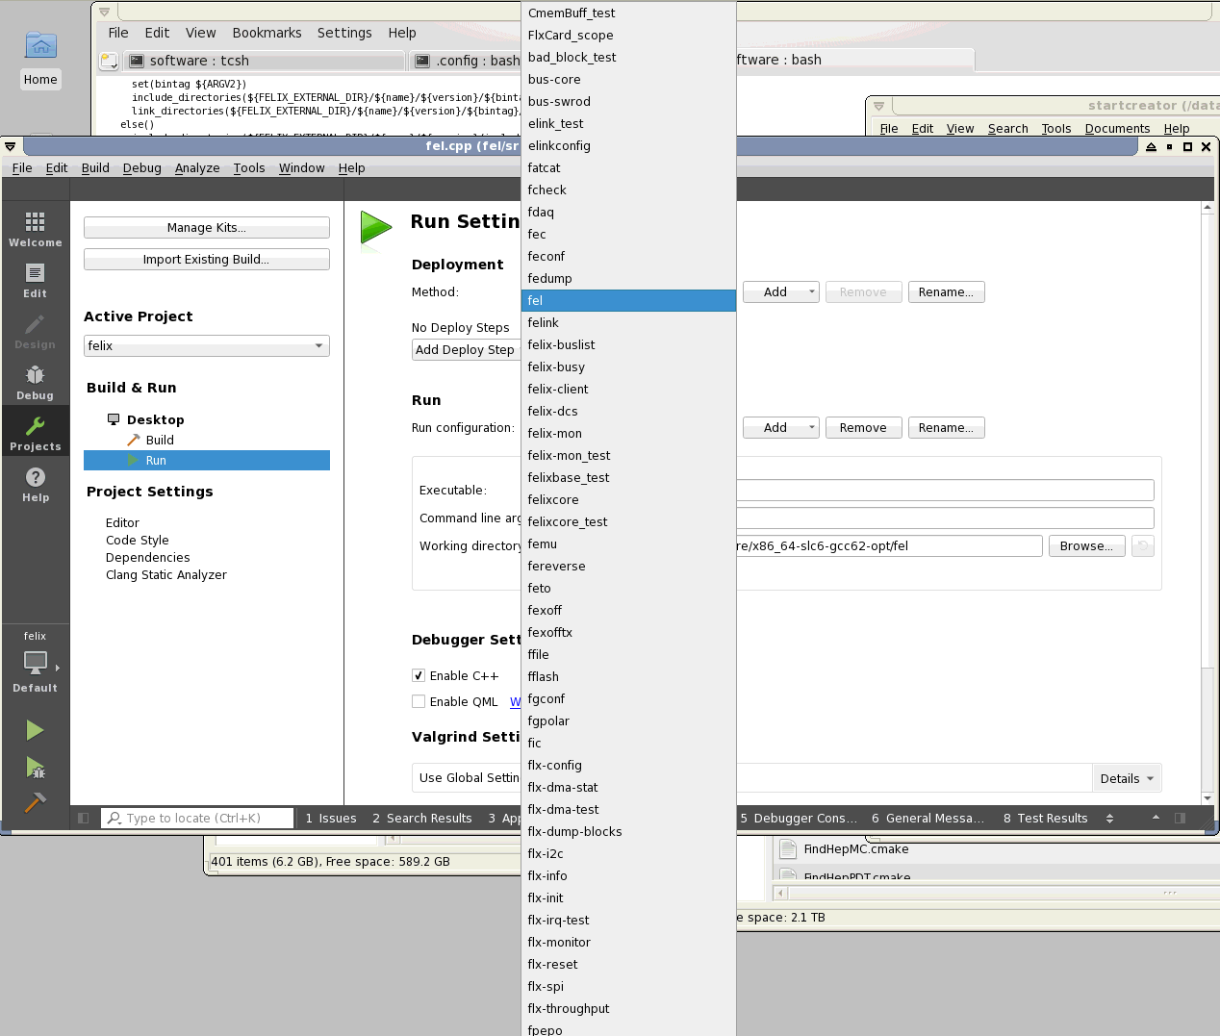
Selection of fel as executable
Click here
for browsing / editing

Slide 23
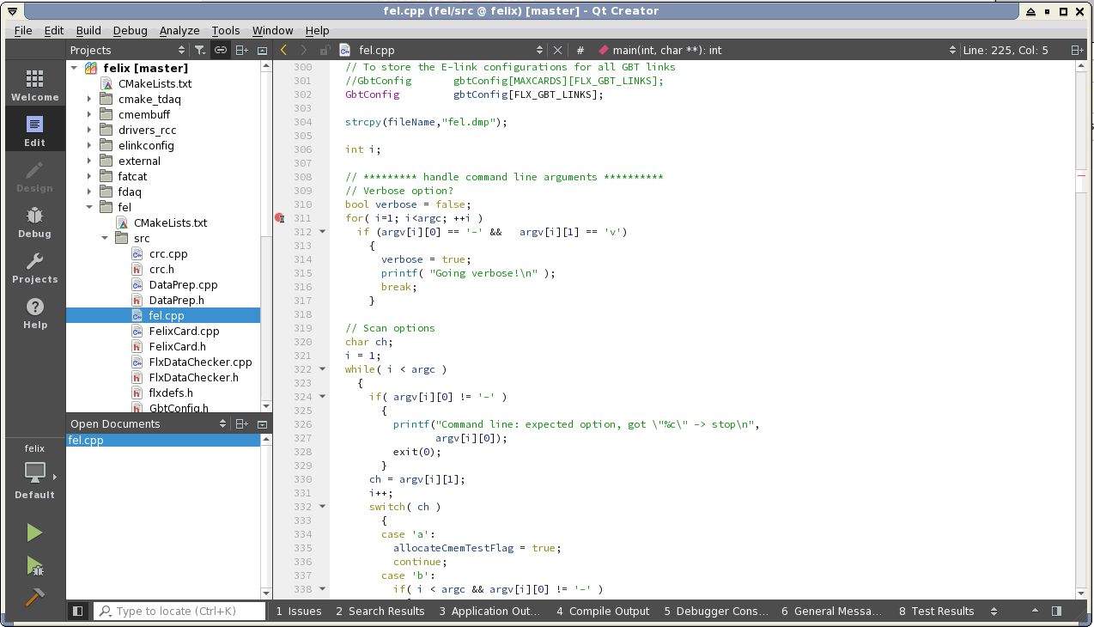
Click a line for setting a breakpoint
Click here
for running the executable
selected
Click here for the output produced by running the executable selected
Click here for
interactive debugging

Slide 24
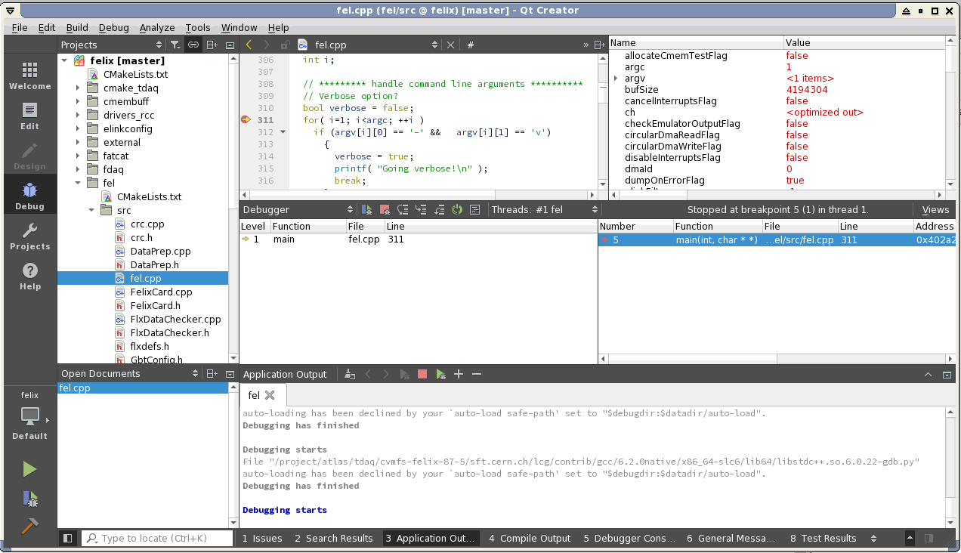
point to variable
to see its value
call stack
thread selection
Continue, Stop, Step over, Step into, Step out
Debugging
put “set auto-load safe-path /” in $HOME/.gdbinit to get rid of this.

Slide 25
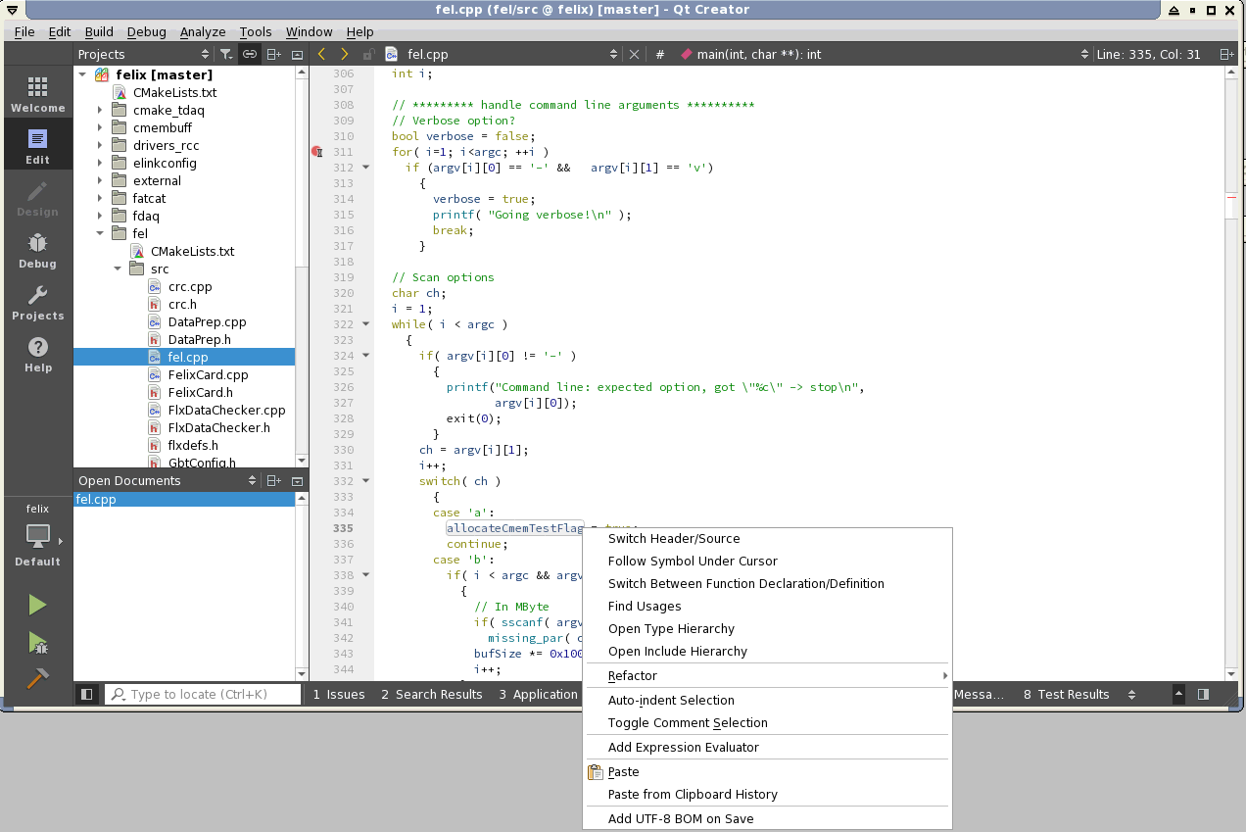
Code browsing
right click on
variable for
menu

