Slide 1
Symposium in honour of prof. Brian Foster
Oxford, September 11, 2024
Jos Engelen,
Professor emeritus University of Amsterdam / Nikhef

Slide 2
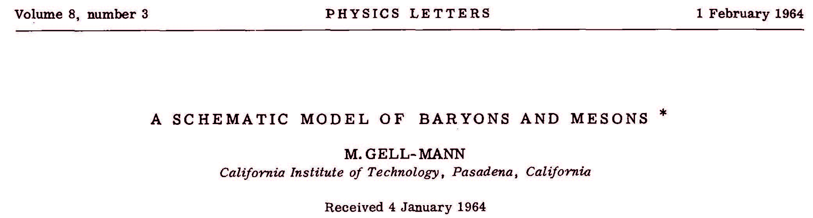
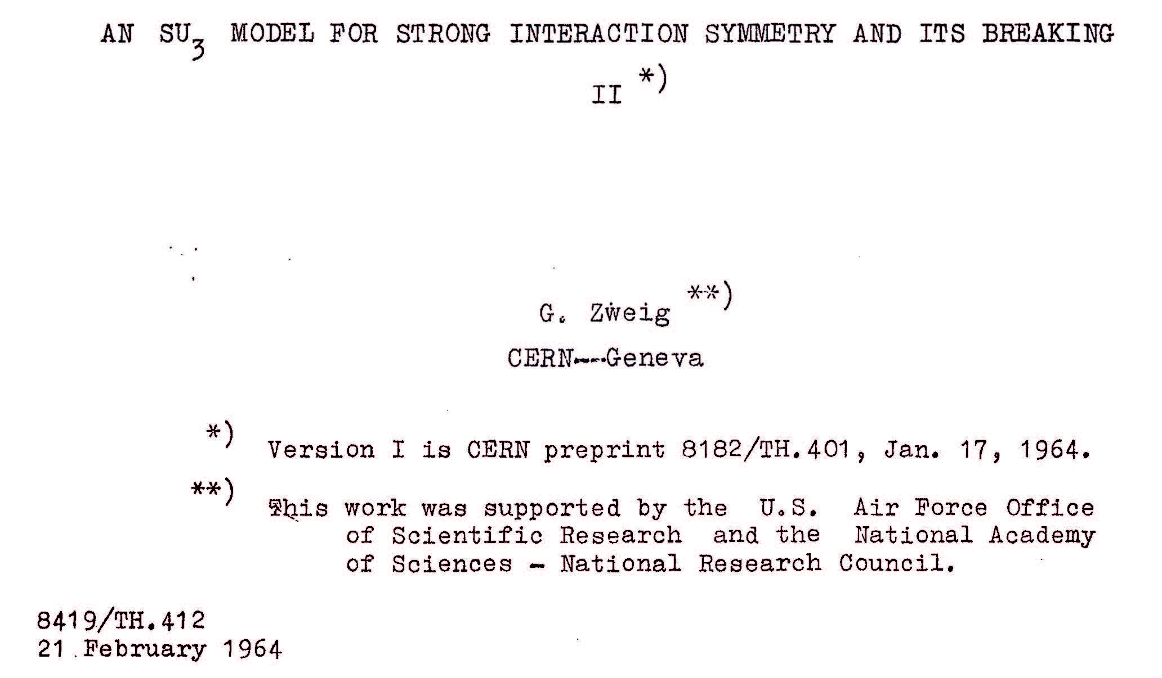
1964: quarks
For more complete account (including role
of Petermann; Serber) see:
Llewellyn Smith, C.
From concrete quarks to QCD:
a personal perspective. EPJ H 48, 13 (2023).
https://doi.org/
10.1140/epjh/s13129-023-00061-4

Slide 3
{3} x {3} x {3} =
{10} + {8} + {8} + {1}
3/2
-1/2
-1/2
-3/2
-I₃
Δ⁺⁺
Δ⁺
Δ⁰
Δ⁻
0
|uuu>
|uud>
|udd>
|ddd>
1232 MeV
Σ⁺
Σ⁰
Σ⁻
-1
1385 MeV
|uus>
|uds>
|dds>
Ξ⁰
Ξ⁻
-2
1530 MeV
|uss>
|dss>
Ω⁻
-3
Predicted by this scheme
Observed Feb. 1964, Brookhaven
1672 MeV
|sss>
A possible example of the decay of this particle was
observed by Y. Eisenberg, Phys. Rev. 196, 541 (1954).
S

Slide 4
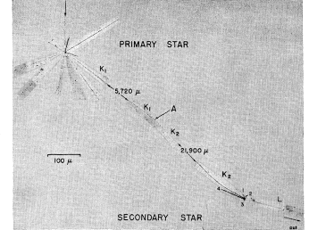







Barnes et al, 1964
Y. Eisenberg, Phys. Rev. 196, 541 (1954).
$$K^{−}p→Ω^{−}K^{+}K^{0}$$
$$Ω^{−}→Ξ^{0}^{−}$$
$Ξ^{0}→☹$ $^{0}$
$$→e^{+}e^{−}$$
$$^{0}→$$
$$→e^{+}e^{−}$$
$$☹→p^{−}$$
Notes:
K

Slide 5
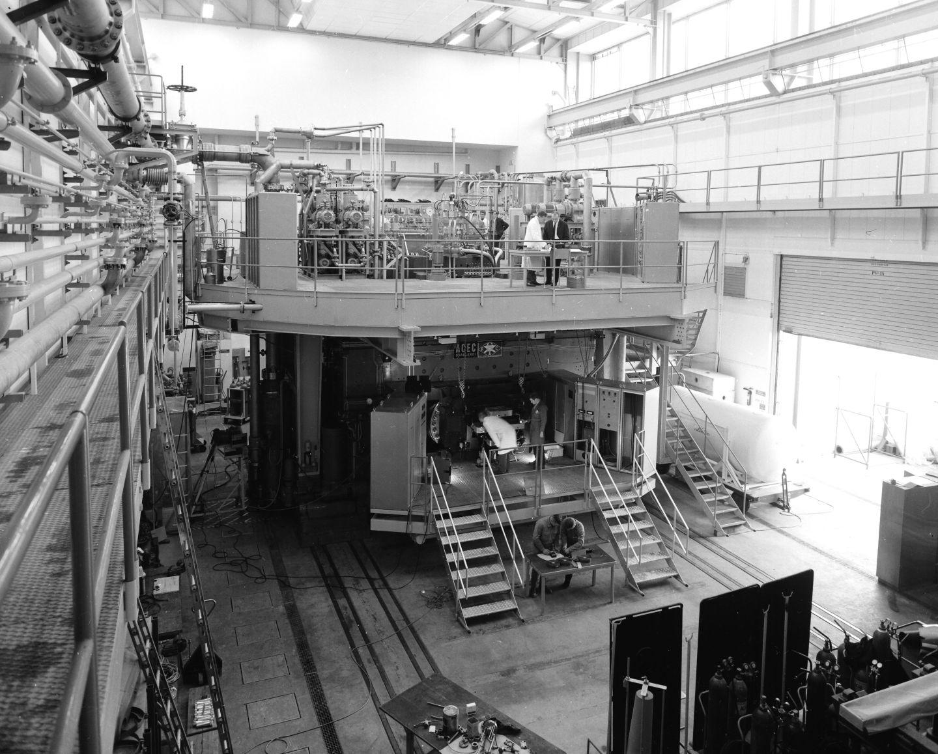
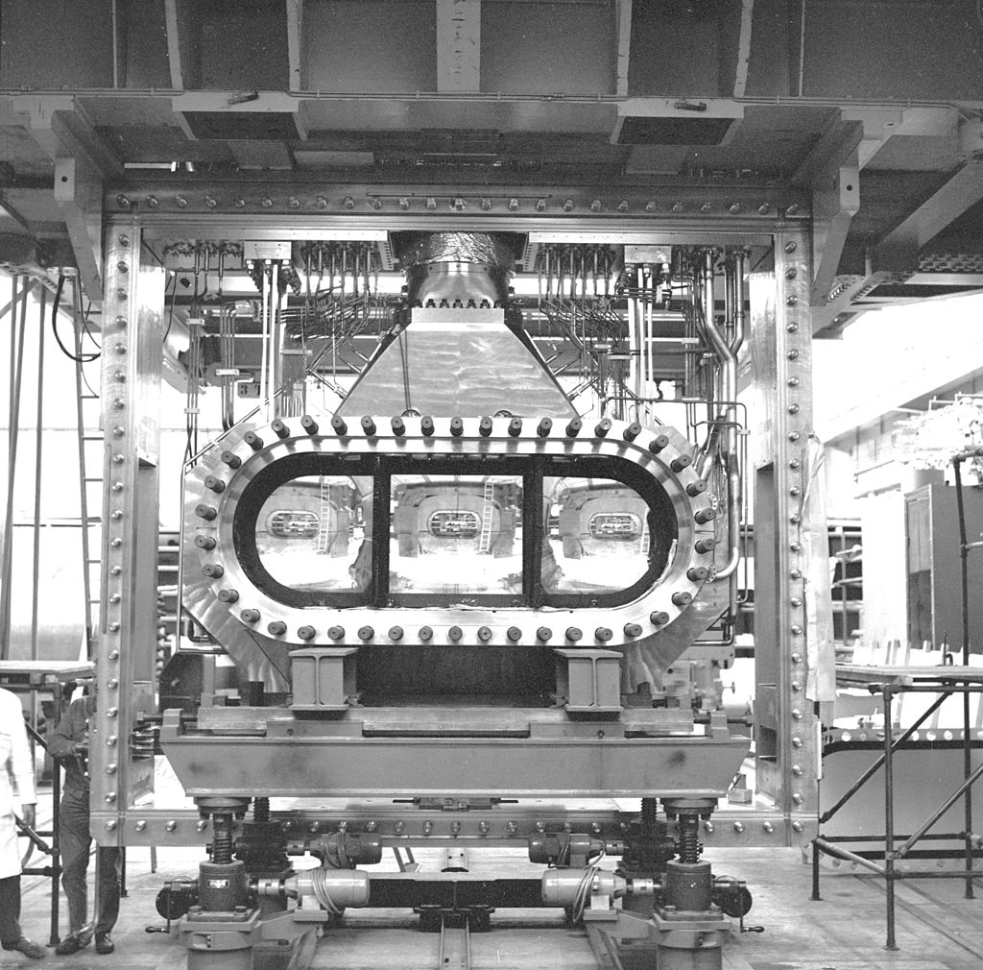
1967-1974: 3 M pictures 2m CERN HBC; 133 events/microbarn
1978: Ph.D. Thesis Brian

Slide 6


Slide 7
Foster:
I would say, Brian and Roger, today is the day to finally
settle this dispute once and for all!

Slide 8
K⁻ p→Ω⁻ K⁺K⁰
Cross section 0.5 +/- 0.1 µb
PDG: 0.821±0.011 10⁻¹⁰ sec
mass 1671.7 -+ 0.6 MeV/c²

Slide 9
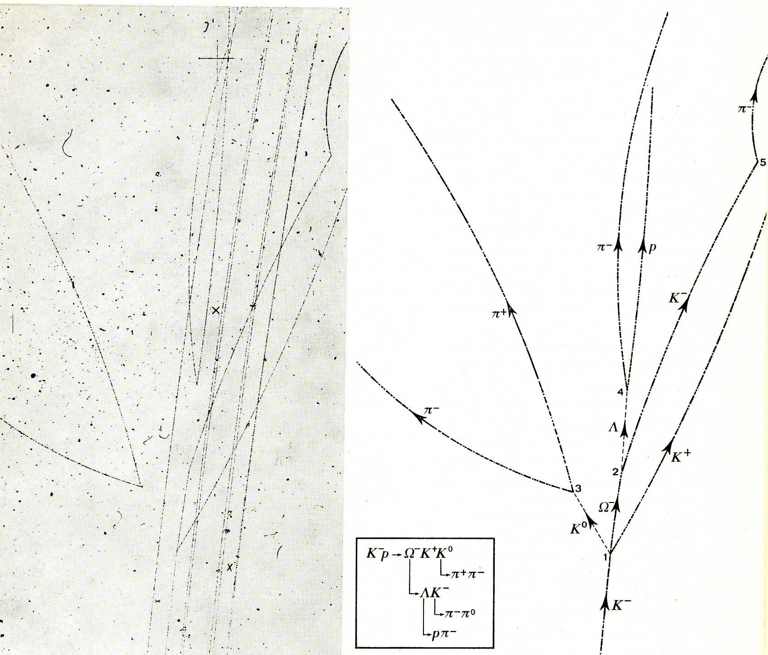
One of 40 Ω-minus events observed in X42

Slide 10
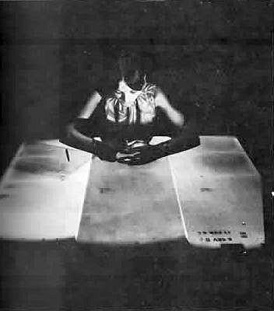
Scanning X42 film (Nijmegen)

Slide 11
The 4.2 GeV/c K⁻p experiment was an inspiring start of
an exciting journey to new territories.
1954 Local gauge invariance (Yang-Mills)
1964 Quarks
1964 Spontaneous symmetry breaking
1968 Invention Multiwire Proportional Chambers
1969 Electroweak unification
1969 Deep inelastic scattering
1971 Renormalisation massive gauge fields
1973 QCD
1973 Neutral currents
1974 Discovery charm (beauty 1977, top 1995)
1974 – 1977 Tau-lepton
1983 Discovery W, Z bosons
1988 Nobel Prize mu neutrino (1962)
2000 Tau neutrino
2012 Discovery Higgs boson
(S)PS
SppS
LEP
LHC
……
FCC …
Doris
Petra
HERA
SPEAR
PEP (II)
SLC
Tevatron
Tristan
KEK-B
RHIC
Future Accelerators
Novel Acceleration Technologies

Slide 12
11.5
75 new hadrons at the LHC
bb bq cc
cc(qq)
ccqq cccc cq cqqq
bqq cqq
ccqqq
11.0
10.5
_{b}(3P)
_{b2}(3P)
_{b1}(3P)
7.5
7.0
+
B*(2S)⁺
T (6900)
B_{c}(2S)
c
B_{c}(2S)⁺
_{b}(6152)⁰
6.5
_{b}(6350) _{b}(6340)
T (6600)
0
_{b}(6227)
(6146)⁰
_{b}(6227)
_{b}(6327)⁰ _{b}(6333)⁰
(5945)⁰
_{b}(5955)
B_{J}(5970)^{+, 0}
b
_{b}(6095)⁰
(5920)⁰
0
6.0
b
b
+
_{b}(6100)
_{b}(6087)
0
B (5840)^{+, 0}
_{b}(6097) _{b}(6097)
_{b}(6070)⁰ B * (6114)⁰
_{b}(5912)
/ (5935)
J
s
b
B * (6063)⁰
Mass [GeV/c²]
5.5
s
5.0
X(4700) X(4500) X(4274)
X(4685) X(4630)
4.5
P^{N}(4450)⁺
P^{N}(4457)⁺ P^{N}(4440)⁺ P^{N}(4312)⁺ ₃(3842)
P _{s}(4338)⁰
T _{s1}(4000)
X(3960)
h (4300)
X(4140)
P^{N}(4380)⁺
T _{s1}(4220)⁺
c
4.0
T (4000)⁺
0
c1
(4010)
s1
h_{c}(4000)
++
cc
T (3875)⁺
3.5
cc
_{c}(3327)⁰
_{c}(3119)⁰
(3090)⁰
0
D_{J}*(3000)^{+, 0}
c c
_{c}(3185)
3.0
D (3000)⁰
D * (2860)⁺
+
(3066)
0
0
_{c}(2939)⁰
T (2900)⁰
++ 0
s1
_{c}(2860)
a
J
cs0
0
T_{cs0}(2900) T_{cs0}(2900)
D_{J}*(2760)⁺
_{c}(3050)
(2923)⁰
T_{cs1}(2900)
a
D (2740)⁰
D * (2760)⁰
_{c}(3000)⁰
c
2.5
J
0
3
D_{s0}(2590)⁺
D_{J}(2580)
2.0
2012 2013 2014 2015 2016 2017 2018 2019 2020 2021 2022 2023 2024
Date of arXiv submission
patrick.koppenburg@cern.ch 2024-06-06

