Slide 1

Some Thoughts on IDEL
OGF37, Charlottesville, VA, US
David Groep, Nikhef
based also on work by Willem van Engen en Mischa Salle
Work supported under BiG Grid, the Dutch eScience Grid, through SURFsara, and by EGI.eu
Participation supported through the Initiative for Globus in Europe

Slide 2
OGF IPR Policies Apply
“I acknowledge that participation in this meeting is subject to the OGF Intellectual Property Policy.”
Intellectual Property Notices Note Well: All statements related to the activities of the OGF and addressed to the OGF are subject to all provisions of Appendix B of GFD-C.1, which grants to the OGF and its participants certain licenses and rights in such statements. Such statements include verbal statements in OGF meetings, as well as written and electronic communications made at any time or place, which are addressed to:
    the OGF plenary session,
    any OGF working group or portion thereof,
    the OGF Board of Directors, the GFSG, or any member thereof on behalf of the OGF,
    the ADCOM, or any member thereof on behalf of the ADCOM,
    any OGF mailing list, including any group list, or any other list functioning under OGF auspices,
    the OGF Editor or the document authoring and review process
Statements made outside of a OGF meeting, mailing list or other function, that are clearly not intended to be input to an OGF activity, group or function, are not subject to these provisions.
Excerpt from Appendix B of GFD-C.1: ”Where the OGF knows of rights, or claimed rights, the OGF secretariat shall attempt to obtain from the claimant of such rights, a written assurance that upon approval by the GFSG of the relevant OGF document(s), any party will be able to obtain the right to implement, use and distribute the technology or works when implementing, using or distributing technology based upon the specific specification(s) under openly specified, reasonable, non-discriminatory terms. The working group or research group proposing the use of the technology with respect to which the proprietary rights are claimed may assist the OGF secretariat in this effort. The results of this procedure shall not affect advancement of document, except that the GFSG may defer approval where a delay may facilitate the obtaining of such assurances. The results will, however, be recorded by the OGF Secretariat, and made available. The GFSG may also direct that a summary of the results be included in any GFD published containing the specification.”
OGF Intellectual Property Policies are adapted from the IETF Intellectual Property Policies that support the Internet Standards Process.
Notes:
IPR Notices Note Well for OGF meetings

Slide 3

Background
Concept used to be simple “A->B->C->D”
With ill-defined but understood constraints
  Delegation should be limitative in time
  Limited in scope (were never very good at that!)
  Preserve traceability for resources so that actions can be attributable to subjects
  non-interactive (pay ‘card-not-present’ peanalties...)
Technically simple in
  pure X.509 RFC3820 world (incl. delegation constraints)
  or pure up-to-date SAML+ECP world

Slide 4
But the world moved elsewhere
PKIX/RFC3820
  nobody ever implemented 3820 constraints
  we probably identified all humans world-wide
  capable of understanding asymmetric crypto (~20k)
  technically works great, though missing a common networked protocol to do so
SAML/ECP issues
  made it only to MS and Shib implementations
  requires all-cooperative IdPs
  non-Java SAML libs don’t even think ECP…
… and both were too late, so we now have:

Slide 5
Alternative solutions to (!I)DEL
Hub/spoke credential translators
  Can add further enriching, and cache user stuff
  Think e.g. OpenConext, PingFederate, …
STS and STS-PKI bridges
  Automated ones (WS-Trust, GEMbus, HIP-EMI-STS)
  manual ones like TCS eScience Personal or CILogon
Credential repositories
  General purpose repos (MyProxy)
  Closely tied to a service (GlobusOnline)
  Tied to a credential issuer (Online CAs + MyProxy)
not really delegation, but they fill the same user nische
and thus have to be considered part of the gameplay

Slide 6
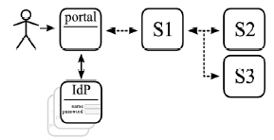
Practical example ISOCAT
meta-data registry needs to query
catalogues access to which is only
granted to individuals by data owners
  cannot easily change the data owner behaviour
  Users may come from any trusted IdP
MPI (CLARIN) production system use case
  Use only mature, deployeable software
  Minimally invasive on IdPs (or we will never get anywhere!)
  Minimize code development
Image from CLARIN/BiG Grid report by Willem van Engen: https://wiki.nikhef.nl/grid/images/f/fa/Report-devel-status-A004.pdf

Slide 7
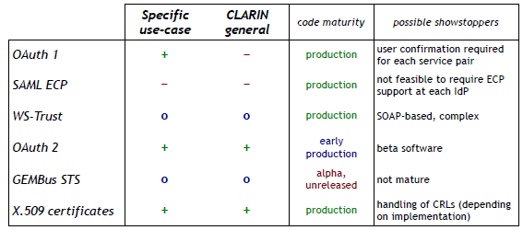
Ended up with OAuth2 & RFC3820
And built a prototype with OAuth2
https://wiki.nikhef.nl/grid/CLARIN/OAuth2

Slide 8
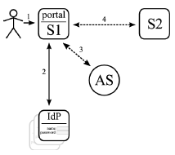
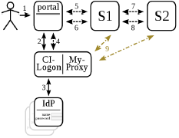
Oauth2 or ‘3820’?
Service providers trust a (shared) Authorization Service, to which the user effectively delegates
  AS is explicit point of trust for S1..Sn
  AS may be collapsed with a (hub/spoke)
  single IdP (think: Google android rights)
  AS limites statement to
  [user IdP, portal, scope (S1..Sn), life time]
CILogon+MyProxy can so the same
  Implicit trust in credential repo (services only
  ever see the user*)
  Proxies may be enriched: but that’s not common!
  Works instantly, but needs our own s/w forever
https://wiki.nikhef.nl/grid/images/6/66/Clarin-security_for_web_services-research-report010.pdf

Slide 9
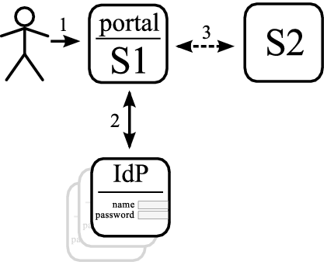
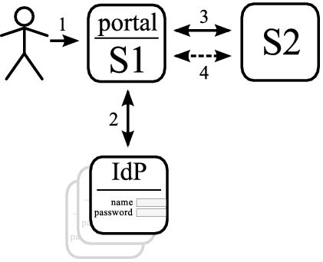
The rest: comparison
Golden App (implicit open)
  + Easy to setup & maintain
  − Doesn't scale
  − Barrier to adding services & portals
OAuth1
  + Widely used technology
  − Single delegation only
  − Confirmation for each service pair

Slide 10
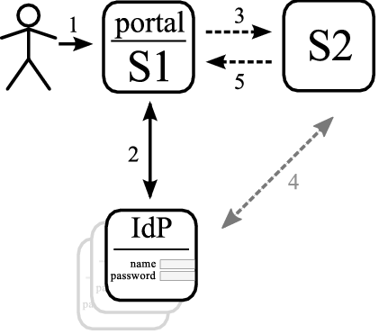
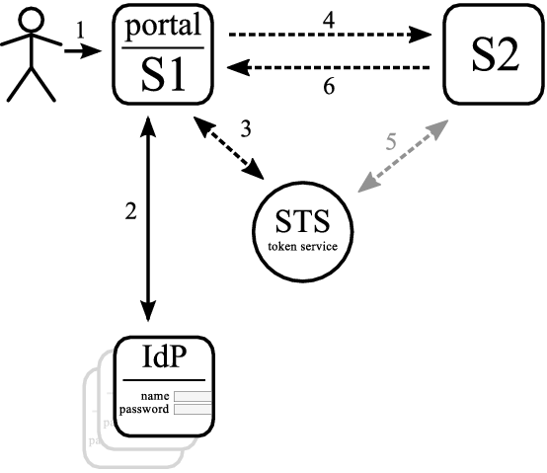
Comparison (contd)
SAML ECP
  + Based on already deployed technology
  − Requires SAML ECP support at all IdPs
  − Metadata exchange necessary for
  each service & IdP, this does not scale
WS-TRUST
  + Widely used technology
  + Flexible
  − Complex
  − SOAP-based, REST can be a problem
  − Central security token service

Slide 11
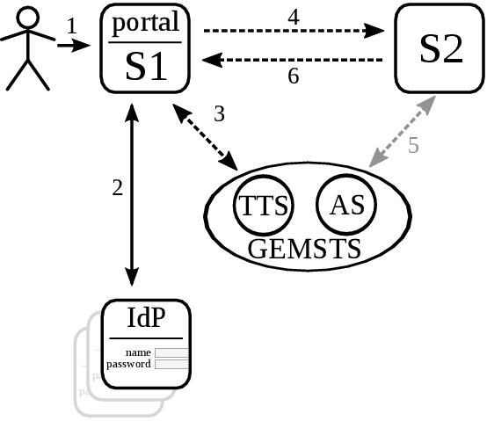
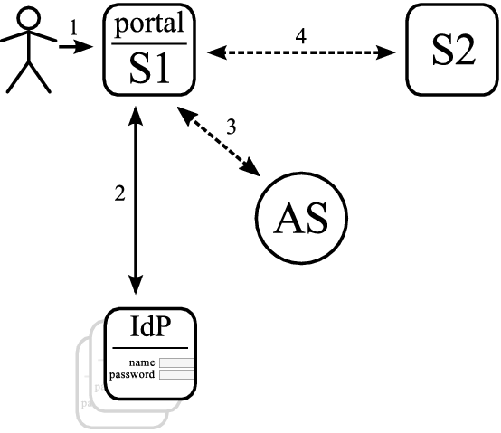
Comparison (contd)
GEMbus STS
  + Constrained delegation possible
  + REST based (using JWT36)
  − Alpha software, not yet available
  − Central GEMSTS service
OAuth2
  + Implementation that supports much of use-case available
  + Constrained delegation possible
  − Fairly new technology
  − Central authorization service
X.509
  + Standard +Fast + Compatible with ‘current’ Grid
  – lots of own S/W – Delegation constraints not so flexible

Slide 12
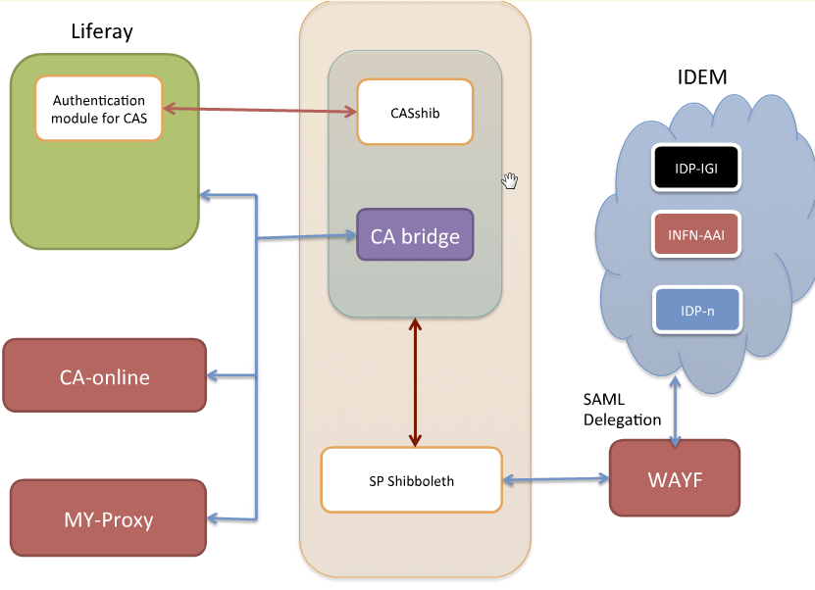
Credential repos
Not strictly delegation, but they act as such!
  IGI Web Portal framework
  LifeRay CA Online
  Showed up in CLARIN use case
  Running a secure credential repo
  is non-trivial! High value target!
  Need policy guidance and auditing around it
  EUGridPMA work item on credential repo security
    A bit similar to the AA Ops Profile, links with PKPWP
    For the CA bit, leverage existing MICS Cas where possible
    But in some cases, that fails due to dual-use (TCS)
    Genelized SLCS/STS profile aims for complementary space
Graphic: Marco Bencivenni, INFN CNAF

Slide 13
What i/f’s to standardise?
Very much depends on the model ☹
Most need a ‘put/retrieve delegation’ operation
  OAuth2 works well in RESTful space
  MyProxy not RESTful AFAIK, but straightforward enough
Others don’t delegate but translate
  STS (GEMbus, and PKIXy HIP/EMI) use WS-Trust protos
  Hub-sopke national faderations
  Some enrich/populate other attributes/groups (‘VOOT’)
Keep close watch on credential repos!
  will be with us for long, only now starting up!
  Generic ones (infrastructure based) or service-local (GO)
  Initial ‘put’ may be federation (SAML) backed
  These ALSO need a common put/get interface – can it be the same one as the delegation interface?

Slide 14
Full Copyright Notice
Copyright (C) Open Grid Forum (2013). All Rights Reserved.
This document and translations of it may be copied and furnished to others, and derivative works that comment on or otherwise explain it or assist in its implementation may be prepared, copied, published and distributed, in whole or in part, without restriction of any kind, provided that the above copyright notice and this paragraph are included on all such copies and derivative works.
The limited permissions granted above are perpetual and will not be revoked by the OGF or its successors or assignees.
Notes:
OGF Full Copyright Notice if necessary

