Slide 1
Credential Validation Middleware Requests
compiling the wish list for authN functionality for EGI
David Groep, Nikhef and BiG Grid, the Dutch NGI, for EGI.eu global task O-E-15
This work is supported by EGI-InSPIRE (RI-251323) under NA2

Slide 2
Why, and Why Now?
Trust anchor releases repeatedly run into ‘trouble’ in deployment
  inconsistencies in the distribution itself (1.39/1.41)
  increasing number of trust anchors
  supposedly-standard features not supported in M/W
Middleware behaviour ‘suddenly’ changes
  use of namespaces RPDNC format in VOMS/Admin implemented in 2009 appeared in production in 2011
  http://indico.cern.ch/getFile.py/access?contribId=16&resId=9&materialId=slides&confId=73381
  changes are useful, but not always sufficiently-well advertised

Slide 3
More reasons why
Operational issues
  CRL downloading and checking is not reliable
  lots of superfluous downloads
  in recent EGI ops VO incident, revocation did not take effect at some sites even after 18 hours
Future hazards
  try to prevent spreading of NSS library use in m/w
  since this is dangerous for scalability and stability
  re-confirm adherence to CBP’s and standards

Slide 4
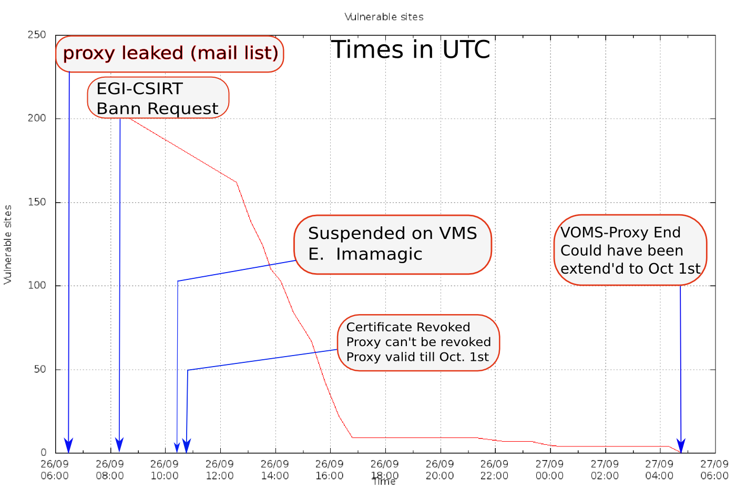
Effect of revocation ...
graphic: Sven Gabriel,Nikhef, for EGI.eu under contract O-E-16

Slide 5
My Wish List: functionality
Support throughout all middleware for SHA-2
  starting January 2012, SHA-2 based certs may start to appear 'in the wild' without further warning…
Support for OCSP allowing for *both* use of
  AIA in the EE certificates itself, and
  for site-configured trusted responders
Support any number of CAs
Failures should be graceful
  incorrect or expired data for a single trust anchor MUST NOT affect the other trust anchors in the set

Slide 6
Wish List: compliance
honour meaning and scope on extensions
  an attribute that says emailProtection is to protect email, not for signing documents, etc.
accept RFC3820 proxies everywhere
  and do the proper thing for proxyPathLen constraints
  beware of NSS again!
allow CRL files to be updated on a file system
  be prepared to re-read such files and implement
  new CRL contents at any time

Slide 7
Wish List: don’t break it!
Support drop-in (directory based) trust anchor distributions, and continue to do so
  no monolithic databases please, no NSS on disk
Announce semantic changes to EGI/NGI&IGTF
  e.g. moving to namespaces needs prep for RPs
  document, and tell which component does what
contribute to the drafting of a new standard
for an RPDNC language,
  based on the GFD.189 analysis
  participate in CAOPS

Slide 8
Where does the wish list go?
via EGI TCB to the middleware providers with which EGI has an MoU
  EMI – harmonize the stack, and define functional unity in any Common Authentication Library
  IGE – is consistent, but needs OCSP support;
  and beware of NSS in moving to Fedora
track progress using EGI mechanisms

Slide 9
EGI RT progress
Trackers created for relevant technical issues
  3074 Unit Test for CRL refresh
  3075 Common Authentication Library (EMI)
  to configure the accepted proxy
  3076 Support for OCSP (EMI + IGE)
  3077 Argus to support OID extensions
  but now Argus wants an explicit list of OIDs
  to convert each one into an XACML policy ☹
  3078 SHA-2 family support*
  3079 Default key size for proxies >=1024
  3080 RPDNC constraints support
  3081 drop-in trust anchor distribution support

Slide 10
3078 SHA-2 support
all modern middleware all supports it
but not all modern M/W still handles legacy GT2 proxies
in the case of jGlobus, it’s mutually exclusive
some M/W still stuck without support for RFC proxies, like some wLCG-specific software (LHCb’s “DIRAC”)
we might need more migration time ... but not too long!

Slide 11
jGlobus2 and emailAddress
But also:
the emailAddress/EMail/E attribute is text-encoded differently in various middlewares
(no standard exists), and jGlobus2 does not support all variants
we need to get rid of emailAddress
CAs still using emailAddress
  IHEP
  APAC
  IUCC -> please consider rolling over to new CA DN

Slide 12
Discussion items for us now
Delay use of SHA-2 (until January 2013)?
or until SHA-1 is broken!
Roll-over CAs with emailAddress in issuer

