Slide 1
Updates from the
EUGridPMA
David Groep, March 8th, 2010

Slide 2
Updates from the EUGridPMA
Towards even more EMEA coverage
Novel CA architectures
  Federation-backed SLCS and MICS CAs
Auditing progress
Authorization Operations WG
Distribution and fetch-crl
OpenSSL 1and distribution format change

Slide 3
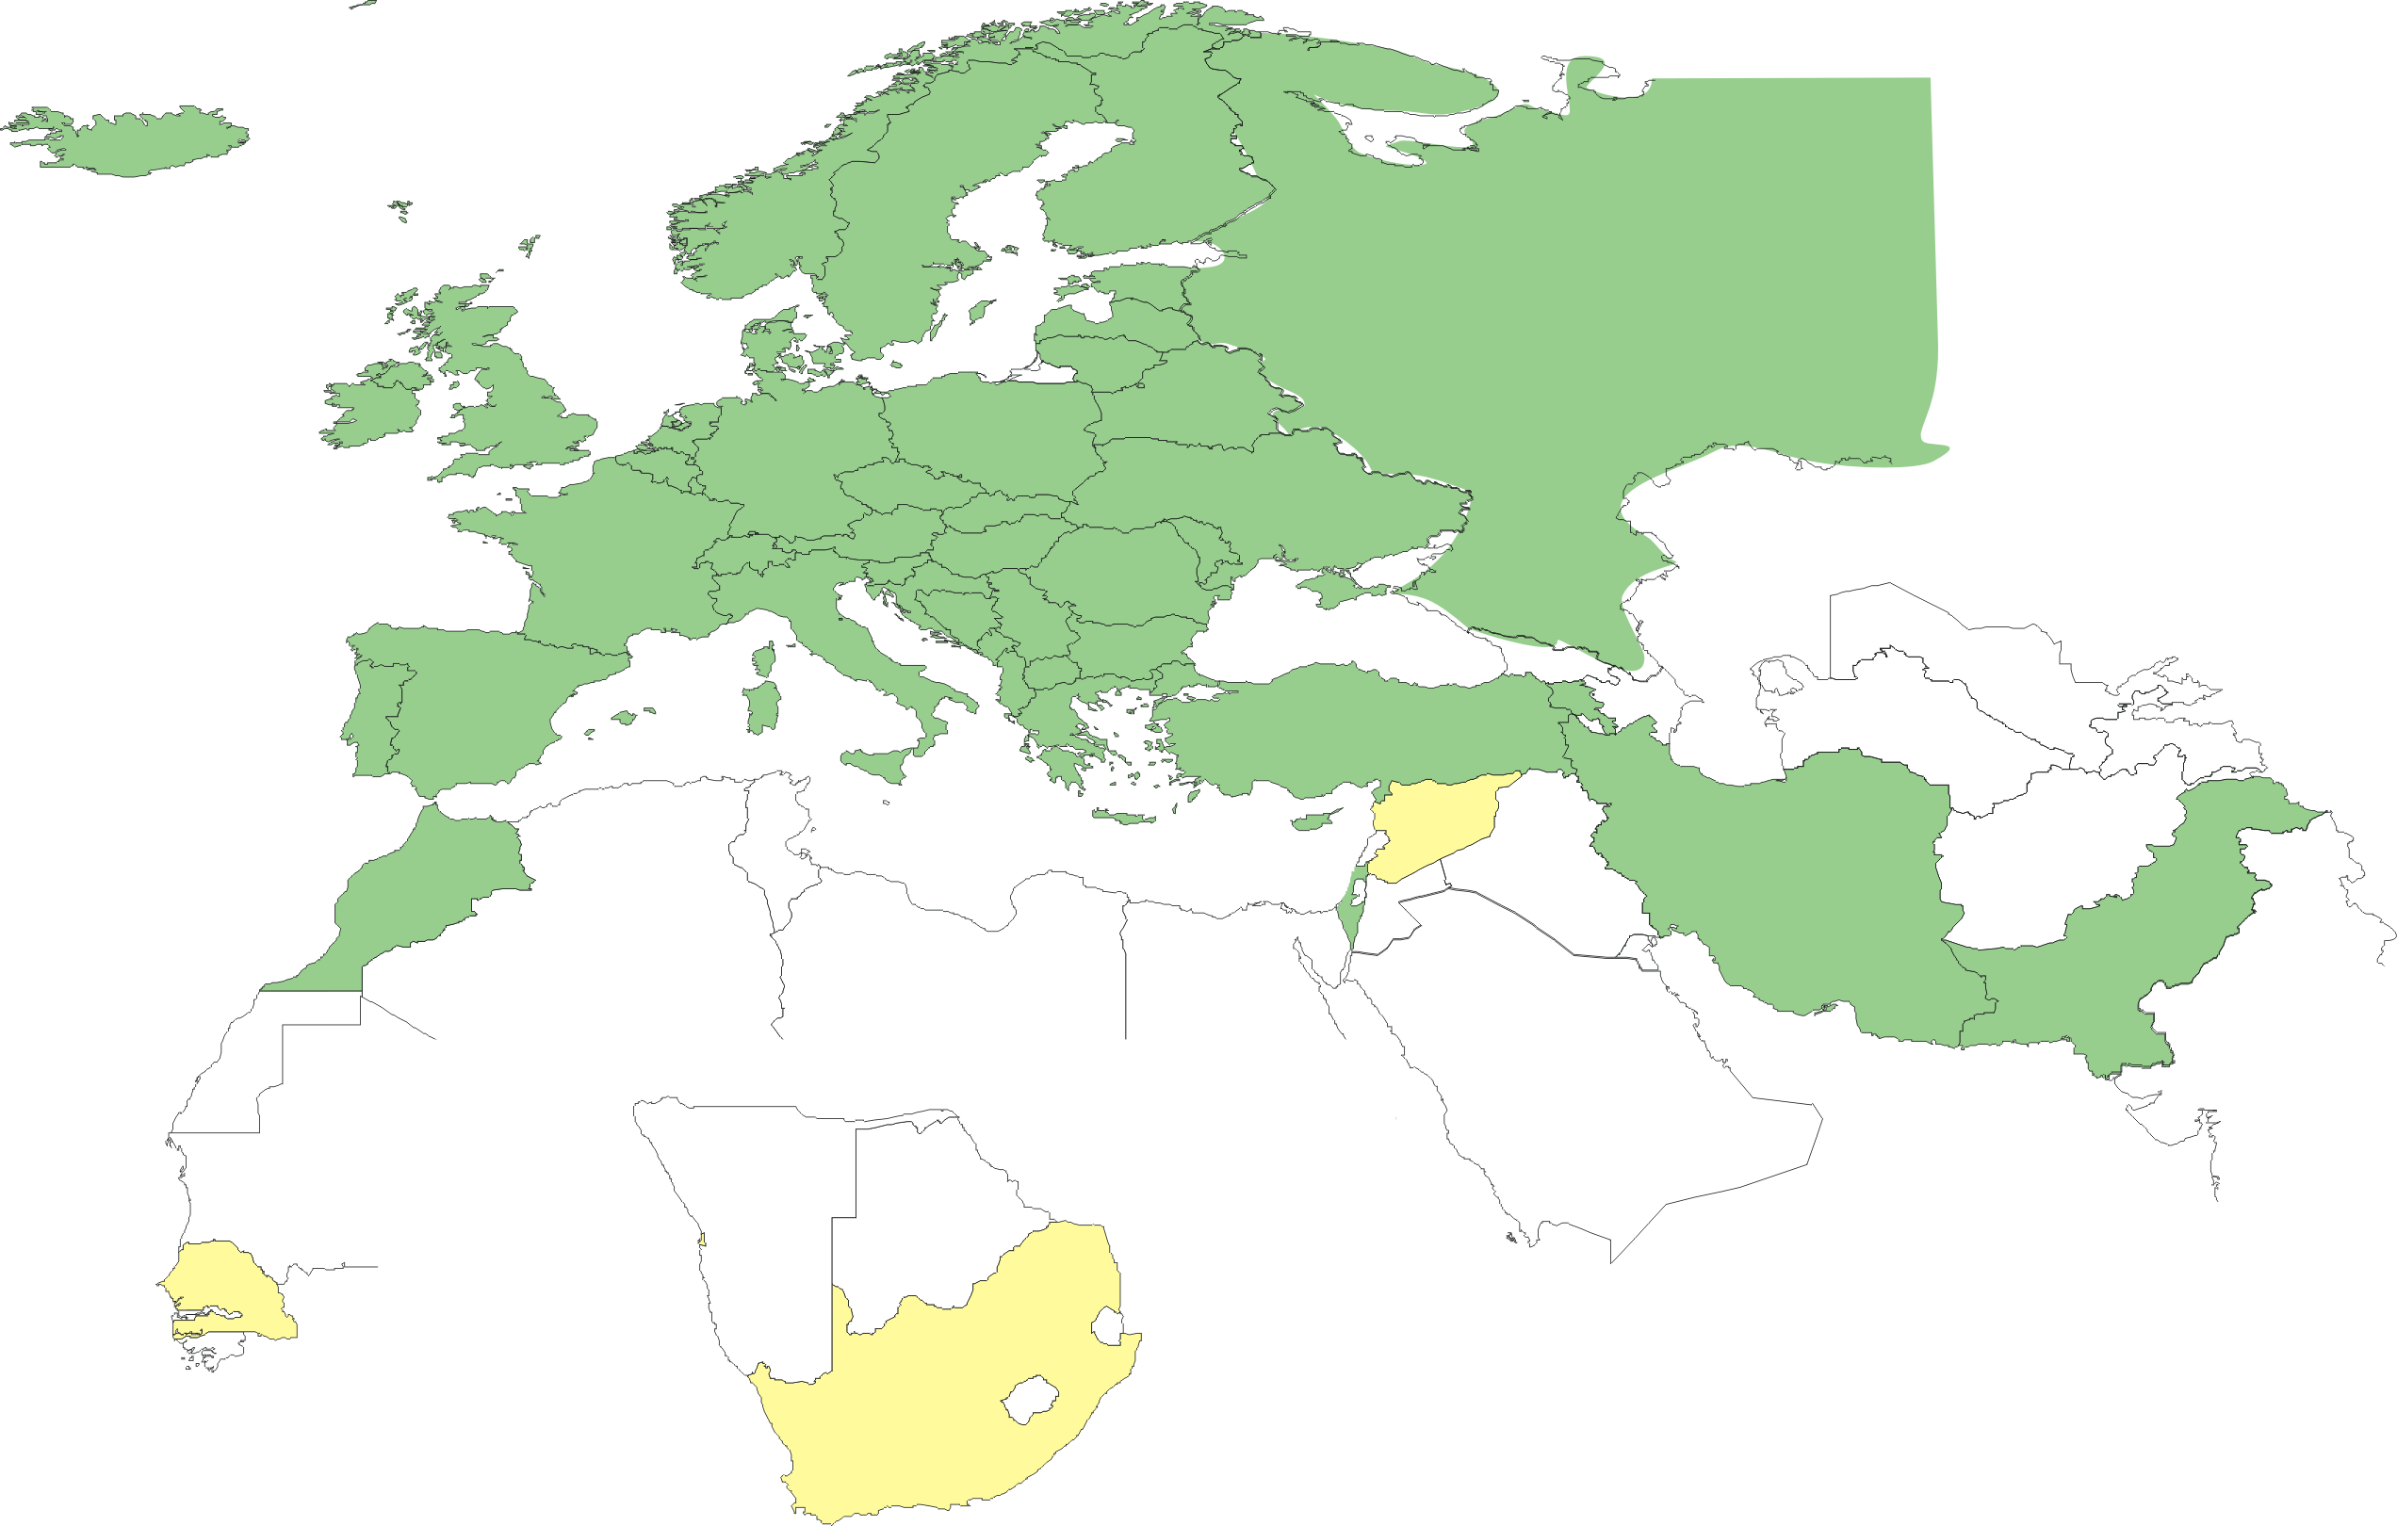
Geographical coverage of the EUGridPMA
25 of 27 EU member states (all except LU, MT)
+ AM, CH, HR, IL, IR, IS, MA, ME, MK, NO, PK, RO, RS, RU, TR,
UA, SEE-GRID + CERN (int), DoEGrids(US)*
Pending or in progress
SY, ZA, SN

Slide 4
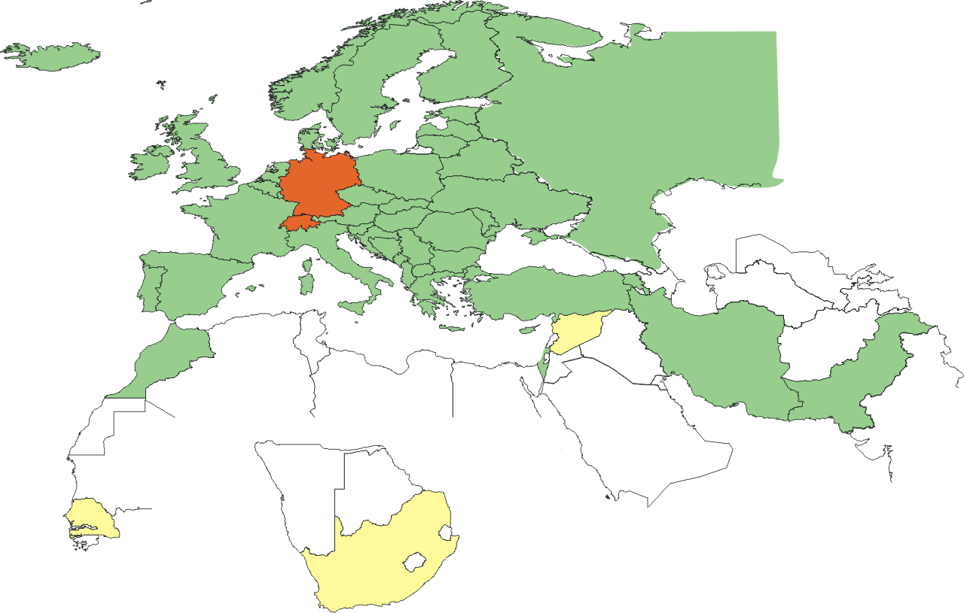
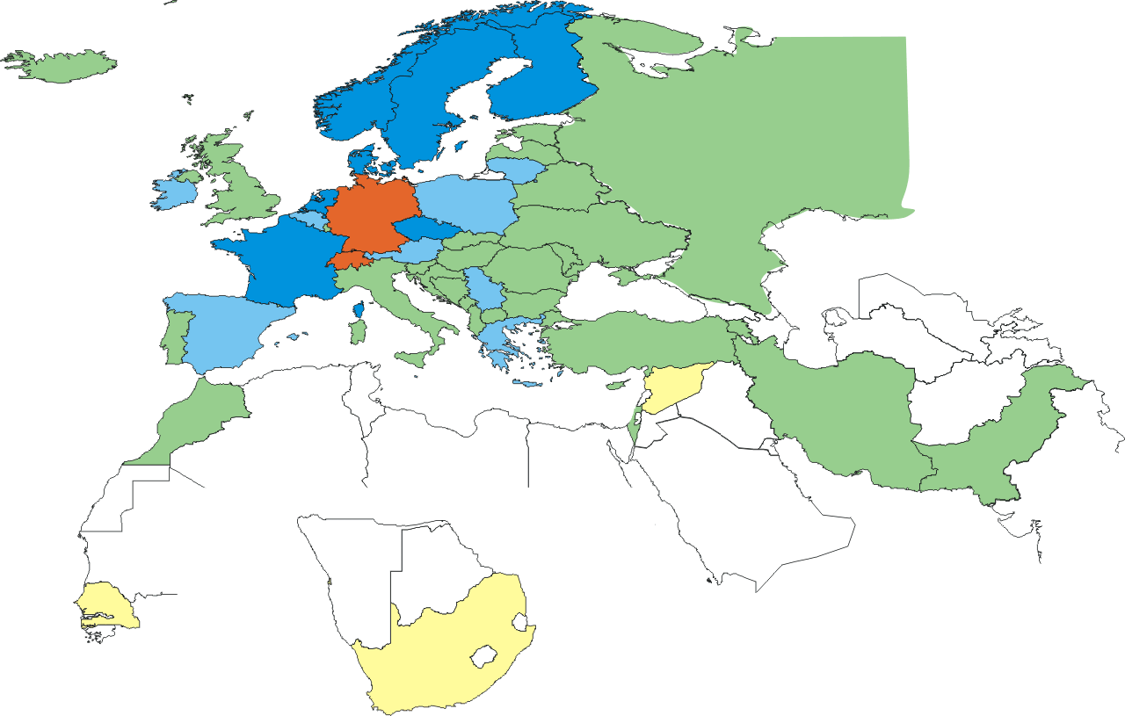
New federated MICS CAs
Already had 2 federation-backed
SLCS CAs: CH, DE
Recently (2010-02-01) accredited
a multi-national federated MICS CA:
  TERENA managed, with a Comodo back-end
  Common portal for user applications
  shared by NL,NO,DK,SE,FI,FR
  Leverages federations, but also requires
  institution to have high-quality IdM
Upcoming: multi-national server CA
for e-Science applications
  Also managed by TERENA, with Comodo back-end

Slide 5
Auditing status
Now done or pending:
BalticGrid CA, NIIF CA, PK-grid, CAPolishGrid CA, CERN CA, IUCC, LIPCA, UK eScience CA, pkIRISGrid, ArmeSFo CA, SRCE CA, AEGIS CA
Status
  Self audits are done rigorously and usually on time
  Implementation of recommendations takes a bit of time (3-6 months)
  Review of the self-audit by peers takes a really long time (>12 months), mainly because of overloaded peer reviewers
https://www.eugridpma.org/review/selfaudit-review

Slide 6
AuthZ operations policy WG
Foster trust by improving operation of AuthZ Auth
New scoping of the AuthZ Working Group
  For now: maintain technical focus on VOMS
  AASPs will not be 'accredited' by any particular body, but
  Write guideline against which AASPs can assess their implementation and subsequently claim compliance.
  Relying parties: either implement post-factum assessment or require pre-auditing of acceptable AASPs
  Interaction with issuance of 'AA issuing certificates' by IGTF CAs remains open question
Further discussions
  wider consultation with (technical) people and VO reps
  focus on AA assertions and infrastructures where actual signature on the assertion is used in the validation

Slide 7
IGTF Release Process and Web
Release Process
  Releases moved to (preferably) Monday or Tuesday
  More documentation of the process still needed
  More checks are now built into the process (Debian!)
  End use: https://dist.eugridpma.info/distribution
  https://www.apgridpma.org/distribution
  EUgridPMA site has off-site warm spare –
  which will be used in July-August during building change
Monitoring and alarms
  Nagios: http://signet-ca.ijs.si/nagios/ (guest/guest)
  Similar setup by Yoshio
  PMA Distribution Warnings by email 4 times/day
  It helps, but reaction to the warnings is down again …

Slide 8
Fetch-CRL
New versions available
  2.7.2: even more paranoid about installing in face of AFS file systeminstabilities
  2.8.2: all of the above, as well as a random wait option
2.8-series fetch-crl packaging
  RPMs now Fedora/EPEL compliant
  Included in Koji testing repository
  Start testing it now: it integrated better with native OS
  Builds: EL4, EL5, F11,12,13
  Thanks for Steve Traylen!
  https://admin.fedoraproject.org/updates/fetch-crl

Slide 9
OpenSSL1
Structure of the trust anchor directory
Hash functions and code

Slide 10
Structure of the trust anchor store
bosui:certificates:1008$ cd /etc/grid-security/certificates/
bosui:certificates:1008$ ls -l|grep 16da
-rw-r--r-- 1 root root 5341 Oct 26 21:02 16da7552.0
-rw-r--r-- 1 root root 40 Oct 26 21:02 16da7552.crl_url
-rw-r--r-- 1 root root 442 Oct 26 21:02 16da7552.info
-rw-r--r-- 1 root root 630 Oct 26 21:02 16da7552.namespaces
-rw-r--r-- 1 root root 4842 Jan 13 08:17 16da7552.r0
-rw-r--r-- 1 root root 342 Oct 26 21:02 16da7552.signing_policy
bosui:certificates:1009$ ls -l policy-*
-rw-r--r-- 1 root root 2633 Oct 26 21:03 policy-igtf-classic.info
-rw-r--r-- 1 root root 152 Oct 26 21:03 policy-igtf-mics.info
-rw-r--r-- 1 root root 256 Oct 26 21:03 policy-igtf-slcs.info
bosui:certificates:1010$ cat policy-igtf-mics.info
# @(#)policy-igtf-mics.info - IGTF mics authorities
# Generated Monday, 26 Oct, 2009
version = 1.32
requires = TACC-MICS = 1.32, \
NCSA-mics = 1.32

Slide 11
Hashes
Hashes used for lookup of the issuing CA for a given certificate
Independent from the ‘fingerprint’
$ openssl x509 -noout -subject -issuer \
-fingerprint -sha1 -hash \
-in 16da7552.0
subject= /C=NL/O=NIKHEF/CN=NIKHEF medium-security certification auth
issuer= /C=NL/O=NIKHEF/CN=NIKHEF medium-security certification auth
SHA1 Fingerprint=E5:FA:C3:3B:44:8F:26:1B:3D:D1:DE:BA:5F:EC:ED:35:A9:3F:23:21
16da7552

Slide 12
Code changed in OpenSSL 1 betas
unsigned long X509_NAME_hash(X509_NAME *x)
{
unsigned long ret=0;
unsigned char md[SHA_DIGEST_LENGTH];
/* Make sure X509_NAME structure contains valid cached encoding */
i2d_X509_NAME(x,NULL);
EVP_Digest(x->canon_enc, x->canon_enclen, md, NULL, EVP_sha1(), NULL);
ret=( ((unsigned long)md[0] )|((unsigned long)md[1]<<8L)|
((unsigned long)md[2]<<16L)|((unsigned long)md[3]<<24L)
)&0xffffffffL;
return(ret);
}
unsigned long X509_NAME_hash_old(X509_NAME *x)
{
unsigned long ret=0;
unsigned char md[16];
/* Make sure X509_NAME structure contains valid cached encoding */
i2d_X509_NAME(x,NULL);
EVP_Digest(x->bytes->data, x->bytes->length, md, NULL, EVP_md5(), NULL);
ret=( ((unsigned long)md[0] )|((unsigned long)md[1]<<8L)|
((unsigned long)md[2]<<16L)|((unsigned long)md[3]<<24L)
)&0xffffffffL;
return(ret);
}

Slide 13
Impact of change
Today: lookup will fail if a new OpenSSL is used
Lookups happen
  via the system OpenSSL, dynamically linked
  Via application-specific OpenSSL versions
  Via statically linked openssl libraries
  Via other implementations of the hash algorithm
  e.g. in the TrustManager Java implementation
  or in Apache, or ...
Both implementations will co-exist on single system
Will thus require
  separate trust stores
  A single trust store that supports both algorithms

Slide 14
Changes to the IGTF distribution
For installation bundles, tar-balls and RPMs:
all CAs and files are named after their alias from the info file
Symlinks are used to generate the structure for both versions of OpenSSL
installation bundle (the "./configure && make && make install" tarball) will create both symlinks
pre-installed bundles have both hashes, also using symlinks

Slide 15
What gets into /etc/grid-security/certificates?
393f7863.0 -> AEGIS.pem
393f7863.info -> AEGIS.info
393f7863.namespaces -> AEGIS.namespaces
393f7863.signing_policy -> AEGIS.signing_policy
AEGIS.crl_url
AEGIS.info
AEGIS.namespaces
AEGIS.pem
AEGIS.signing_policy
cc5645bd.0 -> AEGIS.pem
cc5645bd.info -> AEGIS.info
cc5645bd.namespaces -> AEGIS.namespaces
cc5645bd.signing_policy -> AEGIS.signing_policy

Slide 16
Dual packaging
Pro
  Target system does not need to run c_rehash
  Works for hybrid deployments,
  with some software linked to 0.x, others to 1.0, and others have built-in hashing codes
Con
  Symlinks may upset (or be messed up by) locally running c_rehash
  Unclear which one is used - when the links are severed different programs will react differently
  Doesn’t work on filesystems that do not support symlink

Slide 17
Fetch-crl
locationFiles=`${ls} \
"${locationDirectory}"/*.${crlLocationFileSuffix} \
2>/dev/null`
Will find all files with a “.crl_url” suffix
Use the OpenSSL in the path (since v2.7) to compute the hash locally
Caveats
The .r0 files will be hashed according to openssl version used by fetch-crl, not target software
  make symlinks locally to get a dual-use CRL?
  Should we provide a script, or an update to fetch-crl?

Slide 18
Collateral changes
Update RPM format to v4.4 series
Update Java keytool to Java6
  Now supports CA keys with keysize > 2048
  Keys will not work with old (pre-Java5) tools with Sun JCE
Auto-generated sequence numbers support multiple CAs with the same subject name but different aliases
  Alias MUST be unique for each trust anchor
  Still not supported in fetch-crl, though
  And it’s dangerous anyway
  (see issues related to the two UTNUserFirst-Hardware CA certs, one self-signed and one by Comodo AAA)

Slide 19
Implementation plan
Careful migration to dual-version support:
For 1.33 .. 1.36 releases: both versions available
  with the old style as the advertised one for 1.33 .. 1.35
For 1.36 release, have both versions available with the new style as the advertised one
  No earlier than summer 2010
For 1.37+ release, just have the new one, since it’s fully backward-compatible anyway
  But also no earlier than Q4 2010
RPs: start testing the new dual-stack now, please

Slide 20
Some dates for you to remember and schedule
19-21 April 2010: SigmaNet Riga, LV
20-22 September 2010: SRCE, Zagreb, HR
January 2011: RedIRIS, Madrid or Sevilla, ES
September 2011: IJS, Ljubljana, Slovenia

