Slide 1
Discussions on the Life Ray Portal and credential management David Groep, Oct 11th, 2011

Slide 5
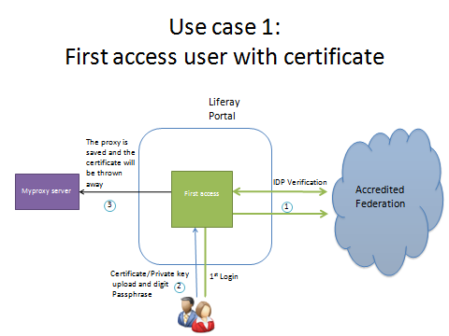

Slide 6
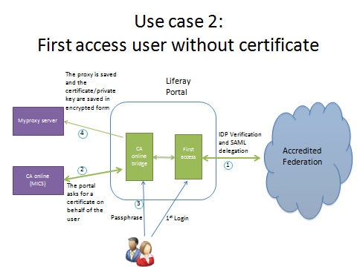

Slide 9
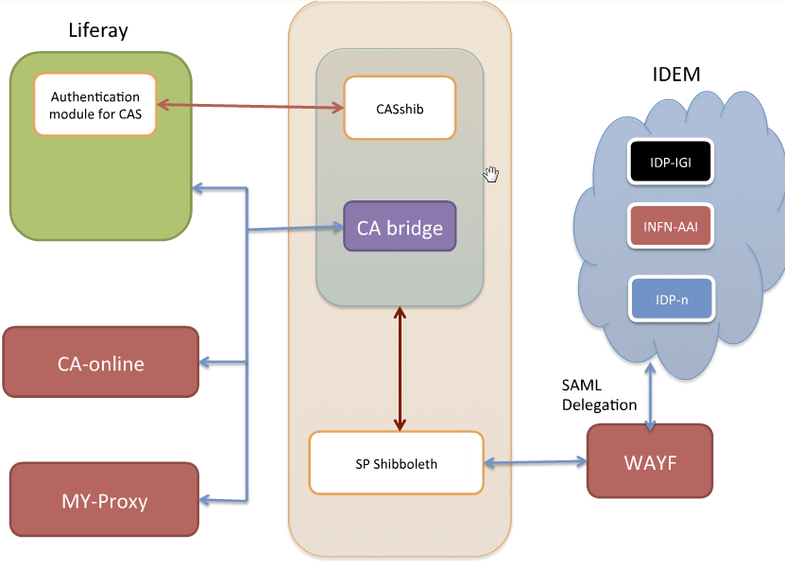
Separation of security functions

Slide 11
EUGridPMA discussion
Separation of functions
thin portal: all credential management on dedicated box
may combine bridge, MyProxy and Uploader on 1 box
Quality of IdM is governed by MICS acceptability
i.e. must be of comparable LoA as TCS Personal
including eligibility requirements
Make sure superfluous keypairs are removed
only the proxy is needed, just like in the uploader case
remove MICS keypair when proxy generation completes
Portal security box acts like a UI to the user
only on explicit request of user & under user control
covered under PKP Guidelines – seems similar to the common ‘remote UI’ use case

Slide 12
Proliferation
Aim to have a limited number of credential management systems, for potentially many portals. But initially one for Italy
Leverage existing MICS CAs as far as possible
no new CA for each portal or portal instance
aim to leverage TERENA TCS eScience Personal
but policy compatibility should still be understood
acceptability of portal instance comes down to CA, i.e. not revoking the certs
it is the MICS CA policy that must be satisfied
PMA only looks at CAs (not at the portals, please)

Slide 13
Next steps
Updated design white paper will reflect changes
Prototype will be developed and demonstrated at later date to appropriate PMAs
Roberto C (and TCS PMA ;-) to study compatibility with TCS Personal
Should be a significant step towards better usability!

