Slide 1
Updates from the
EUGridPMA
David Groep, Nov 7nd, 2008

Slide 2
Updates Today
Towards EMEA coverage
  Autonomous growth
Updates
  AuthZ Operations WG
  Repository issues

Slide 3
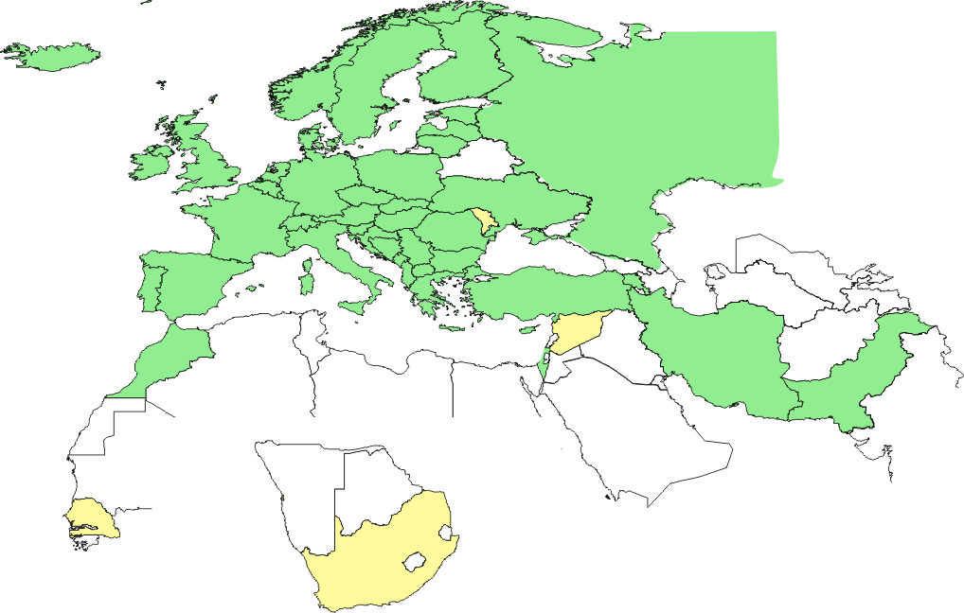
Geographical coverage of the EUGridPMA
23 of 25 EU member states (all except LU, MT)
+ AM, CH, HR, IL, IR, IS, MA, ME, MK, NO, PK, RO, RS, RU, TR,
UA, SEE-GRID + CA, CERN (int), DoEGrids(US)*
Pending or in progress
SY, MD, LV, ZA, SN

Slide 4
More growth expected
Pending EUMedGrid countries: DZ, TN, LY, EG
New initative across the ‘silk road’ countries
  Established by Ara Grigoryan and ArmeSFo
  In collaboration with NATO programme

Slide 5
‘AuthZ op. policy WG’
Extending best practices to AA operations policy
  operational AuthZ policies today are far less clear
  but the minimum requirements on running an AA server may be quite similar to running a CA
  ‘There is no other large group of experts out there waiting to take this on’, and we don’t need a parallel I*TF
  But: scaling the model is quit different
Prototype version of a guideline at the Wiki
‘This is a draft document of the International Grid Trust Federation describing the minimum requirements for the operation of an Attribute Authority (AA) service. The AA service is run by or on behalf of a Grid Virtual Organisation (VO) and maintains attributes for registered VO users and/or VO services. Attribute assertions are securely delivered on request to members of the VO. They are presented by the user and/or service, together with an X.509 credential for authentication, for the purposes of Authorisation of access to a Grid resource.’

Slide 6
Developments and discussion
Repository of “good” and “bad” CP/CPS examples
  boilerplate text repository
  On software used
  Activity ‘owner’: Jens Jensen
Robot certificate
  popularity of robot certs growing rapidly – action needed
  pre-requisite for portal policies in EGEE and many NGIs
  issued on a hardware token – cheap, safe and easy
Credential repository guidelines
  Risks, solutions, and the dissemination thereof is lacking
  Quick-scan of some MyProxy stores reveales ‘interesting’ things
  Guidelines may help – especially for ‘trusted’ credential stores operated by the NGIs (or other persistent infrastructures)

Slide 7
More items for discussion
End-of-life for 1024 bit RSA keys?
  Might possibly impact performance
  (although many CAs are already 2048/4096 bits)
  After a long discussion, figured that this
  is not our major issue for the moment
Emergency escalation contact procedure
  Request all CAs to deposit an emergency contact process
  with the IGTF RAT and their Chair
Please implement robot certs as soon as possible
  See the presentation later on how to do it
  Hardware tokens, e.g. Aladdin eToken, readily available
  Boiler-plate CP/CPS text available

Slide 8
More items
Add more OIDs to your end-entity certs
  At least the OID corresponding to the profile
  More OIDs from 1SCPs that match
And more 1SCPs OIDs are being assigned
  Already there:
  ‘private key is held on a token’
  ‘I was F2F identity-vetted’
  ‘I was vetter through a TTP’
  New:
  ‘I am a Robot/automated client’,
  ‘I an a server/host cert’

Slide 9
Web Cachability, why?
Downloads clustered in first seconds of the minute
Statistics: 88452 downloads per day per CA
14084 distinct IP addresses
average 4 downloads per day per host
Data: DutchGrid CA

Slide 10
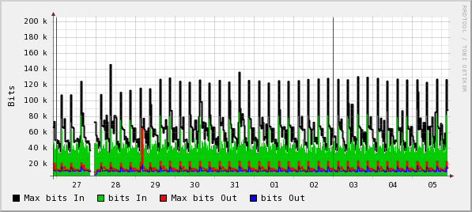
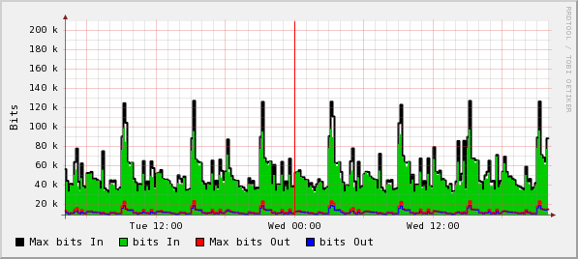
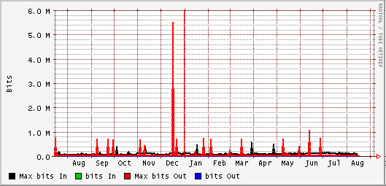
Network traffic
Site cache
misconfigurations
or new sites

Slide 11
There Are Caches
Majority of IPs download individually every 6hours
But there are at least 300 sites that cache!

Slide 12
Web Cacheability
Good
$ HEAD -S http://ca.dutchgrid.nl/medium/cacrl.pem
200 OK
Cache-Control: max-age=3600
Connection: close
Date: Wed, 05 Nov 2008 21:31:48 GMT
Accept-Ranges: bytes
Server: Apache
Content-Length: 4728
Content-Type: text/plain
Expires: Wed, 05 Nov 2008 22:31:48 GMT
Last-Modified: Tue, 04 Nov 2008 10:07:05 GMT
Client-Date: Wed, 05 Nov 2008 21:31:48 GMT
Client-Response-Num: 1

Slide 13
Web Cacheability
Reasonable, but relies on remote site cache setup
$ HEAD http://ca.grid-support.ac.uk/cgi-bin/importCRLpem
200 OK
Connection: close
Date: Wed, 05 Nov 2008 21:15:02 GMT
Accept-Ranges: bytes
ETag: "164011-6b3a-1c7652c0"
Server: Apache/2.0.46 (Red Hat)
Content-Length: 27450
Content-Type: text/plain; charset=UTF-8
Last-Modified: Wed, 09 Jan 2008 13:31:31 GMT
Client-Date: Wed, 05 Nov 2008 21:15:02 GMT
Client-Peer: 130.246.143.144:80
Client-Response-Num: 1

Slide 14
Web Cacheability
Update your CRL URL, but answer is reasonable
Update your CRL URL, answer wastes the cache
$ HEAD http://www.dutchgrid.nl/ca/medium/cacrl.pem
HTTP/1.1 301 Moved Permanently
Date: Mon, 03 Nov 2008 08:59:13 GMT
Server: Apache
Location: http://ca.dutchgrid.nl/medium/cacrl.pem
Content-Length: 247
Content-Type: text/html; charset=iso-8859-1
$ HEAD http://www.lip.pt/ca/lip-crl.pem
HTTP/1.1 302 Found
Date: Mon, 03 Nov 2008 09:04:08 GMT
Server: Apache/2.2.6 (Fedora)
Location: http://ca.lip.pt/lip-crl.pem
Content-Length: 287
Connection: close
Content-Type: text/html; charset=iso-8859-1

Slide 15
Web Cacheability
Uncacheable
(no Last-Modified nor Expires header)
$ HEAD 'http://crls.services.cnrs.fr/get.fcgi?ca=CNRS-Projets&cmd=getpem.crl'
200 OK
Connection: close
Date: Wed, 05 Nov 2008 21:17:05 GMT
Server: Apache/2.2.8 (Fedora) DAV/2 mod_ssl/2.2.8 OpenSSL/0.9.8b
Content-Length: 593
Content-Type: octet/stream
Client-Date: Wed, 05 Nov 2008 21:35:44 GMT
Client-Peer: 195.220.197.22:80
Client-Response-Num: 1
Content-Disposition: attachement; filename="CNRS-Projets.crl"

Slide 16
Web Cacheability
Just plain weird
$ HEAD http://www.cs.tcd.ie/Grid-Ireland/gi-ca/1e43b9cc.r0
200 OK
Cache-Control: max-age=259200
Connection: close
Date: Mon, 03 Nov 2008 09:05:40 GMT
Accept-Ranges: bytes
Server: Apache
Content-Length: 4505
Content-Type: text/plain
Expires: Thu, 06 Nov 2008 09:05:40 GMT
Last-Modified: Tue, 28 Oct 2008 15:42:44 GMT
Client-Date: Mon, 03 Nov 2008 09:05:40 GMT
Client-Peer: 134.226.32.57:80
Client-Response-Num: 1

Slide 17
Web Caching configuration (apache)
Apache 2.x configuration - within your (virtual) host section
<FilesMatch "cacrl.(pem|der|cer)$">
ExpiresActive On
ExpiresDefault "access plus 1 hours"
Options -Includes
</FilesMatch>
<FilesMatch "cacert.(pem|der|cer)$">
ExpiresActive On
ExpiresDefault "access plus 1 days"
Options -Includes
</FilesMatch>

Slide 18
IGTF Release Process and Web
Release Process
  Releases moved to (preferably) Monday or Tuesday
  More documentation of the process still needed
  More checks are now built into the process (Debian!)
  End use: https://dist.eugridpma.info/distribution
  https://www.apgridpma.org/distribution
Monitoring and alarms
  Nagios: http://signet-ca.ijs.si/nagios/ (guest/guest)
  PMA Distribution Warnings by email 4 times/day
  It helps, but reaction to the warnings is down again …

Slide 19
Changes to the Classic AP
See special presentation …

Slide 20
Some dates for you to remember and schedule
26-28 Jan 2009: 15th, CyGrid, Nicosia, CY
11-13 May 2009: 16th, SWITCH, Zurich, CH
14-16 Sept 2009: 17th, DFN, Berlin, DE

