Slide 1
Can I have eduGAIN without pain, please?
Trust and Identity – the AARC way
David Groep,
Nikhef Jamboree,
May 2024

Slide 2
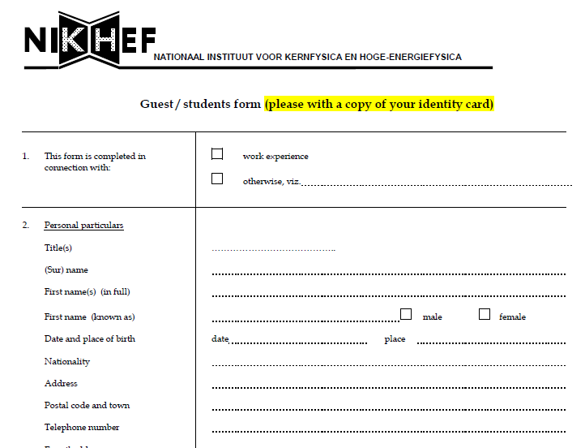
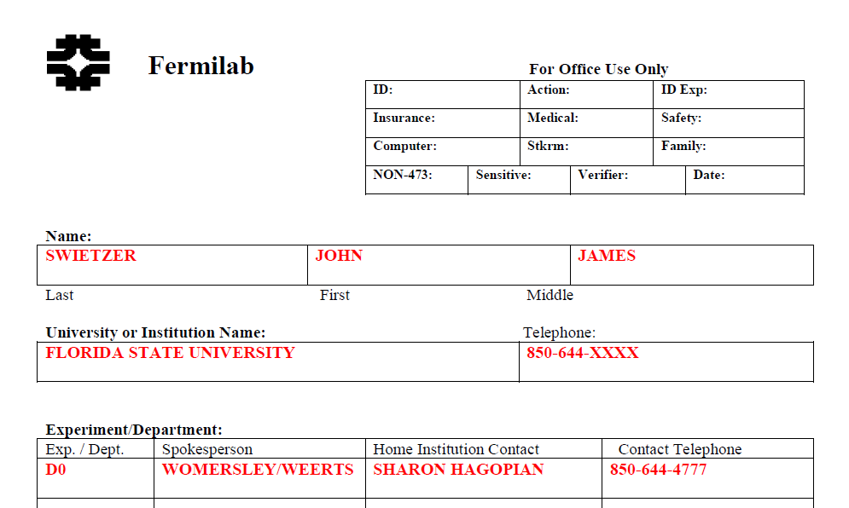
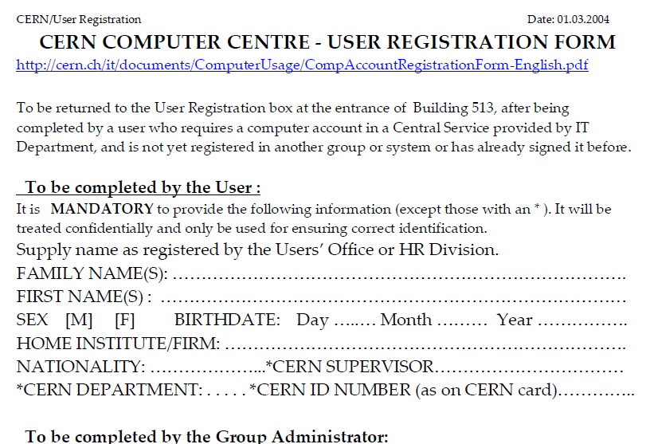
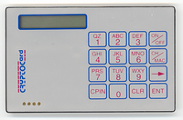
Remember the times? …
Our state of DataGrid and the HEP LHC computing in ~ 2000

Slide 3
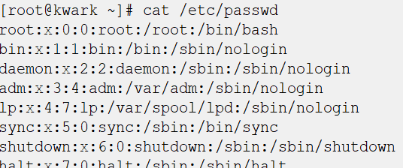
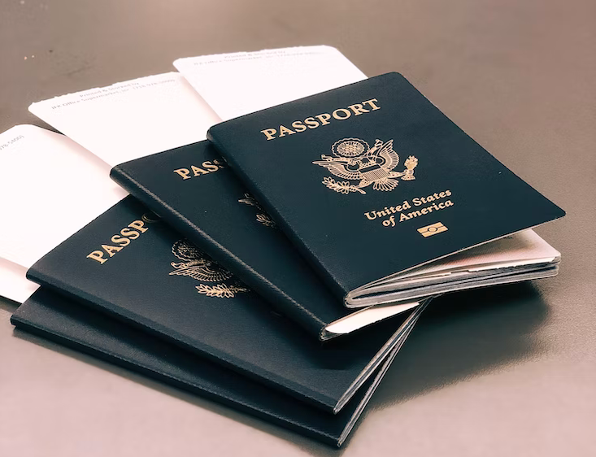
Authentication – who are you
Authenticating to a single service is relatively simple
per-service username and secrets (e.g. password and/or one-time ‘6 digit’ code)
server-side: list of valid users and (hashed and hopefully salted) secrets
Passport image: cropped from original by Jon Tyson on Unsplash https://unsplash.com/photos/Hid-yhommOg

Slide 4
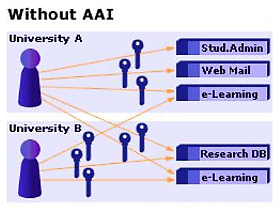


Access control in a single domain
Without AAI,
Authentication & Authorization Infrastructure is dedicated to each service you want to access
account linked directly to service authorization
sometimes even
different accounts for different roles
In a multi-organizational system becomes
O(n_{sites}*n_{services}) * O (n_{users})
Image: AARC NA2 training module “Authentication and Authorisation 101” - https://aarc-community.org/training/aai-101/

Slide 5
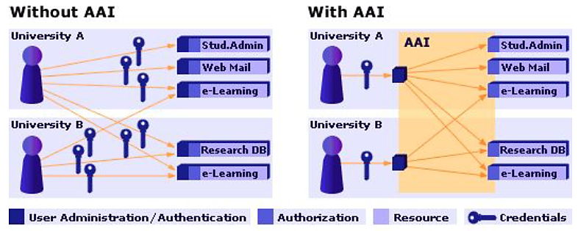
Authentication and Authorization Infrastructure
Image: AARC NA2 training module “Authentication and Authorisation 101” - https://aarc-community.org/training/aai-101/

Slide 6
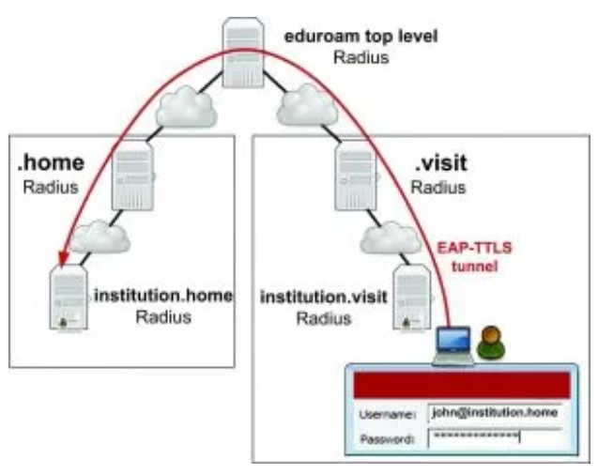

One simple federation you know: eduroam
Service-specific “WiFi” trust
between organisations globally
hierarchichy of authorization servers
based on secure credential exchange
tunneling your credentials
back to your home institution
Local server then instructs WiFi access point/controller
eduroam: Klaas Wieringa et al., image from https://eduroam.org/how/, GEANT ; RADIUS: RC2865 https://www.rfc-editor.org/rfc/rfc2865; see also freeradius.org

Slide 7
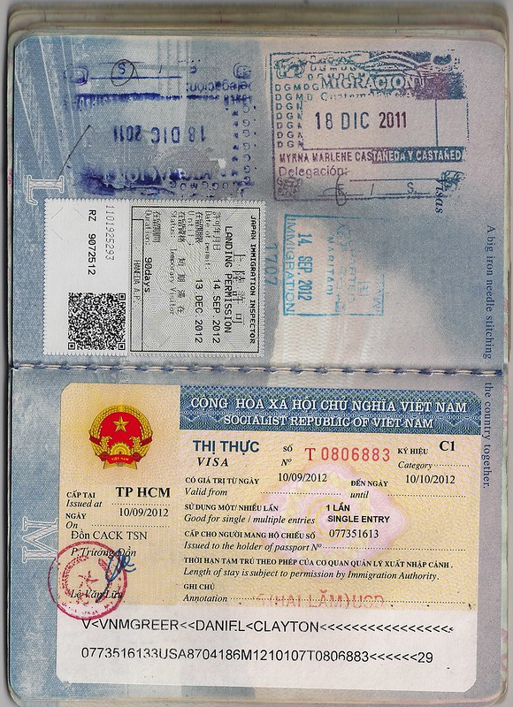
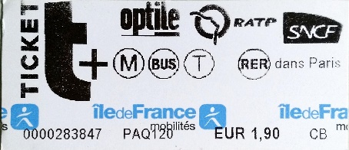
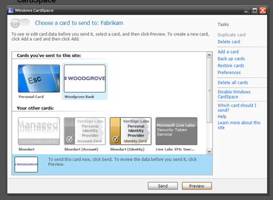
But what can you do? How should a service decide?
Since you’re (probably) not omnipotent … you need
authorization: a statement that the service recognises
bound to an verifiable identity statement
e.g. visa are strongly linked to a specific entity, and
asserted by a trusted party (by the service)
be a bearer token
scoped to a relying party, a service, or an action
self-asserted
quite useless unless backed by verifiable evidence,
like in self-sovereign identity schemes
visa image source: dcgreer on flickr, CC-BY-NC-ND, https://www.flickr.com/photos/dcgreer/6562844777; RATP bearer token, issued for the Paris public transport system; self-managed identity image: Windows Cardspace , Kim Cameron, Mike Jones, et al. image from WikiMedia, Used with permission from Microsoft.(https://en.wikipedia.org/wiki/File:Cardspace_identity_selector.png)

Slide 8
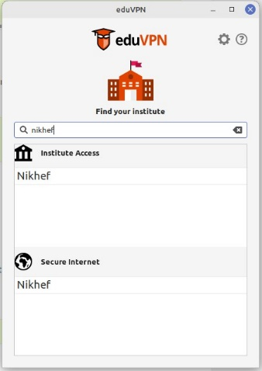
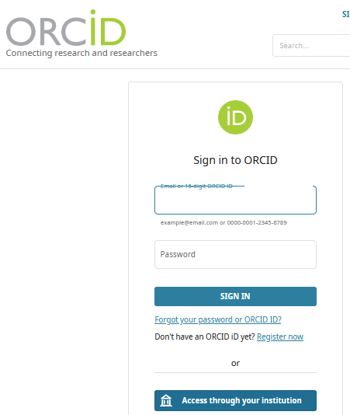
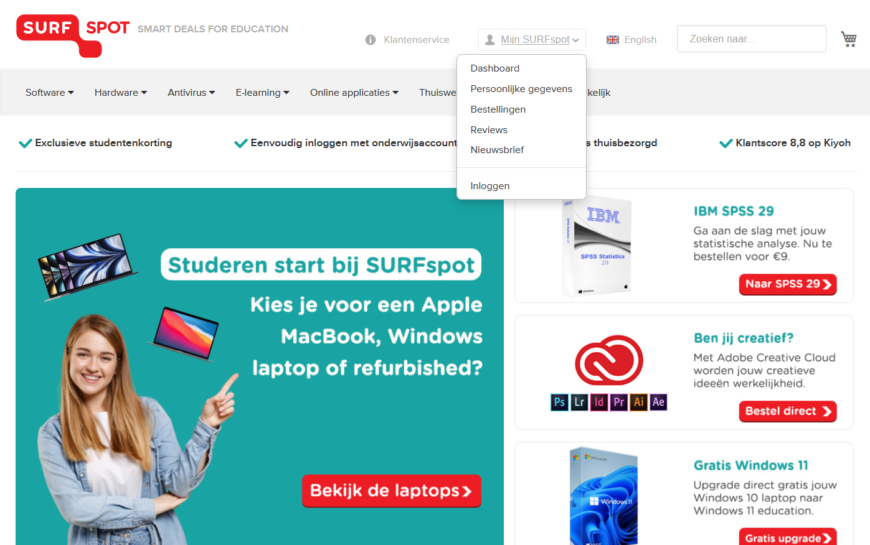
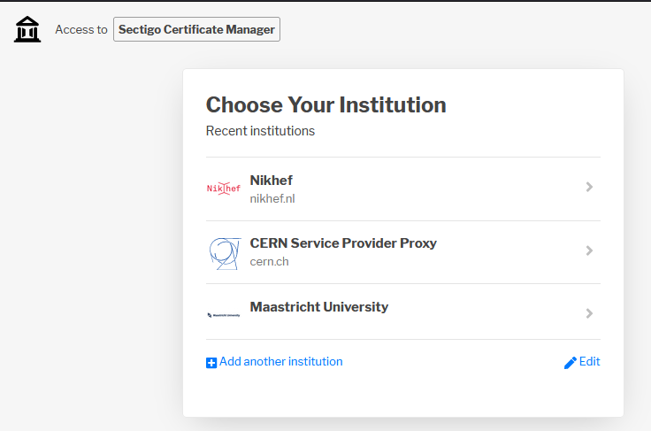
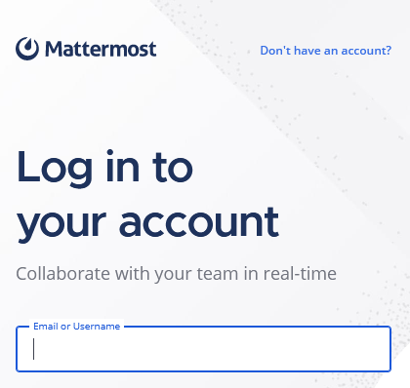


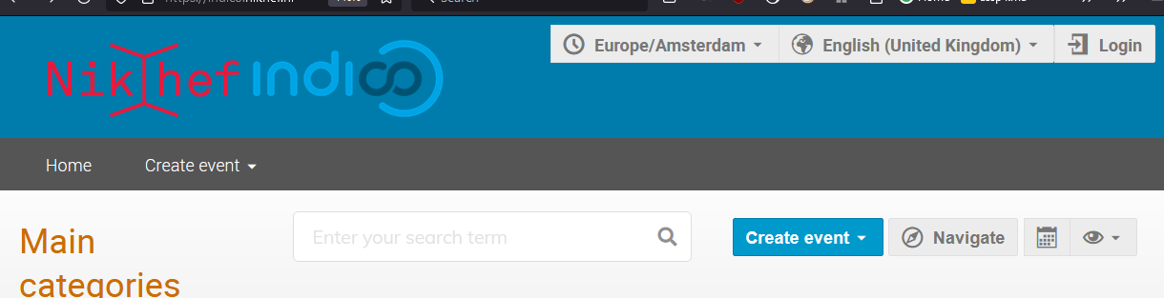
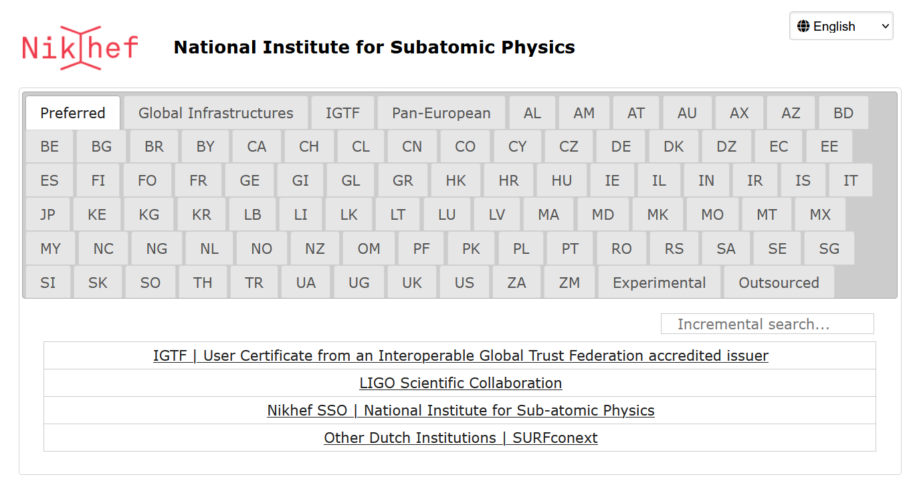
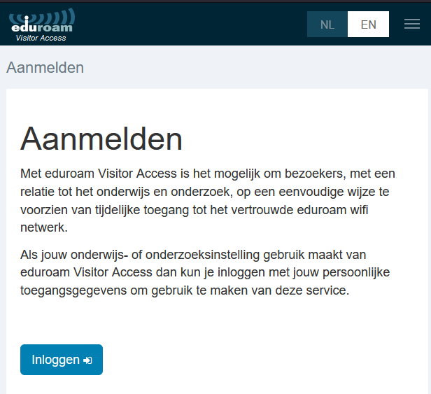
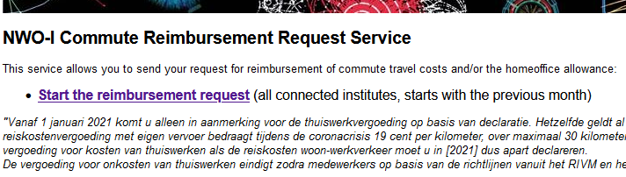
Your favourite federated service?
https://surfspot.nl/ - see also https://kb.nikhef.nl/ct for inspiration on more federated services available to you

Slide 9
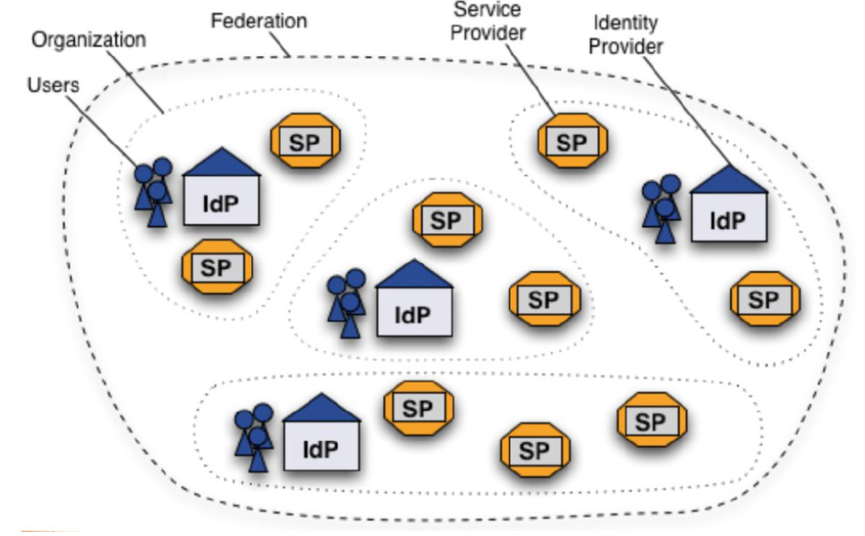
Federation and the ‘SAML dance’ – web-based services
‘portability of identity across administrative domains’
SAML2.0 auth flow
Shibboleth IdP image and SAML2 auth flow by SWITCH (CH) – see also https://refeds.org/ on federation structure and (assurance and security) guidelines

Slide 10
Under the hood, this is a (signed) XML document
<saml:Subject>
<saml:NameID Format="urn:oasis:names:tc:SAML:2.0:nameid-format:persistent">xxxxxxxxxxxxxxxxxxxxxxxxxxxxxxxxxxxxxxxx</saml:NameID>
<saml:SubjectConfirmation Method="urn:oasis:names:tc:SAML:2.0:cm:bearer">
<saml:SubjectConfirmationData NotOnOrAfter="2022-10-21T18:16:40Z"
Recipient="https://attribute-viewer.aai.switch.ch/Shibboleth.sso/SAML2/POST"
InResponseTo="_64c10a60c382bdaeb328653d9d25951c" /></saml:SubjectConfirmation>
</saml:Subject>
<saml:Conditions NotBefore="2022-10-21T18:11:39Z"
NotOnOrAfter="2022-10-21T18:16:40Z">
<saml:AudienceRestriction>
<saml:Audience>https://attribute-viewer.aai.switch.ch/shibboleth</saml:Audience>
</saml:AudienceRestriction>
</saml:Conditions>
<saml:AuthnStatement AuthnInstant="2022-10-21T17:33:29Z"
SessionNotOnOrAfter="2022-10-22T02:33:29Z"
SessionIndex="_90f745f18f712b6a567a3c844269700bd8eb737741">
<saml:AuthnContext>
<saml:AuthnContextClassRef>urn:oasis:names:tc:SAML:2.0:ac:classes:PasswordProtectedTransport</saml:AuthnContextClassRef>
<saml:AuthenticatingAuthority>https://sso.nikhef.nl/sso/saml2/idp/metadata.php</saml:AuthenticatingAuthority>
</saml:AuthnContext>
</saml:AuthnStatement>
<saml:AttributeStatement>
<saml:Attribute Name="urn:mace:dir:attribute-def:cn"
NameFormat="urn:oasis:names:tc:SAML:2.0:attrname-format:uri">
<saml:AttributeValue xsi:type="xs:string">David Groep</saml:AttributeValue>
</saml:Attribute>
<saml:Attribute Name="urn:oid:2.5.4.3"
NameFormat="urn:oasis:names:tc:SAML:2.0:attrname-format:uri">
<saml:AttributeValue xsi:type="xs:string">David Groep</saml:AttributeValue>
</saml:Attribute>
<saml:Attribute Name="urn:mace:dir:attribute-def:eduPersonAffiliation"
NameFormat="urn:oasis:names:tc:SAML:2.0:attrname-format:uri">
<saml:AttributeValue xsi:type="xs:string">employee</saml:AttributeValue>
<saml:AttributeValue xsi:type="xs:string">member</saml:AttributeValue>
<saml:AttributeValue xsi:type="xs:string">faculty</saml:AttributeValue>
</saml:Attribute>
<saml:Attribute Name="urn:oid:1.3.6.1.4.1.5923.1.1.1.1“
...
Nikhef SSO
Try the SAML-tracer for Firefox by Jaime, Thijs and Jan:
https://addons.mozilla.org/en-US/firefox/addon/saml-tracer/

Slide 11
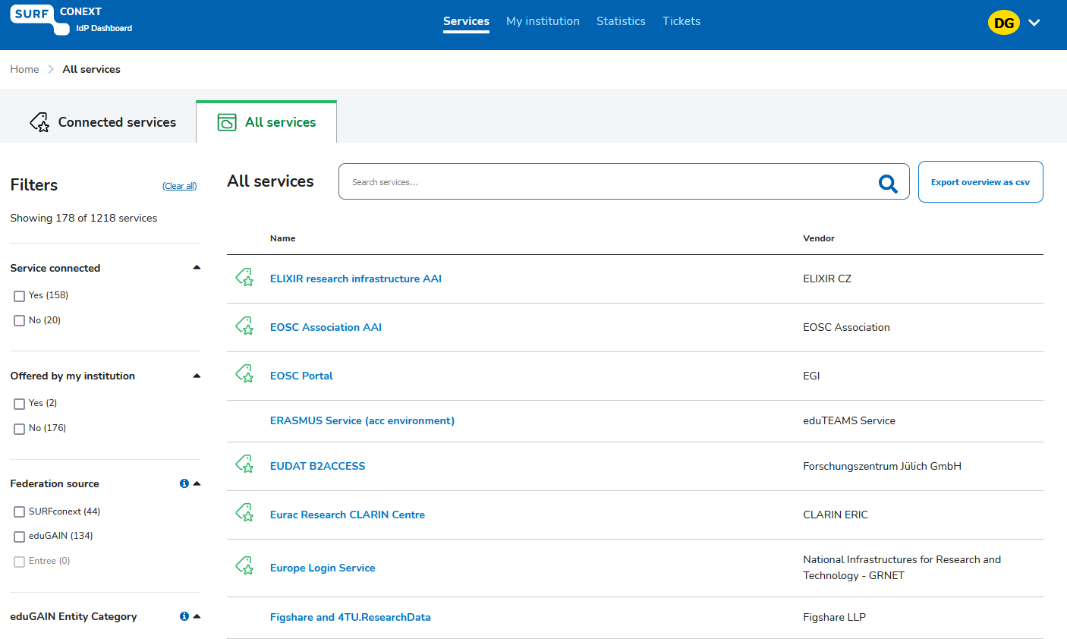

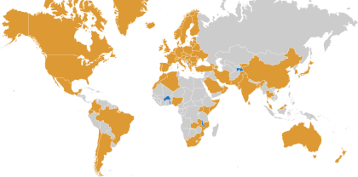
SURFconext & eduGAIN – we only solved half the issues …
Images: SURFconext IdP dashboard by SURF, showing some services tagged with REFEDS R&S; eduGAIN map: GEANT, https://technical.edugain.org/status

Slide 12
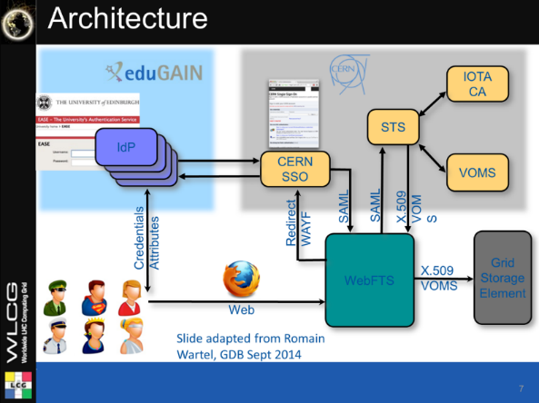
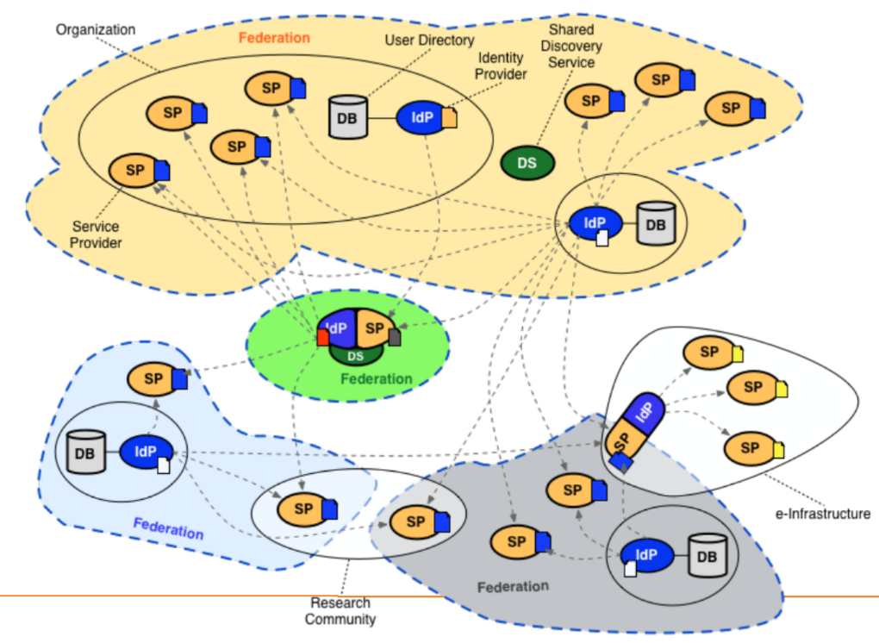
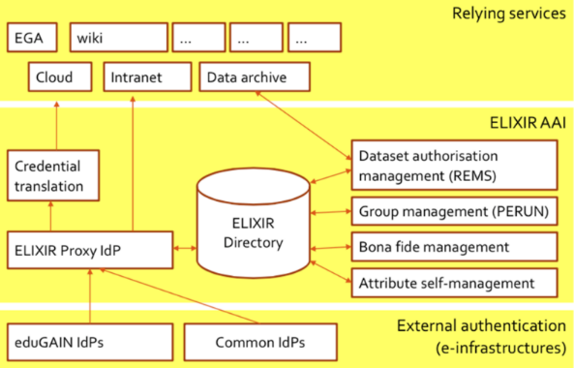
AARC: managing complexities of federated communities
WebFTS prototype
‘FIM4R’ in wLCG
Romain Wartel et al.
ELIXIR reference architecture 2016
Mikael Linden et al.
communities had either invented
their own ‘proxy’ model to abstract complexity
or they were composed of many services
each of which had to manage federation complexity
Community images: Romain Wartel, CERN; Mikael Linden, CSC; Lukas Hammerle, SWITCH

Slide 13

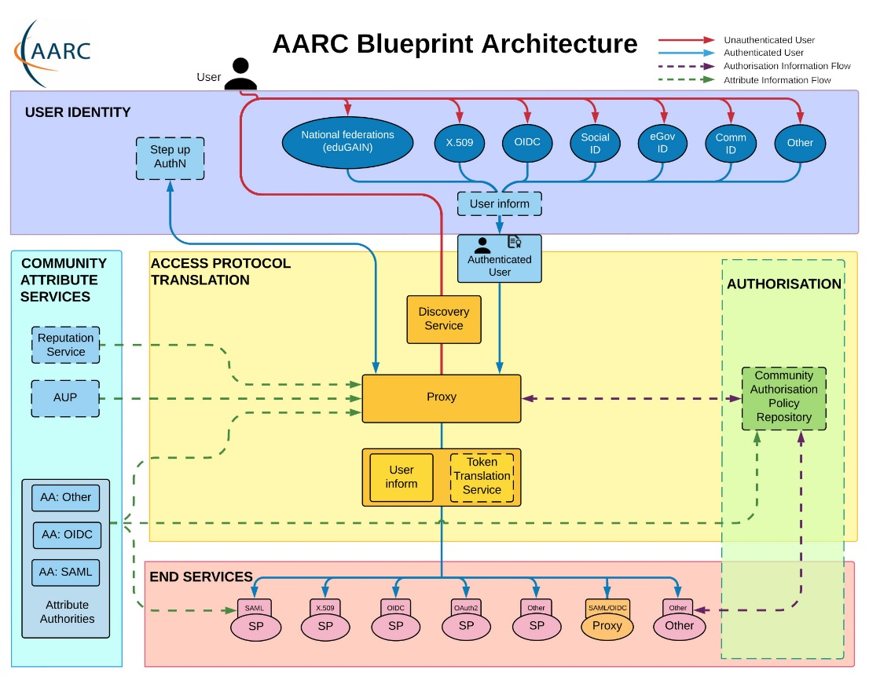
Most trust flows from the (research) community
AARC Blueprint Architecture (2019) AARC-G045 https://aarc-community.org/guidelines/aarc-g045/;
stacked proxies: EOSC AAI Architecture: EOSC Authentication and Authorization Infrastructure (AAI), ISBN 978-92-76-28113-9, http://doi.org/10.2777/8702

Slide 14
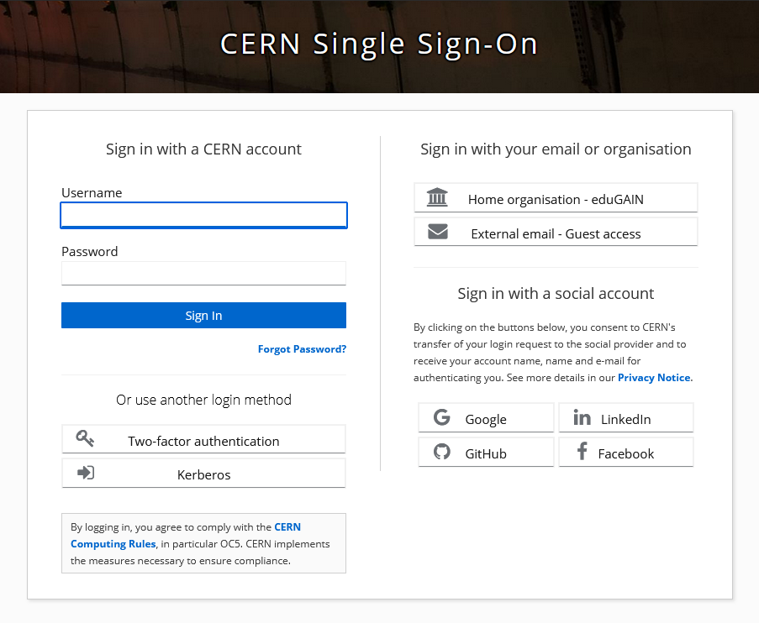
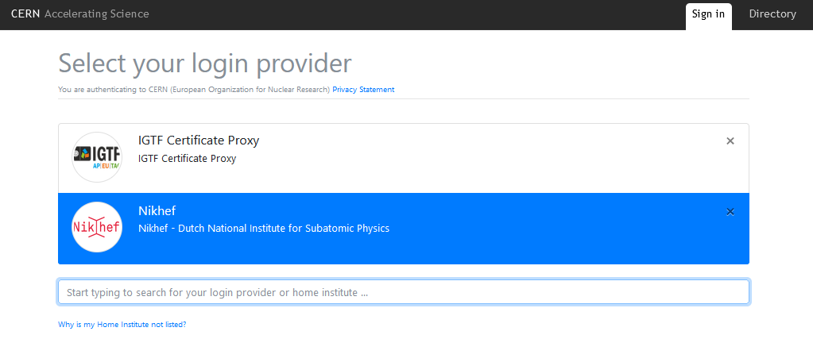
New CERN single sign-on
Having done account linking at CERN,
you can use your Nikhef or university
home identity without having to login again.
For up to ‘cappuccino’ (4/5) assurance level
https://auth.cern.ch/auth/realms/cern/protocol/openid-connect/auth - CERN new SSO system design by Hannah Short et al.

Slide 15
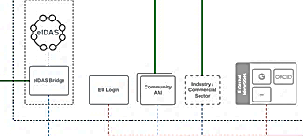
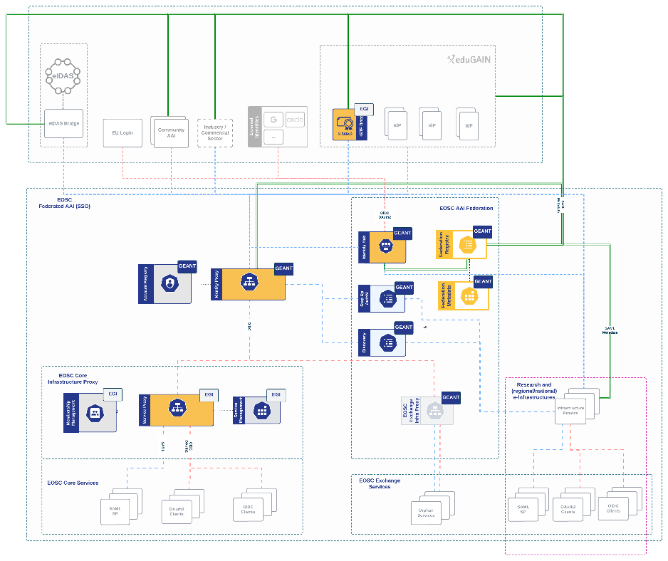
EOSC AAI Federation, MyAccessID
Identity assurance brings the true value: authenticators are aplenty, and ‘MFA’
far less interesting than vetted identities.
But education IdPs seem reluctant to provide it …
user identity comes ‘with the user’ from outside,
mediated by the research community, ORCID,
or from the home member state involved
Image: EOSC AAI for the EOSC Core and Exchange Federation for the EOSC European Node by Christos Kanellopoulos, Nicolas Liampotis, David Groep (June 2023)

Slide 16
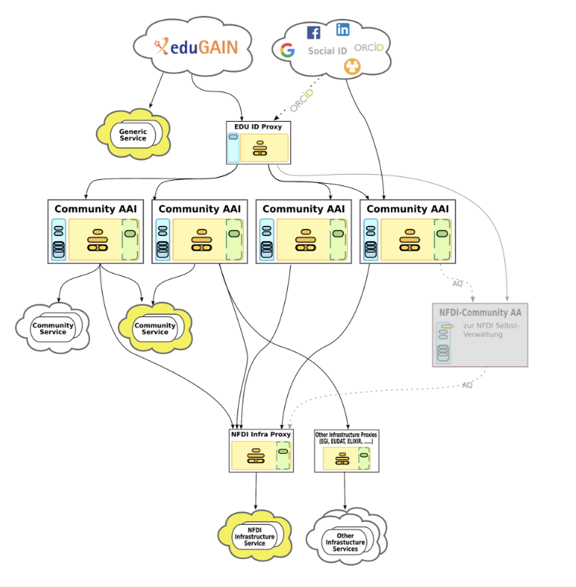
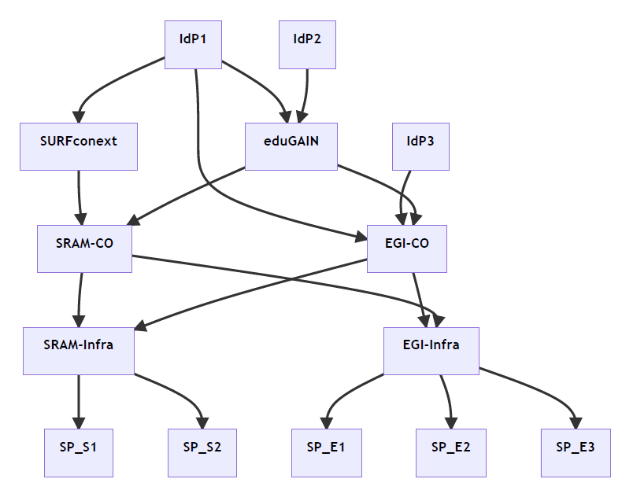

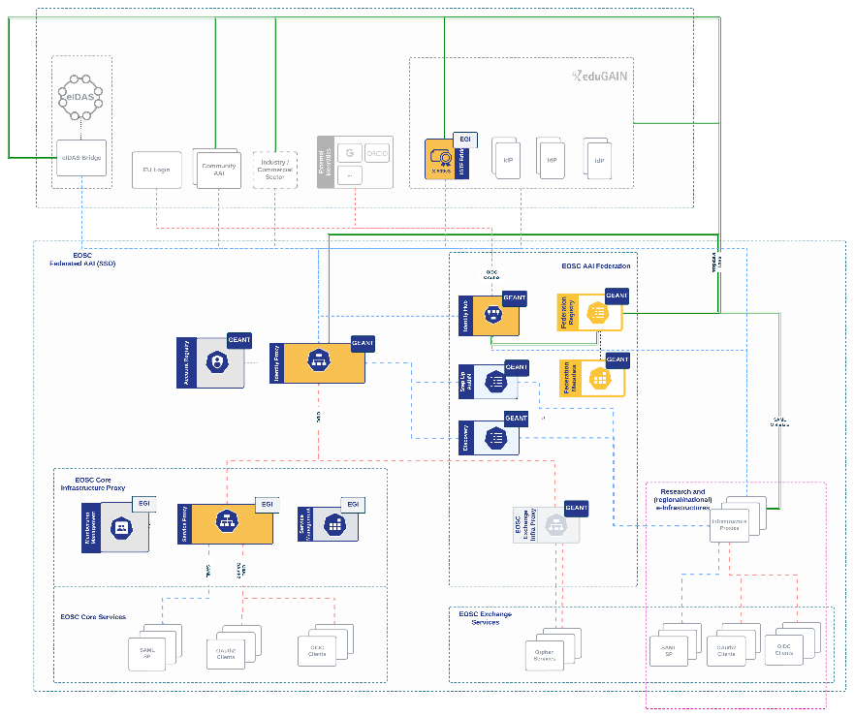
And that is only the beginning!
Images: SURF SSRAM and EGI by Maarten Kremers, NDFI AAI (Marcus Hardt),
EOSC AAI for the EOSC Core and Exchange Federation for the EOSC European Node by Christos Kanellopoulos, Nicolas Liampotis, David Groep (June 2023 version)

Slide 17
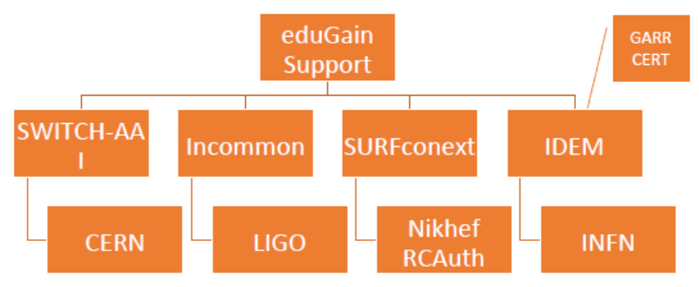
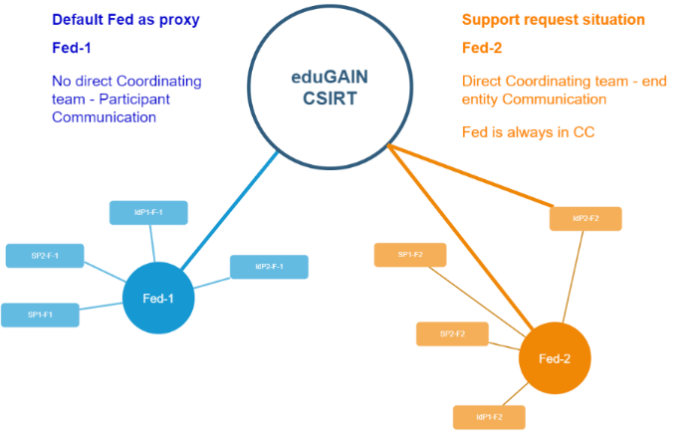
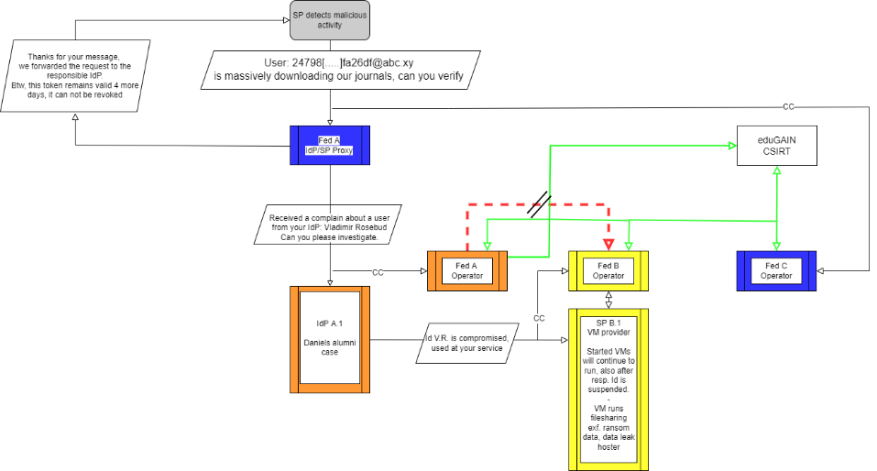
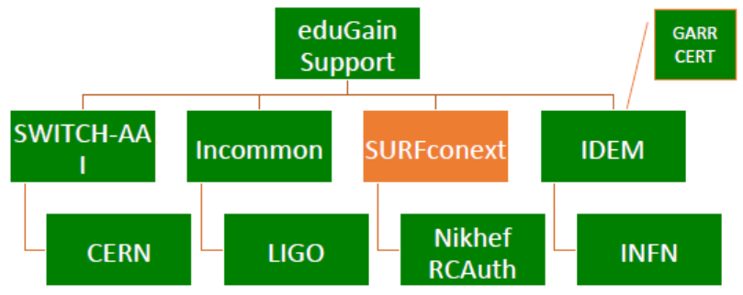




Response and traceability across IdP-SP Proxies and the limits of Sirtfi
Srtfi v1
Guidelines for a joint operational trust baseline for membership management and proxy components,
supplemented by policy guidance for sectoral federations with more specific policies where needed
‘How can we convey the trust in what is in and behind the proxy?’
‘How to provide timely traceability between services and identities through the proxy?’
Based on requirements from FIM4R, WISE, and the proxy operators in AEGIS.
|
|CSIRT
joint work with GN5-1 EnCo and eduGAIN CSIRT
images: AARC Sirtfi v1 exercise (Hannah Short), eduGAIN security TTX (Sven Gabriel, eduGAIN CSIRT)

Slide 18


sso.nikhef.nl aarc-community.org
Co-funded by
the European Union
AARC TREE and GEANT 5-1 are co-funded by the European Union. Views and opinions expressed are however those of the author(s) only and do not necessarily reflect those of the European Union. Neither the European Union nor the granting authority can be held responsible for them.
Thanks to the AARC Community, including folk from whom I re-used graphics and material in this overview. In random order: Licia Florio, Nicolas Liampotis, Christos Kanellopoulos, Marina Adomeit, Janos Mohacsi, Ilaria Fava, Slavek Licehammer, Dave Kelsey, Ian Neilson, Marcus Hardt, Mischa Salle, Hannah Short, and Maarten Kremers.

Slide 19
Background and supporting materials

Slide 20
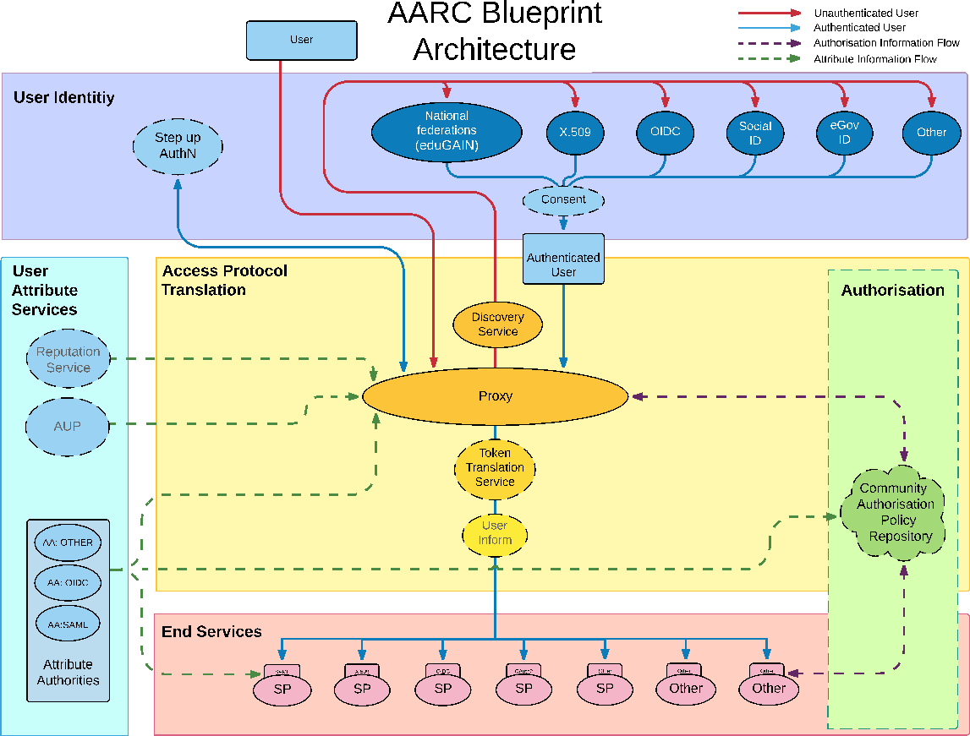
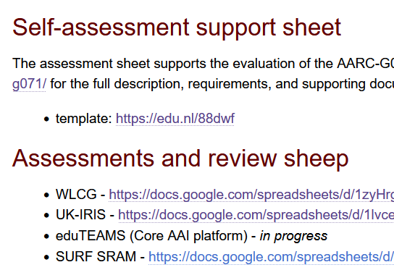

AARC G071 is there to help, but do we ‘get the trust across’?
Membership management service, attribute authorities, and proxy/token translator
integrity of membership
identification, traceability
site and service security
network protections
assertion integrity
> Trust marks and expression
Community membership management directories and attribute authorities
integrity of membership
identification, naming and traceability
site and service security
protection on the network
assertion integrity
But when proxies are proxying proxies, can we proxy the trust?
Agree to a
common baseline
… an approach that was successful previously!
See https://www.igtf.net/guidelines/aaops/ and https://aarc-community.org/guidelines/aarc-g071/

Slide 21
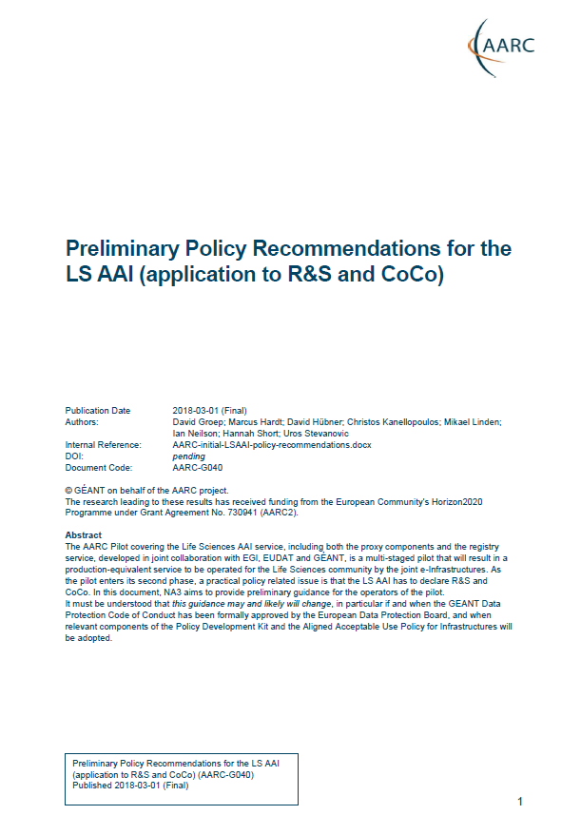
Proxies have their own challenges as well: AUPs, T&Cs, Privacy notices, …
For large ‘multi-tenant’ proxies
some subset users in some communities use a set of services –
how to present their Terms and Conditions and their privacy policies, so that users
  only see the T&Cs and notices for services they will access
  this does not to need to be manually configured for each community
  is automatically updated when services join
For community and dedicated proxies
when new (sensitive) services join, who needs to see the new T&Cs?
can we communicate existing acceptance of T&Cs to downstream services?
What is an acceptable user experience in clicking through agreements?
What is effective in exploiting the WISE Baseline AUP? What do researchers need?
‘with fewer clicks to more resources’
beyond AARC-G040

Slide 22
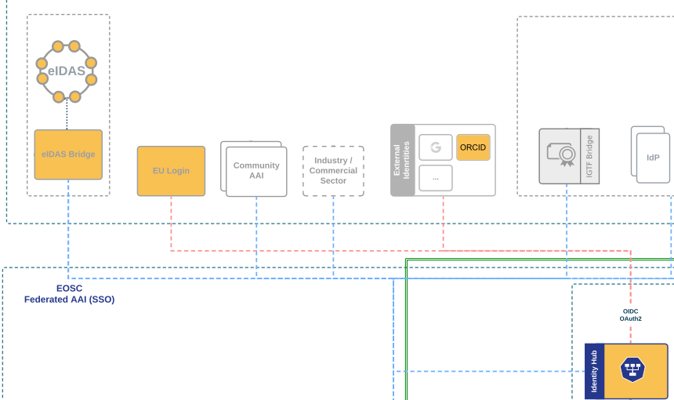
And .. we’ll be seeing more, and diverse, sources of identity assurance
An ‘available’ persistent source of assurance may be the (European) government-ID ecosystem
step-up to at least substantial level can now readily be done ‘at home’ by many users
through their national eID schemes
Joint work on eIDAS, Erasmus Student Mobility,
and more makes this more accessible
step-up-as-a-service as a fall-back (like in .se)
better attainable than relying on home institutions?
… but:
what to do with non-European users?
how to link the identities together

Slide 23
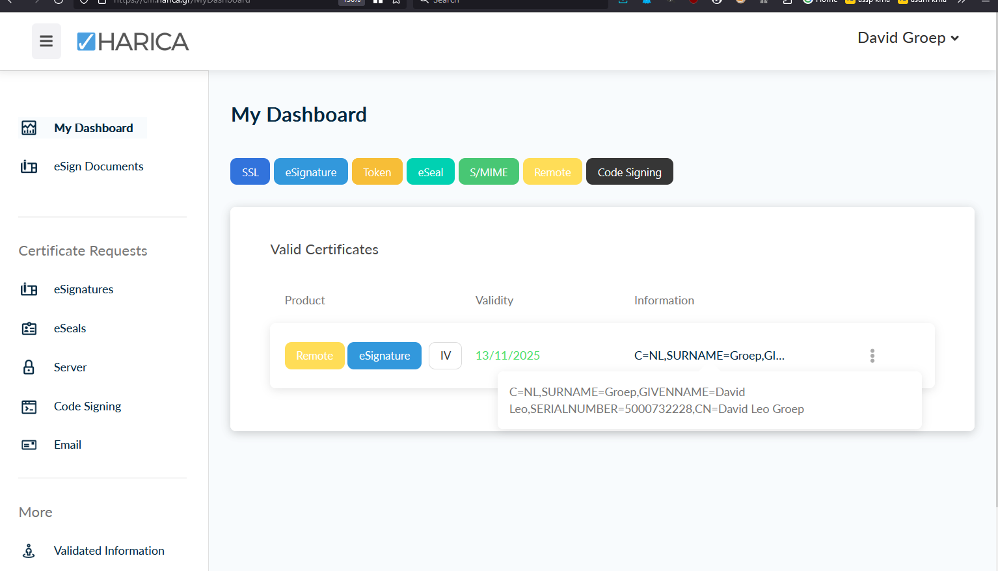

Better than a blue-ink signature, and assurance via DigID
images: screenshot of the HARICA remote signing interface, cm.harica.gr. Dutch eIDAS for citizens: DigID, excerpt from www.digid.nl screen shot
Thanks to Dimitris Zacharopoulos (HARICA) for getting the authentication working. eIDAS connected enabled through GRNET and Logius

Slide 24
Example service translating to certificates
RCauth.eu
by Mischa Sallé et al.

Slide 25
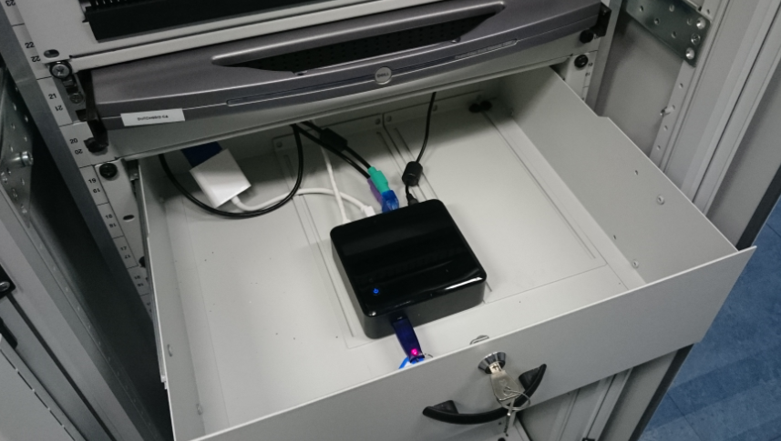
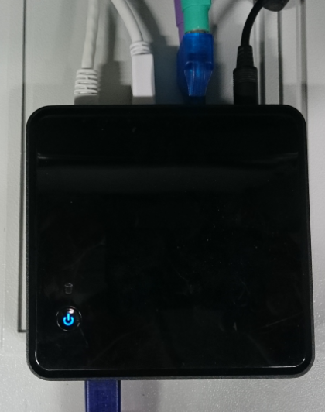
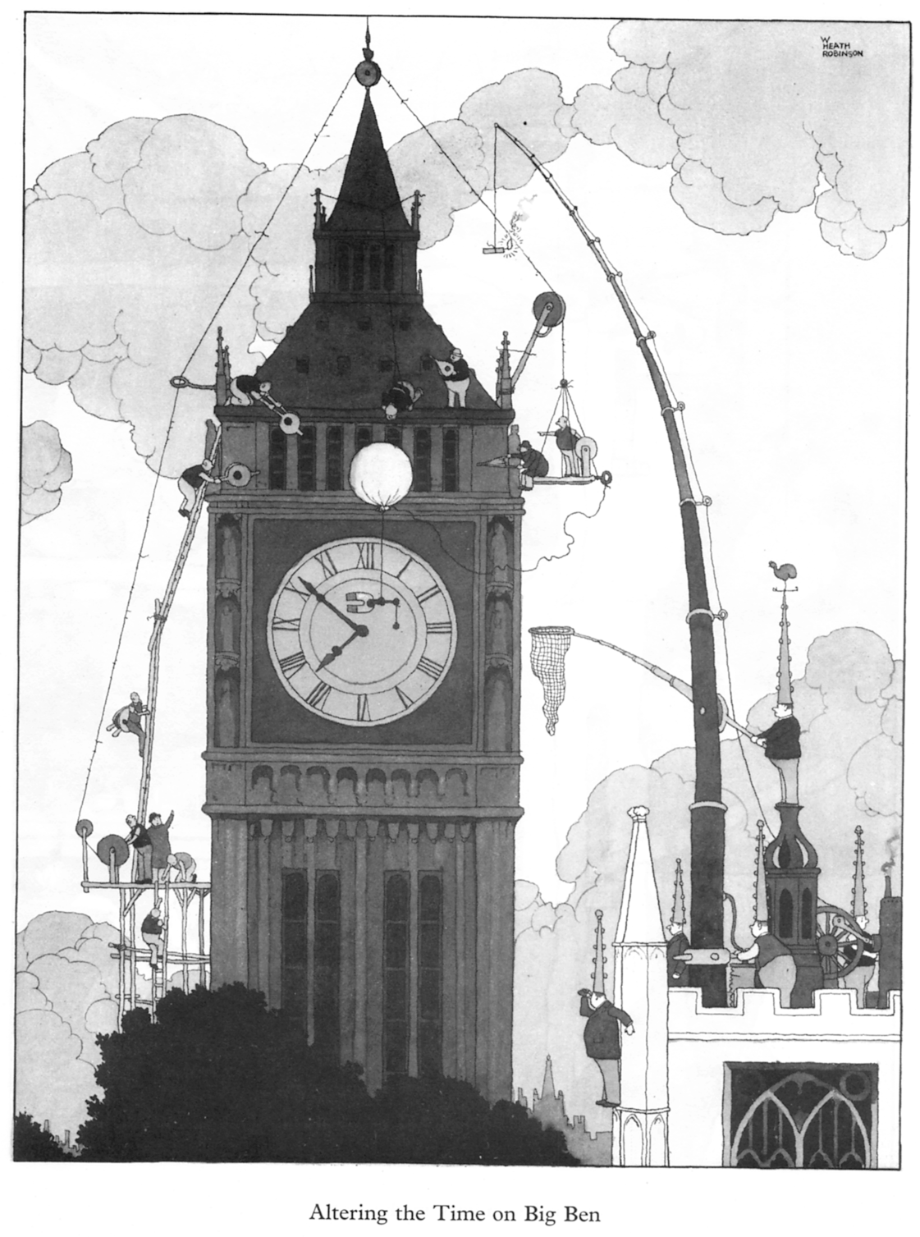
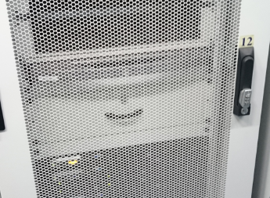
Token translation example: RCauth
from Heath Robinson to anycasted HA infrastructure
Nikhef RCauth prototype instance in 2019
Mischa Sallé

Slide 26
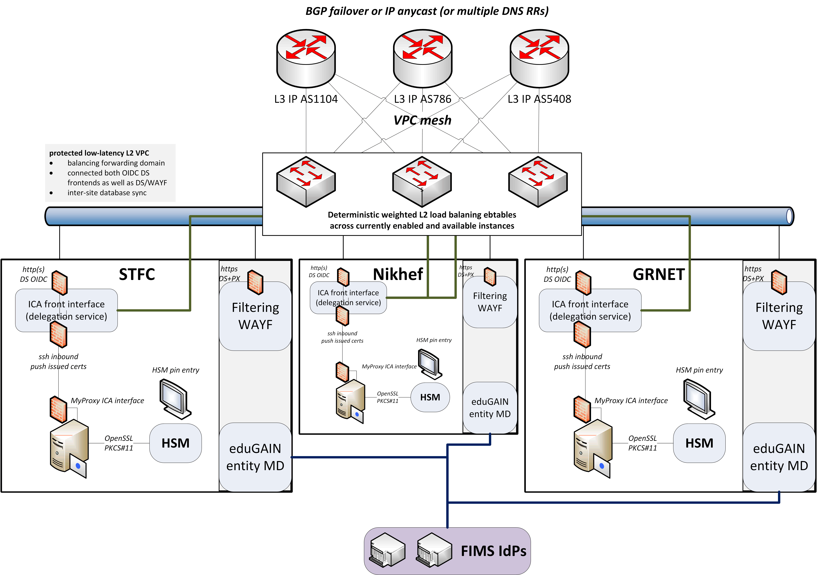
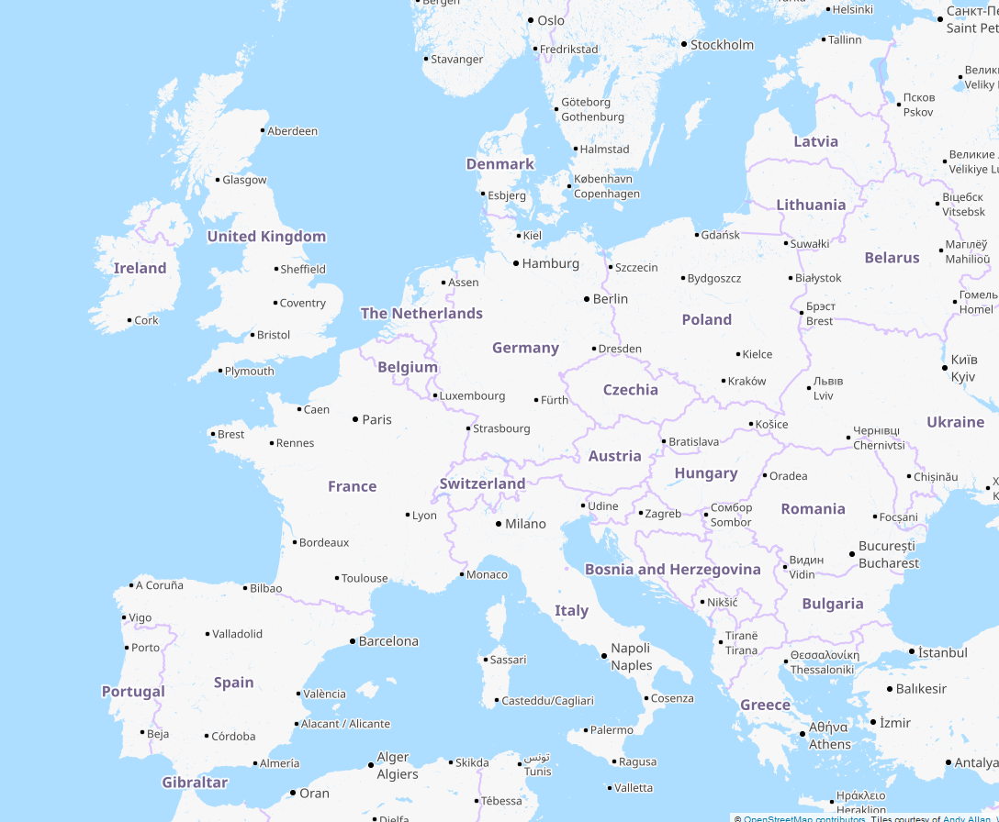
But we did not like ‘SPOFs’
Distributed High Availability setup
across the 3 sites
design for minimal effort
readily-available techniques
  L3 VPN (OpenVPN) or L2 VPC
  Linux HAProxy
STFC (OXF)
Nikhef (AMS)
work supported by the EOSC Hub and EOSC Future projects
co-funded by the European Union
Design by Mischa Sallé, with Nicolas Liampotis and Kyriakos Gkynis
GRNET (ATH)

Slide 27


Getting 2a07:8504:1a0::/48 out there
route maps: bgp.tools for 2a07:8504:1a0::/48 – IPv4 for 145.116.216.0/24 is similar – imagery from November 2022

Slide 28

Always the shortest path!
[root@kwark ~]# traceroute -IA 145.116.216.1
traceroute to 145.116.216.1 (145.116.216.1),
30 hops max, 60 byte packets
1 cmbr.connected.by.freedominter.net
(185.93.175.234) [AS206238]
2 connected.by.freedom.nl
(185.93.175.240) [AS206238]
3 et-0-0-0-1002.core1.fi001.nl.freedomnet.nl
(185.93.175.208) [AS206238]
4 as1104.frys-ix.net (185.1.203.66) [*]
5 parkwachter.nikhef.nl
(192.16.186.141) [AS1104]
6 gw-anyc-01.rcauth.eu
(145.116.216.1) [AS786/AS5408/AS1104]
rcauth.eu HA proxy
Route from home to RCauth.eu, from my home ISP (Freedom Internet)

Slide 29

You get reasonable load balancing in Europe for free
map: RIPE NCC RIPE Atlas - 500 probes, distributed across Europe (https://atlas.ripe.net/measurements/50949024/)

