Slide 1





eResearchers Requirements the IGTF model of interoperable global trust and with a view towards FIM4R
AAI Workshop
Presenter: David Groep, Nikhef

Slide 2
IGTF – Interoperable Global Trust Federation supporting distributed IT infrastructures for research
IGTF brings together
  e-Infrastructure resource providers, user communities and identity authorities
  to agree on
  global, shared minimum requirements and assurance levels
  inspired and coordinated by the needs of relying parties
Trust is technology-agnostic
  focus on global, coordinated identity across communities and across service providers for cooperative services
  define ‘best practices’ for assurance levels, attribute authority operations, credential management, auditing and reviewing

Slide 3
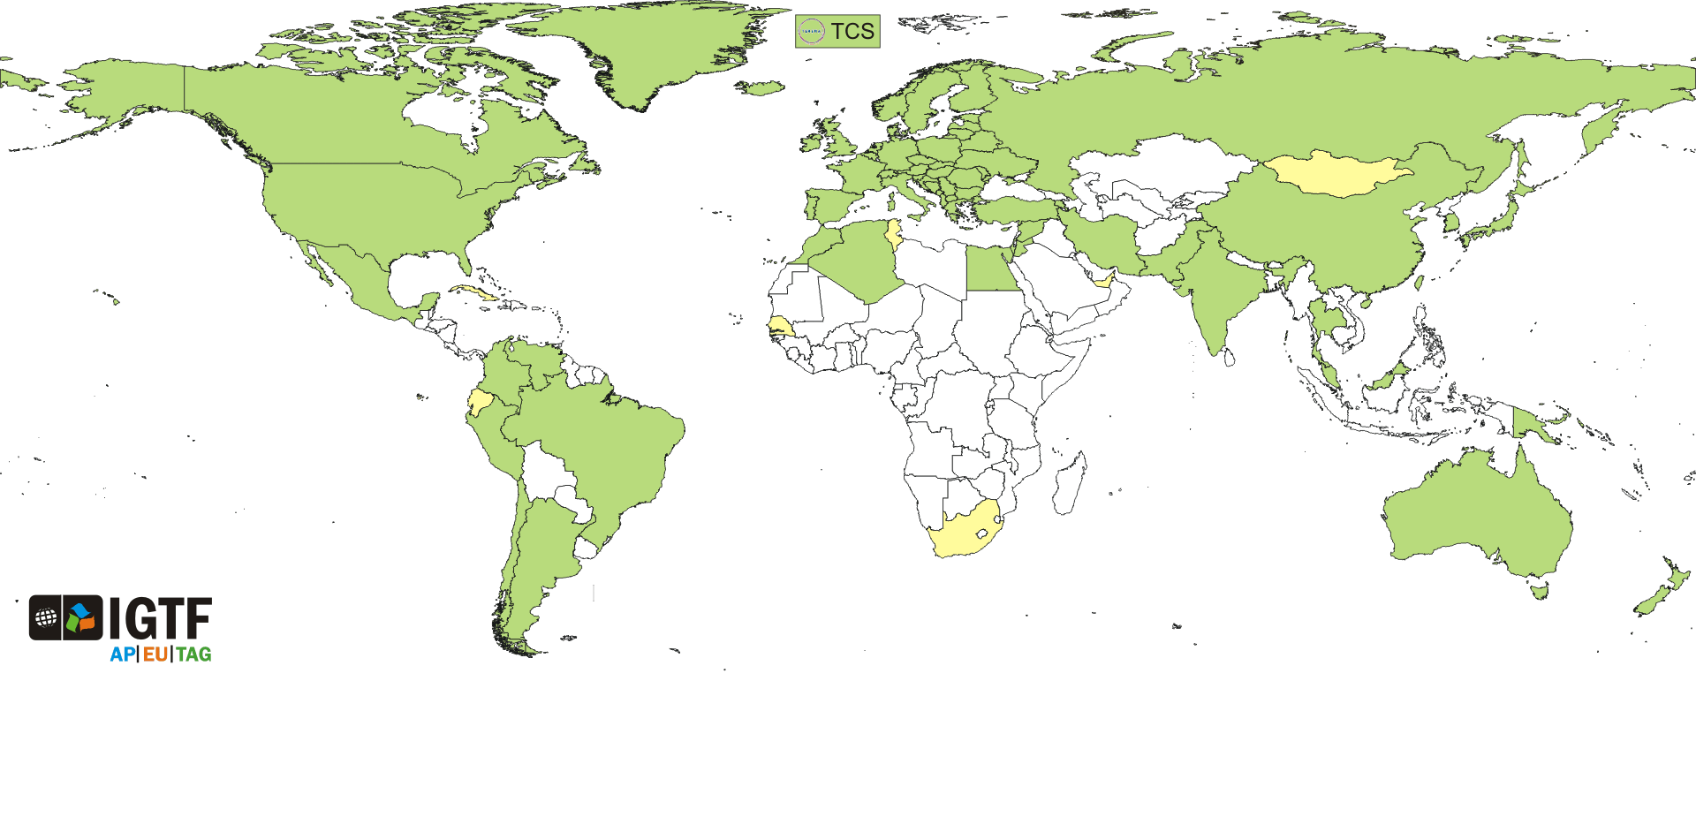
Coverage: users and providers
https://www.igtf.net/
~100 000 users and resources
89 national and regional identity authorities: R&E and commercial
>1000 different user communities: small and large, national and global
Major relying parties: EGI, PRACE, XSEDE, Open Science Grid, HPCI, wLCG, OGF, …
IGTF is a coordinating body, and not a legal entity in itself – although its members may be

Slide 4
Minimum Requirements
Federation imposes minimum requirements
on identity provider participants
  Reflect operational and security needs of resource providers
  Differentiated LoA support
    classic user-based subscriber services: serve all users
    identity services leveraging (R&E) federations with ID vetting
    ‘LoA1+’ Identifier-Only Trust Assurance
    – if relying party has other ways to vet its users, allow for
    lower-assurance identifiers, thus enabling more ID federations
  Research-inspired verification process: self-audits,
  peer-review, transparent open policies and processes
  ‘meet or exceed’ required minimum standards
‘LoA2-’

Slide 5
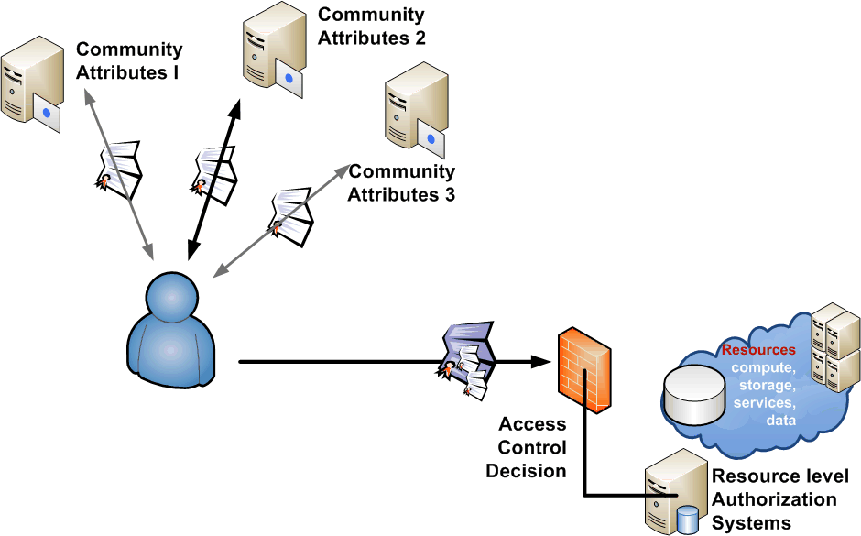
Community characteristics
More than one administrative organisation
More than one service provider
participates in a single transaction
More than one user
in a single transaction
More than one authority
influences effective policy
Single interoperating instance
at a global level

Slide 6
AAI requirements
FIM4R captures the key requirements
different Levels of Assurance with provenance
authorisation under community and/or
facility control
browser & non-browser federated access
attributes must be able to cross national borders
and we also need
federations and IdPs to work in a collaborative security and policy framework, addressing the areas identified in e.g. SCI
support for individual researchers
communities are widely distributed and although
large as a whole may be only a one or a few per institution
global scope: scientific collaborations extend beyond Europe
FIM4R: https://cdsweb.cern.ch/record/1442597/files/CERN-OPEN-2012-006.pdf
SCI – Security for Collaboration among Infrastructures: https://www.igtf.net/sci

Slide 7
Are the Requirements Met?
NO
security trust and operational issues
differentiated LoA: reviewed and/or audited
support for community and facility control, set by themselves and propagated to the SPs
both browser and non-browser access
attributes to cross national borders
Each of these may have been solved in some federations – but what we need is a
coherent European/global view, where these requirements are addressed ubiquitously!

Slide 8
Are the Requirements Met?
YES
Much of the technology is there for
community attributes, facility control, non-web-access
– we ‘just’ need to bridge it to together,
and make sure the technology is deployed uniquitously
there may even be ‘too much’ technology, in that we now need to bridge for interoperability – bridges, proxies, and credential stores will a part (likely supported by the RPs, communities and facilities)
attributes to cross borders: DPCoC is a great step
  now can we do the same for IdPs please?
  the GEANT eduGAIN Federation Template looks like going this way …
  the model of ‘minimum requirements’ and open processes worked well in the IGTF and is ‘natural’ to a research environment

Slide 9



www.igtf.net
Interoperable Global Trust Federation

