Slide 1
Welcome to NikheF
HEPiX Fall 2019 meeting
David Groep
October 2019

Slide 2
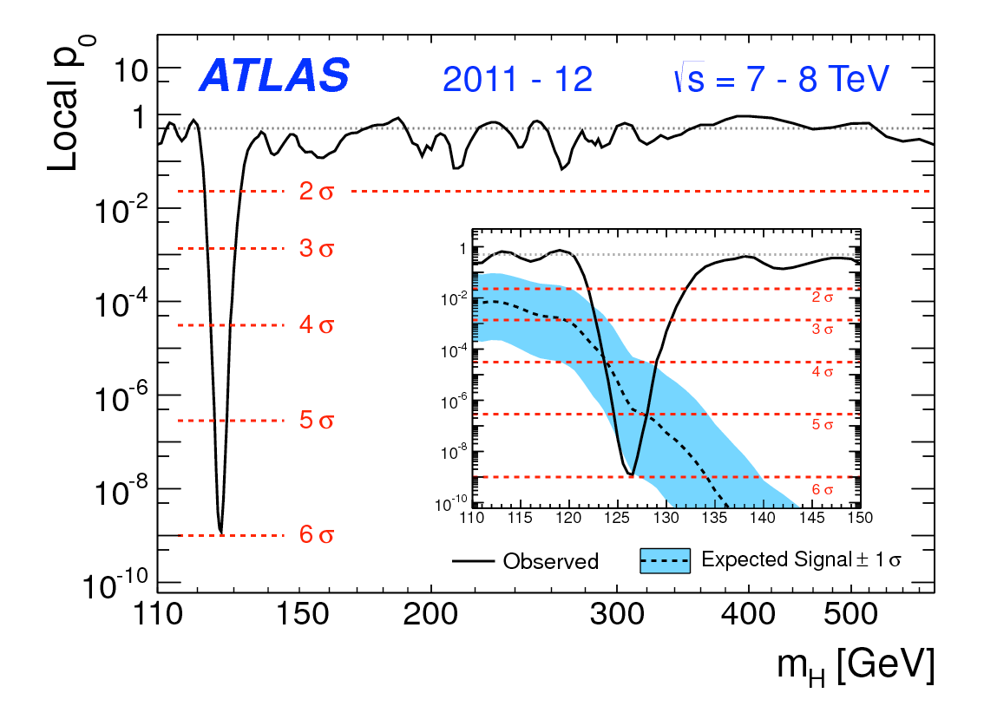
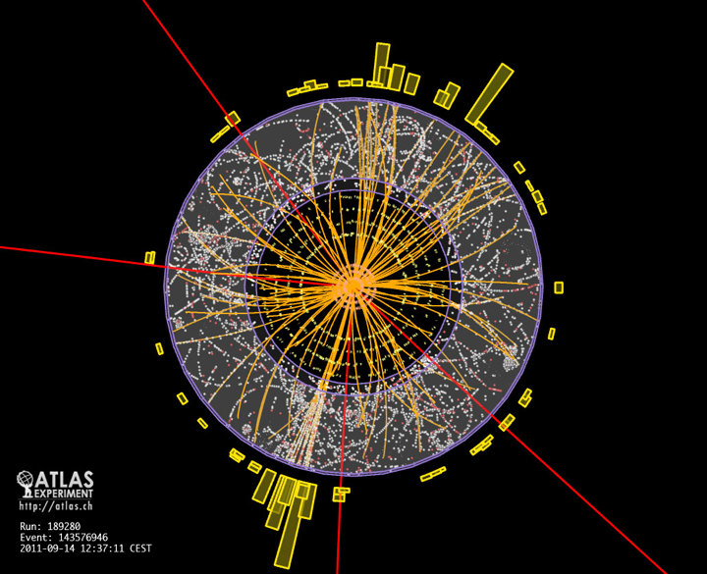
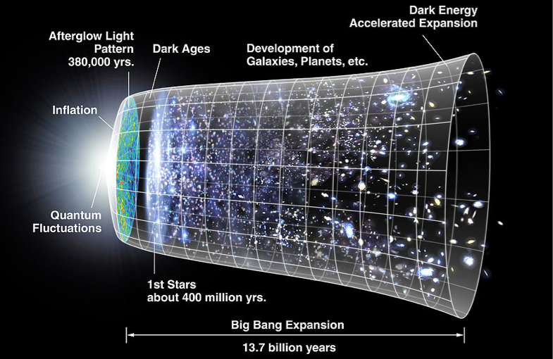
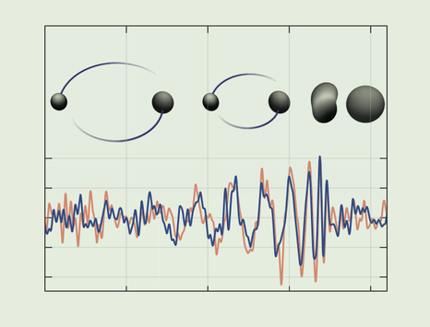
Nikhef – subatomic physics, at every scale
study the interaction and structure
of all elementary particles and fields
collider physics
astro-particle physics
plus knowledge and technology transfer

Slide 3
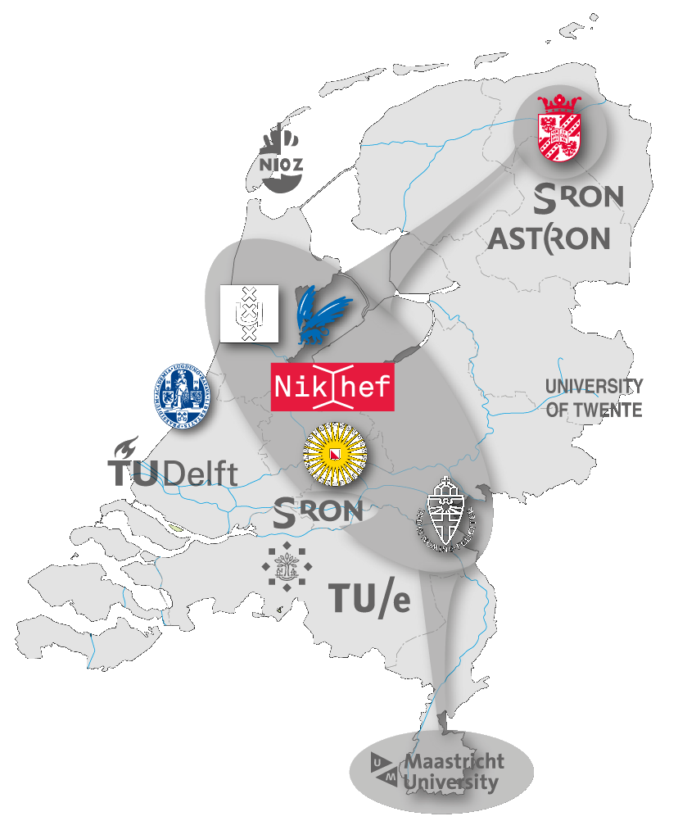


A national science programme
An NWO institute with university partners
  University partners in key positions
    Leaders of the scientific programs
    Comply with the Nikhef National strategy
  Added value Nikhef institute infrastructure
    Technical competence and support
    Large computing infrastructure
    Long term strategy & commitment
  Gain focus and achieve mass
  in world-leading expertiments
Permament Staff | 81
PhD students | 97
Postdocs | 31
Technical/engineer | 71
Support | 33

Slide 4
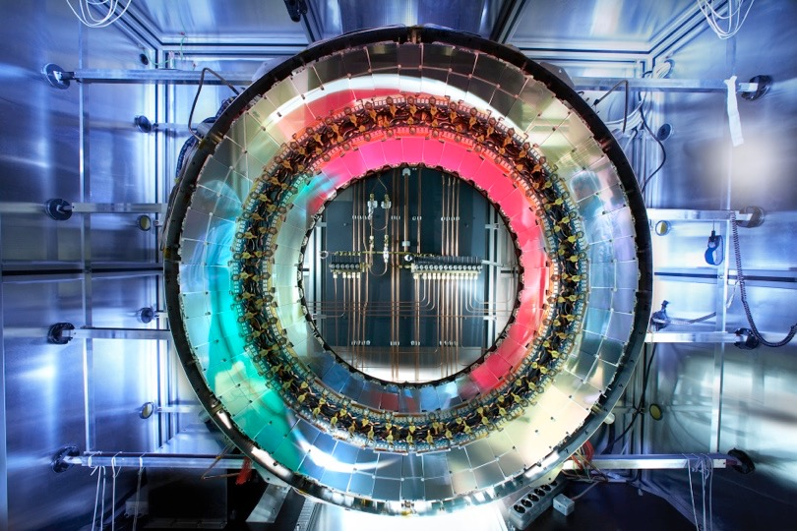
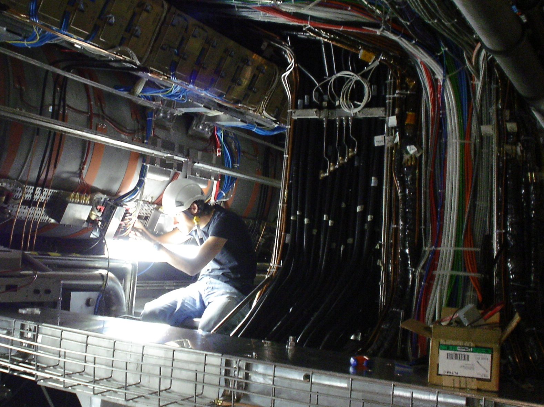
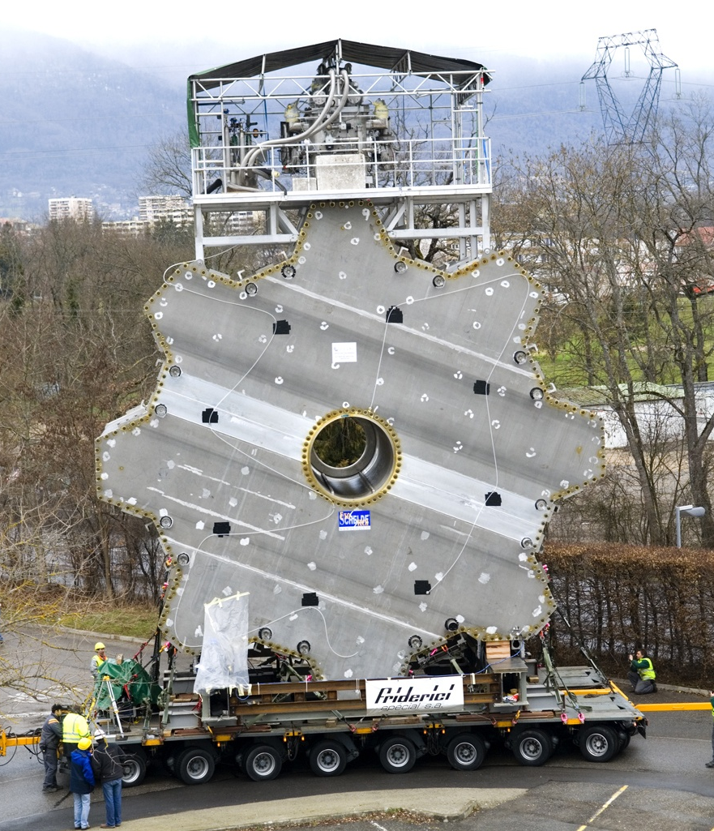
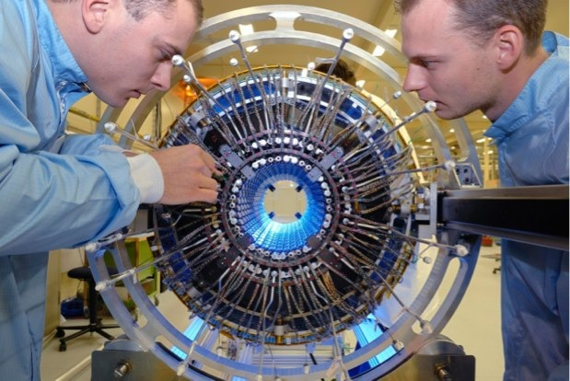
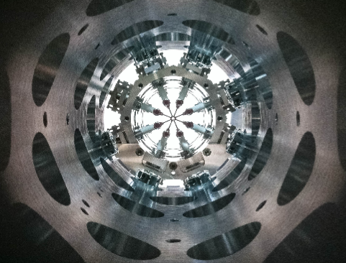
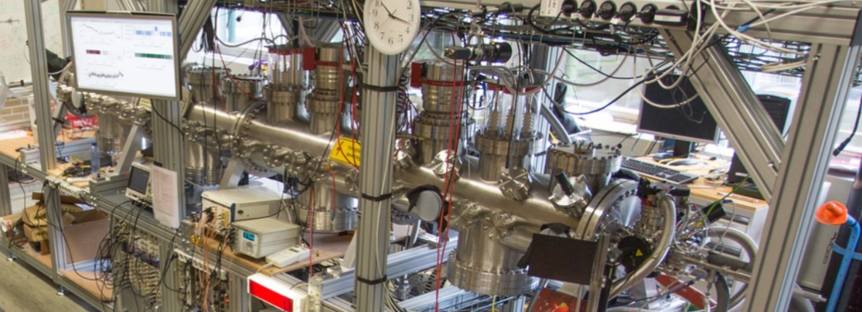
Accellerator physics @CERN
… OR DECELLERATION @RUG

Slide 5
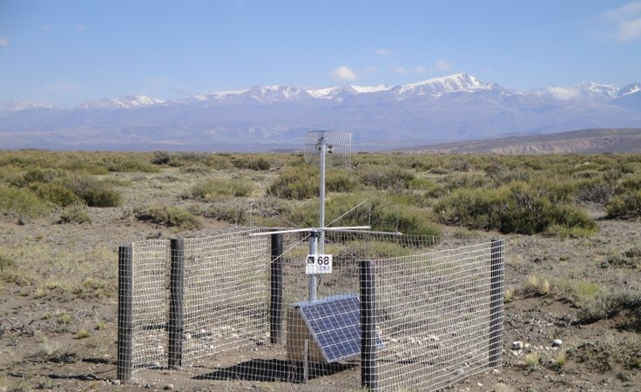
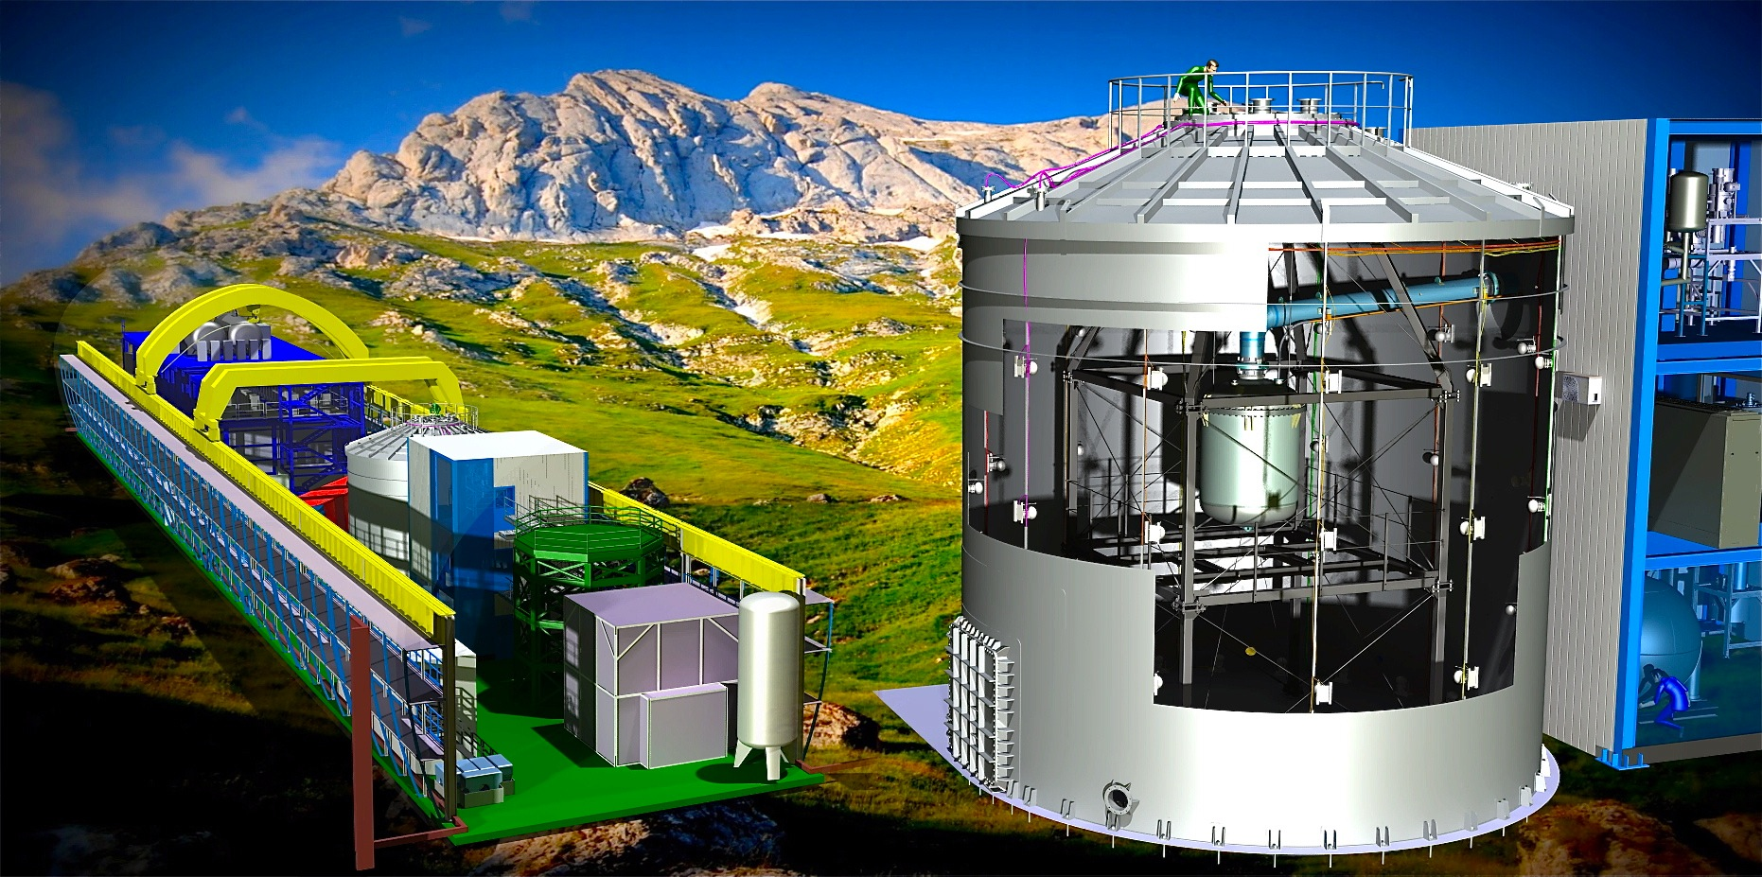

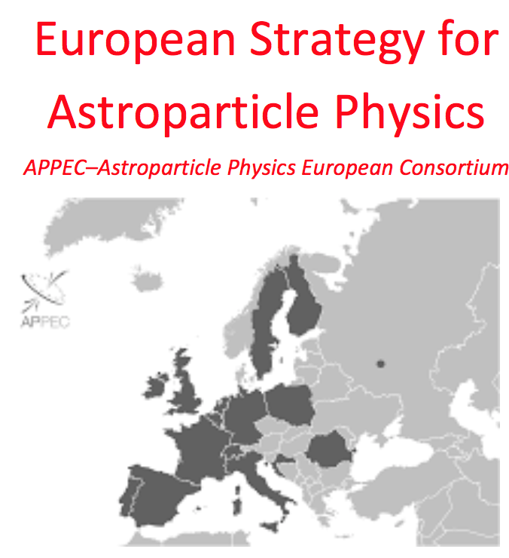
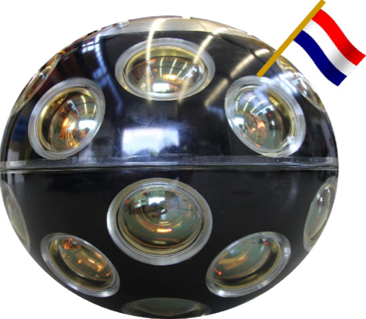
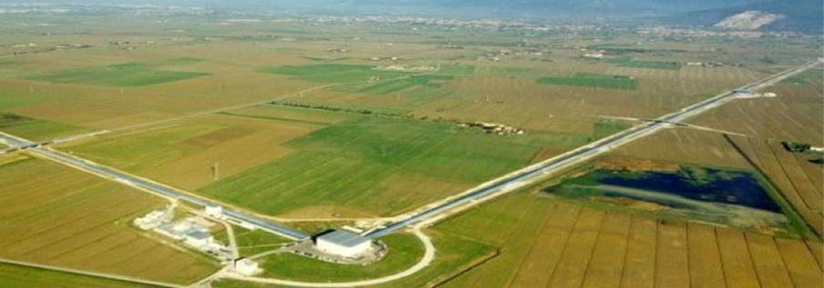
Astroparticle portfolio at Nikhef
Pierre Auger - cosmic rays
Xenon1T - Dark Matter
Adv VIRGO - Gravitational Waves
KM3NeT - neutrino detection

Slide 6
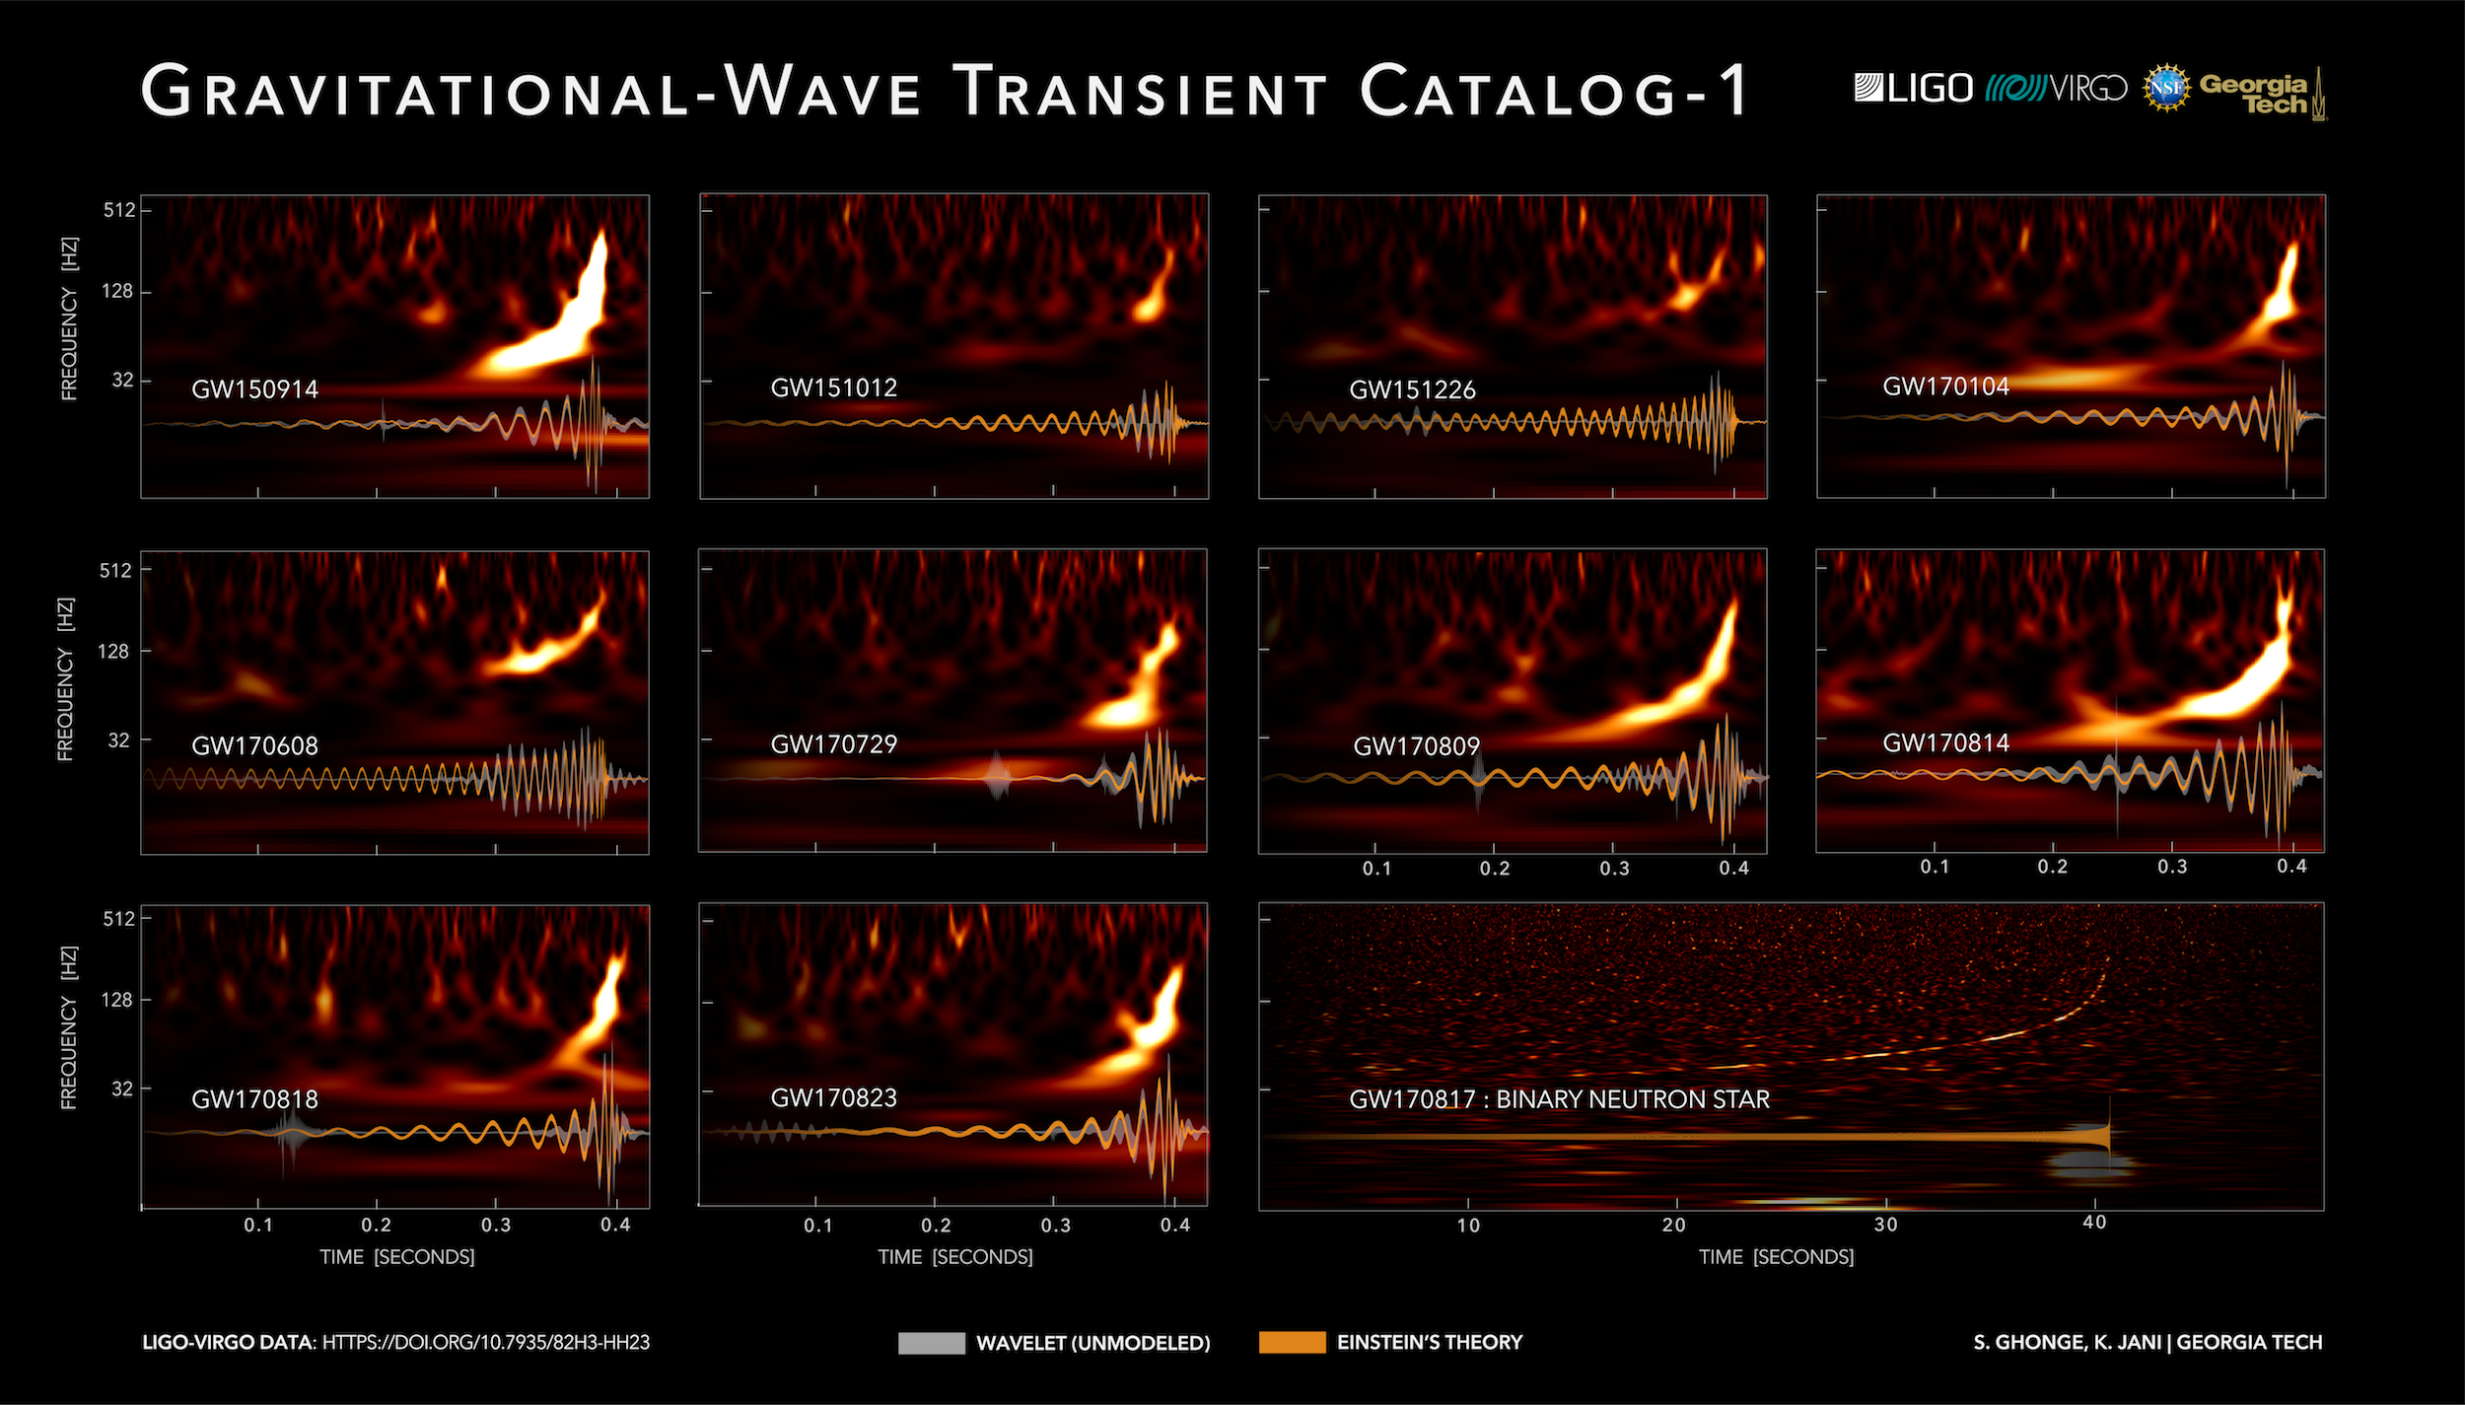
Construct the Einstein Telescope in the Netherlands?
Extend the catalog of GW events

Slide 7
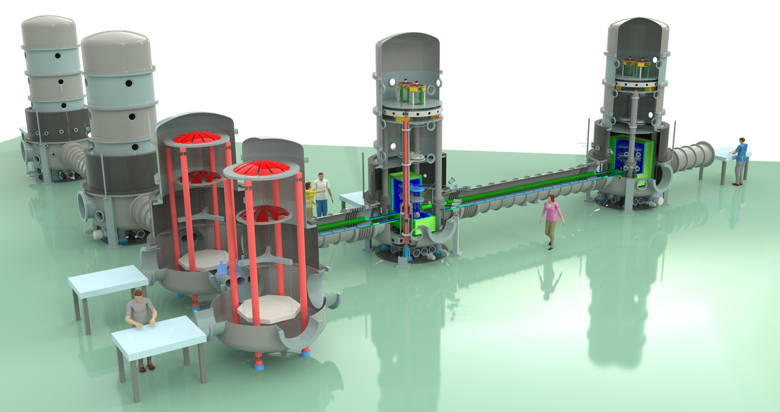
ET pathfinder
construction in coming years

Slide 8
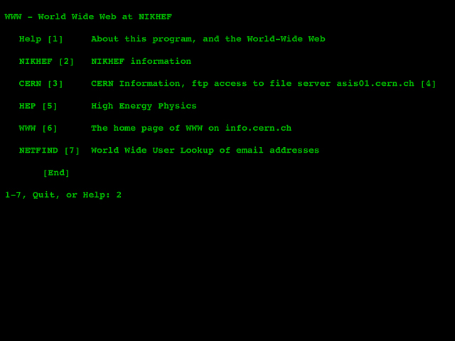
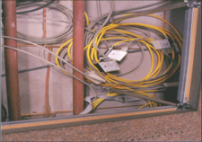
Nikhef and computing – IBR LAN and our web
Computing has long been at the core of Nikhef:
February 1992: nic.nikhef.nl
Early 1996: Nikhef Housing
1996, Nikhef H1.40
the yellow Ethernet cable is the WCW local area loop for the International Backbone Router (IBR-LAN)

Slide 9
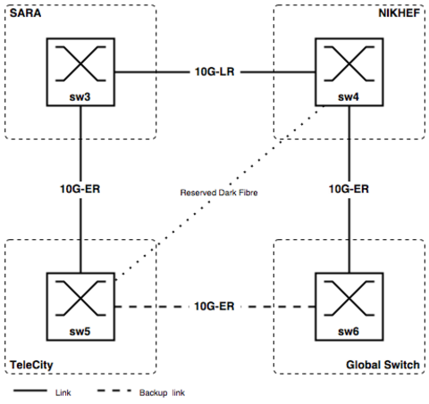
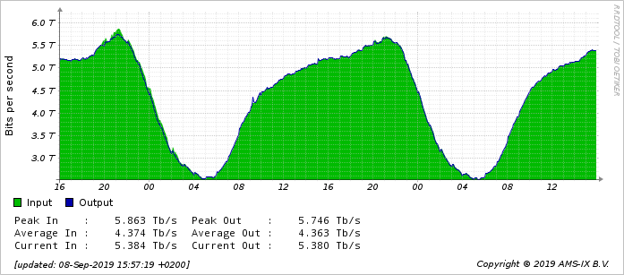
AMS-IX in ~2002, and traffic today
traffic graph: aggregate AMS-IX NL traffic on Sept 9, 2019
about 20% of the AMS-IX traffic is at Nikhef, out of 16 locations total
source: https://stats.ams-ix.net/

Slide 10
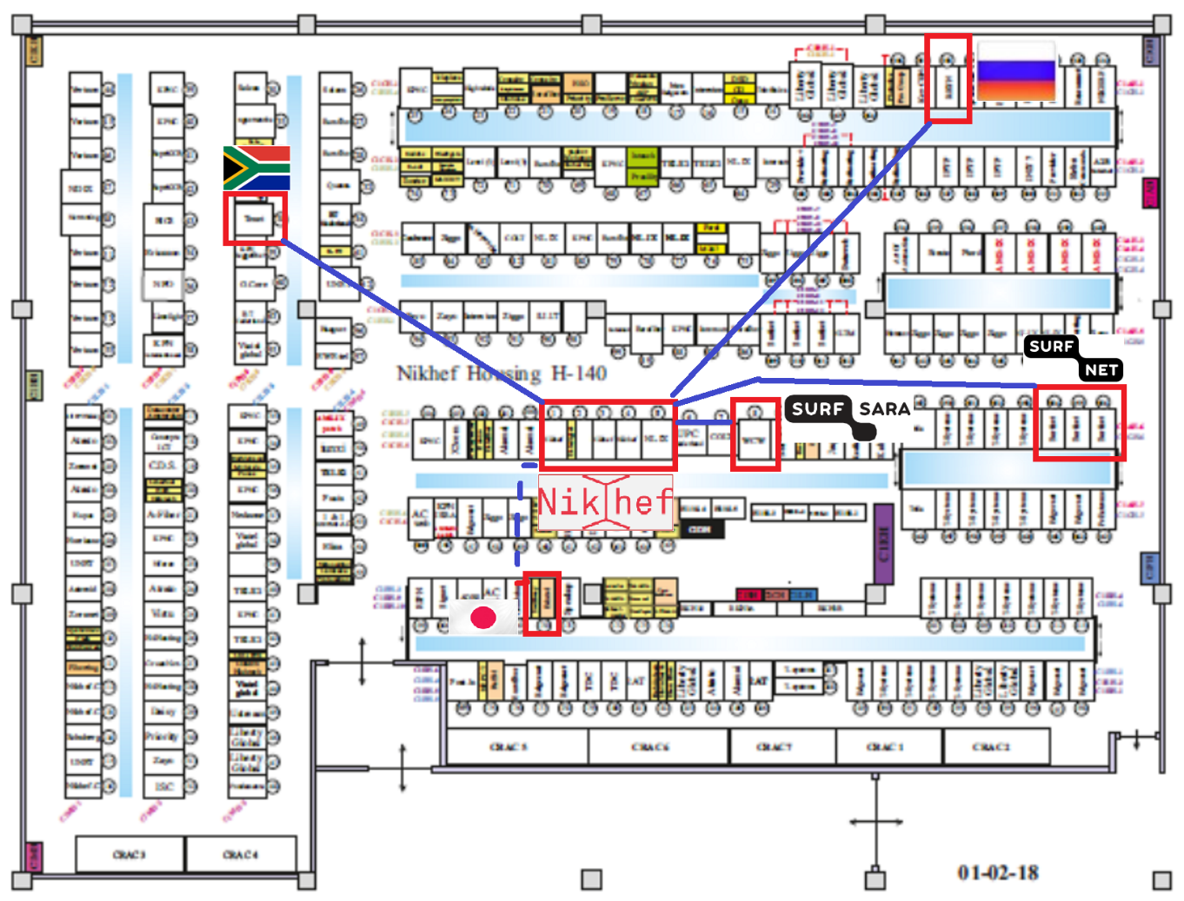
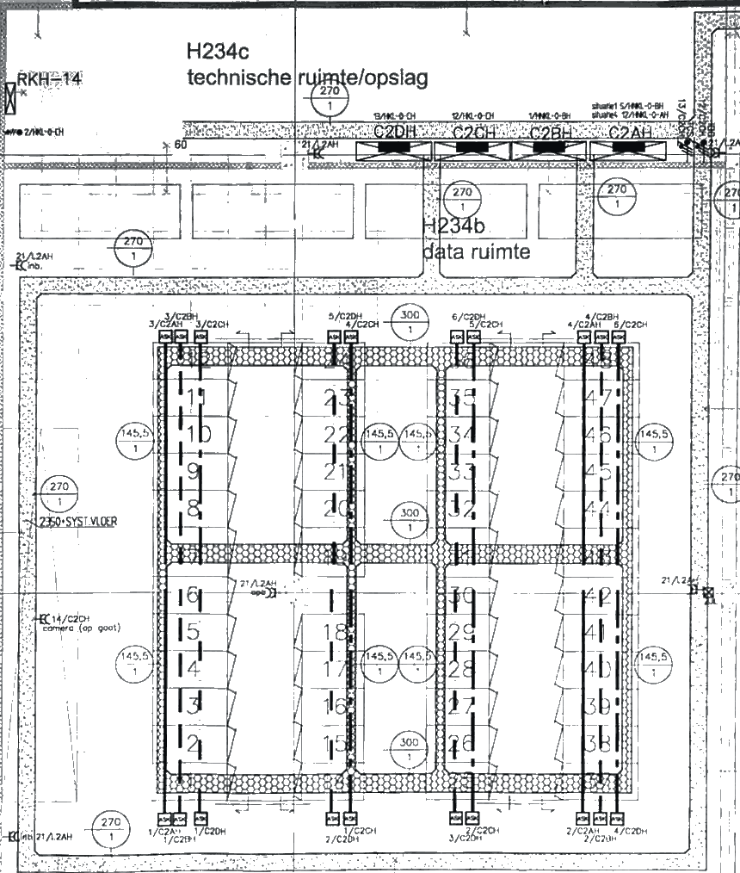
Nikhef Housing - touching the net

Slide 11
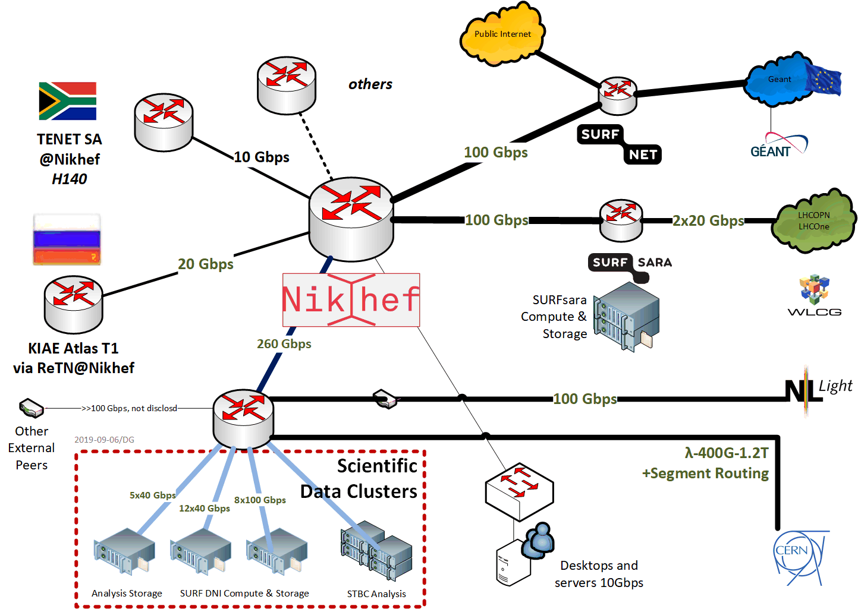
Direct peering infra for ‘big data’

Slide 12
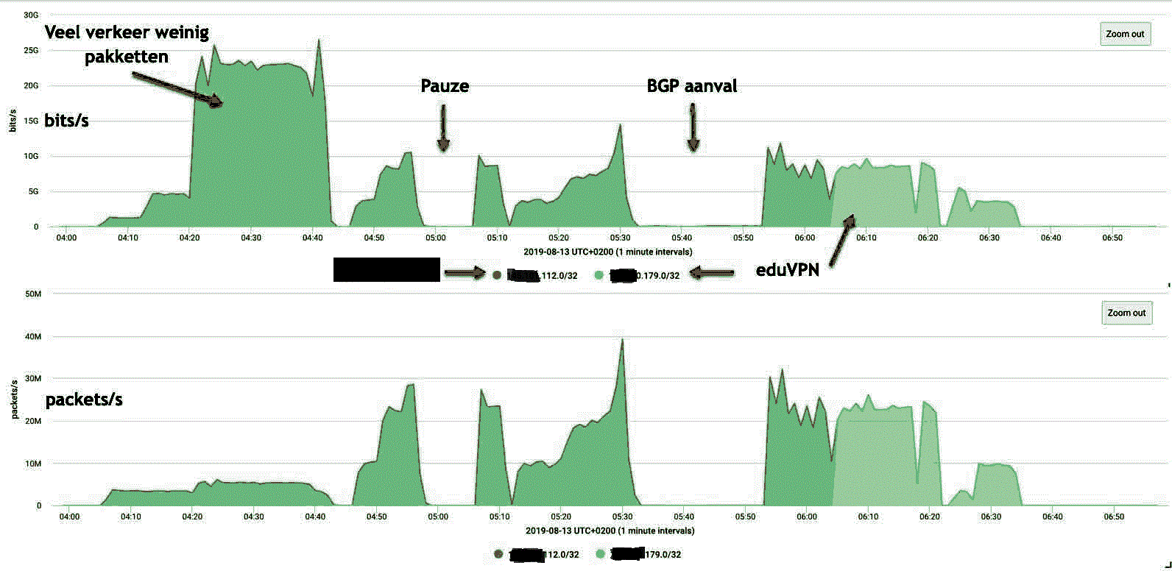
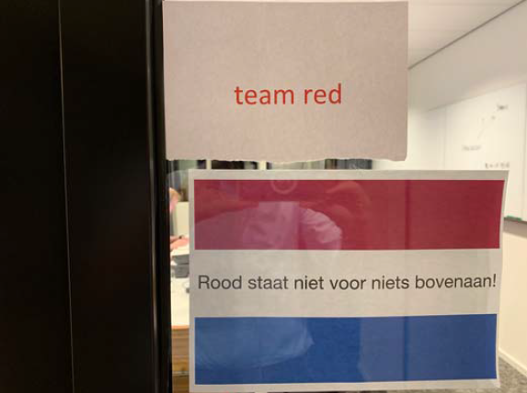
Our science data looks akin to a DDoS
evaluating resilience to cyberattack – in a cooperative way

Slide 13
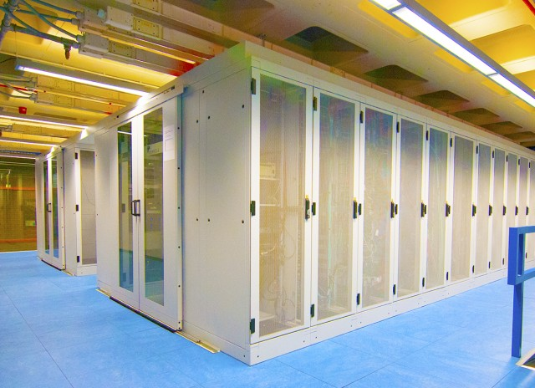
Nikhef and computing as an Infrastructure
The Nikhef Data Processing Facility
nic.nikhef.nl in February 1992
Nikhef Housing since 1996
EU DataGrid in 2000 (jointly with SARA)
Worldwide LHC Computing Grid (WLCG) 2004
BiGGrid, 2008
natl. e-Infrastructure coordinated by SURF: 2013
Services at Nikhef and SURFsara are part of the Dutch National e-Infrastructure supporting WLCG, Virgo/LIGO, WeNMR, Project MinE (ALS), DUNE, DarkMatter, …

Slide 14
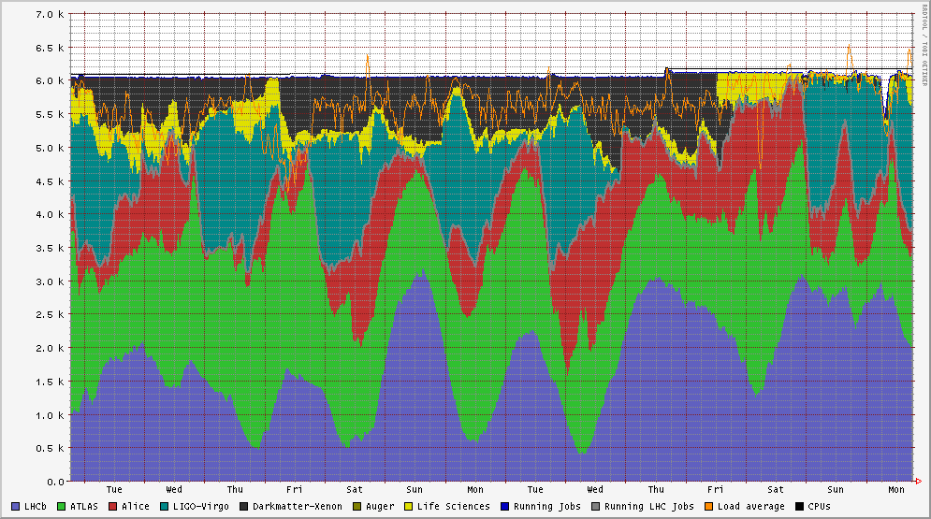
A truly shared national e-Infrastructure
Life Sciences, MinE, WeNMR
Dark matter search
LIGO-Virgo
LHC Alice
LHC ATLAS
NDPF voview short 1 October 2018
LHCb

Slide 15
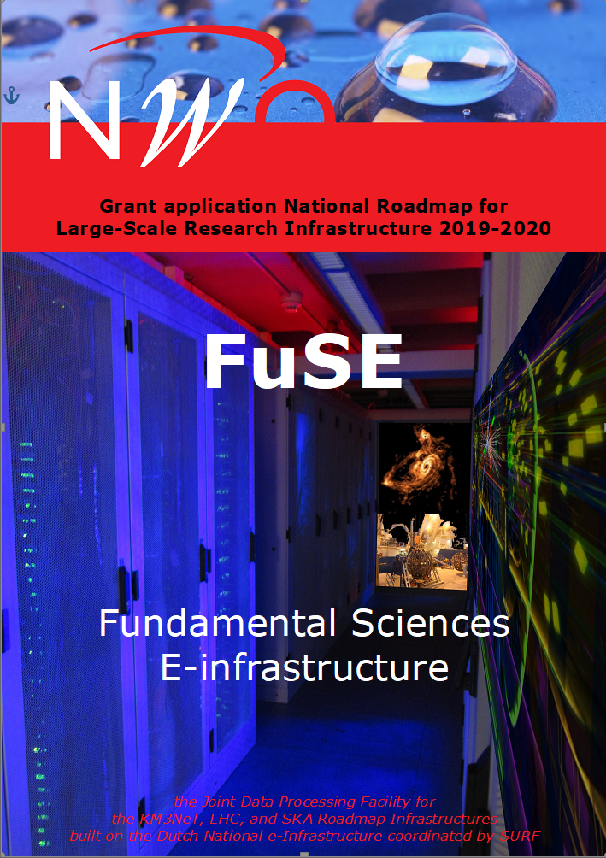
Fundamental Sciences e-Infra NL
Consolidating our national flagship infrastructures
throughout the 2020’s
next generation LHC experiments
KM3NeT processing
SKA Regional Centre
proposed size 28 M€ for 2021-2025
a multi-community infrastructure
for multi-messenger science

Slide 16
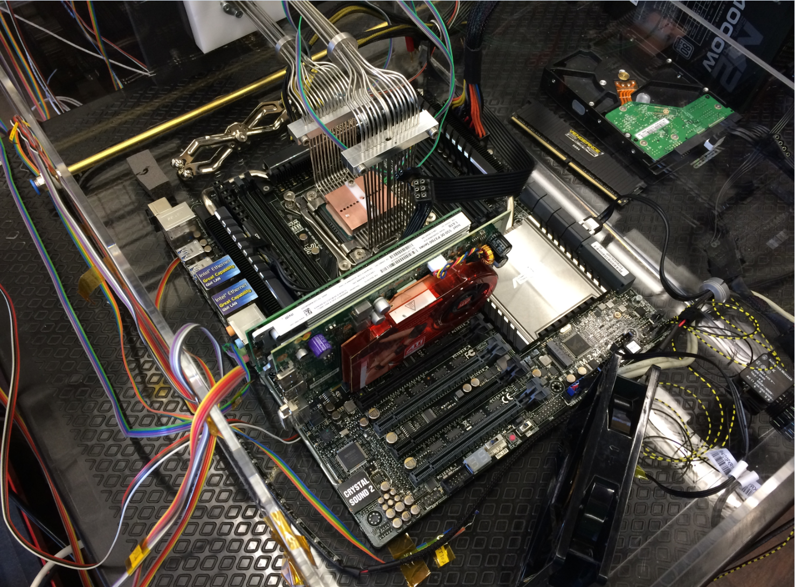

Joining engineering & computing at Nikhef
(but not quite a solution to our challenges)
Collaboration of Intel and Nikhef PDP & MT (Krista de Roo) “CO2 Inside”

