Slide 1
Testing Incident Response Channels and Communications End Points
whilst not overloading the target audience
David Groep
AARC Policy and Best Practice Activity Coordinator
Nikhef
WISE and SIG-ISM meeting Kaunas
April 2019

Slide 2
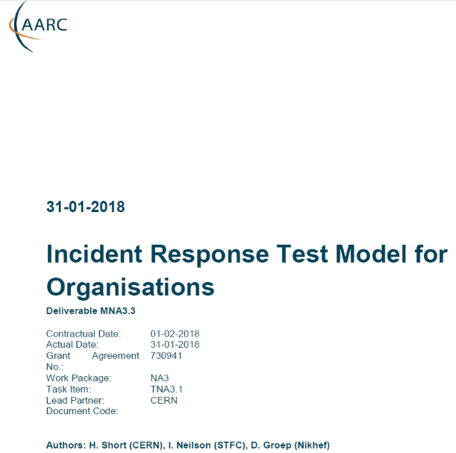
Distributed Incident Response and Readiness Challenges
Sirtfi - version 1 - is gaining traction
provides - self-asserted - security contacts
point-to-point communications
shows interaction not usually visible at the ‘global’ level
now we need to now go ‘beyond Sirtfi’
incidents are not usually bi-lateral
may spread through federated identity systems
and outside to relying parties or entire Infrastructure

Slide 3
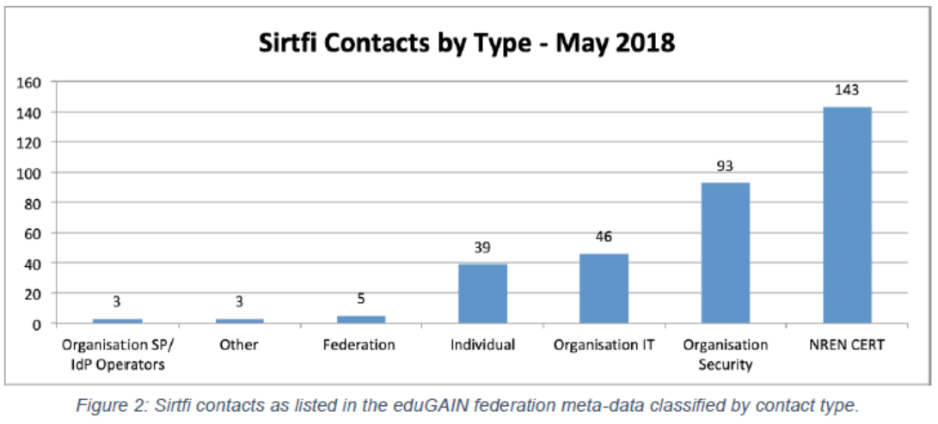
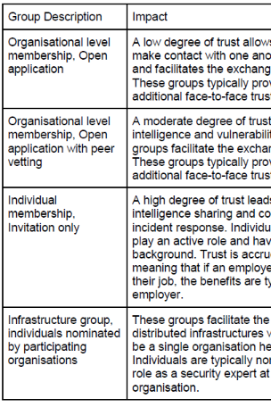
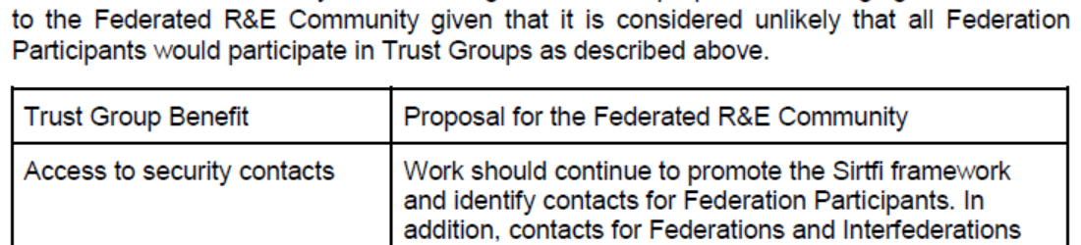
Responding to incidents – sharing relevant information
Sirtfi take-up at proper organizational level
Beyond basic Sirtfi
federation-level engagement in process
Sirtfi+ registry broadens global base
engagement in trust groups valuable
for federated collective response
from DNA3.2 Report on Security Incident Response and Cybersecurity in Federated Authentication Scenarios

Slide 4
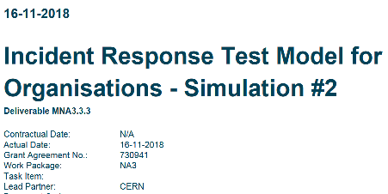
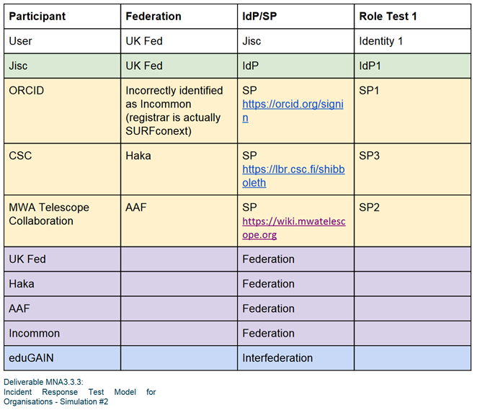
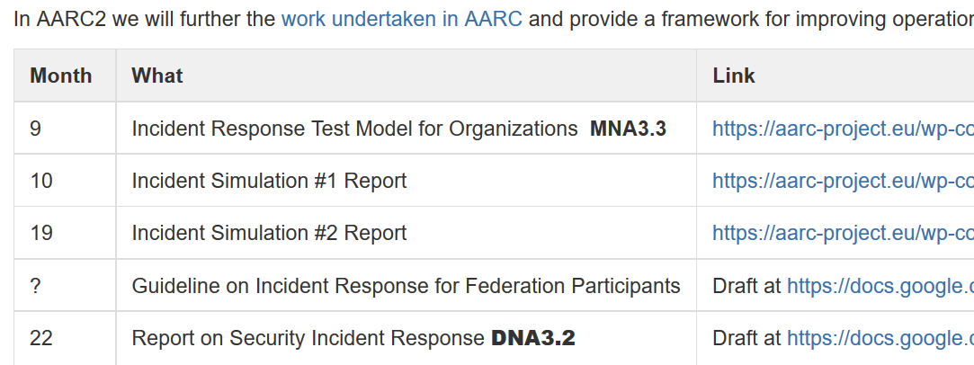
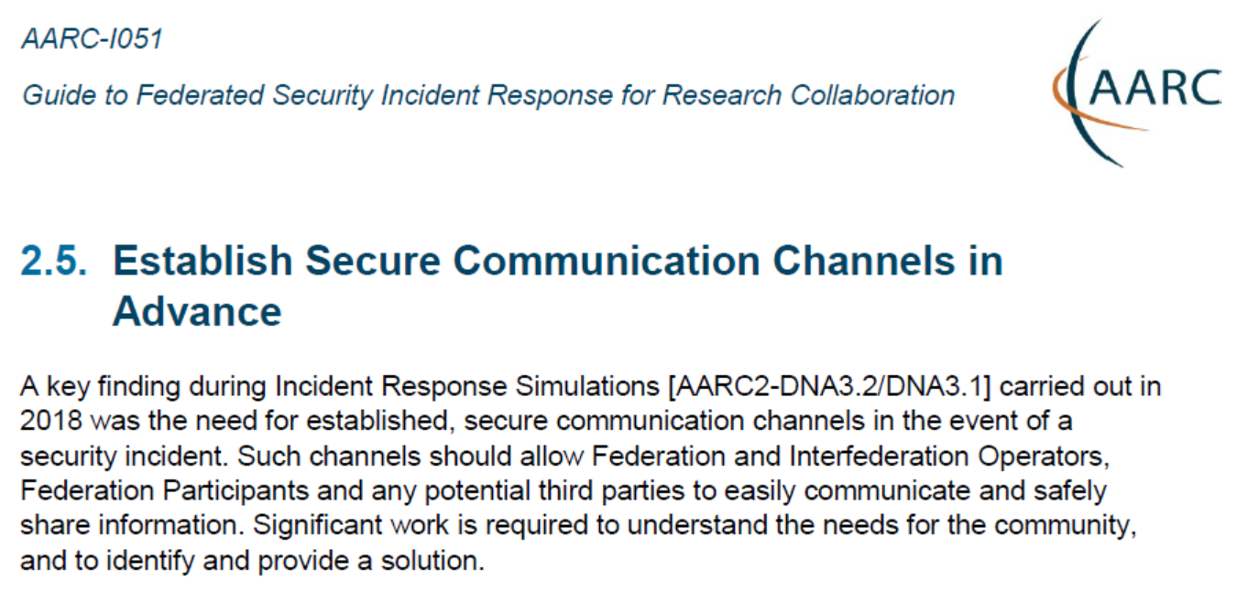
… the rest we test …
https://wiki.geant.org/display/AARC/AARC2+NA3+Task+1+-++Overview
https://aarc-project.eu/guidelines/aarc-i051/

Slide 5
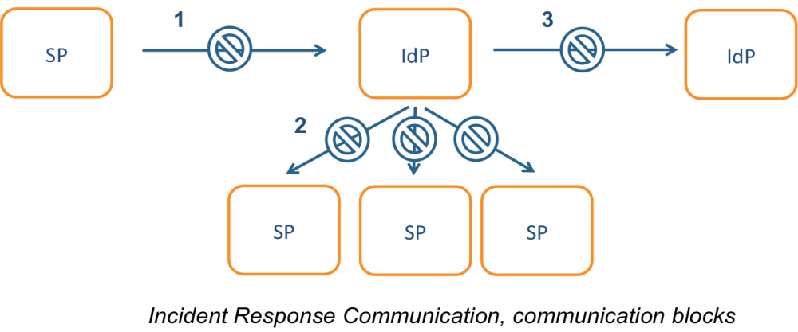
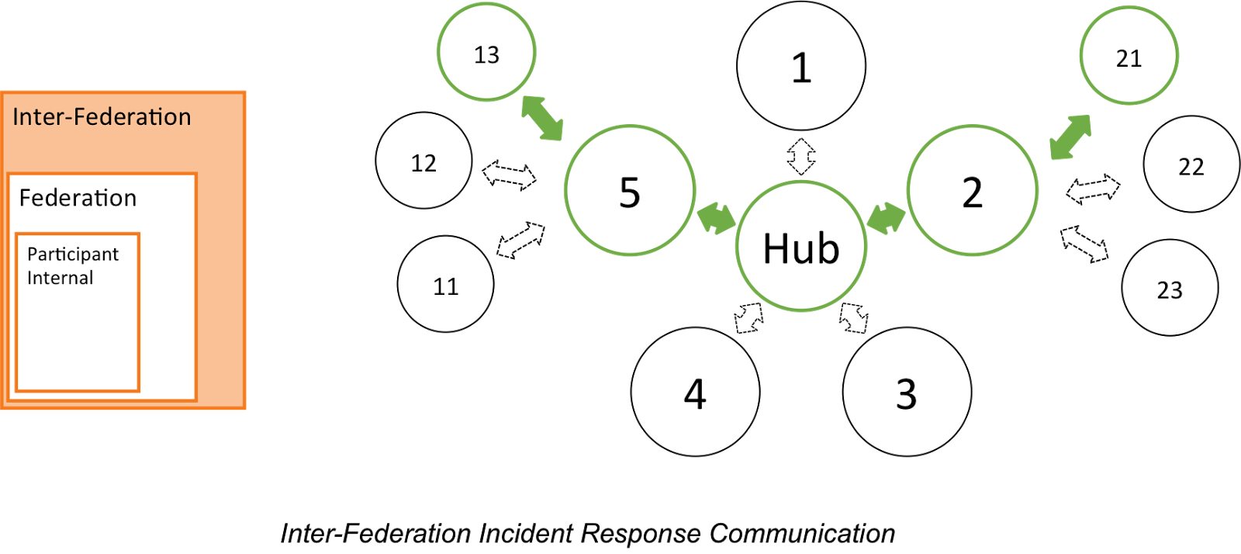
Incident response process evolution in federations
Proposed solutions
Stronger role for federation operators, as
they are known to both SPs and IdPs
Add hub capability centrally (@ eduGAIN)
Challenges
IdP appears ‘outside’ the
service’s security mandate
Lack of contact, or lack of trust, in IdP, which is an ‘unknown party’
IdP fails to inform
other affected SPs, for
fear of leaking data or reputation
No established channels of communication
graphics: Hannah Short, AARC ‘DNA3.1’ incident response models

Slide 6
Who runs the test?
The first tests with these participants were run ‘by AARC’
Logical candidates that could all run the test
… and have an interest in knowing the result to establish trust
eduGAIN
GEANT.org
but also any EOSC-HUB and e-Infrastructure CSIRT teams
the IGTF (as it leverages federated id)
each of the e-Infrastructures XSEDE, EGI, EUDAT, PRACE, OSG, HPCI, …
every research infra with an interest: WLCG, LSAAI, BBMRI, ELIXIR, …
And any institution (or person) with access to https://mds.edugain.org/ can run them, of course
so in a short while, all the email in the world will be on Sirtfi Incident Response tests??

Slide 7
Frequency of challenges and tests - examples
Trusted Introducer and TF-CSIRT
2-3 Reaction Tests per year
supported by web click infrastructure, but requires (team) authentication
SURFcert challenges
annual response challenges, just reply to email to a (traceable) ticket
IGTF RAT Communications Challenges
every 1-2 years
in parallel with continuous operational monitoring
yet we already listed 14 entities that have a real interest in running tests, 5000+ entities can claim the same

Slide 8
Challenge elements – what is valued or expected might differ …
timeliness
investigative capability
confidentiality
ability to take action
….
but a single test can answer the questions of many
if the challenge measures responsiveness and the data are available,
each infrastructure can set its own level of expectancy
but other elements require different probes (and may be complex or intensive to conduct)
responsiveness vs. ability to take action or forensics/traceability capacity

Slide 9
How to coordinate – discussion items!
Designate a lead ‘management’ organization for each element?
so that each ‘target’ does not get hit by many competing and concurrent challenges?
e.g. eduGAIN to run communications challenges against Sirtfi email addresses
the e-Infrastructures to test responsiveness of SPs and RPs
with each RP/SP/Site having a primary e-Infra as its home?
or can we jointly (EOSC-HUB) run these challenges per continent?
coordination must be global
Communications challenges also build ‘confidence’ and trust – an important social aspect
unless you run the test yourself, or get full insight in the results of a challenge,
you may not be growing more trust in the entities tested
so to get that ‘warm and fuzzy feeling of trust’,
results (responsiveness measurement data) should be shared
but that sharing needs to be confidential as well – limit to WISE SCI checked infrastructures?

Slide 10
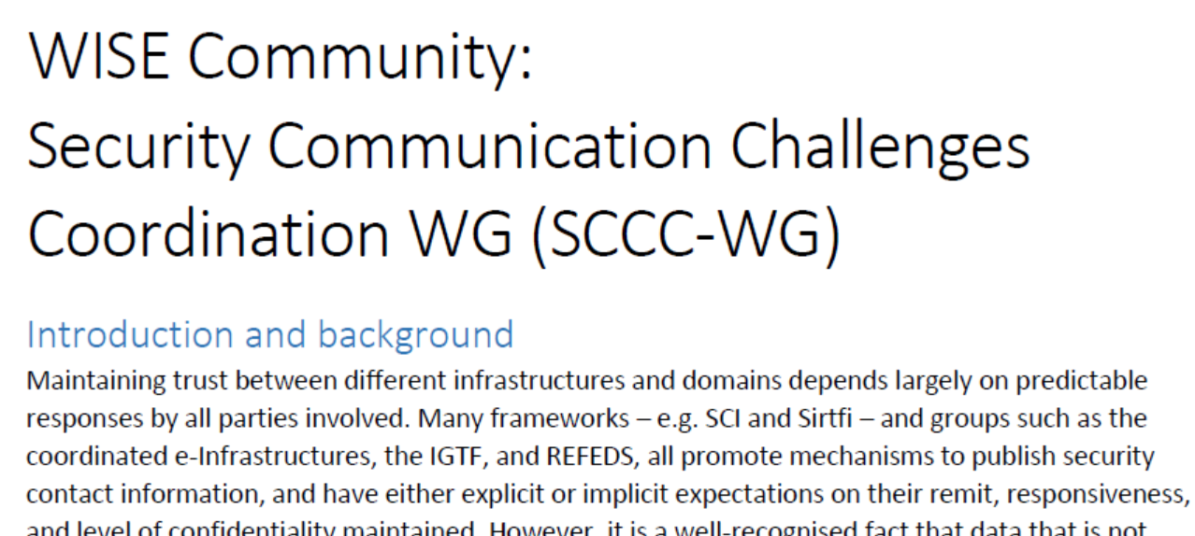
Towards SCCC WG …

Slide 11
Proposal for the SCCC Working Group
Coordination of ‘CCs recipient groups’ among participating infrastructures
ensure targets are not overloaded by coinciding or overlapping challenges, for example by designating lead agency
Transitivity of trust in CC results between infrastructures
for example by specifying the level of disclosure detail for CCs between trusted infrastructures, by using an SCI evaluation framework approach to it, or by coordination of testing and success criteria.
how can requests for CCs between infrastructures be handled, e.g. in response to changing needs or a changed risk assessments; or as remediation after an incident in which communications did not meet expectation.
Definition of CC models and classification
‘depth’ of the CC testing is a balance between the level of trust gained (more profound testing and good results gives more trust) and expediency (asking the recipient to respond to a mail or click a link consumes less resources than requesting forensic investigation of a simulated incident of deliberately unknown nature).
Frequency of CCs
simple communications challenges are often performed one or several times per year (e.g. for TF-CSIRT, by SURFcert for the SURFconext federation, EGI Operations on their sites).
complex challenges are less frequent (e.g. ‘black-box traceability’ trials in EGI take place once every 1-2 years).
following a CC model classification, propose an appropriate frequency for each class.

Slide 12
Open Questions
Mandate – is this the right scope of a ‘SSC sharing’ WG
Members – interested parties and (co-)chairs
Standing coordination function – this WG could live forever …

Slide 13
davidg@nikhef.nl

