Slide 1


The Security Baseline for EOSC and beyond
‘for loosely connected services and infrastructure’
David Groep
EOSC Security Operations and Policy lead, AARC Policy Area coordinator
Nikhef Physics Data Processing (PDP) programme
WISE Community Autumn 2021 meeting
2021.10.26

Slide 2
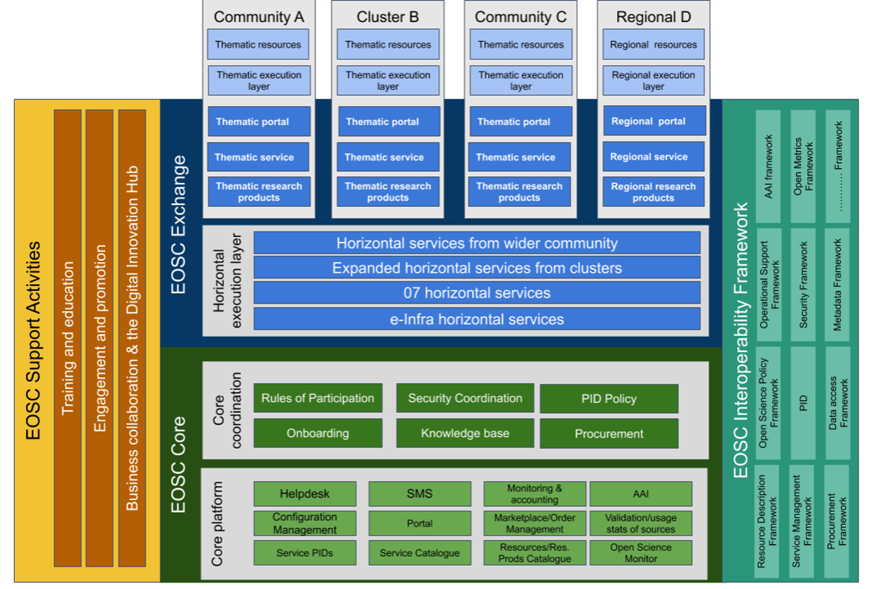
EOSC structure – security coordination and the AAI

Slide 3
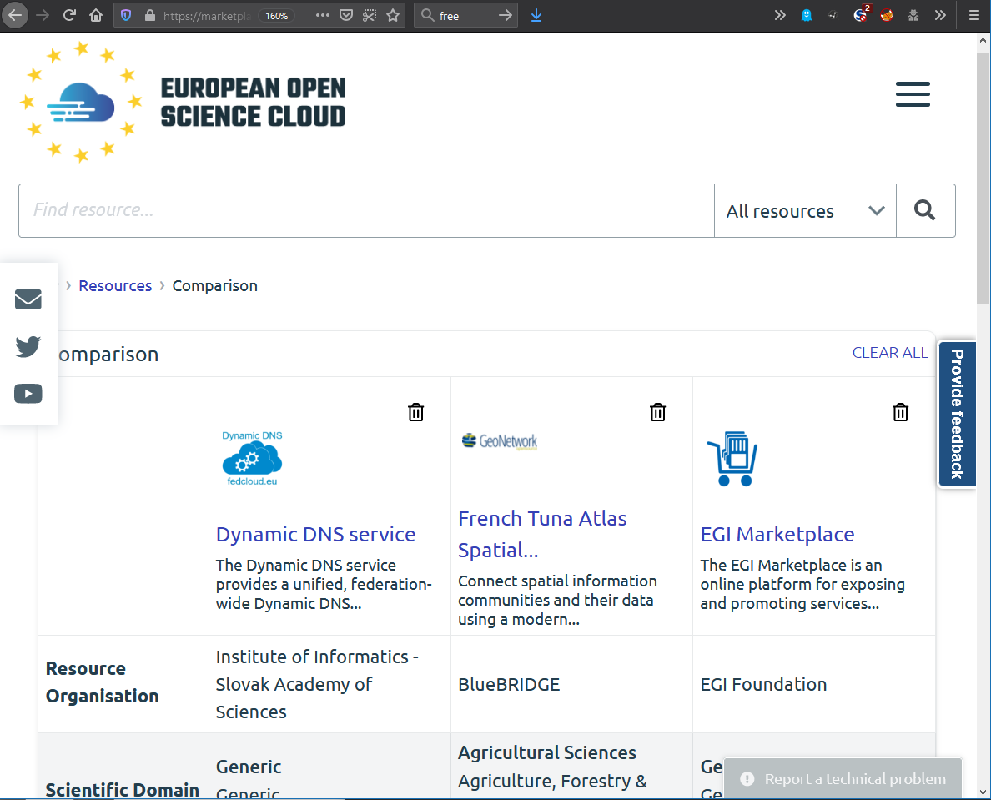
The diverse ecosystem compared
EOSC Core
set of internal services which allow EOSC to operate
EOSC Exchange
set of federation services, resources registered into the EOSC
to serve needs of research communities and widening to public and private sector
EOSC Interoperability Framework
standards and guidelines to support the interoperability and composability of resources
comparing services in the Exchange on the EOSC Portal – from https://eosc-portal.eu/

Slide 4
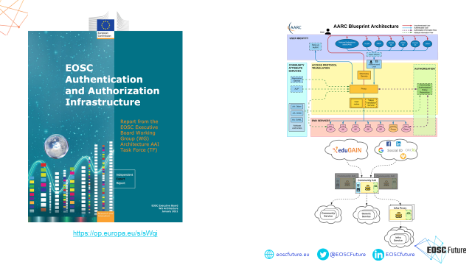
EOSC Authentication and Authorization Infrastructure
slide: Christos Kanellopoulos, GEANT, for EOSC Future WP7.3

Slide 5
The EOSC Ecosystem – a loosely coupled federation of users and services
EOSC Core services
drives the portal
strongly coordinated
ITSM processes in place
underpin other services
key to on-boarding, AAI, monitoring, accounting …
EOSC AAI federation
services from
the wider community
horizontal and thematic
many providers
composed
with other services
use the EOSC AAI model for authentication, authorization, and federated identity
Exchange Listed services
services from
the wider community
have no need for a technical AAI connection to the EOSC federation
still are highly valuable services to the EOSC
composed
with other services
merit security coverage
Security guidance & control points that apply to each category are - and should be - different

Slide 6
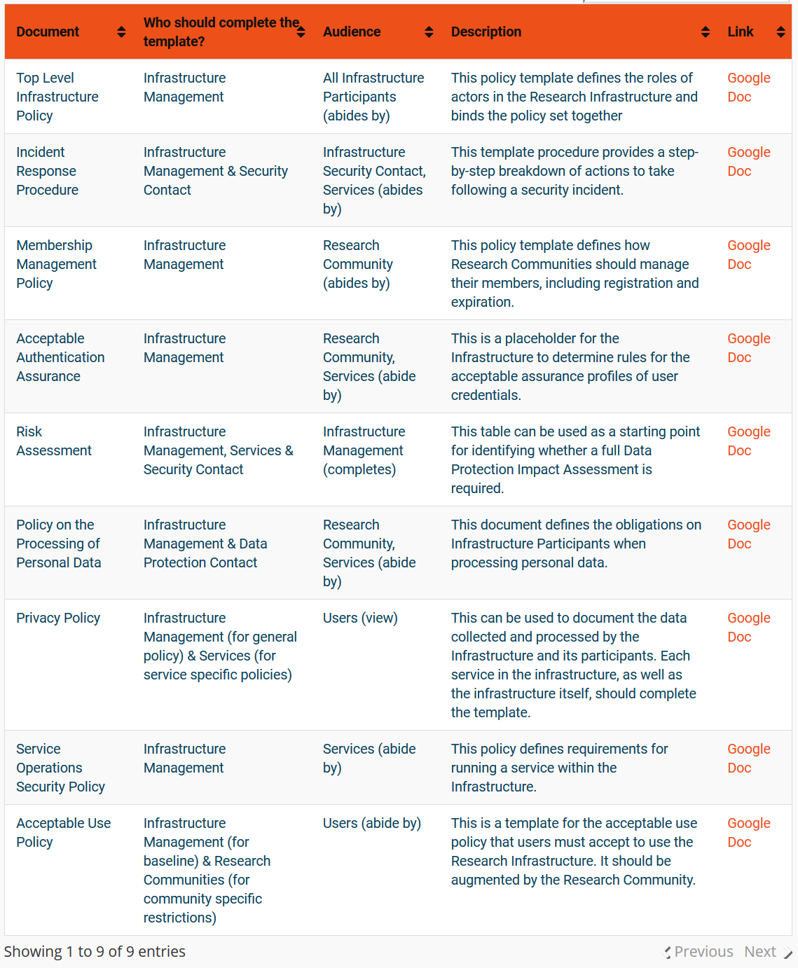
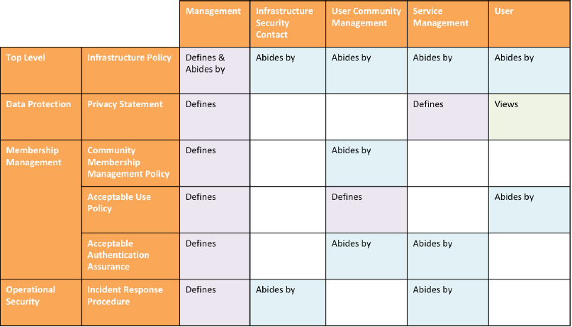

AARC Policy Development Kit – service (infrastructure)-centric policies
https://aarc-project.eu/policies/policy-development-kit/

Slide 7
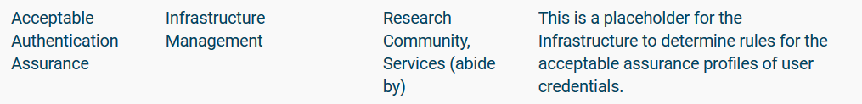
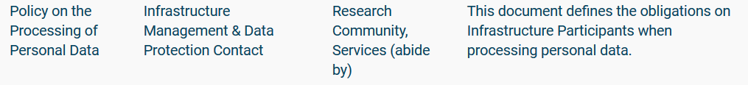
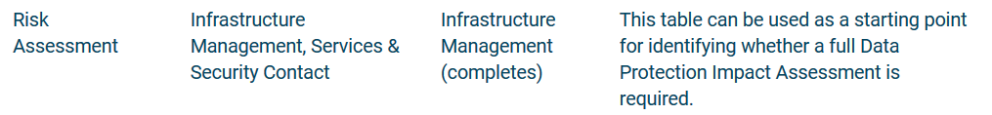
Guidance for Infrastructure Management and Service Contacts
7

Slide 8
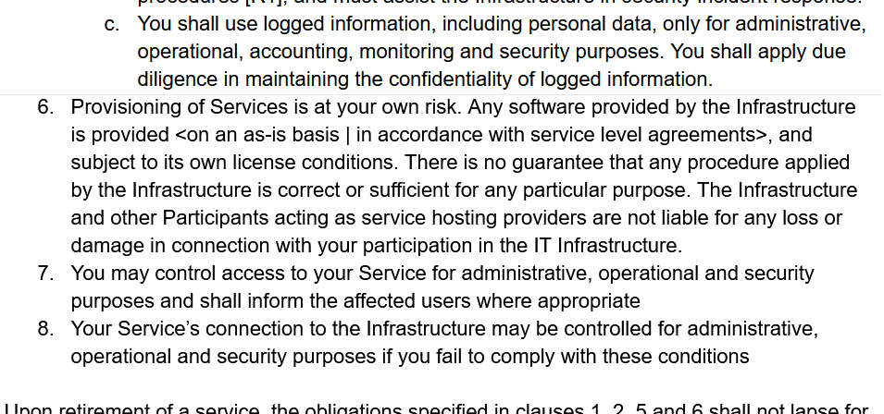
From an infrastructure to an ecosystem view
AARC ‘rev 1’ PDK version of “Service Operations” is rather specific
includes ‘service-internal’
operations and software
embedded in the PDK
document suite:
does not work well as
a ‘stand-alone’ document
has built-in assumption of
coherent and coordinated
single infrastructure

Slide 9
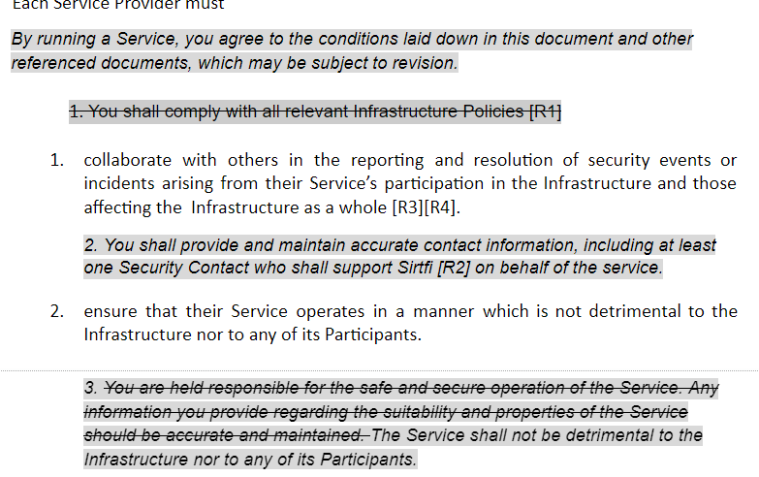
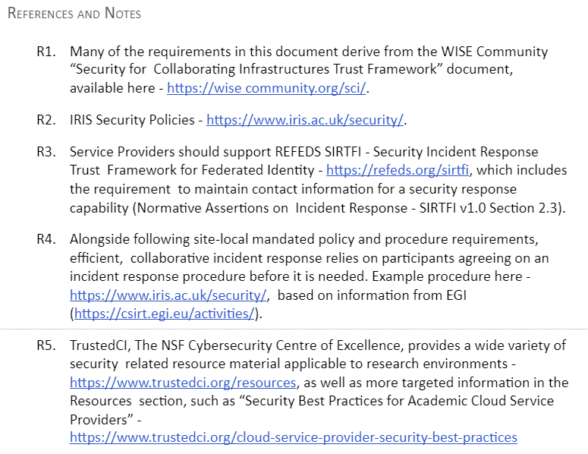
“Service Operations” developments
Evolved by UK-IRIS addressing many of these concerns
can stand alone as policy guidance
better implementable by adding references and notes (‘best practice’, or an ‘FAQ’)
thanks to Ian Neilson, David Crooks, Dave Kelsey, et al.

Slide 10
“Service Operations” developments
In the EOSC ecosystem, more of the original assumptions no longer hold
services provided are less coherent, and much more autonomous then every before
need to accommodate providers with varying maturity levels - and different intentions!
thanks to Ian Neilson, David Crooks, Dave Kelsey, et al.

Slide 11
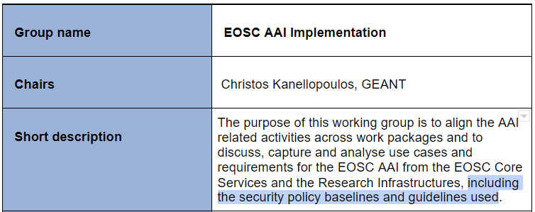
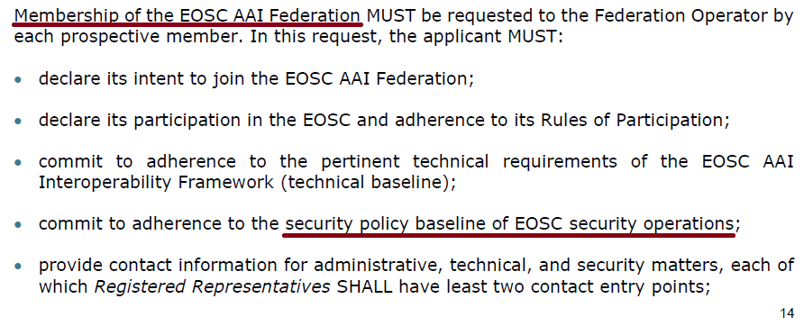
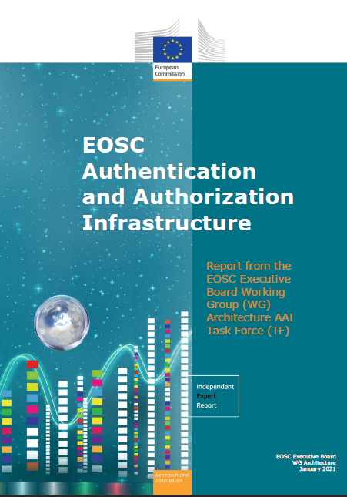
Towards a Baseline instead of a single policy
Not all services are created equal
EOSC primarily about user experience & research success: security there to support this goal
Services are composable – and thus interdependent
Premise: do no harm!
Security Baseline
prerequisite for connecting to the Core Infra Proxy
connection requirement for the EOSC AAI
may evolve over time
Additional elements can be added to augment trust
through service level agreements
by maturity grading (‘WISE SCI’ peer assessments)

Slide 12
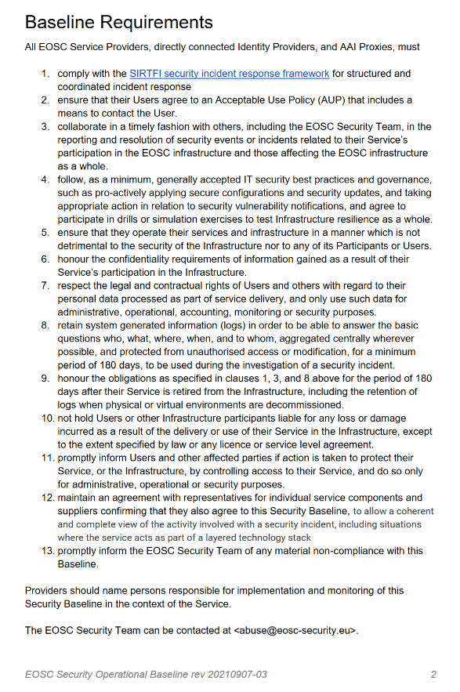
Baseline Process
Co-development of EOSC Future & AARC Policy Community
version based on UK-IRIS evolution of the AARC PDK
specifically geared towards the looser EOSC ecosystem
mindful of urgent need for collective coherent response
AARC Policy team consultation – 1st round just finished
13 itemised points - https://edu.nl/avfv4
complemented by an ‘FAQ’ with guidance and refs
(no new standards, there is enough good stuff out there)
leverages Sirtfi framework
connects to the Core Security Team
https://wiki.eoscfuture.eu/x/Q4sb

Slide 13
Most current version
All EOSC Service Providers, directly connected Identity Providers, and AAI Proxies, must
comply with the SIRTFI security incident response framework for structured and coordinated incident response
ensure that their Users agree to an Acceptable Use Policy (AUP) [or Terms of Use] and that there is a means to contact each User.
collaborate in a timely fashion with others, including the EOSC Security Team, in the reporting and resolution of security events or incidents related to their Service’s participation in the EOSC infrastructure and those affecting the EOSC infrastructure as a whole.
follow, as a minimum, generally accepted IT security best practices and governance, such as pro-actively applying secure configurations and security updates, and taking appropriate action in relation to security vulnerability notifications, and agree to participate in drills or simulation exercises to test Infrastructure resilience as a whole.
ensure that they operate their services and infrastructure in a manner which is not detrimental to the security of the Infrastructure nor to any of its Participants or Users.
honour the confidentiality requirements of information gained as a result of their Service’s participation in the Infrastructure.
respect the legal and contractual rights of Users and others with regard to their personal data processed, and only use such data for administrative, operational, accounting, monitoring or security purposes.

Slide 14
Most current version
retain system generated information (logs) in order to be able to answer the basic questions who, what, where, when, and to whom, [aggregated centrally wherever possible, and protected from unauthorised access or modification], for a minimum period of 180 days, [to be used during the investigation of a security incident].
honour the obligations as specified in clauses 1, 3, and 8 above for the period of 180 days after their Service is retired from the Infrastructure, including the retention of logs when physical or virtual environments are decommissioned.
not hold Users or other Infrastructure participants liable for any loss or damage incurred as a result of the delivery or use of their Service in the Infrastructure, except to the extent specified by law or any license or service level agreement.
promptly inform Users and other affected parties if action is taken to protect their Service, or the Infrastructure, by controlling access to their Service, and do so only for administrative, operational or security purposes.
maintain an agreement with representatives for individual service components and suppliers confirming that they also agree to this Security Baseline, to allow a coherent and complete view of the activity involved with a security incident, including situations where the service acts as part of a layered technology stack
promptly inform the EOSC Security Team of any material non-compliance with this Baseline.
Providers should name persons responsible for implementation and monitoring …

Slide 15
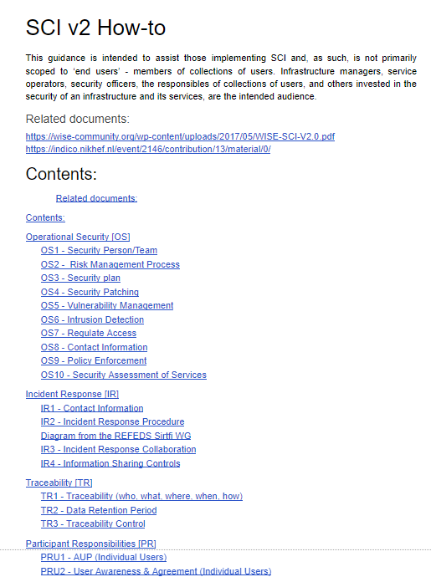
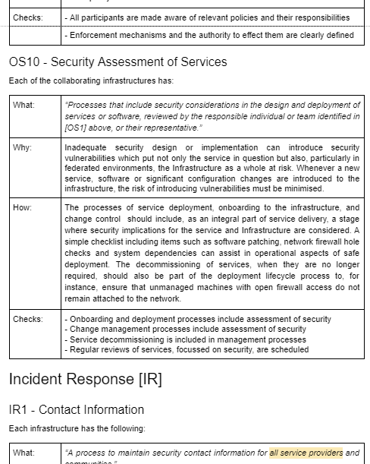
But also the Security Baseline lives in an ecosystem with Complementing elements
the FAQ ‘Annotated Baseline’
(which is actually essential to its understanding)
an EOSC Core Security Team
and response processes and guidance
SCI maturity assessment model
WISE Risk Assessment Templates
…

Slide 16
EOSC Security Operational Baseline (rev 20210908-03)
lastest version (after initial AARC Policy consultation) at https://edu.nl/avfv4
FAQ for now at
https://wiki.eoscfuture.eu/display/EOSCF/EOSC+Security+Operational+Annotated+Baseline
Propose to incorporate this work in the WISE SCIv2 WG

Slide 17
davidg@nikhef.nl
this work is co-supported by the EOSC-Future project, the GN4-3 project, UK-IRIS, and SURF

