Slide 1
Dreaming of a CS lab systems and networking perspective
Concepts and needed capabilities a ‘fieldlab demonstrator’?
David Groep,
November 2024

Slide 2
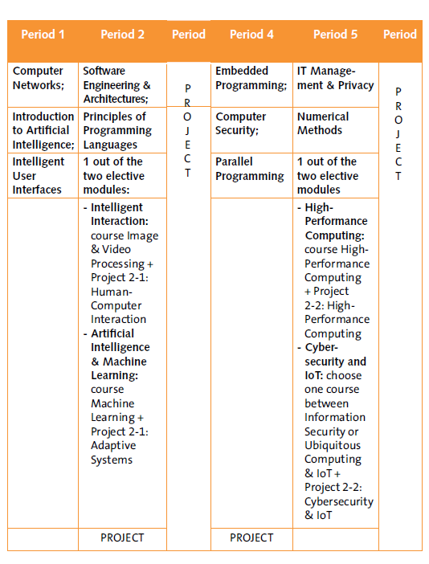
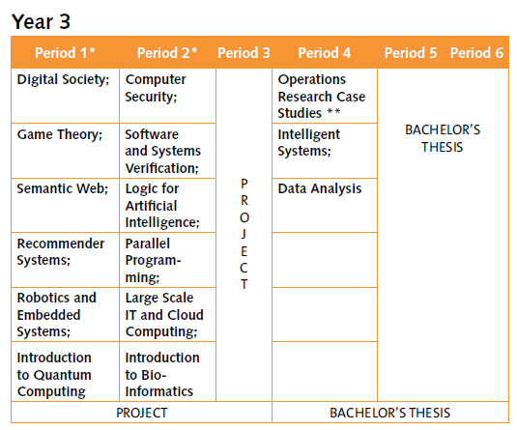
Why the CS lab?
Initiator and ‘basic’ and short-term ‘urgent’ needs
new Bachelor Computer Science, with strong engineering component (esp. in Y2)
Large-scale IT and robotics also in DSAI Year-3
But: it meshes with {master, PhD} thesis work and cross-discipline and cross-organisation research as well:
HPC simulation and modelling , ML models, LLM applications, and collaborating with research output ‘as a service’
science and engineering beyond DACS: ET pathfinder & LHCb for GWFP, the MSP programme, …
data science in other faculties: need for ‘student sandboxes’
large multi-modal 4D imaging (e.g. for NWO ENW XL FASTER with Ron Heeren), and EU Horizon and Euregio collaborations
https://curriculum.maastrichtuniversity.nl/sites/default/files/dacs_-_study_guide_2024-2025.pdf

Slide 3
‘Wereldwijd verbonden vanuit een stevige basis in onze Euregio’
Research and education are inherently collaborative, and ‘services exist’ and are being used .. whether we know about them or not:
European Open Science Cloud, ‘ESFRI’ research infrastructures, Erasmus Without Papers, EU Identity Wallets, SURF-NWO Rekentijd & Snellius, EOSC EU Node ‘free VMs for faculty’
Images: UM Strategic Programme 2022-2026, SURF ETP slide captures: www.nikhef.nl/~davidg/p/ for UM-CI office & LsIT course

Slide 4
Translating ‘wereldwijd verbonden’ education & research as a technical systems and network design
‘we can use existing services from outside’: AAI interoperability, network connectivity and bandwidth, devolution of responsibility and subsidiarity of concern
‘we can contribute in collaborations in education and research’: we can offer services, support pan-European student mobility in our programme, and provide innovative lab environments that attract students and make our programmes unique
‘we teach and train our students to understand, design, build, study, work with, and experiment with interconnected services and systems that are globally connected’
Of course we should do that in a safe, scalable, and transparent way, and at the same time build and use our own science and engineering R&E concepts in an agile way
With a view towards the future … a decadal vision of common reference platform model, usable for DACS & FSE, … for FASTER 4D-imaging, … for SBE, FASoS, and UM-wide?

Slide 5
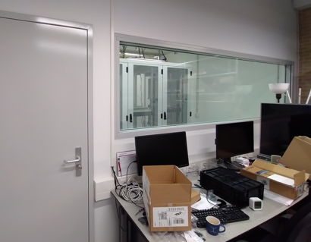
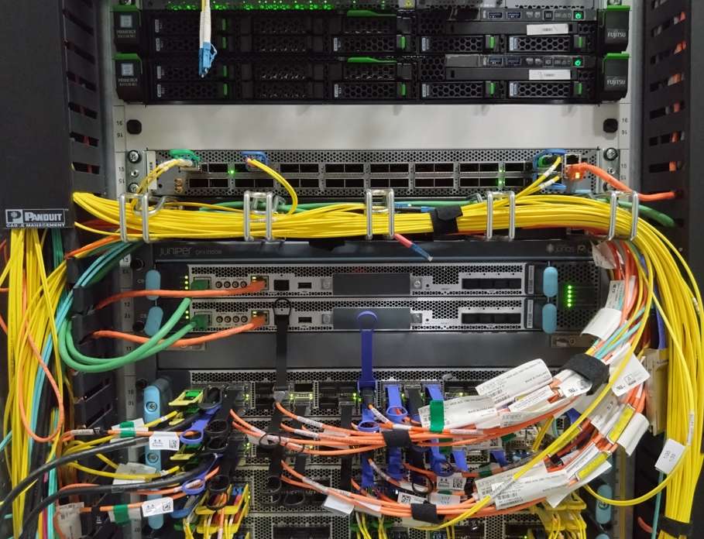
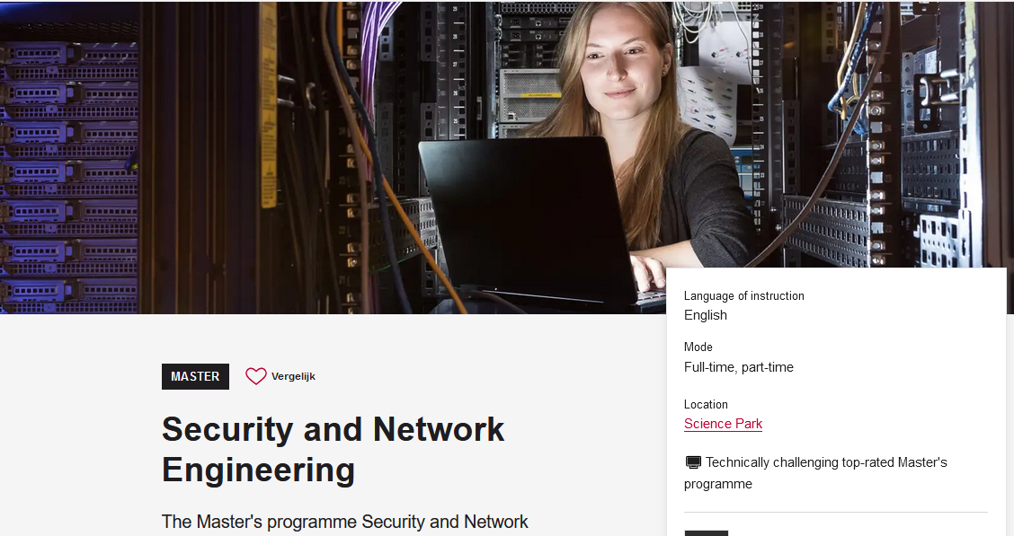
Technical inspiration
DACS CS-Lab concept for today focusses on systems and networks
those act a foundation for more specific lab settings: robotics, XR, security
focus on education labs, but equally applicable to research networks
design around micro-segmented networks and inter-subnet controls
so you could build multiple labs on a partly-shared infrastructure
leveraging the ESnet (US DoE) ‘ScienceDMZ’ concept, and
on the UvA Security and Network Engineering master lab ( ‘every student a machine on the public internet and they are entirely responsible for this box’)
with inspiration from SURF Experimental Technologies Platform and Nikhef open innovation lab
for CS and engineering education (extensible to research), and not targeting enterprise services, nor for now sensitive data services

Slide 6
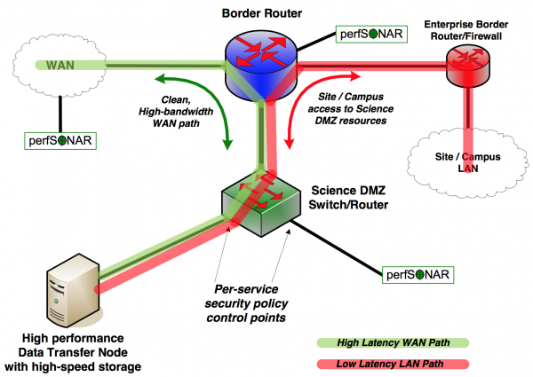
‘ScienceDMZ’
Predicable performance and data access for research
‘where research services, data, and researchers meet’
latency hiding through caching
security zoning/segmentation protects specific data sets
outside any enterprise perimeter
Image and ‘ScienceDMZ’ concept promulgated by ESnet (see fasterdata.es.net)

Slide 7
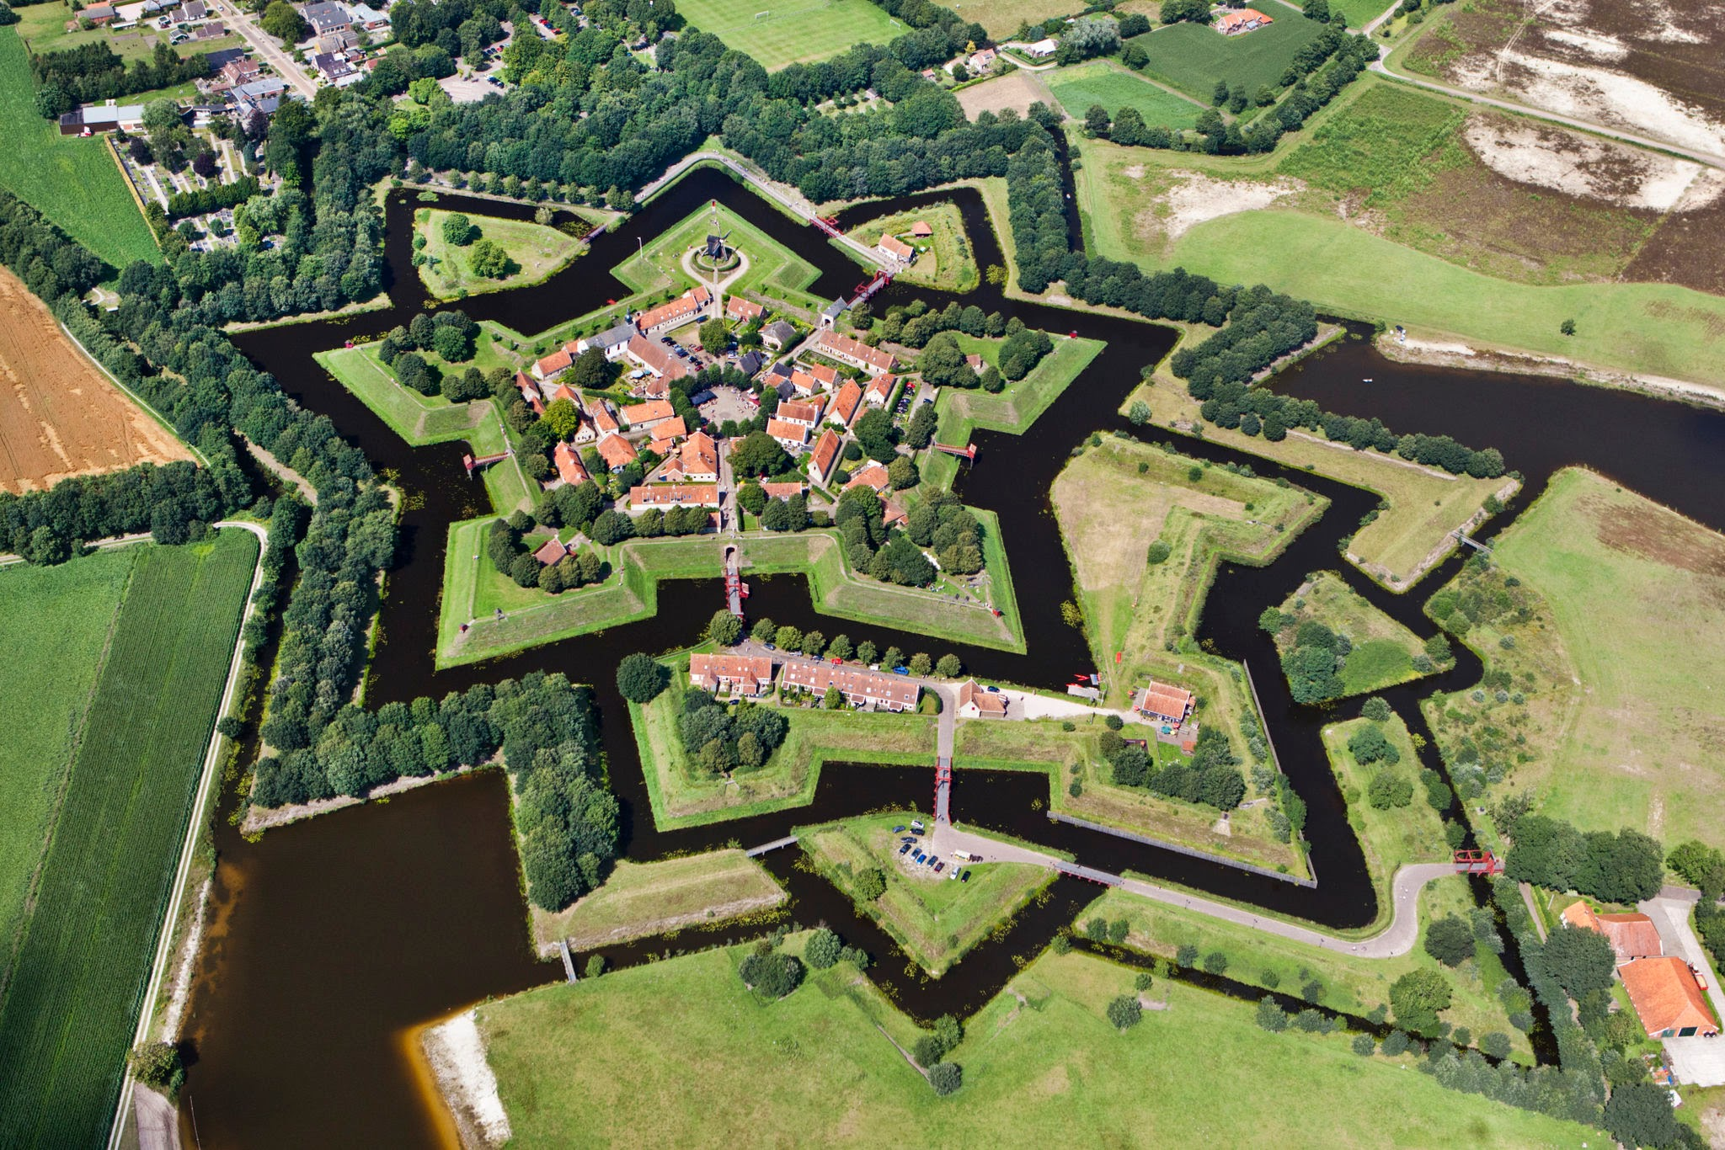
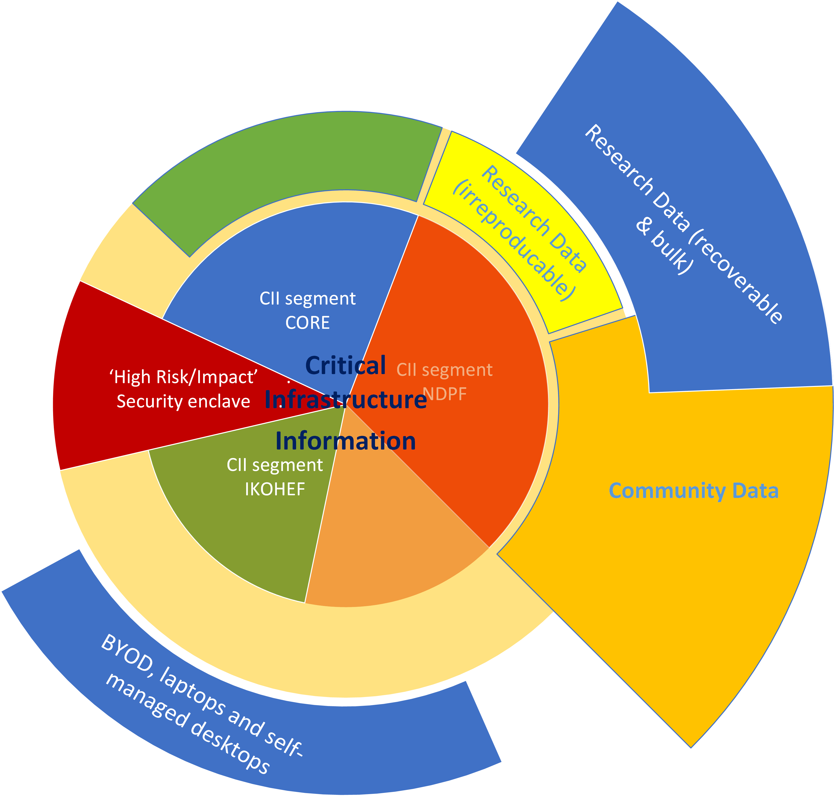
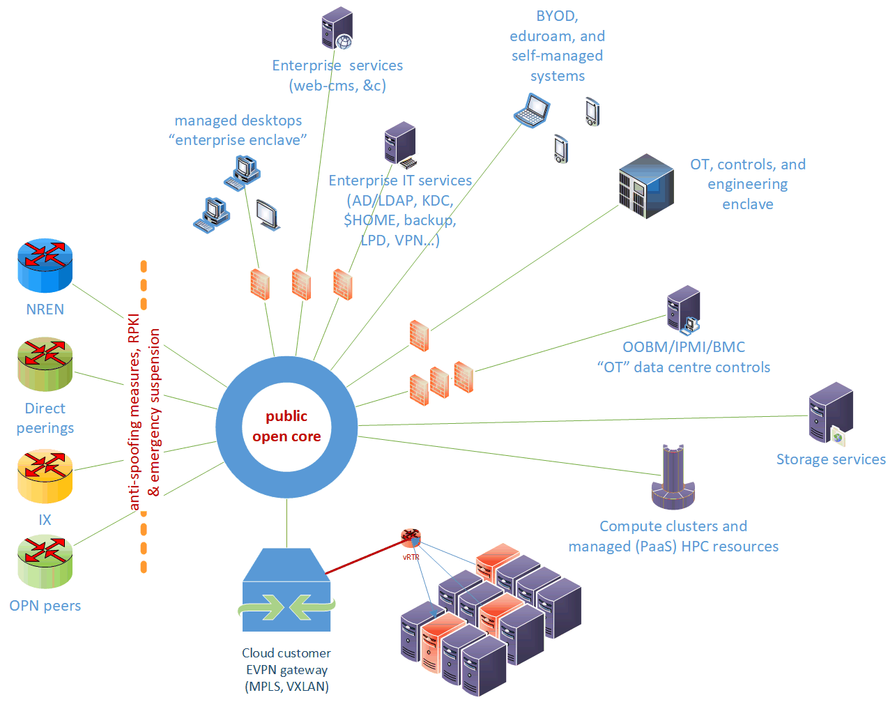
Network structure design: logical and topological view segmentation: a research network with office enclaves
achtergrondbeeld: Vesting Bourtange; segmentation impression represents Nikhef Security Technical and Organisational Measures

Slide 8
From Eli Dart (ESnet), “The Strategic Future of the Science DMZ”, TNC23, https://indico.geant.org/event/2/contributions/186/attachments/168/

Slide 9
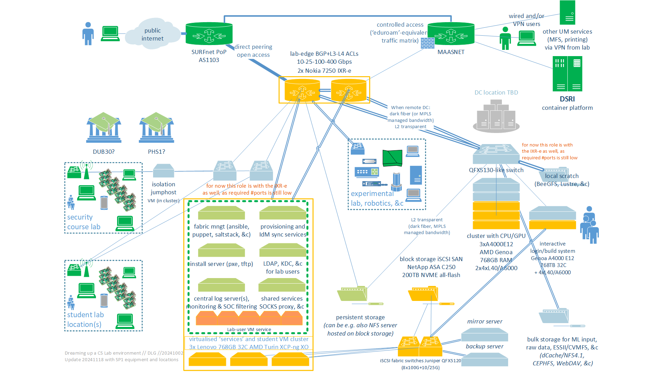
Dreaming up a CS lab environment in a ScienceDMZ
SOLL and IST (yellow, green) state of the CSlab foundation

Slide 10
CS Lab – the 2024 foundation (<20 December 2024)
Virtualised base infrastructure: fabric management, logging, IAM bridging (to SURF SRAM or locally with a SAML SP), proxy and gateway services for sub-labs, ~300+ student sandbox VMs, XCP-ng & XenOrchestra managed with SAML or OIDC auth
3x SR635v3 (each: 786GB RAM, 2x25G data network, 2x25G iSCSI, 64 logical cores 9355P)
Storage back-end service: block storage for VMs (supporting NFSv4 via VM with linux)
NetApp C250 with 200 TByte net NVME all-flash capacity, 4x100G iSCSI
HPC starter cluster: AI/ML courses, reasoning, HPC modelling, interactive & batch
4x ASUS ESC4000A (each: 3.25GHz 64 logical core EPYC 9355P, 768 GB RAM, 2x16TB NVME, 2x25G data network), 3 of these systems have 4 Nvidia L40 GPUs each (so 12 GPUs in total)
one node as the ‘interactive’ validation and compilation node (scheduling will be in a VM)
Network: access gateway for standard edge connectivity (BGP, MPLS, 802.1q, EVPN, L3/L4 ingress and egress ACLs and policers) and iSCSI SAN fabric switches (25/100G)
pair of Nokia 7250 IXR-e, each: 2xQSFP28 100G, 8xSFP28 25G, 24xSFP+ 10G (or 1G)
pair of Juniper QFX 5120’s, each: 8xQSFP28 100G, 28xSFP28 25/10/1G

Slide 11
More discussion time …

Slide 12
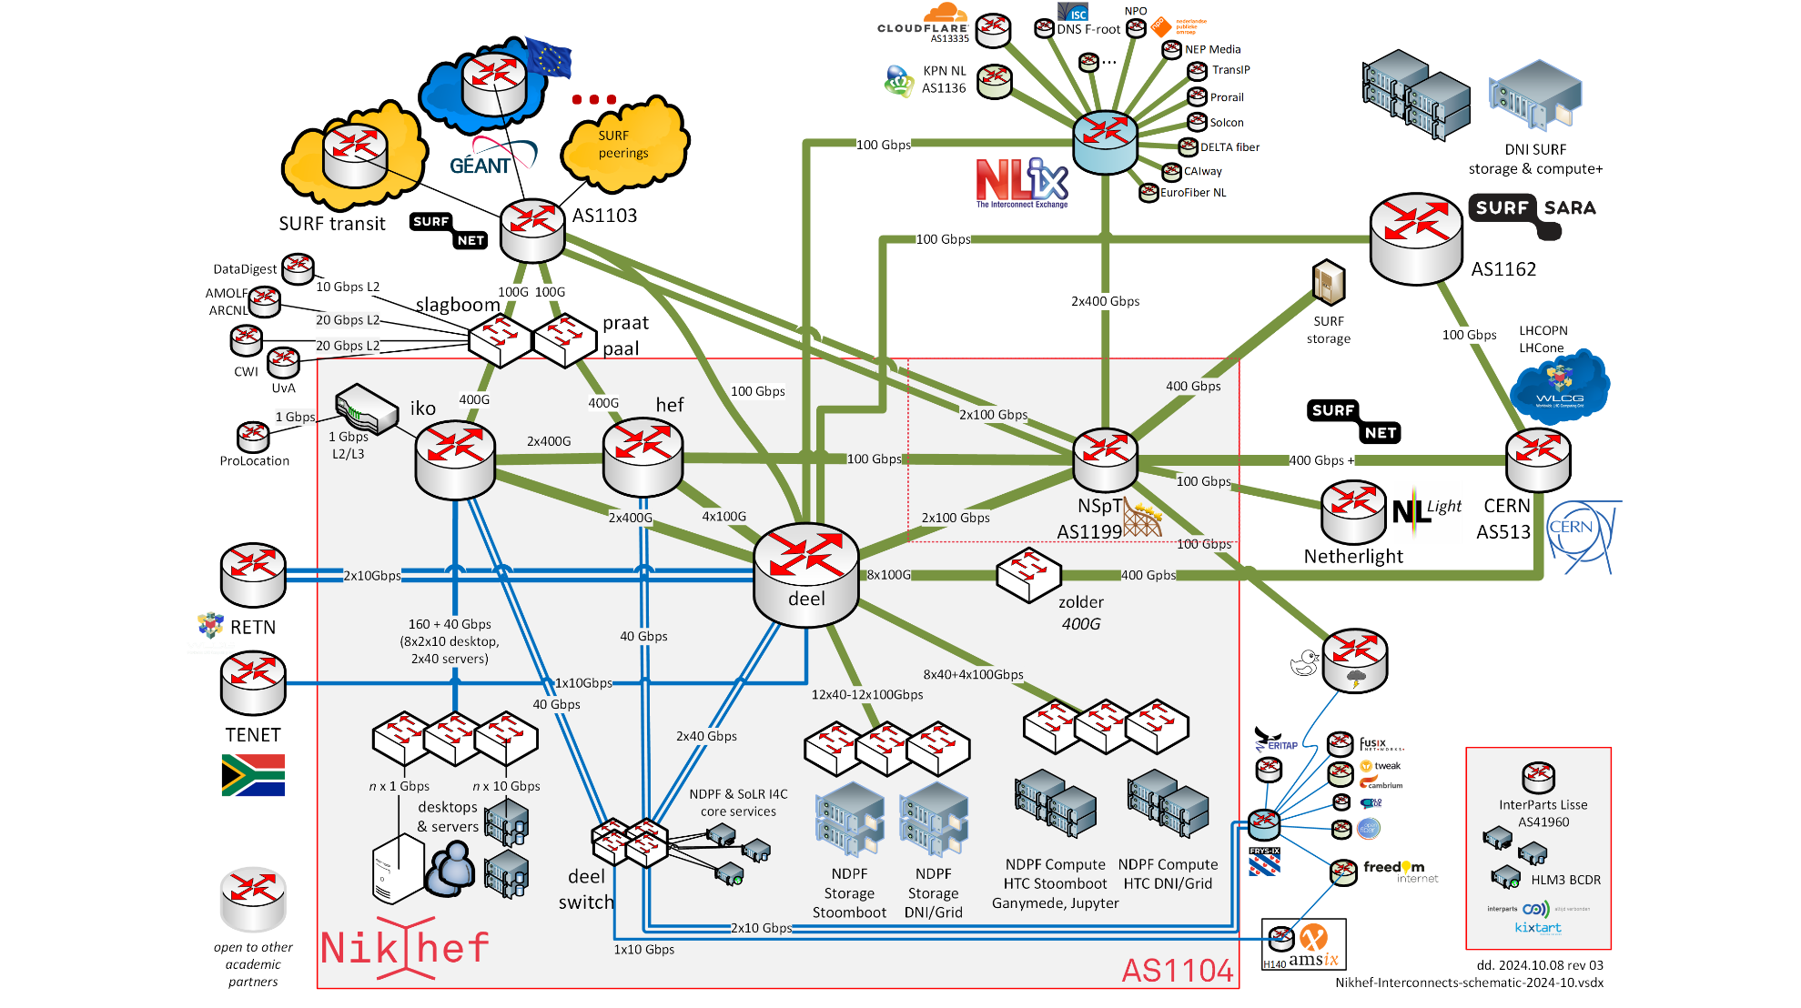
AS1104
https://www.nikhef.nl/pdp/doc/facility

