Slide 1
Trust Policy Coordination & Opsec for the next EOSC phase
David Groep, Nikhef PDP
EOSCHub, GN43, IGTF, EUGridPMA & EGI CSIRT week

Slide 2
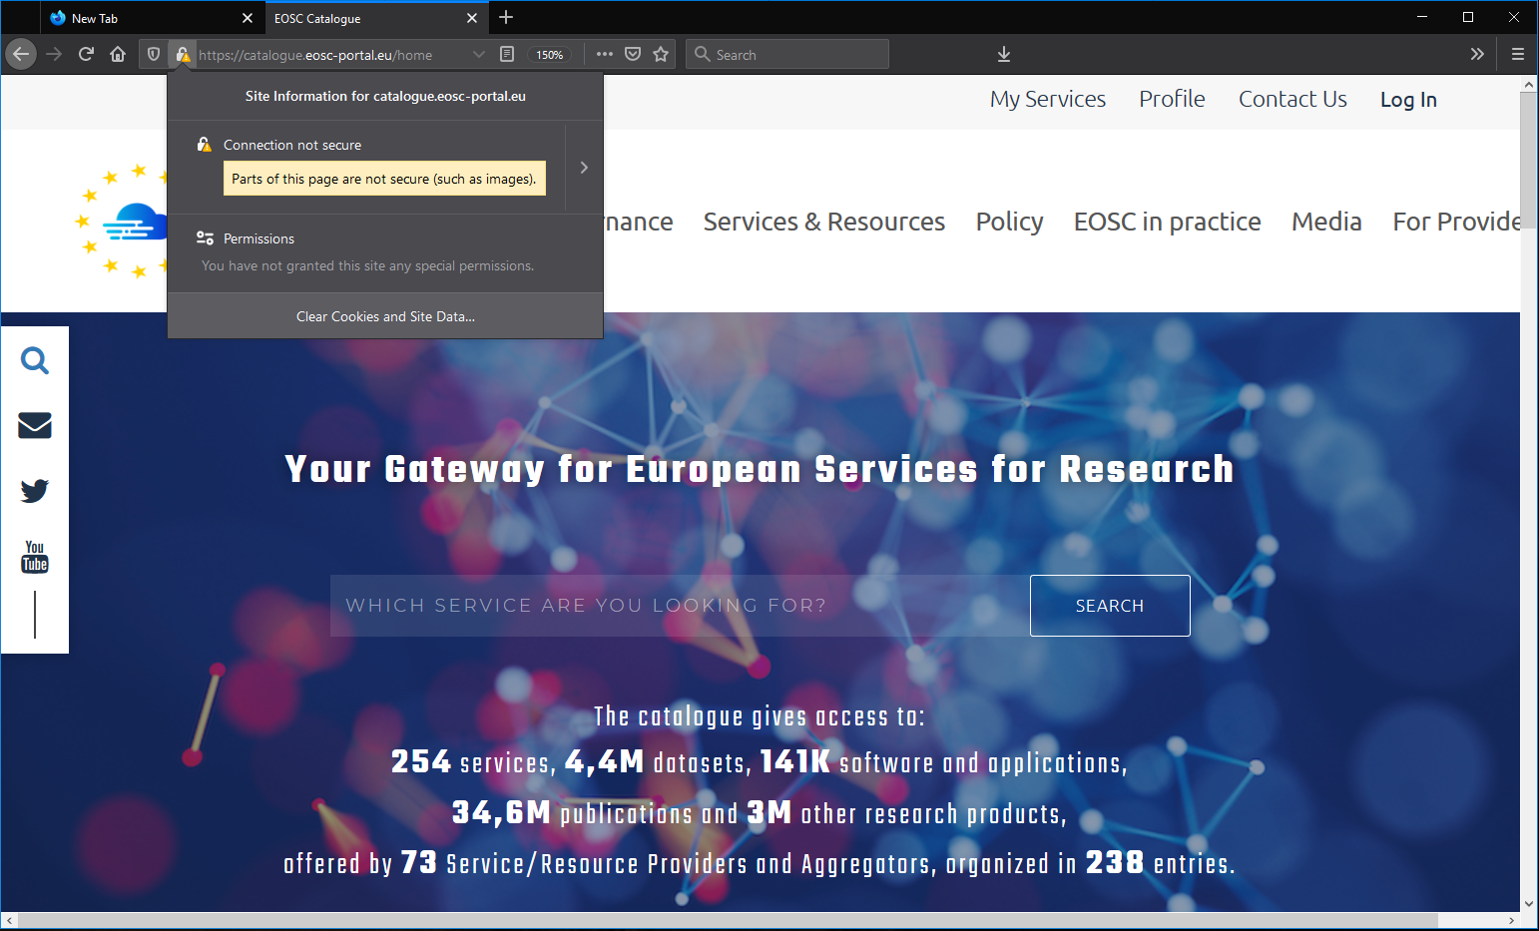

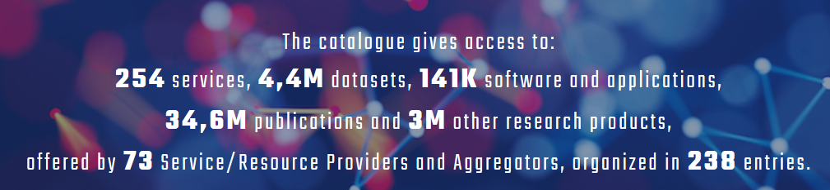
EOSC – a ‘multipronged’ infrastructure

Slide 3
Beyond ‘traditional’ services
Trust, service integrity, (operational) security and policy are established concepts for data centres, storage services, compute services, and portal operators – those we know
yet the EOSC will be integrating many more ‘services’ – many of which will be backed by entities not customarily exposed to trust operations
who may build - or not - on underpinning services like storage, compute, webhosting, PID issuers, and generic repository providers

Slide 4
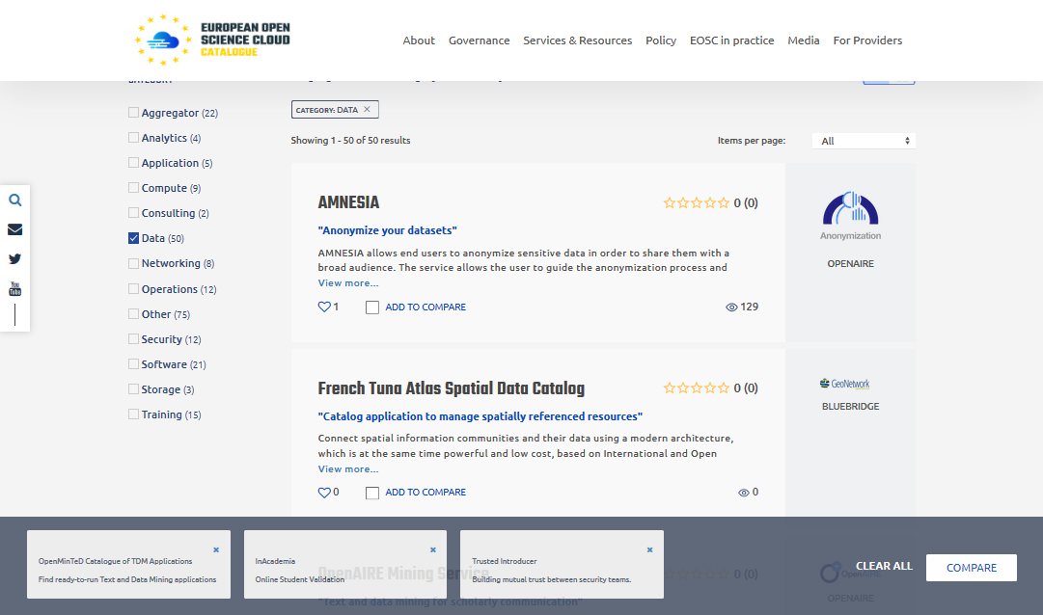

Slide 5
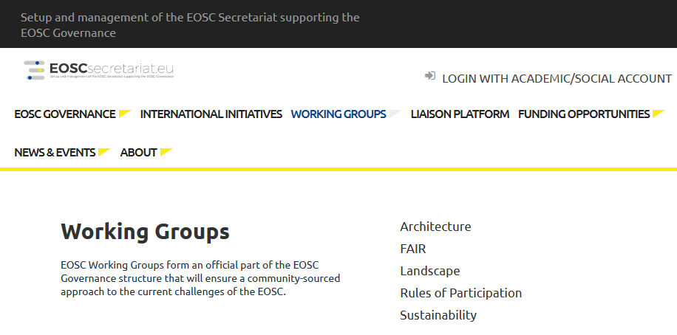
Rules of Participation in the EOSC
‘EOSC’ very much evolving
Most relevant WGs here are Architecture & Rules of Participation

Slide 6
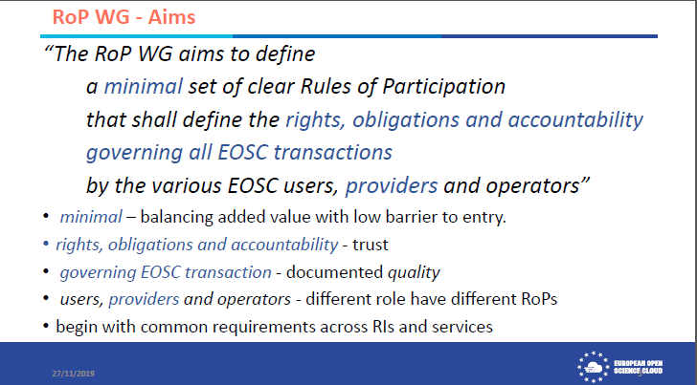

Slide 7
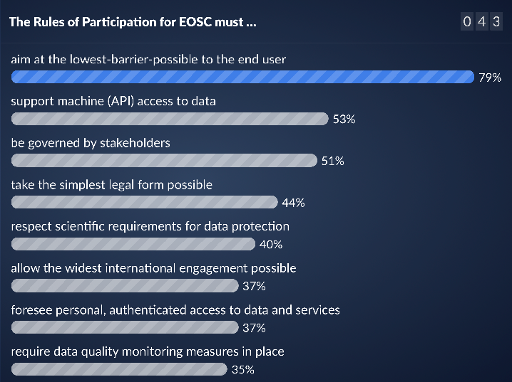
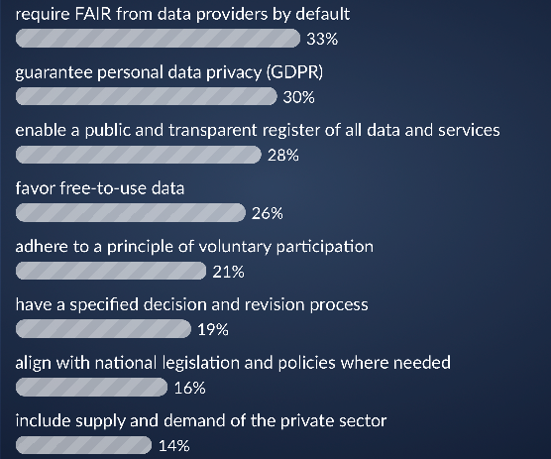
An interesting tasking …
Source RoP WG survey at the EOSC Symposium – Budapest 27 November 2019

Slide 8
Work Programme 2018-2020 (4)
European research infrastructures (including e-Infrastructures)
For an interesting long read:
https://ec.europa.eu/research/participants/data/ref/h2020/wp/2018-2020/main/h2020-wp1820-infrastructures_en.pdf
In brief
one ‘joint’ single project to develop ‘the portal’
a set of complementary projects (one per topic) for the ‘service offering’

Slide 9
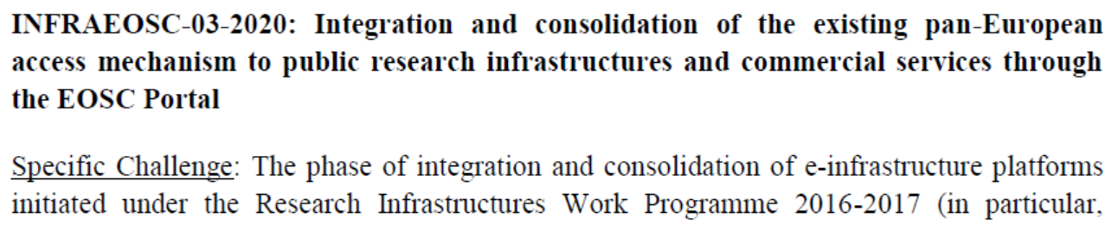
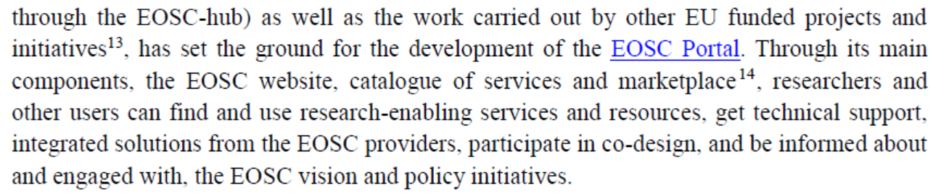
The Single Combined effort: -03

Slide 10
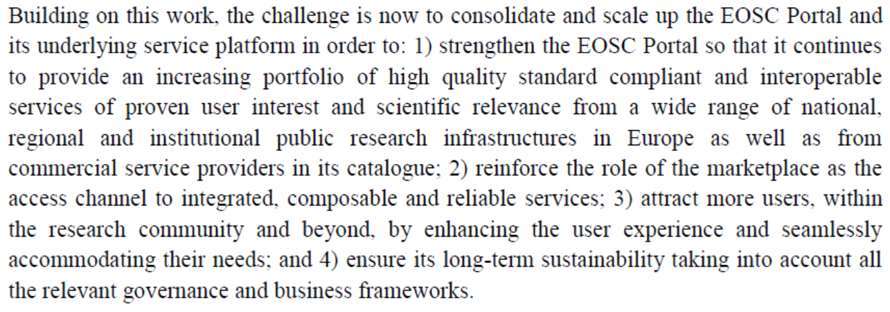

Slide 11
Activities in -03
a. Operation, maintenance and enhancement of the EOSC Portal
b. Fostering and enabling secure service composability
c. User enhanced experience using Artificial Intelligence (AI) techniques
d. Widening the EOSC user base
specifically using AARC, AARC2, EOSCH – and linked to eIDAS
e. Widening the service offer with commercial services
f(i). Outreach and skills (but only user oriented!)
f(ii). Support to the Research Data Alliance’s contribution to the EOSC

Slide 12
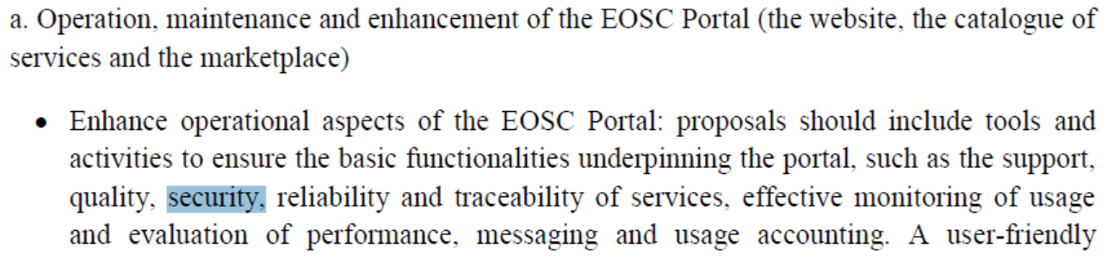
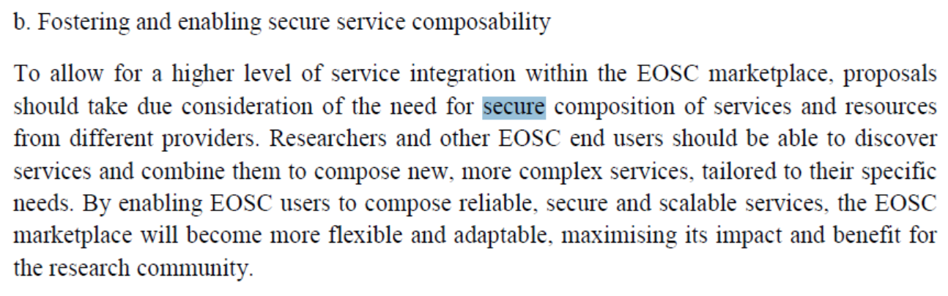

Slide 13
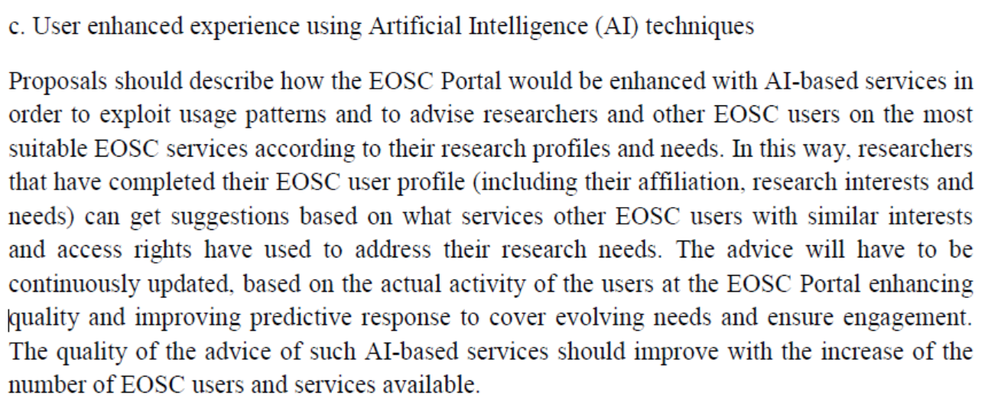
‘with some interesting challenges’

Slide 14
widening the user base
In order to enable users from non-research communities to access EOSC services through the EOSC Portal, the AAI (AARC, EOSCH) federated architecture implemented in the EOSC Portal should be fully aligned with the legal and interoperability framework set by the eIDAS Regulation.
Proposals should include an outline of the legal, technical and business processes to be implemented through contractual agreements between the EOSC Portal and user institutions that are interested in providing increased accessibility to EOSC services and resources to their affiliated members.

Slide 15
Size of -03
As the scope of this activity is to consolidate a single EOSC Portal, at most one single proposal covering all the described activities (a. to f. included) is expected to be funded
The Commission considers that proposals requesting a contribution from the EU of up to EUR 40.9 million and a 30 months duration would allow this challenge to be addressed appropriately.

Slide 16
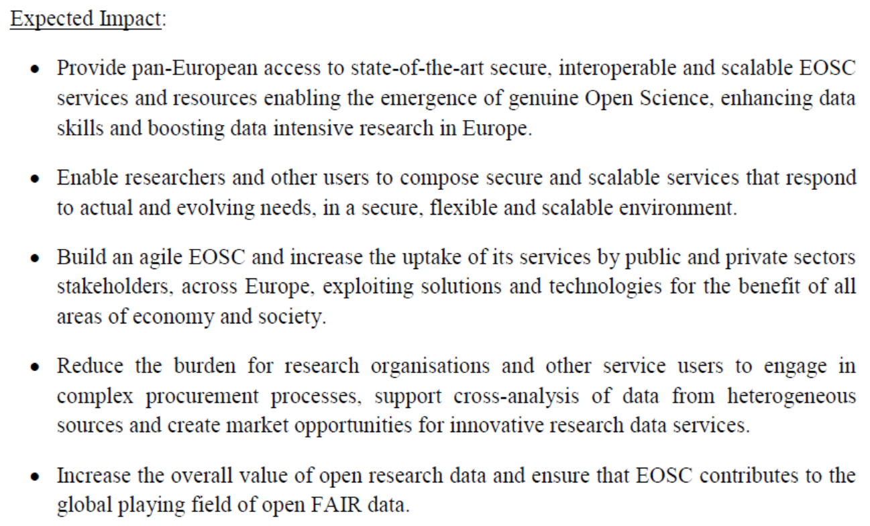

Slide 17
complemented by -07A*
‘Increasing the service offer of the EOSC Portal’
(a1) Distributed and cloud computing resources enabling researchers and other users to process and analyse data in a distributed computing environment.
(a2) Data services providing cost-effective and interoperable solutions for data management and long-term curation and preservation.
(a3) Services supporting scholarly communication and open access:
(a4) Above the net services are added-value applications and services that enable users to communicate, interact and collaborate effectively in a heterogeneous and distributed federated environment. make use of the underlying connectivity infrastructure and its core building blocks (such as security and AAI).
(a5) Services and resources from non-research public sector data providers
(a6) Additional research enabling services

Slide 18
Scope of -07a*
effectively coordinate at pan-European level the provision through the EOSC Portal of state-of-the-art research enabling services from a wide range of national, regional and institutional public infrastructures in Europe, covering diverse thematic domains, and further non-research resources in order to: 1) scale up the EOSC Portal; and 2) set-up a model for interaction between service providers and the EOSC Portal operators through pan-European e-infrastructure entities, based on transparency and effectiveness of cost compensation.

Slide 19
Across the -07a* topics
The progressive federation of the services and resources under the awarded proposals, together with the progressive connection of ESFRI research infrastructures and thematic clouds developed under other parts of the Horizon 2020 programme, should allow the EOSC Portal to provide a catalogue that increasingly meets the researchers’ needs covering the full research life cycle.
‘The proposals have to be flexible in order to take into account all the relevant governance and business models[…] For the areas from a1 to a4, proposals should be built on the capacity of established pan-European e-Infrastructures to act as interlocutor with the EOSC Portal operators.’

Slide 20
Across all of the 07a* bits
‘Coordinate and incentivise institutional and public actors so that they open up their services and resources to researchers across Europe, through a transparent and quality assured process.’
‘Foster synergies between pan-European e-infrastructures operators, leading to harmonised services, improved use of resources and economies of scale across Europe.’

Slide 21
-07
Funding should cover, in particular, the costs incurred by service providers when their services are accessed through the EOSC Portal. Service providers in the consortia must be able to determine the cost of a unit of access and to account for the unit of access consumed by users beyond their usual user community.
‘solely when declared on the basis of unit costs and only for the portion used to provide virtual access under the awarded grant. For areas a1 to a4, it is expected that a substantial part of the total budget per awarded grant will be dedicated to cover the costs of EOSC users accessing the services.’

Slide 22
-07 budgets
The Commission considers that proposals requesting a contribution from the EU of up to:
- EUR 8 million would allow the challenge in area a1 to be addressed appropriately;
- EUR 7 million would allow the challenge in area a2 to be addressed appropriately;
- EUR 4 million would allow the challenge in area a3 to be addressed appropriately;
- EUR 2 million would allow the challenge in area a4 to be addressed appropriately.
- EUR 1 million would allow the challenge in area a5 to be addressed appropriately.
- EUR 2 million would allow the challenge in area a6 to be addressed appropriately.

Slide 23
Trust & ‘Security’ activities

Slide 24
Towards a coherent vision for trust and ‘security’ activities
Coming back to an old concept: “security and availability”
the aim is not security per se, the goal is to have availability, integrity, confidentiality, reliability, and trust (behavior ‘as you expect’)
the very word ‘security’ does not resonate with users or communities
so: define the necessary activities in terms that describe goals & intents

Slide 25
The trust and integrity white paper
‘the document we promised to write in September last year’
Trust and integrity services for the consolidated ecosystem
  risk management and assessment, peer review and SCI
  SPG work and associated implementation measures/targeted policy & PDK
  maintaining the community-wide security posture: SSCs, training, processes
  incident response capability and operational support liaison
Trust and collaboration operational (AAI supporting) services
Trust and integrity for the distributed resource Infrastructures
  those activities that are more tightly bound to the infrastructure: CSIRT, vulnerability assessment, monitoring, infrastructure-AAI bridging trust

Slide 26
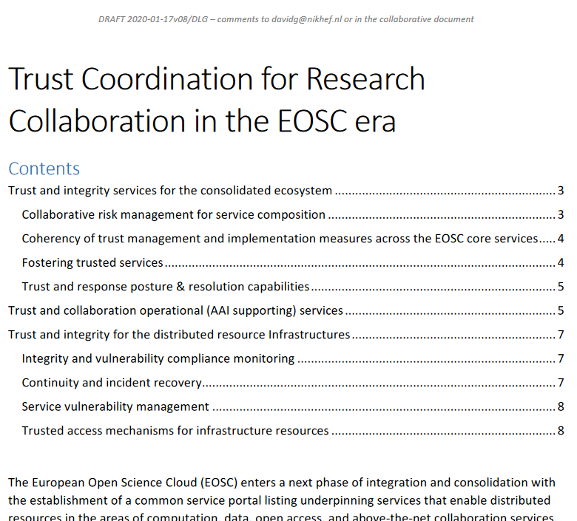
Discussion and evolution
For the latest PDF for reading:
https://g.nikhef.nl/eosc-sec-wp
To make suggestions (still):
https://g.nikhef.nl/eosc-sec-wp-suggest

Slide 27
Collaborative risk management for service composition
Actions:
• Risk assessment framework for EOSC services (based on WISE SCI)
• Formalised peer reviewed maturity model and mechanisms
may be visualized as tags or trust marks in the Catalogue
inspired by Urpo’s suggestions during the CERN meeting last year

Slide 28
Coherency of trust management and implementation measures
Actions:
• Evolve trust availability and security policies to address communities’ needs and the requirements of heterogeneous service providers
• Act as reference expert group on cross-service risk acceptance
• Draft implementation measures in response to EOSC portal evolution, describe the implementation measures that will implement this evolution.
• Provide trustworthy sources for trust anchors matching a limited number of common EOSC assurance profile requirements and protocols.

Slide 29
Fostering trusted services
Actions:
• Security Communications exercises across EOSC service providers and infrastructures
• Development of trust and operational security maturity training
• Advanced forensics training for providers in order to maintain integrity of the EOSC ecosystem
• Development of best practice and guidance for secure service alignment
• Optionally training for trust maturity development and secure joining

Slide 30
Trust and response posture & resolution capabilities
Actions:
• Coordination of operational security response to cyber security events
• Global interoperability of trusted response teams
• Cooperation with peer infrastructures from both the research infrastructures and commercial service providers, including specific collaboration with eduGAIN and GEANT
• Emergency response capabilities to ensure secure, reliable and traceable resolution of incidents that affect the functional abilities of the EOSC ecosystem as a whole

Slide 31
Trust and collaboration operational (AAI supporting) services
AAI is very much driven by the EOSC Architecture WG AAI TF
included here are the ‘latest’ concepts around mesh model of the AAI
a starting point for the AARC BPA 2020 – which will happen in 2020
AppInt as the vehicle for making it happen

Slide 32
Trust and integrity for
the distributed resource Infrastructures
At the service capability pillar/e-Infrastructure level (“07A*”)
This is specific to each infra/service area, and not at the EOSC-portal level
EGI chose to run (mostly) this bit via the CfP core task tendering process
other infrastructure consortia will have used other ways of gathering input
Also here the AAI task is likely best described elsewhere – and is likely more specific to the service portfolio of the area anyway

Slide 33
Integrity and vulnerability compliance monitoring
Actions:
• Operation and evolution of vulnerability identification and assessment tools specific to the services provided in the infrastructure
• Support for service provider self-inspection and assessment, complemented by external probing supported by infrastructure-level expert team, which jointly provide a view of service resilience to integrity threats
• Follow-up for identified threats to service providers by the infrastructure, to support resolution and iterative maturity improvement

Slide 34
Continuity and incident recovery
Actions:
• Provisioning of a (TI accredited/certified) incident response team providing emergency security incident response coordination across the infrastructure services
• Provisioning of advanced forensic capabilities to address and mitigate security incidents, limit their spreading, and support restoration of continuity
• Maintain global liaison with academic, industrial, and government/LE peers to provide early/rapid response and advance warning capability and collect and share threat intelligence
• Planning and execution of readiness posture, and map-table crisis management, exercises

Slide 35
Service vulnerability management
Actions:
• Assessment of reported and identified vulnerabilities in operational services, and provide specific recommendations to service providers in the infrastructure based on an infrastructure-specific risk assessment

Slide 36
Next steps

