Slide 1

Enabling global trust through requirements profiling
enabling the interoperable
global trust federation
David Groep
Nikhef
Nikhef, Amsterdam
supported the Dutch national e-Infrastructure
funded and coordinated by SURFsara,
by EGI.eu, and by EGI-InSPIRE RI-261323,

Slide 2
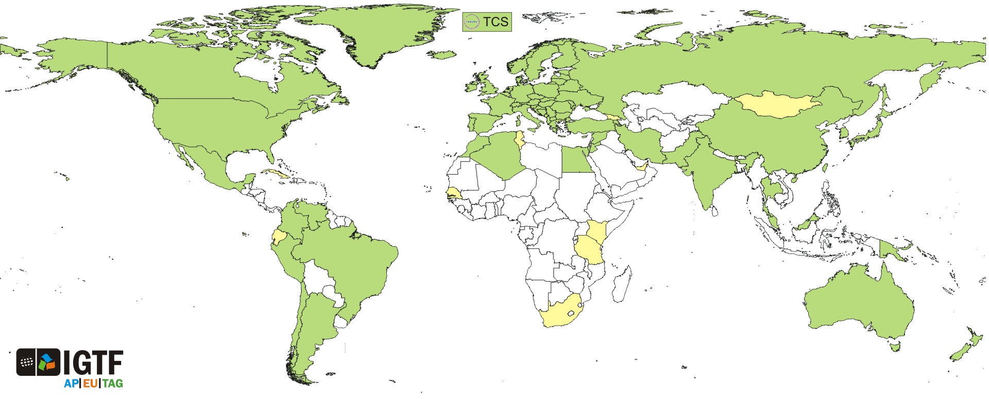
IGTF: Interoperable Global Trust Federation supporting distributed IT infrastructures for research
3 regional coordination groups (AP, EMEA, Americas)
~80 authorities and ~10 cross-national infrastructure members
~100 000 subscribers
Single integrated trust fabric with differentiated LoA

Slide 3
IGTF – Interoperable Global Trust Federation supporting distributed IT infrastructures for research
IGTF brings together
  e-Infrastructure resource providers, user communities and identity authorities
  to agree on
  global, shared minimum requirements and assurance levels
  inspired and coordinated by the needs of relying parties:
  EGI, HPCI, PRACE-RI, PRAGMA, OSG, XSEDE,
  … as well as most national e-infrastructure providers

Slide 4
Minimum Requirements
Federation imposes minimum requirements
on identity provider participants
  Reflect operational and security needs of resource providers
  Differentiated LoA support
    classic user-based subscriber services: serve all users
    identity services leveraging (R&E) federations with ID vetting
    ‘LoA1+’ Identifier-Only Trust Assurance
    – if relying party has other ways to vet its users, allow for
    lower-assurance identifiers, thus enabling more ID federations
  Research-inspired verification process: self-audits,
  peer-review, transparent open policies and processes
  ‘meet or exceed’ required minimum standards
‘LoA2-’

Slide 5
How to think of the IGTF?
It may not be what you might think it is …
Coordination body for of policy and credential
best practices for research communities
Use-case driven differentiated
LoA coordination
Harmonized set of LoA requirements set
by resource providers (e-Infrastructures)
An inclusive bottom-up ‘IdP cooperative’ for distributed
research communities with widely dispersed users
Supporting collective services acting coherently worldwide
… as a part of a larger jigsaw puzzle

Slide 6
A part of the jigsaw …
IGTF
FIM4R
IGTF by now supports many things
agreed LoAs for e-Infrastructures for research
‘LoA2-’ MICS, IOTA, Robots & credential translation
levels inspired by current RPs: infra & user
globally-coordinated unique identifiers
key to cross-domain services with many SPs/RPs
‘best practices’ for AuthZ, credential management, operational security and response for ID providers
qualified trust anchor distribution mechanism
modelled on assurance processes inspired by research
bottom-up extends to all researchers (coverage)
but by design cannot and should not ‘do it all’!
REFEDS
SCI
GEANT
INFRA7 AAI

Slide 7
Going forward from here … ?
Beyond authentication and identity, attributes and authorization are (and are becoming more) important for e-infrastructures
mere authentication likely commonplace in the years to come
authorization, (community) assured attributes, and attribute composition are still unsolved for research e-infrastructures
IGTF to generalise the current profiles into ‘LoA’ documents
we should be able to do away with most of the ‘classical’ independent ID provisioning in Europe …
  but we will still need ways to get to full 100% coverage: catch-all!
  both inside but also outside of Europe – research is global!
  higher level LoA catch-all services should be fully integrated
  don‘t forget about industrial research and SME partners – they’re our research partners and collaborate in projects just like academia!
It is our collective challenge to make it all work together

Slide 8
Building a global trust fabric www.igtf.net
Interoperable Global Trust Federation – AP EU TAG

