Slide 1
TIIME 2026
An Extended Week for Trust and Identity
February 9-13, 2026

Slide 2
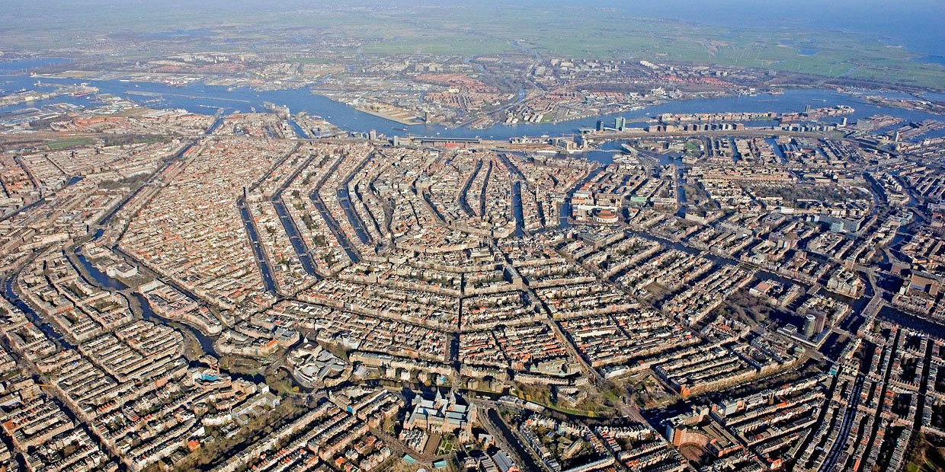
Hosting TIIME 2026 in Amsterdam: February 11-12
Wednesday & Thursday 11-12 February 2026: TIIME
Tuesday 10: AARC TREE symposium
Monday 9 & Friday 13: held for smaller side meetings
joint SURF and Nikhef initiative tiime2026-loc@nikhef.nl
with support from those you know and love: DAASI, GEANT, ..

Slide 3
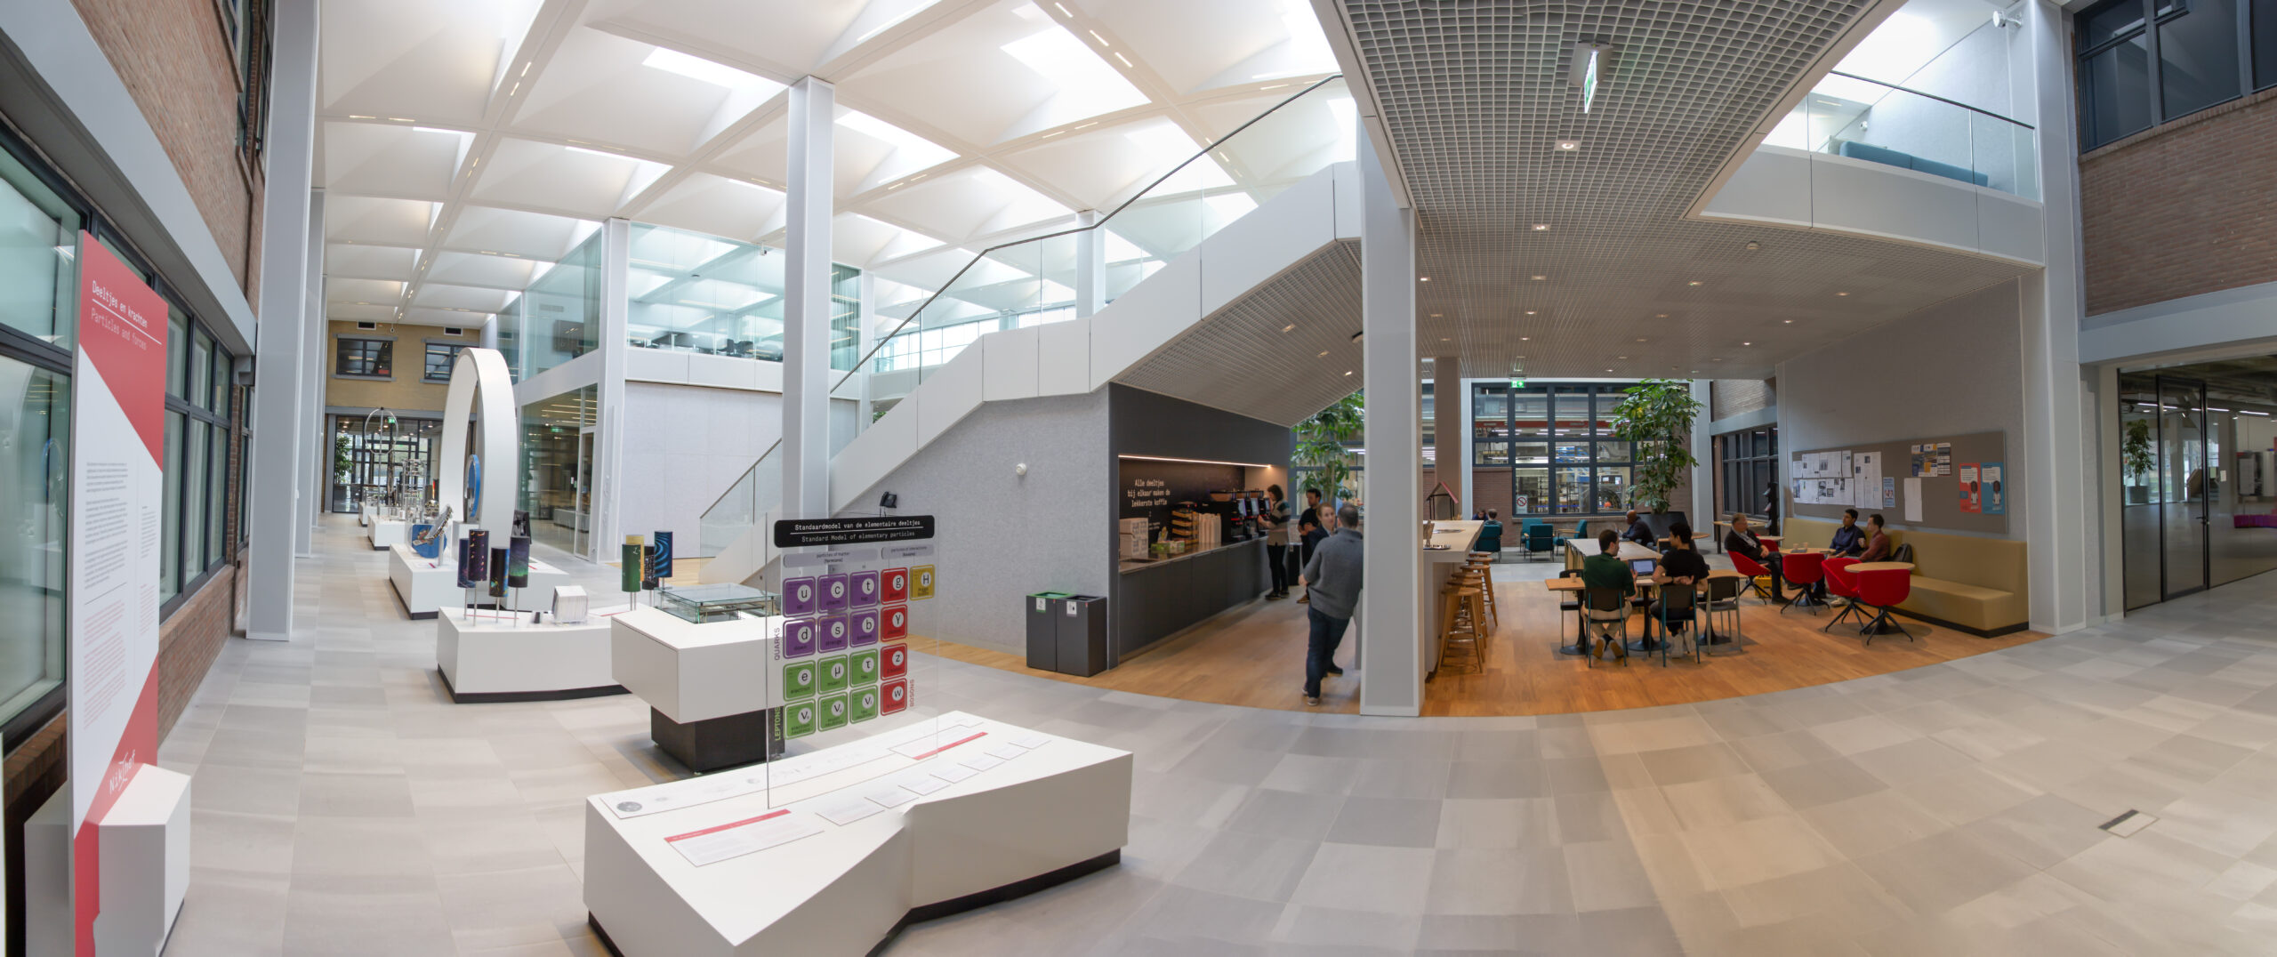
Nikhef: Dutch National Institute for Sub-atomic Physics

Slide 4
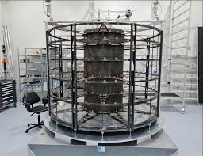
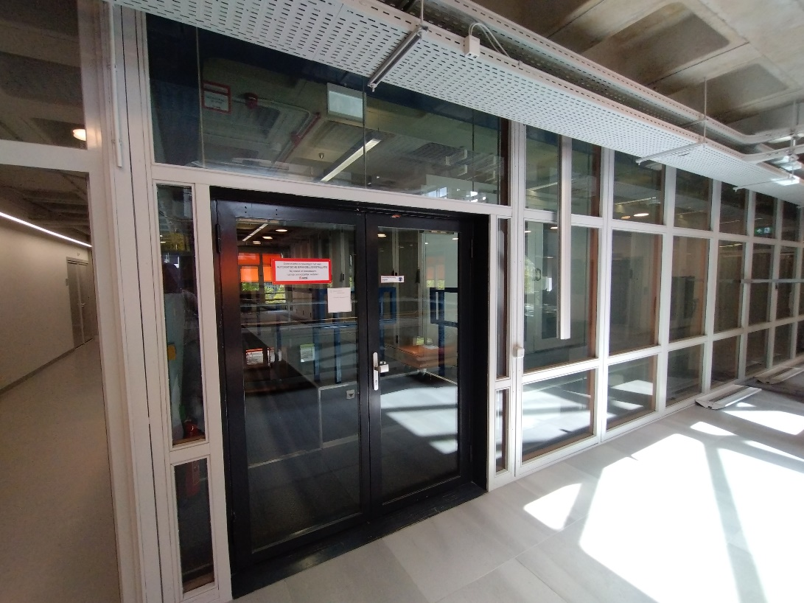
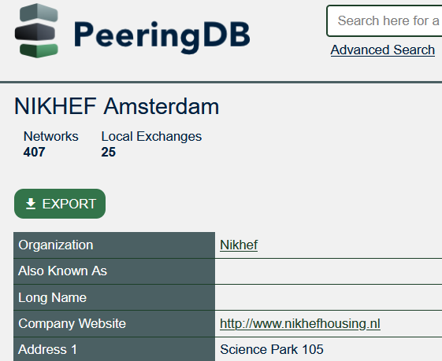
A hub for computing, networking, physics, and lots of trust

Slide 5
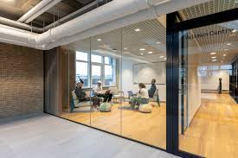
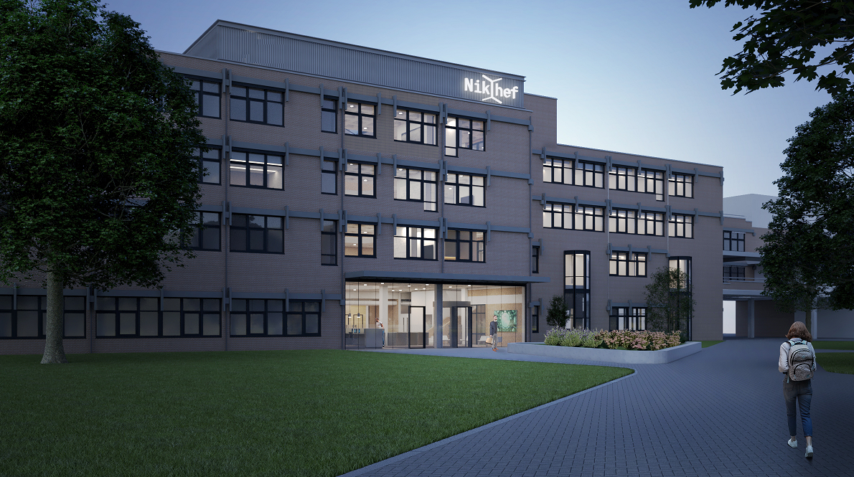
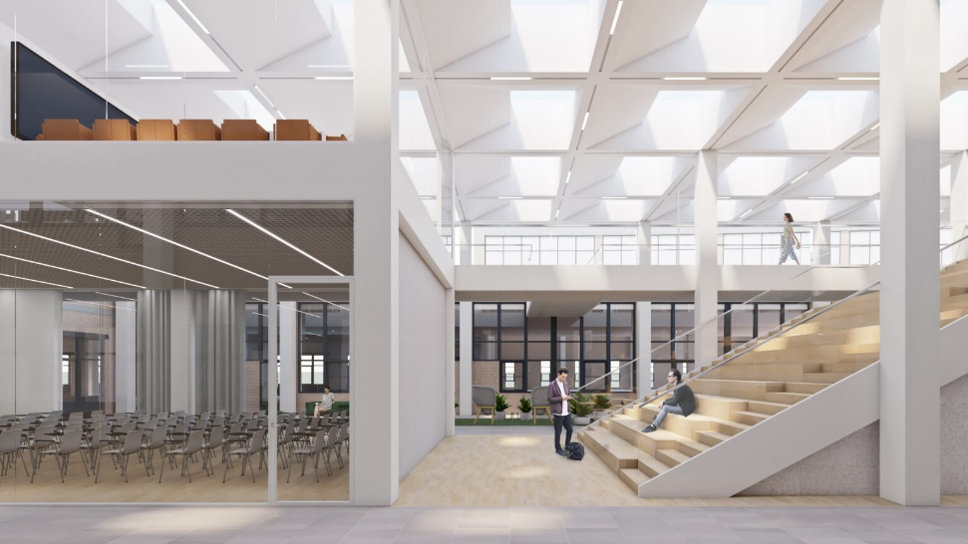
and … lots of space: 6 parallel rooms + lecture theatre
for side meetings and AARC Symposium:
70p plenary room and 3 side rooms 20-30p

Slide 6
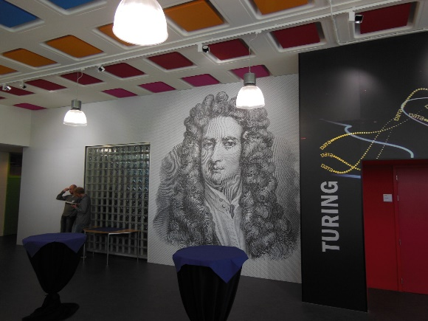
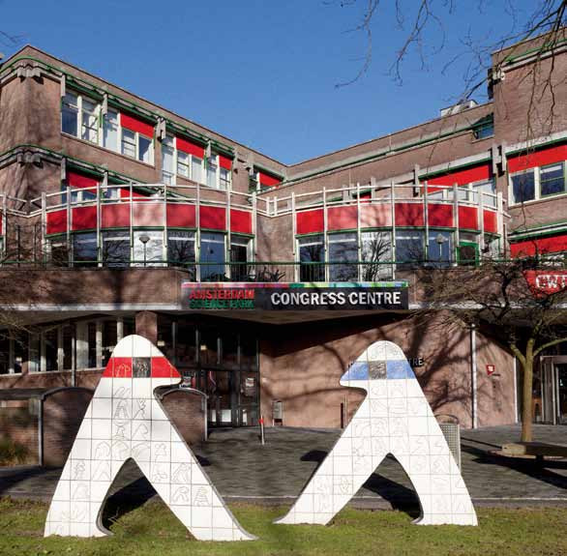
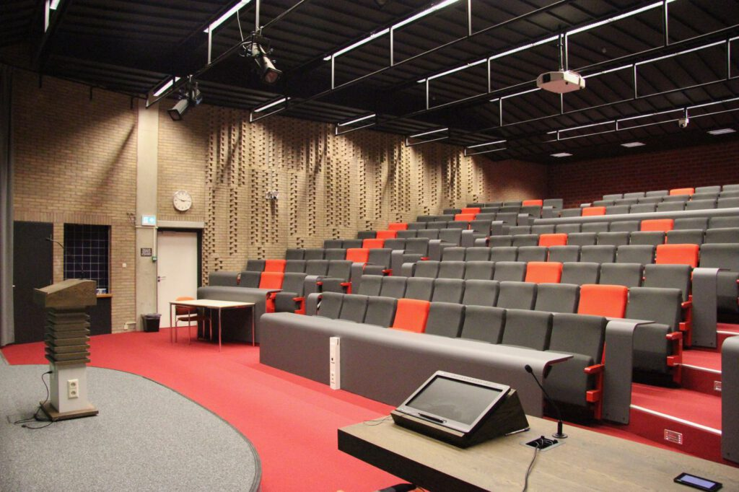

Nikhef and WCW: plenty of room for lively discussions

Slide 7
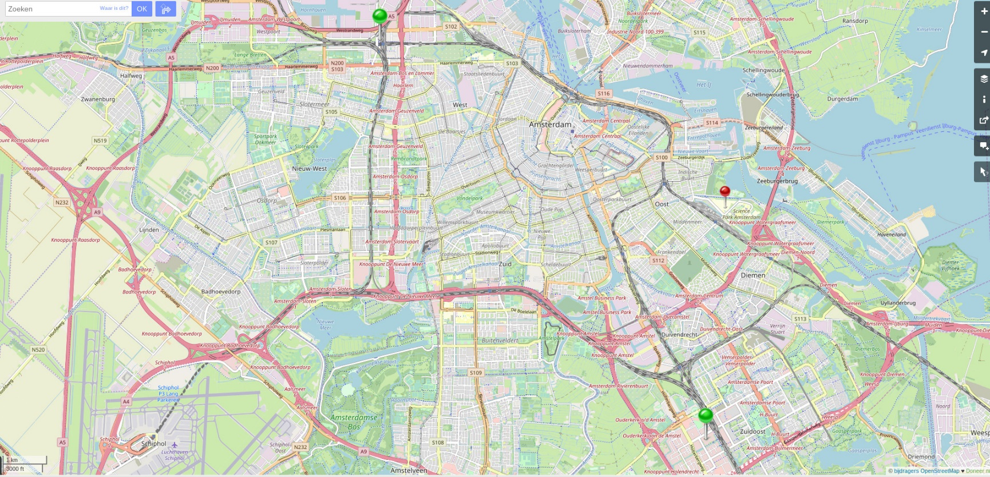
Easy to get to
with direct trains from Amsterdam Airport, Paris, London

Slide 8

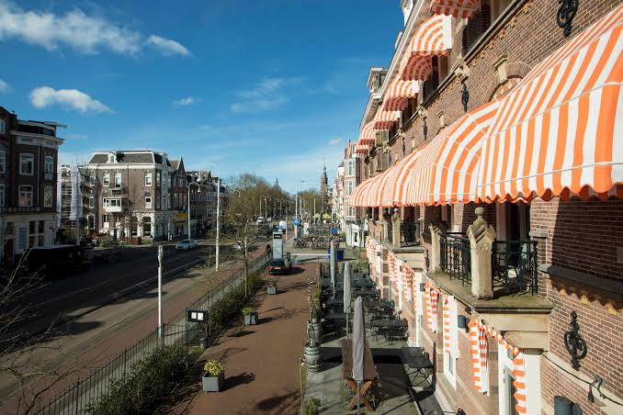
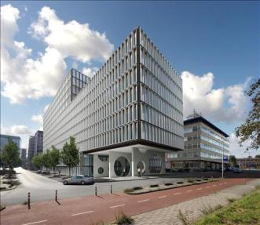
And Amsterdam has accommodation in all shapes & sizes
More than
3000 *** rooms
10000 **** rooms

Slide 9

See you in 2026 at Nikhef
Tuesday 10 Feb AARC Symposium
Wed 11 + Thu 12 Feb TIIME 2026 https://go.nikhef.nl/tiime2026
A joint SURF and Nikhef initiative
Q? tiime2026-loc@nikhef.nl

Slide 10
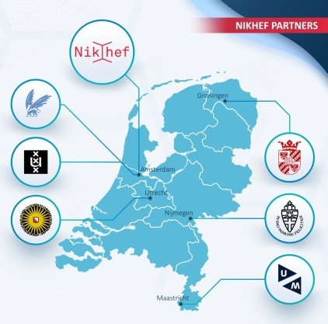

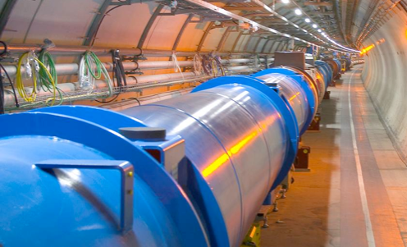
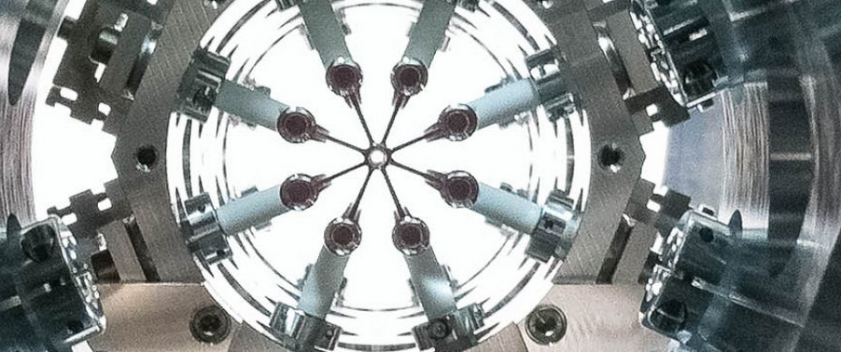
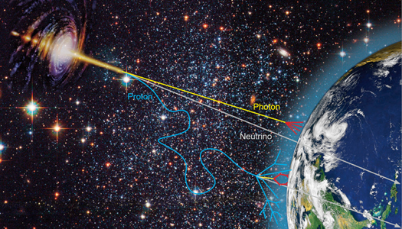

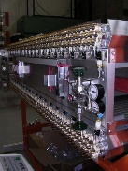
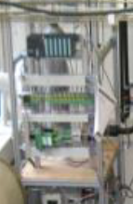

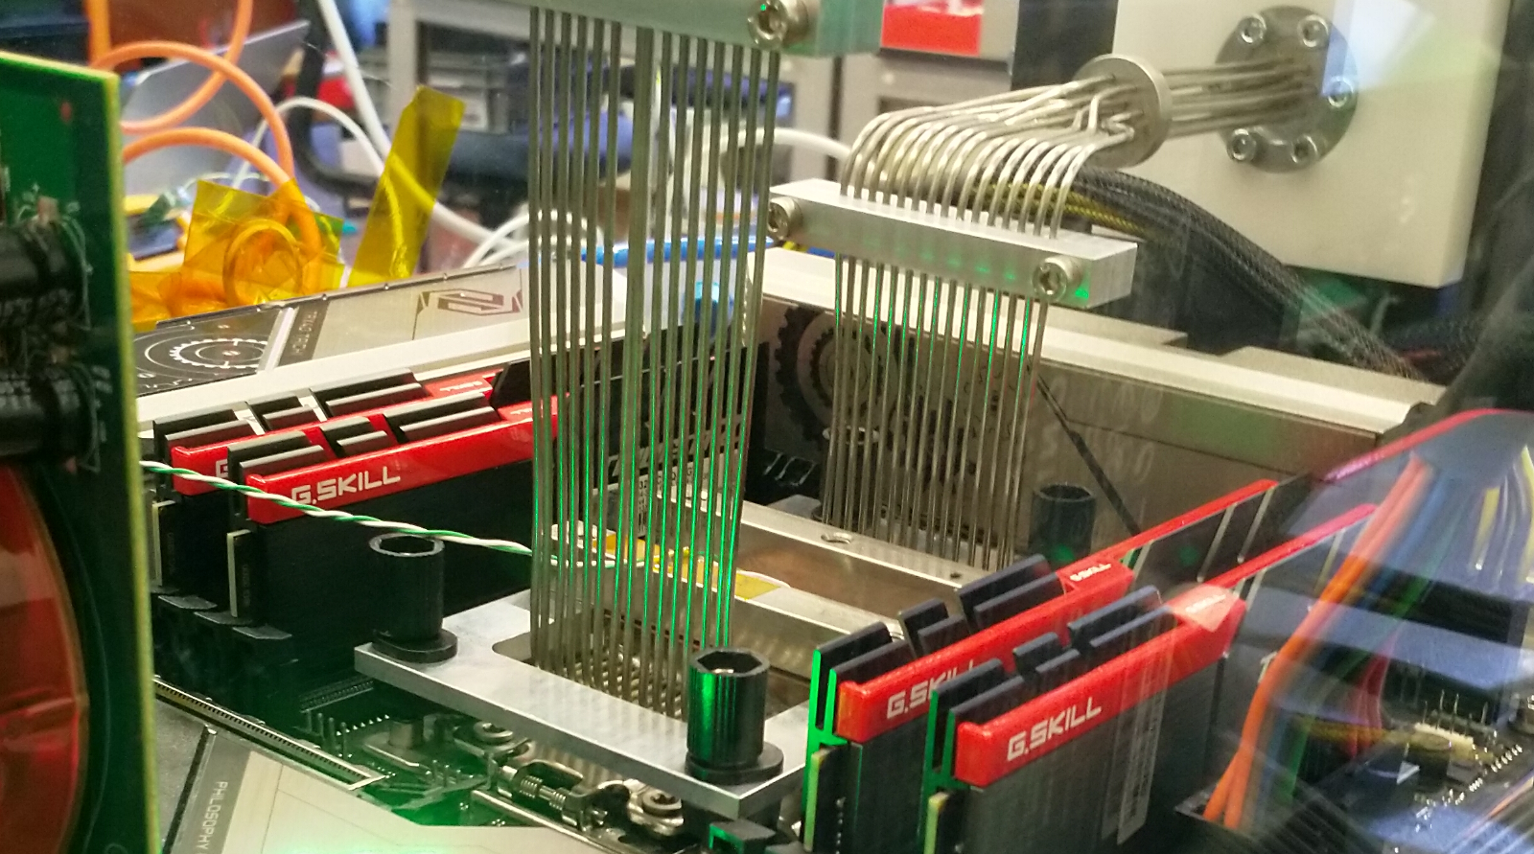

What we usually do …
Atlas
LHCb
Alice
eEDM
Particle physics
Neutrinos
Gravitational
waves
Cosmic Rays
Dark Matter
Astroparticle physics
Physics Data Processing
- better algorithms, faster physics
- infrastructure for collaboration
- networks and system innovation
Detector R&D
Phenomenology
Theoretical Physics
Technology R&D

