Slide 1
Trusted Certificate Service
updating to the Generation 4 back-end provider
David Groep
TCS Policy Management Authority
Nikhef Physics Data Processing group
EUGridPMA48, Prague
January 2020

Slide 2
15 years of TCS service
based on a concept by Jan Meijer back in 2004
driven primarily by the NREN constituency, but with the eScience use cases very much in mind
NREN (GEANT constituency) requirements on public trust, today esp. EV, but also eIDAS
in a way that scales to 45 countries and ~100k active certificates today, increasing steadily
and also ~10000 organisations, most of which cannot deal with certificates … or with much change
now going to its 4th iteration: GlobalSign, Comodo, DigiCert, … and now Sectigo again
1st CfP
SCS G1 (GlobalSign)
2nd CFP and start of TCS eScience with Comodo
TCS G4 CfP
2004
2005
2006
2009
2015
2019
2020
TF-EMC2
concept
Commissioning started
TCS G3 with DigiCert and eduGAIN

Slide 3
TCS constituency
service is ultimately driven by the GEANT members: 45 national R&E network organisations
wide range of inputs: some countries adore Qualified Certificated and eIDAS, others don’t care
some countries really need a native-language interface (like .fr, .es, …), others don’t care (.nl, .se)
stakeholders regard EV as mandatory, and many stakeholders pushed for ultimate stability – since the subscribers have actually no knowledge of PKI, nor of validation, and certainly not about chaining
eScience use cases are important for many, but certainly not the only driving factor in the game
Result of the formal 3-round consultation sessions with the NRENs (22 / 40 participated, April 2019)
one set of knock-out minimum requirements (which then cannot be materially changed any more)
a long list of ‘quality’ criteria, with a strong focus on compliance (CABF), public trust continuity,
all manner of interfaces to the service, and personnel & contract management

Slide 4
Certificate profiles
OV TLS Server | BR OV validated multi-domain with mixed SANs
OV TLS wild | BR OV validated multi-domain with mixed SANs combining both wildcard and non-wildcard domain names
EV TLS | BR EV validated multi-domain with mixed SANs
Personal webClientAuth and S/MIME | End-user personal certificate recognised by the major MUAs suitable for identifying the users real name
Personal webClientAuth IGTF and S/MIME | End-user personal certificate adhering to IGTF profile (using IA5String representation of the name with unique prefix /DC=org/DC=terena/DC=tcs/...), suitable both for authentication, and also including validated name and email address
Personal Robot webClientAuth IGTF and S/MIME | End-user personal software agent certificate adhering to IGTF profile (like above) and Robot Profile, suitable both for authentication, and also including validated name and email address
Robot Email webClientAuth IGTF and S/MIME | E-mail validated software agent certificate adhering to IGTF profile (like above) and Robot Profile, suitable both for authentication, and also including validated email address
IGTF OV TLS Server | BR OV validated multi-domain with mixed SANs including unique prefix "/DC=org/DC=terena/DC=tcs/..."
Document Signing | Adobe AATL compliant signing certificate
Code Signing | Conventional code signing certificate recognised by Oracle, MSFT, &c
EV Code Signing | BR EV Code Signing certificate recognised by MSFT &c

Slide 5
TCS is a GEANT service – with the TCS PMA defining the profiles and policy
TCS PMA drawn from the wider GEANT community (NRENs as well as individual orgs)
Current PMA members … some of whom you will have seen
  Teun Nijssen (SURF, NL)
  Dominique Launay (Renater, FR)
  Kurt Bauer (ACONET, AT)
  Kent Engström (SUNET, SE)
  David Groep (Nikhef, NL)
  Nicole Harris (GEANT)
  Sigita Jurkynaite (GEANT)
GEANT service manager is nowadays Sigita Jurkynaite

Slide 6
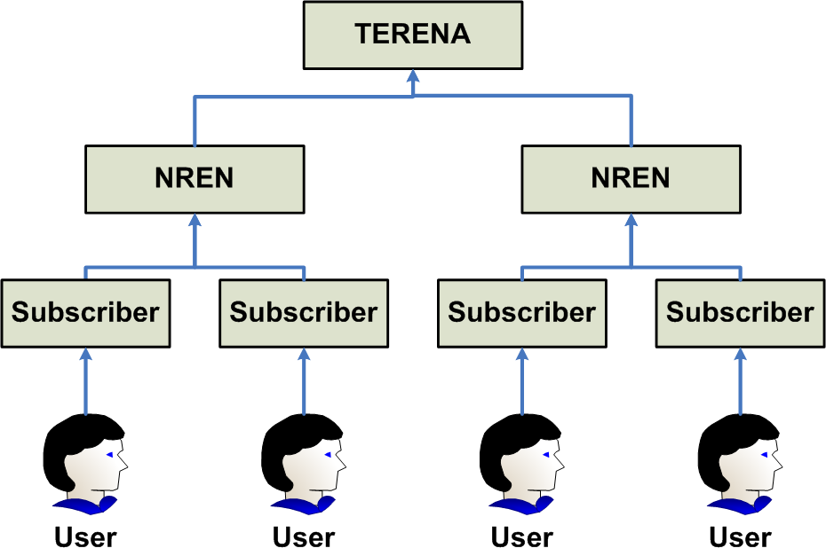
The basic structure remains the same … again!
image source: Jan Meijer, 2008

Slide 7
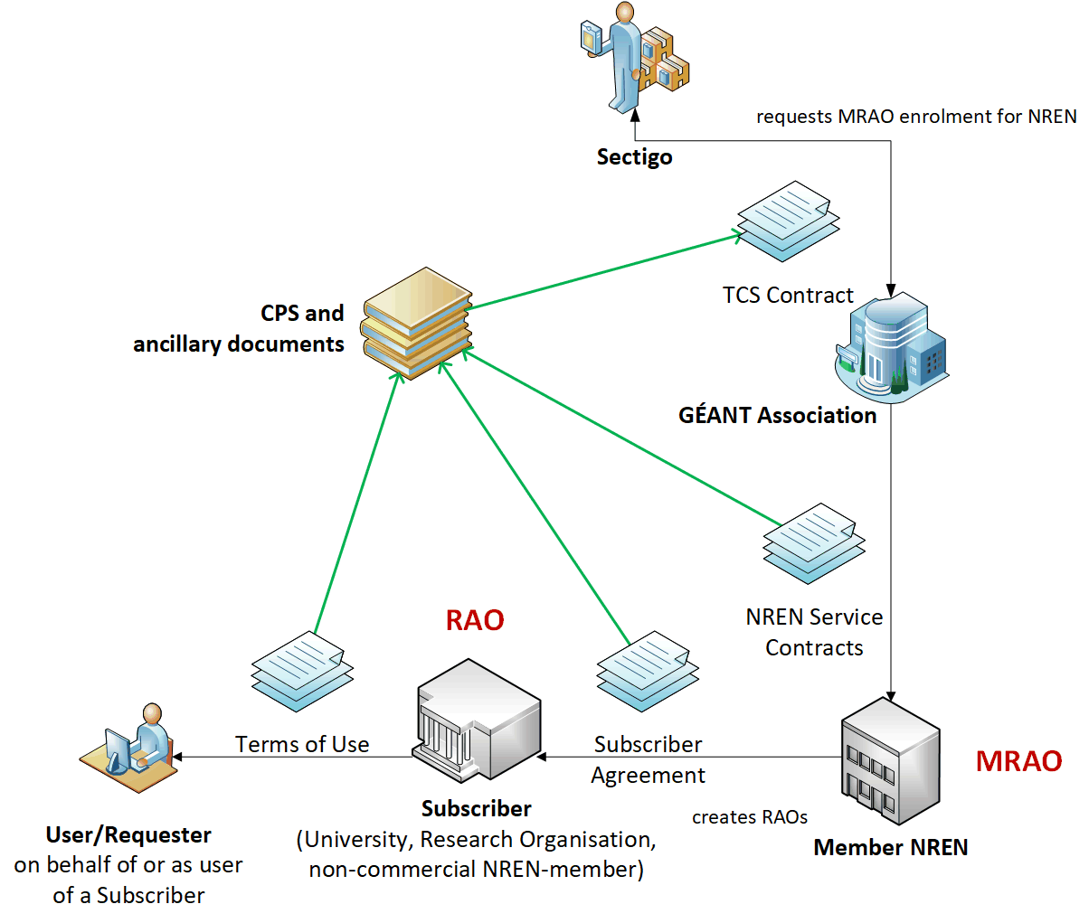
TCS G4

Slide 8
Assurance levels
Host certs all meet CABF OV requirements, which actually exceed ‘IGTF Classic’ a bit
OV validation requires DCV, which is stronger than the RA checks minimally required
the IGTF+public trust combination is getting more important for S3/cloud like deployments
User and personal robot certs
SAML process, and the eligibility checking by the subscribers (organisations), remains the same
urn:mace:terena.org:tcs:personal-user in attribute eduPersonEntitlement
real name of the person – by the subscriber agreement and CP/CPS this goes beyond R&S assurance
manual side-process may remain just like today, based on data entry by the ‘RAO/DRAO’ in SCM
as per https://wiki.geant.org/display/TCSNT/Documentation ‘non-SAML issuance model process’
the CP/CPS requirements though the Subscriber Agreement meet IGTF BIRCH
and this time we will put the _right_ OIDs in the policy extension …
All stuff audited already for CABF/WebTrust things (SSL certs) and similarly for the ‘S/MIME’ use cases

Slide 9
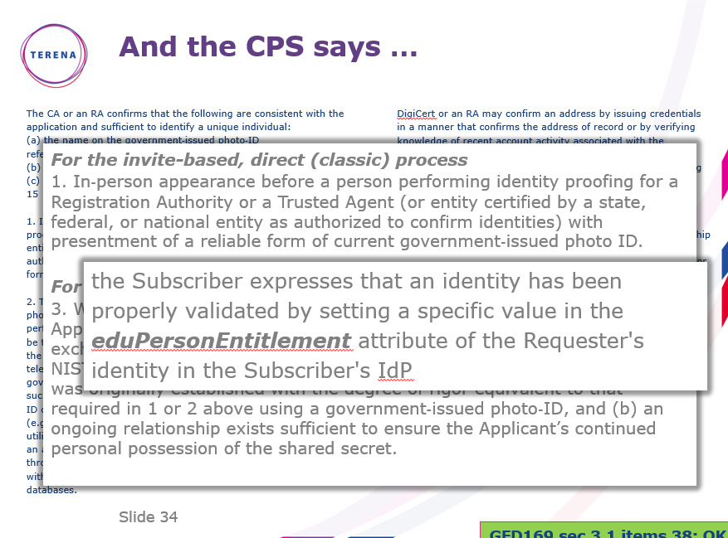

Slide 10
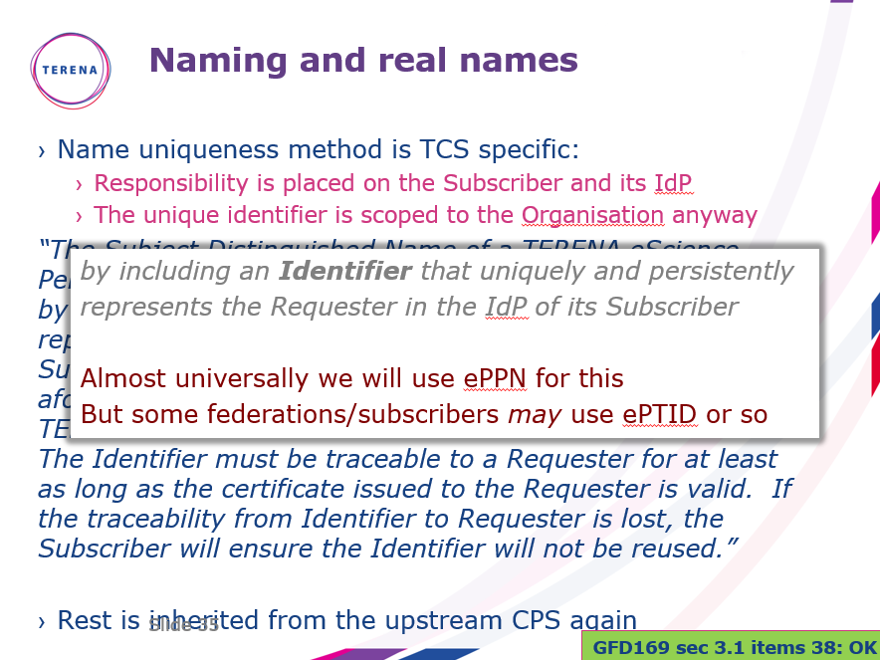

Slide 11
We have been there before … but not quite
The TCS G2 had essentially the same back-end provider (then called Comodo)
which we accredited in 2010 (hosts) and 2012 (personal)
but where personal certs were issued off a central TERENA-managed service (‘Confusa’)
This now all moves to the selected provider
of course we are slightly different from the InCommon use case
… which only does server certs via SAML and not personal or S/MIME
we require the personal issuance based on SAML to be hosted at the provider as well
maybe one-per-NREN, and not a single global instance for all of TCS, but
still this requires multi-lateral federation
We do not want to bring confuse/djangora back!

Slide 12
Phasing is tight
contract final as of the last days in December 2019
Jan 6th 2020 started early-commissioning phase
  challenges in this phase include both the new web-management interface, but also getting the enrolment and provisioning flow right
  there are a lot of orgs and domains to go through, with some interesting DBA vs. legal names
  certificate profile definition (e.g. making sure Robots work even if they are not in the InCommon scheme)
subsequent phases in February & March
  multi-lateral eduGAIN SAML meta-data parsing, client cert portal based on SAML attributes,
  auto-provisioning security
  confirmation of exact profiles and all relevant controls re-implemented in new system + API
  all dedicated intermediates for the (small number of) chains available for distribution
  translation of interfaces and messages to all relevant languages
End of March: commissioning complete and ready for large-scale roll-out
End of April: all subscribers on-boarded, trained, and ready is issue
End of September 2023: last TCS G3 certificates will expire (for IGTF: end of July 2021)

Slide 13
Main relevant items for the IGTF trust
subscriber validation for host/server certs as well as the model for personal/robot remains the same
the contractual obligations and adherence to the TCS CP/CPS remains the same
and the TCS CP/CPS is already today written as an incremental one, so need not change except for the same of the new upstream provider:
“No further stipulations beyond those set forth by the CA Operator.”
now on top of Sectigo’s CP/CPS 5.1.5 (https://sectigo.com/uploads/files/Sectigo-CPS-v5.1.5.pdf)
plus https://sectigo.com/uploads/files/Certificate-Subscriber-Agreement-v2.2-click.pdf
it is a new hierarchy, but it shares some of the HLCAs with the InCommon IGTF Server CA
we will aim to keep the current prefix /DC=org/DC=terena/DC=tcs the same
-- and hope that the GEANT marketing folks will not notice ☺
issuer names will change (since these show visibly in the UX), aim to not have the É (E-acute) in there
will need to distribute the new chains already in February/March
so we seek you approval for distributing the new intermediates already now

