Slide 1
TCSG4 – requirements for Research and e-Infrastructures
David Groep
TCS PMA and Nikhef
EUGridPMA45
January 2019

Slide 2
A long (but rather successful) road
2nd CfP
initial contract
renewed with more partners
Start of SCS
NRENs keep joining
IDEA
Start of TCS
CfP
Contract renewed
Start TCS
eScience
2004
2005
2006
2007
2008
2009
2010
2011
2012
2013
…
2019
End of SCS

Slide 3
R/E Infrastructure certificates today
Actually the ‘eScience’ certificates are generally useful for client authentication purposes
Also services act as clients (e.g. for accounting)
Product types
End-user personal certificates (S/MIME and auth variants)
Robots (personal, or team ‘email’)
Server (OV verified with specific namespace)

Slide 4
The TCS structure
GEANT is the ‘owner’ of the certificate services, which is procures on behalf of the participating NRENs (GEANT members)
It sources the issuing service from a commercial CA service provider and sets the requirements
Via the tender/RfP requirements
Via updates to the CP/CPS
NRENs then act as the user-facing end of the service
They can (or could) define some of the processes
All have to agree to the same CP/CPS and contract(s)
Leveraged federated ID from eduGAIN as much as possible for users
The TCS PMA controlling the CP/CPS is comprised of experts from across the community

Slide 5
Interesting elements
By its intention, the TCS CAs should
Be publicly trusted in all major (mobile) systems
Use mechanisms that scale to the European R&E community
Don’t burden the subscribers (institutions) too much – in particular for auditing
Preserve under GEANT’s control key elements that ensure continuity (no vendor lock-in) – for eScience, this means e.g. subject namespace
but of course not everything is under our control
Changes to baseline requirements affect us
Way the CA interprets those changes affects us even more organization naming for instance, or ASCII-fication
Server certs are more tightly controlled than personal

Slide 6
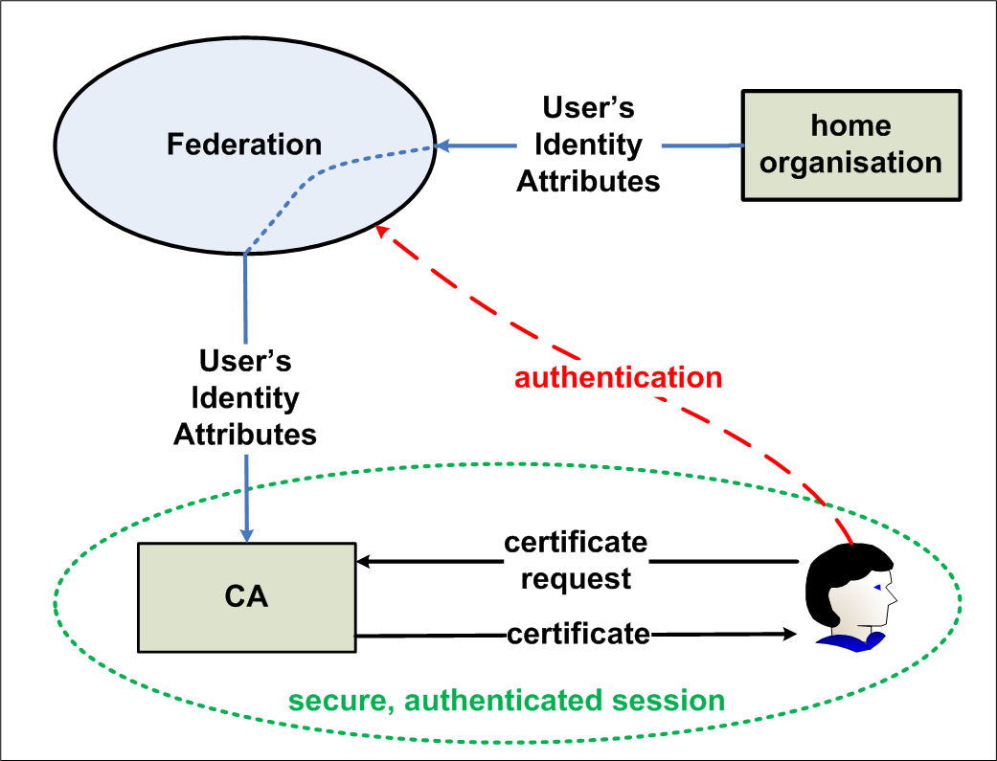
TCS eScience and research requirements
Graphic courtesy Jan Meijer, Uninett, 2009(!)

Slide 7
TCS Gen 4
Landscape is changing again
dynamic ‘DevOps’ provisioning of micro-services and popularity of ACME
browser reaction to certificate types (and to faults)
more cross-over between eScience and other authN use cases (credentials and signing by teams and mailing lists)
‘weird’ use cases (>150 SAN dNSNames in one cert, proxies, &c)
low-power, mobile, and IoT like use cases
eIDAS and the ‘electronic campus’
Google doing its own thing entirely ☹

Slide 8
What key requirements should there be on TCSG4?
What to definitely keep?
distinguished namespace for OV eInfra certificates (specific profile)
eduGAIN fedID integration
single installable trust chain for all platforms
plenty SAN dNSNames
What to definitely add and request?
(continued) use of ECC up to an ECC root
handling (at least) OV with ACME-like protocol – can we push providers to push this one (server API keys, or server oAuth?)
more?

Slide 9
and keep the output of this discussion a bit confidential
davidg@nikhef.nl

