Slide 1
Trusted Certificate Service
Implementing private trust … and SMIME BR changes in TCS Gen 4
David Groep
TCS Policy Management Authority
Nikhef PDP and Maastricht University
EUGridPMA59, Abingdon
3 October 2023

Slide 2
Almost 20 years of TCS service!
based on a concept by Jan Meijer back in 2004
driven primarily by the NREN constituency, but with the eScience use cases very much in mind
NREN (GEANT constituency) requirements on public trust, today esp. EV, but also eIDAS
in a way that scales to 45 countries and ~100k active certificates today, increasing steadily
and also ~10000 organisations, most of which cannot deal with certificates … or with much change
now in its 4th iteration: GlobalSign, Comodo, DigiCert, … and with Sectigo again
1st CfP
SCS G1 (GlobalSign)
2nd CFP and start of TCS eScience with Comodo
TCS G4 CfP
2004
2005
2006
2009
2015
2019
2020
TF-EMC2
concept
Production
TCS G4 started
TCS G3 with DigiCert and eduGAIN

Slide 3
TCS constituency
service is ultimately driven by the GEANT members: 45 national R&E network organisations
wide range of inputs: some countries adore Qualified Certificated and eIDAS, others don’t care
some countries really need a native-language interface (like .fr, .es, …),
while others don’t care (.nl, .se)
stakeholders regard EV as mandatory, and many stakeholders pushed for ultimate stability – since the subscribers have actually no knowledge of PKI, nor of validation, and certainly not about chaining
eScience use cases are important for many, although not the only driving factor in the game

Slide 4
TCS is a GEANT service – with the TCS PMA defining the profiles and policy
TCS PMA drawn from the wider GEANT community
(NRENs as well as individual orgs)
Current PMA members … some of whom you will have seen
  Kurt Bauer (ACONET, AT)
  Kent Engström (SUNET, SE)
  David Groep (Nikhef, NL)
  Nicole Harris (GEANT)
  Barbara Monticini (GARR),
  Jürgen Brauckman (DFN),
  Tim de Boer (SURF).

Slide 5
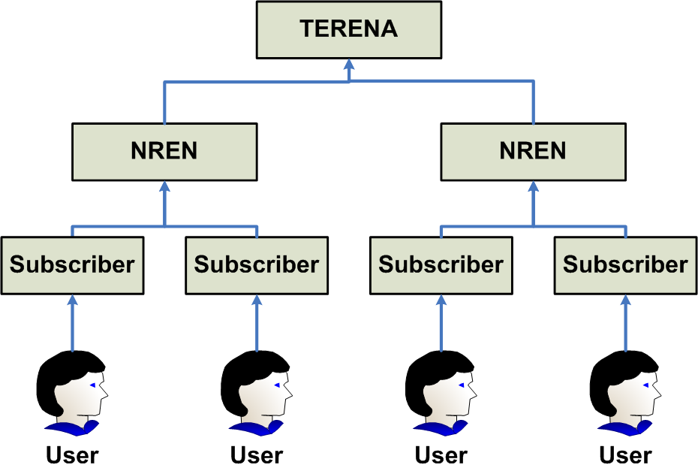
The basic structure remains the same … again!
image source: Jan Meijer, 2008!

Slide 6
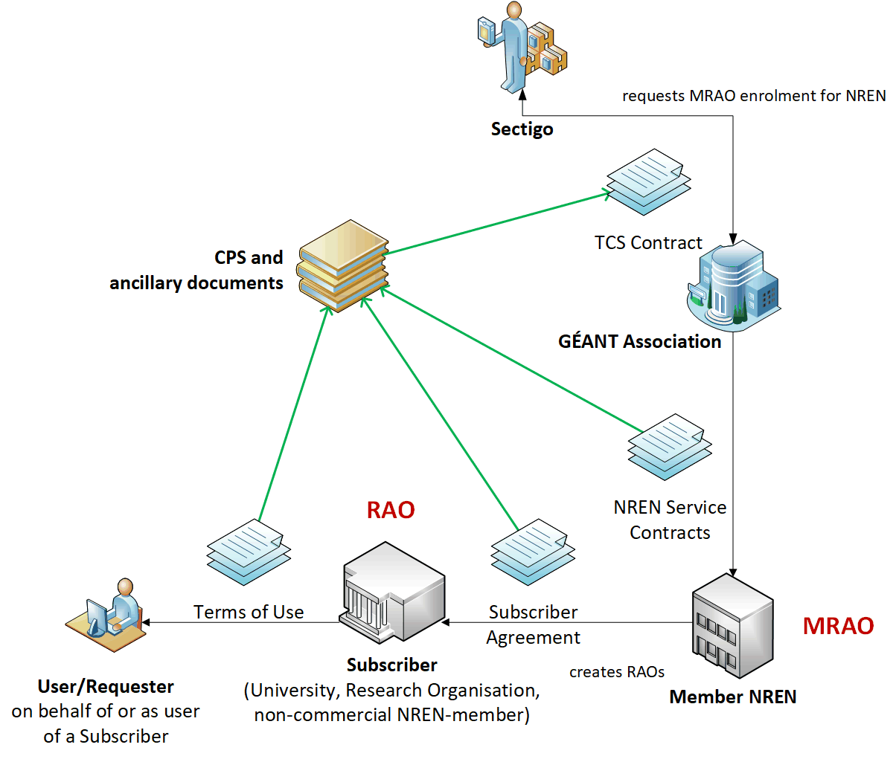
TCS G4

Slide 7
Assurance levels
Joint Public & IGTF trust: certs all meet CABF OV requirements, exceeding ‘IGTF Classic’ a bit
OV validation requires DCV, which is stronger than the RA checks minimally required
the IGTF+public trust combination is getting more important for S3/cloud like deployments
User and personal robot certs
SAML process, and the eligibility checking by the subscribers (organisations), remains the same
urn:mace:terena.org:tcs:personal-user in attribute eduPersonEntitlement
real name of the person – by the subscriber agreement and CP/CPS this goes beyond R&S assurance
manual side-process may remain just like today, based on data entry by the ‘RAO/DRAO’ in SCM
as per https://wiki.geant.org/display/TCSNT/Documentation ‘non-SAML issuance model process’
the CP/CPS requirements though the Subscriber Agreement meet IGTF BIRCH
Audited already for CABF/WebTrust compliance (SSL certs) and similarly for the ‘S/MIME’ use cases

Slide 8
Certificate profiles before the transition in client certs
OV TLS Server (MD) | BR OV validated multi-domain with mixed SANs
EV TLS Server (MD) | BR EV validated multi-domain with mixed SANs
Personal webClientAuth and S/MIME | End-user personal certificate recognised by the major MUAs suitable for identifying the users real name
Personal webClientAuth IGTF and S/MIME | End-user personal certificate adhering to IGTF profile (using IA5String representation of the name with unique prefix /DC=org/DC=terena/DC=tcs/...), suitable both for authentication, and also including validated name and email address
Personal Robot webClientAuth IGTF and S/MIME | End-user personal software agent certificate adhering to IGTF profile (like above) and Robot Profile, suitable both for authentication, and also including validated name and email address
Robot Email webClientAuth IGTF and S/MIME | E-mail validated software agent certificate adhering to IGTF profile (like above) and Robot Profile, suitable both for authentication, and also including validated email address
IGTF OV TLS Server (MD) | BR OV validated multi-domain with mixed SANs including unique prefix "/DC=org/DC=terena/DC=tcs/..."
Document Signing | Adobe AATL compliant signing certificate
Code Signing | Conventional code signing certificate recognised by Oracle, MSFT, &c
EV Code Signing | BR EV Code Signing certificate recognised by MSFT &c

Slide 9
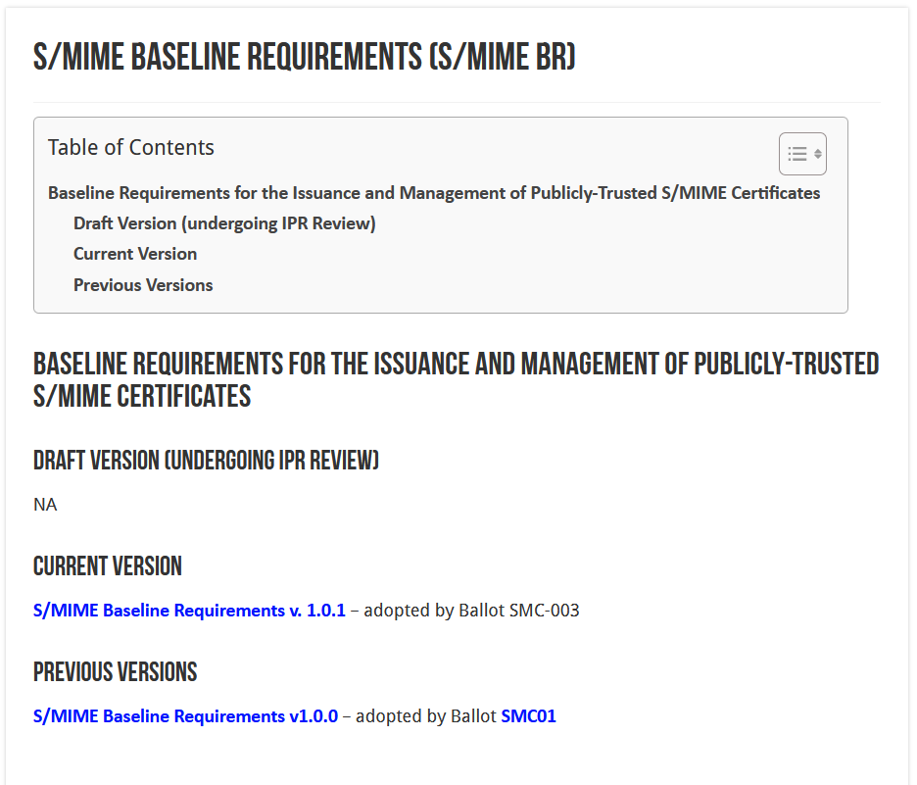
CA/BF now started considering S/MIME trust as well
until now, the IGTF personal requirements were much stricter than ‘public’ email signing, in that we did insist on a reasonable name and a ‘sponsor’ (organization) that was validated
CA/BF is putting requirements on S/MIME for the first time
assurance-wise it is no problem,
but the technicalities change ...

Slide 10
Different ‘profiles’ and validations
Strict
  825-days (2yr), limited RDN attributes allowed
  intended only for S/MIME
Multi-purpose
  825 days (2yr), slightly more eKUs allowed
  crossover use cases between document signing and secure erossover use cases between document signing and secure emailmail
Legacy
  1185 days (3yr)
  transitional profile (likely to be phased out in the end)
  bit more freedom in subject, still allows DC naming, but otherwise not much more than MP
mailbox-validated
  just the rfc822name (only!)
organization-validated
  includes only Organizational (Legal Entity) attributes in the Subject
sponsor-validated
  Combines Individual (Natural Person) attributes and organizationName (associated Legal Entity) attribute
individual-validated
  Includes only Individual (Natural Person) attributes in the Subject

Slide 11
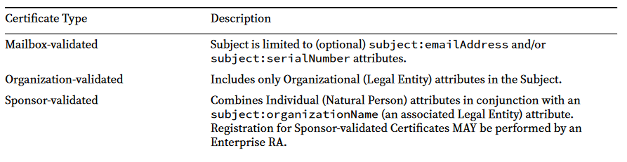
Interesting validation modes: organisation and sponsor
Sponsor‐validated:
‘Refers to a Certificate Subject which combines Individual (Natural Person) attributes in conjunction with an subject:organizationName (an associated Legal Entity) attribute. Registration for Sponsor‐validated Certificates MAY be performed by an Enterprise RA where the subject:organizationName is either that of the delegated enterprise, or an Affiliate of the delegated enterprise, or that the delegated enterprise is an agent of the named Subject Organization.’

Slide 12
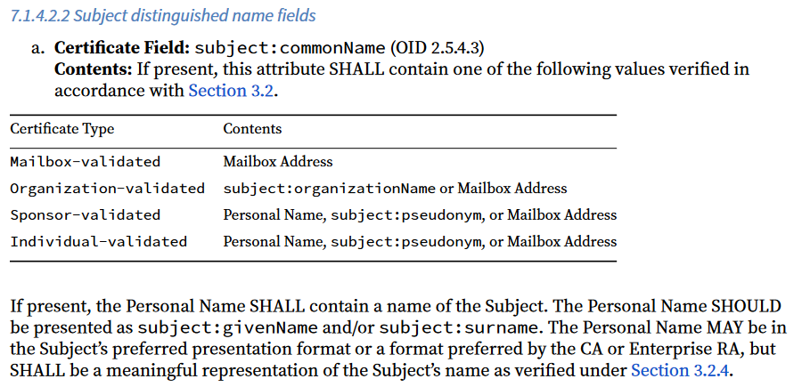
commonName

Slide 13
Where does that leave us?
The ‘Legacy’ profile (still) allowed ‘other’ attributes, so for the moment e.g. DC prefixing would be OK-ish
However the commonName is regulated, and:
  must be derived from (and include!) givenName and surname
  must not contain other elements (like ePPN), impacting uniqueness (as used in TCS)
  does not allow for ‘Robot’s in the commonName
  these would go to Pseudonym, which is an ill-supported attribute
  this anyway inflicts a subjectDN change
who knows when the legacy profile will be deprecated! Will not be long ☹

Slide 14
However …
… contrary to the host-cert issue, there is
no joint-trust needed for email signing and client authentication!
separating these could (should?) always have been done, already in 2005/2008?
using TCS Personal certs for authentication is bad (since they are not unique), and
using TCS IGTF MICS client certs for S/MIME email is bad (since it’s 7-bit ASCII only)
this just formalizes that move beyond restricting keyUsage & eKU

Slide 15
What TCS did
Have S/MIME personal certs, organization-verified, continue to be publicly trusted
  sponsor-validated (multi-purpose) BR-compliant (for ‘humans’) or org-validated (‘robot email’)
  we define all TCS members as Enterprise RAs (clarified in Ballot SMC-03
  does require all orgs to be revalidated using a Government Information Source or LEI (3.2.3.2.1)
  their subject name will be filled with the required fields (such as LEI, jurisdiction, address)
  the /clientgeant SAML endpoint (the only way for personal certs!) auo-upgrades Validation to “High”
Move the client authentication trust to a ‘private CA’ (non-public trust anchor), retaining exactly the same subject DNs, just a different ICA issuerDN and Root
  Add some additional ICAs and non-public Roots to the IGTF distribution
  so for IGTF RPs the change is minimal and transparent
  Inform relying parties, also outside of the IGTF, that client trust will become a specific decision. This is probably good, also for OpenVPN services, web access (.htpasswd), &c. The IGTF RPs are not impacted, others likely will be.

Slide 16
User awareness
This is a change in communications and documentation as well,
not only a set of technical changes
In request systems, have to clearly distinguish for users
which product to order. For example:
  “Personal” stays the same, but is called now “Email signing and Encryption”
  renaming “IGTF MICS Personal” to “Personal Authentication” and explain
  renaming “IGTF MICS Robot Personal” to “Personal Automated Authentication”
  forking “IGTF Classic Robot Email”
    Authentication-only (IGTF) profile “Classic Robot Email”
    Email signing profile “Organisation-validated S/MIME signing” (i.e. team-based or role-based)

Slide 17
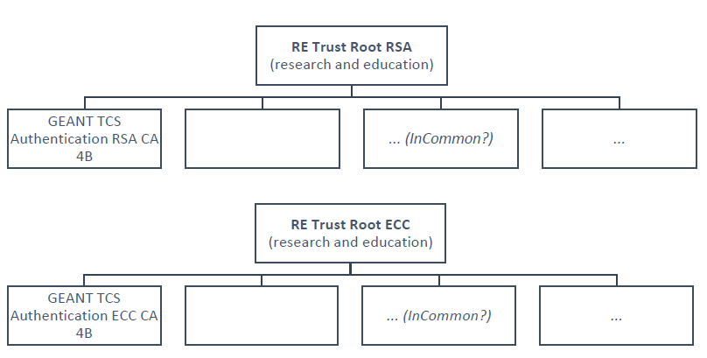
The new TCS Private hierarchies
Two new “RE Trust Roots” (RSA+ECC)
the cost is (apparently) there
can be re-used in R&E
GEANT TCS Authentication RSA/ECC CA 4B issuing subordinate CA
move all authentication use cases here
clarify that this is wider than ‘just e-science’: web site auth, IdP login, any client auth, network login, …
minimize disruption (at least in theory)

Slide 18
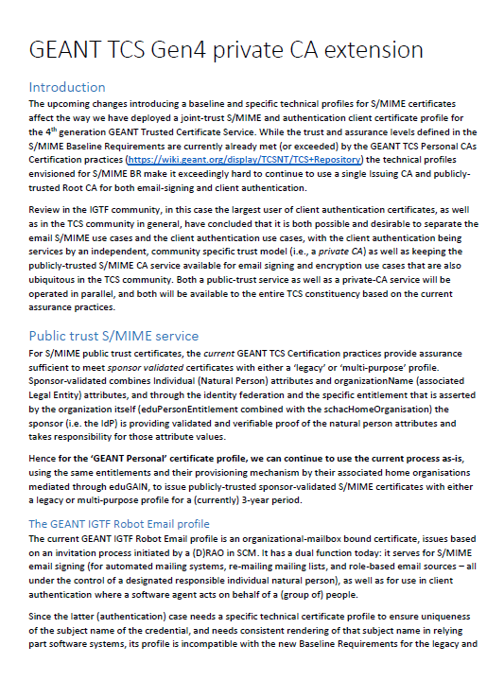
The actual proposed changes described
The “Personal” profile currently used in TCS is UTF-8, and is excellent for email
Since we want ‘email’ to be served well, this profile may evolve as per the SMIME BR requirements
not doing so would void the public trust and render these unusable!
The “IGTF” variants will need to change: new hierarchy, new issuer, same subject DN format, same extensions, ASCII-only, unique naming
See https://www.nikhef.nl/~davidg/tcsg4/TCS-Personal-CPS-2.2/

Slide 19
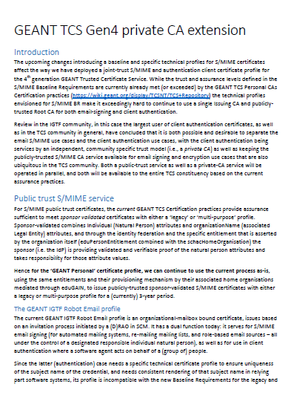
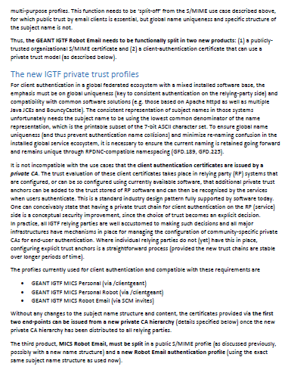
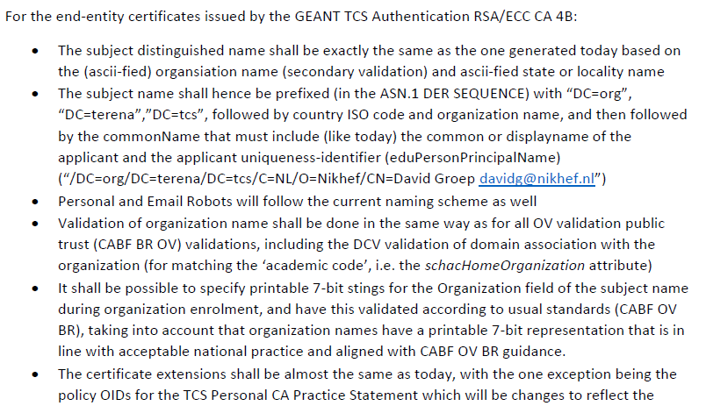
TCS guidance attempted to be complete

Slide 20
Now on to some practice
(not complete yet)
(see demo)

Slide 21
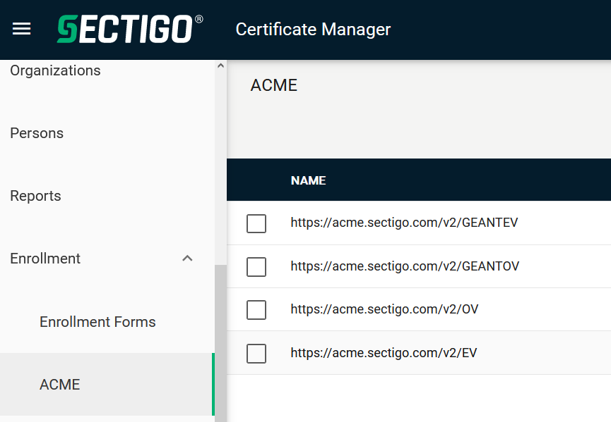
Other CABF things to keep in mind
Server SSL BR has already been updated
  the provision for using DC prefixing has been retained
But expect shorter validity periods in the future
  start preparing for 90-day max in your service deployment automation systems
  increased use of automation (ACME OV using client ID+secret)
[root@hekel ~]# certbot certonly \
--standalone --non-interactive --agree-tos --email davidg@nikhef.nl \
--server https://acme.sectigo.com/v2/GEANTOV \
--eab-kid DUniqueID_forthisclient --eab-hmac-key mv_v3ryl0n9s3cr3tK3y \
--domain hekel.nikhef.nl --cert-name OVGEANTcert

Slide 22
Questions welcome … tcs-pma@lists.geant.org
davidg@nikhef.nl

