Slide 1
TERENA Certificate Service (TCS)
January 2015
David Groep for the TCS PMA and the GÉANT Association

Slide 2
SCS,TCS,TCS-II – the ten year road to simple unlimited certificates
Back in 2004 many NRENs had set-up a CA - but these certificates issued were not trusted by web browsers (the ‘pop-up’ problem)
Buying large numbers of certs one-by-one is slow, tedious, and expensive – so leads to people inventing ‘self-signed’ certs or leaving services insecure (web logins, imap, radius, …)
So why not leverage the combined power of many to make a simple and affordable service –
which is what Jan Meijer started at a TF-AACE meeting in 2004!

Slide 3
A long (but rather successful) road
2nd CfP
DigiCert selected
as TCS partner
contract signed
with GlobalSign
contract signed
with Comodo
Start of SCS
IDEA
Start of TCS
CfP
3rd CfP
Contract
renewed
Start TCS
eScience
Start of
new TCS
Contract
renewed
2004
2005
2006
2007
2008
2009
2010
2011
2012
2013
2014
2015
End of SCS
End of Comodo
TCS service

Slide 4
Certificate Types today
Five types of certificate available:
  Server Certificate - for authenticating servers and establishing secure sessions with end clients.
  e-Science Server Certificate - for authenticating Grid hosts and services. These are IGTF compliant.
  Personal Certificate - for identifying individual users and securing e-mail communications.
  e-Science Personal Certificate - for identifying individual users accessing Grid services. These are IGTF compliant.
  Code-signing Certificates - for authenticating software distributed over the Internet.

Slide 5
The TCS structure
TERENA is the ‘owner’ of the certificate services, which is procures on behalf of the participating NRENs (TERENA members)
It sources the issuing service from a commercial CA service provider and sets the requirements
  Via the tender/RfP requirements
  Via updates to the CP/CPS
NRENs then act as the user-facing end of the service
  They may co-brand the service
  They can (or could) define some of the processes
  All have to agree to the same CP/CPS and contract(s)
  The TCS PMA controlling the CP/CPS is comprised
  of experts from across the community

Slide 6
Interesting elements
By its intention, the TCS CAs should
  Be publicly trusted in all major (mobile) systems
  Use mechanisms that scale to the European R&E community
  Don’t burden the subscribers (institutions) too much – in particular for auditing
  Preserve under TERENA’s control key elements that ensure continuity (no vendor lock-in) –
  for eScience, this means e.g. the subject namespace
but of course not everything is under our control
  Changes to baseline requirements affect us
  The way the CA interprets those changes affects us even more – which is how we ‘lost’ usable OV certs
  Server certs are more tightly controlled than personal

Slide 7

The new ‘G3’ TCS
Selected DigiCert, Inc. of Lehi, Utah, USA
in August 2014
Signed contract in November 2014
Roll-out via staged pilots
  Phase I: expert testing and debugging (almost done)
  Phase II: NREN-level testing and customization options
  Phase III: Customer (Subscriber) testing and roll-out
Should start extended testing in February 2015
Full production before June 2015

Slide 8
Phase I – eScience specific time line
Certificate Profile (done)
  Exactly the same subject DN as today
  Can do that, since we will use the same back-end IdPs
  Rest of profile derived from accredited DigiCert-Grid EEC
Testing of the validation model
  OV validation for servers – more rigourous that Classic
  Classic (invite-based) for personal – for the commissioning phase, as long as there is an IdP behind it
  MICS federation-linked issuance forthcoming
CP/CPS updates - done
Informing the EUGridPMA about the changes
Early Deployment - hopefully in February 2015

Slide 9
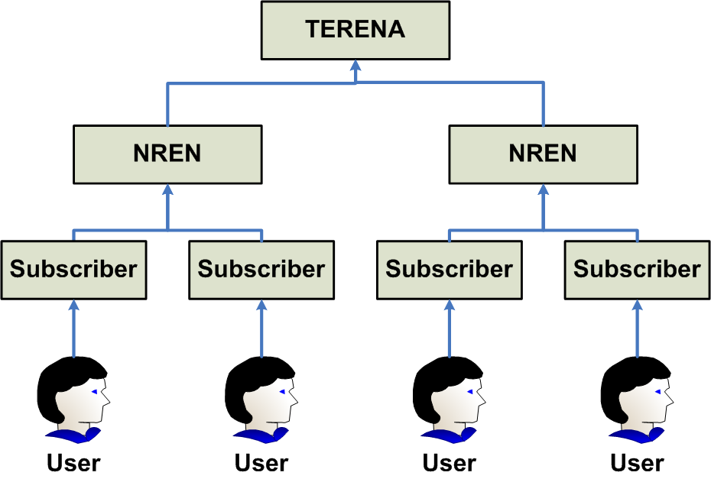
Delegated Responsibilities & Scaling

Slide 10
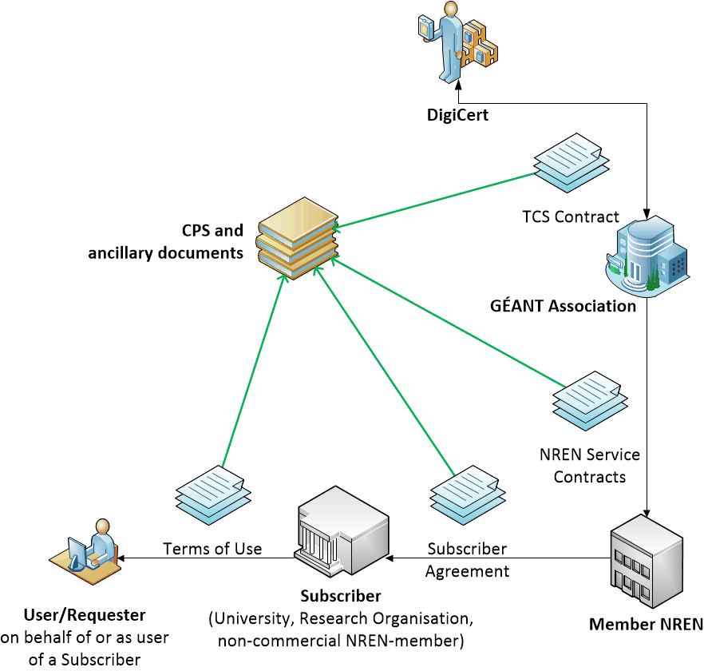
Built using contracts
scales well to large numbers of organisations and users
assurance requirements on subscribers ensure quality ID
bound through legal contracts
listed in specific document and in the CPS

Slide 11
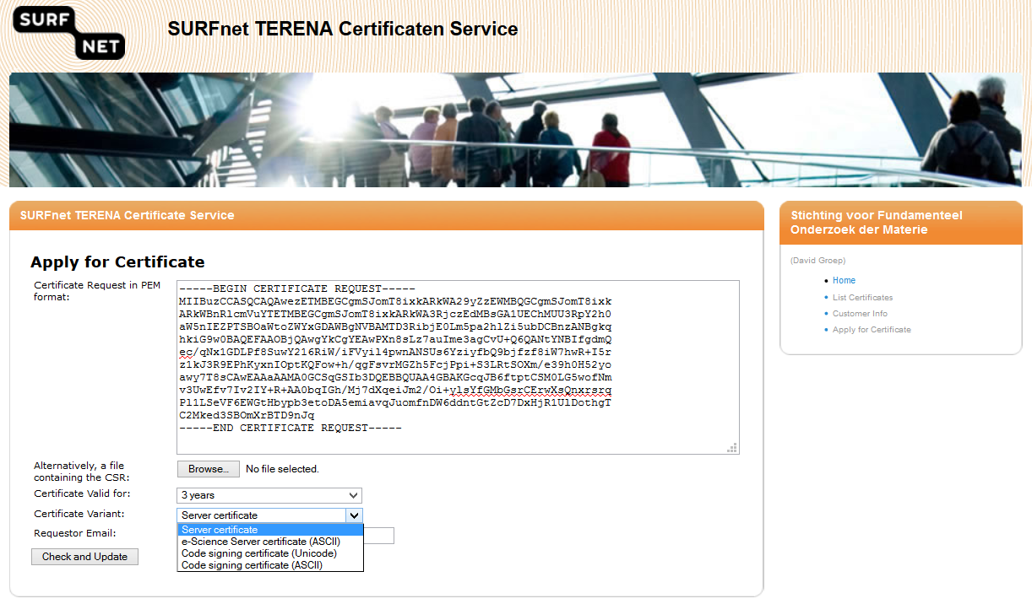
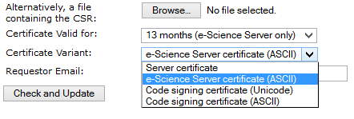
TCS Today: Server certs

Slide 12
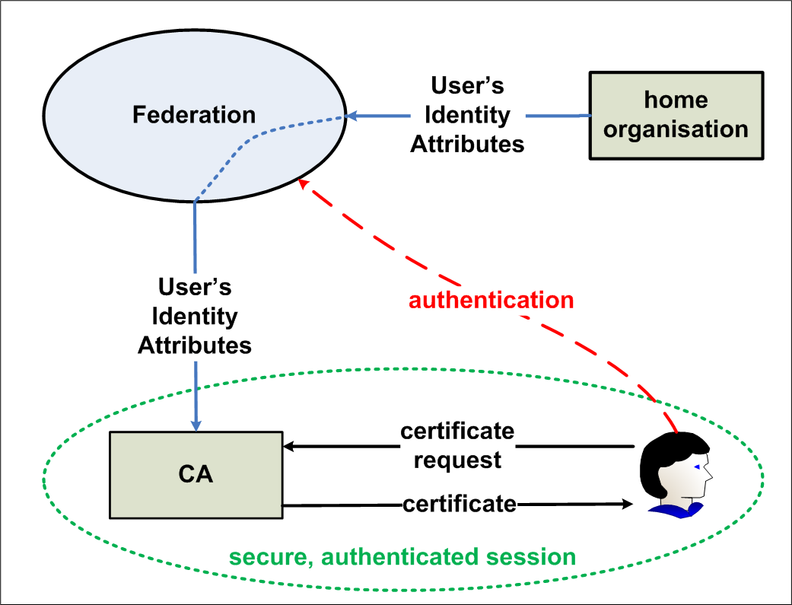
TCS Personal: the Federated
(MICS) CA – shared or NREN portal
From the TCS 2009 presentation!

Slide 13
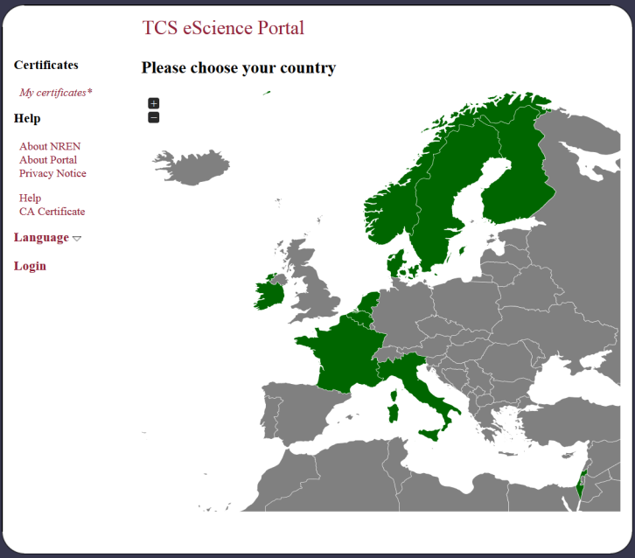
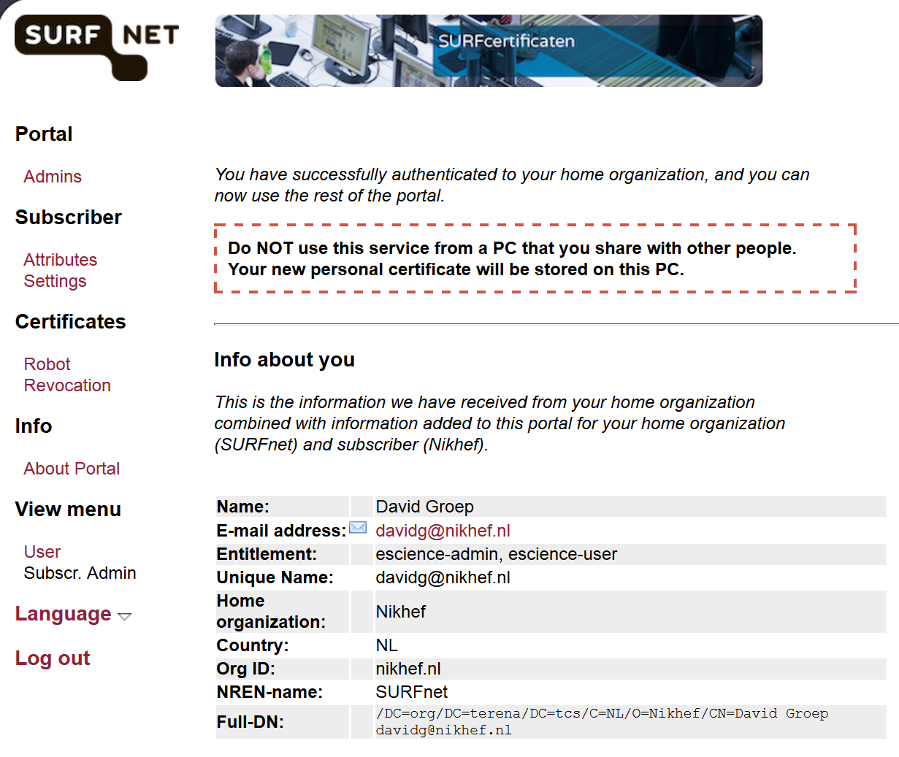
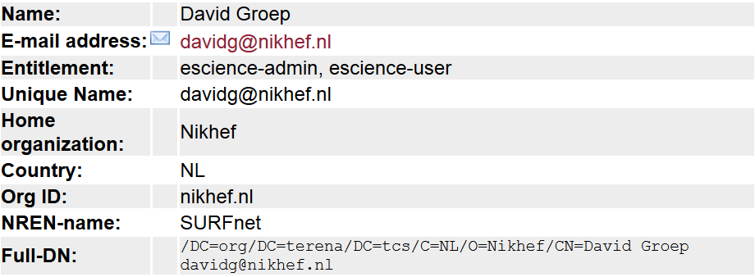
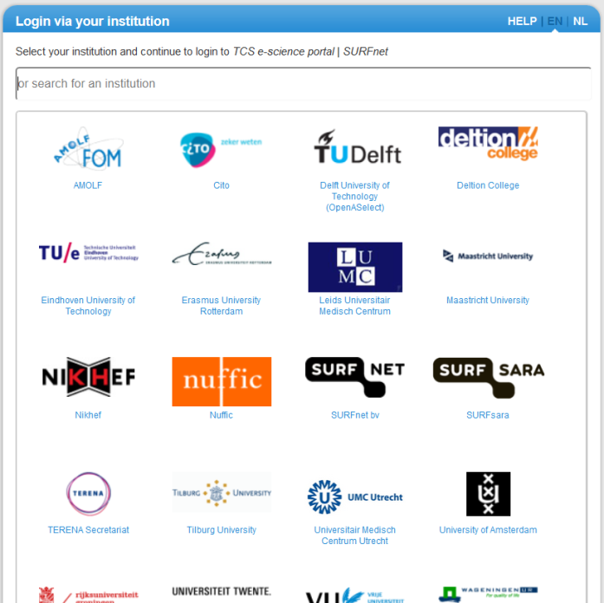
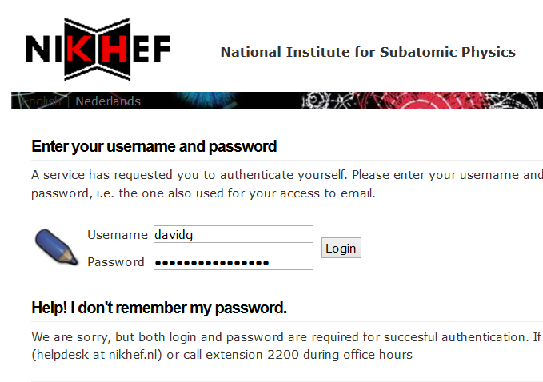
TCS In Practice Today: Personal CA

Slide 14
The New TCS: same, yet different
The model of the TCS stays the same as in ‘G2’
Managed & organised by TERENA (GÉANT Association)
For Server: based on organisational hierarchy
(domain name ownership)
For Personal: leverage organisational IdPs, linked (mostly) through national federations
  How we link them is a technical detail
  used to be national-federation mediated, but directly taking attributes from the subscriber
  we may either continue to use this model, or the
  existing TERENA SP Proxy, or (in the future) eduGAIN
  Does not really matter: the attributes always come validated form the home IdP
  You might even do it from within the organisational (subscriber) RA using personal invited after F2F vetting!

Slide 15
The New TCS: same, yet different
G2 TCS used NREN-developed and member-sponsored portal software
  Djangora: Server and eScience Server (+CS)
  Confusa: (eScience) Personal
  Several per-country home-grown portals (GRNET, CESNET, …)
G3 TCS will use the DigiCert CertCentral portal as much as possible
  Responbility hierarchy natively implemented (‘divisions’)
  Account management organised at the CA level
  Allows subscriber support by DigiCert (nice!)
  Permits pre-validation of Organisations (quick issuance)
  For Personal, a self-service (SAML) issuance system is being developed – for now there’s an subscriber-invite system for the Phase I and II pilots

Slide 16
The New TCS: same, yet different
Old TCS CPS G2
  Self-contained CPS, which we had to update continuously as the G2 provider unleashed changes on us
  Was ‘complete’, but has in-line copying of much of the upstream text
TCS CPS G3
  Inspired by the RPS work, the TCS CPS ‘v2.0’ includes the DigiCert CP and CPS by reference
  We list the certificate product mappings between the TCS name(s) and the names in the DigiCert CP and CPS
  Both have the RFC3647 structure, so link-through is transparent
  DigiCert CP/CPS is already IGTF Classic&MICS accredited!
  so we don’t need to duplicate all that work again for TCS v2.0

Slide 17
TCS Document Set https://wiki.eugridpma.org/Members/TCSG3Documents
TCS Service CPS
  TCS Personal CAs CPS v2.0
  TCS Server & Code Signing CAs CPS v2.0
Subscriber Agreement
Terms of Use
Schedule 4 Required Contractual Terms
Relying Party Agreement
DigiCert CPS
DigiCert CP
http://www.digicert.com/ssl-cps-repository.htm
http://www.terena.org/activities/tcs/repository/
New documents linked to agenda page – not yet in the public repo!

Slide 18
Structure of the Documents
TERENA TCS PMA ‘owns’ the service CPS
  This master document includes, by reference, all others
  Evolves from SCS, to TCS G1/G2, to now TCS G3
  Could be dramatically simplified for G3!
DigiCert CP and CPS
  Already an IGTF Accredited Classic & MICS CA
  CP and CPS reviewed by TAGPMA
  Roots included in IGTF distribution since January 2012
Subscriber Agreement/Terms of Use and the
‘Schedule 4 Contractual Terms’ enforce IGTF Classic/MICS compliance from all participants

Slide 19
TCS CPS Documents
Two ‘branches’ – two CPS documents
TCS Personal CAs v2.0
  1-3 year Client Encryption Certificate LoA1
  1-3 year Client Signing Certificate LoA1
  1-3 year Client s/MIME Certificate LoA1
  1-3 year Document Signing Certificate
  13 month Grid Client Certificate LoA 2, Classic&MICS
  13 month Grid Robot Certificate (x3) Classic
TCS Server & Code Signing CAs v2.0
  1-3 year SSL Plus/UC/Wildcard Certificate
  13 month Grid Host Certificate IGTF Classic
  1-3 year Code Signing Certificate
  1-2 year EV SSL (+UC) Certificate
  1-2 year EV Code Signing Certificate **

Slide 20
CA Hierarchy
Certificate types distributed over 5 TCS specific ICAs
TCS Personal CA 3
TCS eScience Personal CA 3
TCS SSL CA 3
TCS eScience SSL CA 3
TCS Code Signing CA 3
all subordinate to the DigiCertAssuredIDRootCA
Remainder issued from other specific (DigiCert) ICAs
EV SSL from TERENA SSL High Assurance CA 3 under DigiCert High Assurance EV Root CA
Document Signing from DigiCert Document Signing CA under AssuredIDRoot

Slide 21
Running along with GFD.169
CPS is RFC3647 formatted
  TCS CPS, DigiCert CPS, and DigiCert CP all follow
  Many TCS CPS sections say
  “No further stipulations beyond those set forth by the CA Operator.”
  which means: read the rest in the (already accredited) DigiCert CPS and CP …
OIDs, now for version 2.0 of the CPS (§1.2)
  Personal CAs:1.3.6.1.4.1.25178.2.3.2.0
  Server & CS CAs: 1.3.6.1.4.1.25178.2.1.2.0
  and we will change the OID in case of material changes
Once endorsed, will be in the standard TCS repo (§2, §2.1)
Where all current versions already are (§2)
GFD169 sec 3.1 items 1,3,4,5,6: OK

Slide 22

CA Systems
Operated by DigiCert in two secured data centres (§5.1.1)
  Dedicated systems, periodically audited
  Operational details reviewed by TAGPMA
  … and a bunch of other certified auditors
Online CAs, on approved hardware (§6.1.1)
“DigiCert's CA key pairs are generated by multiple trusted individuals acting in trusted roles and using a cryptographic hardware device as part of scripted key generation ceremony. The cryptographic hardware is evaluated to FIPS 140‐1 Level 3 and EAL 4+. Activation of the hardware requires the use two‐factor authentication tokens. DigiCert creates auditable evidence during the key generation process to prove that the CPS was followed and role separation was enforced during the key generation process. DigiCert requires that an auditor witness the generation of any CA keys to be used as publicly trusted root certificates or to sign EV Certificates”
GFD169 sec 3.1 items 7,8,9: OK

Slide 23
CA keys
All ICAs are 2048 bits
  See the signing keys in the Repository
  All are SHA-256 digested as well
All ICAs live for 10 years
Roots live longer (>=25 years)
“Backups of CA Private Keys are securely stored off‐site and require two‐person access” (§6.2.2)
Roll-over managed (see DigiCert CPS 5.6): start using the new key, generated as per original requirements
Tamper-protected log (§5.4.2):
“At least once every two months, a DigiCert administrator reviews the logs generated by DigiCert’s systems, makes system and file integrity checks, and conducts a vulnerability assessment.”
GFD169 sec 3.1 items 10,11,12,13,14,15: OK

Slide 24
CA Certificates
See the repository for actual certs
  http://www.terena.org/activities/tcs/repository/
  https://www.digicert.com/digicert-root-certificates.htm
We have periodically rolled over: now for the 3rd time
eScience Personal Policy OIDs (§7.1)
  2.16.840.1.114412.4.31.1 (Public client trust CPS)
  1.2.840.113612.5.2.2.{1,5} IGTF Classic, MICS
  1.2.840.113612.5.2.3.3.3 (Humans) or 1.2.840.113612.5.2.3.3.1 (Robots)
eScience SSL OIDs
  2.16.840.1.114412.4.1.1 (OV CPS)
  1.2.840.113612.5.2.2.1 (IGTF Classic)
  1.2.840.113612.5.2.3.3.2 (Networked Entity)
GFD.125bis compliant (7.1 and 3.1.1 ‘name forms’)
GFD169 sec 3.1 items 16,17,18,19,20,21: OK

Slide 25
Revocation capability
Can be done
  via the Order portal, by Users (SSL requesters, RA/Subscribers, NRENs)
  by phone or documented email (after verification)
We do rely on the Subscribers to honour their contract and revoke when needed
  this does happen but at times needs some encouragement
  we did handle a lot of revocations&reissuance during heartbleed
“- a Member can request the revocation of any certificate within its constituency of Subscribers;
- a Subscriber can request the revocation of any certificate within its constituency
A revocation request can be initiated by other entities. Such a revocation request has to be properly and convincingly documented.”
GFD169 sec 3.1 items 22,23,24 (via ToU), 25: OK

Slide 26
Revocation specific for (eScience) Personal (section 4.9.1 TCS CPS)
In addition to the circumstances for revocation as documented in the CP and CPS of the CA Operator, the TERENA {Server & SC|Personal} CAs shall also revoke a digital certificate if it becomes aware of any of the following circumstances:
For an eScience Server certificate, there has been loss, theft, modification, unauthorized disclosure, or other compromise of the private key associated with a proxy certificate , directly or indirectly derived at any level from the certificate;
The Requester's IdP account is compromised, revoked or its password is compromised; [for Personal CAs]
The Subscriber, the Requester or the Member has breached a material obligation under this CPS or a relevant agreement;
…
The certificate, if not revoked, will compromise the trust status of TCS.
GFD169 sec 3.1 items 24 (via ToU) also for proxies and upstream IdP : OK

Slide 27
Revocation and CRLs
Issued every hour, automatically by the on-line CA(s)
  Expedited in exceptional cases through a support call
Valid for (almost) 7 days: 6 days and 23 hrs
Certificate Revocation List (CRL):
Version 2 (0x1)
Signature Algorithm: sha256WithRSAEncryption
Issuer: /C=NL/ST=Noord-Holland/L=Amsterdam/O=TERENA/CN=TERENA eScience Personal CA 3
Last Update: Jan 1 18:00:01 2015 GMT
Next Update: Jan 8 17:00:00 2015 GMT
CRL extensions:
X509v3 Authority Key Identifier:
keyid:8C:9F:11:2E:E6:E3:7A:04:A5:1E:55:8B:46:08:04:A6:ED:97:70:A6
X509v3 CRL Number:
42
X509v3 Issuing Distrubution Point: critical
Full Name:
URI:http://crl3.digicert.com/TERENAeSciencePersonalCA3.crl
Revoked Certificates:
Serial Number: 01000000000000000000000000000001
Revocation Date: Jan 1 16:59:59 2015 GMT
GFD169 sec 3.1 items 26,27,28,29,30,31: OK

Slide 28
End-entity (cert) requirements
At least 2048 bit (RSA), SHA-2, and not known-bad
At most 400 days: we use 395 as we did before
GFD.125(bis) compliant
  They are …
  For eScience, we limit the permissible character set
  for users’ Full Name, this will have to be enforced in the portal
  For the organisation name, the Subscriber must choose a permissible representation (a ‘second’ name) in CertCentral
  OU is anyway set by the subscriber/RA
Renewal or rekeying? It’s a MICS, so you just get a
new one easily by only allowing applying for a new cert!
GFD169 sec 3.1 items 32,33,34 (via Schedule 4 & ToU), 35 (by design), 39, 41: OK

Slide 29
Certificate Profile
(eScience Personal)
Version: 3 (0x2)
Serial Number: 0f:5a:14:47:1c:f3:f0:79:5f:bc:f7:47:c4:1f:36:bc
Signature Algorithm: sha256WithRSAEncryption
Issuer: C=NL, ST=Noord-Holland, L=Amsterdam, O=TERENA, CN=TERENA eScience Personal CA 3
Not Before: Dec 31 00:00:00 2014 GMT
Not After : Jan 30 12:00:00 2016 GMT
Subject: DC=org, DC=terena, DC=tcs, C=NL, O=Nikhef, CN=David Groep davidg@nikhef.nl
Public Key Algorithm: rsaEncryption
Public-Key: (2048 bit)
X509v3 extensions:
X509v3 Basic Constraints: critical
CA:FALSE
X509v3 Subject Alternative Name:
email:davidg@nikhef.nl
X509v3 Key Usage: critical
Digital Signature, Key Encipherment, Data Encipherment
X509v3 Extended Key Usage:
TLS Web Client Authentication, E-mail Protection
X509v3 Certificate Policies:
Policy: 1.2.840.113612.5.2.2.1
Policy: 2.16.840.1.114412.4.31.1
Policy: 1.2.840.113612.5.2.3.3.3
GFD169 sec 3.1 items 37: OK

Slide 30
Certificate Profile
(eScience Personal)
X509v3 CRL Distribution Points:
Full Name: URI:http://crl3.digicert.com/TERENAeSciencePersonalCA3.crl
Full Name: URI:http://crl4.digicert.com/TERENAeSciencePersonalCA3.crl
Authority Information Access:
OCSP - URI:http://ocsp.digicert.com
CA Issuers - URI:http://cacerts.digicert.com/TERENAeSciencePersonalCA3.crt
X509v3 Authority Key Identifier:
keyid:8C:9F:11:2E:E6:E3:7A:04:A5:1E:55:8B:46:08:04:A6:ED:97:70:A6
X509v3 Subject Key Identifier:
A0:3A:A9:E3:F0:92:2A:60:8F:DC:EB:2A:24:2C:DD:08:2E:B1:CA:E6

Slide 31
The key bit: vetting!
“The Common Name (CN) attribute value in the Subject Distinguished Name is obtained from the Subscriber's IdP.”
Section 3.1.1 TCS CPS
  This IdP, operated by the Subscriber as supporting the RA functions, acts as the authorization point on behalf of the Subscriber
  Through releasing a specific entitlement attribute, the Subscriber attests to the vetting level being appropriate for “Level 2 Client Certificates and IGTF Classic/MICS Certificates”
  The Subscriber/RA may also convey this through the CertCentral portal by
    Having vetted the user, send in invitation by email to the registered address
    Recoding the vetting information in the order system, or having other auditable records
GFD169 sec 3.1 items 38: OK

Slide 32
Authentication of
Individual Identity (3.2.3)
“When the requesting process is linked to the issuance through electronic means, the Subscriber expresses that an identity has been properly validated by setting a specific value in the eduPersonEntitlement attribute of the Requester's identity in the Subscriber's IdP. The specific value is agreed upon between the Member and the Subscriber.”
GFD169 sec 3.1 items 38: OK

Slide 33
Permissible CertCentral process used mainly during the Pilot Phase I .. III
“A Subscriber may link the certificate request to the authenticated individual entity by other means as provided by the CA Operator, as long as all requirements of the CA Operator and those on the Uniqueness of Names as specified in section 3.1.5 are met. The act of verification must be documented by the Subscriber in either the order system of the CA Operator or through other auditable means.
TCS eScience Personal certificates shall be authenticated according to the requirements for IGTF Classic and MICS certificates as specified by the CA Operator CPS.”

Slide 34
And the DigiCert CPS says …
The CA or an RA confirms that the following are consistent with the
application and sufficient to identify a unique individual:
(a) the name on the government‐issued photo‐ID
referenced below;
(b) date of birth; and
(c) current address or personal telephone number.
15
1. In‐person appearance before a person performing identity
proofing for a Registration Authority or a Trusted Agent (or
entity certified by a state, federal, or national entity as
authorized to confirm identities) with presentment of a reliable
form of current government‐issued photo ID.
2. The Applicant must possess a valid, current, government‐issued,
photo ID. The Registration Authority or Trusted Agent
performing identity proofing must obtain and review, which may
be through remote verification, the following information about
the Applicant: (i) name, date of birth, and current address or
telephone number; (ii) serial number assigned to the primary,
government‐issued photo ID; and (iii) one additional form of ID
such as another government‐issued ID, an employee or student
ID card number, telephone number, a financial account number
(e.g., checking account, savings account, loan or credit card), or a
utility service account number (e.g., electricity, gas, or water) for
an address matching the applicant’s residence. Identity proofing
through remote verification may rely on database record checks
with an agent/institution or through credit bureaus or similar
databases.
DigiCert or an RA may confirm an address by issuing credentials
in a manner that confirms the address of record or by verifying
knowledge of recent account activity associated with the
Applicant’s address and may confirm a telephone number by
sending a challenge‐response SMS text message or by recording
the applicant’s voice during a communication after associating
the telephone number with the applicant in records available to
DigiCert or the RA.
3. Where DigiCert or an RA has a current and ongoing relationship
with the Applicant, identity may be verified through the
exchange of a previously exchanged shared secret (e.g., a PIN or
password) that meets or exceeds NIST SP 800‐63 Level 2
entropy requirements, provided that: (a) identity was originally
established with the degree of rigor equivalent to that required
in 1 or 2 above using a government‐issued photo‐ID, and (b) an
ongoing relationship exists sufficient to ensure the Applicant’s
continued personal possession of the shared secret.
4. Any of the methods used to verify the identity of an applicant for a DigiCert Level 3 or 4 Client Certificate.
For the invite-based, direct (classic) process
1. In‐person appearance before a person performing identity proofing for a Registration Authority or a Trusted Agent (or entity certified by a state, federal, or national entity as authorized to confirm identities) with presentment of a reliable form of current government‐issued photo ID.
For the MICS model (leverage the IdP)
3. Where DigiCert or an RA has a current and ongoing relationship with the Applicant, identity may be verified through the exchange of a previously exchanged shared secret (e.g., a PIN or password) that meets or exceeds NIST SP 800‐63 Level 2 entropy requirements, provided that: (a) identity was originally established with the degree of rigor equivalent to that required in 1 or 2 above using a government‐issued photo‐ID, and (b) an ongoing relationship exists sufficient to ensure the Applicant’s continued personal possession of the shared secret.
the Subscriber expresses that an identity has been properly validated by setting a specific value in the eduPersonEntitlement attribute of the Requester's identity in the Subscriber's IdP
GFD169 sec 3.1 items 38: OK

Slide 35
Naming and real names
Name uniqueness method is TCS specific:
  Responsibility is placed on the Subscriber and its IdP
  The unique identifier is scoped to the Organisation anyway
“The Subject Distinguished Name of a TERENA eScience Personal CA-issued Certificate is unique for each Requester by including an Identifier that uniquely and persistently represents the Requester in the IdP of its Subscriber. A Subscriber will ensure the persistence and uniqueness of the aforementioned Identifier that its IdP releases to the TERENA eScience Personal CA.
The Identifier must be traceable to a Requester for at least as long as the certificate issued to the Requester is valid. If the traceability from Identifier to Requester is lost, the Subscriber will ensure the Identifier will not be reused.”
Rest is inherited from the DigiCert CPS again
by including an Identifier that uniquely and persistently represents the Requester in the IdP of its Subscriber
Almost universally we will use ePPN for this
But some federations/subscribers may use ePTID or so
GFD169 sec 3.1 items 38: OK

Slide 36
‘ID Vetting’ for (eScience) Server
“DigiCert validates the Applicant’s right to use or control the Domain Name(s) that will be listed in the Certificate using the DV SSL Server Certificate validation procedures above.
DigiCert also verifies the identity and address of the Applicant using:
1. a reliable third party/government databases or through communication with the entity or jurisdiction governing the organization’s legal creation, existence, or recognition;
2. a site visit;
3. an attestation letter that is signed by an accountant, lawyer, government official, or other reliable third party; or
4. for address only, a utility bill, bank statement, credit card statement, tax document, or other reliable form of identification.”
Basically, these are the BR Requirements for OV SSL Certs
GFD169 sec 3.1 items 38: OK

Slide 37
And the validation dept. will hunt you down …
1. DigiCert or the RA obtains a legible copy, which discernibly shows the Applicant’s face, of at least one currently valid government‐issued photo ID (passport, driver’s license, military ID, national ID, or equivalent document type). DigiCert or the RA inspects the copy for any indication of alteration or falsification.
2. DigiCert may additionally cross‐check the Applicant’s name and address for consistency with available third party data sources.
3. If further assurance is required, then the Applicant must provide an additional form of identification, such as recent utility bills, financial account statements, credit card, an additional ID credential, or equivalent document type.
4. DigiCert or the RA confirms that the Applicant is able to receive communication by telephone, postal mail/courier, or fax.
They found autonomously that Nikhef existing (which is ‘new’ for us!), and that we were a subordinate of NWO, our National Science Foundation.
So the DigiCert Validation dept must have read the recent Dutch Government’s
Research Policy Agenda – which abolishes our intermediate legal entity FOM,
indeed in favour of NWO ;-)
GFD169 sec 3.1 items 38, 41 (more often, as per BR or EV): OK

Slide 38
For Robots, the typical stuff …
For the eScience Personal CA a subscriber may request additional certificates for automated clients (“Robots”). The types of names used in such certificates follow the specification of Subject Distinguished Names for eScience Personal certificates, with the Common Name (CN) attribute set according to the Guidelines for Approved Robots, using “Robot – “ as the unambiguous identifier, followed by either the reasonable representation of the name of the requester; or an electronic mail address of a persistent group of people responsible for the robot operations; or the validated fully-qualified domain name of the system from which the robot shall be solely operating.
It may be post-pended by further disambiguating name elements. For representations of the name of the requester, the value will be a PrintableString representation thereof as is customary in the best practice for the language involved.
GFD169 sec 3.1 items 40: OK where relevant: software will enforce compliant token

Slide 39
But is the data correct?
We leverage (again) the contract chain
  CPS section 9
  Schedule 4
  Terms of Use & Subscriber Agreement
9.6.3 Subscriber Representations and Warranties
Upon signing and accepting the Subscriber Agreement, the Subscriber represents to TCS and to relying parties that at the time of acceptance and until further notice:
All representations made by the Subscriber to TCS regarding the information contained in the certificate of its Requesters are accurate and true.
The Subscriber agrees with the terms and conditions of this CPS and other agreements and policy statements of TCS.
The Subscriber abides by the laws applicable in its country or territory including those related to intellectual property protection, viruses, accessing computer systems etc.
The Subscriber complies with all export laws and regulations for dual usage goods as may be applicable.
The Subscriber agrees, within reasonable limits, to give full cooperation to periodic audits of its IdP and all procedures used for entering and maintaining identity data in its IdP. Audits can be conducted by/on behalf of the relevant Member or the TCS PMA.
Same as today – it’s in the TCS v1.x “G2” CPS
GFD169 sec 3.1 items 38: OK

Slide 40
User instruction:
“subscribers realize the importance of properly protecting their private data”
Do end-users ever realize that?
We’ll try again, with per-request acceptance of Terms of Use
And it’s in the Subscriber Contract (“Schedule 4”)
“As a Registration Authority, the GÉANT Association shall require each Subscriber to agree to the following terms (which responsibility may be delegated to a NREN acting as a local Registration Authority):
… 3. IGTF Private Key Storage. Subscribers must store Private Keys using one of the following methods: …”
and continues to quote the Private Key Protection Guideline
GFD169 sec 3.1 items 36: OK

Slide 41
And there’s always the DigiCert CP and CPS as well
All sections, also in 9.x, include the accredited DigiCert CPS by reference
Takes care of auditing requirements and record archival
  with a privacy policy at
  https://www.digicert.com/digicert-privacy-policy.htm
  Inspected for compliance yearly
  Quarterly self-audit of DigiCert (8.7)
Through Certificate Transparency will publish certs as well
TCS accepts peer-audits as well (for issuing and CA Operator elements backed by the audit of DigiCert)
GFD169 sec 3.1 items 42,43,44,45,46,47: OK

Slide 42
Contact & repository data
TCS Repository has
  All TCS specific ICAs
  Contains links to the DigiCert Repository
  Links to CRLs and AIA OCSP in CPS and on-line
  All current CPS documents (so not v2.0 yet!)
and you can contact the TCS PMA at tcs-pma@terena.org
TERENA also operates TACAR, so that’s easy ☺
Redistribution
  We don’t (and are not allowed) to claim rights on certs
  DigiCert makes (root & ICA) certs openly available anyway
GFD169 sec 3.1 items 48,49,50,51,52,53: OK

Slide 43
But what about privacy then?
Defined as being defined in the CPS
Certs are public data
  Needed for Certificate Transparency
This is private – using a reasonable degree of care:
  1. Private Keys;
  2. Activation data used to access Private Keys or to gain access to the CA system;
  3. Business continuity, incident response, contingency, and disaster recovery plans;
  4. Other security practices used to protect the confidentiality, integrity, or availability of information;
  5. Information held by DigiCert as private information in accordance with Section 9.4;
  6. Audit logs and archive records; and
  7. Transaction records, financial audit records, and external or internal audit trail records and any audit reports (with the exception of an auditor’s letter confirming the effectiveness of the controls set forth in this CPS).
Including the mechanisms used, which must be confidentiality-protected:
  “NREN shall contractually require each Participant to treat the Authentication Mechanisms as Confidential Information.”
GFD169 sec 3.1 items 54: OK

Slide 44
End-entity privacy
Any information about Subscribers and their Requesters that is not publicly accessible or available through the content of the issued certificate, a CRL, or an OCSP response is treated as private information.
All CA Operator's, Member's, Subscriber's and GÉANT Association 's employees receiving private information are responsible to protect such information from compromise and disclosure to third parties. Each party shall use the same degree of care that it exercises with respect to its own information like importance, but in no event shall the degree of care be less than a reasonable degree of care.
Unless otherwise stated in this CPS, a party will not use private information without the subject’s express written consent.

Slide 45
GFD.169 Audit
Registration Authority section 3.2
We define who the RA is (hierarchically via divisions, with the Subscriber being the RA for end-entities)
  In section 1.3.2 we place specific requirements on the RA
  “Registration Authority (RA) functions are undertaken by Subscribers, according to all provisions and contractual obligations that exist between NRENs and subscribers. Registration Authority personnel at the subscriber organization shall hold an organizational role that includes the management of digital certificates, information security management, management of software distribution, responsibility for organizational identity management, responsibility for relations with the TCS NREN member(s) involved, responsibility for relations with the TCS, or the representation of the organization in managerial or legal matters. It may also be any role as permitted by the CA Operator.
  The identity of Requesters must be vetted by the Subscriber. Requesters need to be explicitly authorised by the Subscriber to apply for a TERENA Server & CS CA certificates, and their requests must only be authorised if their identity information has been properly validated.”
GFD169 sec 3.2 items 1: OK

Slide 46
‘The Rest’ of GFD.169 sction 3.2
The remainder of the RA requirements are
Discussed already in the vetting section
Or already part of
  the accredited DigiCert LoA2 Classic,MICS Client Requirements
  the CABForum BR requirements
and pushed down on the Subscribers and IdP operators by
  The Schedule 4 Required Contractual Terms
  The requester ‘click-through’ Terms of Use/Subscriber Agreement
Records archival
  Is done at the CA Operator end
  For the MICS IdPs, has to be open for the PMA to permit verification
GFD169 sec 3.2 items 2 – 8, 9,10: OK

Slide 47
Transition planning

Slide 48
TCS for eScience certs
Attempting a ‘painless’ transition
keep the subject namespace (which is TERENA’s)
/DC=org/DC=terena/DC=tcs…
/C=XX/O=YY/CN=Given Surname ePPN@ishID
intermediate and root CAs will change name, but services like VOMS can handle that
  Specific configuration hints will come through EGI
  It prevents the trouble that OSG had post-ESnet
both hierarchies will operate in parallel
  Mid-2016 the last ‘Comodo eScience TCS’ will expire
  non-eScience server SSL certs will take till 2018

Slide 49
Technical changes
After today’s presentation
Security/operational audit has already been done
  DigiCertAssuredIDRootCA-Root is already in
  Plenty of external auditing done
PMA to endorse the updates to the CP/CPS or RPS
Introduce new intermediate trust anchors
  Additional namespace for DigiCertAssuredIDRoot
  New intermediates
Fully operational early 2015
We’re ready for it, so we hope you are too …

