Slide 1

TERENA Certificate Service
Certificates4All!
David Groep
standing in for Licia Florio, TERENA,
using material from Jan Meijer, Kevin Meynell and others

Slide 2
TCS in four lines
NREN collaboration
joint procurement & operation
of
x.509 certificate service
Comodo current service provider
recognised in all common browsers and
accredited by the IGTF

Slide 3
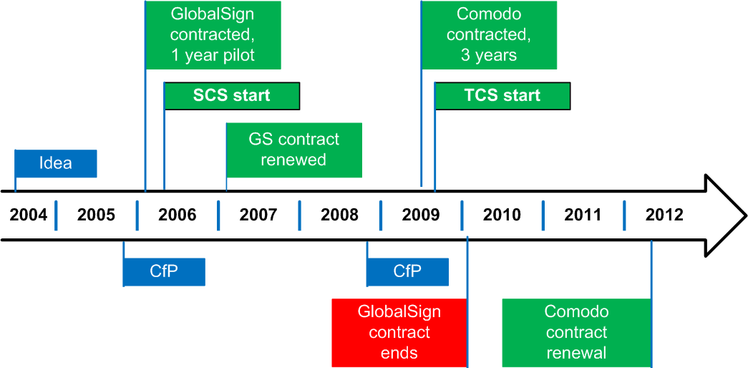
TERENA Certificate Service

Slide 4
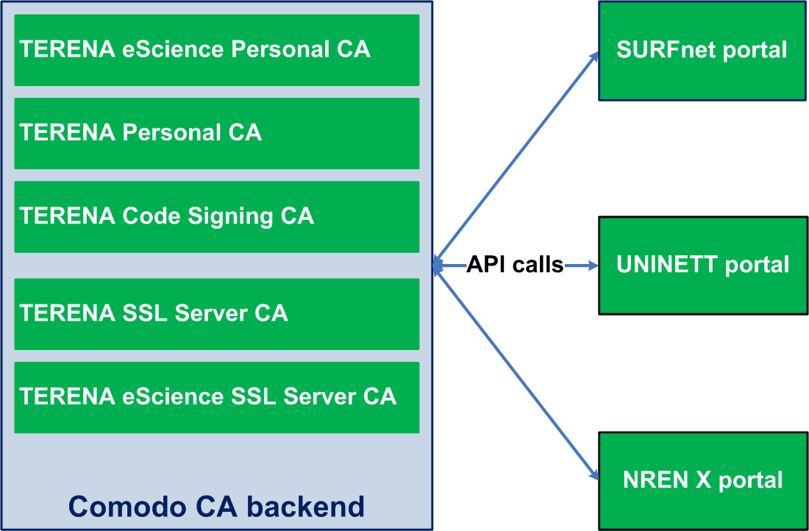
TERENA Certificate Service

Slide 5
TCS organisation
TERENA
  contractual party, financial clearinghouse, contact conduit to Comodo
TCS Representatives
  1 per NREN, Formal decisions
TCS RAs
  day to day operations
TCS PMA
  responsible for policy
  Kent Engstrom, Jan Meijer, Kevin Meynell,, Teun Nijssen, Milan Sova
NREN community
  various other tasks (portal software, etc.)
http://www.terena.org/activities/tcs/repository

Slide 6
Participating NRENs
Country | Member org. | Server | Code Signing | Personal
Austria | ACOnet | X | X | X
Belgium | BELNET | X | X | X
Croatia | CARnet | X
Czech Republic | CESNET | X |  | X
Denmark | UNI-C | X
Finland | CSC | X |  | X
France | RENATER | X |  | X
Greece | GRNET | X |  | X
Hungary | HUNGARNET | X
Ireland | HEAnet | X |  | X
Italy | GARR | X
Lithuania | LITNET | X |  | X
Malta | UoM | X
Netherlands | SURFnet | X | X | X
Norway | UNINETT | X | X | X
Poland | PSNC | X | X | X
Portugal | FCCN | X
Serbia | AMRES | X |  | X
Slovenia | ARNES | X
Spain | RedIRIS | X | X | X
Sweden | SUNET | X | X | X
UK | JANET | X
 |  | 22 | 7 | 14

Slide 7
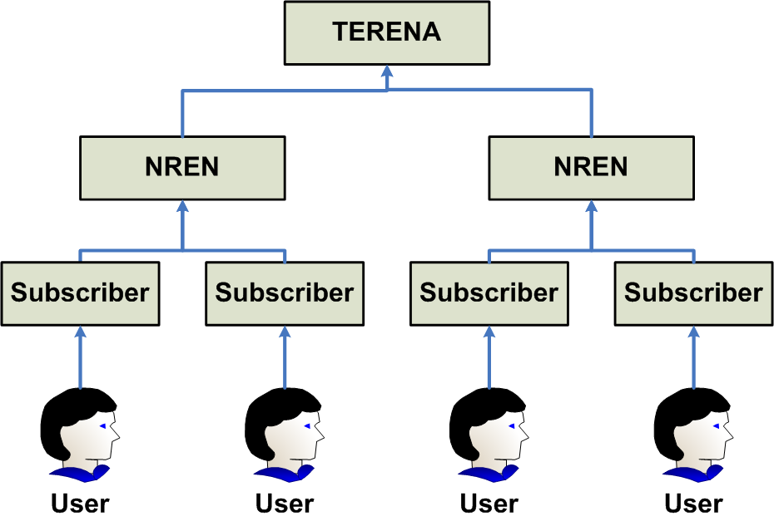
Delegated Responsibilities

Slide 8
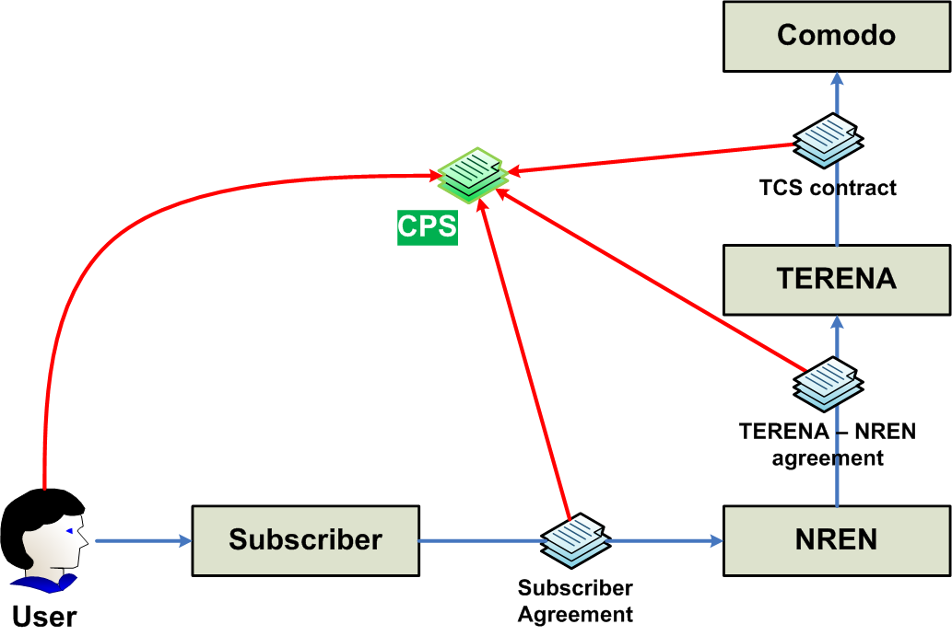
Built using contracts
scales well to large numbers of organisations and users
assurance requirements on subscribers ensure quality ID
bound through legal contracts

Slide 9
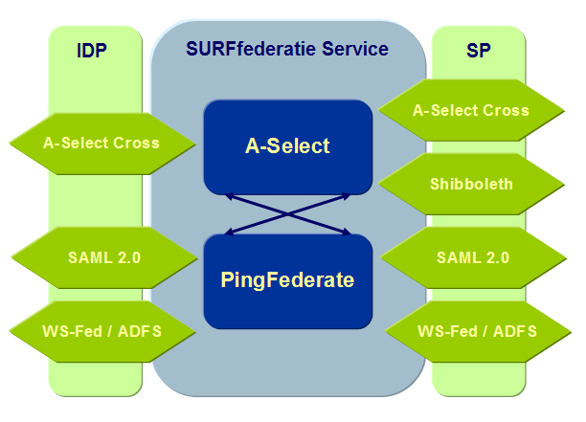







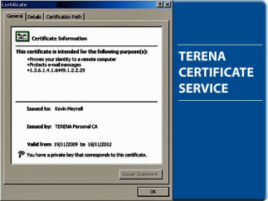





Authenticating users via Subscriber and Federation
NREN or Federation Operator
User’s
home organisation
National research-education federations provide the basis for authenticating users and obtaining key attributes
including assurance level via service entitlements

Slide 10
Deployment: centralised portal
Denmark, France, Netherlands, Norway, Sweden, Finland (Czech Republic: dedicated portal)
TERENA: financial clearing house
UNINETT: project coordination
SURFnet: portal operations
Uses ‘Confusa’ software
Portal up and running since October

Slide 11
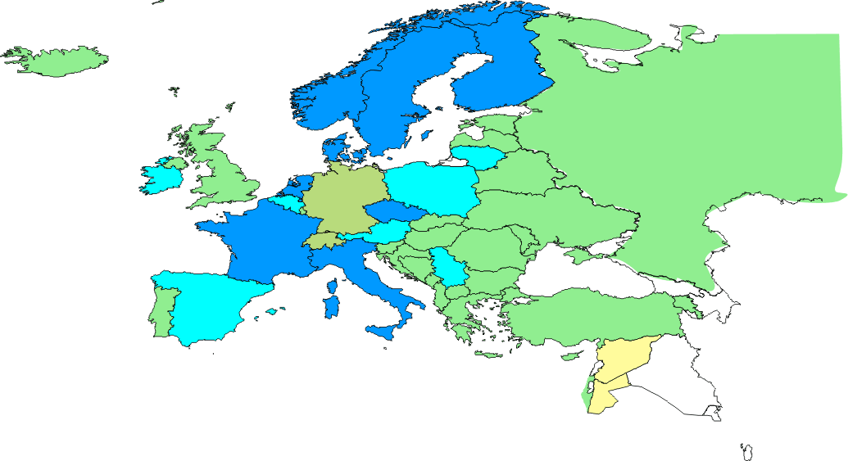
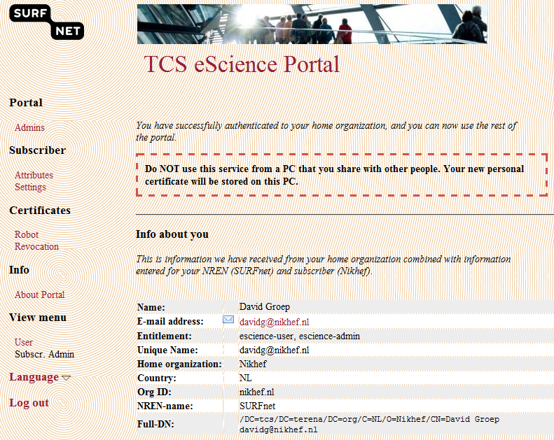
Reach of the TCS Personal service
TCS shared portal and Confusa:
trustworthy credentials
in 3 clicks and 2 minutes

Slide 12
TCS Deployment
TCS Server SSL most prevalent
usage in 2010 more than tripled to 36000 certs
TCS (eScience) Personal is taking off as well
few thousand now,
limited mainly by home organisation participation!
Code-signing certs slowly growing
but take much more effort to get ...

Slide 13
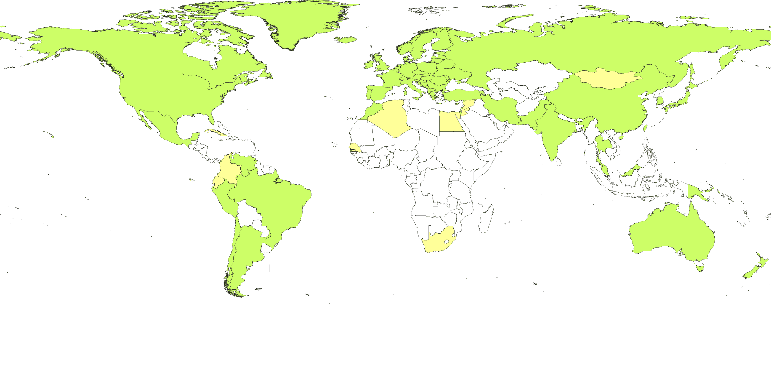

TCS Personal: global recognition

Slide 14
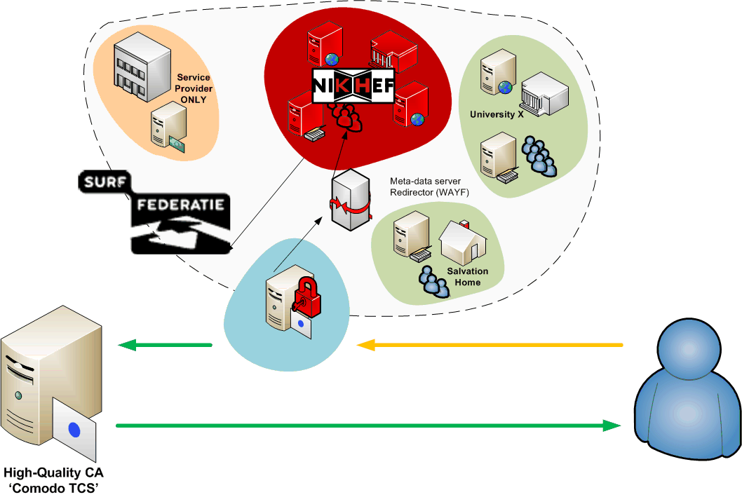
... so from now on: TCS!
web-SSO federations have matured
integration of ‘high-value grid’ &
web federation now becomes reality
Significant benefits for e-Infrastructure and far beyond
Relying parties world-wide now can rely
on trusted institutes that have signed up to the TCS

