Slide 1
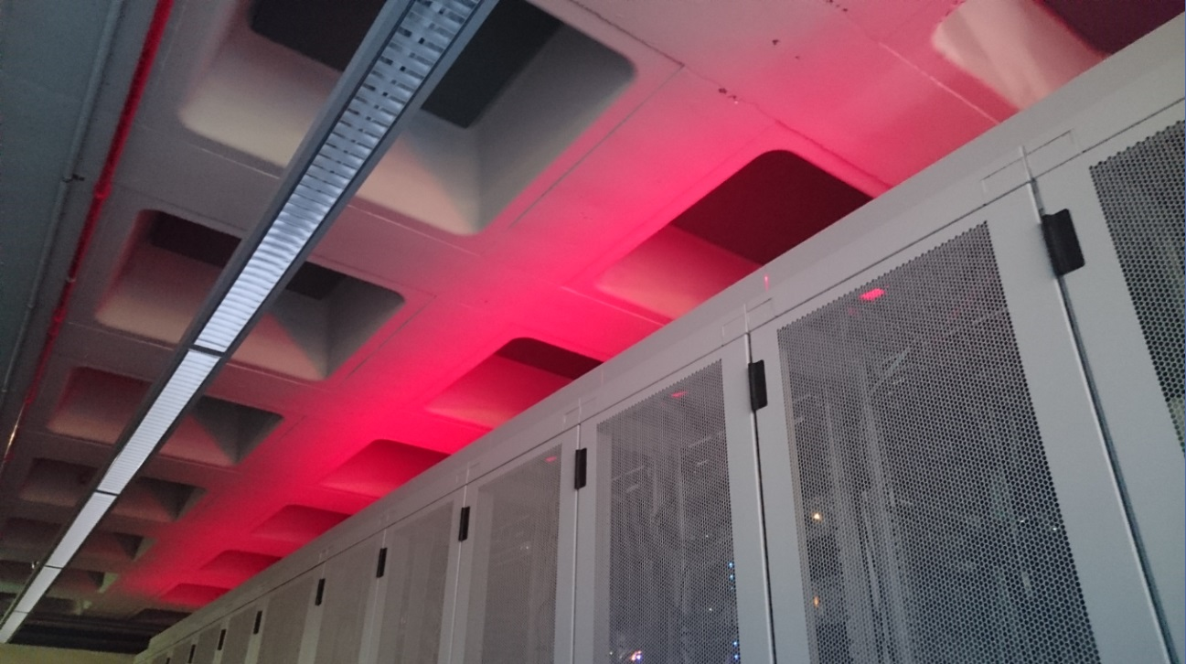
Accelerating Throughput – from the LHC to the World
David Groep
v5
SURFsara Super-D 2016

Slide 2
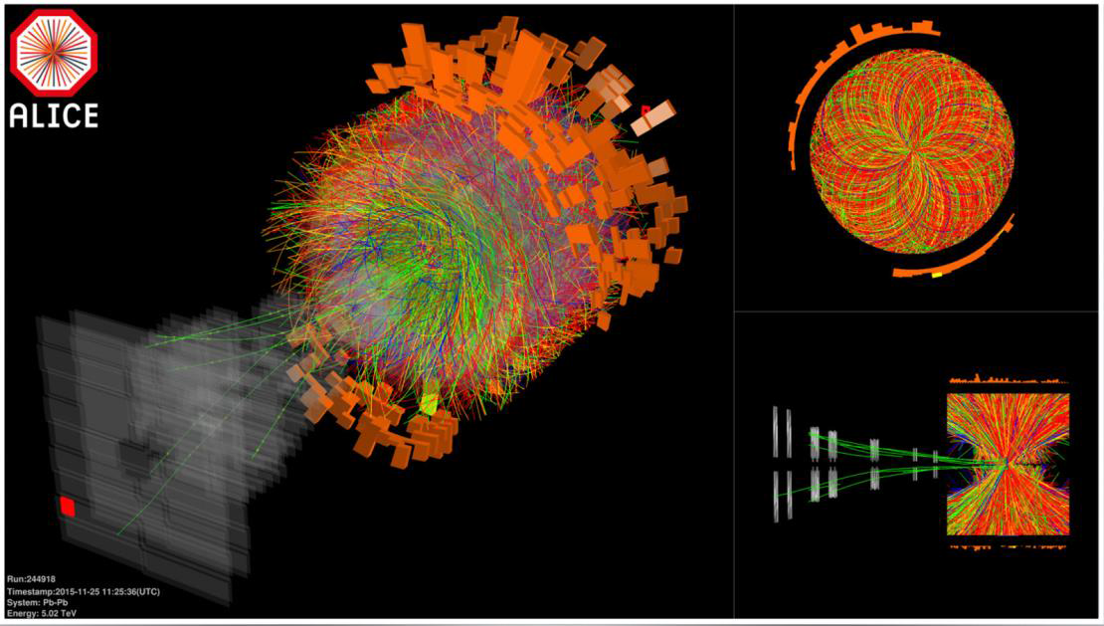
12.5 MByte/event … 120 TByte/s … and now what?

Slide 3
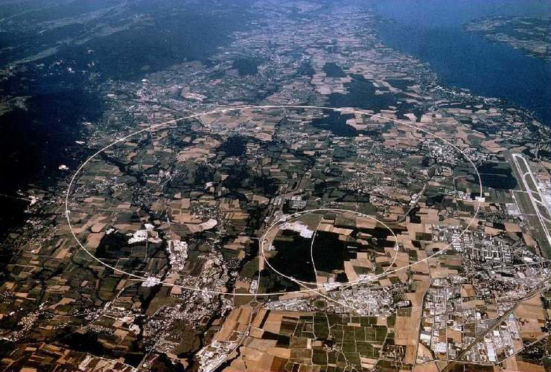
50 PiB/year
primary data

Slide 4
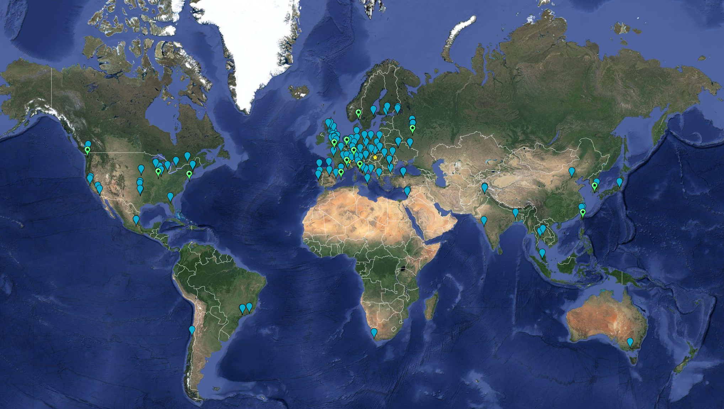
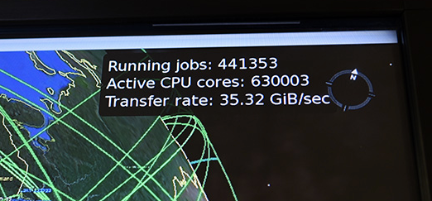
Building the Infrastructure … in a federated way
September 2016:
63 MoU’s
167 sites; 42 countries
CPU: 3.8 M HepSpec06
  If today’s fastest cores: ~ 350,000 cors
  Actually many more (up to 5 yr old cores)
Disk 310 PB
Tape 390 PB

Slide 5
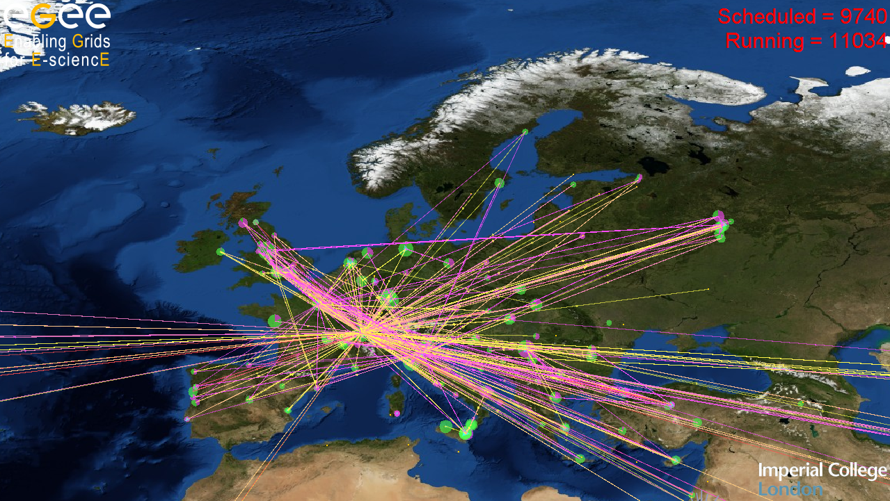

~300 resource centres
~250 communities
Federated infrastructure

Slide 6
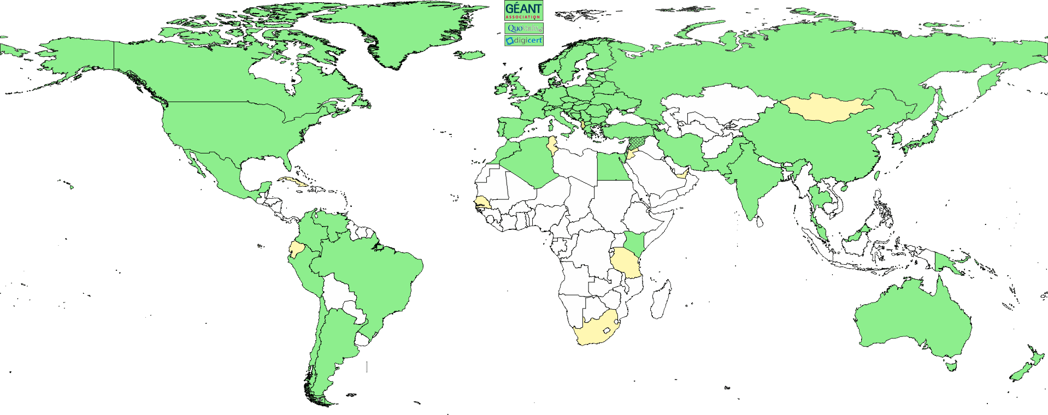
Global collaboration – in a secure way
Collaboration is people as well as (or even more than) systems
A global identity federation for e-Infra and cyber research infrastructures
Common baseline assurance (trust) requirements
Persistent and globally unique
needs a global scope – so we built the
Interoperable Global Trust Federation
  over 80 member Authorities
  Including your GÉANT
  Trusted Certificate Service

Slide 7

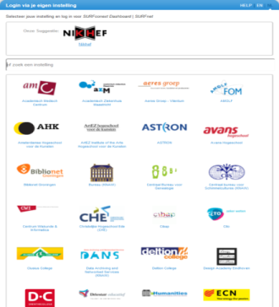
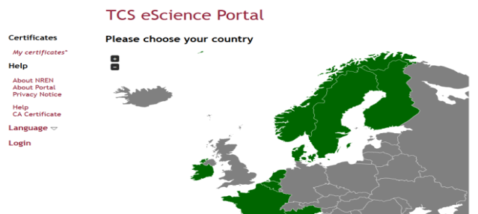
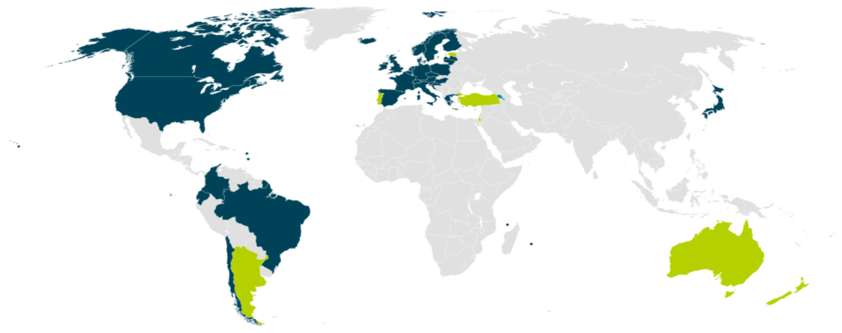


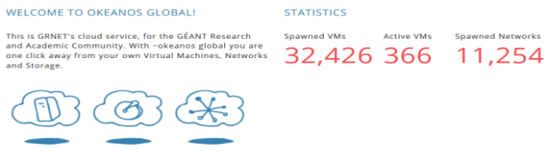

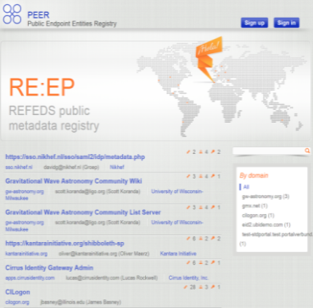
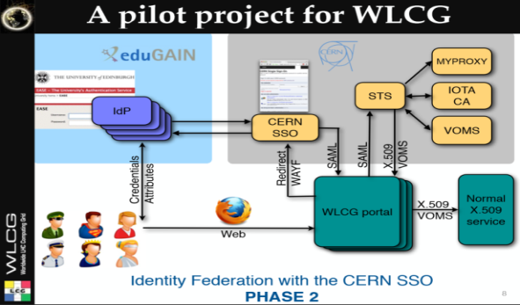
But federation is much more …
wLCG FIM4R pilot

Slide 8
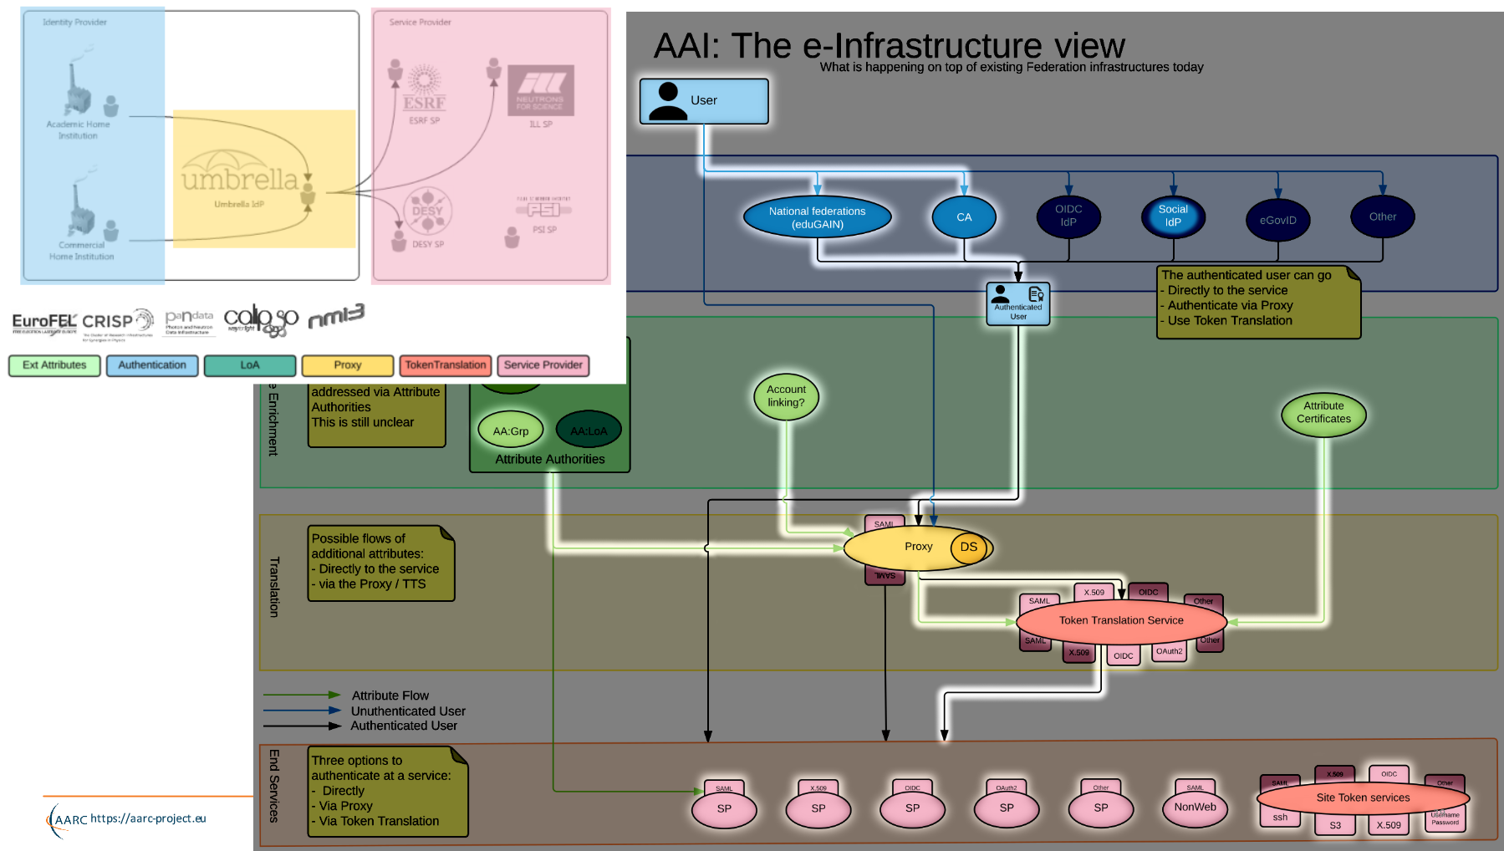
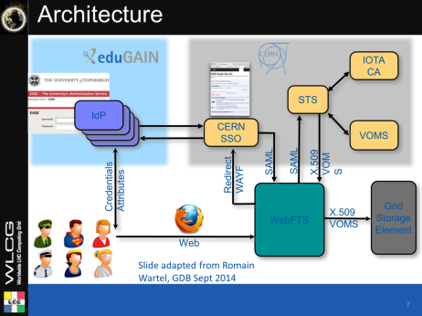
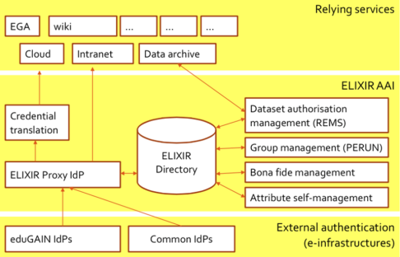
Federation
same pattern
Umbrella
ELIXIR
BBMRI
WLCG
…
https://aarc-project.eu/wp-content/uploads/2015/11/20151102-JRA1.2-Blueprint-Status-Hardt.pdf

Slide 9
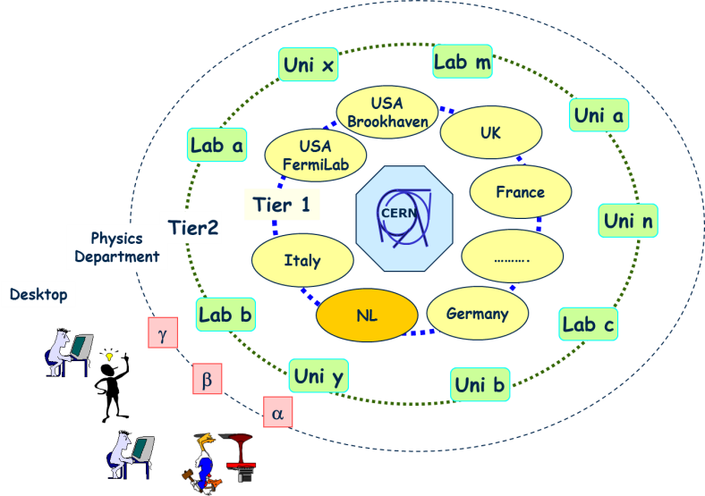
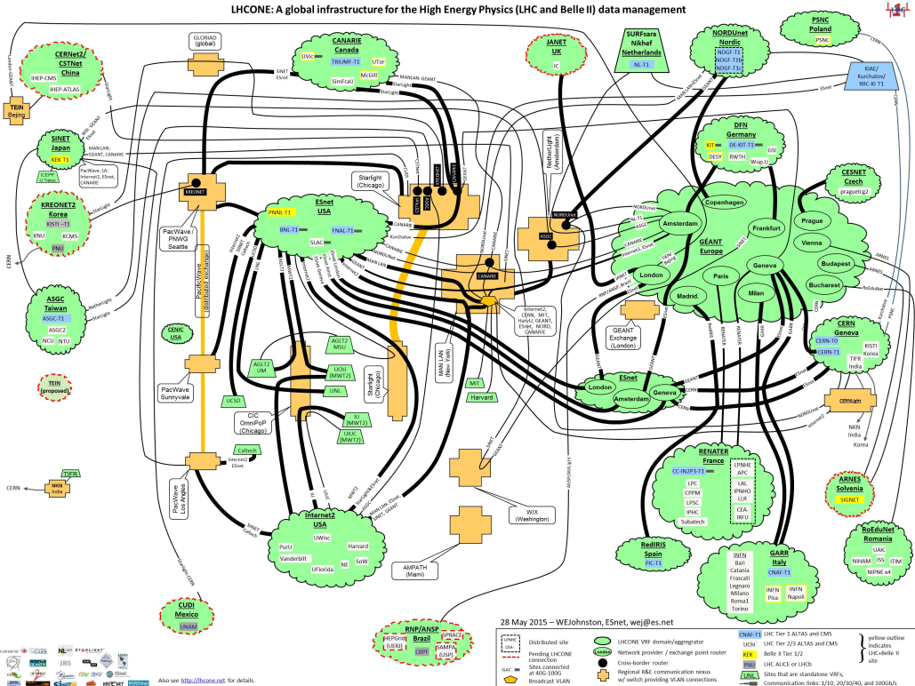

Building the infrastructure for the LHC data
From hierarchical data distribution to
a full mesh and dynamic data placement
Amsterdam/NIKHEF-SARA
LHCOne graphic: lhcone.net

Slide 10
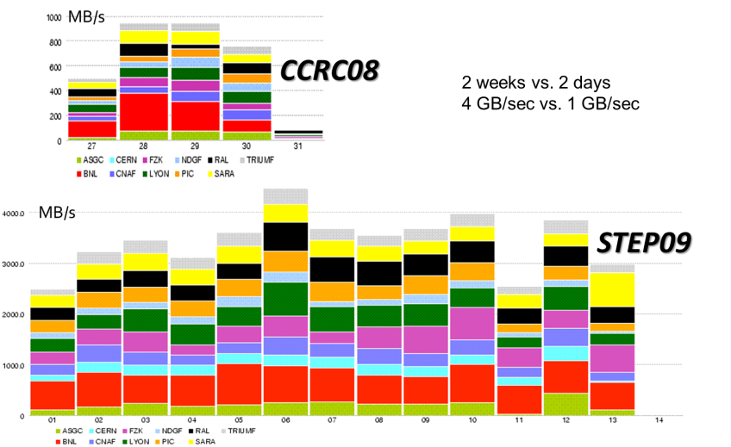
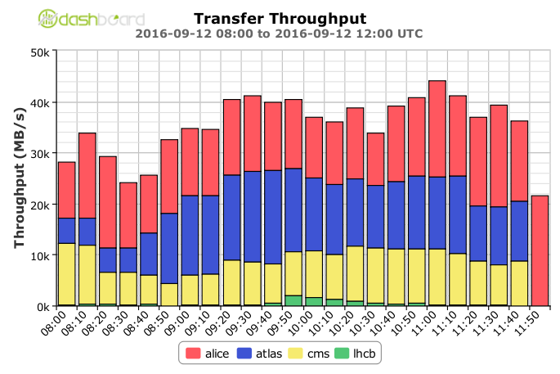
From SC04, CCRC08, STEP09, .. to today …
Global transfer rates increased to > 40 GB/s
Acquisition:10 PB/mo (~x2 for physics data)
STEP09 : Jamie Shiers, CERN IT/GS; Throughput 2016: WLCG Workshop 2016, Ian Bird, CERN

Slide 11
… and tomorrow ?!
Data:
Raw 2016: 50 PB → 2027: 600 PB
Derived (1 copy): 2016: 80 PB → 2027: 900 PB
CPU:
x60 from 2016
Technology at ~20%/year will bring x6-10 in 10-11 years

Slide 12
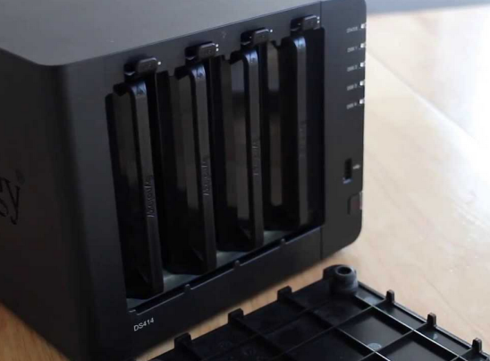
Infrastructure for research: balancing network, CPU, and disk
CPU and disk both expensive, yet idling CPUs are ‘even costlier’
architecture and performance matching averts any single bottleneck
but requires knowledge of application (data flow) behaviour
data pre-placement (local access), mesh data federation (WAN access)
This is why e.g. your USB drive does not cut it
– and neither does your ‘home NAS box’
… however much I like my home system using just
15 Watt idle and offering 16TB for just € 915 …

Slide 13
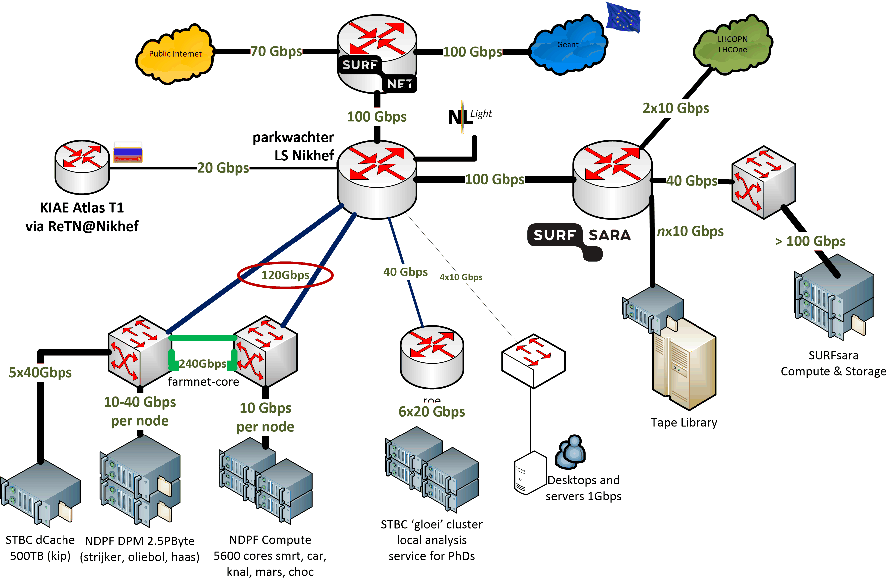
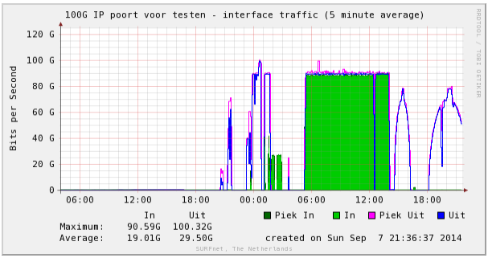
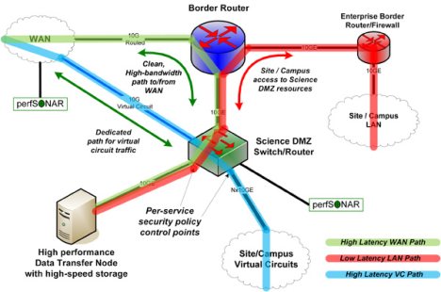
Network built around application data flow
Need to work together!
without our SURFsara peering,
SURFnet gets flooded ☺
and: you really want many of your own peerings

Slide 14
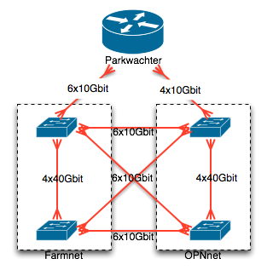
‘Homebrew’ SDN … from the ground up
Software Defined Networking (SDN)
real-time re-programming
of switches to follow
connected topology
“DIY SDN” using
switch-native
python capability
Giving in-switch reprogramming
to support LHCOPN/LHCOne
policy based routes

Slide 15
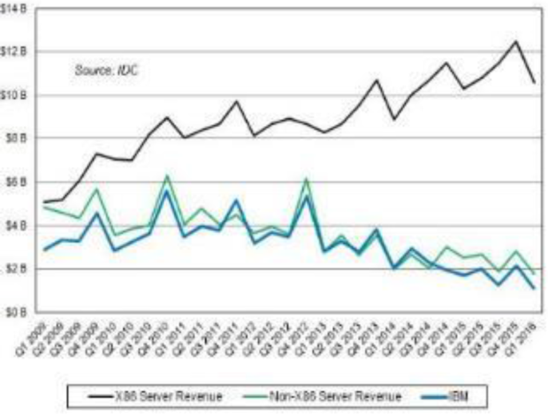
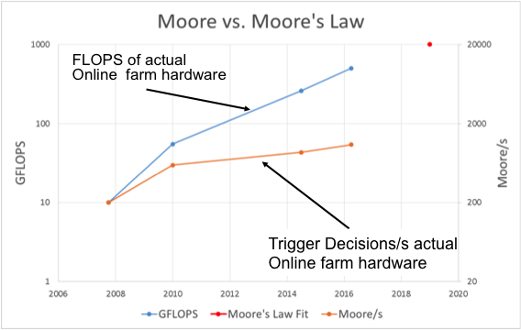
Matching systems architecture
Most applications using x86 today, and probably will for a long time
alternatives (GPGPU or Power) not quite viable
… although for ‘dedicated farms’ FPGAs help,
and KNH works better (we need the memory)
sales volume of different architectures
Yet change must be: most gain to be had from SIMD vectorization and improved memory access patterns
C. Bozzi, INFN and LHCb
Helge Meinhard, Bernd Panzer-Steindel, Technology Evolution, https://indico.cern.ch/event/555063/contributions/2285842/

Slide 16
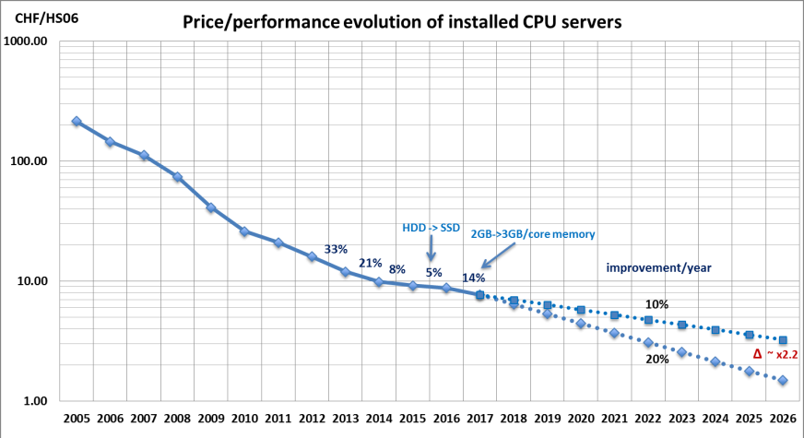
Waiting will not help you any more …
Helge Meinhard, Bernd Panzer-Steindel, Technology Evolution, https://indico.cern.ch/event/555063/contributions/2285842/

Slide 17
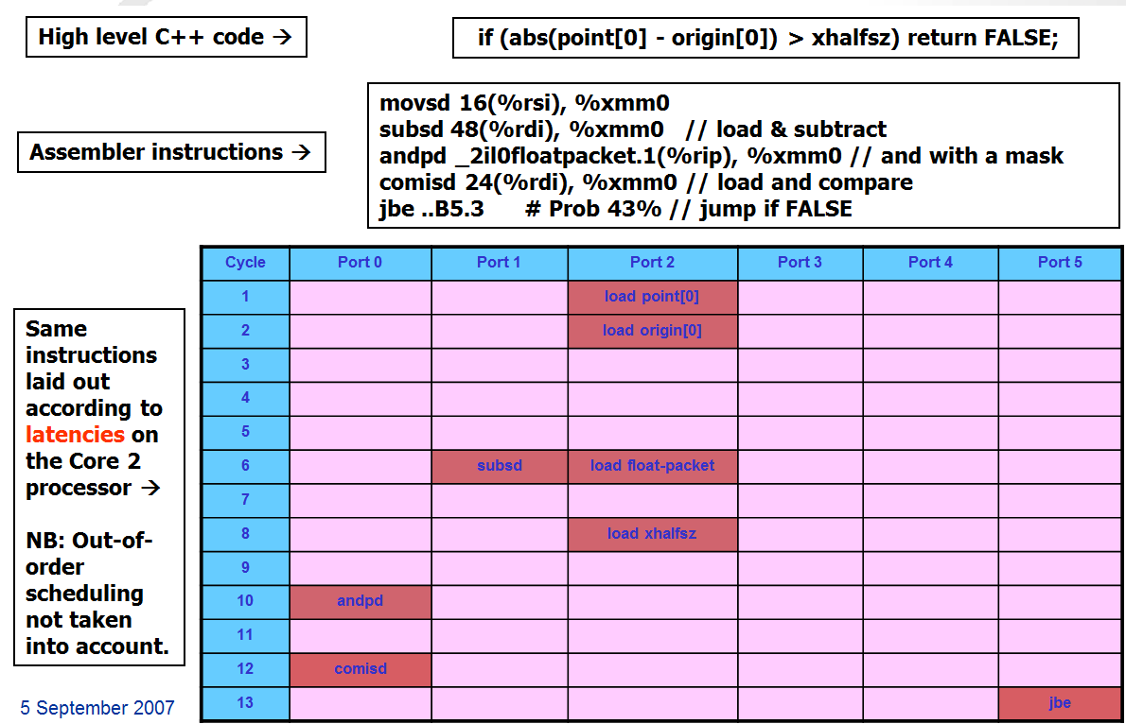
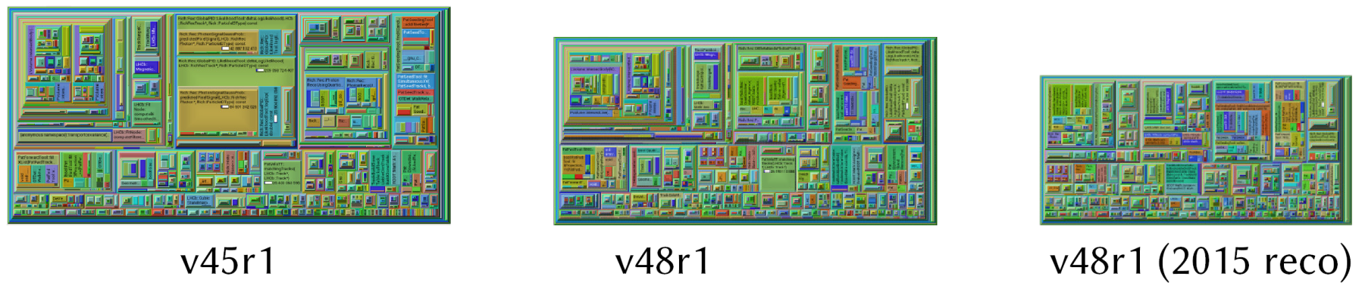
Improvements at the application layer
‘traditional’ (1990’s) style HEP applications were ‘lean’, and fail to scale even in pipelining
let alone vector instructions or multicore
2012
review of algorithms gave overall +34% in LHCb – memory layout still to be done …
To use current processor generations, you need better – machine-aware! – code
2007 Core 2 efficientcy: Sverre Jarp, CHEP2007
Performance data: M Schiller (CERN) et al. for LHCb, - profiling progress (update) 2015;; work by: Gerhard Raven, Nikhef

Slide 18
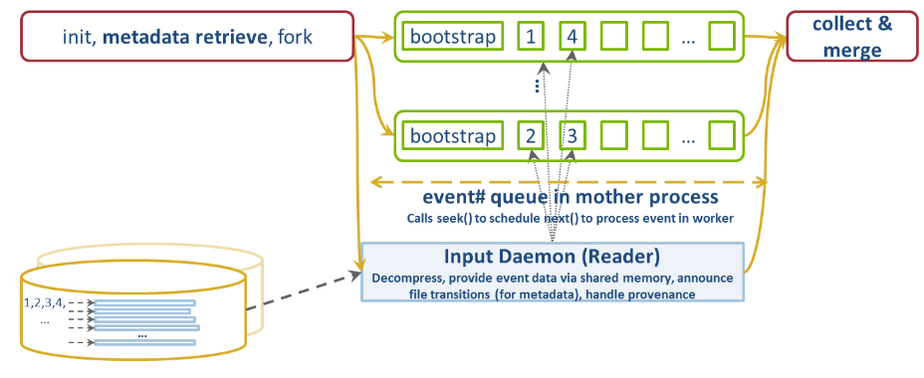
Systems architecture and your application
Many things you only find in production …
If you’re an ‘embarrassingly parallel’ application with a memory challenge
why not try ‘priming’ of memory for the first few events and then fork?
Towards single-socket systems: cache coherence hampering performance
– there’s a penalty to pay for massive multi-socket-big-memory hosts!
Graphic: P van Gemmeren et al. ATLAS collaboration, ATL-SOFT-PROC-2015-020

Slide 19
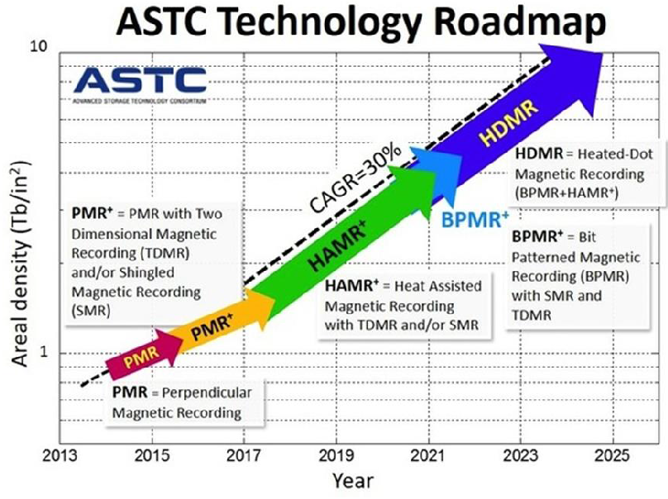
Surviving in the multi-petabyte world
IO characteristics at 20-30TByte HDD
bring unpredictable latencies
for new disk: IOPS/platter ~ constant
any re-writing uses on-disk caches,
those must not be trashed lightly …
with disk vendors, exploring massive
JBOD disk arrays, keeping ~12 MiB/s/TiB
Don’t leave the CPU idle: write ordered data
SSDs will not help us … we would outstrip supply
and it’s hard to get more: initial Fab investments start at $100-200 B
total (all techs) 2016: ~ 600 EB shipped
Graphic: Helge Meinhard, Bernd Panzer-Steindel, Technology Evolution, https://indico.cern.ch/event/555063/contributions/2285842/

Slide 20
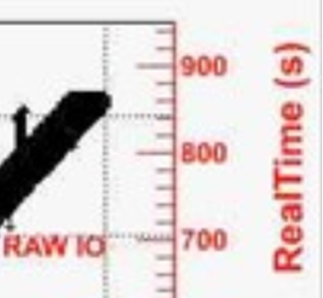
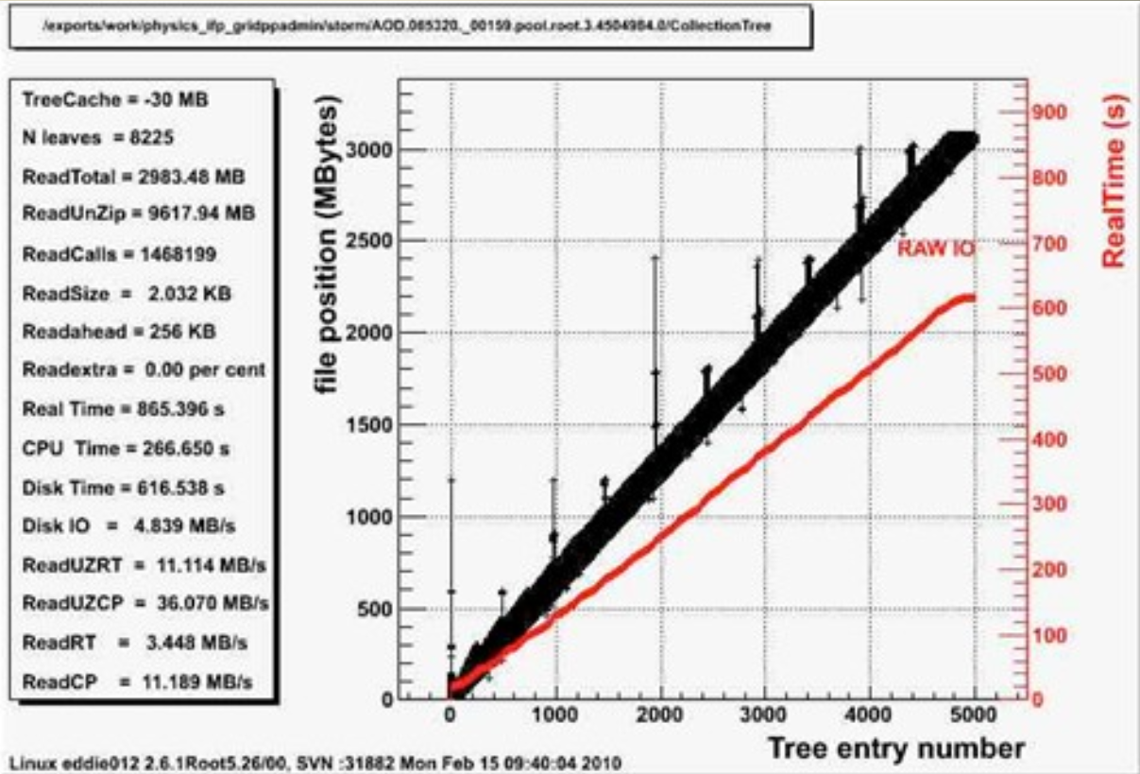
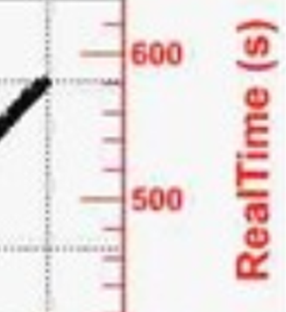
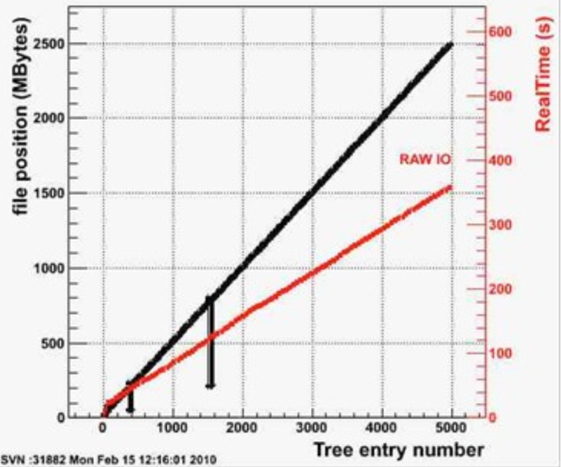
Application awareness in IO patterns
Jumping back 100 MByte leads to cache trashing
Data on Atlas file access pattern: Wahid Bhimji (UEdinburgh) "Filesystems and file access“, GridPP24

Slide 21
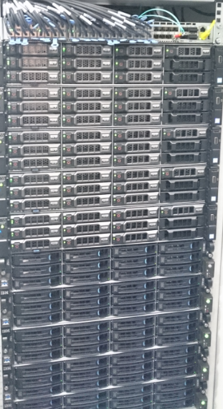
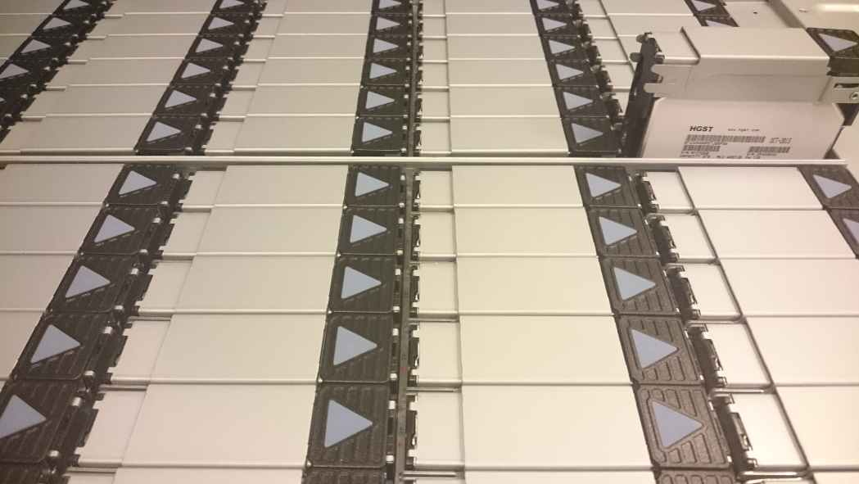
Getting more bytes through?
Power 8: more PCI lanes & higher clock should
give more throughput – if all the bits fit together
Only way to find out is … by trying it!
joint experiment with Nikhef and SURFsara
on comparing IO throughput between x86 & P8
yet more is needed
HGST: 480 TByte gross capacity/4RU
RAID card are now a performance bottleneck
JBOD changes CPU-disk ratio
closer integration of networking to get >100Gbps

Slide 22
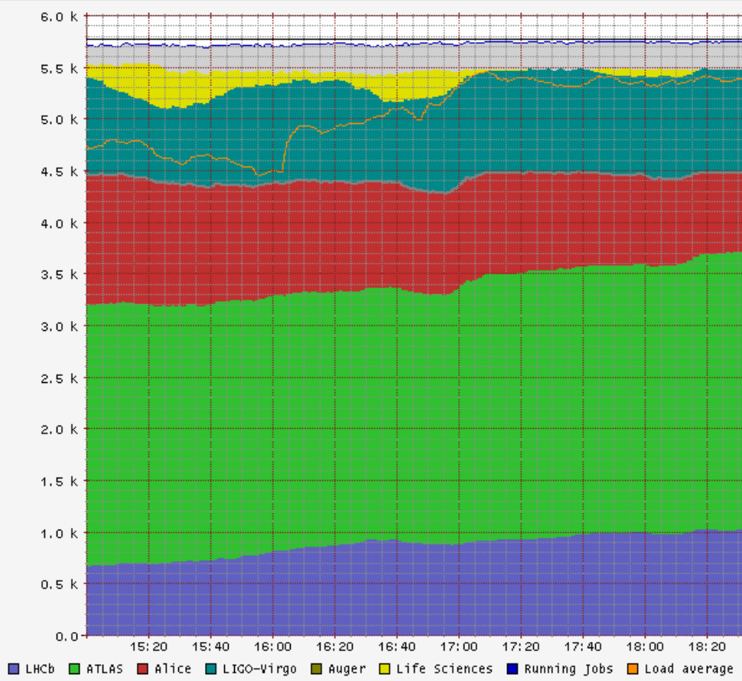
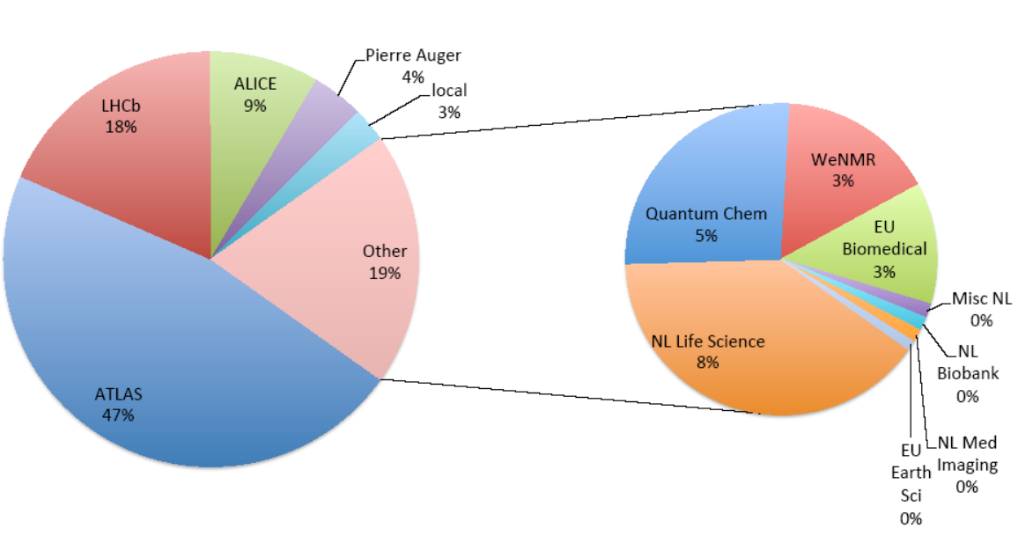
Shared infrastructure, efficient infrastructure!
>98% utilisation, >90% efficiency
NL: WeNMR
EGI biomedical
LIGO/Virgo gravitational waves
LHC Alice
LHC Atlas
LHCb
Right:: NIKHEF-ELPROD facility, Friday, Dec 9th, 2016
Left: annual usage distribution 2013-2014

Slide 23
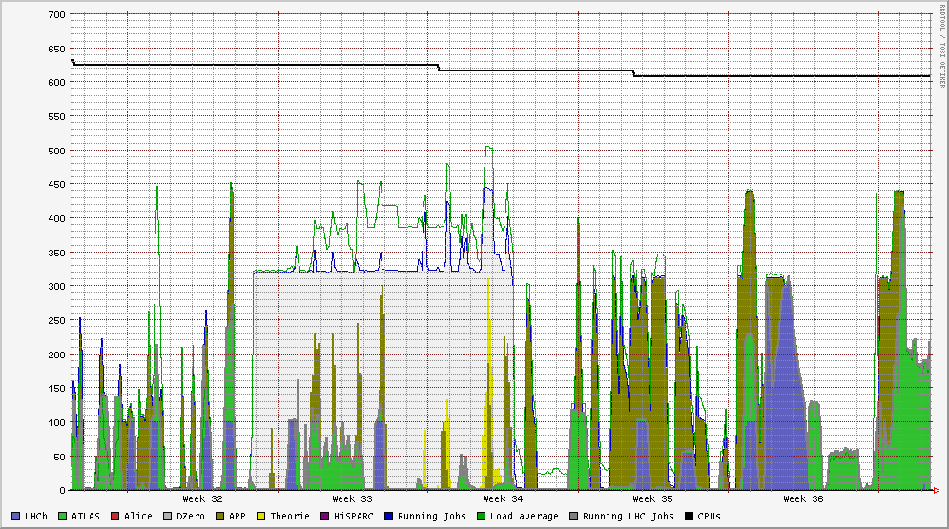
Improve utilisation: towards ‘cloudification’ @Nikhef
attract new HTC use cases beyond WLCG and traditional WeNMR/LS
new communities prefer a different OS distribution and diverse software suites
… although they still like a platform service and indulge in orchestration …
dynamic scaling between DNI nodes, ex-DNI nodes,
and local computing (‘stoomboot’) to allow short-term bursting
easier multi-core scheduling and keep >95% ocupancy

Slide 24
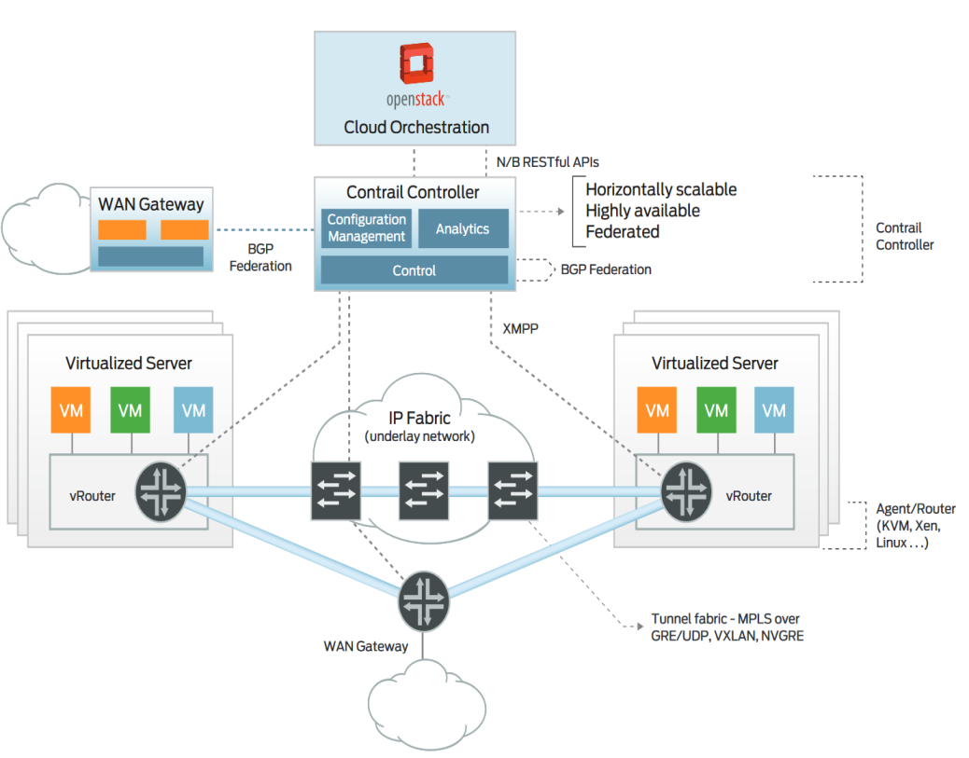
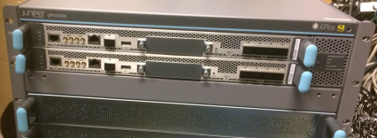
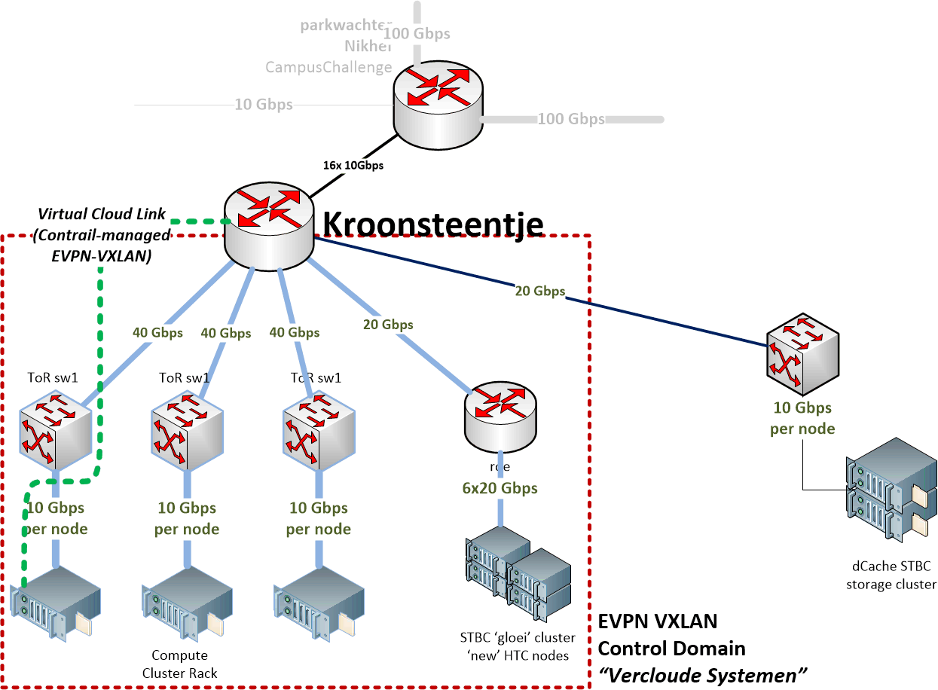
Networking from Datacentre to WAN
Virtualising a high-throughput network
for affordable global collaboration, your network path needs to be ‘dumb’
and only your control plane virtual (and don’t start NATing)
contrail graphic: http://www.juniper.net/assets/us/en/local/pdf/datasheets/1000521-en.pdf

Slide 25

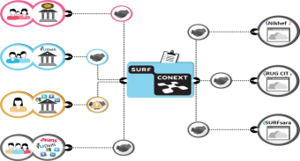
‘Cloudification’: operations and advanced use cases
High Throughput cloud, a quite different beast
  from the HPC cloud because of the bias of throughput over memory
  (and there’s a perfectly great HPC cloud already at SURFsara!)
  from public cloud offerings, because of unlimited and unmetered bandwidth and data transport
  Burstring at the application and at the network layer over lightpaths
Empowering users, but protect them at the same time
  researchers ‘ill suited’ for system hardening & engineering (we’ve seen that!)
  use offered collaboration and support – services are better than machines

Slide 26
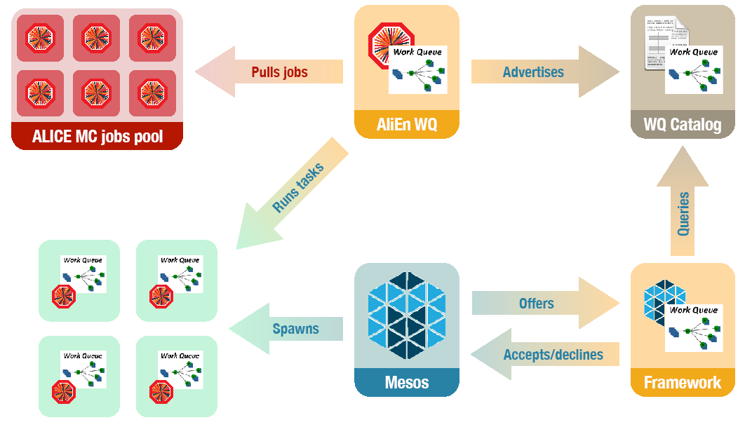
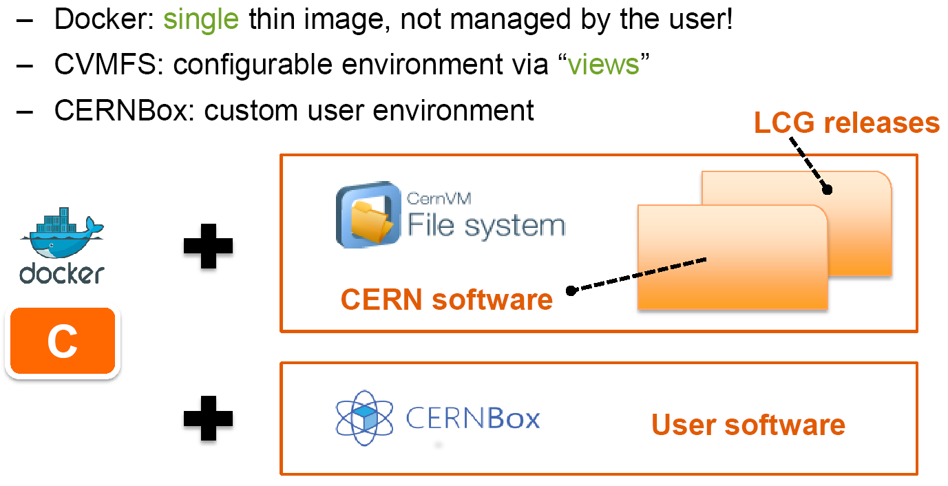
‘cloud’ is a means, not an end-all solution …
/cvmfs/softdrive.nl
E. Tejedor et al., CERN, SWAN Service for Web-based Analtsis, CHEP2016
Dario.Berzano@cern.ch - CHEP 2016 - Experiences with the ALICE Mesos infrastructure
Advantage of collaboration: joint
effort of infrastructure and experiments
http://doc.grid.surfsara.nl/en/latest/Pages/Advanced/grid_software.html#softdrive

Slide 27
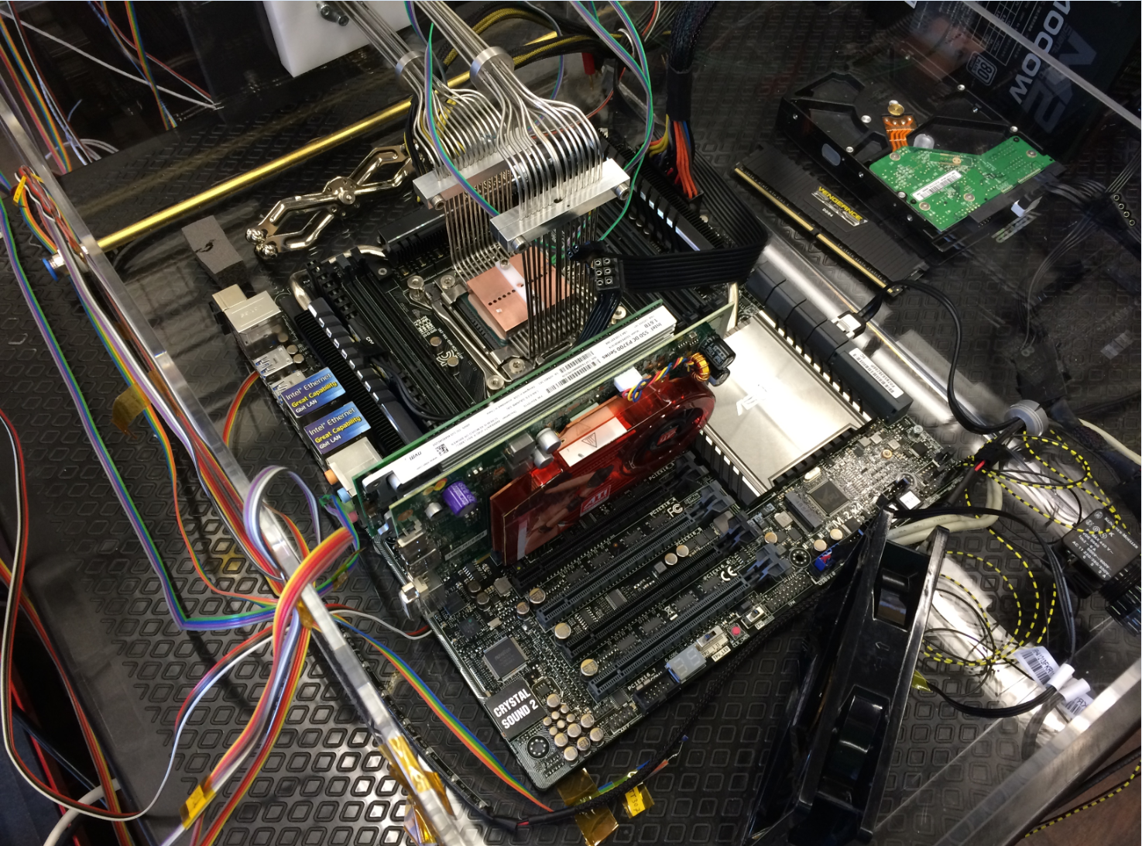
Fun, but not the solution to single-core performance …
Collaboration of Intel™ and Nikhef PDP & MT (Krista de Roo) “CO2 Inside”

Slide 29
Processing of really voluminous data requires more than just a set of disks with a processor glued on top. It needs global networks, continuous performance tuning of storage models, and tight integration with the application framework design to build an efficient data processing system that can span the globe. Using the Netherlands Tier-1 facility for the LHC Computing Grid as an example, we explore how the e-Infrastructure evolves and why the national collaboration is crucial for Nikhef to build such large facilities in a cost-effective way.

