Slide 1
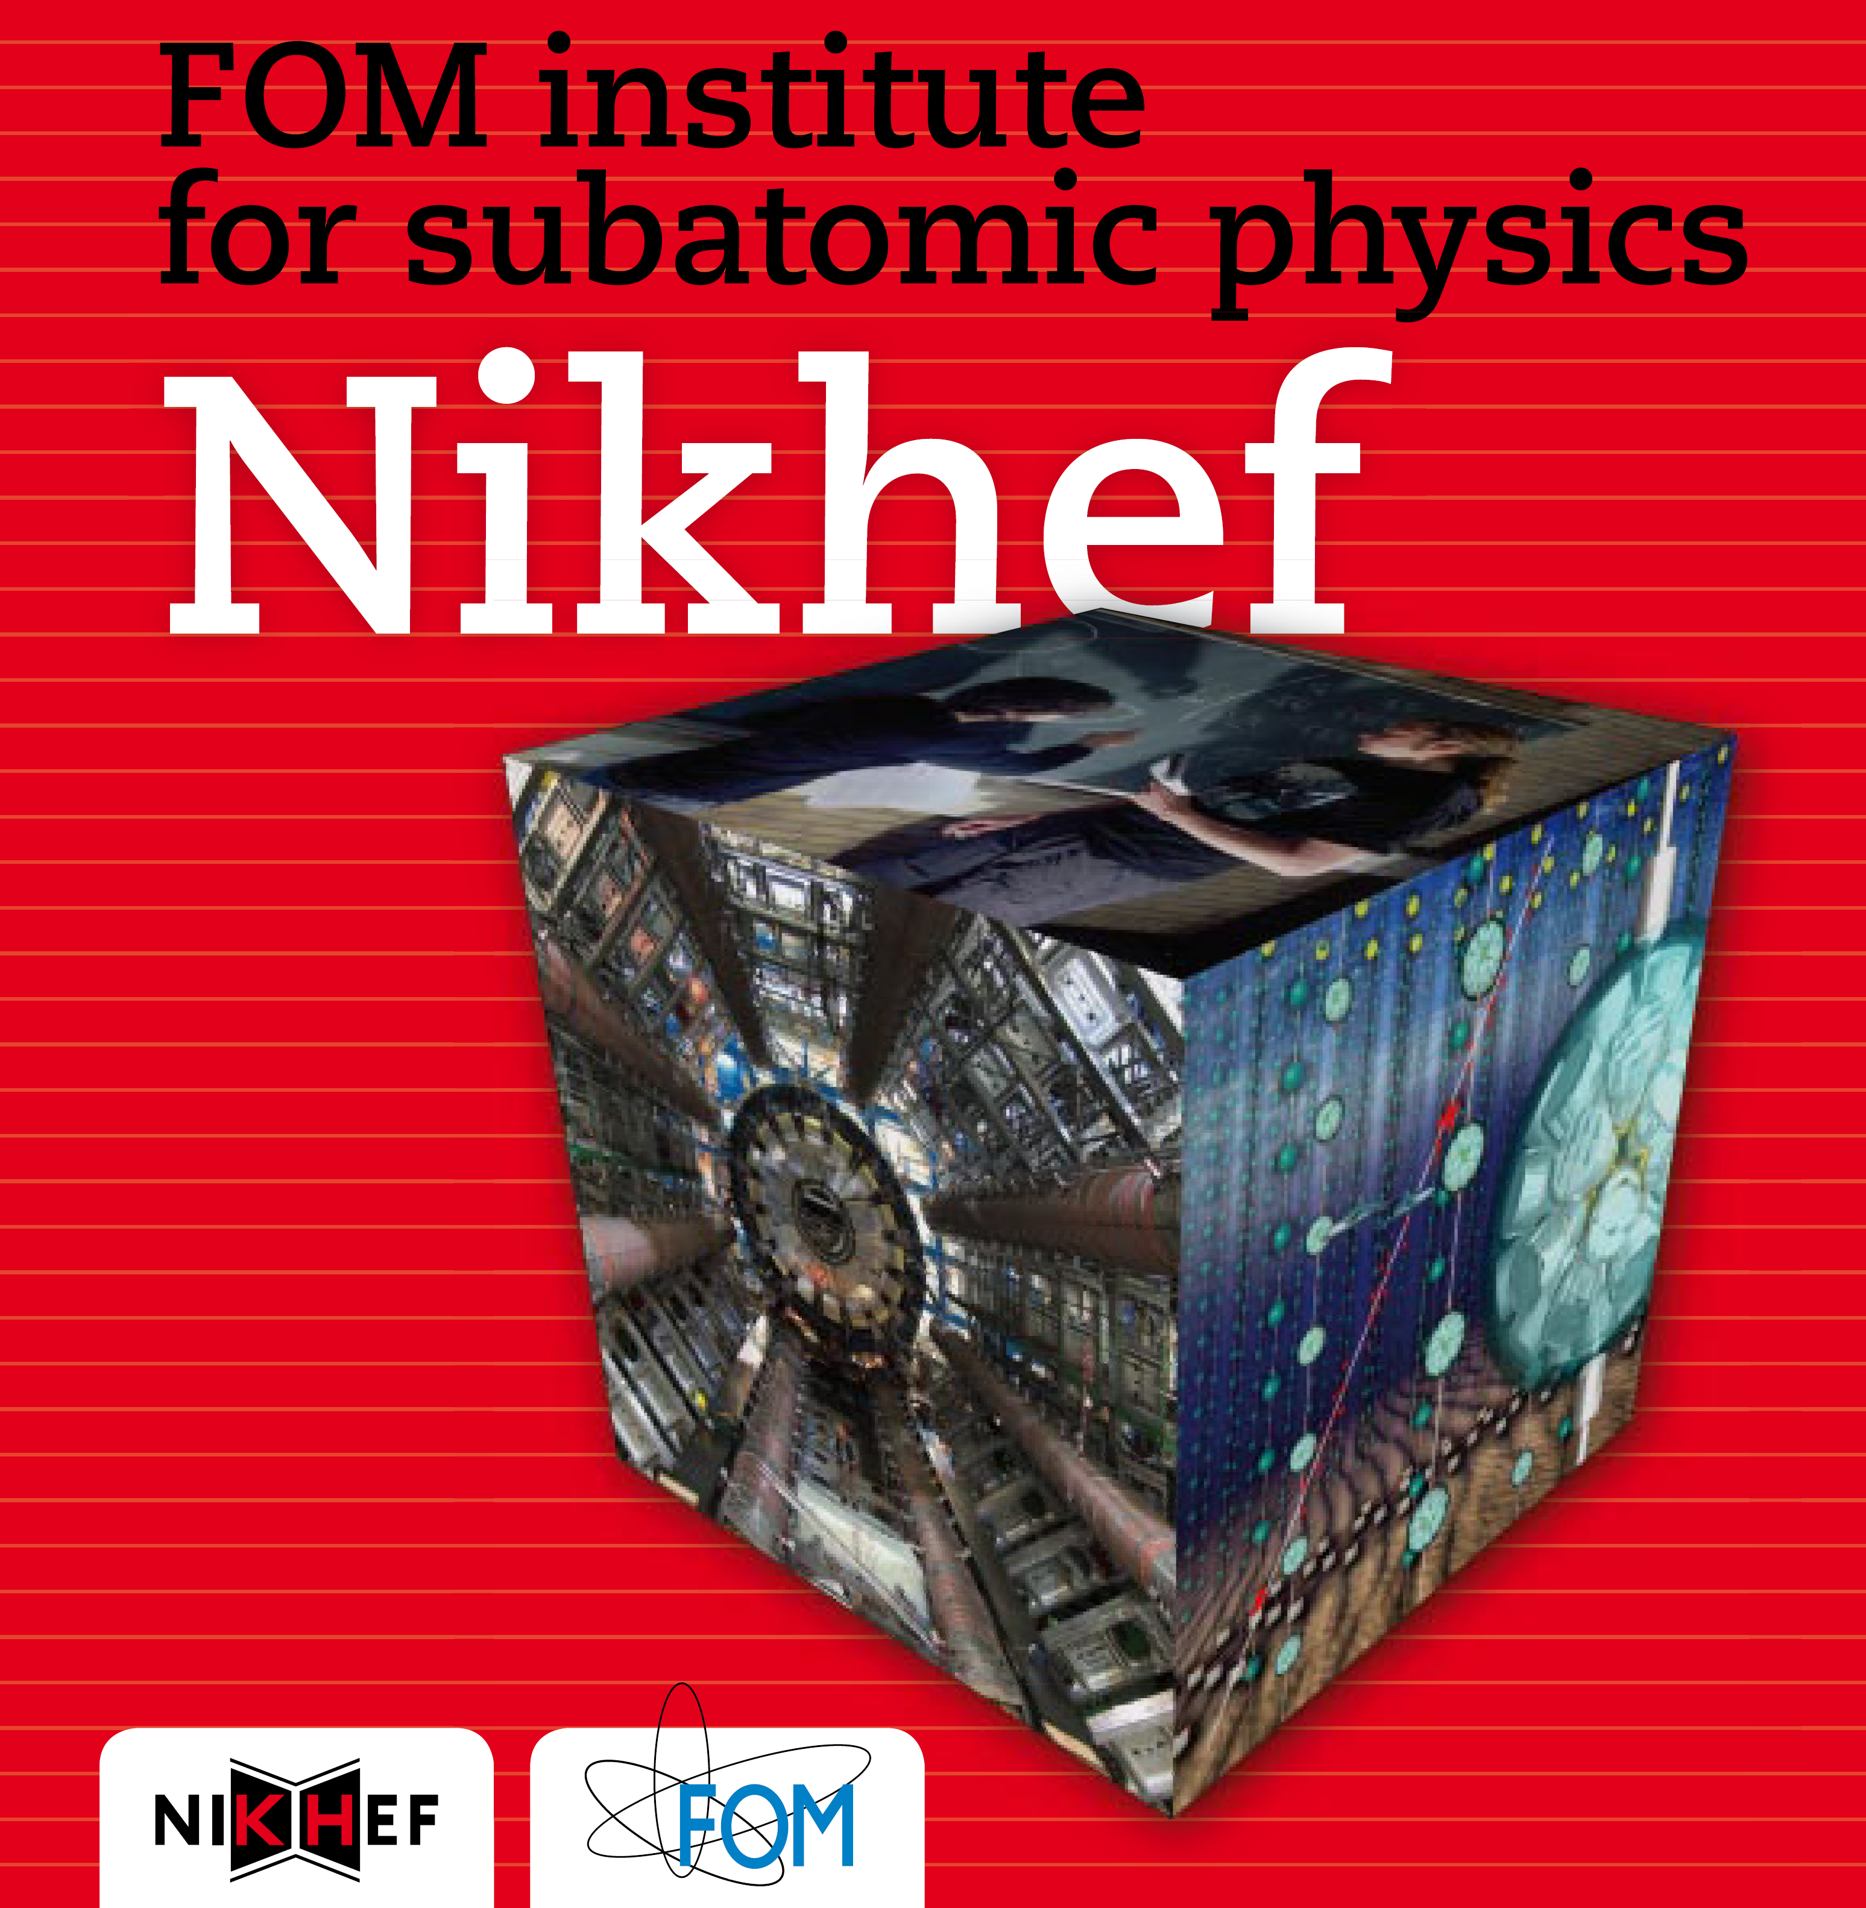


About Nikhef
Physics
Data Processing
Middleware
Operations
BiG Grid & NL T1
SURFnet tour, July 2010

Slide 2
Samenwerking van de Stichting FOM en
VU, UvA, UU en RU, ca. 300 mensen
Coordinatie van alle sub-atomaire fysica in NL
Onderzoek
@CERN/LHC, FNAL/Tevatron (versnellers)
@Antares, Pierre Auger, Virgo (kosmisch)
plus uitgebreid technisch programma

Slide 3

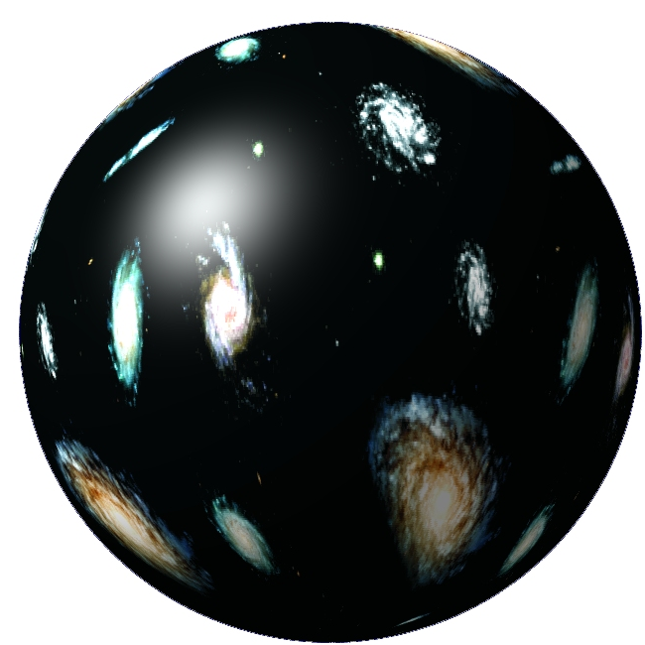


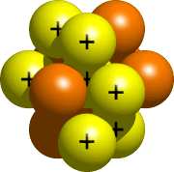
Some fundamental questions
quarks
10⁻¹⁵ m
atom
nucleus

Slide 4
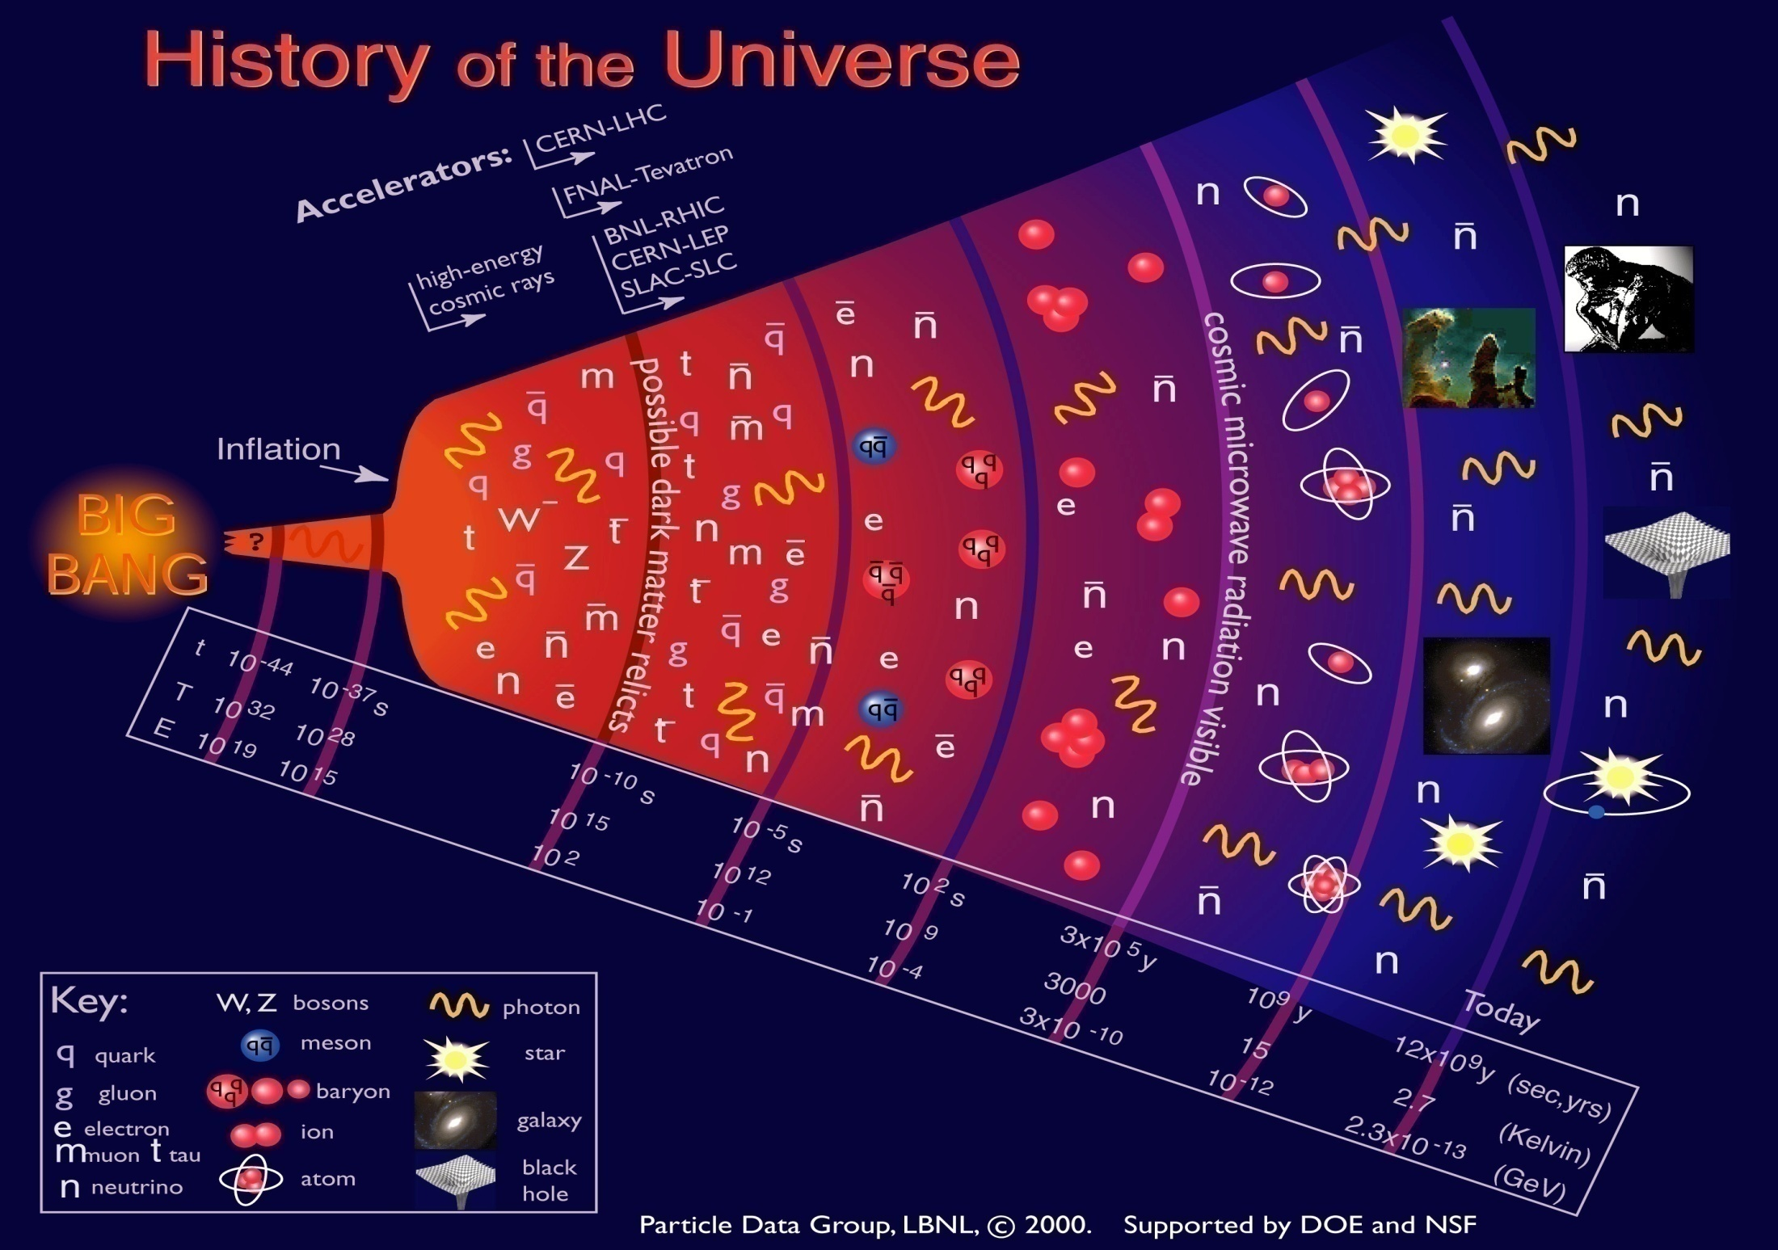

Slide 5
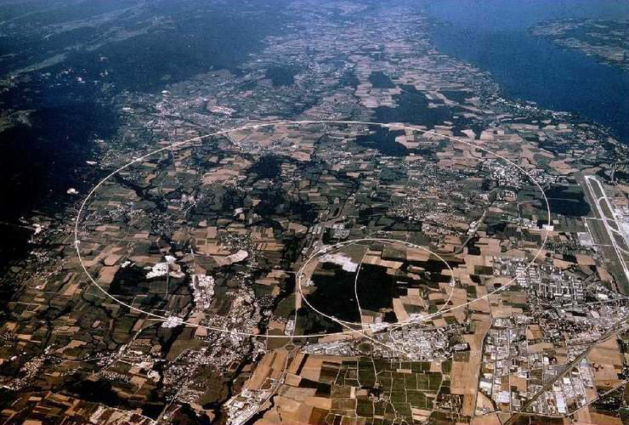

CERN
Atlas

Slide 6
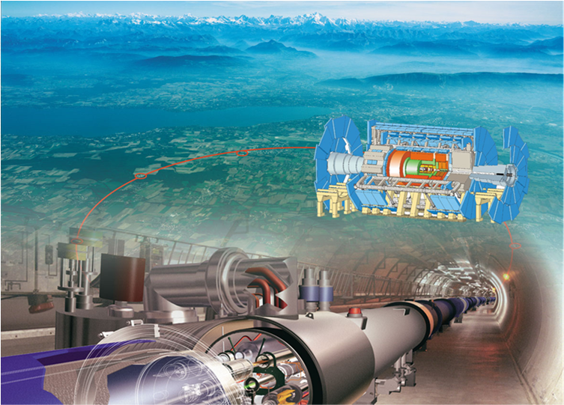

LHC – the Large Hadron Collider
Started in earnest October 09
‘the worlds largest collider’
27 km circumference
Located at CERN, Geneva, CH
2x 3.5 TeV – the higest energy
on earth
quarks
10⁻¹⁵ m
atom
nucleus
but also ... ~ 20 PByte of data per year, ~ 60 000 modern PC style computers

Slide 7
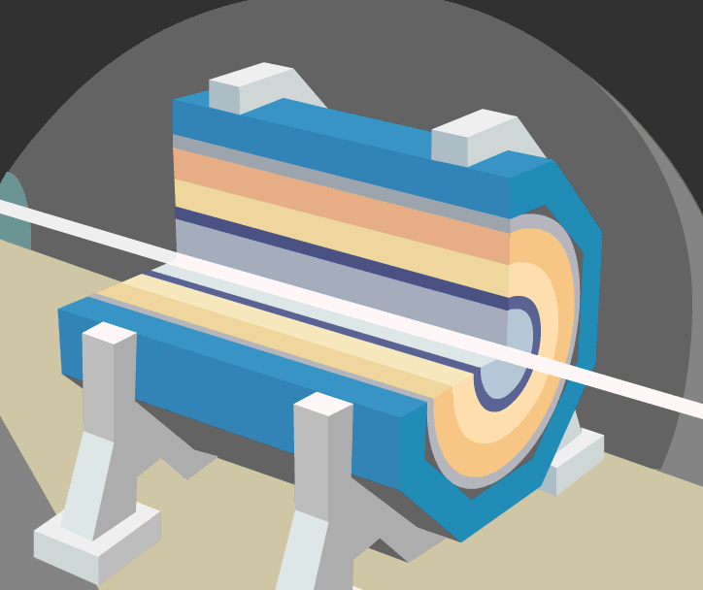

Slide 8
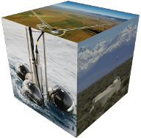
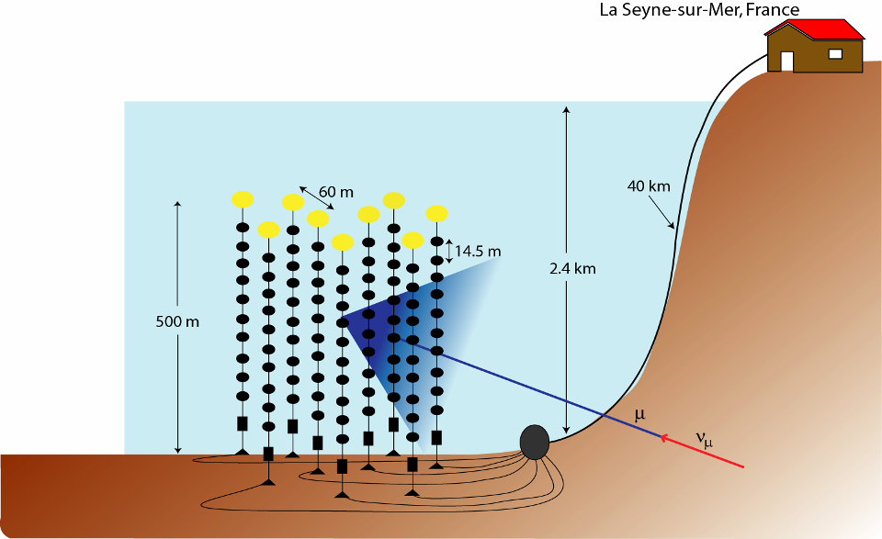
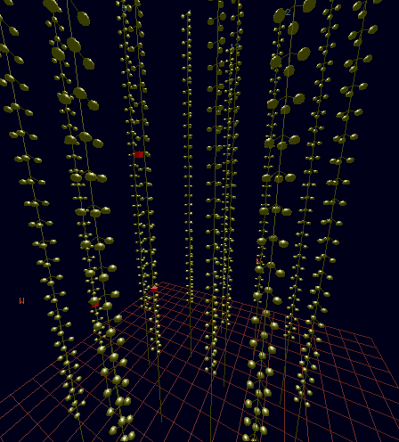
Astroparticle physics

Slide 9
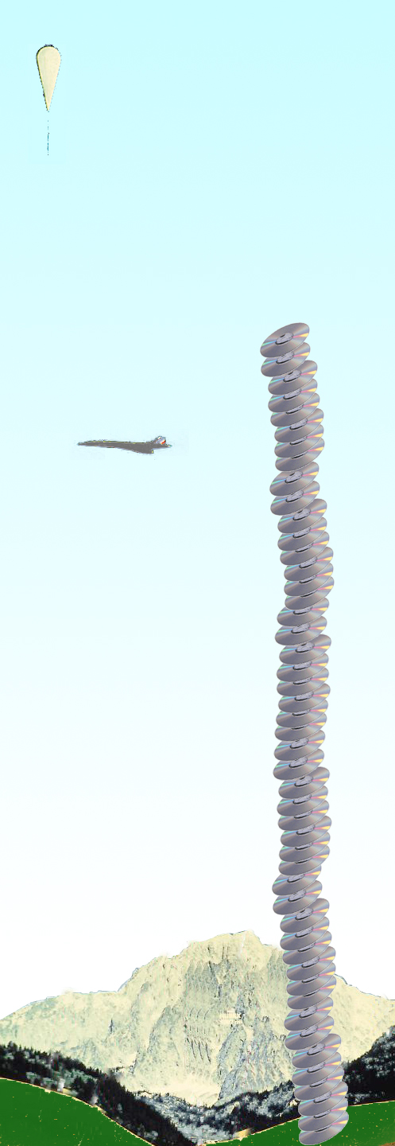
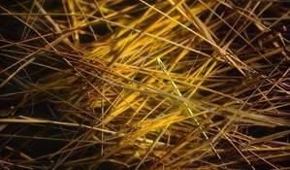
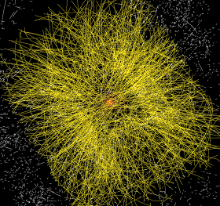
Balloon
(30 Km)
Data from the LHC
CD stack with
1 year LHC data!
(~ 20 Km)
Signal/Background 10⁻⁹
Data volume
  (high rate) X
  (large number of channels) X
  (4 experiments)
  ➔ 20 PetaBytes of new data each year
Compute power
  (event complexity) X
  (number of events) X
  (thousands of users)
  ➔ 60’000 of (today's) fastest CPUs
Concorde
(15 Km)
Mt. Blanc
(4.8 Km)

Slide 10
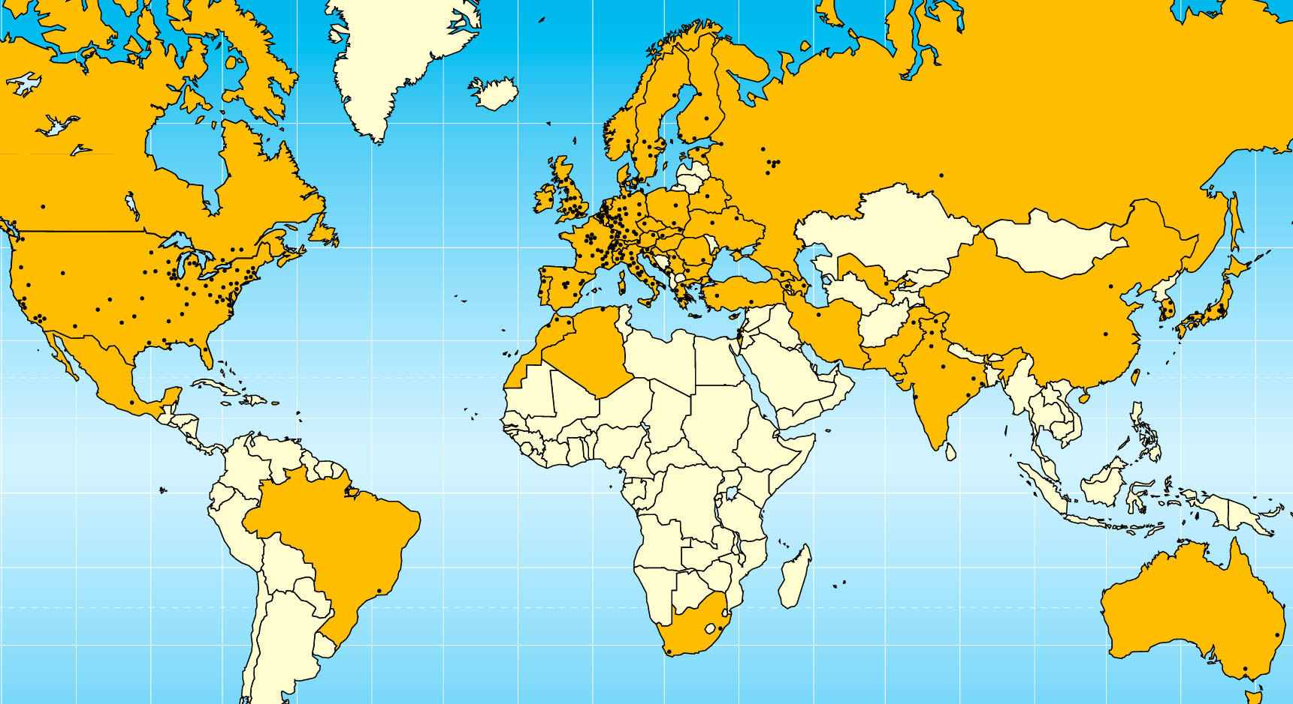

Today –
LHC Collaboration
20 years est. life span
24/7 global operations
~ 4000 person-years of
science software investment
~ 5 000 physicists
~ 150 institutes
53 countries, economic regions

Slide 11
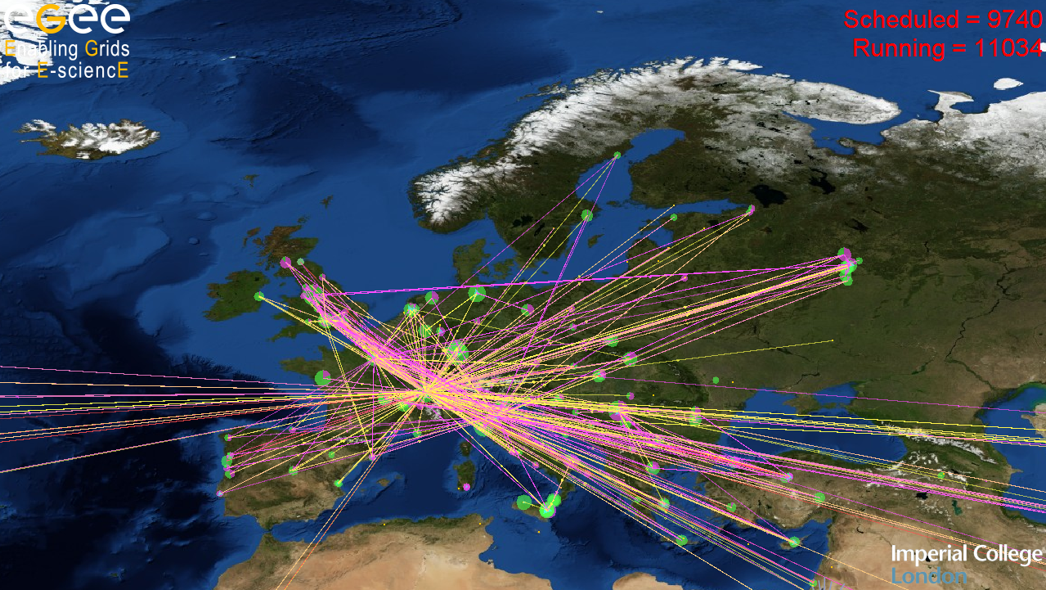
Grid – the global e-Infrastructure

Slide 12
Why would we need it?
Enhanced Science needs more and more computations and
Collected data in science and industry grows exponentially
The Bible | 5 | MByte
X-ray image | 5 | MByte/image
Functional MRI | 1 | GByte/day
Bio-informatics databases | 500 | GByte each
Refereed journal papers | 1 | TByte/yr
Satellite world imagery | 5 | TByte/yr
US LoC contents | 20 | TByte
Internet Archive 1996-2002 | 100 | TByte
LOFAR expected 2010 | ~ 1 | PByte
Particle Physics Today: LHC | 20 | PByte/yr
1 Petabyte = 1 000 000 000 Megabyte

Slide 13
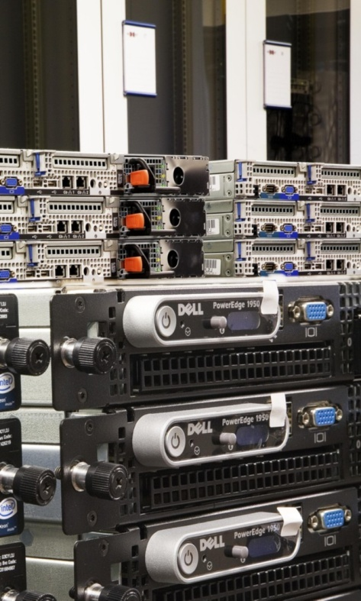
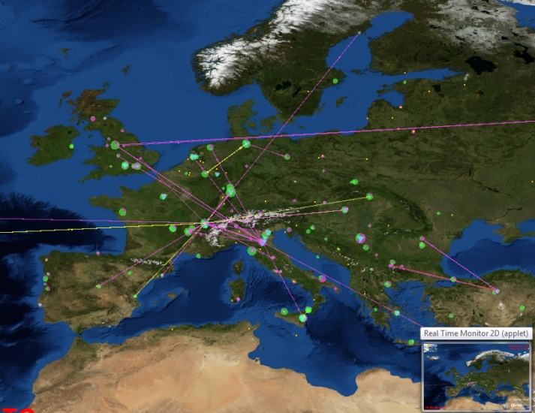
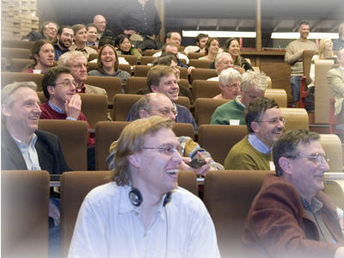
Grids in Science
The Grid is ‘more of everything’
as science struggles to deal
with ever increasing complexity
more than one place on earth
more than one computer
more than one science!
more than …

Slide 14
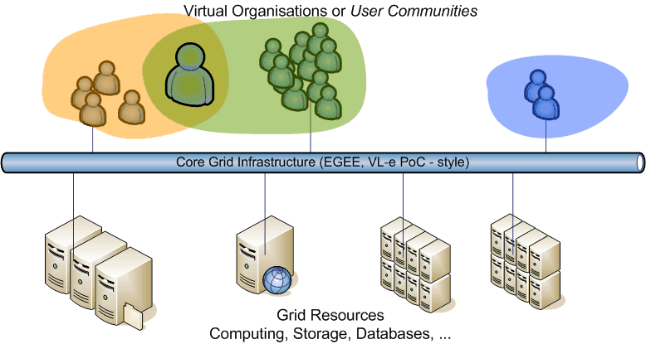

Software – connecting resources
Interoperation
Use standards (mainly web services) to interoperate and prevent lock-in
Use the experience of colleagues and best-of-breed solutions
Connect to the infrastructure based on these open protocols

Slide 15

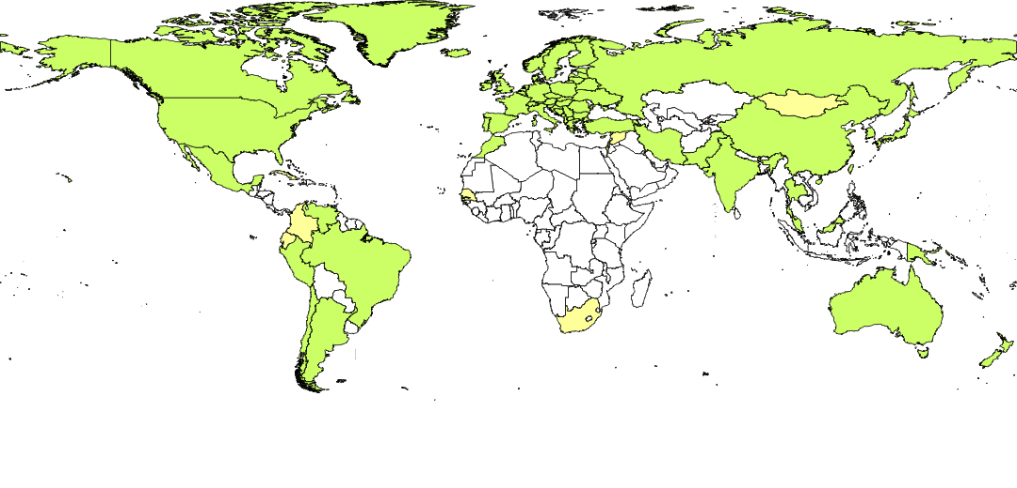
Trust Infrastructure and Security
Why would I trust you? How do I know who you are?
‘digital signatures and certificates be used as digital identities’
But they need to become ubiquitous
With high quality – since they are used to protect high-value assets
Persistent and globally unique
For the Grid a truly global identity is needed
–– so we built the International Grid Trust Federation
  over 80 member Authorities
  Including, e.g., the TCS
And it works in a global federation,
with harmonized requirements, driven by actual relying parties

Slide 16
Nikhef, the Netherlands and the World

Slide 17



BiG Grid, the Dutch e-Science Grid
Since 1999 Nikhef has been working in ‘Grid’
  Building on the VL-e experience in NL
  the European DataGrid and EGEE projects
Started BiG Grid in 2005/2007 to consolidate e-Science infrastructure & production support
Initiative lead by the science domains
  NCF and its scientific user base
  NBIC, Netherlands BioInformatics Center
  Nikhef, who you know by now ☺
With SARA as main operational partner

Slide 18
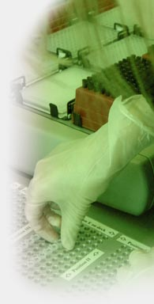
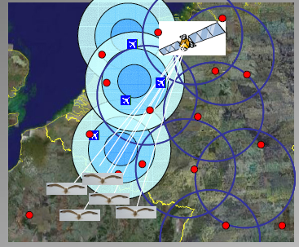
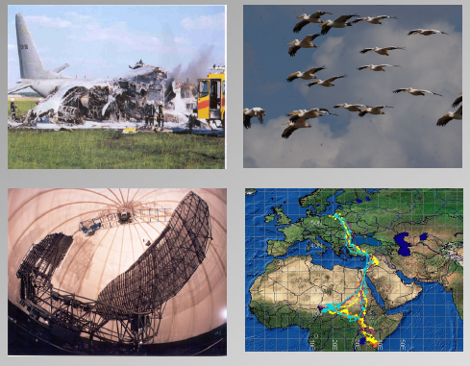
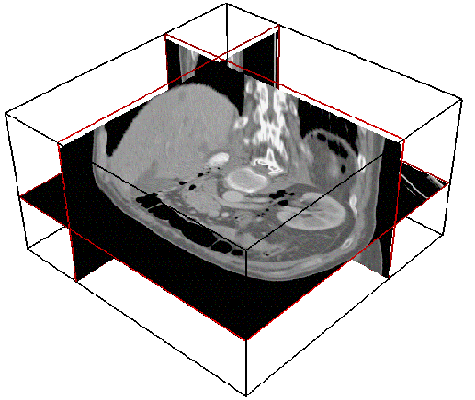
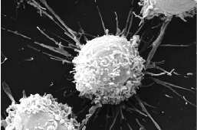
Virtual Laboratory and e-Science
Image sources: VL-e Consortium Partners
Data integration for
genomics, proteomics, etc.
analysis
Timo Breit et al.
Swammerdam
Institute of
Life Sciences
Medical Imaging and fMRI
Silvia Olabarriaga et al.
AMC and UvA IvI
Avian Alert and FlySafe
Willem Bouten et al.
UvA Institute for Biodiversity Ecosystem Dynamics, IBED
Bram Koster et al.
LUMC
Microscopic Imaging group
Molecular Cell Biology and 3D Electron Microscopy

Slide 19
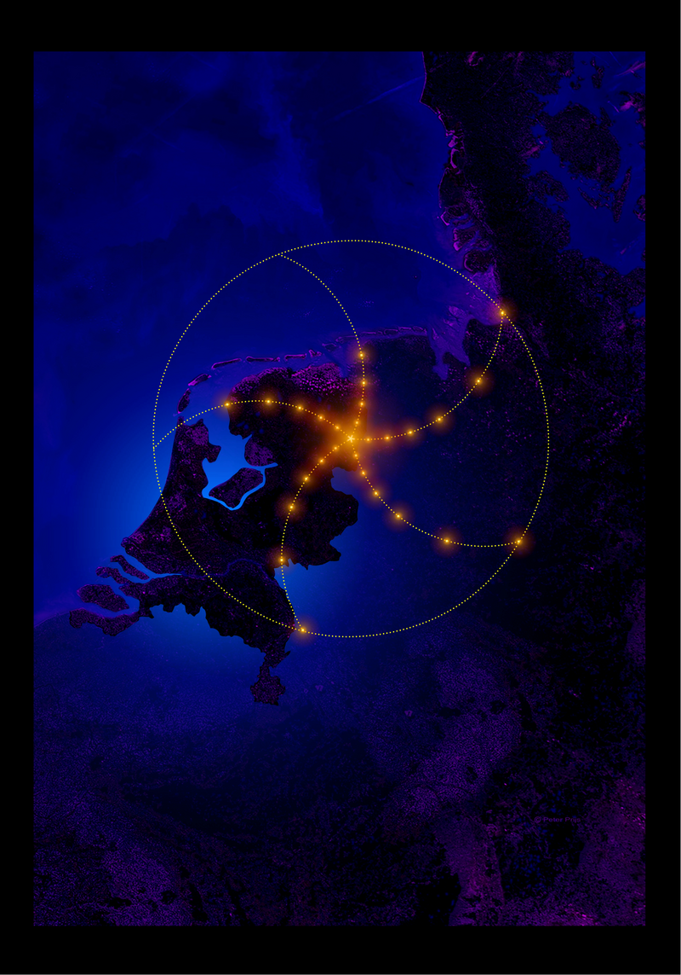
BiG Grid community: LOFAR
Status: Service challenges are ongoing, in which detector-to-archive tests are done
Getting into operational state
FZ Jülich also joined ; they have a 1 PB tape backend using dCache

Slide 20
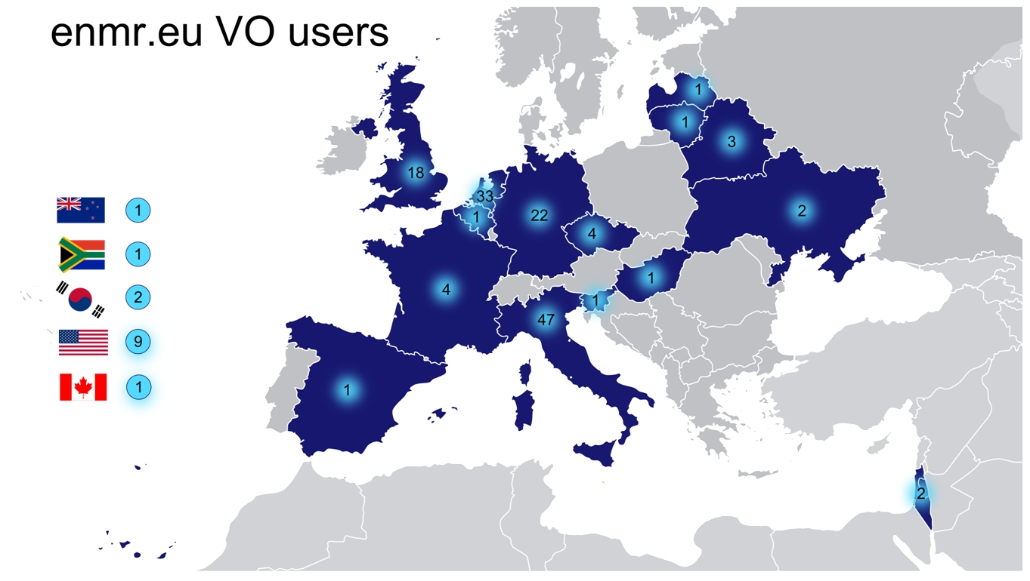
BiG Grid community: eNMR
Status:
> 90% of their jobs run on BiG Grid
Happily running jobs at Nikhef and HTC

Slide 21
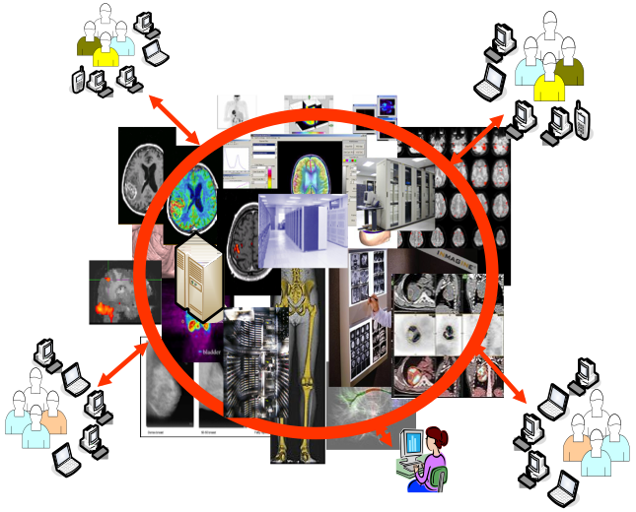
BiG Grid community: VL-eMed
Supporting medical visualisation in clinical setting
Graphical browser frontends to grid
MOTEUR workflow engine
Grid engineer
co-located at AMC:

Slide 22
BiG Grid community: Social Sciences
  DANS: Data Archiving and Network Services
  Grid backend for FEDORA
  Fixity service
VKS: Virtual Knowledge Studio
  Pilot project to process Wikipedia history file
CLARIN: Common LANguages Resources and technology Infrastructure
  ESFRI, with FP7 preparatory phase programme
  Several Dutch linguistics institutes involved

Slide 23
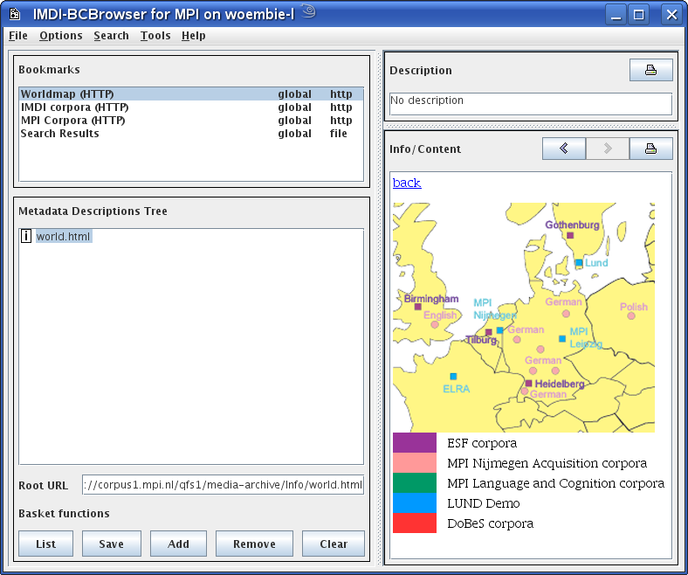
BiG Grid community: MPI/CLARIN
Status:
In collaboration with SURFnet
First version of SLCS & SURFnet Online CA deployed
Possible future in CLARIN,
Europe-wide

Slide 24
More than one community…
In 2009 BiG Grid supported 39 VO’s,
  of which 25 are active,
    HEP (atlas, LHCb, alice, auger, dzero)
    eNMR, biomed,
  of which 7 are Dutch and the others are (large) international collaborations
    Vlemed, pvier, phicos, ncf (catch all, pilot projects), lsgrid, lofar and Local Submission.
In the proposal 60% infra HEP, 20% astro, 10 others
  NOTE: Dutch scientist are part of the International collaborations and benefit

Slide 25
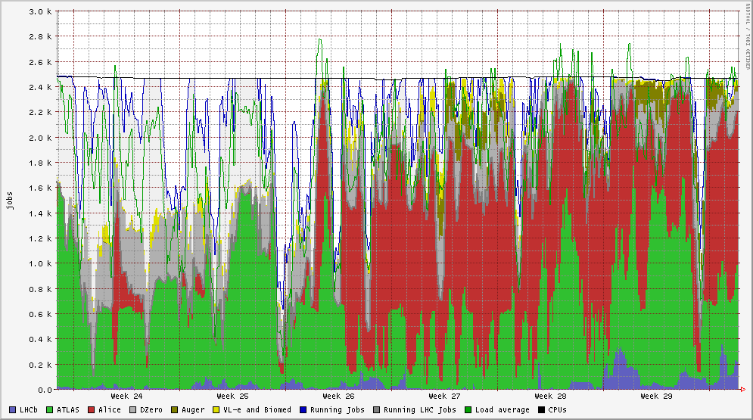
Facilities
2009 utilization
compute ~60-70%
remaining space:
  HEP started real
  data taking in
  November 2009
  LOFAR will come in 2010
 | Nikhef | SARA | RUG-CIT | Philips | LSG
CPUs | 7.908 kSI2k 2550 cores | 7.412 kSI2k 2376 cores | 315 kSI2k 176 cores | 3199 kSI2k 1648 cores | 489 kSI2k 258 cores
Disk Store | 1374 TB | 3545 TB | 34 TB | 20 TB | 61 TB

Slide 26
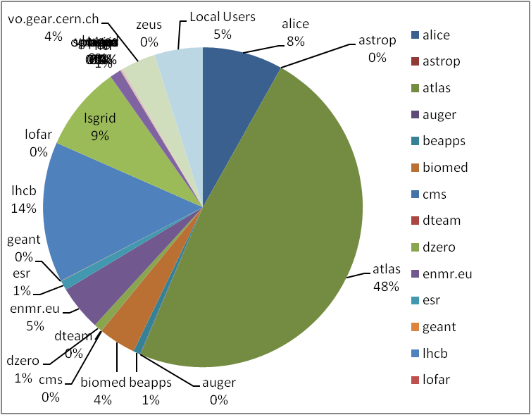
Usage 2009 all of BiG Grid

Slide 27

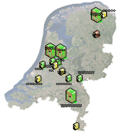
The National Grid
BiG Grid today implements the National Grid Infrastructure for the Netherlands
  We won the tender to host the headquarters of the European Grid Initiative EGI
  And are heavily involved in both deployment
  and software development at the European
  level (in EGI, EMI and IGE)
  Data-intensive cloud services extend
  the range of sciences served today
BiG Grid also provides the NL-T1 service

Slide 28
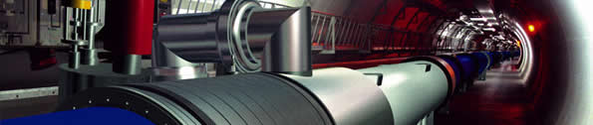
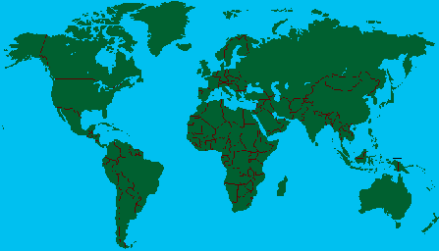
LCG Service Hierarchy
Tier-0 – the accelerator centre
Data acquisition & initial processing
Long-term data curation
Distribution of data → Tier-1 centres
Tier-1 – “online” to the data acquisition process → high availability
Managed Mass Storage –
→ grid-enabled data service
Data-heavy analysis
National, regional support
Canada – Triumf (Vancouver)
France – IN2P3 (Lyon)
Germany – Forschunszentrum Karlsruhe
Italy – CNAF (Bologna)
Netherlands – NIKHEF/SARA (Amsterdam)
Nordic countries – distributed Tier-1
Spain – PIC (Barcelona)
Taiwan – Academia SInica (Taipei)
UK – CLRC (Oxford)
US – FermiLab (Illinois)
– Brookhaven (NY)
Tier-2 – ~120 centres in ~35 countries
End-user (physicist, research group) analysis – where the discoveries are made
Simulation

Slide 29




GridKa
IN2P3
TRIUMF
ASCC
Fermilab

Slide 30
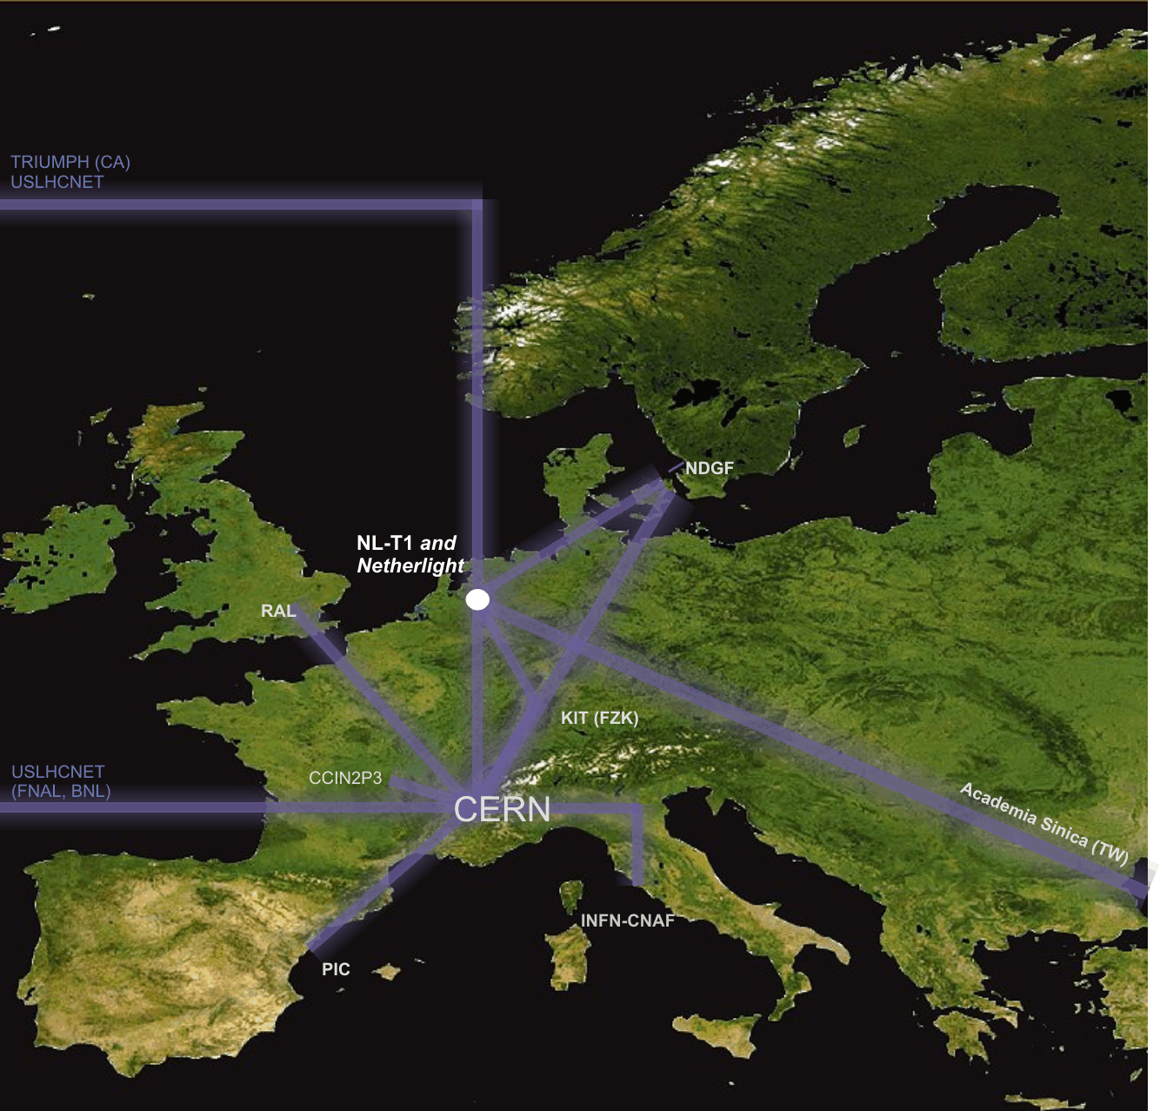
Interconnecting the Grid – the LHC OPN network
LHC Optical Private Network
10 – 40 Gbps dedicated
global networks
Scaled to T0-T1 data transfers
(nominally 300 Mbyte/s/T1 systained)

Slide 31
More challenges ahead …
Distributing the data is not enough
data re-processing stresses mainly LAN
  Analysis and ‘chaotic’ user access to data
  New access patterns (a single CPU cycle per byte?!)
scaling by on order of magnitude every year
…
But also
building a sustainable organisation

Slide 32
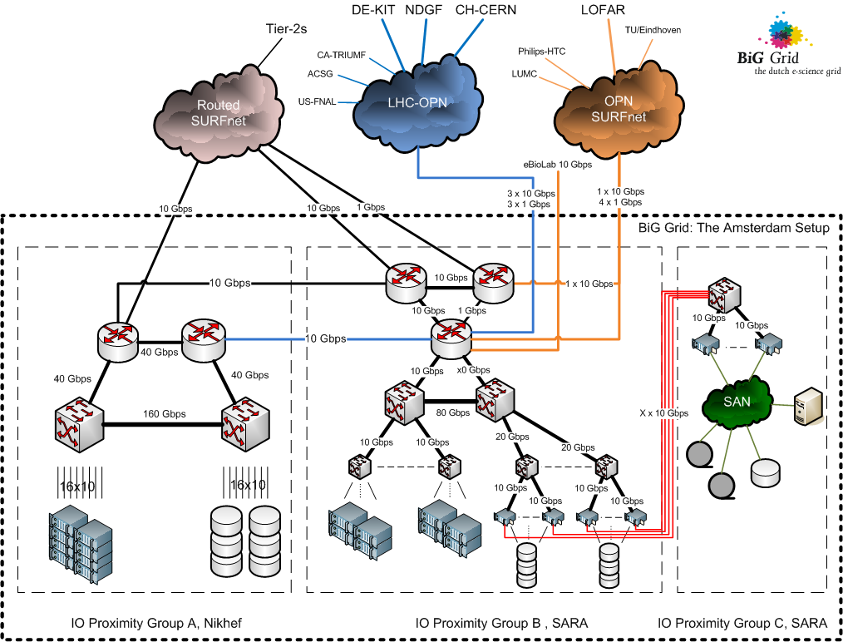


Slide 33

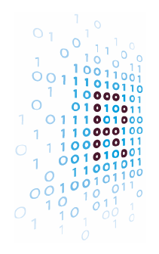
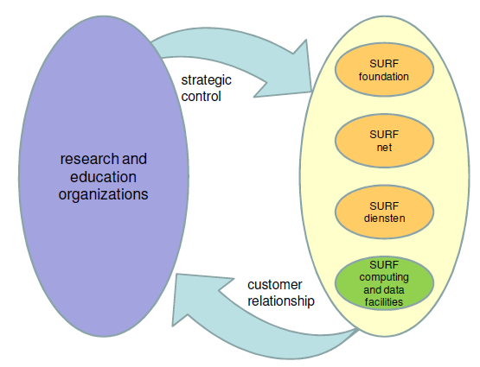
e-Infrastructure in Nederland
http://www.ictregie.nl/publicaties/nl_08-NROI-258_Advies_ICT_infrastructuur_vdef.pdf

