Slide 1
Trust by Demonstration … in a coordinated way
Security Coordination Communications Challenges – all in it together
David Groep
AARC Community, policy and best practice area
Nikhef PDP programme
WISE Community meeting
October 2021

Slide 2
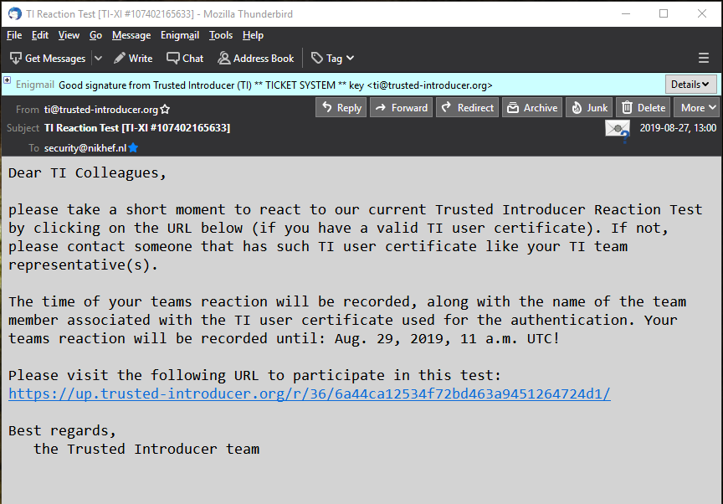
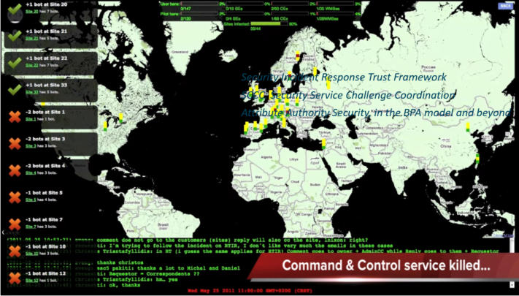
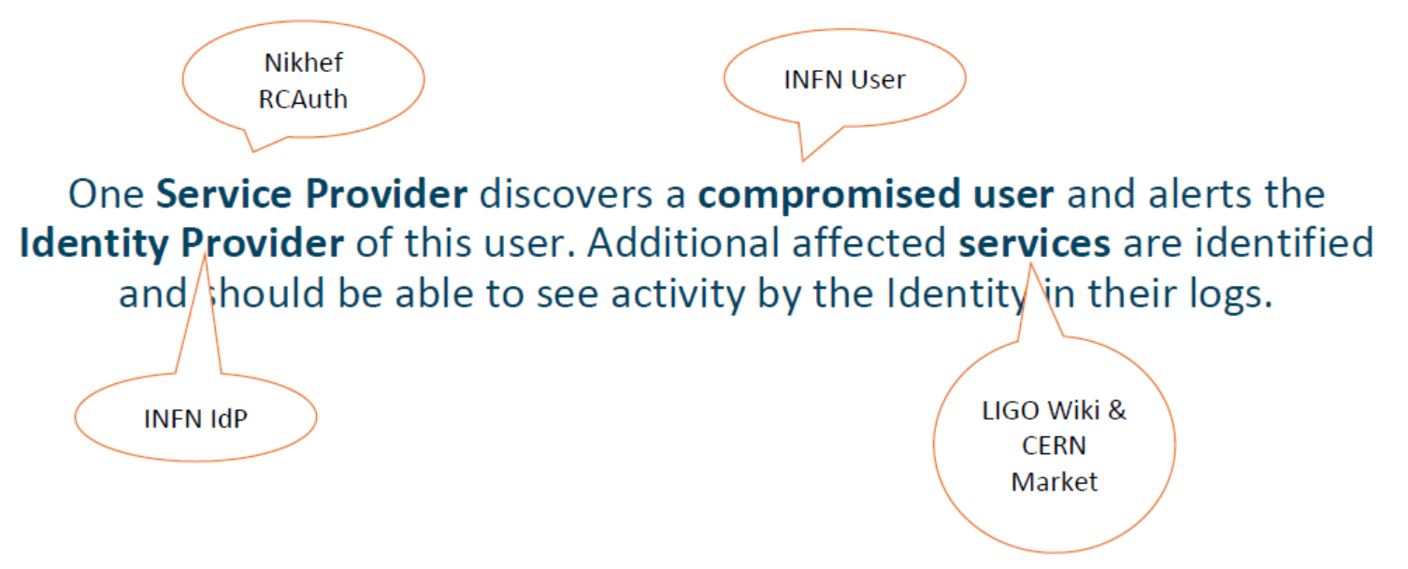


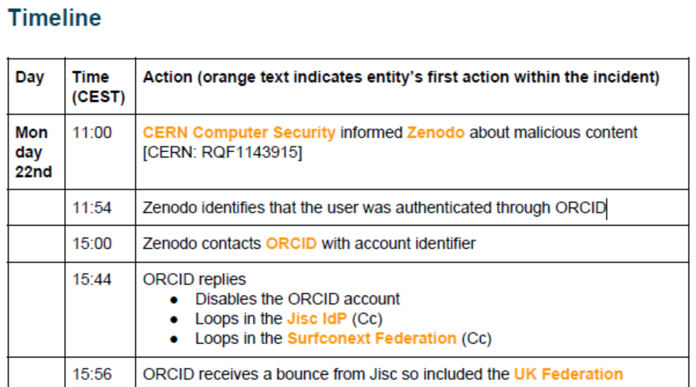



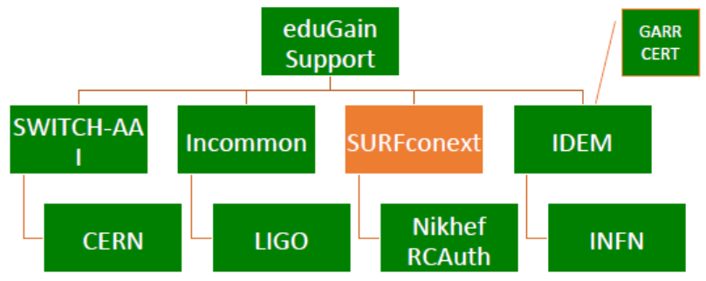
Many communities test, test, and test again

Slide 3
Frequency of challenges and tests - examples
Trusted Introducer and TF-CSIRT
2-3 Reaction Tests per year
supported by web click infrastructure, but requires (team) authentication
SURFcert challenges
annual response challenges, just reply to email to a (traceable) ticket
IGTF RAT Communications Challenges
every 1-2 years, in parallel with continuous operational monitoring
EGI CSIRT Security Service Challenges
every ~2 years, aiming at remediation, forensics, and response to real-life (botnet) incidents

Slide 4




Challenge elements – what is valued or expected might differ …
A single test and challenge can answer one or more of these questions
ability to
take action
confidentiality
timeliness
investigative capability
when data available: infrastructure can set its own level of expectancy and gives deep trust
assessment supported with community controls (suspension) gives a baseline compliance
Communications challenges build ‘confidence’ and trust – an important social aspect!
different tests bring complementary results: responsiveness vs. ability act , or do forensics
unless you run the test yourself, you may not be growing more trust in the entities tested
for a ‘warm and fuzzy feeling of trust’, share results: but this is sociologically still challenging …

Slide 5
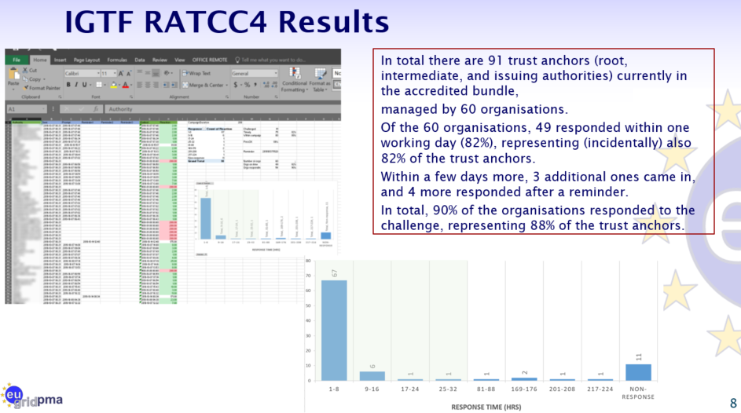
IGFT RATCC4
PS: of the non-response organisations,
4 had their public contact meta-data fixed, and 2 were withdrawn from the distribution

Slide 6
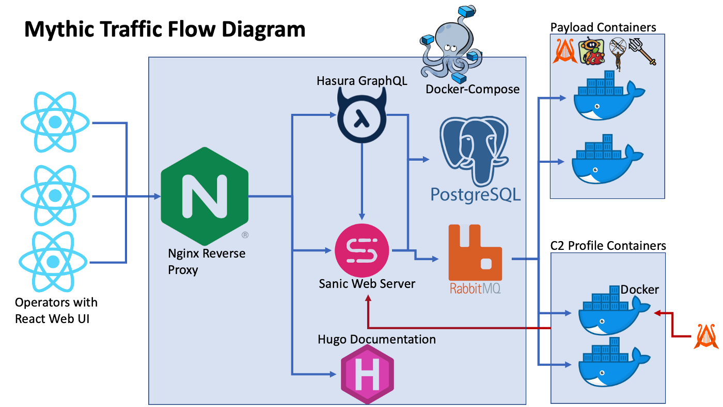
Upcoming EGI SSC challenge … simplified (with the Mythic C2)
Many RedTeaming tools
are now standard (like Mythic C2)
containerisation aids in getting the payloads working across a heterogeneous infrastructure
previous exercises ran into problems with the encrypted binaries and process hiding techniques
integration with the operational submission systems remain
as well as monitoring and report-out
https://docs.mythic-c2.net/
https://posts.specterops.io/learning-from-our-myths-45a19ad4d077

Slide 7
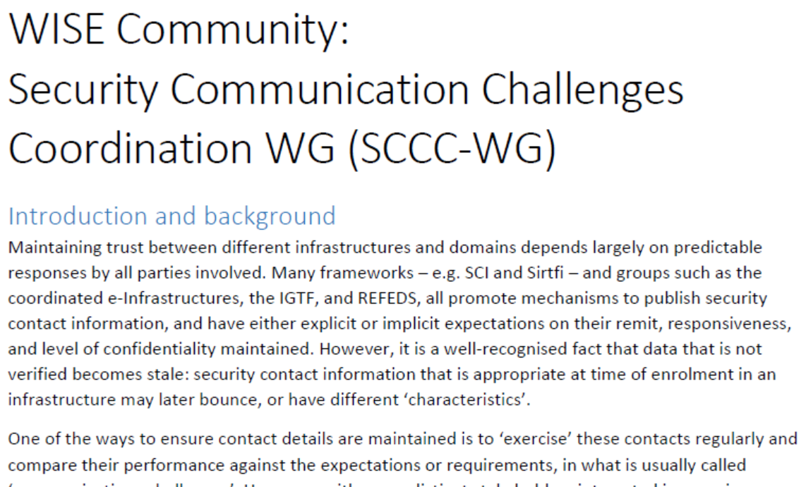
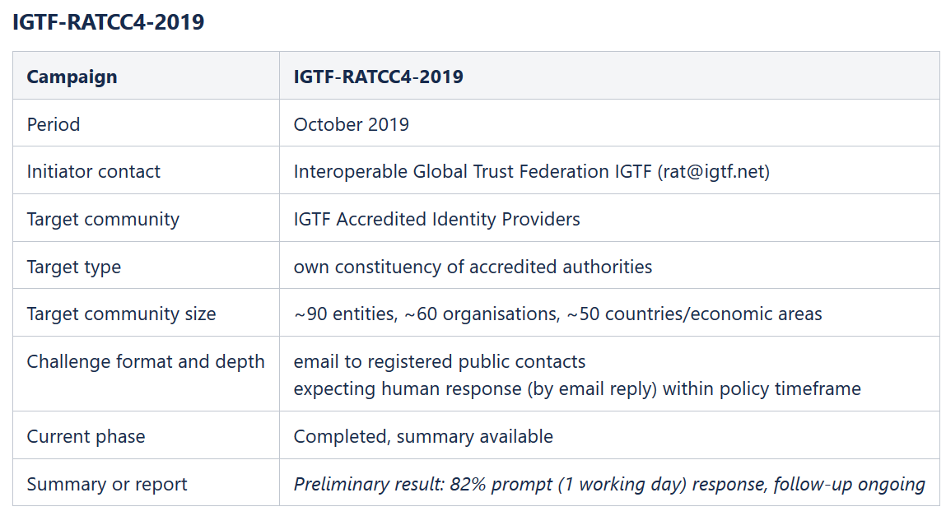
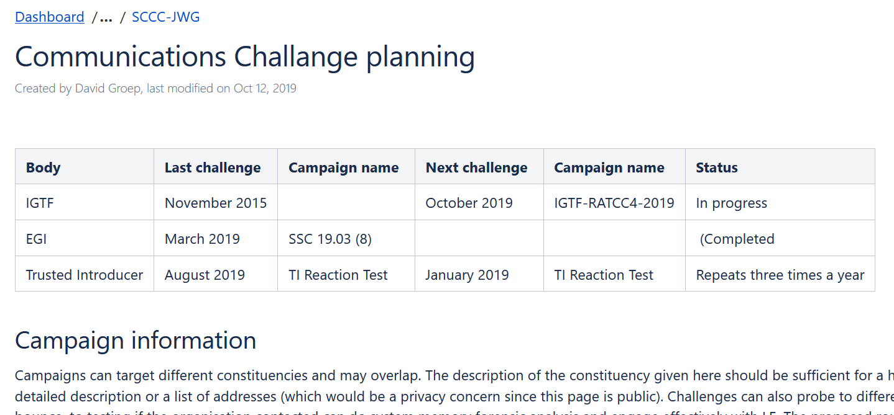
WISE SCCC-WG – participate!
WISE, SIGISM, REFEDS, TI joint working group
see wise-community.org and join!
https://wiki.geant.org/display/WISE/SCCC-JWG
co-chairs: Hannah Short (CERN) and David Groep (Nikhef)

Slide 8
davidg@nikhef.nl
This work is part of a project that has received funding from the European Union’s Horizon 2020 research and innovation programme under Grant Agreement No. 731122 (GN4-2).
We thank the following sources: EC Horizon 2020 projects GN4-3, EOSChub, and AARC-2; and the Dutch National e-Infrastructure coordinated by SURF

Slide 9
The SCCC Working Group – a joint effort of many
Coordination of ‘CCs recipient groups’ among participating infrastructures
ensure targets are not overloaded by coinciding or overlapping challenges, for example by designating lead agency
Transitivity of trust based on challenge frequency and results
for example by specifying the level of disclosure detail for CCs
as extension: could CCs be requested e.g. in response to changed risk assessments between infrastructures?
Definition of CC models and classification
‘depth’ of the CC testing is a balance between the level of trust gained
(more profound testing and good results gives more trust)
and expediency
(asking mail or click response consumes less resources than requesting forensics of simulated incident)
Frequency of CCs
simple communications challenges are often performed one or several times per year
complex challenges are less frequent (e.g. ‘black-box traceability’ trials in EGI take place once every 1-2 years)
following a CC model classification, propose an appropriate frequency for each class

