Slide 1
Get in touch – and be sure to get an answer?
Security Communications Challenge Coordination – all in it together
David Groep
AARC Community, policy and best practice area
Nikhef PDP programme
WISE Community meeting
May 2021

Slide 2
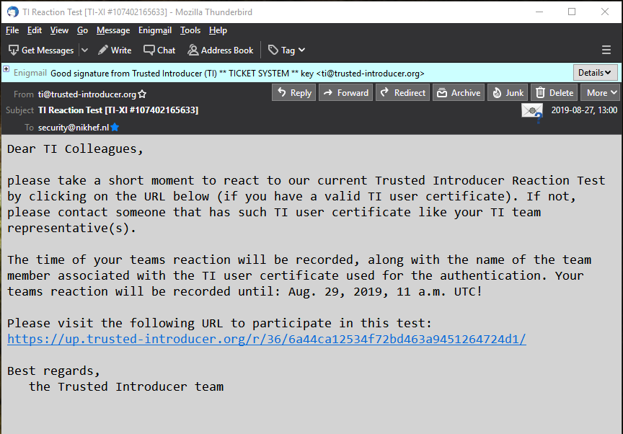
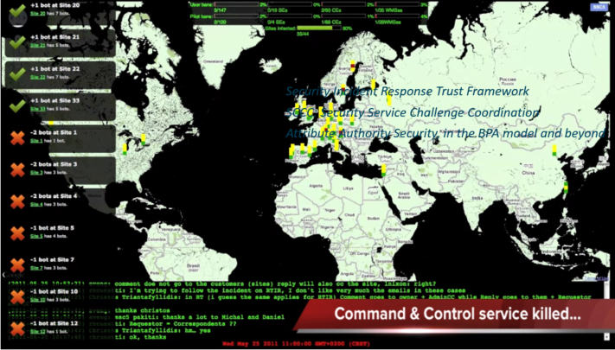
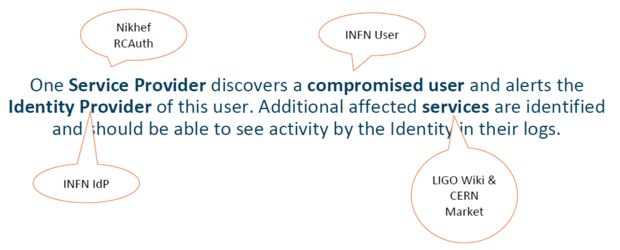


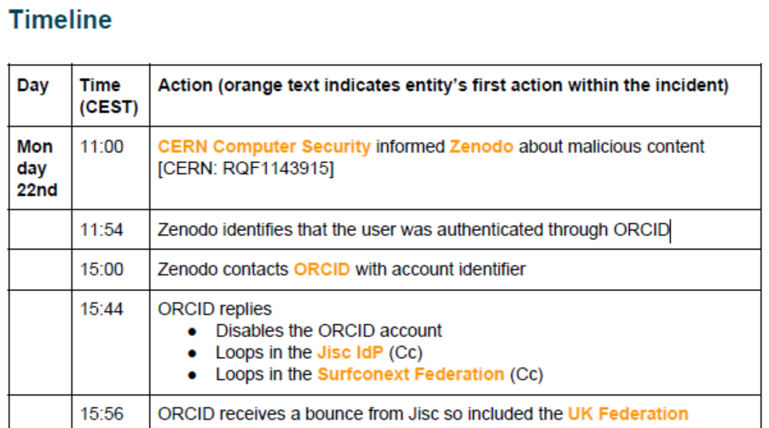



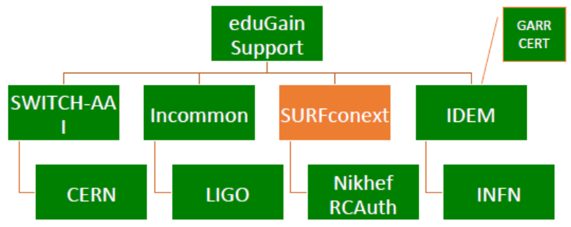
Many communities test, test, and test again

Slide 3
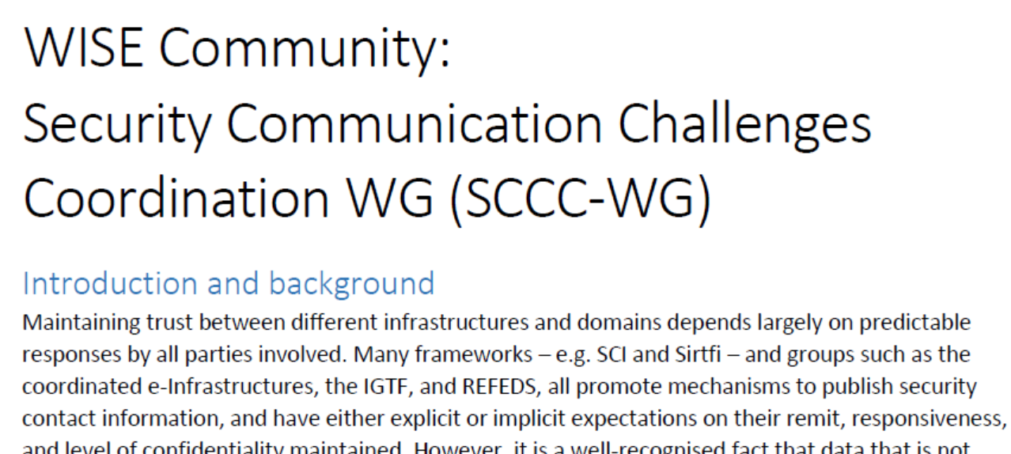
Continued engagement and coordination: WISE SCCC JOINT WG
Joint WG with
WISE
SIG-ISM
REFEDS
IGTF
https://wiki.geant.org/display/WISE/SCCC-JWG

Slide 4




Challenge elements – what is valued or expected might differ …
A single test and challenge can answer one or more of these questions
ability to
take action
confidentiality
timeliness
investigative capability
when data available: infrastructure can set its own level of expectancy and gives deep trust
assessment supported with community controls (suspension) gives a baseline compliance
Communications challenges build ‘confidence’ and trust – an important social aspect!
different tests bring complementary results
responsiveness, ability act, do forensics, …

Slide 5
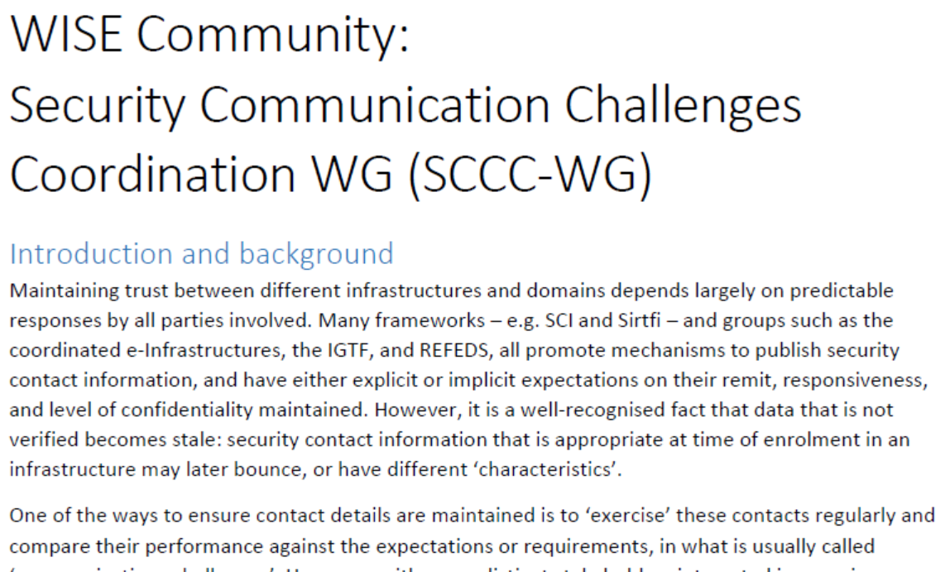
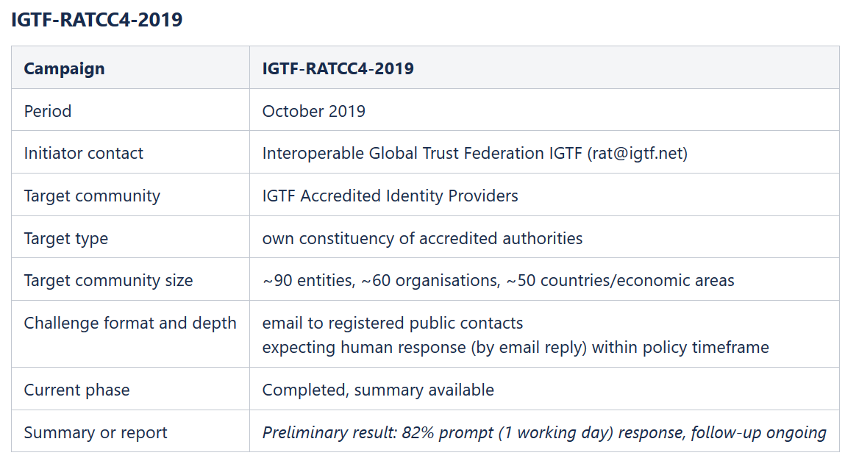
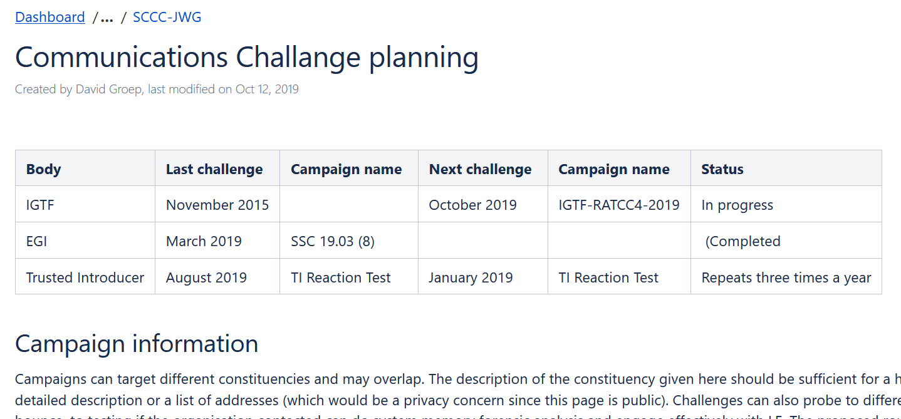
WISE SCCC-WG – participate!
WISE, SIGISM, REFEDS, TI joint working group
see wise-community.org wiki and join!
https://wiki.geant.org/display/WISE/SCCC-JWG
co-chairs: Hannah Short (CERN) and David Groep (Nikhef)

Slide 6
davidg@nikhef.nl
This work is part of a project that has received funding from the European Union’s Horizon 2020 research and innovation programme under Grant Agreement No. 731122 (GN4-3).
We thank the following sources: EC Horizon 2020 projects GN4-3, EOSChub, and AARC-2; and the Dutch National e-Infrastructure coordinated by SURF

