Slide 1
Get in touch – and be sure to get an answer?
Security Communications Challenge Coordination – all in it together
David Groep
AARC Community, policy and best practice area
Nikhef PDP programme
WISE Community meeting
October 2020

Slide 2
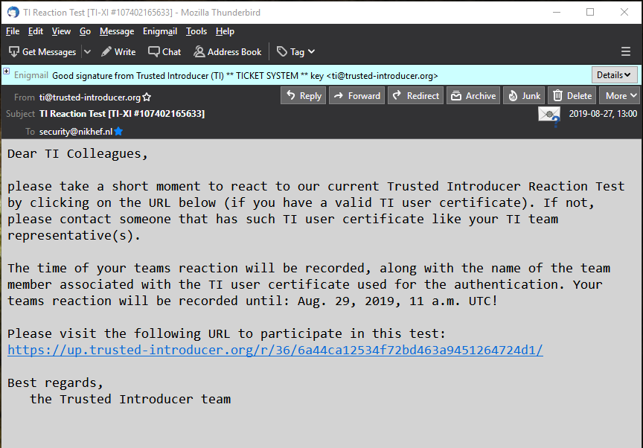
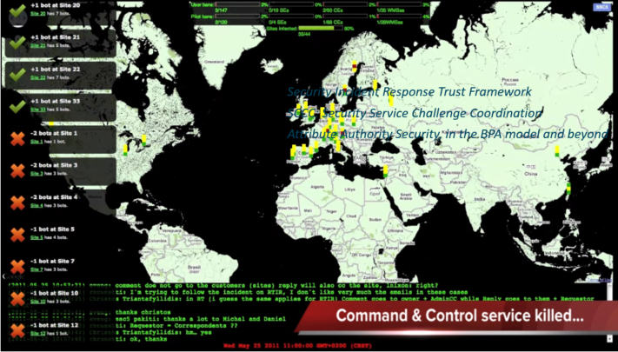
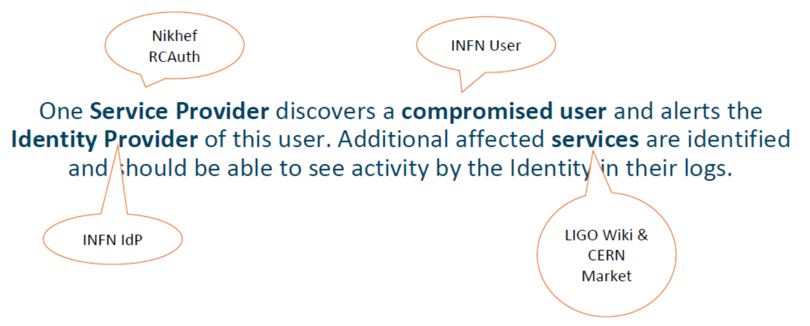


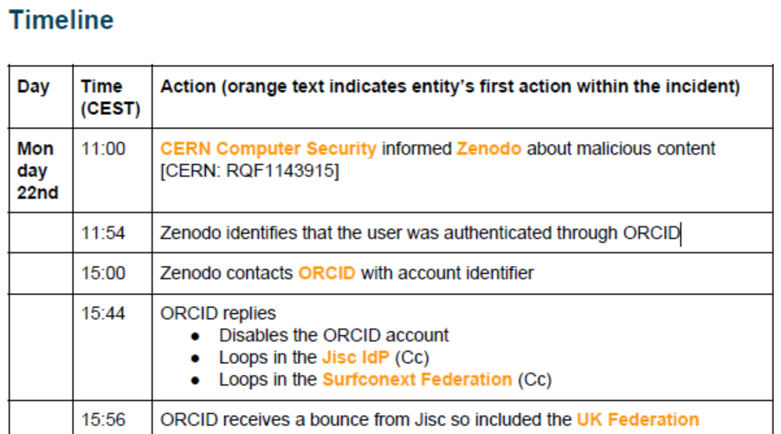



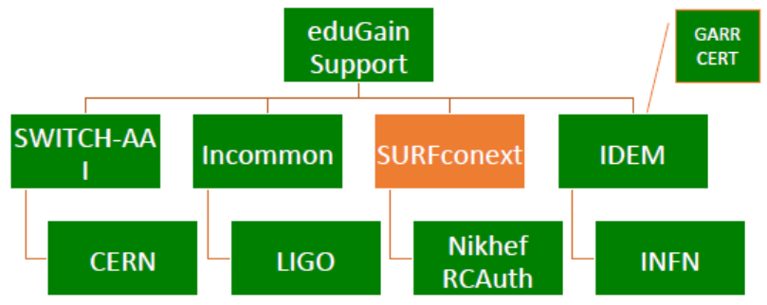
Many communities test, test, and test again

Slide 3
Frequency of challenges and tests - examples
Trusted Introducer and TF-CSIRT
2-3 Reaction Tests per year
supported by web click infrastructure, but requires (team) authentication
SURFcert challenges
annual response challenges, just reply to email to a (traceable) ticket
IGTF RAT Communications Challenges
every 1-2 years
in parallel with continuous operational monitoring

Slide 4
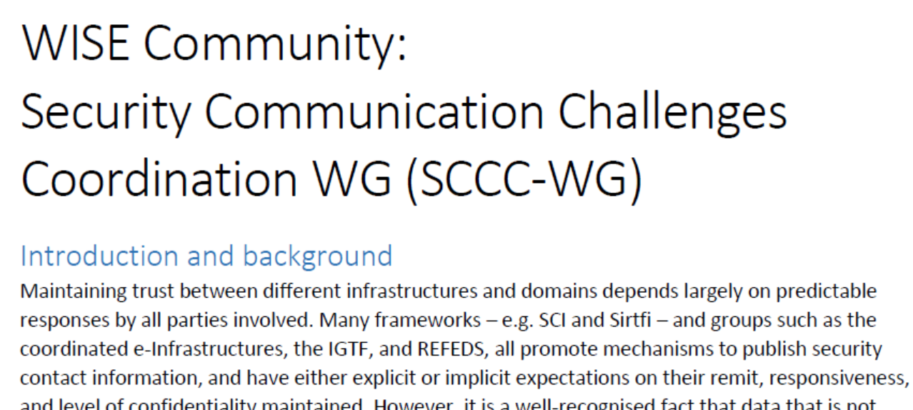
Continued engagement and coordination: WISE SCCC JOINT WG
WISE
SIG-ISM
REFEDS
IGTF
https://wiki.geant.org/display/WISE/SCCC-JWG

Slide 5




Challenge elements – what is valued or expected might differ …
A single test and challenge can answer one or more of these questions
ability to
take action
confidentiality
timeliness
investigative capability
when data available: infrastructure can set its own level of expectancy and gives deep trust
assessment supported with community controls (suspension) gives a baseline compliance
Communications challenges build ‘confidence’ and trust – an important social aspect!
different tests bring complementary results: responsiveness vs. ability act , or do forensics
unless you run the test yourself, you may not be growing more trust in the entities tested
for a ‘warm and fuzzy feeling of trust’, share results: but this is sociologically still challenging …

Slide 6
Addressing a ‘new’ community – eduGAIN entities
‘community is not new, but doing multi-federation security communications therein is’
Still only 939 (in 36 federations) assert Sirtfi … out of 7149 entities (13%)
Quite some open questions
Are the other entities unaware, or actually not interested?
In an ongoing incident, can we reach them nevertheless? Even just to establish a channel?
The contact we do have, do they react? Do Sirtfi contacts react faster?
Or maybe is formally asking for a ‘security’ contact setting off a chain of bureaucracy?
For a first challenge, start with a ‘gameifiable’ responsiveness challenge
and leave log analysis, forensics, and the more complex elements of Sirtfi out of scope

Slide 7
Gradual approach – introducing comms challenges in eduGAIN
A community with ‘a wide diversity in terms of comms challenge acquaintance’
Not even all federation have a designated security contact
but maybe because a formal assignment of such a role is considered daunting responsibility?
Target:
end-entities – initially in some friendly federations that will opt-in all their entities
security contacts if available, otherwise try technical contact (and ask for security contact)
run by the federation (using the software), but also offered ‘as a service’ - supported through Trust and Identity activity (eduGAIN Security and Enabling Communities jointly) – and branded with the federation email address and names.
Sven & Daniel can re-use the existing EGI software tooling for that, on a VM provided
with an .edugain.org domain
https://codimd.web.cern.ch/Fx1LO0O3TrOq_YxkzSMpxw

Slide 8
Subsidiary aim: make security contacts less ‘scary’
The most basic response is to (sorry!) click on a harmless link: making it a challenge to respond ‘as fast as possible’ – a bit like a competition
Ask also a very simple ‘question’ to raise awareness,
‘for security contacts, do you want to be (proactively) informed if we have
security information relevant to your organisation?’
esp. if the contact is the technical rep, i.e. there is no Sirtfi contact
‘you got this message because there is no designated security contact for your organisation. Would you want to receive security information, or who (if not you)
should be your security contact?
Are you aware of Sirtfi?’
And we can add some ads for Sirtfi, although having any kind of contact is better than none …

Slide 9
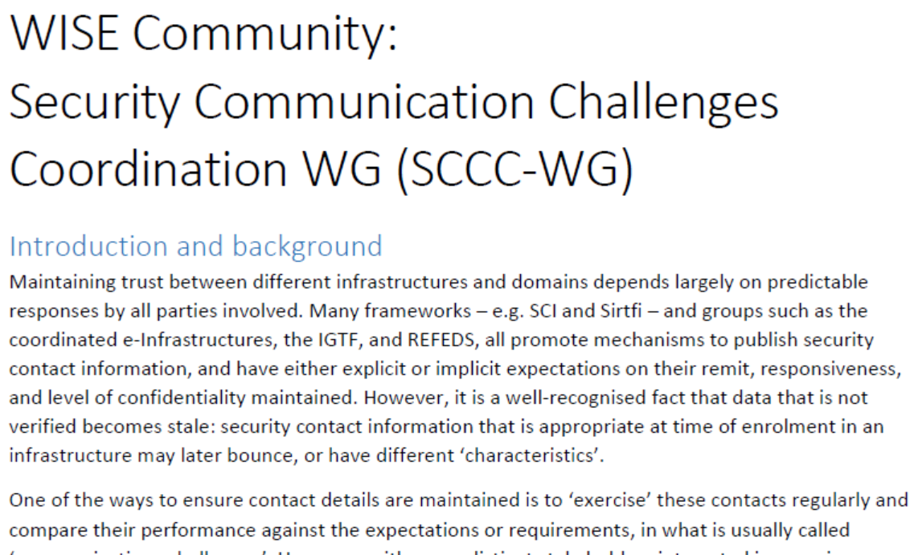
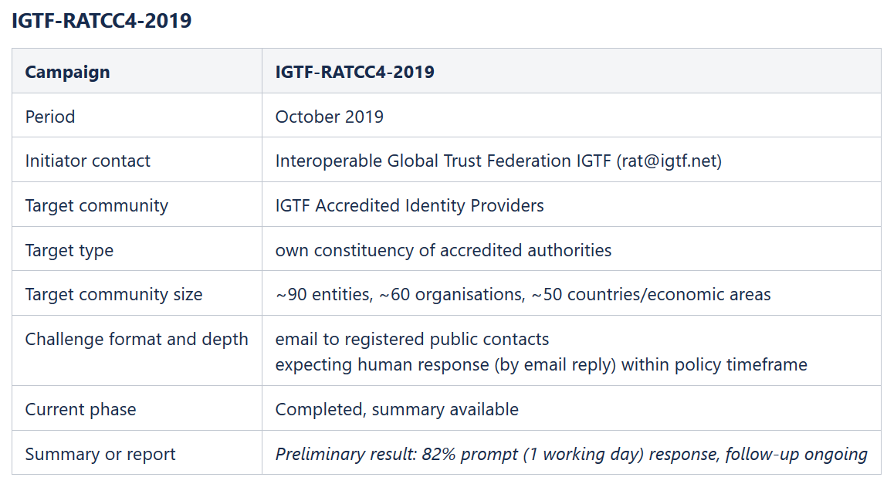
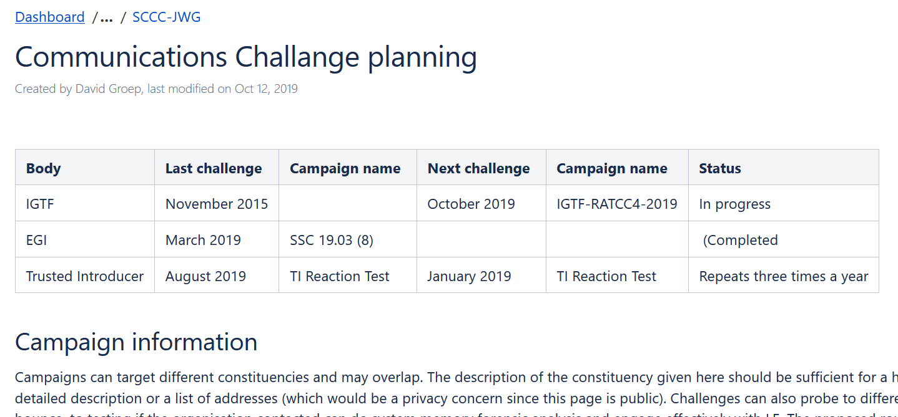
WISE SCCC-WG – participate!
WISE, SIGISM, REFEDS, TI joint working group
see wise-community.org wiki and join!
https://wiki.geant.org/display/WISE/SCCC-JWG
co-chairs: Hannah Short (CERN) and David Groep (Nikhef)

Slide 10
davidg@nikhef.nl
This work is part of a project that has received funding from the European Union’s Horizon 2020 research and innovation programme under Grant Agreement No. 731122 (GN4-3).
We thank the following sources: EC Horizon 2020 projects GN4-3, EOSChub, and AARC-2; and the Dutch National e-Infrastructure coordinated by SURF

