Slide 1
Trust by Demonstration … without overdoing it
Security Coordination Communications Challenges – all in it together
David Groep
AARC Community, policy and best practice area
Nikhef PDP programme
WISE Community meeting
April 2020

Slide 2
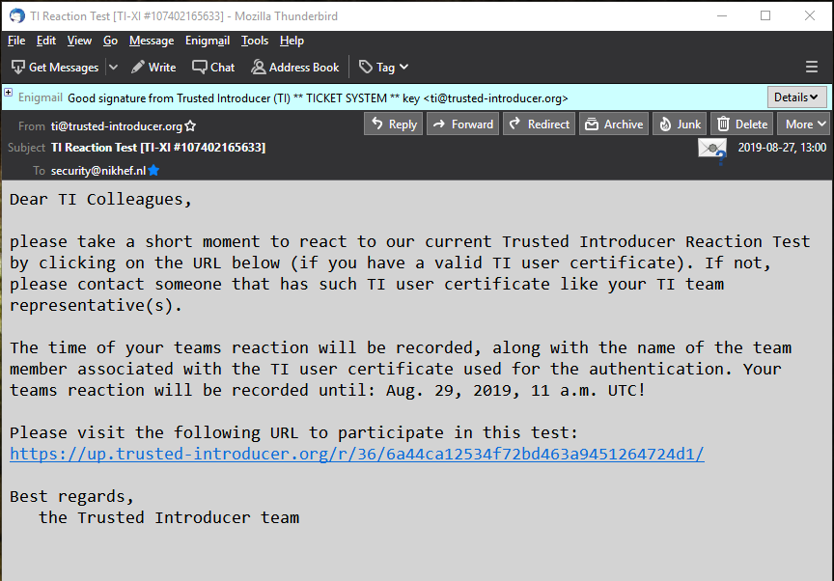
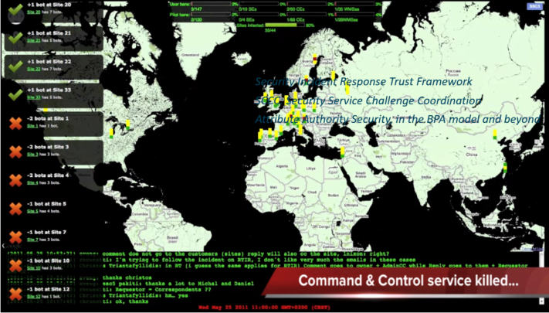
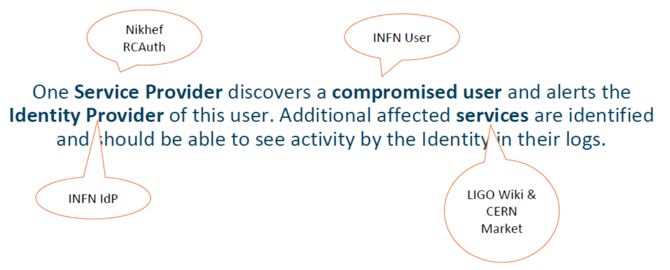


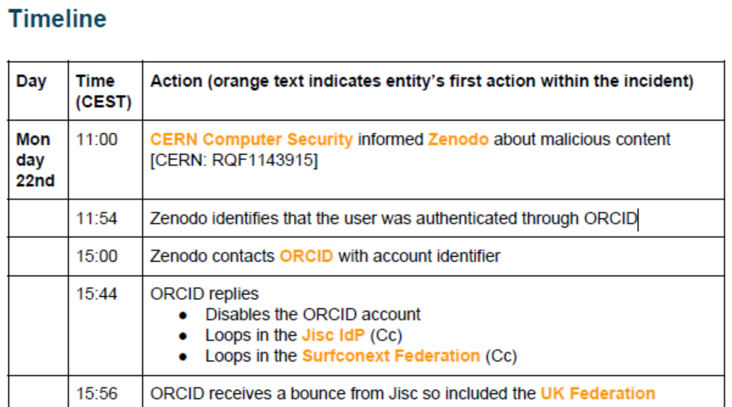



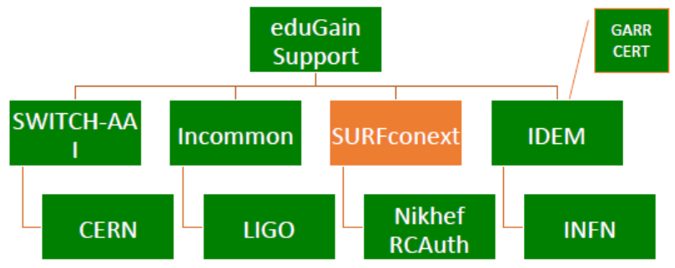
Many communities test, test, and test again

Slide 3
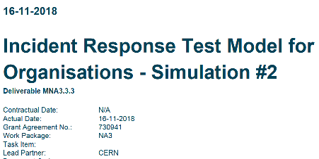
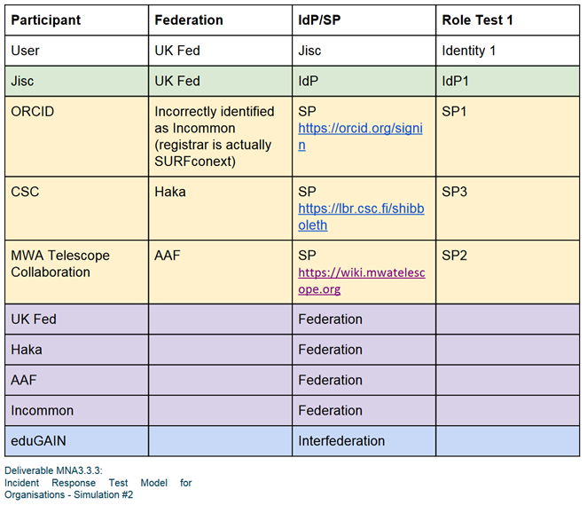
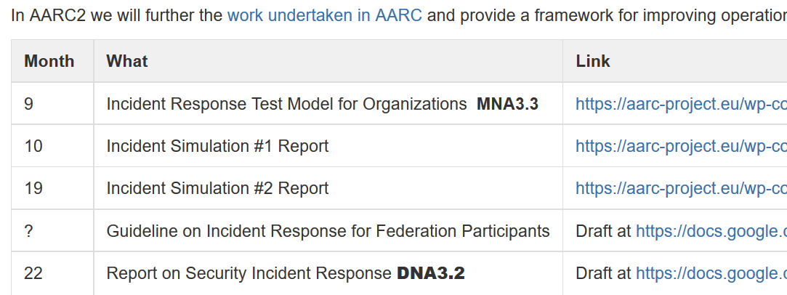
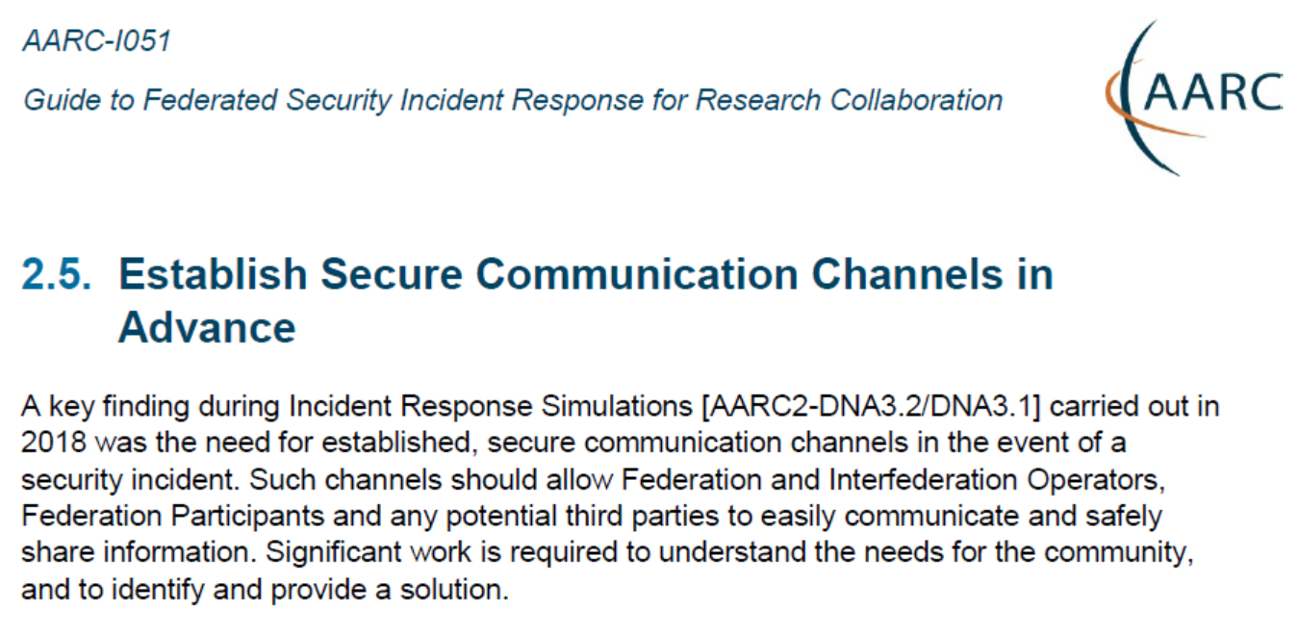
One test amongst many – but the first in the Sirtfi (eduGAIN) community
https://wiki.geant.org/display/AARC/AARC2+NA3+Task+1+-++Overview
https://aarc-project.eu/guidelines/aarc-i051/

Slide 4
Who runs the test?
The first tests with these participants were run ‘by AARC’
Logical candidates that could all run the test
… and have an interest in knowing the result to establish trust
eduGAIN
GEANT.org
but also any EOSC-HUB and e-Infrastructure CSIRT teams
the IGTF (as it leverages federated id)
each of the e-Infrastructures XSEDE, EGI, EUDAT, PRACE, OSG, HPCI, …
every research infra with an interest: WLCG, LSAAI, BBMRI, ELIXIR, …
And any institution (or person) with access to https://mds.edugain.org/ can run them, of course
so in a short while, all the email in the world will be on Sirtfi Incident Response tests??

Slide 5
Frequency of challenges and tests - examples
Trusted Introducer and TF-CSIRT
2-3 Reaction Tests per year
supported by web click infrastructure, but requires (team) authentication
SURFcert challenges
annual response challenges, just reply to email to a (traceable) ticket
IGTF RAT Communications Challenges
every 1-2 years
in parallel with continuous operational monitoring
yet we already listed 14 entities that have a real interest in running tests, 5000+ entities can claim the same

Slide 6




Challenge elements – what is valued or expected might differ …
A single test and challenge can answer one or more of these questions
ability to
take action
confidentiality
timeliness
investigative capability
when data available: infrastructure can set its own level of expectancy and gives deep trust
assessment supported with community controls (suspension) gives a baseline compliance
Communications challenges build ‘confidence’ and trust – an important social aspect!
different tests bring complementary results: responsiveness vs. ability act , or do forensics
unless you run the test yourself, you may not be growing more trust in the entities tested
for a ‘warm and fuzzy feeling of trust’, share results: but this is sociologically still challenging …

Slide 7
Coordination and mutual reliance
Target audiences and capabilities mostly have a ‘natural’ primary home
so that each ‘target’ does not get hit by many concurrent challenges
e.g. eduGAIN to run communications challenges against Sirtfi email addresses
the e-Infrastructures to test responsiveness of SPs and RPs
with each RP/SP/Site having a primary e-Infra as its home?
or can we jointly (EOSC-HUB) run these challenges per continent?
Communications challenges also build ‘confidence’ and trust – an important social aspect
unless you test yourself, or get insight in the results of a challenge, trust may now grow enough
so to get that ‘warm and fuzzy feeling of trust’, results could be shared
and that sharing needs to be confidential as well, and granularity tunes to audience

Slide 8
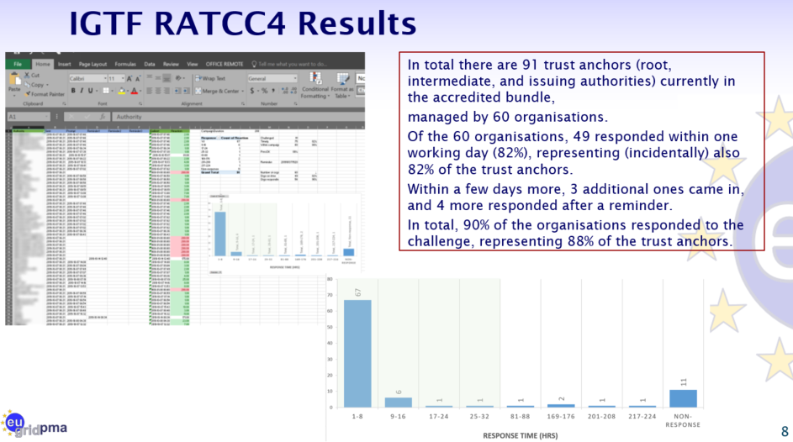
IGFT RATCC4
PS: of the non-response organisations,
4 had their public contact meta-data fixed, and 2 were withdrawn from the distribution

Slide 9
The SCCC Working Group – a joint effort of many
Coordination of ‘CCs recipient groups’ among participating infrastructures
ensure targets are not overloaded by coinciding or overlapping challenges, for example by designating lead agency
Transitivity of trust based on challenge frequency and results
for example by specifying the level of disclosure detail for CCs
as extension: could CCs be requested e.g. in response to changed risk assessments between infrastructures?
Definition of CC models and classification
‘depth’ of the CC testing is a balance between the level of trust gained
(more profound testing and good results gives more trust)
and expediency
(asking mail or click response consumes less resources than requesting forensics of simulated incident)
Frequency of CCs
simple communications challenges are often performed one or several times per year
complex challenges are less frequent (e.g. ‘black-box traceability’ trials in EGI take place once every 1-2 years)
following a CC model classification, propose an appropriate frequency for each class

Slide 10
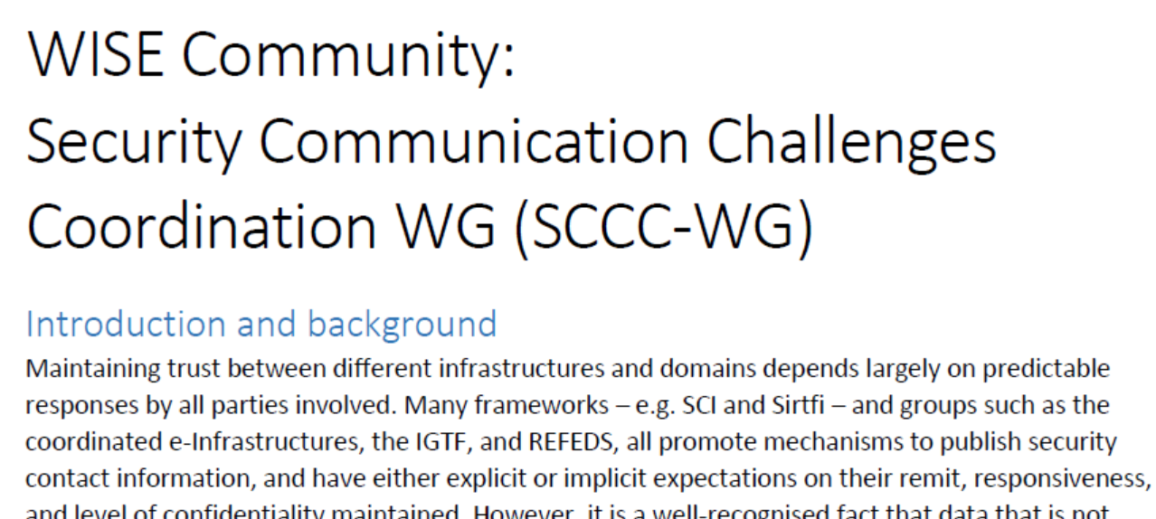
Continued engagement and coordination: WISE SCCC JOINT WG
WISE
SIG-ISM
REFEDS
IGTF
https://wiki.geant.org/display/WISE/SCCC-JWG

Slide 11
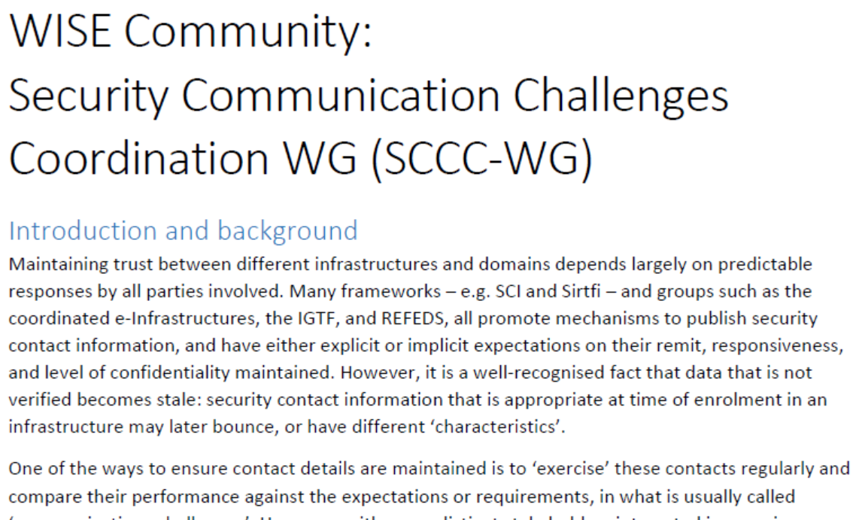
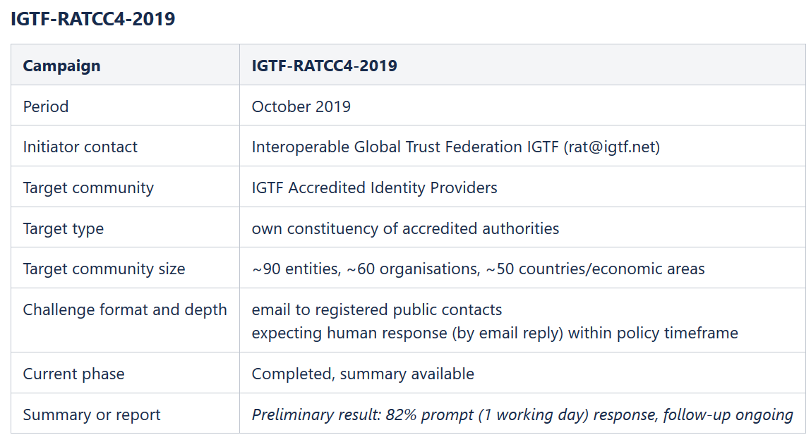
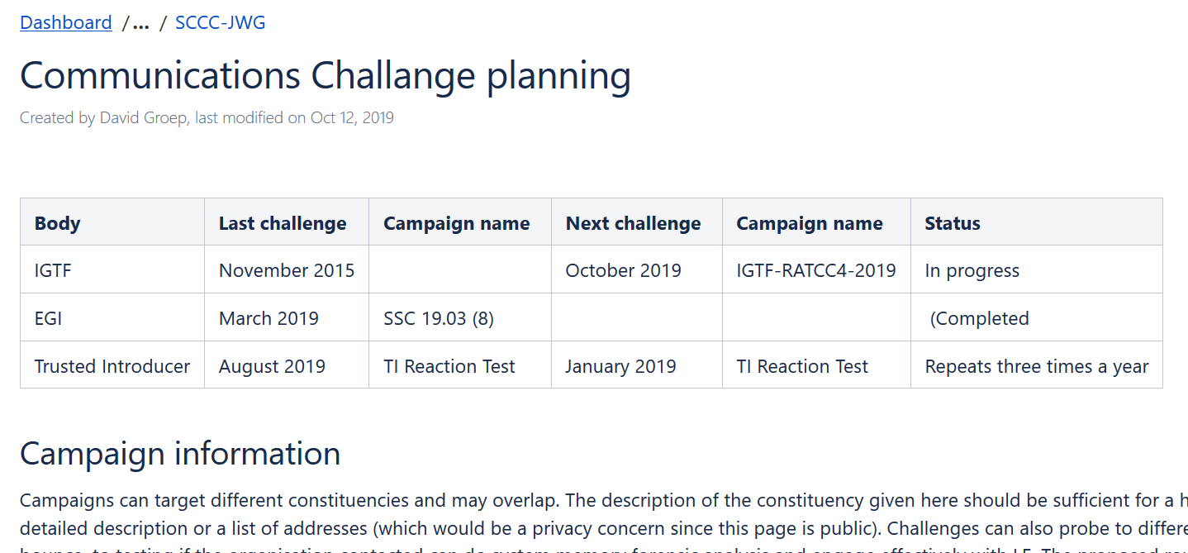
WISE SCCC-WG – participate!
WISE, SIGISM, REFEDS, TI joint working group
see wise-community.org and join!
https://wiki.geant.org/display/WISE/SCCC-JWG
co-chairs: Hannah Short (CERN) and David Groep (Nikhef)

Slide 12
Making the SCCC JWG a useful place for all
How to grow the community and leverage the trust built?
Can we use joint machinery for running challenges?
eduGAIN, EGI, TI, SURF all have tooling, and more is coming
The Wiki page is a start – evolution and completeness requires you!
And beyond communications, there is more to be had:
Crisis exercises – the true test of readiness, and a great way of being prepared!
look at the great things Charlie et al. are doing, like CLAW ☺
eduGAIN communications and crises simulation – join in the discussion
see https://etherpad.servus.at/p/tiime19_edugain

Slide 13
davidg@nikhef.nl
This work is part of a project that has received funding from the European Union’s Horizon 2020 research and innovation programme under Grant Agreement No. 731122 (GN4-2).
We thank the following sources: EC Horizon 2020 projects GN4-3, EOSChub, and AARC-2; and the Dutch National e-Infrastructure coordinated by SURF

