Slide 1
Federated services: spanning countries and crossing borders
Building across the technology chain – when networks and systems,
trust and identity combine

Slide 2


















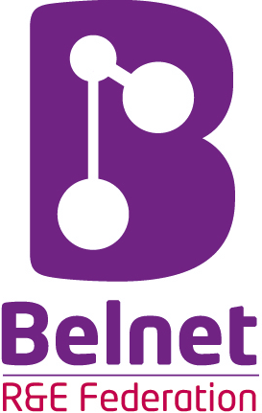















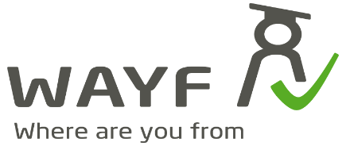
We live in a federated world

Slide 3
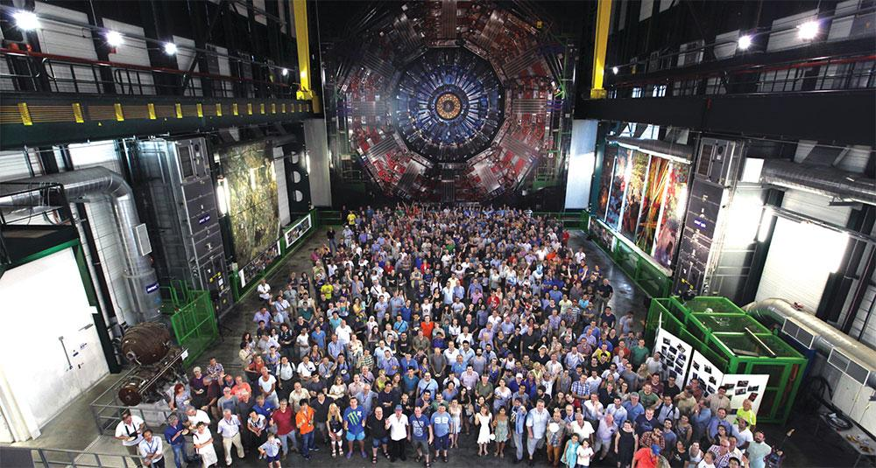

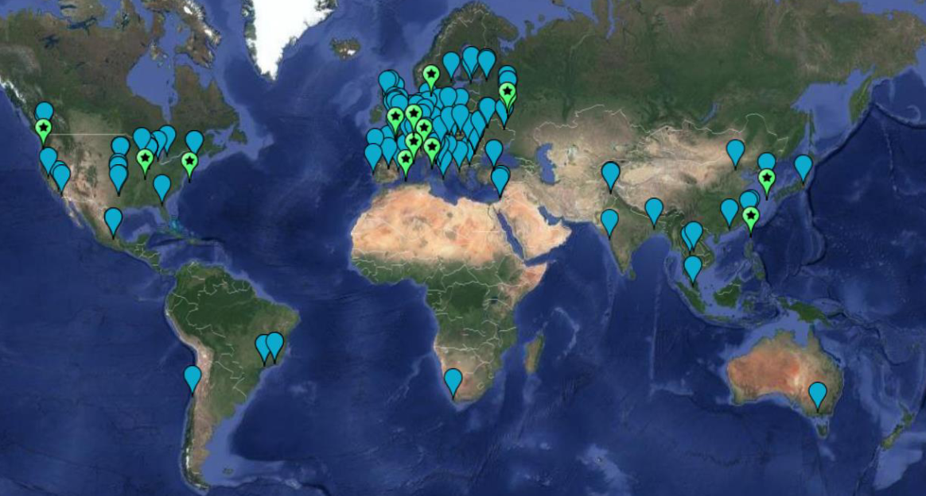
Collaboration: an inherently-cross-domain issue ...
Example from the LHC Computing infrastructure WLCG
170 sites
~50 countries & regions
~20000 users
just how many interactions ??
AuthN & AuthZ, architecture and trust should
align with collaboration structures, and
be outward facing: open, scalable, & multi-domain
people photo: a small part of the CMS collaboration in 2017, Credit: CMS-PHO-PUBLIC-2017-004-3; site map: WLCG sites from Maarten Litmaath (CERN) 2021

Slide 4
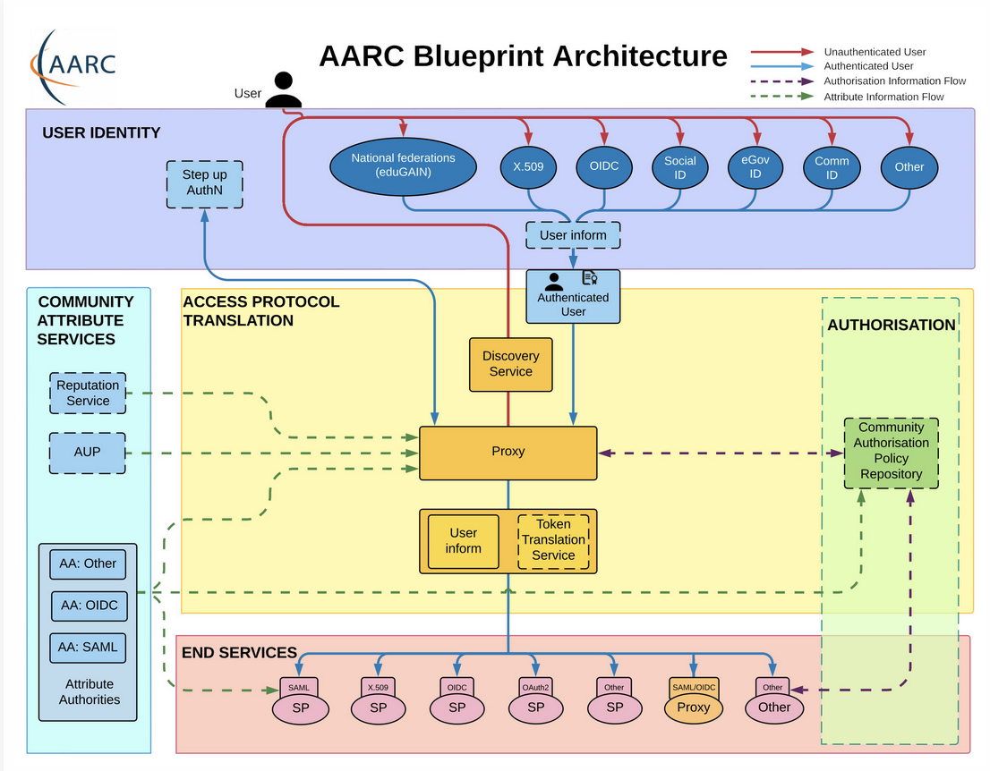









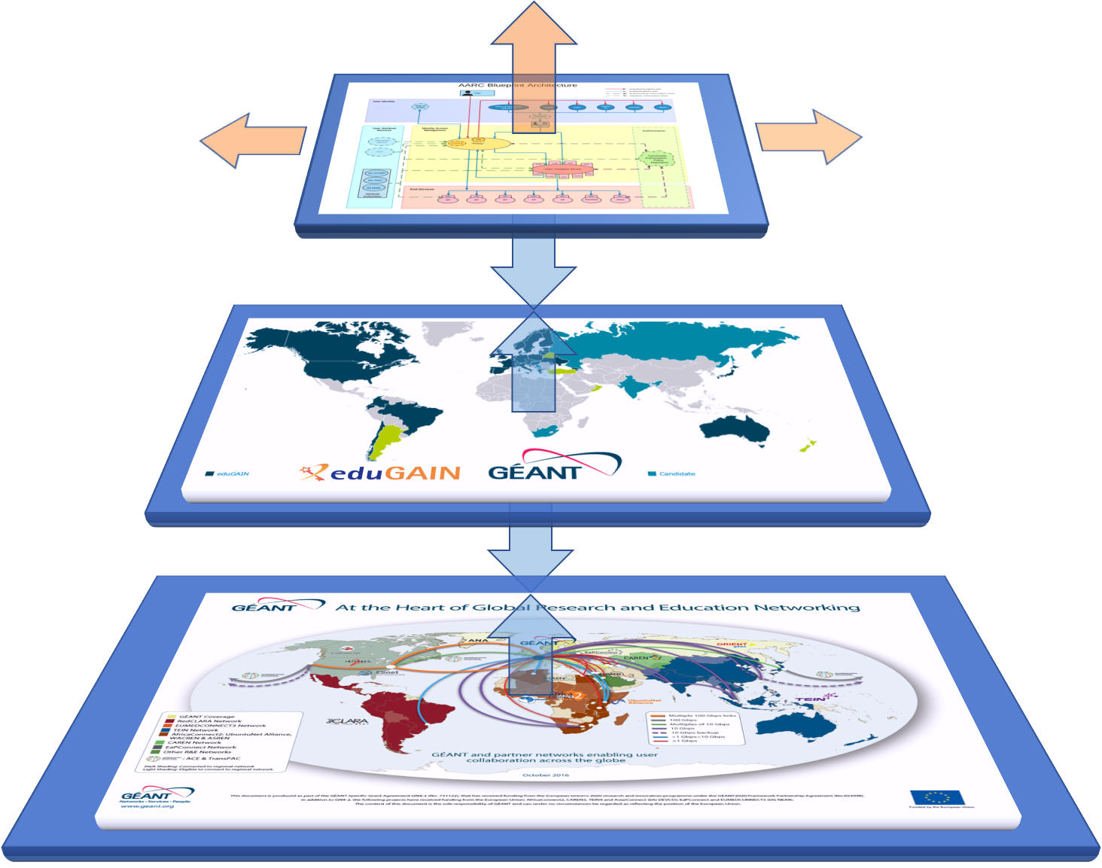
AARC BPA: The Blueprint Architecture

Slide 5
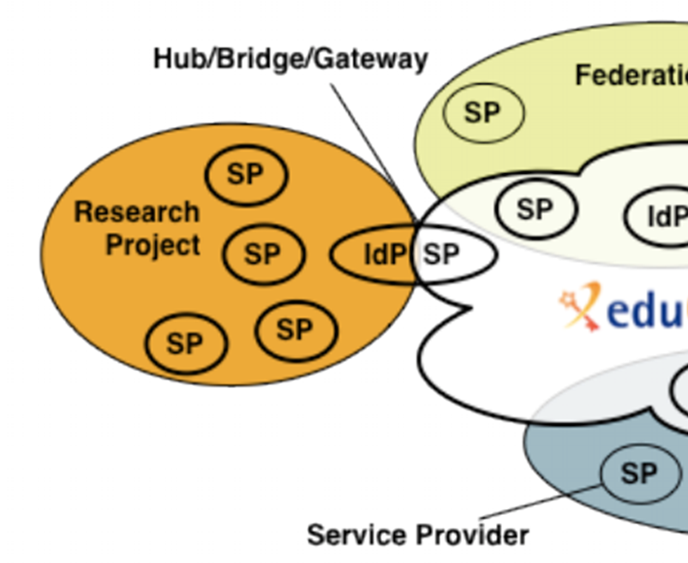
AARC BPA: proxies as first-class citizens of T&I space
Access services using identities from users’ Home Organizations, but hide complexity of multiple IdPs, federations, AA technologies
One persistent identity across all the community’s services through account linking
Access services based on role(s) users have in the collaboration.
For both web and non-web resources
Integration of guest identity solutions
Support for stronger authentication assurance mechanisms
Graphics: Ann Harding and Lukas Hammerle (SWITCH )– from a long time ago now!
Authentication and Authorization for Research Collaboration – https://aarc-community.org/

Slide 6
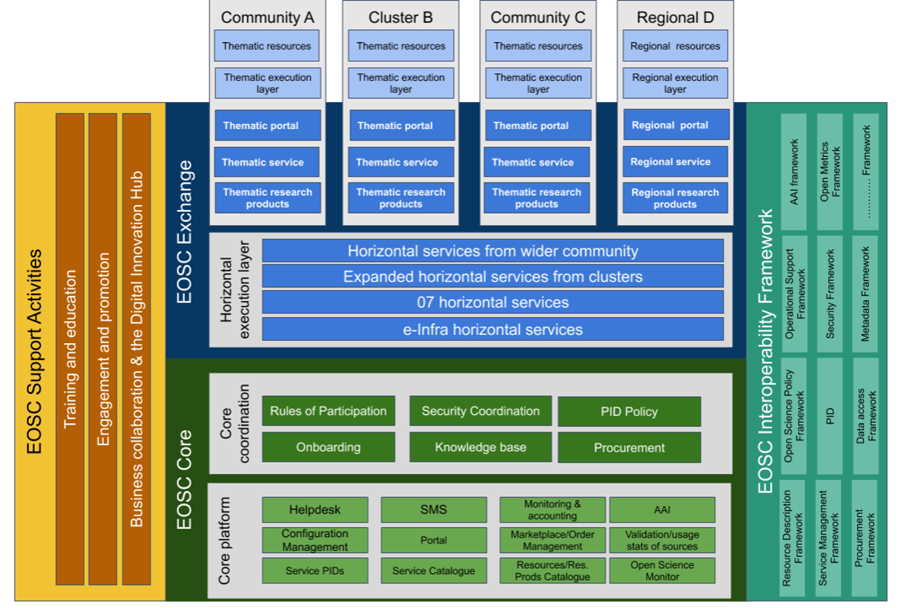
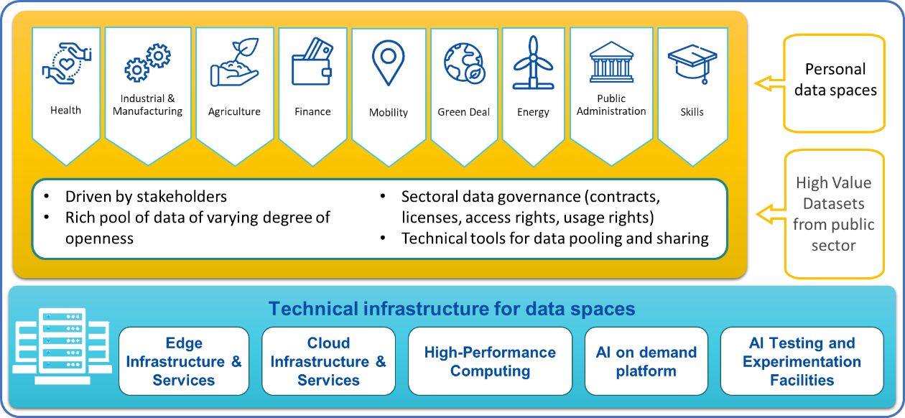
Live applications of the AARC BPA
and many more systems and ‘data spaces’ besides EOSC: e.g. Copernicus EO data, GAIA-X, sectoral spaces, …
EOSC: https://eoscfuture.eu/wp-content/uploads/2022/04/EOSC-Core.pdf; data spaces image: https://digital-strategy.ec.europa.eu/en/library/building-data-economy-brochure

Slide 7







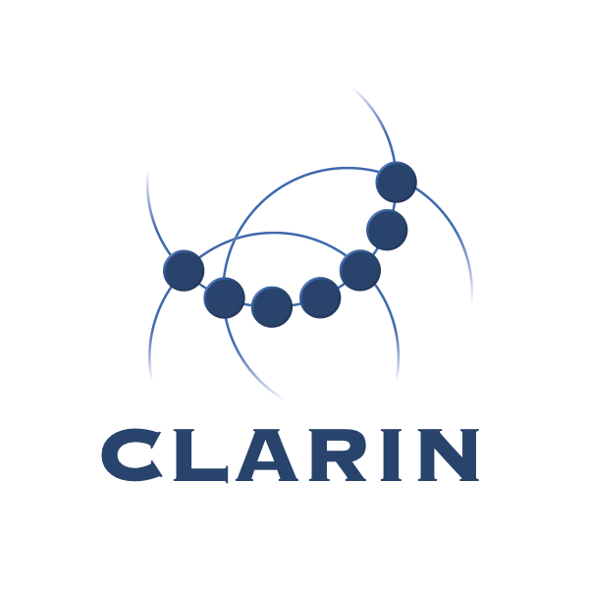

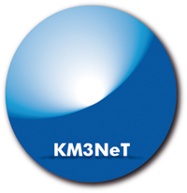
















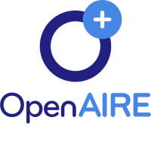
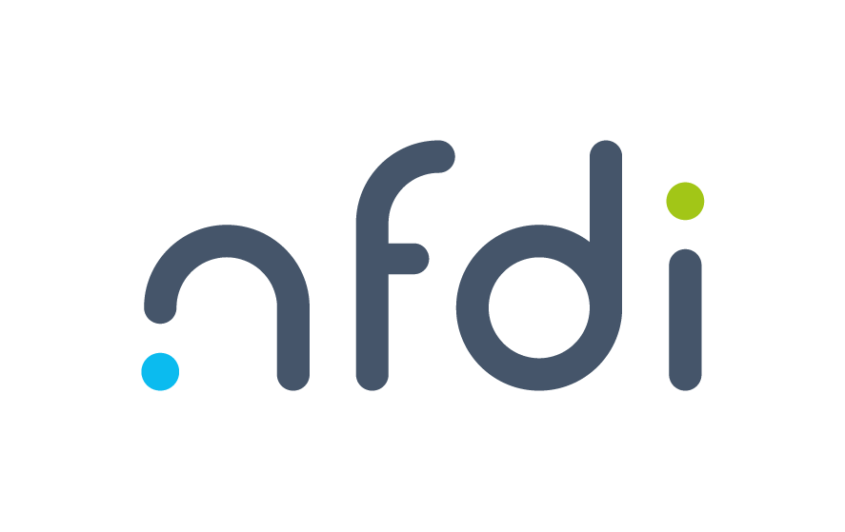
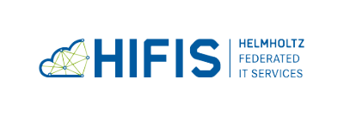

Where researchers find services & collaboration …
represented by logos: some of the (AARC BPA) Research Communities (top) providing federated access using the AAI proxy architecture.
At the ~ bottom: (global) e-Infrastructures, which all use the AARC BPA collaborative model

Slide 8
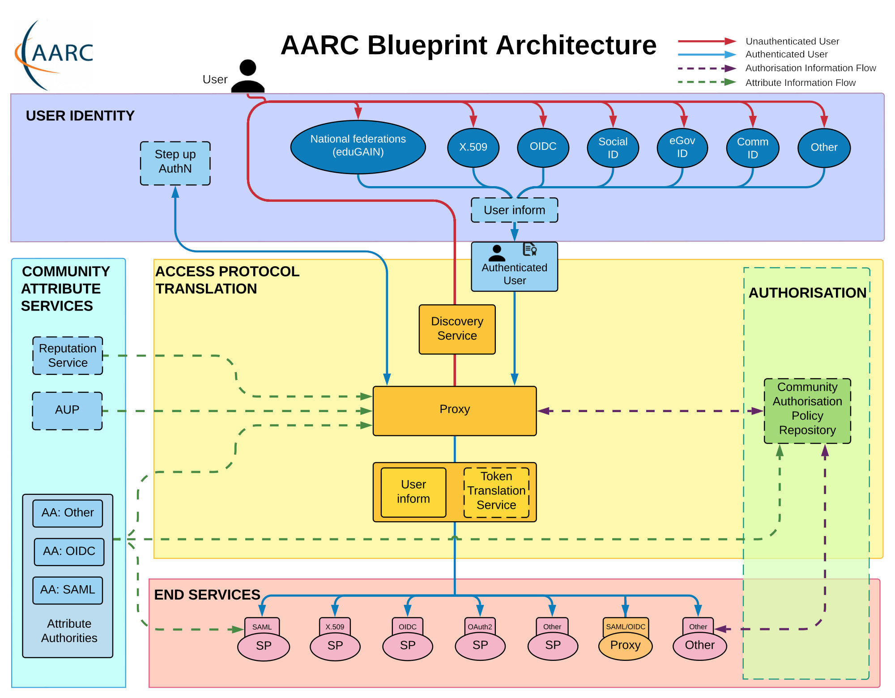
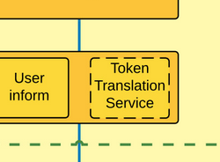
Distributed collaborative ICT instrumentation, a more technical example
Credential translation in the AARC BPA
… building RCauth.eu
Leveraging federation and collaboration
for ubiquitous research credentials

Slide 9
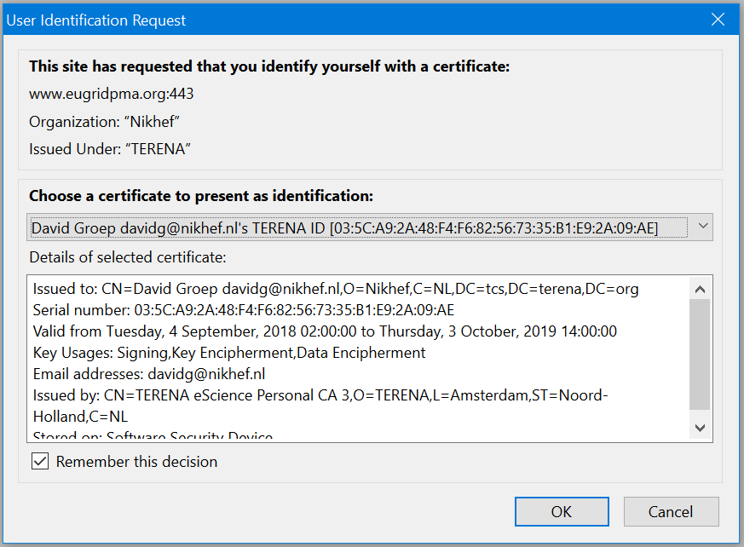
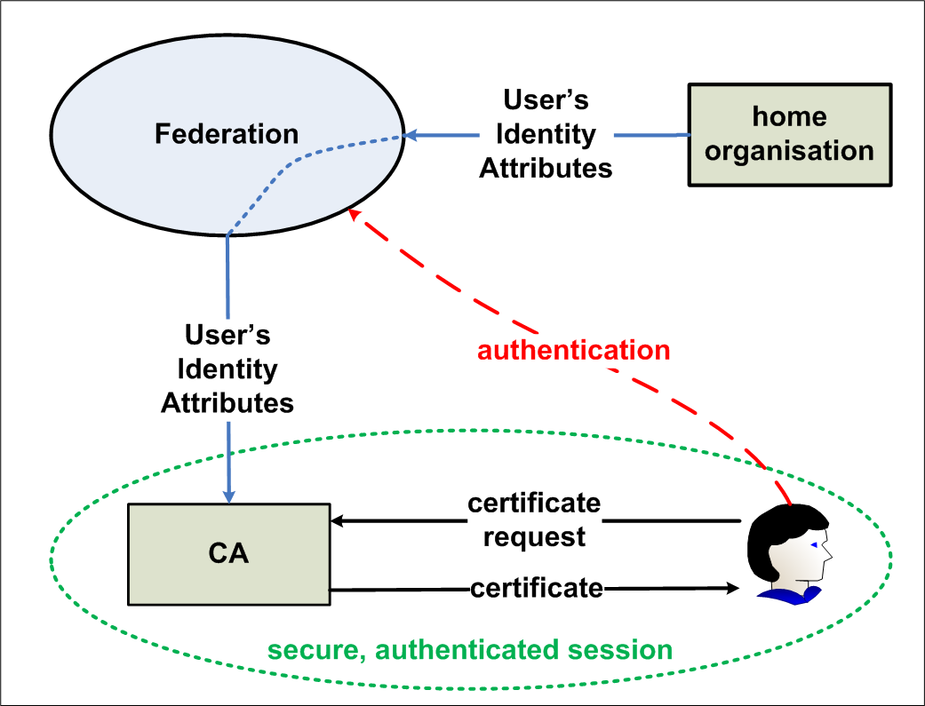
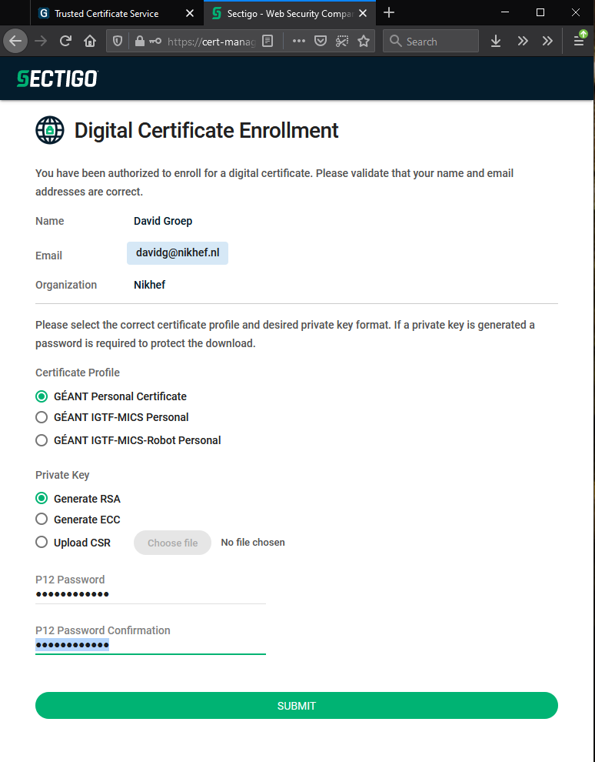


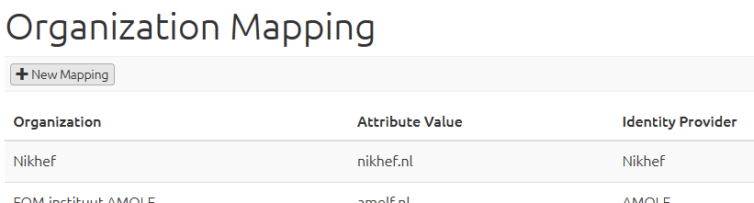
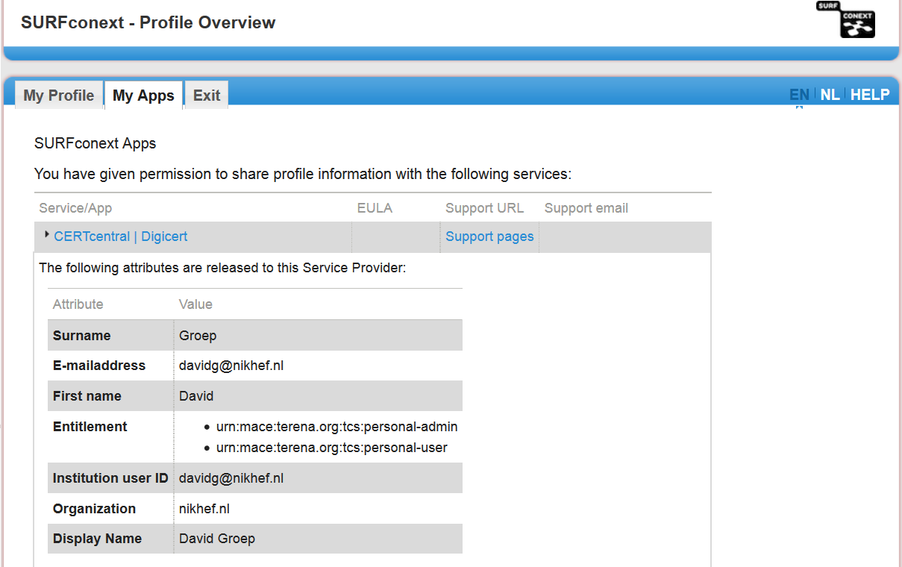
Bridges and Token Translation Services
TCS - for users that manage to grasp the idea
TCS is a SAML Service Provider (today by Sectigo)
to eduGAIN: where eligible authenticated users obtain
client certificates for access to many research services
A globally recognized identity for all employees & students (they are automatically eligible!).
GEANT Trusted Certificate Service - https://ca.dutchgrid.nl/tcs/,
https://cert-manager.com/customer/surfnet/idp/clientgeant, https://www.geant.org/Services/Trust_identity_and_security/Pages/TCS.aspx

Slide 10
Federation in research and e-Infrastructures: command-line and brokered access
‘CLI-based’ access and brokered workflows for non-web services mostly based
on PKIX (‘X.509’) technology and `RFC3820 proxies’ … but relatively complex for users
Infrastructures move to hiding PKIX from the end-user and move to OIDC and Tokens
  Fewer credentials to manage, appearing ‘simpler’ to the user
  But not all services can yet do token-based access – will take some years
Bridging and translation is a pragmatic approach for cases where PKIX worked better
  Does not require major technical changes in existing R&E federations
  Allows for community-centric identities-of-last-resort (or first resort, for that matter…)
  Allows time for introduction of other technologies, such as OIDC and OAuth2 tokens
Provide global token translation services to infrastructures that use CLI and brokerage:
EGI, European Open Science Cloud, Project MinE (ALS research), EGI, WLCG, …

Slide 11
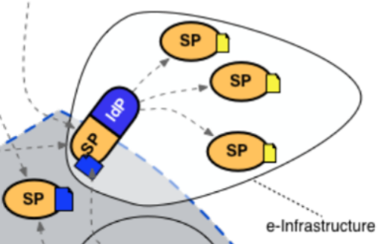

Ingredients for credential minting & token translation
eduGAIN (global R&E)
Entity Categories
e-Infrastructure IGTF Authentication Profiles
Use of
proxy bridging components
Curated grouping of entities
‘REFEDS R&S’
this is a research service
‘DP CoCo’
abides by GDPR
‘Sirtfi’
cares for security response
slower adoption process
adding identity assurance needs action at all 60+ Feds & 4k+ IdPs
Common baseline and profiles
co-defined by relying parties
user-centric ID harmonisation with unique global naming
‘BIRCH’
real person with real name
‘DOGWOOD’
persistent linkable identifier
research-specific user base
Identity and access ‘proxy’ harmonised eduGAIN IdPs
based on entity categories
leverage Sirtfi and ‘R&S’
proxying is bi-directional
responsibility on the proxy operator
https://wiki.geant.org/display/AARC/Current+Status+of+SAML+Entity+Categories+Adoption - https://www.rcauth.eu/ - https://aarc-community.org/

Slide 12
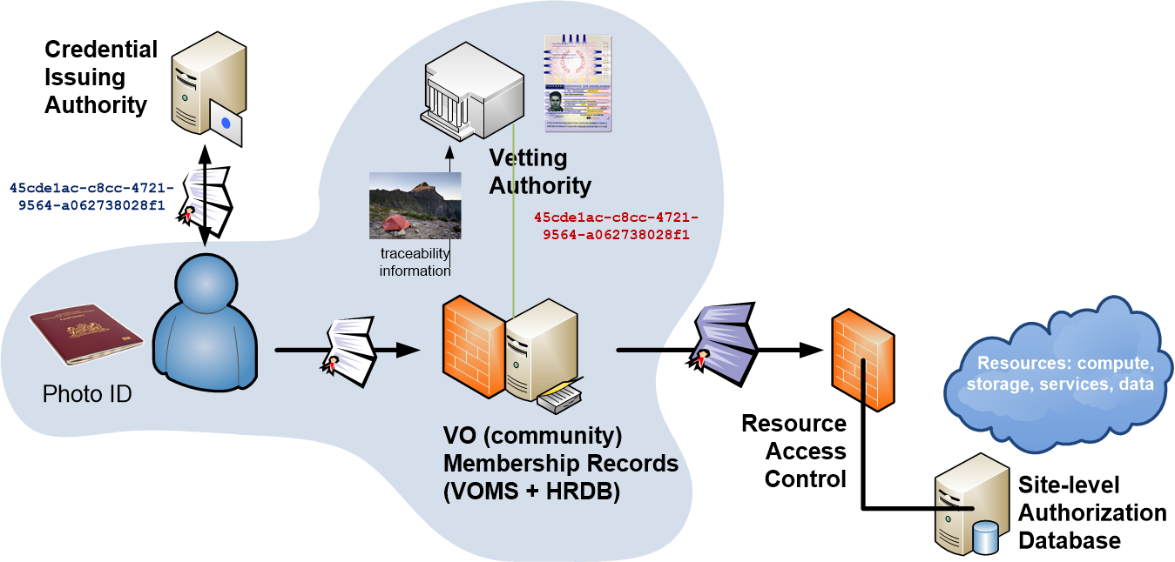
A ‘CILogon-like’ Token Translations Service – RCauth.eu
Ability to serve a large pan-European+ user base without national restrictions
  without specific national participation requirement (serve sparsely distributed users)
Use existing resources and e-Infrastructure services
  no need for revise security model at resource centres or at infrastructure level
Integrate science gateways and portals with minimal effort
  only light-weight industry-standard protocols
Support attribute-cert community membership services
  support community membership via attribute certificates,
  also for science portal access to e-Infrastructure
Concentrate service elements that require security expertise
  not burden research communities with care for security-sensitive service components
  keep a secure credential management model
  coordinate compliance and accreditation

Slide 13
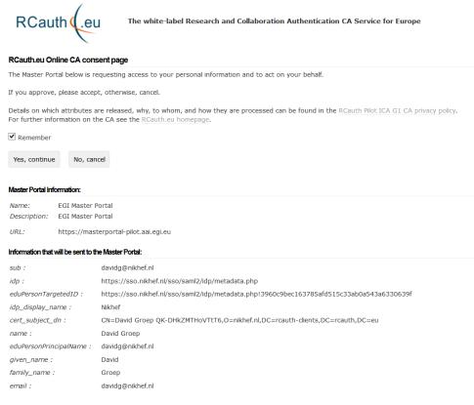
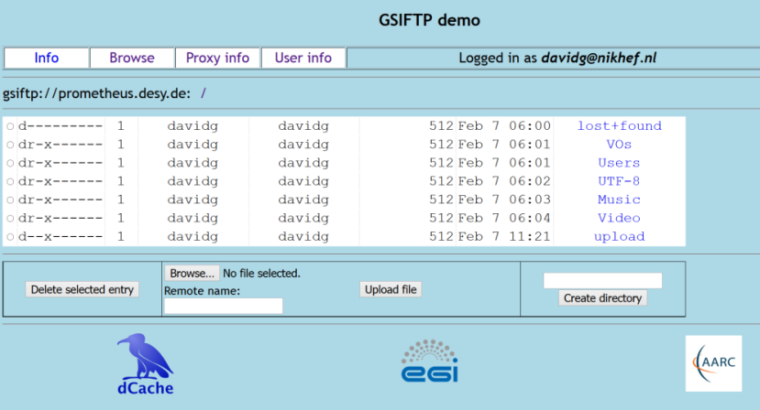
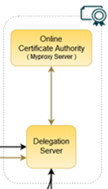
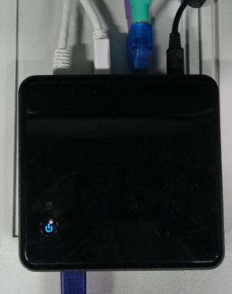

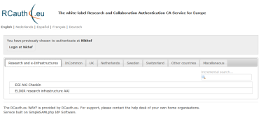

Seamless in-line token translation services from ‘SAML’ to PKIX
user facing
hidden back-end
Community Science Portal
IGTF accredited
PKIX Authority
Infrastructure Master
Portal Credential Store
User Home Org
or Infrastructure IdP
REFEDS R&S
Sirtfi Trust
see also https://rcdemo.nikhef.nl/
Policy Filtering WAYF to eduGAIN
Built on CILogon and MyProxy, see www.cilogon.org
Notes:
VO portal can be anything even a simple shell
Certs stored only for 11 days
Master portal can add attributes via VOMS (or others in the future)

Slide 14
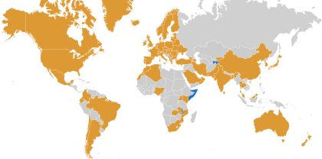
Our Registration Authorities: the Federated IdPs
Distributed RAs: the eligible IdPs
  connected through a federation, primarily: the
  ensemble of IdPs in eduGAIN that
  meet the policy requirements of this CA
  since authN and authZ are split, need is for
  non-reassigned identifier and point-in-time incident response
eligible applicants are then all affiliated to an RA
Three eligibility models
Direct relationship CA-IdP, with agreement declaration
Rest of eduGAIN: – “Sirtfi” security incident response and OpSec capabilities plus
– REFEDS “R&S section 6” non-reassigned identifiers & name (‘personalized’)
are required, and tested via statement in ‘meta-data’ and by releasing the proper attributes
within the Netherlands, SURFconext Annex IX* already ensures compliance for all IdPs
“IdPs within eduGAIN are deemed to have entered materially into an agreement with the CA”

Slide 15
Unique certificated from FIM via eduPerson and REFEDS R&S
Sources of naming and uniqueness, that work today
eduPersonPrincipalName – scoped point-in-time unique identifier, which could be,
but usually is not, privacy preserving: “davidg@nikhef.nl”, “P70081609@maastrichtuniversity.nl”
eduPersonTargetedID – scoped transient non-reassigned identifier, like
urn:geant:nikhef.nl:nikidm:idp:sso!27c8d63ed42c84af2875e2984
subject-id - a scoped persistent non-reassigned identifier, which should be privacy-preserving: 44f7751265a6e8b228f9@nikhef.nl
Plus the (domain-name based) schacHomeOrganisation and a ‘representation of the real name’
/DC=eu/DC=rcauth/DC=rcauth-clients/O=orgdisplayname/CN=commonName +uniqeness
uniqueness will added to commonName via hashing of ePPN, ePTID, subject-id, so that
an enquiry via the issuer allows unique identification of the vetted entity”

Slide 16
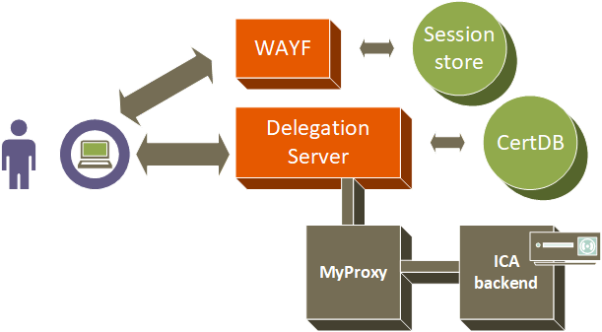
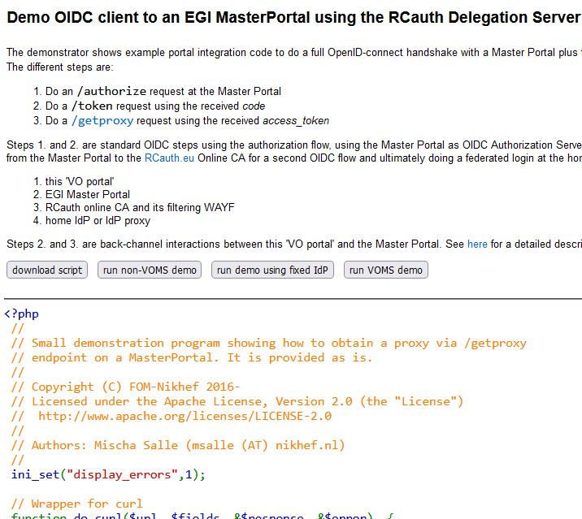
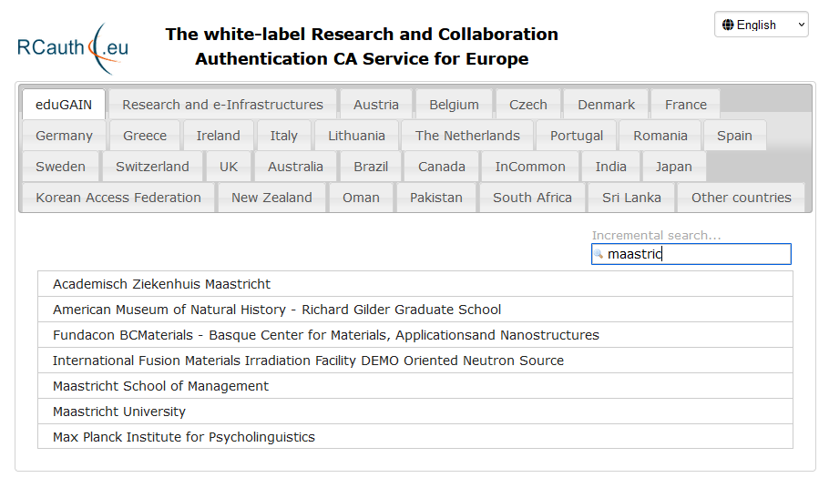
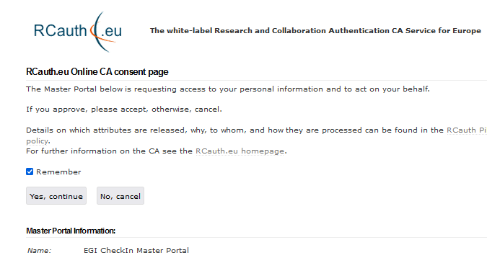
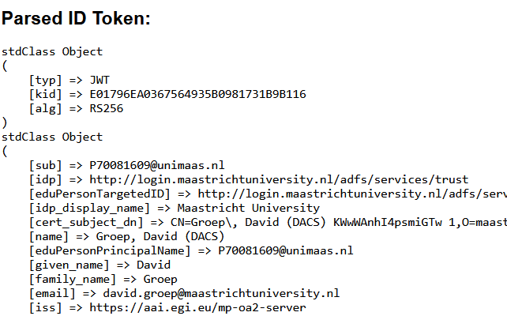
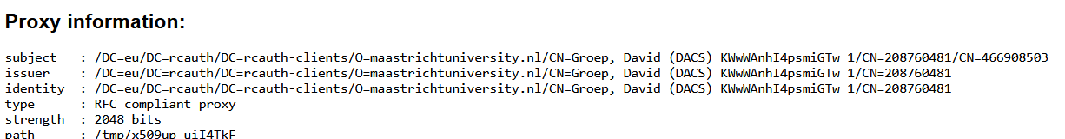
The ‘back side’ of a typical RCauth portal data flow

Slide 17
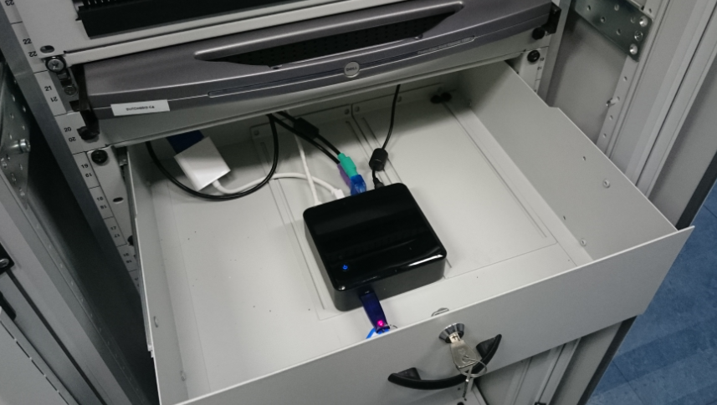

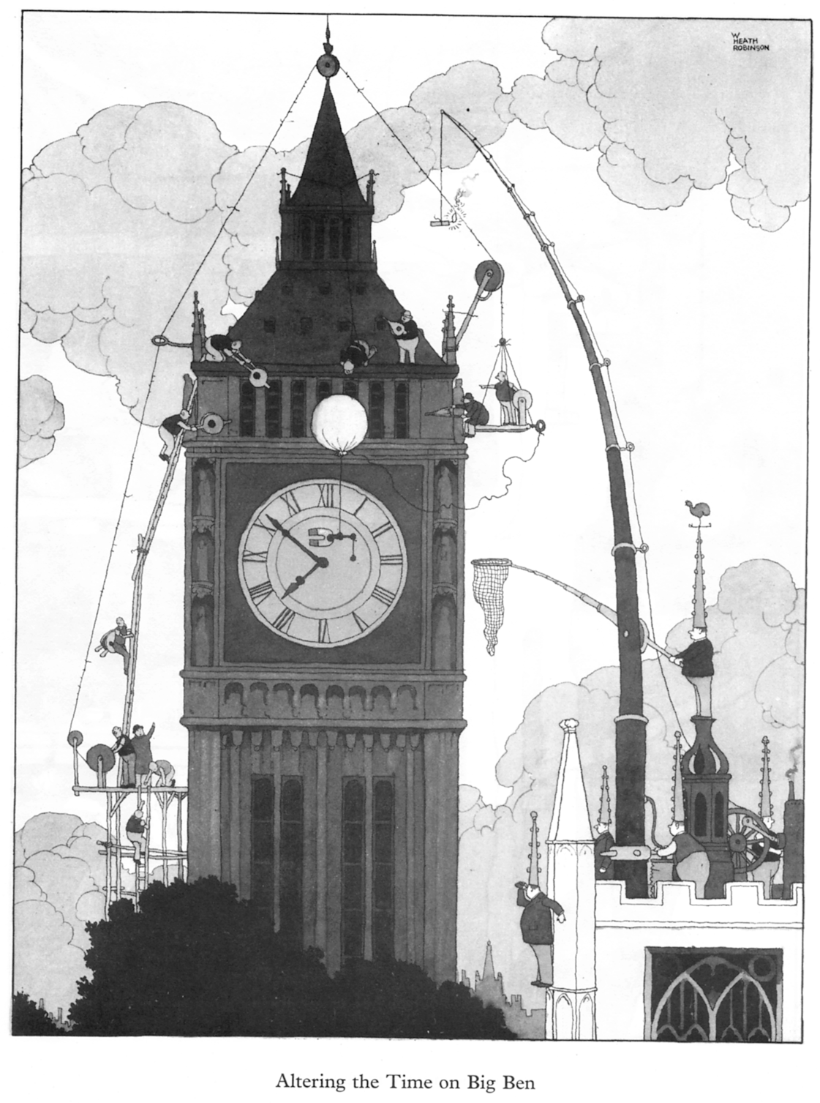
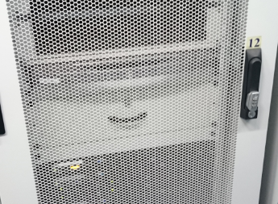
With a single, yet fully compliant, ‘Heath Robinson’ CA

Slide 18
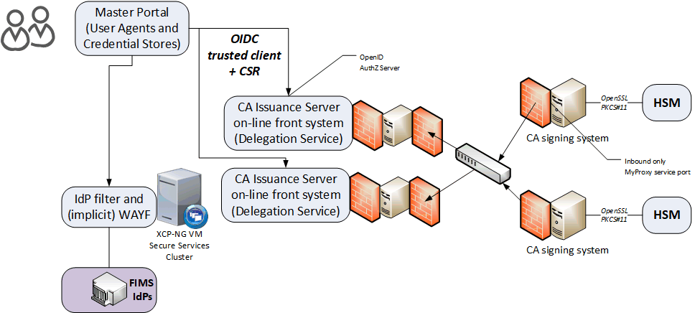
One ‘locally-highly-available’ RCauth at Nikhef Amsterdam
Most ‘fault-prone’ components are
  Intel NUC (single power supply)
  HSM (can lock itself down, and the USB connection is prone to oxidation)
  DS front-end servers (physical hardware, albeit with redundant disks and powersupplies)
private
semi-redundant
switch
Eliminated SPOFs first
using ‘local HA’

Slide 19
Distributing RCauth.eu across three cooperating sites
Governance Board
RCauth PMA
Ops Coordination Team
Representatives (and one alternate) from
each Materially Contributing Stakeholder
EGI.eu, EUDAT (ETFC), GÉANT, Nikhef (SURF)
Individuals drawn from the wide community […]
experts in the field of identity management
for research and collaboration,
PKI technology and identity bridging
STFC
GRNET
Nikhef
Operations people from each of the hosting partners with a (copy of) the RCauth.eu signing key,
and those partners otherwise involved in OPS

Slide 20
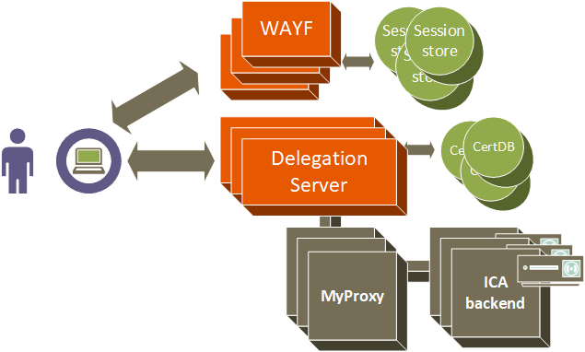
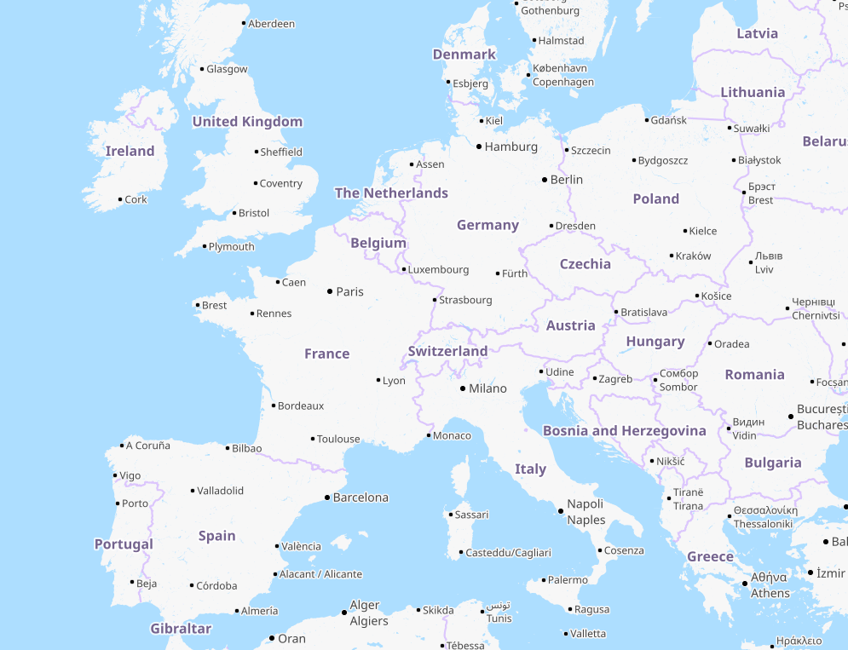
… to a 3-fold, continuously-consistent, European setup
STFC (OXF)
Nikhef (AMS)
GRNET (ATH)

Slide 21
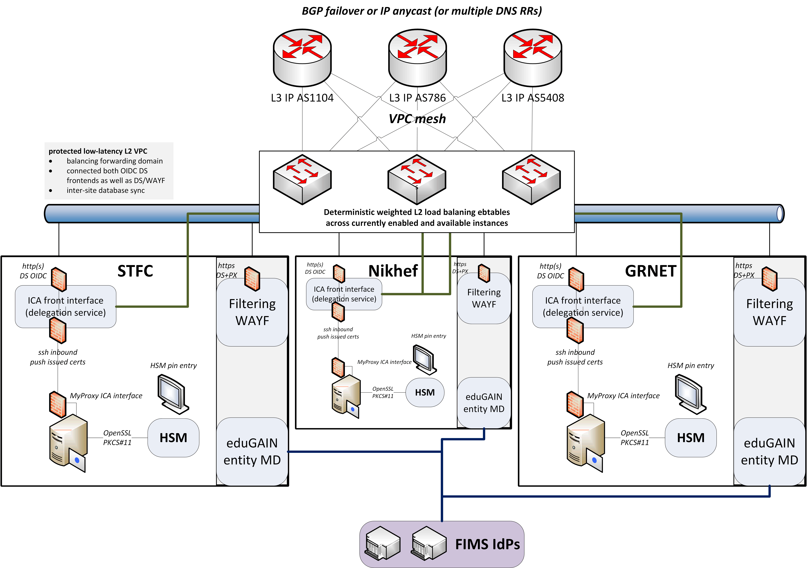
Since we do not like SPOFs …
Distributed High Availability setup
across the 3 sites
design for minimal effort
readily-available techniques
  L3 VPN (OpenVPN) or L2 VPC
  Linux HAProxy
work supported by the EOSC Hub and EOSC Future Horizon Europe projects

Slide 22
A transparent multi-site setup is needed for the user
User
connects to HA proxy at {wayf,pilot-ica-g1}.rcauth.eu
HA proxy sends users to “closest” working service
primarily forward to its own DS when available
HA proxy
HA proxy
VPC or VPN interconnect
Straightforward proven solution is IP anycast
wherever the user is, the service is at
2a07:8504:01a0::1
or for legacy IP users at 145.116.216.1
HA proxy
If a HA loses its
backend DS, can still
route to another DS
over VPC/VPN backend
selected imagery: Mischa Sallé, Jens Jensen, Nicolas Liampotis

Slide 23
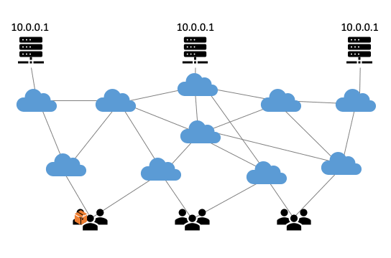
Anycast: when the same place exists many times
So we used
3 (for now: 2) sites
one VM at each site
exposing 2a07:8504:01a0::1
smallest v6 subnet (/48)
bird + a service probe
each site’s own ASN
some IRR DB editing
IPv4 is similar, with a /24
and some monitoring
routing image: SIDNlabs - https://www.sidnlabs.nl/en/news-and-blogs/the-bgp-tuner-intuitive-management-applied-to-dns-anycast-infrastructure

Slide 24
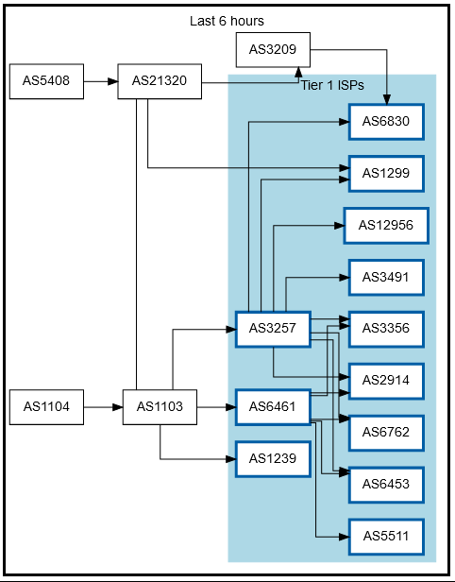
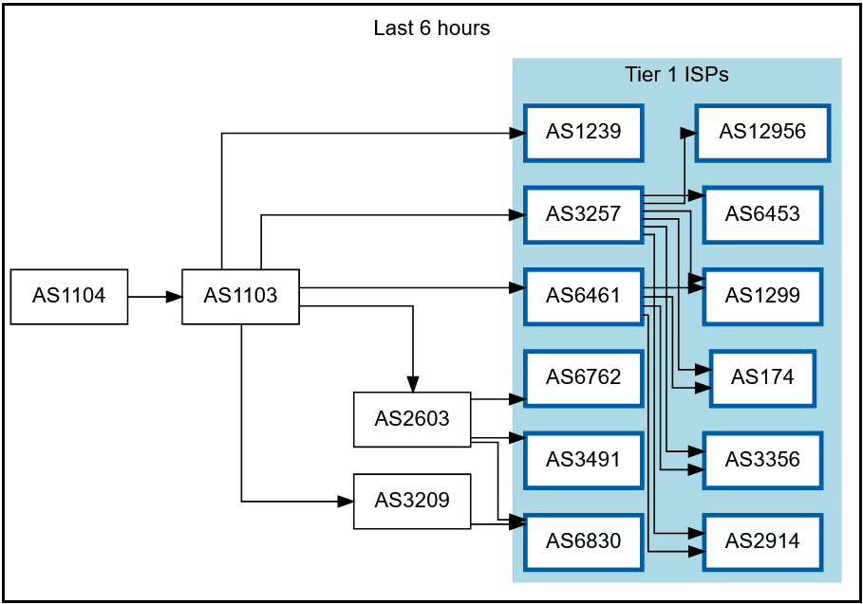
Getting 2a07:8504:1a0::/48 out there
route maps: bgp.tools for 2a07:8504:1a0::/48 – IPv4 for 145.116.216.0/24 is similar – imagery from November 2022

Slide 25
‘Birds flock together’
# /etc/bird.conf route config
define ASN_OWN = 65530;
define ASN_NEIGHBOUR = 1104;
define ADDR_NEIGHBOUR4 = 194.171.98.94;
define ADDR_NEIGHBOUR6 = 2a07:8500:120:e011::1;
# /etc/anycast-healthchecker.d/haproxy.conf
[haproxy]
check_cmd = /usr/local/sbin/check_haproxy.sh
check_interval = 20
check_timeout = 5
check_fail = 2
check_rise = 2
check_disabled = false
on_disabled = withdraw
ip_prefix = 145.116.216.1/32
[haproxy6]
check_cmd = /usr/local/sbin/check_haproxy.sh
check_interval = 20
check_timeout = 5
check_fail = 2
check_rise = 2
check_disabled = false
on_disabled = withdraw
ip_prefix = 2a07:8504:1a0::1/128
# /etc/bird.d/anycast-prefixes.conf
# …
# Generated 2023-02-05 14:49:36.047801
# by anycast-healthchecker (pid=1299)
# 10.189.200.255/32 is a dummy IP Prefix. …
define ACAST_PS_ADVERTISE =
[
10.189.200.255/32,
145.116.216.1/32
];
Bird Internet Routing Daemon http://bird.network.cz/; for anycast-healthchecker: anycast-healthchecker-0.9.2.dev9-1.noarch Pavlos Parissis, Mischa Sallé

Slide 26
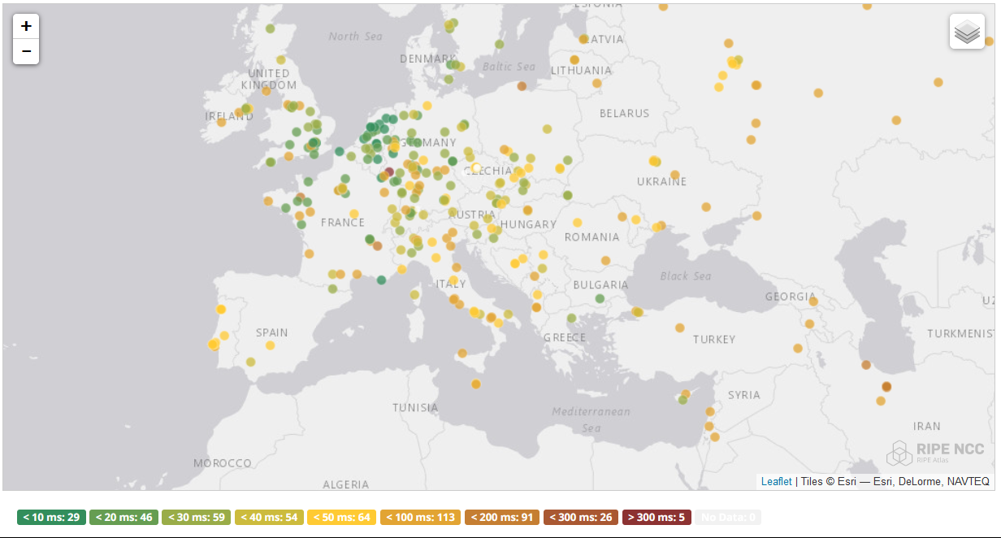
And you get reasonable load balancing in Europe for free
map: RIPE NCC RIPE Atlas - 500 probes, distributed across Europe (https://atlas.ripe.net/measurements/50949024/)

Slide 27
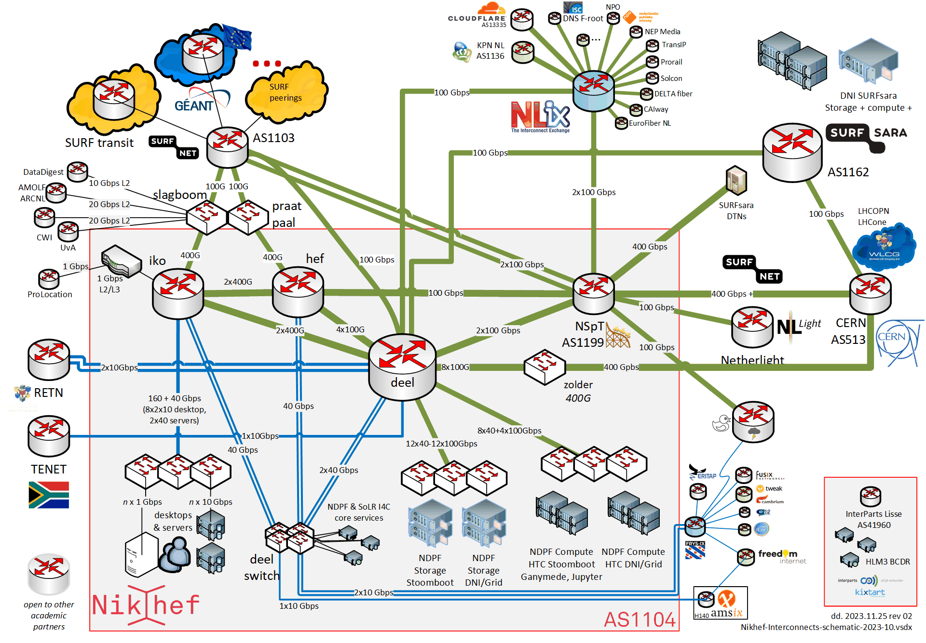
Shortest path, also when mixing with the default-free zone
[root@kwark ~]# traceroute -IA 145.116.216.1
traceroute to 145.116.216.1 (145.116.216.1), 30 hops max, 60 byte packets
1 lo0-3.bras0.fi001.nl.freedomnet.nl
(185.93.175.232) [AS206238]
2 et-0-0-2-1001.core0.fi001.freedomnet.nl
(185.93.175.223) [AS206238]
3 as1104.frys-ix.net (185.1.203.182) [*]
4 protnet-gw.nikhef.nl
(194.171.98.94) [AS1104]
5 gw-anyc-01.rcauth.eu
(145.116.216.1) [AS786/AS5408/AS1104]
rcauth.eu HA proxy
Route from home to RCauth.eu, from my home Freedom Internet ISP
me, at home

Slide 28
So is there a common pattern?
Infrastructure may be distributed, but that’s nothing truly ‘magic’
  and every collaborating organization, university, and national lab is part of it and can do it!
Move complexity and volume requirements to the edge
  the edge scales horizontally and scaling from 2+ is much easier than from 1→ 2
Any central (network) components should be passive and as stateless as possible
  research (and computing education) infrastructure performance ought to just be ‘a given’
  any stateful device in the data path will block performant data transfers and reliability
  although persistent storage obviously has to retain some state ☺
Scaling collaboration infrastructure, trust & identity, and federation of expertise needed as much as we need scaling of our computing and networks

