Slide 1
“RaaS” – towards RCauth.eu as a Service
Changes in RCauth governance as a production service
David Groep
Policy and Best Practice Coordination, AARC
Nikhef PDP Advanced Computing Research
42nd EUGridPMA Plenary Meeting
January 2018

Slide 2
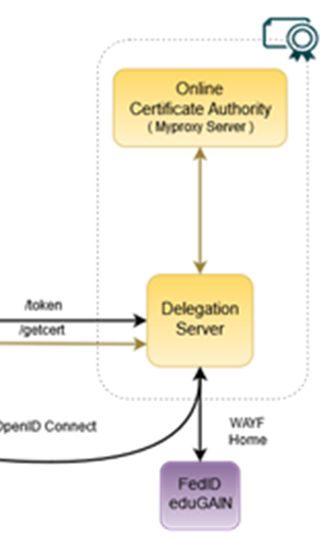
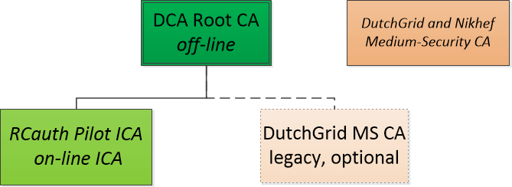
RCauth.eu – a white-label IOTA CA in Europe
Cover as much as R&E Federated Europe as possible
Scoped to research and collaborative use cases
In a scalable and sustainable deployment model
Following the AARC pilot
operates as a ‘production-compatible’ pilot service
which will operate for as long as necessary and useful
is supported by the Dutch National e-Infrastructure & Nikhef
… to support multiple applications and communities:
EGI CheckIn, B2ACCESS, and WaTTS instances
Project MinE
ELIXIR, and the Life Sciences AAI

Slide 3
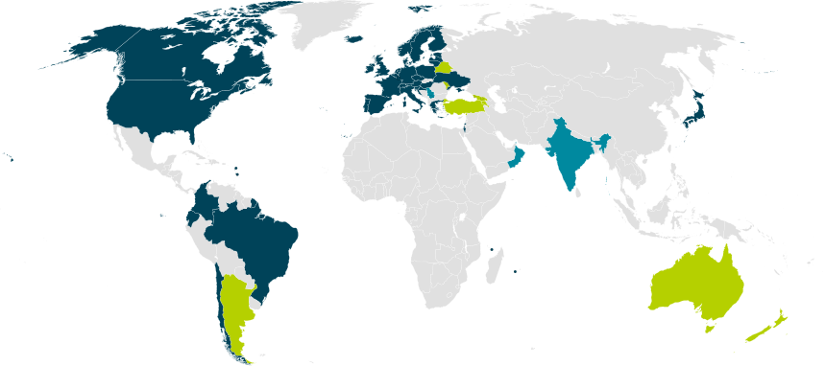
Our Registration Authorities: the Federated IdPs [1.3.2]
RAs are the eligible IdPs connected through a
Federated Identity Management System (FIMS)
primarily: ensemble of IdPs in eduGAIN that
meet the policy requirements of this CA
Eligible applicants are all affiliated to an RA
Three eligibility models
Direct relationship CA-IdP, with agreement declaration
Within the Netherlands: SURFconext Annex IX* compliance for all IdPs
Rest of eduGAIN: – “Sirtfi” security incident response and OpSec capabilities plus
– REFEDS “R&S section 6” non-reassigned identifiers and applicant name
are required, and tested via statement in ‘meta-data’ any by releasing the proper attributes
“IdPs within eduGAIN [#3] are deemed to have entered materially into an agreement with the CA”

Slide 4
RCauth.eu – values and principles
To guide management decisions, core principles (of scalable policy) were made explicit:
RCauth.eu is a ‘white label’ service that can be integrated with as many services as useful
target research and innovation capabilities of
global, cross-national, and national Research and e-Infrastructures
accessible to any qualified person that has a federated identity
shall meet assurance requirements commonly agreed
leverages inter-federation … Yet the service shall allow for exceptions
and explicit trust relationships [to support] ubiquitous availability
the service is a collaborative effort based on peer review and on appropriate assessments
service shall be open, and its positions taken towards its peer and accreditation bodies
be openly discussed

Slide 5
From what you accredited …

Slide 6
RCauth Today
Operated by the “DutchGrid CA” – a collaboration under the DNI operated by Nikhef
for science and research
for the purpose of cross-organisational distributed resource access,
solely in the context of academic and research and similar, not-commercially competitive, applications.
“These services are
primarily intended for the practitioners of scientific research in the Netherlands,
appropriately taking into account the European and global nature of research and collaboration”
read: we will offer it to Europe and the world, but if the world diverges wildly from
the aims of the Dutch National e-Infrastructure we might have to reconsider

Slide 7
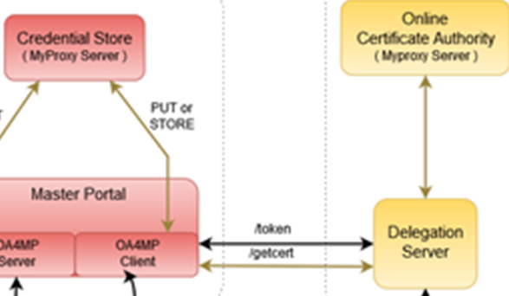
Other Participants
RCauth will seldom see individual users
authentication requests come via the Master Portals
we will (ourselves & directly!) authenticate the users, but …
… then release the certificate to the intermediary
In the RCauth case:
Explicit relationships required
Encoded via a (shared) OIDC Client ID and Client Secret
Contrary to e.g. Google, we will not accept ‘any’ OIDC client, but explicitly configure trust
Assessment based on PKP Guidelines and Trusted Credential Repository guidelines
Along with other criteria (for scalability): constituency, community size, relevance, &c

Slide 8
Operators and Administrators [1.5]
Three roles defined
Managers of the DCA Service (by construction: joint with all other DCA CAs)
Administrators of the RCauth Pilot ICA (de facto joint with all other DCA CAs)
Operators, “individuals that can issue certificate and publish updated revocation information” (specific to the RCauth service)
The Operators know how to activate the HSM and access the off-line machine, but have no access to the private key outside the HSM*
There are more people that have selected access to some physical systems (Housing, ICT operators staff), but they don’t know any activation data and controls are in place to make physical interventions complicated (padlocks, protected cabinets, nested safe boxes)
* they may have physically touched encrypted key material, but don’t know the activation data

Slide 9
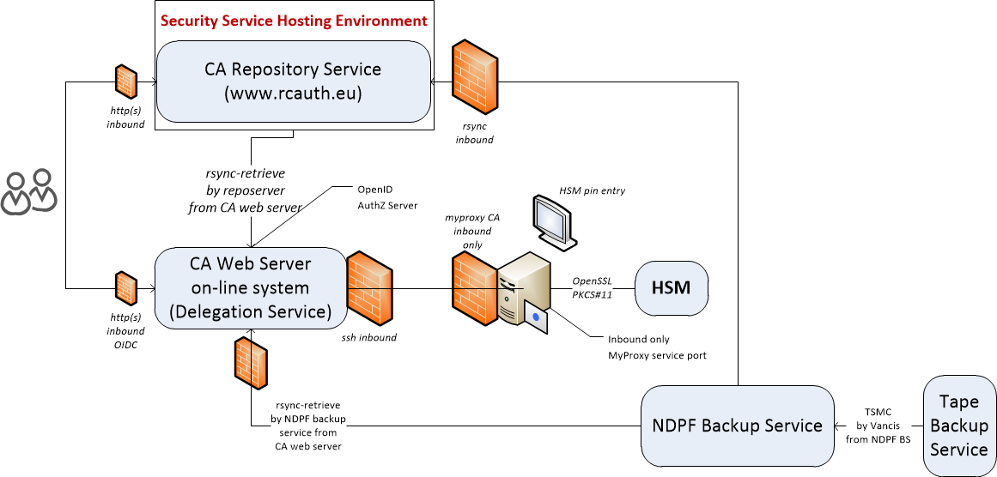
Logical set-up

Slide 10
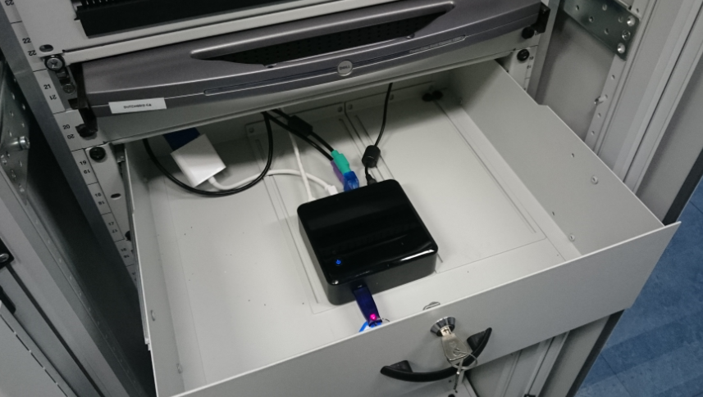
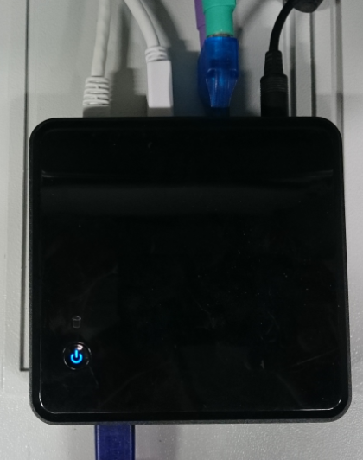

More pretty pictures

Slide 11
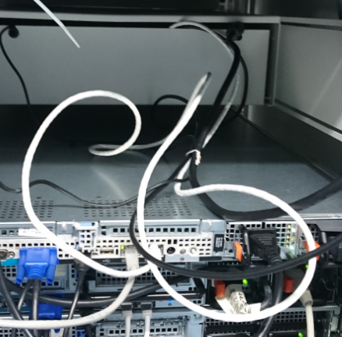
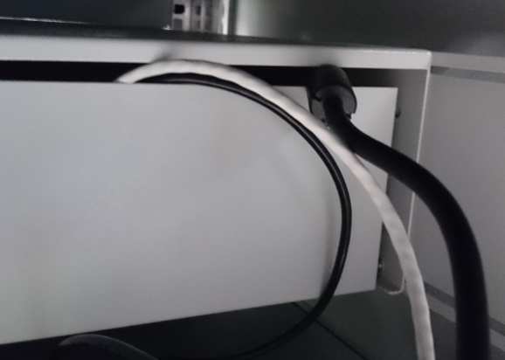

Slightly more ugly pictures …

Slide 12
… to what it could become: Tiered Governance

Slide 13


Multiple stakeholders – uniform governance
Qualified Stakeholders
Research Infrastructures
User Communities
Users
Generic e-Infrastructures
those actively relying on
RCauth.eu credentials
and that contribute (in any way) to the service
…
GRNET
Nikhef
STFC
Materially Contributing Qualified Stakeholders
are qualified stakeholders
that contribute materially to the service
with effort, money, hardware, or services
possibly …

Slide 14
Considerations
Part of the operations will be funded
by EOSC-HUB through its partners for the technical ops
by SURF DNI for both support and operations
in-kind for trusted network connectivity by GÉANT
and those who put in resources have a rightful say in where the resources go … up to a point
Core values and principles of RCauth.eu are beyond those contributing stakeholders
must be open to anyone for any acceptable work – we don’t want a fragmented community
nobody to be ‘left out of the rain’ (unlike to TCS which depends on NREN policy and sign-up)
usefulness to research and collaboration is paramount and must be the deciding factor

Slide 15
RCauth.eu Governance
Governance Board
RCauth PMA
Ops Coordination Team
Representatives (and one alternate) from
each Materially Contributing Stakeholder
EGI.eu, EUDAT (ETFC), GÉANT, Nikhef (SURF)
Individuals drawn from the wide community […]
experts in the field of identity management
for research and collaboration,
PKI technology and identity bridging
STFC
GRNET
Nikhef
Operations people from each of the hosting partners with a (copy of) the RCauth.eu signing key,
and those partners otherwise involved in OPS

Slide 16
What do they manage? Two options!
Most consistent external view – closest internal coordination and trust
  Single RCauth.eu signing key
  Securely distributed to each operational partner
  Fully owned and managed by the PMA
  Requires partners to accept stringent controls by the PMA to ensure trust
  Fully transparent to users and external RPs
Most distributed and resilient view – with global user and RP impact on usability
  Each partner gets a different RCauth.eu signing key
  These will show up as independent ICAs in the IGTF distribution
  Same Subject DN namespace, but different issuer names in parallel and simultaneously
  Partners can join and leave, validity of ICA controlled through the CRL of upstream root
  Allows PMA to control a leaving party without such party’s co-operation and without special measures
  Floods IGTF distribution with multiple ICAs, and persistently exposes CA internal to VOMS and RPs

Slide 17
Governance board
ensuring continued and adequate material support for the service
ensuring the service fulfils its mission and adheres to its principles and values
appointing and dismissing Policy Management Authority members based on the recommendations and nominations of the Policy Management Authority
designate and support the operational management and the operational coordination team
liaising with Qualified Stakeholders to ensure the service meets needs of its target audience
rule on all aspects that are not otherwise covered in the mission statement, the principle and values, this Governing Model, the CP and CPS, and that cannot be resolved by the Policy Management Authority
[It may] decide to terminate the service only by unanimous vote following a one-year consultation period with all Qualified Stakeholders, and then only in accordance with the CP and CPS policies.

Slide 18
PMA
implementing the Management Guidance
monitoring the operations of the service by the operational team(s) with respect to the Mission and the CP and CPS policies and practices
ensuring continued accreditation of RCauth.eu to the IGTF and other relevant accreditation bodies
informing the Governance Board about requisite changes to the CP and CPS policies and practices
liaising with standardisation and technology groups to improve and evolve the service to further the fulfilment of its mission
proposing new PMA members to the Governance Board
The PMA shall have at least 3 members. The members of the PMA shall exercise their duty independently and on a personal basis.
The PMA members shall be appointed or dismissed by the Governance Board, based on nomination by the current PMA membership. PMA members may step down on their own accord.

Slide 19
Operations Coordination Team maintains
records of all places where trust anchor key material is maintained
a registry of directly-connected federated identity providers, including such documentation submitted by them to assert compliance with the CP and CPS
a registry of connected credential repository and management systems that are connected as clients to the RCauth.eu delegation service instances,
including such documentation submitted by them to assert compliance with the CP and CPS
any audit records maintained or prepared for assessment by the RCauth PMA
a list of Qualified Stakeholders and contact information to the extent to which these have registered themselves to receive information from the RCauth.eu service
This team shall be responsible for the day-to-day provisioning of the service, implementing the decisions of and reporting to the Policy Management Authority, resolving issues of availability, reliability, and access to the service, and for the maintenance of any registries so-designated by the Policy Management Authority.

Slide 20
The most important element of trust
… I cannot yet write on a slide …

Slide 21
www.rcauth.eu/policy
davidg@nikhef.nl
ca@rcauth.eu

