Slide 1
The RCauth.eu CILogon-like service in the EGI AAI
The CILogon-like TTS Pilot, its scalability and applicability
in the EGI Infrastructure landscape
David Groep
AARC NA3 coordinator
Nikhef PDP (Advanced Computing for Research) group
EGI AAI TCB
Feb 8th, 2017

Slide 2
The AAI evolution of e-Infrastructures and Research Infrastructures
Most infrastructures move to completely hiding PKIX from the end-user
  Less credentials to manage, appearing ‘simpler’ to the user, but …
  EEPKI + RFC3820 proxies did solve both the CLI and delegation use case rather nicely!
Bridging and translation is the pragmatic approach
  Does not require major technical changes in existing R&E federations
  Allows for community-centric identities-of-last-resort (or first resort, for that matter!)
  Time line is more predictable, because fewer entities are involved –
  and those entities have a stake in and the benefits off the results
Emerging as a pattern in many Research Infrastructures that use CLI or brokerage
  ELIXIR, UMBRELLA, WLCG, INDIGO DC
  SAML->OIDC, SAML->X509, X509->OIDC, X509->SAML, OIDC->X509, …

Slide 3
RCauth and ‘CILogon-like Pilot’ - aims
Ability to serve a large pan-European user base without national restrictions
  without having to rely on specific national participation exclusively for this service
  serving the needs of cross-national user communities that have a large but sparsely distributed user base
Use existing resources and e-Infrastructure services
  without the needs for security model changes at the resource centre or national level
Allow integration of this system in science gateways and portals with minimal effort
  only light-weight industry-standard protocols, limit security expertise (and exposure)
Permit the use of the VOMS community membership service
  attributes for group and role management in attribute certificates
  also for portals and science gateways access the e-Infrastructure
Concentrate those service elements that require significant operational expertise
  not burden research communities with the need to care for security-sensitive service components
  keep a secure credential management model
  coordinate compliance and accreditation – and help meet EU privacy stuff in just one place to ease adoption
Optional elements: ability to obtain CLI tokens (via ssh agent or even U/P); implicit AuthZ

Slide 4
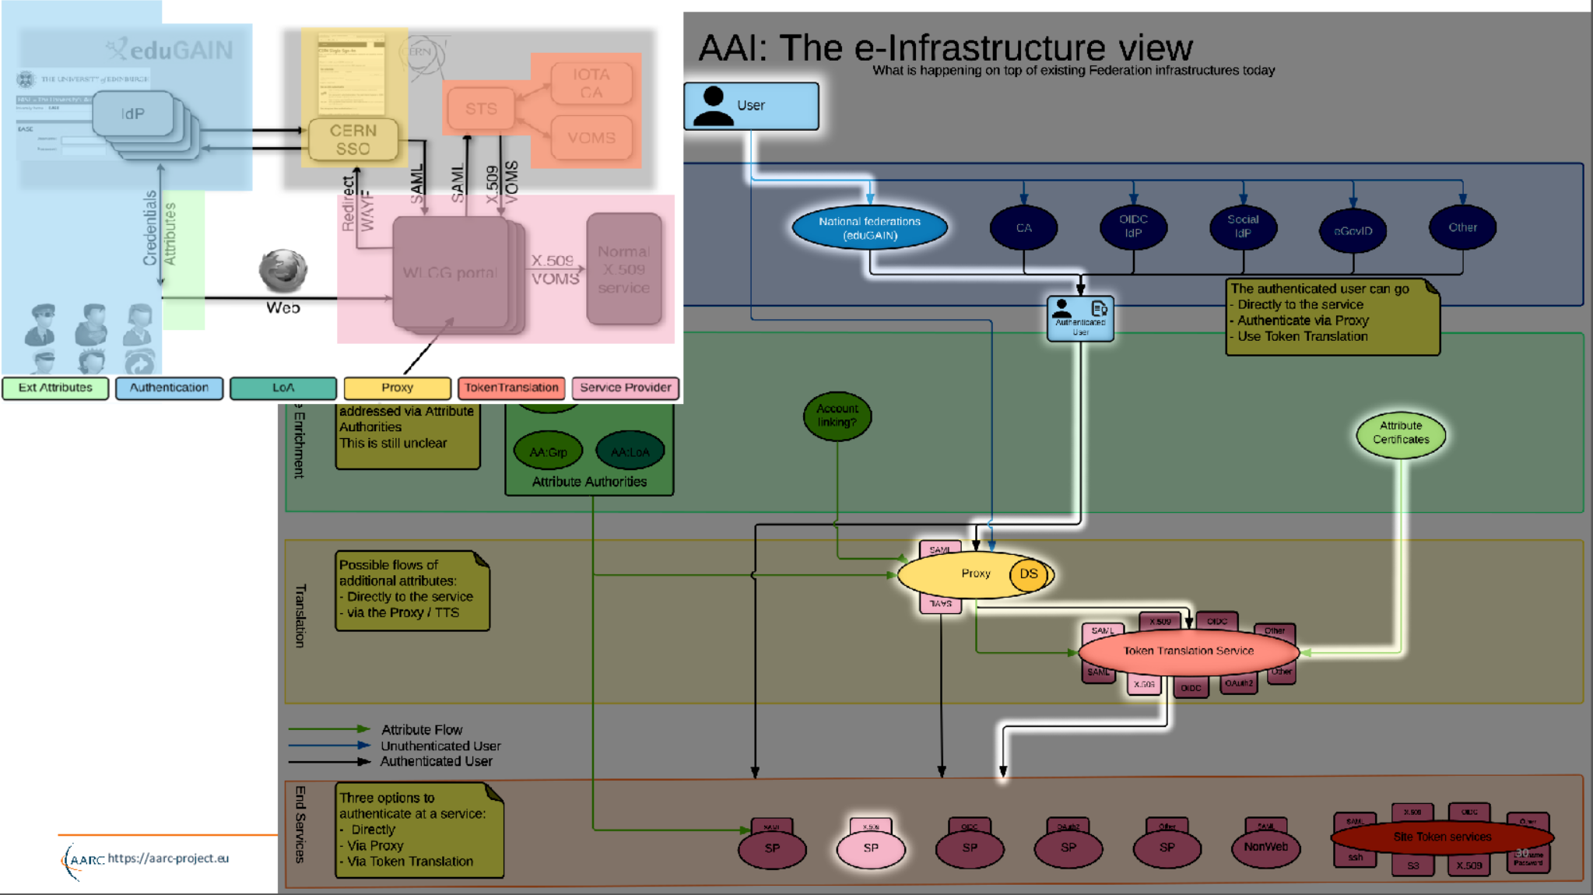
Example: WLCG
Although the TTS looks like a ‘box’, it is an interactive component that usually requires initially the user
to be ‘in the loop’
https://aarc-project.eu/wp-content/uploads/2015/11/20151102-JRA1.2-Blueprint-Status-Hardt.pdf

Slide 5



PKI targeting translation services – an overview
NCSA (IL,USA) operated service and project
InCommon backed MICS and IOTA
Generic ‘opaque’ certificate in Europe
Helps with PII data protection and integration with ESFRIs and e-Infrastructure
CERN wLCG IOTA CA
eduGAIN backed with added
CERN HR DB controls
GEANT Trusted Certificate Service TCS
could be turned into a translation service, when each subscriber would enable that since it has a subscriber-centric validation model

Slide 6
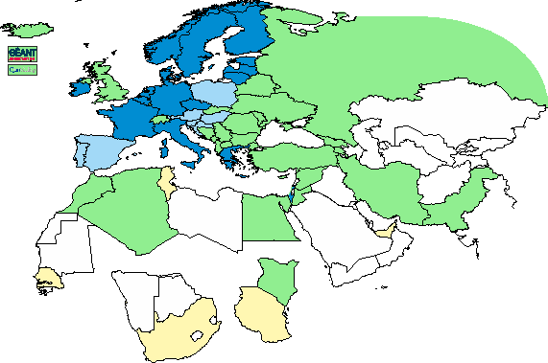
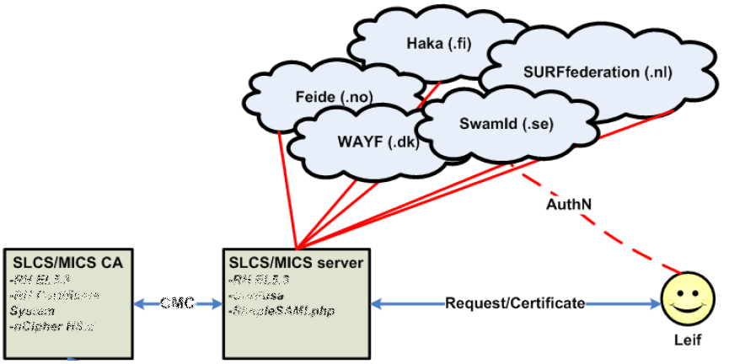
Leveraging R&E federations: TCS, DFN SLCS, CILogon … - with extended LoA
Bridging conventional R&E federated organisations to the trusted e-Infra world requires more
Release of relevant attributes, unique non-reassigned ID, higher assurance profile via contracts
Graphic: IGTF 2015
Graphic from: Jan Meijer, UNINETT

Slide 7
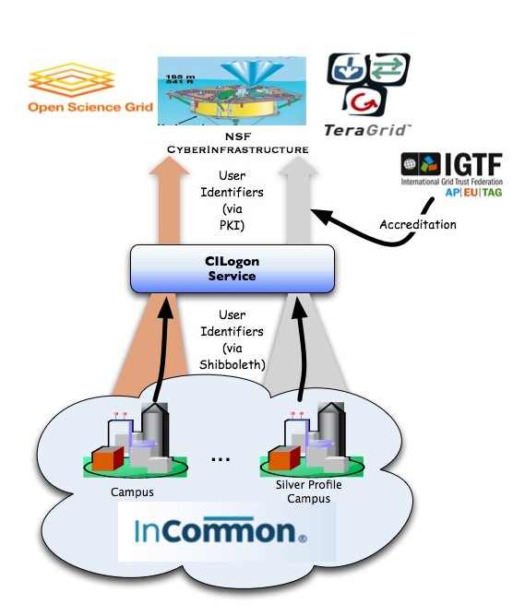
CILogon service and project (Jim Basney et al.)
Enable campus logon to CyberInfrastructure (CI)
  Use researchers’ existing security credentials at their home institution
  Ease credential management for researchers and CI providers
Multiple interfaces
SAML/OpenID Web Browser SSO
  PKCS12 certificate download
  Certificate issuance via OAuth
  OpenID Connect token issuance
  SAML ECP for CLI issuance
Slide content: Jim Basney, based on http://www.cilogon.org/docs/201106-cilogon-cern.pptx?attredirects=0&d=1
and http://www.cilogon.org/docs/20141030-basney-cilogon.pdf?attredirects=0&d=1

Slide 8
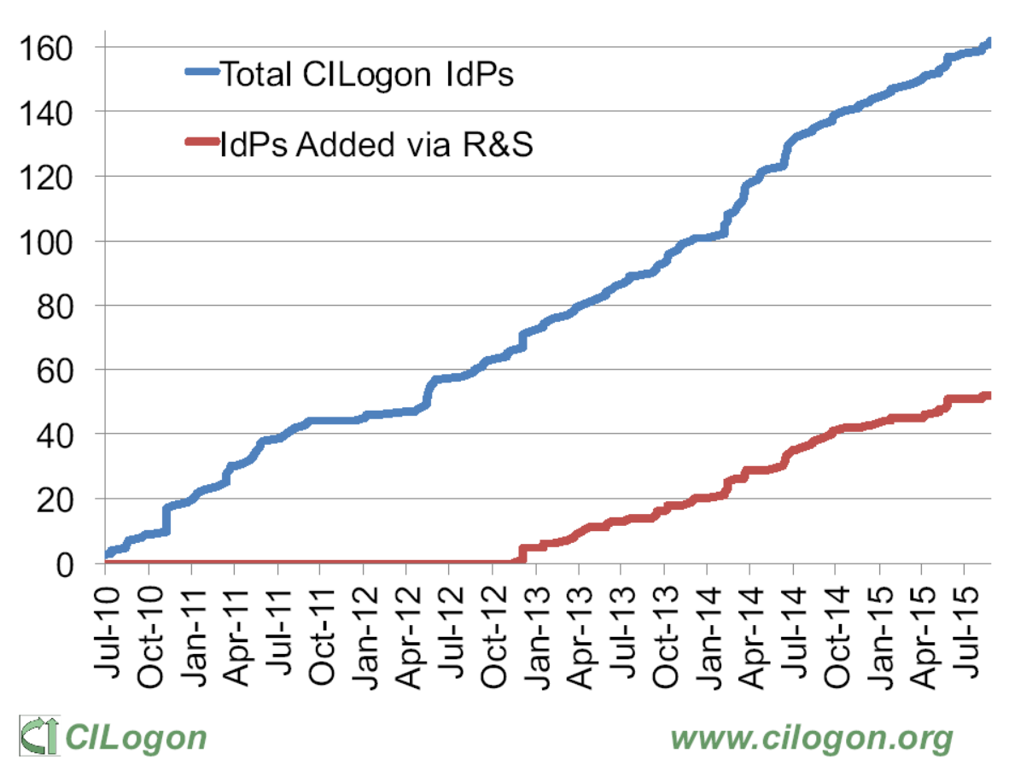
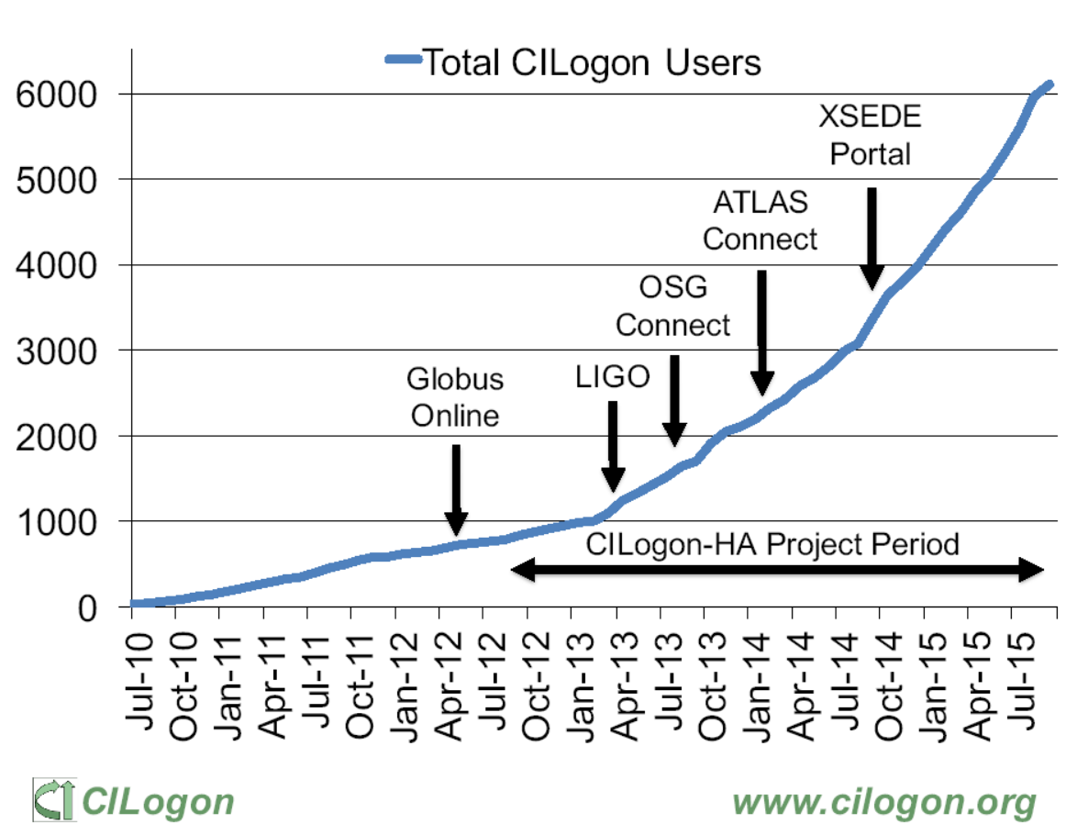
CILogon adoption in the US/InCommon
http://www.cilogon.org/docs/2015-09-cilogon-ha.pdf?attredirects=0&d=1

Slide 9
But many elements are coming together now!
e-Infrastructure & IGTF differentiated assurance profiles: DOGWOOD (IOTA), CEDAR/BIRCH (Classic, MICS)
Research communities establishing themselves higher-quality attribute stores
Better community management and more structured user communities
Attribute release conventions and scalable methodologies like REFEDS R&S
Higher awareness of multi-actor AAI and ‘VOs’ within the traditional R&E federation world
“Operationalizing” federations, e.g. through traceability and incident response (Sirtfi)
Software evolution for non-web use cases (OIDC – OAuth2, SAML ECP, MyProxy, …)

Slide 10
Selective trust for (federated) baseline assurance credentials in EGI based on the Acceptable Authentication Assurance policy
EGI – by design - supports loose and flexible user collaboration
300+ communities
Many established ‘bottom-up’ with fairly light-weight processes
Membership management policy is deliberately light-weight
Most VO managers rely on naming in credentials to enroll colleagues
A few VOs provide independent assurance elements
LHC VOs: enrolment is based on the users’ entry in a special HR database, based on a separate face-to-face vetting process and eligibility checks, including government photo ID + institutional attestations
ELIXIR directory and bona-fide management
NGI-consultancy-backed vetting for LToS community (likely, though as of yet unconfirmed)
… a few more, probably …
for these communities, combined IOTA identifiers + VO enrolment assurance is adequate for entry
EGI ‘combined-adequacy-model’ (or ‘cam’) policy bundle to be distributed in v1.81, due Feb 28th 2017
Acceptable Authentication Assurance : https://documents.egi.eu/document/2930

Slide 11
All the elements in place: Credential Translation & Management

Slide 12
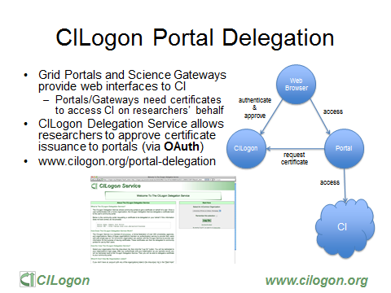
Slide: Jim Basney,
NCSA and CILogon

Slide 13
AARC SA1 “CIlogon-like Pre-Pilot”
Establish a CILogon (like) service in Europe
Integrated closely with R&E federation landscape (with all of full-mesh, H&S, mixed-models)
Integration with user community services and attribute services
Close co-operation with the CILogon Project (Jim Basney et al.)
Pilot work based on AARC (and also EGI) requirements gathering
FIM4R requests, alignment with known user communities (EGI evolution, ELIXIR)
Potential to support the EGI ENGAGE community ‘competence centre’ work
Leveraging existing components and services: CIlogon + ‘OAuth4MyProxy’ components, VOMS Attribute Certificate service, OIDC libraries, …
Fit in the existing policy framework: Approved Robots (and “PUSPs”), Trusted Credential Stores, PKP Guidelines, IGTF ‘DOGWOOD’ …

Slide 14
End-user credential hiding in the AARC CILogon-like Pilot
Do not assume any changes in the IdPs: no ECP, no new policies, no nothing (reality, sorry!)
Assume no major changes in the e-Infrastructures: interfaces remain a mix of Web and PKIX, policies remain mostly as-is
Should show results ‘fairly soon’ (concrete demos and integration that works quickly)
Leverage existing CILogon and MyProxy, thanks to the collaboration of AARC-CTSC/MyProxy
Beyond CILogon
CILogon assumes the e-Infrastructures (CIs) build the portals and interfaces
CILogon assumes that users in the end might retrieve certificates explicitly
Larger RIs and e-Infra in Europe could do it, but not the large number of small communities
So the AARC Pilots adds additional control elements: credential management, light-weight portal interfacing, (VOMS) attribute management, optional: opaque credential retrieval

Slide 15
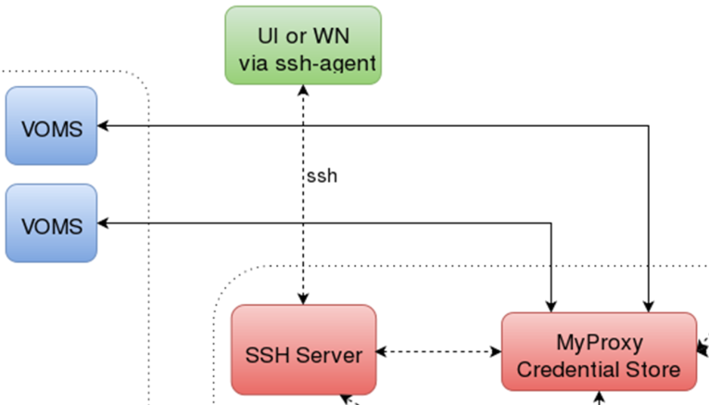
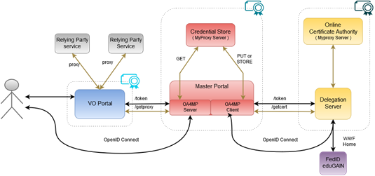
CILogon-like TTS Pilot - distributable elements

Slide 16
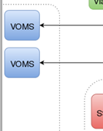
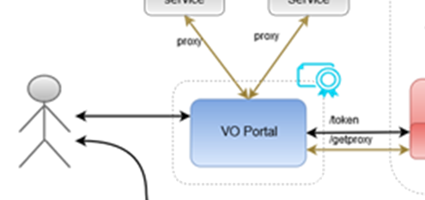
Blue: VO services and resources
Are around today, either self-managed or hosted, in most communities
Science gateways, portals, e.g. HADDOCK, Galaxy, generic ones, WebFTS, …
Omnipresent (and has unfortunately proven to be an easily compromised target,
especially when end-user instantiated in a cloud environment)
Will have to get credentials from the MPs, but should be able to
do so only for authenticated users
Downtime will impact its’ own users, but there will be
many of these (same service by different sites?)
VO management impact high (VOMS but usually hosted)
Considerations:
Ease of deployment, trust by MPs and end-users, usability, containment of incidents

Slide 17
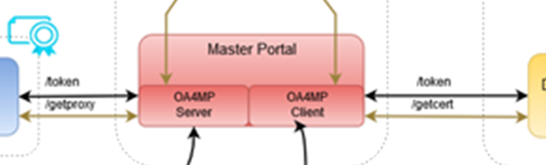
Red: the Master Portal (MP) and Credential Repository
Needs to be a trusted element (to permit credential storage by the TTS)
Requires some operational and security expertise (managed data centre, locked racks, access controls, ability to designate infrastructure for security operations, trained staff)
Connects to (many) workflow-specific VO portals
Connects to a (single, we hope!) Delegation Service/TTS-CA
The credential repository is a highly valuable resource for attackers
Similarly, a downtime of the MP/Credential Repo disables resource access for connected VO portals – so it can (and usually will) be a SPoF
Considerations:
scalability, A/R, trust by the VO portals

Slide 18
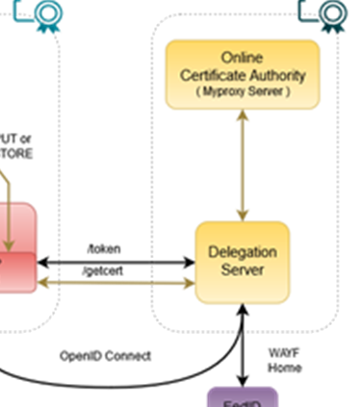
Yellow: the Token Translator/OA4MP/CA service
Is a highly trusted element:security and policy expertise, ability to maintain accreditation
Needs operational and technical capabilities: hardware security modules,
managed data centres, off-line and on-line secure areas, ROBAB-proof trained
personnel, ability to designate infrastructure for security operations
Connects to (a few, we hope) Master Portals (MPs)
Connects (many, we hope scalably) federations, IdPs and (few) SP-IdP-Proxies
May have to present a WAYF, if the VO portal does not pass IdP entityID
Deal with heterogeneity in global federations (uniqueID, heuristics, &c &c &c)
Needs to be a trusted element for Relying Parties (resource owners), users, and federations
Becomes extremely valuable target for attackers, and
downtime impacts all connected MPs, and (with delay) impact all VO portals anywhere
Considerations:
trust, recoverability, A/R, compliance, need to conclude specific agreements with MPs

Slide 19
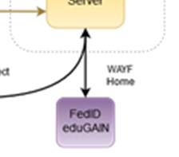
Purple: connected federations and IdPs (proxies)
In the generic case (conventionsl R&E federations) limited control possible
RI/eI proxy IdPs will provide more specific capabilities (uniqueness, user management ability)
Connects to many services, of which the DS/TTS is just one
Build on common technology (keep with SAML, no OIDC here)
Shared policy compliance: REFEDS R&S, Sirtfi
Negotiate non-scaleably only when needed (but a TTS must serve all users to prevent fragmentation!)
Cope with heterogeneity (i.e.: use a ‘filtering WAYF/entity filter proxy’)
Considerations:
Trust, scalability, non-intrusiveness, service-specific filtering

Slide 20
Some appeal?
Pilot appears to be appealing to RIs and e-Infrastructures
ELIXIR instance (demo) managed under SA1 on CESNET resources for EBI
EGI AAI (that’s why we are here at the AAI TCB):
initiated under ENGAGE JRA1 on GRNET resources for EGI
Continuing discussions on alignment with WLCG … (but who already have a setup anyway ;-)
Effect: expressions on interest received to host ‘the service’ (various elements) from many
With EGI being the most concrete by including support for it in the planned core activities

Slide 21
Where are we now?
Several instances deployed, for EGI and ELIXIR (usually co-managed by Nikhef)
Accredited ‘production demonstrator’ instance of the TTS set up in conceptually the ‘right way’:
  Dedicated servers, secure environment, FIPS 140 level 3 approved HSM, anchored in a stable way
  Policy and practices accredited (under the ‘unique-identifier-only’ DOGWOOD profile) at the IGTF
  – is good enough for some infrastuctures, and expected to be enough in EGI combined with managed communities
  Scalable negotiation model based on Sirtfi and REFEDS R&S section 6
  Model requirements on attached MPs defined (for key protection)
  Trust anchors in production (RCauth.eu and its “DCAROOT” HLCA)
Includes also the policy-filtering ‘proxy-WAYF’ to link to eduGAIN & individual authentication sources
But it’s a production demonstrator, not ensured production, so without an SLA, with limited capacity
… and it’s a bit of a ‘Heath Robinson’ service, using mostly pre-available hardware

Slide 22
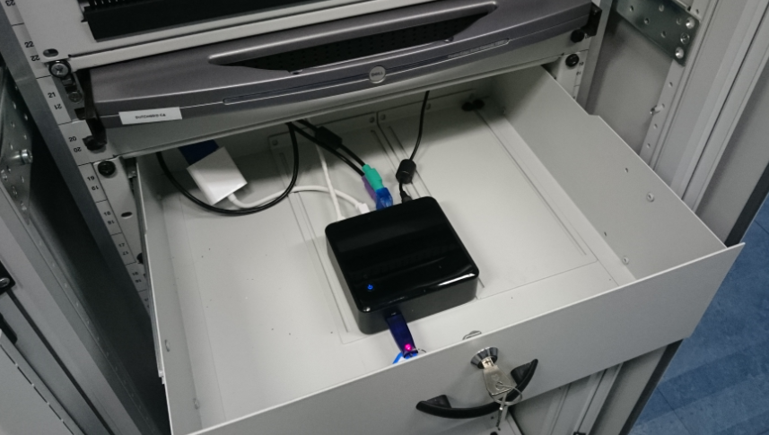
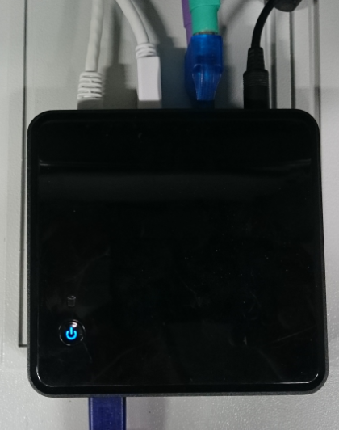
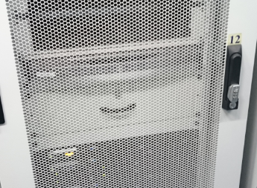
Pretty pictures

Slide 23
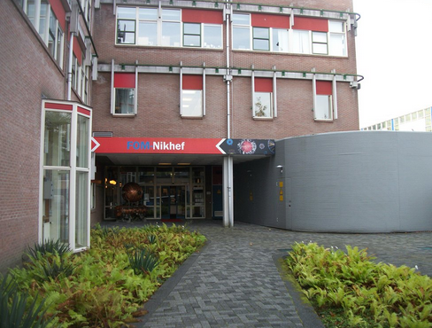
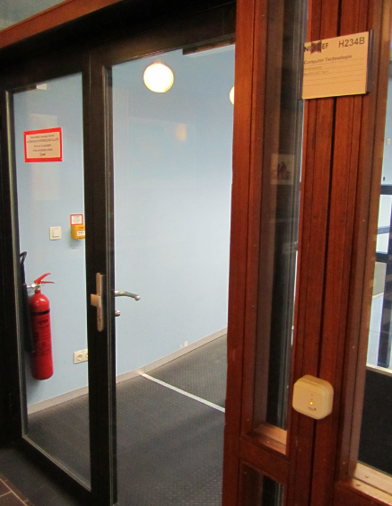
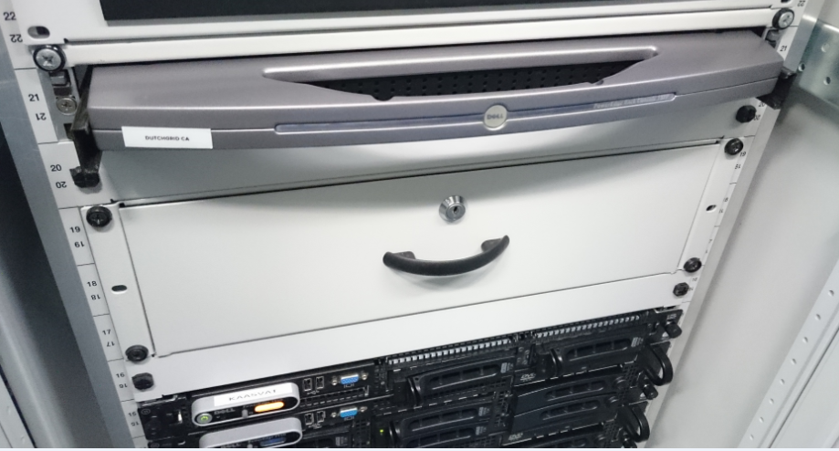
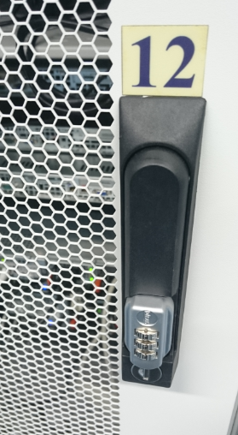
Physical controls are quite OK ☺
Located at Nikhef, Amsterdam, NL
Nikhef-specific part of the DC Housing Facilities
Room capacity 400kW, total ~ 2MW, 2N+ no-break
ID based access control, 24hr guard on-site, 2nd floor (above see-level)
CA and security systems in locked dedicated cabinet.
On-line CA signing system in locked drawer
CA signing system
Delegation Server

Slide 24
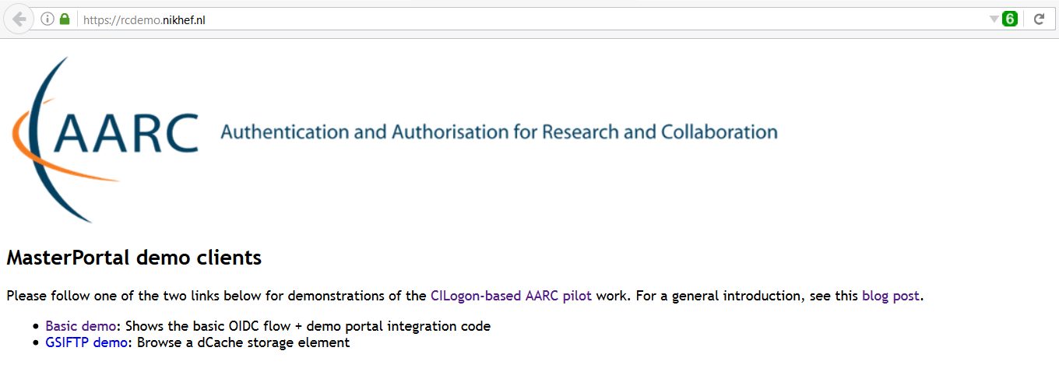
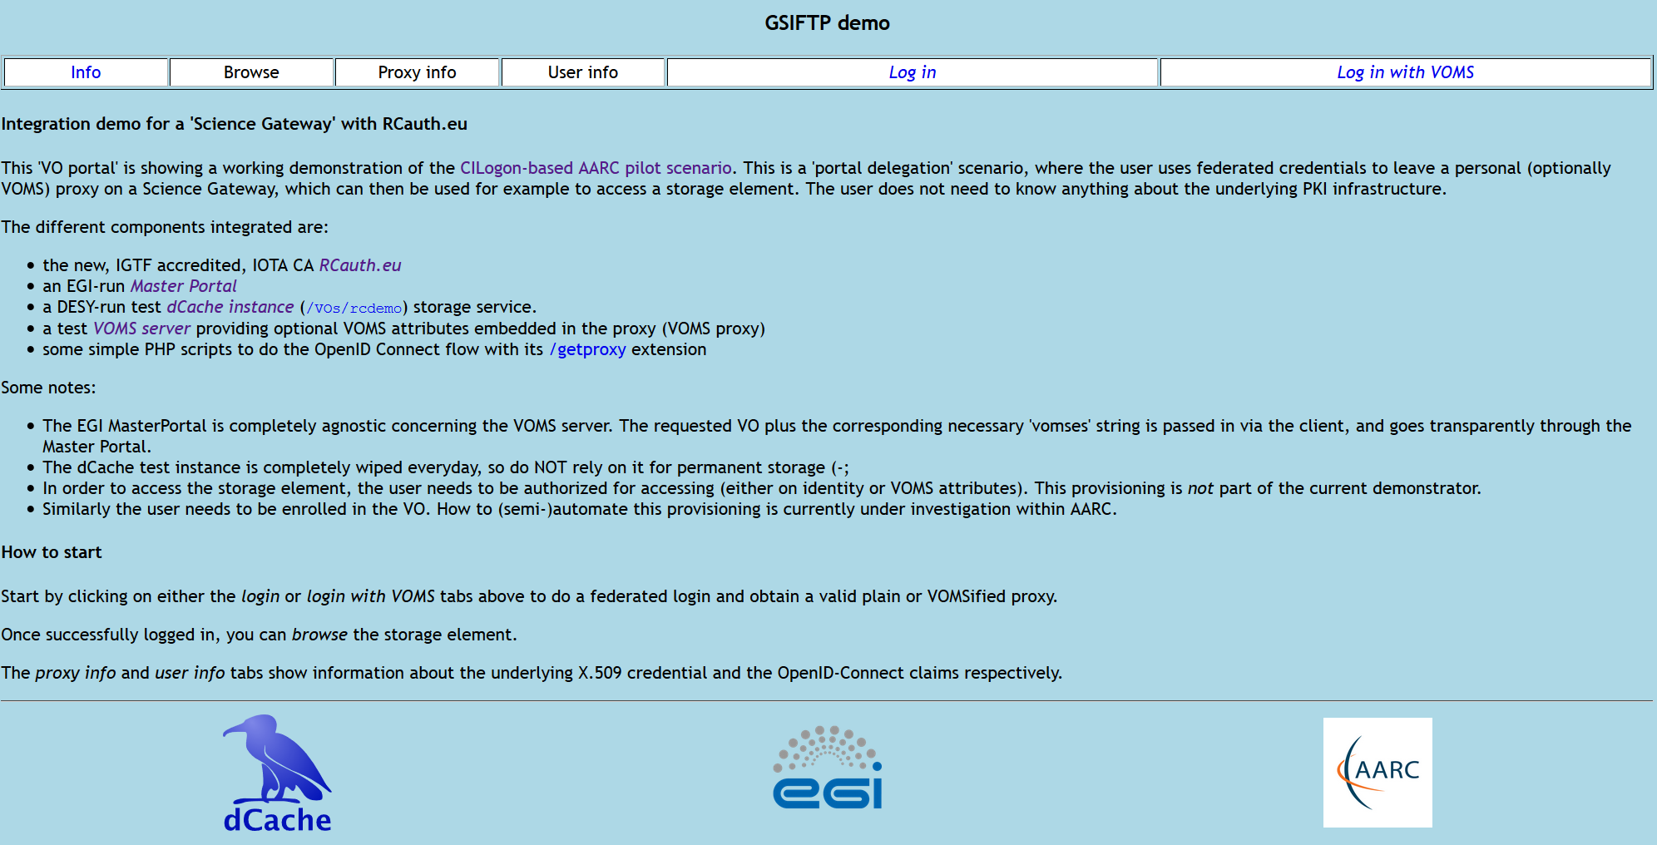
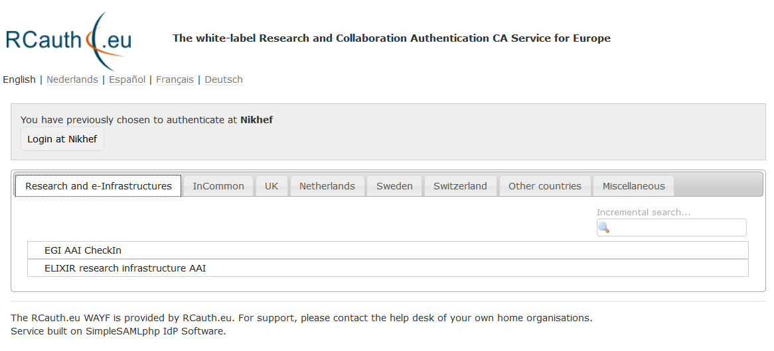
https://rcdemo.nikhef.nl/ -- with optional IdP hint for Infrastructures …

Slide 25
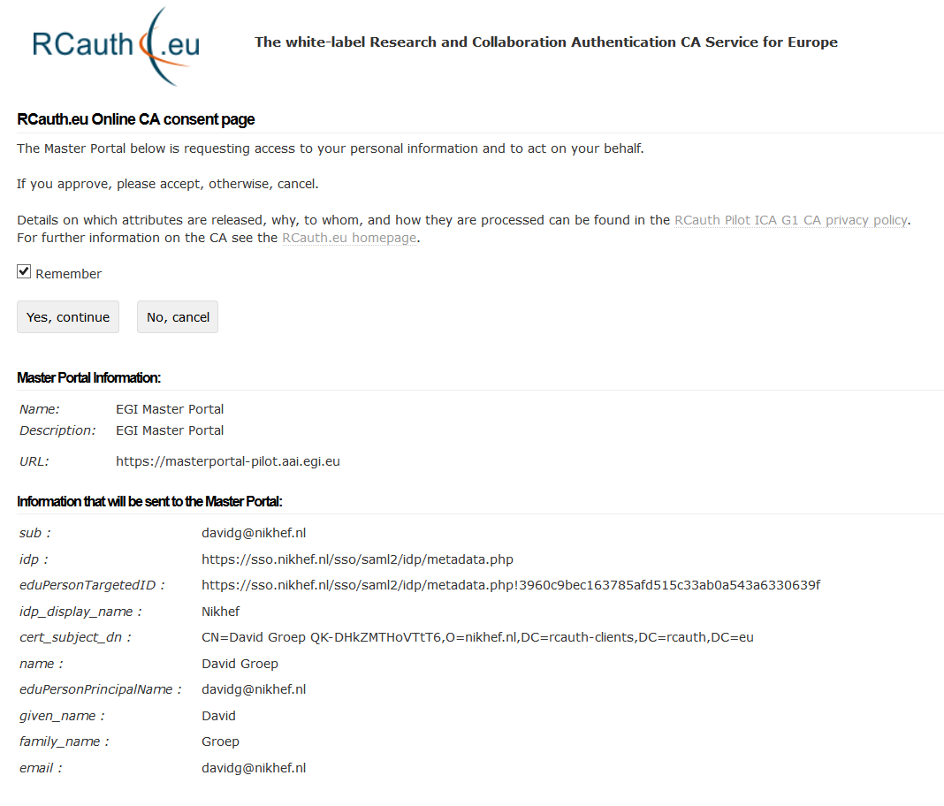
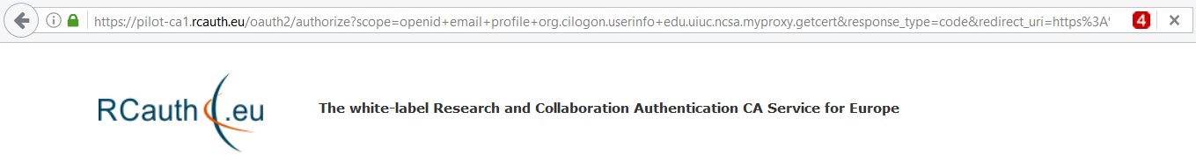
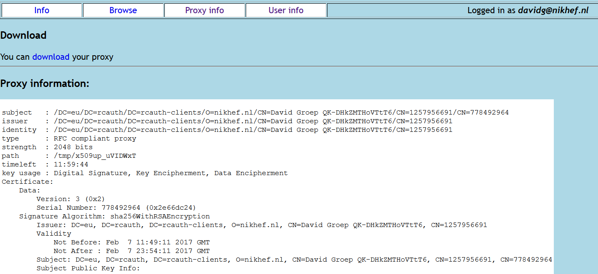
The Master Portal – necessary consent …

Slide 26
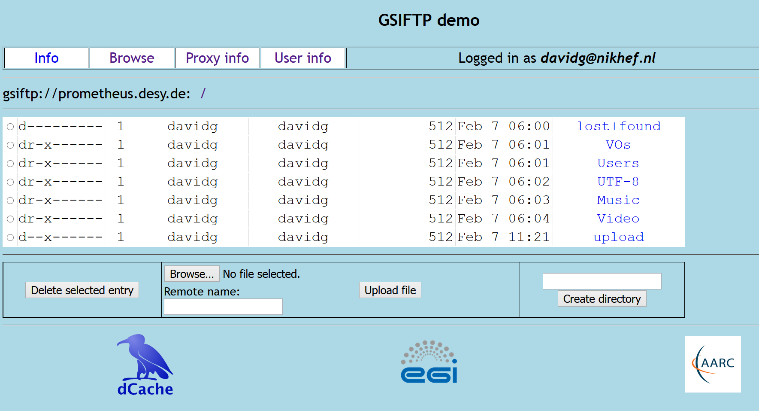
The Most Transient VO Portal in the World (the expedited data life cycle :-)

Slide 27
Sustainability models for the future: functional decomposition
https://wiki.geant.org/display/AARC/Models+for+the+CILogon-like+TTS+Pilot

Slide 28


Deployment and (financial) sustainability models
VO portals
High volatility of services and platforms – best left to user groups and (sub) communities
Light-weight linkage – technically OIDC, with need to connect explicitly with an MP (MP will distribute user credentials, and has some responsibility for trust) – frequent communications between VO portal and MP operators foreseen
Suggest to keep with users and (sub) communities
VO membership services: assume unchanged from today
Master Portal & Credential Store (plus CLI token acquisition)
More costly: runs specific glue software (maintenance cost), needs to have some secure infra
Needs to gain trust from users (for which it manages credentials), VO portals, and the TTS ICA
Some distribution options – but it needs professional hosting and management
operational capabilities & usability: not too many WAYFs or consent screens

Slide 29
MP operating options
At home institutions and research labs
  Easy to gain user trust: they ‘know’ the operator. With a small per-institutional user base not likely to get traction
  As soon as use of the service extends to VO portals outside the home org, branding (and trust) conflicts emerge
At generic e-Infrastructures (EGI, EUDAT, GEANT, …)
  Close to relying parties, so easier to gain trust, and connected to managed data centres that do secure hosting
  Pretty remote from the typical researchers, so unlikely to ‘know’ the many connecting VO portals
  VO portal builders/operators may not easily find a ‘generic e-Infra’ that is beyond their research domain
  Yet may work well for largish VOs, and for VOs whose management service is already outsourced to centres that are closely linked to a generic e-Infrastructure
At the (ESFRI) Research Infrastructures (like ELIXIR, …)
  Usually have a good IT (and trust) capability
  Are logically close to the VO portals and may feel ‘dutybound’ to support community portals in their research domain
  Are few enough in number so that the negotiation with a (single) back-end TTS ICA remains feasible
Outsourcing this as “SAAS” by the RIS
  can work – but outsourcing the management of connecting VO portals defeats the purpose – and needs a multi-tenant MP management implementation
Scale is important: if master portal is down, dependent VO portals may not work. Scope (#users), available service agreements, and (implicit) expectations may drive relationship between end-users (portals) and the MP operators.
operational capabilities & usability: not too many WAYFs or consent screens

Slide 30

DS/TTS back-end ICA options
Delegation service (with the ‘filtering proxy WAYF’) and the ICA are a joint trust enclave
Must jointly be run under the same policy management controls
Maintains the ultimate trust link to the generic relying parties (through IGTF accreditation)
Visible to end-user since user must knowingly permit transfer of the tokens to the MP store
May also become visible to the user if it has to present a WAYF
Has to establish relationships with the MPs and the upstream IdPs/federations
WAYF redirection may be primary factor to decide between single or multiple instances:
widest possible user base – and not steering user away from her or his only working IdP
operational capabilities & usability: not too many WAYFs or consent screens

Slide 31
DS/TTS back-end ICA options (I)
At ‘natural home’ organisation of the user or of the VO operator: not feasible trust-wise
At the generic e-Infrastructures (EGI, EUDAT, GEANT, …)
  They will have participating centres that can do secure hosting, and operational link eases trust
  May be unlikely to agree on a single one, so the WAYF problem emerges and creates silo’s
  Potential for ‘lock-in’ between the TTS and specific relying parties only within same infrastructure
  … if global accreditation is bypassed in favour of instantaneous easy satisfaction
  Cost may be prohibitive for even some of these entities, but they all have cost recuperation systems in place
At the (ESFRI) Research Infrastructures (like ELIXIR, …)
  The RIs also have access to capable participating hosting centres and could do it (or outsource it!)
  Same issue in creating silos, easy rapid bypasses, and lock-in
  There are even more RIs than there are generic e-Infras: scalability issues emerge stronger
  Smaller user base makes for higher per-user costs, but operational need may make it easier to bear
A single one for Europe
A single one for the world: great!

Slide 32
DS/TTS back-end ICA options (II)
At the generic e-Infrastructures (EGI, EUDAT, GEANT, …)
At the (ESFRI) Research Infrastructures (like ELIXIR, …)
A single one for Europe
  prevents silos and does away with any fronting-WAYF issues
  – but the fact that it needs to ask user to trust the master portal leads to branding questions ☹
  cost per user is lower due to scale, so recuperation could be easier – yet it has to be independent and thus has to hunt for funding through either fees (per user, per MP, per authentication?) or through contracts with e-Infra s or RIs
  lack of clear ‘ownership’ leaves it vulnerable to vendor longevity – too few subscribers give spiraling costs
  can maybe go through joint procurement (e.g. TCS has option for ‘enterprise-specific TA’ hosting)
  each e-Infra wants to be the exclusive provider of the back-end IdP, to provide the uniqueID
  – and certainly not allow the user to ‘escape out’ of the e-Infra/RI silo (can be done with entityID forwarding)
A single one for the world: great!
  but: legal issues in DP from the EU
  needs extremely high reliability, and probably regional distribution anyway for acceptable latency and 24x7 support

Slide 33
Costing the services
Highly depends!
what is ‘the service’? Delegation Service & WAYF? Master Portals?
technical elements only, or operational service implementation?
desired service level (support & availability)
extent of the service (number of users, communities, …)
Recuperation model very much a business decision as well:
can be anywhere between few kEur to well over 100+kEur cost per year (for >3year service)
EGI plans foreseen (co) support of the Delegation Service, CA back-end, and integration of (at least one) Master Portal
Collaboration working towards a single one for Europe is part of the plan
this necessitates a closely coordinated management authority for the Delegation Service/CA

Slide 34
Current State
Pilot working with the Research and e-Infrastructures supported through AARC SA1
Nikhef (and the Dutch National e-Infrastructure coordinated by SURF) run the operations today
Will continue to operate central parts (CA, DS) for as long as relevant, but
without any capacity increase and at the current SLA (“Nikhef Best Effort”)
We surely hope that a long-term sustainability model in place by end of 2017
That inclusively satisfies the pan-European e-Infrastructures and Research Infrastructures
EGI planning is well aligned with these wishes ☺

Slide 35
References
https://rcauth.eu/
https://wiki.geant.org/display/AARC/Models+for+the+CILogon-like+TTS+Pilot

Slide 36
davidg@nikhef.nl

