Slide 1
RCauth.eu – a white-label IOTA CA for Europe
On-line CA for the AARC CILogon-like TTS Pilot Service
David Groep
NA3 Policy and Best Practice Coordination, AARC
Nikhef PDP Advanced Computing Research
37th EUGridPMA Plenary Meeting
May 2016

Slide 2
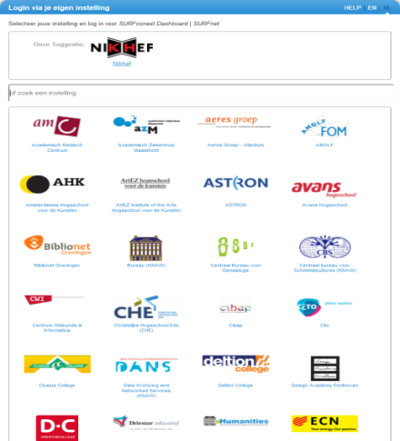
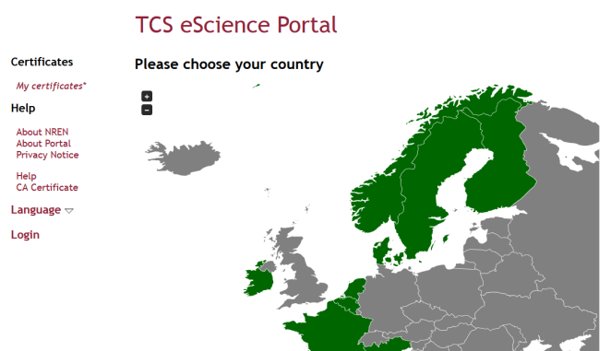
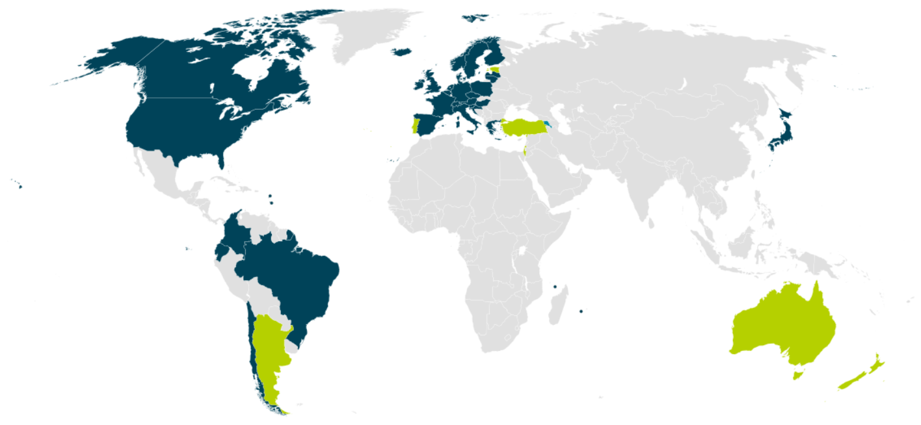


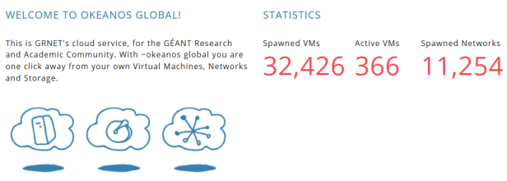

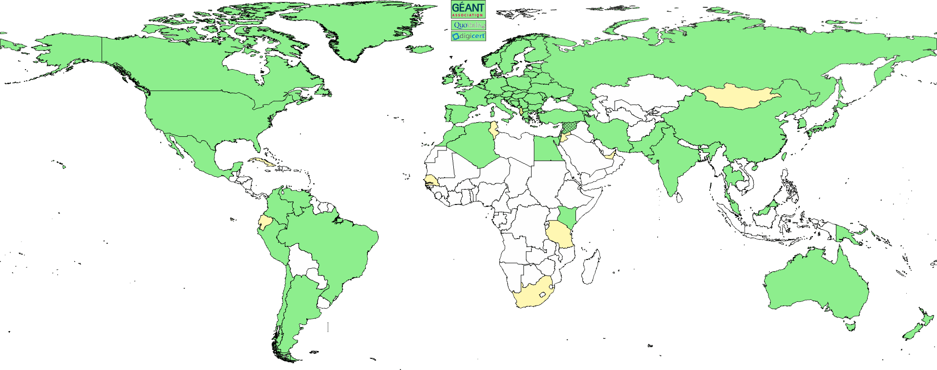
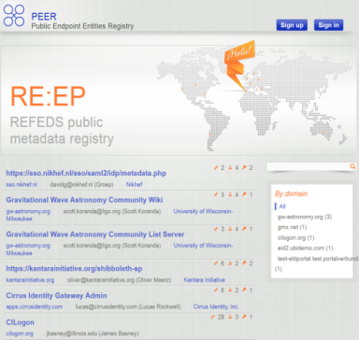
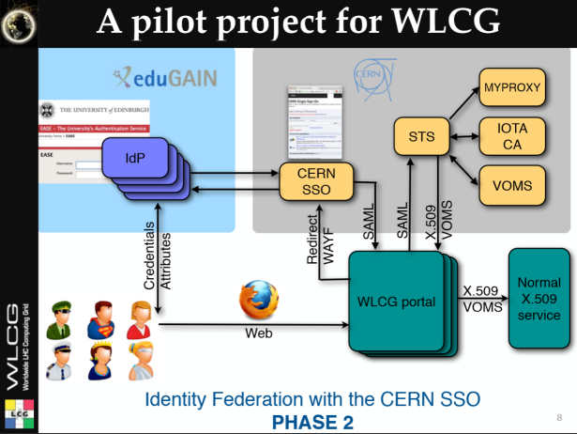

We live in a federated world …
wLCG FIM4R pilot
background: eduGAIN connected federations as of November 2014, and others – Brook Schofield, TERENA

Slide 3
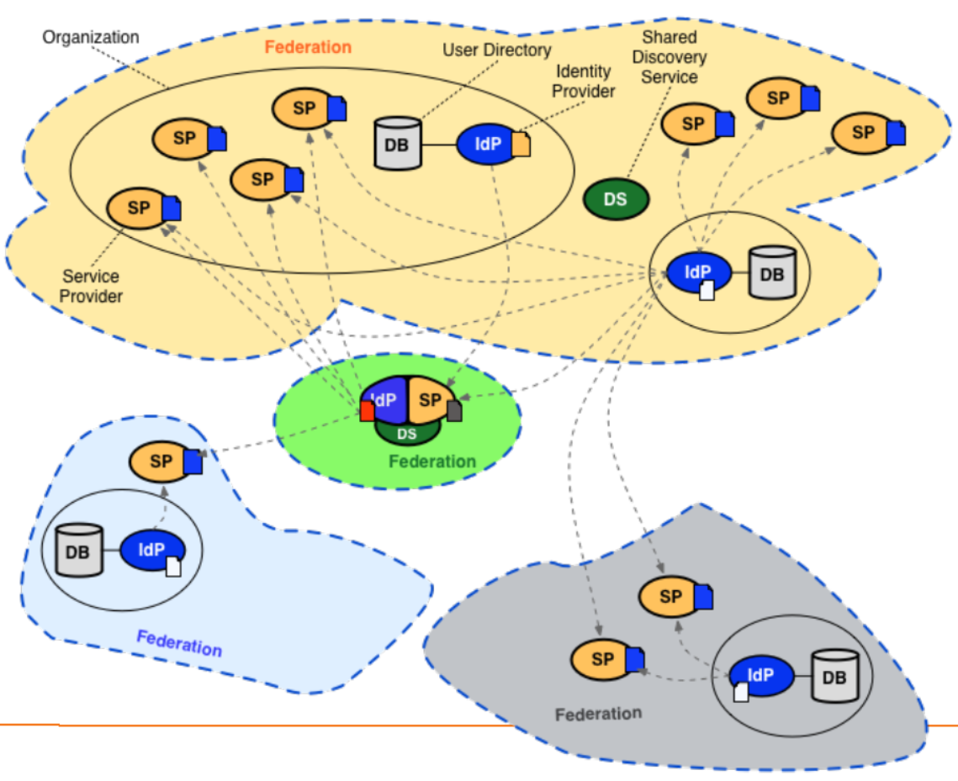
Conventional R&E federations (web-only, selected services only)

Slide 4
The AAI evolution of e-Infrastructures and Research Infrastructures
Most infrastructures move to completely hiding PKIX from the end-user
  Less credentials to manage, appearing ‘simpler’ to the user, but …
  EEPKI + RFC3820 proxies did solve both the CLI and delegation use case rather nicely!
Bridging and translation is the pragmatic approach
  Does not require major technical changes in existing R&E federations
  Allows for community-centric identities-of-last-resort (or first resort, for that matter!)
  Time line is more predictable, because fewer entities are involved –
  and those entities have a stake in and the benefits off the results
Emerging as a pattern in many Research Infrastructures that use CLI or brokerage
  ELIXIR, UMBRELLA, WLCG, INDIGO DC
  SAML->OIDC, SAML->X509, X509->OIDC, X509->SAML, OIDC->X509, …

Slide 5
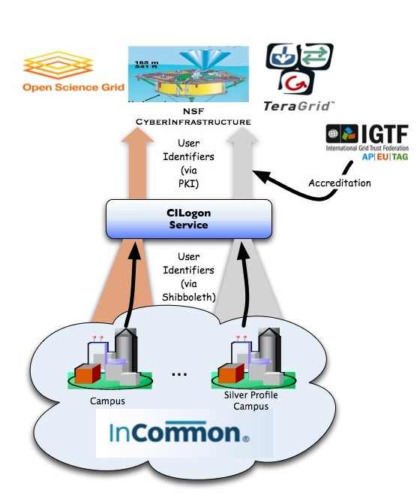
CILogon service and project (Jim Basney et al.)
Enable campus logon to CyberInfrastructure (CI)
  Use researchers’ existing security credentials at their home institution
  Ease credential management for researchers and CI providers
Multiple interfaces
SAML/OpenID Web Browser SSO
  PKCS12 certificate download
  Certificate issuance via OAuth
  OpenID Connect token issuance
  SAML ECP for CLI issuance
Slide content: Jim Basney, based on http://www.cilogon.org/docs/201106-cilogon-cern.pptx?attredirects=0&d=1
and http://www.cilogon.org/docs/20141030-basney-cilogon.pdf?attredirects=0&d=1

Slide 6
A CILogon-like Token Translations Service for Europe – RCauth.eu
Ability to serve a large pan-European user base without national restrictions
  without having to rely on specific national participation exclusively for this service
  serving the needs of cross-national user communities that have a large but sparsely distributed user base
Use existing resources and e-Infrastructure services
  without the needs for security model changes at the resource centre or national level
Allow integration of this system in science gateways and portals with minimal effort
  only light-weight industry-standard protocols
Permit the use of the VOMS community membership service
  attributes for group and role management in attribute certificates
  also for portals and science gateways access the e-Infrastructure
Concentrate service elements that require significant operational expertise
  not burden research communities with the need to care for security-sensitive service components
  keep a secure credential management model
  coordinate compliance and accreditation

Slide 7
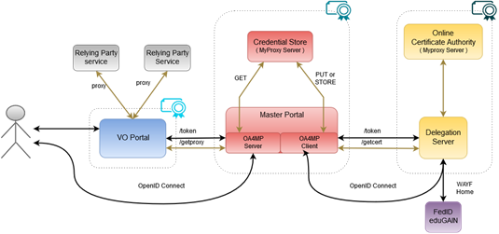
AARC CILogon-like TTS Pilot components

Slide 8
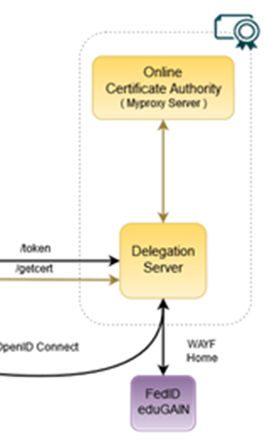
RCauth.eu – a white-label IOTA CA in Europe
Cover as much as R&E Federated Europe as possible
Scoped to research and collaborative use cases
In a scalable and sustainable deployment model
In today’s AARC Pilot we
build a production-worthy pilot service
which will operate for as long as necessary and useful
is supported by the Dutch National e-Infrastructure & Nikhef
… and that can, in the subsequent phase, be:
taken up by sustained infrastructures (RIs or e-Infra’s)
replicated by the same if so preferred
co-branded and migrated to a new managing entity

Slide 9
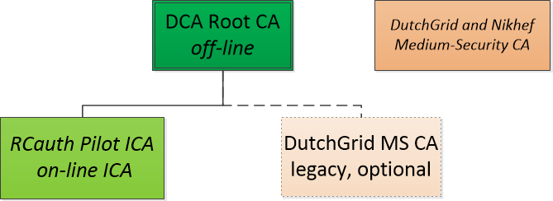
RCauth.eu – reference implementation
as a ‘white label’ service so that it can be integrated
operated by Nikhef and the Dutch National
e-Infrastructure (DNI) coordinated by SURF
will offer this service to any user … and
integrate with Master Portals from
established Research Infrastructures
and e-Infrastructures in Europe
run on a best-effort basis, for an indeterminate time period, and we plan to operate it as long as reasonably needed
expectation that the service elements be taken up by qualified other parties,
based on the sustainability model study
cannot guarantee it will run uninterrupted, run for any given number of years, or is suitable for any specific community
‘Operations, maintenance and ongoing accreditation status are funded exclusively and voluntarily by Nikhef and the Dutch National e-Infrastructure coordinated by SURF’

Slide 10
RCauth Pilot ICA G1 Policy and Practices

Slide 11
Scope of RCauth [1.1]
Operated by the “DutchGrid CA” – a collaboration under the DNI operated by Nikhef
for science and research
for the purpose of cross-organisational distributed resource access,
solely in the context of academic and research and similar, not-commercially competitive, applications.
“These services are
primarily intended for the practitioners of scientific research in the Netherlands,
appropriately taking into account the European and global nature of research and collaboration”
read: we will offer it to Europe and the world, but if the world diverges wildly from
the aims of the Dutch National e-Infrastructure we might have to reconsider

Slide 12
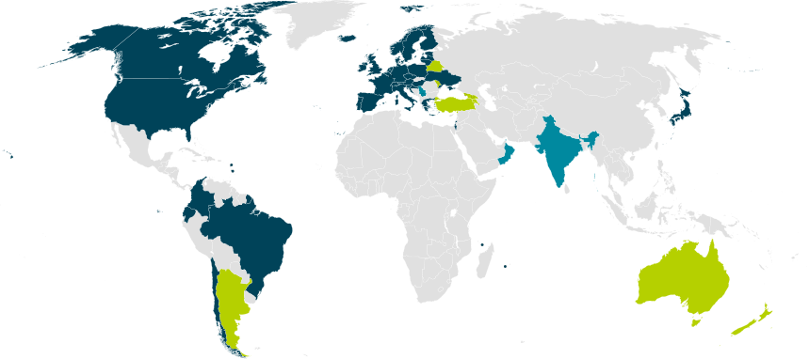
Our Registration Authorities: the Federated IdPs [1.3.2]
RAs are the eligible IdPs connected through a
Federated Identity Management System (FIMS)
primarily: ensemble of IdPs in eduGAIN that
meet the policy requirements of this CA
Eligible applicants are all affiliated to an RA
Three eligibility models
Direct relationship CA-IdP, with agreement declaration
Within the Netherlands: SURFconext Annex IX* compliance for all IdPs
Rest of eduGAIN: – “Sirtfi” security incident response and OpSec capabilities plus
– REFEDS “R&S section 6” non-reassigned identifiers and applicant name
are required, and tested via statement in ‘meta-data’ any by releasing the proper attributes
“IdPs within eduGAIN [#3] are deemed to have entered materially into an agreement with the CA”

Slide 13
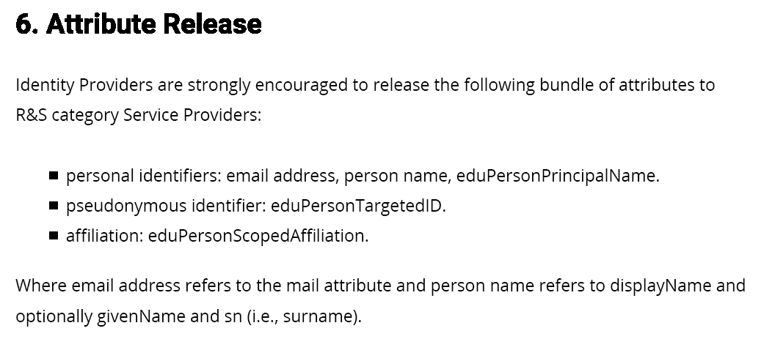
REFEDS R&S section 6
https://refeds.org/category/research-and-scholarship

Slide 14
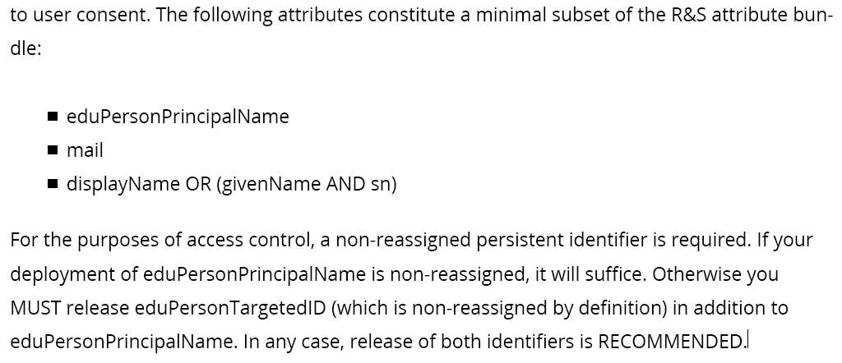
REFEDS R&S section 6 – the non-reassigned identifier

Slide 15
Sirtfi – Security Incident Response Trust framework for Federated Identity
A means by which to enable a coordinated response to a security incident in a federated context that does not depend on a centralised authority or governance structure to assign roles and responsibilities for doing so.
Defines a set of capabilities and roles associated with security incident response that an IdP
or SP organisation self-asserts. The Sirtfi trust framework posits that organisations asserting conformance with these will coordinate their response to security incidents.
Derived from the first four elements of the SCI Framework:
Operational Security: patch and vulnerability management; IDS and threat mitigation; service ownership management; user suspension and termination; CSIRT capability
Incident Response: CSIRT contact in meta-data; timely response; collaborate in IR; defined processes; privacy respect; TLP information sharing
Traceability: timestamped accurate logs are available; log retention process in place
Participant Responsibilities: users agree to an AUP; awareness and acceptance of the AUP
https://refeds.org/SIRTFI

Slide 16
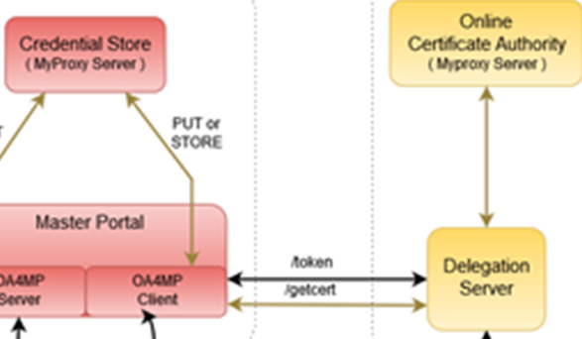
Other Participants
RCauth will seldom see individual users
authentication requests come via the Master Portals
we will (ourselves & directly!) authenticate the users, but …
… then release the certificate to the intermediary
In the RCauth case:
Explicit relationships required
Encoded via a (shared) OIDC Client ID and Client Secret
Contrary to e.g. Google, we will not accept ‘any’ OIDC client, but explicitly configure trust
Assessment based on PKP Guidelines and Trusted Credential Repository guidelines
Along with other criteria (for scalability): constituency, community size, relevance, &c

Slide 17
Operators and Administrators [1.5]
Three roles defined
Managers of the DCA Service (by construction: joint with all other DCA CAs)
Administrators of the RCauth Pilot ICA (de facto joint with all other DCA CAs)
Operators, “individuals that can issue certificate and publish updated revocation information” (specific to the RCauth service)
The Operators know how to activate the HSM and access the off-line machine, but have no access to the private key outside the HSM*
There are more people that have selected access to some physical systems (Housing, ICT operators staff), but they don’t know any activation data and controls are in place to make physical interventions complicated (padlocks, protected cabinets, nested safe boxes)
* they may have physically touched encrypted key material, but don’t know the activation data

Slide 18
Repository [2.1]
https://www.rcauth.eu/
CP/CPS document
CA certs, link to superior (“DCA Root”) CA
CRL – issued daily for a period of 30 days (and after each revocation)
Supplementary policy documents (links to SURFnet contract Annex IX, eduGAIN, R&S, Sirtfi)
Sign-up form (unilateral) for explicit IdPs
– but the fact that you can sign up does not mean you’ll be accepted…

Slide 19
Naming – getting a reasonable, non-reassigned name

Slide 20
Name uniqueness [3.1]
Federations, with their distributed responsibility model, always face a consistency challenge
  Release of any identifier associated with a individual person (‘privacy concerns’)
  Guaranteeing non-reassignment of an identifier - has not played a major role inside any single org till now
  Agreeing on how to name the name (attribute) of the authenticated user is different
  Ability to trace an identifier to a person – and how to find the person at all
We have to rely on the RAs (institutions) to provide an identifier that we can use - even if the institution itself does not consider RCauth.eu on its own worthy of specific attention
We can leverage grander schemes and agreements
eduPerson schema – almost all federations use this, and most require specs compliance
REFEDS Research and Scholarship (“R&S”) specification – aligns attribute release (and federation registrars check for minimal compliance
Sirtfi – new standard to harmonize incident response and opsec capabilities and processes

Slide 21
eduPerson and REFEDS R&S
MACE-Dir (an I2 activity originating in the 90s) manages the eduPerson schema, defining
eduPersonPrincipalName – a scoped point-in-time unique identifer, which could be (but usually is not) privacy preserving: “davidg@nikhef.nl”, s23612@uvt.nl
eduPersonUniqueID - a scoped persistent non-reassigned identifier, which should be privacy-preserving: 44f7751265a6e8b228f9@nikhef.nl
eduPersonTargetedID – a scoped transient non-reassigned identifier, different for each targeted service in the world – so every SP gets a different one of these: urn:geant:nikhef.nl:nikidm:idp:sso!27c8d63ed42c84af2875e2984
Others of interest
eduPersonAffiliation – staff, faculty, member, employee, student, library-walk-in, affiliate
eduPersonScopedAffiliation – same, but with a scope: member@nikhef.nl
eduPersonAssurance – open string representation (but see RFC XXXX!)
schacHomeOrganization – subdomain-name styled identifier of the home org (from SCHAC)

Slide 22
Constructing a non-reassigned subjectName
/DC=eu/DC=rcauth/DC=rcauth-clients/O=orgdisplayname/CN=commonName
All the uniqueness will be in the commonName – that will “contain sufficient information such that an enquiry via the issuer allows unique identification of the vetted entity”
The orgdisplayname is used to “identify the identity management system via which the identity of this person was vetted” [IOTA 3.2]
So if – over time – the orgdisplayname may conflict, be re-used, or is ambiguous, we don’t need it: we will use the commonName to trace and ensure non-reassignment!

Slide 23
Organisation name
We have 64 characters (per ISO X.501), so we should be careful! We will try – in order:
value of the schacHomeOrganisation (“O=nikhef.nl”)
organisationDisplayName (“O=Nikhef”)
the IdP entity ID is a URL: the domain name element (“O=sso.nikhef.nl”)
the IdP entity ID is a URN: the entityID (“urn:geant:nikhef.nl:ct:fedid:sso:idp”)
If it’s longer than 61 characters? Then we truncate and add “...”:
https://birk.wayf.dk/birk.php/wayf.ibc.dk/simplesaml/saml2/id...
Istituto Zooprofilattico Sperimentale dellXAbruzzo e del Moli...
and we make (limited) PrintableString out of it:
Vysoká škola chemicko-technologická Praze → Vysoka skola chemicko-technologicka Praze
\nUniversite de Namur\n → XUniversite de NamurX

Slide 24
CommonName – the big challenge
Requirements
Contain a representation of the real name of the applicant as asserted by the IdP
the opaque option is not very friendly to downstream services
Must be unique and non-reassigned
Allow – via the issuer – unique identification of the entity in the stated IdP
So we construct it out of 2 or 3 elements
Readable name of the applicant (max. 40 characters)
Unique Shortened Representation of the identifier provided by the IdP (16 characters)
Optional: ensured-uniqueness sequence number (max. 3 digits)

Slide 25
commonName – readable name element
REFEDS R&S gives a subset of attributes that should be released: displayName, givenName + surname, commonName. We construct the readable name from
the displayName attribute from the IdP
the givenName attribute, followed by a space, followed by the sn attribute from the IdP
the commonName (cn) attribute from the IdP
and then make it printable using java.text.Normalizer.Form.NFD and map the remainder to “X”
If IdP sends us this UTF-8 | Representation in CN RDN
Jőzsi Bácsi | Jozsi Bacsi
Guðrún Ósvífursdóttir | GuXrun Osvifursdottir
Χριστος Κανελλοπουλος | XXXXXXX XXXXXXXXXXXXX
簡禎儀 | XXX

Slide 26
commonName – USR of the IdP identifier
Provides for issuer-assisted traceability of people. We pick and record the attribute used, preferring:
eduPersonUniqueID attribute (scoped) from the IdP (the ‘perfect’ attribute, available nowhere)
eduPersonPrincipalName (scoped) attribute from the IdP (a good attribute, OK 97% of the time)
eduPersonTargetedID constructed from IdP entityID and IdP-local (but targeted) opaque value
This is then pushed through the “Unique Shortened Representation”:
first 16 characters of the base-64 encoded binary representation of the SHA-256 hash of the value, with any SOLIDUS (“/”) characters replaced by HYPHEN-MINUS (“-“) characters
This mapping leaves 96 bits of entropy of the hash and a collision probability of 1 in 10²⁸
If the IdP gives | USR in CN RDN
40ea621a0a7355cf4fb1ca8d4f22a53d@nikhef.nl | uXmc85peL+35ONPO
davidg@nikhef.nl | Kydx8KT6xc1CHjD1
https://sso.nikhef.nl/sso/saml2/idp/metadata.php!02f7dfbb9605cf549e874bce55bfe0de030e9140 | Wgt0ltSuF7BAA7FM

Slide 27
Uniqueness heuristics – what you get is definitely unique [3.1.5]
Non-reassignment is the hardest challenge for global federated ID – since most IdPs were not designed with this feature in mind (contrary to most OIDC IdPs)
ePTID and ePUID are non-assigned by specification – but ePUID is hardly used, and ePTID is very transient (it could change more often than you like)
ePPN is usually OK, but ‘usually’ is ~97% - not good enough for IOTA
RCauth uses heuristics to ensure non-assignment - at the expense of maybe annoying users:
“… only re-associated when the entityID of the FIMS IdP is the same, and all of the attributes value of the set (eduPersonUniqueID, eduPersonTargetedID, eduPersonPrincipalName, displayName, sn, givenName, commonName) that have been provided on the initial authentication remain unchanged.”
And we keep a database forever to detect such changes – but take care to preserve privacy:
sha256(commonName RDN) | seqno | sha256(salt+attr-value-set) | salt | attribute-set-used

Slide 28
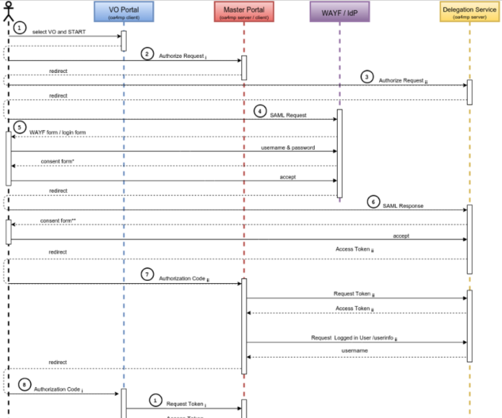
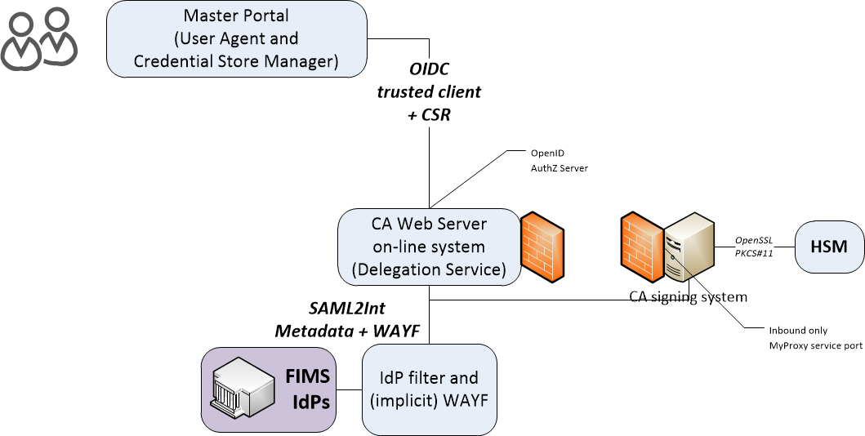
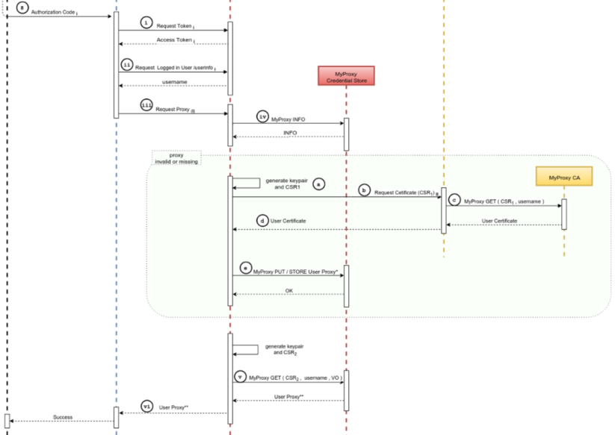
Identity validation and proof of possession [3.2]
All identity vetting is through the FIMS home IdP
Request is sent as PKCS#10 CSR in a channel authenticated by
the FIMS (and rewrapped as an OpenIDConnect OIDC flow)
Permissible IdPs under the control of RCauth – via the filtering WAYF

Slide 29

Enrolment and issuance [4.2]
Users could enroll directly, but are in practice using a Master Portal/Credential Manager
The credential manager is explicitly trusted by the RCauth CA service
  exchange of OIDC client secret to authenticate
  ‘need to know’: (master) portals will hold user credentials, and we need to protect users per the PKP Guidelines
CA web server checks the incoming assertions from the IdP filter
  Uses CILogon/OAuth4MP software based on the Shibboleth SAML implementation over server-side TLS
  Connected for now to the SURFconext WAYF
  … and yes, we check the SAML signature ;-)
When moving to wider support of eduGAIN
WAYF IdP filter check the incoming SAML2Int
  Use multi-domain WAYF over server-side TLS
  Based on SimpleSAMLphp implemenation with custom filters
  … and yes, also here we’ll check the SAML signature
FIMS IdPs: leverage existing infrastructures

Slide 30
Other quality checks [4.2, 4.3]
At least 2048 bit RSA keys for the end-entities
Check for key re-use (which could e.g. identify master portals that try to use a shared key)
We log all signing and key usage operations on the CA signing system
We can revoke certificates (manually) if need be
Any attributes that should be scoped are checked with the scope in the meta-data entry

Slide 31
Physical and technical controls

Slide 32
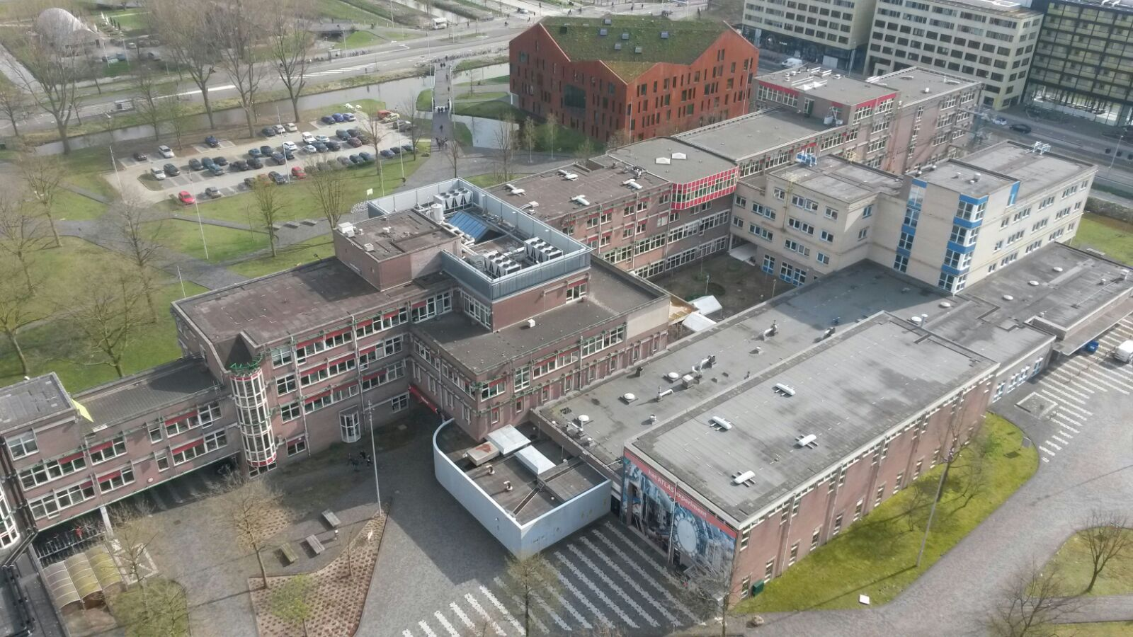
Nikhef

Slide 33
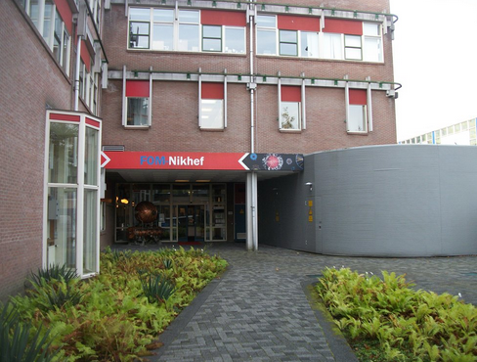
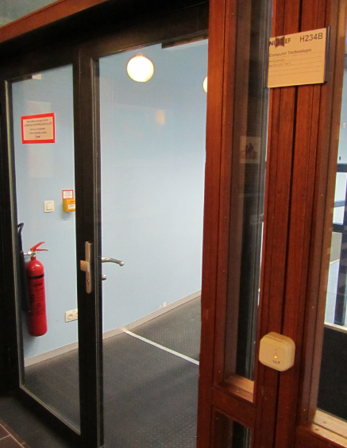
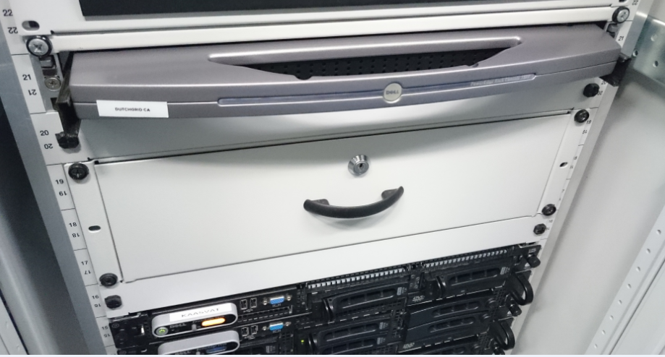
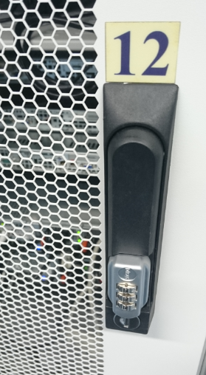
Physical controls
Located at Nikhef, Amsterdam, NL
Nikhef-specific part of the DC Housing Facilities
Room capacity 400kW, total ~ 2MW, 2N+ no-break
ID based access control, 24hr guard on-site, 2nd floor (above see-level)
CA and security systems in locked dedicated cabinet.
On-line CA signing system in locked drawer
CA signing system
Delegation Server

Slide 34
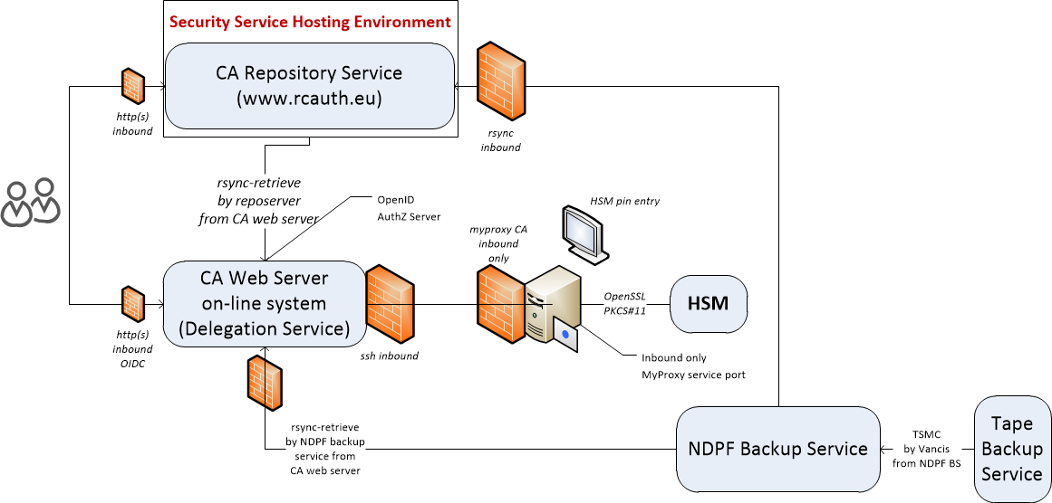
Logical set-up

Slide 35
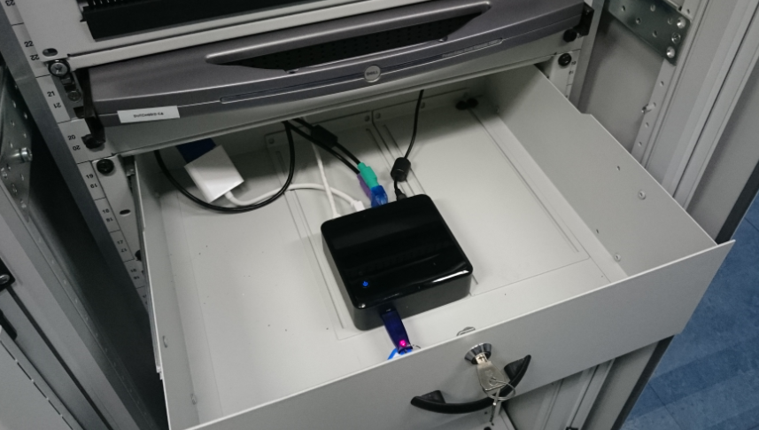
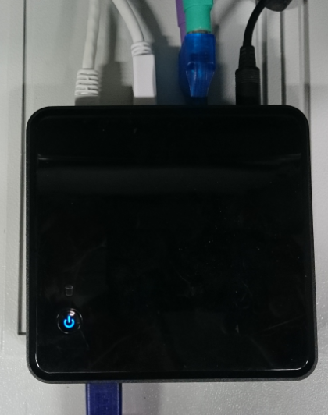

More pretty pictures

Slide 36

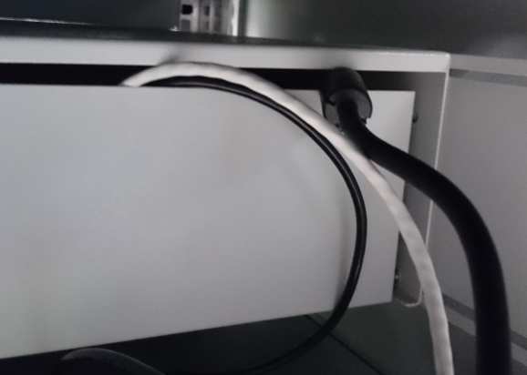
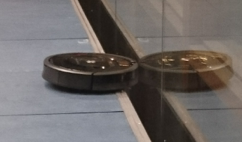
Slightly more ugly pictures …

Slide 37
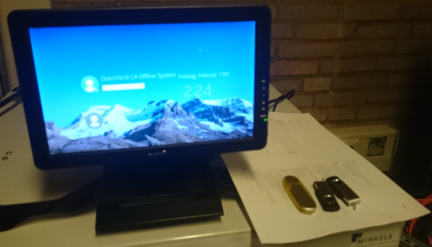
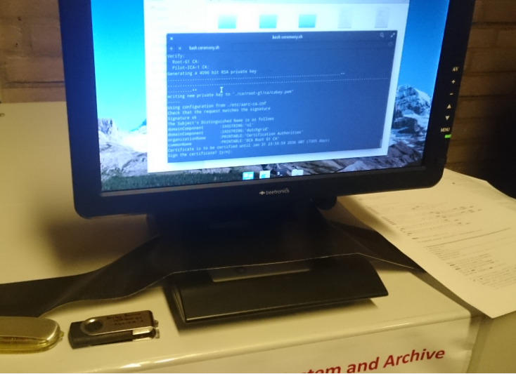
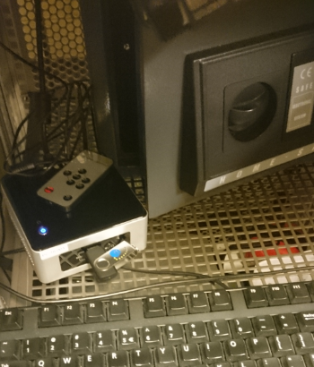

Key generation ceremony
In a single ceremony session generated both the off-line DCA Root and the RCauth.eu ICA
Prepared a script that would generate the key pairs,
self-sign the Root, and with the Root sign the RCauth ICA
Reviewed script with experts and operators for RCauth
Stored print-out of the script in the archive
Created copies on USB sticks and on the same day
deposited in off-site safe

Slide 38
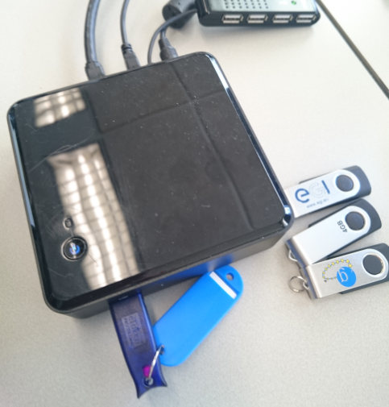
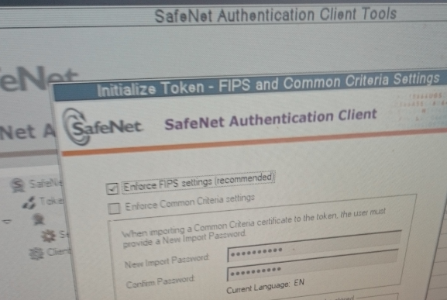
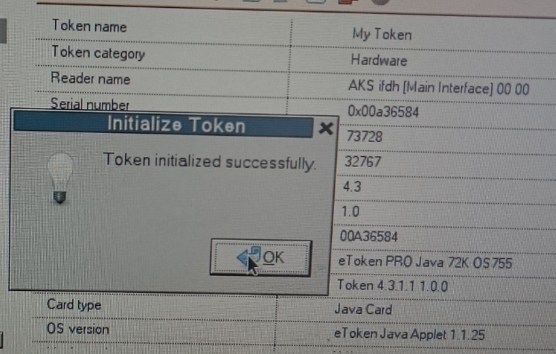
It is on the HSM …

Slide 39
Other operational considerations: auditing [5.x]
For the RCauth.eu ICA
Audit data: need to balance data protection rules, federation policy, and IGTF RP needs
  We keep system audit logs for three years, both system logs (boot, login), HSM activation, and issuance/revocation
  The ePUID, ePTID, and ePPN are not considered personal data, but still hashed and protected
  Note: logs are archived 6 month after expiration (19 months after issuance) and then may be used for dispute resolution only
  All data is backed up: for the on-line systems (incl signing system) is goes to a local disk backup and then (for 90 days) to a redundant tape storage both 0.5 and 15 miles away
CA operators and administrators can act singly (except during the key generation ceremony)
We can restore service based on recipes (Ansible scripts) and one surviving CA admin
For the DCA Root
It has no personal data, since everything is organisation or function based
It keeps data for longer and need not worry too much
Access to the DCA Root is limited to two people …

Slide 40
Other operational considerations: activation data, IT controls [6.x]
Key pair and protection
The HSM we use (and almost all other USB HSMs) are limited to 2048-bit RSA keys
Activation data protection: we have USB copies of the private key on-site and 30mi out
IT security controls
CA web server, repo server, and backup
are together on a ‘security’ network segment
Segment also holds the PMA servers, and the
Nikhef NDPF controlled web servers –
no public logins, only O(10) people in total
CA signing system is on a dedicated physical link
All backup-services are pull-based from backup host

Slide 41
Distribution of secrets – trade confidentiality vs. ROBAB-proof-ness
For the off-line Root
  encrypted private key on USB sticks in two safes: one the common DutchGrid CA safe, one of the CA Manager
  passphrase: kept by the (two) Root CA Administrators, in a separate place (not the same safe), but in whole
  you cannot distribute the key in fragments and retain redundancy with just two people
  but sharing the key with more people makes it more prone to leakage
  Administrators are all permanent employees of Nikhef in good standing (> 10 years in service)
For the RCauth on-line HSM-held key
  encrypted private key backup on USB sticks in the (same) two safes
  Passphrase of the backup with the same two CA Administrators in the same way
  PIN of the HSM known to the CA Administrators and an operator – but the operator does not have access to the safes, nor the back-up copies, not the passphrase of the backup. But does know the whole PIN
  Operators and Administrators are all permanent employees of Nikhef in good standing (> 8 years in service)

Slide 42
Privacy policy and legalese

Slide 43
Privacy of Personal Information [9.4.1]
Balance several sources of wisdom
IOTA (DOGWOOD) AP and (incident response) needs of the relying parties
Requirement to keep the ‘minimum necessary’ based on EU directive and regulation
Privacy policies of the Dutch SURFconext federation where we cannot change them
Stay within the basic waiver clauses of the Dutch DPA – so that we do not have to file this service with the DPA registrar and can actually start operating this decade and without lawyers
Be transparent to all users, and give them clear statements as to what we do with their data
Not all documents assume the same basis for processing. We uphold that RCauth is a service offering to customers, where we have a legitimate interest to process some minimal data,
and that changing names or loosing access to the service will not have significant impact on any individual (we’re a pilot service, after all)

Slide 44
Section 9.4.1 – the Privacy Plan
“The DCA Service will keep a minimal amount of personal information,
compatible with the goals of the service.”
Goal of the information processing
User consent
What information will be processed and stored
Where will the information be processed
Who may receive the information
User information and transparency
Protection of personal data
Information retention periods

Slide 45
Selecting what to keep – and for how long
issued certificates, including name of the user, the IdP-provided administrative number, and the users affiliation (organisation name) for 6 months after the end of the validity period of the issued certificate, i.e. in total up to 19 months
underlying information used to construct any shortened names also for 19 months
After 19 months: this is all archived and kept for 3 years after issuance, but accessible only for dispute resolution (that purpose limitation keeps us within the Dutch DPA Waiver Art. 29)
All necessary detailed attributes (which we use for tracing mis-issuance, debugging, &c)
for 6 months after the initial authentication – and this is not archived further
All salted and non-salted hashes: forever! We state that these are not personal data anymore

Slide 46
Certificate and CRL profiles

Slide 47
Certificate Profile: DCA Root CA G1
Version: 3 (0x2)
Serial Number:
8c:d3:6d:c8:e8:3d:2b:41:63:6f:8c:cf:3a:51:e4:53
Signature Algorithm: sha256WithRSAEncryption
Issuer: DC=nl, DC=dutchgrid, O=Certification Authorities, CN=DCA Root G1 CA
Validity
Not Before: Feb 1 00:00:00 2016 GMT
Not After : Jan 31 23:59:59 2036 GMT
Subject: DC=nl, DC=dutchgrid, O=Certification Authorities, CN=DCA Root G1 CA
Public Key Algorithm: rsaEncryption - Public-Key: (4096 bit)
X509v3 extensions:
X509v3 Basic Constraints: critical
CA:TRUE
X509v3 Key Usage: critical
Certificate Sign, CRL Sign
X509v3 Subject Key Identifier:
52:7C:2F:B2:82:59:49:A6:F0:08:1D:EF:68:05:A1:35:32:8A:28:27
X509v3 Certificate Policies:
Policy: 1.3.6.1.4.1.10434.4.2.7.1

Slide 48
Certificate Profile: RCauth Pilot ICA G1 profile
Version: 3 (0x2); Serial Number: 09:f5:d7:56:8e:89:e8:87:d8:16:53:fe:ab:c7:84:e2
Signature Algorithm: sha256WithRSAEncryption
Issuer: DC=nl, DC=dutchgrid, O=Certification Authorities, CN=DCA Root G1 CA
Validity
Not Before: Feb 1 00:00:00 2016 GMT
Not After : Jan 31 23:59:59 2036 GMT
Subject: DC=eu, DC=rcauth, O=Certification Authorities,
CN=Research and Collaboration Authentication Pilot G1 CA
Public Key Algorithm: rsaEncryption - Public-Key: (2048 bit)
X509v3 extensions:
X509v3 Basic Constraints: critical; CA:TRUE
X509v3 Key Usage: critical; Certificate Sign, CRL Sign
X509v3 Subject Key Identifier:
1F:BD:44:D3:CD:C4:D9:90:17:E9:F7:34:98:60:A3:44:5B:7D:06:47
X509v3 Authority Key Identifier:
keyid:52:7C:2F:B2:82:59:49:A6:F0:08:1D:EF:68:05:A1:35:32:8A:28:27
X509v3 Certificate Policies:
Policy: 1.3.6.1.4.1.10434.4.2.7.1.1
X509v3 CRL Distribution Points:
Full Name: URI:http://crl.dutchgrid.nl/dcaroot/g1/crl/crl.crl

Slide 49
Certificate Profile: RCauth EEC client certificate
Version: 3 (0x2); Serial Number: XX:XX:XX:XX:XX:...
Signature Algorithm: sha256WithRSAEncryption
Issuer: DC=eu, DC=rcauth, O=Certification Authorities,
CN=Research and Collaboration Authentication Pilot G1 CA
Subject: DC=nl, DC=rcauth, DC=rcauth-clients,
O=orgDisplayName, CN=Readable Name USRREPRESENTATIN 666
Public Key Algorithm: rsaEncryption - Public-Key: (2048 bit)
X509v3 extensions:
X509v3 Basic Constraints: critical; CA:FALSE
X509v3 Key Usage: critical; Digital Signature, Key Encipherment, Data Encipherment
X509v3 Subject Key Identifier: XX:XX:XX
X509v3 Authority Key Identifier:
keyid:1F:BD:44:D3:CD:C4:D9:90:17:E9:F7:34:98:60:A3:44:5B:7D:06:47
X509v3 Certificate Policies:
Policy: 1.3.6.1.4.1.10434.4.2.8.1.1; 1.2.840.113612.5.2.2.6
X509v3 CRL Distribution Points:
Full Name: URI:http://crl.rcauth.eu/pilot/g1/crl/crl.crl
X509v3 Extended Key Usage: TLS Web Client Authentication

Slide 50
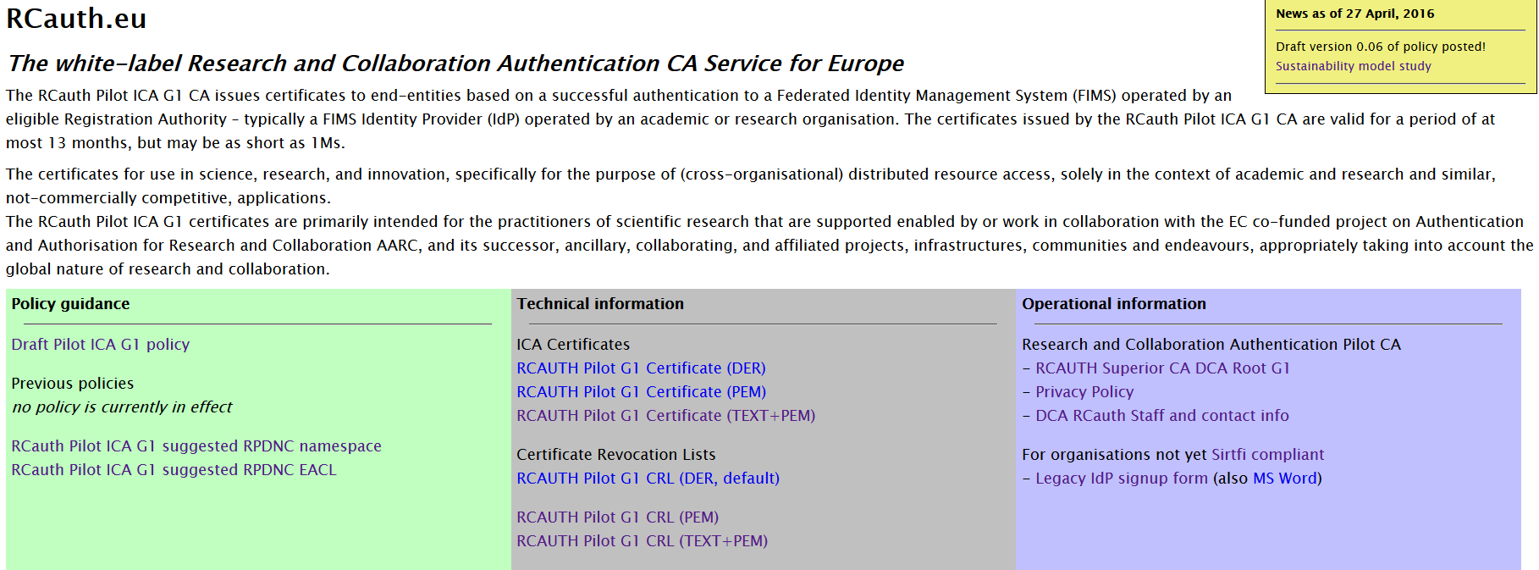
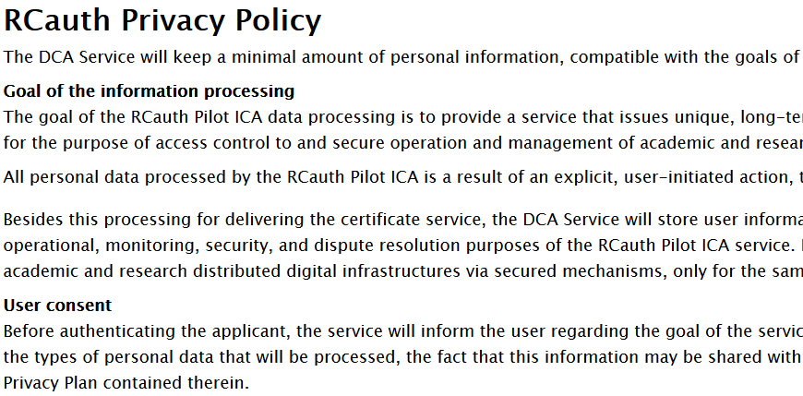
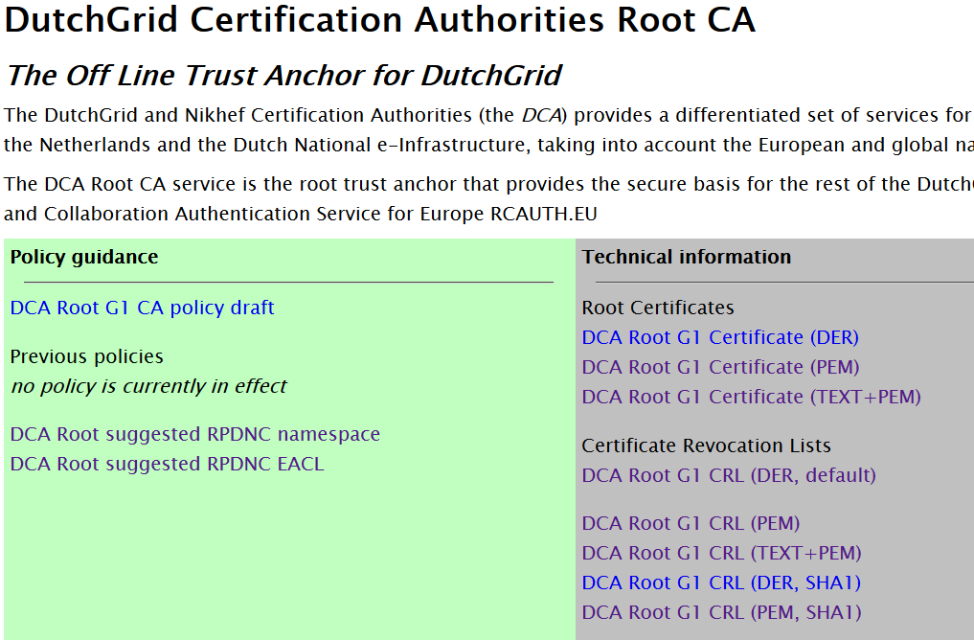
On-line repositories and services
www.rcauth.eu
Policy
Links to privacy statement
Suggested namespaces
pilot-ca1.rcauth.eu/oauth2/…
Delegation Server (https only)
Accessible via master portals
ca.dutchgrid.nl/dcaroot/

Slide 51
And Now?
Thanks a lot to Reimer for a very detailed review of both RCauth ICA and the DCA Root!
Next:
Connect the service to the production SURFconext and then push to eduGAIN
Finalise the WAYF/IdP filter implementation (which we need once we get to eduGAIN)
Get to production – so that
we can use this for the ELIXIR and EGI services, and ELIXIR can start with EGI test services
promote the deployment of VO-CA-authZ decisions and get IOTA accepted in EGI and wLCG
declare success as soon as possible and start encouraging users that using good distributed AAI is useful, and linking R&S federations and PKI-based delegation services is feasible!

Slide 52
Longer term sustainability
The CILogon-like TTS Pilot contains several distinct elements
Delegation server & WAYF/Filter
CA signing system
Master Portal(s)
VO portals
and business (sustainability) models have been identified for each of these.
“Nikhef strongly encourages the e-Infrastructures, Research Infrastructures, and user consortia to find a persistent and sustainable solution within a reasonable amount of time. We note that the AARC project will end around mid 2017.”
So we’re now talking to the e-Infras and RIs on who will or should operate which elements
https://wiki.geant.org/display/AARC/Models+for+the+CILogon-like+TTS+Pilot

Slide 53
www.rcauth.eu/policy
davidg@nikhef.nl
ca@rcauth.eu

