Slide 1
IGTF EUGridPMA 48 in collaboration with
GN4-3 EnCo, EOSCH-ISM, and AARC-Community
January 22-24, 2020
CESNET, Praha, CZ

Slide 2
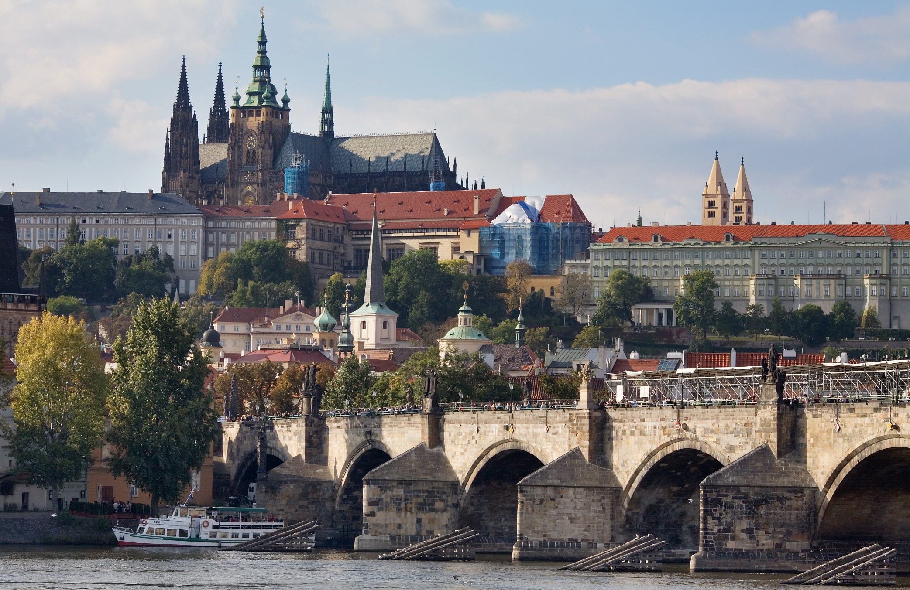




Still fresh?

Slide 3
Some logistical information
On-line agenda and materials at
https://www.eugridpma.org/agenda/48
Please upload presentations – use the ‘usual’ password if required
Videoconference and presentation sharing
https://www.nikhef.nl/pdp/video/?m=eugridpma

Slide 4
Introductions
For minutes of last meeting see https://www.eugridpma.org/meetings/2019-09/
Note takers, anyone?
Agenda planning
EnCo planning

Slide 5
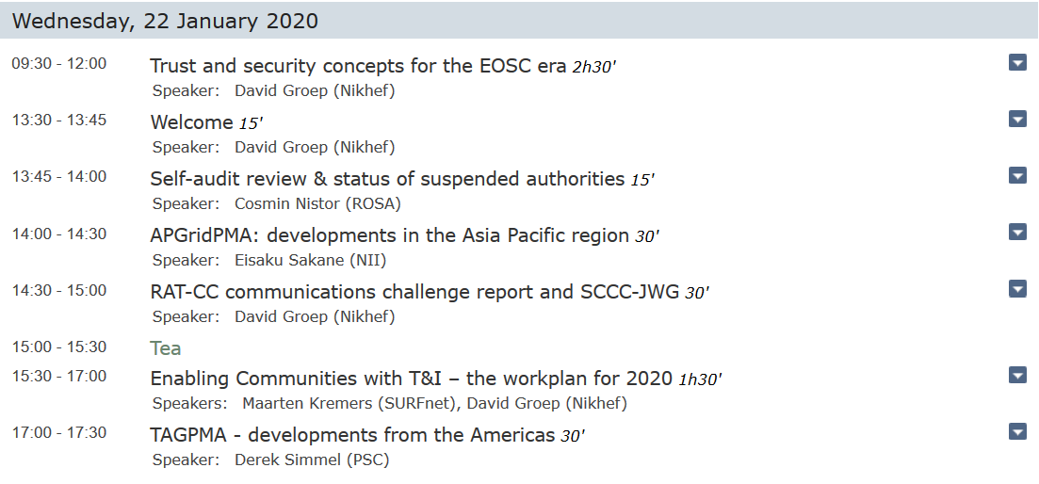

Slide 6
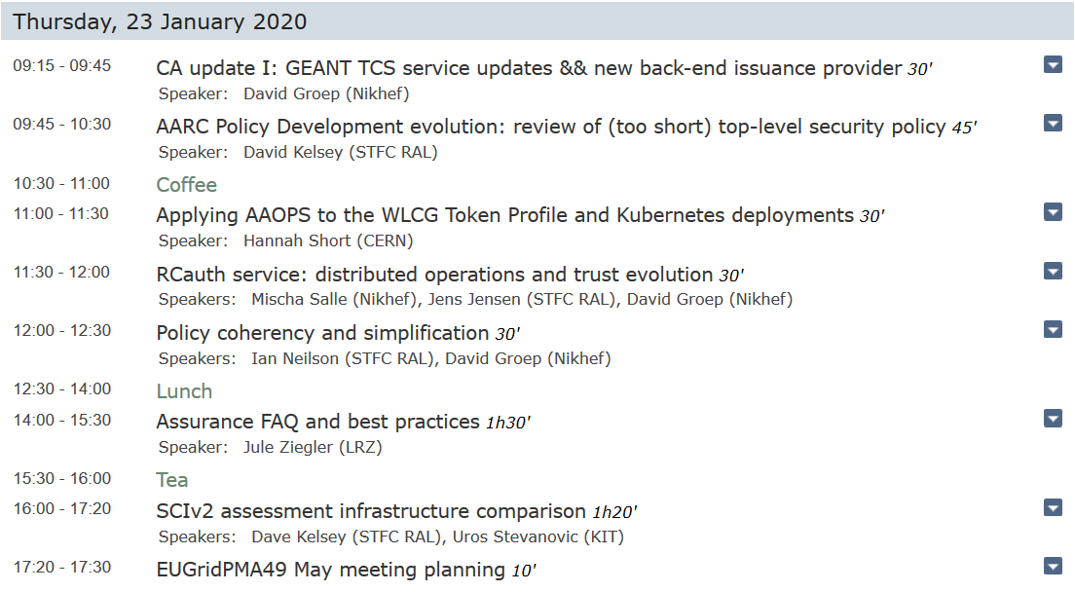

Slide 7
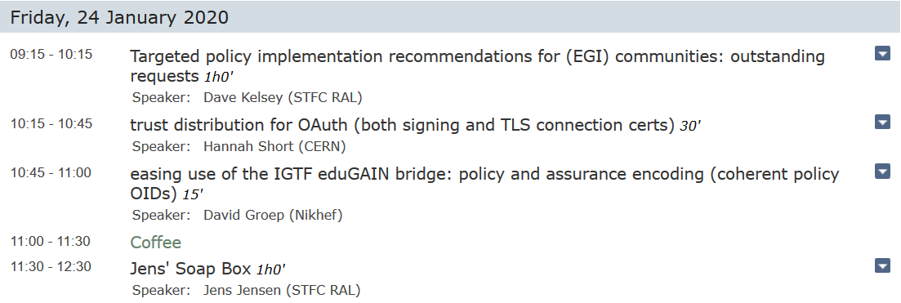
and the final day …

Slide 8
… although: there are Next Meetings!
FIM4R + TIIME Vienna, AT February 17-20
APGridPMA 2020 Taipei, TW Sun March 8
I2GS Indianapolis, IN, USA March 29 – April 1st
WISE+ SIGISM London, UK April 21-23
EOSCHub week Karlsruhe, DE May 18-20
EUGridPMA 49 May 2020
TNC2020 + REFEDS Brighton, UK June 7-11
NSF Cybersec Summit Indianapolis, IN, USA September 22-24
+ IGTF AHM Champaign, IL, USA adjacent to NSF-CSS
I2 TechEx + REFEDS Atlanta, GA, USA October (4) 5-8

