Slide 1

Portals and Credentials
David Groep
Physics Data Processing group NIKHEF

Slide 2
Outline
Portals all around
  EGEE TCG Portal working group
  Dutch BiG Grid portals

Slide 3
The EGEE Portal WG
Started in 2007 in order to …
“propose "best-practice" rules for the access of portals to the grid. […] To do so, a portal responsible should […] then to be able to register this portal certificate to a VO allowed on the grid. Once the portal have been accepted into the concerned VO, it should be able to store and access data inside the VO area, and also to run job on site accepting this VO. […]”
Lead by Christophe Blanchet with others
Identified a set of 5 portal scenarios, ranging from simple queries to complex workflow execution.

Slide 4
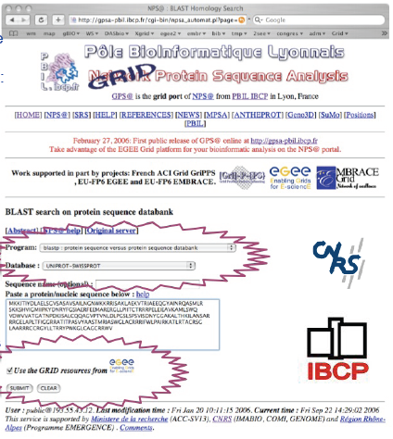
Example: Christophe’s GPS@ portal
BLAST searches on the grid
Provide Biologists with an usual Web
interface: NPS@
  NPS@ Web portal online since 1998
  46 tools & 12 updated databases
  + 9,000,000 jobs & 5,000 jobs/day
Ease the access to updated databases
and algorithms.
  Protein databases are stored on the grid storage
  as flat files, encrypted if needed.
  Wrapping legacy bioinformatics applications
  Transparent remote access through
  local file-system accesses
Display results in graphical Web interface.
Has to complete with ‘free’ portals in the genomics community
Virtually anonymous access

Slide 5
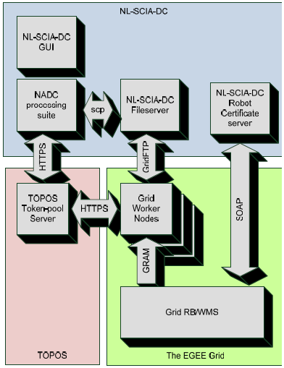
SCIAGrid portal
KNMI/SRON/SARA/Nikhef effort
Processing Sciamachy data
  Predefined workflow
  Large input data sets
  Access limited to identified researchers
  Raw data is actually protected as well
Portal controls access through GUI
  User identify use username/password
  NADC processing created the workflow
  Upload output data to dedicated system
Jobs submitted to the grid identify themselves as a Robot

Slide 6
A Robot?
A Robot What? A Robot Certificate:
‘Automated Client’ (see the old OGF document)
  Identified as such in the CN
  “Robot: <what-i-am>” plus name of a human responsible
With private key held on a secured hardware device
As per boiler-plate text from the UK, NL and IT CP/CPSs

Slide 7
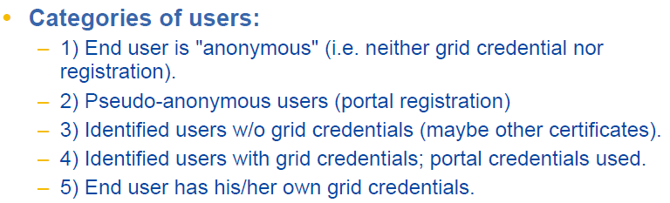
Various types of portals
Questions to ask
From: Christophe Blanchet and TCG Portal WG

Slide 8
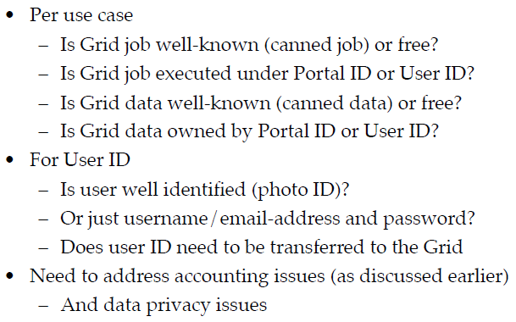
Types of Portals
More Questions
From: Date Kelsey, TCG Portal WG

Slide 9
Portal Classification
Classify by auth method or function? BiG Grid tried function:
The Web User invokes functionality on the Portal where jobs submitted to the Grid use executable code that is provided by the Portal to the Grid as part of the job submission process. All parameters and input data are defined exclusively by the Portal and cannot be influenced by the user.
The Web User invokes functionality on the Portal where jobs submitted to the Grid use executable code that is provided by the Portal to the Grid as part of the job submission process. The Web User may only provide run-time parameter settings from an enumerable and limitative set, and may select data files from a enumerable repository of data files that are pre-vetted for use by the Portal.
The Web User invokes functionality on the Portal where jobs submitted to the Grid use executable code that is provided by the Portal to the Grid as part of the job submission process. The Web User may provide run-time parameter settings from an enumerable and limitative set, and may provide non-validated input data to the executable code.
The Web User invokes functionality on the Portal where jobs submitted to the Grid use executable code that is provided by the Web User. Whether this code is passed through unmodified by the Portal and is submitted to the Grid as-is, or whether this code is inspected and analysed on the Portal does not change the classification of this Portal.

Slide 10
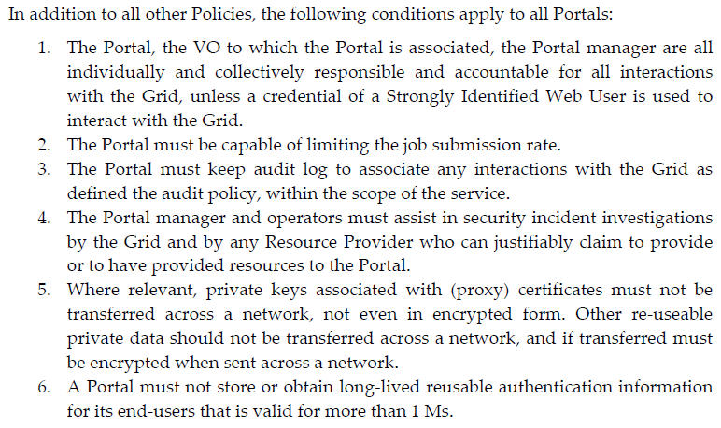
And set policies for each of these cases
Common elements
  Should fit in the JSPG “Security and Availability Policy”

Slide 11
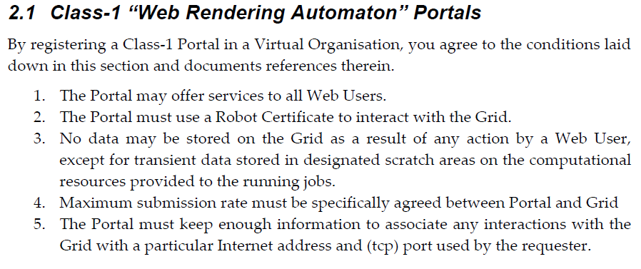
Function 1 portals (rendering of pages)
for example: render latest forecast, update a picture)

Slide 12
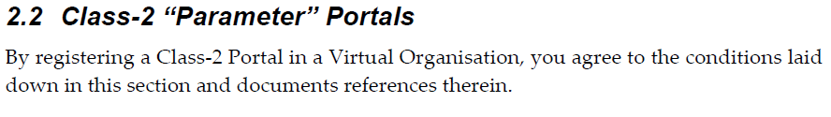
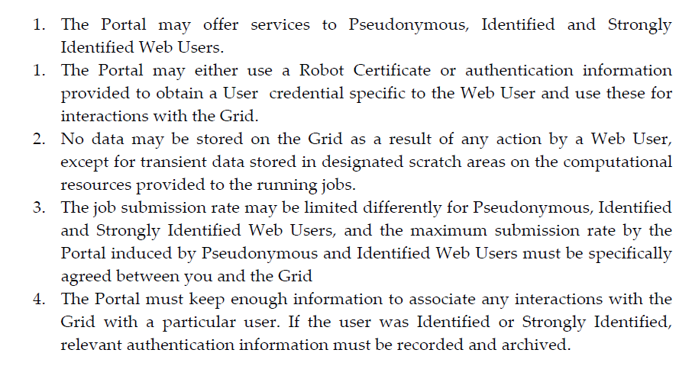
Function 2 (like GPS@)

Slide 13
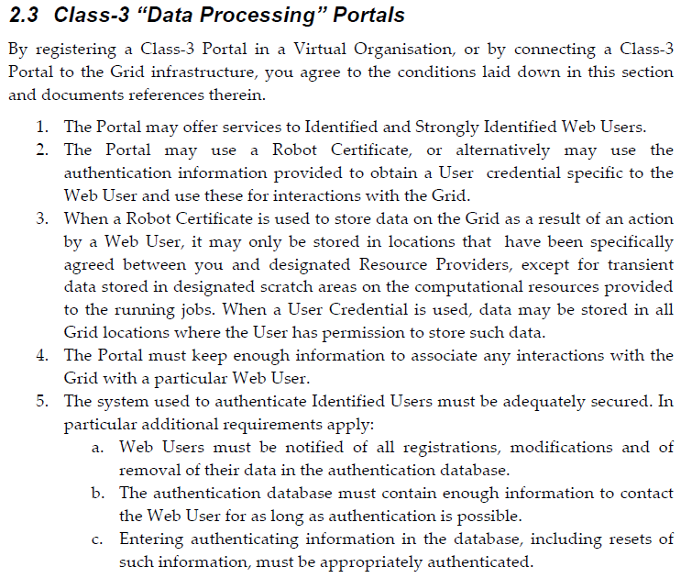
Function 3 (like NL-SCIA-DC on Grid)

Slide 14

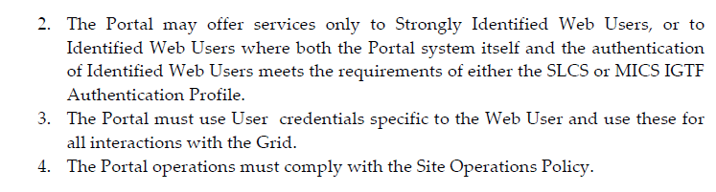
Function 4 (like Genius et al.)

Slide 15
The Document and implementation
Based on this interim policy,
BiG Grid allows registration of Robot certificates in its Vos
Two portals with robot certs now in production
  NL-SCIA-DC (KNMI, SRON)
  eNMR (Bijvoet Centre, UU)
Contributed to JSPG for improvements to policy, see
https://edms.cern.ch/document/972973

Slide 16

From here
‘gut feeling’ requires well-identified credentials for
Function1 to Function3 portals
A service/host cert does not fulfill these requirements!
Robot certs, issued on hardware tokens are
  Simple and cheap
  NL gives them out ‘for free’, supported by VL-e and BiG Grid
  see http://ca.dutchgrid.nl/etokens for documentations and software
  Well secured – and protect against abusing the keypair off the portal machine somewhere else
  Middleware cannot verify ‘source of origin’ in a reliable way in a system that supports delegation
  (binding to a source address does not survive first delegation)

Slide 17
Wards Globally Available Robot Certs
Robot certificate support needed ‘globally’
to enable compliant portals …
… do you support them already?

